Slide 1


East Area Experiment Highlights and Requests
Proton & Ion Beams
D. Banerjee (BE-EA-LE)
On behalf of the East Area Users
Date: 05.12.2022

Slide 2
Primary Beam: T08
Irradiation Facilities (IRRAD/CHARM)
F. Ravotti (EP-DT) / S. Danzeca (BE-CEM)

Slide 3
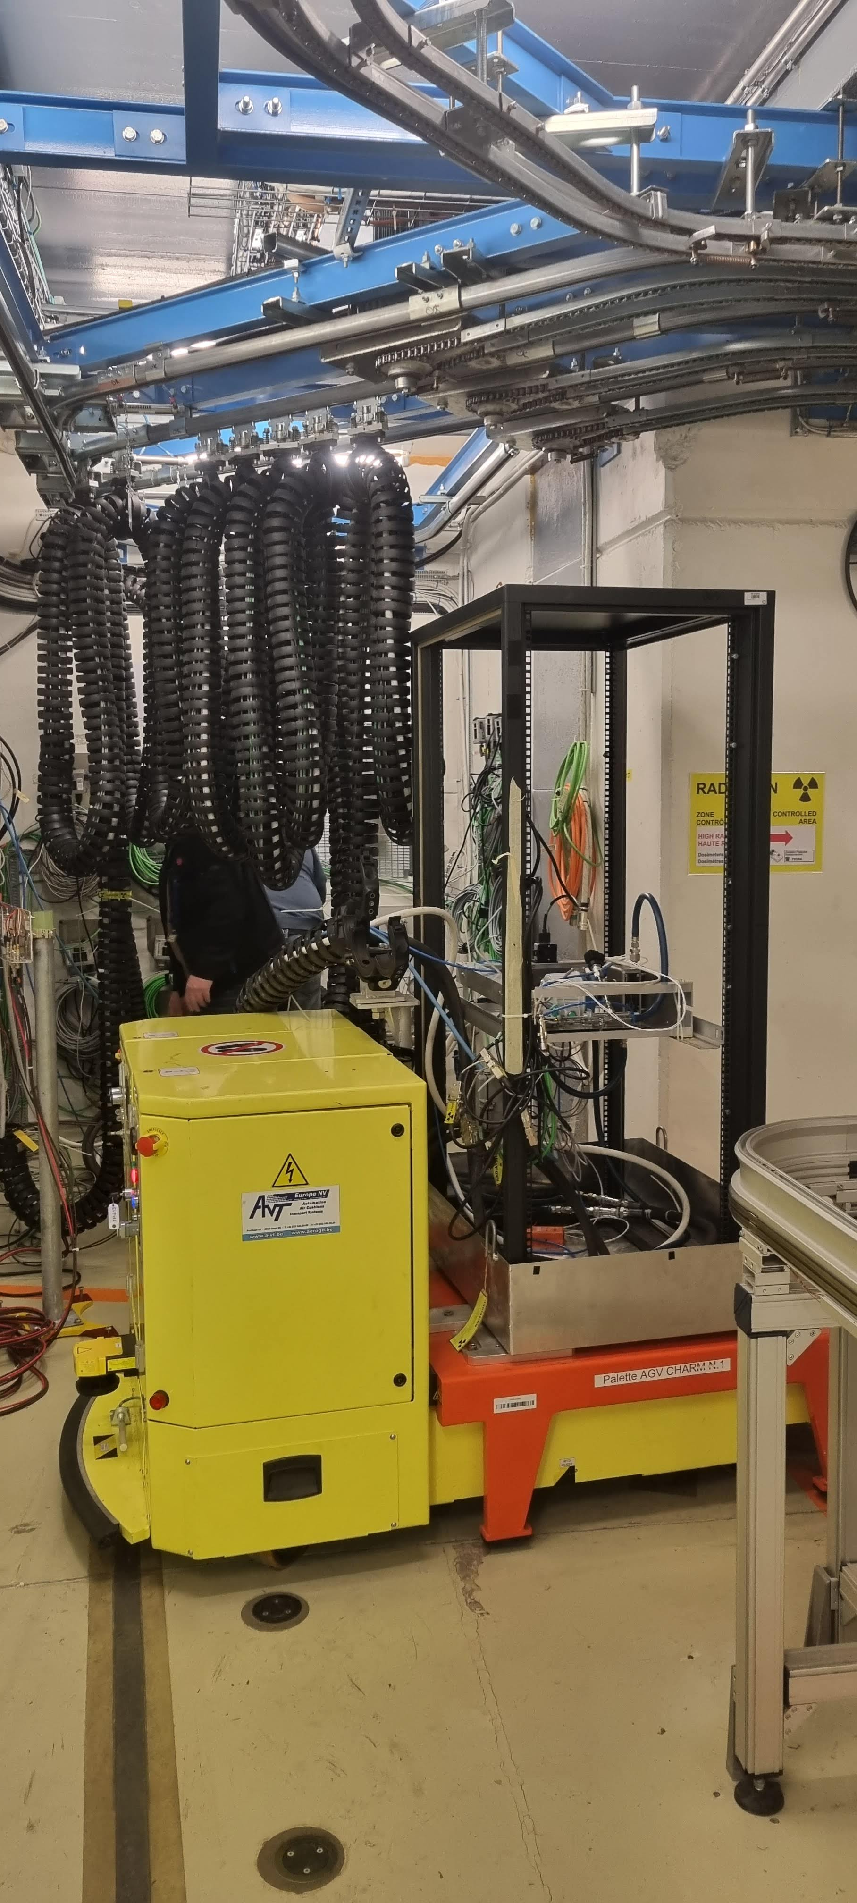
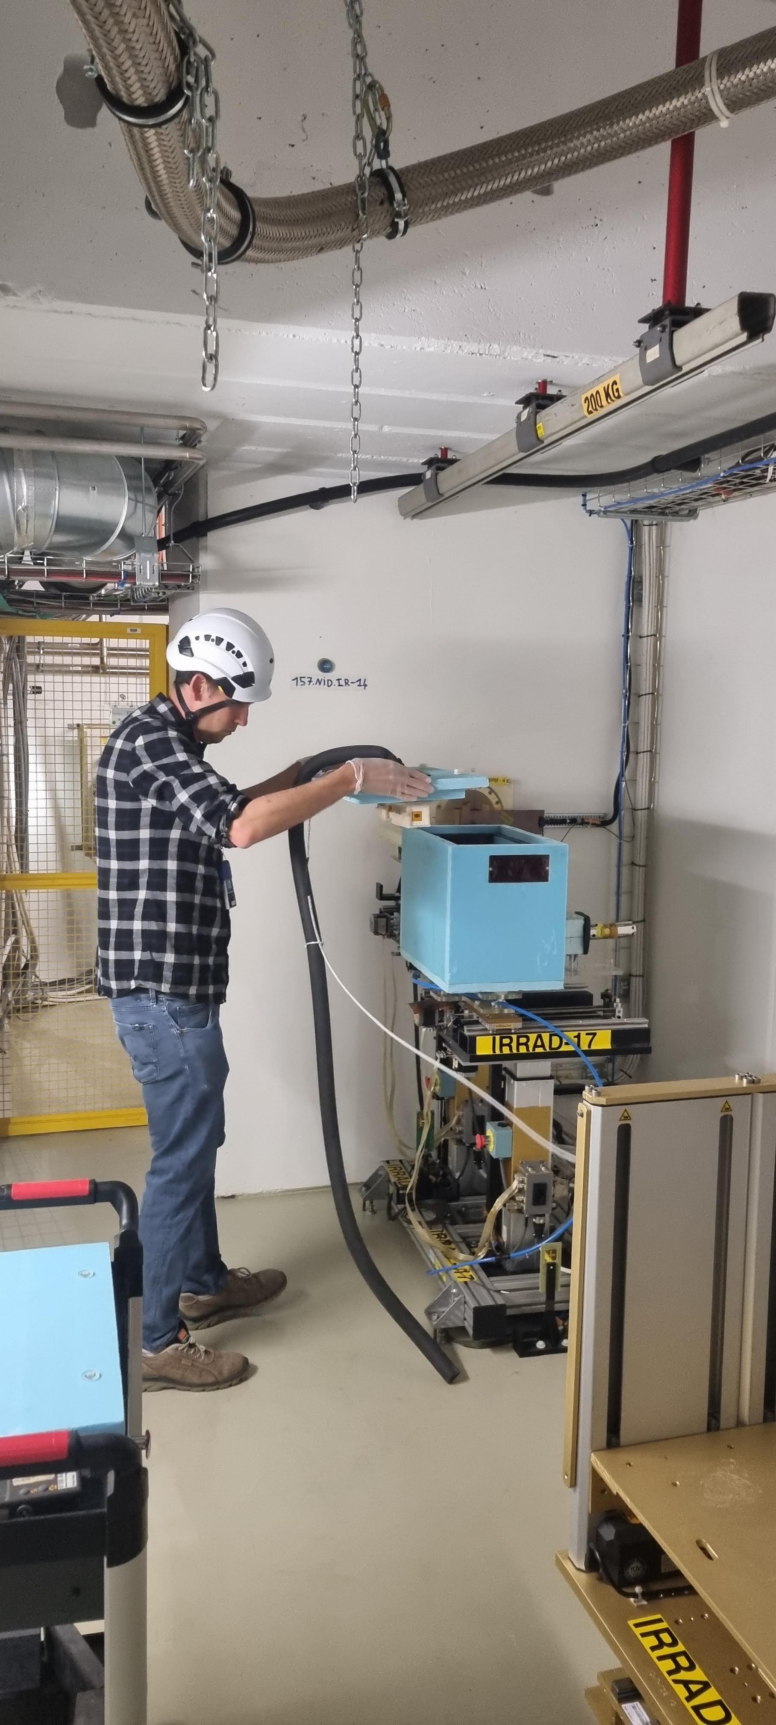
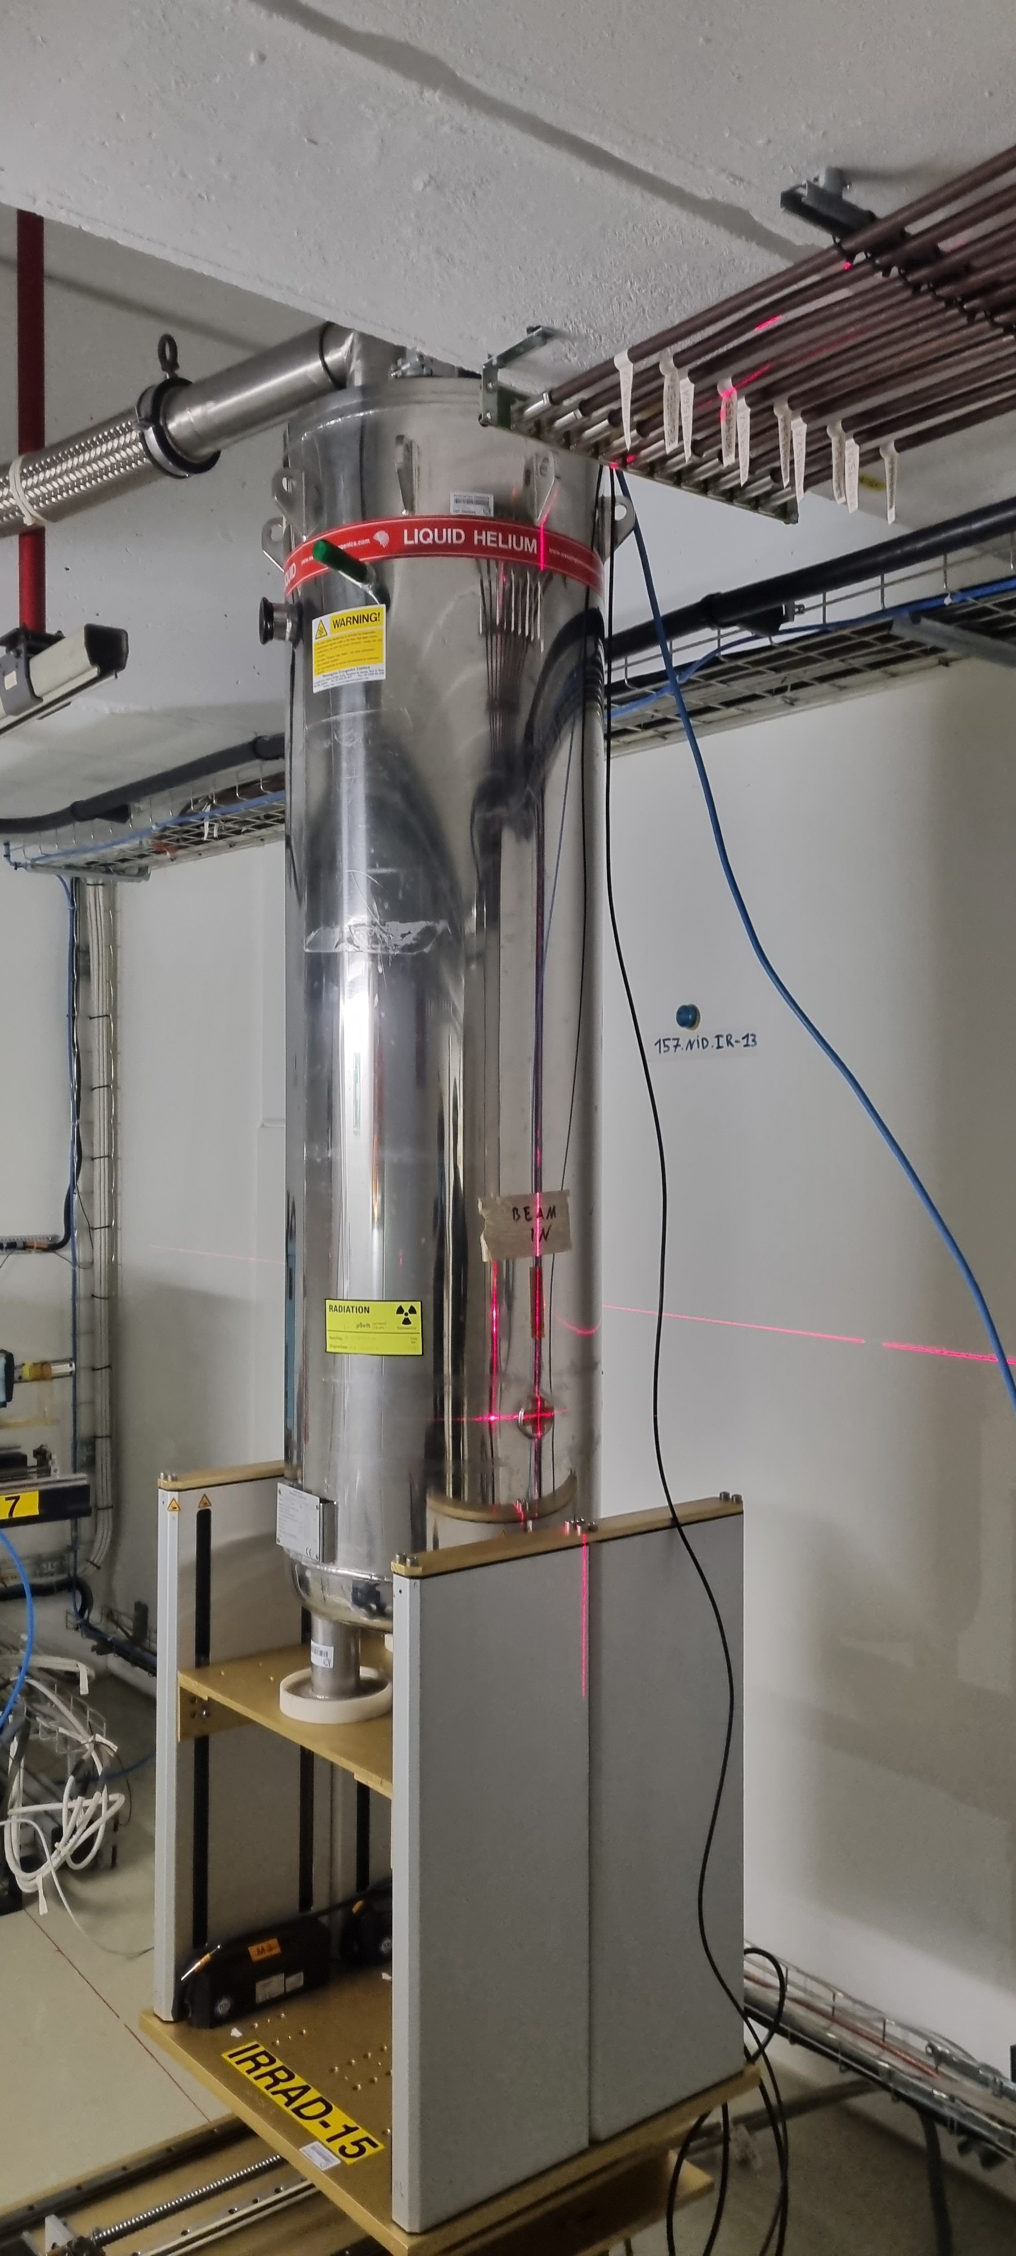
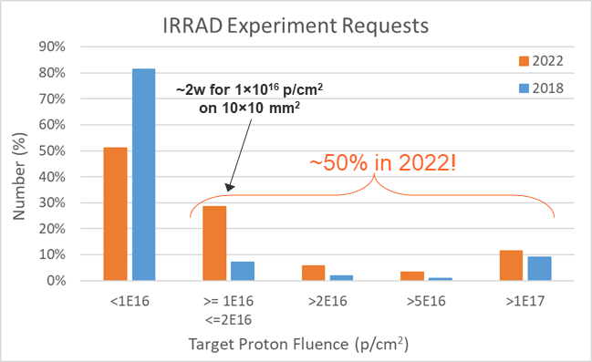
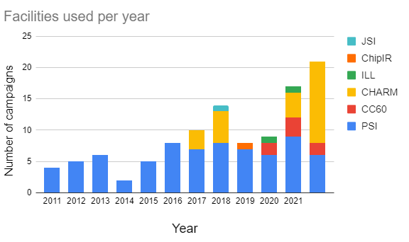
2022 Proton Run
SYSTEM-LEVEL TEST (CHARM)
EXPERIMENTS R&D (IRRAD)
CRYOGENIC TEST (IRRAD)
IRRAD:
  54 experiments registered
  >600 samples processed:
    LHC Experiments: ATLAS, CMS, LHCb Phase II upgrade
    R&D & expt. support: EPRD, RD53, RD50, EP-ESE / DT
    CERN ATS Projects: TE-MSC, EN-EL, R2E
    EU- projects & external: AIDAinnova, CNES (FR)
  ~50% requests exceeding 10¹⁶ p/cm²
CHARM:
  29 users scheduled
  39 system-level & 13 component tests:
    ATS: SY-BI / EPC / STI, TE-MPE / VSC, BE-CEM
    RCS: EP-DT, CMS, ATLAS, Caen, Wiener
    EU-projects: RADNEXT (3 users)
  increasing number of requests
CHARM COMPONENTS TEST CAMPAIGNS
2022

Slide 4
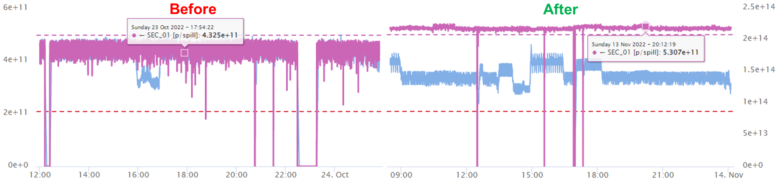
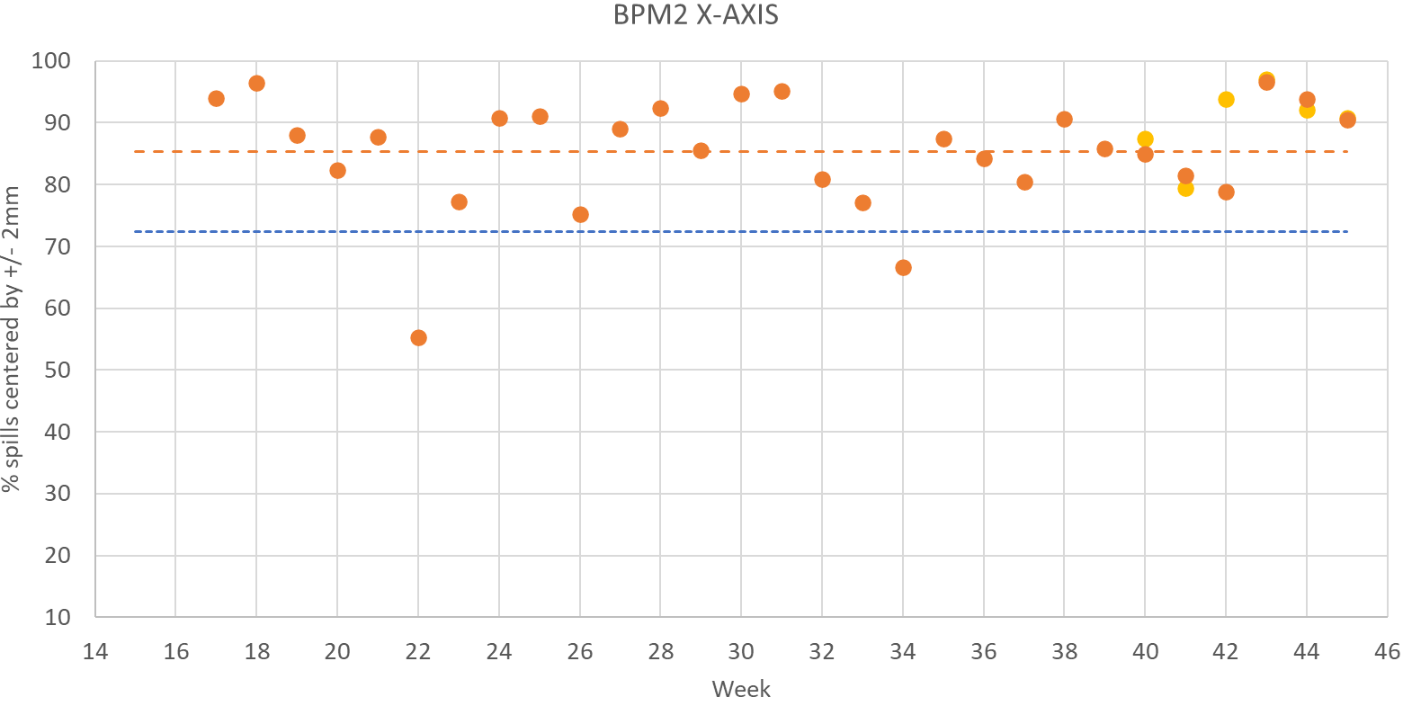
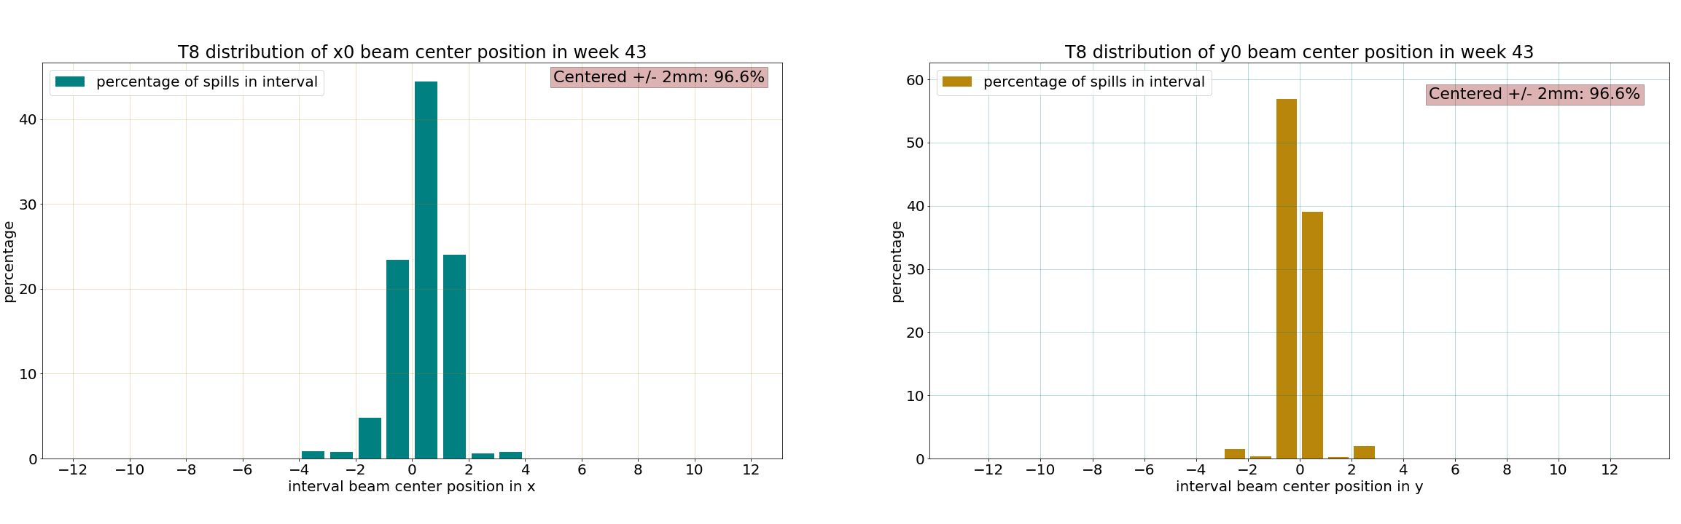
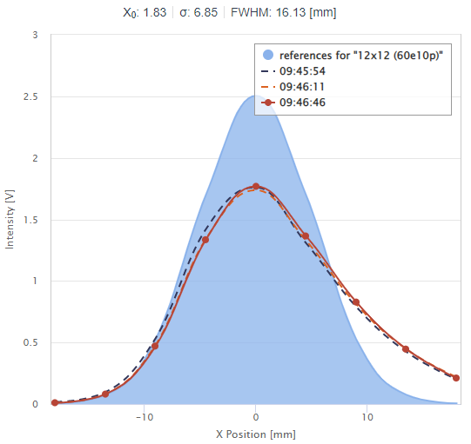
Feedback and Status of 2021 Desiderata
“As much as possible” proton intensity :
Cumulated Intensity on T08 in 2022 ~1.8×10¹⁶ p/w vs. 1.6×10¹⁶ p/w (performance 2018)
beam sharing target achieved during ~55% of the weeks (target 1 EAST_T8 each ~ 10 BP)
“Reduce proton beam losses & improve stability”
dedicated Al-foil / BCT calibration of XSEC070 (EDMS 2783968) confirm the ~20% transmission loss during slow-extraction
intensity variations ~>1×10¹¹ p/spill sometime observed
“Optimise beam profile”
preliminary analysis on BPM2 (center within ± 2mm) shows improved beam trajectory (both axes), but larger variation.
slow “drift” of the beam center (x-axis only) along the weeks
tail on the horizontal profile (BPM1)
  scattering of lower energy particles when reducing extraction losses ?
85 ± 10%
2022
2018
72 ± 5%
optimization 26/10
ALIGNEMENT
PROFILE

Slide 5
Requests & Desiderata for 2023
Targeting the 2.2×10¹⁶ p/w intensity baseline is becoming critical to compensate for the shorter run and satisfy evolving needs and increasing number of requests from both IRRAD/CHARM experiment & accelerator users.
Beam intensity & transmission:
  successful collaboration with BI in 2022 (thanks to SY-BI!)
  continue XSEC/BCT calibration runs and related studies
  increase spill intensity ? optimize EAST sharing ? etc.
  clean extraction, reduce losses while preserving the beam shape!
Beam profile & optics:
  essential to provide homogeneous irradiation of large areas
  a lot of (ongoing) work on the T08 optics & beam alignment during dedicated MDs (many thanks to BE-OP and SY-ABT!)
Spill length & quality:
  not a primary requirement now, it could become in the future (for on-line detector DAQ or electronics testing)

Slide 6
Secondary Beam: T09/T10/T11
Test Beams & CLOUD

Slide 7
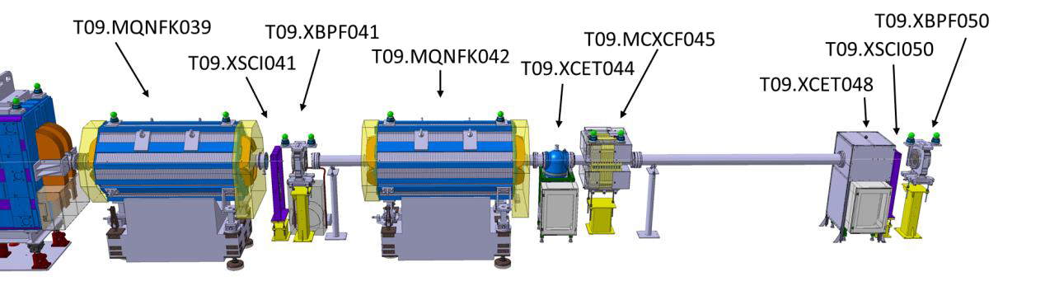
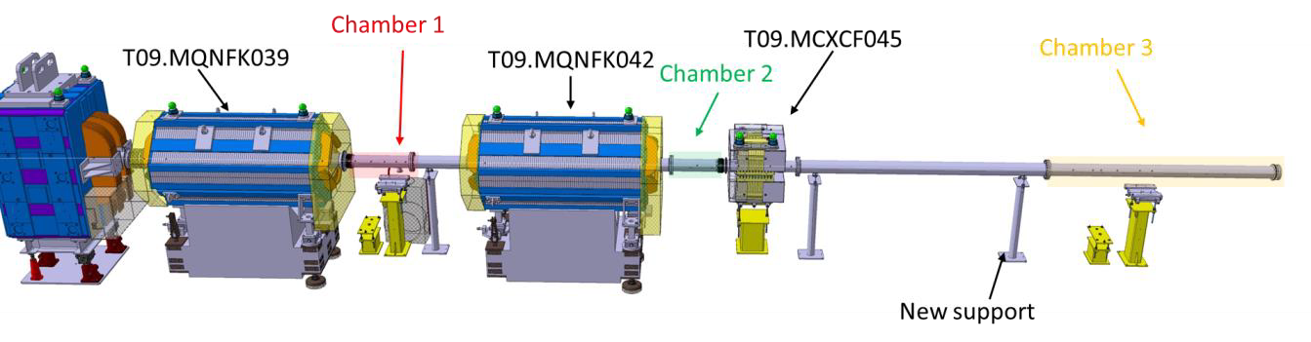
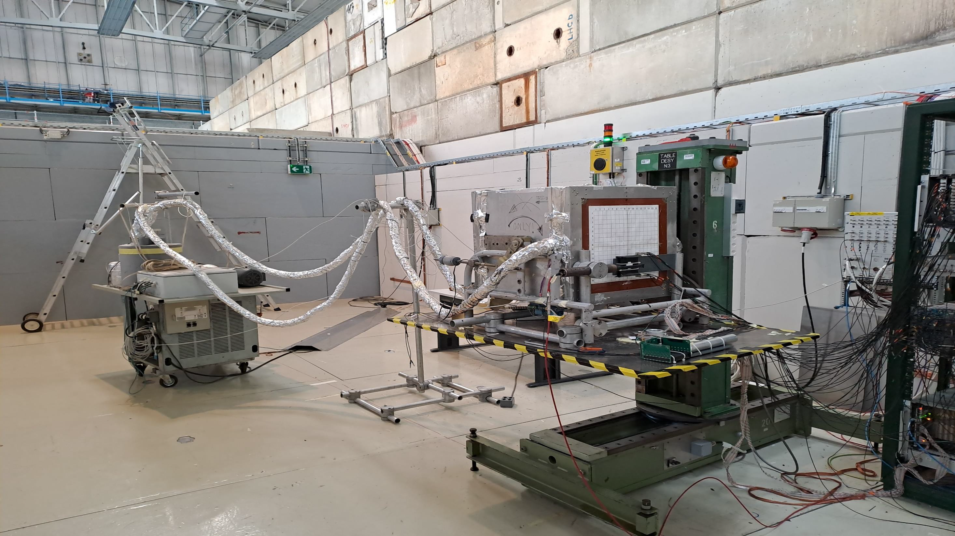
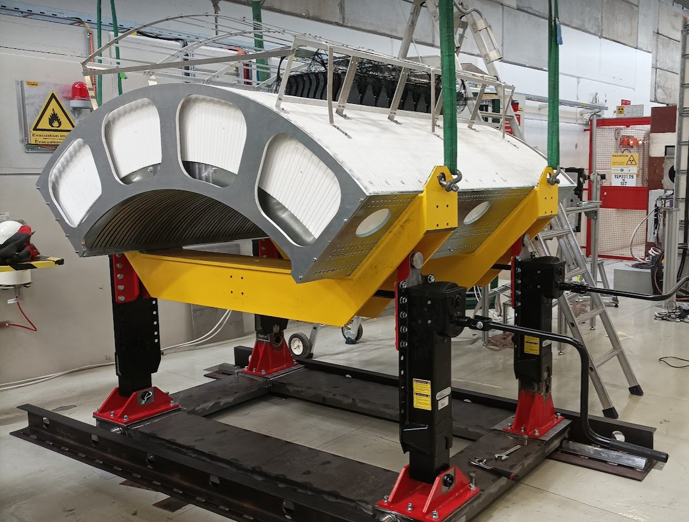
2022 Proton Run
T09:
  Various users with requests of beam ranging between 0.1 GeV/c to 16 GeV/c.
  First Low momentum run in T09 for SHERPA and WCTE successful with complete vacuum.
  Data collected by WCTE at low momentum served as input to potentially only need secondary beam thus reducing considerably their data taking period in 2024 (updated planning to be confirmed by the experiment).
  Return of BL4S in T09 with two experiments.
  Many special requests met due to great support from all teams.
    Installation of large scintillators for calibration runs with muons for LDMX.
    Installation and powering of a MDX magnet for HERD and GammaMeV for tracking and tagged photon beam respectively.
T09 Standard Configuration
T09 Low Momentum Configuration
ALICE PHOS T09
ENUBET T09

Slide 8
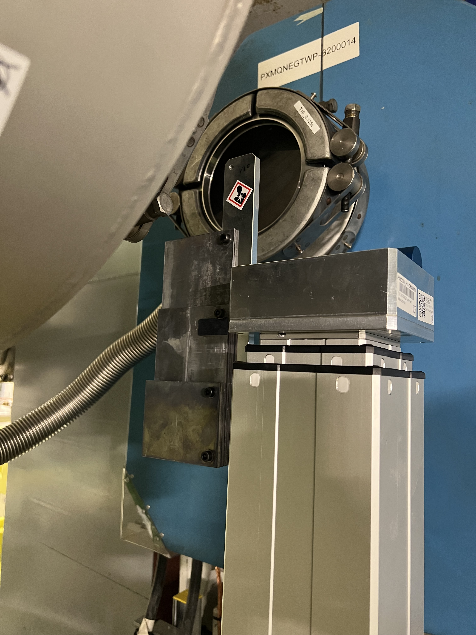
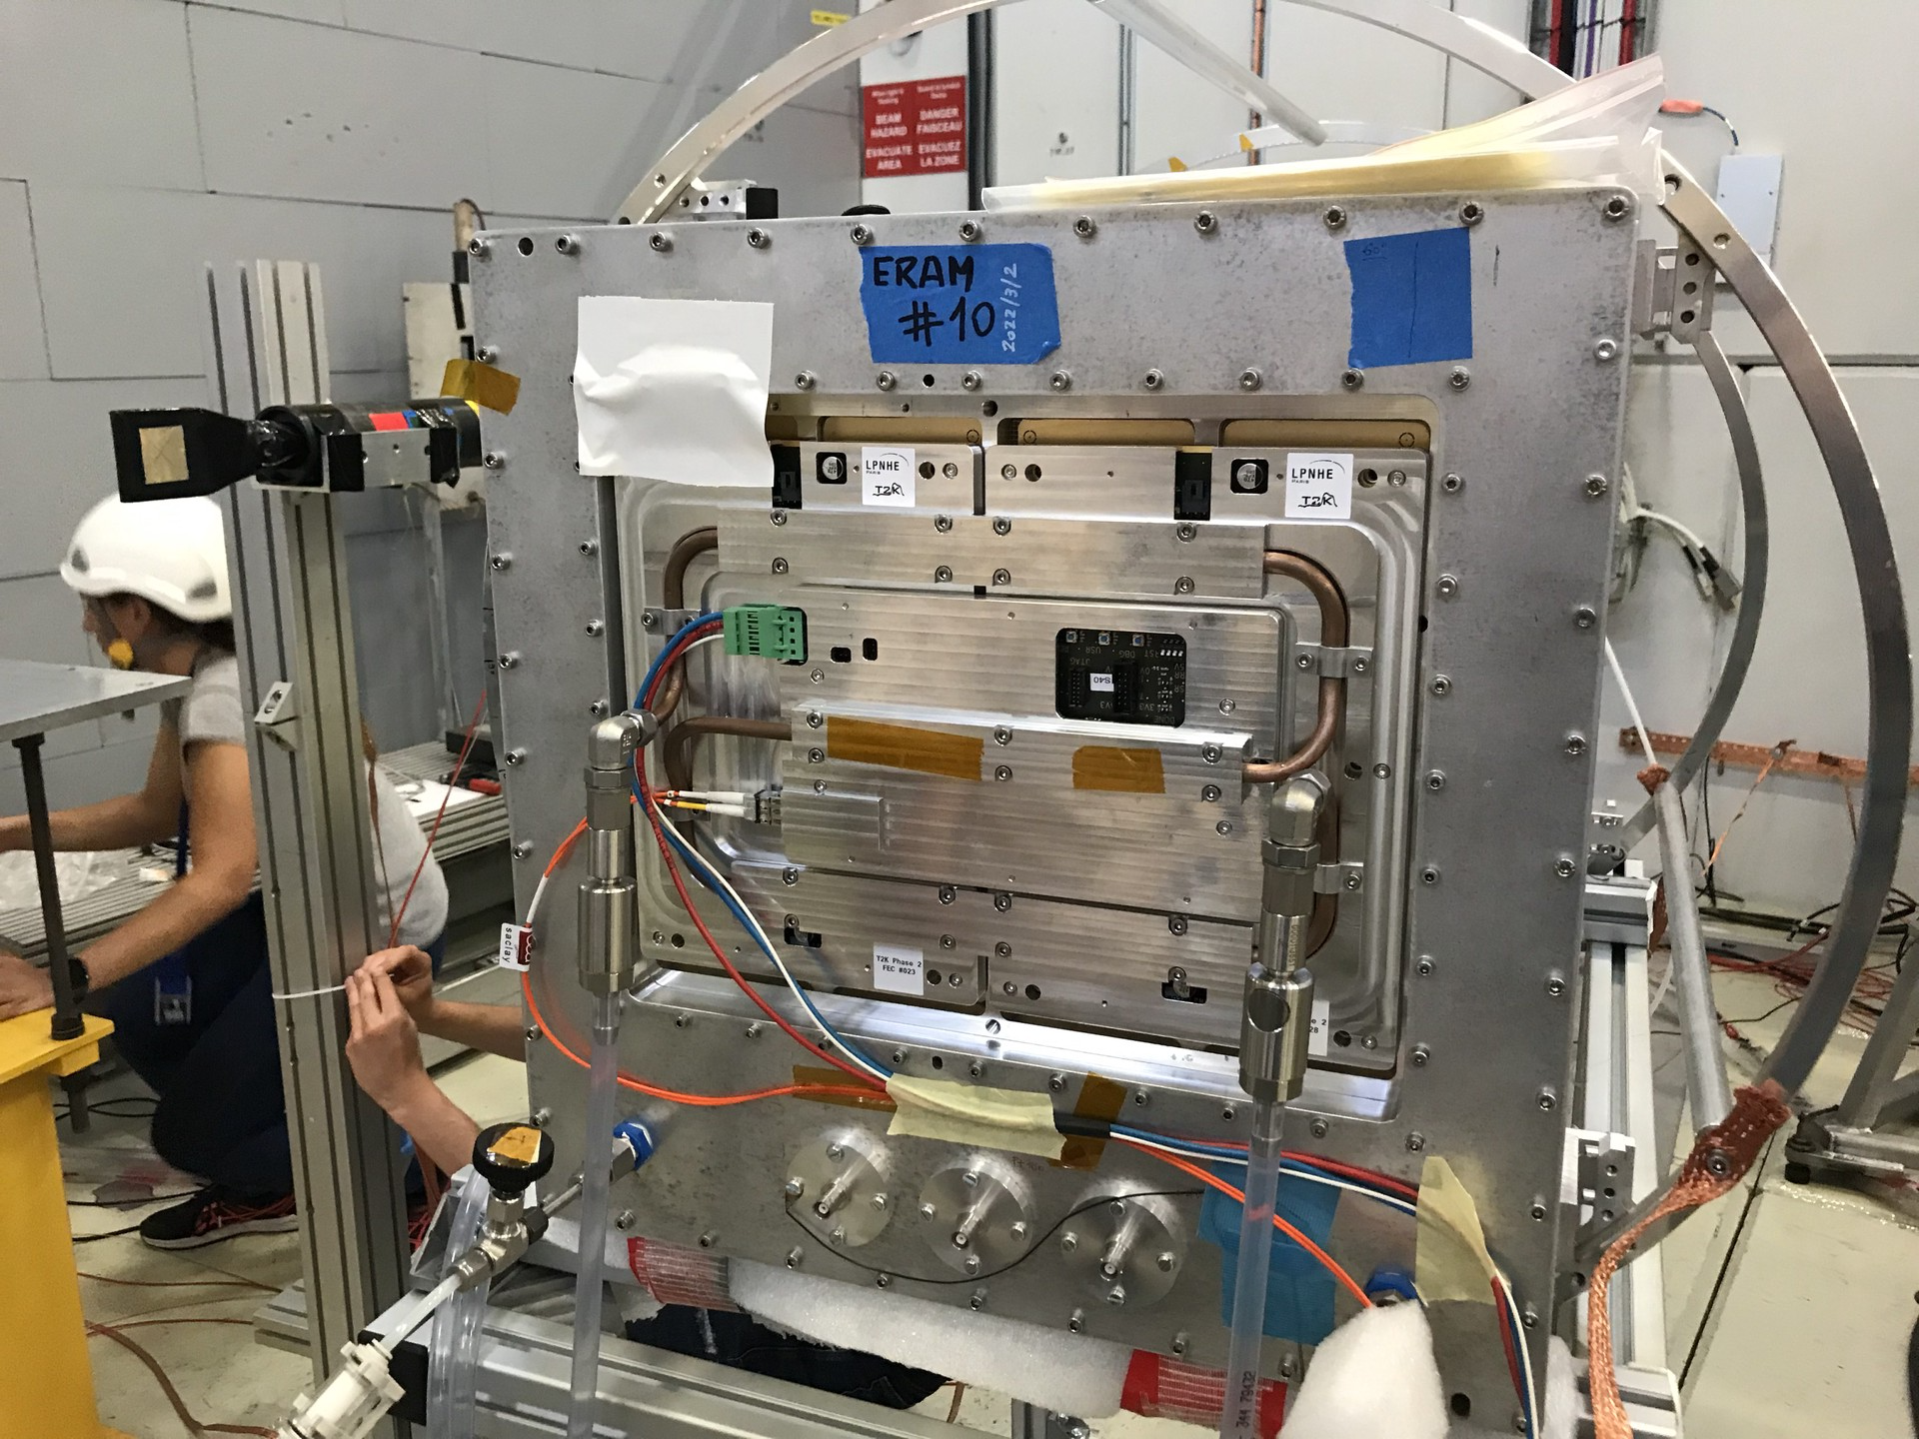
2022 Proton Run
T10:
  Many users requesting different energies mixed hadron and electron enriched beam.
  Installation of absorber to have pure hadron beams in T10.
  Beam composition studies performed with the threshold Cherenkov detectors at different energies.
  Long-term operation shows that the line can be operated stably up to 11.5 GeV/c momentum, close to the 12 GeV/c design parameter.
  Hadron beam intensities up to 5 x 10⁶ particles per 0.4 s extraction were achieved.
PB 4 mm
PB 8 mm
PB 18 mm
NP07 T10

Slide 9
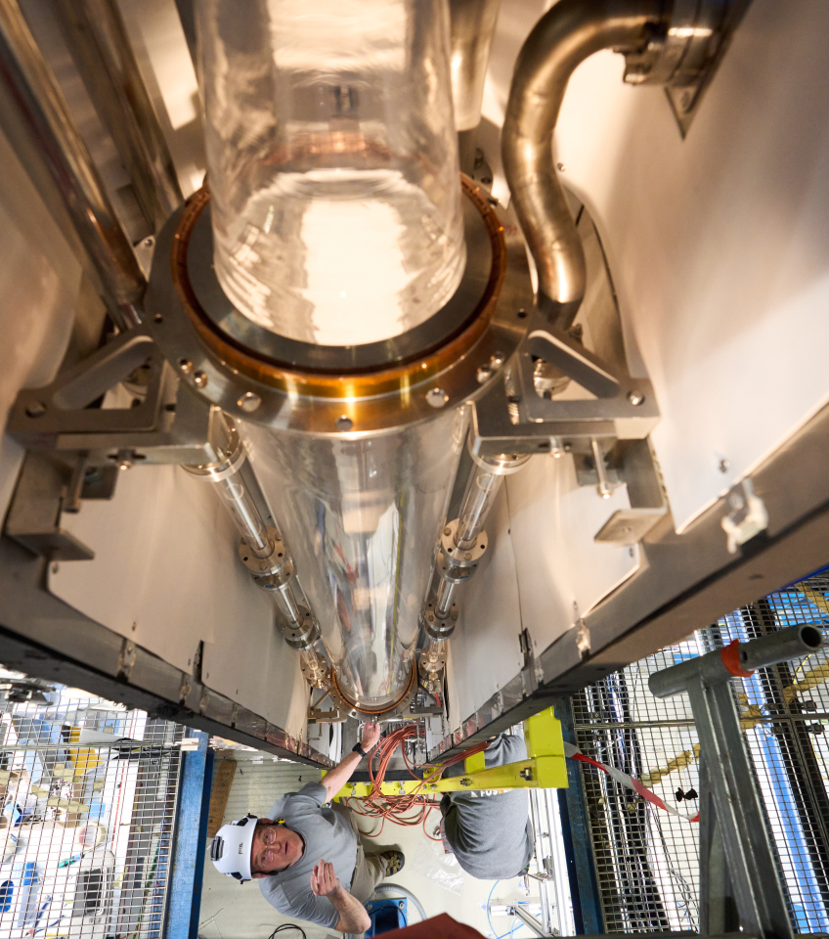
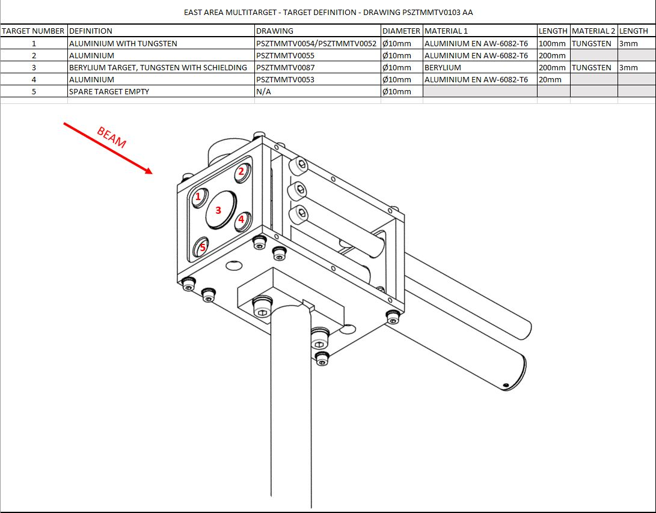
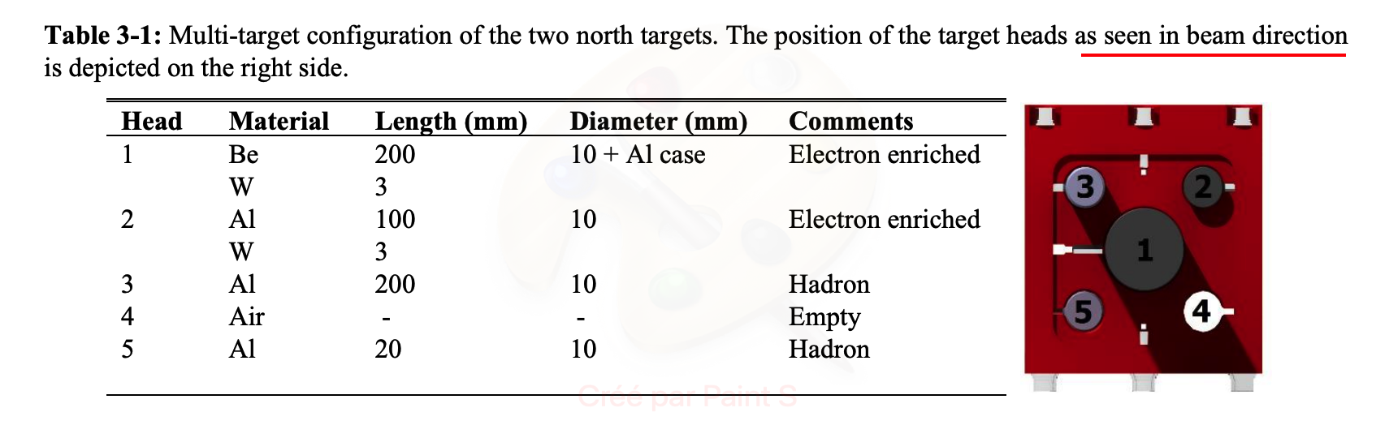
2022 Proton Run
T11:
  CLOUD had a long physics run including the new FLOTUS set-up that will allow a sustained cloud in the reaction chamber without the need for expansion of the volume.
  Late September a mismatch between the software and the multi-target definition was found. The electron enriched Target 1 (200 mm Be + 3 mm W) was being used for the run as opposed to Target 3 (200 mm Al). Same for T09.
  On 27th September, this was corrected but TN (T10/T11) continued with Target 1 to be consistent with the beginning of the run.
Design in Yellow report. Beam coming out of the page.
Current configuration in software
Configuration in software before correction

Slide 10
Feedback & Status of 2021 Desiderata
“More signal cables accessible from the control room and Experimental Area”
Analog cables have been connected between the experimental area and the control rooms for all beam instrumentation (scintillators + XCETs).
“Better infrastructure (phone, control room, vistar page)”
Phone and CESAR console available along-with a screen with the CPS vistar page.
In 2022 mobile air-conditioning used in the control rooms helped alleviate the high temperatures. Permanent installations are scheduled between 30th Nov – 6th Dec to be ready for 2023.
“High temperatures and temperature adjustment”
Discussions done with EN-CV and SCE regarding the high temperatures in the hall which will require detailed thermal study. Temperature probes were placed by CV in different locations, however the results were inconclusive as the big material doors were regularly opened due to high temperatures.
“Better hygiene & logistic services (closer toilet, sink) ”
SCE confirmed its not possible to have a toilet or sink inside the building as connection to the sewers is not possible due to the galleries.

Slide 11
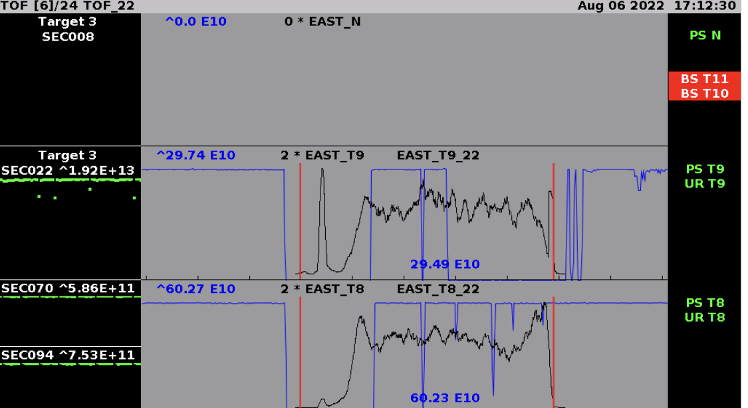
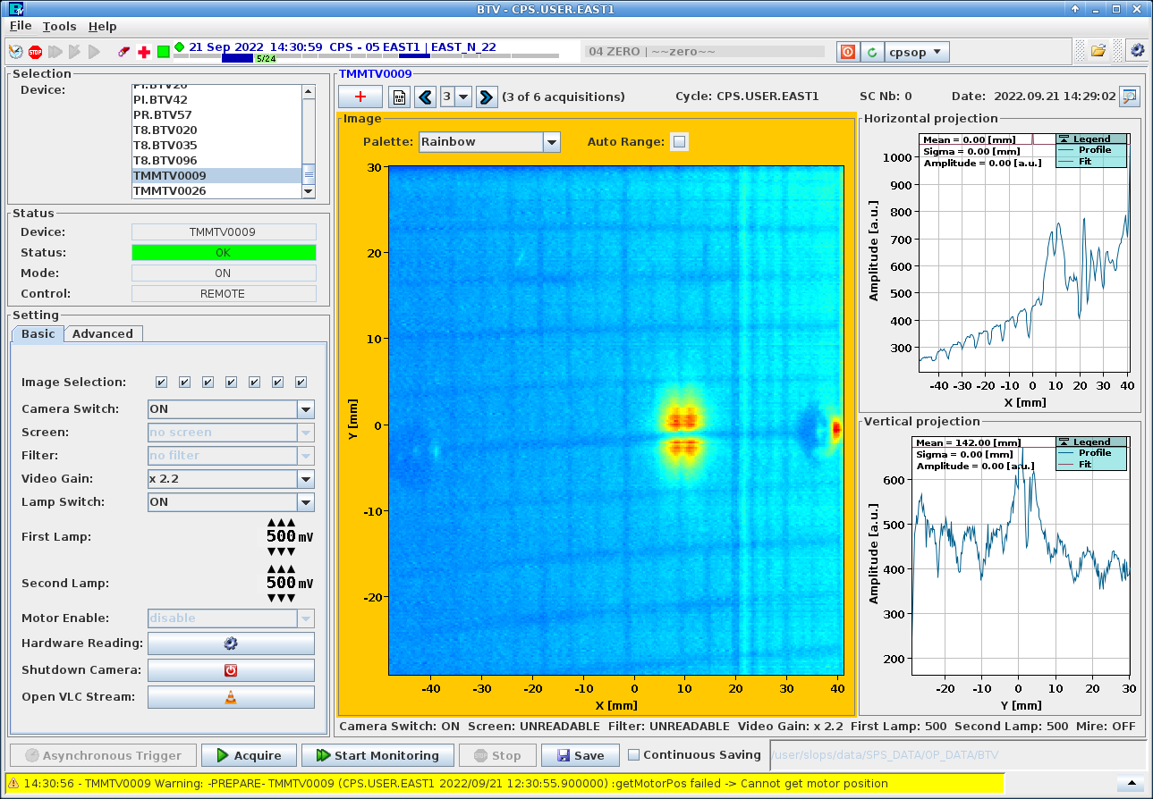
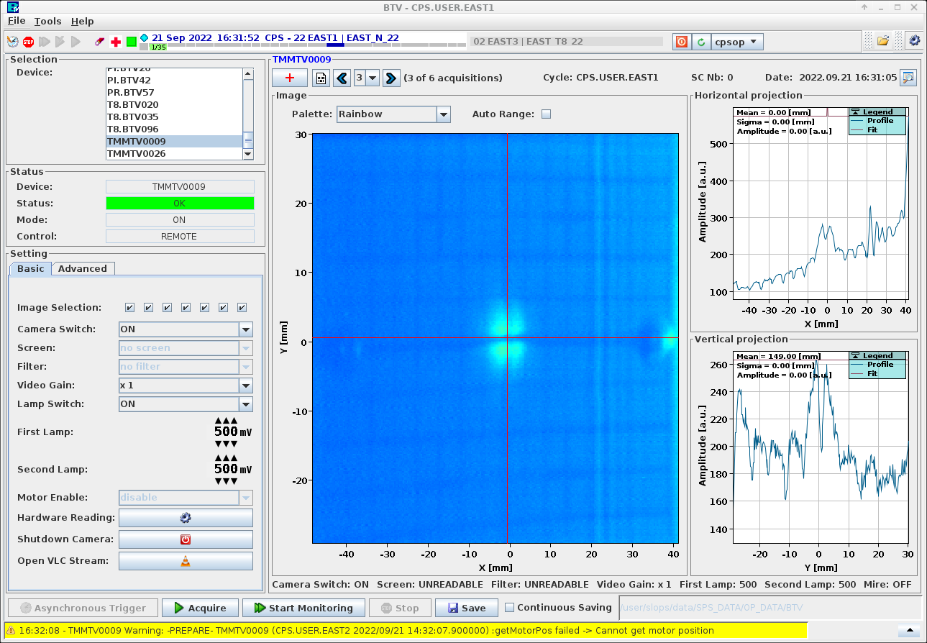
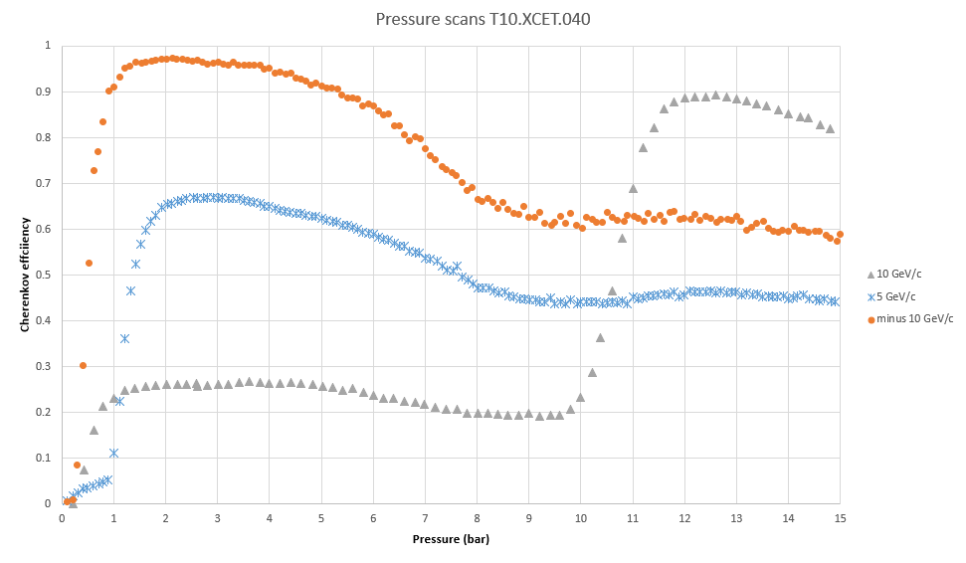
Requests & Desiderata for 2023
Beam:
  Beam has been quite stable with few fluctuations from time to time. Request for a flatter spill structure with the fluctuation of the overall instantaneous intensity over the flat top within 10% to 20%.
  Monitoring of the proton beam on target, similar to symmetry of the beam as done in the North Area. Beam position changes affect the intensity and position of the secondary beam at the experiment.
  Possibility of longer spills (0.5s – 0.6s ?).
  Lower primary beam energy (< 20 GeV/c ?) for low momenta particles for WCTE. Studies to confirm the gain ongoing.
Infrastructure and Instrumentation:
  Control of high temperatures in the hall (~ 35°C on the CLOUD platform).
  Investigate dropping efficiency of the high pressure XCET in T10. Studies are already underway with SY-BI to check the cause. PMTs have been exchanged. Readout and detector optics to be checked.
  Calibration for the XSEC detectors to precisely measure the number of protons on target.
  CESAR modification for shutter and access conditions for CLOUD.
Before Alignment
After Alignment

Slide 12
Ion Beam: T08
CHIMERA
R. Garcia Alia (SY-STI)
On behalf of CHIMERA team

Slide 13
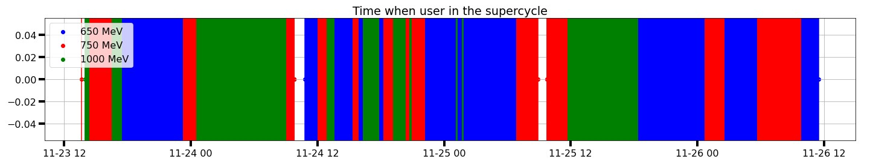
2022 Run
Aim to provide high-energy (>100 MeV/u) heavy ion beams for radiation effects testing of electronics, for accelerator and space applications, and with the support of the European Space Agency (ESA) and European Commission
Three PS energies selected for the CHIMERA 2022 run – 650 MeV/u, 750 MeV/u, 1000 MeV/u.
Two main (and complementary) analysis axes → a) Accurate determination of beam flux at device-under-test location; b) Accurate determination of beam energy at device-under-test location
2022 experimental schedule:
  Several parallel MDs since ion setup in PS, with the beam propagated until the F61 East Area dump
  Two dedicated Wednesday MDs with the beam propagated down to T8
  5-day run from 23/28-11, including external users from ESA

Slide 14
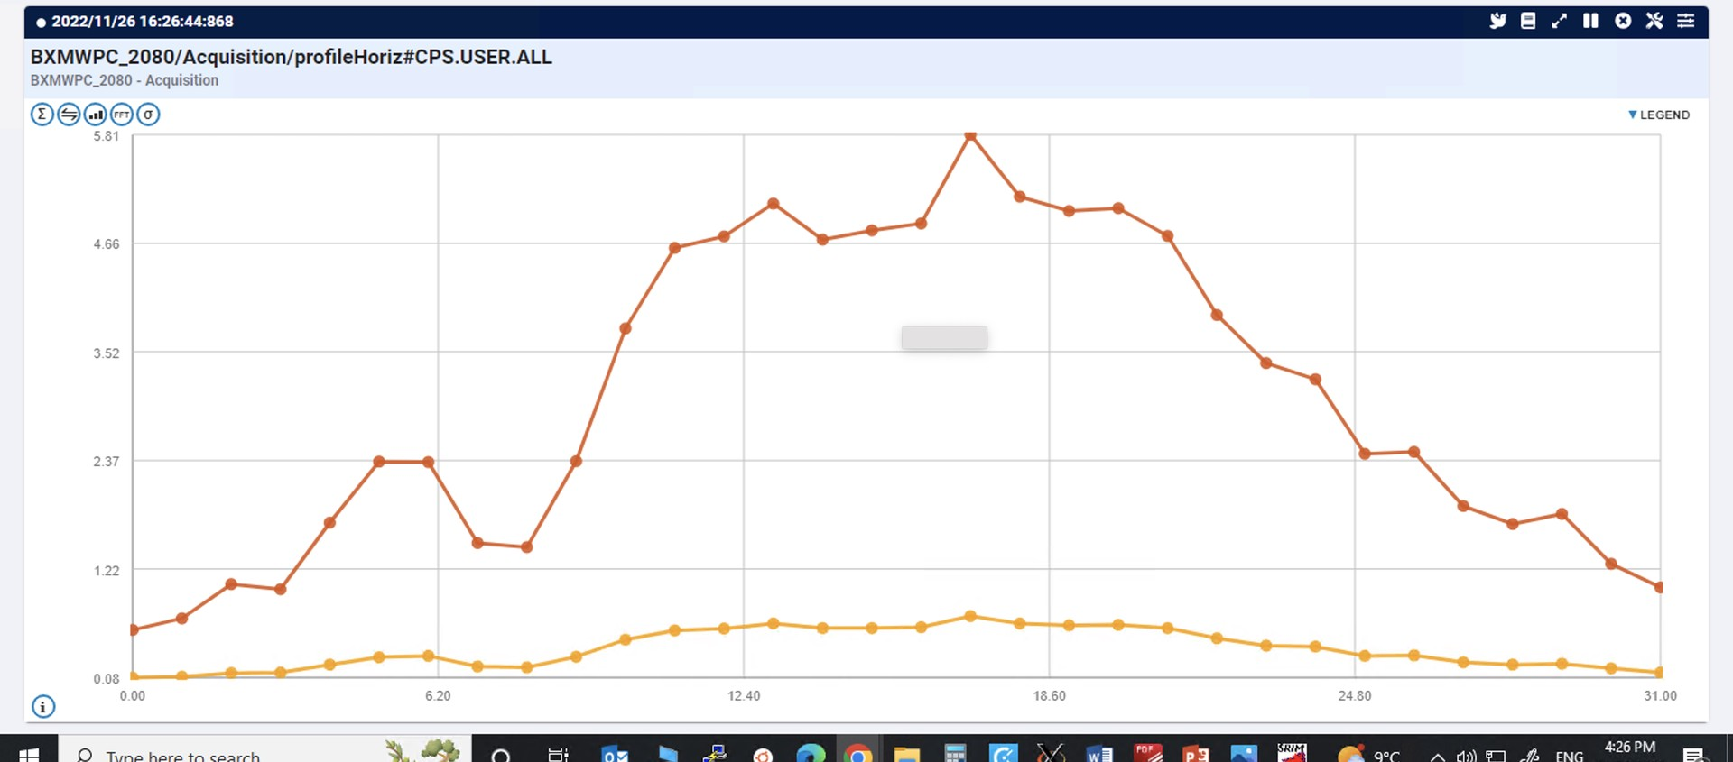
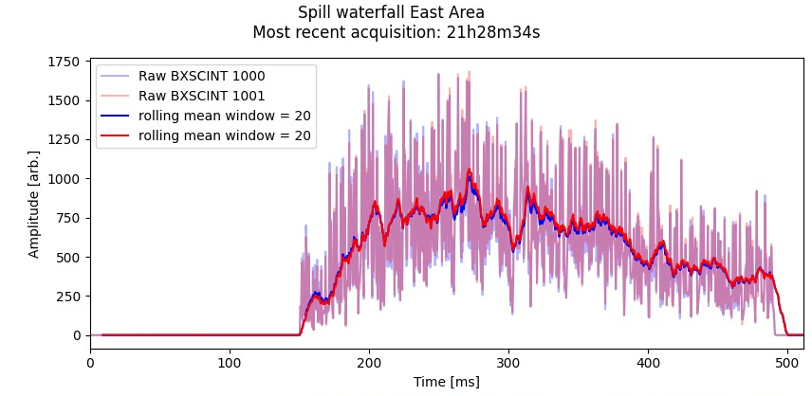
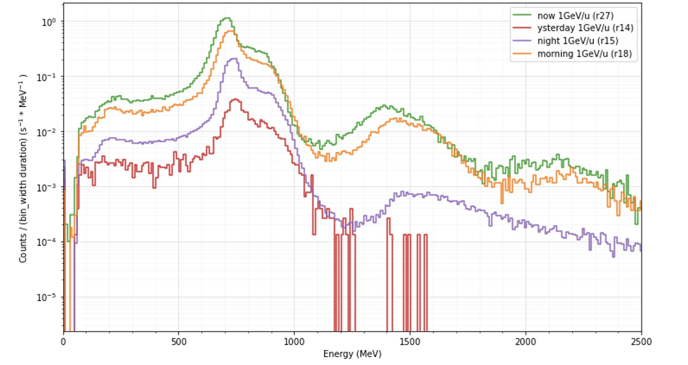
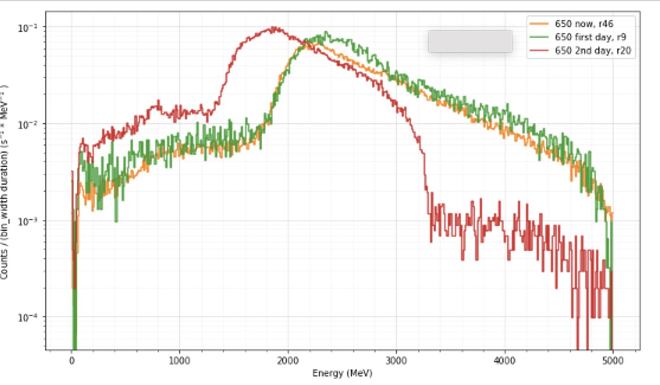
Feedback
Very successful test campaign – a lot of data collected, waiting to be analyzed in detail.
Preliminary analysis shows relatively large beam as requested (several cm FWHM) with dips in profile due to material in the beam (e.g., support frame) and independent of beam intensity.
Spill time structure measured with variety of instruments found to be overall long and uniform enough for radiation effects testing.
Online dashboard for flux estimate based on SEC measurements developed by K. Bilko – very useful and necessary for the users.
Flux calculation using diodes as beam diagnostic shows different runs with the same beam settings yield identical energy deposition distributions.
However, surprisingly shifts in the deposited energy were observed for all three primary energies. These seem to have occurred when switching from one energy to the other (as opposed to during a run).

Slide 15
CHIMERA Outlook for 2023
Cause of change of the beam energy of the beam throughout the different runs?
Initial hypothesis is some additional material budget being put in and out of the line. Being investigated!!
Some initial thoughts for 2023:
  A lot of data analysis and reporting! (also, in the context of contractual commitments with ESA and the EU)
  Schedule definition (including, if possible, some parallel and dedicated Wed MDs, once ions are available in the PS)
  Target station development and considerations
    Solution for installation of ancillary electronics near the device-under-test
    Remotely controlled degrader and collimator system

Slide 16
Summary
The renovation of the East Area has greatly increased the performance of all beamlines including their availability and stability.
Very good co-ordination between the users and BE-OP to optimise the sharing of the beam between the destinations.
Overall very happy users and a productive year.
Discussions are also ongoing to increase the frequency of spills and/or intensity on target to the East Area beyond the design values (Denis’s talk).
Thank you !!

