Slide 1
Aggressive hardware & beam commissioning in the injectors
Gian Piero Di Giovanni
Piotr Skowronski

Slide 2
Introduction

Slide 3
The electricity crisis, shortage during winter and its price increase,
led to shortening of 2023 run by 6 weeks
314th IEFC issued action for BE-OP:
Make startup planning in 2023 (IST, HW and BC commissioning) with a most aggressive schedule
2022 Run
YETS’22-23
2023 Run
YETS’23-24
SPS: 38 Weeks
17 Weeks
SPS: 32 Weeks
19 Weeks
Was 40 weeks → -2 Weeks
Was 38 weeks → -6 Weeks
YETS is defined beam to beam

Slide 4
Preamble
In this talk
  We discuss what are the options to speed up commissioning
  What are their pros and cons
  Which ones we try to endeavour
  should come from this workshop
Notes:
Last year we were asked

Slide 5
Commissioning planning

Slide 6
Accelerator commissioning
Every year, each accelerator, is setup basically from scratch ensuring
  Its safety
  The best beam performance
It involves many actors:
  BE/OP Team
    Operators
    Physicists/Engineers in Charge
  BE/ABP Team
  SY Experts responsible for all various subsystems
    SY/BI, SY/EPC, SY/RF, SY/ABT, SY/STI, …

Slide 7
Accelerator commissioning prerequisites
Hardware readiness of all systems
All systems fully integrated and tested in the controls environment
  FESA classes
  Settings: parameters, value generators, make rules
Tools and applications ready and tested during dry-runs and checkout
All systems successfully commissioned and tested without beam
Operational scenarios tested during dry-runs and checkout

Slide 8
Accelerator commissioning
Before enabling the beam all the hardware elements and
interlocks are checked
  Individual System Tests (IST) by the Experts
  Hardware Commissioning (HC) by Operation
Beam is started with the lowest reasonable intensity
At each step it is sent only to the next safe dump location
Beam parameters are measured with all possible instruments
  Often, the instruments first need to be checked and calibrated with beam
The results are verified against the expectations and,
if needed, the settings are corrected
Intensities are ramped to reach the design / maximum performance

Slide 9
Commissioning planning
Commissioning is a more or less a sequential process
  Testing the hardware before starting the beam
  Interlocks
  Beam Instrumentation setup and calibration with beam
  Injection → Steering → RF Setup → Ejection → Dumping
  Optics → Collimation → Verification

Slide 10
Commissioning planning
Sometimes, the tasks of different experts are densely interleaved
as the beam is transported further down the machine
  Circular dependencies
    For example: beam setup <--> BI setup & calibration
The planning is started with a list of steps to be completed
Time estimate for each step is defined by the Experts
  By the EiC for the operational steps
The plan is constructed such that
  The required sequence is respected
  The Expert steps are scheduled during working hours
  Nights are populated with OP steps
    For HC the operations work on morning & afternoon shifts

Slide 11
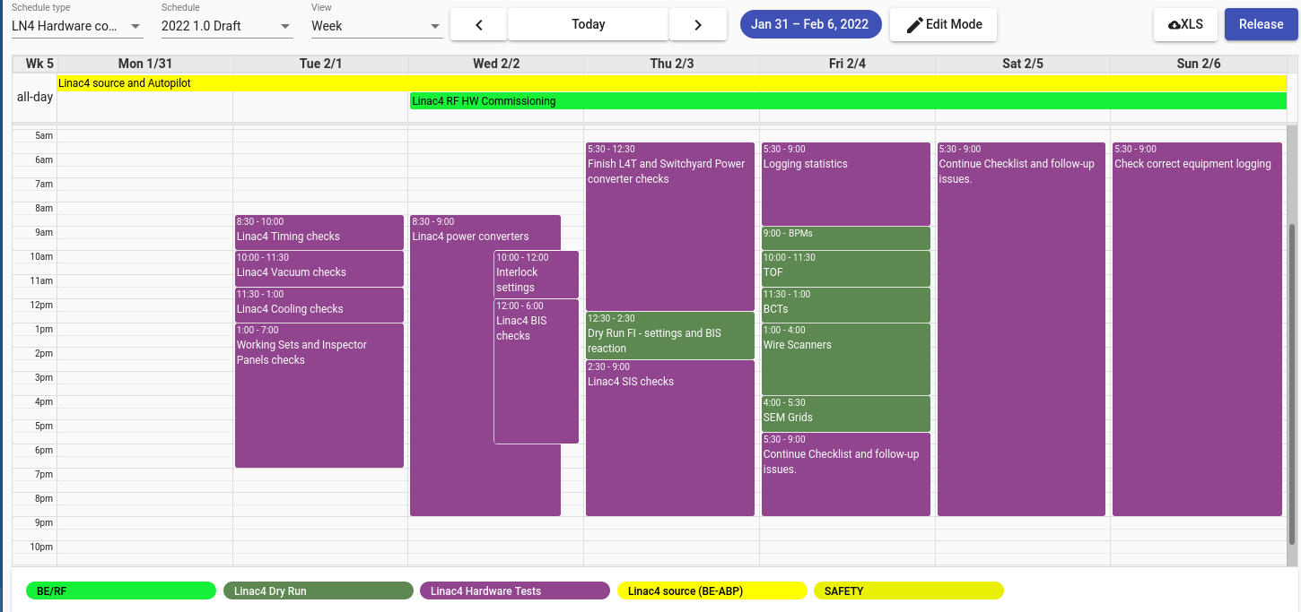
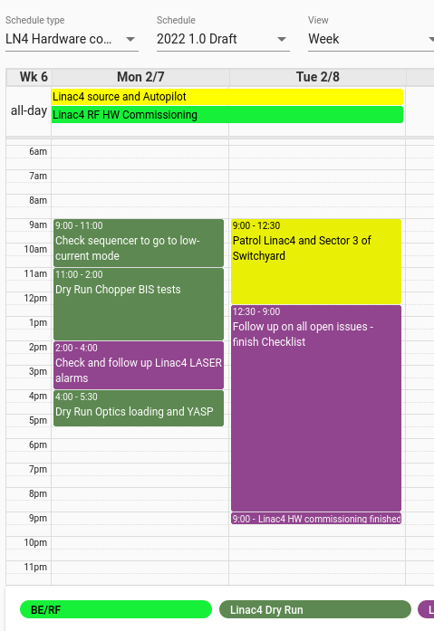
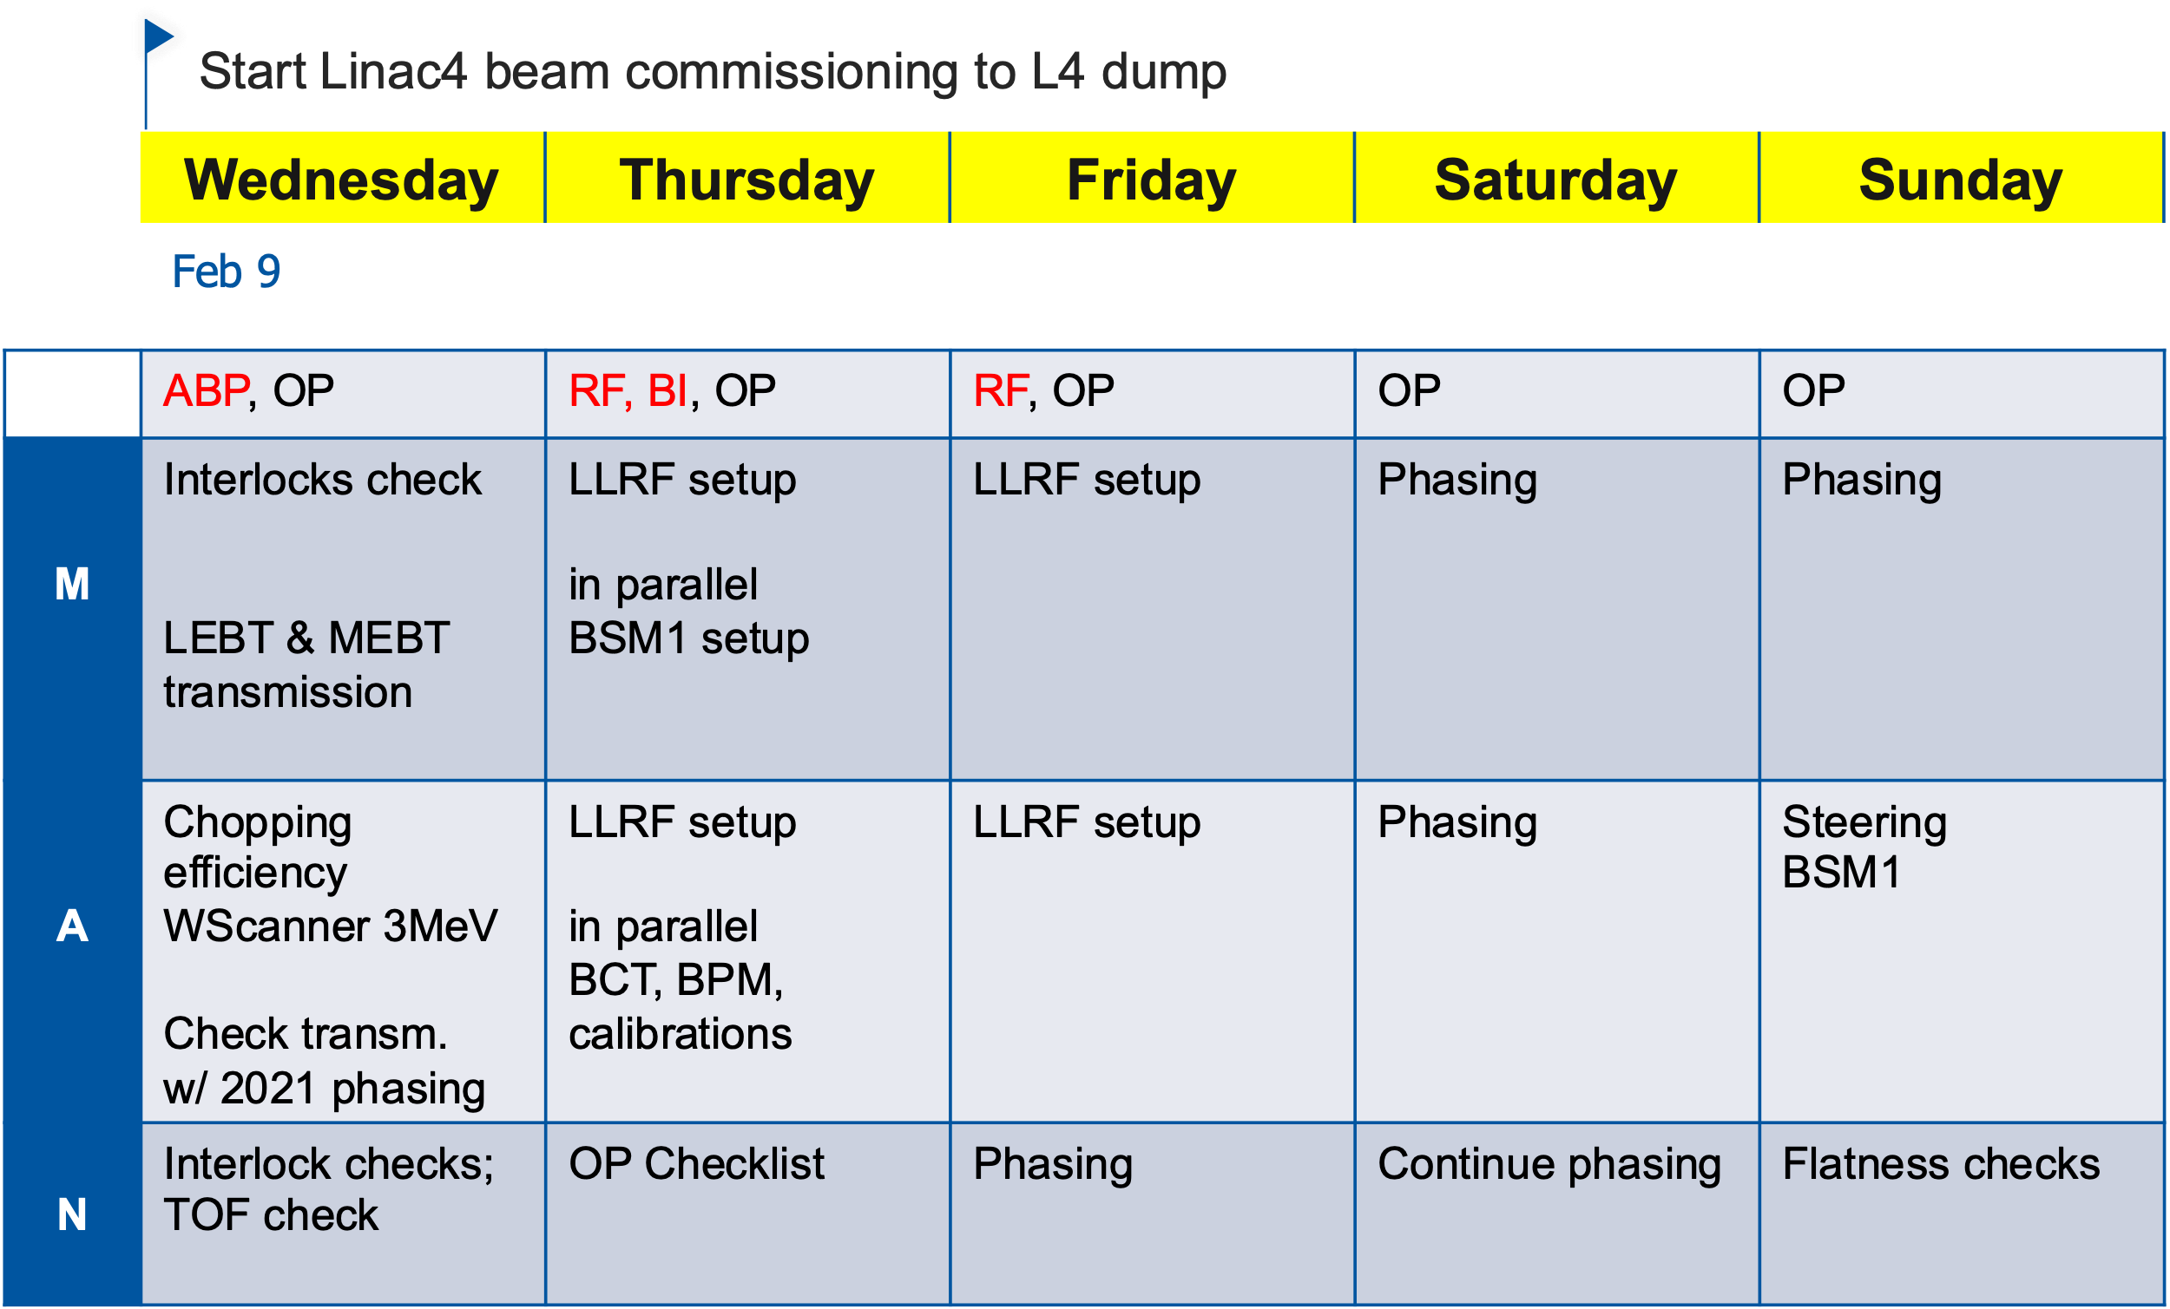
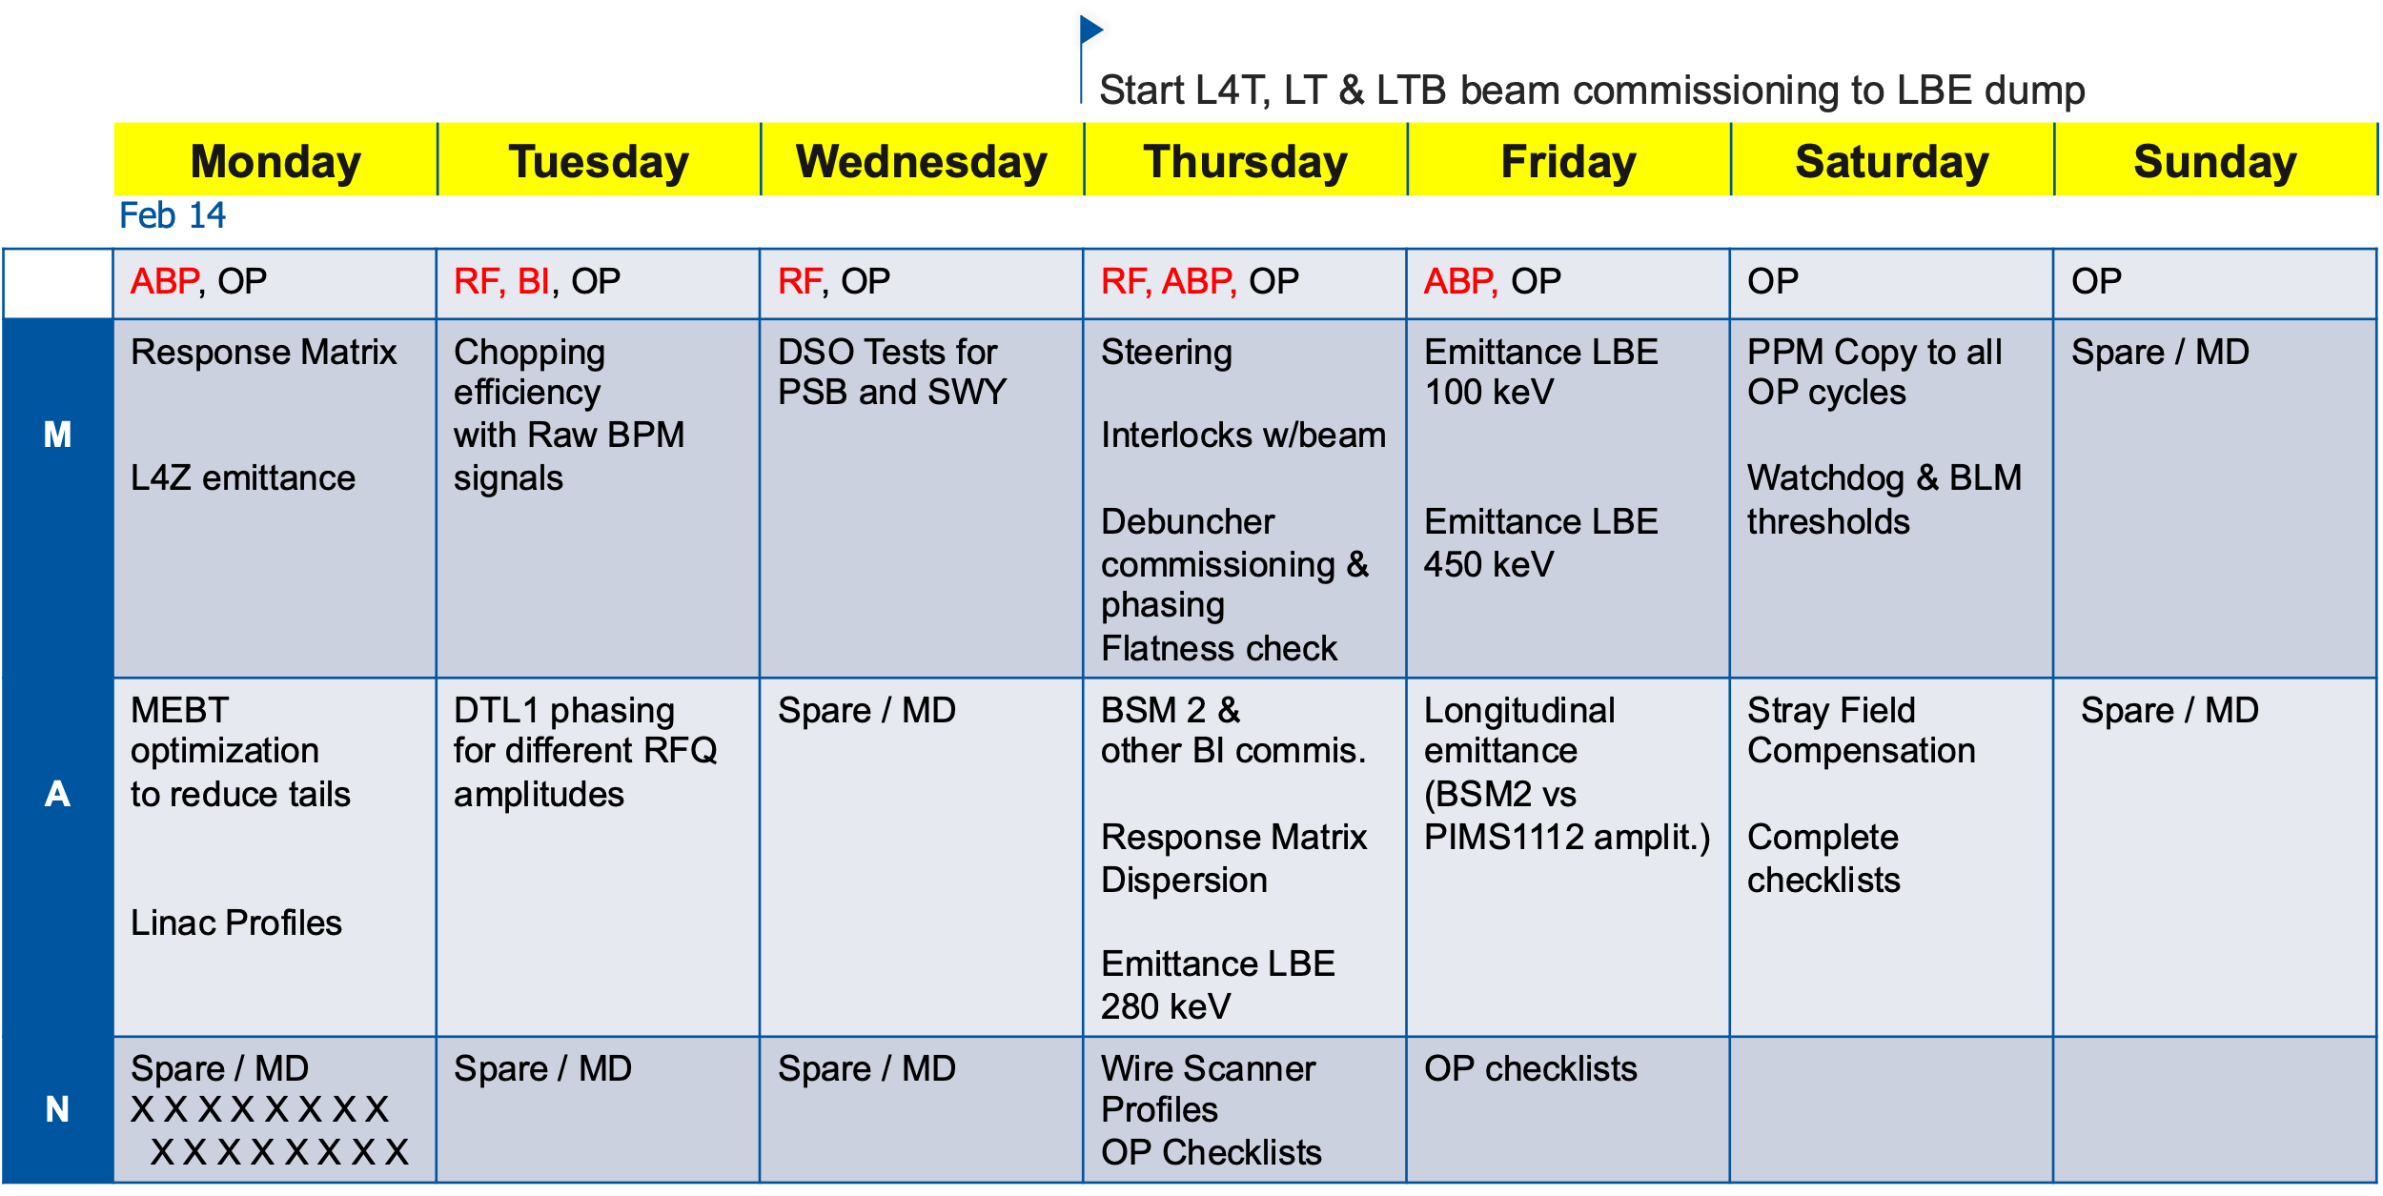
2022 Commissioning in LINAC4
7 + 12 days (HC+BC)
The longest items:
  Power Converters
  Phasing
  LLRF setup with beam

Slide 12
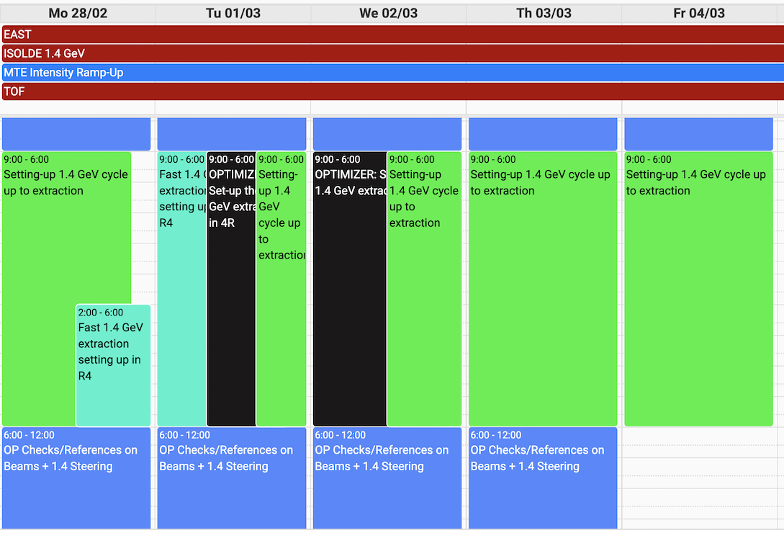
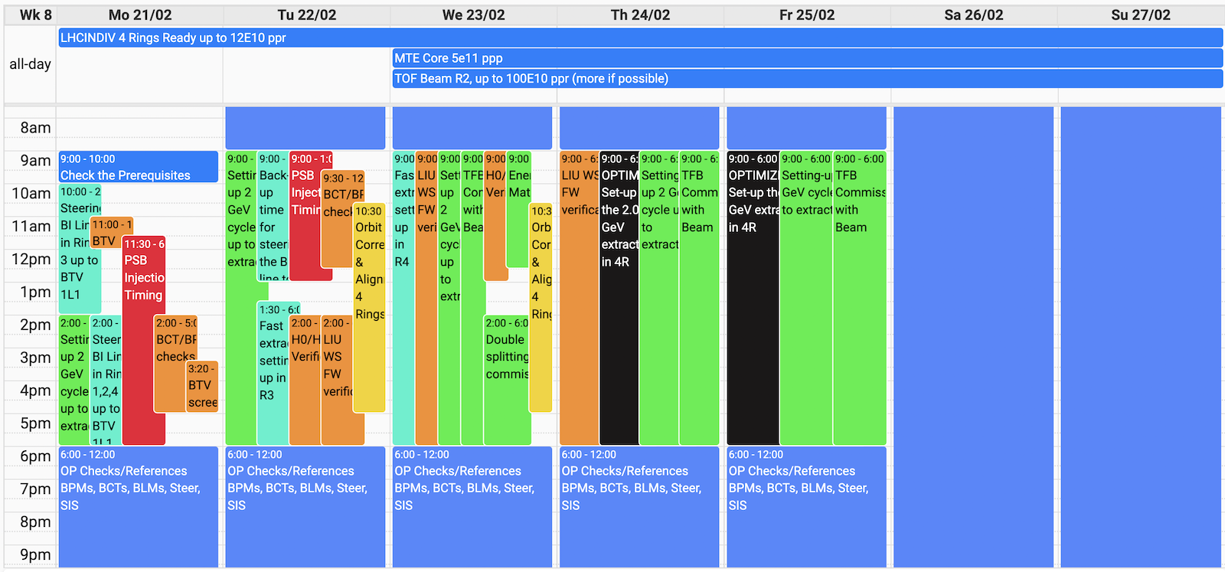
2022 Commissioning in the PSB
14 + 7 days
The longest items:
  Power converters
  Interlocks

Slide 13
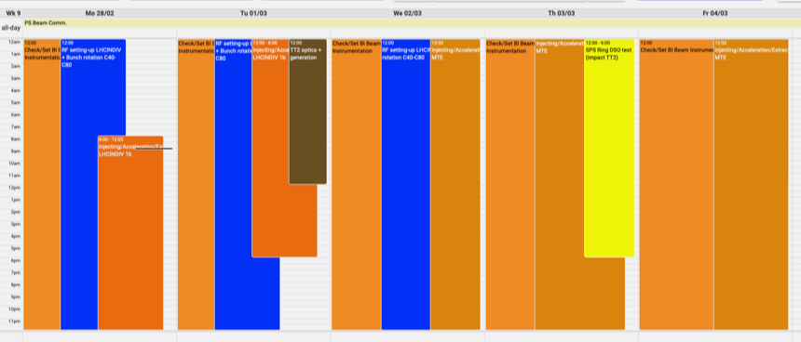
2022 Commissioning in the PS
14 + 7 days
  In 2023 it will be 7 + 7 days
The longest items:
  Power converters
  RF Setup

Slide 14
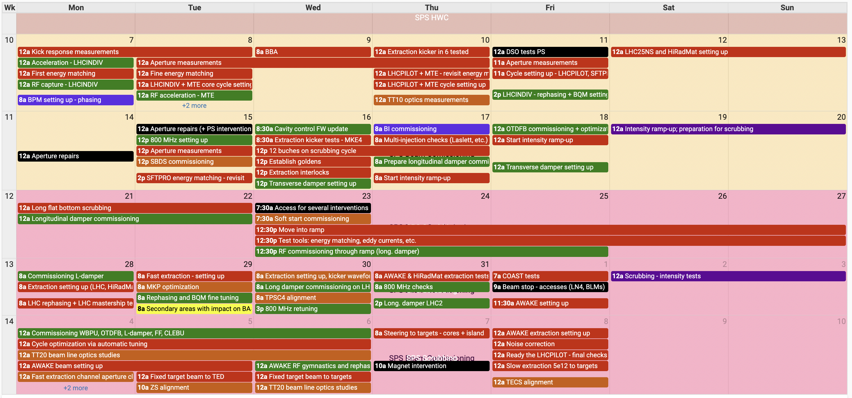
2022 Commissioning in the SPS
3 + 2 weeks (LHC) and additional 2-3 weeks for NA
The longest items:
  Scrubbing
  Slow extraction steering to target
  Power converters

Slide 15
No gain in some cases
Aggressive commissioning doesn’t always make sense
For each machine minimum YETS duration is different
Downstream machine may not be ready yet to take the beam
if the upstream accelerator provides the beam earlier
  For example, for LINAC4 YETS, normally is 2 weeks shorter than for the PSB, which is exactly the time needed for beam commissioning of LN4

Slide 16
Automation & Optimization

Slide 17
Automation is not aggressive!
We don’t consider automation as an aggressive approach:
  In other words: “automation” is not a synonym of “aggressive”
It’s our obligation to improve performance and
minimize the required time by automation of all possible tasks
Every year, in each machine, there are many examples of new automatizations
  Phasing and beam intensity change in LINAC4
  FGC power converter testing in SPS & PS
  BLM channel testing in SPS
  …

Slide 18
Automation: space for improvement
However, there is still space for further improvements
in the field of automation
But with the limited work force we are not able
to implement everything within one or two years
  A good program takes time to develop
  Also, testing automatics for commissioning is not always straight forward
  during beam operation or YETS
Automation of regular beam operation, improving machine operability, reducing fault recovery time, is usually given higher priority than
the tasks done once per year during commissioning
  Downtime recovery vs. commissioning speed

Slide 19
Automation prospects
Potential to reduce Hardware Commissioning
by 1 week in PSB and PS
Automatic testing won’t bring all its fruits
in the first time it’s implemented
  Teething problems: bugs, corner cases, real vs. test environment
  Software obsolescence
Even if the tests can be run very quickly,
we need time to solve the discovered problems

Slide 20
Optimization
Think what really needs to be tested: can we reduce the list of checks?
  New hardware technologies contain sufficient intelligence
  to immediately show problems on the alarm console
  The experts normally do test their hardware in Individual System Tests
  → Full testing by OP is likely redundant
  It depends on the particular system technology
    For example, it could be reduced for FGC 62&63 of LN4 & PSB,
    but it cannot be done in AD (old technology)
    Interlocks are still critical and this cannot be shrunk

Slide 21
Aggressive Options

Slide 22
Option 1: Use the past year setup
If hardware did not change too much over YETS then
it might be possible to run the machine with the past year settings
  If necessary, correct the steering and tunes to the old reference
  Verify that the bunch sizes, losses and other key parameters are still fine
Before LS1 it was often the way to start
The post LS1 troubles (see Chamonix 2014 slides&paper by K. Hanke)
lead to creation of a Injectors Recommissioning WG (119th IEFC )
  IRWG Indico
It imposed more rigorous approach that we have now
Notes:
The machine controls may be inconsistent if things are not checked and setup.
Risk that it will take even longer then normal

Slide 23
Use the past year setup: consequences
It’s likely that the beam parameters won’t have the best performance
→ brightness, losses (activation), intensity
  Machine parameters usually drift away in course of a run
  A set of good enough parameter values to be defined for each beam
  The parameters will likely continue drifting away:
  count-in safety margins
  Certain items will be left unchecked
  More difficult beam setup for the downstream machines
    The imperfect incoming beam will be the reason for all their troubles
  Risk of full re-commissioning → uncertainty for the downstream machines planning
Notes:
The machine controls may be inconsistent if things are not checked and setup.
Risk that it will take even longer then normal

Slide 24
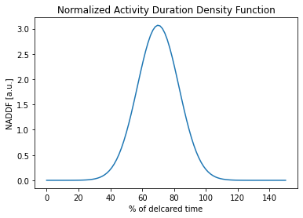
Option 2: Reduce contingencies
Every team counts in safety margins
in the required duration of their activities
  Observation from the past time:
  Most of the activities are completed much faster than declared
  → The downstream facility usually can start commissioning a few days earlier
  Declared time is longer than the expectation value
  Time needed for standard amount of problems
  Gives flexibility in execution of parallel activities
  Nobody wants to be responsible for delays and
  rescheduling of subsequent activities
declared value
expectation value

Slide 25
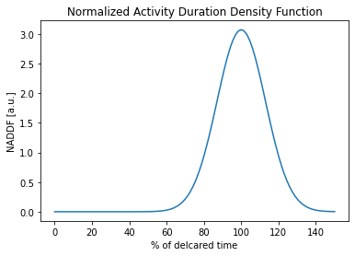
Reduction of contingencies: consequences
Everyone needs to accept delays, that would become much more likely
  Environment needs to be prepared for delays
This includes the downstream machines and the experiments
  They could receive no beam or poor quality beam to start with
  As more downstream facility as bigger the uncertainty is!
The planning of each team
would have to be very agile
→ Consequences for all other activities of the team
declared value
expectation value

Slide 26
Agile planning
Ensure that machine commissioning has the top priority
Dynamic rescheduling of other activities
  Including YETS installations & ISTs in other machines
  Can all the teams afford it?
Be ready to start an activity earlier then scheduled
Effective problem communication and handling

Slide 27
Option 3: Extend Expert working hours
Naturally, if the expert activities could be scheduled also beyond working hours then the total commissioning time could be reduced
Consequences:
Longer support requires larger pool of experts
  Maximum working time per day must be respected
  An Expert working a late evening cannot be available
  on the following morning
Homogenous compensation schema across the sector

Slide 28
Expert availability
Ensure that the Experts can focus on commissioning and
avoid conflicts with other activities
  MERITs
  Meetings: reduce to minimum
    Regular meetings (FOM, IEFC, IPP)
      Morning meeting only?
      Zoom?
    Avoid conferences, workshops & events (FCC week, IPAC)
All the experts, also the backup ones, need to be available
→ leave policy during the commissioning period
  For some machines the commissioning systematically falls into
  winter or Easter vacation periods

Slide 29
Option 4: Transfer expert activities to OP
If Operators are trained to perform currently expert tasks then
they could be scheduled outside working hours
Study what can and what definitively cannot be given to OP
  For example, RF setup clearly must be done by the experts
It requires
  Expert agreement
  Documentation
  Software tooling and adjustment of operational control interface
  Training

Slide 30
Remarks
Commissioning time is the best moment to train new staff members
Ability to react to unexpected problems comes from the experience gained during the setup

Slide 31
Conclusions
There are possibilities to speed up machine restart,
that all the teams already actively work on
  Automatization
  Optimization
  Rationalization
Four aggressive options
  Running with past year settings
  Reducing contingencies
  Scheduling expert activities also outside working hours
  Transfer selected Expert activities to OP
These are not exclusive, each of them can be applied independently

Slide 32
Conclusions
Each of the aggressive options comes with a price to pay:
important consequences
  Not the best beam performance
  Uncertainty in time of the activities and the commissioning completion
  Compensations for outside working hours activities
  Work on documentation and training
  Agile planning of the commissioning, YETS and
  other adjacent activities
    Increased entropy requires energy to keep the temperature cool,
    well below boiling point

Slide 33
Conclusions
There are opportunities to improve the whole process
of accelerator restart
It requires global discussion and
a shared vision across whole ATS sector

