Slide 1
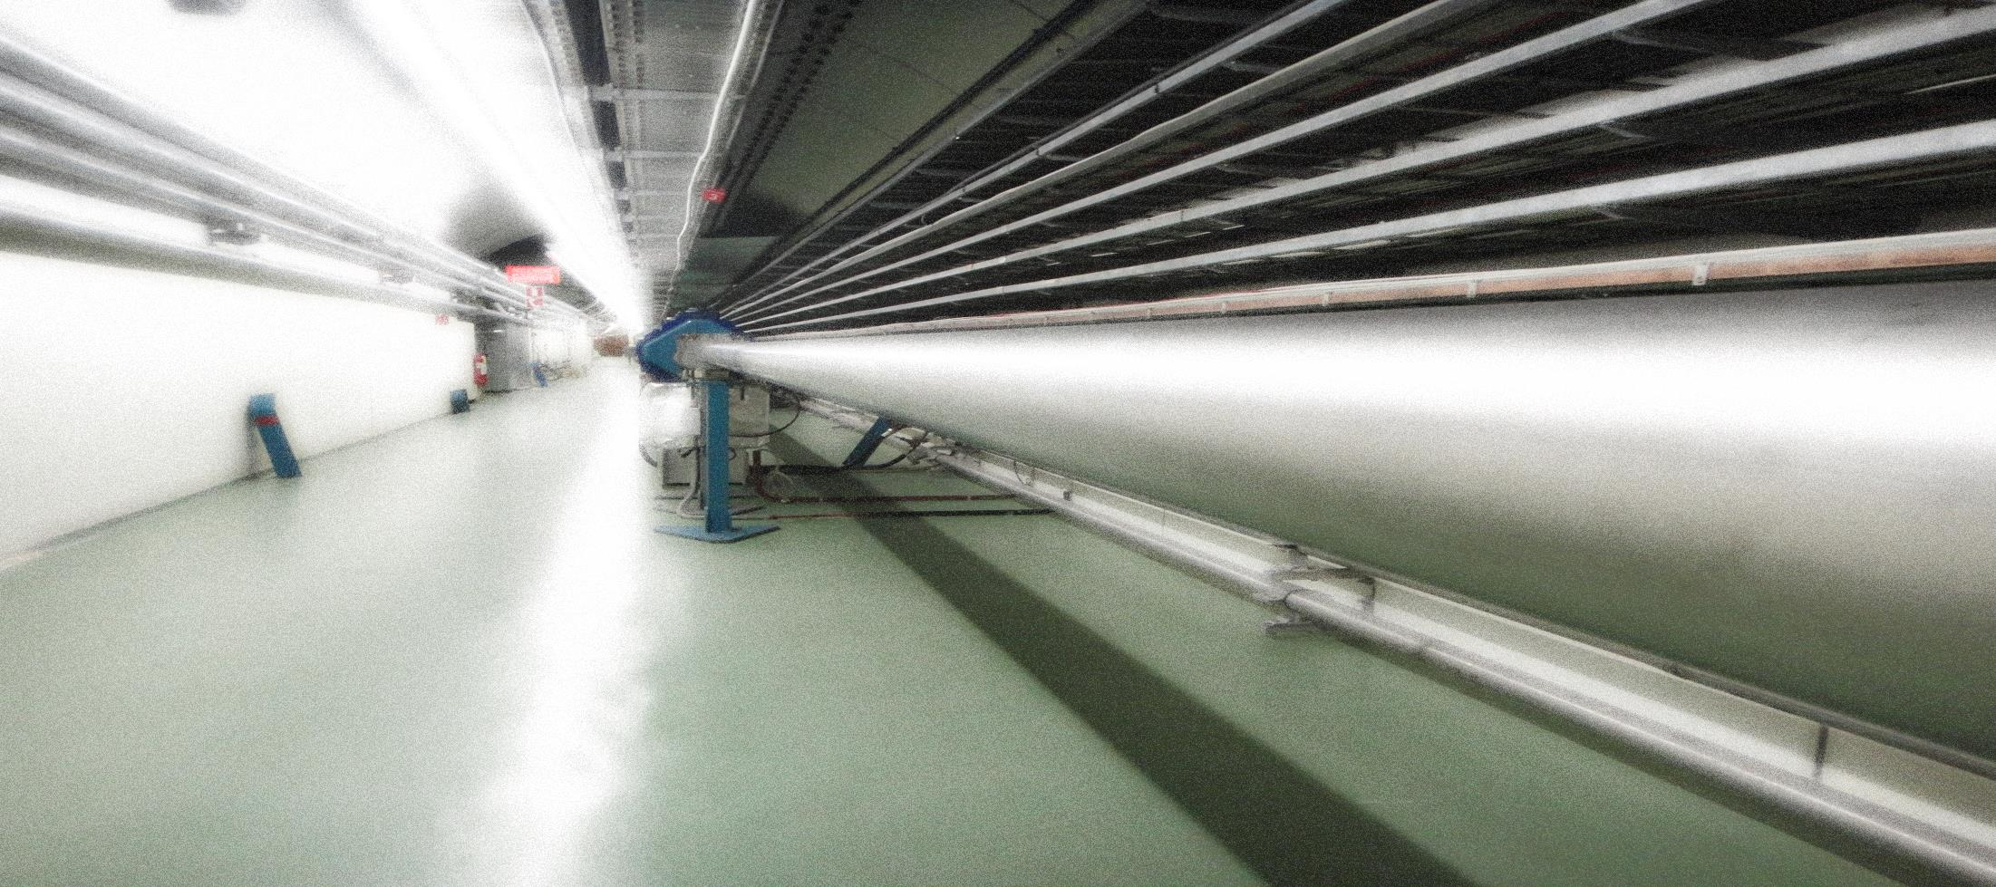
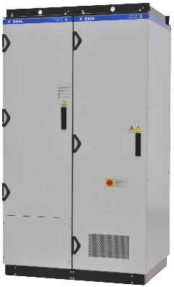
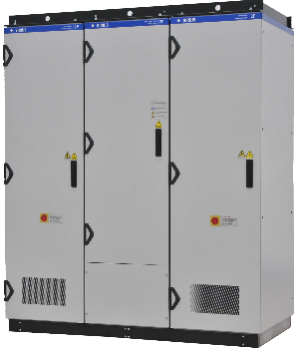
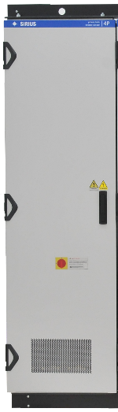
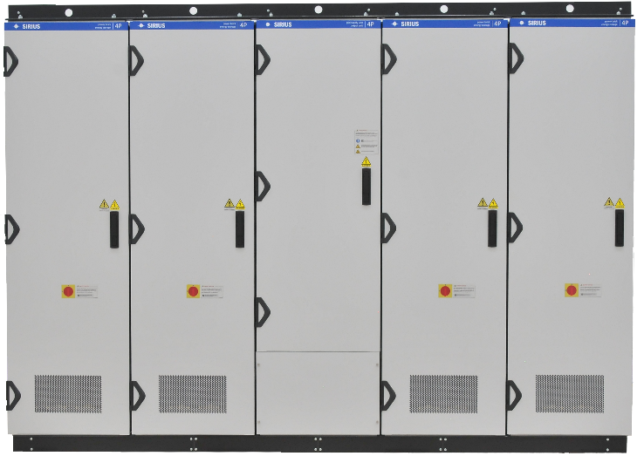
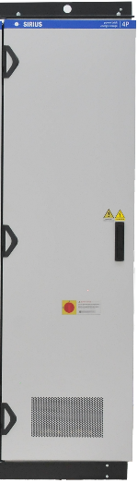
Moving complexity from hardware to software
…and other ideas from hardware people
Joint Accelerator Performance Workshop, December 2022
Session 7: Efficiency, reliability and tools across the complex
Konstantinos Papastergiou
Electrical Power Converters Group – SY Dept.
Many thanks to Ivan, @EfficiencyThinkTank, Valerie, Verena, Francesco, Alex, Nikos, Dipanwita, Charles, Remi, Timm, Krister, Stephane, Raul

Slide 2
Summary
Powering of accelerators and the need for efficiency metrics
  Energy intensive processes and hidden operating costs
  An example of KPI for equipment utilisation
Addressing hardware problems with software
  from dc to cycling in transfer lines (eliminate dc operation)
  Addressing the magnetic field reproducibility issue
  Addressing consolidations needs with a fresh view
Ideas for the future Mega-accelerators and concluding remarks
  Containerisation & orchestration
  Digital embryos/twins as (early-stage) feasibility and operation tools

Slide 3
The electrical system overview
1-2%
waste
1-4%
waste
no-load/always-on power losses
5-20%
waste
1%
waste
60-70%
accelerator

Slide 4
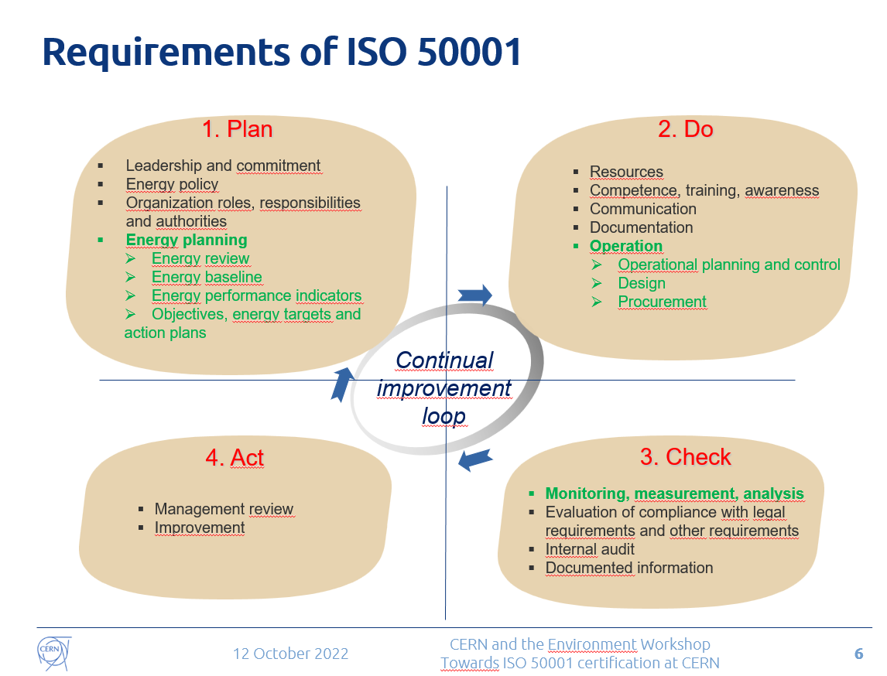
Efficient use of energy: Getting there
CERN level:
Plan consumption
Key performance indicators
Operations/Experts:
Resources
Raise awareness
Monitor what matters
Perform data analysis
Start over ☺
Slide of Nicolas Bellegarde, Towards ISO50001 certification at CERN, https://indico.cern.ch/event/1193771/

Slide 5
An example of an “expert” KPI
Objective
raise awareness about energy & and equipment life consumption
Indicator
percent % of used magnetic cycles
Example with data extracted with pyTimber for the month of August:
Using SPS mains (RPPEL.BA3.MBI) timeseries
and BCT (SPS.BCTDC.41435) timeseries
to evaluate use of SPS mains (beam time, wasted cycles, etc)

Slide 6
Accelerator time usage
Utilisation 92.5%
of time in month
Beam 64.3%
of time in month

Slide 7
Energy usage
Waste cost does not scale linearly to time waste. Attention to the “rms weight”/quantity of wasted cycles
40%
70%
60%
30%

Slide 8
Transitioning from DC to PPM
1

Slide 9

Direct versus Cycling operation
1
Magnet type | Total (1.2sec) | Recoverable | Thermal loss (1.2sec)
Quadrupole (26Gev) | 11kJ | 6kJ | 5kJ
Small Dipole (26Gev) | 31.5kJ | 25kJ | 6.5kJ
Large Dipole (26Gev) | 101kJ | 82kJ | 19kJ
Annual cost of electricity for 1kJ:
(Non-recoverable/consumed every 1.2seconds)
484- 806Euro*
Cost
9KEur
up to 15.3kEur
per year*
Cost
21KEur
up to 35kEur
per year*
* Assuming cost of electricity between 0.09 and 0.15CHF/kWh. 1kJ of energy over a 1.2sec cycle corresponds to 1kJ/1.2sec=0.83kW of average power. Assuming this 1.2sec (PS) cycle repeats for 24hours over 270 working days the total energy required from the power network (for each 1kJ) is 5378kWh/annum. If this energy is not recovered in capacitor banks after every magnet cycle it is returned to the power network and is not remunerated by the provider.

Slide 10
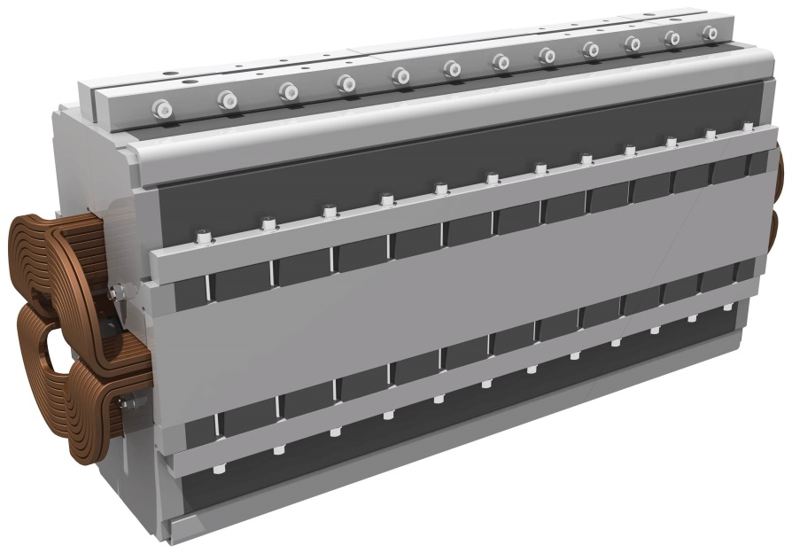
Example North Area Consolidation
1
Action for equipment designers:
Replace solid yokes in magnets with laminated silicon steel of latest technology.
Action for Operators:
Employ new FGC functionality developed for transfer lines to perform:
pre-functions and post-functions such as MINRMS and
dynamic economy.
✓
Moving complexity to software

Slide 11
The East Area example
1
Magnets
Solid to laminated yoke
Converters
Regenerative braking technology
<2010
2012
2021
15
GWh/year
11
GWh/year
0.6
GWh/year
As built in 1967
Spectrometer removed
New cycling operation

Slide 12
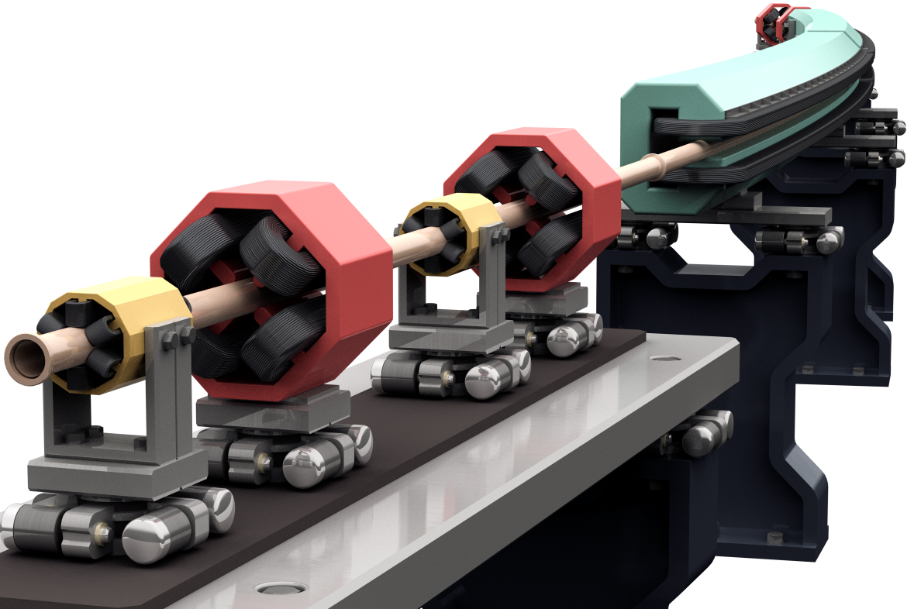
Magnetic field reproducibility
2
(c) Rey Hori / KEK

Slide 13
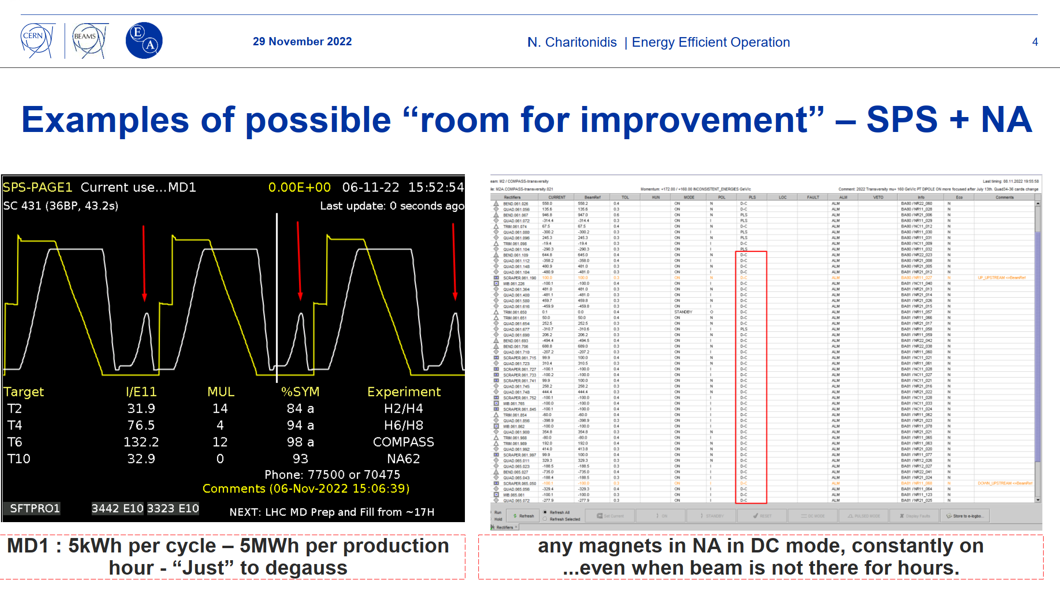
The impact
2
It is evident (see Nikos talk) that “de-gaussing” cycles and pre-functions are consuming “accelerator time” and energy
Calculation for SPS mains monthly cost
August 2022, magnets only, scenario 90Eur/kWh
Physics cycles: 778,302 Euro
“degauss” cycles: 54,001 Euro
“waste” cycles: 82,320 Euro
Thanks to Nikos Charitonidis
See talk : Energy-efficient operation – concrete ideas to save energy
Preliminary data source

Slide 14
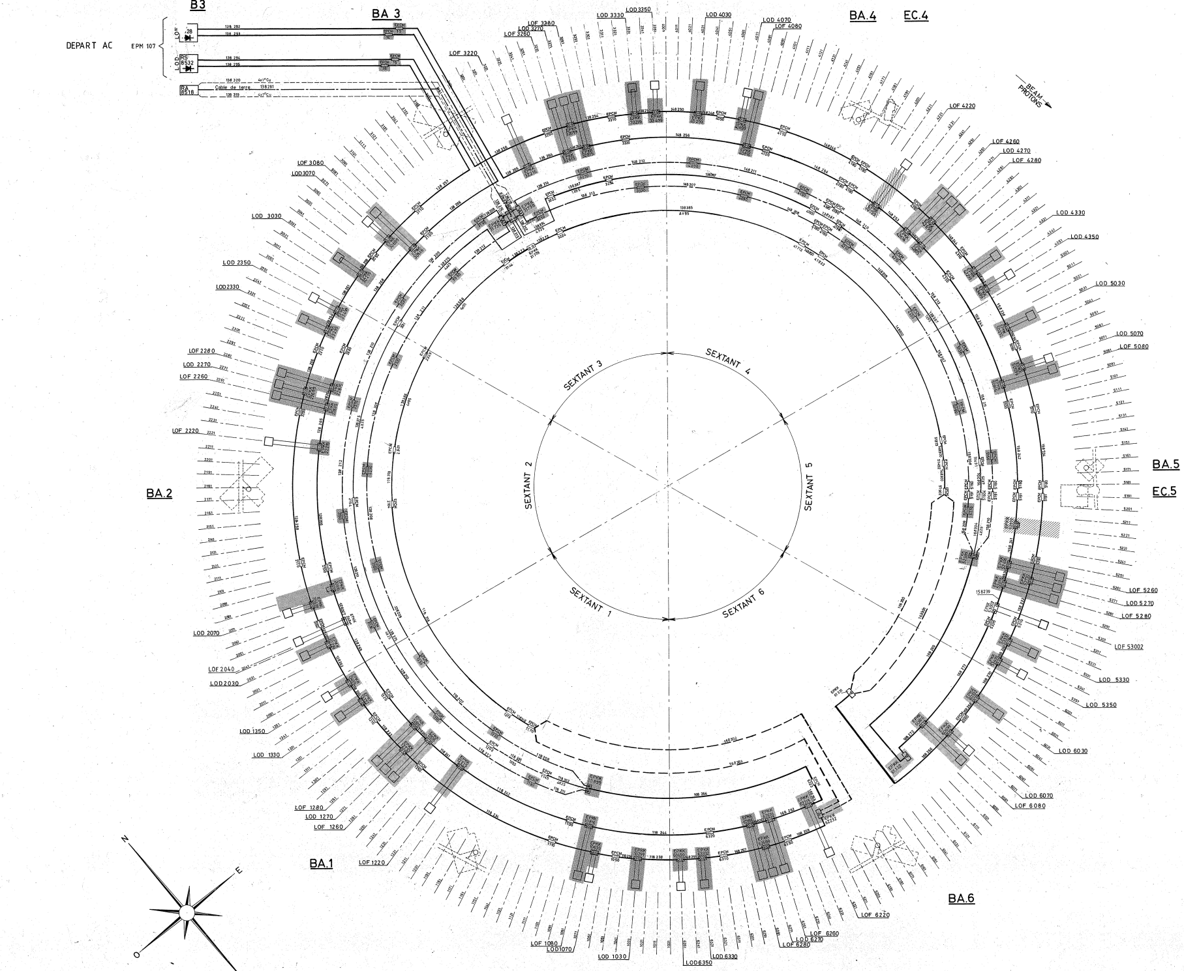
Impact to a Consolidation Project: the SPS Octupoles case
Series connected magnets
Peak stored energy 140 Joule
Max OP current: 15A
Max required voltage 400V
Required converter ratings:
Max current: 15A
RMS current: 15A
Max voltage: 400V
RMS power: 6kW
Peak power: 6kW

Slide 15
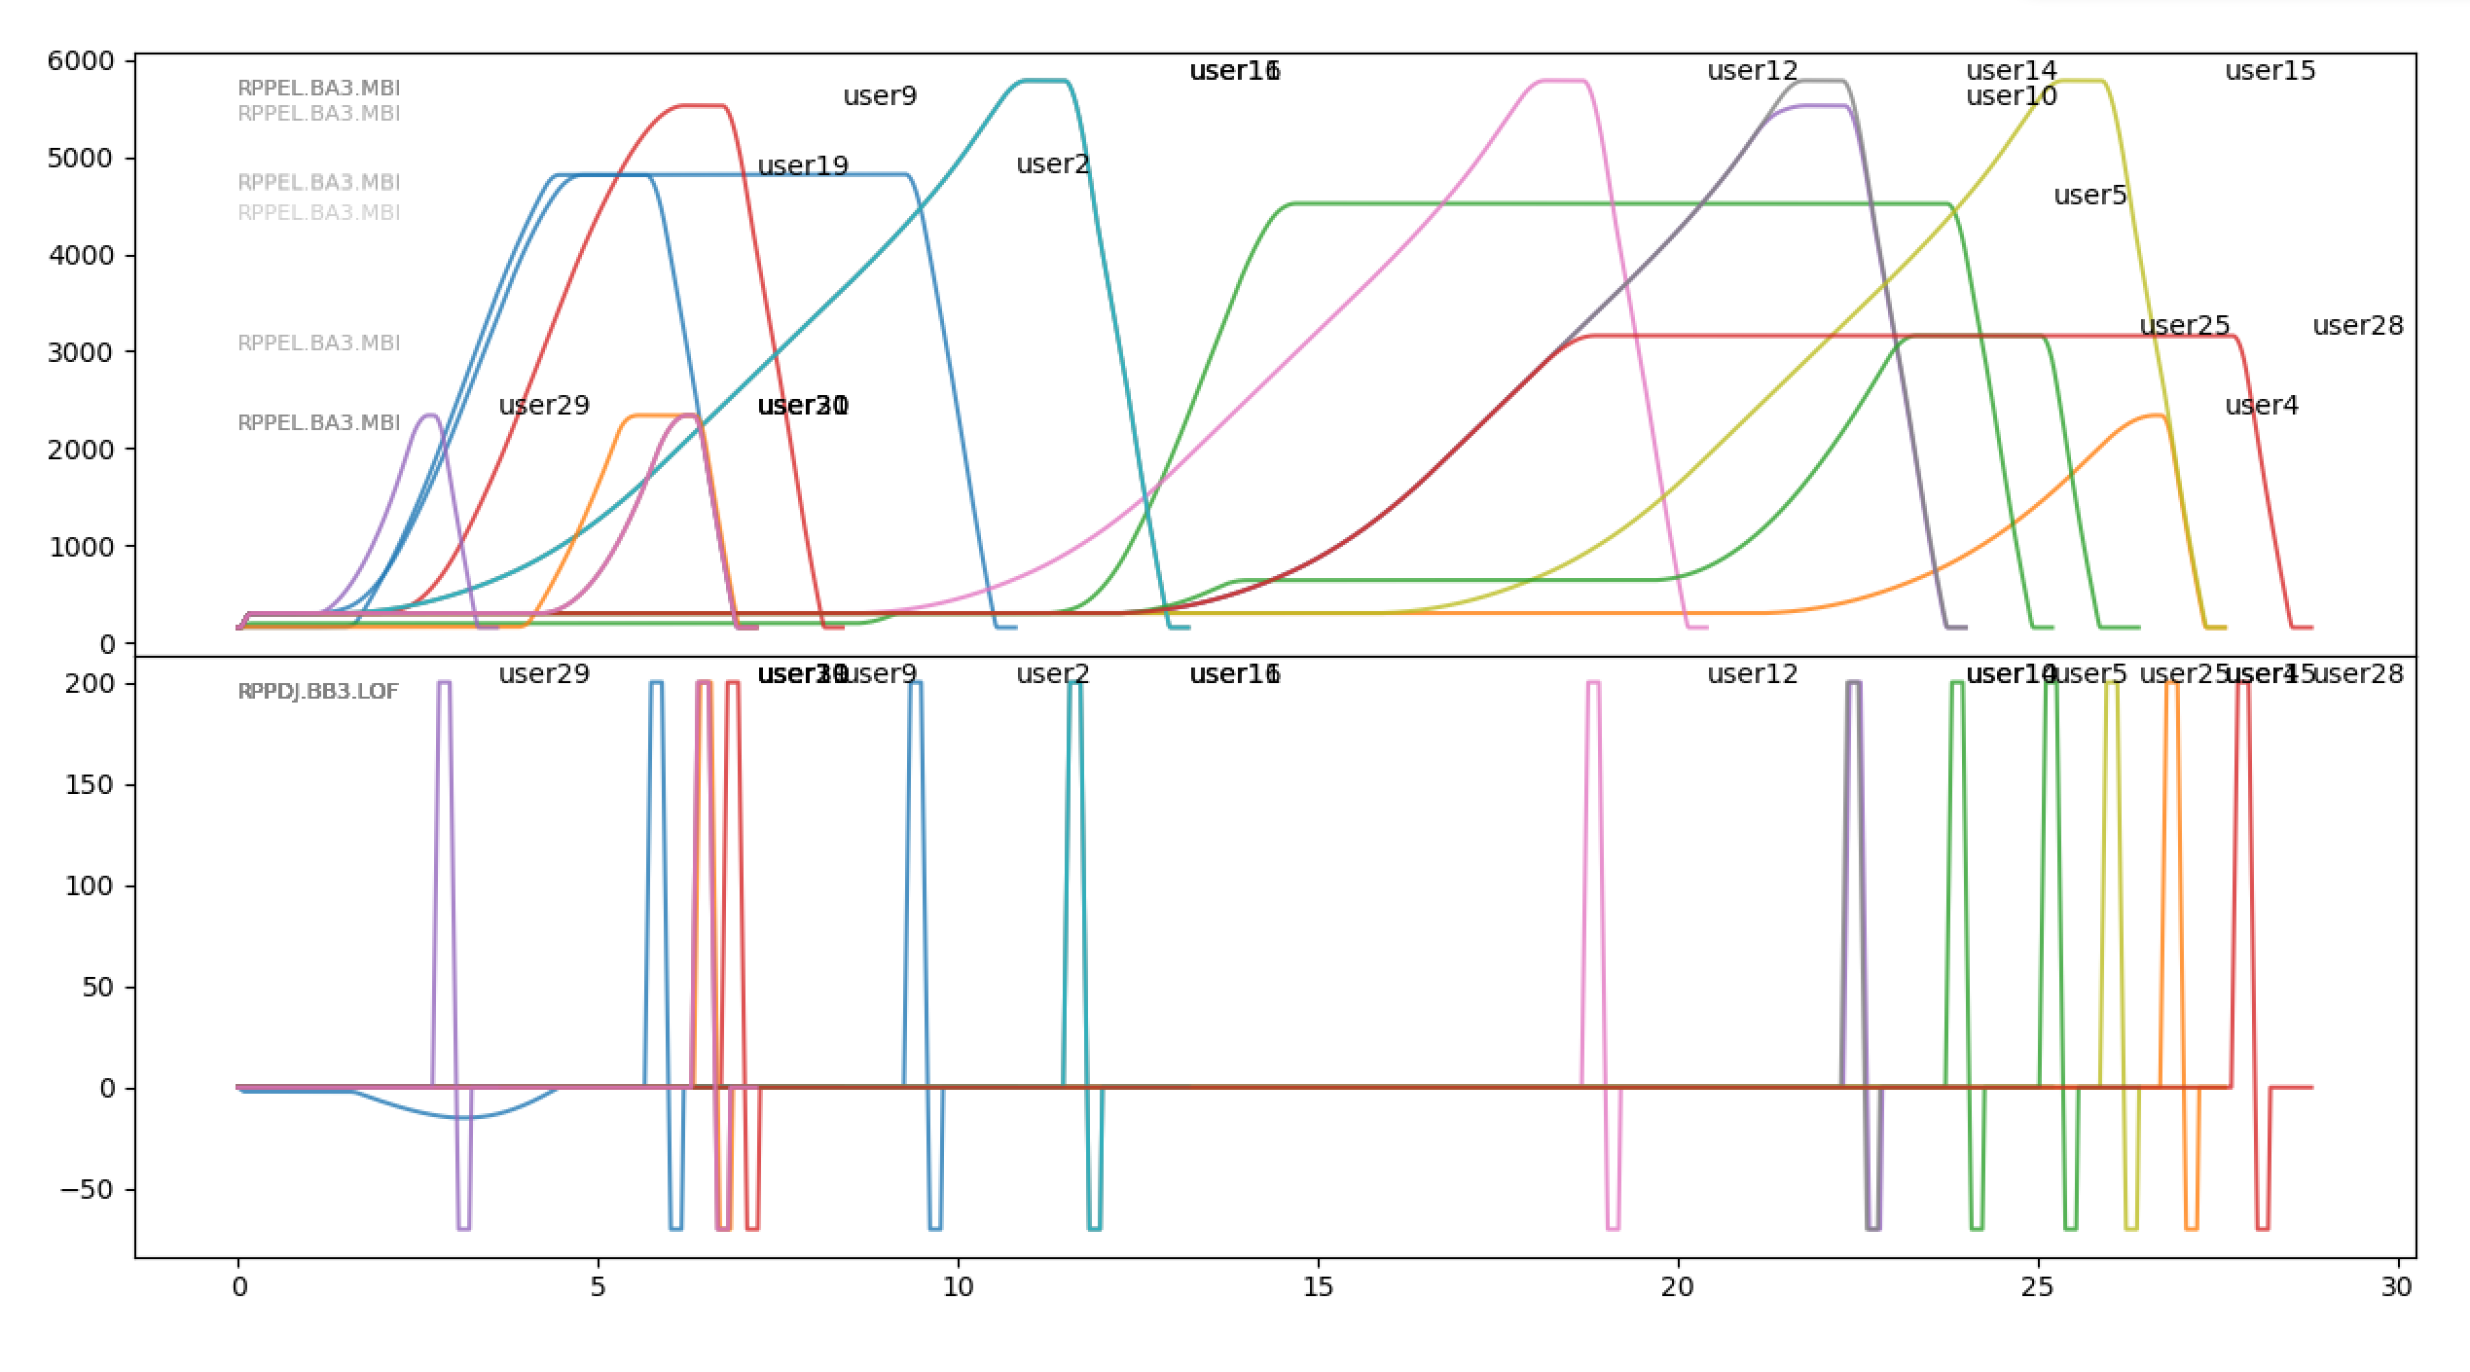
Impact of a magnetic reset pulse
RPPDJ.BB3.LOF
Series connected magnets
Peak stored energy 27KJoule
Max OP current: 200A
Max required voltage 1800V
Required converter ratings:
Max current: 15A 200A
RMS current: 15A 35A
Max voltage: 400V 1800V
RMS power: 6kW 63kW
Peak power: 6kW 360kW

Slide 16
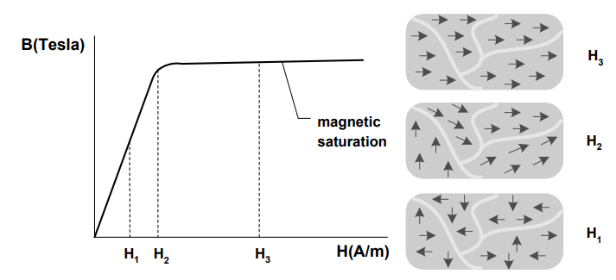
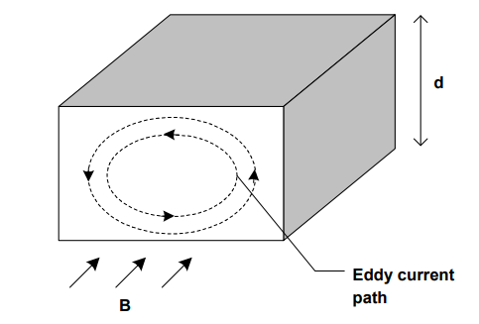
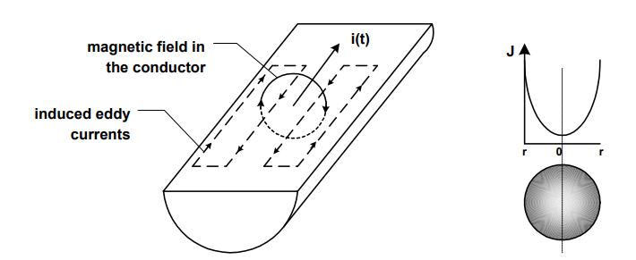



The issue non linear B=f(I)
2
Magnetic reproducibility issues due to:
  Magnetic field saturation
  Magnetic Hysteresis (phenomenon of energy loss in magnetic material)
  Eddy currents (magnet-end caps, vacuum chamber)
  High frequency phenomena (skin depth, proximity effect)

Slide 17
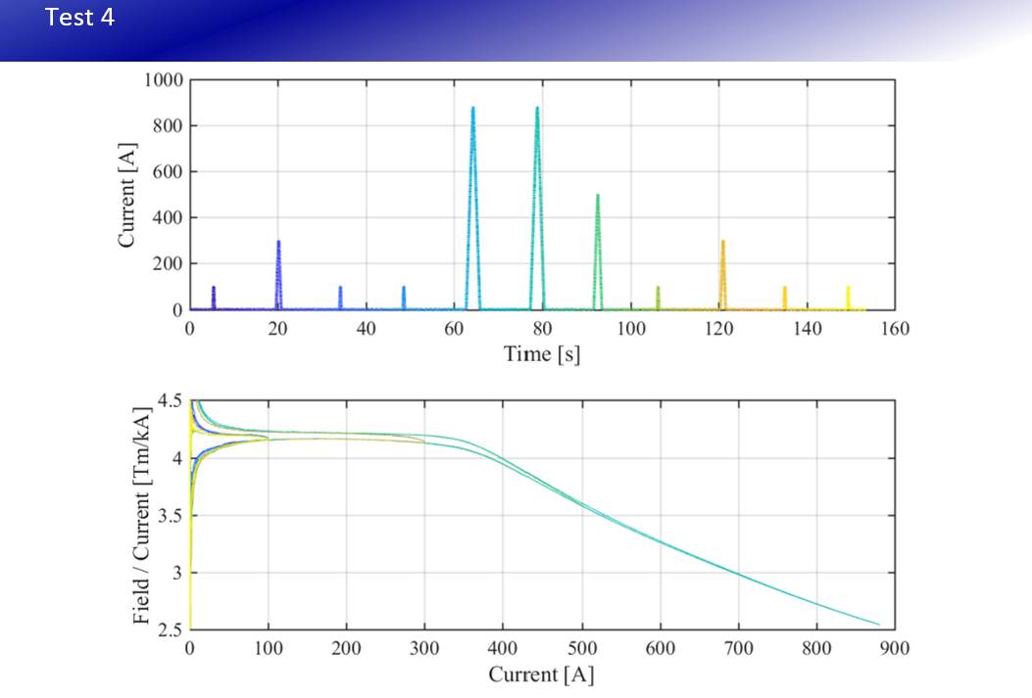
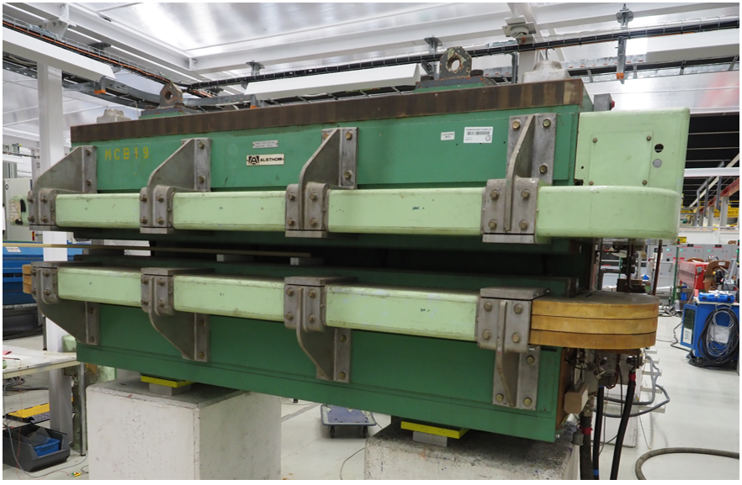
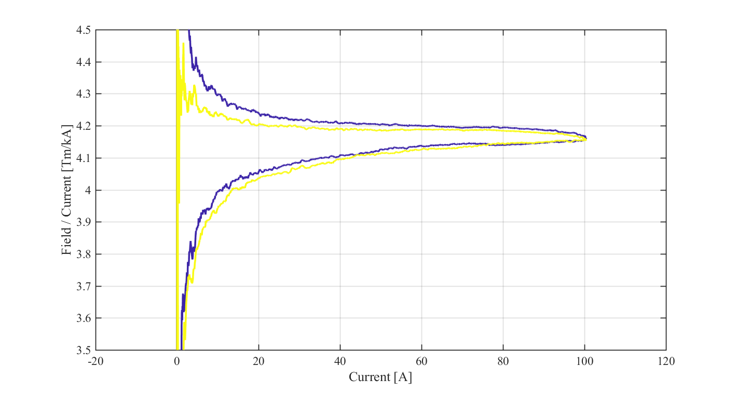
Example of magnetic measurements
2
2
Field difference of 100⋅10⁻⁴
Thanks to Carlo Petrone, TE/MSC/MM -29 05 2018

Slide 18
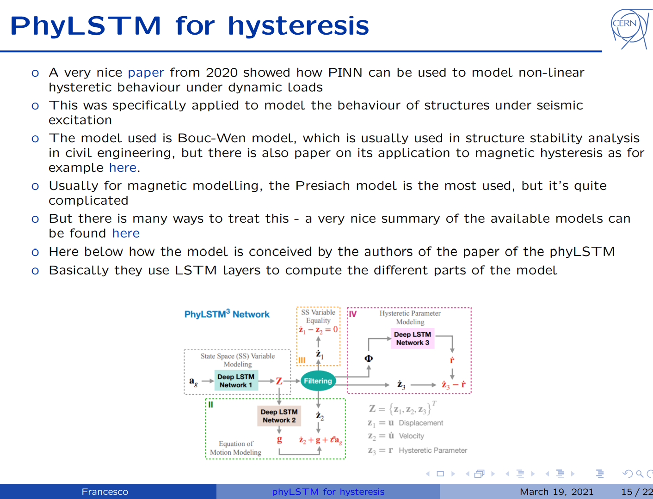
From Hardware to Software solutions
2
Phase A: Build intelligence into FGCs
  Implementation the RMS minimiser into FGCs
  Implementation of an UP-MIN-MAX magnetic pre-function
  Software adjustable ramp rates, max value, flat-top duration
  Software implementation of the current stabilisation
  Suitable for Transfer Lines but not for Rings
Part B: Train ML models with real magnet data
  Physics-informed NN demonstrator already built!
  Start with MBI and QD/QFs in the SPS
DONE
Only a partial solution
Francesco Velotti, on Hysteresis prediction on quadrupoles
https://indico.cern.ch/event/1019698/contributions/4279813/attachments/2212392/3744574/main.pdf

Slide 19
Solving the magnetic field reproducibility
Phd Student starting on this in BE-CSS!
2
With the evolution of computational tools such as machine learning, it is becoming possible to revisit the problem
Cross-department effort.
Magnetic measurements Lab
Accelerator
Train Machine learning models (or PINN as proposed) with real all-inclusive data of magnetic field for a variety of Supercycle compositions
Use PINN to guess the magnet current that results in the desired field-value using as input the magnetic history
✓
Moving complexity to software

Slide 20
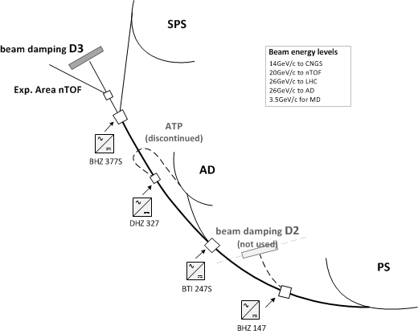
Better to avoid saturation all together
~80% of the magnets enter saturation in transfer lines
Result of the historical beam energy increases or reuse of old magnets in new accelerators (example ISR, Linac3…).
Results to unnecessary I²R in the magnet/powering system upstream.
Tesla per Ampere ratio is very poor
3
Voltage
Current
Magnet Inductance
Inductance is half at full current!

Slide 21
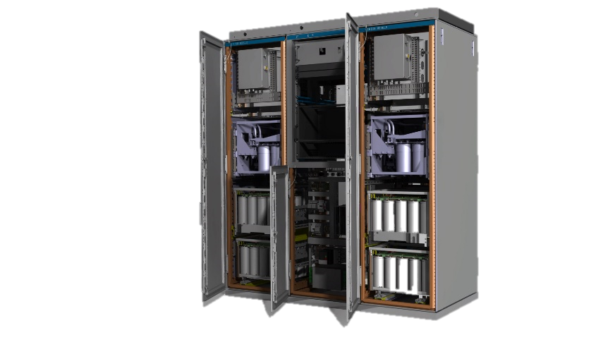
Equipment
Operation, maintenance
& End of life
4

Slide 22
Situation today
Consolidation work
Initiated and driven by equipment Groups
Typically a fragmented effort, missing system level view
Off-line, not informed by machine operational data.
Preventive maintenance
Mainly comprises:
Visual inspections
Scheduled replacement of parts
Adjustments of parameters
Is mostly done off-line, not informed by machine operational data
4
Future decision-making to be informed using data analytics!

Slide 23
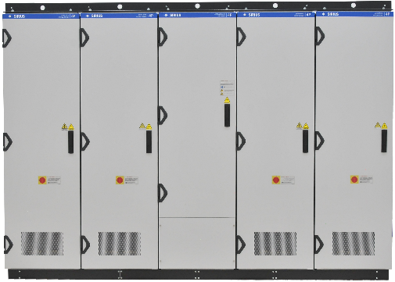
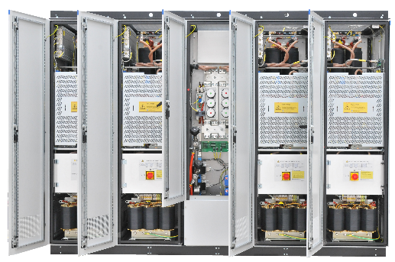
SIRIUS converter fleet
SPS
nToF
SIRIUS 4P+
S
Extra large dipoles & high energy beams
S
S
S
S
FTN
S
S
S
S
S
SIRIUS 4P
S
S
S
Large dipoles & series-connected magnets
S
S
F16
S
S
S
S
4
S
S
AD
SIRIUS 2P
S
FTA
BOOSTER
S
S
T11:CLOUD
Small quadrupoles & dipoles
S
S
ISOLDE
T11
S
S
S
S
S
S
S
S
S
S
S
S
S
T10
S
S
S
S
S
S
S
S
S
S
S
T9
S
BTL
S
S
S
S
S
S
S
SIRIUS S
PS
S
F63
T09
S
S
S
S
S
S
S
T8:IRRAD
Small quadrupoles & correctors
S
S
S
S
S
S
S
S
S
S
S
S
S
T08
S
S
S
S
S
S
S
F61
F62
EAST AREA

Slide 24
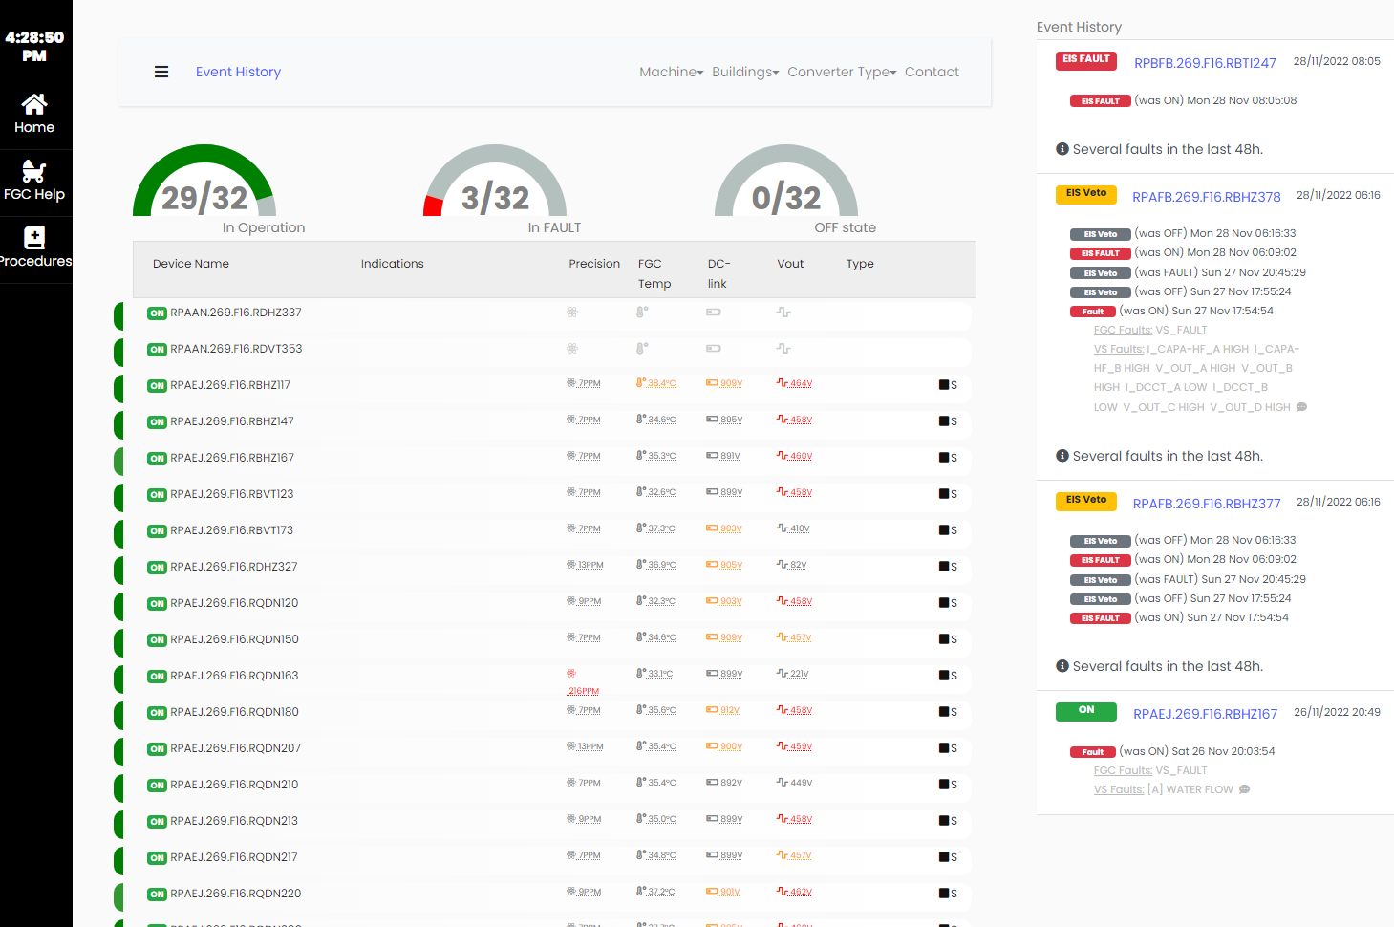
Power Converter fleet management
Athena: is a data analytics prototyping experiment.
4
Source: https://converters.web.cern.ch/converters/converterAnalytics.php?asset=RPAFB.269.F16.RBHZ378

Slide 25
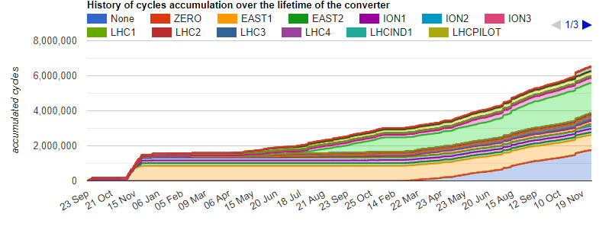
Power Converter fleet management
4
Source: https://converters.web.cern.ch/converters/converterAnalytics.php?asset=RPAFB.269.F16.RBHZ378

Slide 26
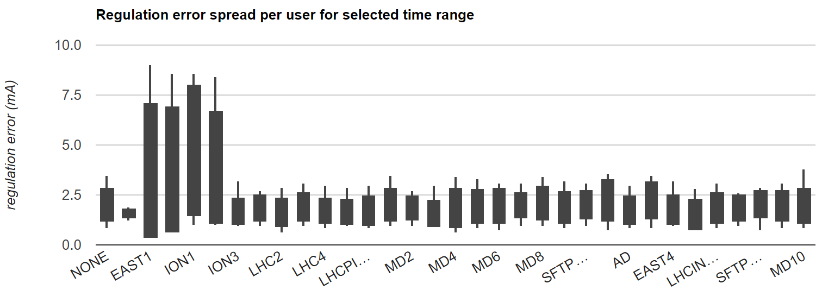
Power Converter fleet management
4
Source: https://converters.web.cern.ch/converters/converterAnalytics.php?asset=RPAFB.269.F16.RBHZ378

Slide 27
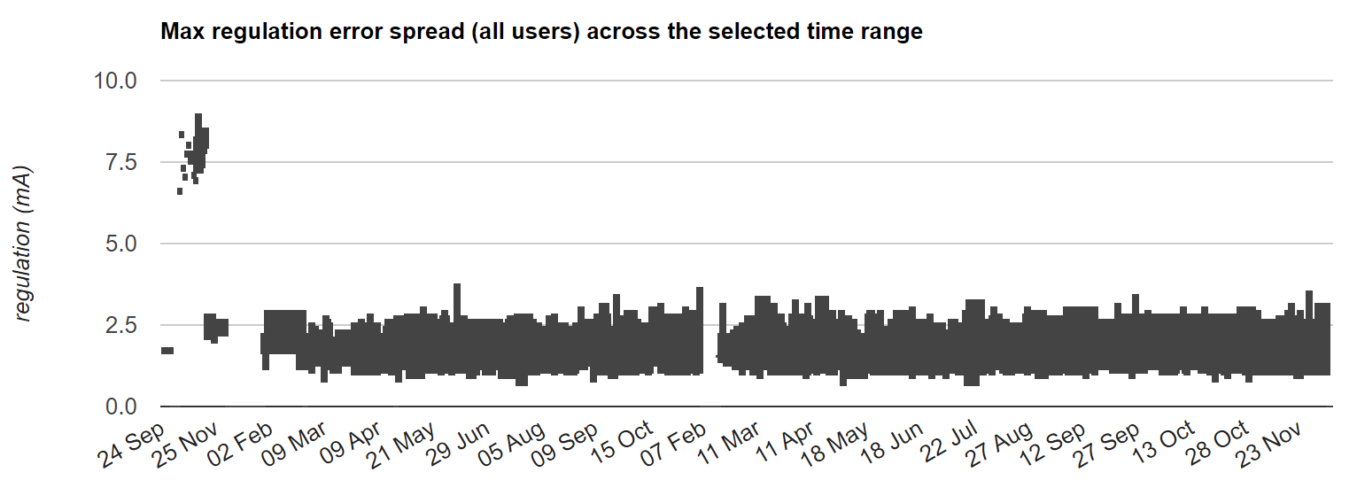
Power Converter fleet management
event
4
✓
Moving complexity to software
Source: https://converters.web.cern.ch/converters/converterAnalytics.php?asset=RPAFB.269.F16.RBHZ378

Slide 28
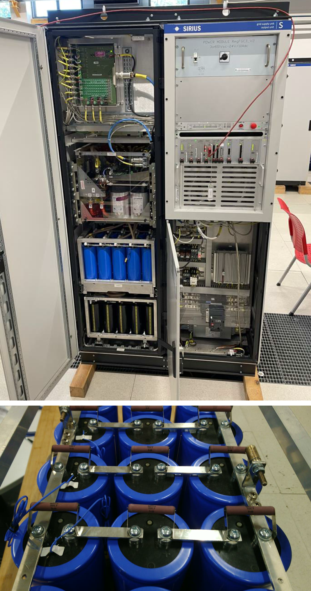
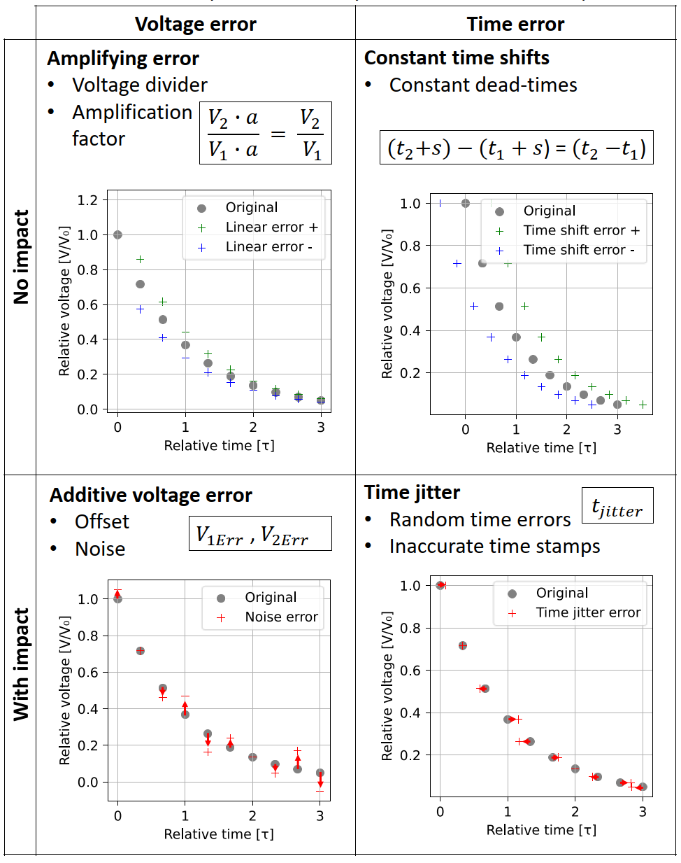
Exploration of new directions with ML
Prognostics of component degradation in power converters
Project objectives:
Identify signatures to be searched for
Find minimum data requirements, what, how often, what precision
Train ML models with simulated/real data
4
✓
Moving complexity to software
Thanks to Timm Baumann, European Power Electronics Conference 2022

Slide 29
Summary
Replacement of magnets is of paramount importance for energy efficiency
However:
We are constantly moving complexity from Hardware to software
  New FGC CClibs to minimise flux walking effect
  New prefunctions with I_{RMS} minimiser algorith
Data science team to revisit problems with new computational tools
  Concept includes the entire Balance of System (cables, power supply, magnet, cooling)
  Interesting aspects: data sampling, field homogeneity, powering reproducibility etc…
Operation & maintenance using data analytics
New data-informed Consolidations in the future
4

Slide 30
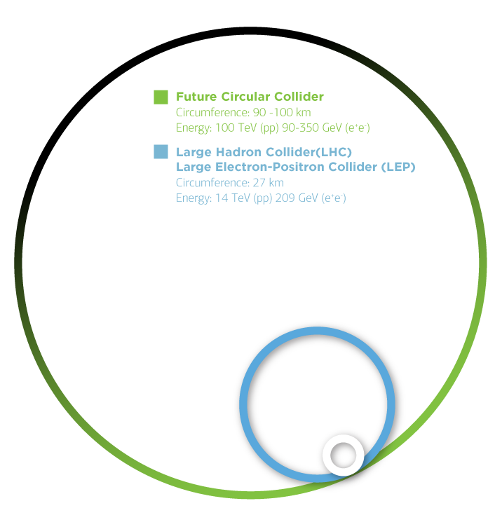
Ideas for the Mega-accelerators

Slide 31
From Hardware ownership to service ownership
Mega-structures to require, virtually, infinite software services, agents, and on demand tools to be deployed for operation and development.
Some of them to only be used occasionally (data analysis, machine development, prognostic functions)
Ownership (administration, maintenance) of computing infrastructure too expensive for the “common user”.
Energy use of data-centres to be constantly scrutinised internally & externally
The State of the art solution is Containerisation & Orchestration
n-1

Slide 32
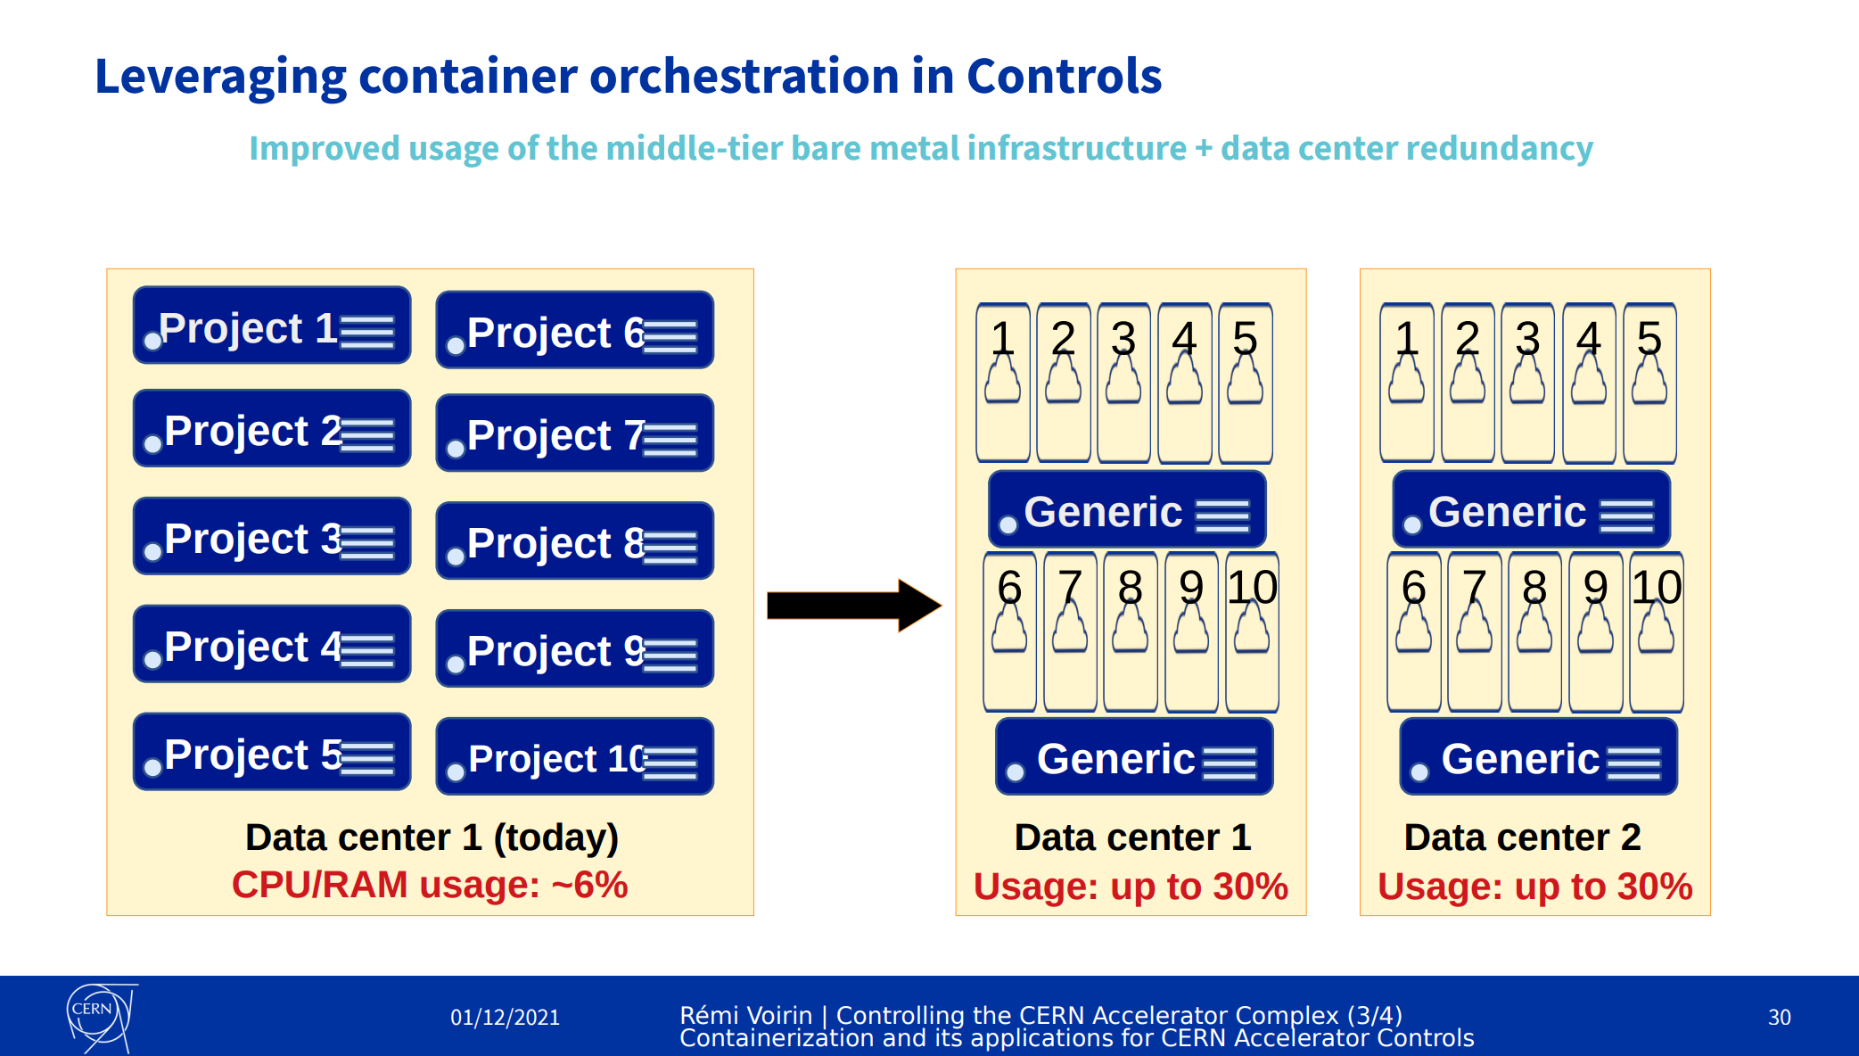
Kubernetes
n-1
Thanks to Remi Voirin, BE-CSS more on: https://indico.cern.ch/event/1054891/

Slide 33
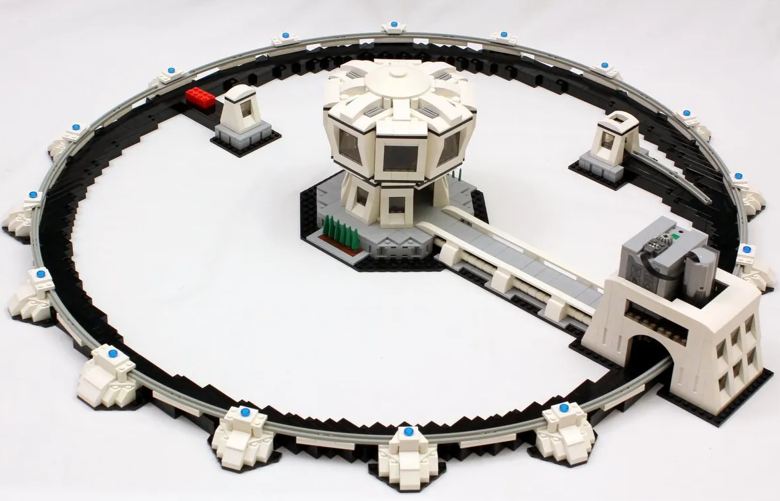
From basic models to digital twins
This technology is a consequence of our recent ability to run simulation models in real time.
Refers to a model that runs next to a physical system
Receives stimuli from physical/ production systems
Replicates the behaviour of a process or of an entire system
Aims to identify
inefficient operation
incorrect inputs or stimuli
incoherent outputs of a physical system
n
Operator to test new machine configuration
Load profile to digital twin and verify
Minimise downtime due to misconfiguration

Slide 34
From basic models to digital twins
Today, when someone asks one of these questions, at least x experts need to calculate/simulate and at least one person needs to aggregate results.
What is the expected reliability of an asset or of a process?
What is the operation cost of energy for an SFTPRO Cycle?
Which equipment consumes the largest energy in a complex?
What is the operating capacity a certain asset (substation, etc)?
What is the remaining lifetime of certain equipment/installation?
How will data analytics be done tomorrow while operating mega-structures?
#softwareAutomation #onlySolution
n

Slide 35

Selected take away messages
Impact of higher energy consumption is multifaceted.
Environment & CERN
Establish Key Performance Indices on which we can act day to day.

Slide 36

Selected take away messages
Impact of higher energy consumption is multifaceted.
Environment & CERN
Establish Key Performance Indices on which we can act day to day.
Ability to spend in new projects
Use discounted cashflow methods to bring future costs to present

Slide 37

Selected take away messages
Impact of higher energy consumption is multifaceted.
Environment & CERN
Establish Key Performance Indices on which we can act day to day.
Ability to spend in new projects
Use discounted cashflow methods to bring future costs to present
Planning of Mega-machines:
Effective use of computing resources
Integrate expert knowledge in digital twin accelerator models

Slide 38
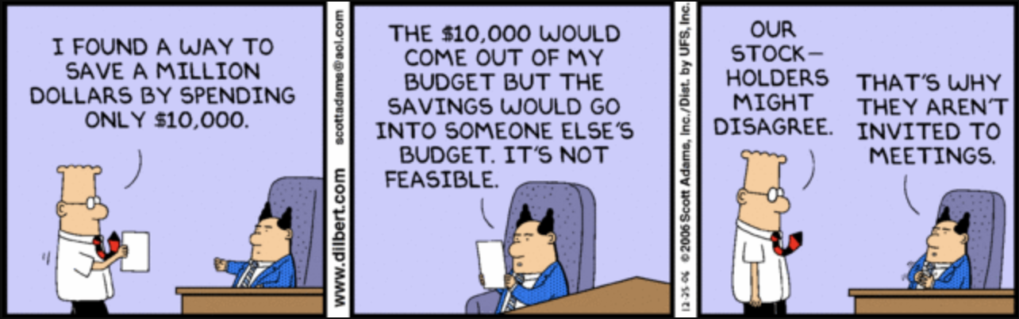
Thank you

Slide 39
A look into the way we operate our machines
Accelerator Ring
Transfer Lines in DC
LHC
SPS
Cycling Transfer Lines
Non-recoverable thermal losses
Storing energy in the magnets
Recovering energy in the magnets

Slide 40
Control Room
Local front-end
Surface building
Recycled energy
AC Distribution
DC distribution
Thermal losses
Machine protection (WIC)
Personnel Protection (EIS)
Heat Exchanger
Tunnel

Slide 41
Software solution for magnetic “reset”
2
Up-Min-Max Type – introduced when in transition to a higher current
During this operation we always arrive at the desired field by following a downwards current path.
Point D is unique hence we will arrive at any field density with much better accuracy

Slide 42
SPS user data in August 2022
Cycles | count | beam cycles | Imax,min | Imax,max | Prms,max | Ecycle | Ephysics | Ewaste | Efficiency
3.6 | 139907 | 0 | 1531.96 | 2340.07 | 5.6 MW | 786 | 0.00 | 600.01 | 0.0%
7.2 | 18524 | 15343 | 2339.92 | 4814.68 | 28.1 MW | 1041 | 612.69 | 50.09 | 82.8%
8.4 | 1346 | 1037 | 902.59 | 5527.43 | 31.7 MW | 100 | 32.63 | 11.75 | 77.0%
10.8 | 147705 | 134108 | 894.58 | 4829.42 | 46.3 MW | 20518 | 18191.14 | 414.96 | 90.8%
24 | 619 | 435 | 5784.72 | 5784.78 | 16.3 MW | 67 | 47.21 | 19.97 | 70.3%
27.6 | 6410 | 4851 | 730.45 | 5784.8 | 14.5 MW | 713 | 527.96 | 169.49 | 75.7%
Preliminary data – to be scrutinized ☺ https://cernbox.cern.ch/s/eiamKRvTYJlFtLK

