Slide 1
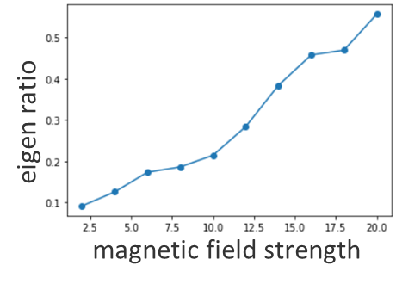
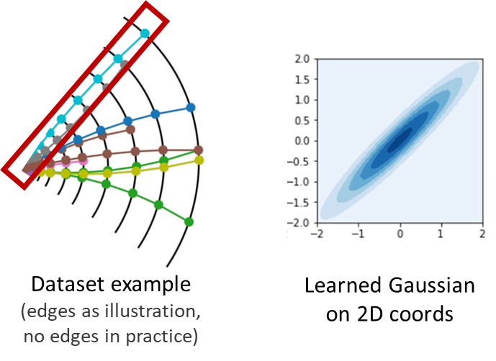
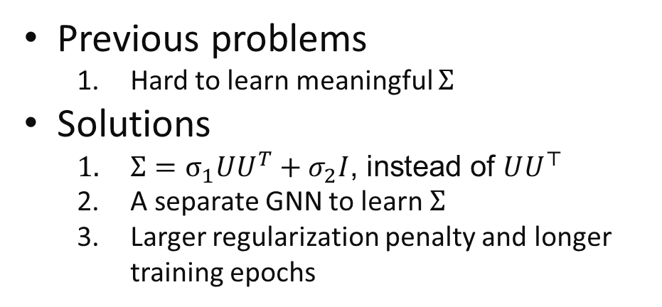
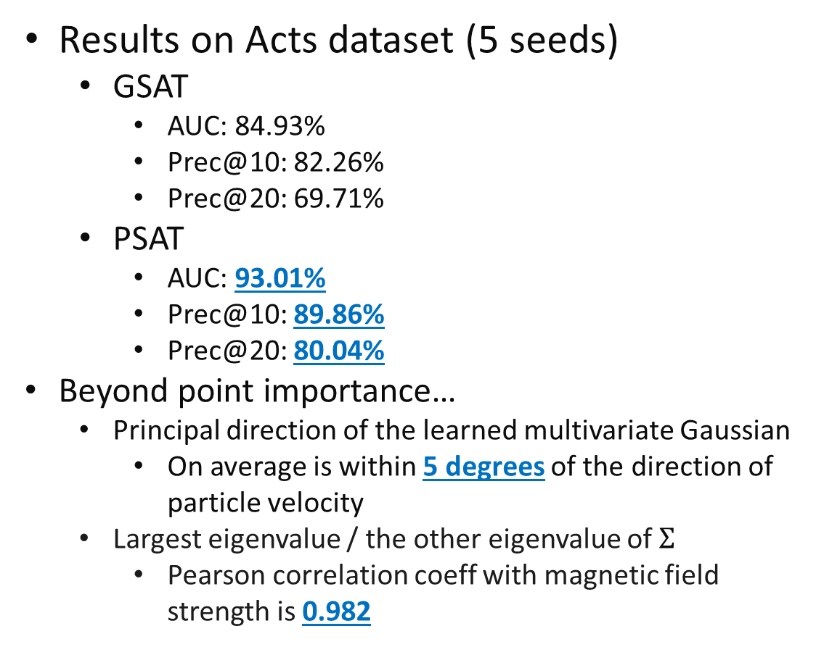
Inherently Interpretable Learning on Point Cloud Data
Previous problems
  Hard to learn meaningful $Σ$
Solutions
  $Σ=σ_{1}UU^{T}+σ_{2}I$, instead of $UU^{⊤}$
  A separate GNN to learn $Σ$
  Larger regularization penalty and longer training epochs
Results on Acts dataset (5 seeds)
  GSAT
    AUC: 84.93%
    Prec@10: 82.26%
    Prec@20: 69.71%
  PSAT
    AUC: 93.01%
    Prec@10: 89.86%
    Prec@20: 80.04%
Beyond point importance…
  Principal direction of the learned multivariate Gaussian
    On average is within 5 degrees of the direction of particle velocity
  Largest eigenvalue / the other eigenvalue of $Σ$
    Pearson correlation coeff with magnetic field strength is 0.982
Notes:
Previously, we find it hard to learn meaningful Sigma that can indicate import geometric feature directions
For example, in a dataset that we are given tracks and to predict if there is a certain decay
For a background particle, no matter how much gaussian noise we add on it, it shouldn’t affect model predictions
Yet, for a signal particle, we can either
Learn a very small gaussian, and almost add zero noise on it
Or, we can learn a gaussian that matches the direction of particle velocity, as shown in the image
We add extra three modifications in our model, and eventually make it possible to
Provide point importance interpretation
Provide important feature directions
As we have a track dataset, which enables us to evaluate these two aspects quantitatively
Specifically,
In terms of interpretation AUC and prec@k, we outperform previous SOTA significantly
Beyond that,
Our learned important feature direction on average is within 5 degrees of the direction of particle velocity
The ratio between Largest eigenvalue and the other eigenvalue of $Σ$, can indicate the strength of magnetic field
As its pearson correlation coeff with magnetic field strength is 0.982

Slide 2
Inherently Interpretable Learning on Point Cloud Data
Results on Tau3mu dataset (5 seeds)
  GSAT
    X AUC: 73.06%
    Prec@3: 62.40%
    Prec@6: 56.06%
  PSAT
    X AUC: 74.56%
    Prec@10: 62.11%
    Prec@20: 55.82%
Results on SynBind dataset (5 seeds)
  GSAT
    X AUC: 77.41%
    Prec@5: 96.57%
    Prec@10: 69.86%
  PSAT
    X AUC: 79.68%
    Prec@10: 97.32%
    Prec@20: 72.98%
Results on PDBBind dataset
  GSAT (5 seeds)
    X AUC: 58.01%
    Prec@10: 74.70%
    Prec@20: 71.57%
  PSAT (1 seed, not done yet)
    X AUC: 65.30%
    Prec@10: 68.03%
    Prec@20: 70.13%
Notes:
We also have evaluated GSAT and PSAT on other datasets we collected
On Tau3mu and SynBind, PSAT achieve (slightly) better performance compared with previous SOTA GSAT
On PDBBind, the experiments of PSAT are not finished yet.
though PSAT performs well on 1 seed, preliminary results show that the performance of PSAT has very large variance on PDBBind dataset
We might see more results on this dataset later.

