Slide 1





The Rise of Tightly-Coupled Processor Clusters
Luca Benini <lbenini@iis.ee.ethz.ch,luca.Benini@unibo.it>

Slide 2
Computing is Power Bound: HPC
HPC Performance
Energy / Op (for a 20MW budget)
Copyright © European Processor Initiative 2019. EPI Tutorial/Barcelona/17-07-2019
x10 every 4 years
Frontier
1.1EFLOP
19.2pJ/FLOP
/10 every 4 years
HPC: 10x every 4 years

Slide 3
Computing is Power Bound: ML
(Largest datacenter <150MW)
AI training: 10x every year!!!
Sevilla 22: arXiv:2202.05924
Machine Learning (training): 10x every 2 years

Slide 4
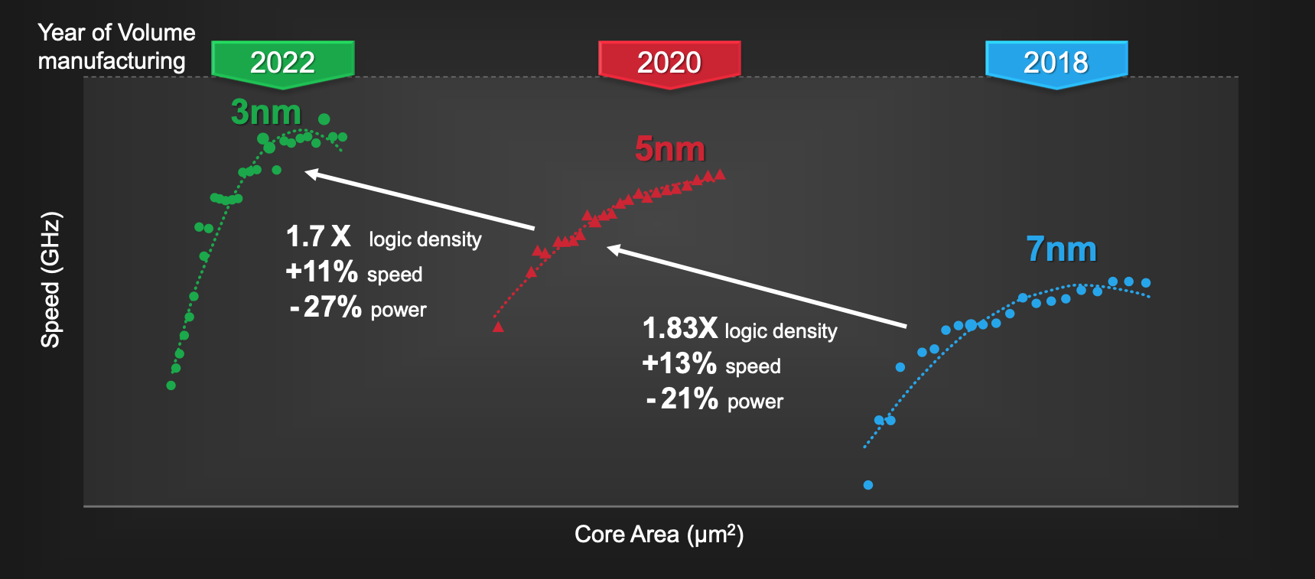

Technology Scaling?
TSMC, ISSCC21
@ iso-area 1.24x power ↑
Energy Efficiency ($\frac{1}{Power∙Time}$)→ 10x every 12 years…

Slide 5
Chiplets?
AMD, ISCAS22
Good news for Cost+Density, no silver buller for Energy

Slide 6
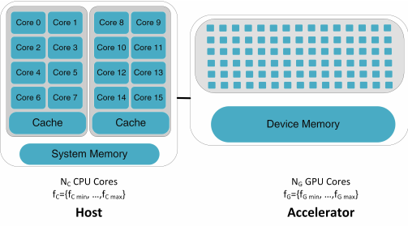
Efficient Architecture: Heterogeneous+Parallel
Decide
Compute
<
>
6

Slide 7
Heterogeneous + Parallel… Why?
Processors can do two kinds of useful work:
Today’s workloads are dominated by “Compute”:
  Tons of data, few (as fast as possible) decisions based on the computed values,
  “Data-Oblivious Algorithms” (ML, or better DNNs are so!)
  Large data footprint + sparsity
Decide (jump to different program part)
Modulate flow of instructions
Mostly sequential decisions:
  Don’t work too much
  Be clever about the battles you pick
  (latency is king)
Lots of decisions
Little number crunching
Compute (plough through numbers)
Modulate flow of data
Embarassing data parallel:
  Don’t think too much
  Plough through the data
  (throughput is king)
Few decisions
Lots of number crunching
How to design an efficient “Compute” fabric?
Notes:
0:50
- Programs have different characteristics
- Two kinds of useful work
-- Decide
-- Compute
- Lots of diligence today
- "We'd like to call [...] data-oblivious"

Slide 8
Compute Efficiency for PE, Cluster, SoC
From/To L1
RegFile
L1
L2
PE core
Cluster
Cluster
Cluster
Cluster
From/To L2
& Others
DMA
PE
core
PE
core
PE
core
PE
core
Cluster
Cluster
Cluster
Reg
L0:Operand Memory
Latency=1
Density=1
Private
L1: Tightly Coupled DM
Latency<10
Density≈10
Shared
L2: Main Memory
Latency>100
Density≈100
Shared, Remote
8

Slide 9
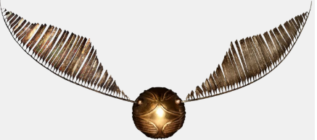
PE: Snitch, a Tiny RISC-V Control Core
A versatile building block
Simplest core: around 20KGE
  Speed via simplicity (1GHZ+)
  L0 Icache/buffer for low energy fetch
  Shared L1 for instruction reuse (SPMD)
Extensible→ Accelerator port
  Minimal baseline ISA (RISC-V)
  Extensibility: Performance through ISA extensions (via accelerator port)
Latency-tolerant →Scoreboard
  Tracks instruction dependencies
  Much simpler than OOO support!
Dependencies
Scoreboard
L0 ICache
Notes:
Following Occam's razor, the idea is to start with the most simplistic integer core we can imagine. (click) The focus shall be on size, simplicity, and high IPC for control tasks.
(click) The Snitch core is based on RISC-V, where the base instruction set only needs to decode 47 instructions, the register file reads and the arithmetic operations are all performed in a single-cycle.
(click) The load-store units have a decoupled interface towards the memory hierarchy, and the standardized accelerator port facilitates the high extendability and customizability of the Snitch core.
(click) To tolerate latency on the load-store unit and on the accelerator port, the core contains a tiny scoreboard which tracks instruction operands. That enables the core to execute independent instructions on the accelerator port, while supporting multiple out standing loads in-flight.
(click) To reach a competitive frequency, instructions are fetched from a small, private L0 cache. The L0 cache is backed by a multi-cycle shared l1 cache on a miss.
(click) The entire core comes in at around ten kGE. To give an intuition of how small that is, consider this Zen2 die (click). The entire die contains eight cores (click). One Snitch core is only a tiny, tiny fraction of the big out-of-order core (click) (actually, it is even smaller, but power-point wouldn't allow me to draw such small shapes).
Let's have a look, based on Xssr and Xfrep, at how ISA extensions can be used to significantly boost energy-efficiency.

Slide 10
Snitch PE: ISA Extension for efficient “Compute”
How can we remove the Von Neumann Bottleneck?
Targeting “compute” code
fld ft0, 0(a1)
fld ft1, 0(a2)
addi a1, a1, 8
addi a2, a2, 8
fmadd.d fa0, ft0, ft1, fa0
bne a1, a3, -5
70 pJ
double sum = 0;
for (int i = 0; i < N; ++i) {
sum += A[i] * B[i];
}
70 pJ
50 pJ
50 pJ
80 pJ
50 pJ
Memory access, operation, iteration control – can we do better?
Note: memory access (>1 cycle even for L1) → need latency tolerance for LD/ST
Notes:
0:40
- Why attractive today in cores
- C-like impl
- Start at 0, N elements, load A/B, mul, add to sum
- Compile "hot" repeated part
- Details in a bit, 50-80 pJ per inst (shoutout Flo)
- fmadd vs. bookkeeping

Slide 11
Stream Semantic Registers
LD/ST elision
Intuition: High FPU utilization ≈ high energy-efficiency
Idea: Turn register read/writes into implicit memory loads/stores.
Extension around the core’s register file
Address generation hardware
Increase FPU/ALU utilization by ~3x up to 100%
SSRs ≠ memory operands
  Perfect prefetching, latency-tolerant
Notes:
Let’s start by looking at the floating-point capabilities and stream semantic registers of Snitch.
(click) A first-order rule of thumb to improve energy-efficiency is to increase the FPU utilization and therefore increase the amount of useful work pushed through the system. In very efficient but constraint, single-issue, in-order systems, load and stores take away valuable issue bandwidth; in other words: every cycle used for a load or store is one lost for compute.
(click) If we could turn register reads/writes into implicit memory load and stores, we can push the FPU utilization as explicit load and store are elided.
(click) The SSR extension logically wraps around the core's register file. Accesses to the first two floating-point registers are implicitly mapped to load and stores where the address is being calculated by a dedicated address generation hardware. (click) The address generator is a lightweight module that can generate up to 4-dimensional affine patterns.
(click) Consider, for example, the following loop of a dot product. Two load get the operand from memory, the fused-multiply-add multiplies the operands and adds them to the value in r2. For a single-issue in-order core the maximum FPU utilization is 33%. (click) When using SSRs, the loop body decomposes into just the floating-point multiply-accumulate preceded by two-loop configuration instructions that are only executed once.
(click) With this simple extension we can already push the FPU utilization up to 100%.
(click) It is vital to notice that SSRs are no memory operands. As the access pattern is known in advance, the address generator can go ahead and already perfectly prefetch future elements (click, click), therefore successfully hiding memory latency and enabling almost 100% FPU utilization (click). At this stage, the integer core still is busy issuing instructions to the FPU. We will see how the Floating-point repetition instruction alleviates this.

Slide 12
Floating-point Repetition Buffer
Remove control flow overhead in compute stream
Programmable micro-loop buffer
Sequencer steps through the buffer, independently of the FPU
Integer core free to operate in parallel: Pseudo-dual issue
High area- and energy-efficiency
Notes:
The FREP buffer is a small micro-loop buffer.
(click) Dedicated sequencer hardware steps through the buffer and issues instruction to the FPU, independently of the Snitch core.
(click) For example consider this simple loop instruction. Instead of the core stepping through the loop, (click) the frep buffer is being programmed using a special frep instruction to sequence the fmadd, independently of the core, to the FPU. That frees up the integer core to do other work, such as configuring the next loop iteration or preparing DMA transfers;
(click) we call this behaviour pseudo-dual-issue.
(click) Together with the SSRs, we have enabled the same capabilities as in NTX with a much higher control ratio, so that we can off-load much shorter and finer-grained compute patterns.

Slide 13
SNITCH vs GPU PE
Snitch dissipates significant fraction of power in its FPU (more is better):
  GPUs not much (5% reported in [1])
Compared to NVIDIA GPU :
  Register file in GPU holds registers and thread-local data
  Each register read/write is an SRAM access
  Data and register accesses are in SRAM
GPU Assembly
Snitch Assembly
LDS R2, [R0]
LDS R3, [R1]
FFMA R4, R2, R3, R2
FMAdd R2, SSR0, SSR1
2 mem. acc. (“[…]”)
8 reg. acc.
2 mem. acc. (“”)
4 reg access
(no load instructions)
= 10 SRAM hits total
= 2 SRAM hits total

Slide 14
Efficient PE architecture in perspective
Minimize control overhead → Simple, shallow pipelines
Reduce VNB → amortize IF: SSR-FREP + SIMD (Vector processing)
Hide memory latency → non-blocking LD/ST+dependency tracking
Highly expressive, domain-specific instructions with SPUs
Notes:
The FREP buffer is a small micro-loop buffer.
(click) Dedicated sequencer hardware steps through the buffer and issues instruction to the FPU, independently of the Snitch core.
(click) For example consider this simple loop instruction. Instead of the core stepping through the loop, (click) the frep buffer is being programmed using a special frep instruction to sequence the fmadd, independently of the core, to the FPU. That frees up the integer core to do other work, such as configuring the next loop iteration or preparing DMA transfers;
(click) we call this behaviour pseudo-dual-issue.
(click) Together with the SSRs, we have enabled the same capabilities as in NTX with a much higher control ratio, so that we can off-load much shorter and finer-grained compute patterns.

Slide 15
Compute Efficiency for PE, Cluster, SoC
From/To L1
RegFile
L1
L2
PE core
Cluster
Cluster
Cluster
Cluster
From/To L2
& Others
DMA
PE
core
PE
core
PE
core
PE
core
Cluster
Cluster
Cluster
Reg
L0:Operand Memory
Latency=1
Density=1
Private
L1: Tightly Coupled DM
Latency<10
Density≈10
Shared
L2: Main Memory
Latency>100
Density≈100
Shared, Remote
15

Slide 16
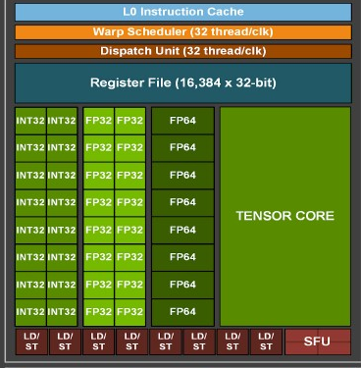
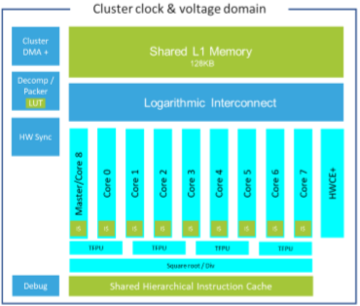
Tightly-Coupled Processors Clusters
HPC: Ampere’s SP
HPE: RamonChips RC64
IoT: Greenwave’s GAP9
Pervasive Architectural Pattern for Data-Parallel Computing!

Slide 17
The Cluster: Design Challenges
Low latency access TCDM
  Multi-banked architecture
  Fast logarithmic interconnect
Fast synchronization
  Atomics
  Barriers
Efficient PE
  Hide TCDM “residual” latency
  Remove Von Neumann Bottleneck
CLUSTER
Tightly Coupled Data Memory
Mem
Mem
Mem
Mem
Mem
Mem
Mem
Mem
Mem
Mem
Logarithmic Interconnect
RISC-V
core
RISC-V
core
RISC-V
core
RISC-V
core

Slide 18
High speed logarithmic interconnect
P1
P2
P3
P4
Processors
Routing Tree
Arbitration Tree
N
N+1
N+2
N+3
N+4
N+5
N+6
N+7
Memory Banks
N+8
B1
B2
B3
B4
B5
B6
B7
B8
World-level bank interleaving «emulates» multiported mem
Latency: 2 cycles + stalls for banking conflicts
A. Rahimi, I. Loi, M. R. Kakoee and L. Benini, "A fully-synthesizable single-cycle interconnection network for Shared-L1 processor clusters," 2011 Design, Automation & Test in Europe, 2011, pp. 1-6.
18

Slide 19
Fast synchronization and Atomics
Atomic instructions
  Leverage fast memory access
  Based on per-bank atomic adapters
Fast synchronization
  Atomics for generic primitives
  Accelerating barriers in HW (make the common case fast)
  Minimize idle power while waiting
CLUSTER
Tightly Coupled Data Memory
Mem
Mem
Mem
Mem
Mem
Mem
Mem
Mem
Mem
Mem
Logarithmic Interconnect
Event
Unit
RISC-V
core
RISC-V
core
RISC-V
core
RISC-V
core

Slide 20
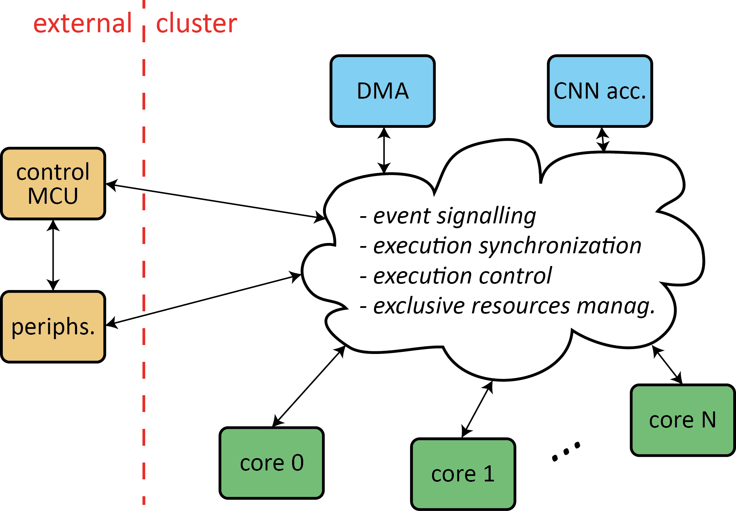
Hardware-Accelerated, Event-Based Barrier
Avoid busy waiting!
Minimize sw synchro. overhead
Efficient fine-grain parallelization
PE₀
PE₁
PE₂
PE₃
Private, per core port
→single cycle latency
→no contention
HW
SYNCH
F. Glaser, et al, "Energy-Efficient Hardware-Accelerated Synchronization for Shared-L1-Memory Multiprocessor Clusters," in IEEE TPDS, vol. 32, no. 3, pp. 633-648, 1 March 2021.
20

Slide 21
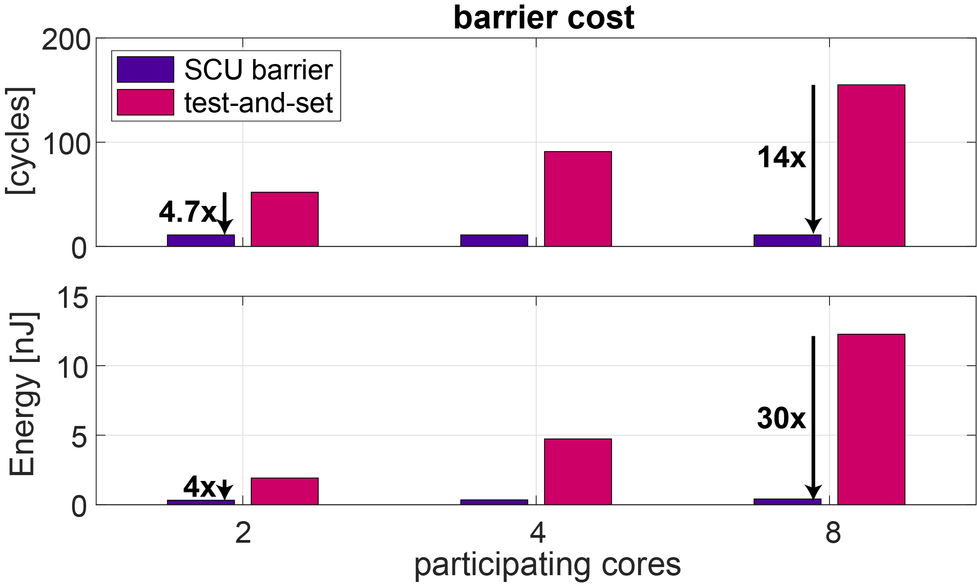
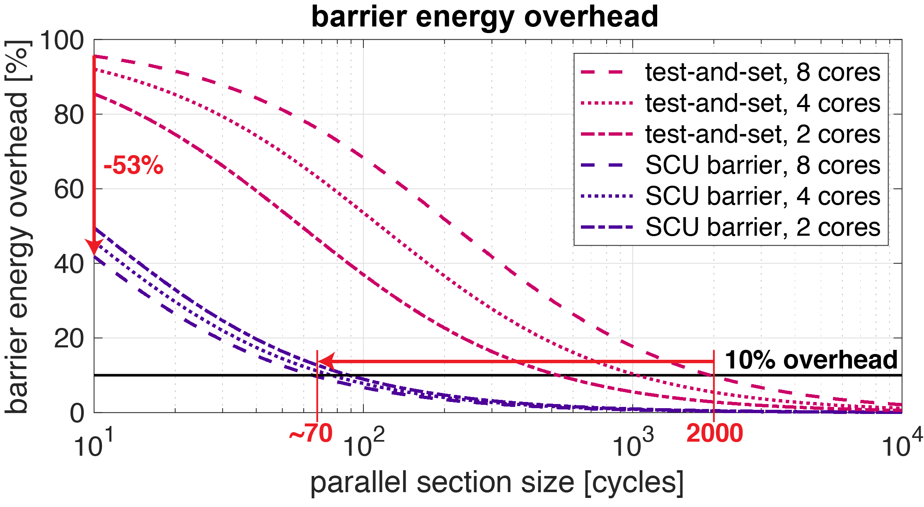
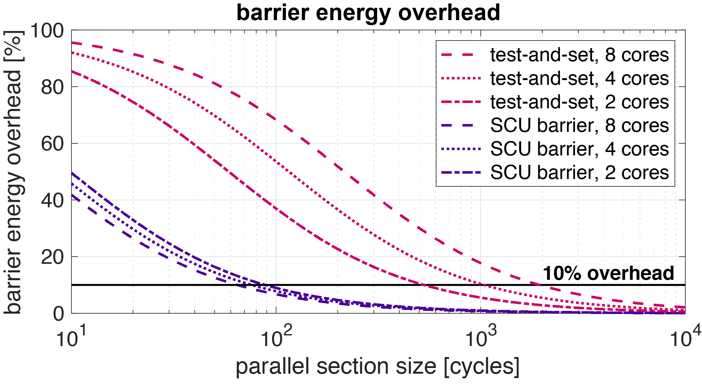
Barrier: Results
Fully parallel access to SCU: Barrier cost constant
Primitive energy cost: Down by up to 30x
Minimum parallel section for 10% overhead in terms of …
  … cycles: ~100 instead of > 1000 cycles
  … energy: ~70 instead of > 2000 cycles

Slide 22
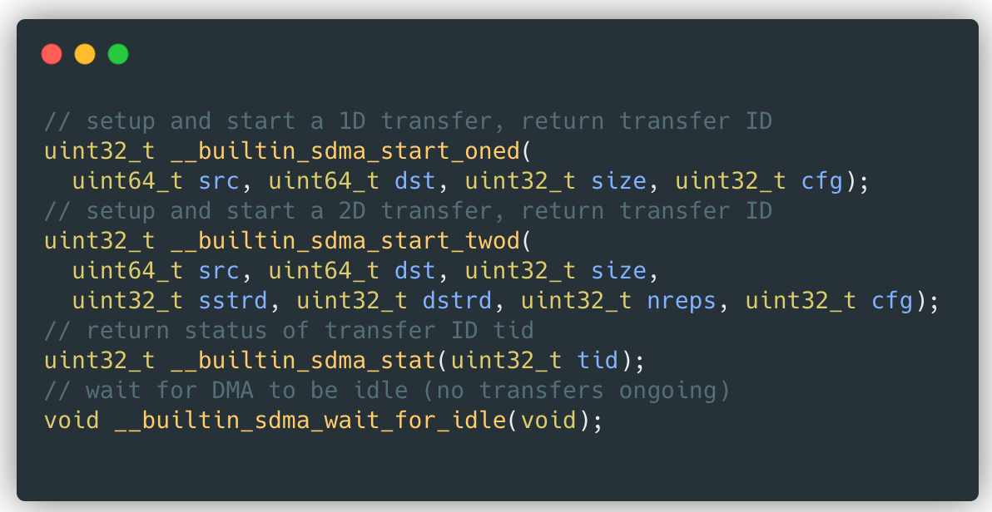
Efficiently Global Data Mover hide L2main memory latency
Snitch Core
DMA
Decoder
2D Extension
DMA Backend
64-bit AXI DMA – explicit double-buffered transfers – better than D$
Tightly coupled with Snitch (<10 cycles configuration)
Operates on wide 512-bit data-bus
Hardware support to copy 2D shapes
Higher-dimensionality handled by SW
Intrinsics/library for easy programming

Slide 23
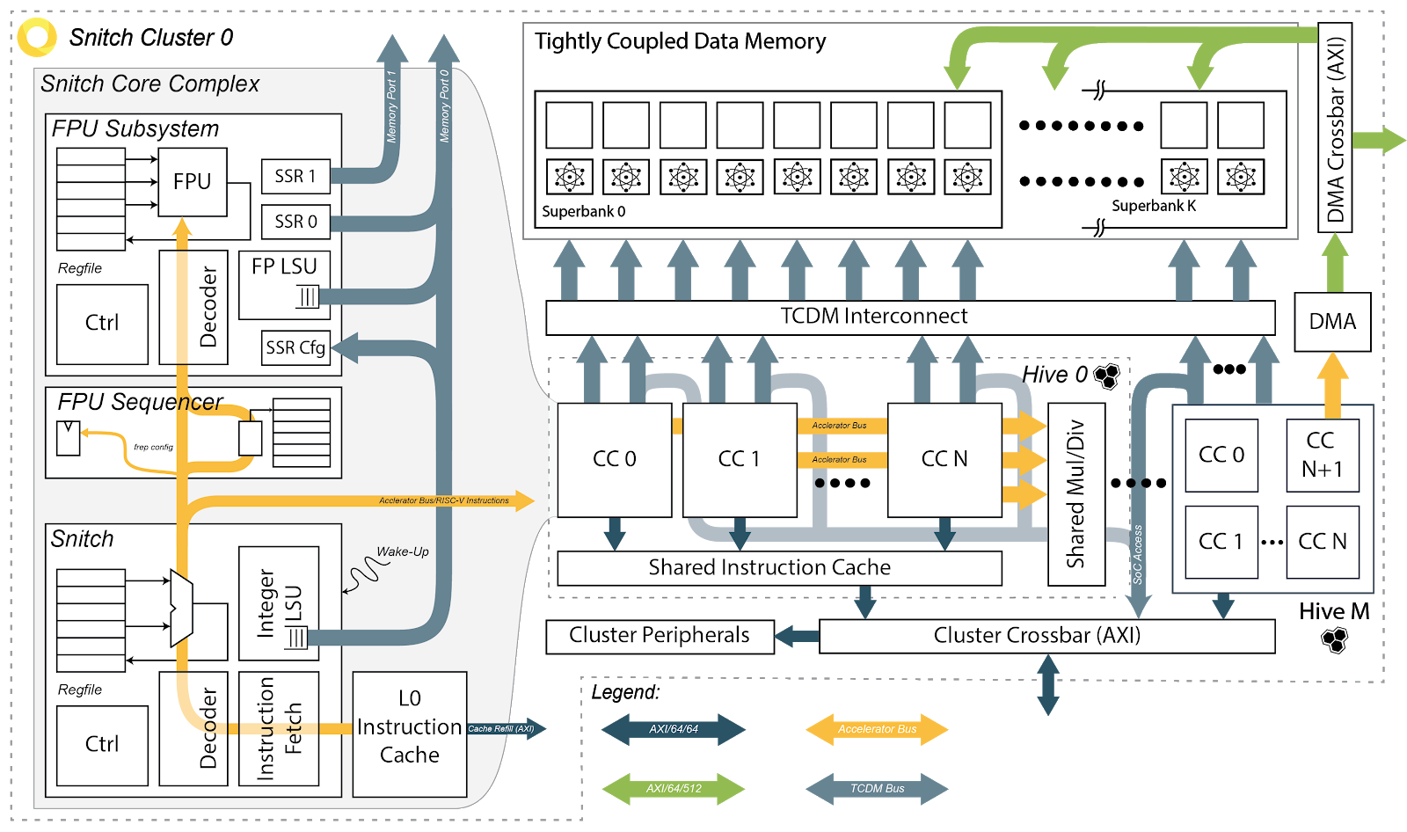
Snitch Cluster Architecture
…
Multibanked L1 (BF>1)
Logarithmic Interco
Snitch 0
Snitch 2
Snitch N
Snitch N+1
DIV
SSR
SSR
SSR
FPU
FPU
FPU
DMA
Shared Instruction Cache

Slide 24
Where does the Energy go?
Inevitable to have local memory
(e.g., GPU/GPU L1 cache, vector register file)
In an 8-core cluster
FPU uses 50% of power
Integer core uses
2% of power
SSR/FREP hardware
uses 5% of power
Spending energy where it contributes to the result → High Efficiency
Notes:
1:00
- Lots of talk on FPU busy, focus energy
- Where does it go in real silicon?
- Int core 2%
- SSR/FREP 5%
- Inevitable local memory: quarter
- FPU: 50% !!!
- Spend energy where useful = efficiency
- End of the day: eff = energy accrued next to FPU

Slide 25
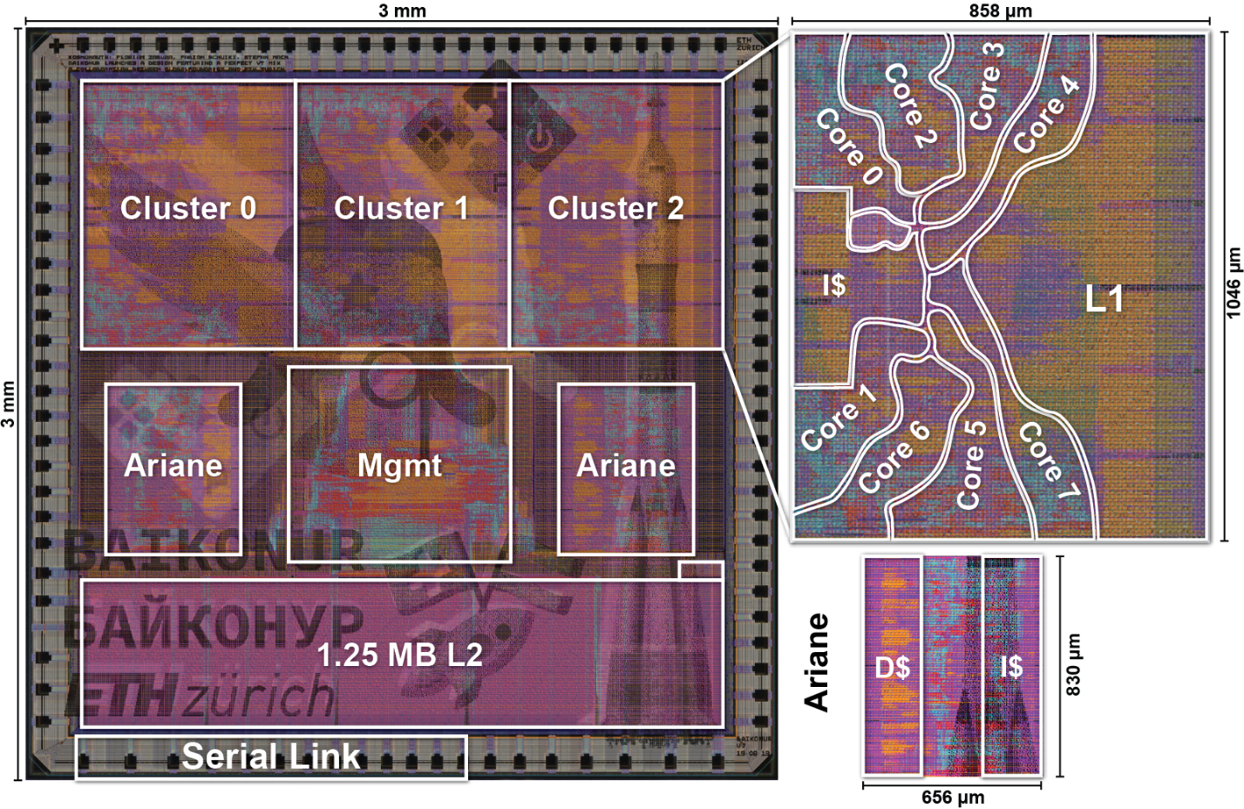
Baikonur
The first Snitch-based test chip.
Snitch compute cluster:
  8x RV32G Snitch cores
  8x large FPUs
  > 40% energy spent on FPU
  High energy-efficiency of ~80 Gdpflop/s/W
  104 Gspflop/s/W similar to accelerators
9 mm² prototype in GF 22FDX
Testbed for key architectural components
  Snitch octa-core cluster
  Ariane cores
> 50%
FP
S
S
Sni
t
ch
FPU Seq
Re
gs
R
e
s
t
188
142
21
13
8
4
FPU
Re
gfile
S
SR
L
SU
R
e
s
t
Re
gfile
P
erf Cnt
L
SU
Co
r
e
142
21
96
24
16
2
5
5
11
2
1
8
[
]
kGE
Very efficient, versatile, compute cluster! How do we scale?
Notes:
To provide an efficient compute system, (click) we have bundled eight Snitch cores into a common cluster.
(click) Each core is coupled to a large double-precision floating-point unit.
(click) Over 40% of the total cluster energy is spent on the FPU, (click) which allows us to achieve a high energy-efficiency of 80 Gdpflop/s/W and 104 Gspflop/s/W, which is similar to NTX.
(click) Even looking at the high-level system area break-down, we can clearly see that the FPU to integer core ratio is much higher than for the Ariane core.
(click) Zooming further into the units we can see that over (click) 50% of the area is dedicated to the FPU.
(click) We have manufactured a 9mm2 prototype in 22 nm FDX as a testpad for the key architectural components.
(click) The chip contains 3 octa-core Snitch clusters and
(click) two Ariane management cores.
(click) This is a very efficient and versatile compute cluster, but how do we scale to larger systems?

Slide 26
Efficient Cluster architecture in perspective
Memory pool – efficient sharing of L1 memory
Fast and parsimonious synchronization
Data Mover + Double buffering – explicitly managed block transfers at the boundary
More cores and more memory per cluster… that would be nice!
Notes:
The FREP buffer is a small micro-loop buffer.
(click) Dedicated sequencer hardware steps through the buffer and issues instruction to the FPU, independently of the Snitch core.
(click) For example consider this simple loop instruction. Instead of the core stepping through the loop, (click) the frep buffer is being programmed using a special frep instruction to sequence the fmadd, independently of the core, to the FPU. That frees up the integer core to do other work, such as configuring the next loop iteration or preparing DMA transfers;
(click) we call this behaviour pseudo-dual-issue.
(click) Together with the SSRs, we have enabled the same capabilities as in NTX with a much higher control ratio, so that we can off-load much shorter and finer-grained compute patterns.

Slide 27
Compute Efficiency for PE, Cluster, SoC
From/To L1
RegFile
L1
L2
PE core
Cluster
Cluster
Cluster
Cluster
From/To L2
& Others
DMA
PE
core
PE
core
PE
core
PE
core
Cluster
Cluster
Cluster
Reg
L0:Operand Memory
Latency=1
Density=1
Private
L1: Tightly Coupled DM
Latency<10
Density≈10
Shared
L2: Main Memory
Latency>100
Density≈100
Shared, Remote
27

Slide 28
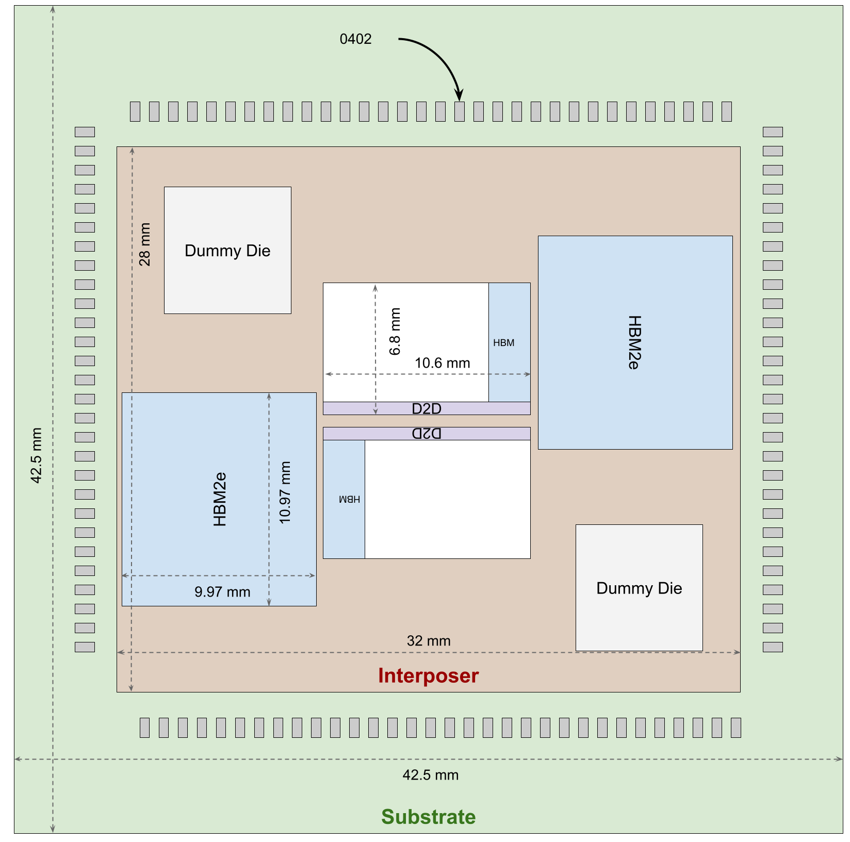



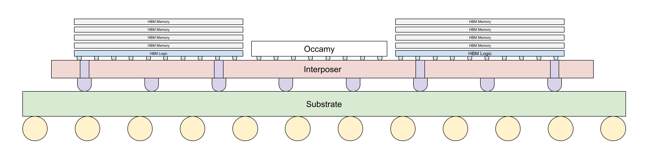
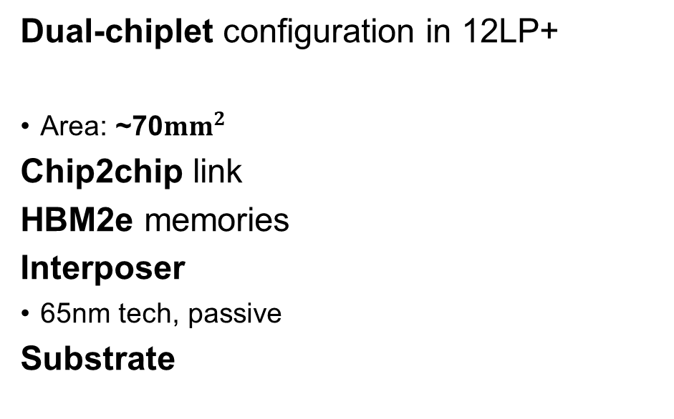
Occamy: a 12LPP+ AI & Stream Computing Chiplet
Silicon implementation of all key IPs (core, Phys, chiplet)
Dual-chiplet configuration in 12LP+
Area: ~70$mm^{2}$
Chip2chip link
HBM2e memories
Interposer
65nm tech, passive
Substrate

Slide 29
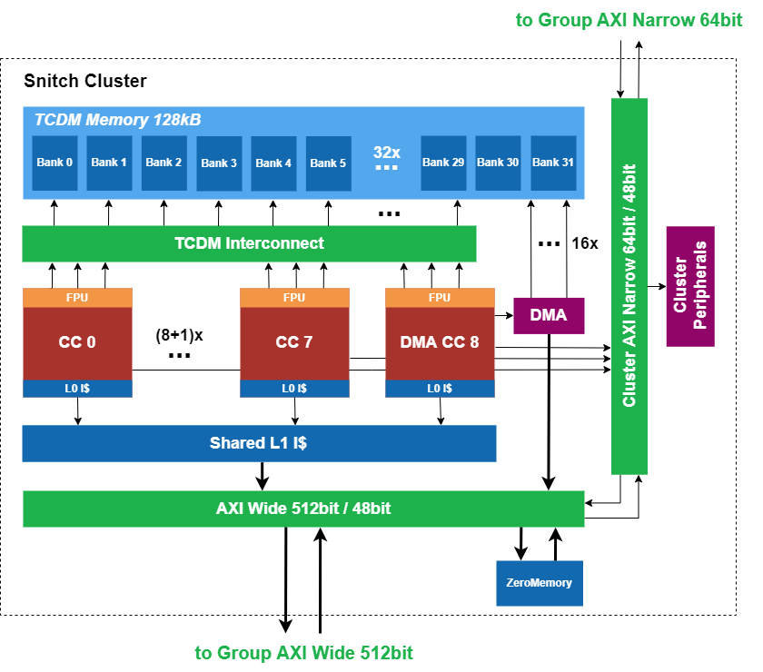
From Snitch Cluster
8 Snitch compute cores
Single-stage, small Integer control core
9th Core: DMA
512 bit data interface
Efficient data movement
128 kB TCDM
Scratchpad for predictable memory accesses
32 Banks
Custom ISA extensions
Xfrep, Xssr
New: Xissr sparsity support
1 FPU per Snitch core
Decoupled and heavily pipelined
Multi-format FPU (+SIMD)
New: Minifloat support + SDOTP

Slide 30
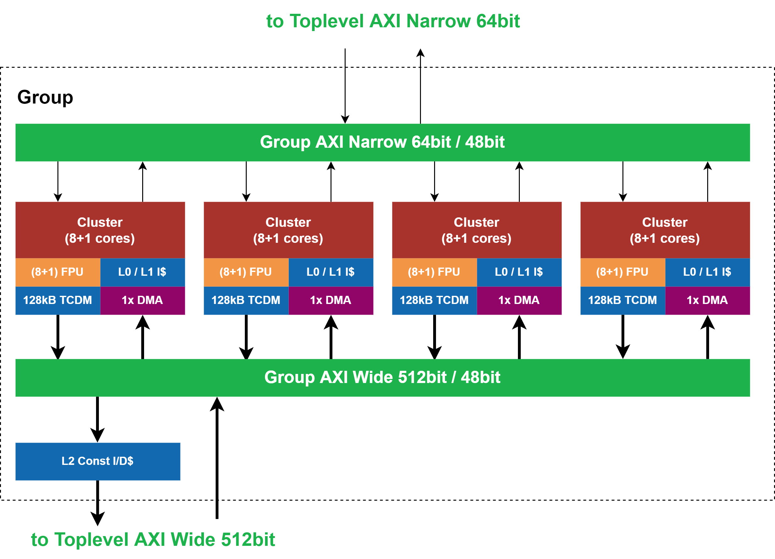
To Snitch Group

Slide 31
Snitch Group
4 Clusters per Group
Single-stage, small Integer control core
2 AXI Busses
64-bit narrow interface: config
512-bit wide interface: DMA
Constant Cache
D/I-Cache hierarchy

Slide 32
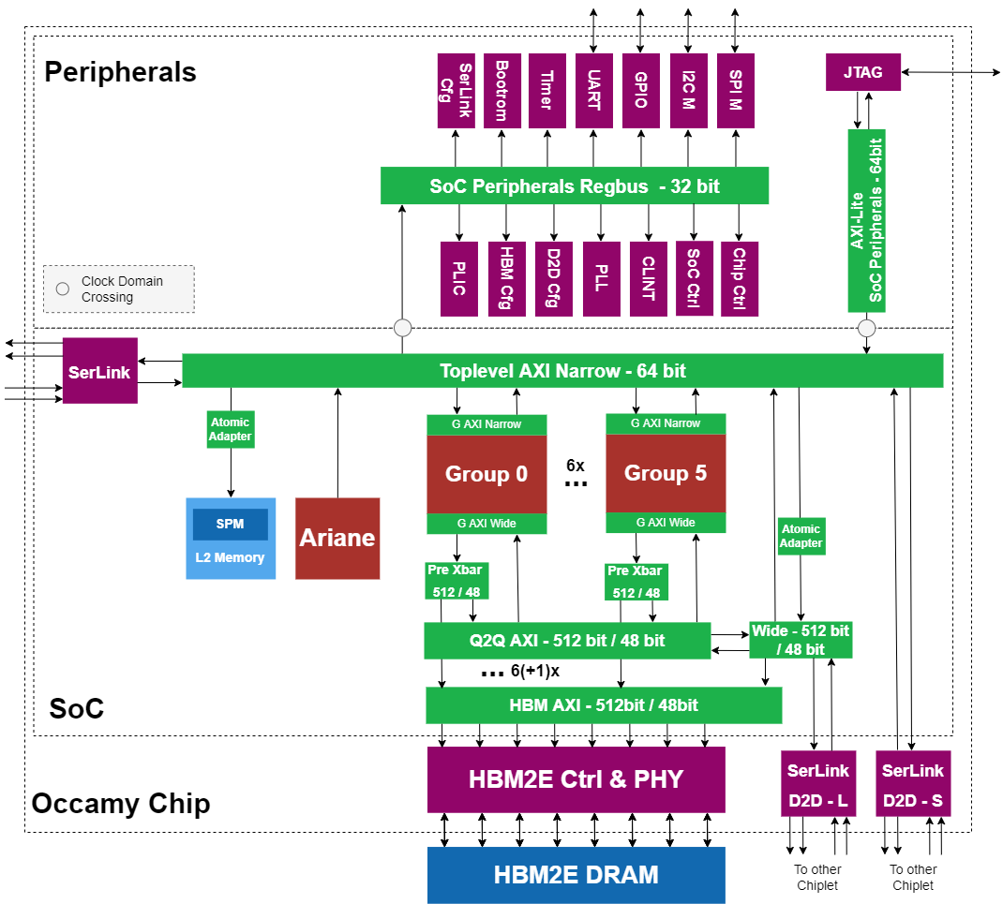
From Snitch Group

Slide 33
To Multi-Group

Slide 34
Occamy – Chiplet Architecture
2 AXI Busses
64-bit narrow interface: config
512-bit wide interface: DMA
Peripherals
Complex address space management
Linux-capable manager core CVA6
6 Groups: 216 cores/die
  4 cluster / group:
    8 compute cores / cluster
    1 DMA core / cluster
  512bit Constant Cache
8-channel HBM2e (8GB)
D2D serial link

Slide 35
Occamy NoC: Efficient and Flexible Data Movement
Problem: HBM Accesses are critical in terms of
  Access energy
  Congestion
  High latency
Instead reuse data on lower levels of the memory hierarchy
  Between clusters
  Across groups
Smartly distribute workload
  Clusters: DORY framework for tiling strategy [1]
  Chiplets: E.g. Layer pipelining
HBM
Die2Die
…
…
System Crossbar
Group Crossbar
Group Crossbar
Cluster
Cluster
Cluster
Cluster
[1] Burrello, Alessio, et al. "Dory: Automatic end-to-end deployment of real-world dnns on low-cost iot mcus." IEEE Transactions on Computers 70.8 (2021): 1253-1268.
Big trend today!

Slide 36
Occamy’s C2C Link

Slide 37
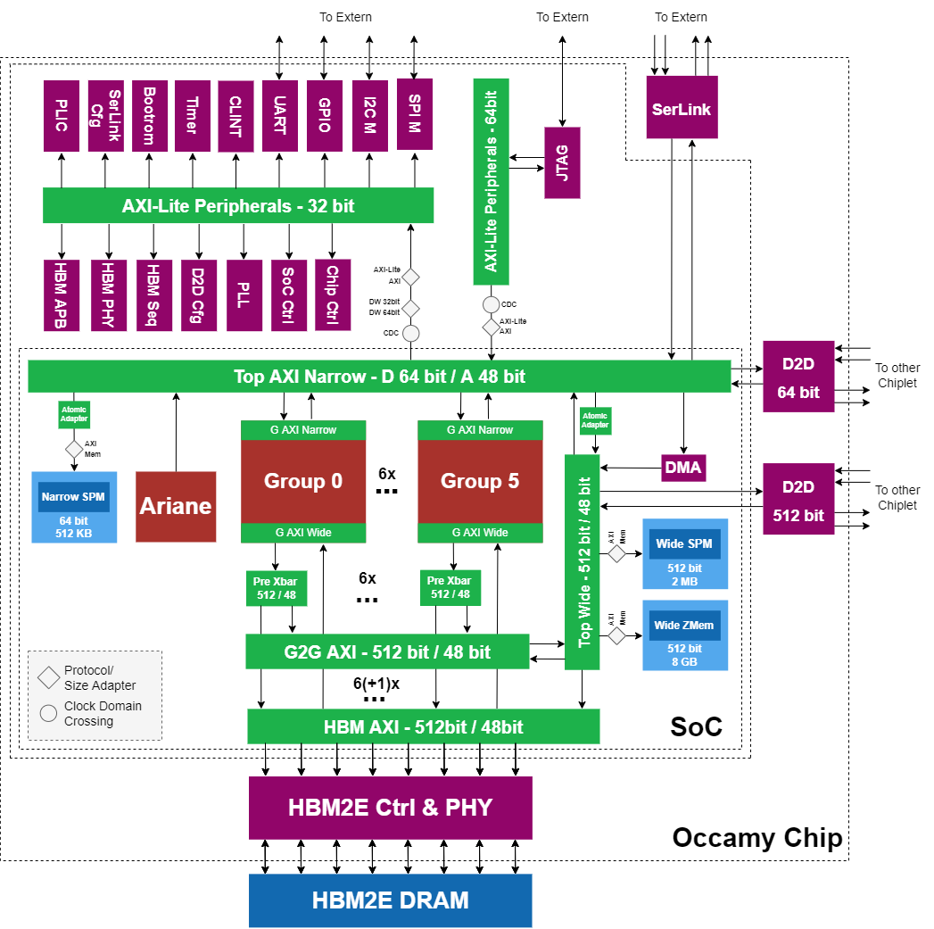
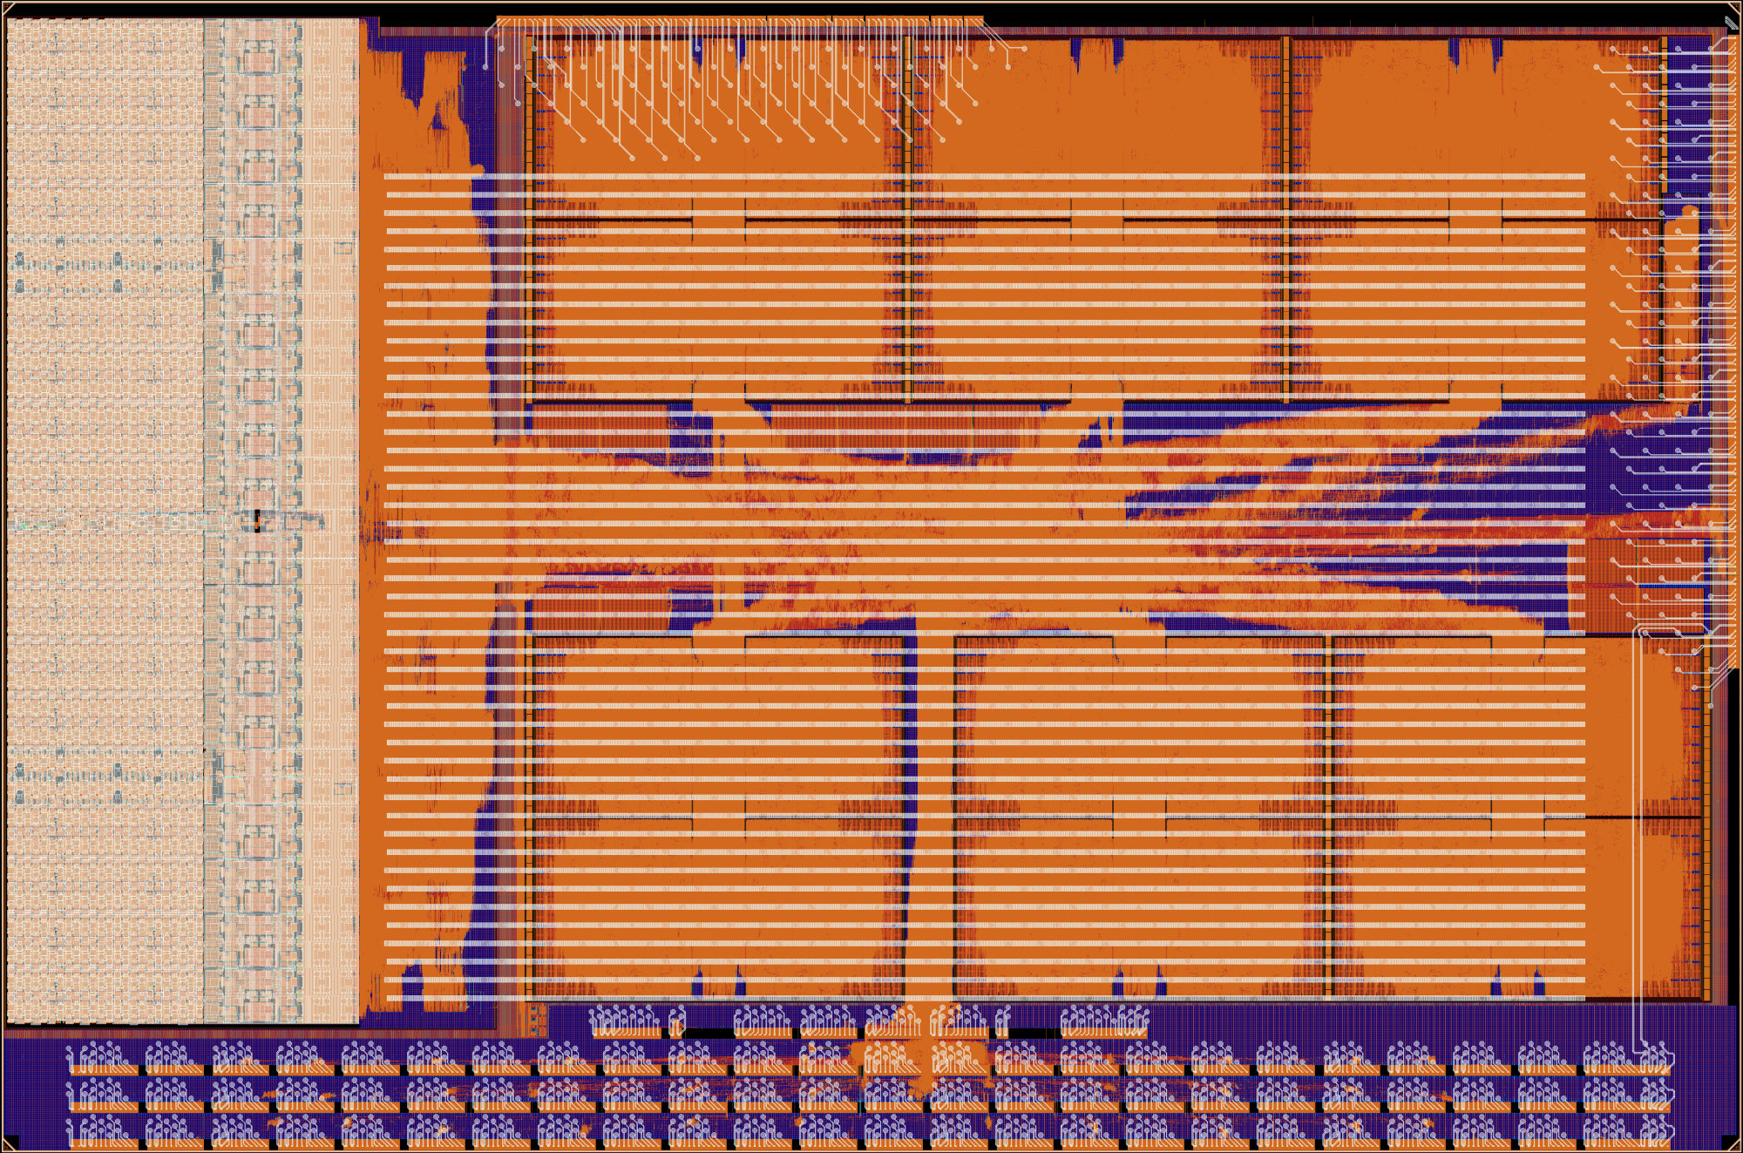
Occamy Chiplet
GF12, target 1GHz (typ)
2 AXI NoCs (multi-hierarchy)
  64-bit
  512-bit with “interleaved” mode
Peripherals
Linux-capable manager core CVA6
6 Quadrants: 216 cores/chiplet
  4 cluster / quadrant:
    8 compute +1 DMA core / cluster
    1 multi-format FPU / core (FP64,x2 32, x4 16/alt, x8 8/alt)
8-channel HBM2e (8GB) 512GB/s
D2D link (Wide, Narrow) 70+2GB/s
System-level DMA
SPM (2MB wide, 512KB narrow)
Peak 384 GDPflop/s per chiplet – Taped-out in July

Slide 38
Efficient SoC architecture in Perspective
Multi-cluster single-die scaling → strong latency tolerance, modularity
NoC for flexible Clus2Clus, Clus2Mem traffic → reduce pressure to Main memory
Full chiplet architecture: HBM2e, NoC-wrapped C2C, multi-chiplet ready
Notes:
The FREP buffer is a small micro-loop buffer.
(click) Dedicated sequencer hardware steps through the buffer and issues instruction to the FPU, independently of the Snitch core.
(click) For example consider this simple loop instruction. Instead of the core stepping through the loop, (click) the frep buffer is being programmed using a special frep instruction to sequence the fmadd, independently of the core, to the FPU. That frees up the integer core to do other work, such as configuring the next loop iteration or preparing DMA transfers;
(click) we call this behaviour pseudo-dual-issue.
(click) Together with the SSRs, we have enabled the same capabilities as in NTX with a much higher control ratio, so that we can off-load much shorter and finer-grained compute patterns.

Slide 39

Back to the cluster… Can we make it Bigger?
Why?
  Better global latency tolerance if L1 > 2*Latency*Bandwidth
  Easier to program (data-parallel, functional pipeline…)
  Smaller data partitioning overhead
An efficient many-core cluster with low-latency shared L1
  256+ cores
  1+ MiB of shared L1 data memory
  ≤ 5 cycles latency (without contention)
Physical-aware design
  WC Frequency > 500 Mhz
  Targeting iso-frequency with small cluster
MemPool

Slide 40
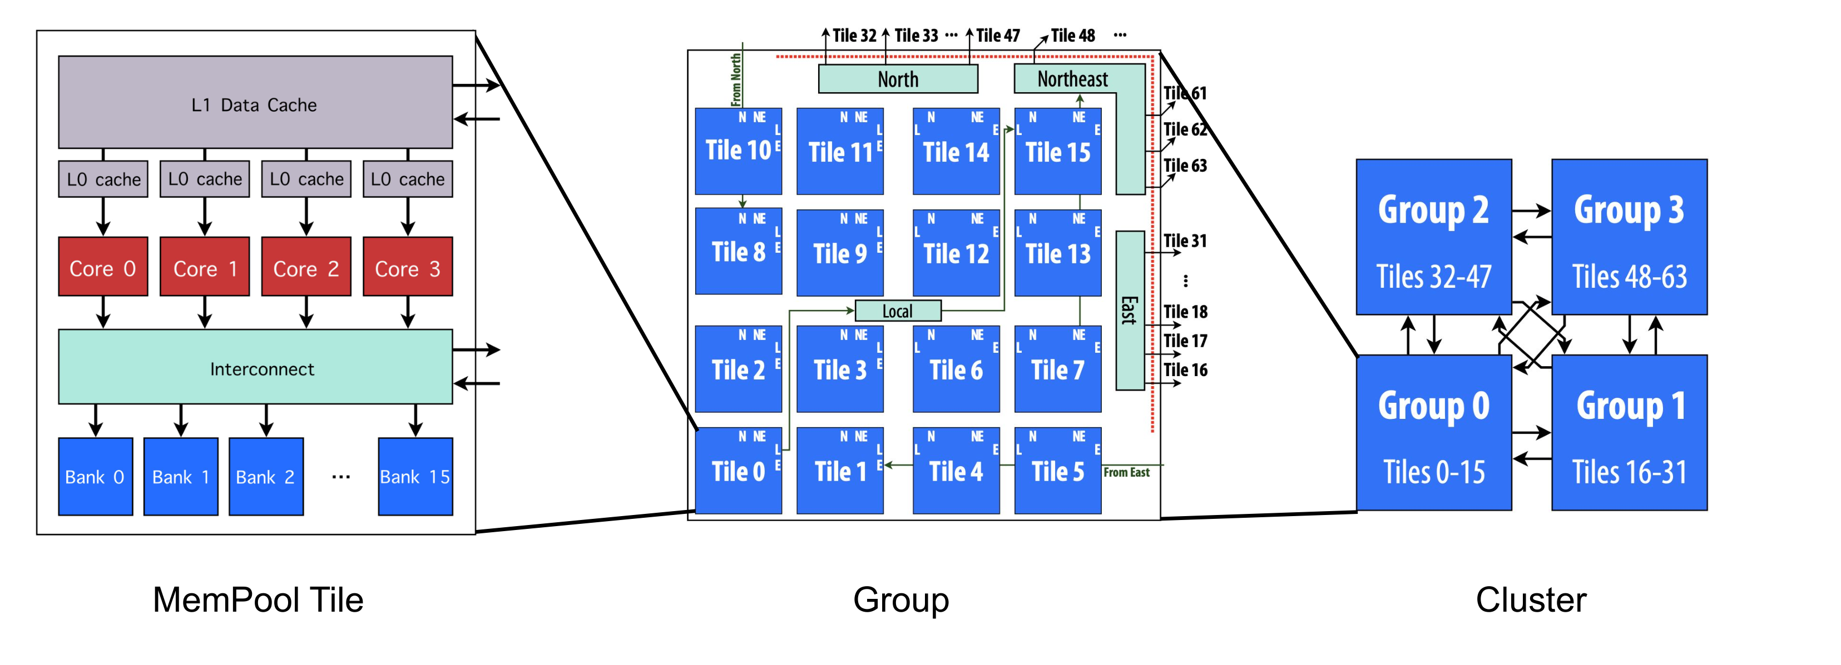
Hierarchical Physical Architecture
Tile
  4 32-bit cores
  16 banks
  Single cycle memory access
Group
  64 cores
  256 banks
  3-cycles latency
Cluster
  256 cores
  1 MiB of memory (1024 banks)
  5-cycles latency
TopH: Butterfly Multi-stage Interconnect 0.3req/core/cycle

Slide 41
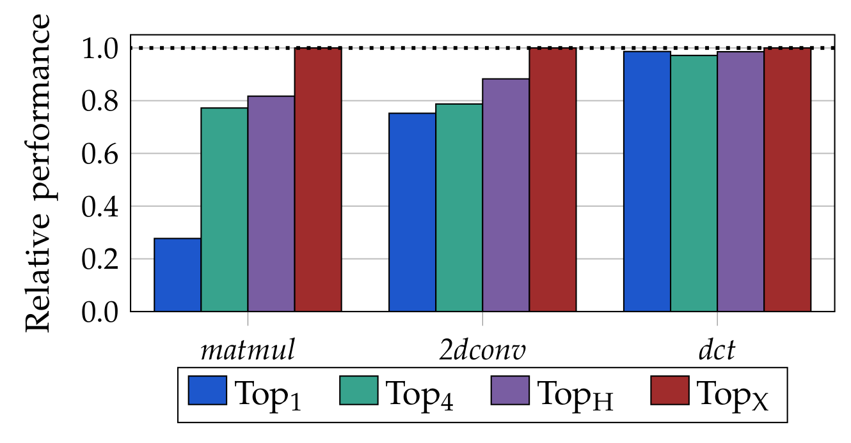
Benchmarks: can we compete with the impossible?
Baseline: idealized Top_{X}
  Fully connected logarithmic crossbar between 256 cores and 1024 banks
Cycle-accurate RTL simulation
  Matmul
    Multiplication of two 64 × 64 matrices
  2dconv
    2D Convolution with a 3 × 3 kernel
  dct
    2D Discrete Cosine Transform on 8 × 8 blocks in local memory
Top_{H} has a performance penalty of at most 20%, on all kernels

Slide 42
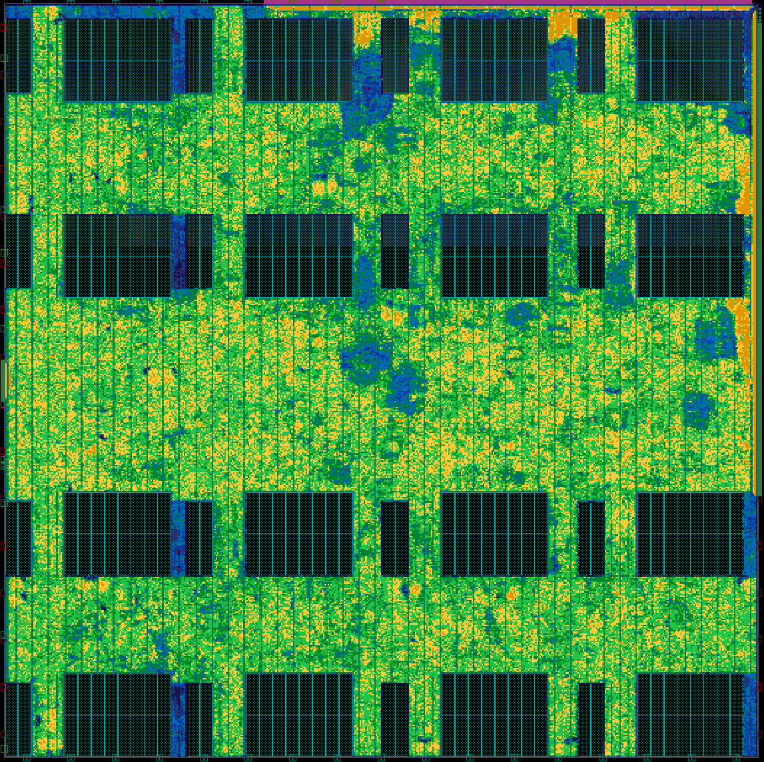
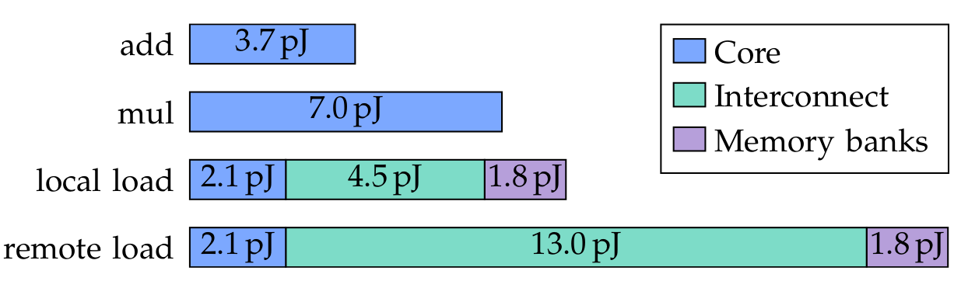
Energy Analysis (500 MHz, TT, 0.80 V, 25 °C)
Breakdown of the energy consumption per instruction:
Local loads consume about as much energy as a mul
  About half of it, 4.5pJ, by the interconnect
Remote loads: twice the energy of a local load
  Despite crossing the whole cluster, twice!
Terapool (1024 cores) seems viable @ 7 cycles latency

Slide 43
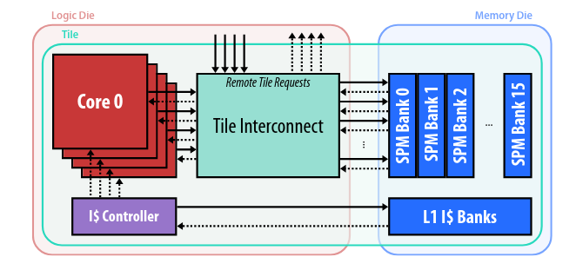
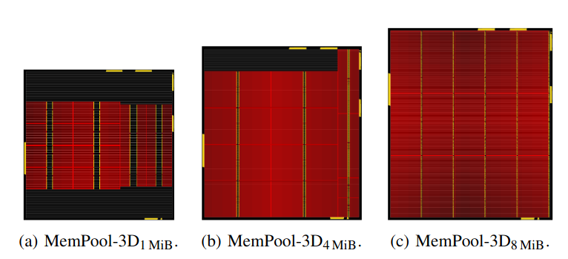
MemPool-3D
Memory-on-Logic implementation of MemPool
Implementation of MemPool with 1, 2, 4, 8 MiB of L1
Leading to a higher utilization of the memory die

Slide 44
Groups: MemPool-2D vs. MemPool-3D
MemPool-2D
MemPool-3D
128 KiB
Footprint: 1.000
Footprint: 0.665
7% larger
Same footprint
256 KiB
Footprint: 1.074
Footprint: 0.665
512 KiB
Footprint: 1.299
Footprint: 0.737
14% smaller, despite 8x the L1 capacity!
1 MiB
Footprint: 1.572
Footprint: 0.857
Similar trends for Wire length and #Buffers

Slide 45
Conclusion
[AMD Naffziger ISCAS22]
Energy efficiency quest: PE, Cluster, SoC
Key ideas
  Application specific PEs → extensible ISAs (RISC-V!)
  VNB removal + Latency hiding: large OOO processors not needed
  Low-overhead work distribution → large “mempool”
  Heterogeneous architecture →host+accelerator(s)
Game-changing technologies
  Chiplets: 2.5D, 3D, (WFI?)
  Computing “at” memory,
  Coming (less than ten years): optical IO
[RIKEN Matsuoka MODSIM22]
45

Slide 46



Luca Benini, Alessandro Capotondi, Alessandro Ottaviano, Alessandro Nadalini, Alessio Burrello, Alfio Di Mauro, Andrea Borghesi, Andrea Cossettini, Andreas Kurth, Angelo Garofalo, Antonio Pullini, Arpan Prasad, Bjoern Forsberg, Corrado Bonfanti, Cristian Cioflan, Daniele Palossi, Davide Rossi, Davide Nadalini, Fabio Montagna, Florian Glaser, Florian Zaruba, Francesco Conti, Frank K. Gürkaynak, Georg Rutishauser, Germain Haugou, Gianna Paulin, Gianmarco Ottavi, Giuseppe Tagliavini, Hanna Müller, Lorenzo Lamberti, Luca Bertaccini, Luca Valente, Luca Colagrande, Luka Macan, Manuel Eggimann, Manuele Rusci, Marco Guermandi, Marcello Zanghieri, Matheus Cavalcante, Matteo Perotti, Matteo Spallanzani, Mattia Sinigaglia, Michael Rogenmoser, Moritz Scherer, Moritz Schneider, Nazareno Bruschi, Nils Wistoff, Pasquale Davide Schiavone, Paul Scheffler, Philipp Mayer, Robert Balas, Samuel Riedel, Sergio Mazzola, Sergei Vostrikov, Simone Benatti, Stefan Mach, Thomas Benz, Thorir Ingolfsson, Tim Fischer, Victor Javier Kartsch Morinigo, Vlad Niculescu, Xiaying Wang, Yichao Zhang, Yvan Tortorella, all our past collaborators and many more that we forgot to mention
http://pulp-platform.org @pulp_platform

Slide 47
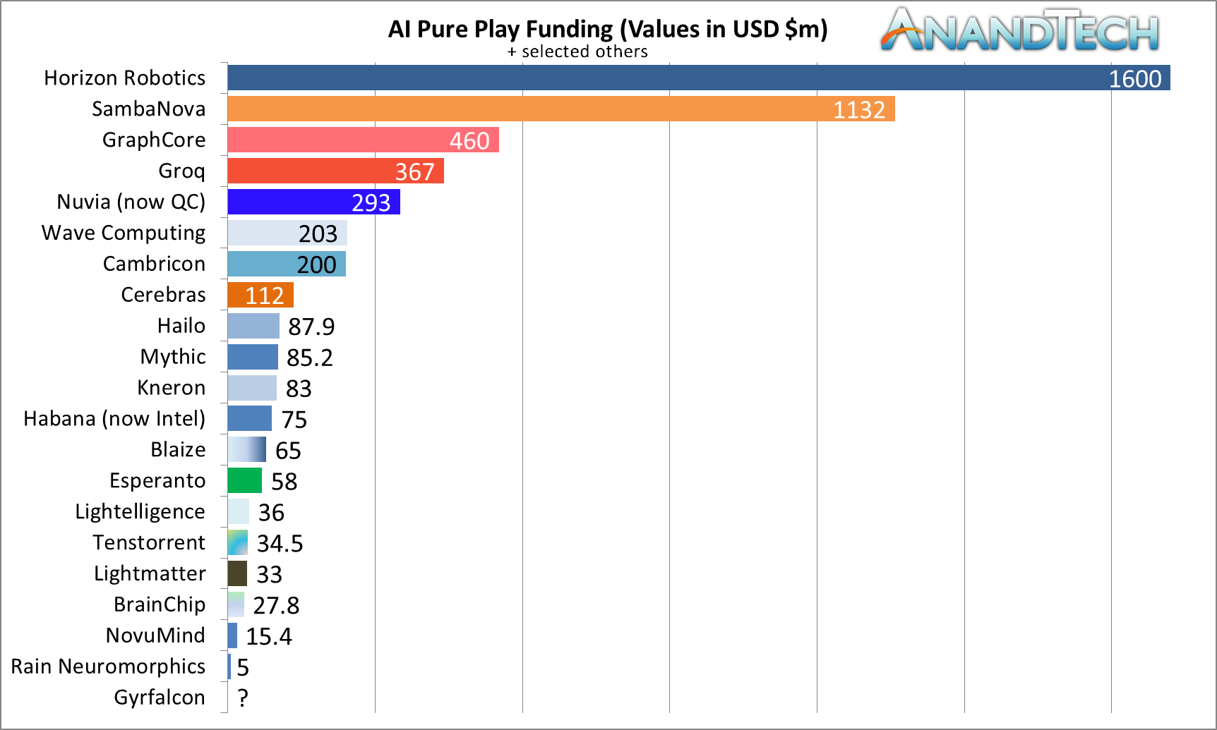

Specialize?
Avoid over-specialization (small market window)
47
Notes:
Also, in industry, energy-efficiency is a huge driving factor.
We are seeing specially built processors for high-performance computers such as the Fujitsu A64FX, existing architectures gaining improved support for new domains such as machine learning in the NVIDIA Ampere, as well as companies not traditionally into building chips entering the field, such as Google’s Cloud TPU.
The theme of them is similar: maximize the computational data-path with respect to control and scale-over huge chip areas.
(click) The A64FX does so by using Arm's scalable vector extension,
(click) NVIDIA’s Ampere GPU by using SIMT and specialized tensor cores,
(click) and the TPU by coupling four vector cores with massive matrix multiplication units, so called systolic arrays.
(click) Finally, we can observe a trend towards more integrated packaging such as 2.5D integration or even emerging 3D integration trends - which is the common theme of the just mentioned chips.
Let's sketch a path on how we want to achieve building a system that can outperform the existing state-of-the-art.
GA102

Slide 48
SSR+FREP Streaming for Energy Efficiency
Repeat list of float instructions
Programmable patterns
Amplified instructions
Memory
Core Complex
SSRs
Address Generator Unit
FREP
Snitch Core
FPU
Stream Semantic Registers
FP Register File
Sequencer
Some registers redirect to memory
Core can run in parallel
Notes:
2:00
- Streaming / One op / Expensive config / No regs
- Regular core setup, FPU, regfile
- Streaming: SSRs, redirect to mem
- AGU: from NTX, prog pattern
- Core still issues many FP ops
- Sequencer, µloop buffer
- Amplify inst BW
- Core in parallel
- SSR: [DSPs already have AGUs]
- FREP: [Decoupled Access/Execute Machines]

Slide 49
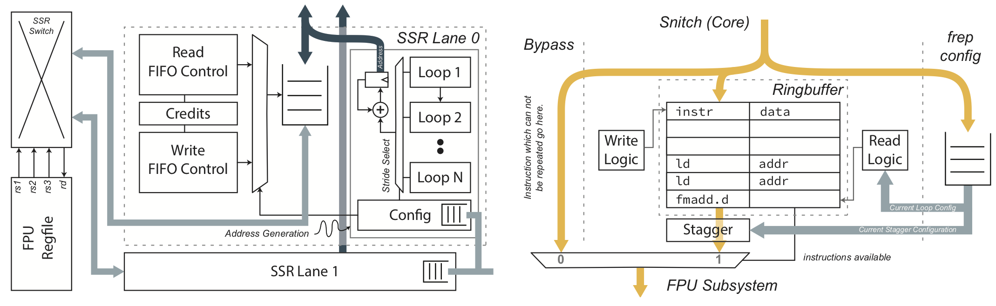
SSR/FREP Architecture
SSR (1-3)
  Non-blocking access to Mem (credits)
  Configurable number of nested loops
  Handles affine, strided patterns
  4K/lane
FREP
  Configurable ring-buffer
  Supports staggering
  Can be bypassed

Slide 50
C2C Link
Scalable and fault tolerant Chiplet2Chiplet Link
Network Layer
  Full AXI4 interface
  AXI4 to AXI stream converter
Data Link Layer
  Credit-based flow control
  RX synchronisation
Channel Allocator
  Chops and reshuffles payload
  Fault tolerance mechanisms
Physical layer (decoupled)
  Source-synchronous DDR sampling
  Scalable number of channels
  (38 x 8-bit full-duplex DDR channels in Occamy)
  Compatible with fast serial phy (e.g. HBI)
Network Layer
Link Layer
Channel Allocator
…
PHY0
PHY1
PHYn

Slide 51
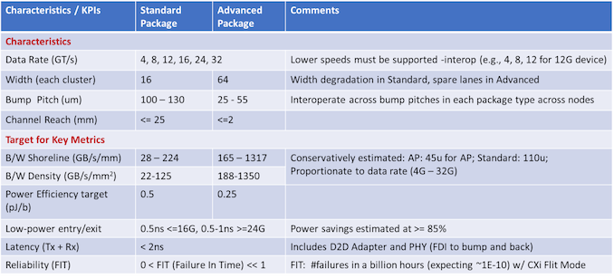
Notes:
https://www.anandtech.com/show/17288/universal-chiplet-interconnect-express-ucie-announced-setting-standards-for-the-chiplet-ecosystem

