Slide 1
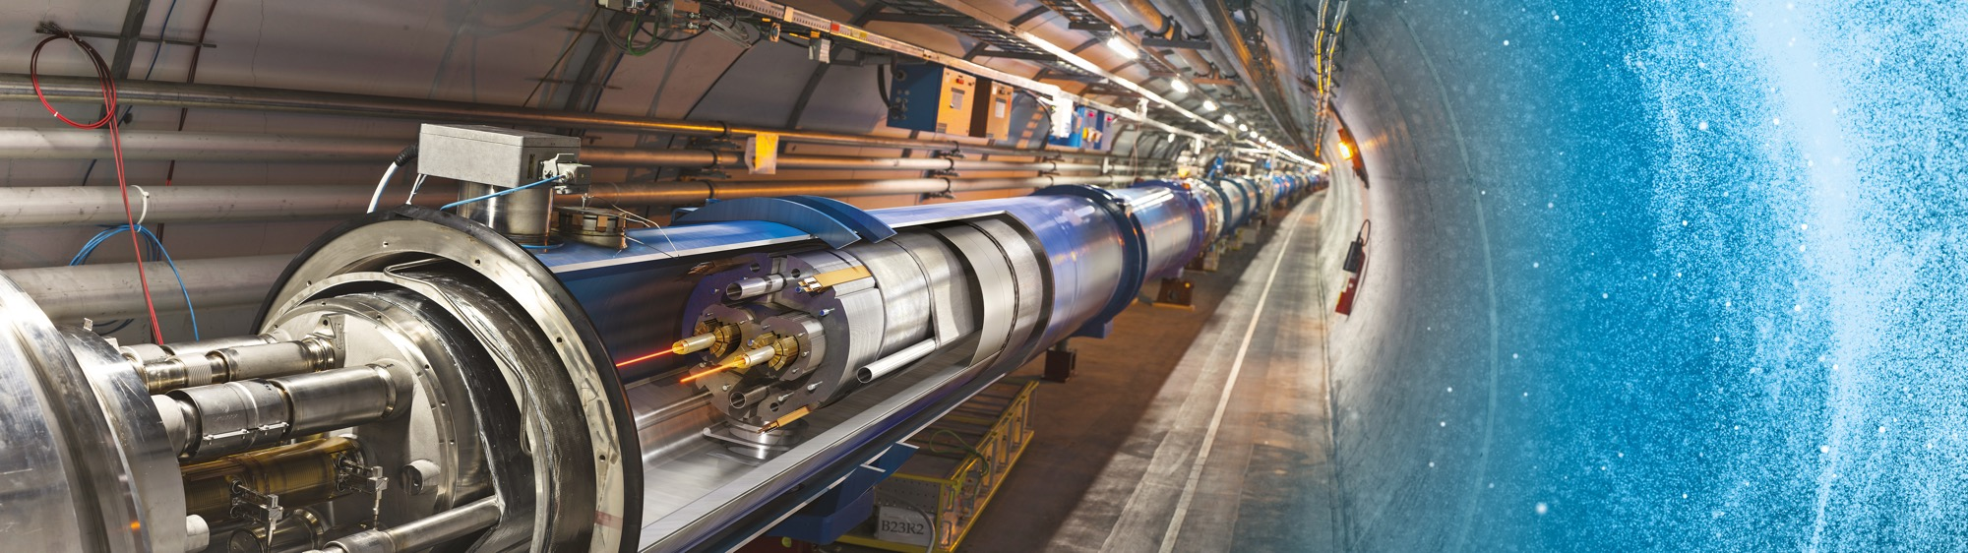
Upcoming Tenders at CERN
ILO Forum
Jérôme Pierlot
Head of Procurement for Accelerators and Technology 27 September 2022

Slide 2
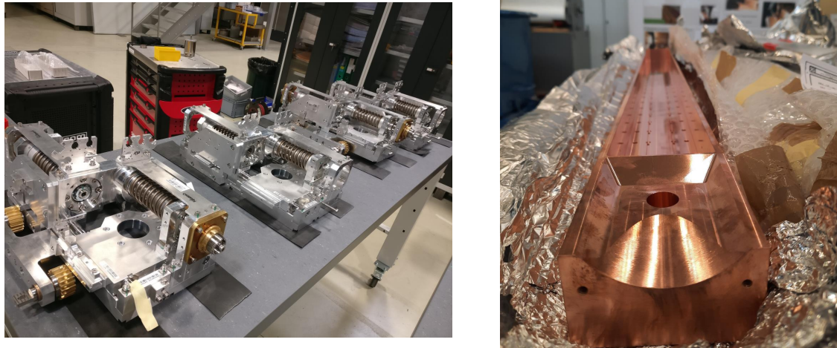
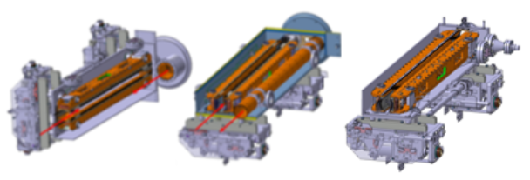
Supply of 36 Collimators
Procurement Code: 05.04.00.00
Cost Range : under assessment
Planning: MS: Q1 2023
IT: Q4 2023
Description & Specific Condition :
Around LHC3 & 7 (Dumps) & Experiments
Brazing
Electron beam welding
Cleaning (UHV environments)
High precision machining
Qualification samples during MS phase
Contact: francois-xavier.nuiry@cern.ch

Slide 3
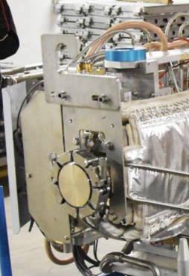
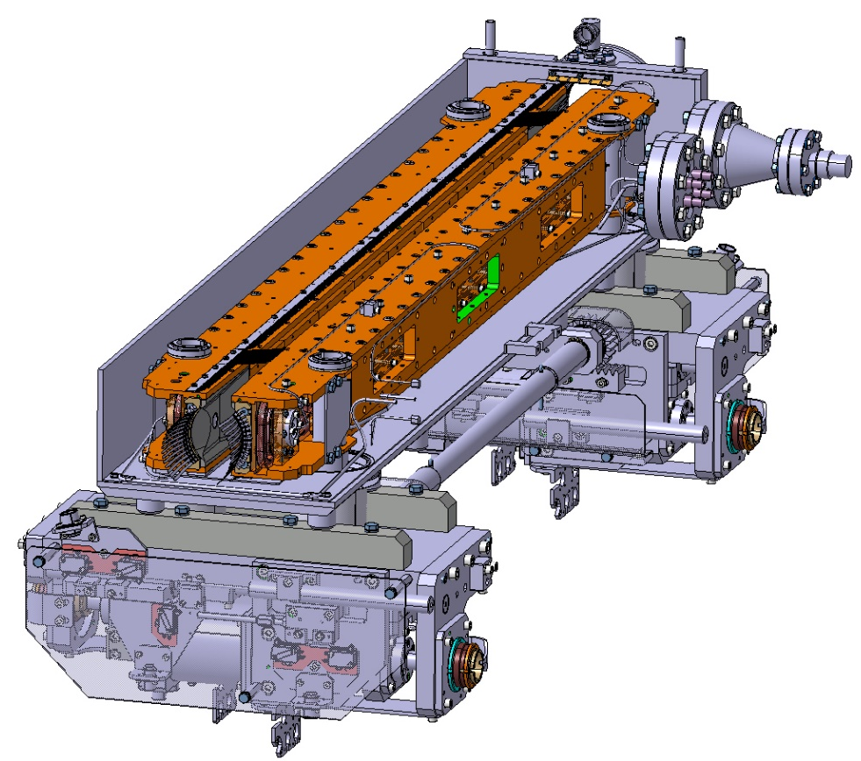
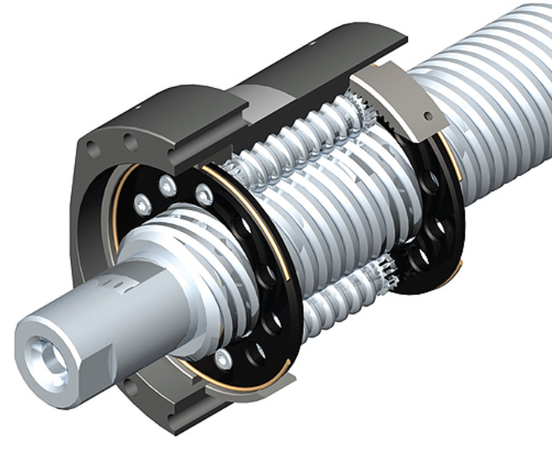
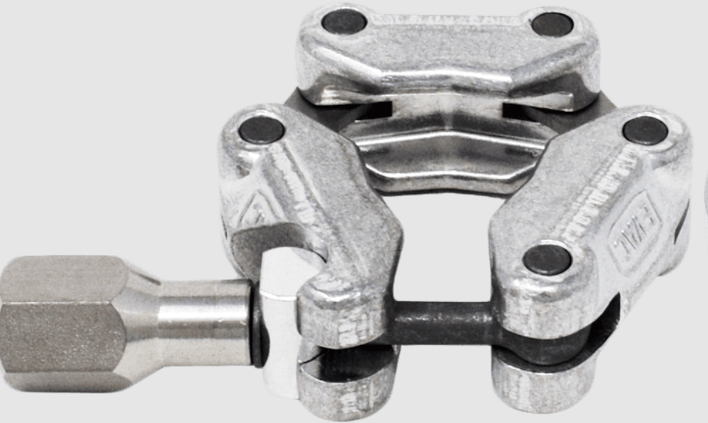
Supply of Roller Screws for Actuation Systems & Chains for UHV Flanges
Procurement Code: 05.04.00.00
Cost Range : under assessment
Planning: MS: Q1 2023
IT: Q4 2023
Contact: francois-xavier.nuiry@cern.ch

Slide 4
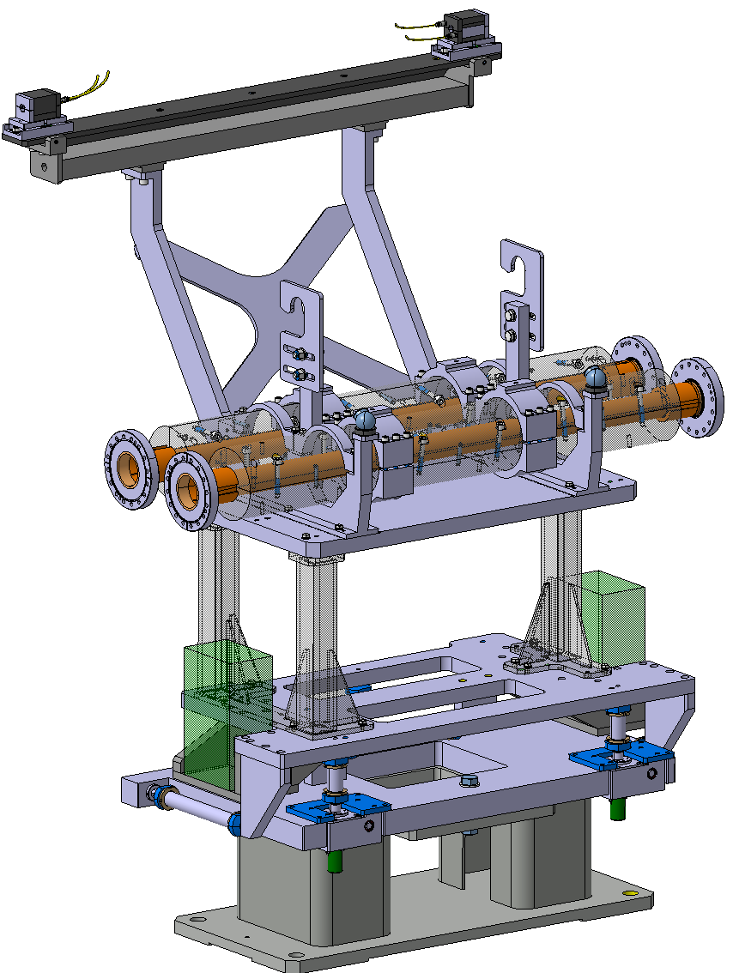
Supply of 15 Masks for the Vacuum Chambers Protection
Procurement Code: 05.04.00.00
Cost Range : under assessment
Planning: MS: Q2 2023
IT: Q4 2023
Contact: francois-xavier.nuiry@cern.ch
Description & Specific Condition :
Passive collimator – Protection for the magnets
Machined Tungsten blocs provided by CERN
Tolerances, Brazing
Copper, Inconel

Slide 5
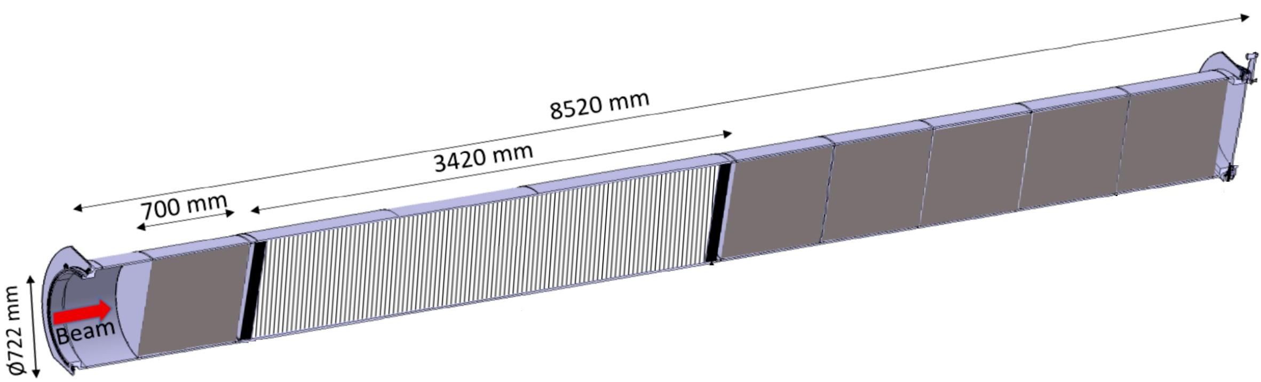
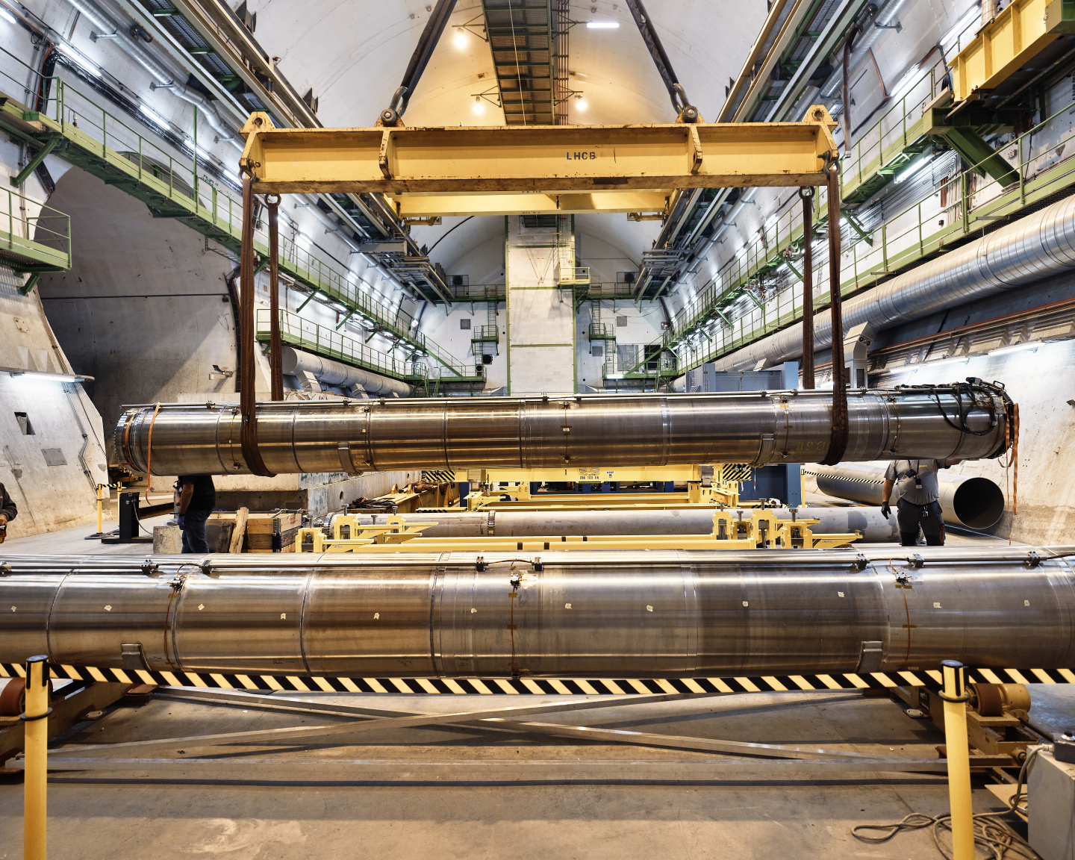
Supply of materials for the HL-LHC TDE Dumps
Procurement Code: 05.04.00.00
Cost Range : 750 k CHF ⬄ 5 M CHF
Planning: MS: Q2 2023 - IT: Q3 2024
Contact: Marco.Calviani@cern.ch
Description & Specific Condition :
LHC3 & LHC 7
Graphitic materials
Isostatic Grade, CFC, Flexible Graphite
Vacuum vessels : 318 LN vs Titanium

Slide 6
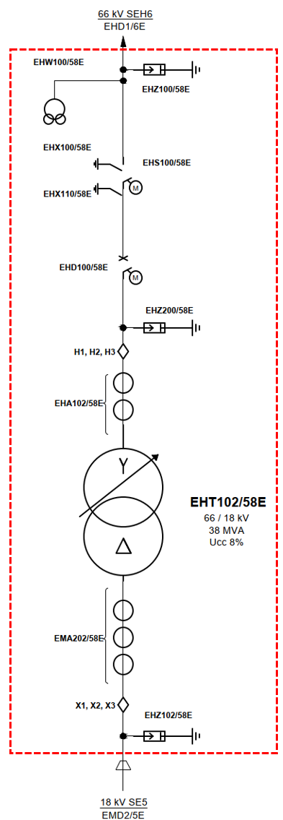
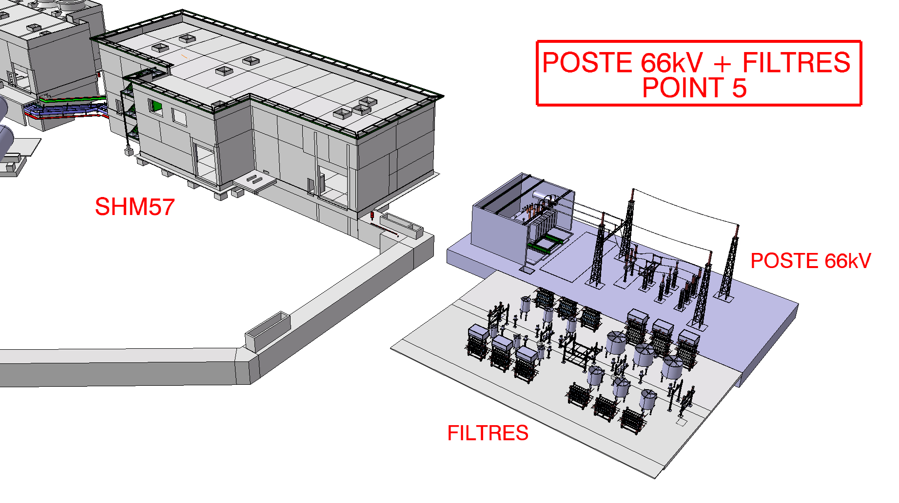
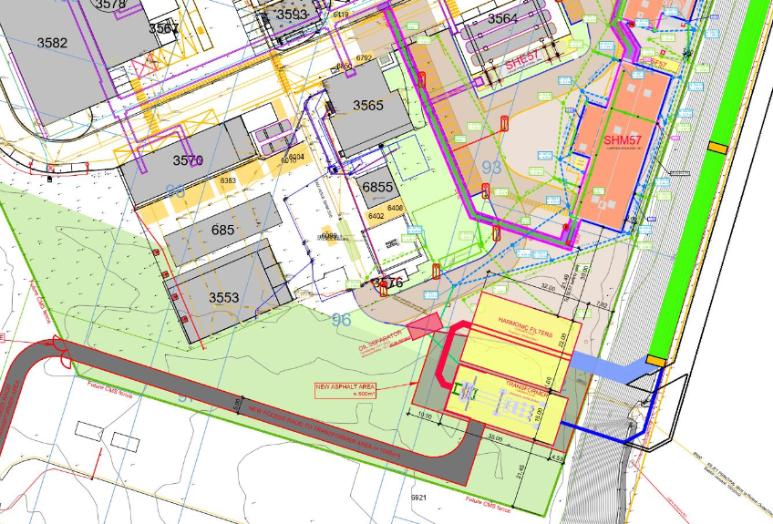
Supply, Installation and Commissioning of the new 66/18 k V Substation, LHC 5
Procurement Code: 02.02.01.00
Cost Range : 250 k CHF ⬄ 750 k CHF
Planning: MS: Q4 2022
IT: Q2 2023
Contact: Stefano.Bertolasi@cern.ch
Description & Specific Condition :
Civil Engineering excluded
Transformer excluded
Verification of CERN preliminary design
Procurement, installation and commissioning of the substation

Slide 7
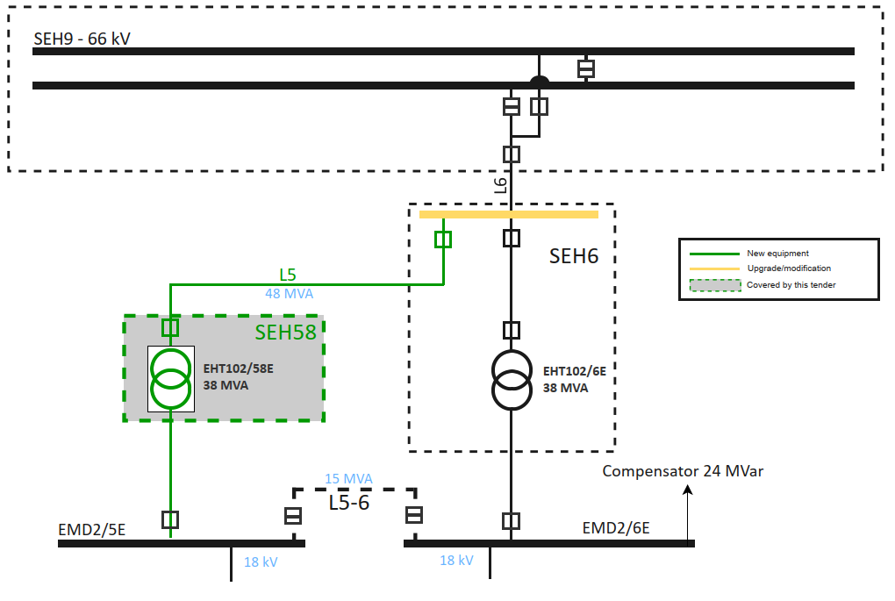
Supply, Installation and Commissioning of a 38MVA Oil Transformer, LHC 5
Procurement Code: 02.01.01.00
Cost Range : 250 k CHF ⬄ 750 k CHF
Planning: MS-4807/-EN (Q1 2023)
IT: Q3 2023
Contact: Giuseppe.Cappai@cern.ch
Description & Specific Condition :
38 MVA
Oil Transformer
YD
Installation in March 2025
Accessories included
Commissioning

Slide 8
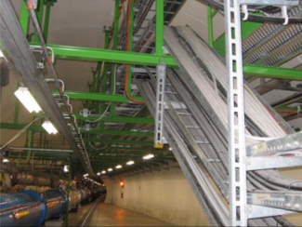
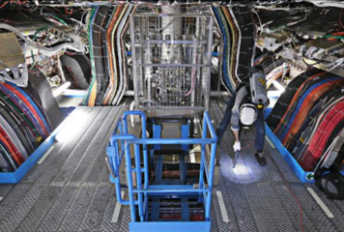
Supply of Radiation Hard and Radiation Tolerant Cables for General Purpose.
Procurement Code: 02.05.00.00
Cost Range : 750 k CHF ⬄ 5 M CHF
Planning: MS: Q4 2022
IT: Q4 2023
Contact: Cedric.Garino@cern.ch
Description & Specific Condition :
1000 km of Cables
Installation during LS3
1 MS => 3 IT
General purpose, Rad-Tol, and Rad Hard
Qualification test during MS phase: Irradiation test, aging, etc.

Slide 9
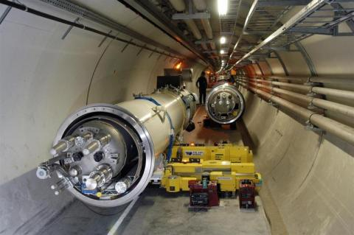
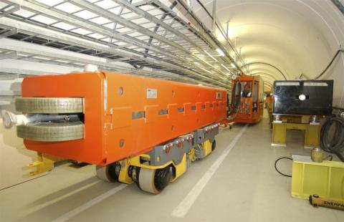
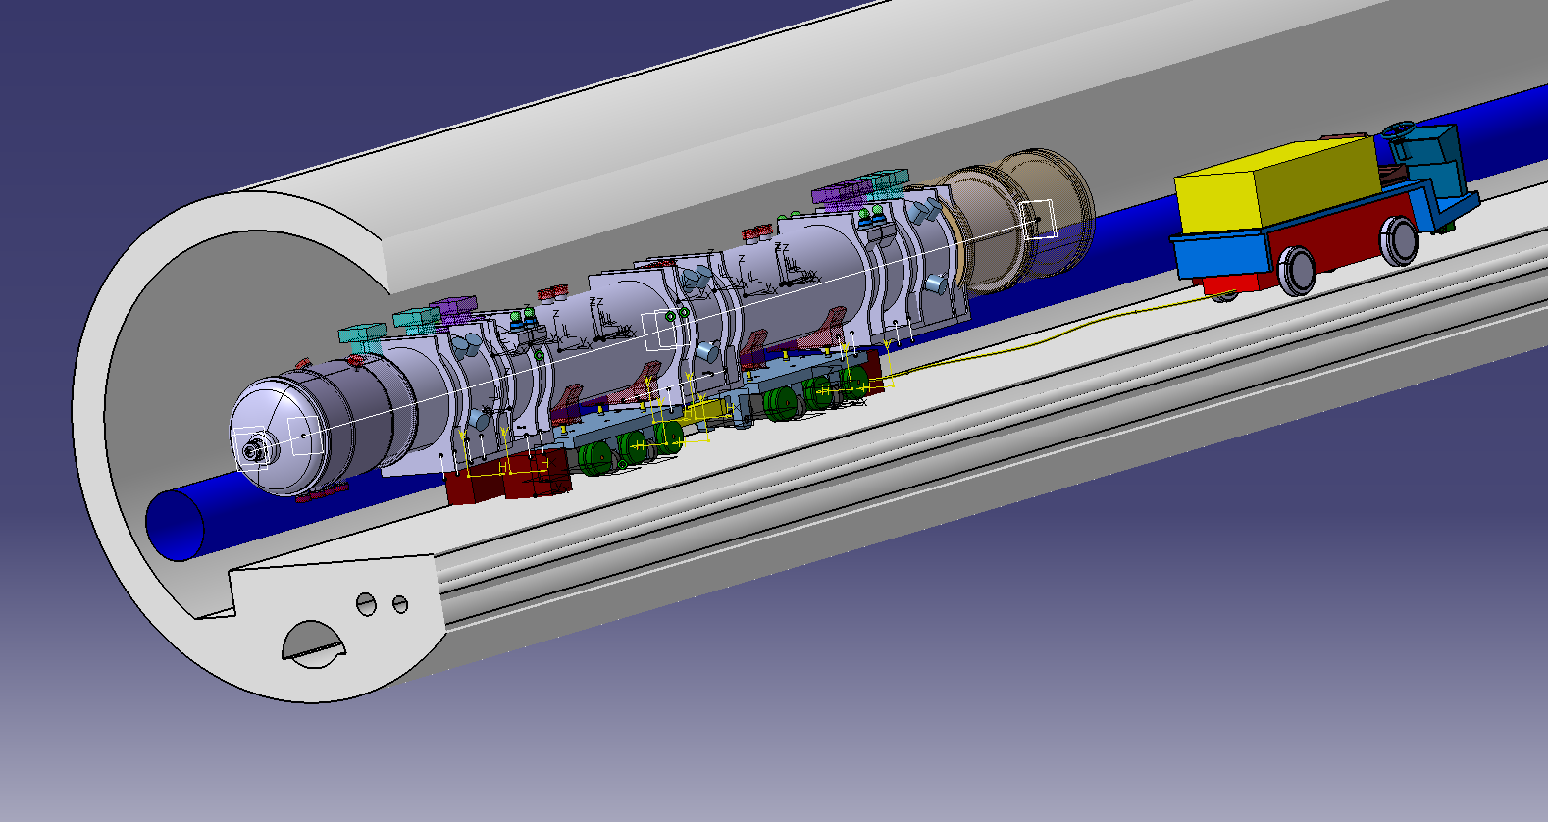
Supply of Transport Equipment for Magnets & SC Links
Procurement Code: 11 04 06 00
Cost Range : 250 k CHF ⬄ 750 k CHF
Planning: MS: Q2 2023
IT: Q2 2023
Description & Specific Condition :
Customize forklift for DCM and Feed Boxes
Trailer and transfer system for Absorber (TAN, TAXN)
Contact: Caterine.Bertone@cern.ch

Slide 10
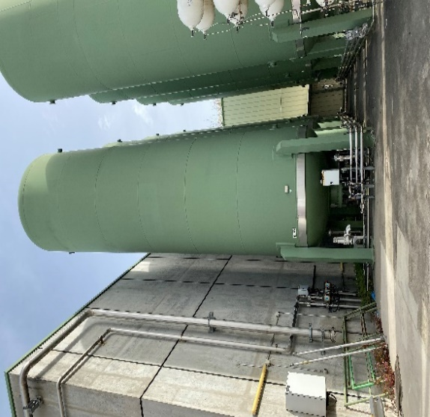
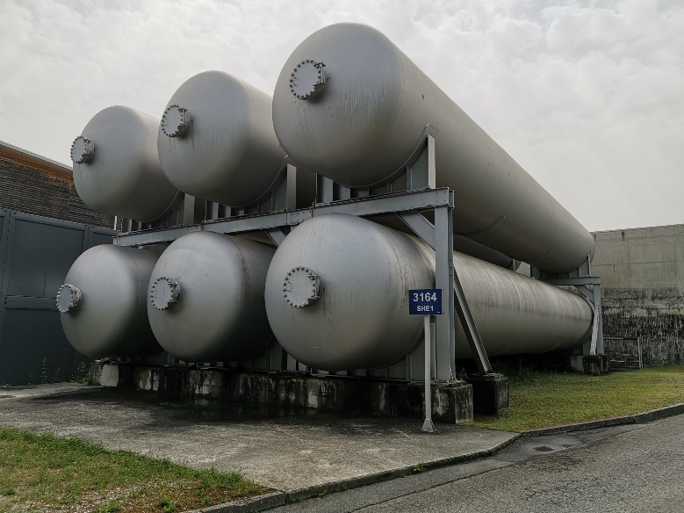
Supply of Cylindrical Gaseous Helium Vessels
Procurement Code: 09.01.05.01
Cost Range : 750 k CHF ⬄ 5 M CHF
Planning: MS-4802/TE (sent)
IT: Q1 2023
Contact: Antonio.Suraci@cern.ch
Description & Specific Condition :
Storage of gaseous He at room temperature
LHC 1 & 5 / Buffer for the refrigerator and compressor systems
25 bar
4 Cylindrical vessels
2 x 250 m3 & 2 x 80 m3

Slide 11
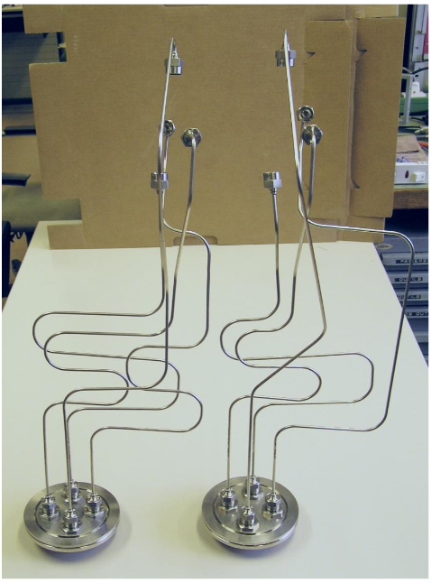
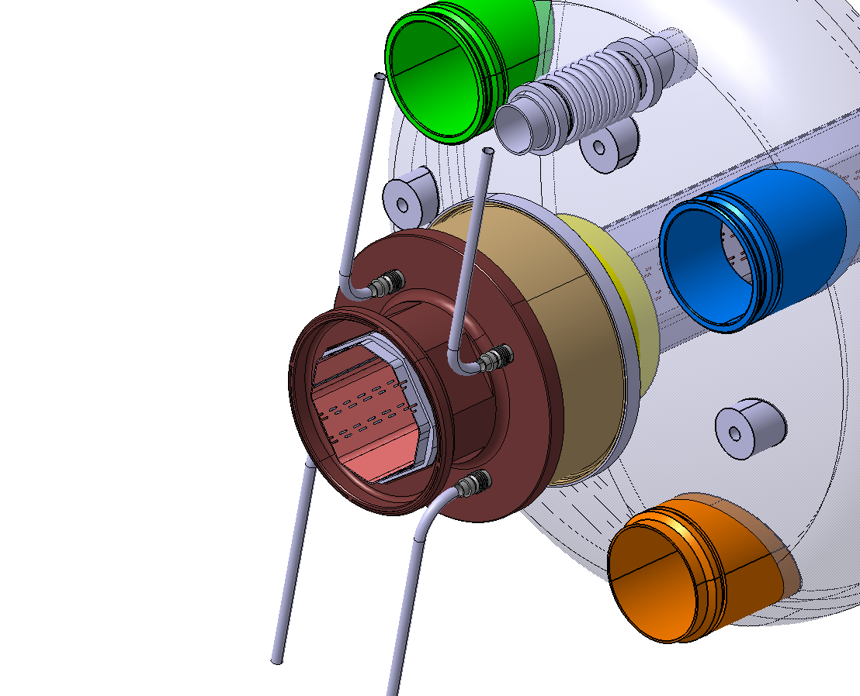
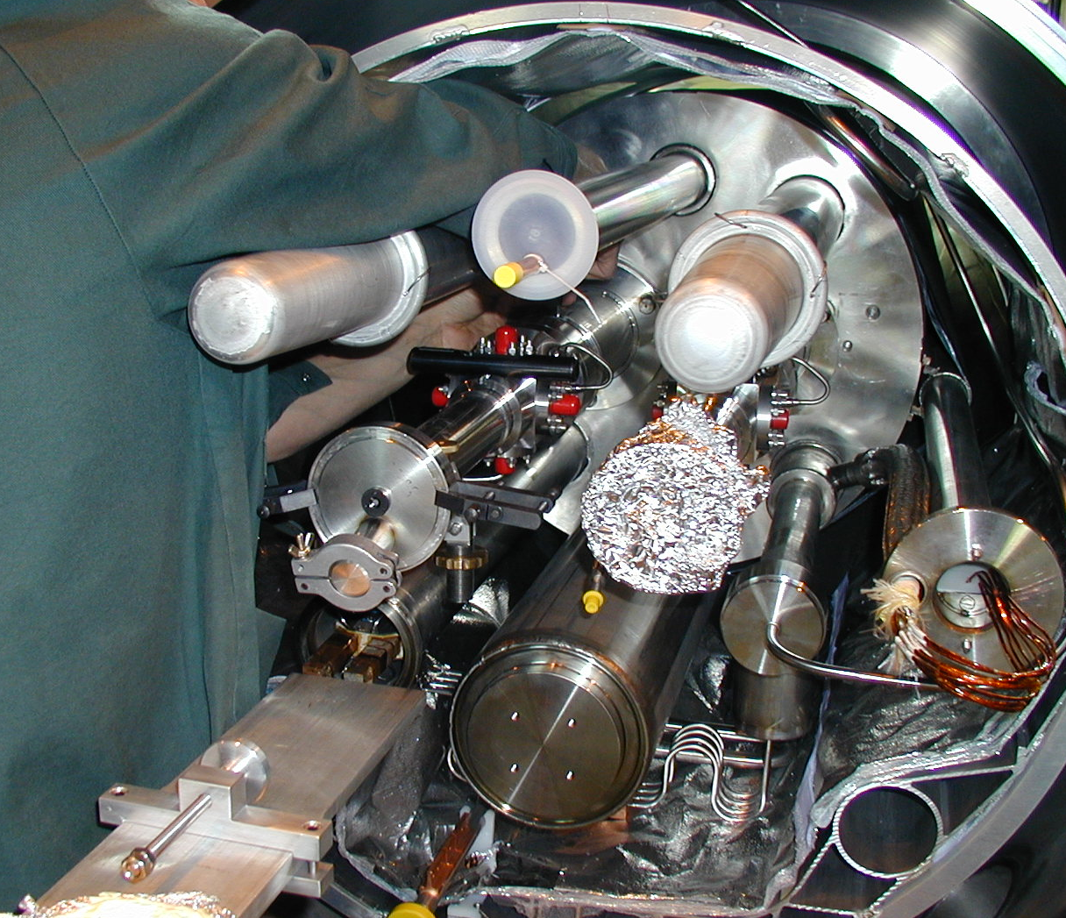
Supply of Cryogenic Cables for Beam Position Monitors
Procurement Code: 02.05.05.00
Cost Range : 250 k CHF ⬄ 750 k CHF
Planning: MS: Q3 2023
IT: Q1 2024
Contact: Michal.Krupa@cern.ch
Description & Specific Condition :
600 cable assemblies needed (proto, series, spares)
Cables to withstand cryogenic temperatures (~ 5K) and high temperature (600⁰C in collimators)
SiO2 Coaxial RF Cables
Laser Welding Cable-Connector challenging. Micro-cracks can’t be present

Slide 12
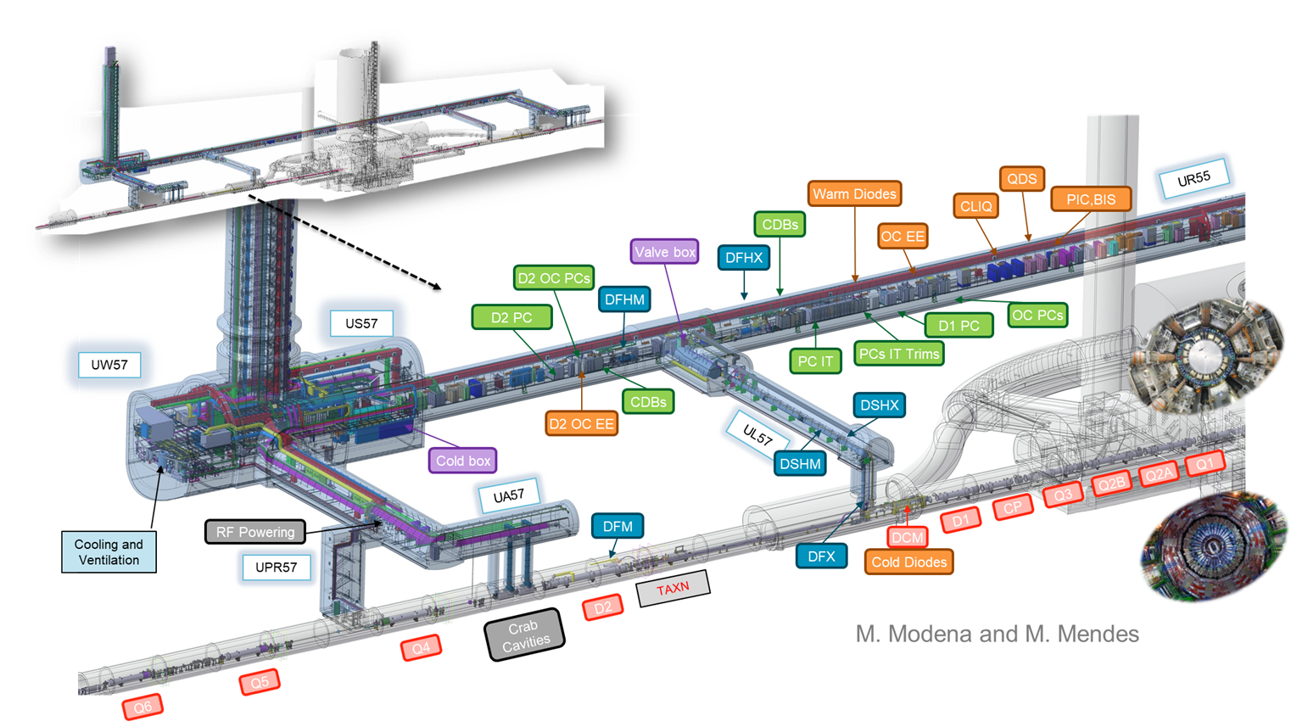
Supply of Vertical Core Excavation
Procurement Code: 01.02.01.01
Cost Range : 750 k CHF ⬄ 5 M CHF
Planning: MS: Q1 2023 - IT: Q3 2023
Contact: Pieter.Mattelaer@cern.ch
Description & Specific Condition :
LHC1 & LHC 5
Construction of 24 vertical cores - 6 L & R from IP
1m diameter
5 to 7 meters long
Confinement & Existing Equipment

Slide 13
Thank you

