Slide 1
Feedback from the CERN – first Thematic Day
19-20 September 2022 – On-line
Cabling, assembly and industrialization of electrical cabinets/switchboards, power converters and switchgears
Lisa Bellini-Devictor (Daniel Schoerling) IPT-PI

Slide 2
Timeline
ILO Forum March 2022: suggestion of a first thematic day on Power Conversion
Informal ILO forum Mid-June 2022: discussion about thematic day in September on “Cabling, assembly and industrialization of electrical cabinets/switchboards and switchgears”
27 June 2022: Email from CERN-IPT to all ILOs
  confirming the event, date, outline programme and examples
  CERN participants and examples of forthcoming needs in the specific field
  calling for list of participating companies
6 September 2022: Agenda and B2match tool on line for setting up meetings
12 September 2022: final deadline for proposing participating firms
19-20 September 2022: Event with presentations on first half day (4 departments) followed by B2B meetings
Notes:
A virtual event between CERN and companies from CERN Member States
These events are planned to supplement the longstanding ‘Country at CERN’ events with more targeted thematic industry gatherings
The objective is to facilitate the critical contact between suppliers and CERN technical groups, in a structured and targeted way
A particular emphasis will be given to increasing awareness, both of CERN’s technical activities and also of previously lesser known or unfamiliar industrial suppliers
For this first event, the topic of “Cabling, assembly and industrialization of electrical cabinets/switchboards, power converters and switchgears’
CERN presentations will be technical, with details on requirements and scope for forthcoming needs
Meetings between CERN and companies have been arranged, focussing on identifying new suppliers or with whom CERN has little experience. If required, CERN has given priority to suppliers from poorly balanced and associate member states.

Slide 3
Statistics
Statistics per country:
Up to 85 participants to the webinar
60 companies participating
15 MS – 2 AMS represented:
3 VPB
9 PB
5 WB
31 companies were invited to meetings
Country | Number of firms | Number of meetings
Belgium | 1 | 0
Czech Republic | 3 | 3
Denmark | 1 | 1
Finland | 1 | 0
France | 3 | 3
Germany | 6 | 2
Greece | 1 | 0
Hungary | 1 | 2
Italy | 7 | 5
Norway | 5 | 8
Portugal | 6 | 8
Slovenia | 3 | 1
Spain | 9 | 21
Sweden | 3 | 2
Switzerland | 3 | 2
Turkey | 2 | 0
UK | 4 | 6
TOTAL | 59 | 64

Slide 4
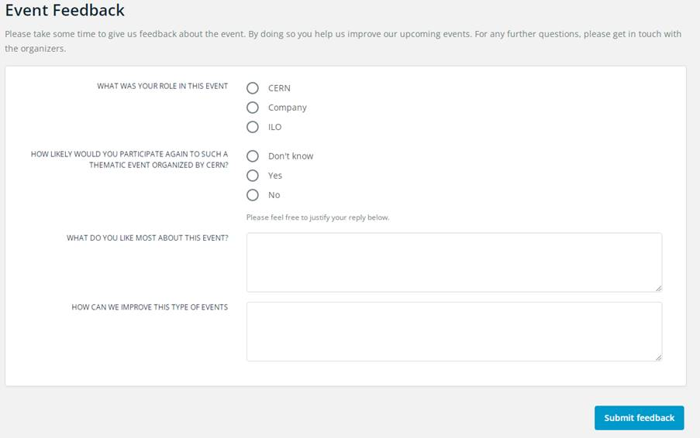
Event Feedback (1/2)
Questionnaire sent to :
                firms with B2B meetings,
                CERN technical officers with meetings,
                ILOs from countries with participating firms
                Three key stakeholder groups with different interests and expectations
11 replies received (3 CERN contacts, 1 ILO, 7 Companies)

Slide 5
Event Feedback (2/2)
Positive feedback overall:
                10/11 of respondents are likely to participate to similar events
                Efficient event
                Relevant and detailed presentations by CERN technical teams
                Detailed information about future projects
Improvements: mainly related to Tool and Management of meetings
                Improve follow up of participating firms and improve planning of meetings
                Add “decline meeting request” option on the B2Match tool

Slide 6
Thank you

