Slide 1
CERN Environmentally Responsible Procurement Policy Project (CERP3)
ILO Forum 27th September 2022
Enrico Cennini, IPT-PI
27.09.2022
EDMS 2777358

Slide 2
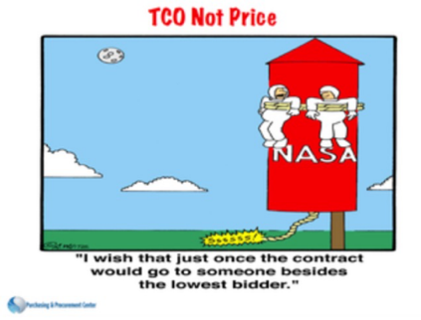
Context & Definitions
Sustainable Procurement
2016
Social
Economical
Environment
A
I
M
Check supply chains wrt socially responsible and ethical behaviour.
Develop social value in supply chains.
Reduce operating and maintenance costs.
Avoid procurement beyond real needs.
Develop co-innovation with strategic suppliers.
Adopt environmentally preferable goods and services.
Avoid/minimize damage to the environment.
Socially Responsible Procurement
Economically Responsible Procurement
Environmentally Responsible Procurement
B
E
N
E
F
I
T
S
Reduced use of energy (efficiency, renewable).
Reduced energy emitted (Heat, noise, vibration…).
Improved air quality (CO2 emissions reduction).
Reduced use of water (savings, efficiency).
Improved water/soil quality (pollution prevention).
Reduced needs of raw materials/natural resources.
Reduced waste and by-products.
Fair employment practices.
Fair trade and ethical sourcing practices.
Promoting workforce health/safety/wellbeing.
Creating training opportunities.
Social inclusion.
Diversity and equality in the supplier market.
Local sustainability.
Total Cost of Ownership (TCO) not Price
to achieve value for money.
Efficient supply chains.
Adoption of green technologies.
Create markets from recycling.
Favour open competition.
Support small/medium companies.
Reinforce resilience.
EDMS 2777358

Slide 3
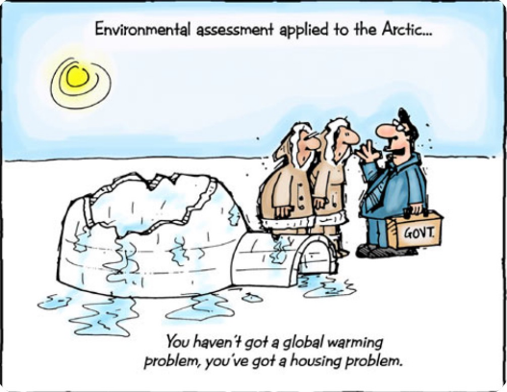
Key environmental impacts to consider
IMPACT | ISSUES
Climate change | Climate change impacts associated with the production, distribution, use and disposal of the goods. Specific focus on Greenhouse gases: Carbon, CH4, HFCs, PFCs, SF6, NO2 and low level ozone.
Energy | Energy use and efficiency. Use of renewable energy e.g. solar, wind.
Water use and quality | Water use and efficiency. Water recycling. Impact on water pollution, and measures to reduce discharges.
Waste | Volume/type of waste created associated with the production, distribution, use and disposal of the goods. Hazardous or toxic waste. Reusability and/or recyclability. Product efficiency and longevity: options for reuse, repair, upgrade or modification to increase product life. Environmental pollution that reduces fertility and diversity of wild species.
Hazardous substances Pollutants Emissions | Substances that adversely affect human health or the environments associated with the production, distribution use and disposal of the goods, e.g.: Heavy metals, (e.g. lead, mercury, cadmium). Ozone-depleting chlorinated compounds such as CFCs. Organic solvents, (e.g. chlorinated and aromatic hydrocarbons). Carcinogens, mutagens, teratogens. Volatile organic compounds (VOCs). Phosphorous, Phthalates (additives in PVC). Substances that can bio accumulate and that result in acute or chronic toxicity. Consider reactivity, corrosiveness, flammability, irritation potential of toxic substances and pollutants.
Resource use and intensity | Volume and type of raw material and consumables associated with the goods. Sustainability of utilising the resources (renewability of resources). Product efficiency and longevity: options for reuse, repair, upgrade or modification, to increase product life. Impacts on land use. Recycled content of goods (reduces demand for virgin resources).
Source. betterprocurement@hpw.qld.gov.au
EDMS 2777358

Slide 4
CERP3 Project Deliverables - Reminder
Original Deliverables
D1: Propose a draft CERN environmentally responsible procurement policy and its strategic positioning.
(Q1-2022)
D2: Identify and propose detailed mitigation and optimization objectives for CERN’s Scope 3 Procurement Emissions
(Q2/Q3-2022)
WP2: Guidelines + formalization of an environment procurement policy
WP3: Procurement practices analysis
WP3: Identify leverage points
WP3: Suppliers’ ranking
WP4: Identifying needs
WP4: Defining action plans
D3a: 2021-2022 CERN Scope 3 Procurement emissions evaluation (Q4-2022).
WP3: Environmental Diagnostic (2021-2022 Update)
Project of the 3^{d} CERN environment Report
Additional Deliverables
  WP3: Suppliers’ ranking
  WP4: Defining action plans
D3b: Scope 3 Supplier Engagement Programme
(Q3-2022).
  WP3: Suppliers’ ranking
  WP4: Defining action plans
D4a: Selection and onboarding of Supplier Sustainability Rating Platform (Q1/Q2-2022)
EDMS 2777358

Slide 5
D1 - CERN environmentally responsible procurement policy
1
2
3
4
Information Review
Understand Procurement Structure/Activities/Process
Policy draft, review, refine and validate
Create final policy and strategic positioning
Draft Policy finalized
The draft Environmental Responsible Procurement Policy will be sent to the ILOs this week!
Feedback by latest mid-October would be very welcome to integrate the comment before sendind the draft Policy to the Department Heads and present it for approval to the Enlarged Directorate this year.
A guideline document is foreseen to list, per Procurement Families, practical means to implement the Environmentally Responsible Policy.
EDMS 2777358

Slide 6
Code of professional ethics https://procurement.web.cern.ch/en/code-of-professional-ethics
CERN Environmentally Responsible Procurement Policy Key Concepts
IF,
WHY buying?
As user/owner?
Functional approach
KPIs e.g. % recycled
Procurement Supplies >200 KCHF – Module 1: Procurement Rules, Strategy and Market Survey
Challenge the need!
Eco-design/Life Cycle Analysis
Resource optimization (water/energy)
Total Cost of Ownership (TCO)
WHAT do I buy?
Polluting materials?
Carbon footprint?
(Very) Poorly balanced Countries
Labels/Certification
Local purchase/Diversity
WHO I buy from?
Reciprocal dependencies
Duty of vigilance/Compliance
Reasoned negotiation
Suppliers’ performance
Respect of commitments
Sustainable Procurement
HOW do I buy?
Fair competition
Payment deadline
EDMS 2777358

Slide 7
D2 – Identify detailed mitigation/optimization objectives for CERN’s Scope 3 Procurement Emissions
1
2
3
4
5
Understand Procurement Category Strategy & Approach
Category Review: Identify levers
Supplier Review: Assess maturity
Category Actions/Plans External and Internal
Prioritise and create action plan
50% DONE
Workshops were held for Procurement Families (PF) 1-4-9-11-13.
Liquidation of Procura Consulting Ltd in July 2022. Objective is to hire a new consultant asap.
EDMS 2777358

Slide 8
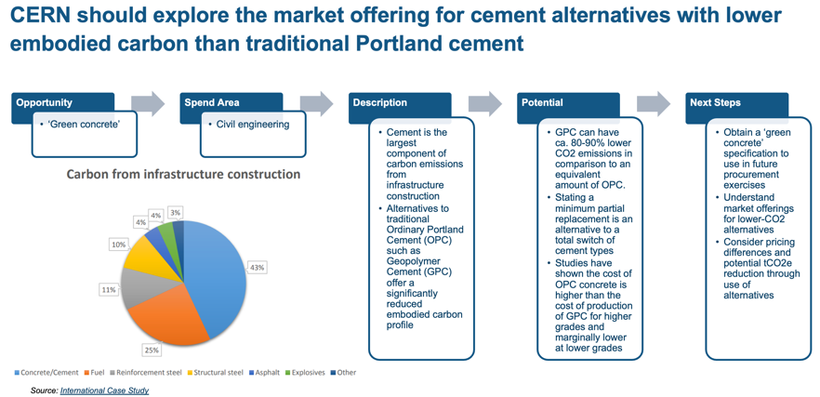
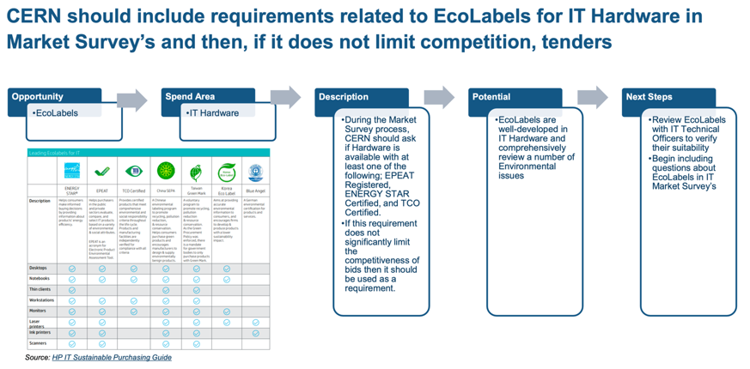
D2 – Identify detailed mitigation/optimization objectives for CERN’s Scope 3 Procurement Emissions (cont)
Feasibility of mitigation/optimization objectives are discussed with Procurement and Technical Officers.
Category Decarbonization Strategies will be formalized in a guide.
This guide will help Procurement Officers and Technical Officers when considering the environmental responsibility in procurement activities.
Examples
EDMS 2777358

Slide 9
D3a: Evaluation of CERN’s Scope 3 procurement emissions for the 2021-22
Additional Deliverables
Refresh and refine 21/22 Scope 3 emissions evaluation (Q4-22)
  Evaluate Scope 3 procurement emissions for the 2023 Environment Report
  Give Category Managers greater granularity to assist with scope 3 mitigation and optimization objectives
Scheduled Q1-2023
Update?
EDMS 2777358

Slide 10
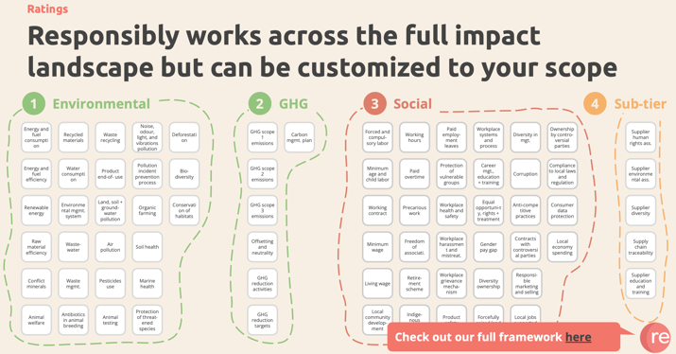
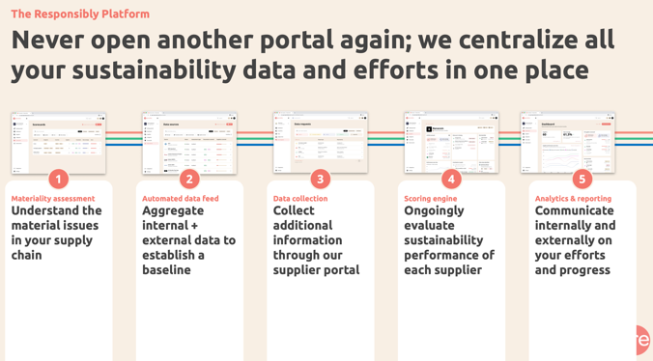
D3b-D4: Supplier Engagement Programme and onboarding of a Supplier’ Sustainability Rating Platform
Additional Deliverables
  D3b: Scope 3 Supplier Engagement Programme (Q3-2022):
  To improve the granularity of emissions reported in the 2023 Environment Report Procura will run a supplier engagement programme to get actual GHG data from the top 80% of CERN’s suppliers by Scope 3 Emission (350 suppliers). In addition, we aim to understand if the 350 CERN suppliers are setting GHG reduction targets and making progress towards GHG reduction. If they have not set targets (short/medium term reduction objectives) then we can encourage them to do so through the educational workshops. This will begin in Q3 2022.
  D4: Selection and onboarding of Supplier Sustainability Rating Platform (Q1/Q2-2022)
  This is already in progress but has now been officially scoped as a deliverable. Procura will also facilitate the payment between CERN and Responsibly
Scheduled Q4-2022
DONE
EDMS 2777358

Slide 11
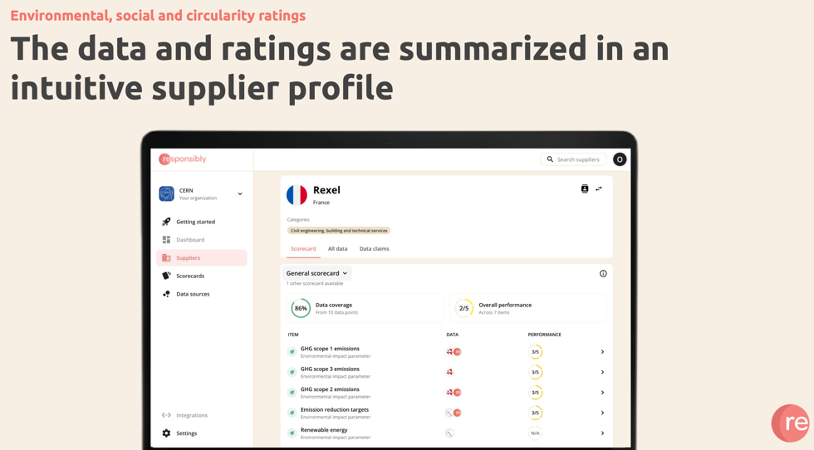
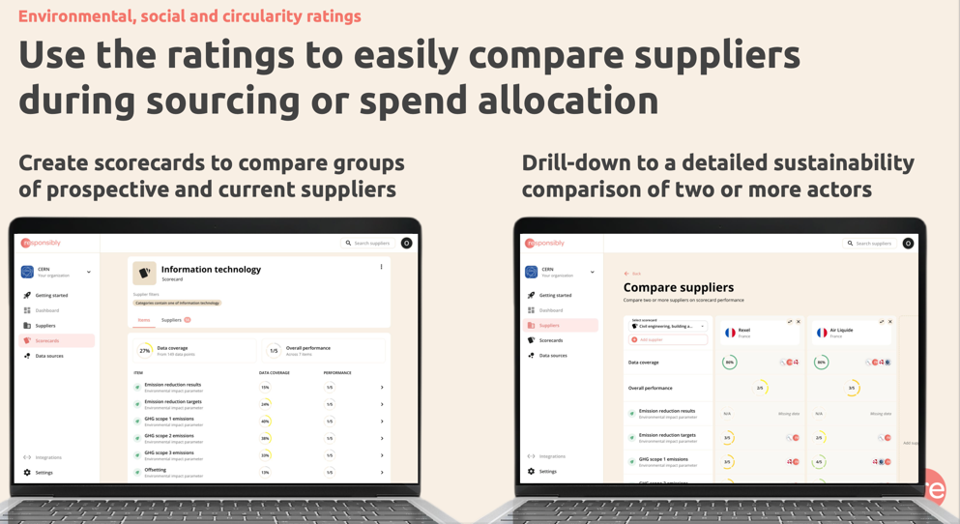
D4: Responsibly Supplier’ Sustainability Rating Platform
The tool will concentrate on CO₂ emissions reduction first and progressively evolve towards other sustainability criteria.
EDMS 2777358

Slide 12
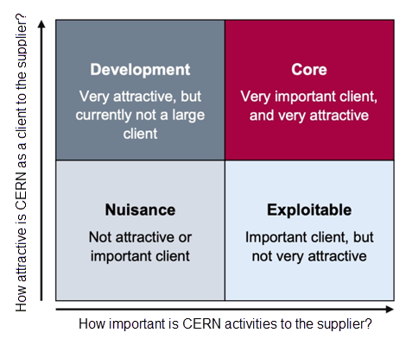
CERN suppliers’ sustainability rating
We would like ILOs, Procurement Officers and Technical Officers to rank new/existing suppliers according to the following matrix:
Source. betterprocurement@hpw.qld.gov.au
Supplier seeking to grow their business with CERN are more receptive to sustainability requests.
Opportunity for supplier in the development
in terms of sustainability and innovation.
Open to change and to sustainability requests.
Focus on driving sustainability objectives
and influencing the supply market.
(Attractiveness of the Account)
Low potential to drive sustainability issues.
If possible consider changing the supply base.
Focus on improving CERN relationship with the supplier.
Potential in pushing sustainability agenda through building attractiveness as a client.
This categorisation will then be added
to the Responsibly tool.
(Relative Value of Contract)
+
Specific CERN supplier logo(s) highlighting sustainability agendas/results are foreseen.
EDMS 2777358

Slide 13
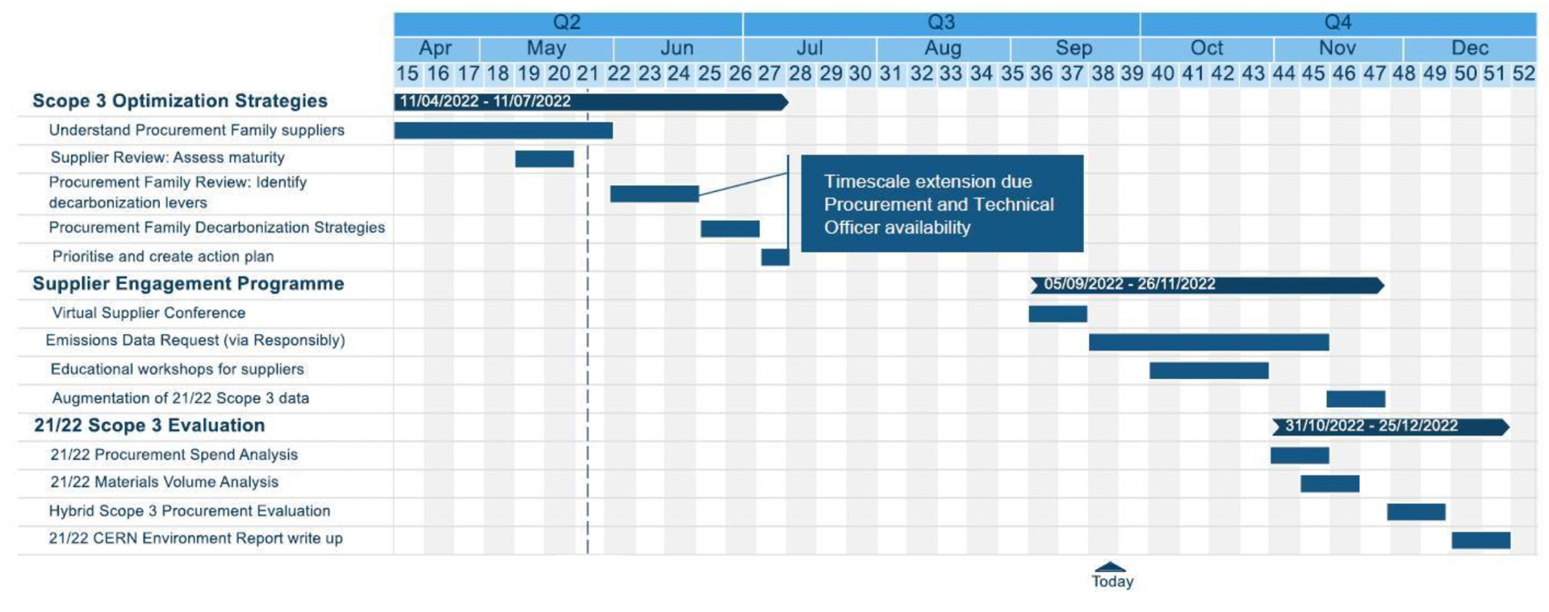
Timeline
Delayed
EDMS 2777358

Slide 14
THANK YOU FOR YOUR ATTENTION!
QUESTIONS?

