Slide 1
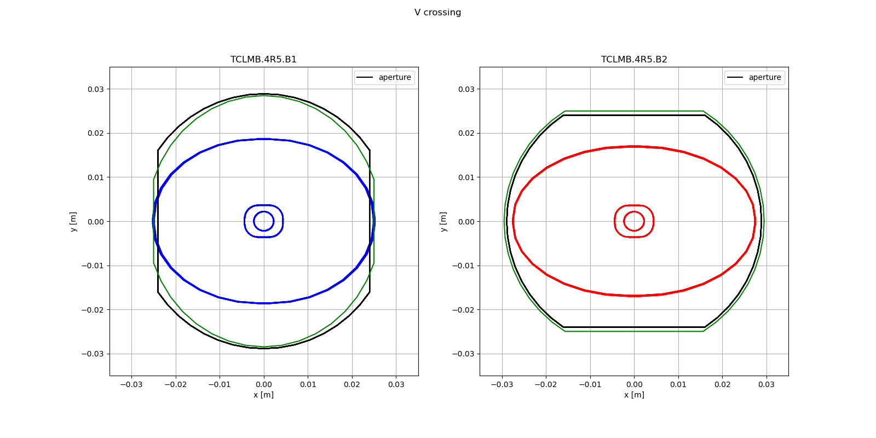
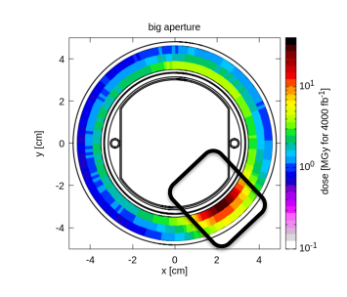
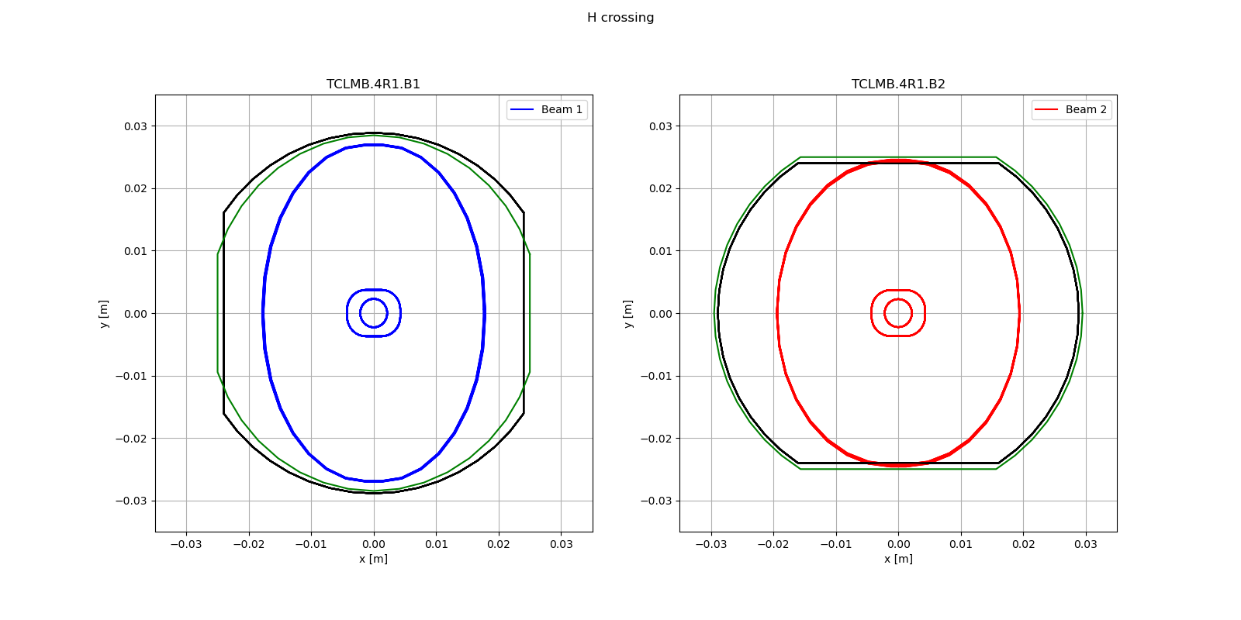
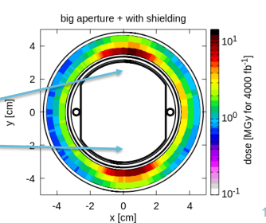
IP side TCLMB.4 Right
Present shape for both Inermet and copper:
Round gap = 60.2+-1mm
Flat gap = 50.6+-1mm
Inermet+
copper
Copper
Proposed shape (green) taking into account the recent tolerances and energy depositions studies
Inermet+copper
Round gap = 58/54 (H,V)+-1mm (+)
Flat gap = 51+-1mm
Copper_only
Round gap = 60+-1mm (*)
Flat gap = 51+-1mm
Gain:
2 mm of additional protection
0.8 sigma increase of aperture thanks to an increase of the not exposed aperture
Next step: WP10 validate worst case of the new proposed shapes
V Crossing
Beam envelope 14.2 sigma
H Crossing
Beam 1
Beam 2
(*) Could be made same of Inermet but not needed either for hardware nor for protection
(+) Elliptical shape should improve protection on the V crossing case

