Slide 1
MKI Cool: Longitudinal Impedance
M.J. Barnes
Acknowledgements:
O. Bjorkqvist, M. Diaz, V. Vlachodimitropoulos

Slide 2
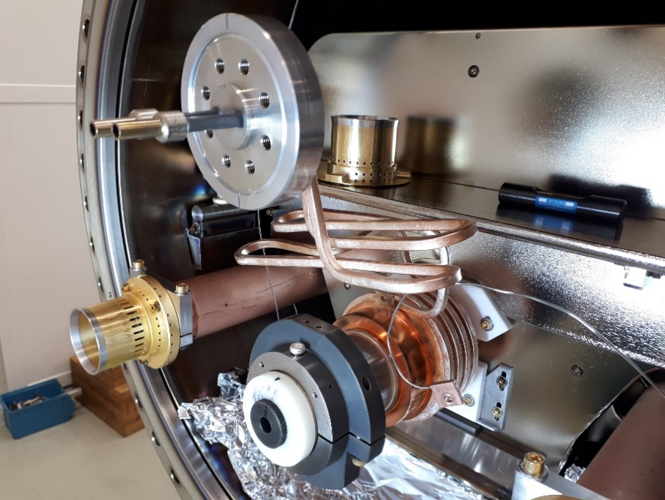
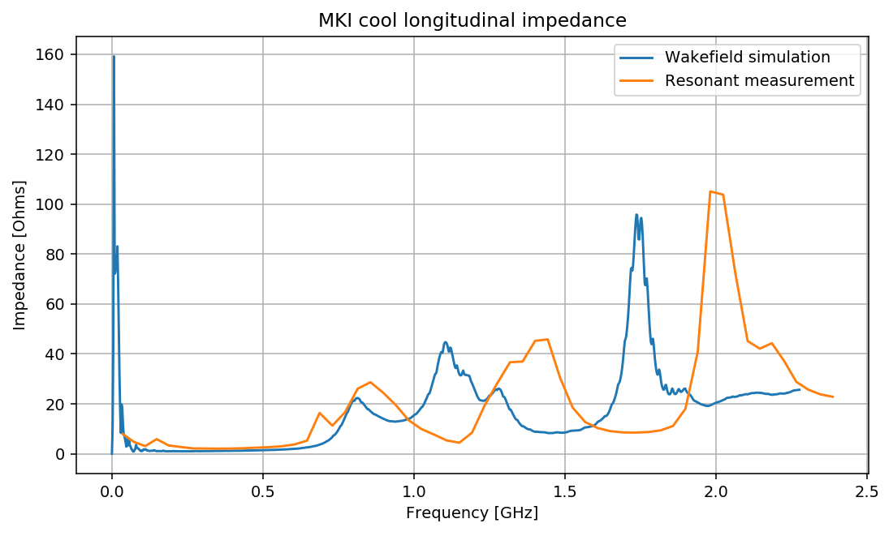
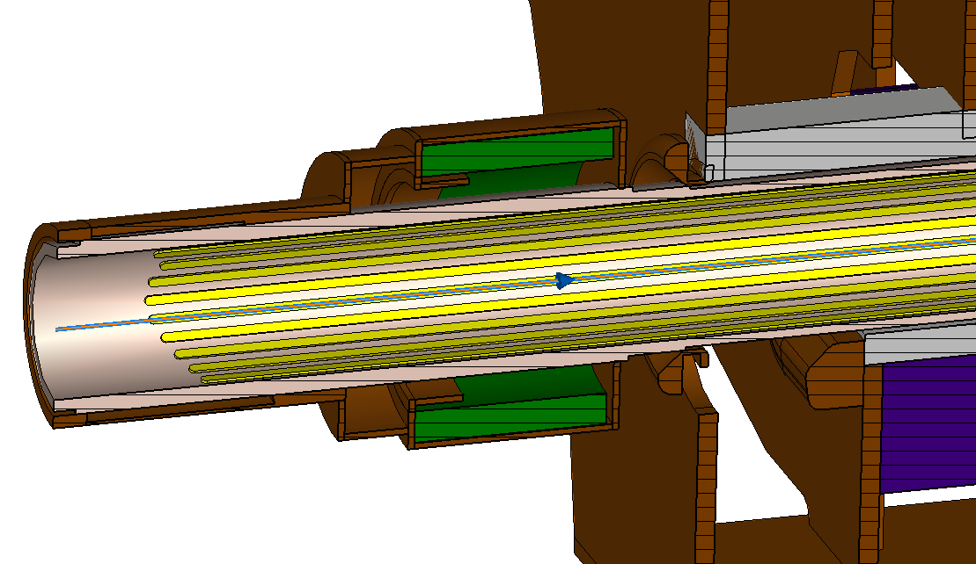
Longitudinal impedance (30/1/2020)
Resonant measurement on 29/01/2022 compared with prediction from Wakefield simulation (3D model imported from CATIA, courtesy of Vasileios Vlachodimitropoulos) – see presentation by Oskar @ IWG of 30/1/2020.
Measurements on MKI Cool with modifications shown on right
Macor support
Frequency shift?
Real Impedance [Ohms]
Measured mode at ~150 MHz, not seen in simulations
Frequency shift?
4mm larger hole diameter in RF damper end cap
Impedance Working Group 30 January 2020: MKI Cool Status

Slide 3
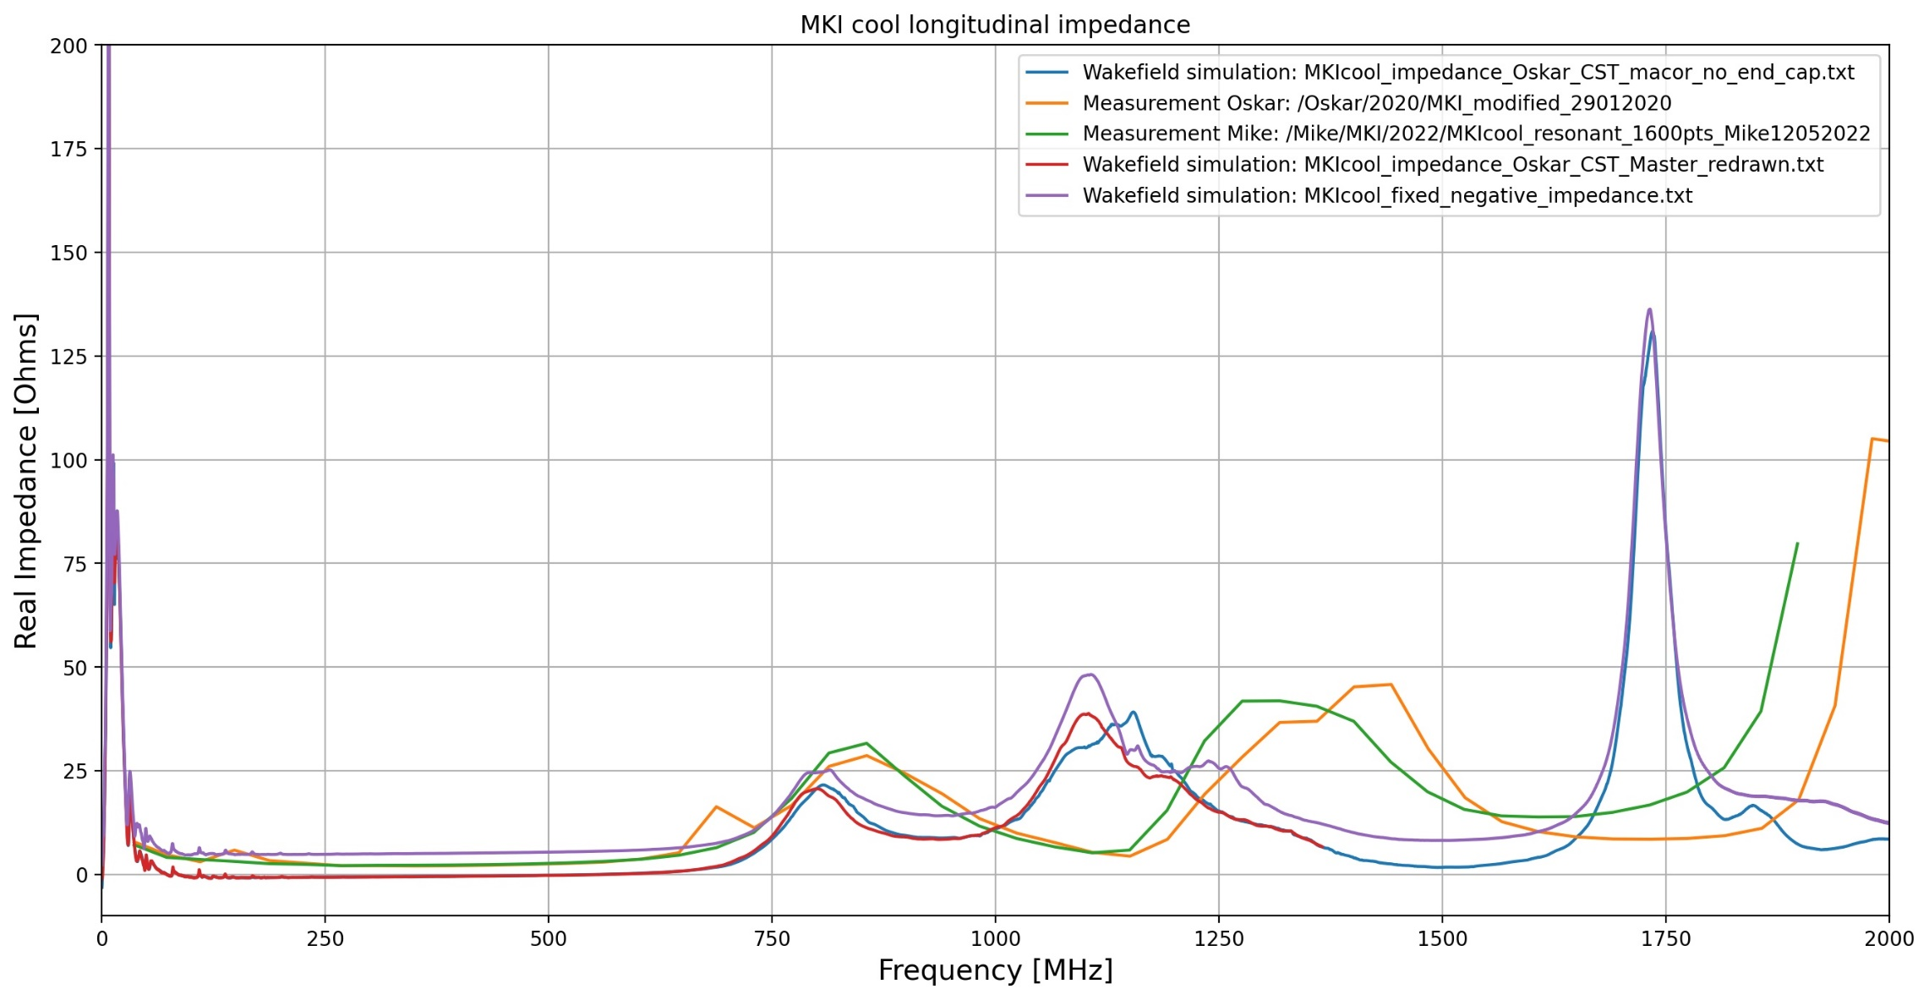
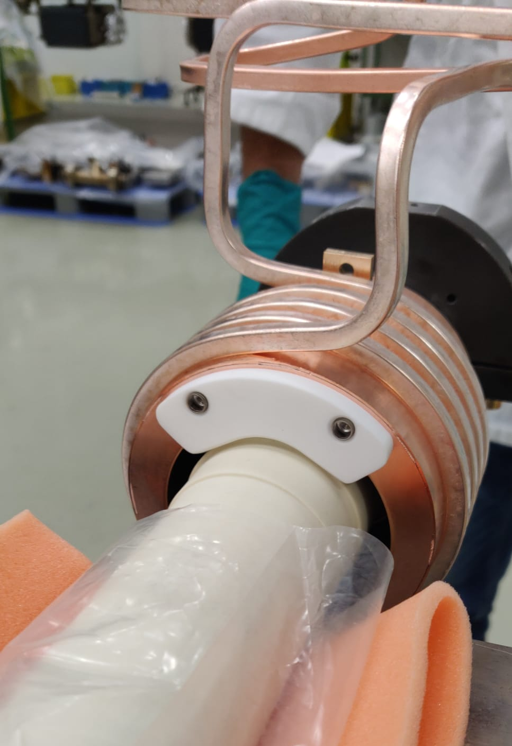
Longitudinal impedance
Reduced frequency shift between simulations and measurements
Measurements of 29/1/2020
Resonance at ~150MHz (29/01/2020) not in measurements of 15/5/2022
RF damper 05/2022 (macor support)
Measurements of 15/5/2022
Prediction (Oskar): better fit to measurements < ~600MHz

Slide 4
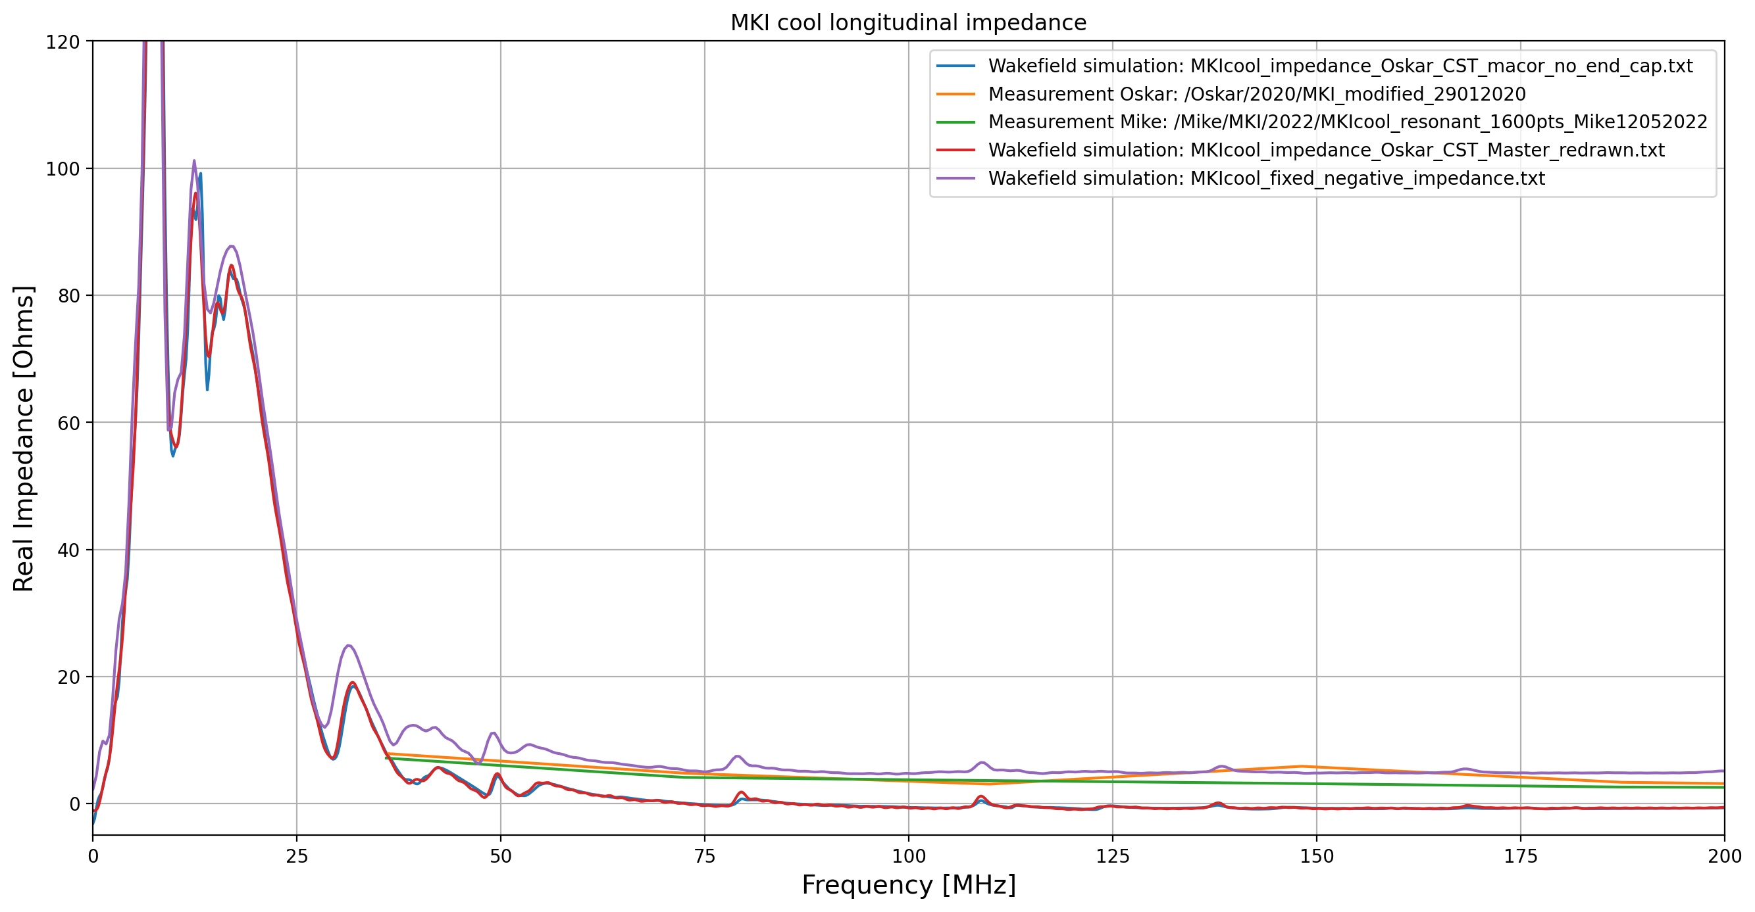
Longitudinal impedance (low frequency zoom)
Resonance at ~150MHz (29/01/2020) not in measurements of 15/5/2022

