Slide 1
EuCARD HFM
Dipole Design Review
20-21 january 2011
Overview of the dipole
Jean-Michel Rifflet

Slide 2
Overview of the dipole - Outline
Dipole specifications
Conductor choice
Size considerations
History of the design
Baseline 2D configuration
Conclusion
Work organized around 4 working groups :
Specification
Magnet predesign
Conductor
Dipole/Insert interface and interaction

Slide 3
Dipole specification
EUCARD requirements: Already presented by Gijs
Magnetic field in the center of the bore: 13 T
Magnet free aperture: 100 mm diameter
Magnet length: 1.5 m (coil end-to-end)
Fresca cable test station requirements:
Magnetic field in the center of the bore: 13 T at 4.2 K
Operational temperature : 1.8 to 4.2 K
Magnet free aperture: 100 mm diameter
Minimum length of straight part: 0.7 m
Maximum operational current: 20 kA
Field homogeneity 2% at 2/3 of aperture (Accelerator magnets generally require a few units)

Slide 4
Dipole specification
Test station constraints:
Maximum outer diameter of the cold mass: 1300 mm
Maximum overall length of the cold mass: 2500 mm
Pre-cooling tubes: 300 K - 70 K cooling at 16 bar
Furnace constraints:
Maximum width of the coil pole cross-section: 350 mm
Maximum height of the coil pole cross-section: 200 mm
Safety constraints:
Stray field maximum 500 mT on places where personnel can be present in the test station

Slide 5
Conductor Choice (See Luc's Presentation for details)
NED Program: FP6 – CARE Project :
At least two firms in Europe able to produce Nb3Sn strands. Internal tin and PIT (Alstom and Bruker EAS)
  Jc = 2500 A/mm² @ 4.2K and 12 T
Ø_{strand} = 1.25 mm
  Alstom stopped working on that subject
  Bruker EAS OK with 1.25 mm strand, but instabilities issues with this strand diameter.
  + OST in the US. Produce 0.8 mm strand
Compromise cable:
1 mm strand → necessary development
Cable current as high as possible (to decrease coil inductance)
40 strand cable (limit of CERN cabling machine)

Slide 6
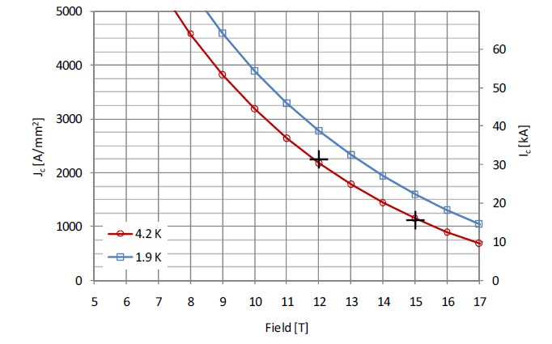
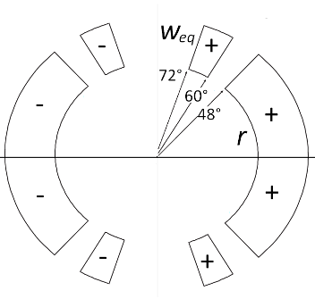
Size considerations (Attilio)
Conductor :
Jc @ 4.2 K , 12 T = 2500 A/mm²
Jc @ 4.2 K , 15 T = 1250 A/mm²
Cabling degradation : 10 %
r = 60 mm (mechanics)
Nb of turns per pole | Weq (mm) | Bss, 4.2 K (T) | Bss, 1,9 K (T)
140 | 68.6 | 13.8 | 14.9
150 | 72.2 | 14.0 | 15.1
156 | 74.2 | 14.1 | 15.2
160 | 75.6 | 14.2 | 15.2
170 | 79.0 | 14.3 | 15.4
Weq = 74.2 mm
Wedges = 15 %
85.3 mm
➔ 21 mm per layer

Slide 7
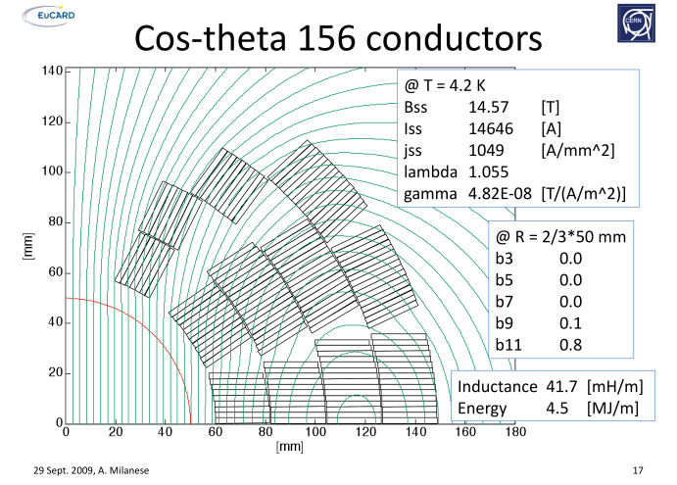
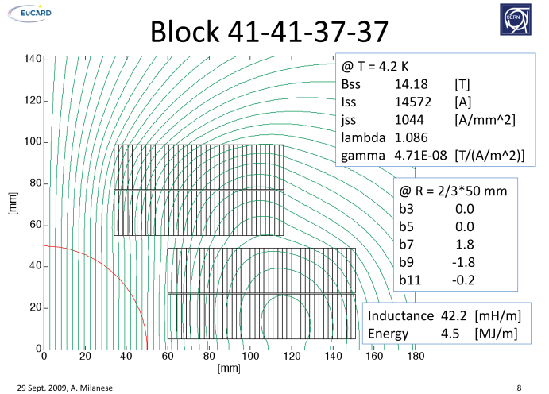
History of the design
Official start of project : 1st April 2009 but
  LHC Repair → CERN people not available
  Saclay's people busy on other projects
First discussions at CERN in August 2009 → draft of conductor specification
Real start of work September 2009
Constitution of the Magnet Predesign Working Group; 1rst meeting in November 2009: proposition of 2 layouts by Attilio

Slide 8
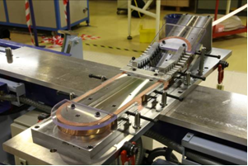
History of the design
February 2010: the "Hard Way wending test" helps to convince that the block coil configuration is feasible (See Françoise's presentation for details)
May 2010 : report "EuCARD-HFM dipole model design options" : comparison of cosθ and block coils configurations.
June 2010 : HFM meeting in Geneva : Choice of block coils configuration:
  From magnetic and mechanical point of view, both configuration are not very different
  The shapes of the block coils are simpler. This should lead to more adaptable and less costly tooling
  It is probably the basic mechanical structure for stress management in future higher field magnets. It allows for efficient grading of Nb-Ti Nb3Sn and HTS

Slide 9



History of the design
June 2010 : Stay of Shlomo Caspi at CERN (→ October 2010). Great help in the 2D and 3D conceptual design
Last 6 months :
Optimization of 2D cross section (Attilio's talk)
3D conceptual design (Attilio's talk)
Quench protection analysis (Phillipe's talk)
Cooling and heat transfer studies (Slavek's talk)
Fabrication process and engineering (Maria and Pierre's talk)
Tooling and validation tests definition (Françoise's talk)
39-39-39-39
36-36-42-42
39-39-45-45

Slide 10
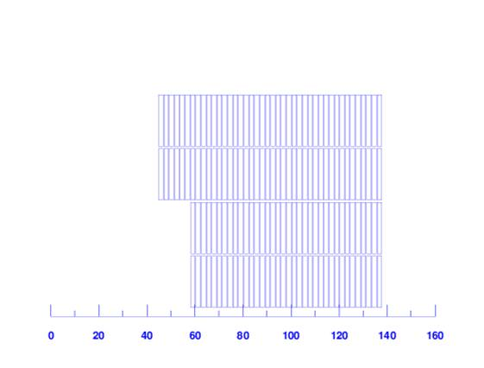
Baseline 2D configuration
Insulated conductor : 21.8 x 2.22 mm²; rectangular
Insulation thickness : 0.2 mm per conductor face
Coils :
  36 – 36 – 42 – 42 turns ➔156 total turns
  Inner coil radius : 58 mm
  Midplane insulation : 3.5 mm (per pole)
  Interlayer insulation thickness: 0.5 mm
Bo = 13 T , I = 10.5 kA
Fx = 7.7 MN/m
Fy = -3.8 MN/m
(Per quadrant)

Slide 11
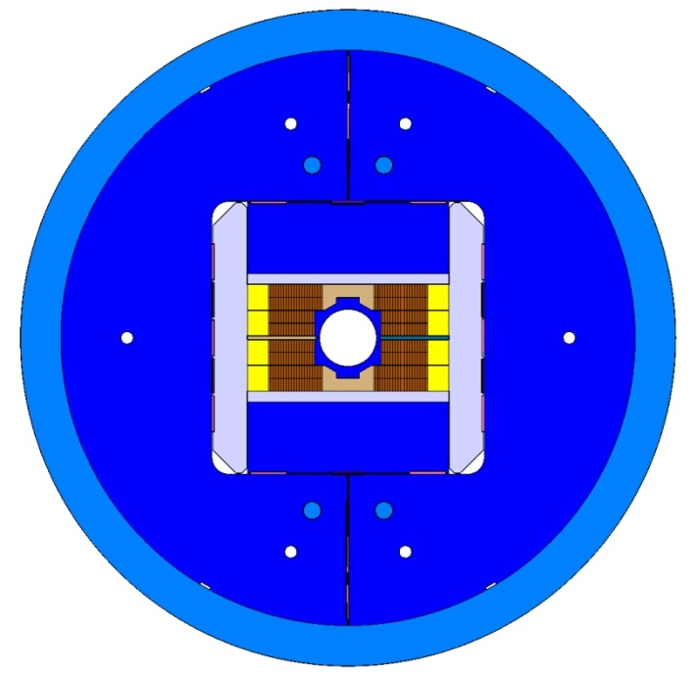
Baseline 2D configuration
Inner bore tube : Ø 100 mm
External yoke radius : 500 mm
Aluminum shell thickness: 70 mm
Reasons for bladders and keys:
The SMC Program uses this technology (Juan Carlos's talk) → experience
Low stress in coils at warm (Pre-stress in coils comes from cool-down) (Attilio's talk)
Can be extensively tested before final assembly
Allows for dismantling and size adaptation if needed
Parts with simple shapes; can be easily adjusted

Slide 12
Conclusion
The baseline for the FRESCA2 dipole is fixed.
The magnet is optimized for the Fresca test station; not all aspects of accelerator magnets are covered (radiation resistant materials, field homogeneity, …), but technology can be adapted (eventually after another R&D step)
Detailed studies are going on
The conceptual design will be described in details during this review
We expect a lot of comments from the reviewers

Slide 13
Participants to EuCARD/HFM task 3:
CERN : Attilio Milanese, Luc Oberli, Juan Carlos Perez, Gijs de Rijk, Ezio Todesco + Shlomo Caspi
Saclay : Bertrand Baudouy, Christophe Berriaud, Thomas Dalla Foglia, Mélanie Devaux, Maria Durante, Philippe Fazilleau, Jean-Jacques Goc, François Kircher, Pascal Labrune, Jean-François Millot, Slavek Pietrowicz, Alain Przybylski, Jean-Michel Rifflet, Jean-Michel Rey, Françoise Rondeaux
Thanks for your attention !

