Slide 1
Conductor choice, properties and procurement strategy
Luc Oberli
Outline:
Main characteristics of the FRESCA2 cable
Main characteristics of the strand
Strand stability, an issue to avoid magnet quench at low field
Procurement strategy

Slide 2
Main characteristics of the FRESCA2 cable
The cable was defined with the following requirements:
The transport current has to be high enough to achieve with enough margin a central field of 13 T at 4.2 K in a large aperture dipole, but with a maximum current of 16 kA to be compatible with the power supply installed in the FRESCA test facility.
The cable has to be flexible enough to facilitate the winding of the coil, not only for a block coil structure but also for a cosφ dipole.
The cable has to be produced with the cabling machine installed at CERN (maximum 40 spools).
To satisfy all these requirements and for other reasons which will be given later in this presentation, the strand diameter was fixed to 1 mm and the number of strands to 40.

Slide 3
Main characteristics of the FRESCA2 cable
Cable width | (mm) | 21.4
Cable mid-thickness at 50 MPa | (mm) | 1.82
Keystone angle | (degree) | 0
Cable transposition pitch | (mm) | ≈ 120
Number of strands | (-) | 40
I_{C} (12 T, 4.2 K) | (A) | 31420
I_{C} (15 T, 4.2 K) | (A) | 15170
n-value @ 15 T and 4.2 K | - | 20
RRR after HT | - | > 120
Minimum cable unit length | (m) | 260
Cable width calculated to compact only slightly the strands on the width.
Nd/2cosφ + 0.732 d
The critical current of the cable is calculated taking into account a degradation of 10 % due to cabling.

Slide 4
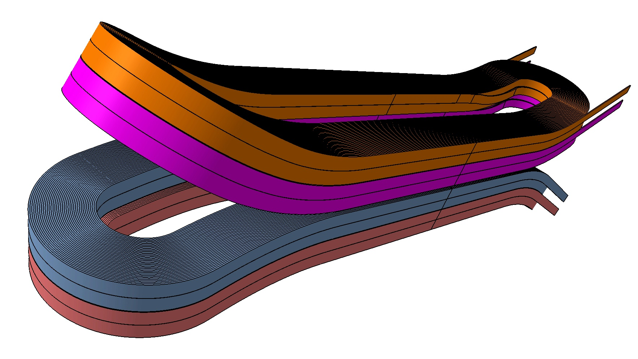
Main characteristics of the FRESCA2 cable
The cable has to be flexible enough to wind the coil having a bending radius as small as 45 mm and to make the jump between the 2 layers of each double-pancake.
The reduction of the strand diameter to 1.0 mm has given a flexible cable.
The transposition pitch of the cable was determined from cabling test done with Cu strands to have a cable mechanically stable.

Slide 5
Main characteristics of the strand
Following the results obtained by the NED program on a strand of 1.25 mm in diameter, where only one supplier has been able to produce the conductor with 288 sub-elements and with a Jc around 1400 A/mm² at 15 T and 4.2 K, the performances of the strand in term of Jc have not been pushed too high.
 |  | NED | FRESCA2
Strand diameter | (mm) | 1.25 | 1.00
Sub-element diameter | (μm) | < 50 | < 50
Copper to non-Copper volume ratio | - | 1.25 | 1.25
J_{C}(12 T, 4.2 K) | (A/mm²) | 3000 | 2500
J_{C}(15 T, 4.2 K) | (A/mm²) | 1500 | 1250
n-value @15 T and 4.2 K | - | > 30 | > 30
RRR (after full reaction) | - | > 200 | > 150
Piece length | (m) | > 1000 | > 400

Slide 6
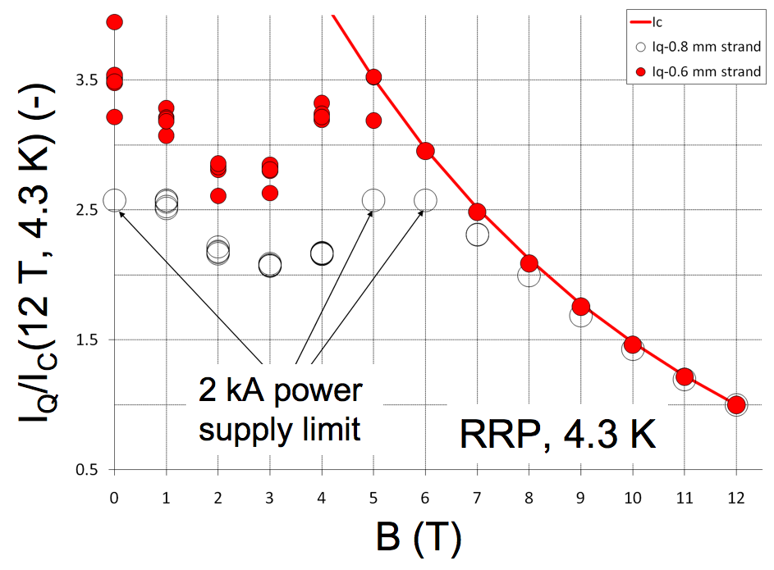
Strand stability: an issue to avoid magnet quench at low field
The stability of the Nb₃Sn strand could be an issue with high Jc, large sub-element diameter and low RRR.
Stability improves as strand diameter is reduced, as measured at 4.3 K on the RRP 54/61 strand having sub-element of ~ 80 μm in diameter at a strand diameter of 0.8 mm.
For this reason, the strand diameter was fixed to 1.0 mm as a compromise between the need to have a high transport current and the need to avoid magneto-thermal instabilities at low field.
The sub-element diameter has also to be small enough to reduce the flux jumps at low fields and a maximum value of 50 μm was specified.

Slide 7
Strand stability: effect of RRR
Stability improves as the RRR of the strand is increased from around 8 to 120, it is beneficial both at 4.2 K and at 1.9 K.
The RRR of the virgin strand has to be large enough to have some guaranty not to get “hot-spots” in the cable, in particular near the cable edge. RRR degradation over a length of ~ 1 mm is sufficient to create severe instability and to impair the current capability of the strand.
For these reasons, the request on the RRR value is high. A minimum value of 150 was specified.
Analysis of B. Bordini (CERN), conservative model used to predict the stability of a 0.8 mm strand with 80 μm sub-element diameter

Slide 8
Nb₃Sn Strand Procurement strategy
Two suppliers have the technology to develop a Nb₃Sn strand (in a short time) meeting the specification for the FRESCA2 cable:
Bruker-EAS and Oxford Superconducting Technology (OST).
Bruker-EAS has developed for NED a 1.25 mm strand with 50 μm sub-elements diameter achieving around 1400 A/mm² at 15 T and 4.2 K.
OST has developed for LARP a 1.0 mm strand with 66 μm sub-elements diameter achieving around 1300-1400 A/mm² at 15 T and 4.2 K.
The procurement is divided in 3 steps:
a 1st step called “qualification phase”
a 2nd step called “pilot production”
a 3rd step for the full production
The objective is to have at the end of the first 2 steps the qualification of the 2 suppliers.

Slide 9
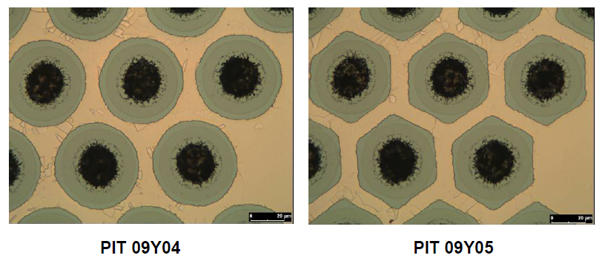
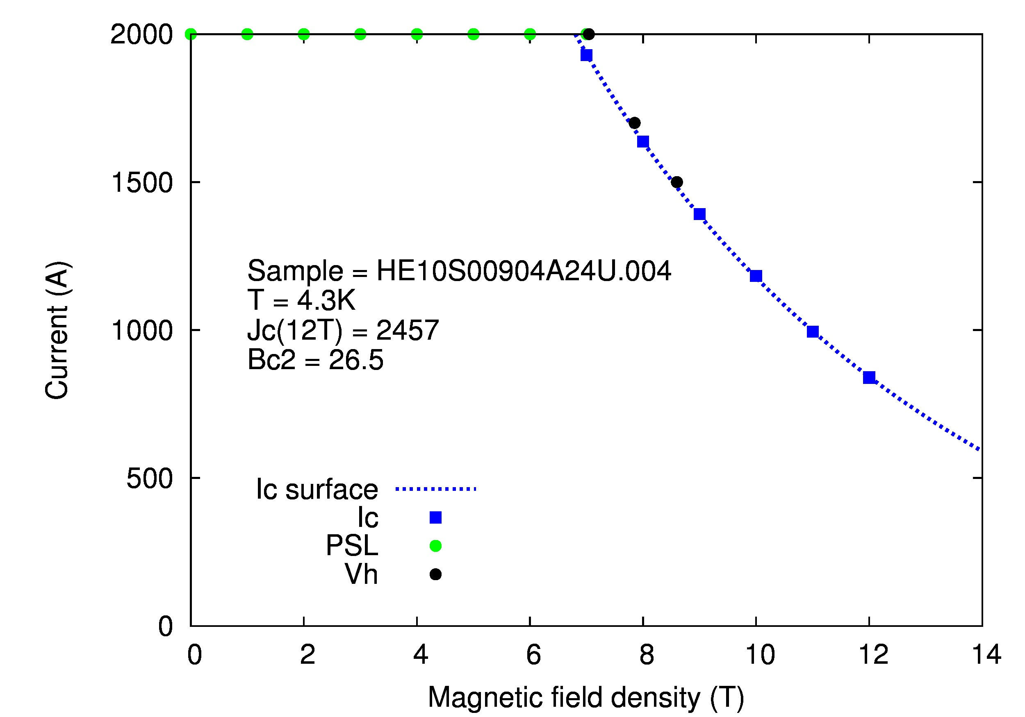
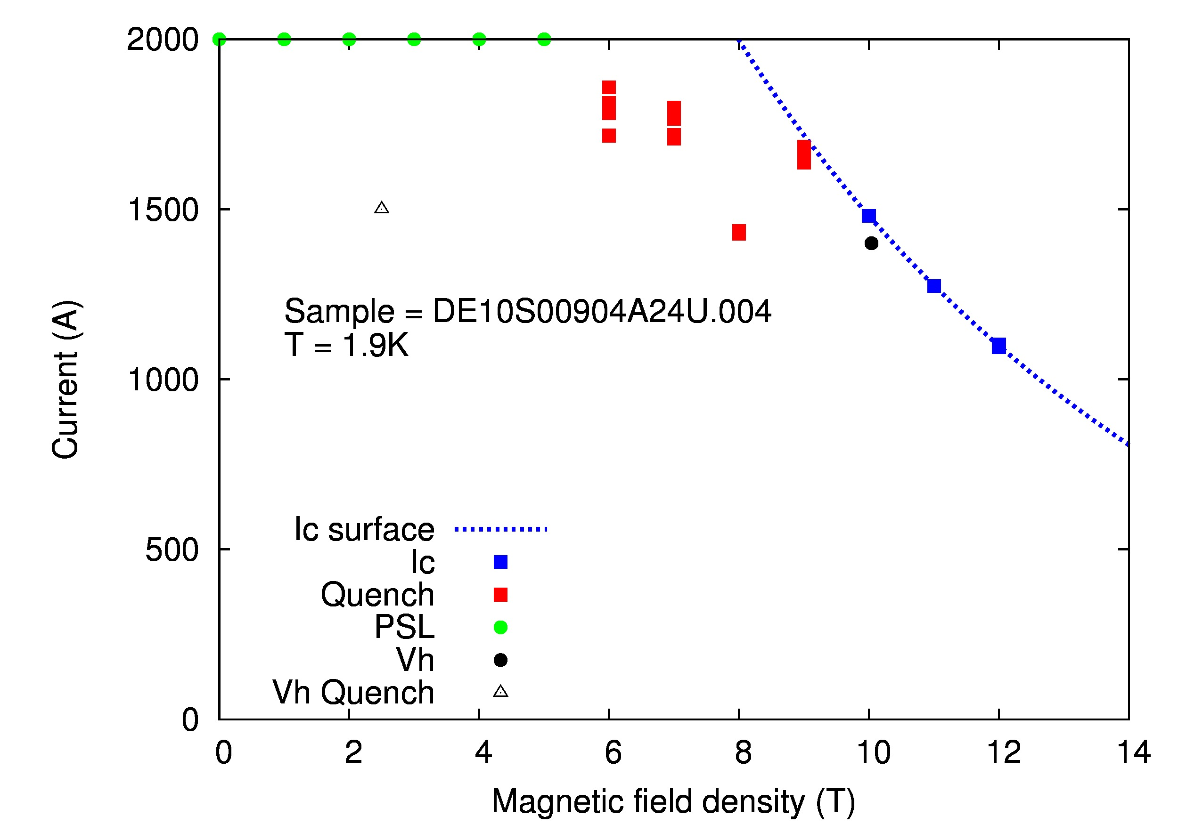
Nb₃Sn Strand Procurement strategy
First Step: qualification phase
A first order for 9 km of PIT strand placed by CERN to Bruker-EAS in March 2010
Three billets fabricated, one with round filaments and two with hexagonal filaments.
Jc achieved: Jc(15T, 4.2K) ≅ 1350 A/mm² and Jc(12T, 4.2K) ≅ 2450 A/mm².
Kilometer long strand piece lengths obtained.
RRR ≅ 196 – 260 for the billet 09Y04
RRR ≅ 40 - 67 for the billet 09Y05
Magnet load line

Slide 10
Nb₃Sn Strand Procurement strategy
First Step: qualification phase
Two orders placed by CERN:
10 km of PIT strand placed to Bruker-EAS in August 2010 (delivery expected before June 2011)
Strand with round filaments, RRR > 150 and minimum piece length > 150 m
10 km of RRP strand placed to OST in September 2010 (delivery expected before October 2011)
Difficulties seen by OST to guarantee simultaneously Jc, RRR and long strand piece lengths for a strand of 1 mm in diameter with 50 μm sub-element diameter .
order accepted by OST with the following restrictions: RRR > 75 and minimum piece length > 150 m.
Second Step: pilot production
2 orders (2 X 15 km) will be placed by CEA to Bruker-EAS and OST
Price enquiry sent in December 2010, deadline for answering end of January 2011
Minimum piece lengths required > 400 m
RRR > 100 required to OST and RRR > 150 required to Bruker-EAS

Slide 11
Nb₃Sn Strand Procurement strategy
Third Step: 35 km strand production
On the basis of CERN order results, CEA will launch a 35 km strand production (mid of 2011) to one supplier.
Thank you for your attention !

Slide 12
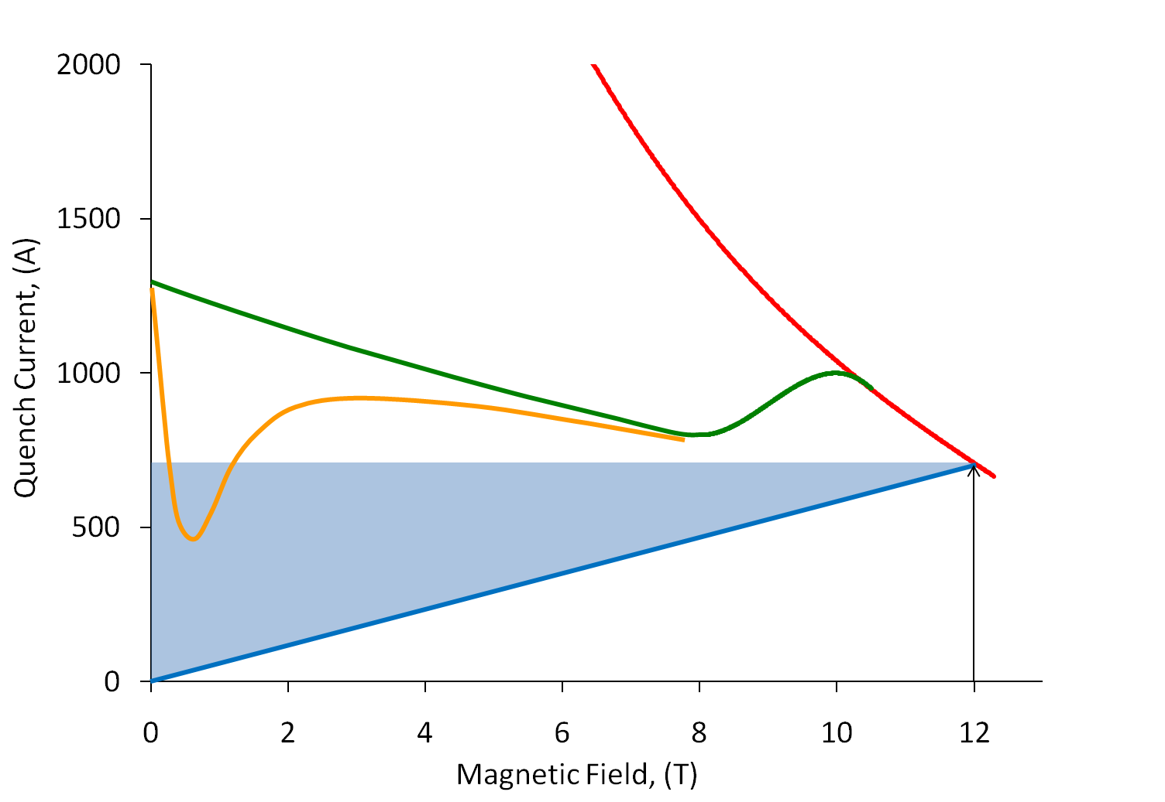
Magneto-Thermal Stability
  At 4.2 K the combination of the Self-Field Instability with the Magnetization Instability at low fields is the most dangerous
SF+M Instability
Critical Current
SF Instability
Magnet
Design Field
Magnet
Load Line
by courtesy of B. Bordini (CERN)

