Slide 1


ESAC Review of the high field dipole design
SMC as preparatory project
January 2011 for EuCARD-WP7-HFM
J.C. Perez on behalf of SMC collaboration team
J.C. Perez

Slide 2
OUTLINE
Aim of the SMC series
SMC description
SMC program
SMC1 tests results
SMC3 status
Future planed activities

Slide 3
Aim of the SMC series
SMC is a tool to learn:
Technologies needed for a Nb3Sn based high field magnet fabrication:
  Cable insulation
  Coil reaction
  Coil impregnation
  Trace fabrication
  Bladder fabrication
Techniques of coil fabrication and magnet assembly
  Winding
  Coil instrumentation and Protection
  Structure instrumentation
  Magnet assembly with bladders and keys
  Nb3Sn – Nb-Ti cable connection
SMC is a tool to qualify:
Nb₃Sn cables in a real magnet configuration
SMC is the “STEP 0” to build a Nb₃Sn accelerator magnet at CERN

Slide 4
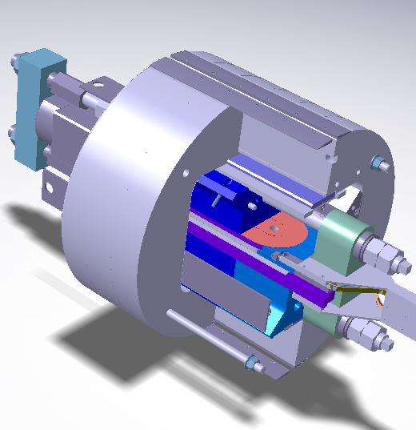
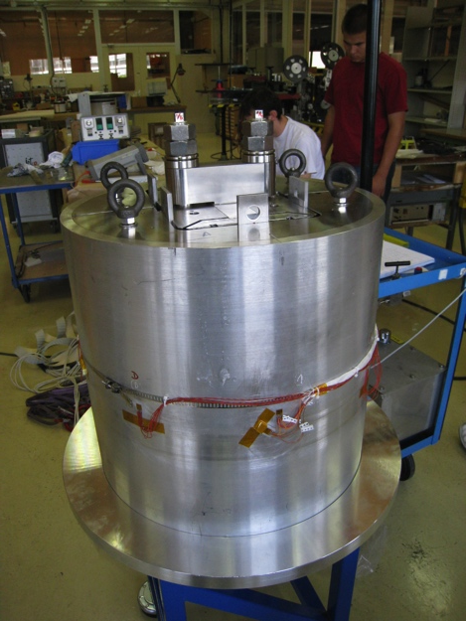
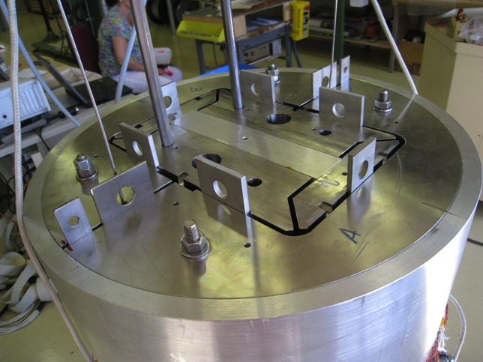
SMC configuration
Longitudinal compressing system for the rods
Vertical key
Iron yoke
Lateral pad
Vertical pad
Longitudinal rods
Racetrack coil
Coil pack and Iron yoke mounted in the instrumented Al2219 T851 shell

Slide 5
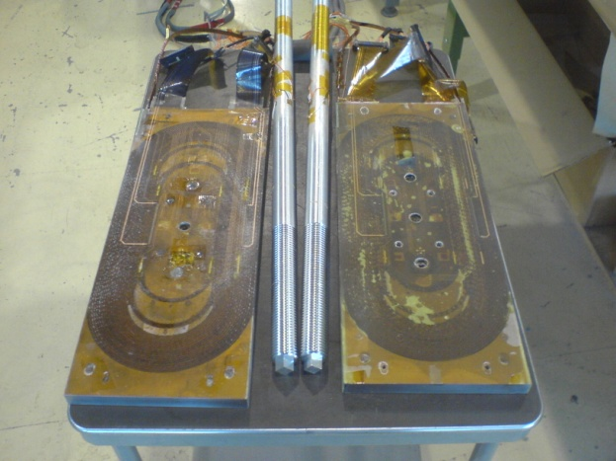
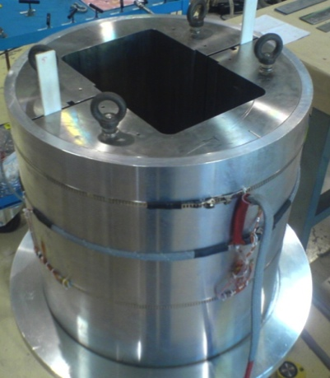
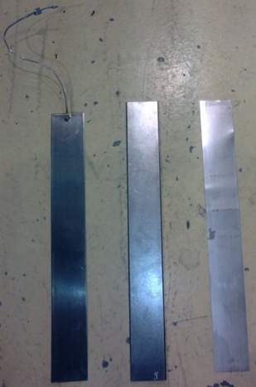
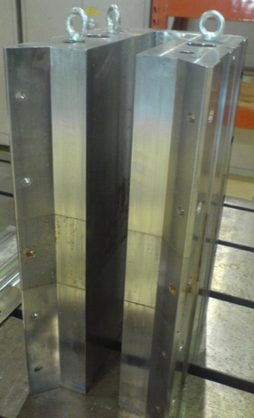
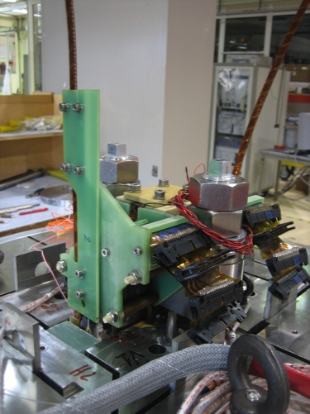
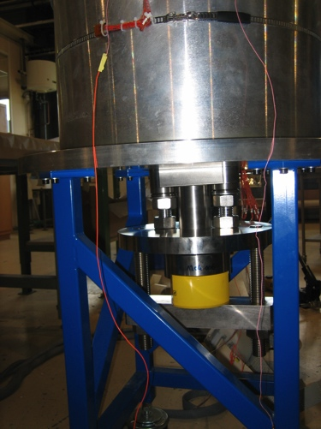
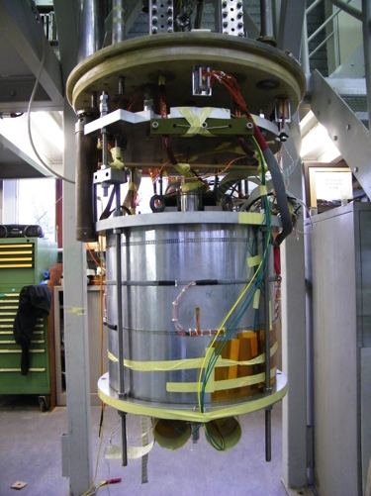
SMC Assembly Parts
Assembly Parts
Coils & Rods
Shell & Yoke
Pads
Bladders
Keys
Shims
Assembly Overview
Connection Side
Non-Connection Side
Ready for cold tests

Slide 6
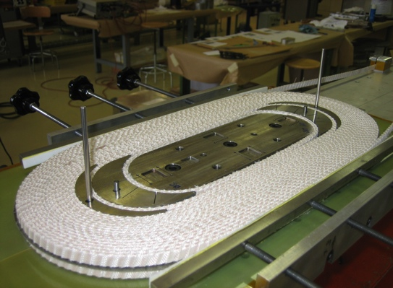
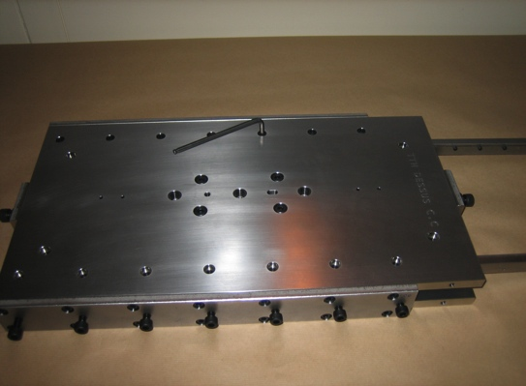
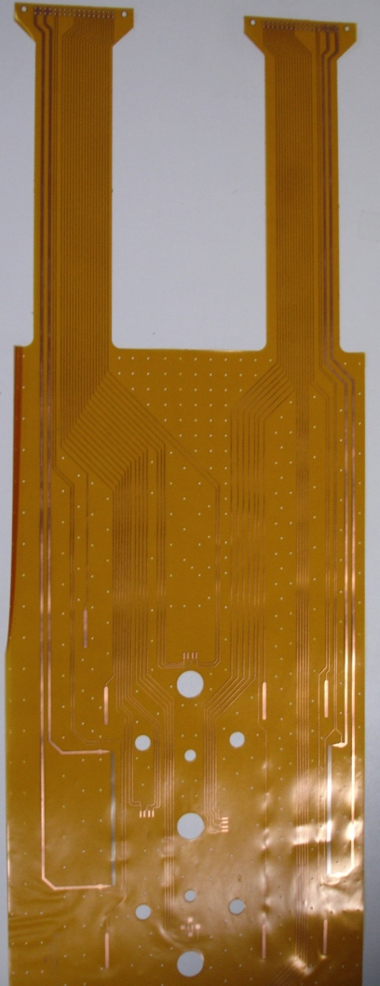
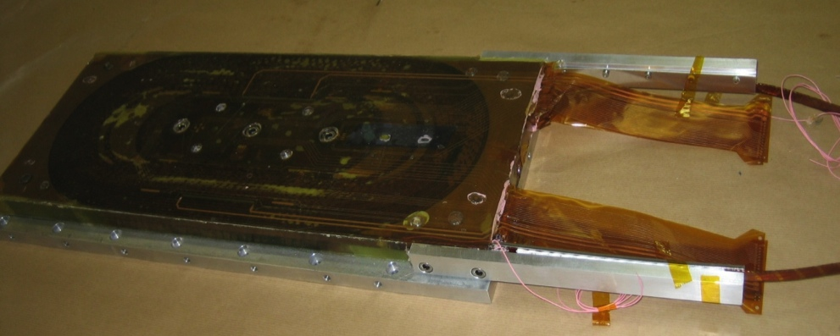
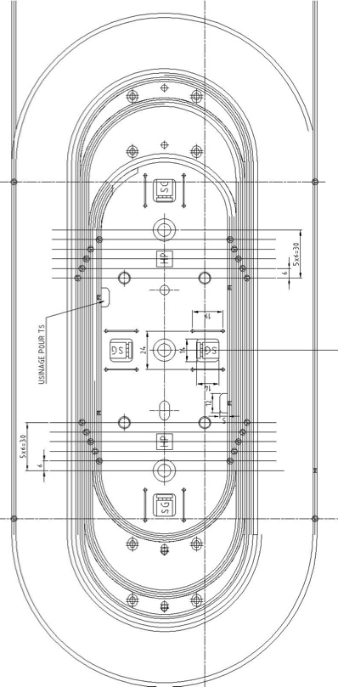
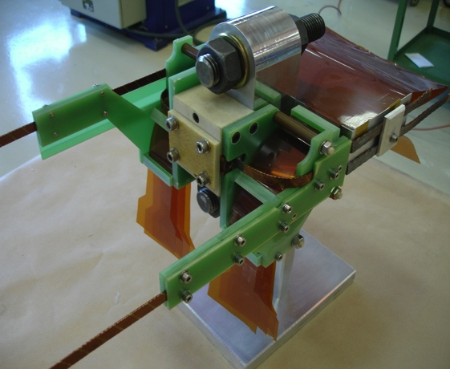
SMC coils
Coil and reaction mould
Instrumented coil
Traces
Interconnection mock-up

Slide 7
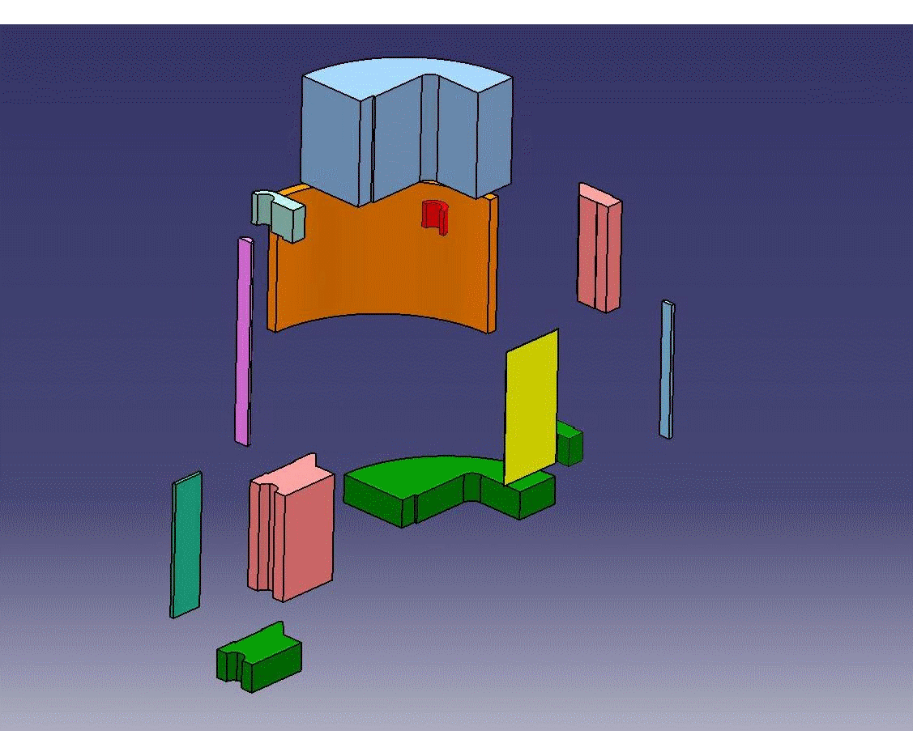
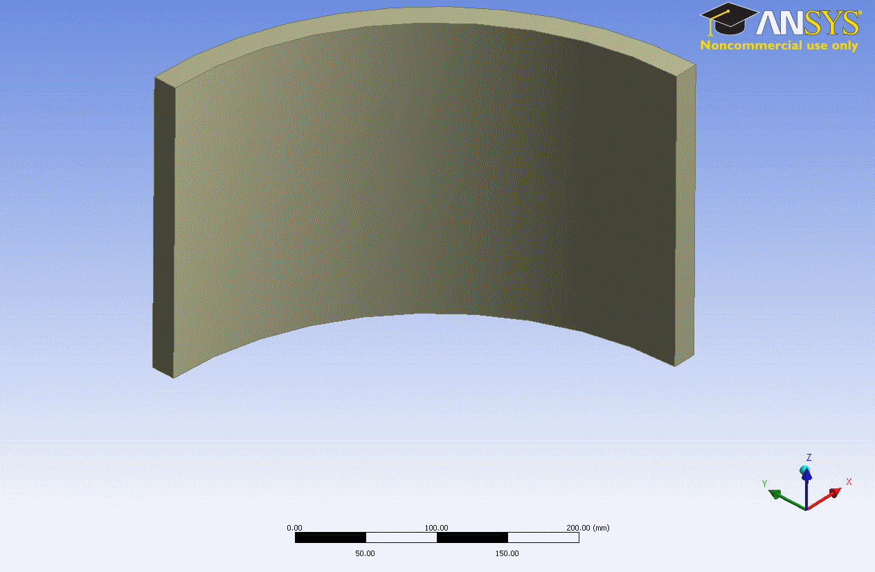
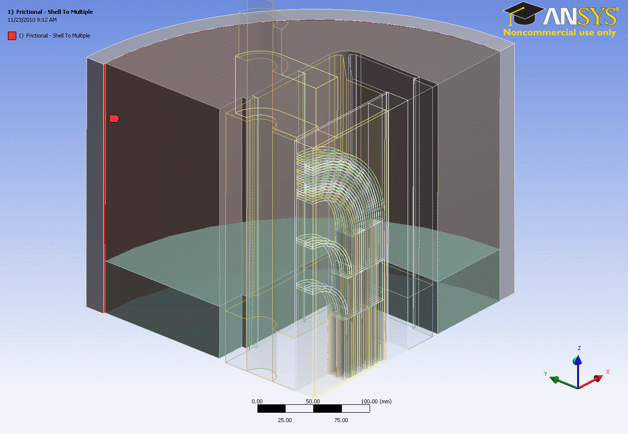
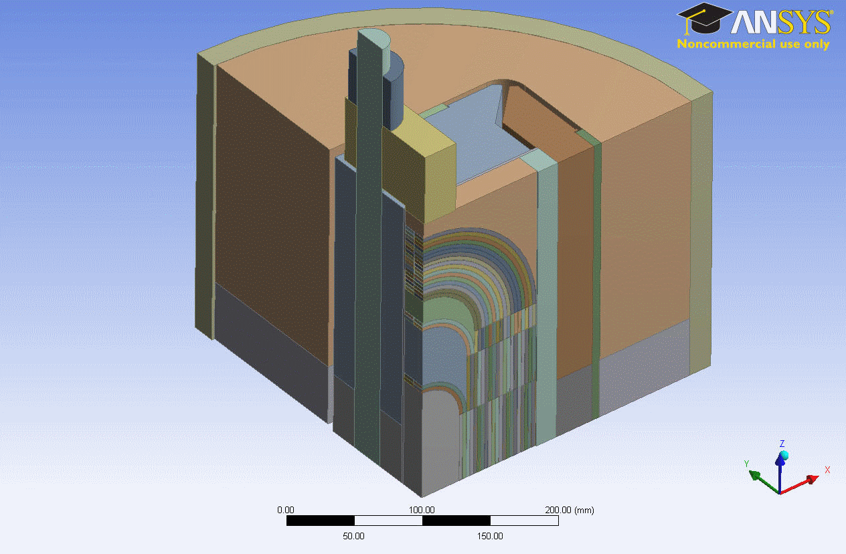
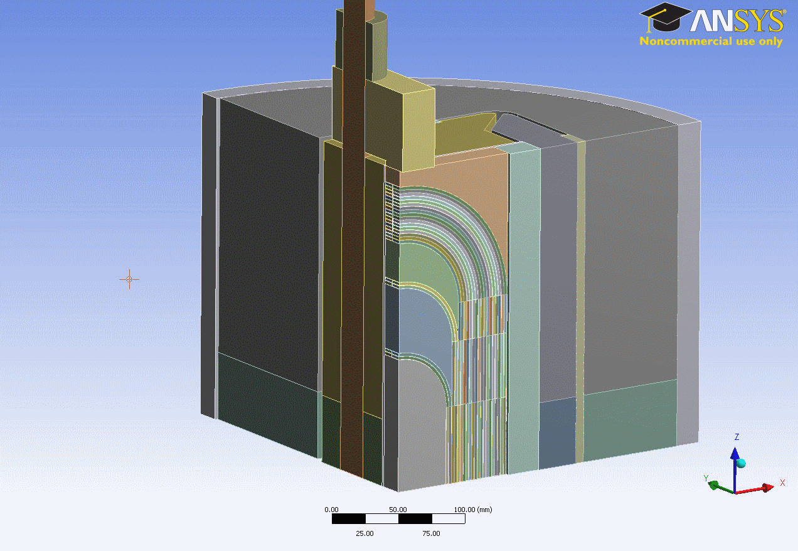
SMC FEM Models
Courtesy of C. Kokkinos
CATIA
ANSYS
Design Modeler
ANSYS Mechanical
Assembly Design
Geometry Design
Contact Regions
ANSYS Workbench
Direct use of parameterized CATIA models
Friendly environment for FEA
Makes use of the new features and capabilities of the latest version of ANSYS
Parametric Coil Block
Meshing Process

Slide 8
SMC Program
SMC | Coils winding | Cable | Insulation | Spacers | Impregnation
1 | RAL & CERN | Alstom IT 14 x ø1.25 mm | Tape JPS ♯416 | Ti Coated | NY 750 & D400
2 | CEA/Saclay | PIT EAS 14 x ø1.25 mm | HILTEX S2-Glass + Ceram. | Ti | Ceramic precursor
3 | CERN | PIT 14 x ø1.25 mm | S2-Glass sleeve FNAL type | Ti | NY 750 & D400
4 | CERN | PIT 18 x ø1.00 mm | TBD | TBD | NY 750 & D400
5 | CERN | PIT 40 x ø1.00 mm | TBD | Ti | NY 750 & D400
6 | RAL & CERN | PIT 40 x ø1.00 mm | Braided S2-Glass Fibre | Ti Coated | Cyanate Esther
Not for prep. Fresca2, outside this review

Slide 9
Coil fabrication for SMC1
2 double pancakes wound @ CERN in collaboration with RAL using “Low performance” cable (14 x Ø1.25 mm Alstom IT with low Jc from NED)
Cables insulated with S2-Glass tape wrapped with 50% overlap
Coils reacted @ RAL in TWO different furnaces and reaction tooling
Coils instrumented and potted @ RAL in collaboration with CERN using TWO different moulds
Coil #1 made in November 2009. Coil #2 made in March 2010
Coil #1 dimensions: 198 mm * 478 mm* 21 mm
Coil #2 dimensions: 193 mm * 480 mm * 21 mm

Slide 10
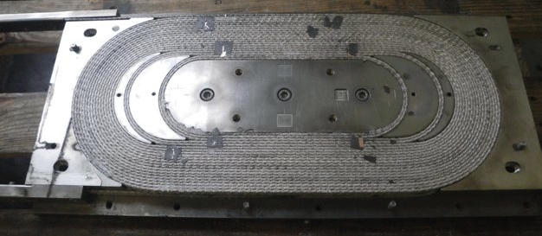
Heat treatment of SMC1 Coils
Only coil#2 has been treated with a strand sample in the furnace
Ic measurements of this sample performed at CERN (Ic= 1403 A @ 10T @ 4.3K)
Ic measurements on an extracted sample of the 14 strand cable
(Ic= 1570 A @ 10T @ 4.3K which corresponds to a Ic_{cable}= 21980 A)
No degradation due to cabling !
Changer photo

Slide 11
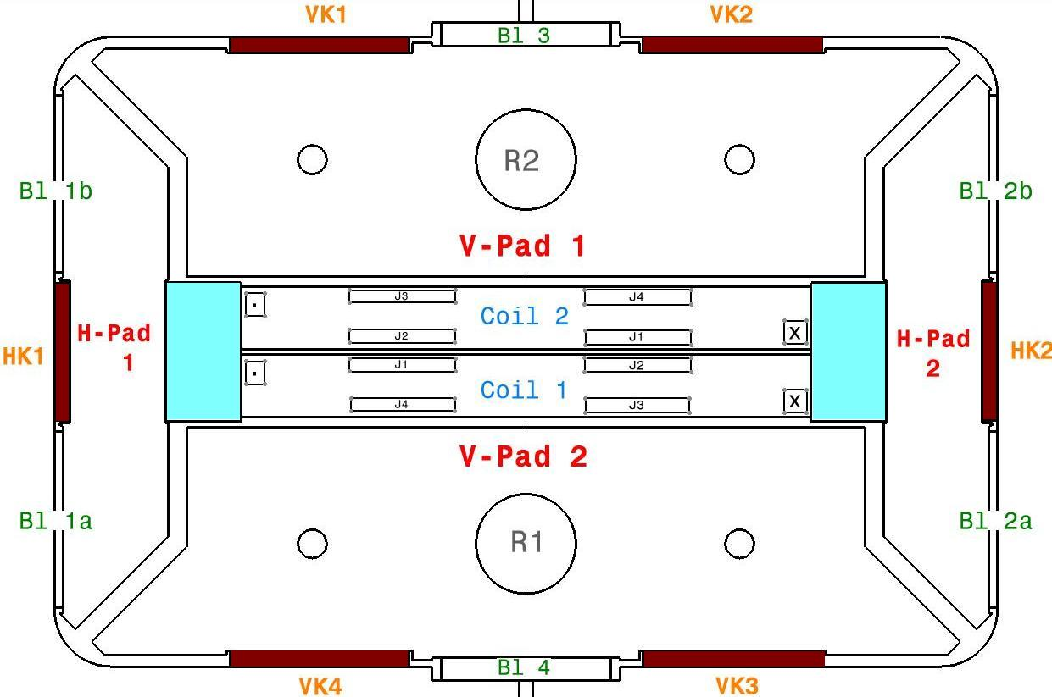
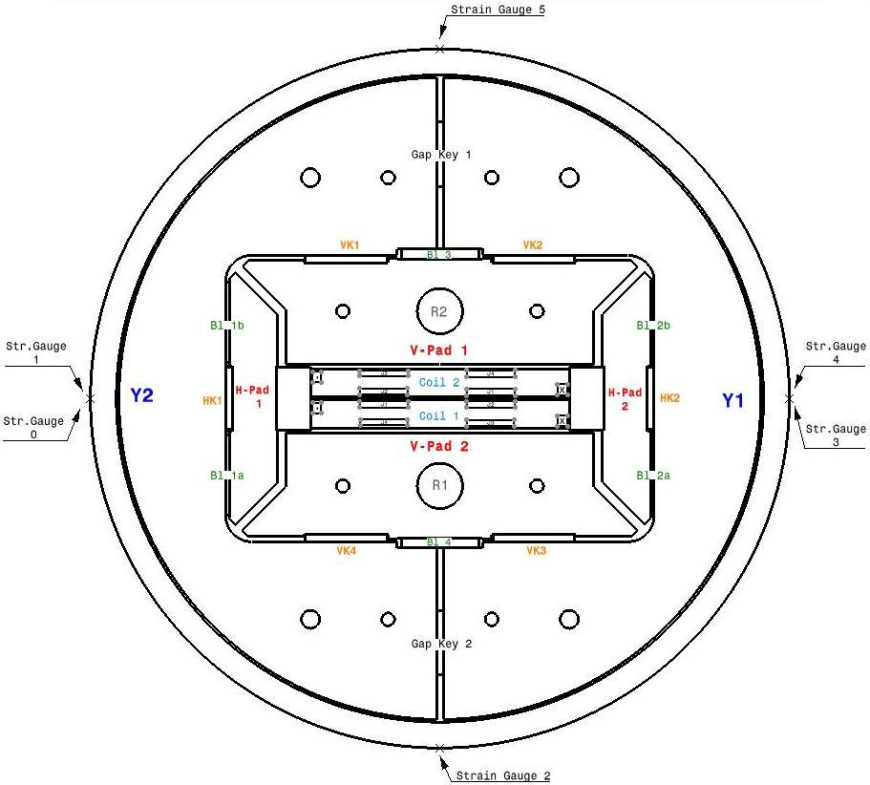
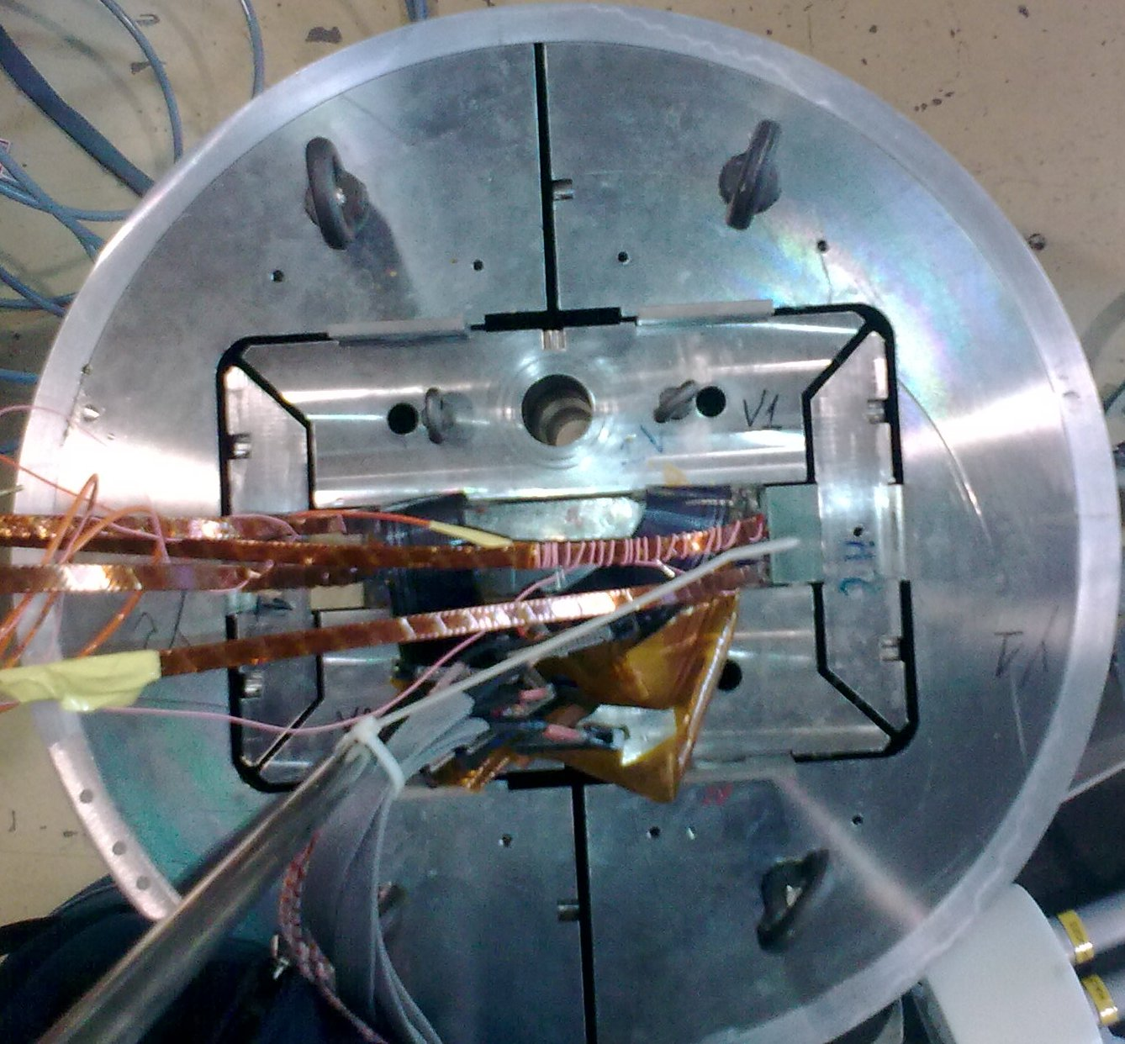
Assembly Configuration
Overview- Assembly Parts
Acronyms Explanation
J | Strain Gauges @ Coil Packs Connectors
V-Pad | Vertical Pad
H-Pad | Horizontal Pad
VK | Vertical Keys
HK | Horizontal Keys
Bl | Bladders
R | Rods
Y | Half Yoke
Gap Keys | Gap Keys @ Yoke
. x | Current Flow Direction

Slide 12
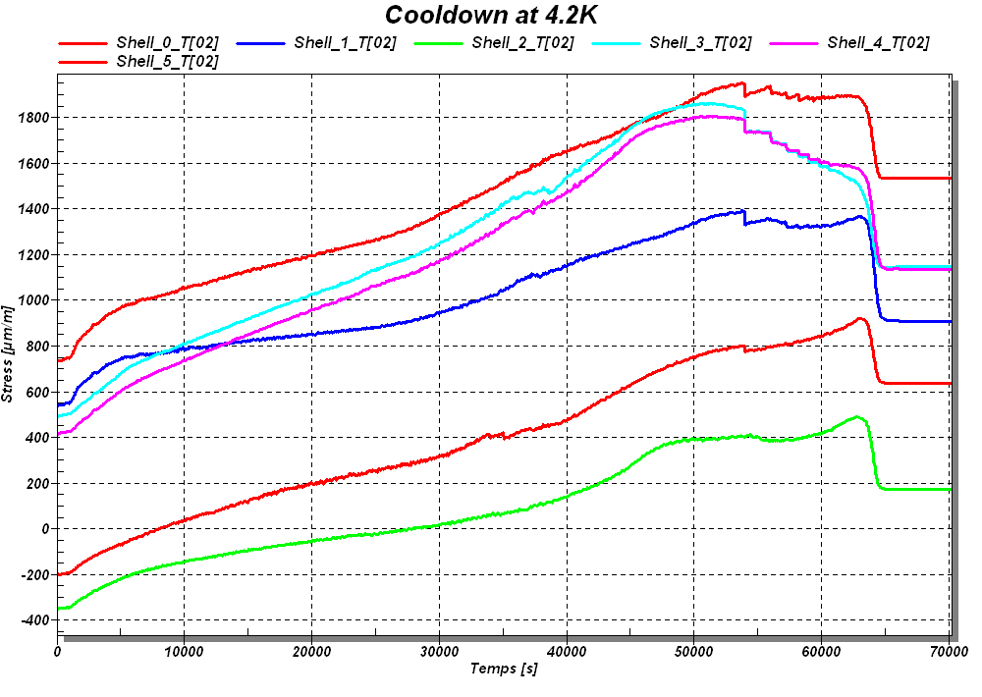
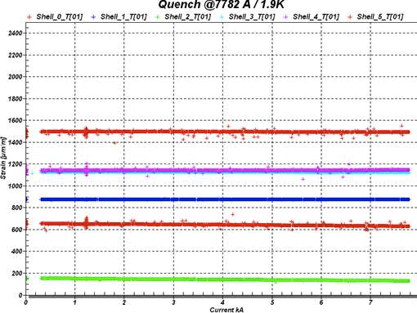
Mechanical measurements during Assembly
& Cold Tests
Pump & Purge procedure to adapt the required pre-stress in the coil by using the LBNL type “Bladders & Keys” technique
An accurate procedure to correlate the strain gauge readings with the FEA

Slide 13
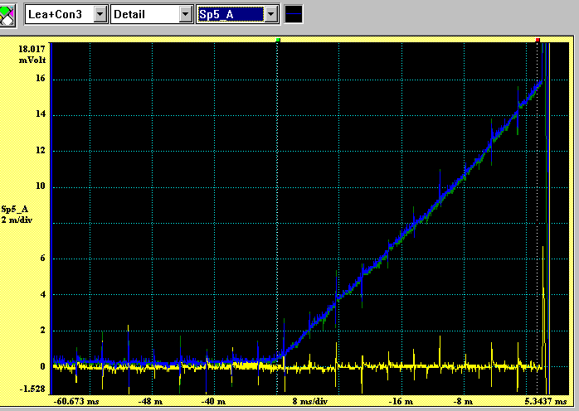
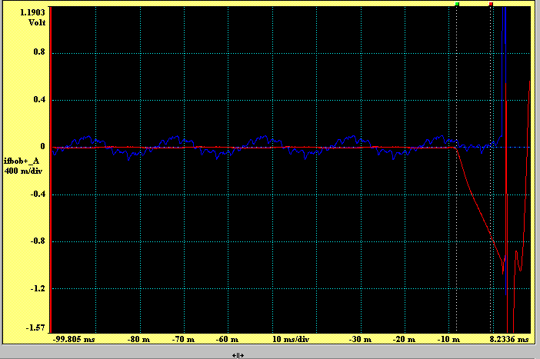
SMC1 Cold Powering Tests
Cold test 1: Limited to 3915 A. Quench detected in one Nb3Sn/Nb-Ti splice on coil #2 : 40 nOhms contact resistance measured
Cold test 2: Single coil powering configuration using coil #1.
Only one quench detected in layer 1 (estimated QPV: 25 m/s)
All other quenches detected in layer 2 and never in the splice area
Quench in the splice
Quench in coil #1

Slide 14
SMC1 Training Summary
Possible causes for lower than expected performance of the magnet are under investigation

Slide 15
Lessons from SMC1
The splice zone between Nb3Sn and Nb-Ti cable has been identified as a possible high pre-stress area in the cable during heat treatment and magnet operation. The end saddle geometry and insulating pieces has been modified to prevent this phenomenon on SMC3
The heat treatment mould has been modified to guaranty the parallelism of the sides pushing bars and to better control the cavity dimension during reaction operation. Similar modifications of the impregnation mould have been made
The layer jump at the central post extremity is a weak point of the present coil geometry (jump to be made on straight section on longer coils)
Electrical insulation of the central island, particularly on the layer jump area has to be improved as well as for the end- spacers

Slide 16
Coil Fabrication at CERN for SMC3 (1/2)
2 coils for SMC3 with PIT 14 x Ø1.25 mm strand with Ti islands and spacers wound in November
Cable insulated with S2-Glass sleeve (FNAL type)
Electrical insulation of the central island on the layer jump area with ceramic 989F
Heat treatment in a vacuum furnace @ CERN
Coils instrumentation underway
Coils will be potted Q1_2011 using Epoxy NY 750 & Jeffamine D-400
Magnet assembly scheduled for the end of Q1_2011
Cold powering tests scheduled Q2_2011 (Moving of Block4 to SM18)

Slide 17
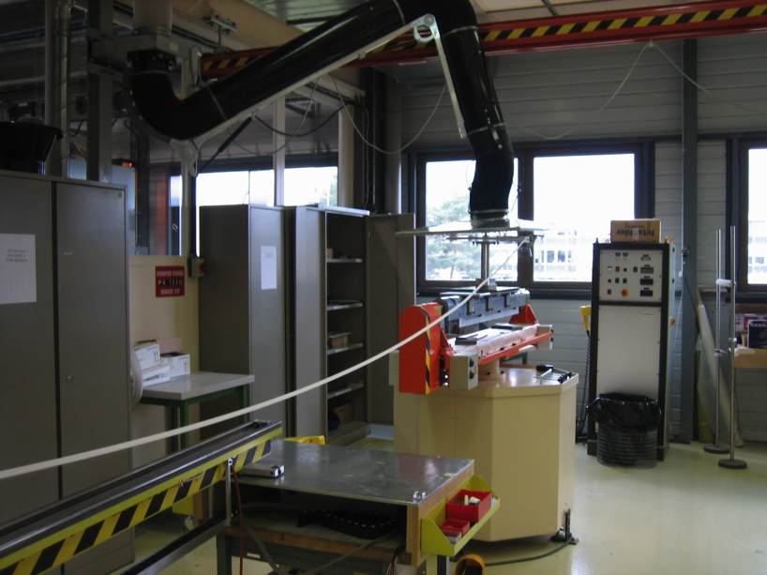
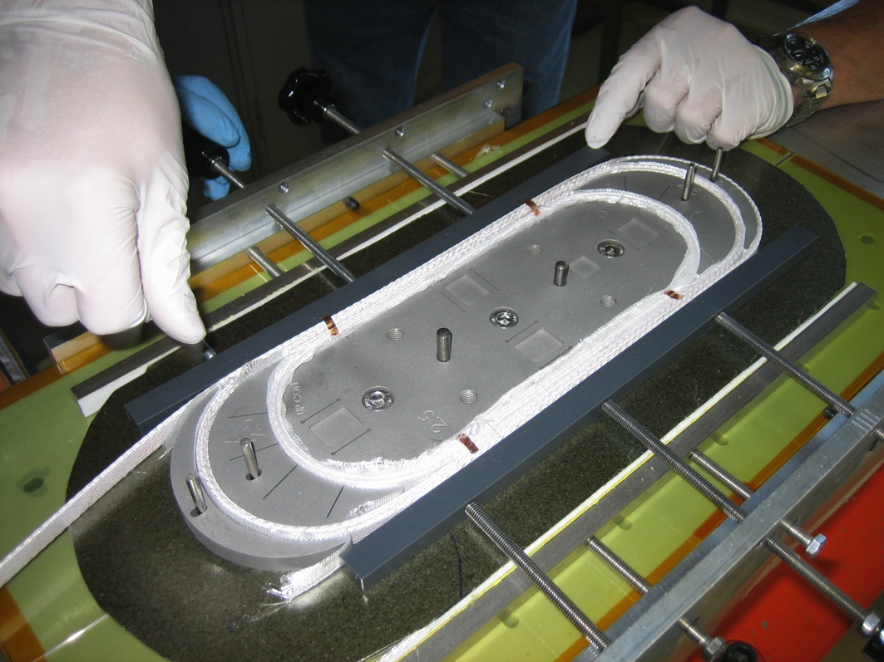
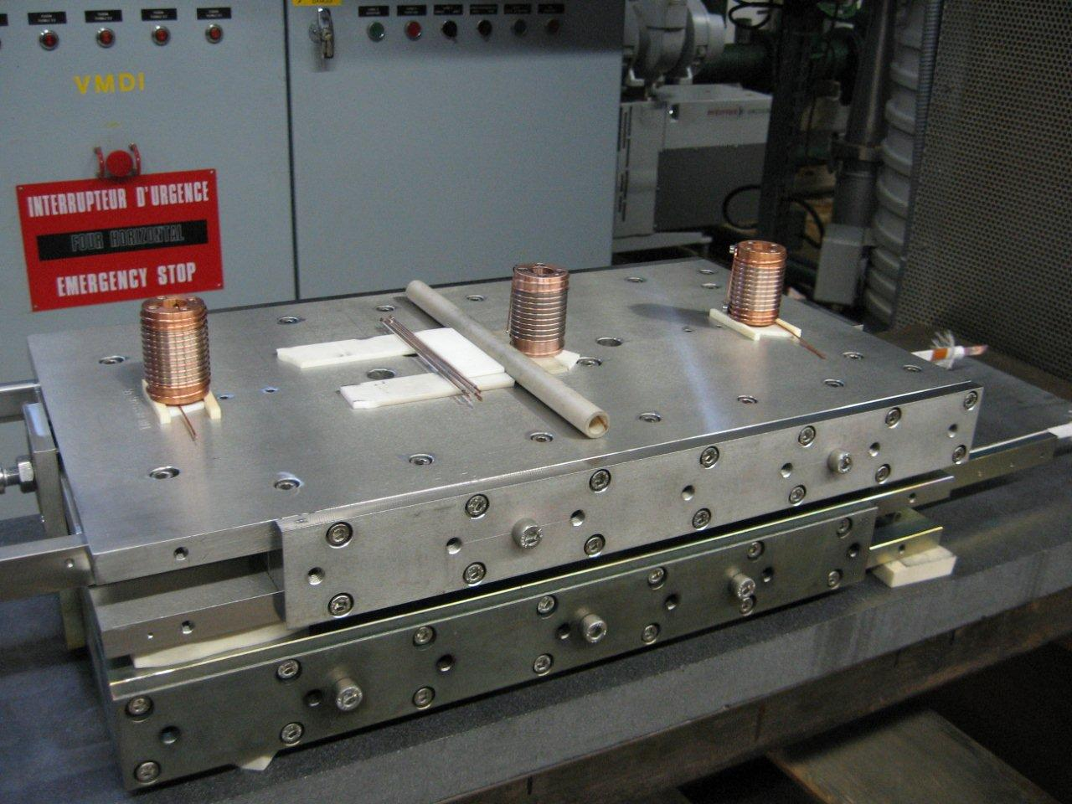
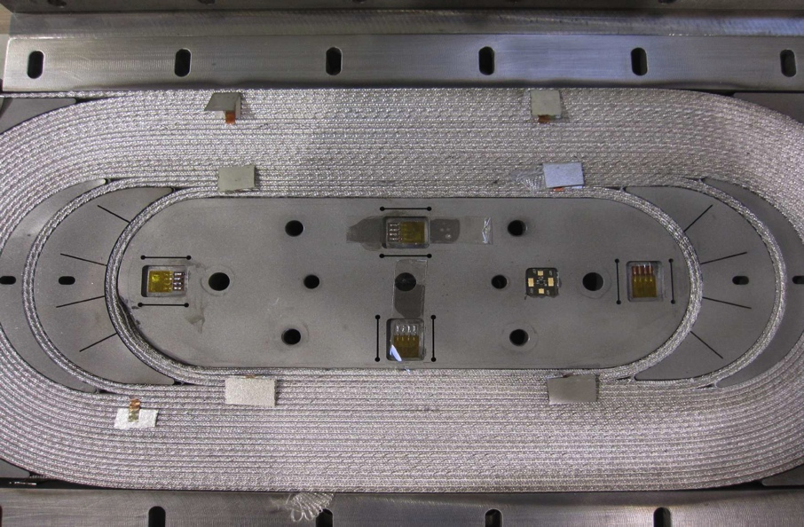
Coil Fabrication at CERN for SMC3 (2/2)
Winding machine
Winding operation
Coil ready for reaction
Instrumented coil

Slide 18
Future Activities
Coil fabrication
2 coils for SMC3 with PIT 14 x Ø1.25 mm strand to be completed at CERN (January 2011)
2 coils for SMC4 with PIT 18 x Ø1.0 mm strand to be wound at CERN (Q1_2011)
2 coils for SMC5 with PIT 40 x Ø1.0 mm strand (FRESCA2- type cable) to be wound at CERN (Q2_2011)
2 coils for SMC6 with PIT 40 x Ø1.0 mm strand (FRESCA2-type cable) to be wound in collaboration CERN/RAL (using coated islands, braided glass fibre, Cyanate Esther, Q2_2011)

Slide 19
Future Activities
Magnet assembly
SMC3 equipped with coils SMC3_C#_PIT_14/1.25 to be assembled and cold tested at CERN (Q2_2011)
SMC4 equipped with coils SMC4_C#_PIT_18/1 to be assembled and cold tested at CERN (Q3_2011)
SMC5 equipped with coil SMC5_C#_PIT_40/1.0 to be assembled and cold tested at CERN (Q3_2011)
SMC6 equipped with coil SMC6_R#_PIT_40/1.0 to be assembled and cold tested at CERN (Q4_2011)

Slide 20
Future Activities
Technology improvement
Electrical insulation method for central islands and end spacers to be investigated (collaboration agreement with RAL)
Cable insulation to be improved: S2-Glass tape, braided glass fibre, S2 Glass sleeve... (CERN, RAL, CEA)
Cyanate Esther impregnation to be tried (collaboration agreement with RAL)
Coil fabrication using “FNAL-LARP type” ceramic binder to be tried
FRESCA2-type coil using final cable, insulation and impregnation method to be used for the Fresca2 magnet to be built
Thanks for your attention

