Slide 1
EuCARD-WP7-HFM
Dipole Conceptual Review
Nb₃Sn dipole protection
Philippe FAZILLEAU
CEA/iRFU/SACM
January 20, 2011 @ SACLAY

Slide 2
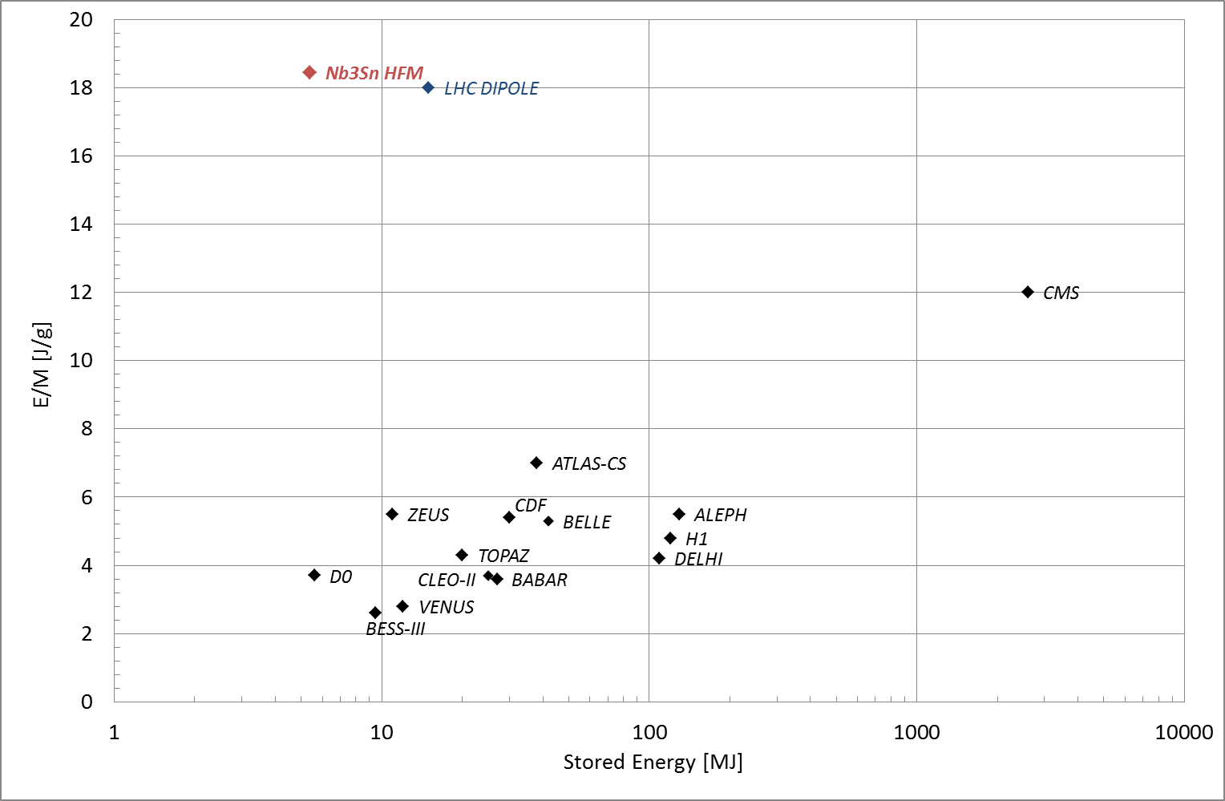
Introduction
Cold mass 293 kg and Energy 5.4 MJ
i.e. energy density 18.4 J/g

Slide 3
Introduction
Uniform dissipation
All magnet [118 MJ/m³] → T_{mean} = 126 K
  1 pole → T_{mean} = 182 K
  ¹/₂ pole → T_{mean} = 276 K
J(T) : overall current density,
T : time,
ρ(θ) : overall resistivity,
γ : density, θ : temperature,
C(θ) = specific heat.
Adiabatic hot spot criteria
V_{max} = 1000 V, I = 10,5 kA → R_{dump} = 95 mΩ
→ θ_{max} = 228 K
importance of the detection

Slide 4
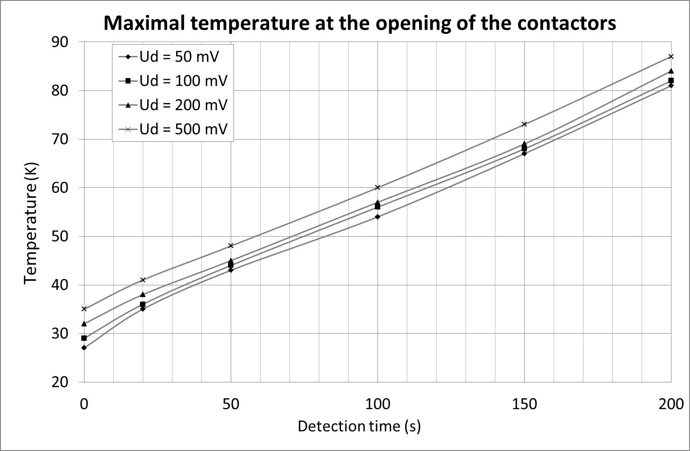
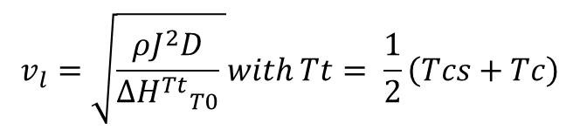
Detection
The quench propagation and detection depends mainly on:
$$v_{l}=\sqrt{\frac{ρJ^{2}D}{∆{H^{Tt}}_{T0}^{}} }with Tt= \frac{1}{2}\left(Tcs+Tc\right)$$
The propagation velocities
But for Nb₃Sn @ (13.2 T, 4.2 K) Tcs= 8 K Tc = 11,96 K [Summers]
→ Tt = 9,98 K so v_{l} = 10,8 m/s
Tt = Tcs v_{l} = 19,4 m/s
Tt = Tc v_{l} = 6,7 m/s (conservative case)
The detection thresholds; voltage and time thresholds :
U_{d} = 100 mV
t_{d} = 100 ms

Slide 5
Calculations : QTRANSIT code
home made code (fortran),
checked on several magnet (CMS, ALEPH, ATLAS, QPOLES…),
3D simulation of the quench thermal transient in the magnet,
based on the quench propagation velocities and the resistance growth with time,
material property dependences on temperature, magnetic field and RRR,
Computes voltages, temperatures and resistance rise in the winding,
Includes quench heaters.
longitudinal
propagation
transverse
propagation

Slide 6
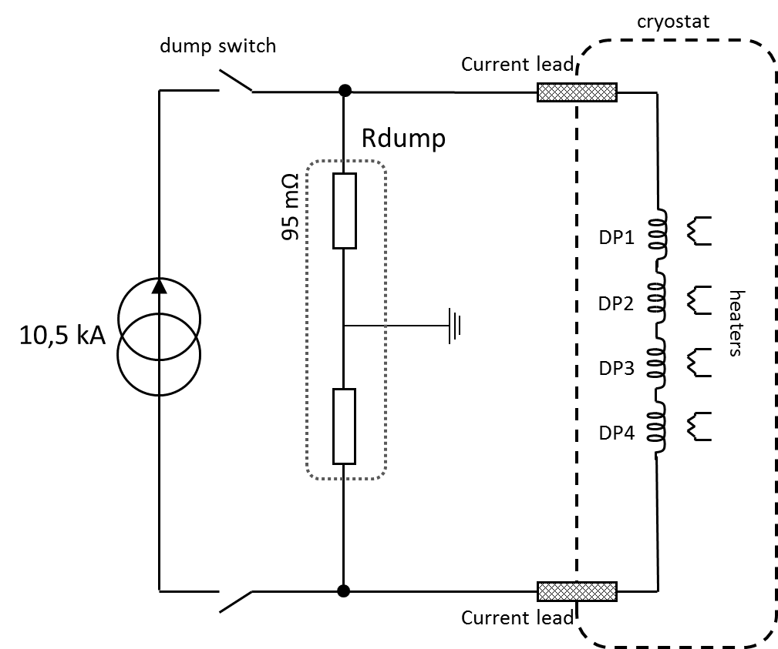
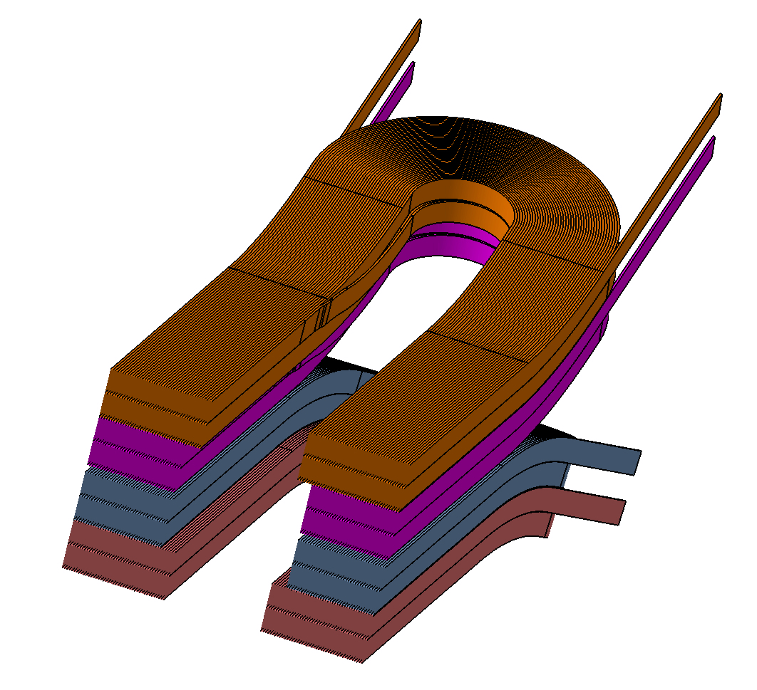
Electrical protection circuit
protection principle based on the extraction of the magnetic stored energy into a dump resistor,
takes benefit of quench heaters (if needed),
grounding circuit ± V_{max}/2 to ground,
Inductances computed with ROXIE.
DP1
DP2
DP4
DP3

Slide 7
Computation hypothesis
Do we need heaters ?
①
heaters location
quench
ignition
or
②
or
③

Slide 8
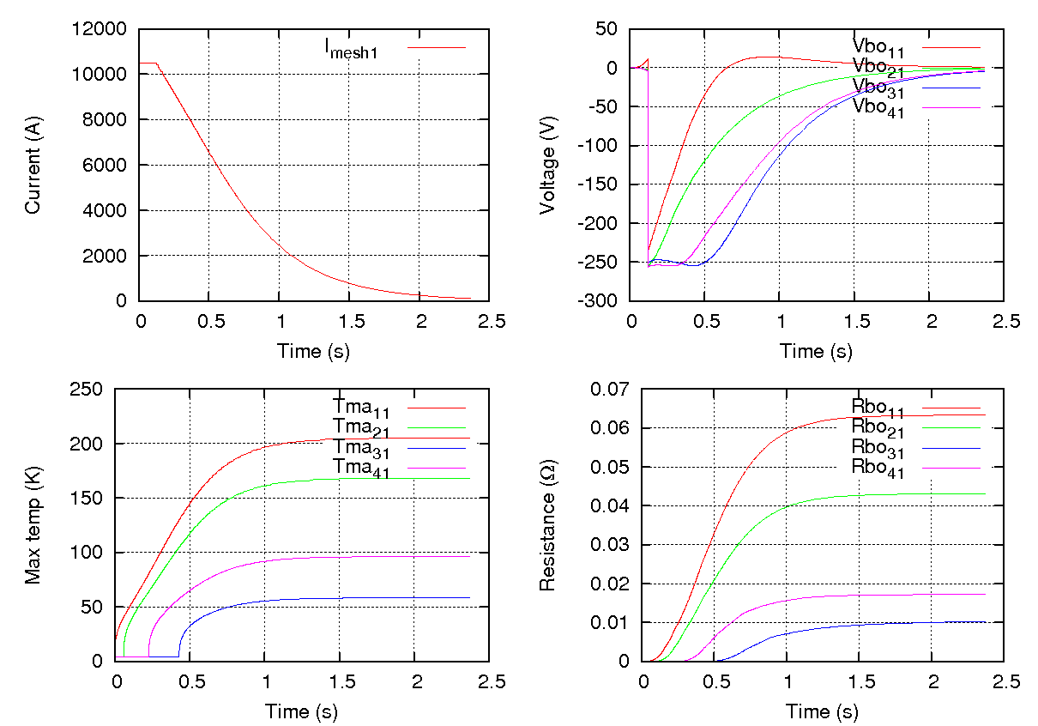

Nominal case – no heaters
The worst case (T_{max} and V_{max}) occurs for a quench ignition in a corner of DP1,
The contactors open 100 ms after the detection (Ud > 100 mV),
t = 0 s
t = 24 ms
t = 59 ms
t = 124 ms
t = 221 ms
t = 415 ms
t = 2,37 s
t = 424 ms
t = 429 ms
t = 711 ms
DP1
DP2
DP3
DP4
A quench starts to
expand in DP1
Switches open
DP4 starts to quench
V_{resistive} > U_{d}
Detection of the quench
End of the discharge
DP2 starts to quench
DP3 starts to quench

Slide 9
Nominal case – no heaters
The high temperature gradient within the magnet could induce mechanical issues
⇒ Heaters could solve it by spreading the quench more uniformely.

Slide 10
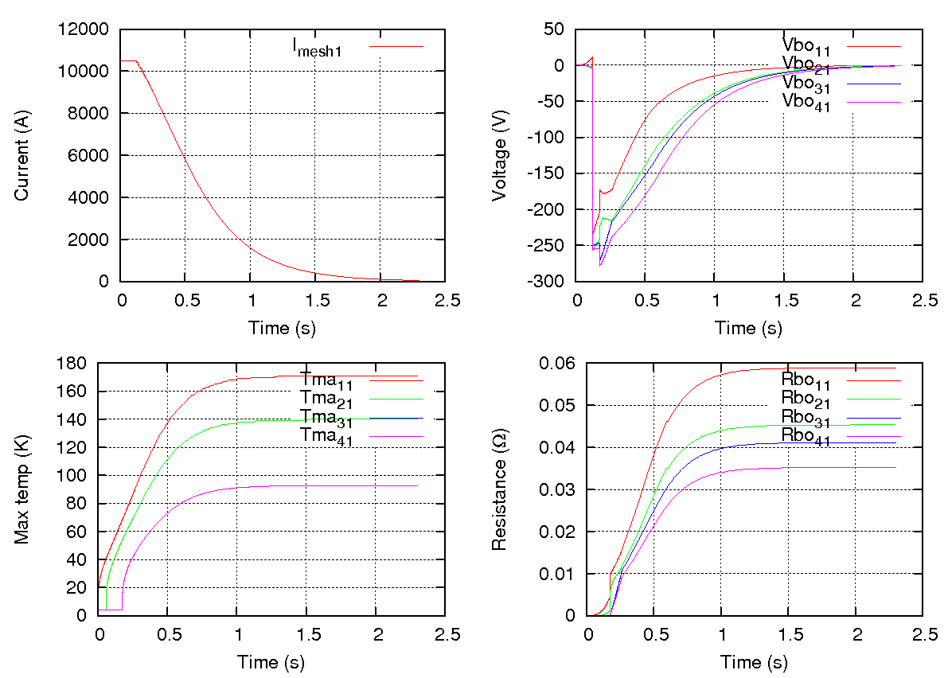
Nominal case – with heaters
The worst case (T_{max} and V_{max}) occurs for a quench ignition in a corner of DP1,
The contactors open 100 ms after the detection (Ud > 100 mV),
The heaters are effective 50 ms after this time (150 ms after the detection).
t = 24 ms
t = 59 ms
t = 124 ms
t = 174 ms
t = 0 s
t = 200 ms
t = 265 ms
t = 1,97 s
DP1
DP2
DP3
DP4
A quench starts to
expand in DP1
Switches open
Heaters effective
V_{resistive} > U_{d}
Detection of the quench
End of the discharge
DP2 starts to quench

Slide 11
Nominal case – with heaters
Heaters have strongly decrease the temperature gradient (factor 2),
they slightly increase the voltage at the terminals of 2 double-pancakes.

Slide 12
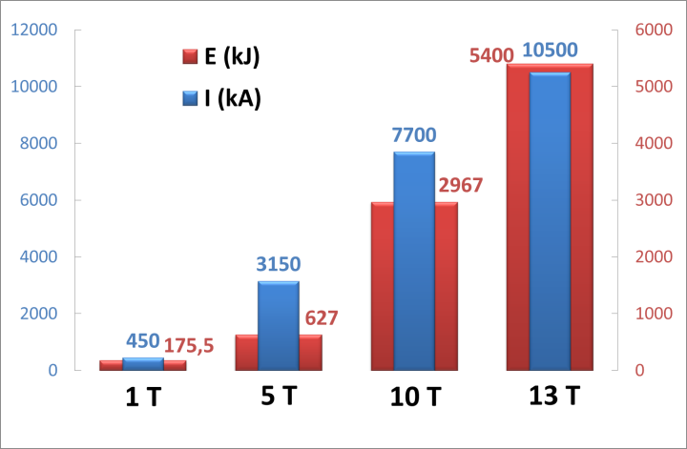
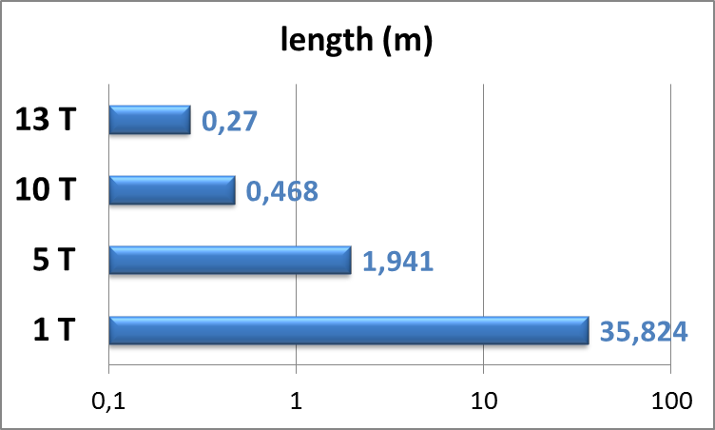
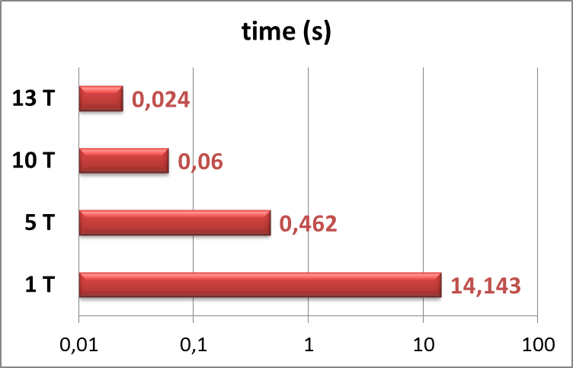
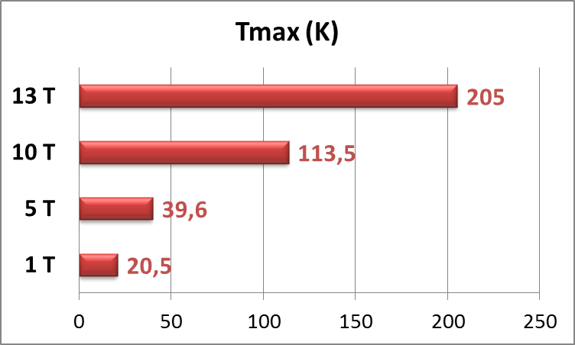
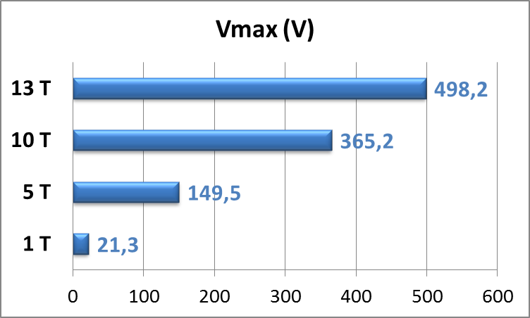
Quench behaviour – 1 T, 5 T, 10 T, 13 T
Detection
Threshold voltage U_{d} = 100 mV
A quench starts in a corner of DP1
Time to reach the threshold
Length of the quenched zone
Discharge results
Time threshold t_{d} = 100 ms, R_{dump} = 95 mΩ, No heaters

Slide 13
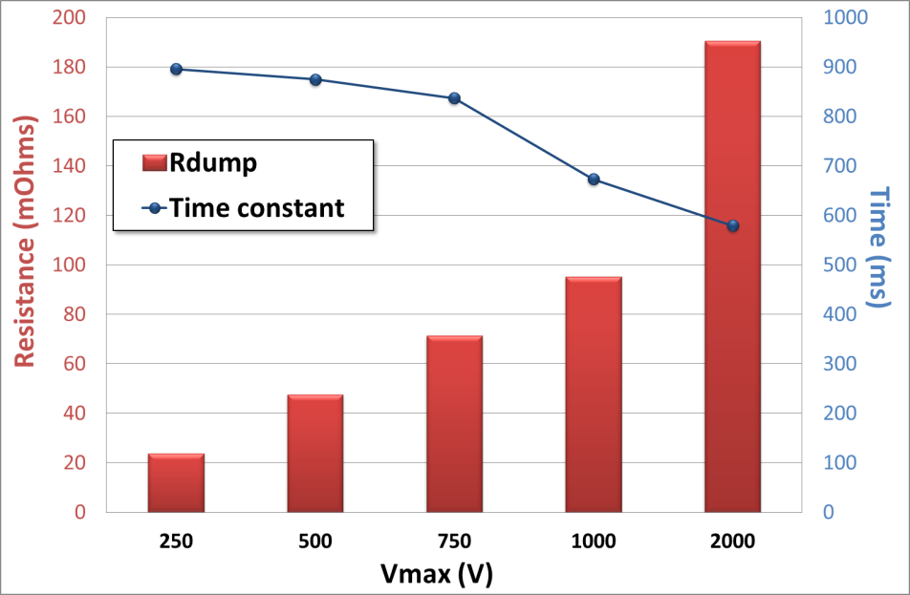
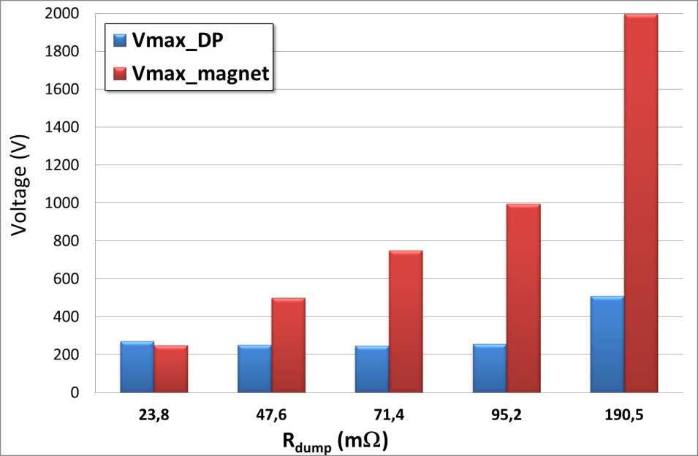
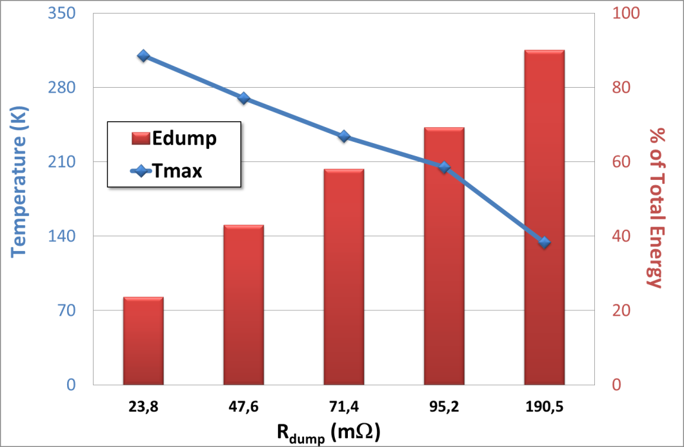
Dump resistor parametric study

Slide 14
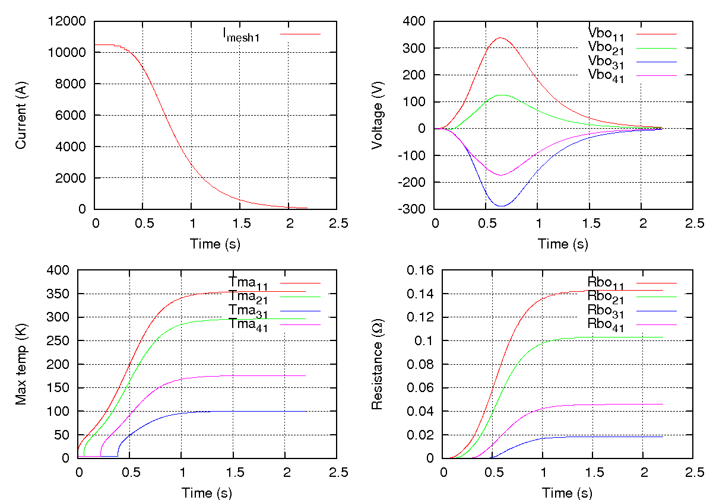
Fault scenario
A quench is fired in a corner of DP1,
No detection:
→ no dump into the external resistor
→ no heaters
t = 0 s
t = 59 ms
t = 221 ms
t = 378 ms
t = 388 ms
t = 2,2 s
t = 384 ms
t = 568 ms
t = 0,981 s
DP1
DP2
DP3
DP4
A quench starts to
expand in DP1
DP4 starts to quench
DP2 starts to quench
DP3 starts to quench
End of the discharge

Slide 15
Fault scenario

Slide 16
Conclusion
The ratio E/M of the dipole is high but manageable with a good detection system,
A study of the detection lead to thresholds values of 100 mV and 100 ms,
The use of heaters is not necessary as T_{max} < 250 K, V_{max} < 500 V; but the high temperature gradient within a coil could induce mechanical issues,
Heaters lower the temperature gradient, the maximal temperature and slightly increase the maximal voltage at the terminals of the double-pancakes,
The study of the protection at different currents does not show any issues; a thermal study will be led for the use of heaters and the ignition of the quench at the lowest current values.
The fault scenario shows that the magnet will not burn-out even if it will experiment high temperatures (up to 354 K) and high temperature gradient (251 K).
The presence of the HTS insert and its implications on the protection will be studied.

