Slide 1


Nanomaps Chip
Enrique Lópezª , Jose María Hinojoª , Fernando Márquezª , Clara I. Lujánª , Jorge Jiménezª , Luis Callejónª , Fernando Muñozª , Francisco Rogelio Palomo ª
fpalomo@us.es,
ª Electronic Engineering Department of School for Engineering in University of Seville, Spain
September 1st 2022 https://indico.cern.ch/event/1196255/

Slide 2

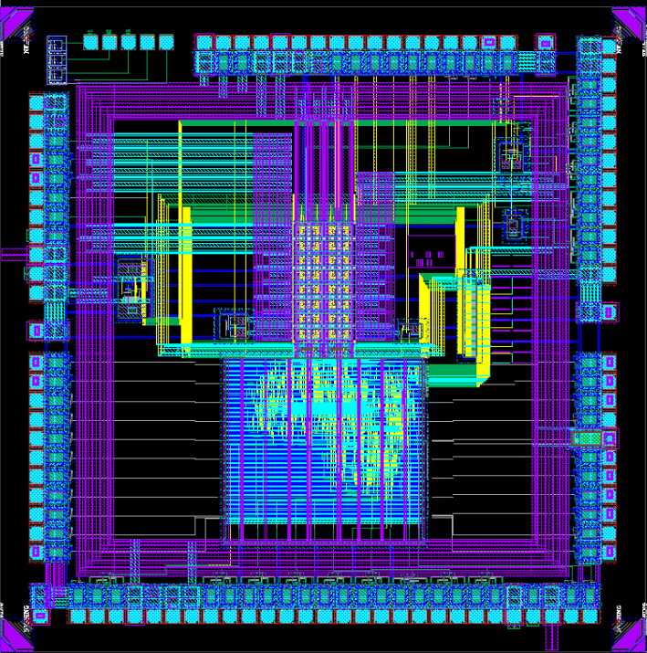
General Description
NANOMAPS is a test chip designed by the GIE
(Group of Electronic Engineering) at School of Engineering,
Sevilla, just sent to LFoundry for manufacturing.
It is derived from the MPW3 chip design to test new pixel
analog backend designs.
The new analog backend design is TDC (Time to Digital
Converter) to reduce the Time Walk error by measuring the
Leading Edge/Trailing Edge instants (Time Over Threshold)
The TDC implements VCDLs (Voltage Controlled Delay
Line). To reduce pixel area and routing, the TDC is distributed: inside each pixel we find a VCDL, outside it is Digital Delay Lines that set the voltage control of each double column.
The DLL input is connected to COMPOUT, not to CLK so
the VCDL switch only two times per bit, one at LE and the next at TE in order to reduce power consumption
Objective: a 2 ns time resolution. Time Stamp at 80 MHz,
TSCLK segmented in 6 slots (5 delay cells for DLL)

Slide 3
General Description
NANOMAPS test chip has 12 mm². Several cells, such as
Biasing block, Analog Buffer, most of the pixel circuitry and
PADs are reused from MPW3 design.
Detectors
8x4 PIXEL matrix: similar to the MPW3 pixel design but
with a 75x75 μm2 area to get room for the new electronics and digital routing. 2 double columns with 8 rows each one. Each double column has an independent DLL, with two flavours: DLL v1 locks in the CLK rising edge, DLL v2 locks in both rising and falling edges.
Pixel Matrix
PFD +
DLL v2
test block
A Redesigned digital block. Similar to the MPW3 relative
to slow control, monitoring, configuration and matrix data collection. New serialization and data transmision from each End Of Column FIFO to output: 5 serial-parallel registers at 80 MHz (there is no 640 MHz clock).
DLL
monitoring
buffer
Test vehicles:
  3 75x75 mm2 detector diodes
  One Phase Frequency Detector chain
  One DLL v2
Digital
Electronics

Slide 4
Needs
Detectors
Nanomaps is a design derived from the MPW3 effort. To get the maximum compatibility we would like to adapt the MPW3 HDL control logic and also the MPW3 PCB designs
Pixel Matrix
PFD +
DLL v2
test block
DLL
monitoring
buffer
Digital
Electronics

Slide 5
Thanks for your attention
fpalomo@us.es

