Slide 1


sPHENIX:
Status and Plans
Anders Knospe
Lehigh University
on behalf of the sPHENIX Collaboration
February 10, 2023

Slide 2
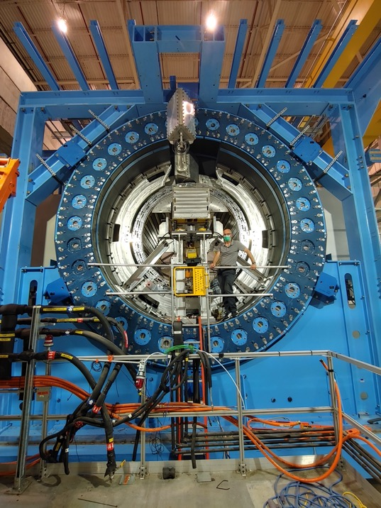
sPHENIX
Radical upgrade of PHENIX detector being installed at RHIC
  Has purpose-built capabilities not seen previously at RHIC
Key requirement for completion of RHIC’s scientific mission
  Highest priority for runs 2023–2025
RHIC & LHC are complementary: different initial conditions & QGP evolution → study scale and temp. dependence

Slide 3
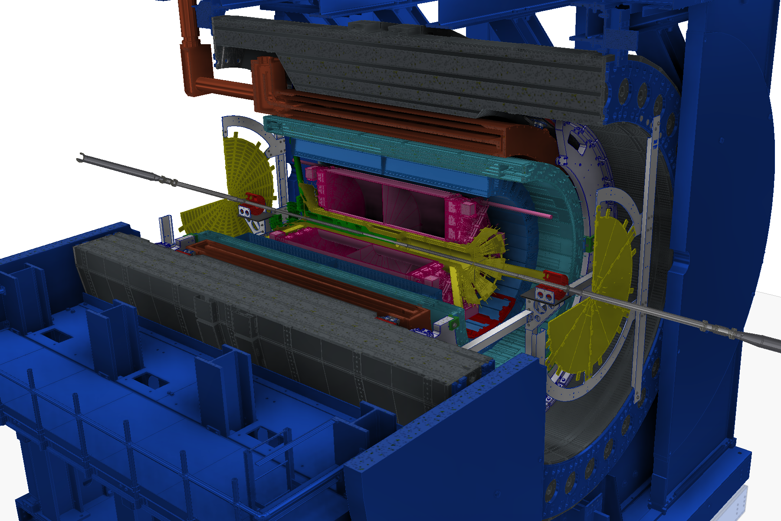
sPHENIX Detector

Slide 4
sPHENIX Detector
MAGNET
• Barrel Detectors: |η | < 1.1

Slide 5
sPHENIX Detector
MVTX
MAGNET
INTT
• Barrel Detectors: |η | < 1.1
• Precision Tracking
TPC
TPOT

Slide 6
sPHENIX Detector
oHCAL
MVTX
MAGNET
INTT
iHCAL
EMCAL
• Barrel Detectors: |η | < 1.1
• Precision Tracking
• Large-Acceptance Calorimeters
TPC
TPOT

Slide 7
sPHENIX Detector
oHCAL
MVTX
MAGNET
INTT
iHCAL
EMCAL
sEPD
• Barrel Detectors: |η | < 1.1
• Precision Tracking
• Large-Acceptance Calorimeters
MinBIAS
TPC
TPOT

Slide 8
sPHENIX Detector
oHCAL
MVTX
MAGNET
INTT
iHCAL
EMCAL
sEPD
• Barrel Detectors: |η | < 1.1
• Precision Tracking
• Large-Acceptance Calorimeters
• High-Rate DAQ:
15 kHz
Trigger Capability
Streaming Readout
MinBIAS
TPC
TPOT

Slide 9
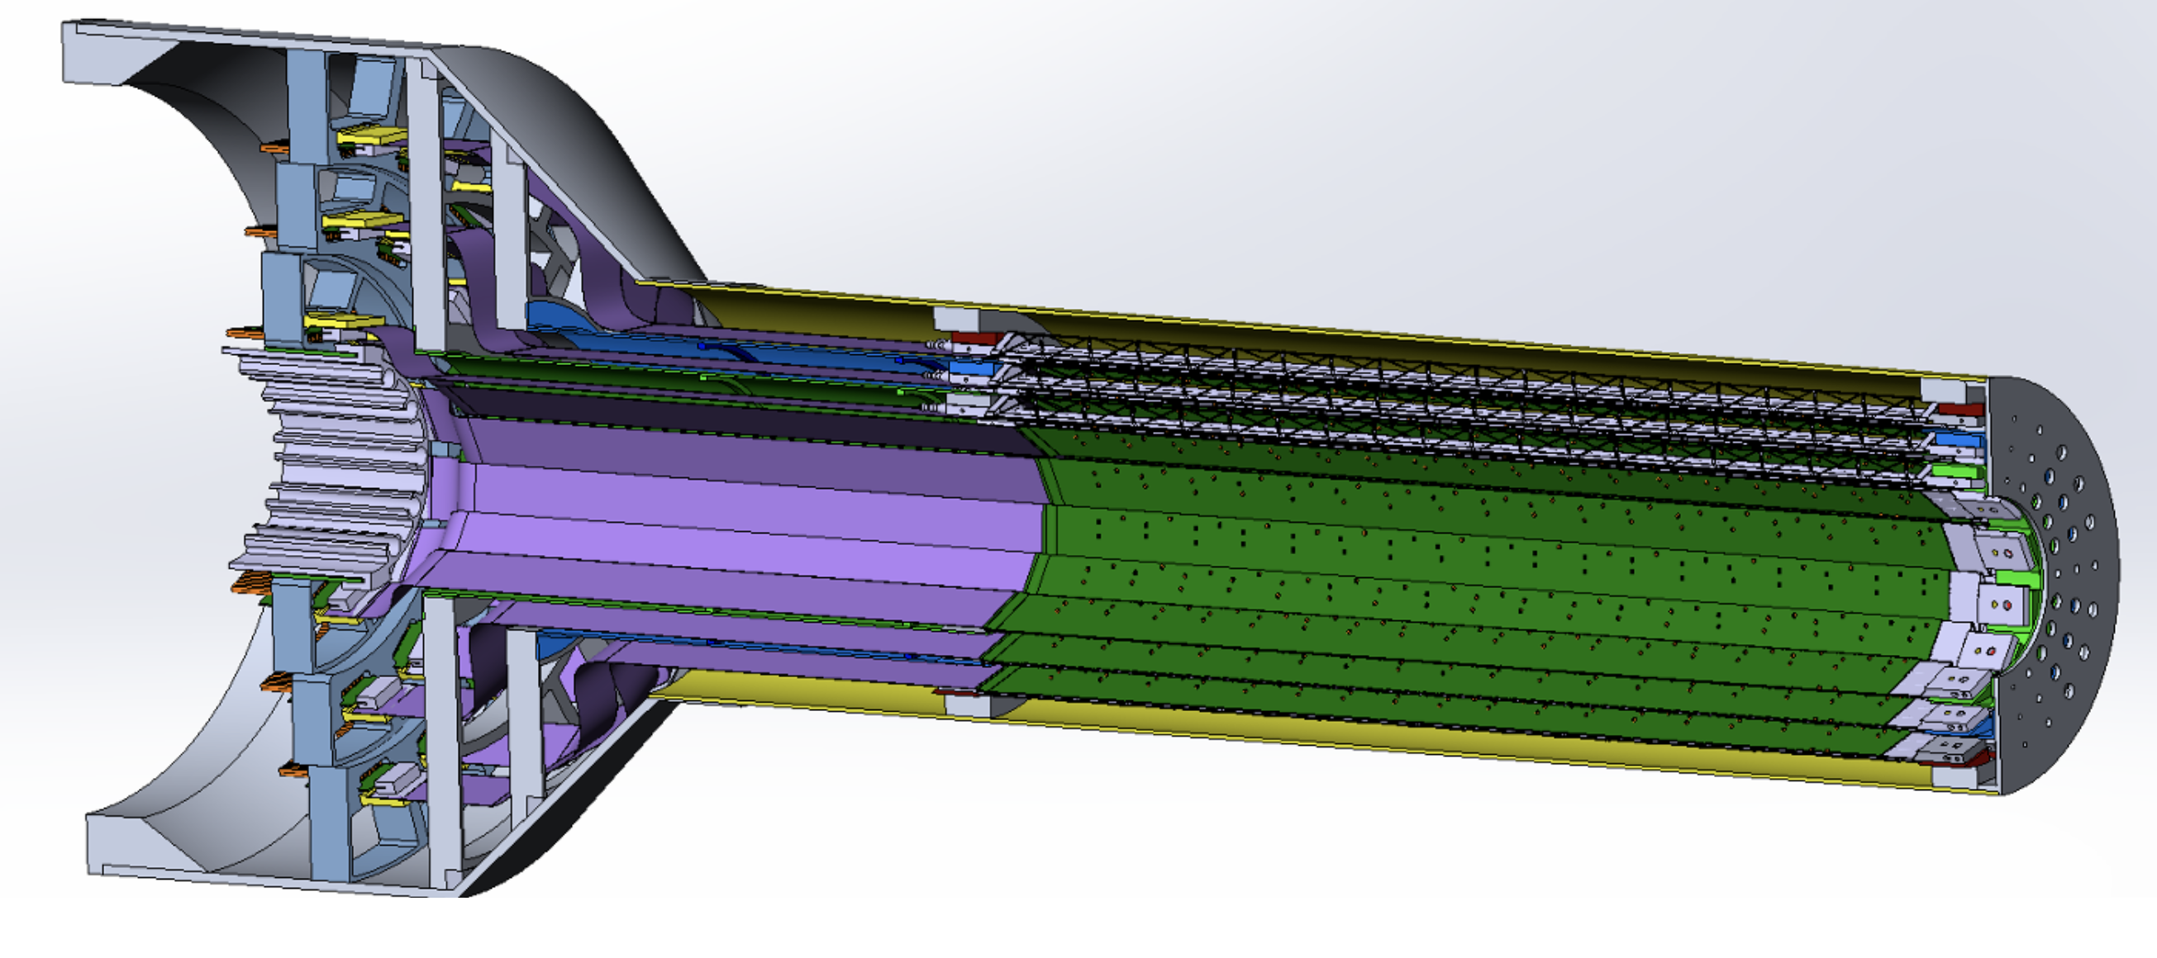
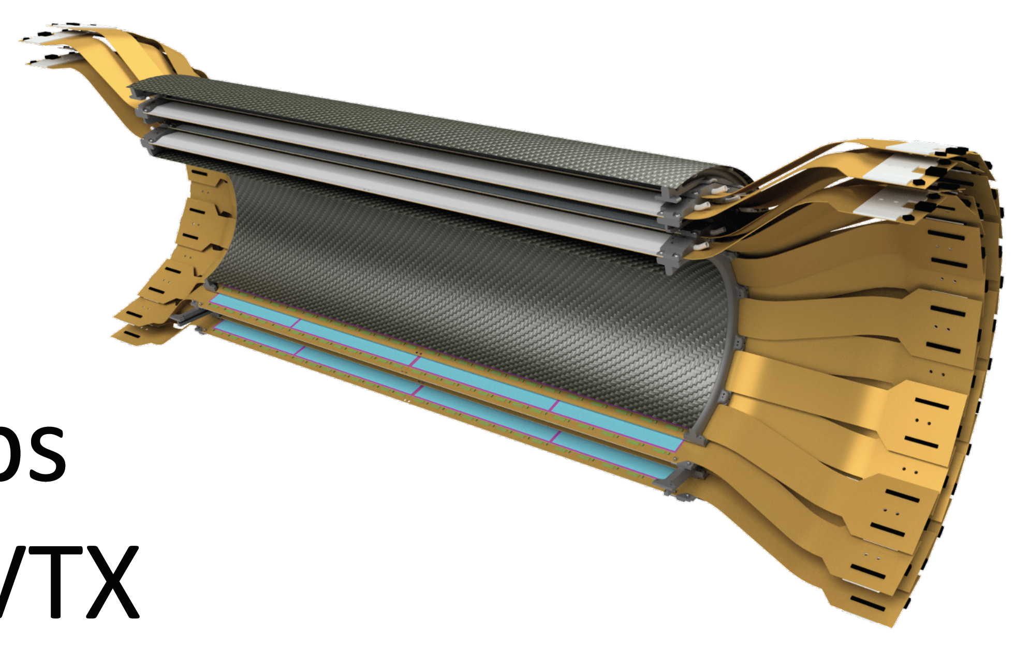
Inner Tracking
MVTX
  Precision vertexing
  Position: 2.3 < r < 3.9 cm
  3 layers of Monolithic Active Pixel Sensors
  Based on new ALICE ITS
  Pixel size: 29✕27 μm
  Position resolution: 5 μm (tracks w/ p_{T} > 1 GeV/c)
INTT
  Position: 7 < r < 12 cm
  2 layers of Si strips
  Pitch: 86 μm
  Single-beam-crossing timing resolution

Slide 10
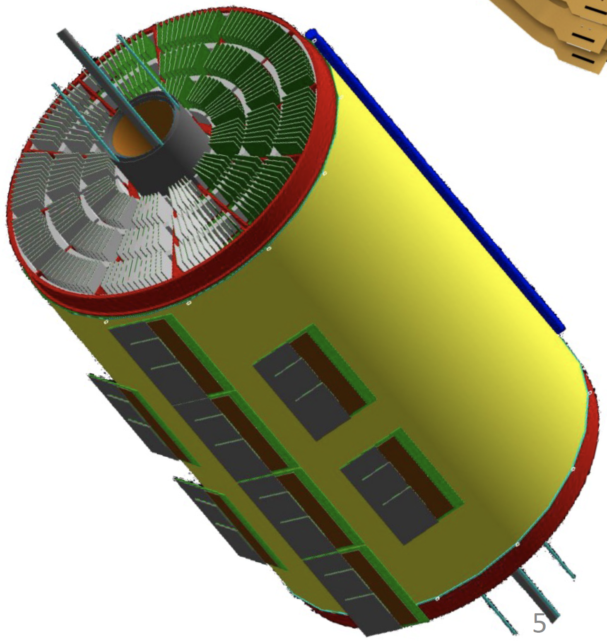
TPC & TPOT
TPC
  Tracking
  Position: 20 < r < 78 cm
  Compact, GEM-based
  Effective hit resolution: ~250 μm
  Continuous (non-gated) readout
TPOT
  Additional information for calibration of beam-induced space charge distortions
  Position: outside TPC
  8 modules of Micromegas

Slide 11
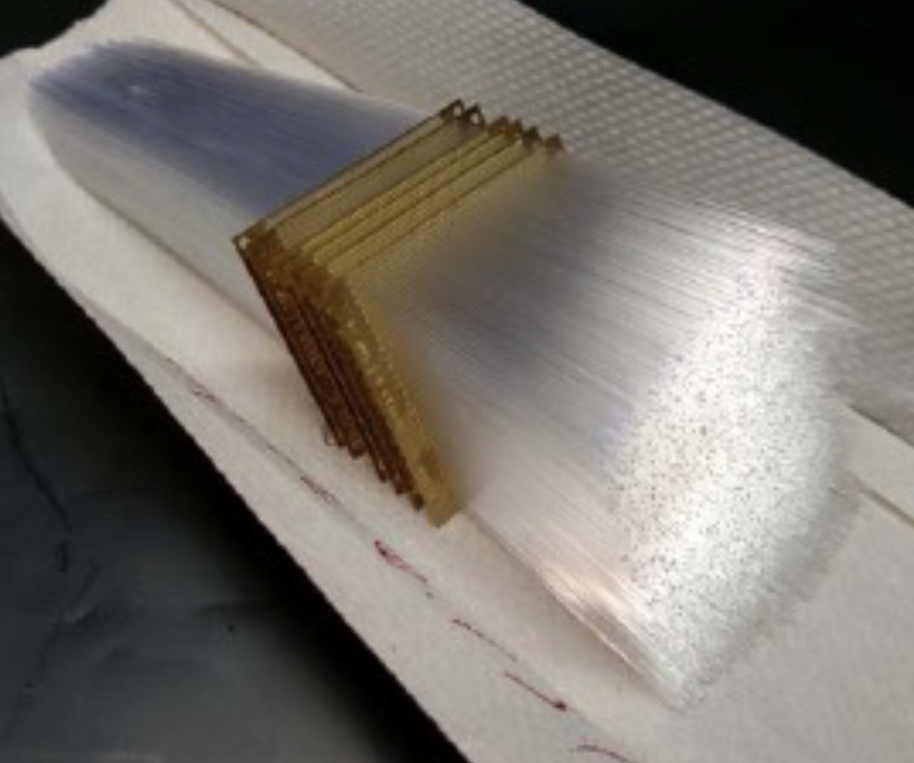
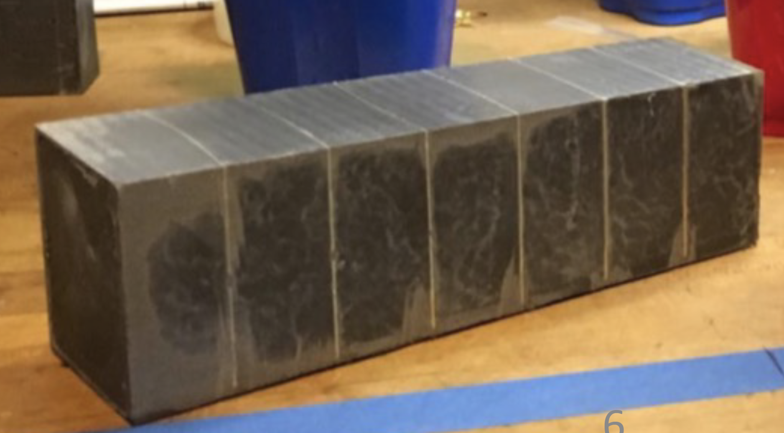
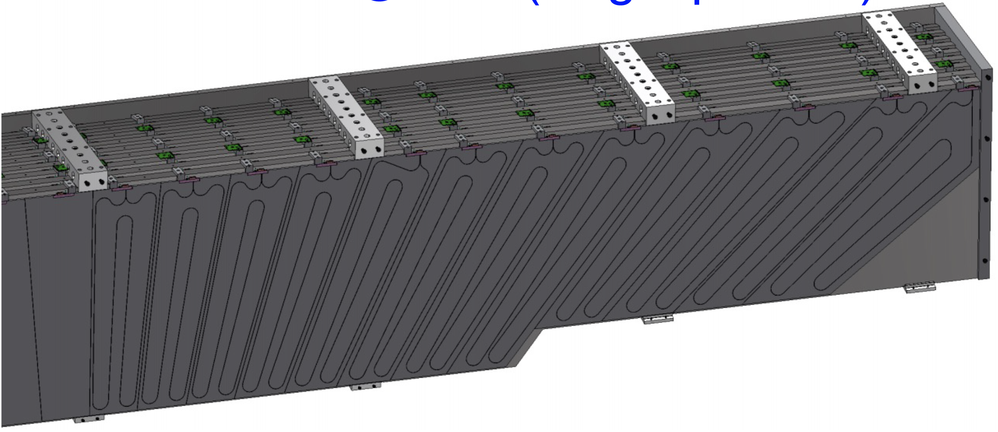
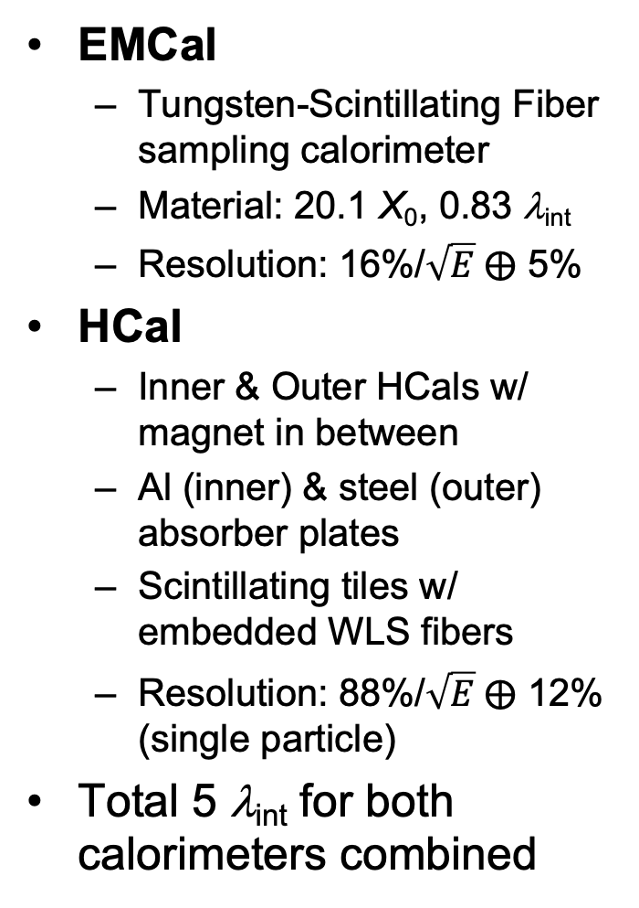
Calorimeters
EMCal
  Tungsten-Scintillating Fiber sampling calorimeter
  Material: 20.1 X₀, 0.83 λ_{int}
  Resolution: 16%/$\sqrt{E} ⨁$ 5%
HCal
  Inner & Outer HCals w/ magnet in between
  Al (inner) & steel (outer) absorber plates
  Scintillating tiles w/ embedded WLS fibers
  Resolution: 88%/$\sqrt{E} ⨁$ 12% (single particle)
Total 5 λ_{int} for both calorimeters combined
Δη ✕ Δφ =
0.025 ✕ 0.025
EMCal
EMCal
Outer HCal

Slide 12
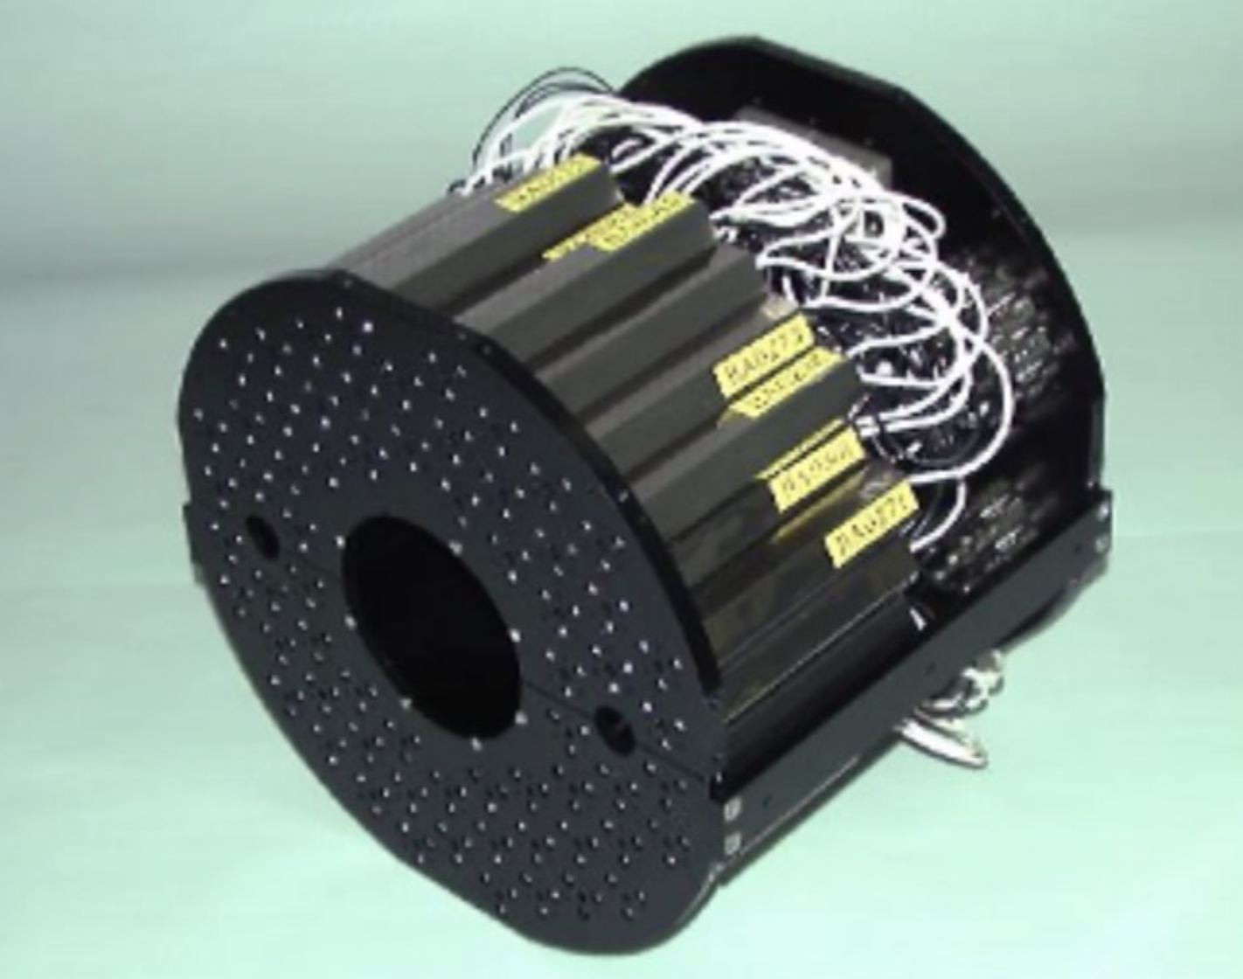
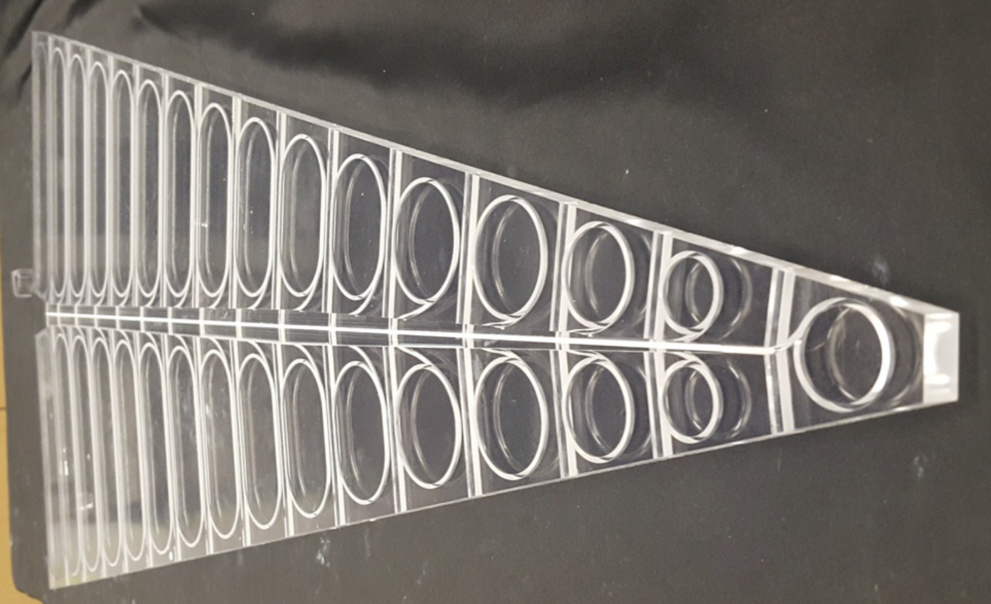
Event Characterization
Min. Bias Detector (MBD)
  Covers 3.51 < |η | < 4.61
  Reuse PHENIX Beam-Beam Counter
  128 channels of 3 cm thick quartz radiator on mesh dynode PMT
  Timing resolution: 120 ps
sPHENIX Event Plane Detector (sEPD)
  2 wheels; 2.0 < |η | < 4.9
  Scintillator plastic (1.2 cm thick), embedded WLS fibers
  Significant improvement of event plane resolution
  Closely based on STAR EPD

Slide 13
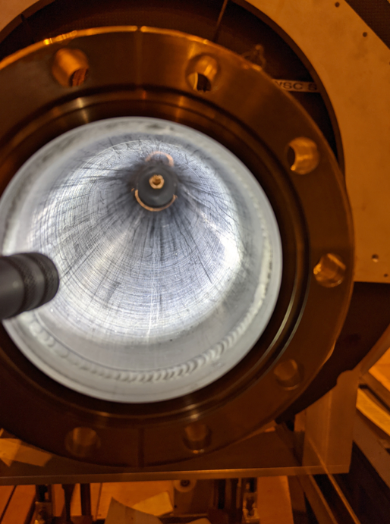
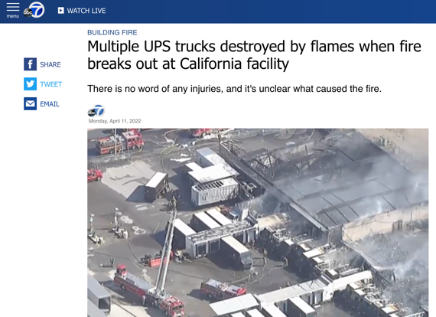
Beampipe
sPHENIX beampipe shipped to California for work
Lost in warehouse fire in 2022!
STAR had a spare beampipe that is in good condition and is compatible with sPHENIX design.

Slide 14
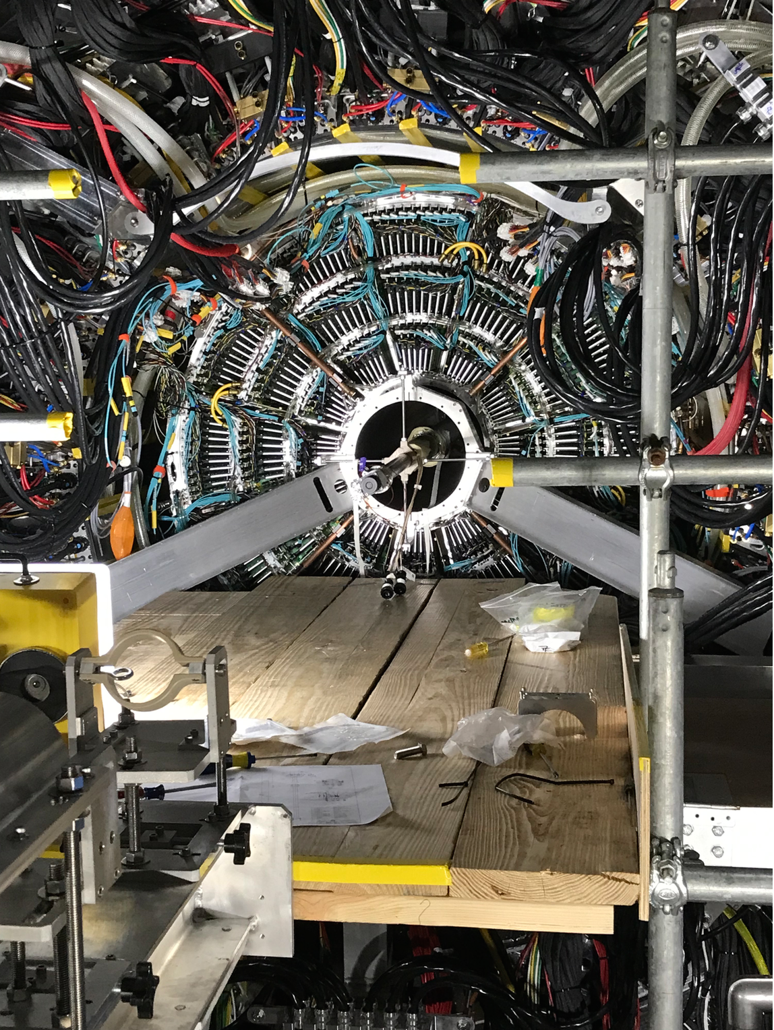
Beampipe
sPHENIX beampipe shipped to California for work
Lost in warehouse fire in 2022!
STAR had a spare beampipe that is in good condition and is compatible with sPHENIX design.
Beampipe installed on Tuesday and pump-down began on Wednesday!

Slide 15
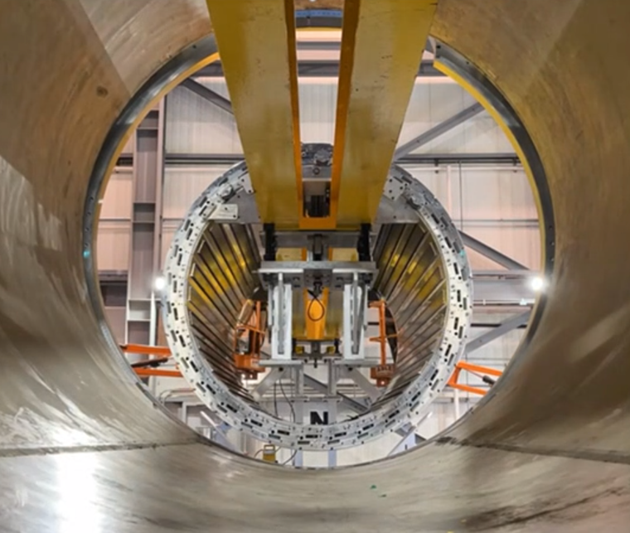
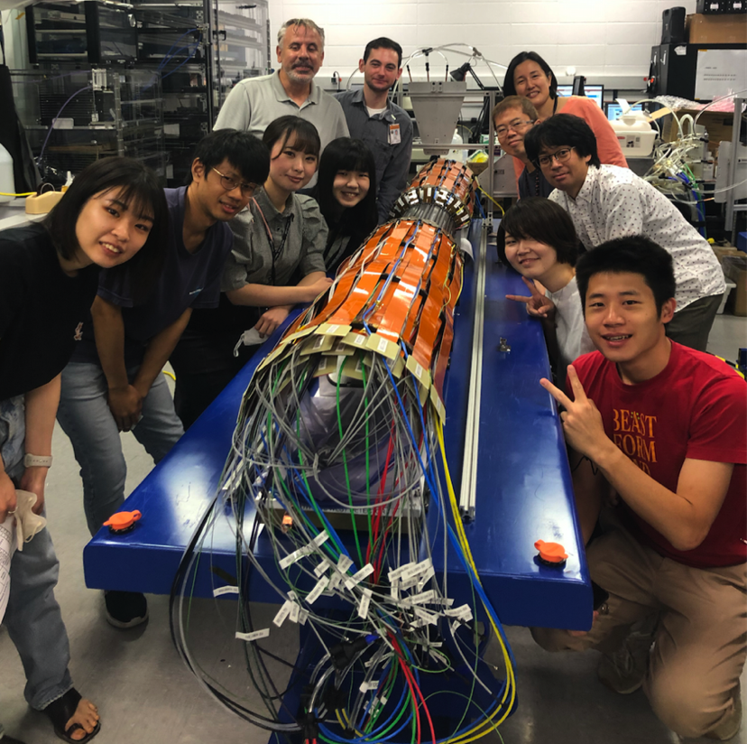
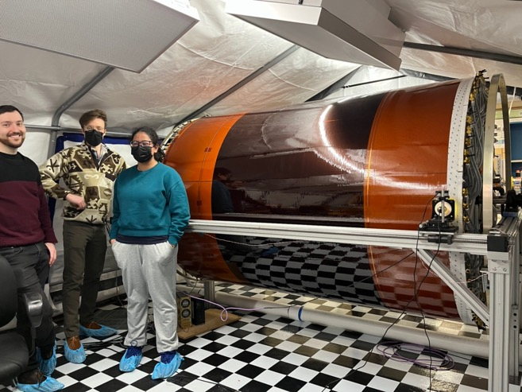
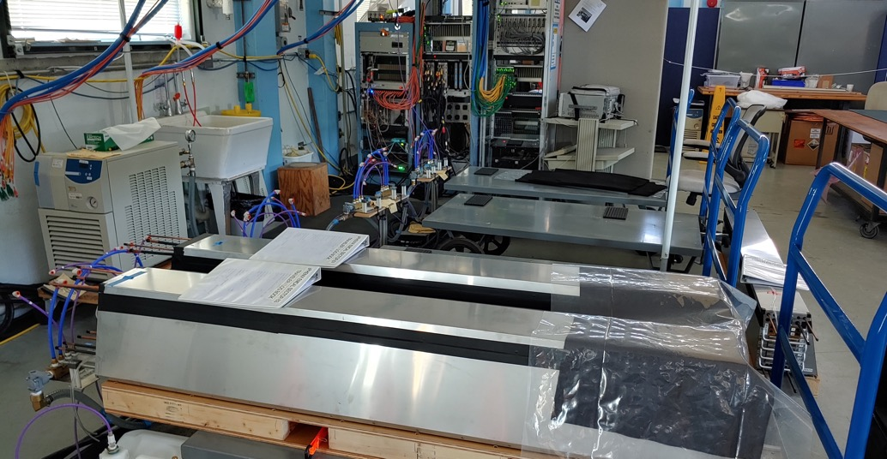
Installation
HCal
INTT
TPC
EMCal

Slide 16
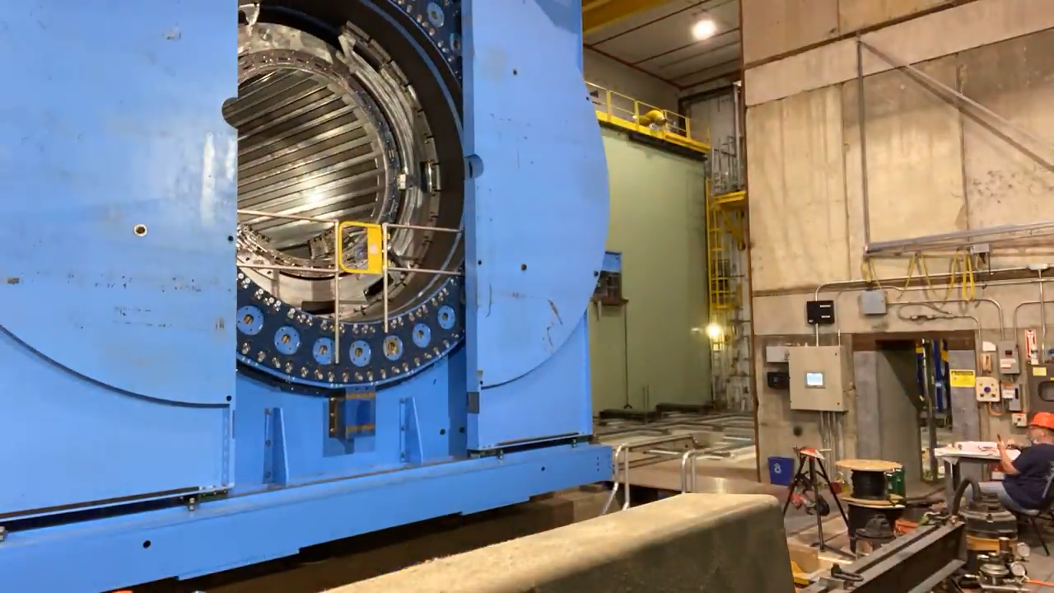
Installation
Detector has been moved into data-taking position
Magnet mapping done by CERN team (center at 1.4 T)
Most components have been installed
Start of data taking is a few months away!

Slide 17
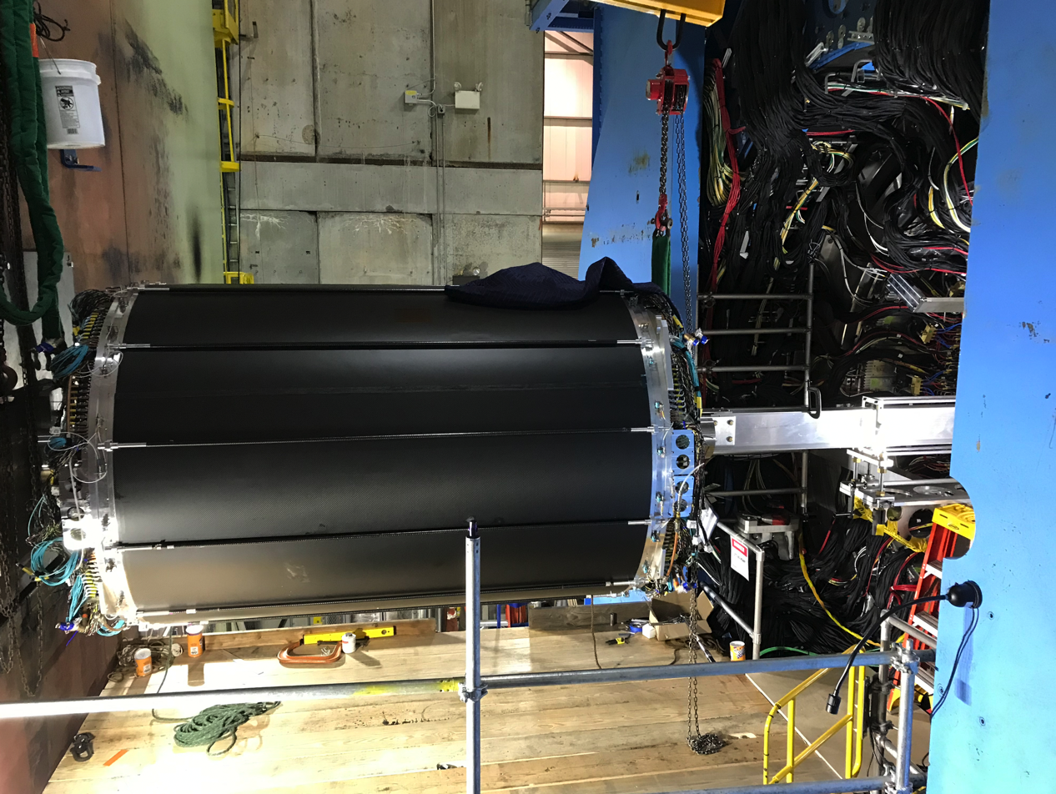
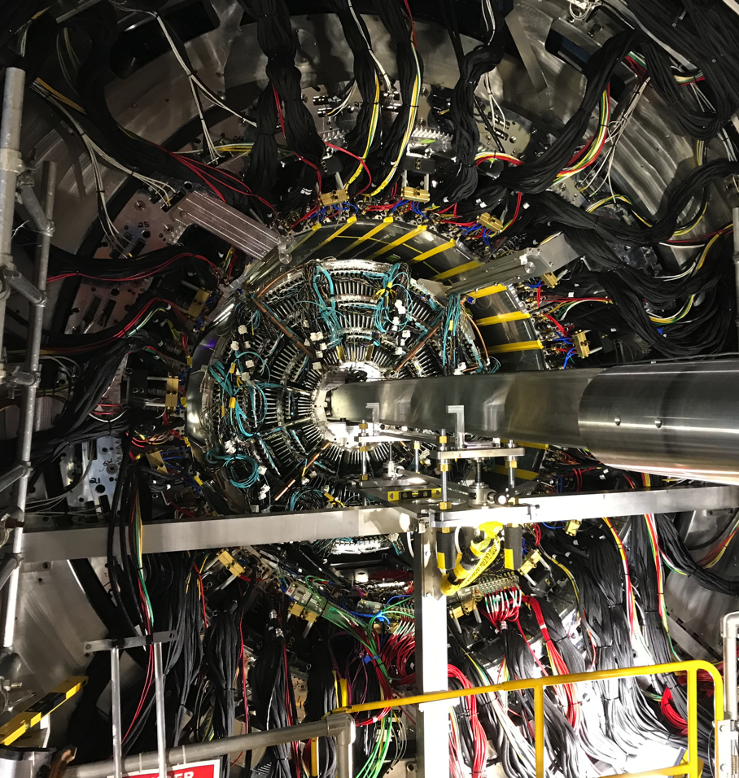
Installation
Detector has been moved into data-taking position
Magnet mapping done by CERN team (center at 1.4 T)
Most components have been installed
Start of data taking is a few months away!

Slide 18
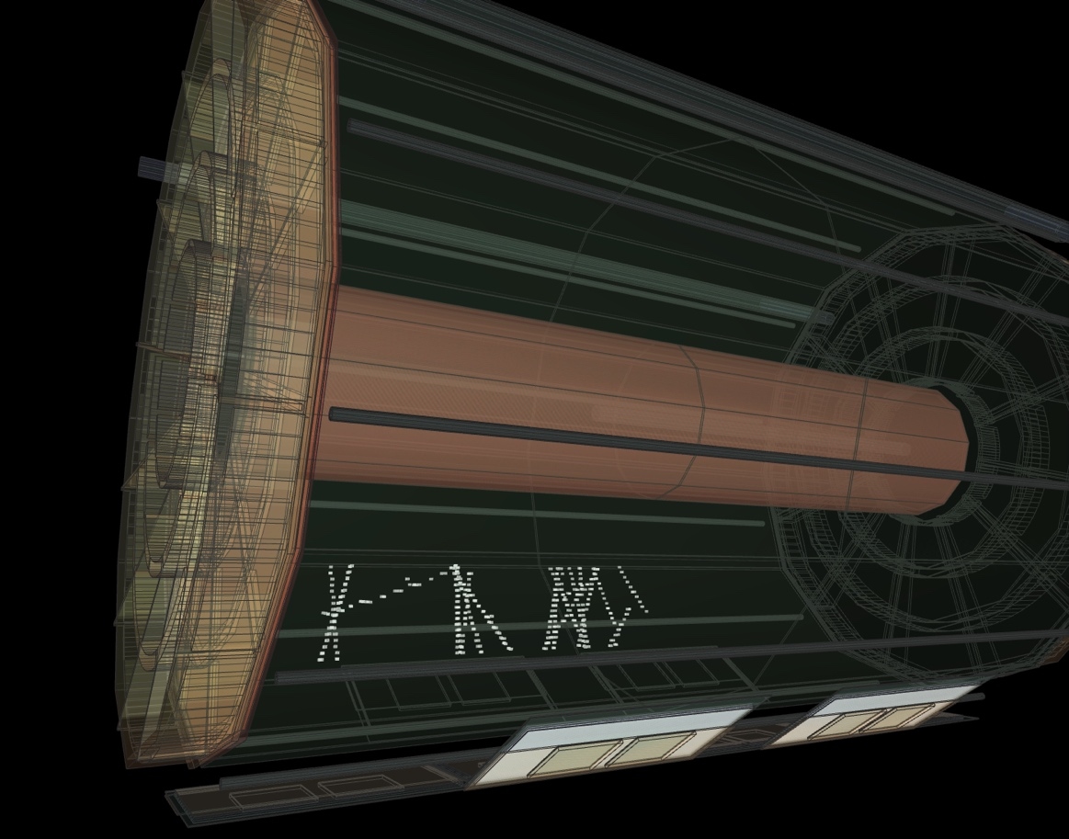
Cosmic Rays
The TPC sees cosmic rays.

Slide 19
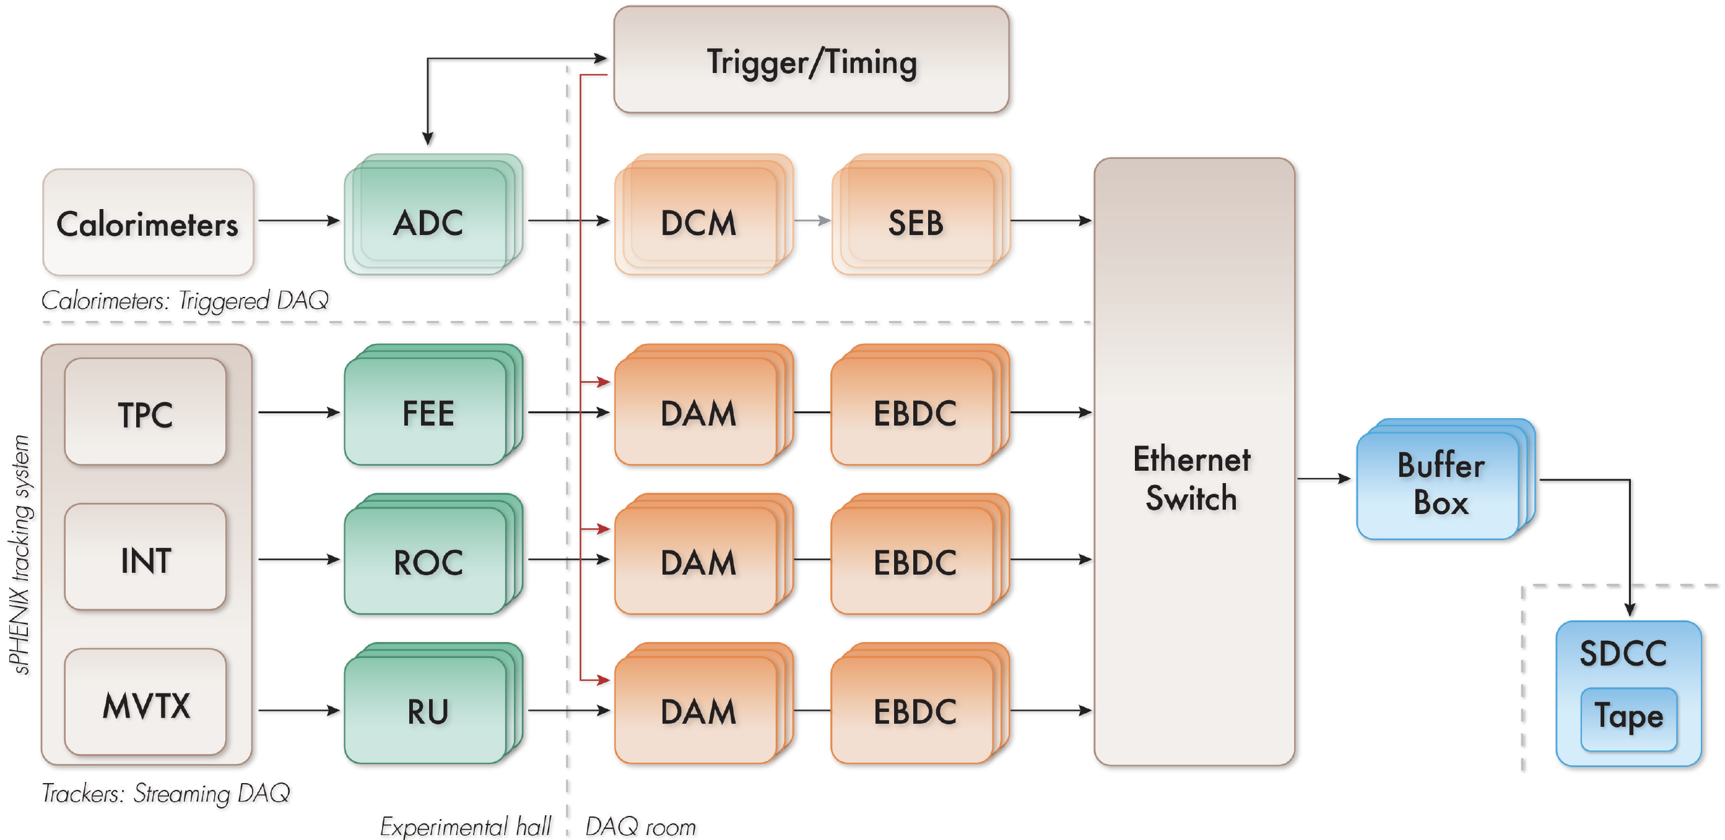
Data Acquisition
Hybrid DAQ
Triggered readout for calorimeters
Streaming (triggerless) readout for tracking detectors
  Records ~10% of all collisions
  Key to get full p+p statistics in 2024
  Crucial for HF & Cold QCD physics
2023: will record all collisions (Au+Au) w/ minimum-bias trigger

Slide 20
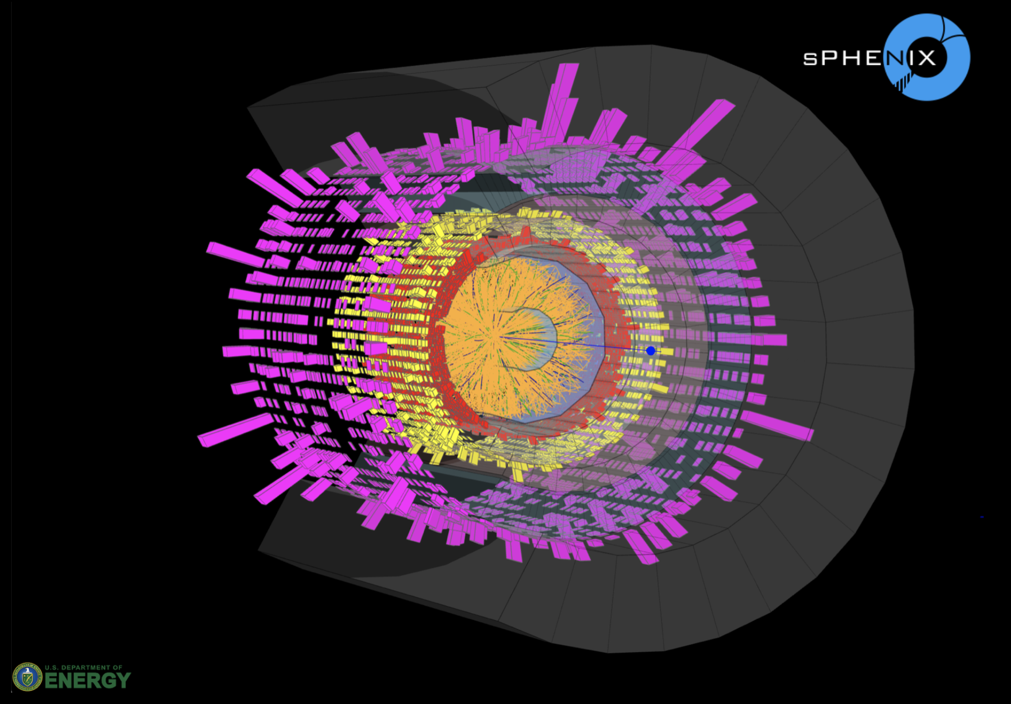
Event Display

Slide 21
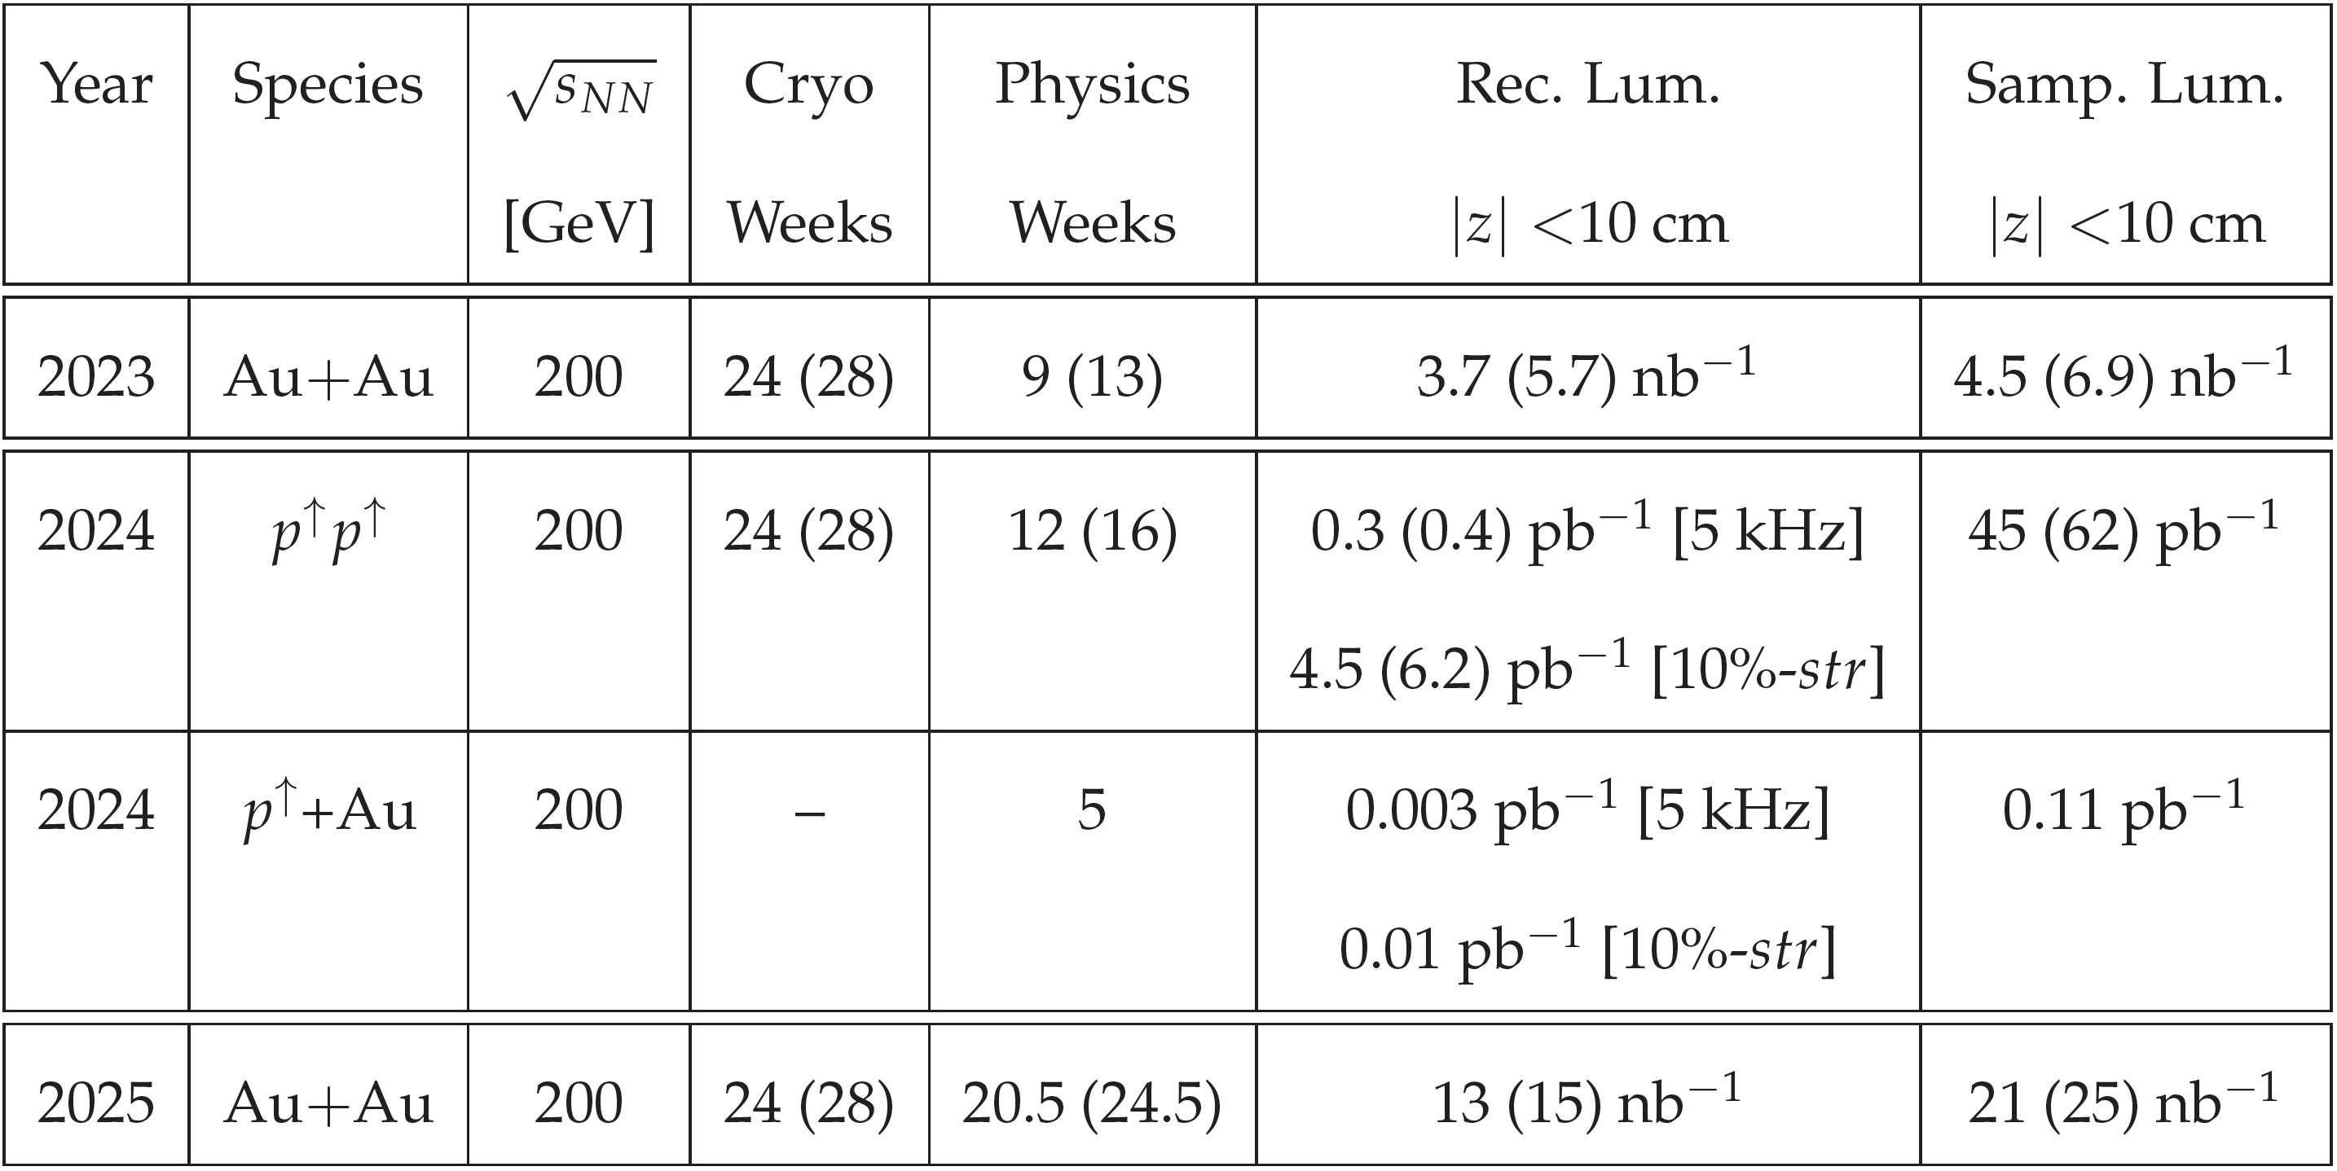
Run Schedule
sPHENIX scientific program can be completed with 3 years of running:
2023: Au+Au
Commissioning & Calibration, standard candle measurements,
first sPHENIX physics
2024: p+p & p+Au
Reference measurements for heavy ions, cold QCD
2025: Au+Au
Heavy ions (high statistics)

Slide 22
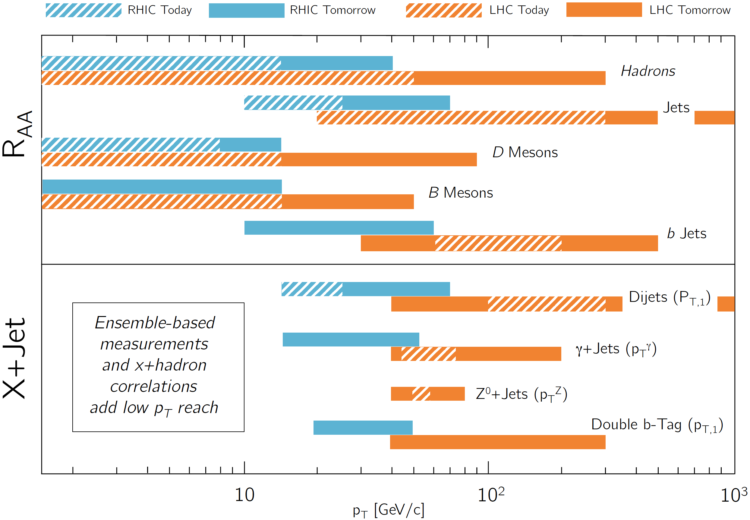
RHIC & LHC
sPHENIX enables expanded kinematic ranges for many observables → allows for overlap with LHC
Some measurements for first time at RHIC!

Slide 23
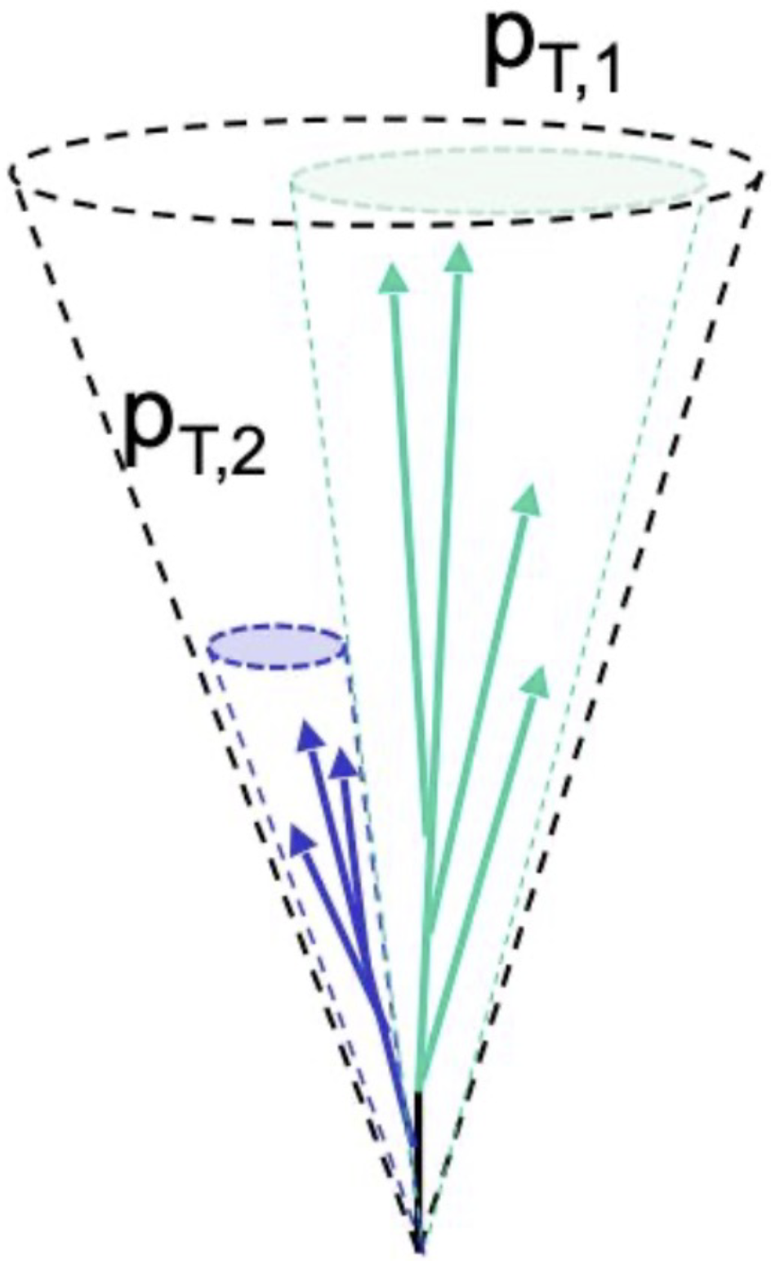
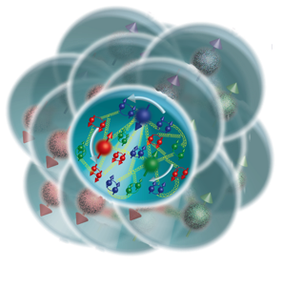
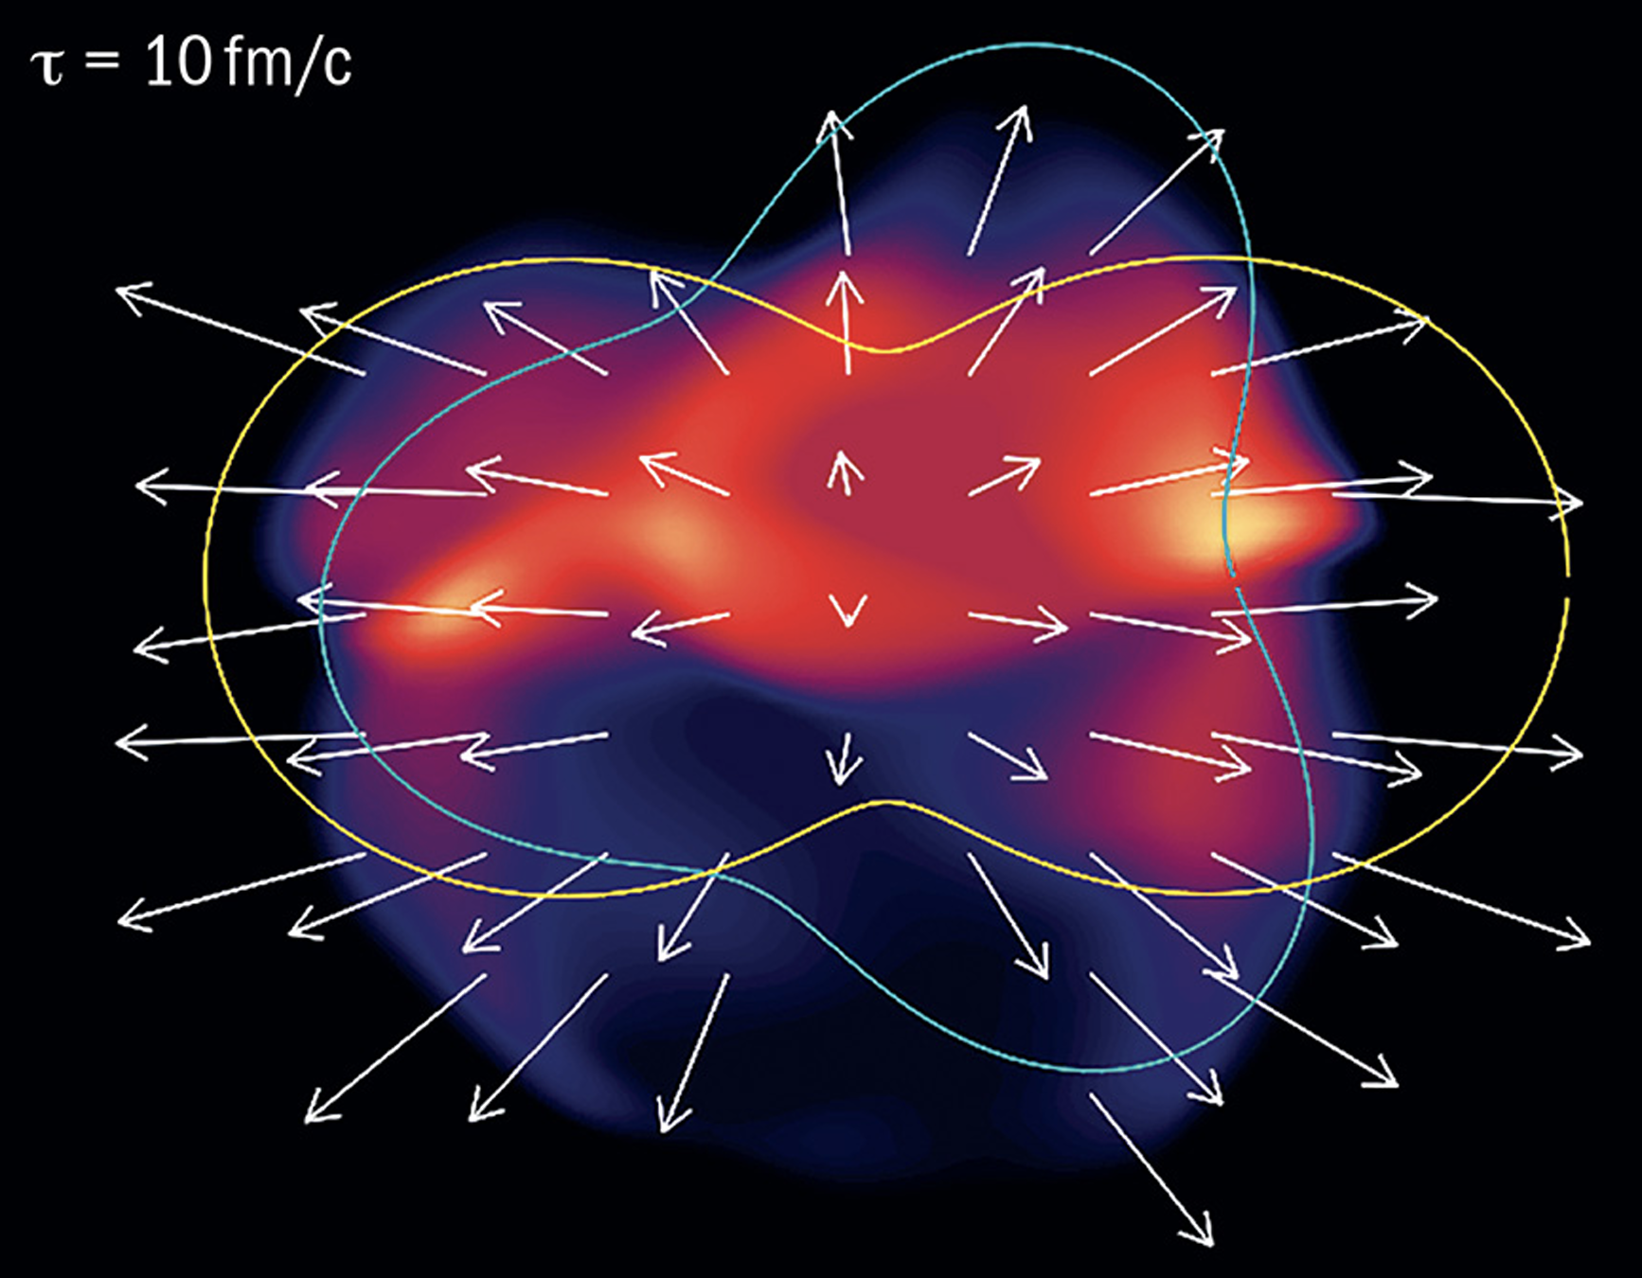















sPHENIX Physics Program
$$g$$
$$u$$
$$d$$
Jet Correlations
& Structure
vary momentum &
angular size of probe
Quarkonia
vary size of probe
$$s$$
$$Υ\left(1S\right)$$
$$Υ\left(2S\right)$$
$$c$$
$$b$$
$$b$$
$$\overline{b}$$
$$b$$
$$\overline{b}$$
0.28 fm
0.56 fm
Heavy Flavor
vary mass & momentum
of probe
$$Υ\left(3S\right)$$
$$b$$
$$\overline{b}$$
0.78 fm
Bulk QCD
collective behavior in large & small systems
Cold QCD
vary temperature of QCD matter, study proton spin, transverse momentum, & nuclear effects

Slide 24
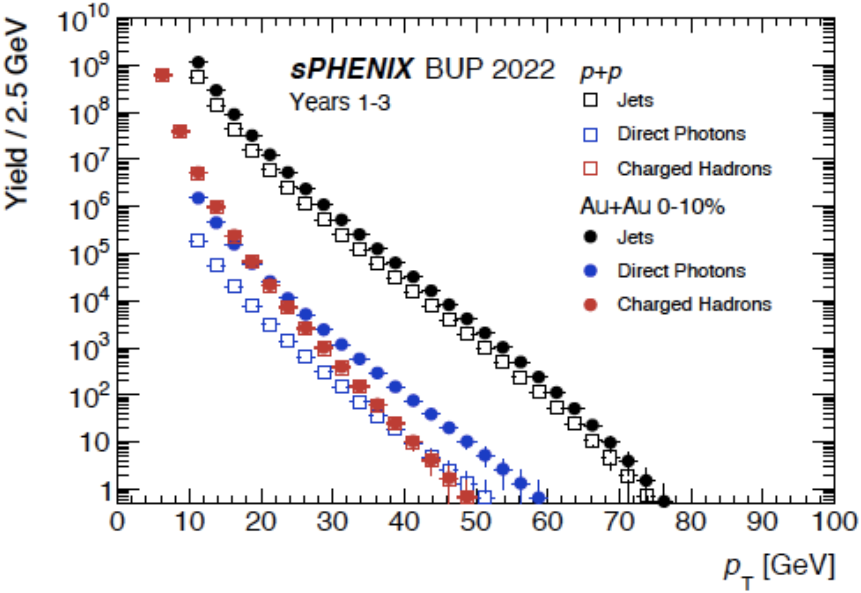
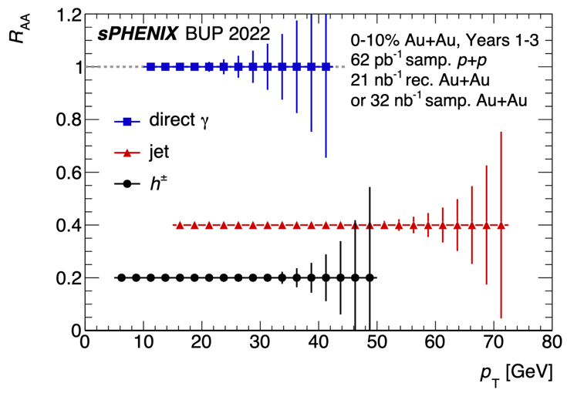
High-p_{T} Probes
In 3 years of data taking, sPHENIX will measure
  Jets out to p_{T} ~ 70 GeV/c
  Charged hadrons out to p_{T} ~ 50 GeV/c
  Direct photons out to p_{T} ~ 40 GeV/c
Kinematic overlap with LHC measurements
  And access to kinematic regimes LHC can’t explore

Slide 25
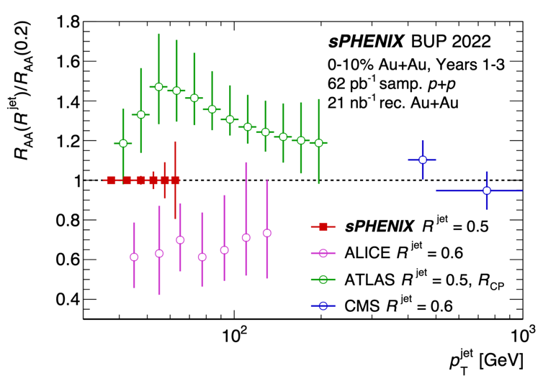
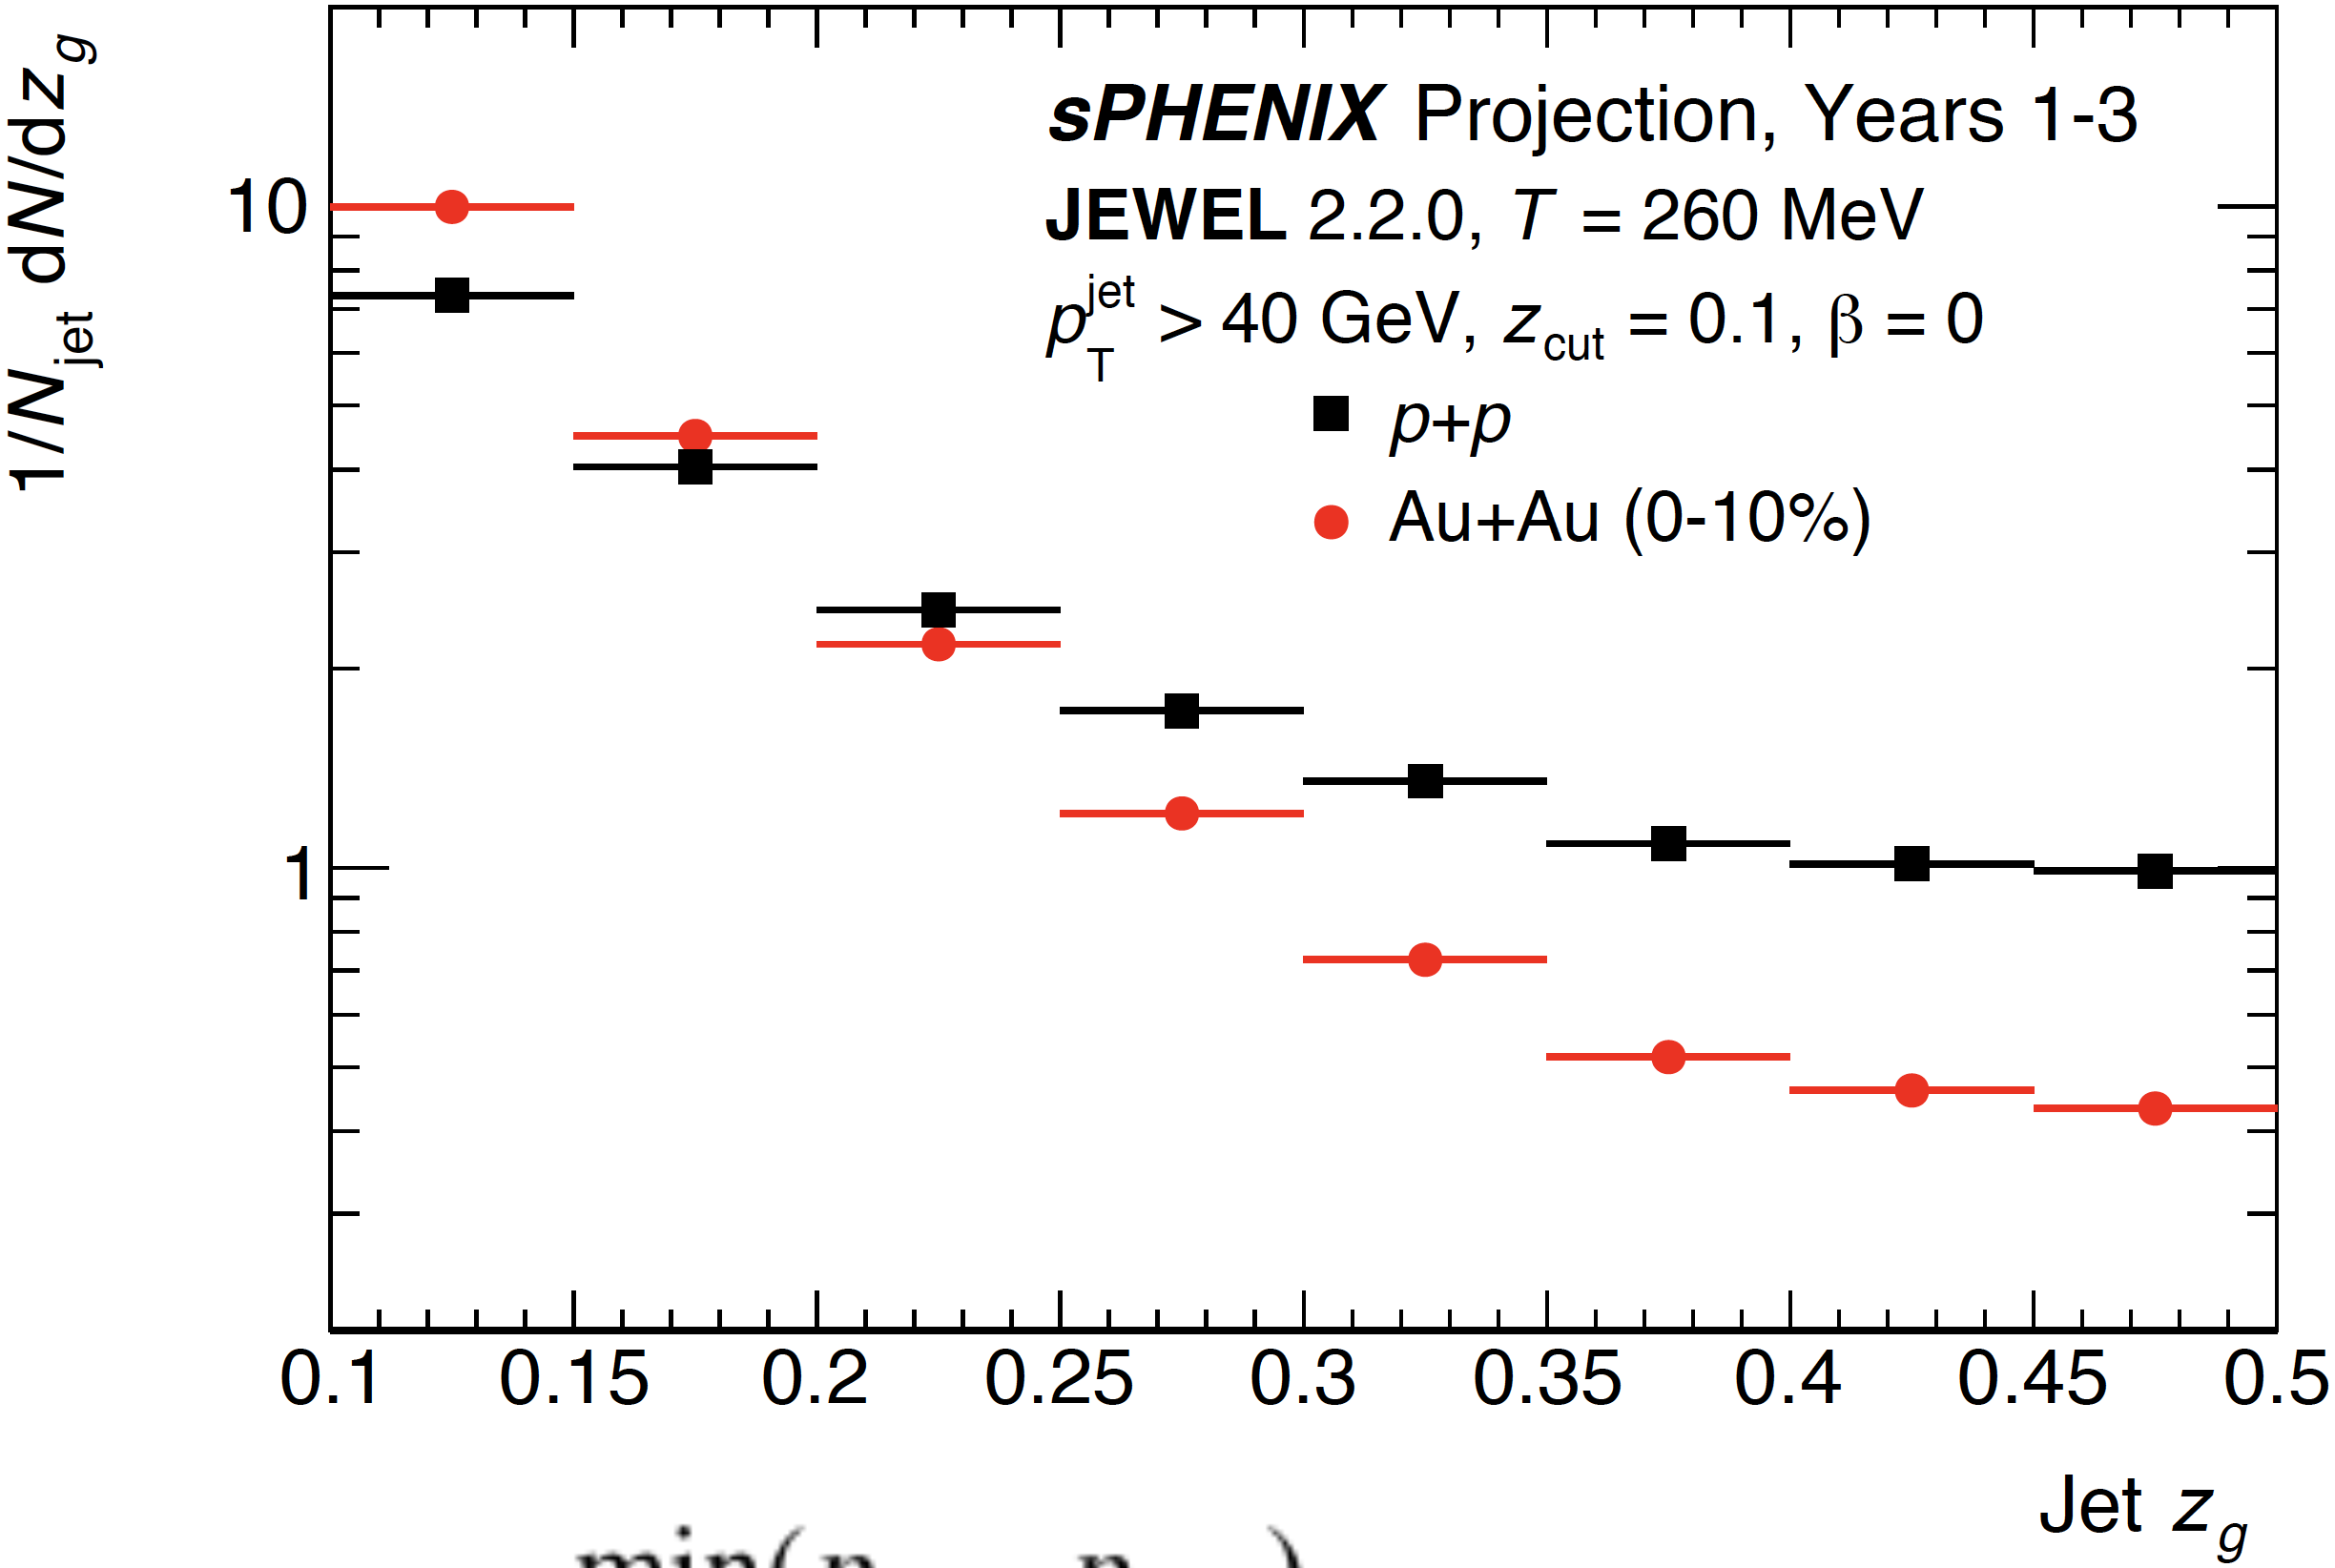

Jets
Will measure jets for p_{T} < 100 GeV/c: tension in LHC jet results here
Jet (sub)structure studies will be used to explore how energy loss depends on the parton shower
  Connection to fundamental QCD
  Probe to measure QGP properties
$$z_{g}≡\frac{min\left(p_{T,1},p_{T,2}\right)}{p_{T,1}+p_{T,2}}$$

Slide 26
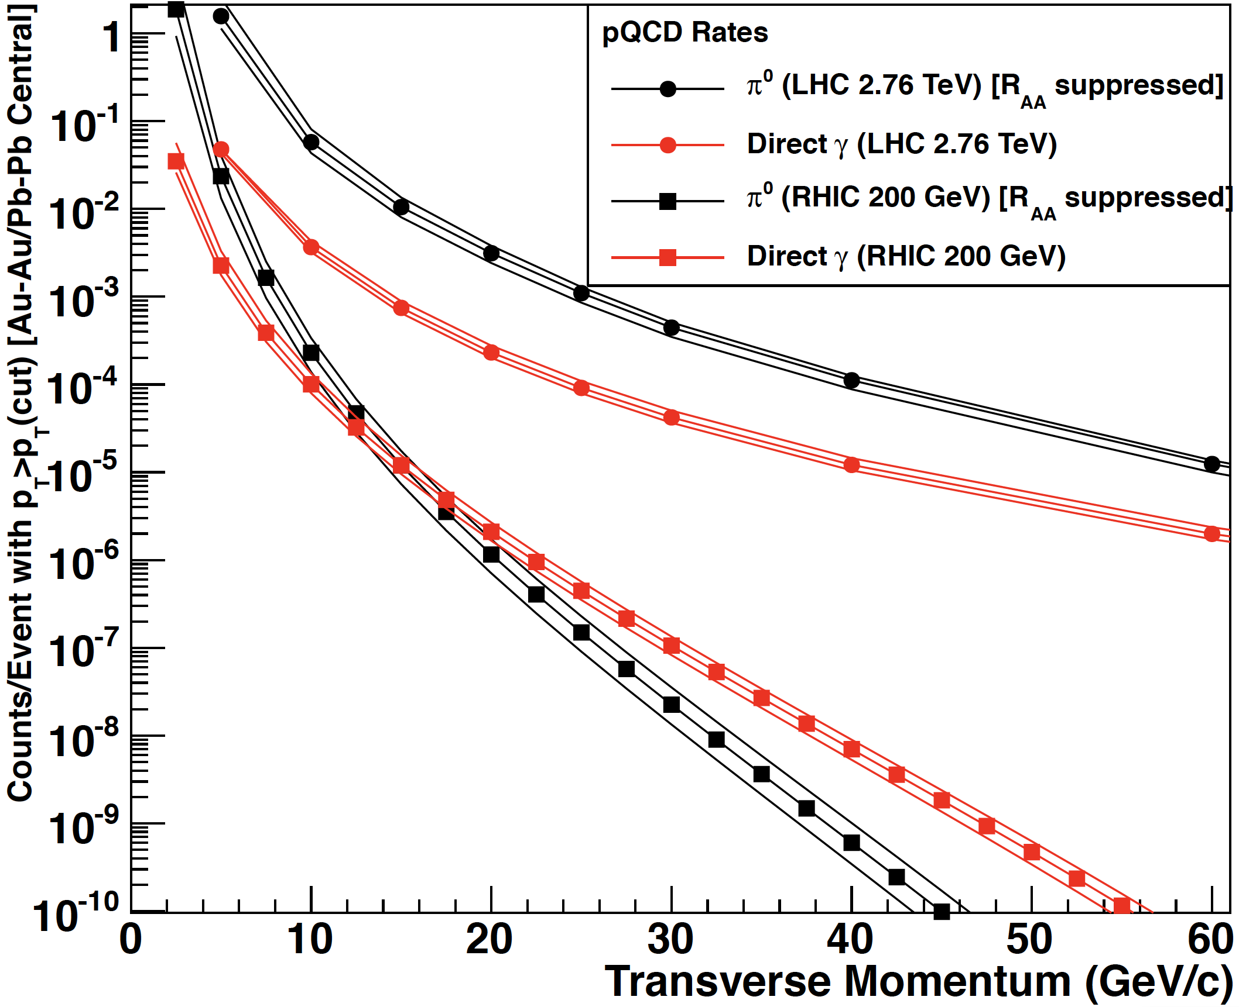
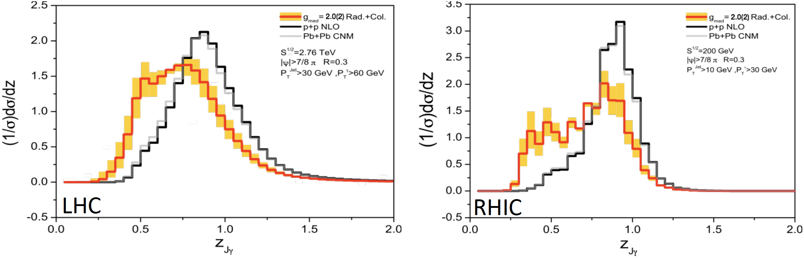
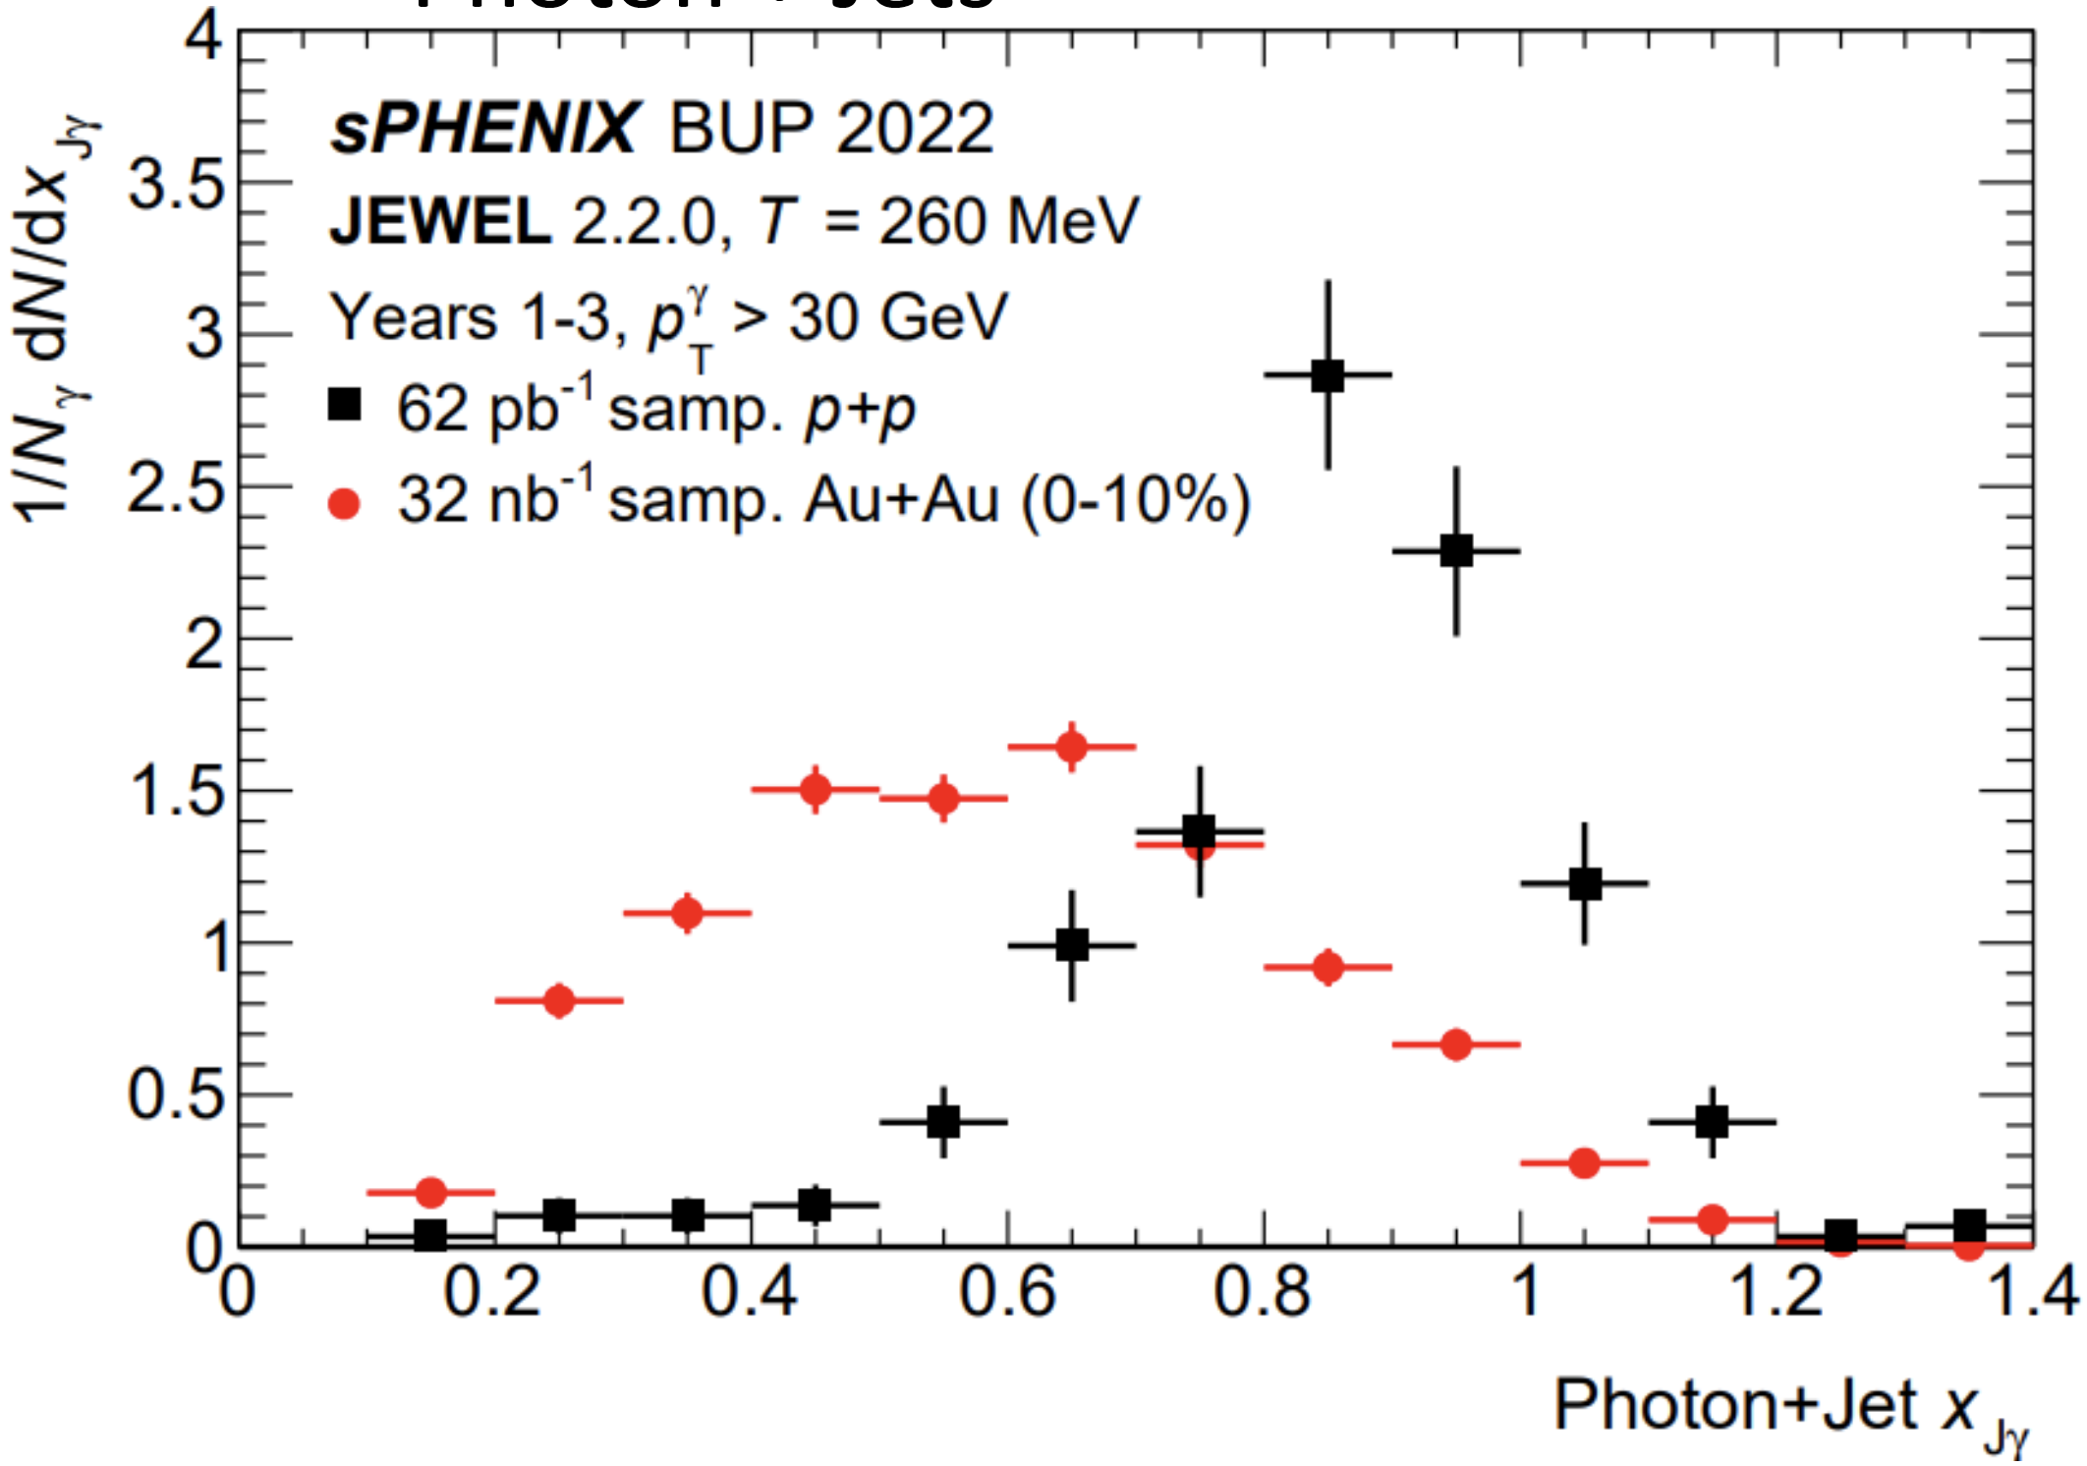
Photon-Tagged Jets
Key measurement in sPHENIX physics program.
RHIC is ideal for measuring direct photons.
Measurements of z_{Jγ} may be more sensitive at RHIC.
LHC

Slide 27
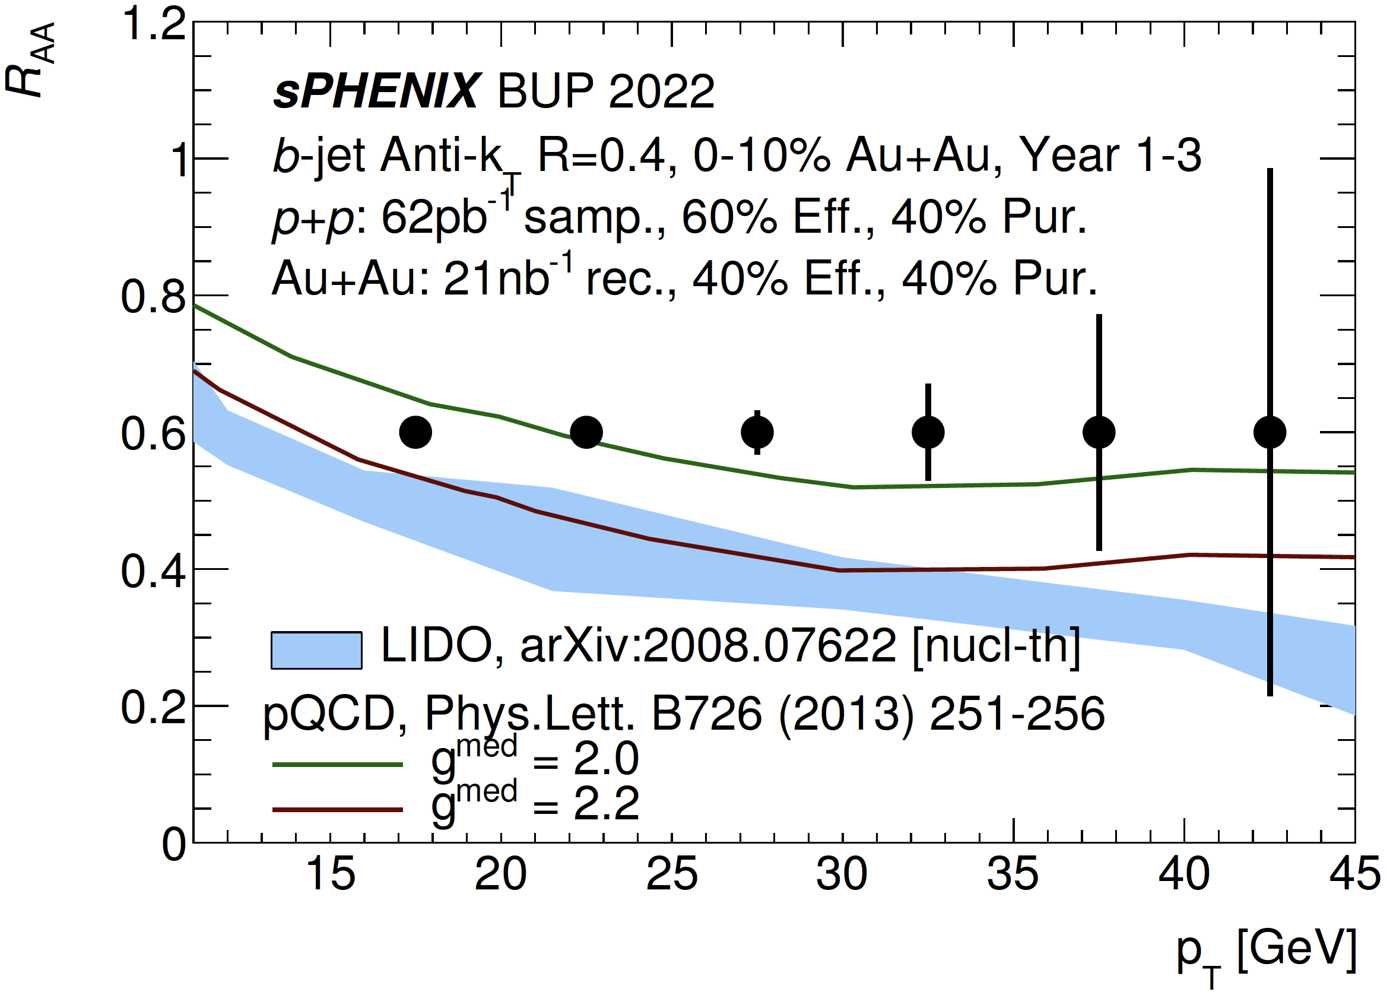
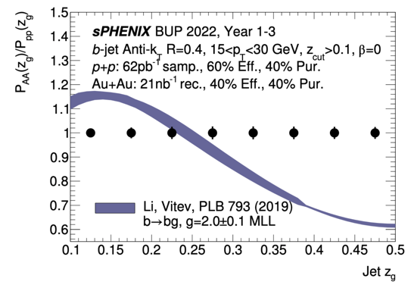
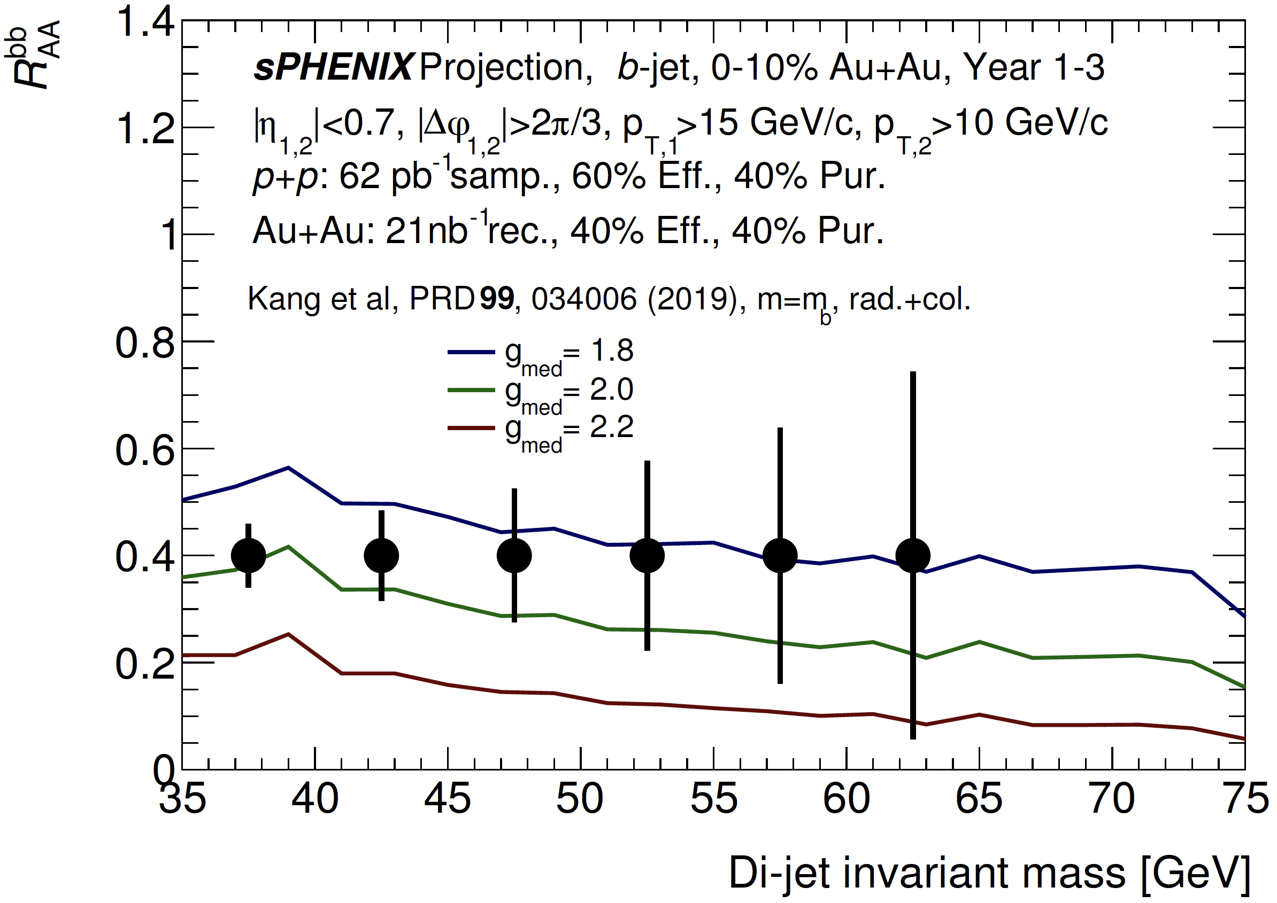

b-Tagged Jets
Sensitive to collisional vs. radiative energy loss
1st RHIC b-jet measurement!
Lower p_{T} range than LHC
  Larger heavy-quark mass effect
Studies of b-jet substructure
$$z_{g}≡\frac{min\left(p_{T,1},p_{T,2}\right)}{p_{T,1}+p_{T,2}}$$

Slide 28
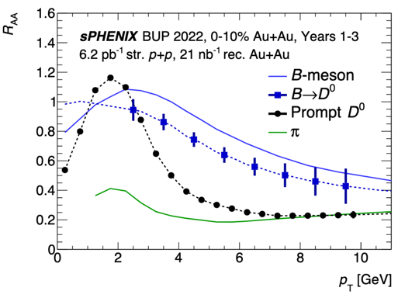
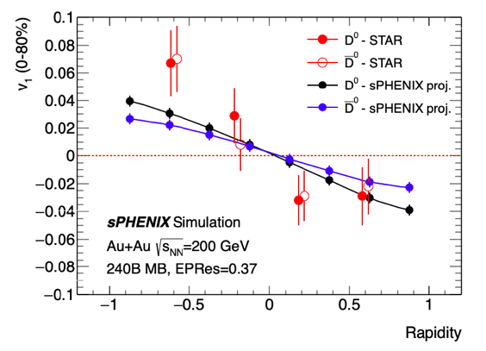
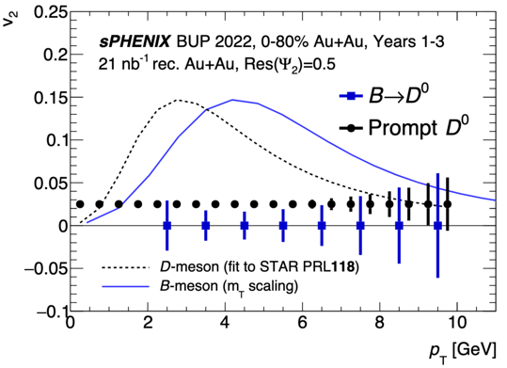

Open Heavy Flavor
Streaming readout → large min. bias data set & HF measurements down to p_{T} = 0
Will access b-quark R_{AA} & v₂ via non-prompt $D^{0}$, full b-hadron reconstruction.
Transient magnetic field may influence v₁ differently for $D^{0}$ & ${\overline{D}}^{0}$

Slide 29
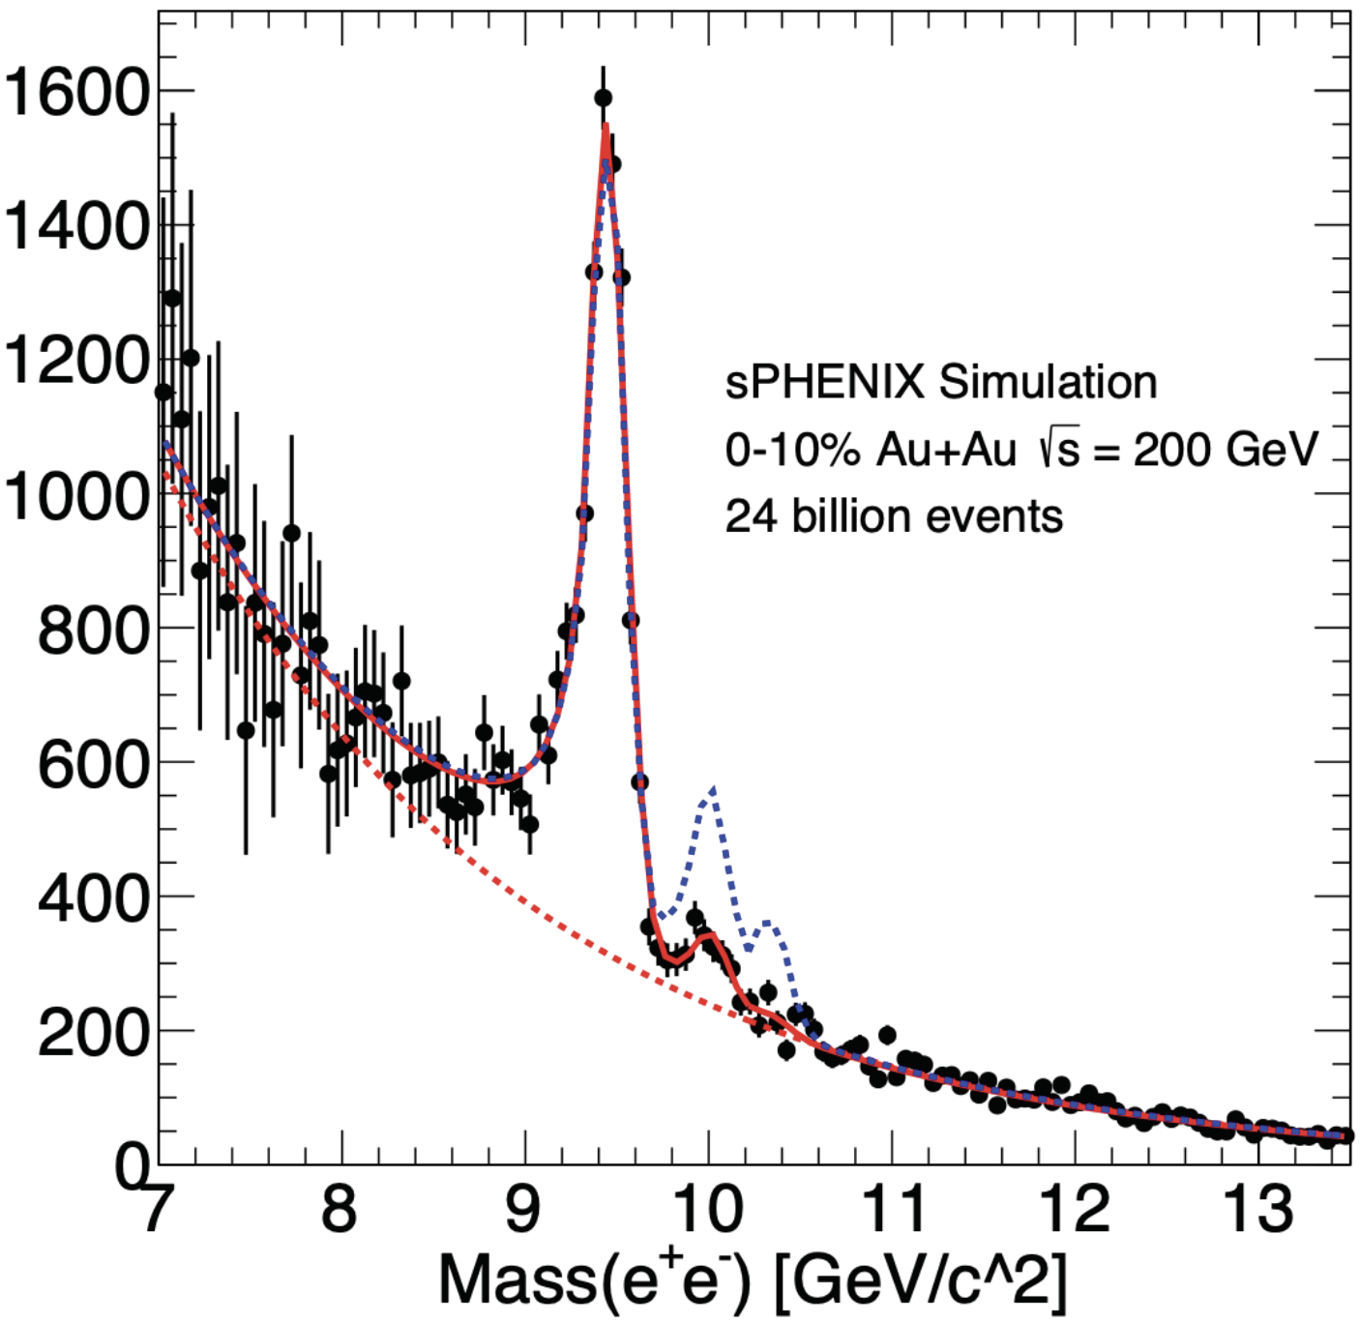
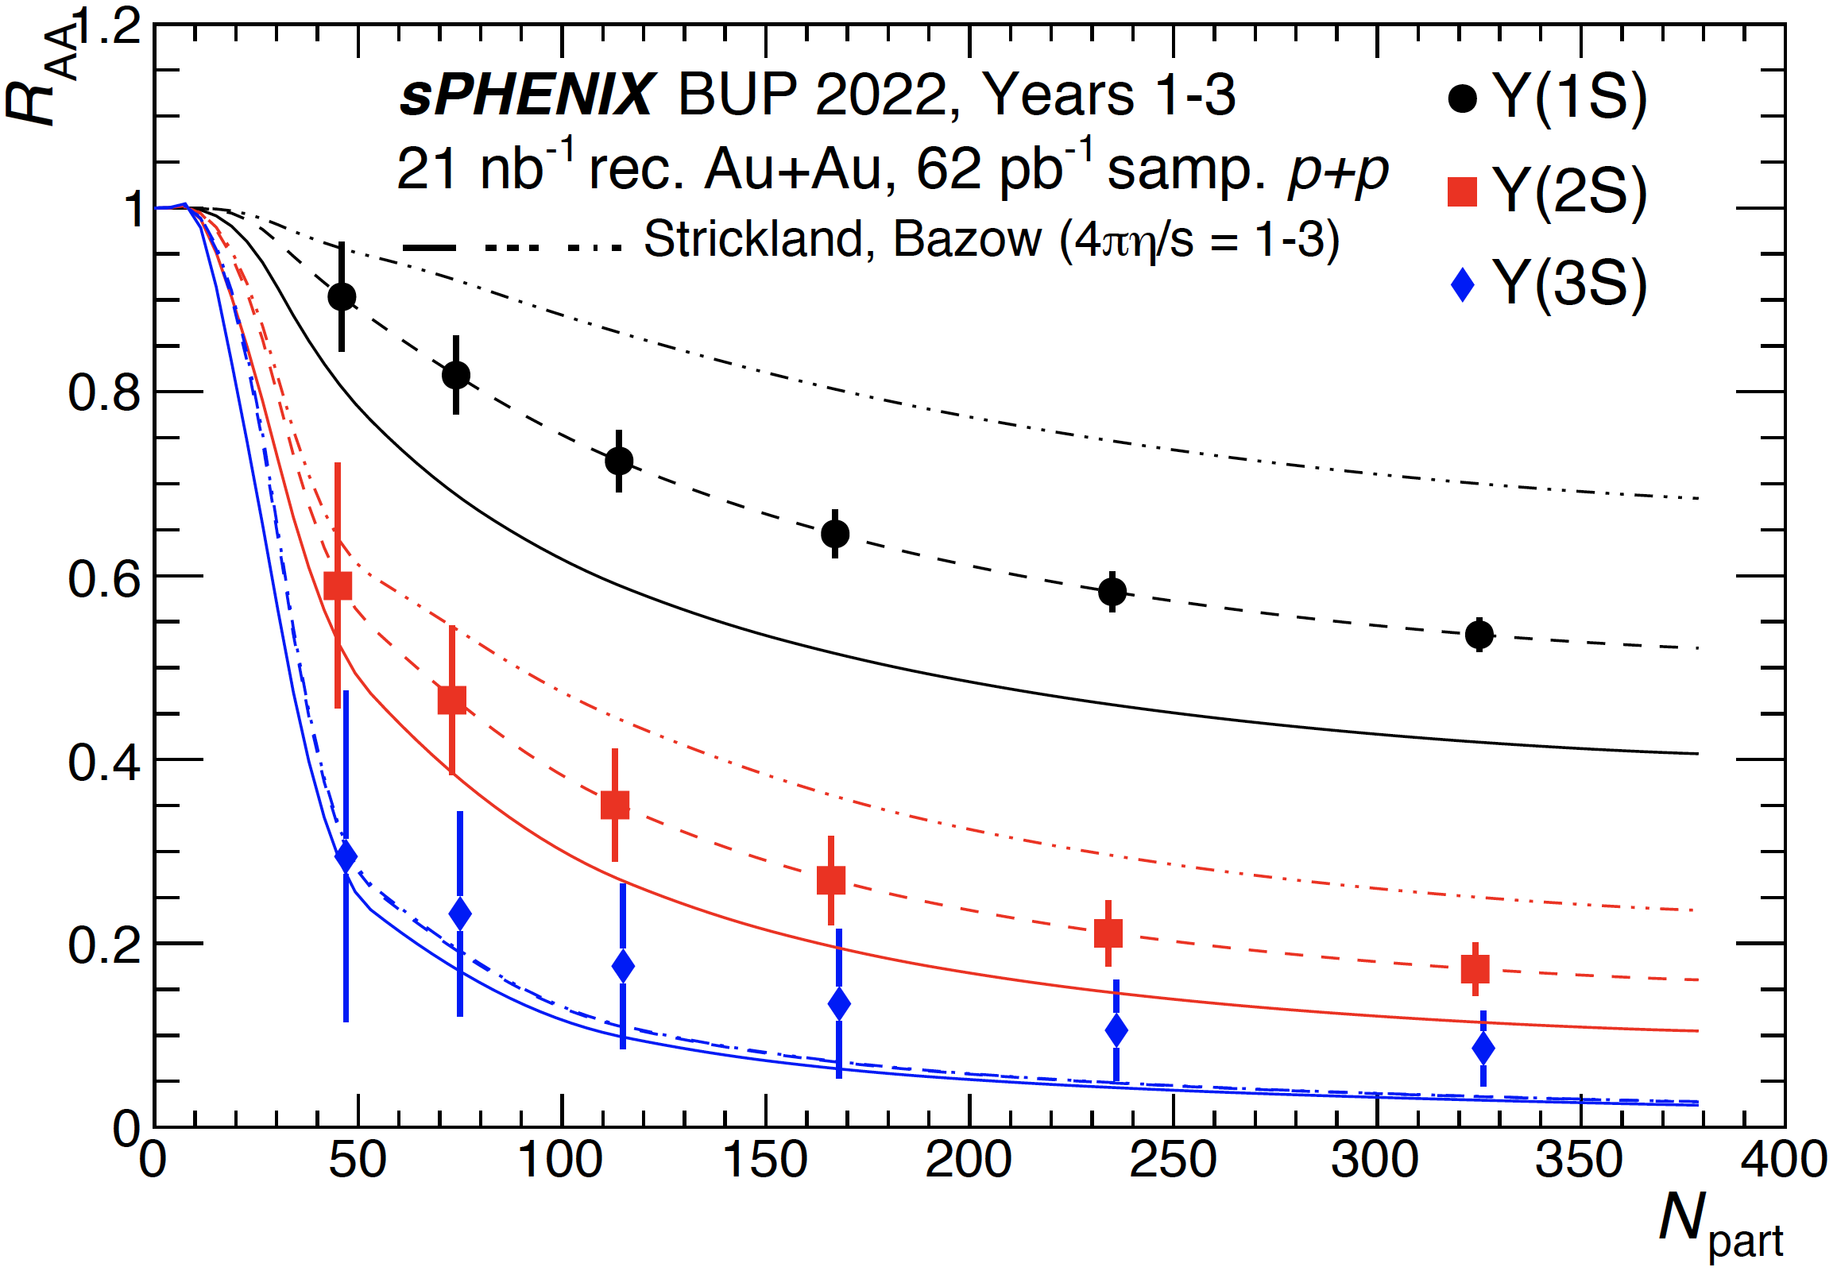
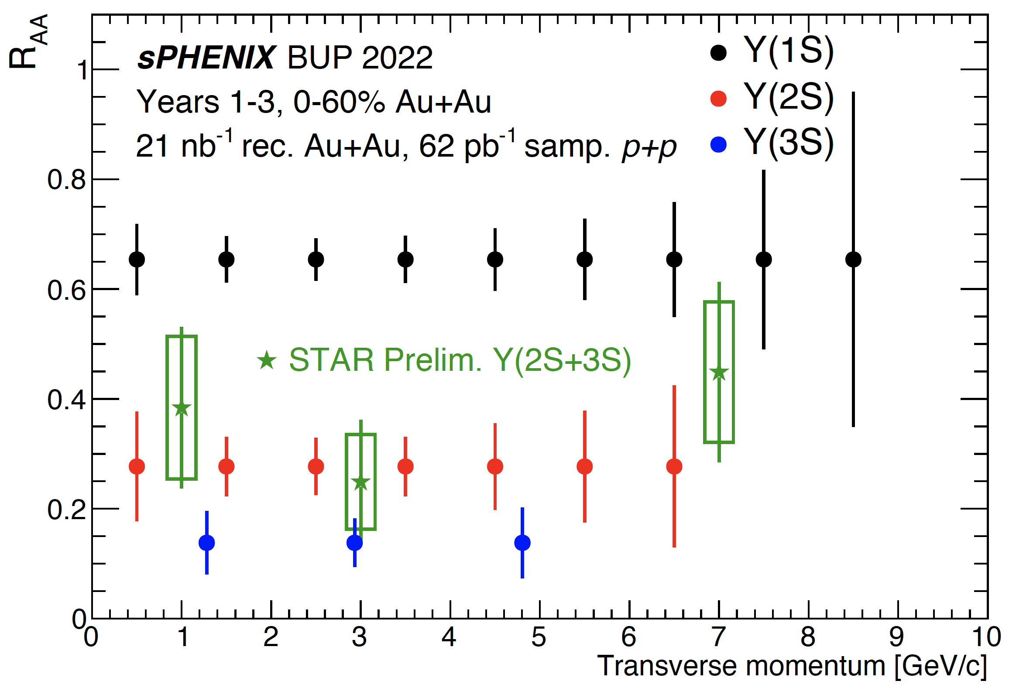
Quarkonia
Excellent mass resolution will allow clean separation of three Υ states
  First time at RHIC!
Chance for clear measurement of Υ(3S) suppression → test of theoretical predictions
ML tools for hadron rejection

Slide 30
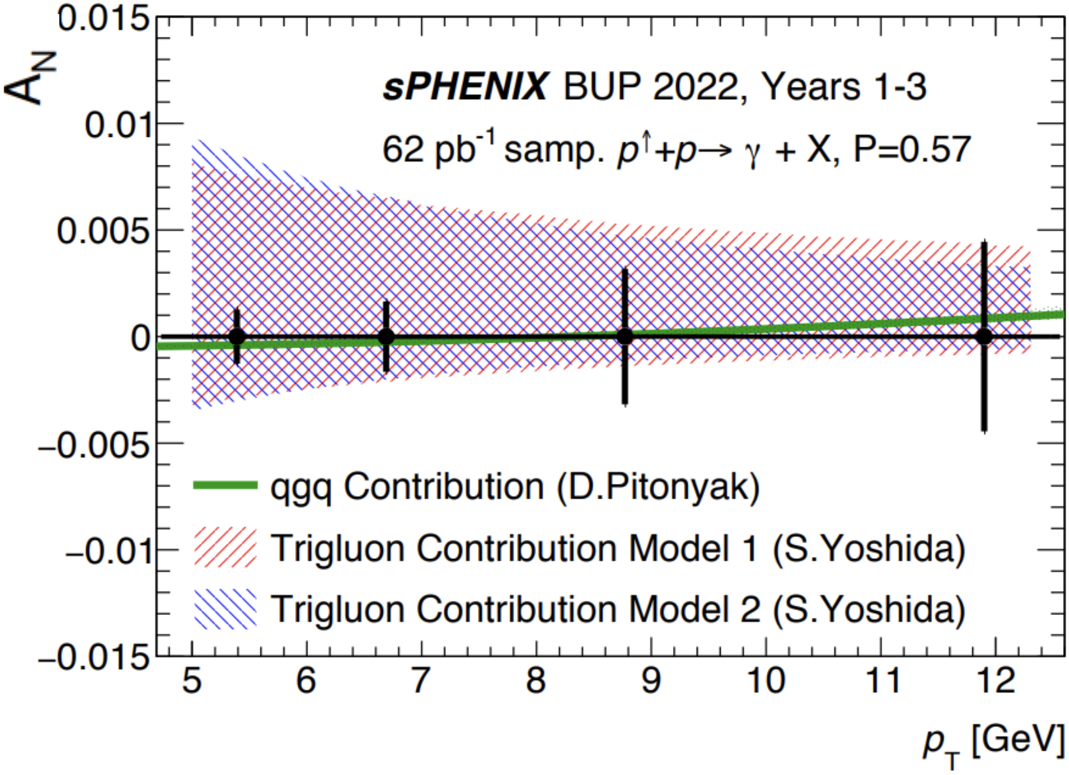
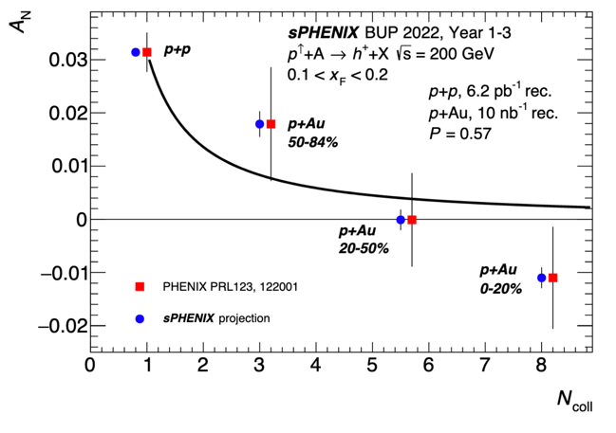
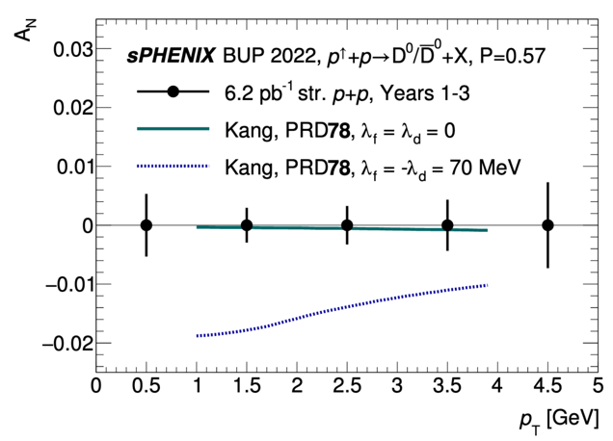

Cold QCD
TSSA via prompt γ & $D^{0}$
p+Au: Measure nuclear dependence of TSSA
Apply unique sPHENIX capabilities to answer questions posed by PHENIX measurements

Slide 31

sPHENIX Collaboration
• 358 Members
• 83 Institutions
• 14 Countries
• 4 Continents
Encouraging diversity is a priority for our collaboration.
  Diversity, Equity, & Inclusion training will be a requirement for being an sPHENIX author.

Slide 32

Conclusions
sPHENIX is the first new detector at RHIC in > 20 years
  Key component of RHIC’s science mission for 2023–2025.
The physics program focuses on measuring jet and heavy-flavor observables.
  Much improved precision w.r.t. previous RHIC experiments.
  First RHIC measurements of b-jets, Υ(3S) suppression.
  Kinematic overlap with LHC also possible in many cases.
Detector installation in progress
  Most detectors installed inside magnet, detector is in position.
We look forward to an exciting physics program!

Slide 33
Backup

Slide 34


Jet Azimuthal Anisotropy
Event Plane Detector will improve resolution
  More precise v₂ studies – including jet v₂
sPHENIX jet v₂ will complement LHC measurements:
  Lower p_{T} than ATLAS with comparable uncertainties
  Overlaps with ALICE kinematic range
Also plans to measure jet v₂ in p+Au collisions

