Slide 1


RF for non-linear ramping functions and emittance studies for different number of RF stations
F. Batsch¹, I. Karpov, H. Damerau
Acknowledgements: A. Chance, A. Grudiev, D. Amorim, E. Metral, F. Boattini, L. Bottura
MC RF WG meeting #11
13/09/2022

Slide 2

Outline:
Different magnetic ramping functions and their influence on accelerator performance, RF gradient, synchrotron phase, and bunch stability
Emittance growth versus number of RF stations
[1] |  | Unit | RCS-LE | RCS-ME | RCS-HE
Injection energy | E_{inj} | [GeV] | 63 | 313 | 750
Ejection energy | E_{ej} | [GeV] | 313 | 750 | 1500
Energy ratio E_{ej}/ E_{inj} | - | 4.98 | 4.76 | 2.39 | 2.00
Circumference | 2πR | [m] | 5990 | 5990 | 10700
Acceleration time | τ_{acc} | [ms] | 0.34 | 1.10 | 2.37
# turns | # | - | 17 | 55 | 66
Energy gain per turn | ΔΕ | [GeV] | 14.6 | 7.9 | 11.3
RF voltage per turn for φ_{s}=45° | V_{RF} | [GV] | 20.7 | 11.23 | 16.0
Parameters used:
BLonD code extended for multiple RF stations and muon decay, 3 RCSs
> 265 1.3 GHz TESLA cavities
Cavity parameter: L=1.04m, Q_{L}=2.2e6, R/Q = 518Ω, gradient in cavity 30MV/m
Bunch population of 2.34e12, emittance 0.01eVs
Beam current 18.8 mA
Total R_{S} = 306 GΩ
Parameters summarized in [1] and here online
2

Slide 3
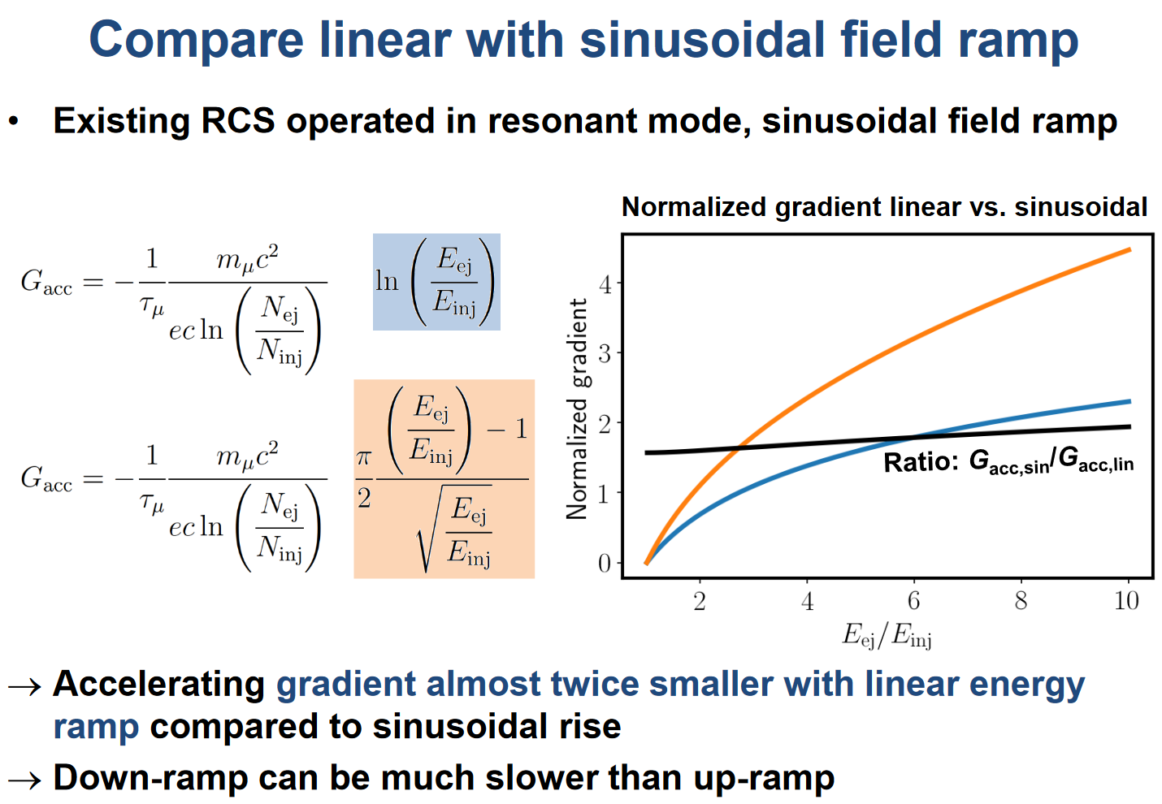
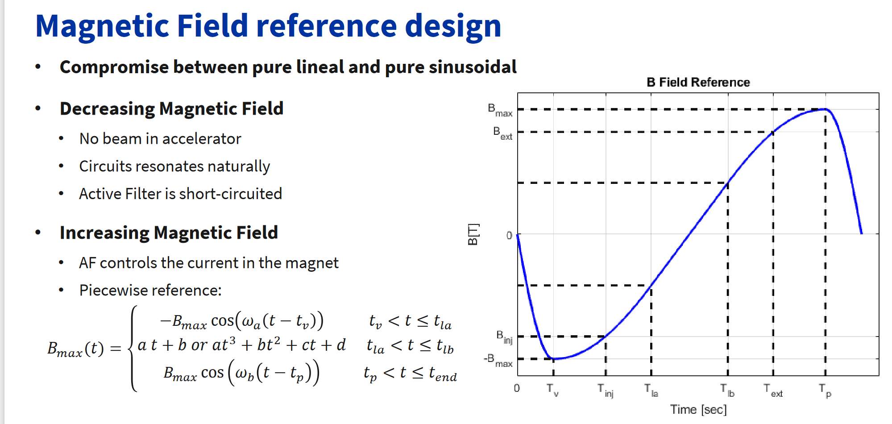

Key points for differently shaped ramp rate
Optimization problem between magnet powering and RF voltage / power
Linear ramping would lead to a constant RF voltage -> simplest RF solution
However: this is not a RF requirement for good beam transport!
Non-linear ramping will decrease peak power and thus powering costs of magnets significantly (presentation by G. Brauchli, D. Aguglia, F. Boattini here)
Sinusoidal ramp function lead to a performance decrease of 50%, see here
Slide by H. Damerau, I. Karpov, MC RF WG meeting #3
Slide by G. Brauchli, D. Aguglia, F. Boattini
3

Slide 4
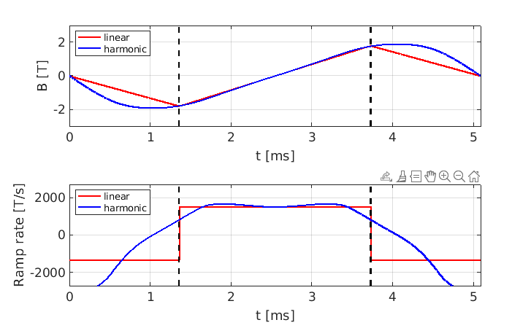
Non-linear ramping of the B-field
As a compromise, peak power can be lowered by e.g. natural resonant discharge of two harmonics and active filter that give an approximately linear ramping
A possible ramping function as supplied by F. Boattini is:
The corresponding ramp rate
Example for RCS3, hybrid magnet scheme (±1.8T normal conducting, 10T SC), 2.4ms acceleration time, but equal trend line for the other RCSs
Injection
Ejection
4
From F. Boattini

Slide 5
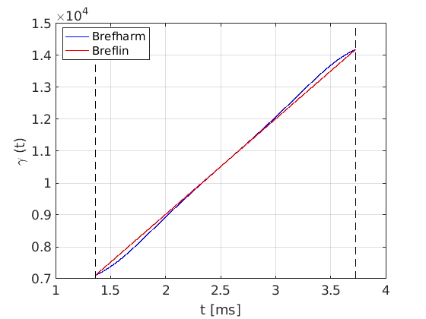
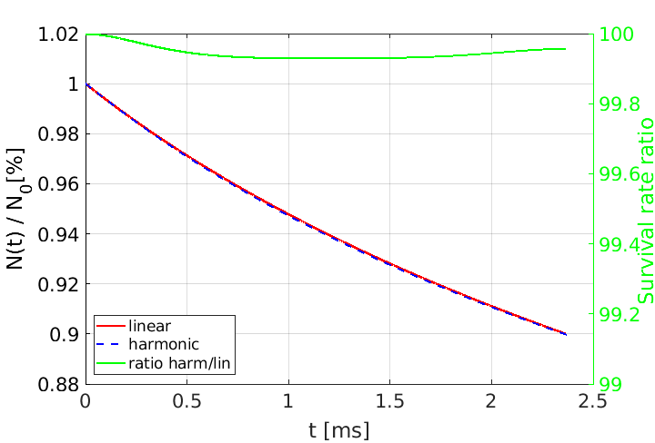
Acceleration with non-linear ramping
The corresponding beam energies over time for RCS3, acceleration from 750GeV to 1.5TeV, expressed by their γ functions, follow the same trend as B(t):
Ramp with harmonics
Linear ramp
Similar decay rate!
Injection
Ejection
Despite small differences in particle energy, losses due to muon decay are identical when allowing for higher acceleration gradients:
5

Slide 6
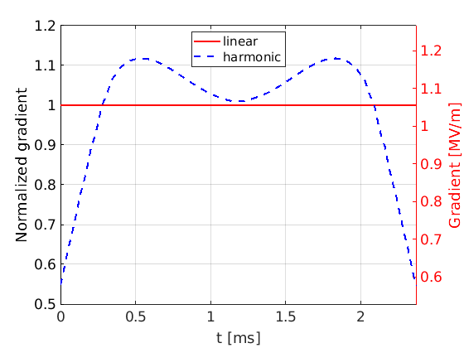
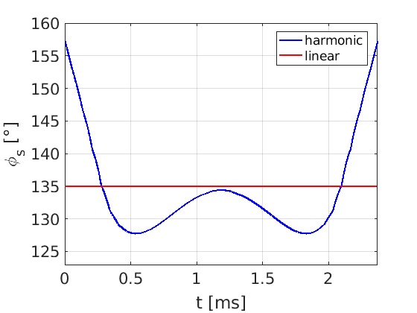
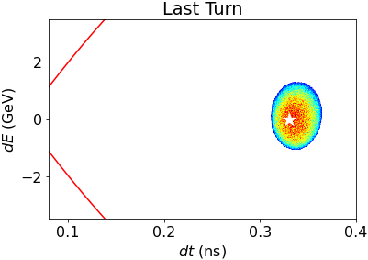
Gradients for non-linear B-field ramping
The accelerating voltage or average gradient has to be increased by 12% to achieve the same acceleration performance, but not by a factor of two as for a sine-like ramp:
The filling time of the cavity (2*Q_{L}/f)=3.4ms is longer than t_{acc}<2.4ms
(f=1.3GHz, Q_{L}=2.2e6)
This can be handled by sweep the synchrotron phase, as shown
in BLonD simulations with the given momentum program and fixed
RF voltage (example for RCS3, no intensity effects)
Constant gradient
6

Slide 7
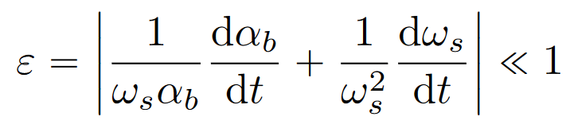
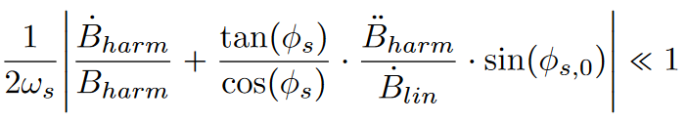

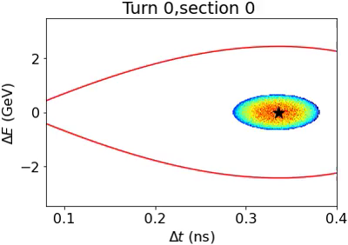
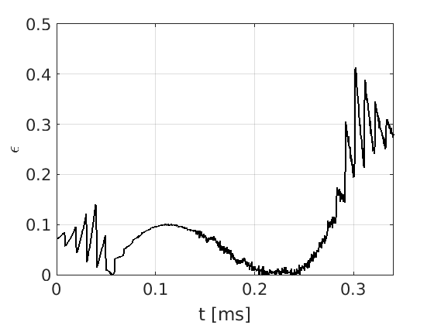
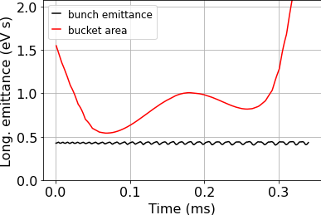

Limitations of the ramping functions
The sweeping of φ_{s} or the gradient raises the question of limitations in ramping B
We consider the bucket area deformation and the longitudinal emittance budget
In this progress, we analysed the adiabaticity factor ε with the requirement that
For RCS1 (63→313 GeV), no intensity effects, n_{RF}=48 RF stations
=
The beam is transported with approx. 3% emittance growth despite the large ε
→ ε not a measure?
Peaks non-physical, from
Note: Beam not properly matched with non-linear ramp and multiple RF stations
7

Slide 8
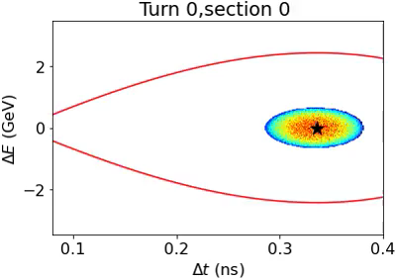
Summary (1)
Linear ramping not a requirement for optimal beam transport, non-linear or harmonic ramping functions that are quasi-linear are under investigation to optimize the RF/ magnet powering costs
While maintaining a similar accelerator performance, the harmonic ramping can be obtained while keeping the cavity voltage constant and letting the synchronous phase sweep
The proposed function requires 12% more voltage for some parts of the cycle
The change in voltage deforms the bucket, for which the longitudinal emittance budge is investigated (see 2nd part)
Simulations without intensity effects show that
the beam transport through all 3 RCS is not
substantially affected by the non-linear ramping
Beam transport through 3 RCSs, without intensity effects to observe effect of ramping, n_{RF}=48

Slide 9
Outline:
Different magnetic ramping functions and their influence on accelerator performance, RF gradient, synchrotron phase, and bunch stability
Emittance growth versus number of RF stations
9

Slide 10
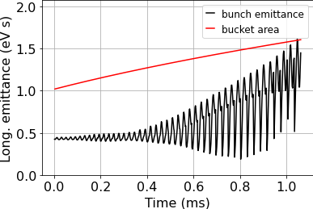
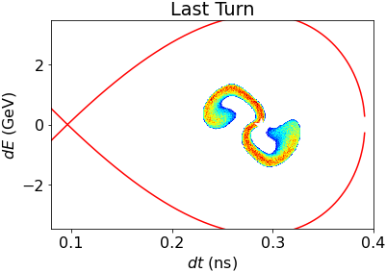
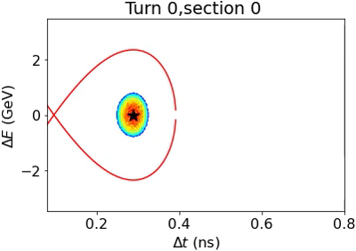
The number of RF stations n_{RF} …
Reminder: n_{RF} >> 1 because of the high synchrotron tune of ≈ 0.3-1.5
The higher n_{RF}, the smaller the quadrupole-like oscillations because of the discreet energy steps and resulting mismatching
A higher n_{RF} might result in higher construction and powering costs, even though the total number of cavities is constant and defined by the energy gain per turn
-> investigate this with EN-EL or CV
Here: Determine emittance growth as a function of n_{RF} as main criteria for beam quality for each RCS
Obtained emittance from simulation, i.e. 4πσ_{t}σ_{E}, along cycle and determine increase in emittance with respect to its end, with linear ramping
Simulation for RCS2,
n_{RF} = 12
10

Slide 11
The number of RF stations n_{RF} …
Reminder: n_{RF} >> 1 because of the high synchrotron tune of ≈ 0.3-1.5
The higher n_{RF}, the smaller the quadrupole-like oscillations because of the discreet energy steps and resulting mismatching
A higher n_{RF} might result in higher construction and powering costs, even though the total number of cavities is constant and defined by the energy gain per turn
-> investigate this with EN-EL or CV
Here: Determine emittance growth as a function of n_{RF} as main criteria for beam quality for each RCS
Obtained emittance from simulation, i.e. 4πσ_{t}σ_{E}, along cycle and determine increase in emittance with respect to its end → better definition of emittance in the code under investigation
Simulation for RCS2,
n_{RF} = 12
11

Slide 12
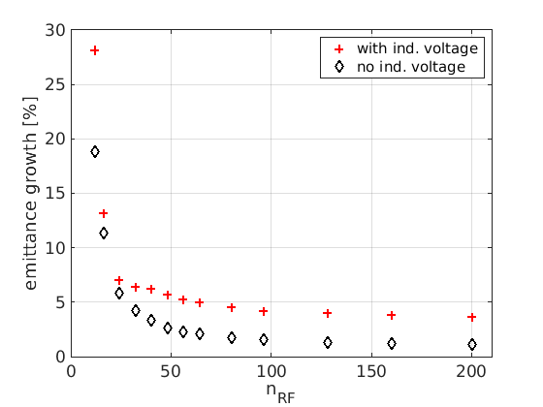
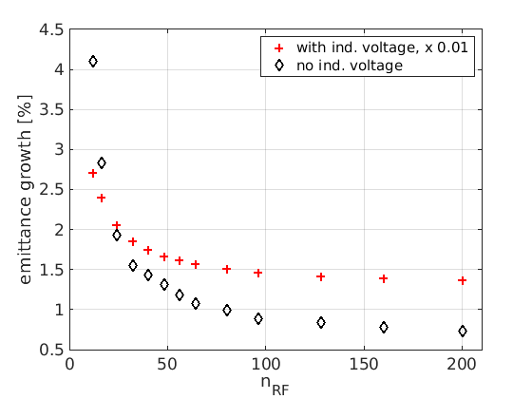
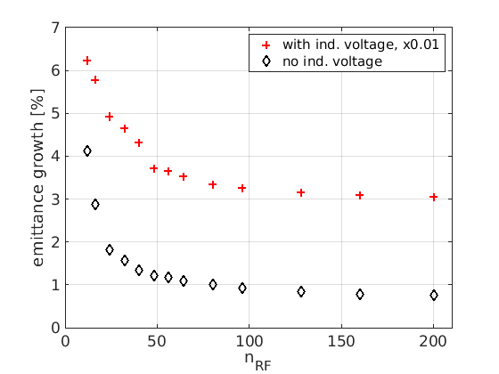
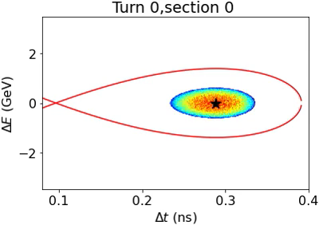
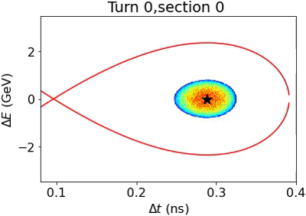
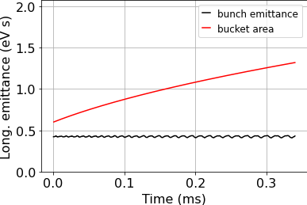
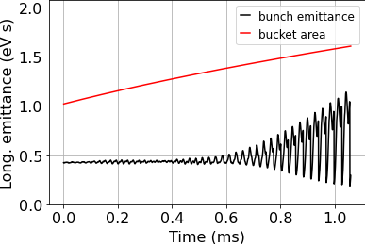
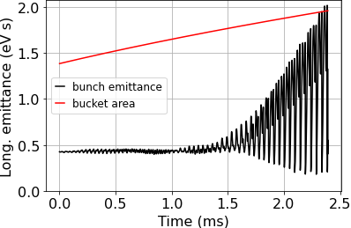
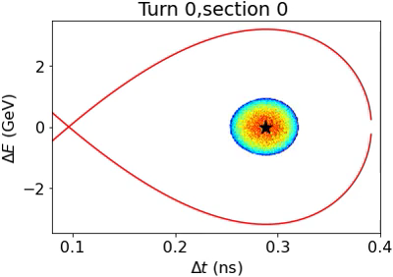
Emittance growth vs. n_{RF}
For each RCS and with and without induced voltage / intensity effects
No significant improvement of the emittance for n_{RF} >48
n_{RF} > 24 as minimum number of stations
RCS1
RCS2
RCS3
Above 24 as minimum?
12

Slide 13
Summary (2)
The study of the emittance growth vs n_{RF} for otherwise equal parameter is already a first effective tool to determine a range for n_{RF}
Approximately 24 < n_{RF} < 48 or 60 seems a reasonable choice
No different in trend caused by wakefields, as expected for the synchrotron tune

Slide 15
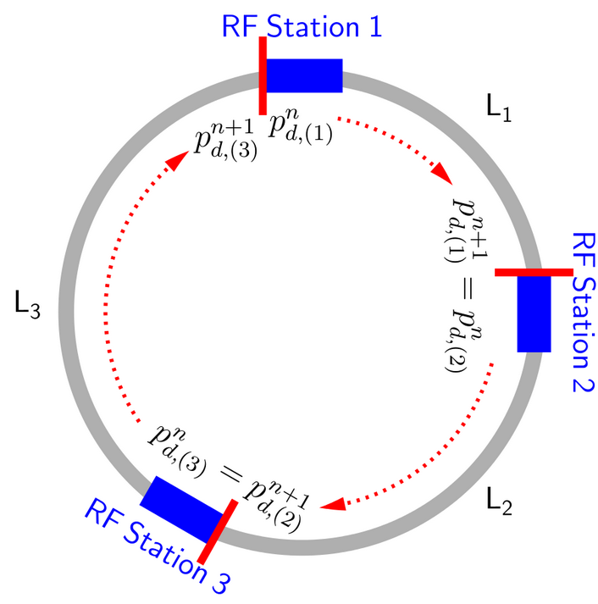
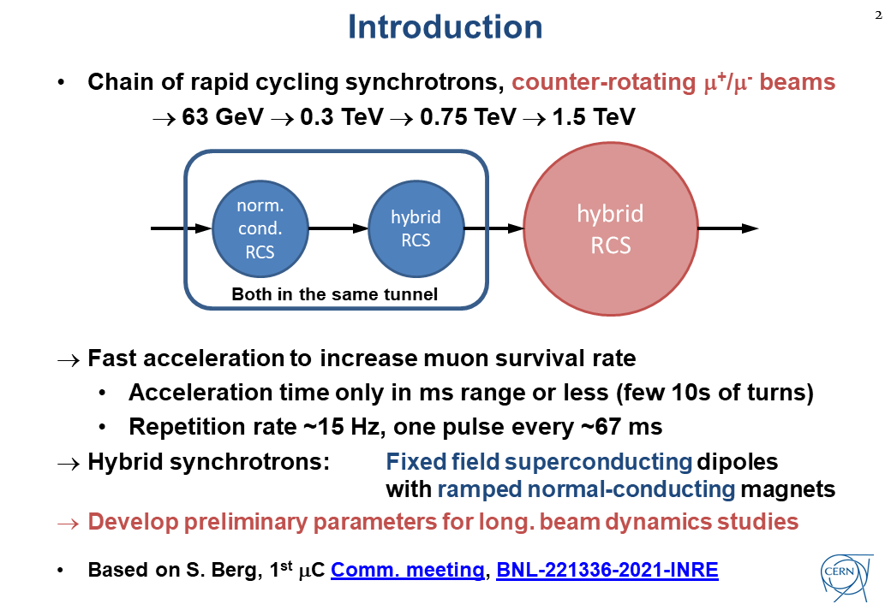
BLonD Simulations
BLonD: (Beam Longitudinal Dynamics code) macro-particle tracking code, developed at CERN from 2014 on. Links: documentation and github
Reminder
From BLonD documentation

Slide 16
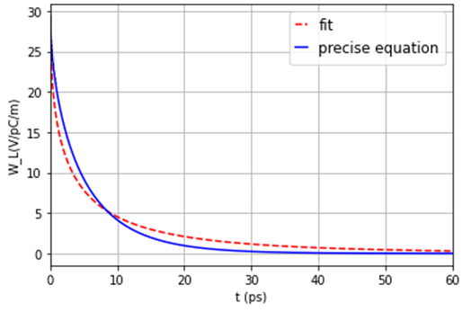
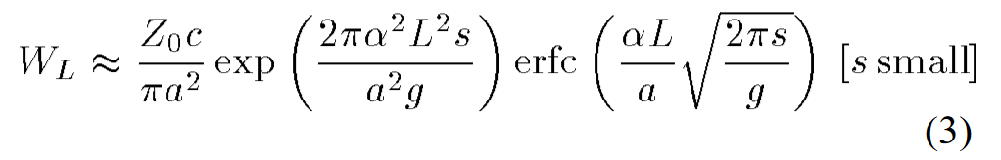
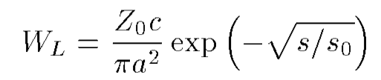
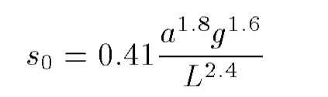
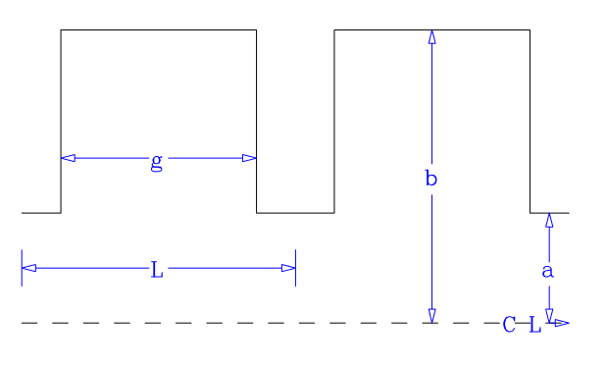
Short-range wakefields:
Based on K. Bane et al., ‘Calculation of the short-range longitudinal wakefields in the NLC linac’, ICAP98, 1998
The longitudinal wake function is given by:
One can approximate this by a semi-analytically expression, valid for small s and s/L<0.15:
The parameters for the Tesla cavity¹ gives long. wake functions on the order of 30 V/pC/m:
The BLonD code convolutes the wake function with the beam profile to obtain the induced voltage
L= 115.4 mm
g= 82 mm
a= 35 mm
b= 103.3 mm
12 September 2022
16
¹Wakefield studies for the Tesla cavity shown in TESLA Report 2003-19

