Slide 1

Q1-TAXS vacuum system design
Jaime Pérez Espinós on behalf of WP12
12th HL-LHC Collaboration Meeting Uppsala (Sweden), 19-22 September 2022

Slide 2
Contents
Q1-TAXS module design
Pumping / Ne venting lines
Integration and installation aspects with impact on the Q1-TAXS area
Summary of main open points

Slide 3
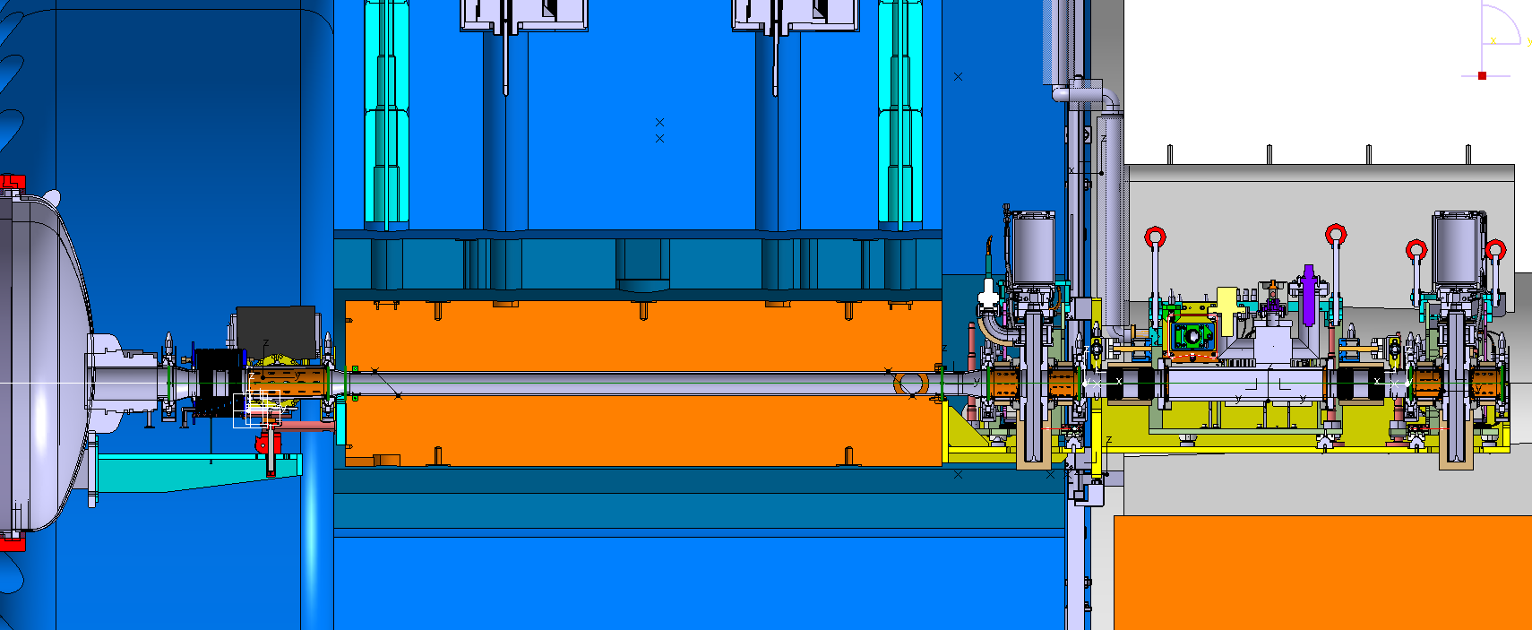
Q1-TAXS connection - ATLAS
Pumping / Ne venting lines routed along outer shielding
Q1-TAXS connection
TAXS chamber

Slide 4
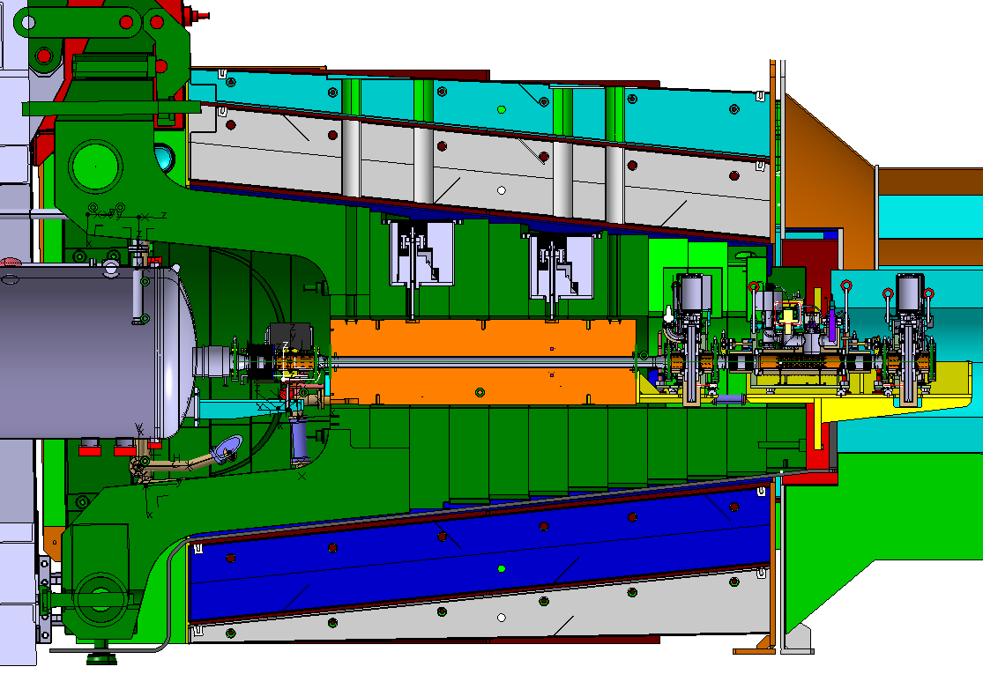
Q1-TAXS connection - CMS
Q1-TAXS connection
TAXS chamber
Pumping / Ne venting lines routed along outer shielding

Slide 5
Q1-TAXS module design

Slide 6
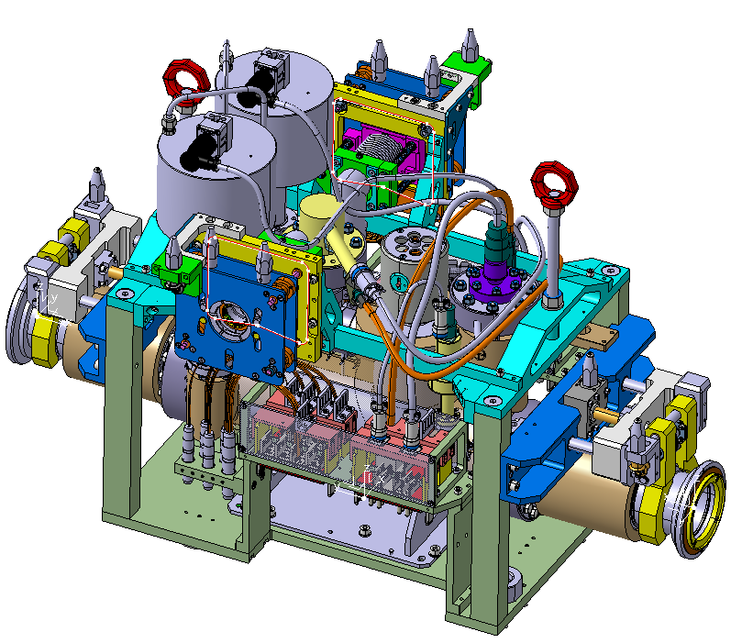
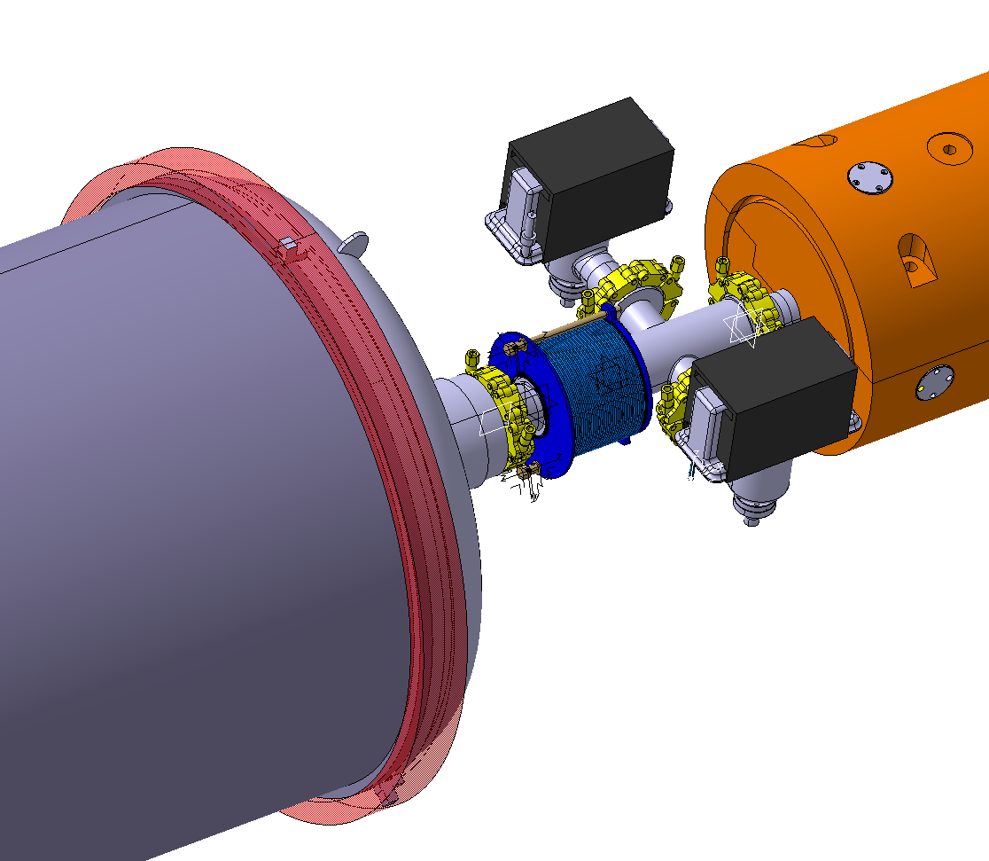
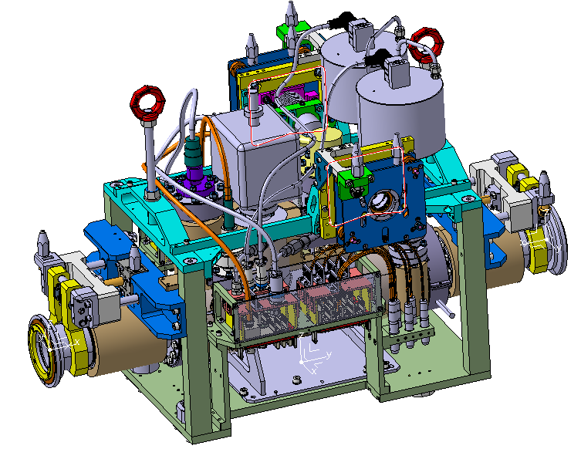
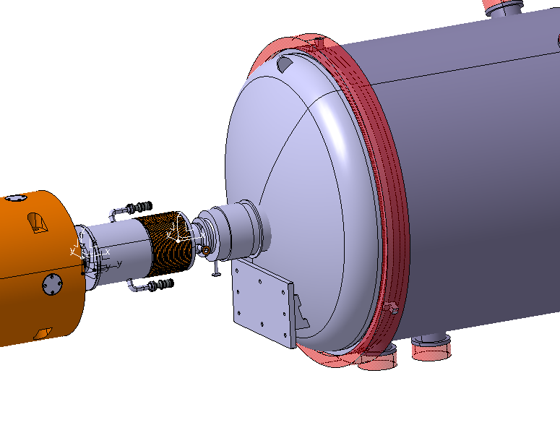
Vacuum layout alternatives
NEG coating
1x VPNCA
2x VPIAN
2x VPNCA
BASELINE
a-C coating
Cryogenic
Q1 cryostat
IP sector
VAX M3
VAX
M2
VAX M1
TAXS
TAXS
Module
2x VPIAN
2x VPNCA
2x UHV1400 wafer
LAST PROPOSAL (TBC)
1x VPNCA
+ 1x VPIXD or + 1x VPIB
NEG coating
a-C coating
Cryogenic
Q1 cryostat
IP sector
VAX M3
VAX
M2
VAX M1
TAXS
TAXS
Module

Slide 7
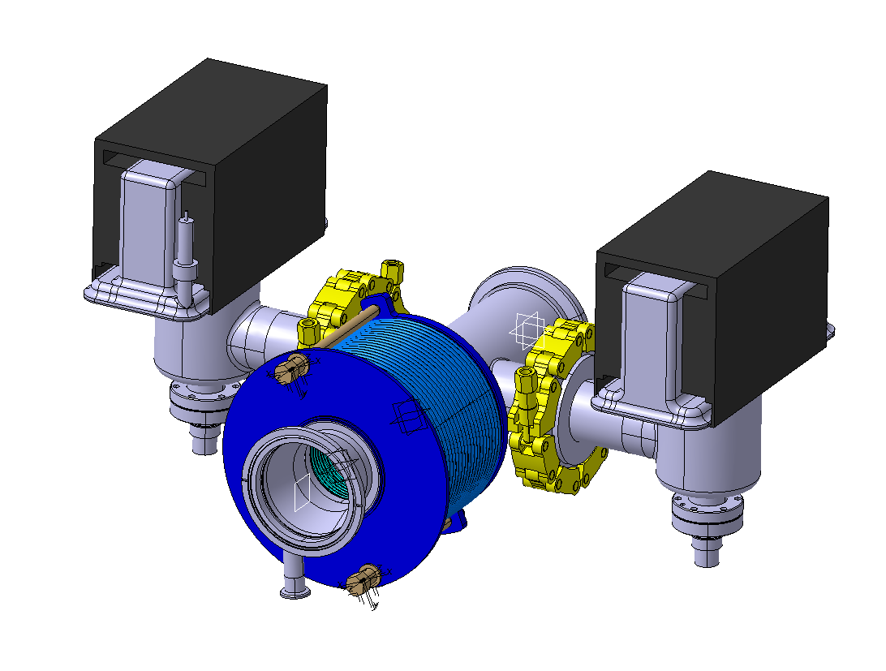
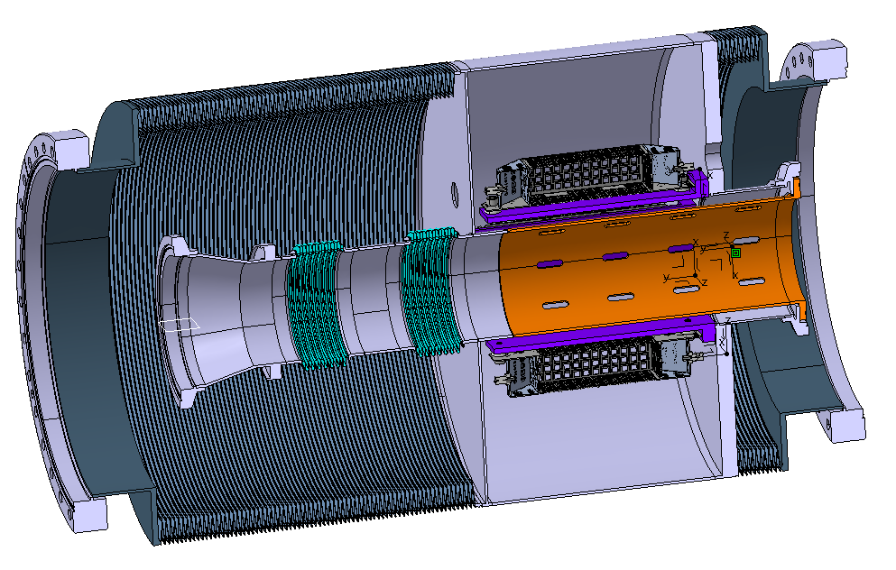
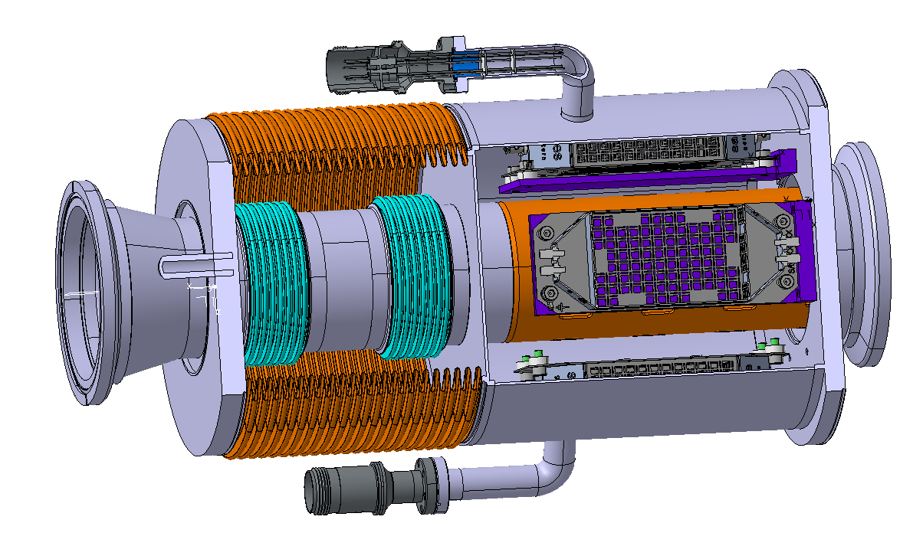
Q1-TAXS module working models
Estimated weights
66 kg
19 kg
45 kg
Current baseline
Alternative design with NEG wafers #1
Alternative design with NEG wafers #2
NEG wafers under qualification at CERN

Slide 8
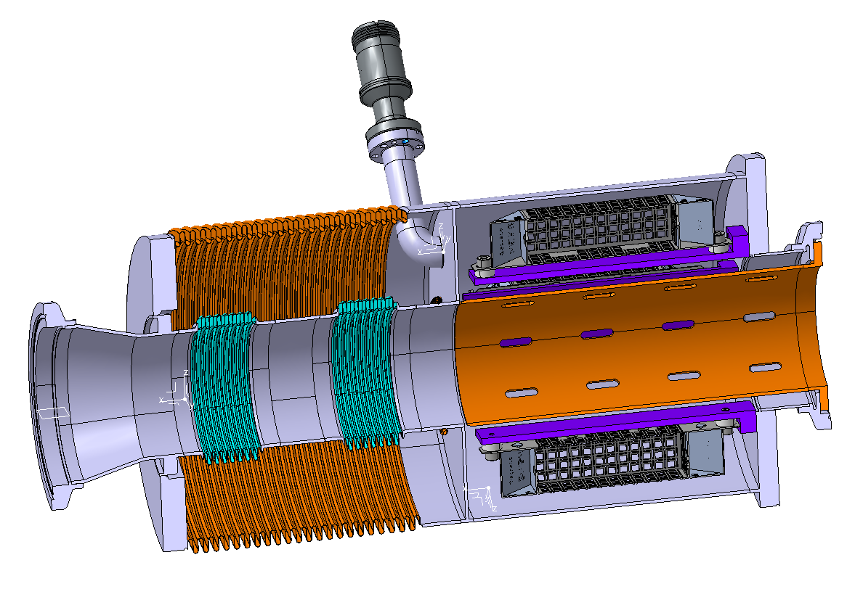
Alternative design with NEG wafers #1
Tube D204/200 (minimum diameter to fit the NEG wafers)
4 NEG wafers HV400 integrated
Double bellows system enables secondary vacuum to mitigate potential future leak on internal bellows and locate intermediate feedthrough
  Internal double bellows (same as for the VAX)
  Outer bellows (same shape convolution as for existing solution on plug-in)
2 feedthrough connections (up to 2 wafers per connection)
Distance of wafers to beam pipe is to be defined following vacuum qualification process
Integration of NEG wafer cabling and feedthroughs is open

Slide 9
Alternative design with NEG wafers #2
Tube D340/336 used
4 NEG wafers HV400 integrated
Double bellows system enables secondary vacuum to mitigate potential future leak on internal bellows, on wafer feedthrough and on vacuum connections
  Internal double bellows (same as for the VAX)
  2x outer bellows → edge-welded bellows
2 feedthrough connections (up to 2 wafers per connection)
Distance of wafers to beam pipe is to be defined following vacuum qualification process
Design much more complex and difficult to implement (TBC)
Compression system is required
More bulky solution to integrate quick flanges DN100
He dome and outer sealing connection at TAXS side are blocking points

Slide 10
Pumping / Ne venting lines

Slide 11
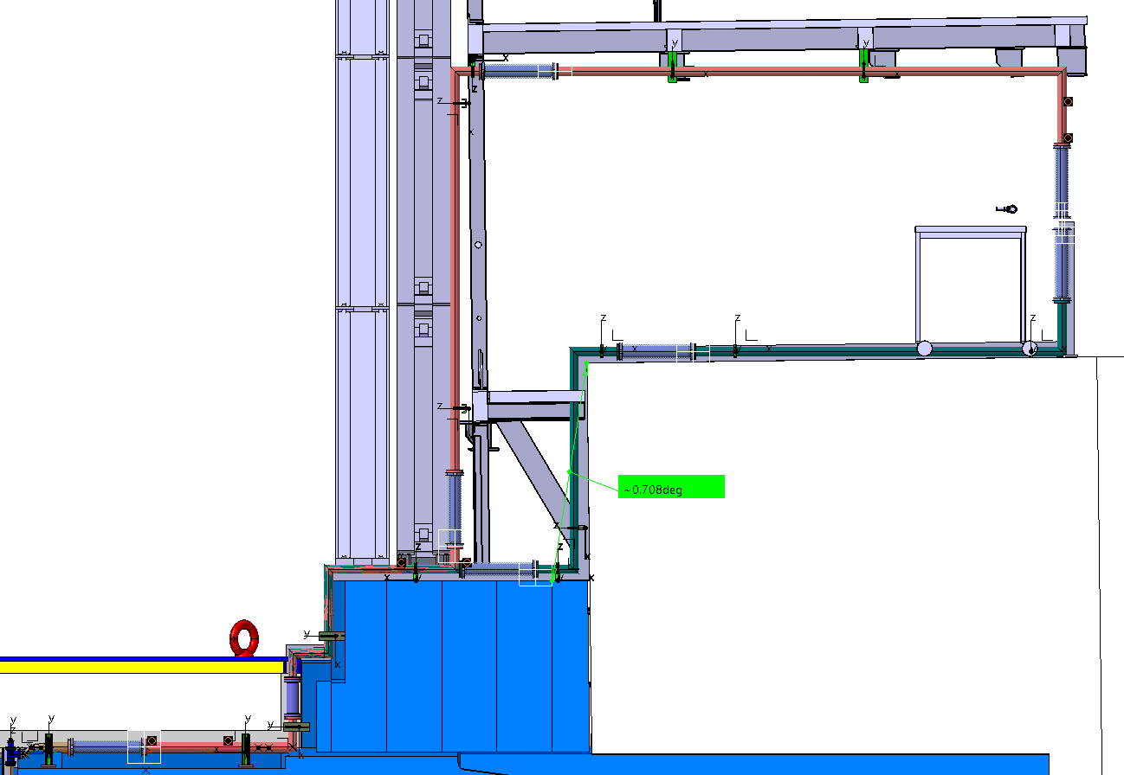
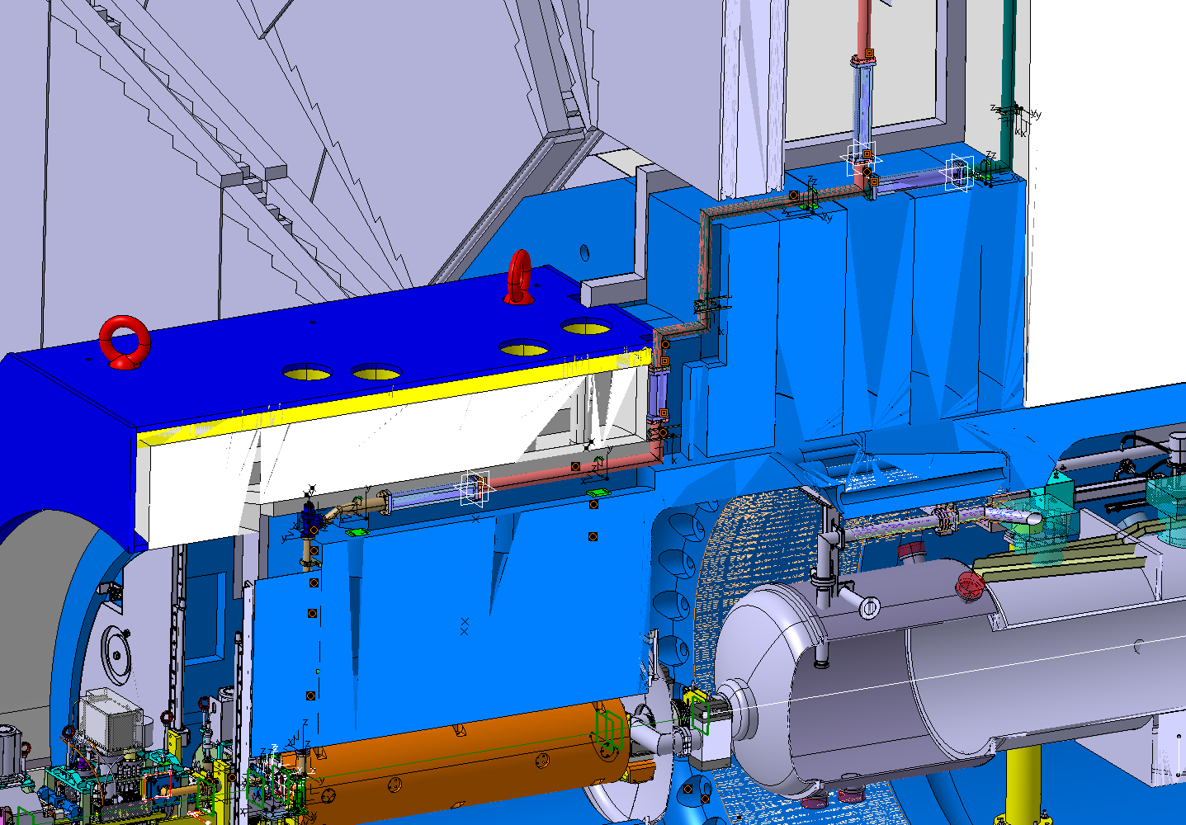


Status of pumping lines - ATLAS
Conceptual design is defined for A-side
Baseline is to retain a symmetrical solution at C-side → GIS to be installed symmetrically on similar location (reduced height wrt A-side) (TBC)
Connection at VAX side is open. 2x alternatives are being analyzed (see next slide):
  Manual connection at JFSU octagon level → involves extending structure of M2-M3 support
  Remotely operated connection at alignment plate level → involves making space at JFC3 or TX1SP shields (detailed analysis required)
Stays in place
Moves during LS
Out of walking area – nonadditional protective equipment required
More complex anchor points
Uncertainty of real position of beams, cables or other equipment
TXS1SO
GIS Area
JFSU - Octagon
DN63/60 pipe
Easier installation
Hazard situation – walking area
Fragile components to be protected
Platform to be machined
Monoblock
TXS1SO
JFSU - octagon
Monoblock
DN38/34 pipe

Slide 12
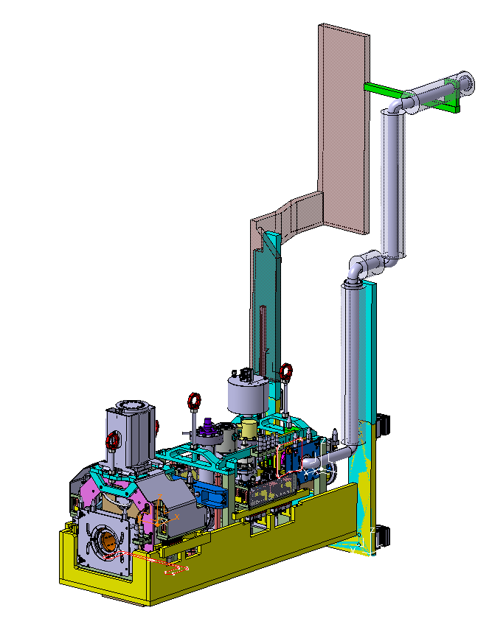
Status of pumping lines – ATLAS (VAX area)
Remotely operated connection at alignment plate level
Manual connection at JFSU octagon level
Modification on shielding is necessary
Services remain fixed to the shield
Services move with M2-M3 support
Extending support structure is envisaged as part of M2-M3 support

Slide 13
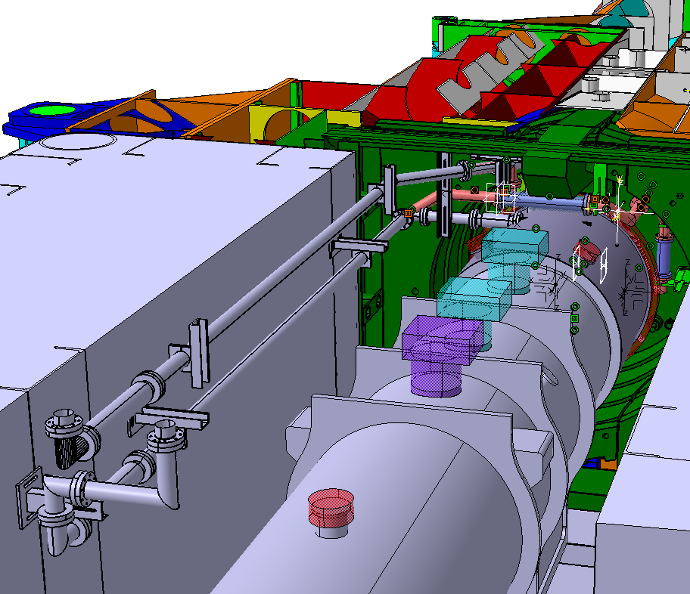
Status of pumping lines – CMS (Q1-TAXS area)
Baseline is to retain routing of lines up to current LHC VAX → WP12.2.4 scope is design of new lines crossing TAXS and connection to existing pumping lines
Conceptual studies are made for right and left sides (no symmetrical solution) with lines connecting from above and from below → current baseline is to route from below (TBC from tests on WP8 Q1-TAXS area mock-up)
Integration studies of new routing of “existing” lines has been made following request by WP15
Lines to be dismantled
Lines to be kept
Pumping lines 5L

Slide 14
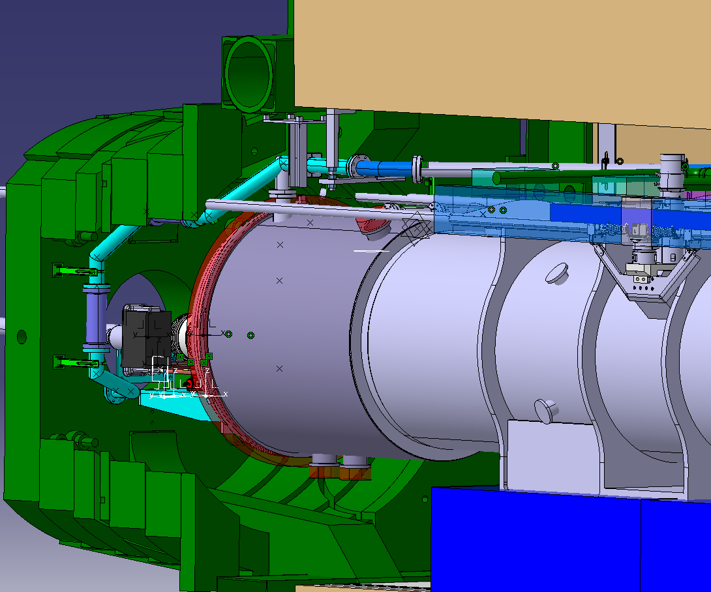
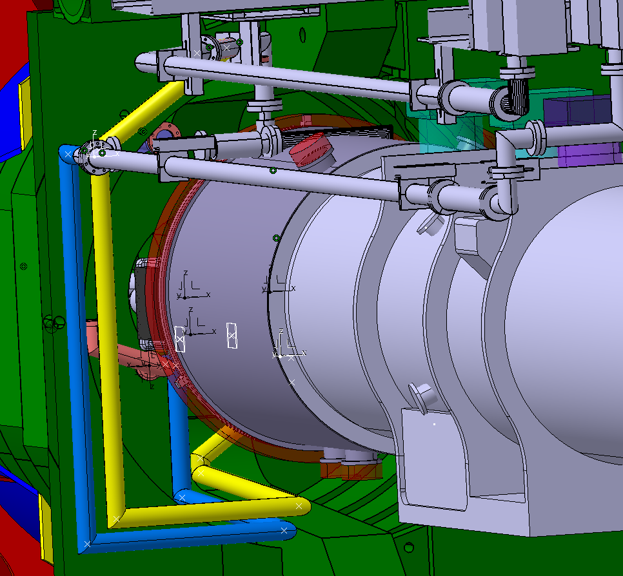
Routing of pumping lines – CMS (I)
Design is ongoing for left and right sides (no symmetrical)
Multiple iterations and interfaces: WP8, WP12 (BVO), WP15 (integration + schedule/installation), CMS (integration + schedule/installation)
Routing from above
Routing from below (BASELINE)

Slide 15
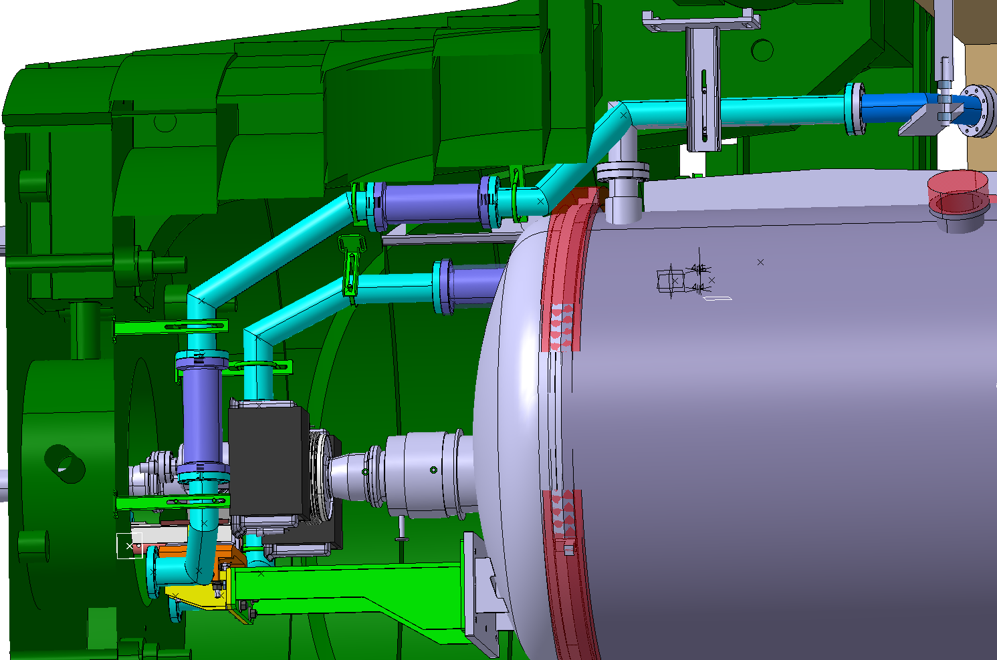
Status of pumping lines – CMS (II)
Example of line routing from above
DN63/60 pipe
DN38/34 pipe

Slide 16
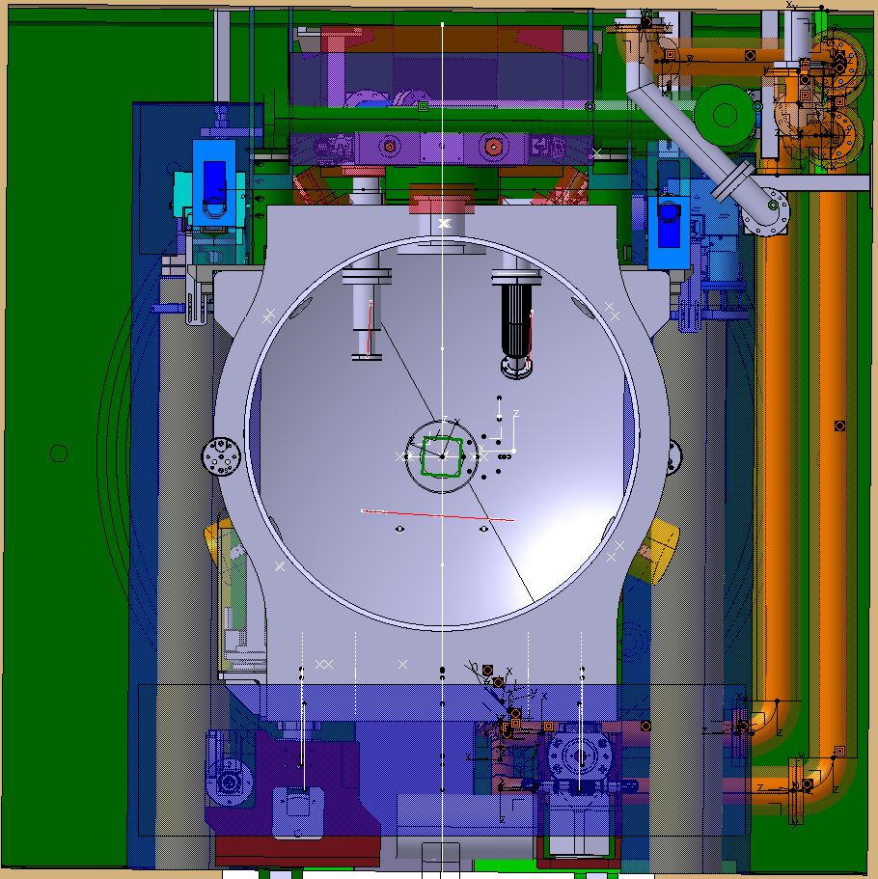
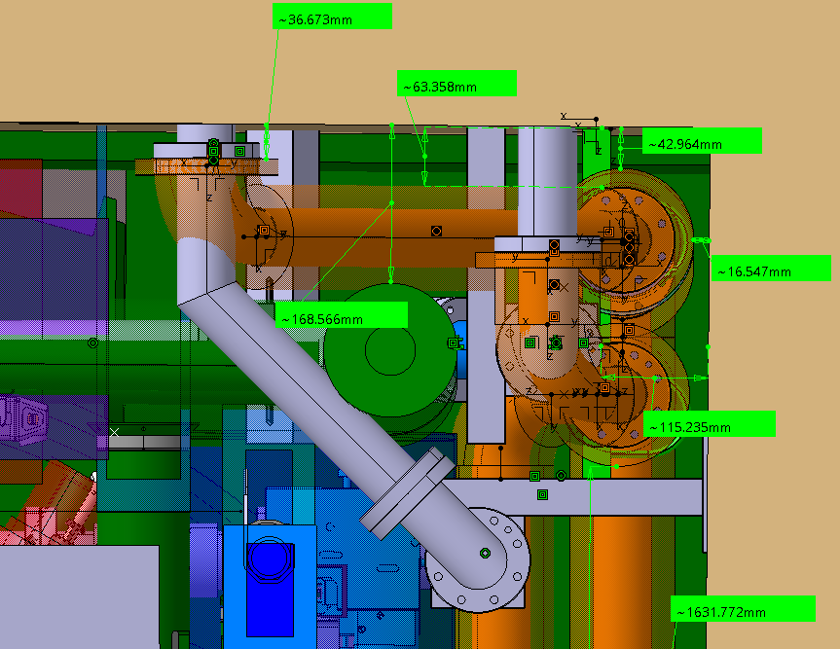
Conceptual integration studies 5R following request by WP15
Up to 3 options studied – to avoid clash with new survey device envelopes
WP15 to take a decision on next steps → possible additional scope for WP12.2.4

Slide 17
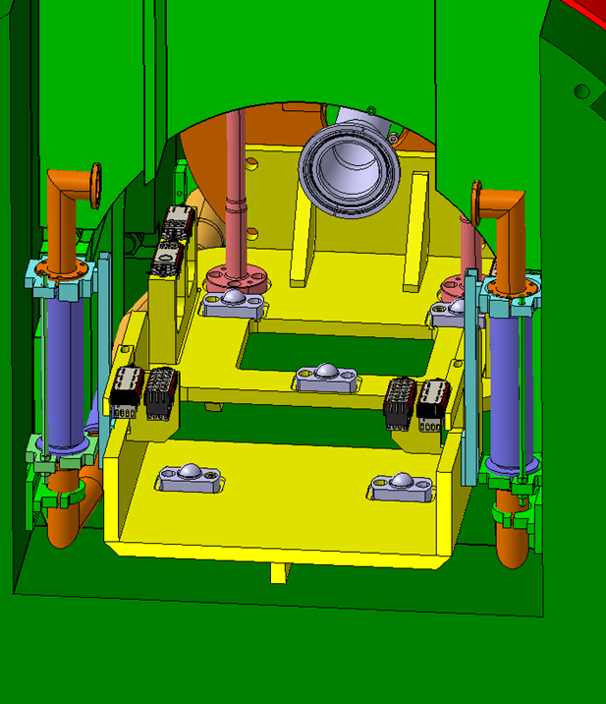
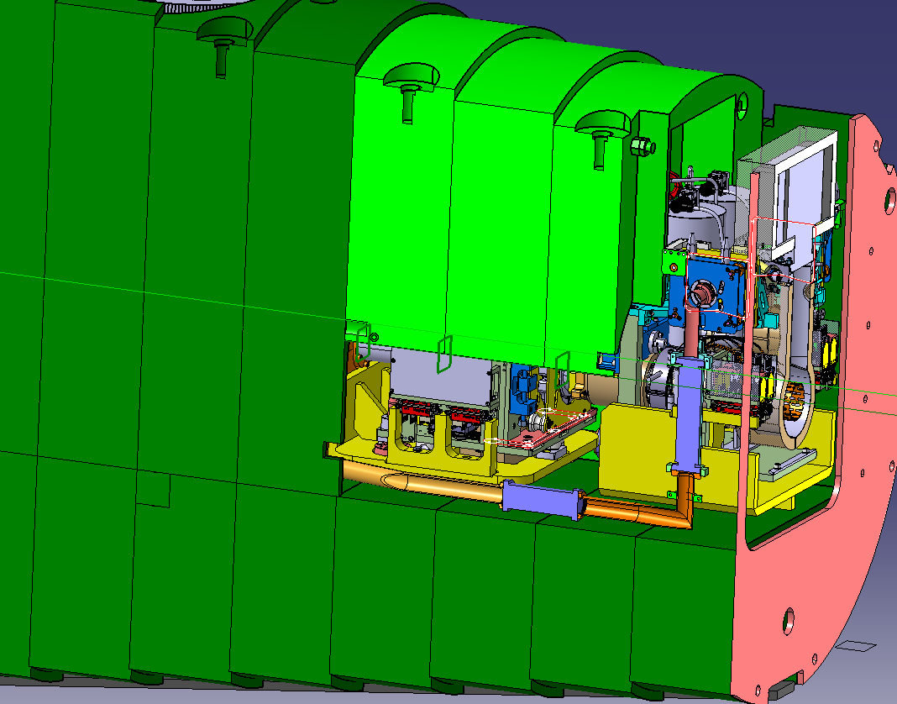
Status of pumping lines – CMS (VAX area)
Plug-in
Plug-in
FIN
Routed between the VAX supports and FIN;
Not possible to place them below the support:
  Clearance of +/-20mm is required for alignment;
  The envelope of heating elements is considered.
Concern:
Clearance between the VAX plug-in and the venting lines → Shielding re-design is under study
FIN

Slide 18
Integration and installation aspects with impact on the Q1-TAXS area

Slide 19
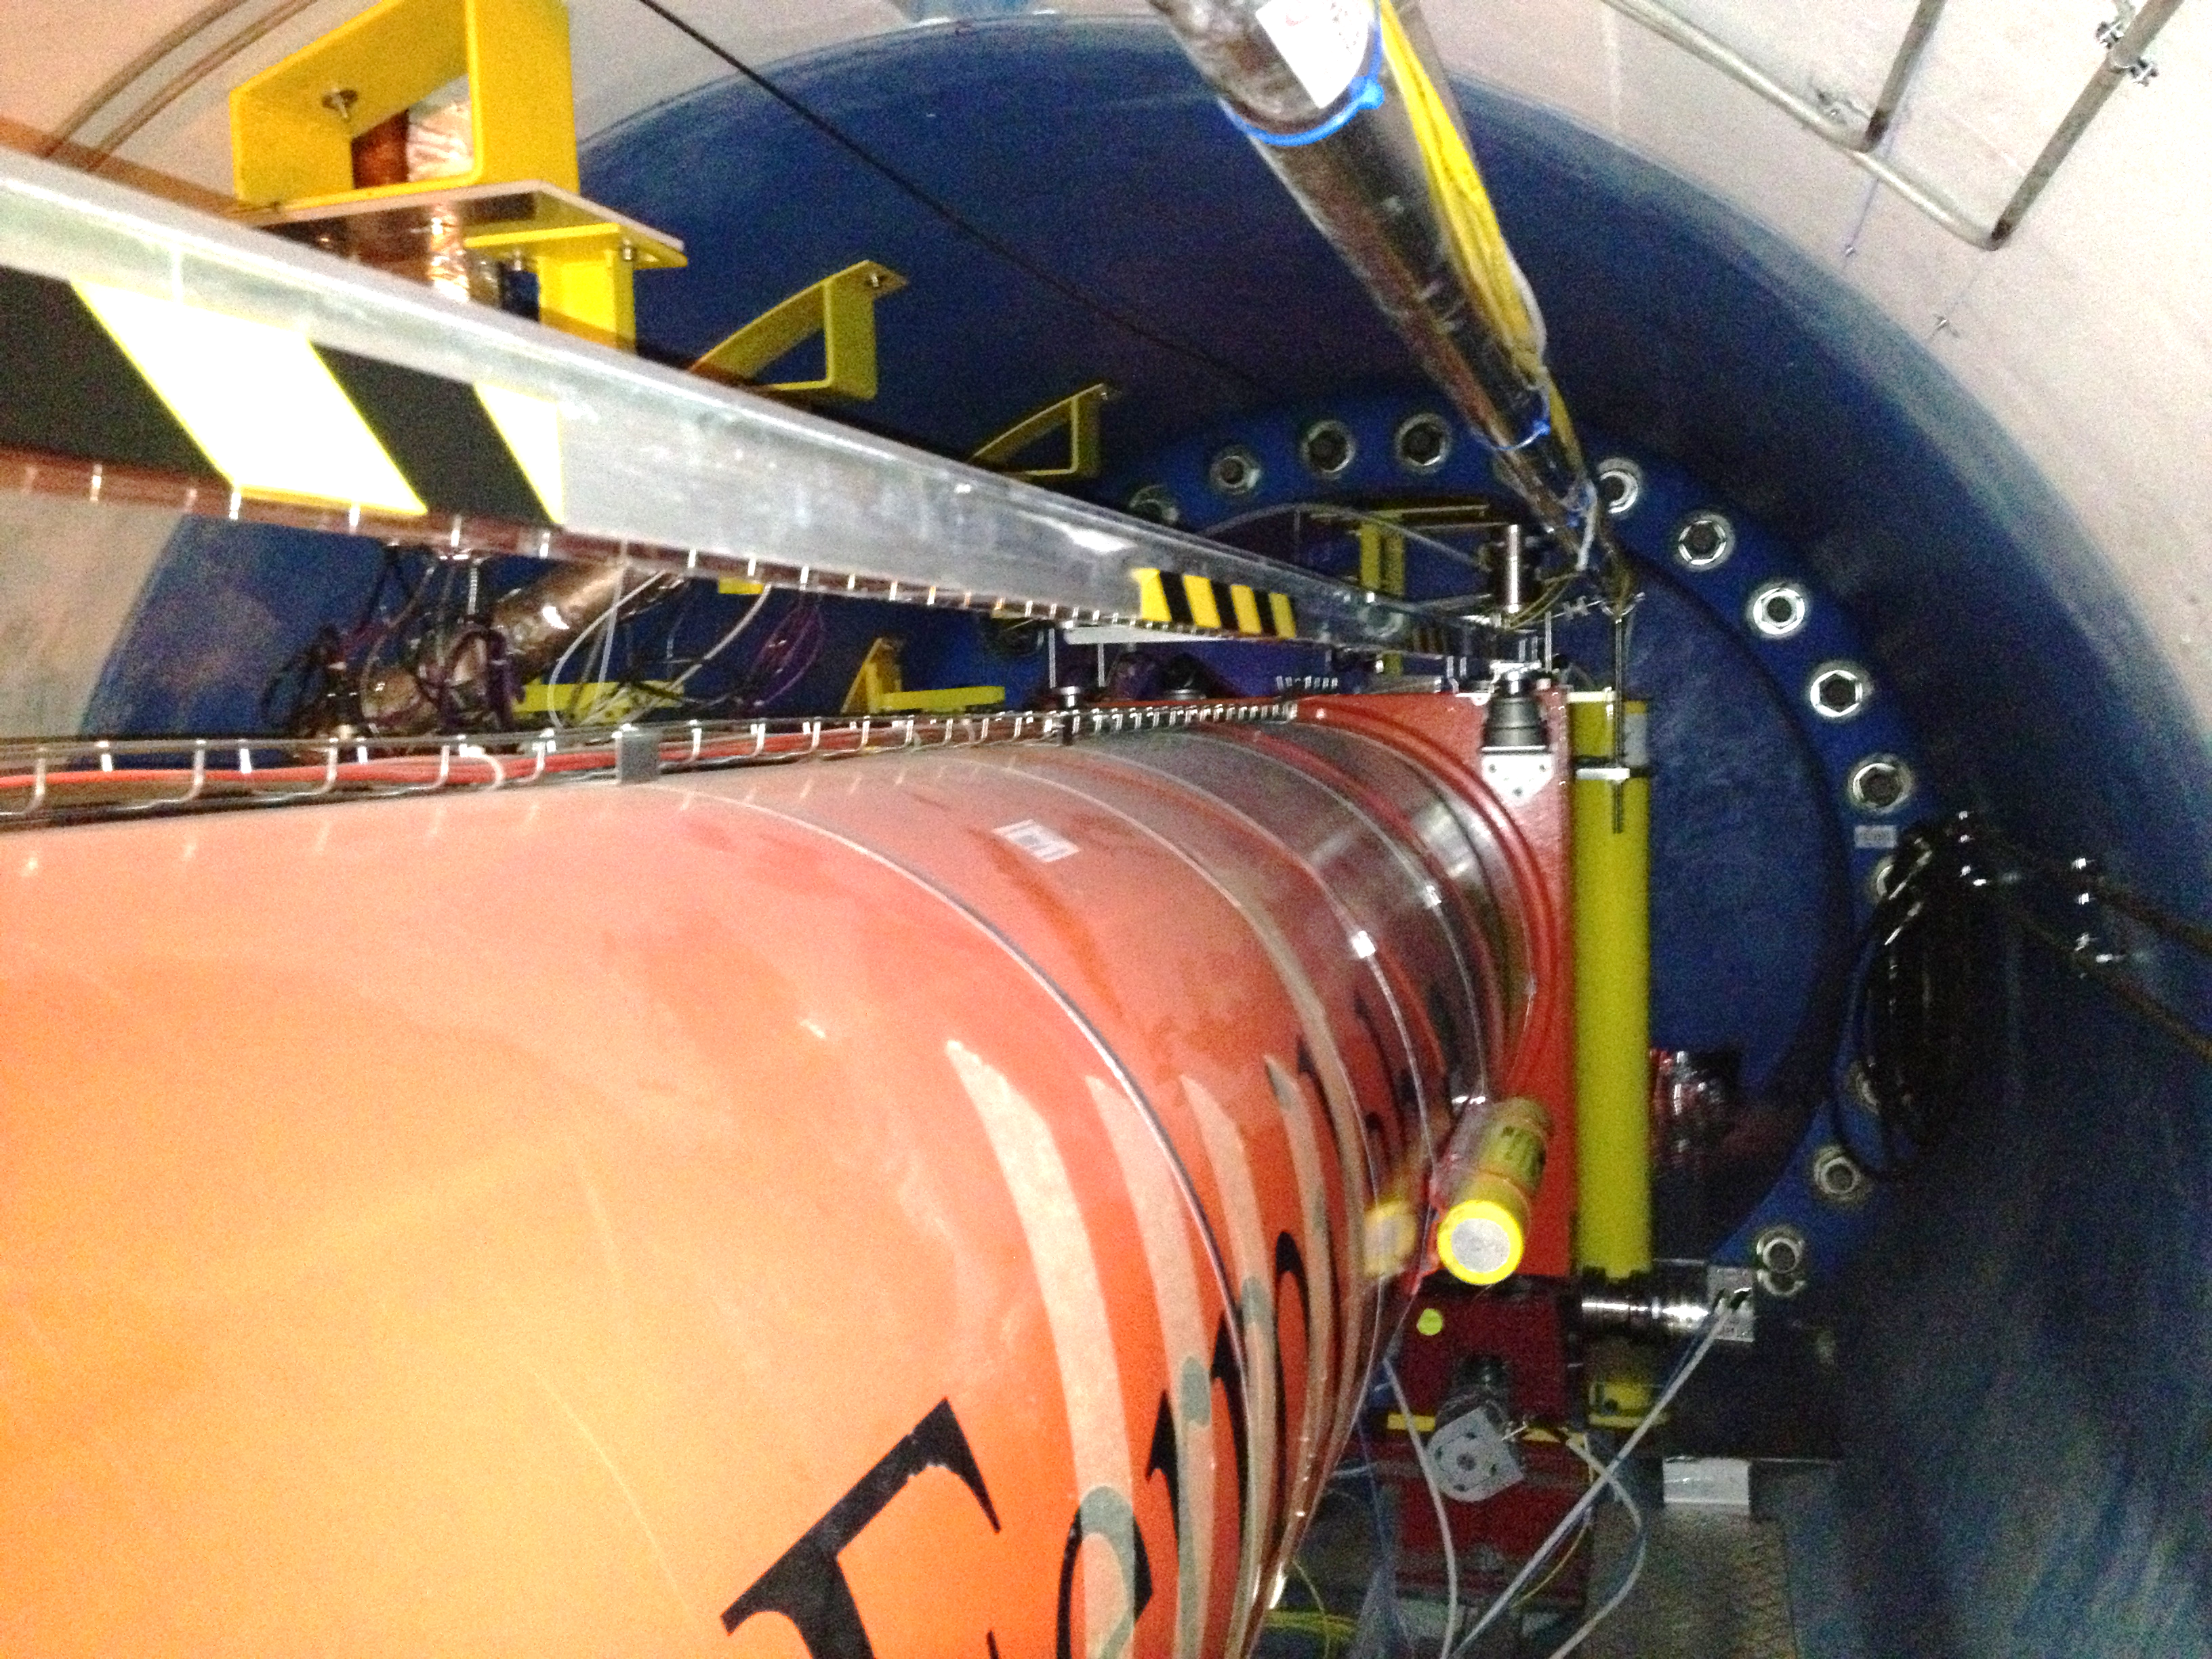
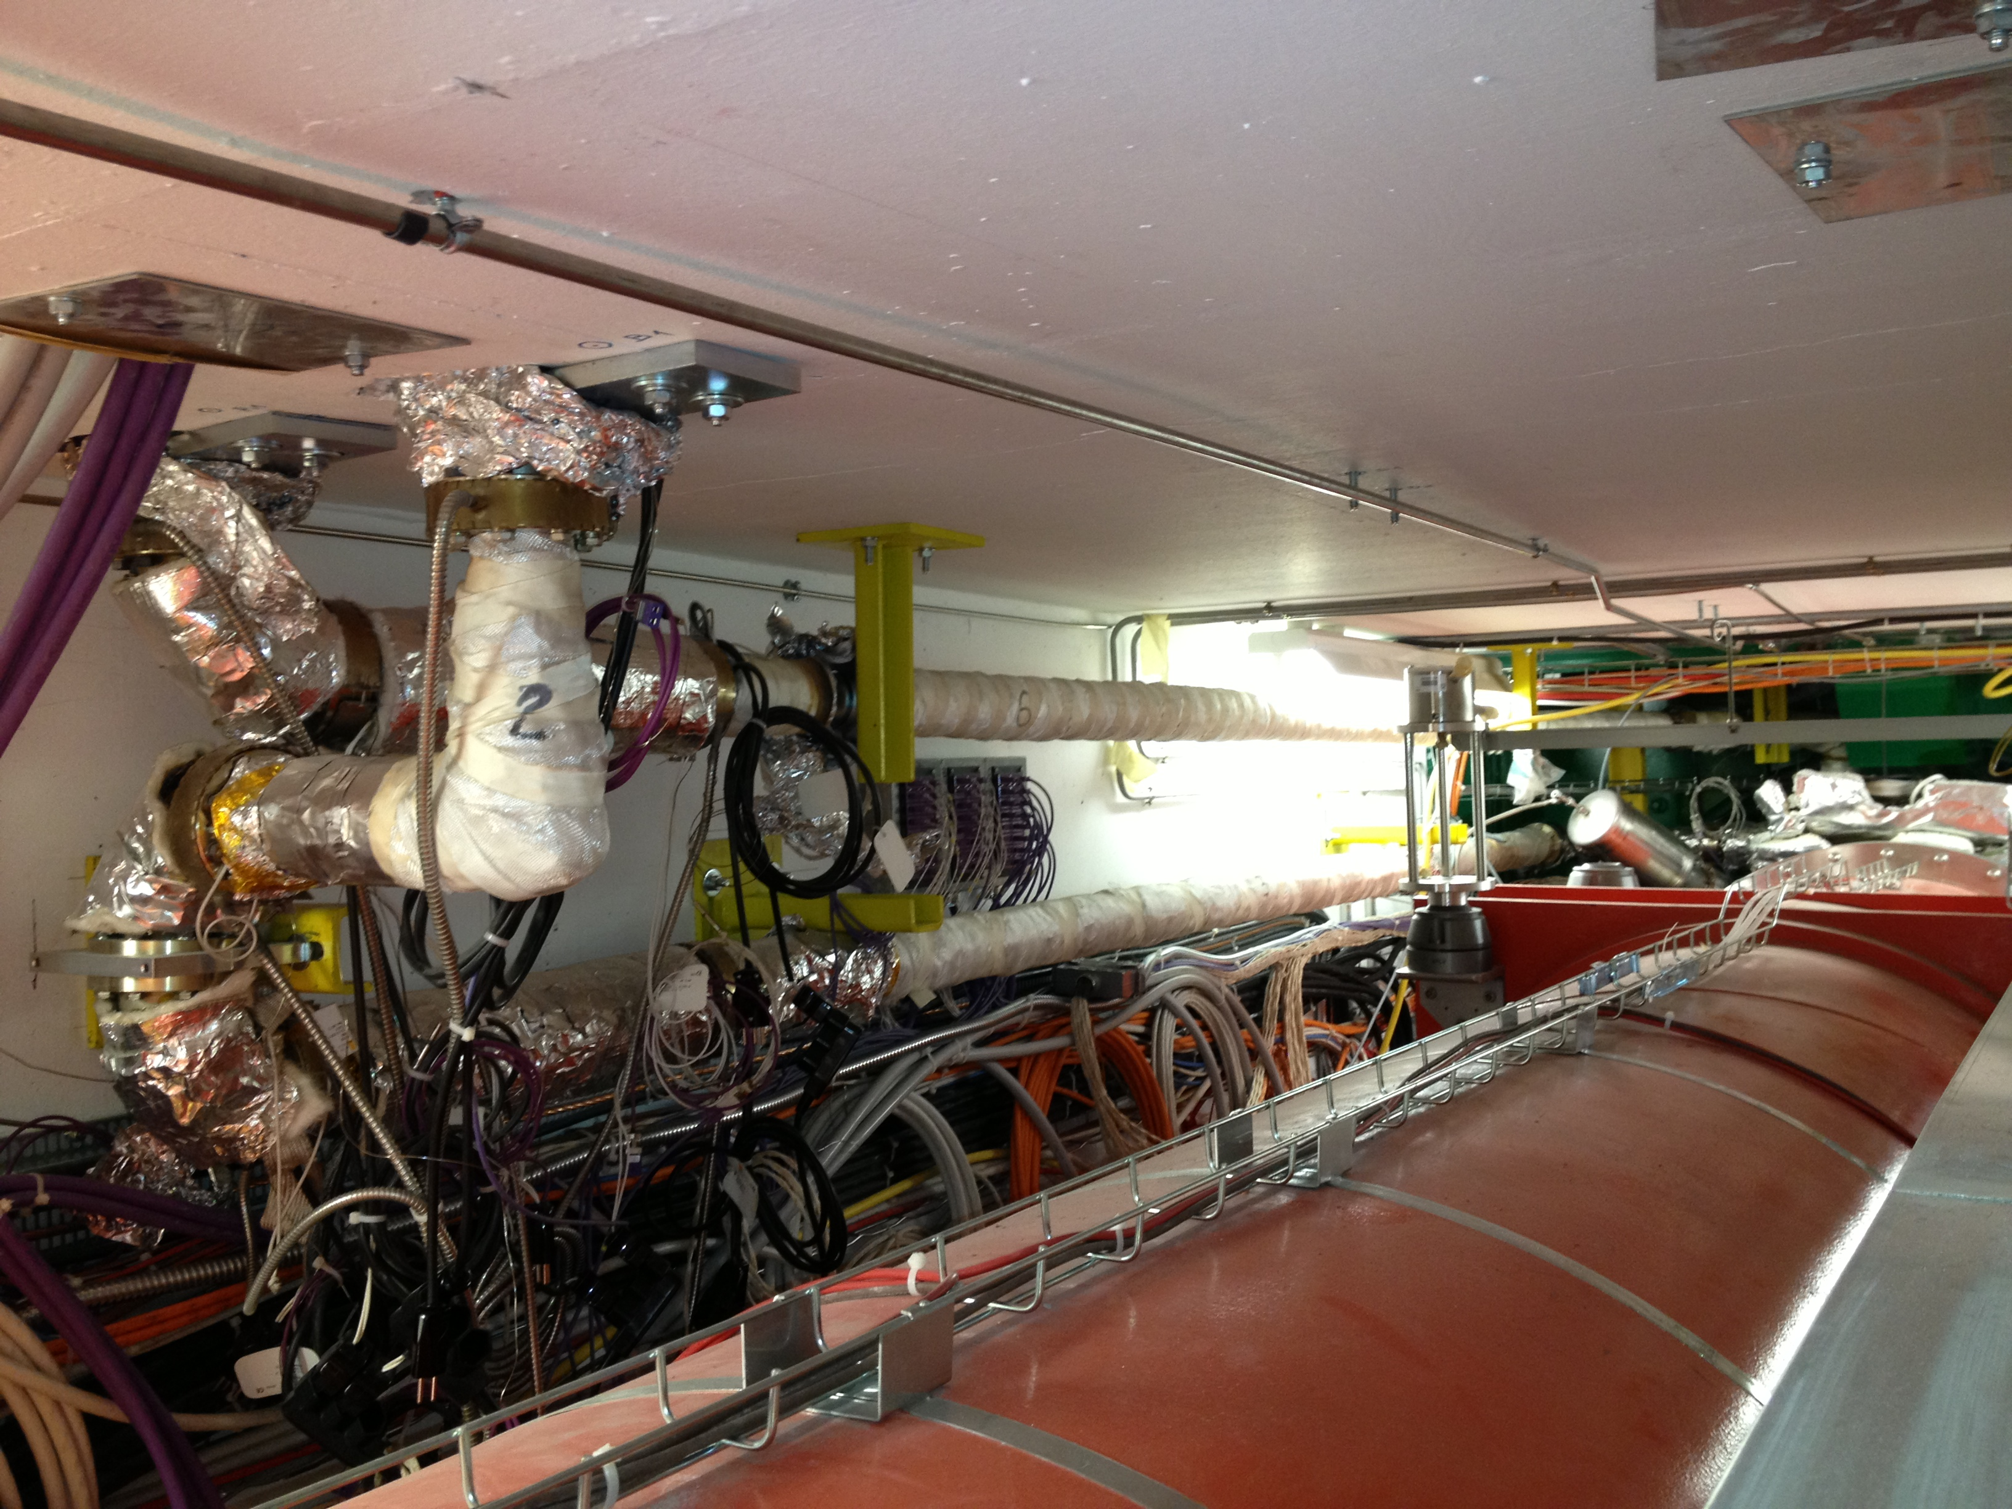
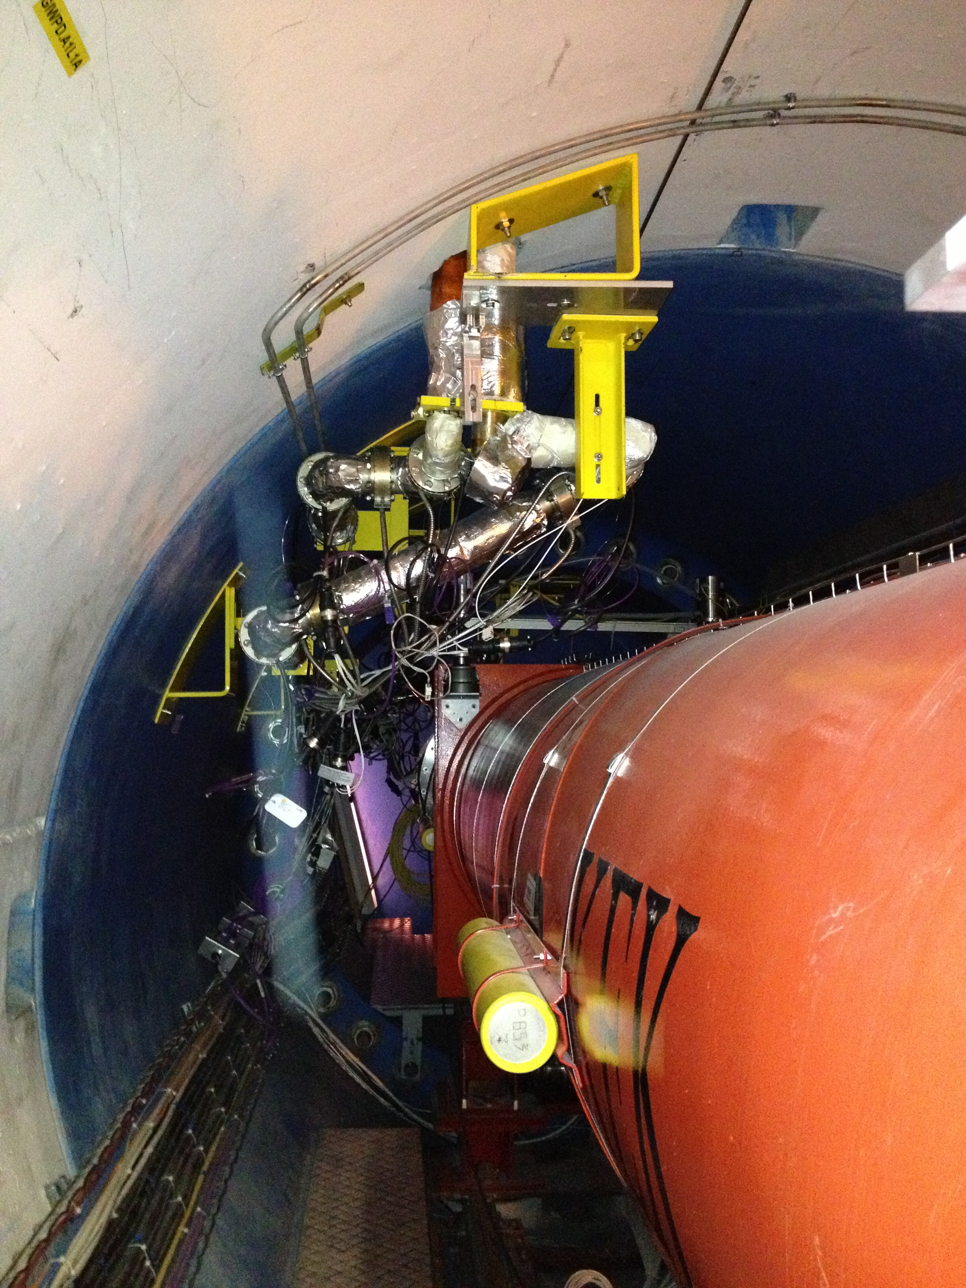
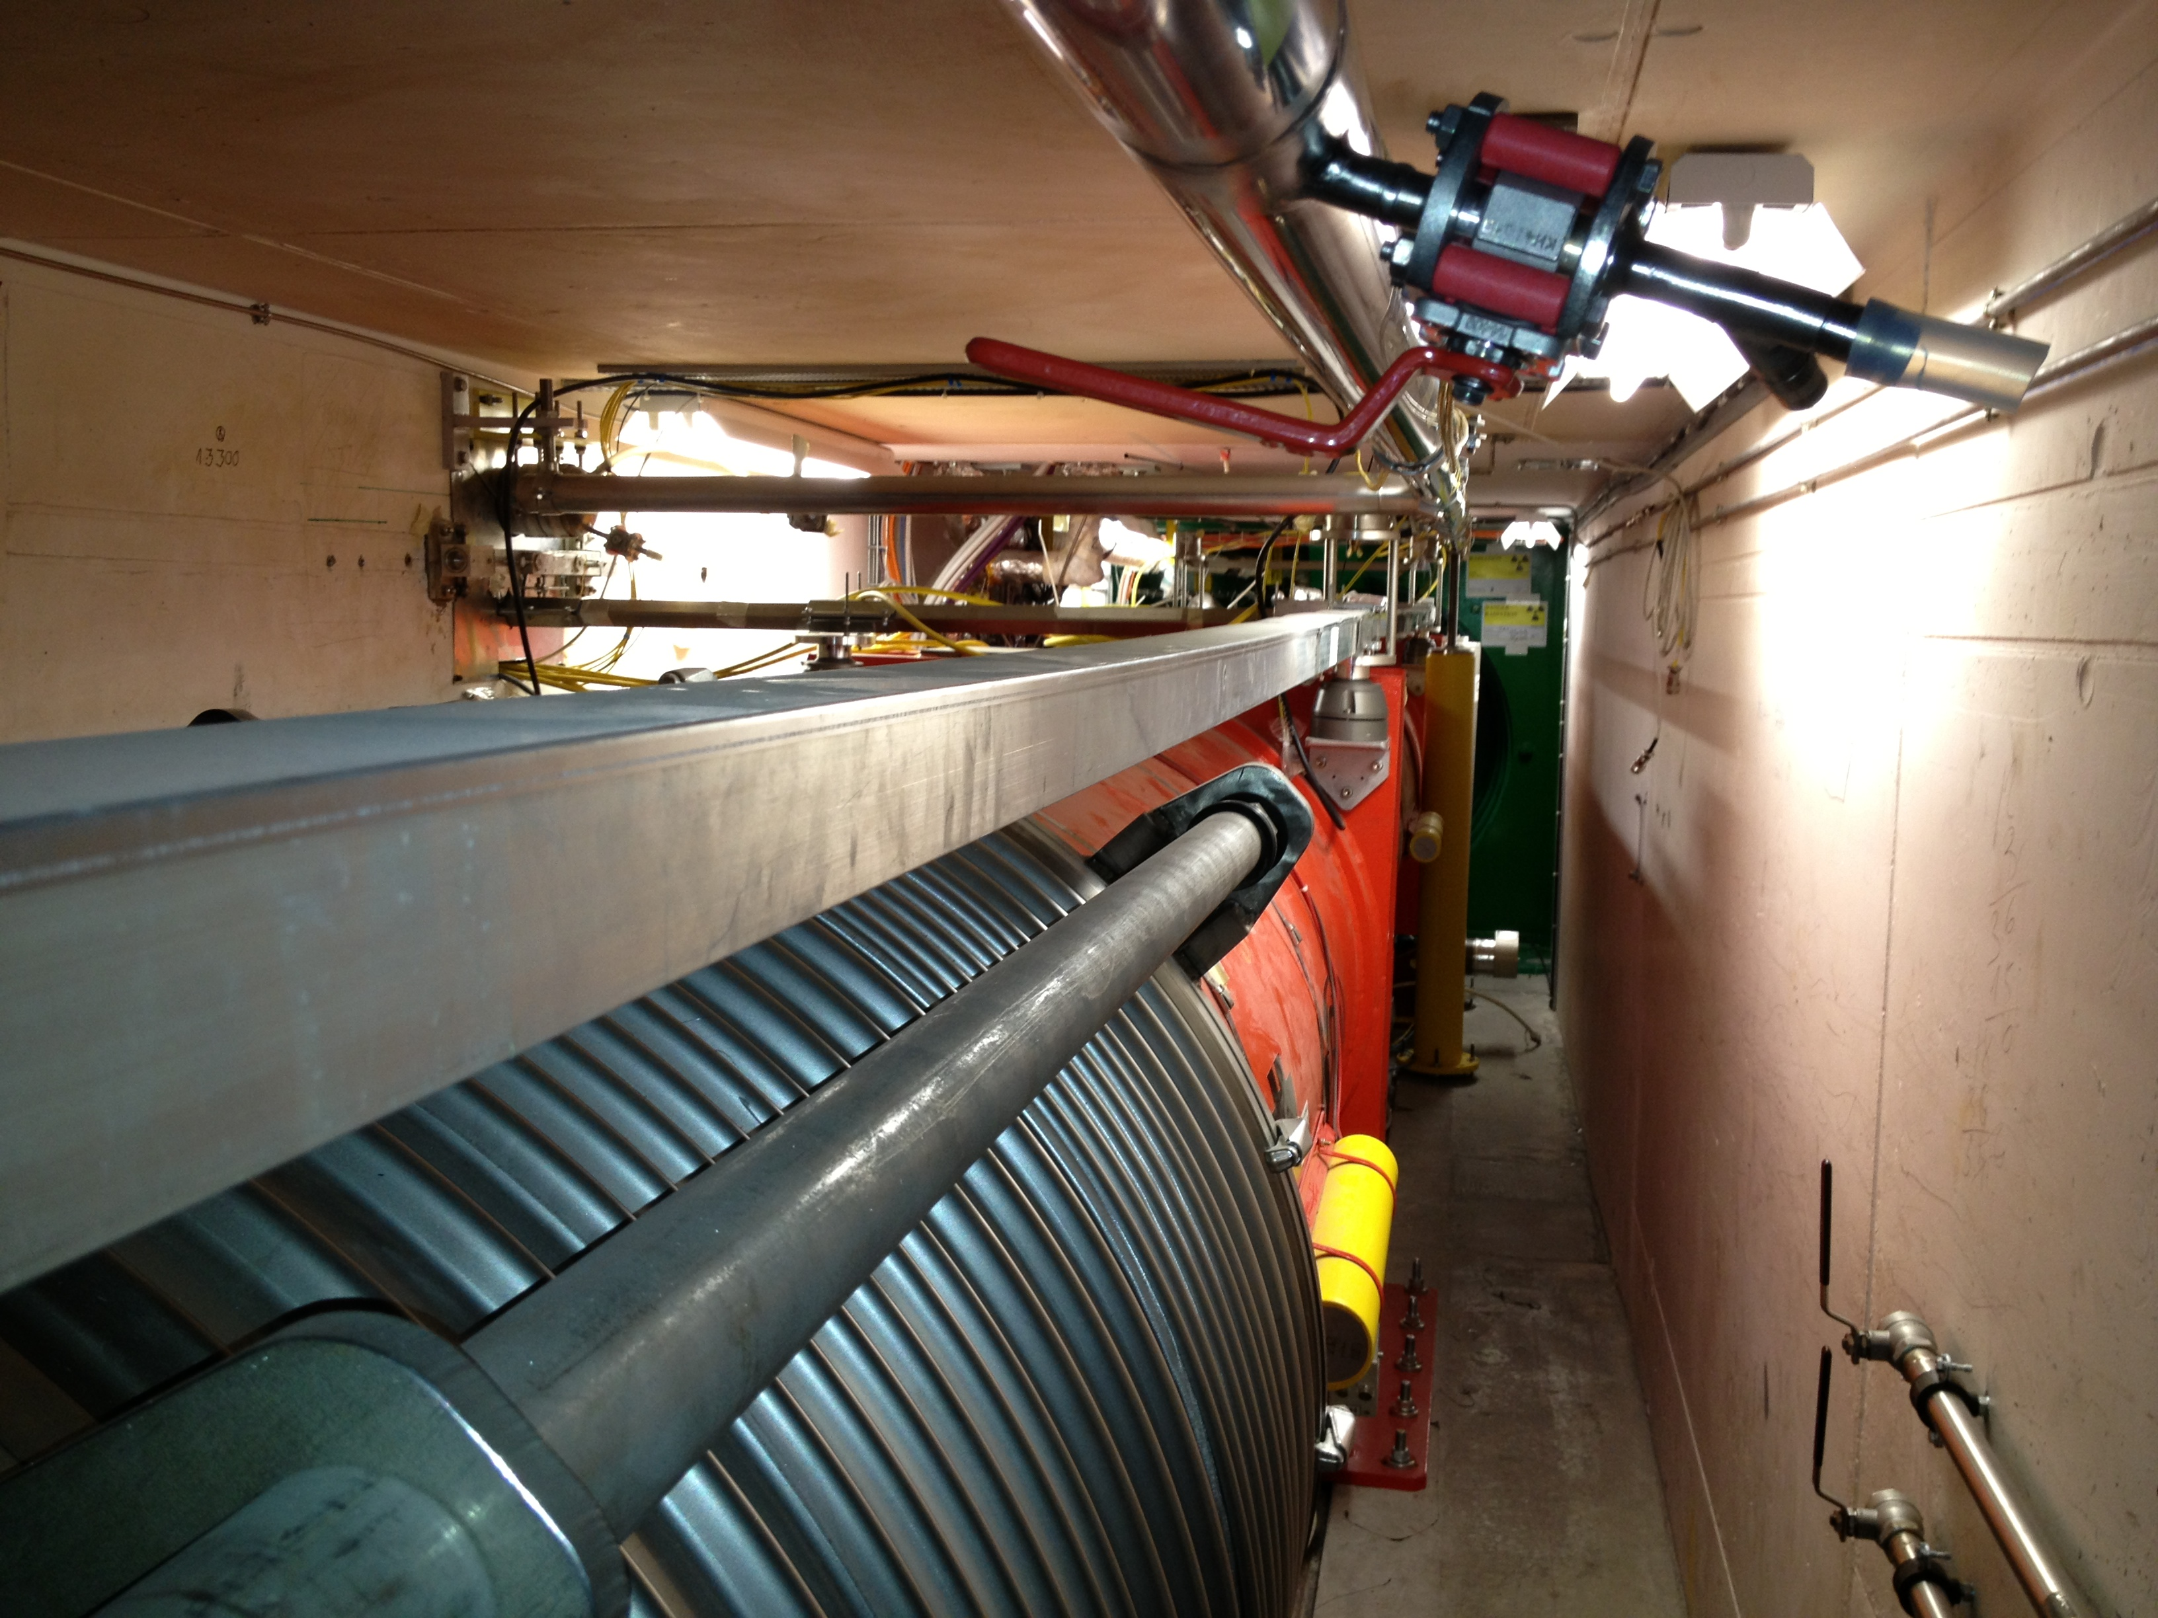
Access to VAX in LHC
CMS pumping and venting lines → to be retained for HL-LHC
ATLAS access pathway
ATLAS pumping and venting lines → to be dismantled and removed for HL-LHC
CMS access pathway

Slide 20
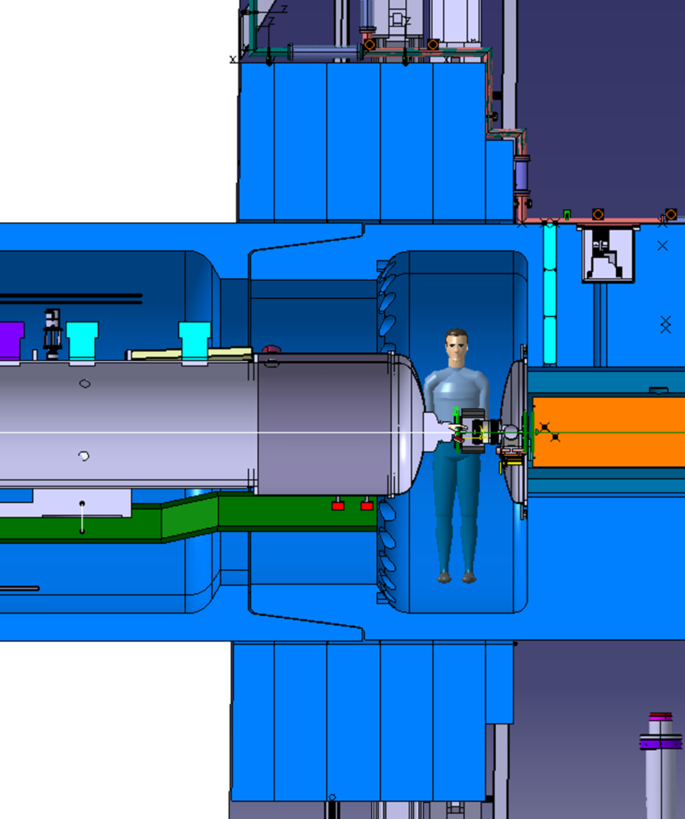
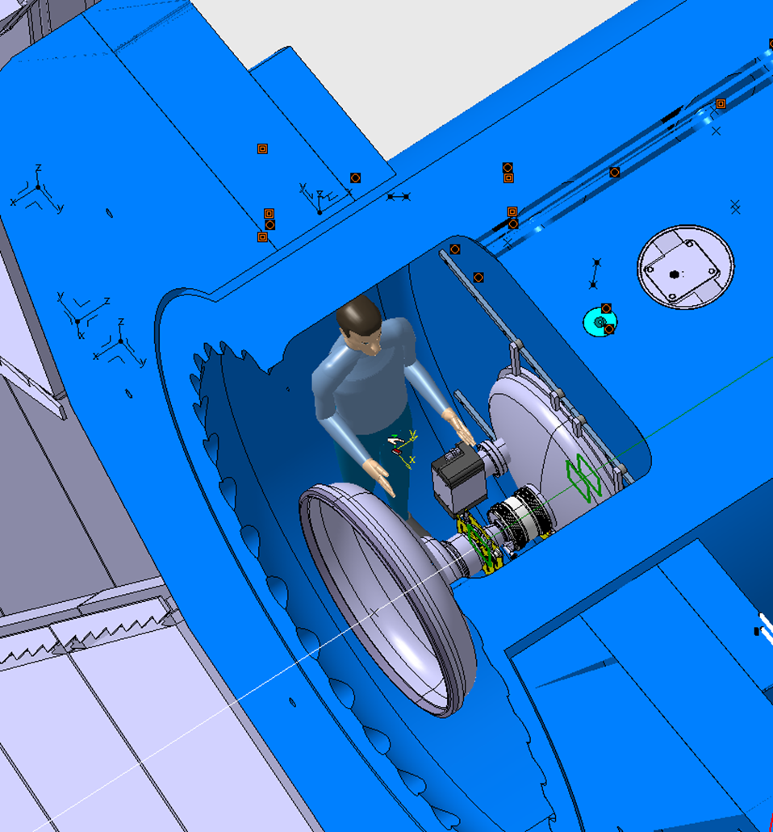
ATLAS Q1-TAXS area accessibility
Access through the LHC tunnel

Slide 21
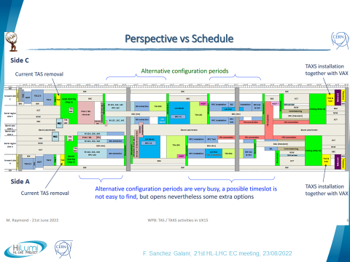
TAXS installation planning baseline in ATLAS
The option to anticipate the TAXS installation is under study → it would give more margin, facilitate the LHC vacuum system commissioning and enhance the installation process BUT would slightly impact the supporting configuration (see slide 26)
April 2026
October 2028

Slide 22
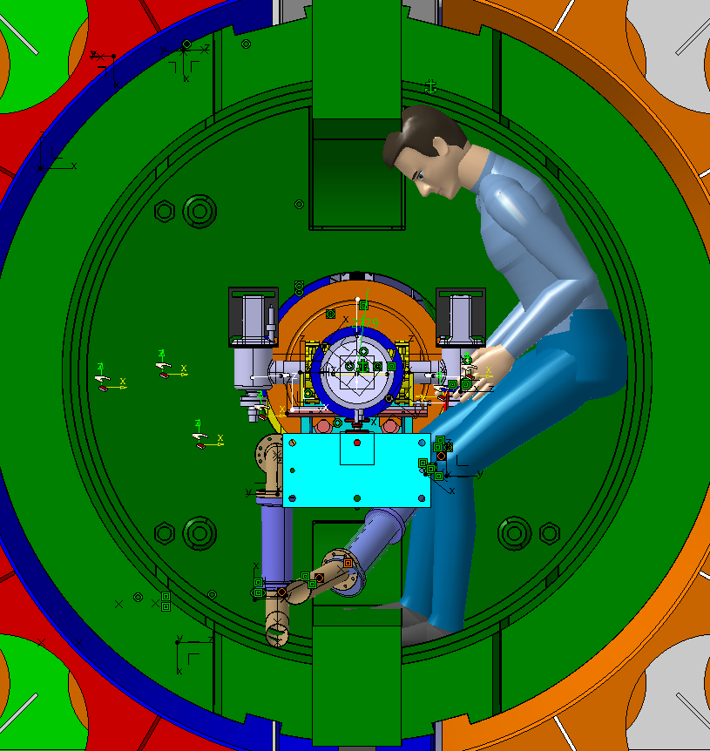
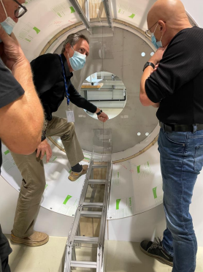
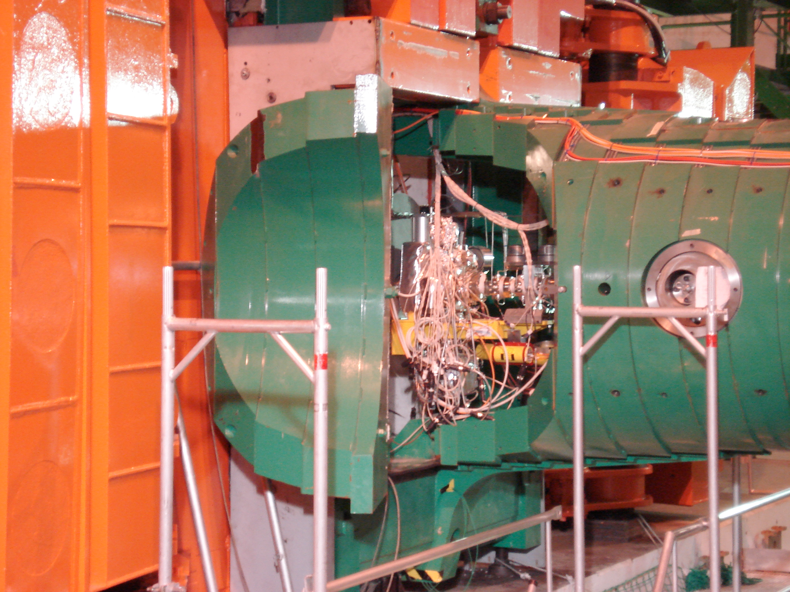
CMS Q1-TAXS area accessibility (I)
Q1-TAXS area mock-up
Access possible ONLY through cavern

Slide 23
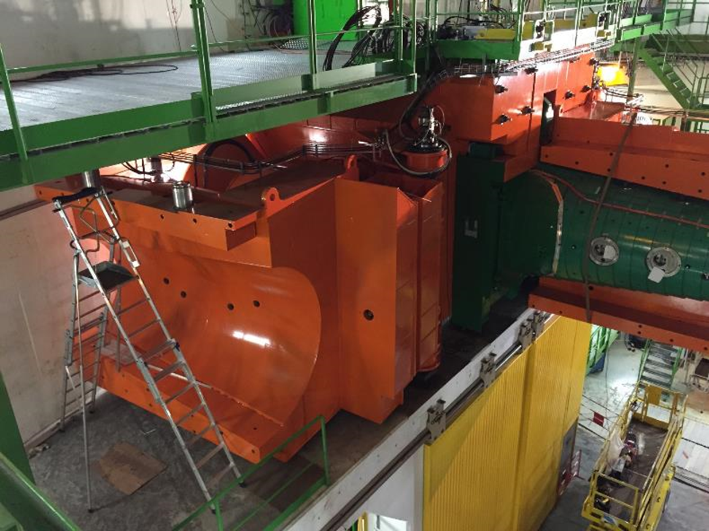
CMS Q1-TAXS area accessibility (II)

Slide 24
Installation sequence approach (CMS case)
(A)
Leak tightness validation of Q1-TAXS vacuum instrumentation
Q1-TAXS vacuum equipment assembly on Q1 cryostat [B]
Assembly of pumping lines and M1 support on TAXS
Experimental chamber installation and connection
Q1 installation
M2-M3 support structure installation
Leak testing of M3-to-experimental chamber connection
TAXS installation
Total/partial installation of pumping lines [A]
Leak testing of M2 and M3 interconnections
Leak testing of Q1-TAXS vacuum equipment connection to Q1
TAXS chamber to Q1-TAXS instrumentation connection
Pumping lines installation completeness (Q1-TAXS area) [A]
M2-M3 support structure pre-alignment
M2 and M3 installation [B]
M1 installation [B]
Leak testing of M1 connection to TAXS beampipe
Pumping lines installation completeness (VAX area) [A]
Leak tightness validation of pumping line connection at Q1-TAXS area
Electrical and compressed air connection checks (M1, M2, M3)
Key aspect: Q1 installation before TAXS installation
(A)
M2-M3 cable pulling
(A)
(B)
(B)
(A)
Leak tightness validation of pumping lines installed + checking and commissioning of existing bake-out
(B)
Module assembled and verified leak tight on surface. If applicable, bake out already verified on surface

Slide 25
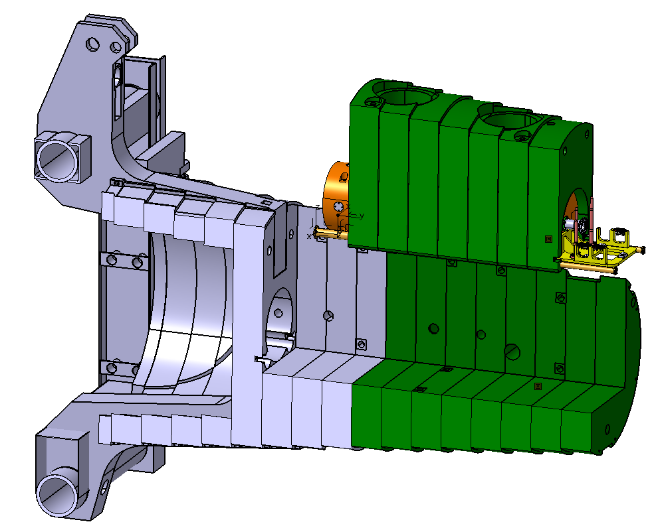
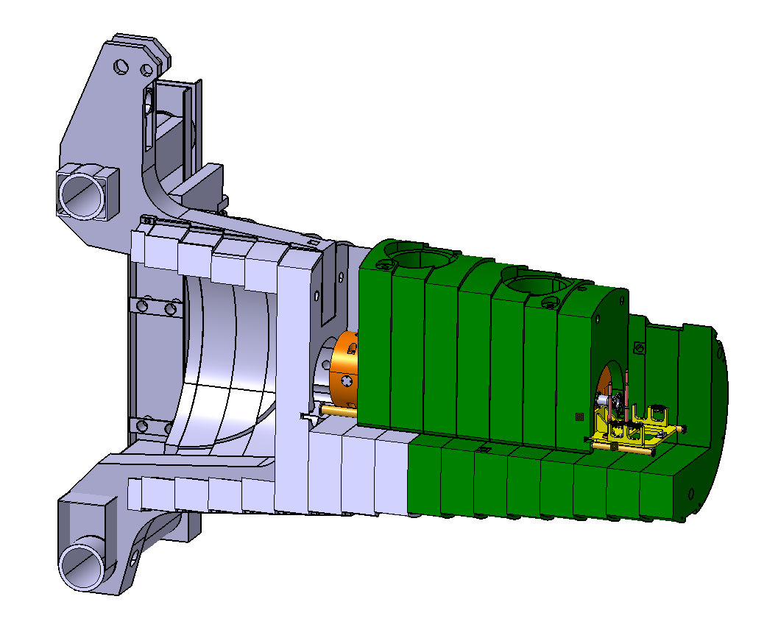
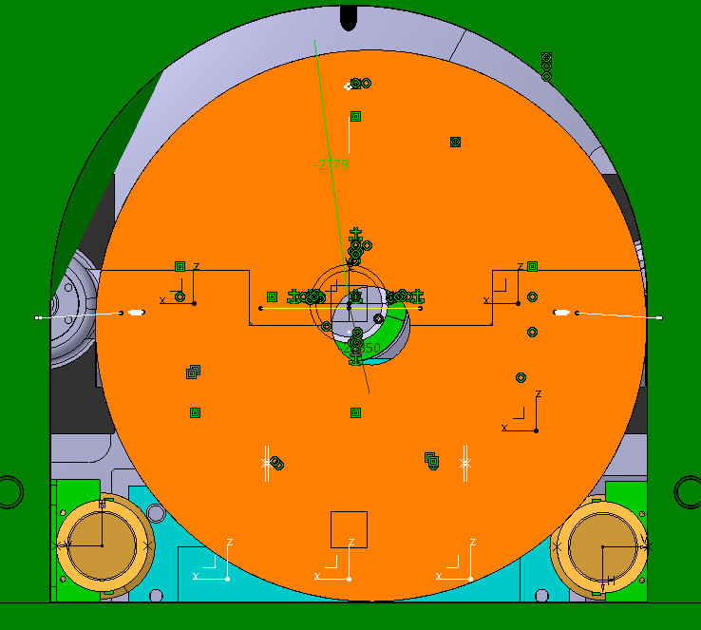
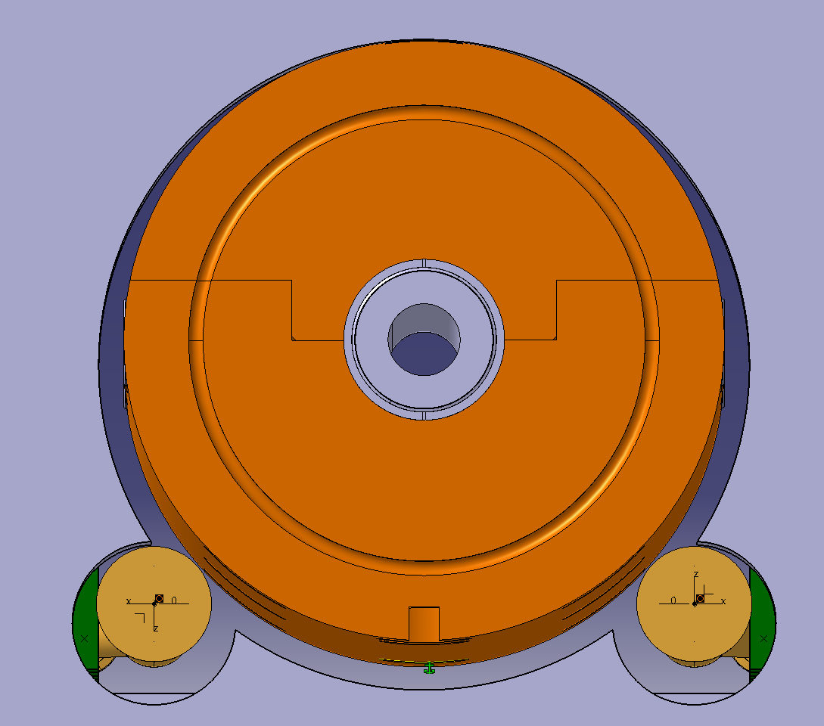
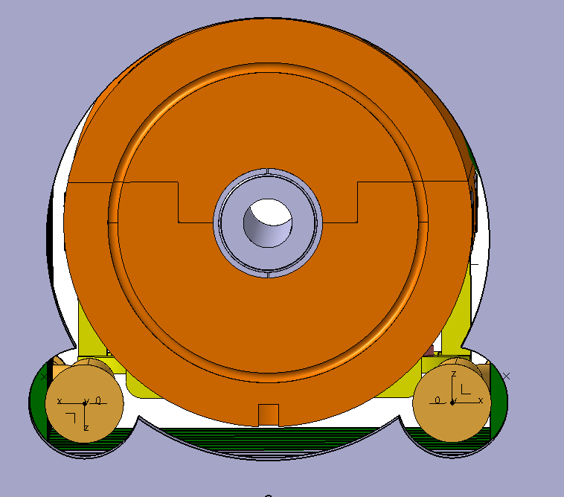
TAXS installation at CMS – impact on pumping line design
BASELINE: Q1 installation before TAXS installation
Q1
Q1
Pumping lines and TAXS chamber pre-assembled on FIN + TAXS
Solution involves clearance of 20 mm wrt TAXS including bake-out jackets
Shield hole machining must be optimized for transport configuration

Slide 26
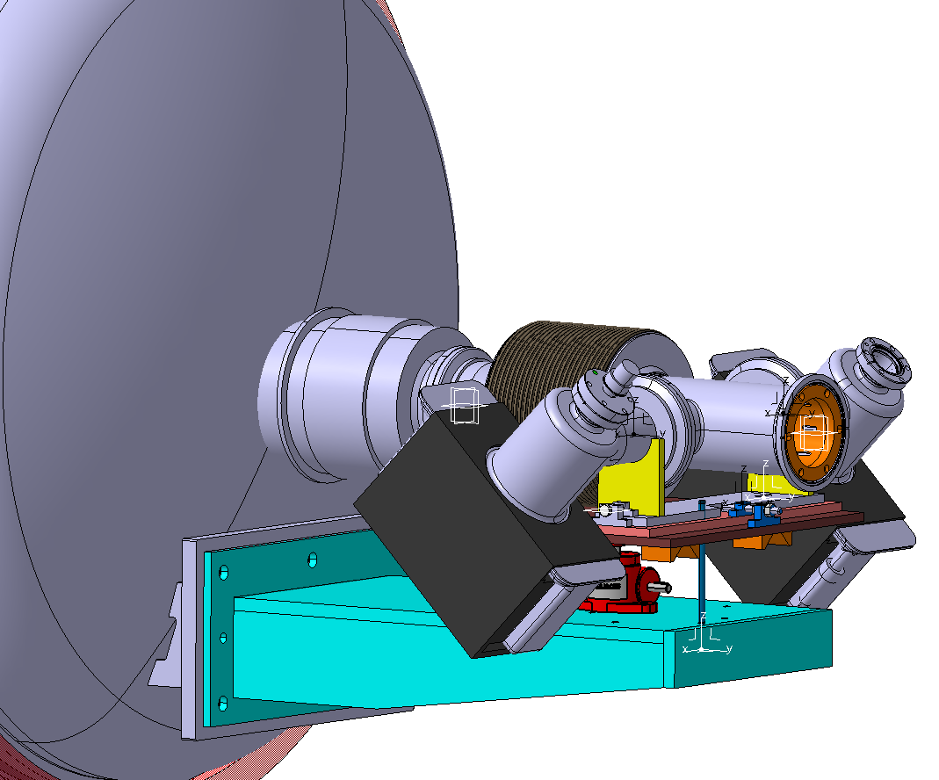
Q1-TAXS module temporary support
Closed with a blank flange
Temporary support is required to facilitate installation of Q1-TAXS module and connection to TAXS chamber once the TAXS is installed
For ATLAS, no temporary support would be required if the installation of the TAXS comes before Q1. However, depending on the relative misalignment (up to 5 mm max.) between the TAXS and Q1, it would require additional tooling to execute the connection

Slide 27
Summary of main open points

Slide 28
Summary of main open points
Freezing of vacuum layout, following NEG wafer test and qualification;
  Choice of best design approach;
ATLAS:
  Confirmation of GIS location at C-side;
  Cable and pumping line disconnection method and location in VAX area of ATLAS;
    Action on support and/or shielding;
  Confirmation of planning for TAXS installation;
CMS:
  Freezing of pumping line routing;
  Definition of Q1-TAXS module connection process;
  Definition of pumping line pre-installation process on plug-in (for TAXS installation) and plug-in shield modifictions.

Slide 29
Thanks for your attention
Special thanks to Rita, Frederic, Herve, Josef, Alessio, Giuseppe, Vincent, Cedric, Oliver, Ruth, Antonio, Francisco and many others

Slide 30
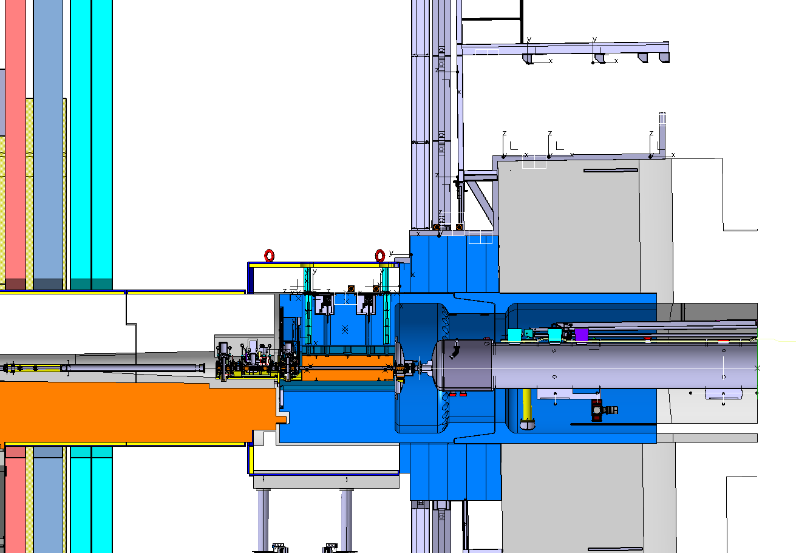
ATLAS shielding from LS3
ATLAS side A
New design
Stays in place
Moves during LS
GIS Area
TX1SP
NEW DESIGN*
Cradle
NEW DESIGN*
TXS1SO
JFC_2
JFC_3
JFC_1
Monoblock
VAX
JFSU - Octagon
Nothing can remain beyond the alignment plate during LS
Q1
TAXS
*Information provided by WP8

Slide 31
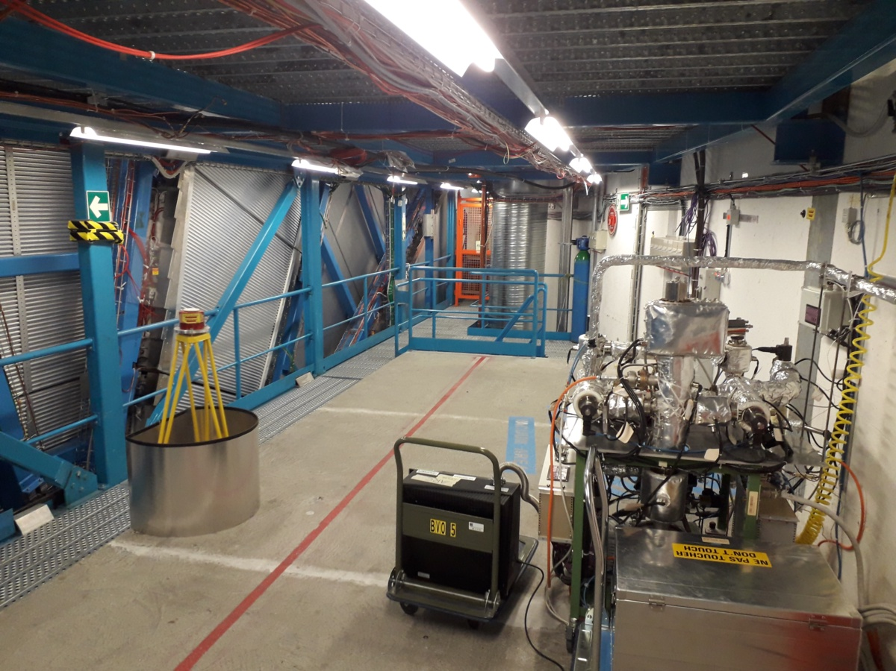
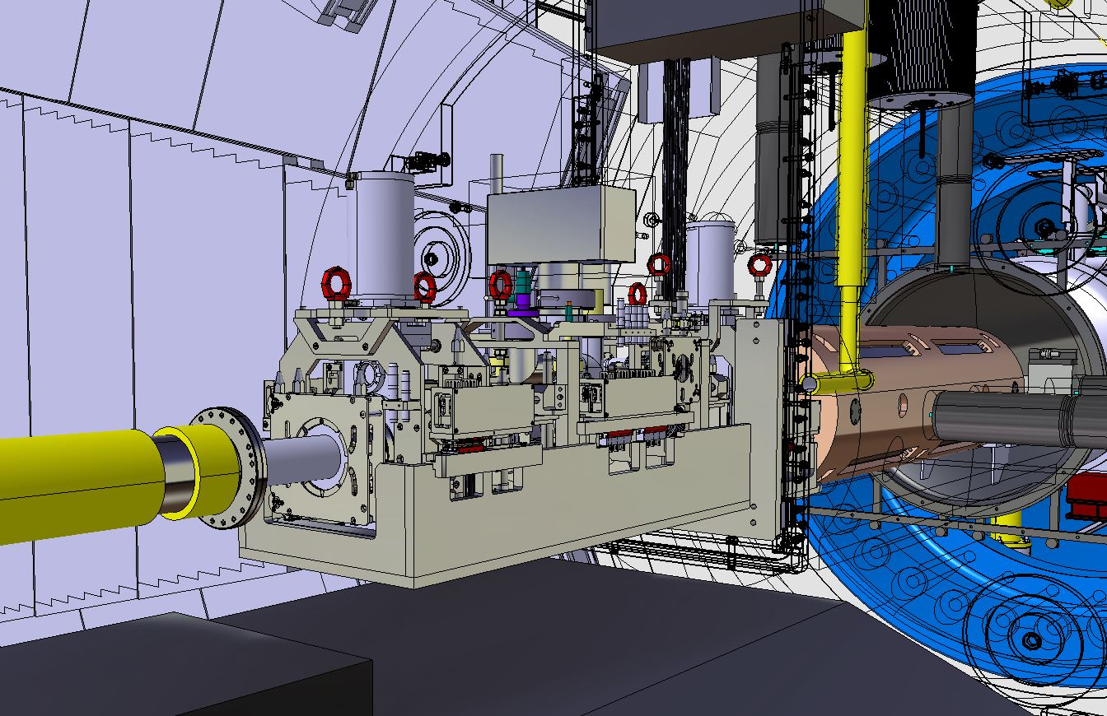
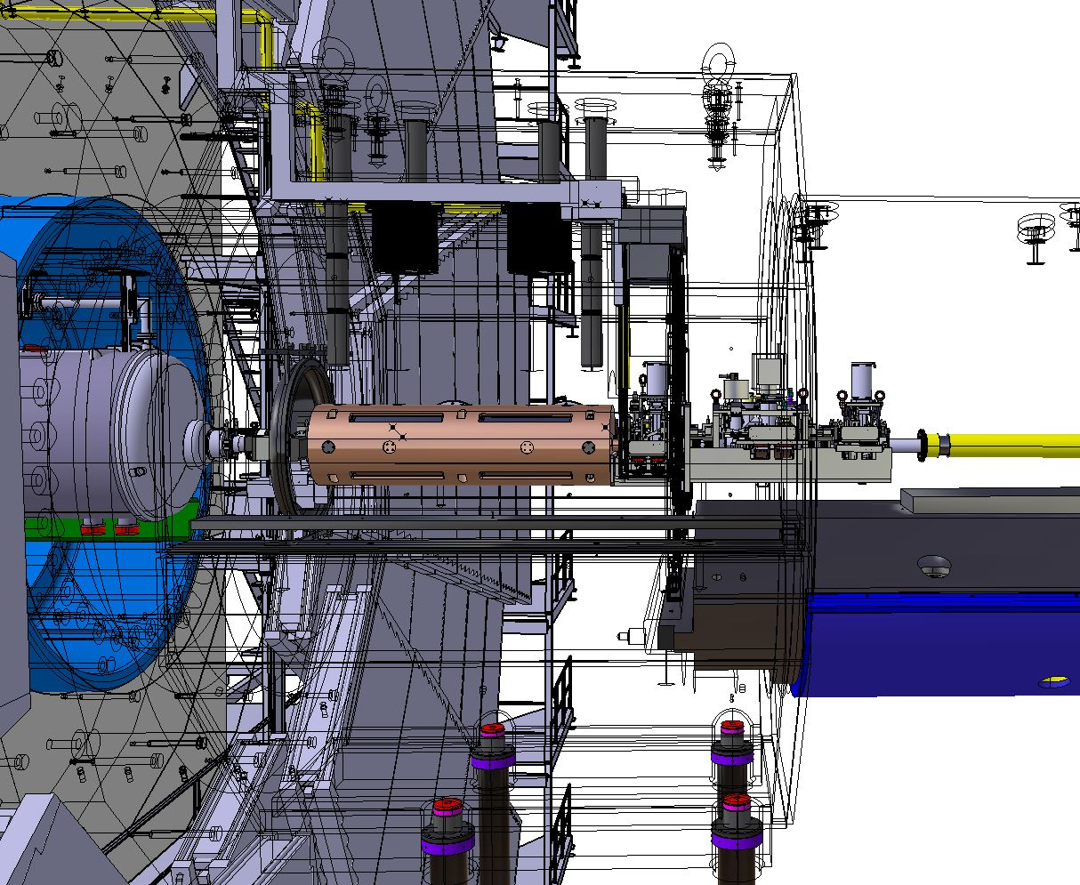
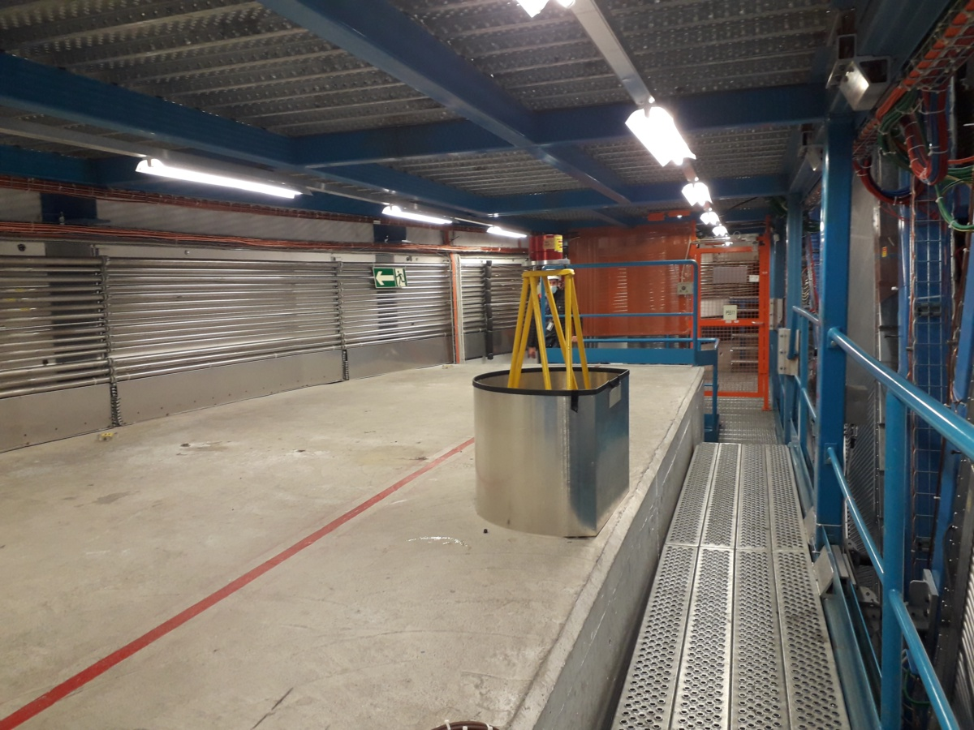
VAX integration at pt. 1 – ATLAS
GIS A-side
Cabling and pumping line to rise vertically at A-side
Space for GIS at C-side on symmetric solution

Slide 32
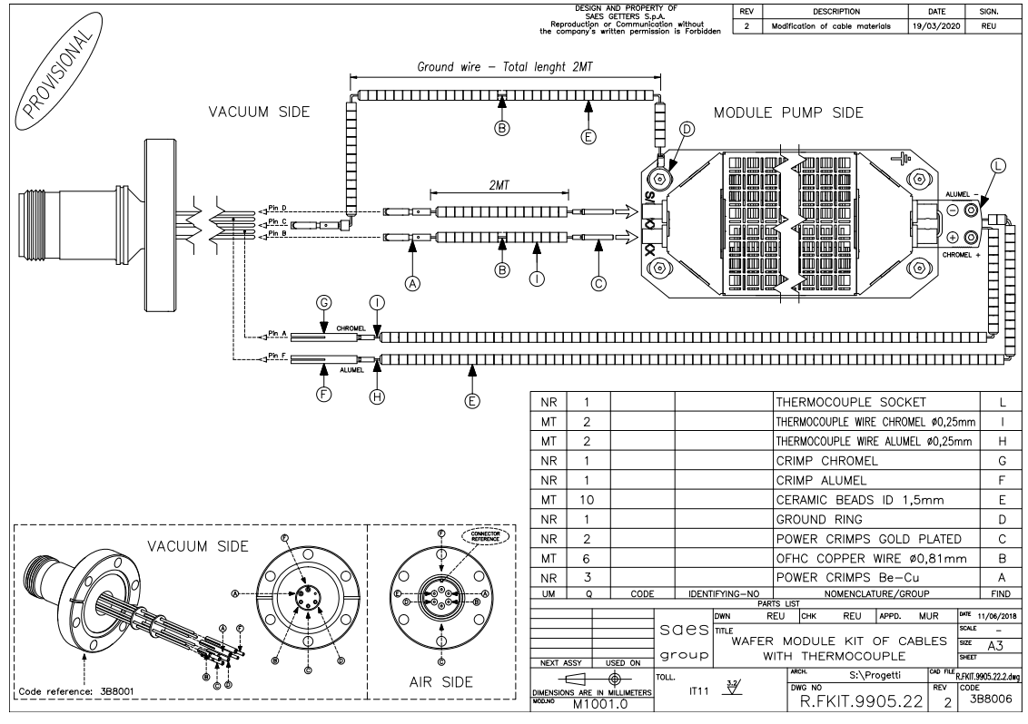
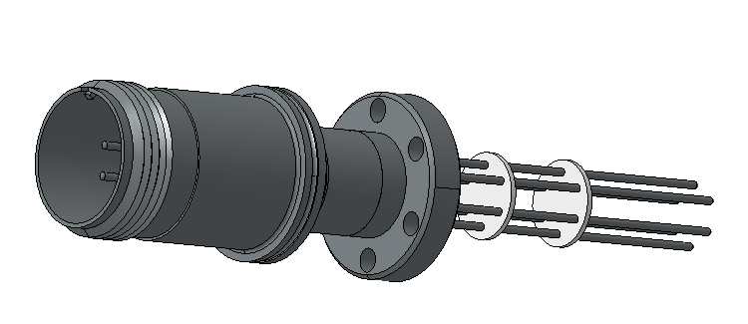
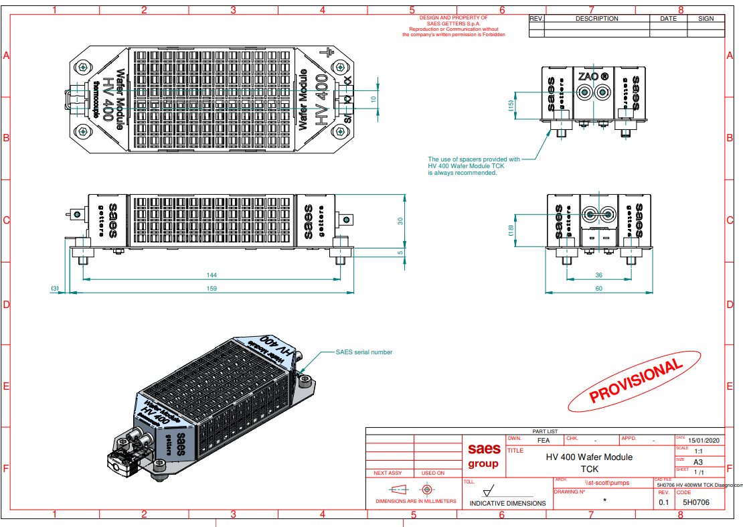
Information from the company:
With or without thermocouple
Standard 2m cables (needs to be discussed if we want a customized length).
CF16 feedthrough connection: up to 2 NEG wafers in parallel or series.
Other flanges sizes are possible for the feedthrough.
Positioning limitations? “ No problems on its positioning. The ZAO is particle free NEG sintered material. It is used in superconducting cavities.”
They offered to have a meeting to discuss about our specific application

Slide 33
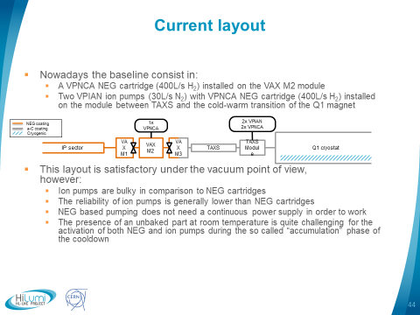

Slide 34
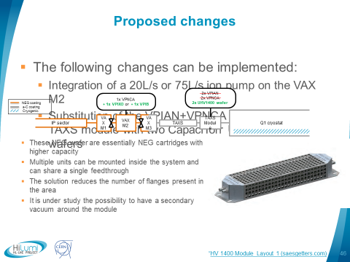

Slide 35
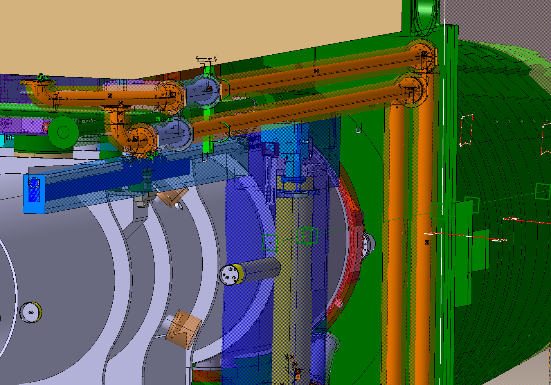
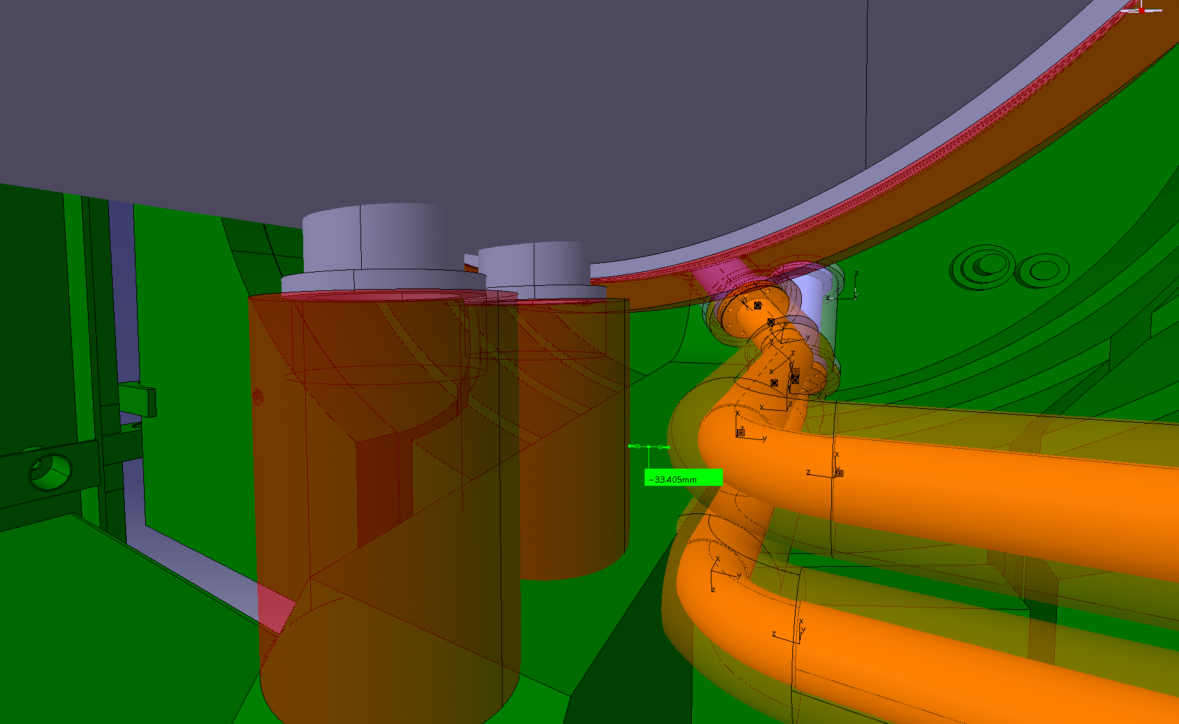
Pumping line routing in CMS

Slide 36


Pumping line integration studies – CMS
Existing (currently installed) lines 5R
Passage for the lines
GIS - tunnel
Pipe 1
Pipe 2
3 options considered:
  Option 1: routing pipe 1 over the water pipes; involves lowering down of pipe 2.
  Option 2: routing pipe 1 below pipe 2 (pipe 1 to cross between water pipes and wire).
  Option 3: Using another conduct for pipe 1 (available? – used for something else?) → nothing included in the 3D; involves lowering down of pipe 2? (TBC).
ST1553945
(WP8 model)

Slide 37


Pumping line integration at VAX area – CMS
Last elbow fixed to the Module 2 support → connection with module 2 checked on surface.
Previous rigid tube connected to FIN.
Bellow in between to absorb the misalignments if the position of the support is adjusted (connected to alignment plate)

Slide 38


Q1-TAXS area mock-up - ATLAS configuration

