Slide 1

TAS Removal & TAXS Installation scenarios
Antonio Alonso on behalf of WP8,
Contributions from M. Raymond, D. Mergelkuhl, J. Sestak, J. Perez Espinos.
HL-LHC Collaboration meeting, Uppsala. 20 sept 2022

Slide 2
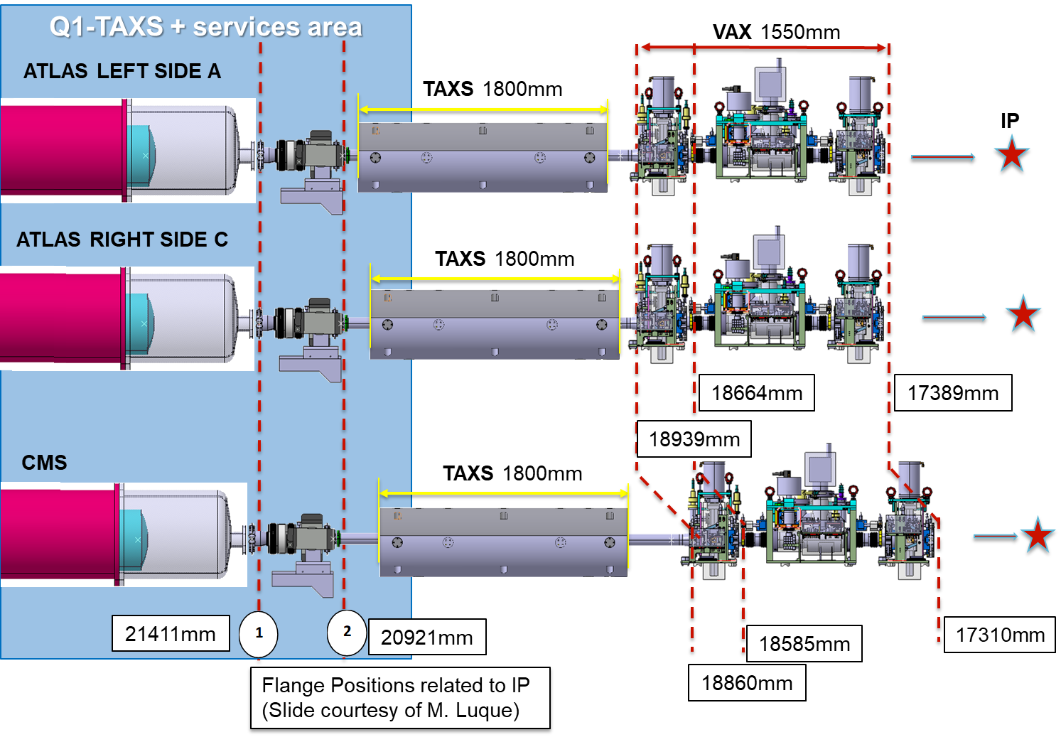
Reminder
LHC Commissioning: Now linking VAX installed & vacuum tests because of sector valve
TAXS & VAX will need to be operational in ~ May 2028
VAX support will need to be installed in ATLAS in ~ Nov 2028
Need to find/agree a window (1 week per side) allowing access to TX1S for services, TAXS and 1st valve installation between IT removal & LHC commissioning (8 months before end of LS3)
If a window cannot be identified, we need to create it!
(Extension to LS3 in an agreed slot: ATLAS, TE-VSC, BE-EA, EN-HE)

Slide 3

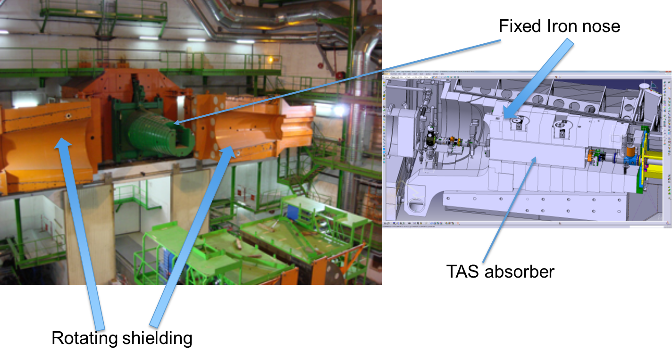
TAS, TAXS in CMS Forward Shielding

Slide 4
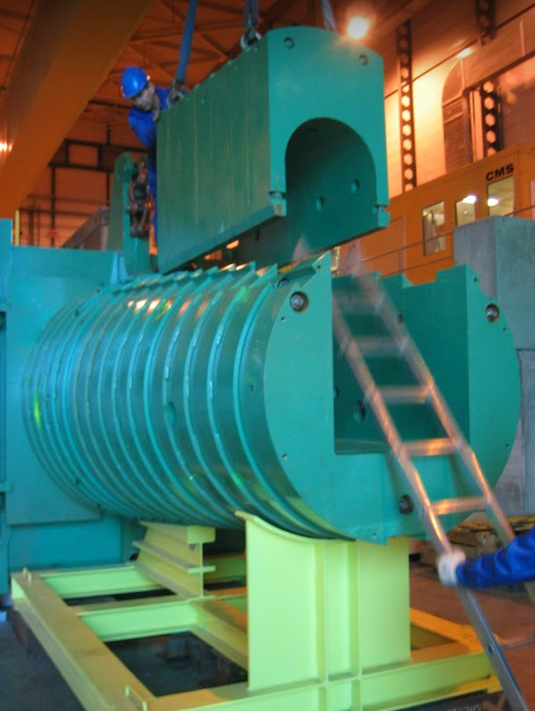
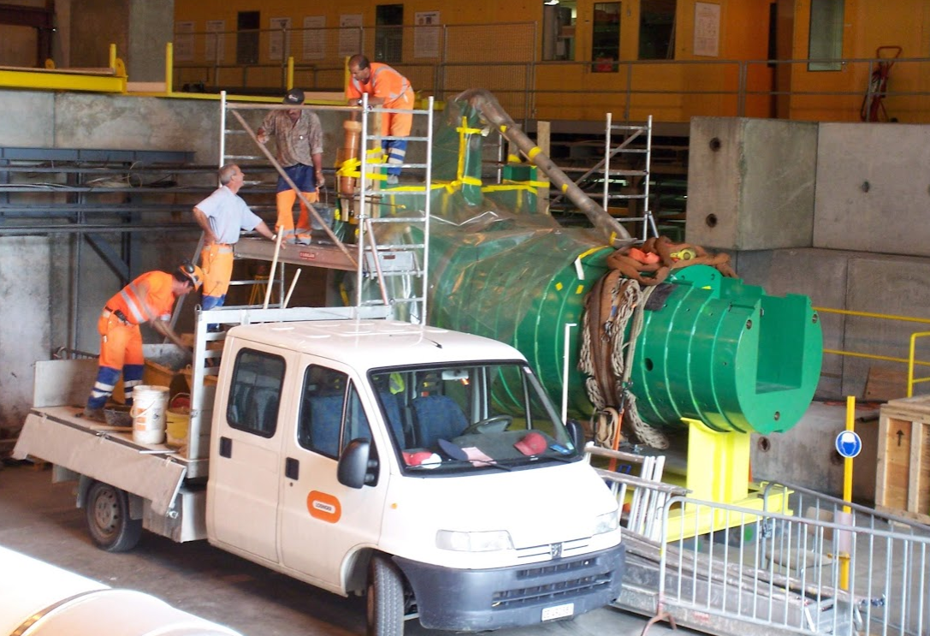
LHC, TAS Installation @ CMS

Slide 5
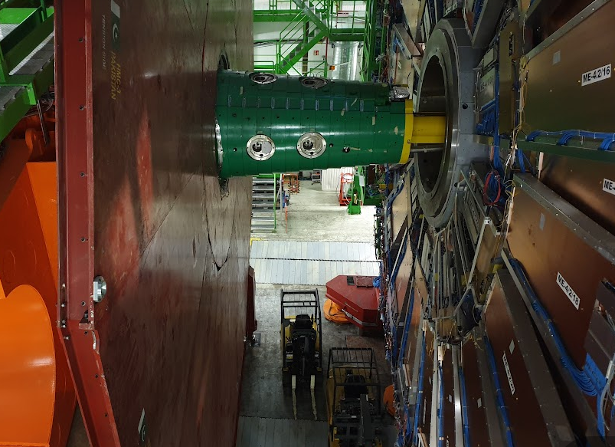
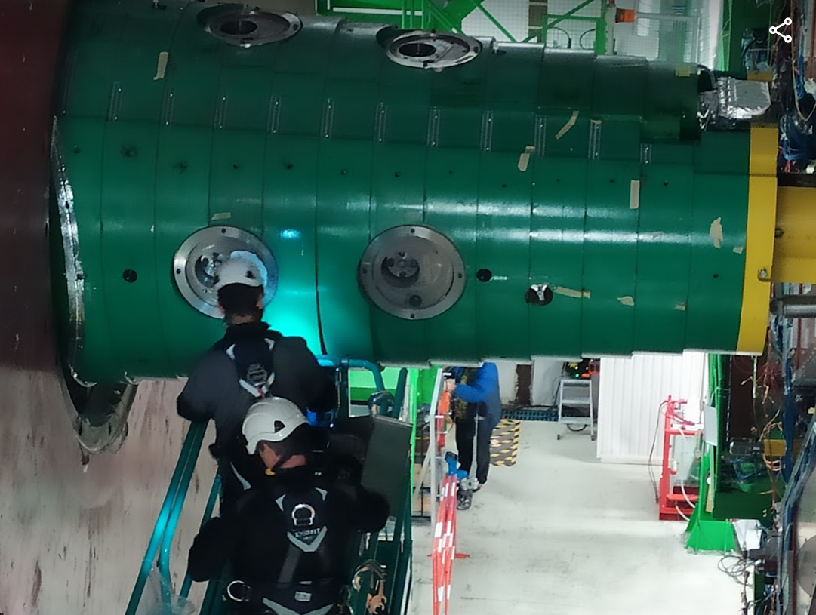
LS3 Deinstallation (Q1 2026) @ CMS
Tunnel side activity
Cavern side activity
Q1/TAS
TE-VSC: Disconnection of TAS from VAX
BE-EA: Removal of lateral alignment supports.
EN-HE / CMS: Removal of TAS with Upper-Plug
BE-EA: Removal He protection dome, disconnection cooling pipes
TE-VSC: Disconnection Q1-TAS
TE-VSC: Removal of pump, services
Safety, RP
Safety assessment with Experiment, RP

Slide 6
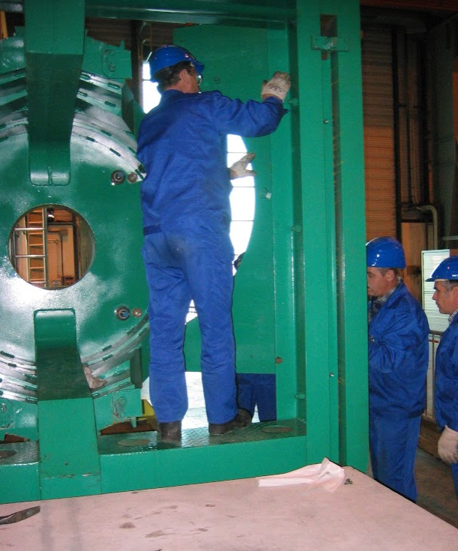
CMS challenges
Machining of FIN
VAX-related- routing of services @ CMS
Services inside tunnel

Slide 7
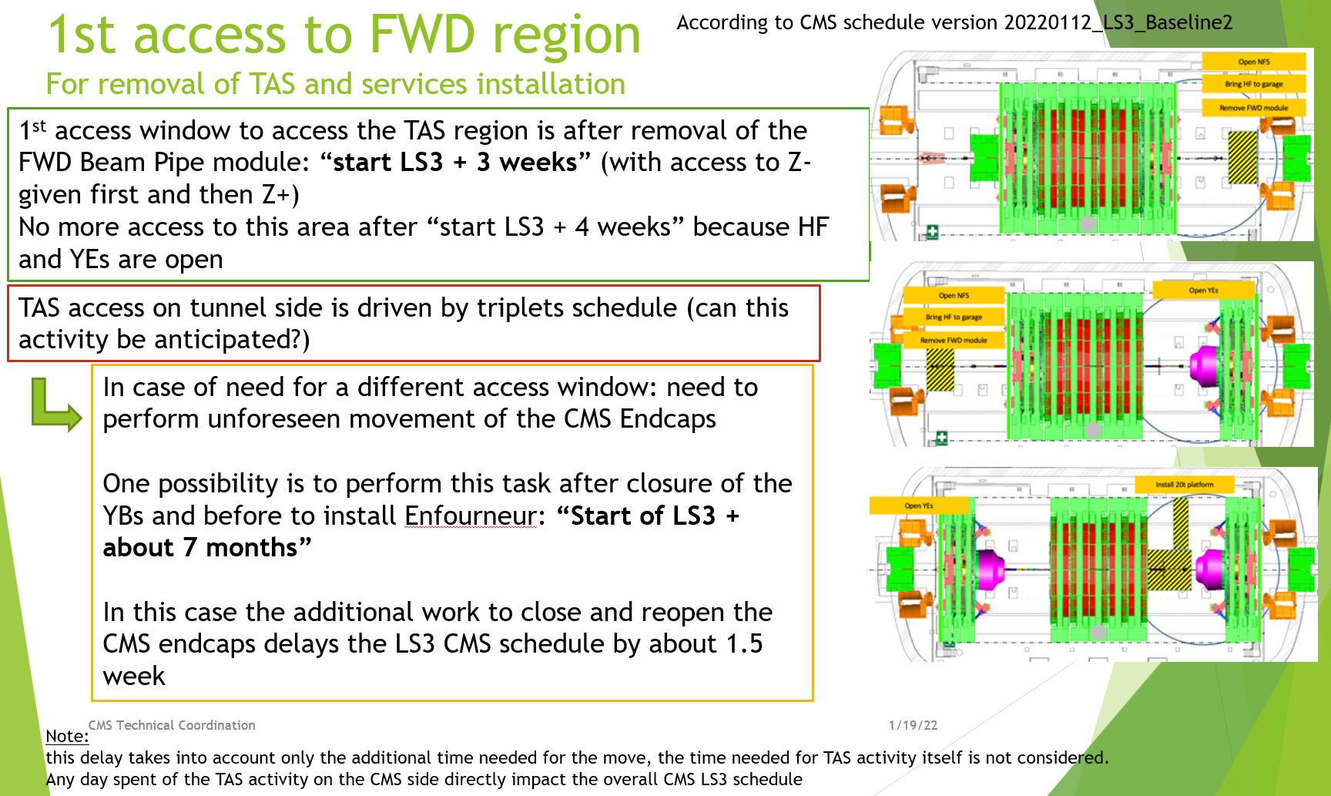
CMS Schedule: OPENING STUDY

Slide 8
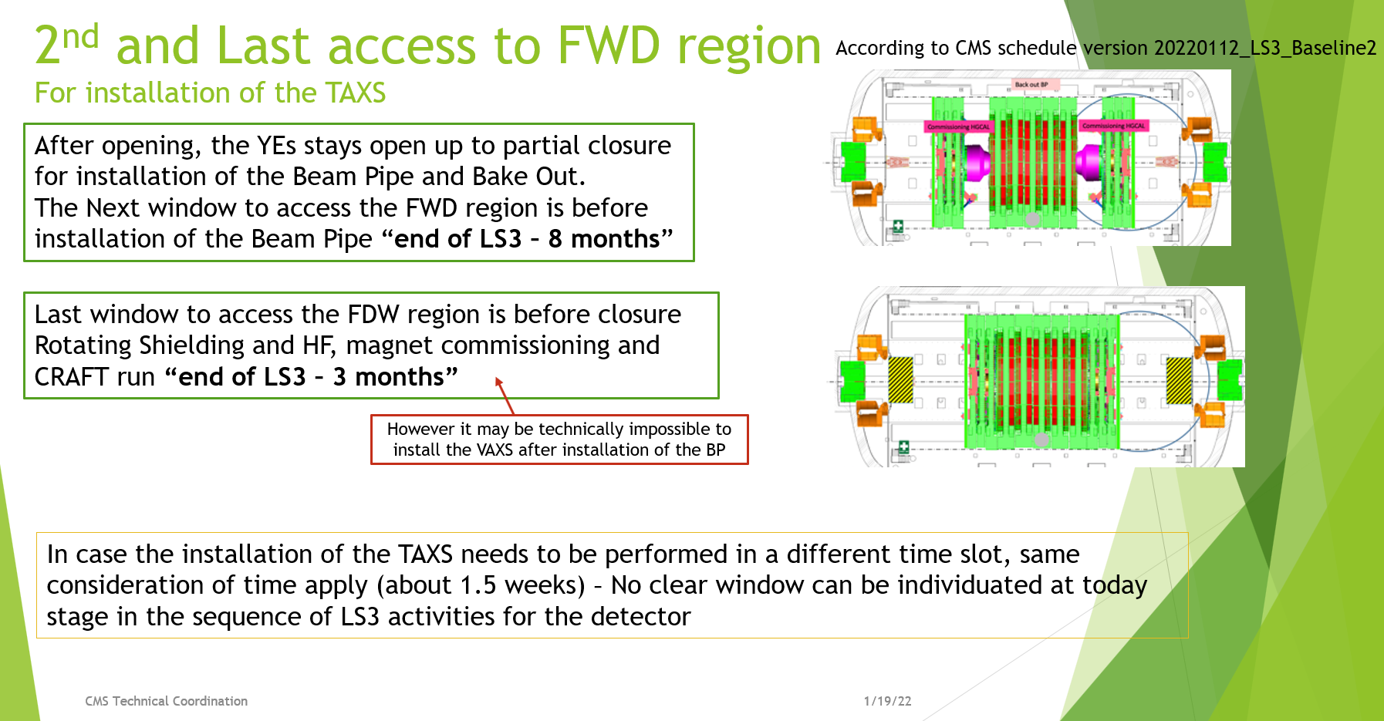
CMS Schedule: OPENING STUDY

Slide 9
Next steps-planning
Confirm:
In CMS, TAS will be removed at the start of LS3 (~ Apr 2026)
Machining of FIN will be done in Q1-to-Q1 time slot- (write procedure & confirm RP)
Both plannings/windows (from machine/WP8 & CMS) need to be officially confirmed & approved in a HL-LHC CG.
TAXS will be installed in ~ Apr 2028

Slide 10
Open points
Services:
Passage @ tunnel side
Routing @ experimental side
Thin RS closing/ M3 (Gate valve) clearance
VAX support
TAXS installation

Slide 11
Many thanks (special to Michel, Dirk, Josef, Jaime, Francisco & Oliver ) to be continued
NEXT
Tbc WP8 meetings,
HL-LHC CG

Slide 12
Backup slides

Slide 13
Latest references
Chamonix- LHC Performance workshop 2022
119th HL-LHC WP8 Meeting https://indico.cern.ch/event/1163785/contributions/4887270/attachments/2466273/4229473/HL-LHC_WP8_Meeting_20220621.pdf
NEXT
Tbc WP8 meetings,
Uppsala, parallel sessions WP8/WP12,
HL-LHC CG
https://indico.cern.ch/event/1097716/

Slide 14
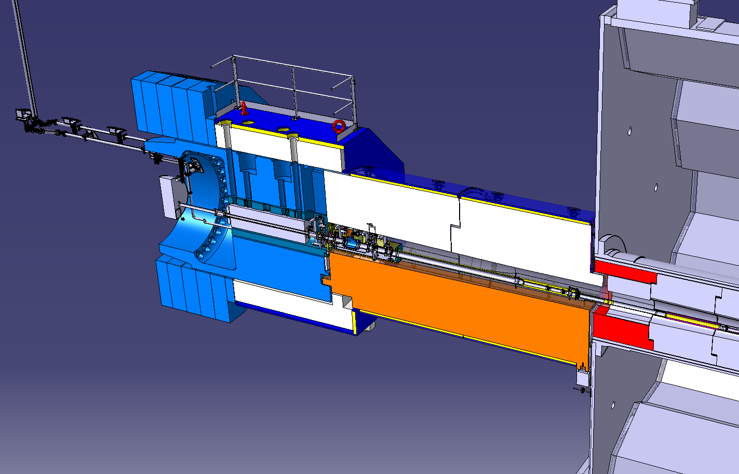
ATLAS Layout

Slide 15
Removal/Installation scenarios
TAS removal
ATLAS
https://edms.cern.ch/document/1764384/2
CMS
https://indico.cern.ch/event/647382/contributions/2630663/attachments/1479507/2293645/INDC_WP8_pres_2_20170620.pdf
https://edms.cern.ch/document/1952410/1

Slide 16
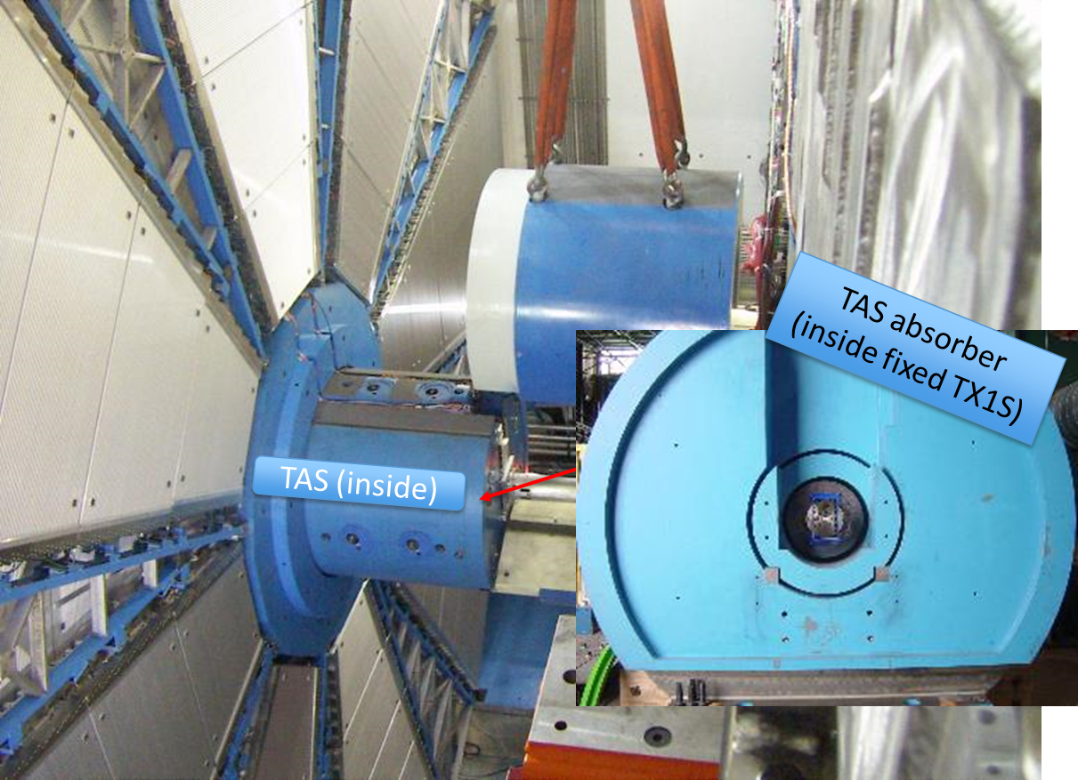
TAS ATLAS removal step-by-step v2 (Paul Strahle / EN-HE)
https://edms.cern.ch/document/1764384/2

Slide 17

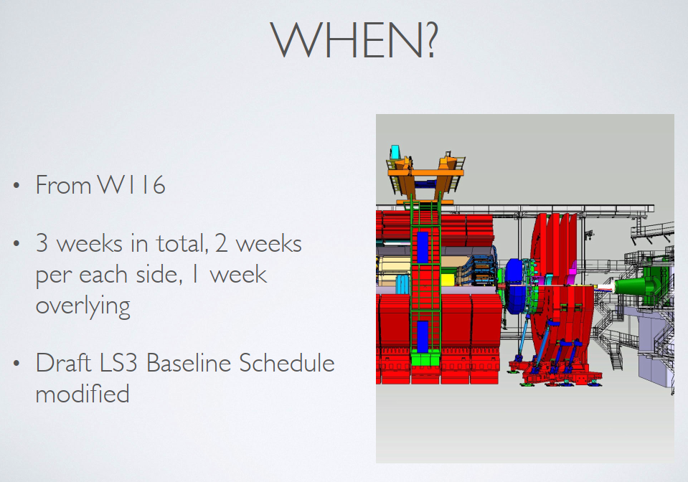
TAS CMS removal step-by-step (Isabel Naranjo De Candido / CMS)
https://edms.cern.ch/document/1952410/1

