Slide 1
Preparation for Review of
Civil Engineering and Infrastructure for Experimental Sites (3-4 October, 2022)
W. Riegler
Sept. 2nd, 2022

Slide 2
Preparation for Review of
The FCC civil engineering study has to proceed to a ‘concrete implementation’ plan for Tunnel, Caverns, Surface Infrastructure.
Of course we do not yet have a detailed design of all the FCC detectors, but we should provide a maximum of
‘pragmatic common sense’ input that allows the CE study to make a first round.
The goal is that on October 3-4 we provide this input and conclude on it together.
The list of questions provided by Tim & Co.

Slide 3
The FCC civil engineering study has to proceed to a ‘concrete implementation’ plan for Tunnel, Caverns, Surface Infrastructure.
Of course we do not yet have a detailed design of all the FCC detectors, but we should provide a maximum of
‘pragmatic common sense’ input that allows the CE study to make a first round.
The goal is that on October 3-4 we provide this input and conclude on it together.
The list of questions provided by Tim & Co.
Underground:
One shaft only on UX cavern (Is this OK?)
If so, does it generate other constraints such as cavern width to pass components from one end to the other and/or large access gallery to link UX to PM shaft (As per CMS)?
Shaft diameter for PX.
Is PM used by experiment for lowering components? Is proposed shape OK?
Width of beam tunnel as it arrives at experimental cavern
Width of cavern (are the beams now aligned??)
Length of cavern Height of cavern
Cranes in cavern (number and capacity)
Distance to service cavern (50m of rock or can be reduced? Could it be increased if necessary?)
Access for humans, components, cabling/piping etc
Need for survey galleries?
Need for shielding to be incorporated into civil engineering? (as per CMS point 5).
Service cavern functional requirements for the experiment.
Staging (ie what do we not need for ee but will only need at hh stage) – needs discussion.
Surface
Surface constraints mean that each surface layout will probably need to be slightly different. For the moment we wish to focus on Point A as this is the one to be passed onto FNAL for further development and costing.
Assembly Hall ee (length, width, height under crane hook, cranes (capacity and number)
Lowering scenario (large heavy as per CMS) or smaller with subsequent underground assembly?
Assembly hall hh. Dimensions, crane capacities and numbers, can it be split into two or three buildings (coil winding, assembly and then lowering)?
Lift capacities
Cryo needs for ee? Do we need to extend later for hh?
Comparison with CDR?
→ I will show some preliminary answers from the FCC-hh study and will then make a suggestion on how to proceed

Slide 4
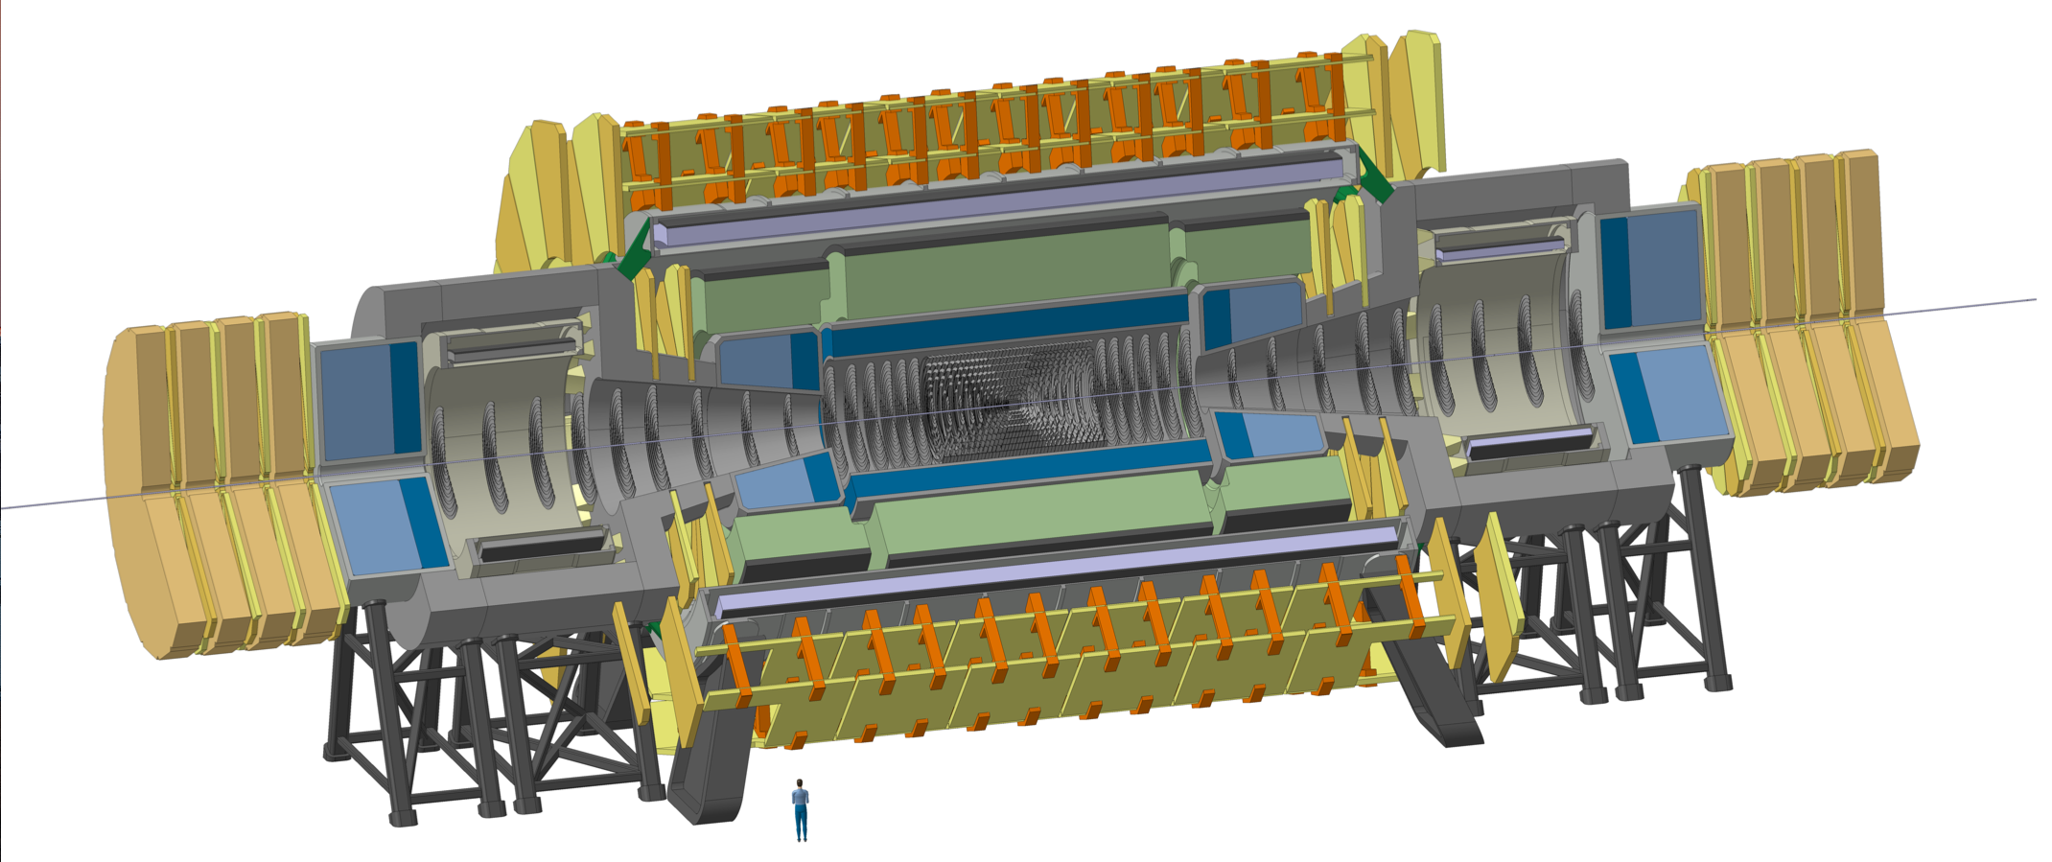
FCC-hh Reference Detector
4T, 10m free bore diameter solenoid, unshielded
Forward solenoids, unshielded
Silicon tracker
Barrel ECAL LAr
Barrel HCAL Fe/Sci
Endcap HCAL/ECAL LAr
Forward HCAL/ECAL LAr
50m length, 20m diameter
similar to size of ATLAS

Slide 5
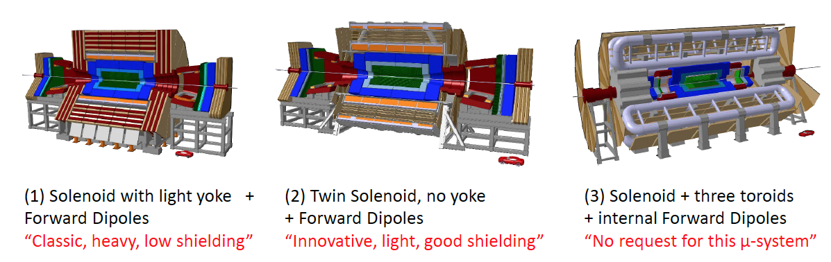
Previous options that are difficult to realize
Shielding too heavy, expensive, inefficient
Maybe possible with a reduced coil size.
Magent system i.e. main coil + shielding coil too expensive and too large to be brought to the cavern
Arguments in favour of a huge toroid are weak. ‘Standalone’ muon performance was a key requirement at LHC with all the worries about silicon trackers at LHC rates. Not strong any more.

Slide 6
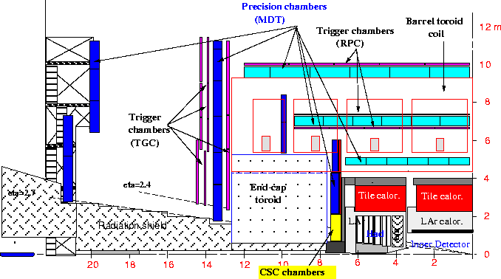
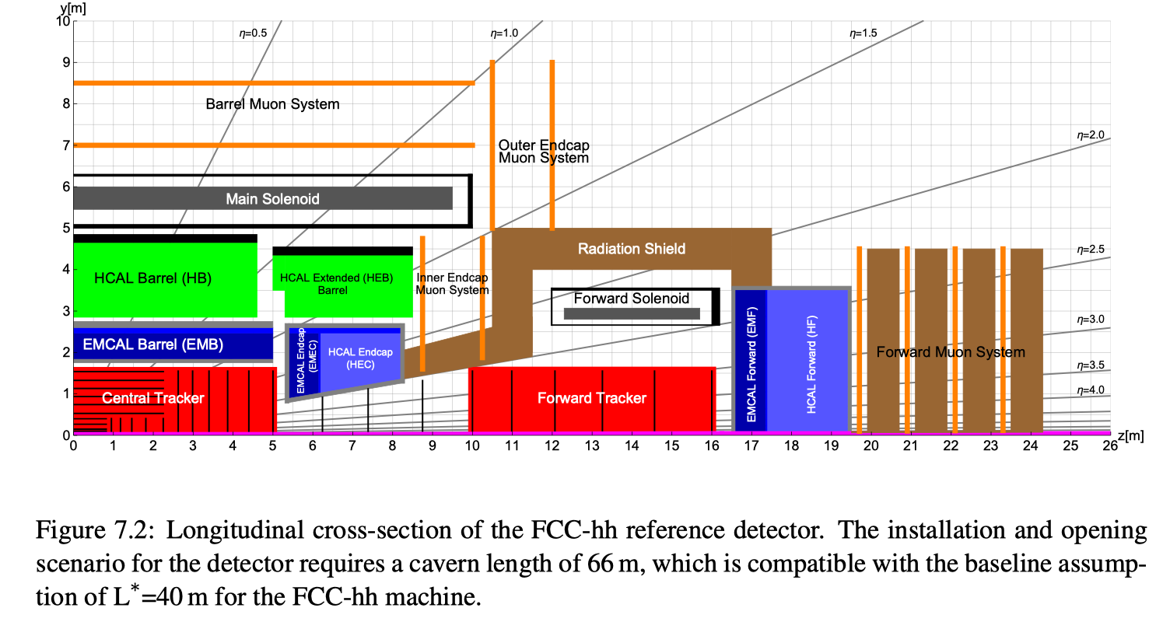
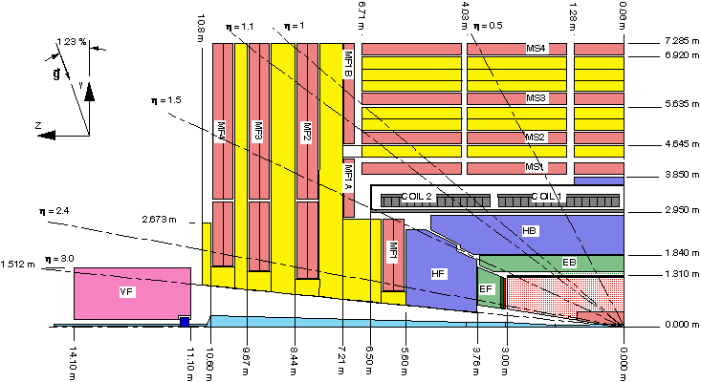
Comparison to ATLAS & CMS
FCC-hh detector longer, not much larger in radial dimension than LHC

Slide 7
FCC-hh Reference Detector
50m long, 20m diameter
Cavern length 66m
L* of FCC 40m.
90% of ‘heavy‘ physics will take place in η<2.5.
Increase of acceptance for precision spectroscopy and calorimetry from 2.5 at LHC to 3.8-4 for SM physics.

Slide 8
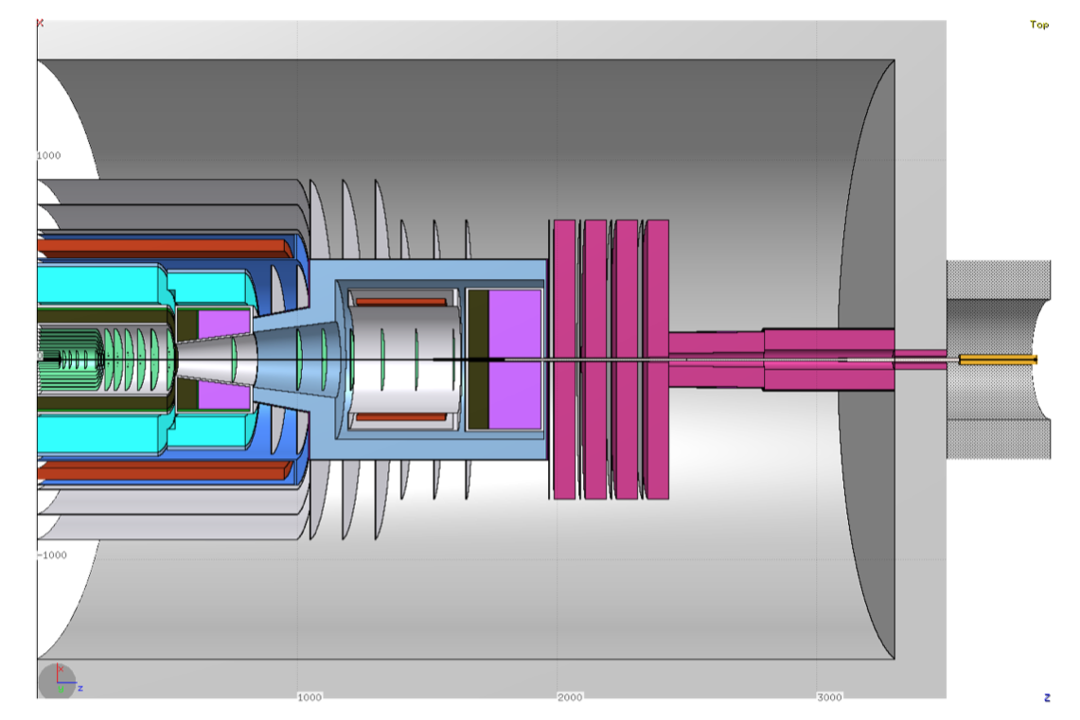
L*=40m
TASS=35.5m
z=33m

Slide 9
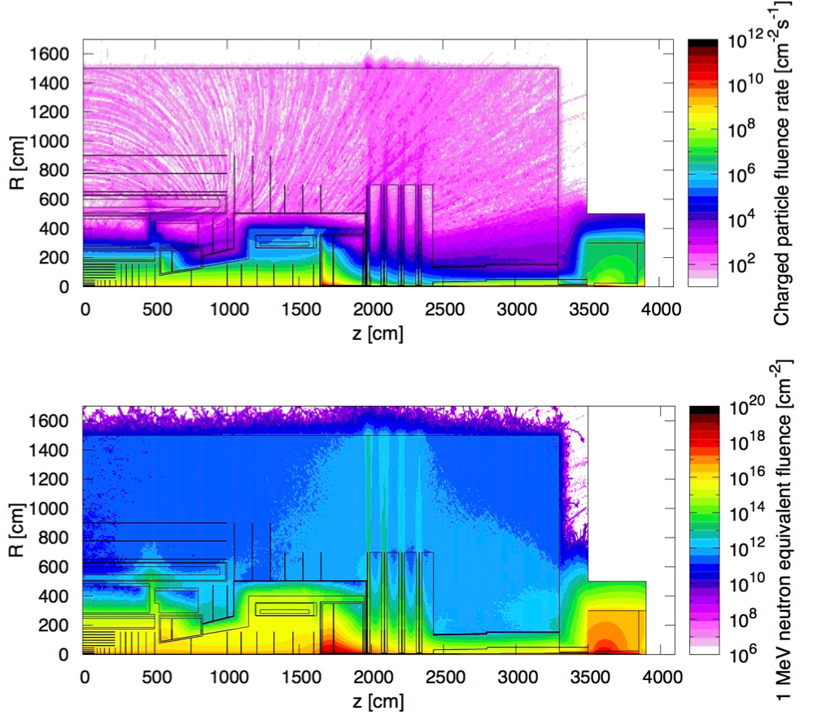
Radiation Studies for L=3x10³⁶ cm⁻²s⁻¹ and 30ab⁻¹
Maximum of 10kHz/cm² of charged particle rate in the Barrel and Forward Muon System, similar to HL-LHC Muon Systems.
In the tracker volume the charged particle rate is just a function of distance from the beampipe with rather small dependence on z.
Hadron fluence in the order of 10¹⁸ /cm² close to the beampipe and 10¹⁵ -10¹⁶ /cm² (HL-LHC levels) for r>40cm.
Extreme fluences in the forward calorimeter …
Triplet (z=40m), Triplet shielding TAS (z=35m) and related radiation are nicely ‘burried’ inside the tunnel.

Slide 10
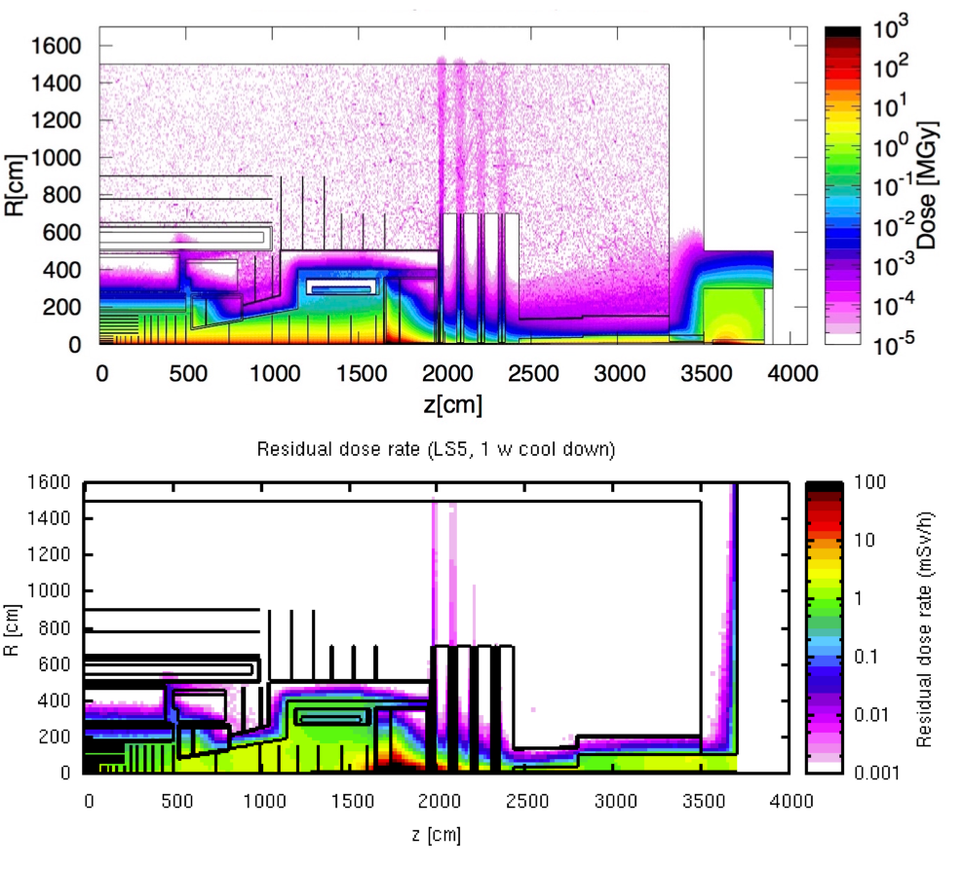
Radiation Studies for L=3x10³⁶ cm⁻²s⁻¹ and 30ab⁻¹
Dose of 300MGy in the first tracker layers.
<10kGy in HCAL barrel and extended barrel.
Dose from activation towards the end of FCC operation, 1 week of cooldown, so significant decrease for 1month, 1 year.

Slide 11
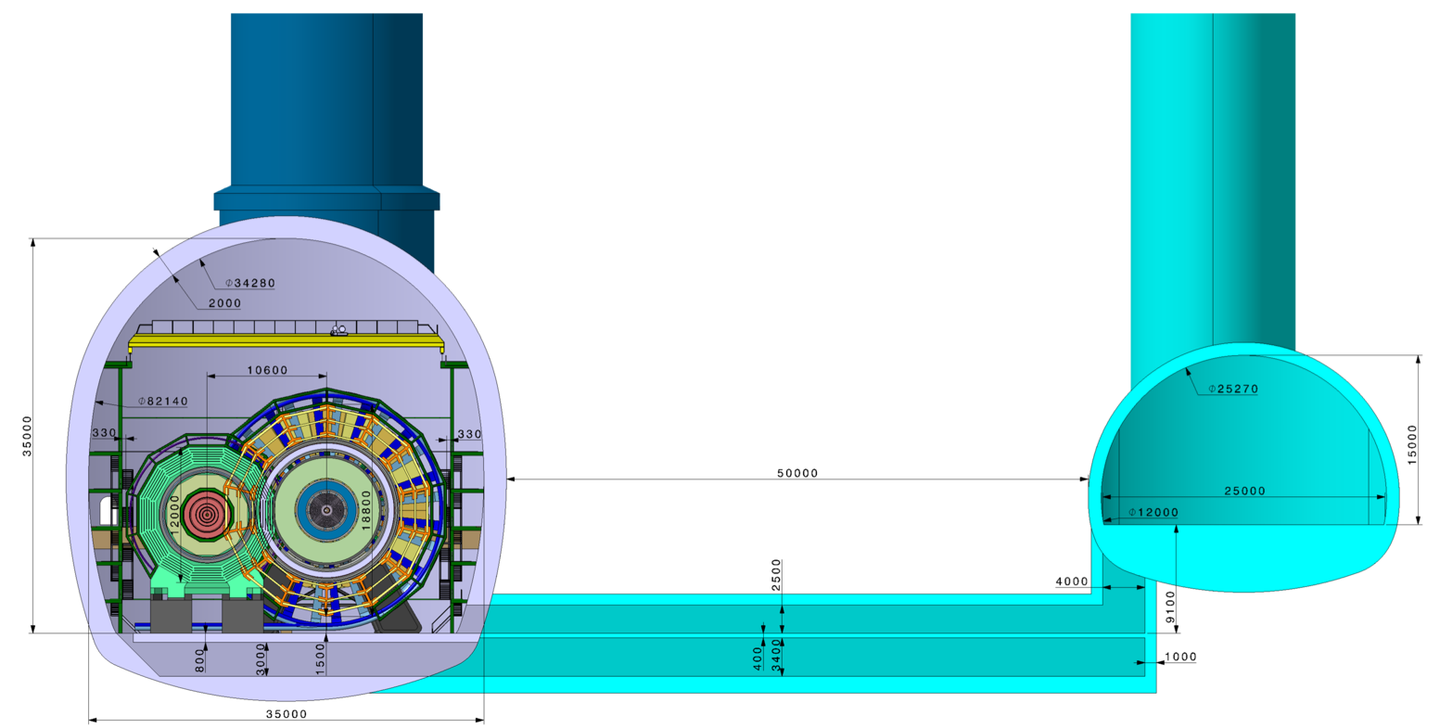
FCC-hh Reference Detector Cavern
Shaft diameter 15m
Distance of 50m for
civil engineering
stray field reduction
Radiation shielding (10-15m would be sufficient)
Detector Cavern
Service Cavern

Slide 12
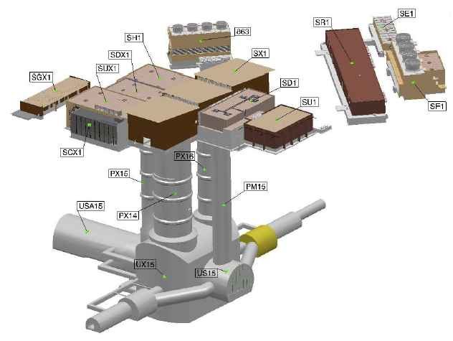
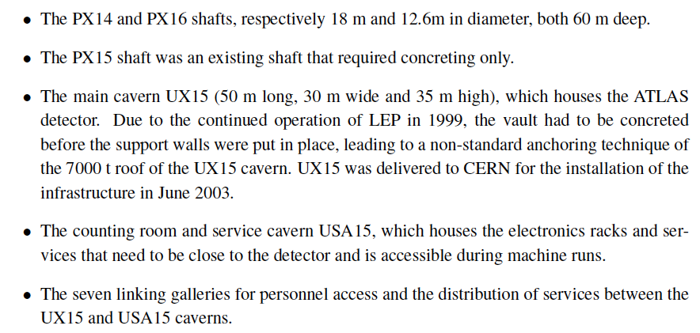
ATLAS
12.6m diameter
18m diameter
35m
50m
30m
Two shafts to the main cavern.

Slide 13
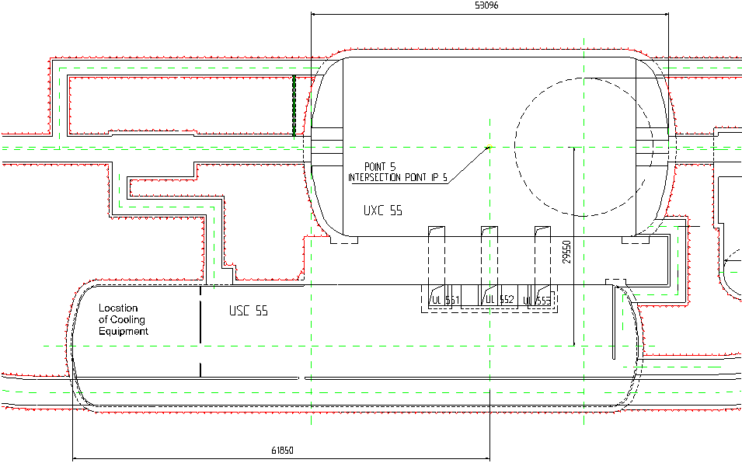
CMS
50m
27m
21m
18m
84m
One shaft to the main cavern, second shaft to the service cavern and gallery for transport to the main cavern.

Slide 14
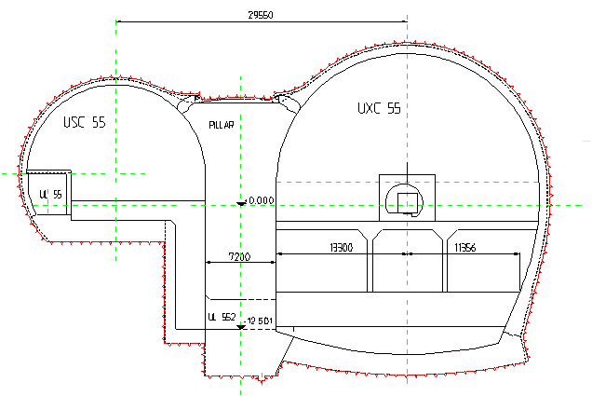
CMS
25m
13m
27m
25m
NB: ALICE and LHCb have only one shaft with overhead crane.

Slide 15
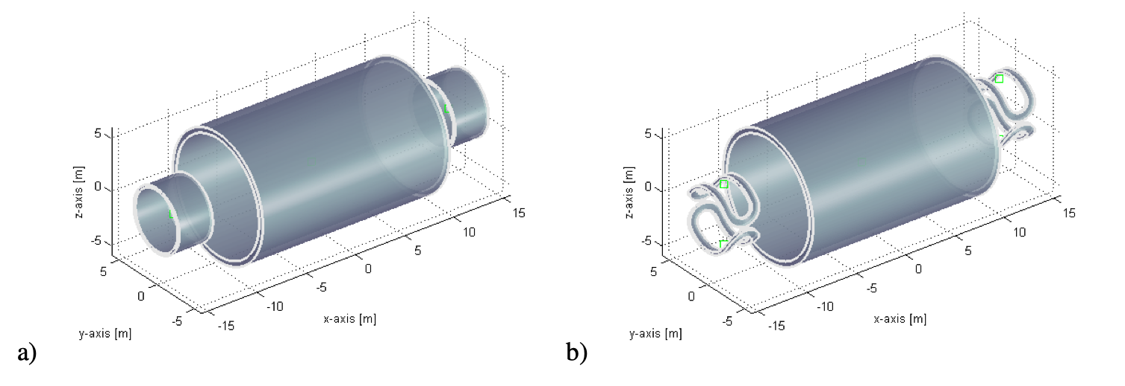
Magnet System
Central Solenoid + 2 Forward Solenoids
Central Solenoid + 2 Forward Dipoles

Slide 16
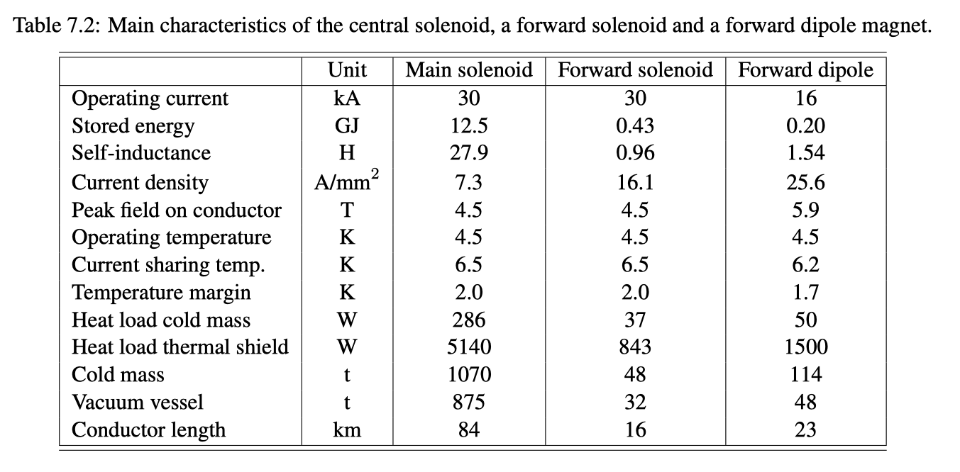
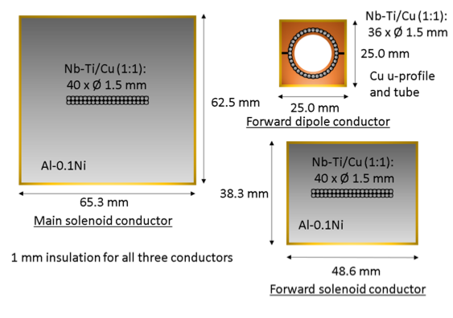
Magnet System Parameters
ATLAS Magnet System 2.7GJ
CMS Magnet System 1.6 GJ
Cold Mass + Cryostat around 2000 tons.

Slide 17
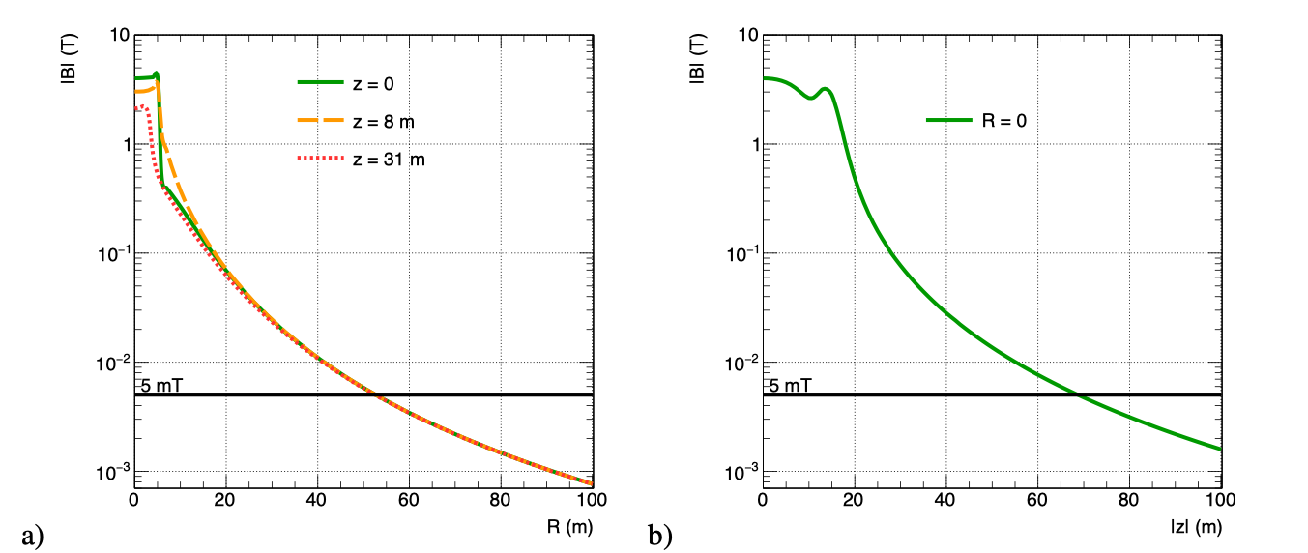
Stray Field
Less than 5mT in the Service Cavern, 200-300mT outside the detector.

Slide 18
Magnet Construction, Transport, Installation
Recently, a preliminary study on the FCC-hh magnet construction, installation etc. was done.
It is quite clear that the FCC-hh coil cannot be produced somewhere else and then be transported to CERN. It has to be built on the experiment site. This requires significant (temporary) infrastructure and buildings.
A coil with the dimensions of the CMS coil is the maximum that can possibly be built outside and be transported to CERN.
(Very important point to verify that this is the case for the present FCC detectors).
The dimension of the main shaft has to fit the biggest object, typically the magnet coil (only the coil or the coil+Yoke).
Important to verify the shaft dimensions need for the ‘CMS style Coil + Yoke lowering’.
From the FCC-hh side we agree to have
one main shaft and a secondary shaft
a second shaft to the service cavern with a gallery to the main cavern
are a good baseline assumption. We just have to verify that all components on one side of the experiment can be brought to the shaft side for maintenance and repair. For the FCC-hh reference detector this refers mainly to the small forward coil.

Slide 19
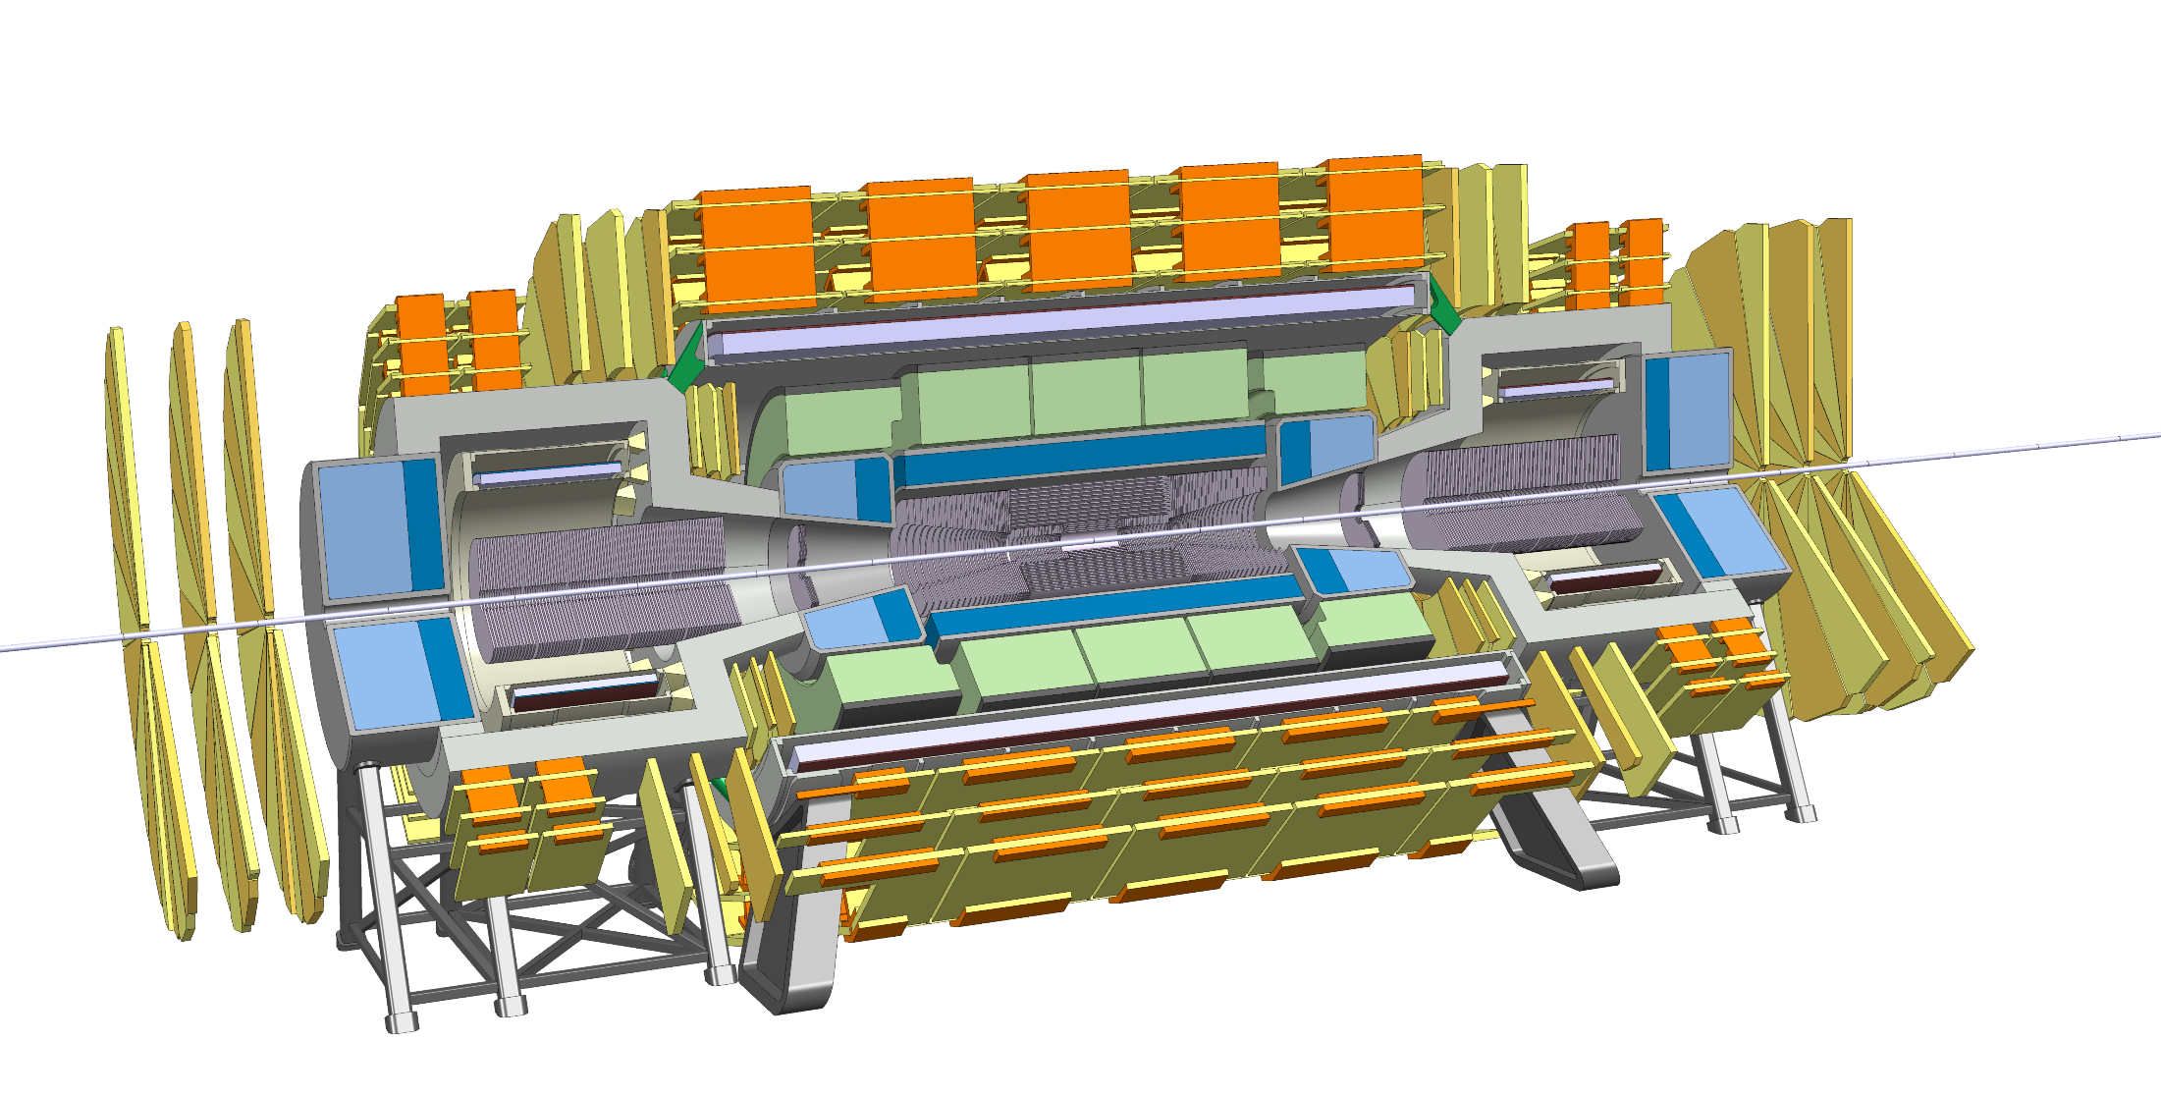
Trigger/DAQ
Example: ATLAS Phase2 calorimetry will be digitized at 40MHz and sent via optical fibers to L1 electronics outside the cavern at 25TByte/s to create the L1 Trigger at about 10us latency.
Muon system will also be read out at 40MHz to produce a L1 Trigger.
Reading out the FCC detector calorimetry and muon system at 40MHz will result in 200-300 TByte/s, which seems feasible.
40MHz readout of the tracker would produce about 1000 TByte/s.
Question:
Can the L1 Calo+Muon Trigger have enough selectivity to allow readout of the tracker at a reasonable rate of e.g. 1MHz ?
Un-triggered readout of the detector at 40MHz would result in 1000-1500TByte/s over optical links to the underground service cavern and/or a HLT computing farm on the surface.

Slide 20
DAQ Today, ALICE continuous readout
ALICE writes all data to permanent storage:
The key numbers are
50kHz PbPb collision rate
600 GB/s into our computing farm (12 MB/event)
—> The computing farm does data compression and NOT HLT selection
100GB/s to permanent storage (2MB/event)
During Run3 and Run4 ALICE will collect 10nb-1 of data i.e. 10¹¹ PbPb events.
The dN/d eta for pp collsions is around 6 while it is 100 times more for PbPb collision i.e. 600.
All our computers are finally in 2 of the 4 computing containers.
FCC-ee needs much less than this infrastructure that exists at this very moment.
Iphone-42 will be sufficient for FCC-ee DAQ.

Slide 21
Underground:
One shaft only on UX cavern (Is this OK?)
Yes, second shat to service cavern with gallery to main cavern.
If so, does it generate other constraints such as cavern width to pass components from one end to the other and/or large access gallery to link UX to PM shaft (As per CMS)?
We have to verify whether with the present cavern size we can move the small solenoid coil from one side to the other. CMS like size will be sufficient
Shaft diameter for PX.
15m for FCC-hh. For FCC-ee to be verified.
Is PM used by experiment for lowering components? Is proposed shape OK?
It will be used for lowering components. The present shape is ok.
Width of beam tunnel as it arrives at experimental cavern
Question to FCC-ee
Width of cavern (are the beams now aligned??) Length of cavern Height of cavern.
W=35m, H=35m, L=66m for FCC-hh.
We assume that FCC-ee and FCC-hh IPs coincide. Size of FCC-ee booster+ shielding to be understood.
Cranes in cavern (number and capacity)
Same as CMS and ATLAS for FCC-hh
Distance to service cavern (50m of rock or can be reduced? Could it be increased if necessary?)
For unshielded detector magnet this distance cannot be reduced. The reason is the magnetic stray field.
Radiation shielding can be achieved already with 10-15m of ‘concrete’ between main cavern and service cavern.
Access for humans, components, cabling/piping etc
Nothing special to be considered.
Need for survey galleries?
Question to the machine.
Need for shielding to be incorporated into civil engineering? (as per CMS point 5).
No – FCC-hh triplet and TAS is inside the FCC tunnel.
Service cavern functional requirements for the experiment.
Service caverns with surfaces equal to the present ATLAS and CMS caverns should be sufficient for FCC-hh.
Staging (ie what do we not need for ee but will only need at hh stage) – needs discussion.

Slide 22
Surface
Surface constraints mean that each surface layout will probably need to be slightly different. For the moment we wish to focus on Point A as this is the one to be passed onto FNAL for further development and costing.
Assembly Hall ee (length, width, height under crane hook, cranes (capacity and number)
CMS type surface hall should be a good reference.
Lowering scenario (large heavy as per CMS) or smaller with subsequent underground assembly?
Not considered for FCC-hh at this moment, but probably for FCC-ee.
FCC-hh coil needs 2.5kT lowering infrastructure.
Assembly hall hh. Dimensions, crane capacities and numbers, can it be split into two or three buildings (coil winding, assembly and then lowering)?
Lift capacities
At least as much at ATLAS, CMS. More is welcome, especially because the shafts are much deeper.
Cryo needs for ee? Do we need to extend later for hh?
Similar to CMS cryo plant. Compressor stage on the surface, Cold box to be decided whether on the surface or in the cavern.
Comparison with CDR?
???
Does the FCC-ee need a service cavern at all ? ALICE, LHCb do not …
I will try to get dimensions and layouts of caverns, shafts, surface buildings for LEP and LHC experiment sites.
Assemble all dimensions for LEP, LHC, ILC, CLIC, FCC-ee, FCC-hh detectors,
Specifically the coil, i.e. cryostat dimensions, to be able to relate our conclusions.

