Slide 1
FCC-hh detector concepts and requirements
Review of Civil Engineering and Technical Infrastructure Requirements for FCC Experimental Sites
(3-4 October, 2022)
W. Riegler

Slide 2
Review goals and charge
The October meeting should review the surface and underground CE and TI requirements, implied by the principal detector concepts (in particular detector magnets and main support structures) of both FCC-ee and FCC-hh, for construction, installation, operation and maintenance phases.
Assumptions:
  Two or four experimental detectors for FCC-ee,
  Locations in PA (Ferney) and PG (Charvonnex and Groisy) and/or in PD (Nangy) and PJ (Vulbens/Dingy-en-Vuache)
  two primary and two secondary experiments for FCC-hh (PA, PD, PG, PJ)
  single access shafts to all experimental caverns
  addtl. access to exp. cavern via detector service cavern and service cavern shaft
Detector for FCC-ee
  Production, transport, assembly, and installation of detector support & magnet systems
  Detector requirements on CE, cryo, gases, EL, CV infrastructure and computing
  Cryogenic infrastructure system concept (installation, maintenance, etc)
  EL, CV system concepts and integration
  Readout electronics and data processing infrastructures
  Operation, maintenance and safety requirements
Detector for FCC-hh
  Production, transport, assembly and installation of detector magnet system
  Detector requirements on CE, cryo, gases, EL, CV infrastructure and computing
  Cryogenic infrastructure system concept (installation, maintenance, etc)
  EL, CV system concepts and integration
  Readout electronics and data processing infrastructures
  Operation, maintenance and safety requirements
Requirements on civil engineering and surface sites
Technical infrastructure evolution from ee to hh

Slide 3
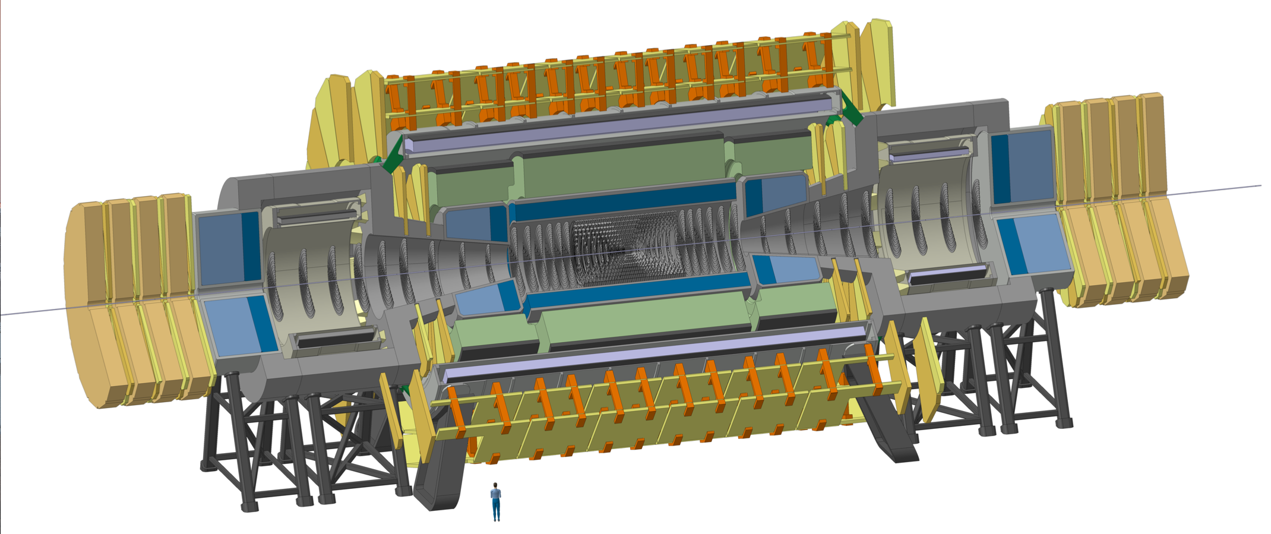
FCC-hh Reference Detector
4T, 10m solenoid, unshielded
Forward solenoids, unshielded
Silicon tracker
Barrel ECAL LAr
Barrel HCAL Fe/Sci
Endcap HCAL/ECAL LAr
Forward HCAL/ECAL LAr
The cost and weight of a yoke that returns the magnetic flux is considered excessive.
50m length, 20m diameter
similar to size of ATLAS

Slide 4
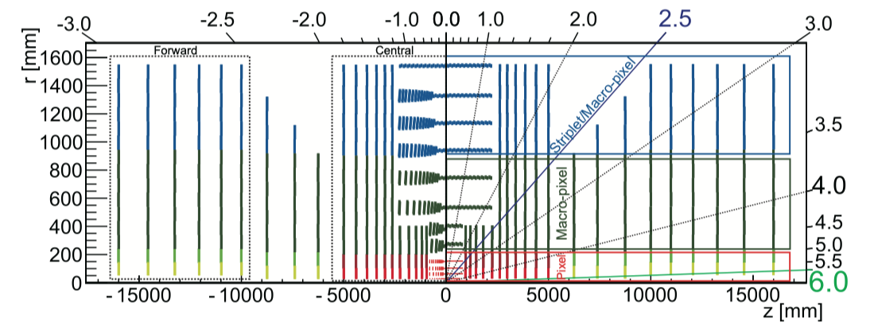
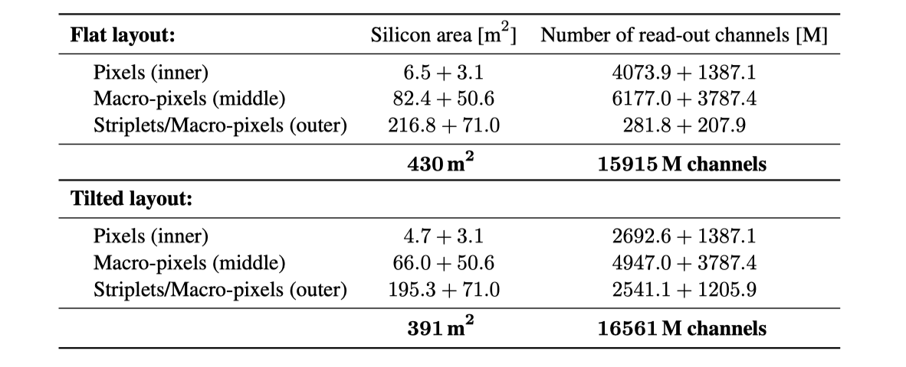
Tracker Numbers

Slide 5
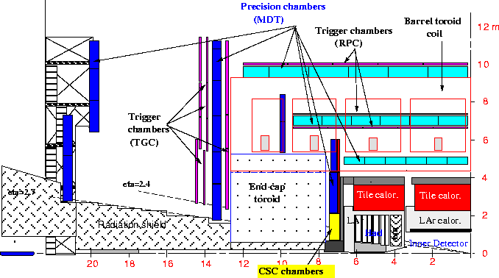
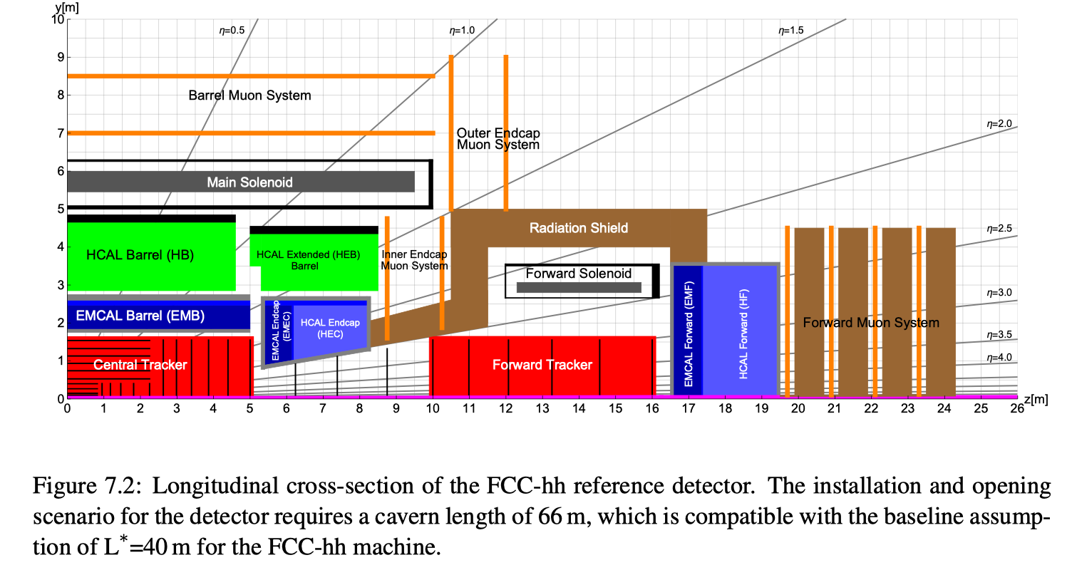
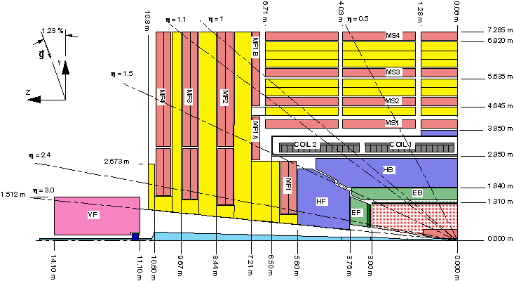
Comparison to ATLAS & CMS
FCC-hh reference detector
similar to size similar to ATLAS

Slide 6
FCC-hh Reference Detector
50m long, 20m diameter
Cavern length 66m
L* of FCC 40m.
90% of ‘heavy‘ physics will take place in η<2.5.
Increase of acceptance for precision spectroscopy and calorimetry from 2.5 at LHC to 3.8-4 for SM physics.
Calorimetry and tracking up to η=6 to have sufficient acceptance for VFB jets

Slide 7
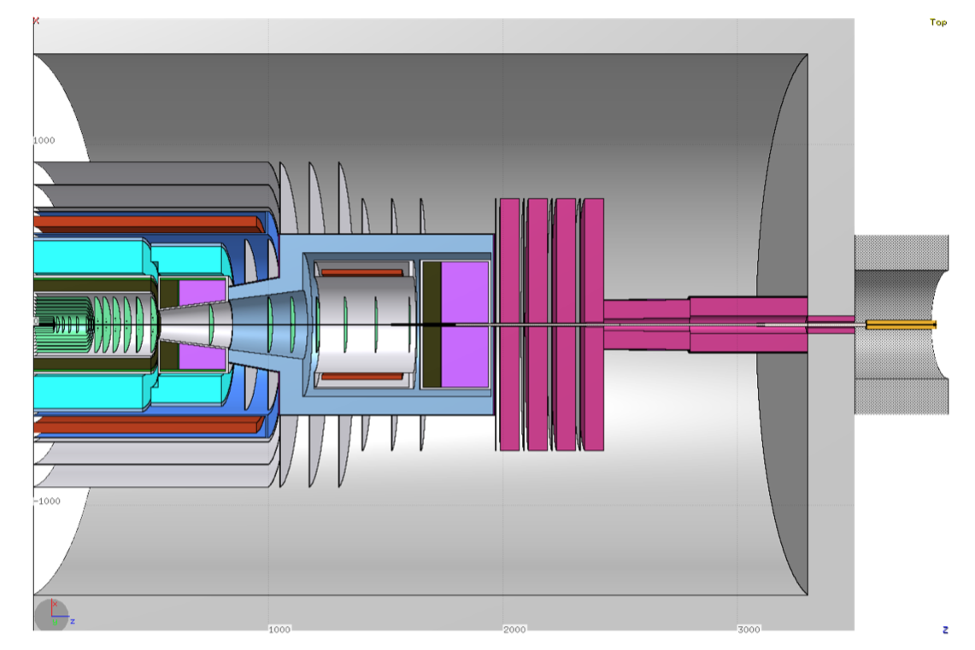
The L* of FCC-hh is 40m, TASS starts at 35.5m
The TASS produced a huge amount of radiation and it will be highly activated.
→ We clearly want this object to be hidden inside the tunnel and shielded from the the experiment.
N.b. L* of LHC is 23m → rotating shielding in CMS, big shield inside ATLAS muon system …
This defines the cavern half-length to be 33m.
L*=40m
TASS=35.5m
z=33m

Slide 8
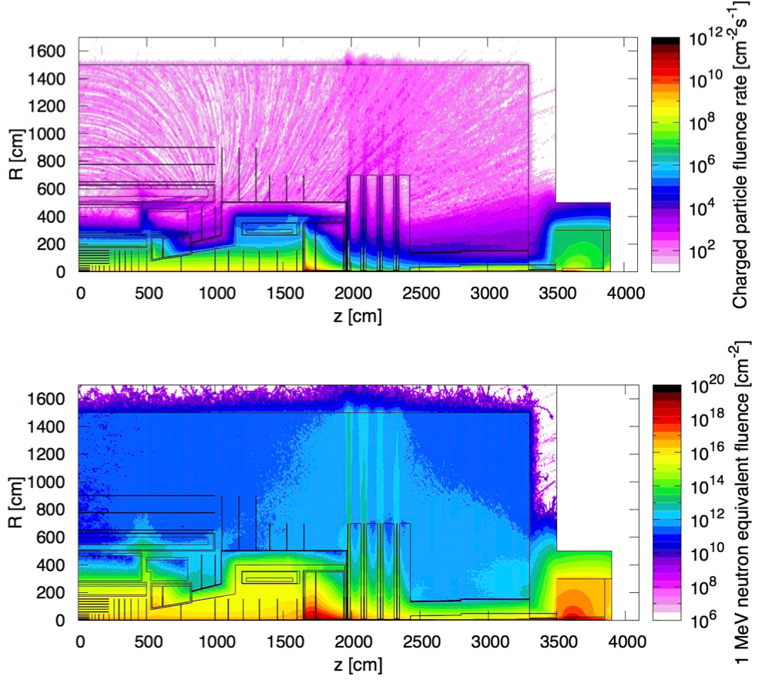
Radiation Studies for L=3x10³⁶ cm⁻²s⁻¹ and 30ab⁻¹
Maximum of 10kHz/cm² of charged particle rate in the Barrel and Forward Muon System, similar to HL-LHC Muon Systems.
In the tracker volume the charged particle rate is just a function of distance from the beampipe with rather small dependence on z.
Hadron fluence in the order of 10¹⁸ /cm² close to the beampipe and 10¹⁵ -10¹⁶ /cm² (HL-LHC levels) for r>40cm.
Extreme fluences in the forward calorimeter …
Triplet (z=40m), Triplet shielding TAS (z=35m) and related radiation are nicely ‘burried’ inside the tunnel.

Slide 9
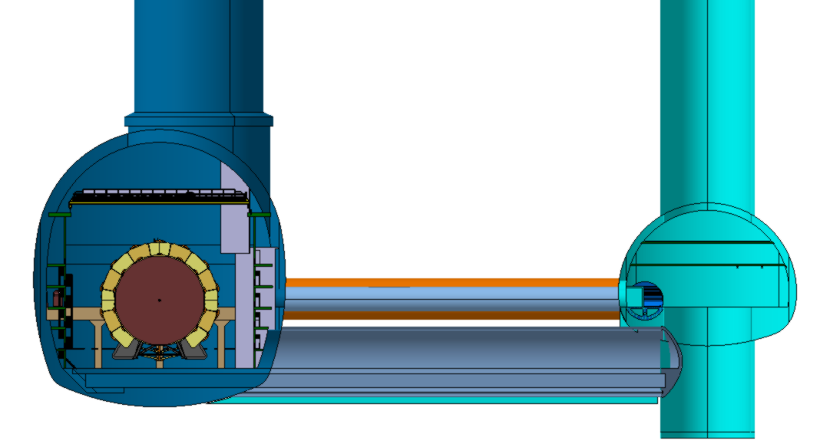
Distance of 50m for
civil engineering (separate object, no pillar)
Radiation shielding (10-15m might be sufficient)
stray field reduction
Detector Cavern
Service Cavern
Trigger Latencies: 100m propagation time = 0.5 us. ATLAS/CMS Phase-II L1 latency is 10us → No issue.

Slide 10
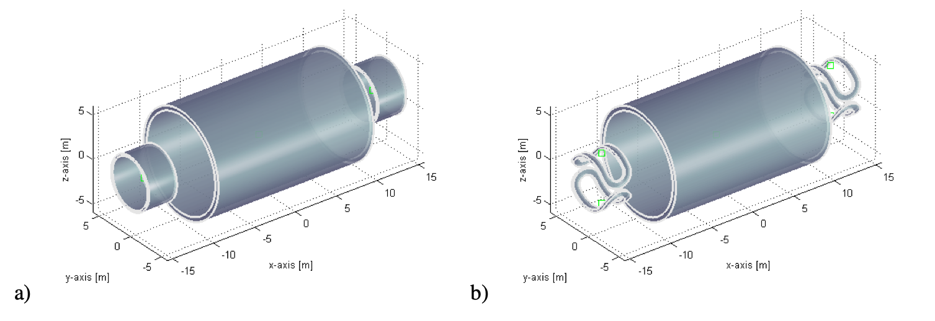
Magnet System
Central Solenoid + 2 Forward Solenoids
Central Solenoid + 2 Forward Dipoles

Slide 11
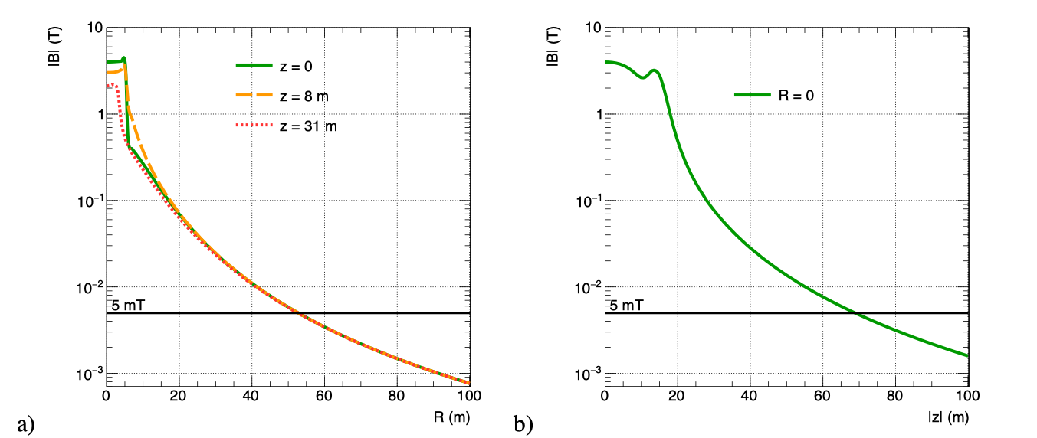
Stray Field
200-300mT outside the detector.
Less than 5mT in the service cavern.
→ This allows the use of standard equipment (pumps, motors, turbines …)

Slide 12
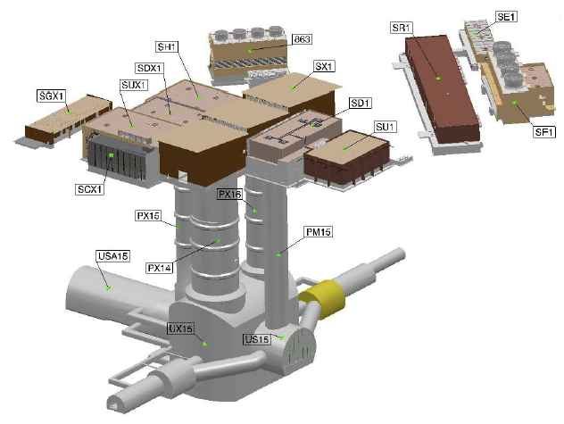
ATLAS
12.6m diameter
18m diameter
35m
50m
30m

Slide 13
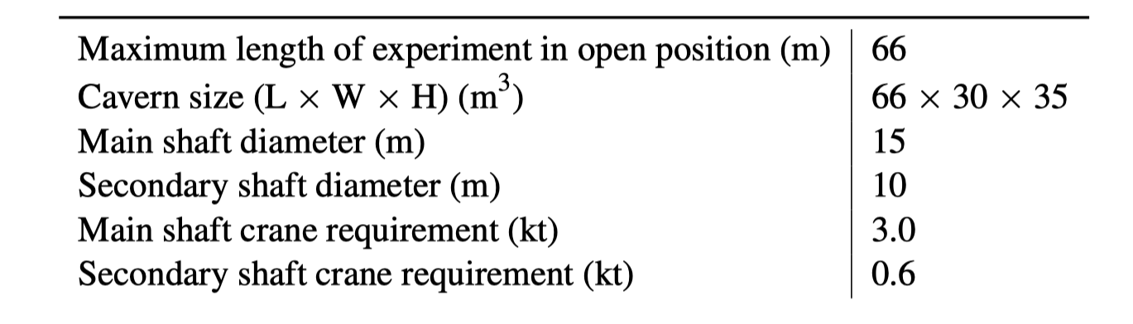
Requirements for FCC-hh (CDR)

Slide 14
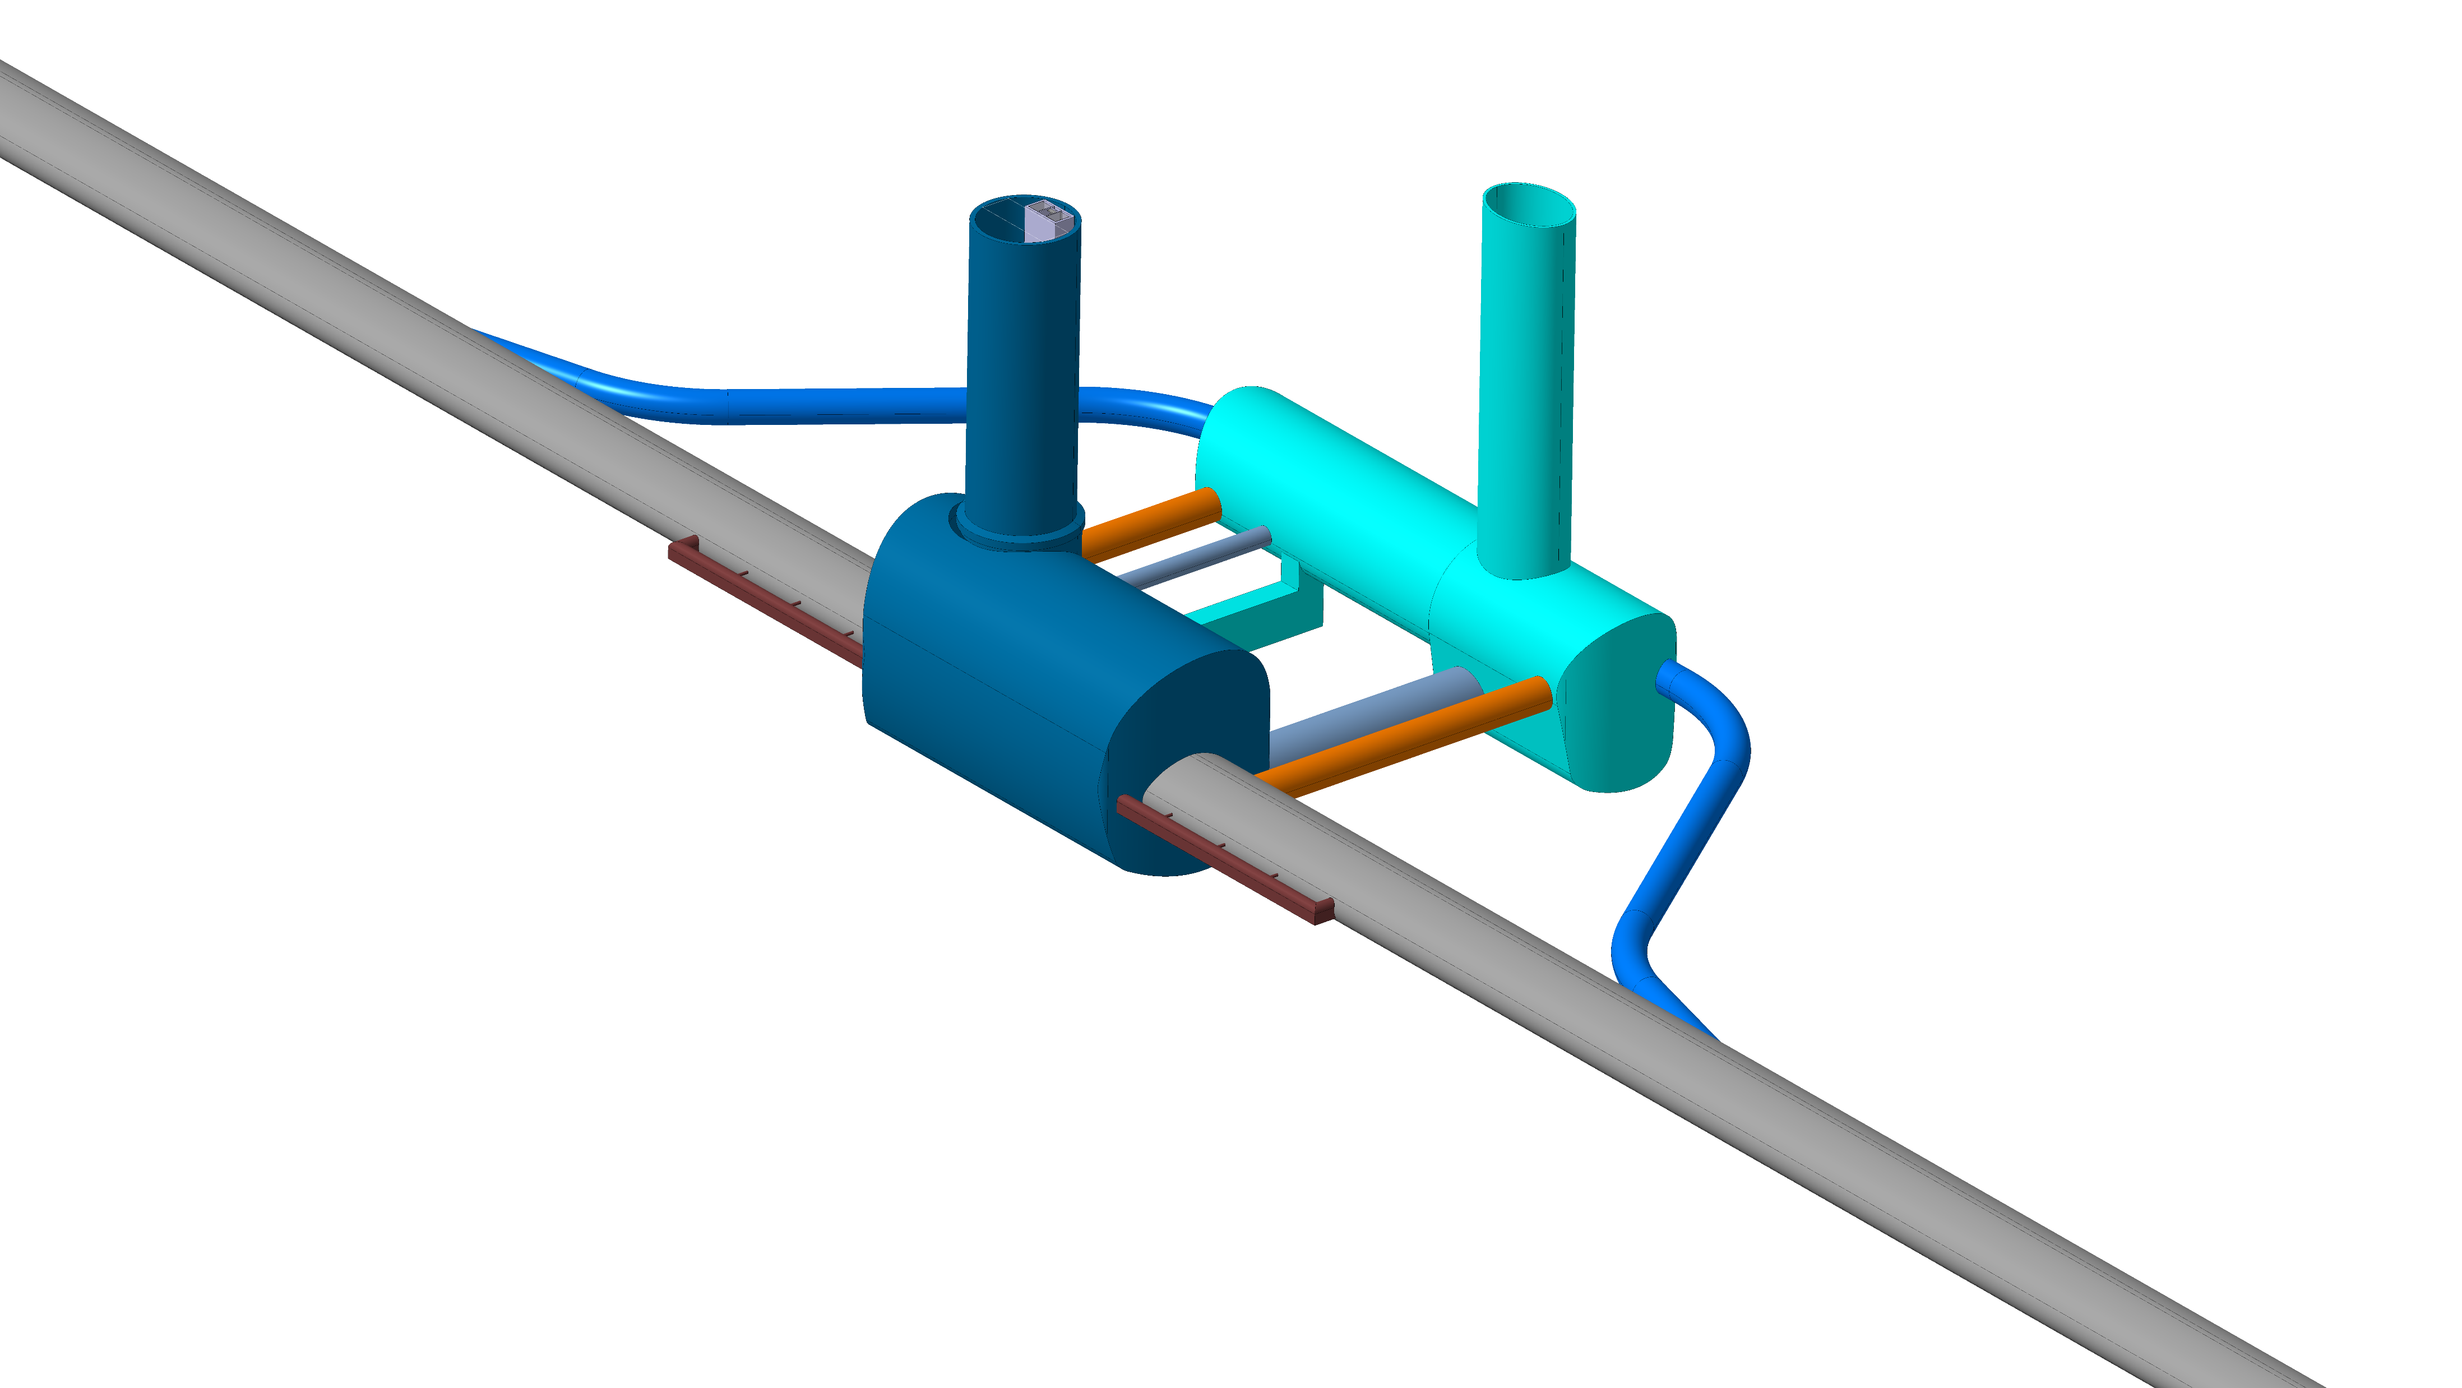
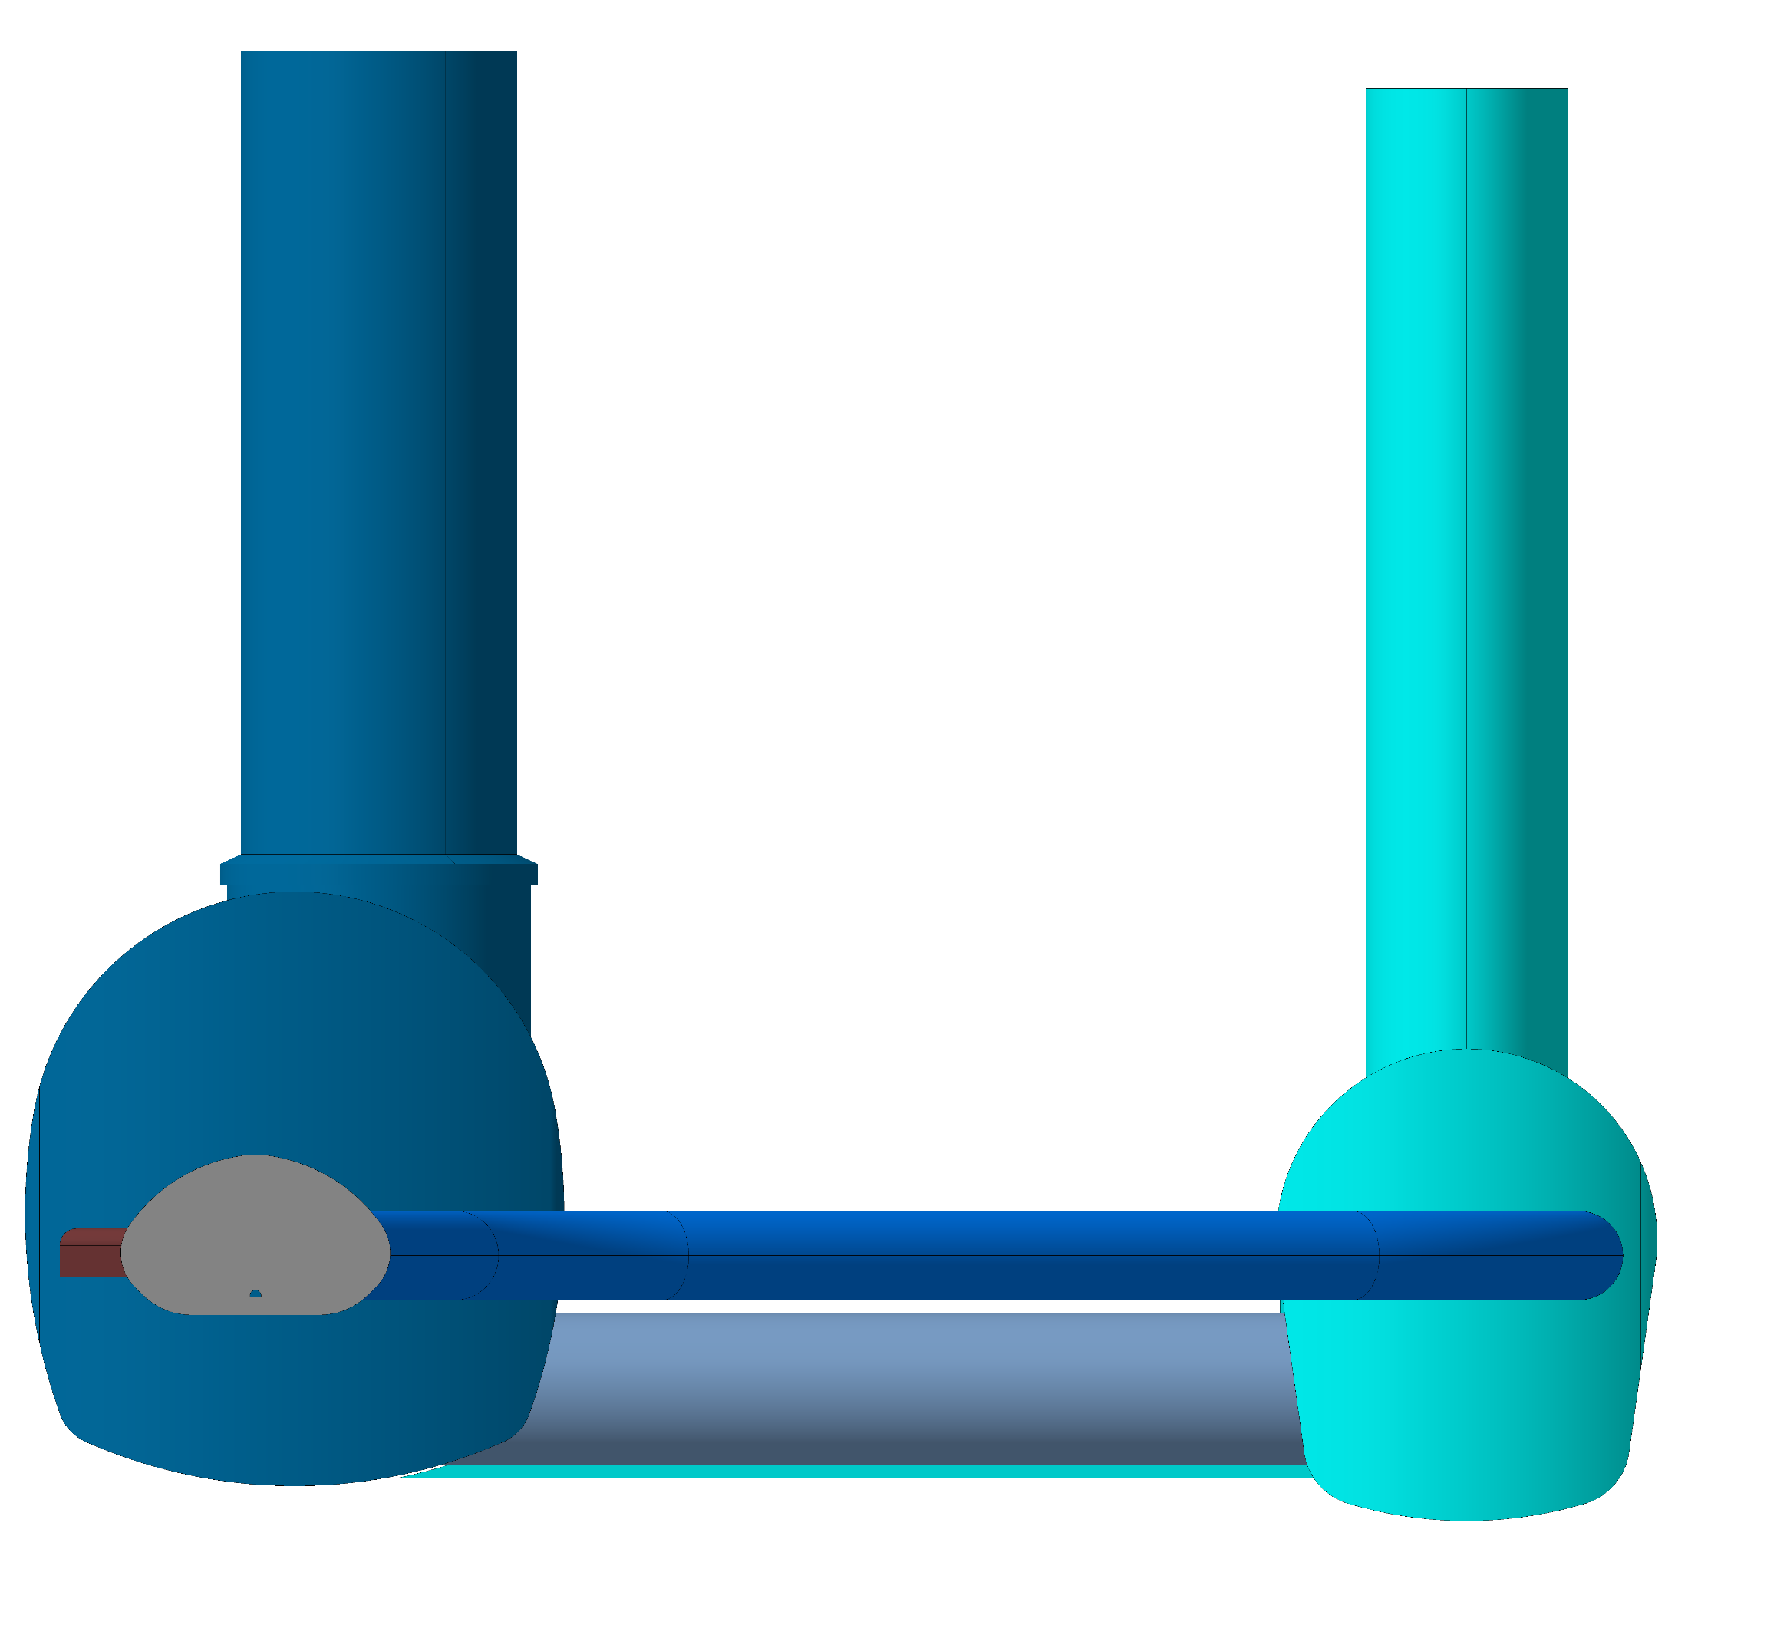
27.09.2022
F. Valchkova-Georgieva
  FCC Experiment Underground Structure version 2022
Experimental Shaft ø18m
Elliptical Service Shaft
Evacuation
connection tunnel
Service Cavern
Connection tunnel ø 5.5m
Experiment Cavern
Machine tunnel
Survey Galleries
Connection tunnel ø 5.5m
Connection tunnel ø 10m

Slide 15
27.09.2022
F. Valchkova-Georgieva
  FCC Experiment Underground Structure version 2022
Experimental Shaft ø18m
Elliptical Service Shaft
Evacuation
connection tunnel
Service Cavern
Connection tunnel ø 5.5m
We consider one shaft (15m clearance) to the experiment cavern to be sufficient.
The largest part on the ‘away’ side is the forward solenoid, which can pass to the shaft side.
CMS installed their detector in the same configuration.
Machine tunnel

Slide 16
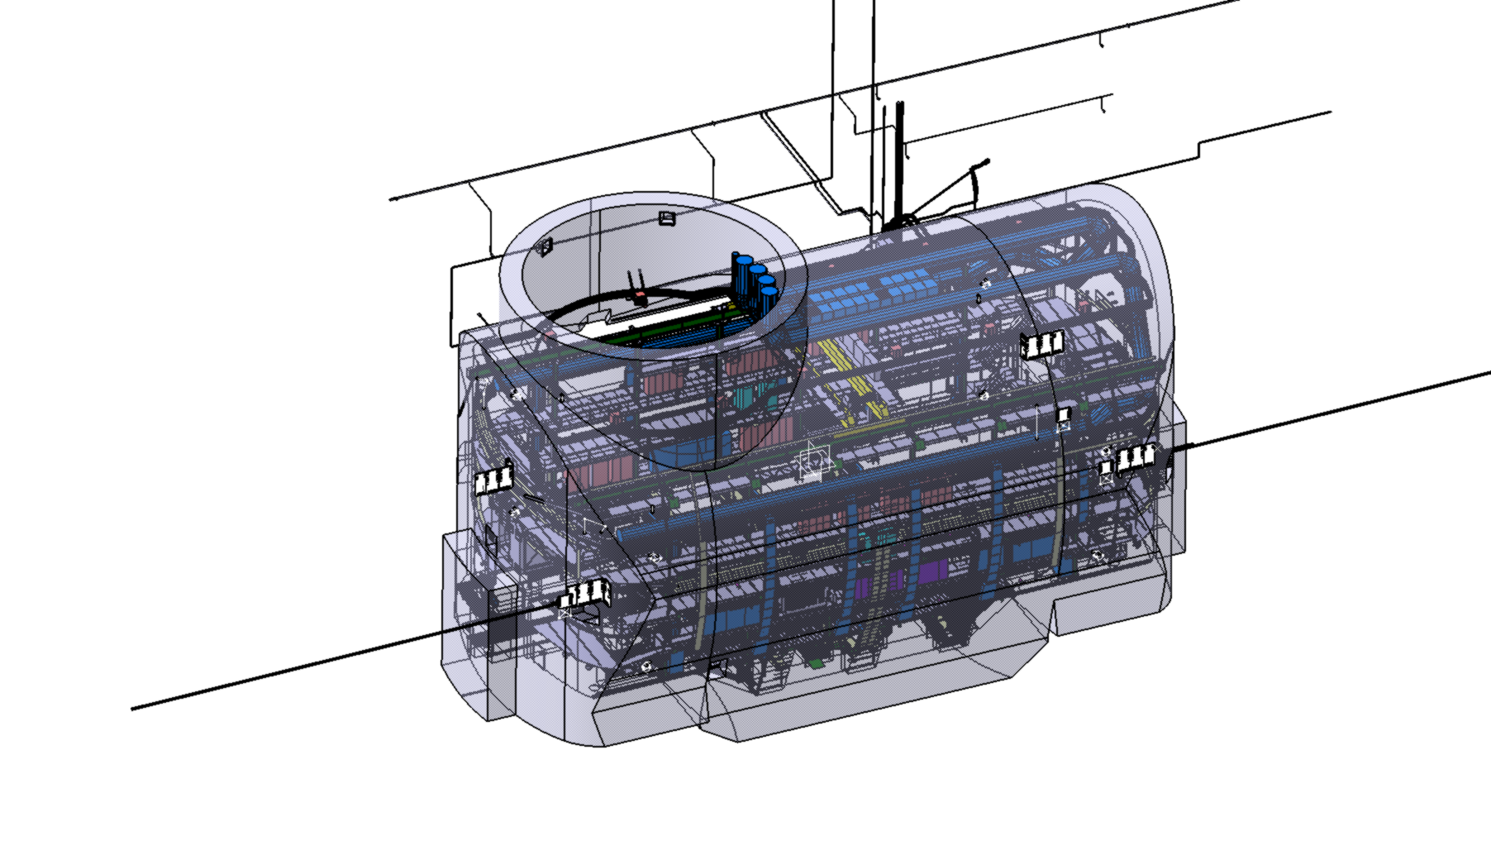
27.09.2022
F. Valchkova-Georgieva
  FCC Experiment Underground Structure version 2022
Experimental Shaft ø18m
Elliptical Service Shaft
Evacuation
connection tunnel
Service Cavern
Connection tunnel ø 5.5m
We do not consider the CMS strategy of assembling the the detector on the surface.
It is not an option for the FCC-hh reference detector.
It might be a possibility for other detector types, but it is one of many possibilities, not a priori the preferred one.
Machine tunnel
CMS shaft ø20.5m

Slide 17
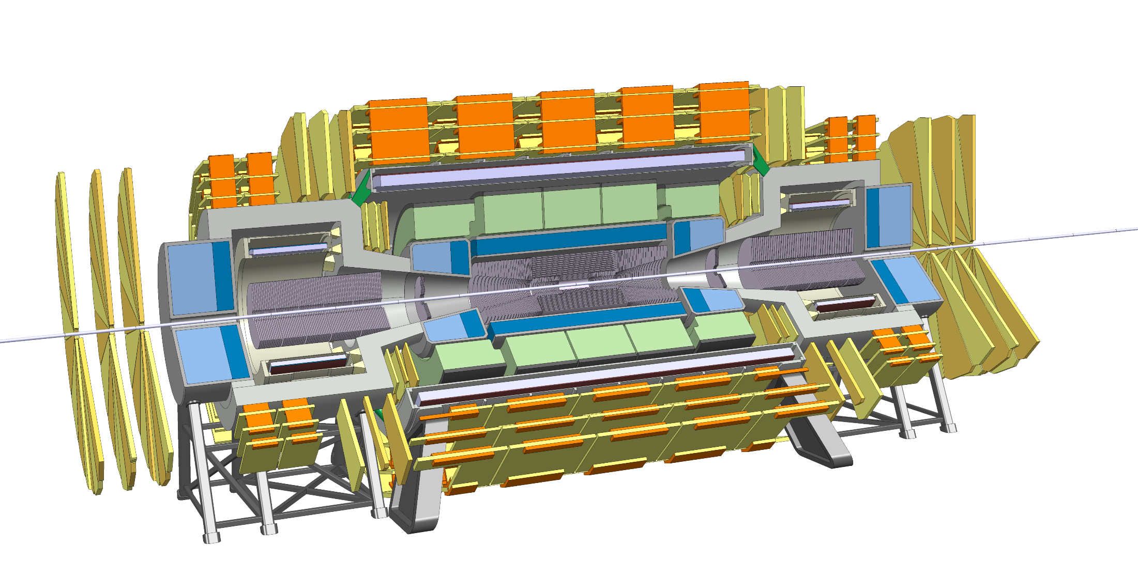
Trigger/DAQ
Example: ATLAS Phase2 calorimetry will be digitized at 40MHz and sent via optical fibers to L1 electronics outside the cavern at 25TByte/s to create the L1 Trigger at about 10us latency.
Muon system will also be read out at 40MHz to produce a L1 Trigger.
Reading out the FCC detector calorimetry and muon system at 40MHz will result in 200-300 TByte/s, which seems feasible.
40MHz readout of the tracker would produce about 1000 TByte/s.
Question:
Can the L1 Calo+Muon Trigger have enough selectivity to allow readout of the tracker at a reasonable rate of e.g. 1MHz ?
Un-triggered readout of the detector at 40MHz would result in 1000-1500TByte/s over optical links to the underground service cavern and/or a HLT computing farm on the surface.

Slide 18
We consider a total power of 10MW for the detector + computing at the experiment site.

Slide 19
Magnet Construction
The CMS solenoid is ‘pretty much’ the largest dimension that can built outside CERN and transported to CERN.
The FCC-hh main solenoid is clearly beyond this scale and therefore has to be built at the experiment site.
This requires major assembly infrastructure at the experiment site.

Slide 20
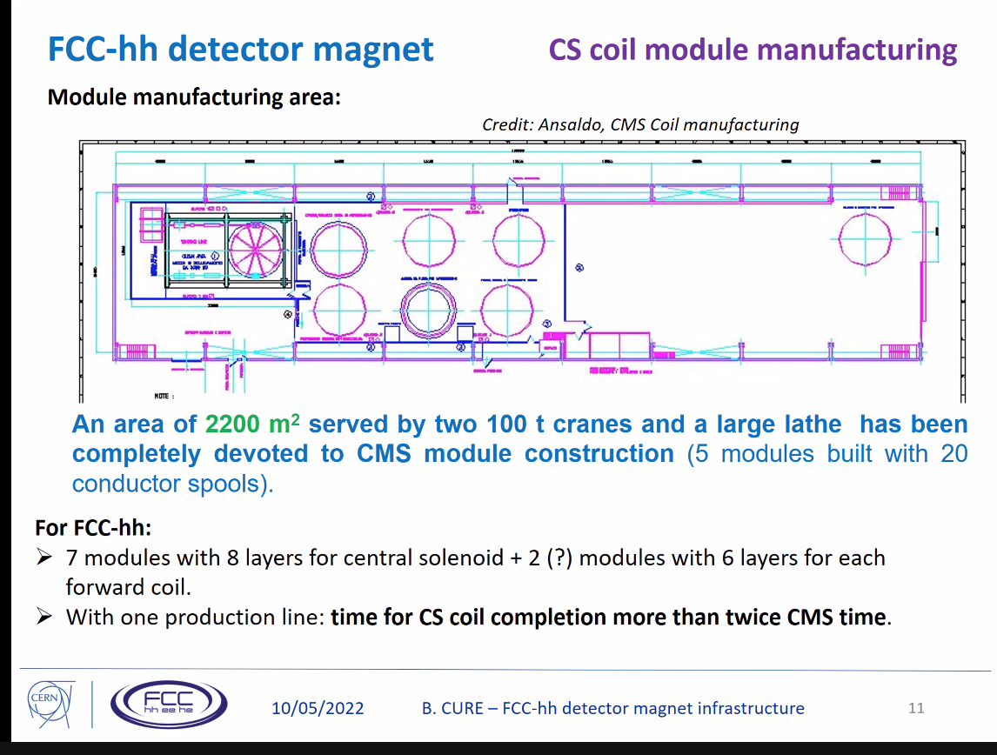
Magnet Construction

Slide 21
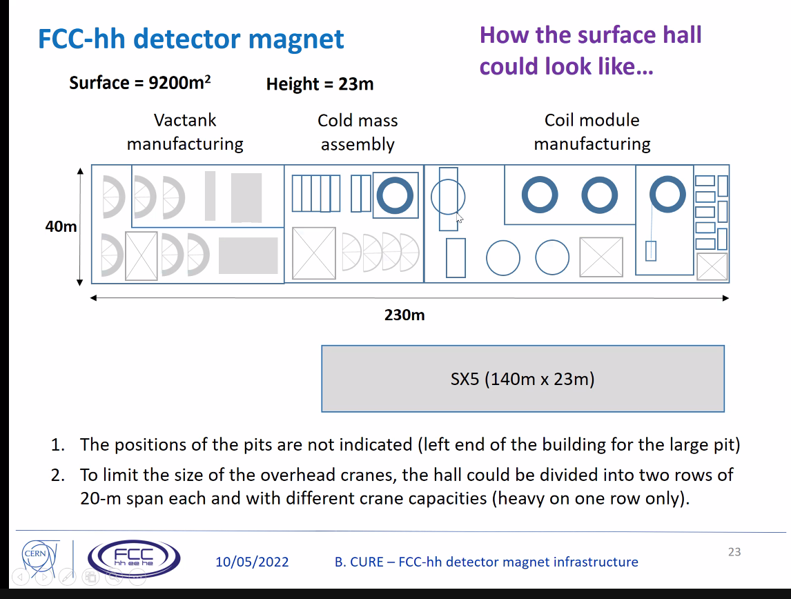
Magnet Construction

