Slide 1
Preparation for review of Civil Engineering and Infrastructure for Experimental sites (3-4 October, 2022)
Mogens Dam
September 16, 2022

Slide 2
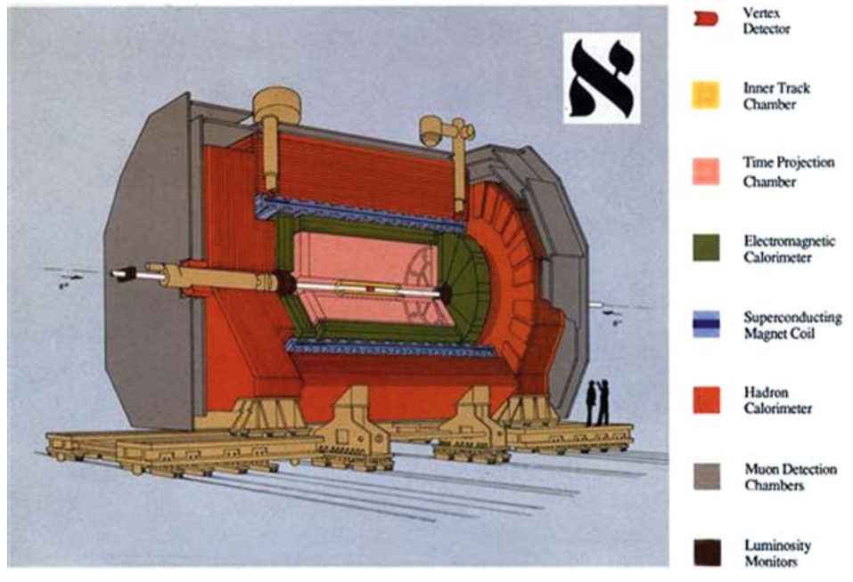
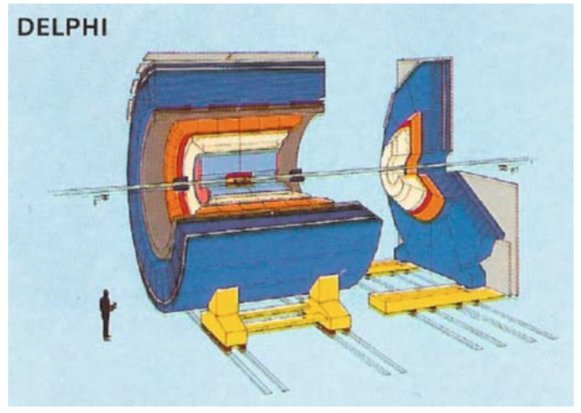
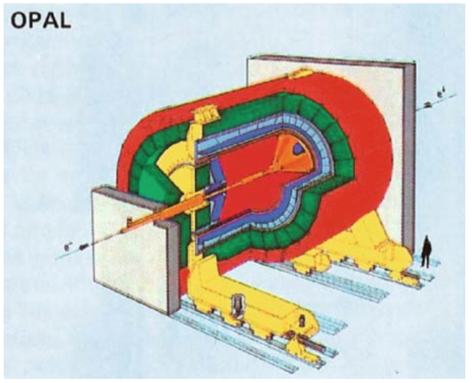
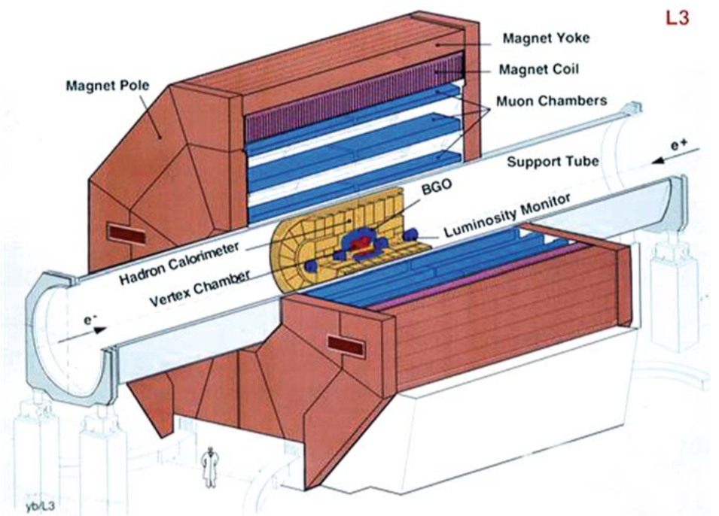
LEP Detectors
Typical design - Aleph, Delphi, Opal
Fit inside cylinder of: 12 m x 12 m
Assembled underground
Largest components to lower:
  Coil: max dimension 7.4 m length x 6.2 m diameter (DELPHI)
  HCAL modules: 10 m long x 1 m width
Experimental cavern: 70 (L) x16.5 (W) x18.6 (H) m³
Service cavern: 21.4 x 16 x 13.3 m³
Experimental shaft: 10.1 m diameter
Atypical design - L3
Assembled underground
Largest component:
Big support tube, 4.2 m diameter exgending throughout the cavern
Big magnet: 15.8(L) x 12(H) m
Exp.Cavern: 53.5 x 15.5 x 22.7m³
Exp. Shaft: 23 m diameter

Slide 3
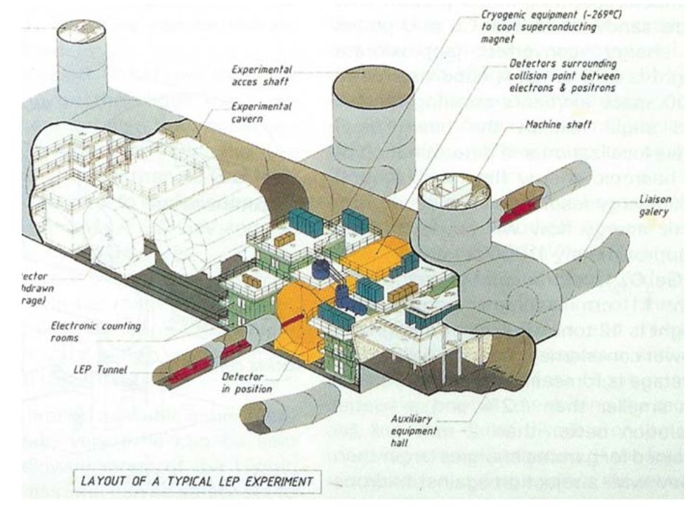
Typical experimental cavern at LEP
70 m long, 17 m wide, 18.5 m high
Shaft: 10.1 m diameter
Enough space for detector, including barracks for electronics, cryogenics, services, and even empty space to move the detector into garage position
Length direction perpendicular to beam direction
H.Schopper: ”Lord of the Collider Rings”

Slide 4
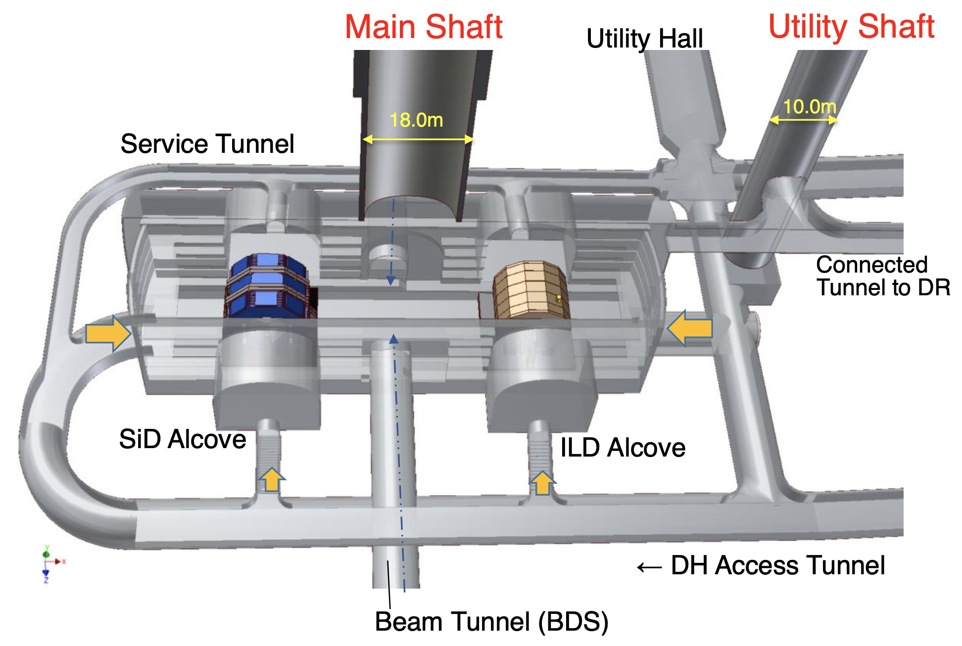
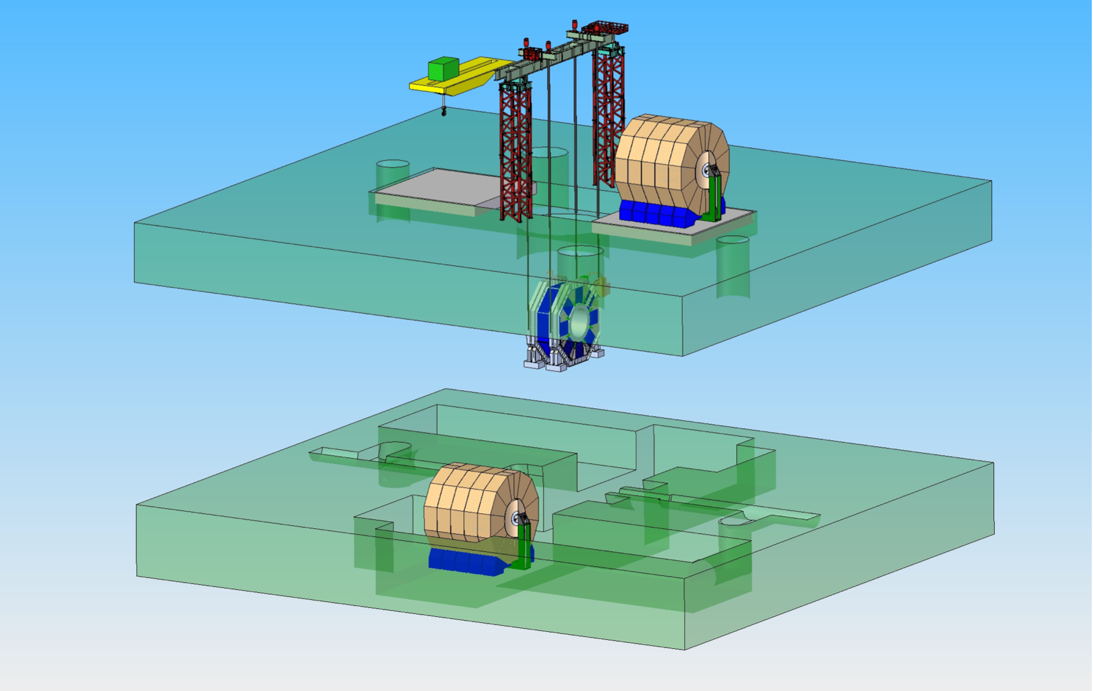
ILC Underground Hall
Large underground hall with push-pull of two detectors
  ILD: 15.6 m high, 13.2 m long
  SiD: 12.4 m high, 11.6 m long
Large shaft of 18 m diameter
Detectors are assembled at surface (CMS style) and lowered down in main parts

Slide 5
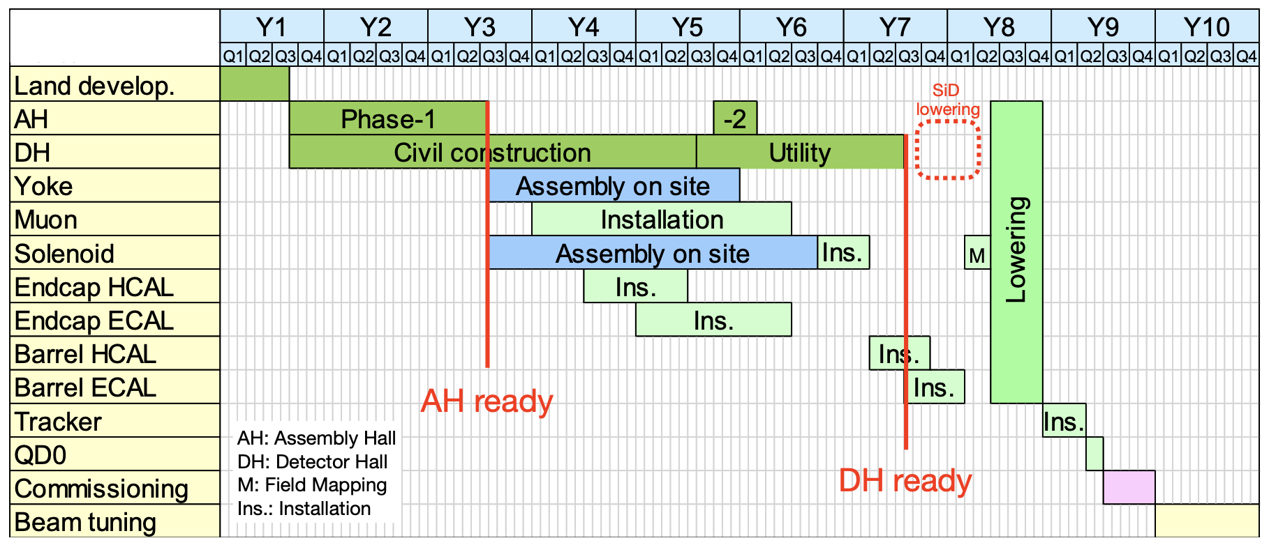
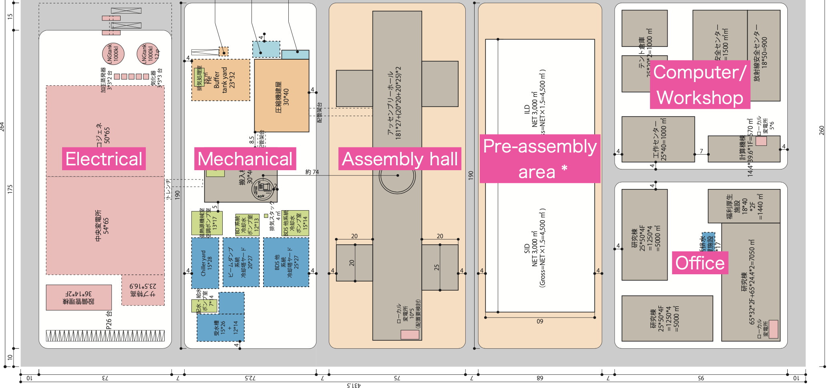
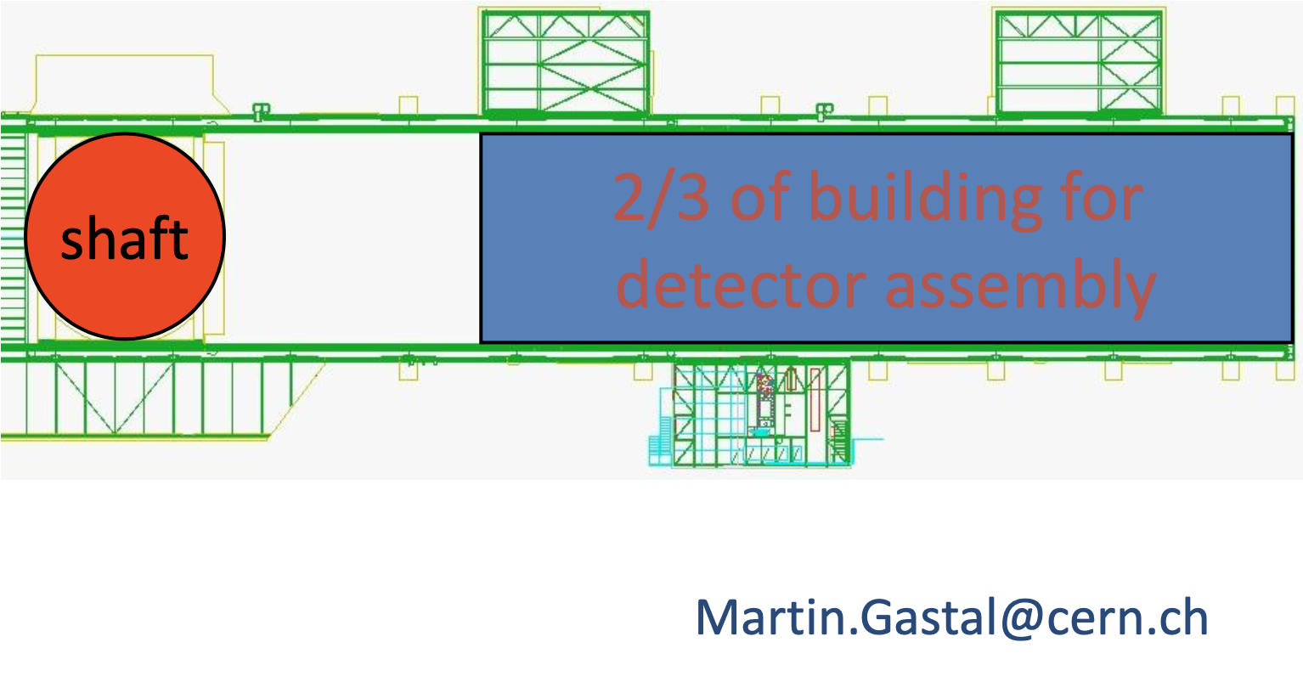
ILC Detector Assembly
Detector assembly at surface
  Saves 4 years in schedule with detector assembly and cavern construction running in parallel
  Cost of 3500 m² assembly hall per experiment (on top of 4000 m² for pre-assembly)
  Need of 18 m shaft
Similar to CMS and ILC, also the CLIC detector is planned to be assembled at surface and lowered into cavern
18m

Slide 6
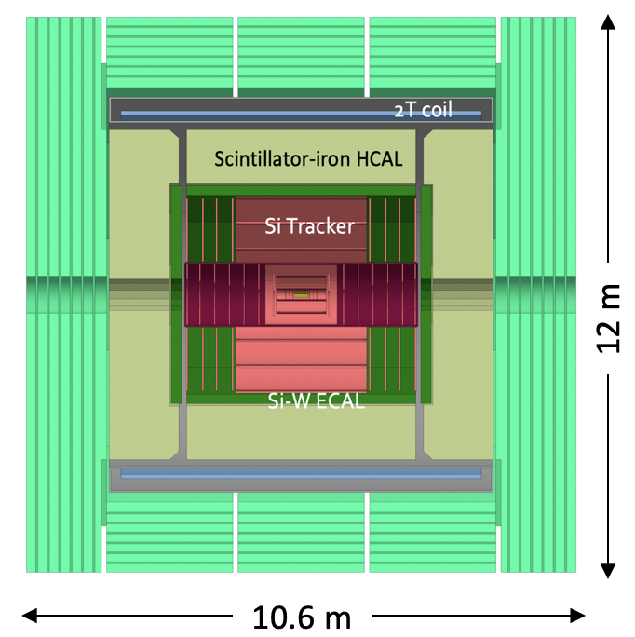
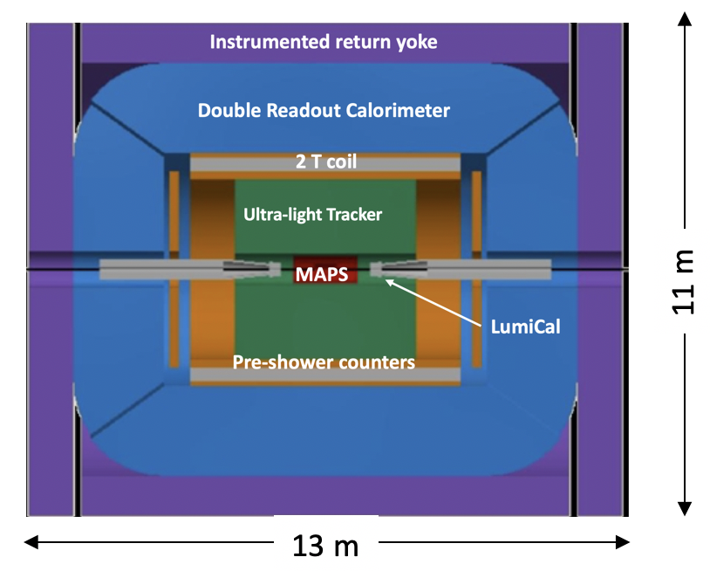
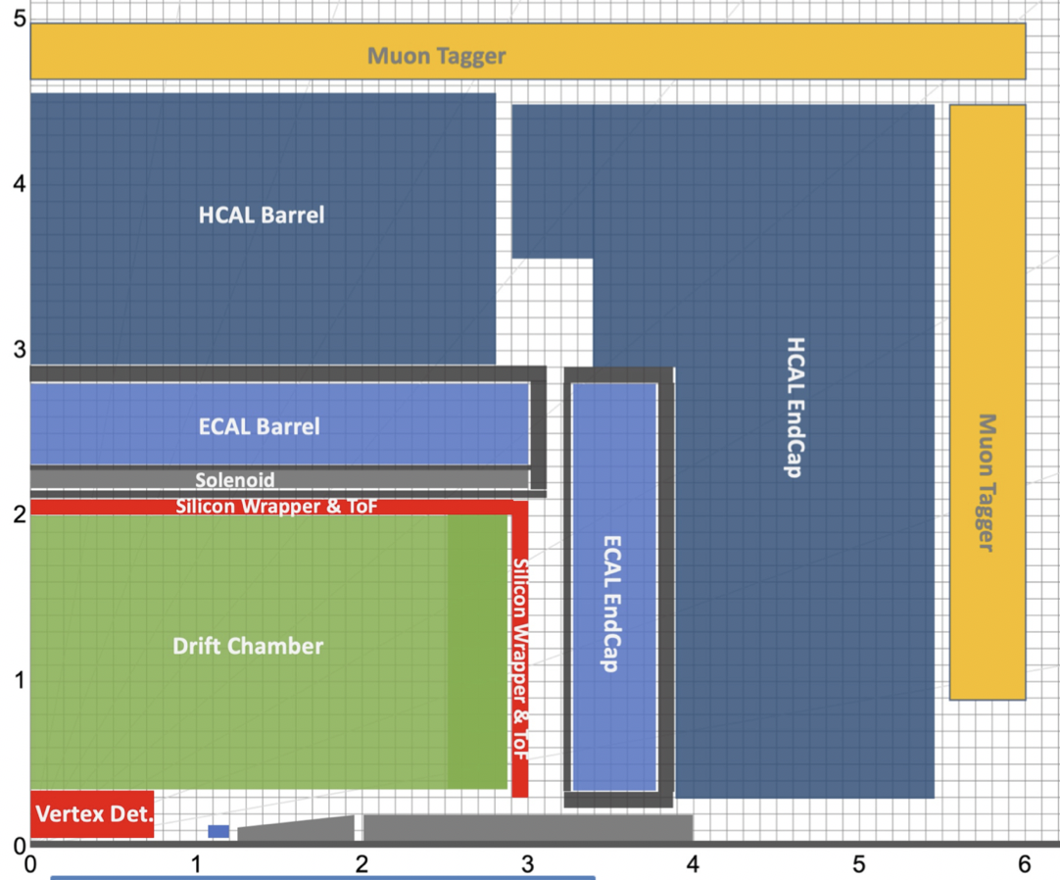
FCC Detector concepts
CLD
IDEA
Noble Liquid ECAL based
5 m
6 m
Cryostat:
Outer diameter: 8.55 m
Length : 7.4 m
Cryostat:
Outer diameter: 4.8 m
Length : 6.0 m
Cryostat:
Outer diameter: ~6 m
Length : ~6 m
All concepts fitting inside typical e+e- 12x12 m envolope
Tentatively, assume that largest single piece is cryostat
In comparison, CMS cryostat:
Outer diameter: 7.2 m
Length : 12.5 m
CDF cryostat wider by 1.3 m than CMS
Transportation?! Build on site?

Slide 7
FCC-ee Cavern Needs
It is estimated that a FCC-ee detector including all services (cooling plants, cryo cold box, gas systems, electronics barracks) would fit inside the cavern of the FCC-hh reference detector (66m x 35m x 35m) [and probably even inside a somewhat smaller cavern corresponding a typical LEP detector (70m x 20m x 20m)]
  Have to check whether radiation levels are low enough for cohabitation of detector and services (incl. people) in the same cavern.
    LHCb readout electronics is in detector cavern behind brick wall. Similar rate as Tera-Z and with higher particicle multiplicity
  The innermost part of the FCC-ee detectors (beam pipe, vertex detector, luminosity monitors, etc) may be installed inside small radius support tube and guided into the main detector on rails. Important to have and extra detector length available at one end of the detector for this operation.
  FCC-hh caverns have their length direction parallel to the beam. If there will be dedicated FCC-ee caverns, it could be considered whether a perpendicular orientation (as at LEP and ILC) is advantageous.
  Is there a need for garage positions?

Slide 8
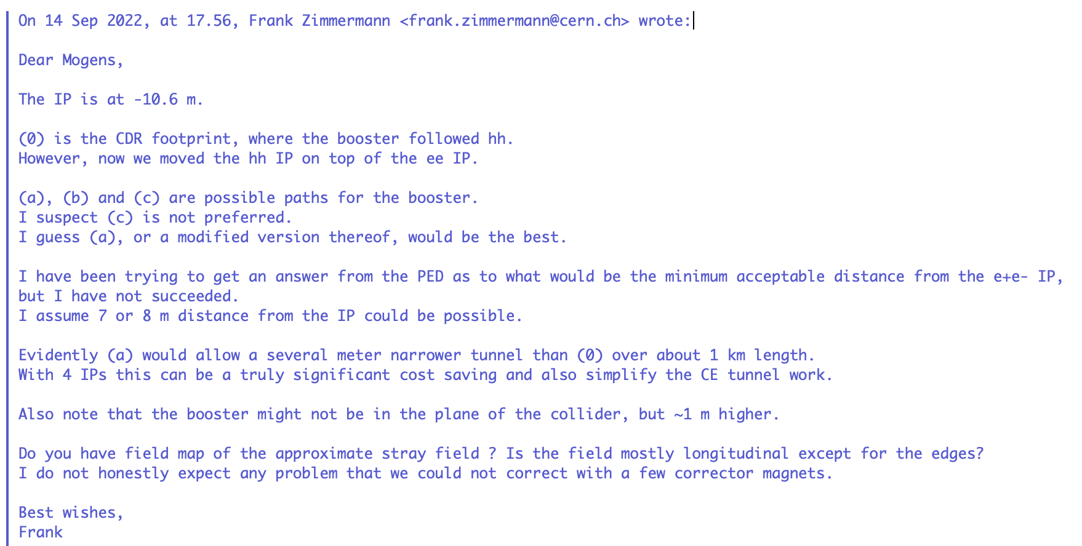
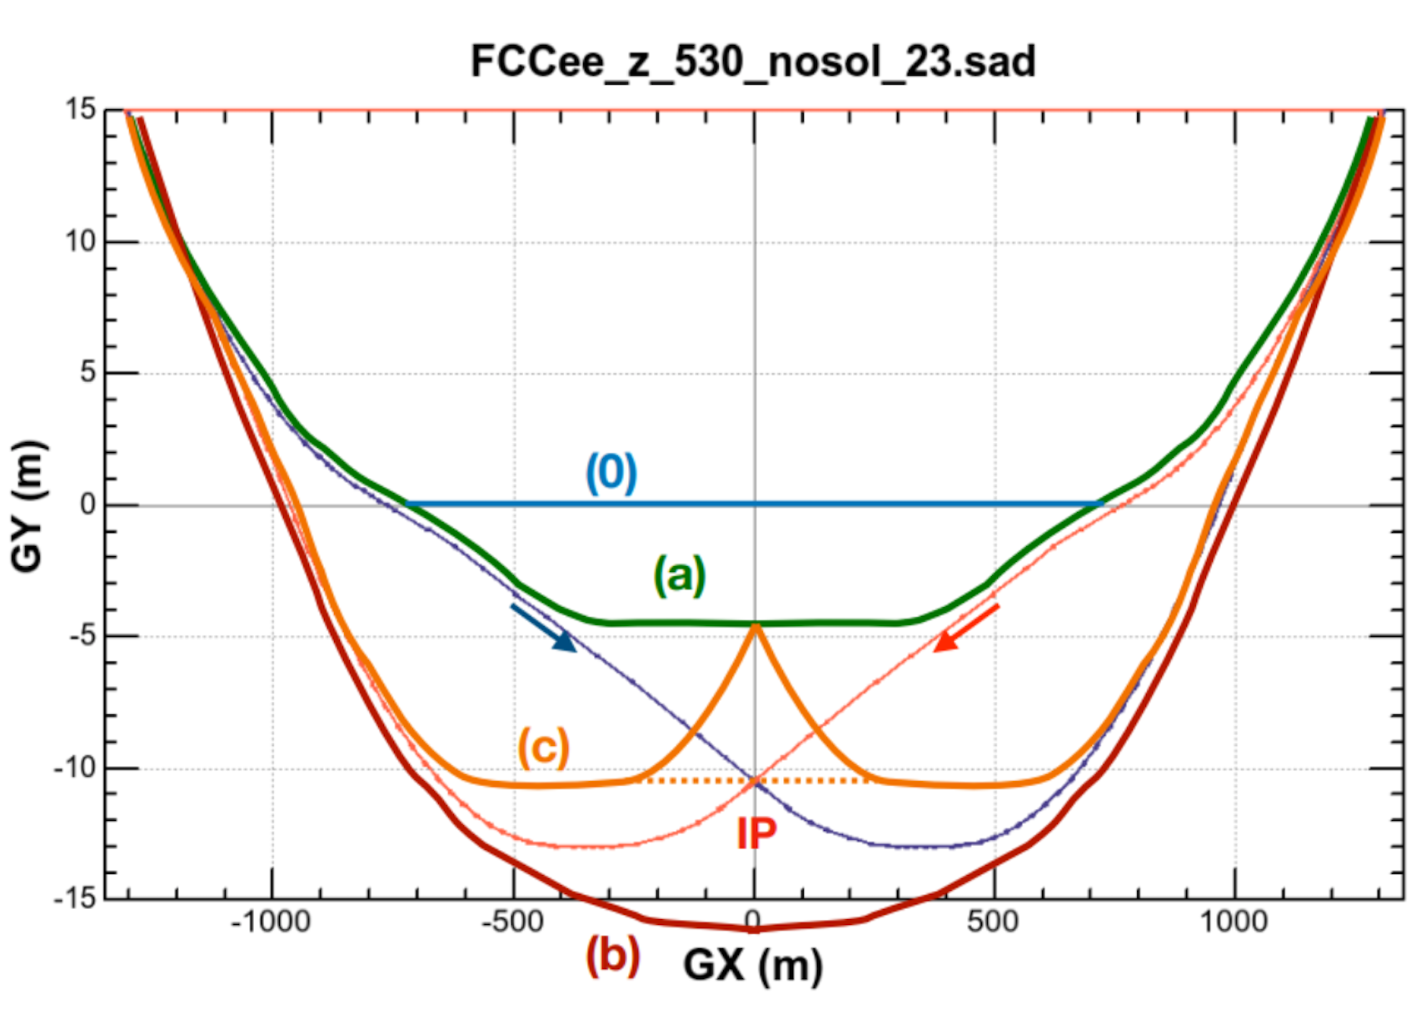
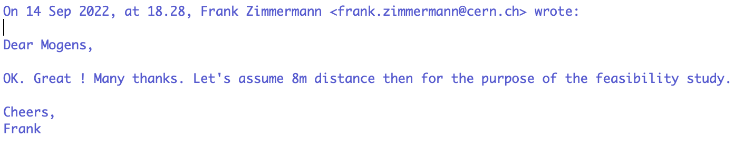
Booster ring
My understanding:
The two collider rings (separated by 1m at +/-30m) will enter cavern trough the same tunnel
The booster is 8 m away from IP (and probably enter through a separate tunnel?)
Shielding of booster ring seems to be no problem.

Slide 9
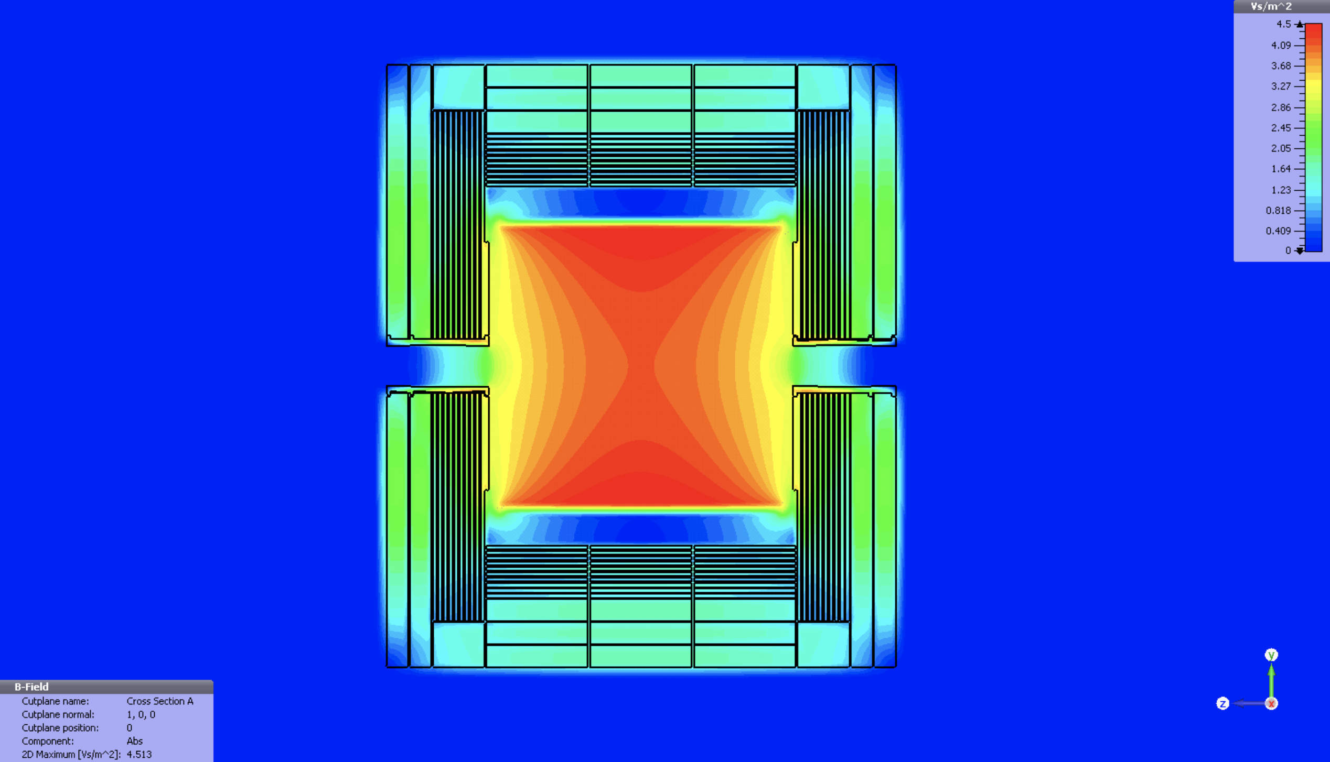
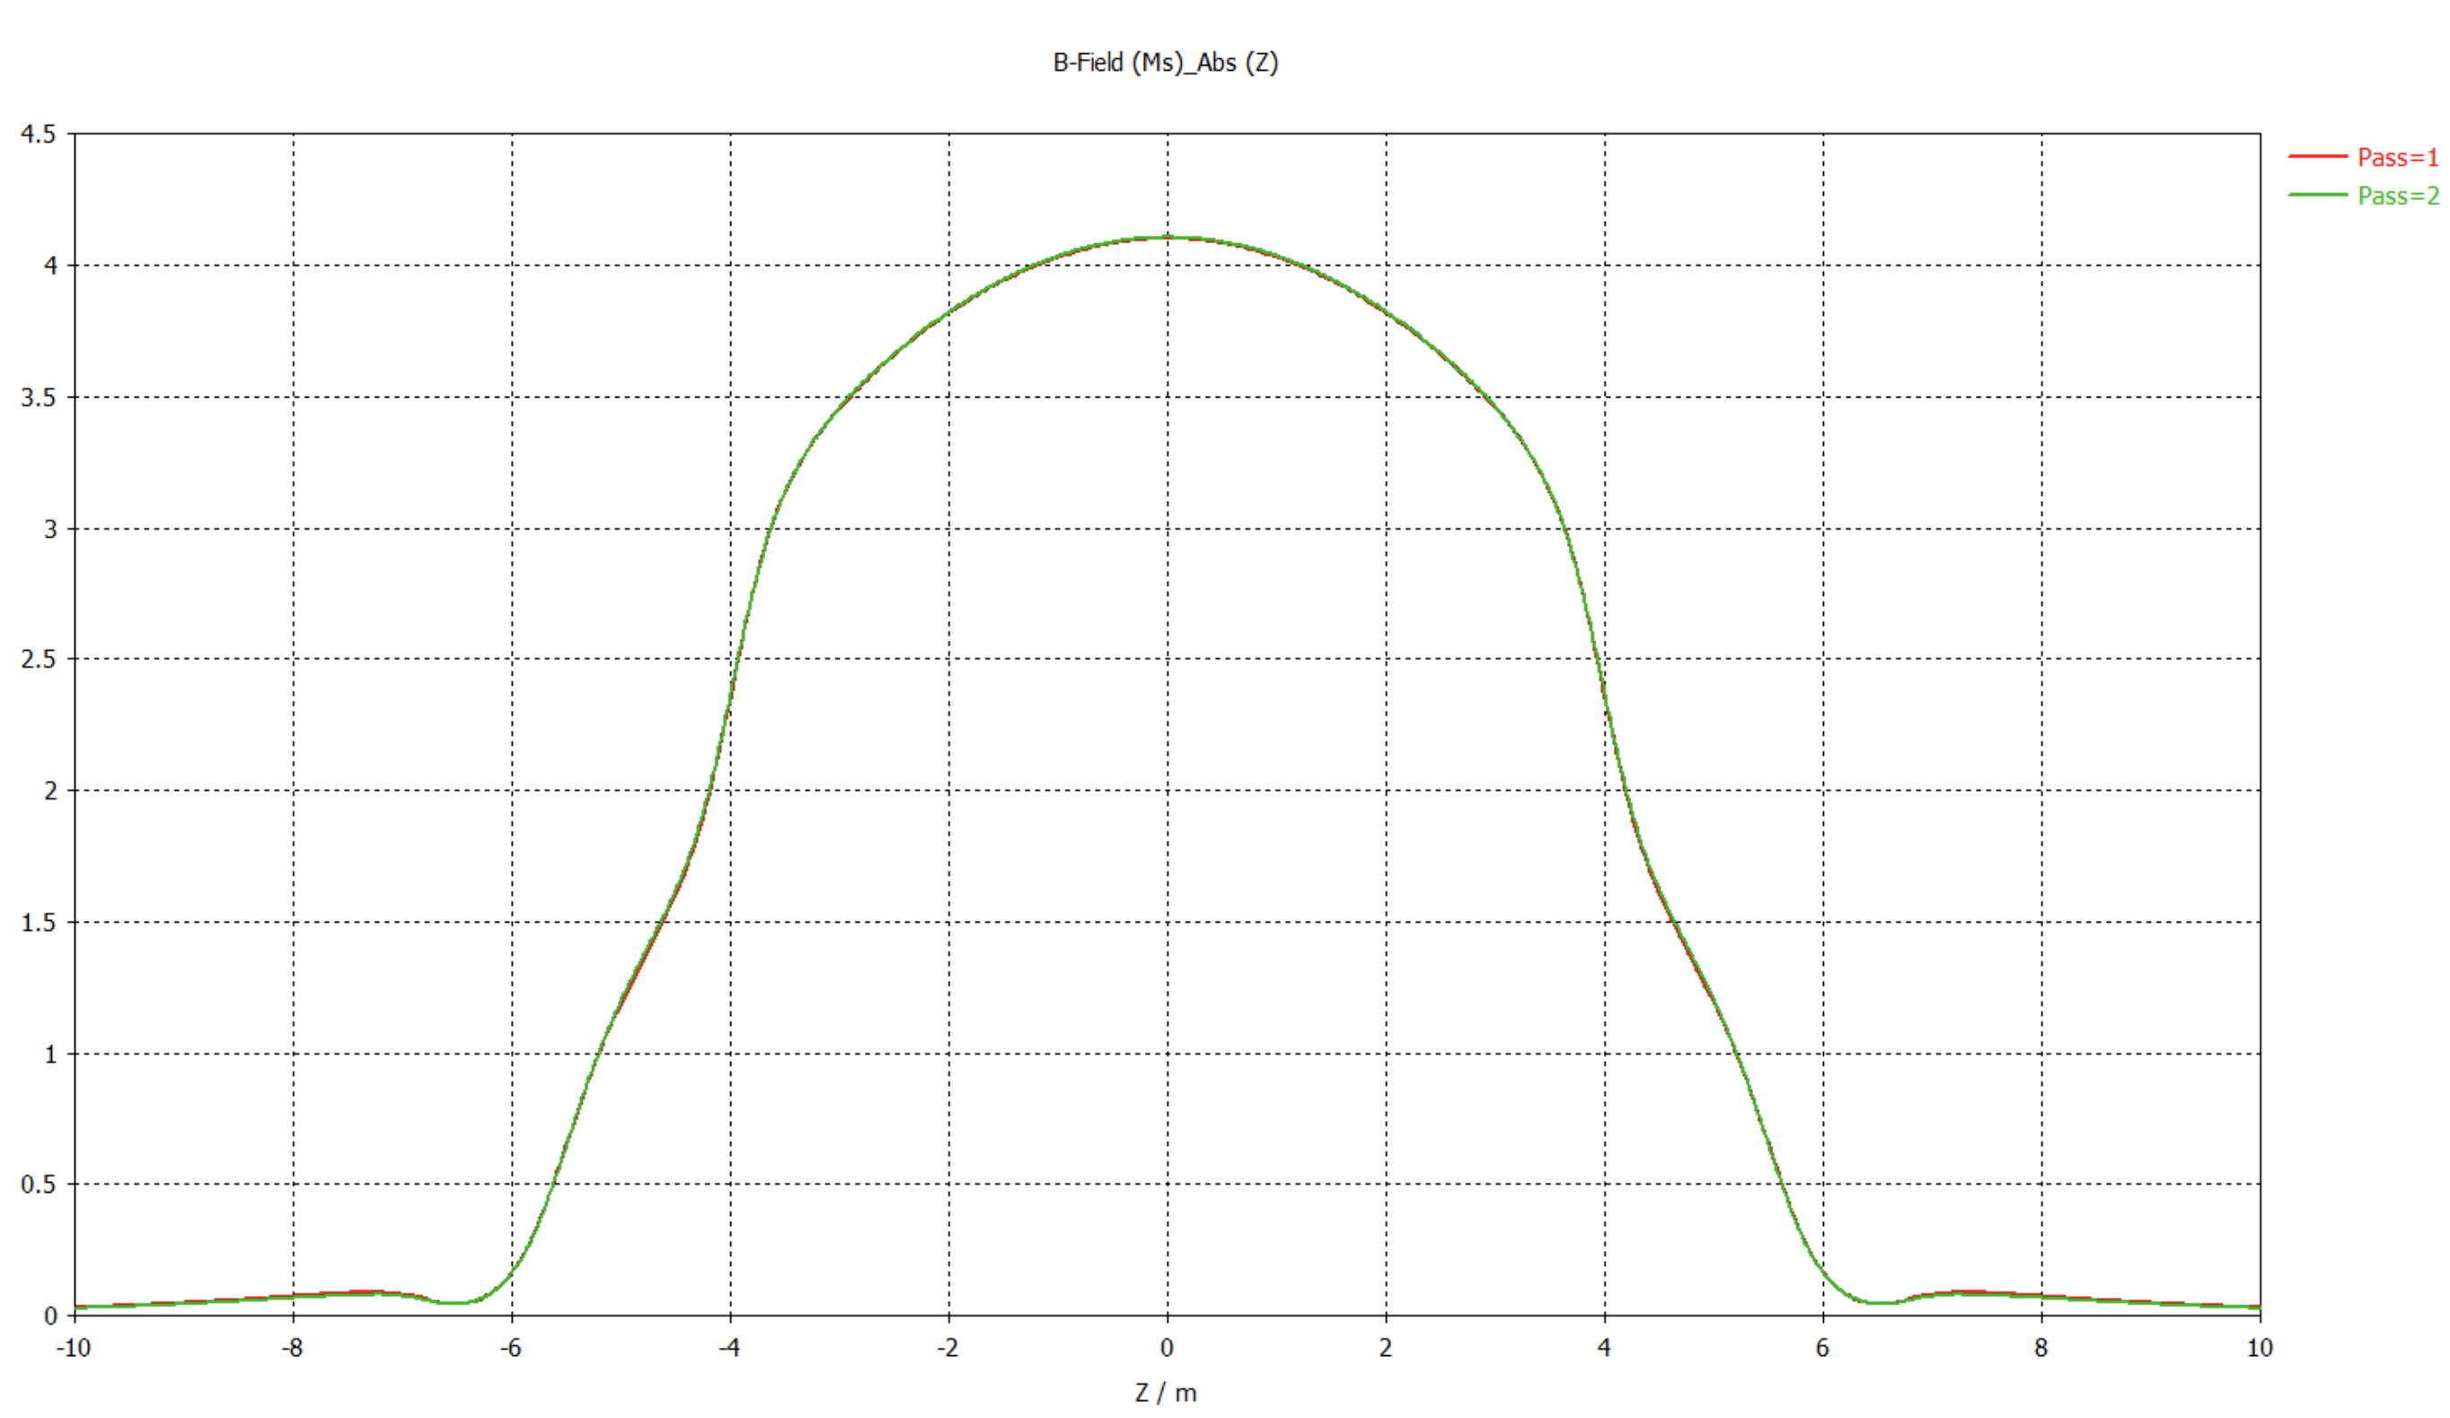
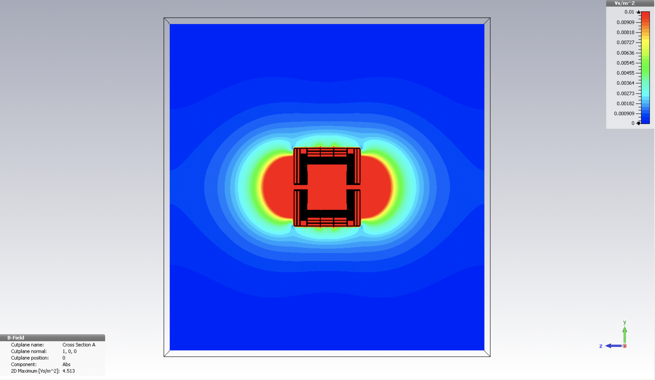
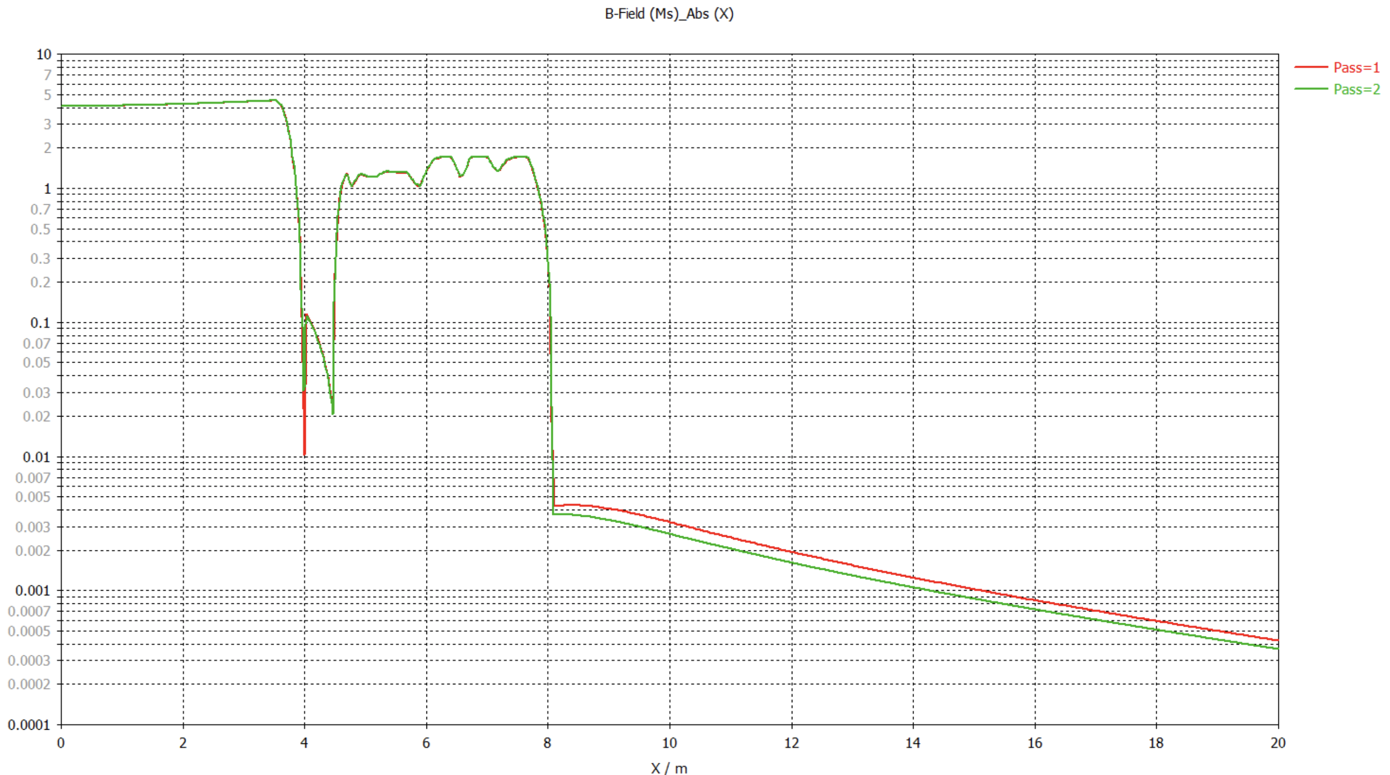
ILD Stray Field
Limited to max 0.01 T
~3 mTesla
x10 for thinner coil

Slide 10
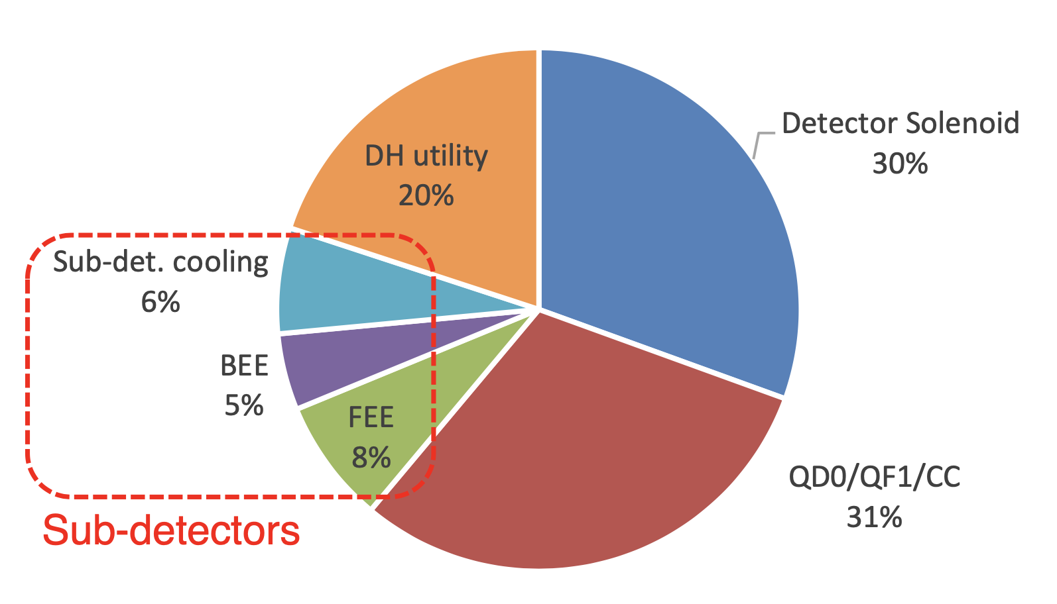
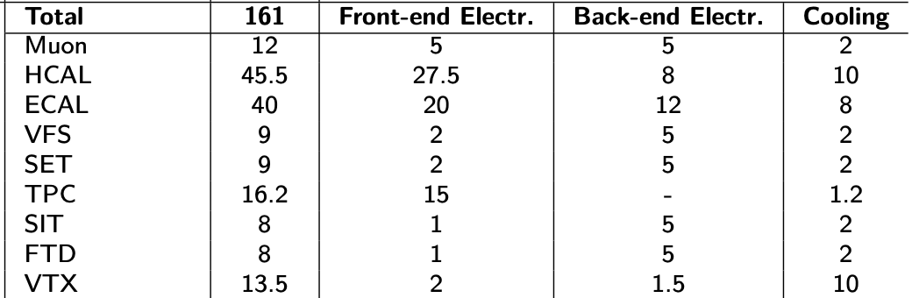
Cavern Power Consumption
Example: ILD
Total of 1 MW
DH = Detector Hall
20% for sub-detectors
FCC-ee differences
Weaker (and smaller) solenoid
No power pulsing
At FCC-ee-Z, higher data rates
20 year younger electronics
Leave estimate at 1 MW ?
At which level is ATLAS, CMS?

Slide 11
Gas & Cryo
Like at LEP ?
Smaller than ATLAS, CMS ?

Slide 12
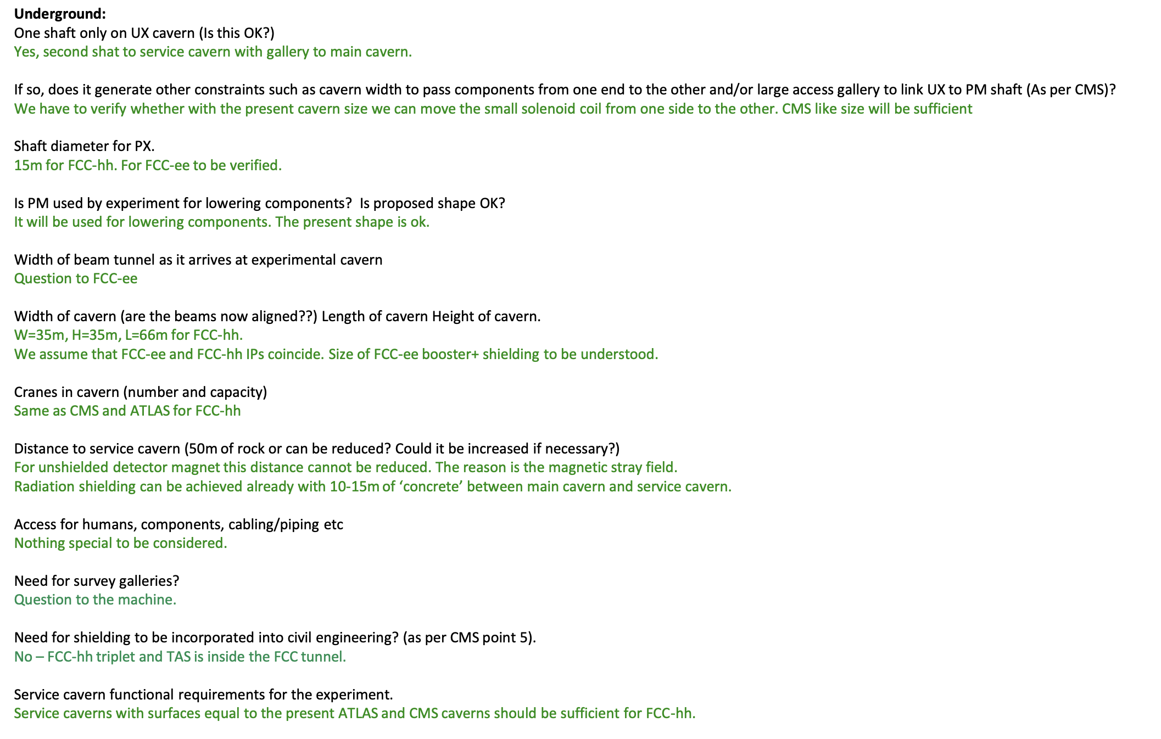
One shaft ok
No
If assembly underground, LEP-like shaft (11 m) ok. If assembly at surface, probably 18 m as ILC and CLIC
Don’t know.
Due to crossing angle, incoming and outgoing beam separate by 3 cm/m, i.e. one meter at 30 m. Booster 8 m away from IP (separate tunnel?).
Yes, hh and ee IP coincides. Booster ring 8 m from IP. F.Zimmerman: ”I do not expect any problem that we could not correct with a few corrector magnets.”
If assembly at surface, as CMS. If assembly underground, same as at LEP.
No need for service cavern
Radiation level in cavern being estimated. Shield by concrete wall if necessary.
No (?)
No need for service cavern

Slide 13
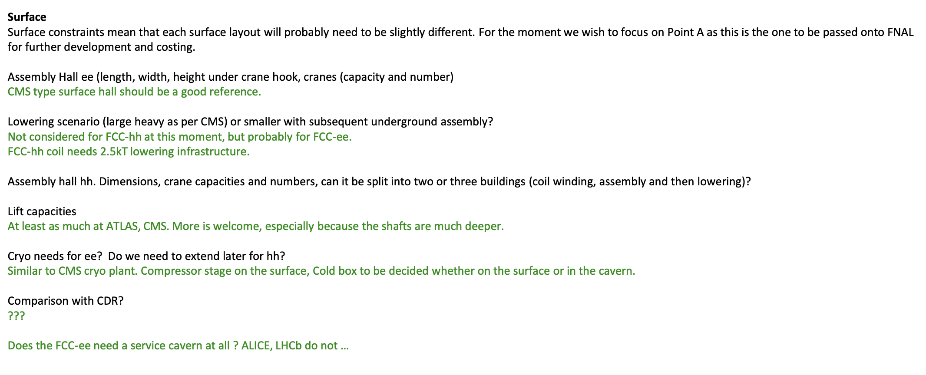
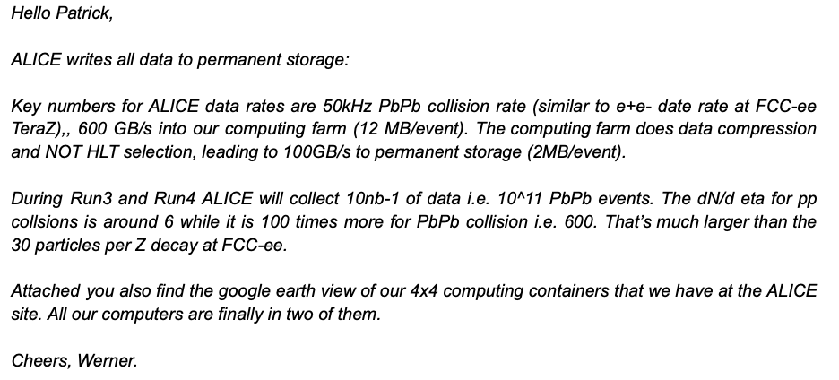
[30m wide, 140m long and 23m with a 80 tonne capacity crane]
Agree, that CMS is a good reference (4100 m²). LEP: 5000 m²; ILC: 4000 m² + 3500 m² for surface assembly
CLD coil mass about 1/6th of FCC-hh detector’s (?);
Similar to CMS, at least for CLD. [Smaller coil in IDEA/LAr]
Most likely not
Space for local computer center looks to be a non-issue

