Slide 1
CE and TI Requirements for FCC-ee Detectors
Review of Civil Engineering and Techincal Infrastructure Requirements for FCC Experimental Sites
3-4 October, 2022
Mogens Dam, Niels Bohr Institute

Slide 2
Disclaimer:
So far, FCC-ee studies have had their emphasis primarily on the development of the physics case, and our ideas about Detector Concepts are less mature than in the case of FCC-hh.

Slide 3
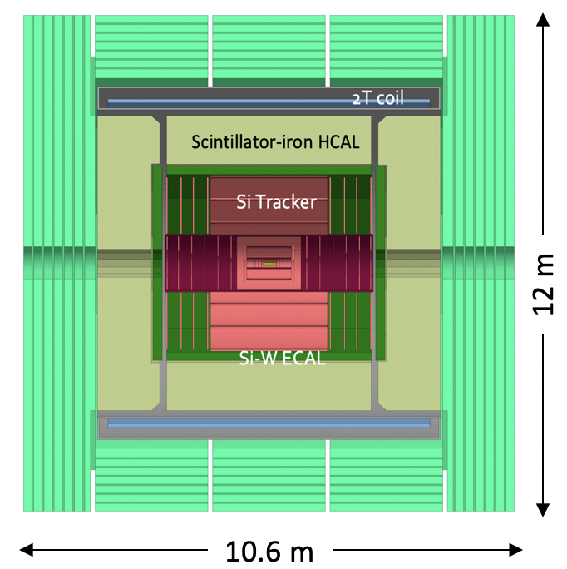
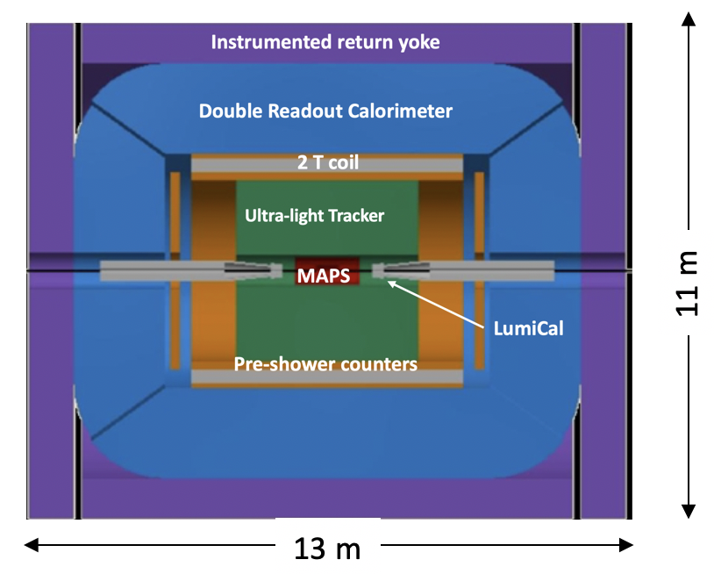
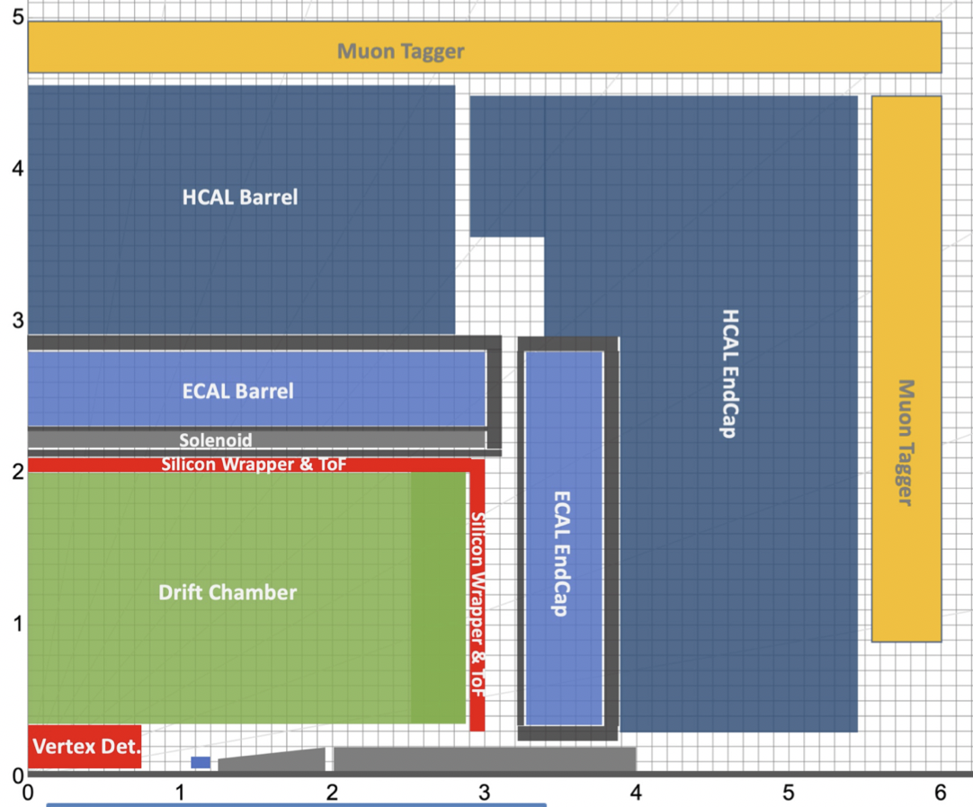
Developing Landscape of FCC-ee Detector Concepts
CLD
IDEA
Noble Liquid ECAL based
new
CDR
Full Silicon vertex detector + tracker;
Very high granularity, CALICE-like calorimetry;
Muon system
Large coil outside calorimeter system;
Possible optimization for
  Improved momentum and energy resolutions
  PID capabilities
Si vertex detector;
Ultra light drift chamber w. powerfull PID;
Monolitic dual readout calorimeter;
Muon system;
Compact, light coil inside calorimeter;
Possibly augmented by crystal ECAL in front of coil;
High granularity Noble Liquid ECAL as core;
  PB+LAr (or denser W+LCr)
Drift chamber (or Si) tracking;
CALICE-like HCAL;
Muon system;
Coil inside same cryostat as LAr, possibly outside ECAL.

Slide 4
CLD
IDEA
Noble Liquid ECAL based
5 m
6 m
Cryostat:
Outer diameter: 8.55 m
Length : 7.4 m
Cryostat:
Outer diameter: 4.8 m
Length : 6.0 m
Cryostat:
Outer diameter: ~6 m
Length : ~6 m
All concepts fit inside 12x12 m envolope
Tentatively, assume that largest single piece (undismountable) is coil/cryostat
Assume that coil/cryostat dimensions allow remote production with transportation to site
  CLD has the largest coil/cryostat with dimensions similar to that of CMS:
    length x outer diameter = 7.4m x 8.55m [CMS: 12.5m x 7.2m]

Slide 5
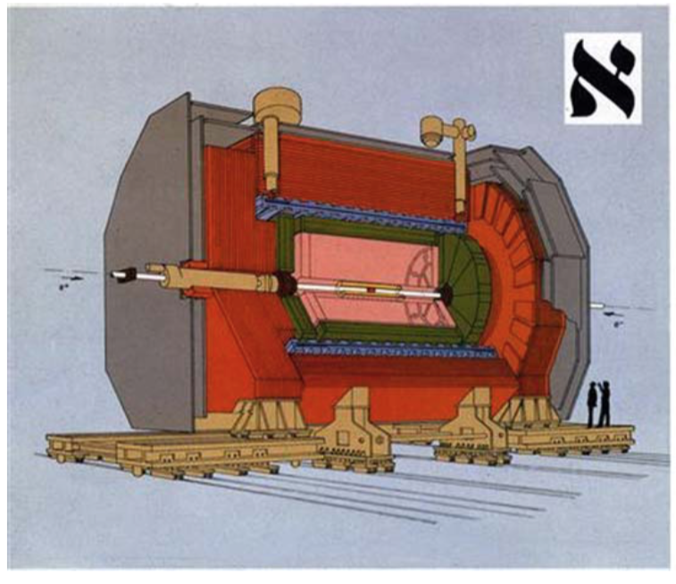
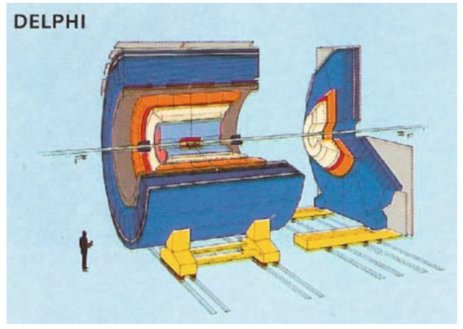
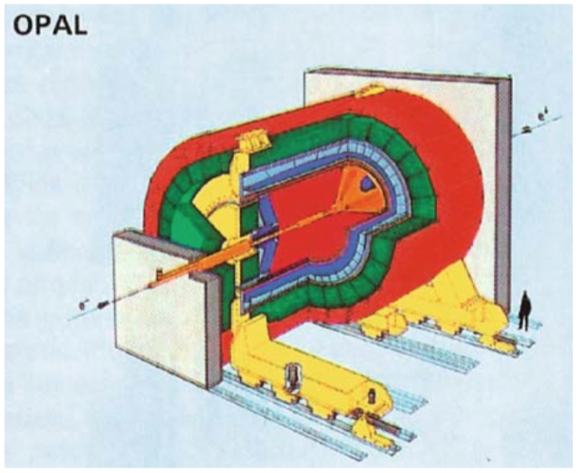
Detectors at LEP (i)
Typical design: Aleph, Delphi, Opal
Fit inside cylinder of: 12 m x 12 m
Assembled underground.
Largest components to lower into cavern:
Coil: max dimension 7.4 m length x 6.2 m diameter (DELPHI)
HCAL modules: 10 m long x 1 m width
In terms of size, FCC-ee detector concepts have many similarities with typical LEP detectors.
Exception: CLD’s larger diameter coil of 7.4m x 8.55m

Slide 6
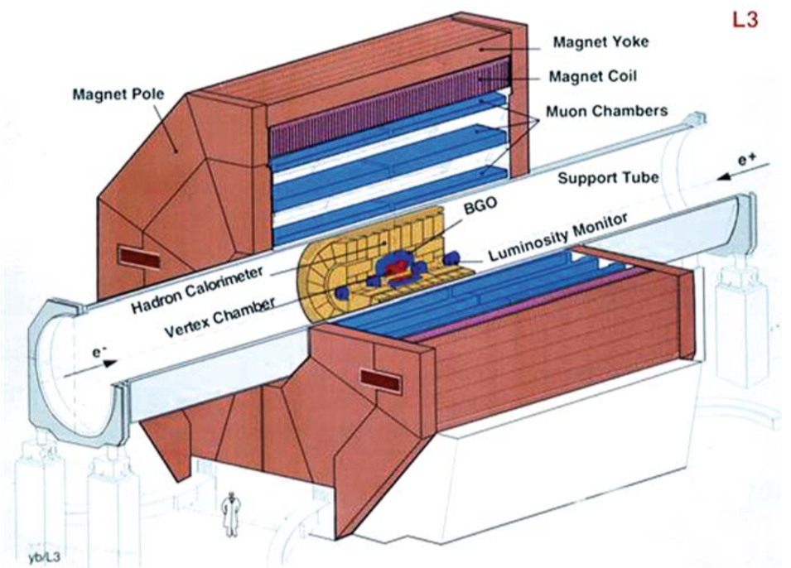
Detectors at LEP (ii)
Atypical design - L3
Large detector with very large magnet: 15.8(L) x 12(H) m
Assembled underground
Largest component:
Big support tube, 4.2 m diameter extending throughout the cavern
Cavern and shaft different from typical LEP detectors:
Cavern: 53.5 x 15.5 x 22.7m³
Shaft: 23 m diameter
No FCC-ee studies point in to an atypical detector design à la L3

Slide 7
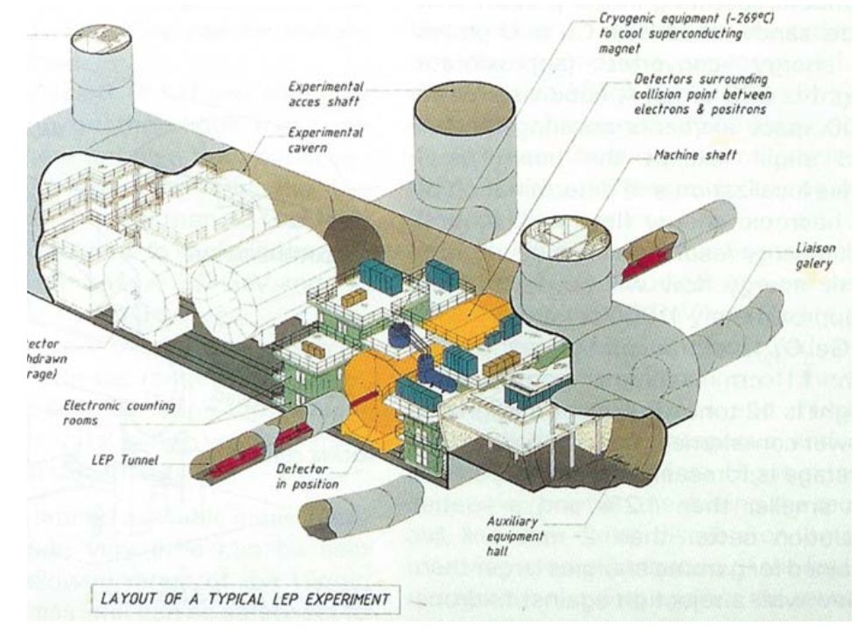
LEP Cavern Layout of the three typical Detectors
Baseline is that FCC-ee detetors will be assembled under ground as at LEP.
With similar sizes, FCC-ee detectors would fit into a typical LEP underground area
Cavern: 70m long, 17m wide, 18.5 m high
A single shaft of 10.1 m diameter
Main cavern with enough space for detector, including barracks for electronics, cryogenics, services, and even empty space to move the detector into garage position (never used)
No service cavern used by experiments
Length direction perpendicular to beam direction
H.Schopper: ”Lord of the Collider Rings”

Slide 8
Cavern dimension along beam direction
LEP caverns were placed perpendicular to beam direction; only 17m wide along beam
For FCC-ee detectors, the innermost parts (beam pipe, vertex detector, luminosity monitors, etc) may be installed inside a small radius support tube and guided into the main detector on rails.
  Necessary to have ~one extra detector length available at one end of the detector for this operation

Slide 9
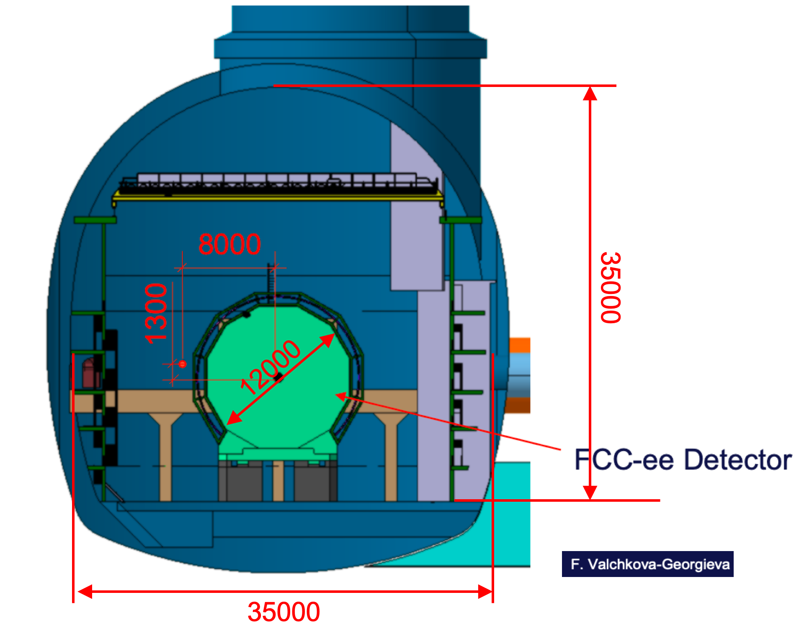
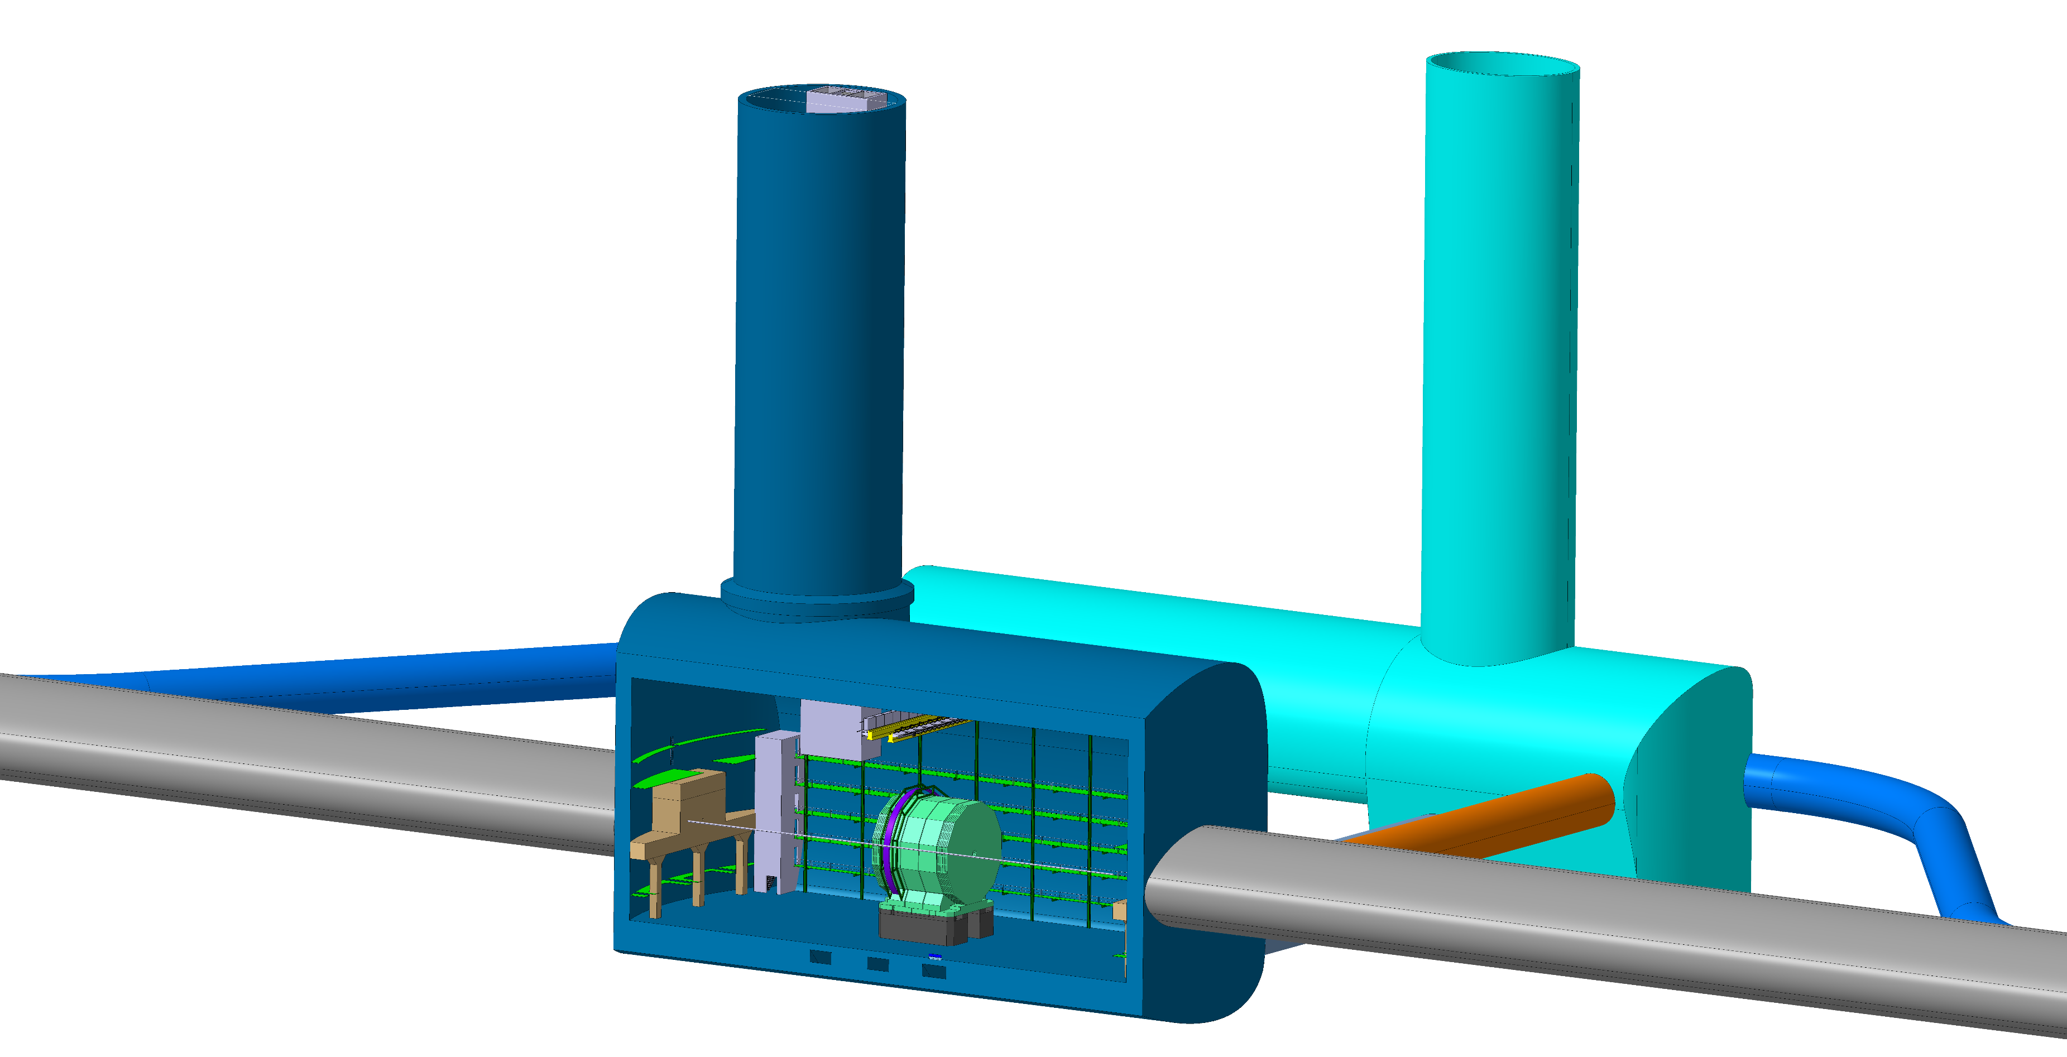
FCC-hh Experiment Underground Structure
With FCC-ee detectors being considerably smaller than FCC-hh detectors, a baseline FCC-hh cavern works perfectly for the housing of a FCC-ee detector including all services
cooling plants, cryo cold box, gas systems, electronics barracks
A FCC-ee detector would also fit well inside a somewhat smaller CMS-like cavern of size 53x25x25 m³.
A shaft of 10m diamater is sufficient

Slide 10
Radiation level in the Main Cavern
Radiation levels are estimated to be low enough to allow cohabitation of detector and services (incl. electronics and people) in the main cavern
  Example: LHCb readout electronics is located in the detector cavern behind a brick wall
    2-3 orders higher collision rate than Tera-Z and with higher particle multiplicity
  Detailed simulation studies of FCC-ee cavern backgrund conditions are ongoing
    Preliminary results show that the fluence from Tera-Z operation can be kept at close to the normal background radioactivity level
Conclusion: No a priori need of a service cavern

Slide 11
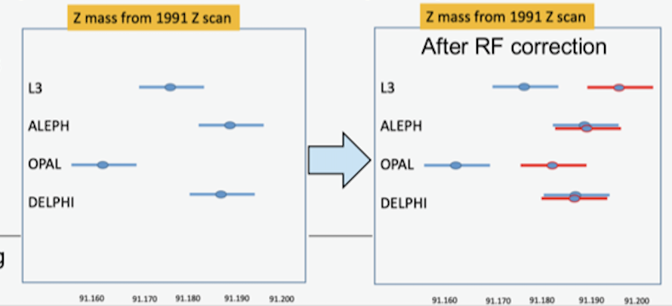
The case for four Interaction Points
One of the many advantgages of circular colliders: can serve several IPs
Overall gain in luminosity and in luminosity/MW (greener collider)
  Many measurements are statistics limited – some are tantalizingly close with only 2 IPs
    E.g., Higgs self-coupling, search for HNL, Flavour anomalies, Electron Yukawa coupling, etc.
Variety of detector requirements may not be satisfied by one or even two detectors
  E.g., high precision, high granularity, high stability, geometric accuracy, PID
    Having four IPs allows for a range of detector solutions to cover all FCC-ee opportunities
Four IPs provide an attractive challenge for all skills in the field of particle physics
Redundancy is invaluable in uncovering hidden systematic biases or conspiracy of errors
  E.g., m_{z} discrepancy at LEP in 1991
    Found to be an effect of RF phases and voltages
      Correction of ~+19 MeV for L3 and OPAL
  Could have remained unnoticed for ever with
    only ALEPH and DELPHI, or
    only L3 and OPAL

Slide 12
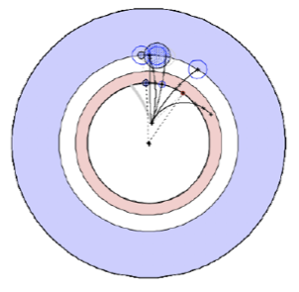
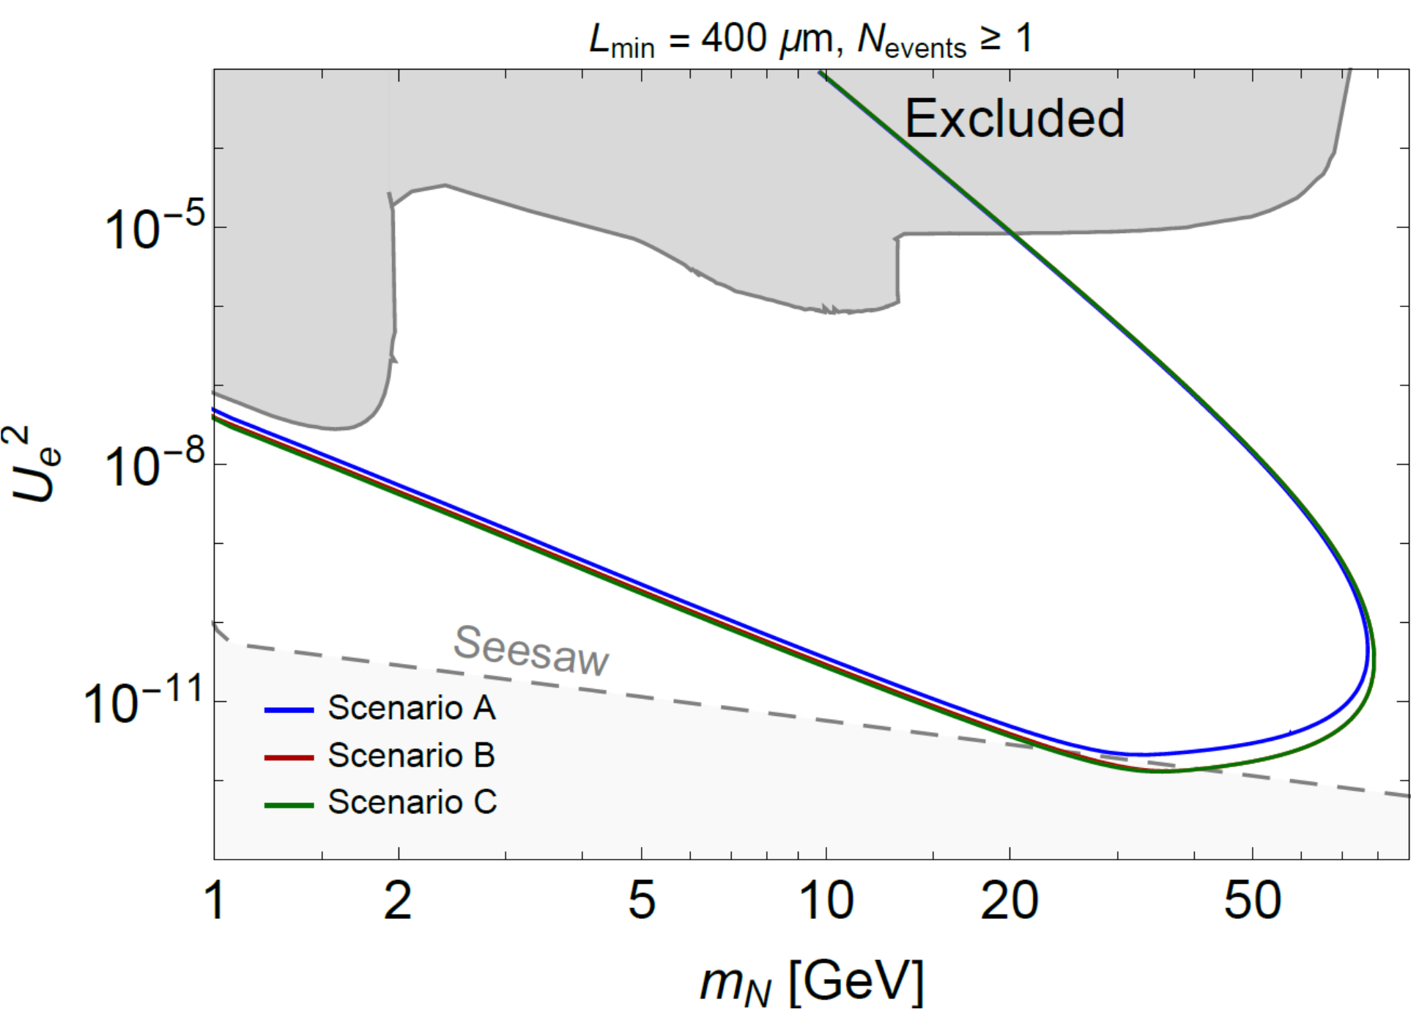
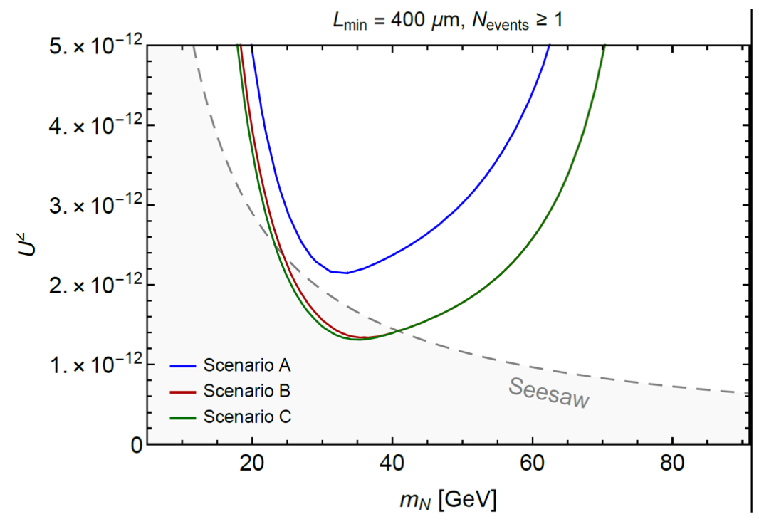
Cavern size versus physics outcome
For ”normal” measurements, cavern geometry has no influence on physcis outcome
Important exception: Search for Heavy Neutral Leptons in the form of LLPs
  Production: Z ➝ 𝜈N followed by N ➝ Z*𝜈 or W*𝓁
  Signature: Detached mono-jet
By instrumenting cavern walls, access (also) to very long lifetimes (small masses)
Sensitivity estimate for baseline run plan and instrumented cavern walls:
- Blue: 2IP
- Green: 4IP
- Red: 4IP, somewhat
smaller caverns
linear zoom
Conclusion: Luminosity increase from 2IP ➝ 4IP gives very significant gain; increased cavern size less so

Slide 13
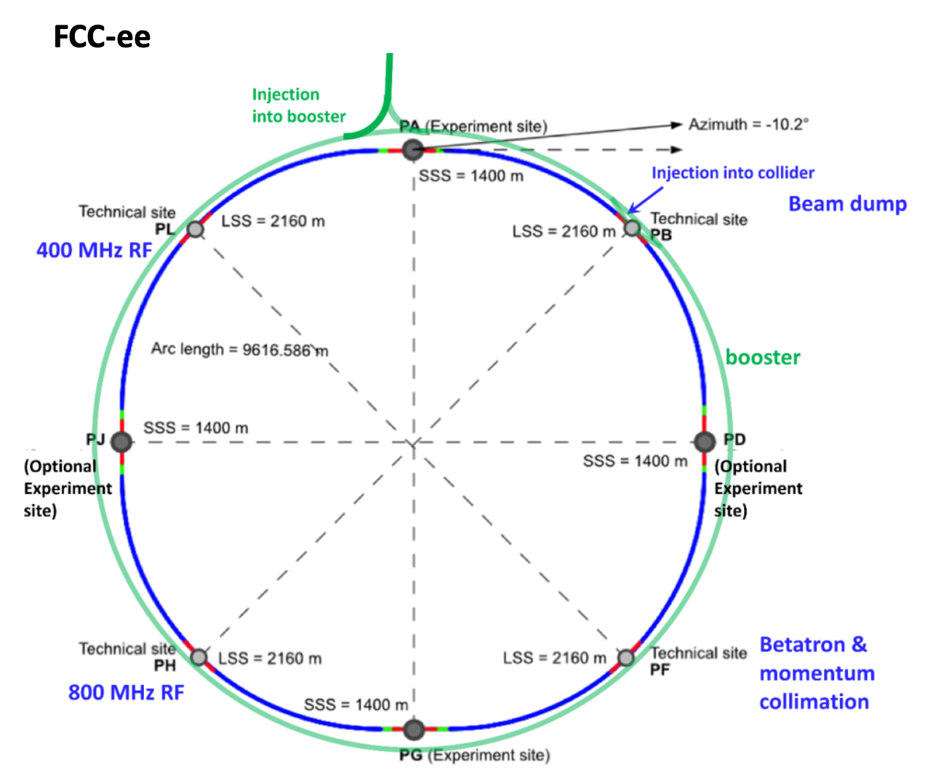
The four experiental sites
PA and PG are the ”main” sites
FCC-hh size caverns
PD and PJ are the ”additional” sites
Possibly with somewhat smaller caverns

Slide 14
Consumable in Cavern
Electricity: Consider a total need of 3 MW for detector solenoid, accelerator quadrupoles, sub-detectors, and cavern utilities
  Smaller than the 5 MW for LHC detectors
  Larger than the estimated 1 MW needed for ILC detectors
    At ILC, front-end electronics is power-pulsed to limit power consumption and cooling needs
    FCC-ee data rates are considerably higher than at ILC
Gas & Cryogenics: Somewhere between LEP and LHC
  Detectors are generally smaller than at LHC
  The CLD detector concept has a considerably larger coil that LEP detectors

Slide 15
Surface building needs
Detector pre-assembly and storage
  As at LEP, need ~1000 m²
Computing system:
  Experience from ALICE with a comparable event rate is that space needs for computing are small: no specific consequences on CE and TI
Offices:
  Experimantal sites are away from CERN; people need places to work

Slide 16
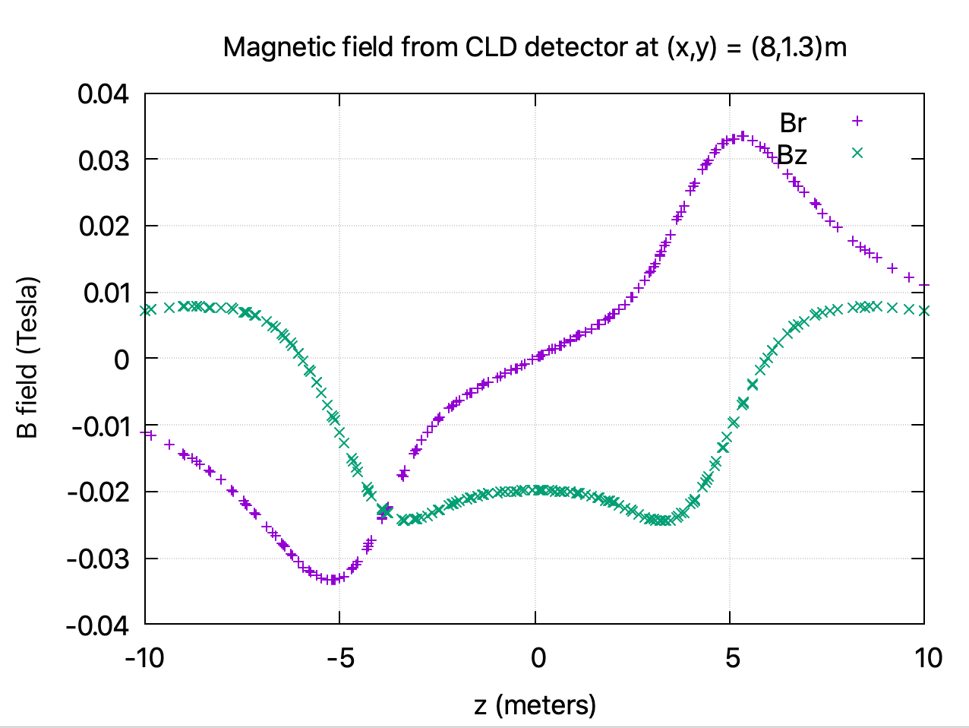
Cavern and Booster ring
Booster ring passes through cavern outside detector volume at [x, y]= [8.0, 1.3]m
Detector stray field at the booster location is up to ten times stronger than the 3 mT dipole field strength at injection
  Needs to be corrected for
Data from the CERN magnet group, Nikkie Deelen
A solution for shielding and/or correction has to be developed
Booster position must be so, that there is at least 1 m free space around the detector envelope with the shielding/compensation is in place.

Slide 17
Conclusions
A FCC-ee detector including services fits within the size of a standard FCC-hh cavern and can be serviced by its capacity for consumables
  A somewhat smaller CMS-like cavern would also be appropriate
One shaft suffices for each experiment; a shaft diameter of 10 m is sufficient
The FCC-ee physics outcome increases significantly by having four rather than two IPs
  The cavern size only has an influence on the physics reach in the search for LLPs, and here it is small
Radiation levels in the cavern will be low enough to allow people to work downstairs
  There is no a priori need for a service cavern
Surface-building needs are commensurate to those at LEP
The stray magnetic field is such that the booster will need compensation and/or shielding
  It must be assured, that there is a minimum free space available between the detector envelope and the booster including its shielding

Slide 18
Extras

Slide 19
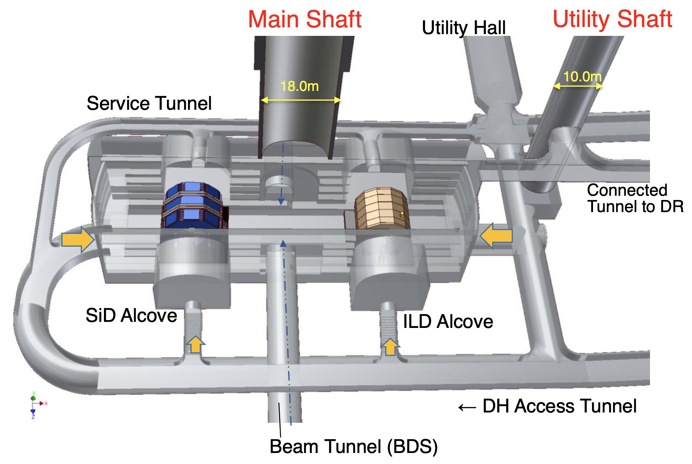
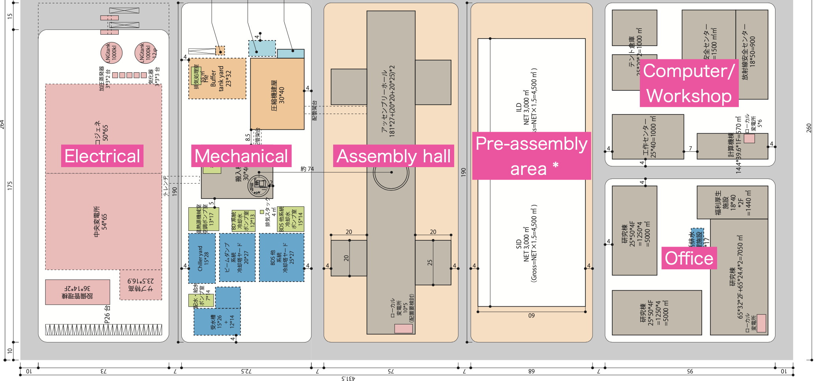
In comparison: ILC Underground Hall
Large underground hall with push-pull of two detectors
  ILD: 15.6 m high, 13.2 m long
  SiD: 12.4 m high, 11.6 m long
Detectors planned to be assembled at surface and lowered down in main parts (CMS style)
  Supposedly saving 4 years of scheduling time with detector assembly and cavern construction running in parallel
  Cost of 3500 m² assembly hall per experiment (in addition to 4000 m² for pre-assembly)
  Requires large shaft of 18 m diameter
Surface buildings
3500 m²
4000 m²
3500 m²
4000 m²

