Slide 1

FCC-ee: the benefits of a layout with 4 IPs
Alain BLONDEL Patrick JANOT
With many contributions from the FCC PED SG and coordination group

Slide 2
Motivation
One of the great advantages of the circular e+ e- colliders is:
-- The possibility of serving several interaction points with net overall gain
both in integrated luminosity and luminosity/MW.
The FCC-ee is a machine with a very rich menu of physics possibilities
-- this leads to many detector requirements, which cannot be simultaneously satisfied
by only two detectors. example: EM calorimeter (high E precision vs high granularity vs high stability vs geometric accuracy vs PID vs cost)
Furthermore
-- many measurements will serve as input to future programmes in particular FCC-hh
-- many are statistically limited
-- redundancy provided by 4IPs is essential for high precision measurements
-- and different detector solutions will be invaluable in uncovering hidden systematic biases.
Last but not least
-- some key physics capabilities are nearly missed with the present run plan and 2 IPs.

Slide 3
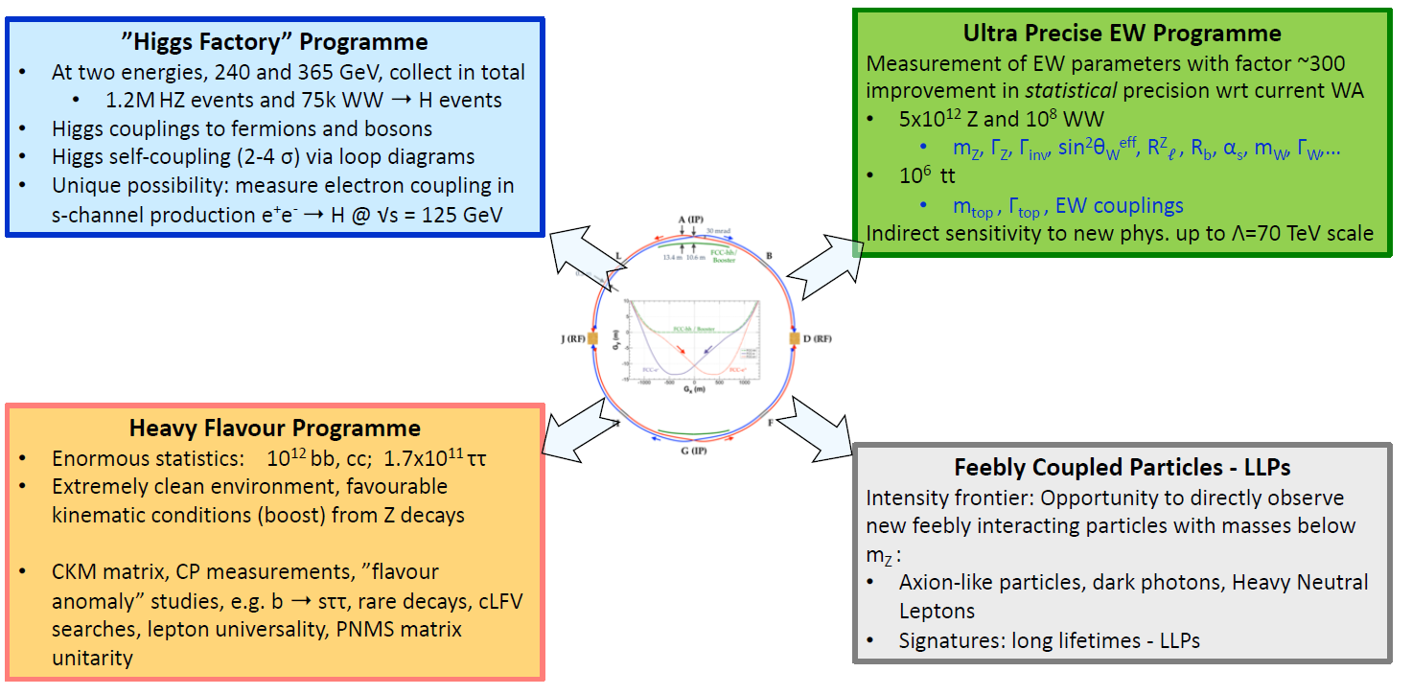
FCC-ee physics programme
M. Dam ECFA R&D road map input
https://indico.cern.ch/event/994685/
& QCD

Slide 4
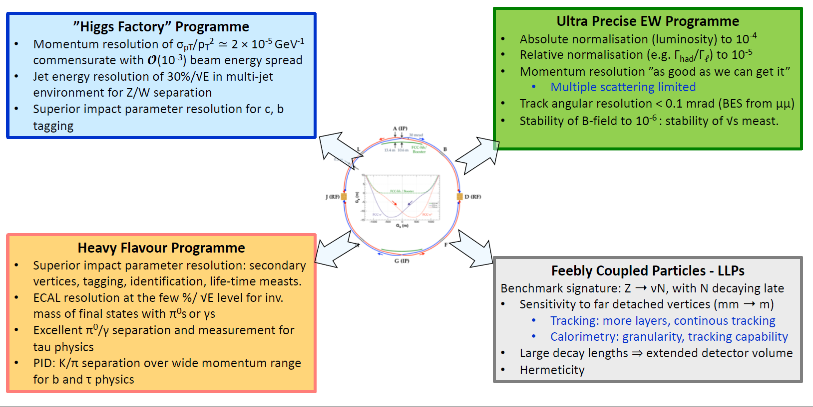
Detector requirements (present status)
M. Dam ECFA R&D road map input
https://indico.cern.ch/event/994685/

Slide 5
Physics of the Higgs boson
Baseline (2IP): at 240 and 365 GeV, collect in total 1.2MHZ events and 75k WW ➝H events
Statistics-limited:
-- Higgs couplings to fermions & bosons; model-independent, normalized to e+e- →ZH cross-section
→ fixed candle for past (HL-LHC) and future (FCC-hh) studies at hadron colliders (H→ ZZ)
-- Higgs properties: CP violation, H→ gg ... ...
Close to discovery level
-- Higgs self-coupling (2-5? σ) via loop diagrams : a very fundamental question!
complementary w.r.t. HH production at higher energy machines (CLIC3000(9%) , FCC-hh (2-3%))
-- Unique possibility: measure electron coupling in s-channel production e+e-➝H @ √s = 125 GeV
highly demanding on luminosity, monochromatization with 1, 2 or 4 IPs?

Slide 6
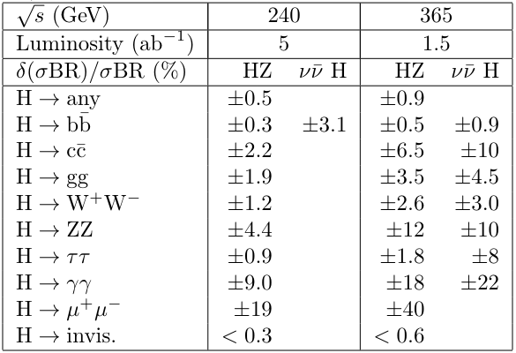
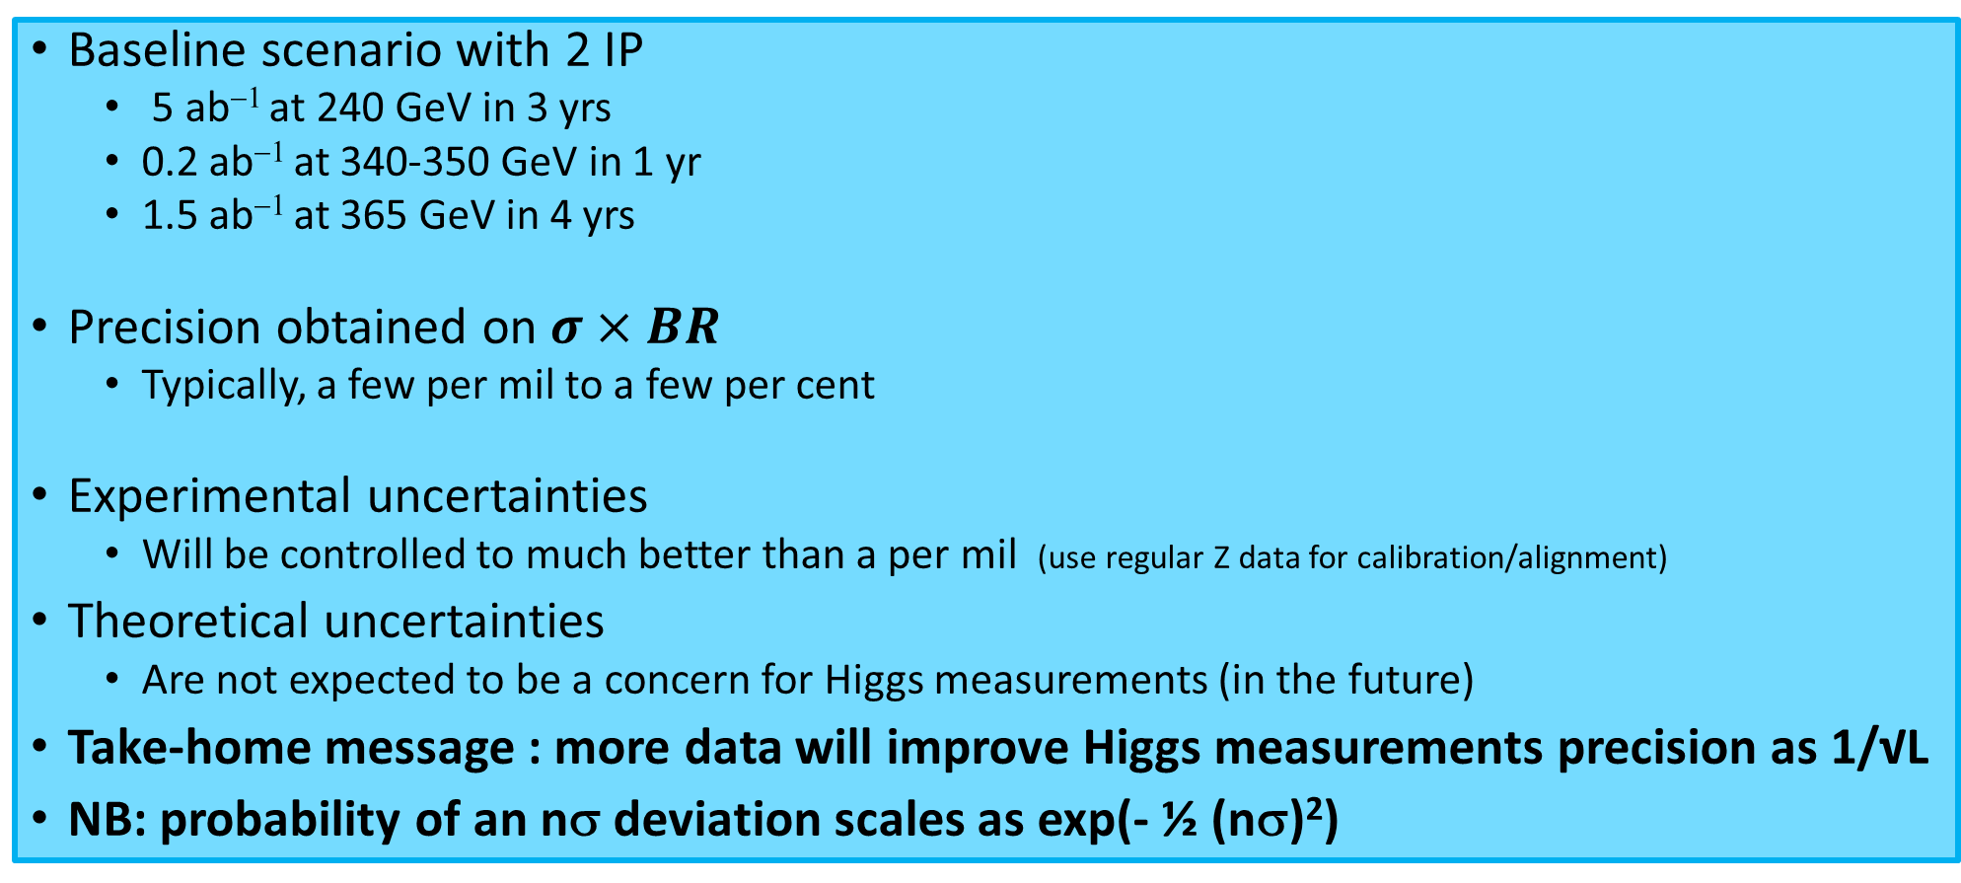
Higgs couplings and properties
Baseline scenario with 2 IP
5 ab⁻¹ at 240 GeV in 3 yrs
0.2 ab⁻¹ at 340-350 GeV in 1 yr
1.5 ab⁻¹ at 365 GeV in 4 yrs
Precision obtained on $σ×BR$
Typically, a few per mil to a few per cent
Experimental uncertainties
Will be controlled to much better than a per mil (use regular Z data for calibration/alignment)
Theoretical uncertainties
Are not expected to be a concern for Higgs measurements (in the future)
Take-home message : more data will improve Higgs measurements precision as 1/√L
NB: probability of an nσ deviation scales as exp(- ½ (nσ)²)

Slide 7
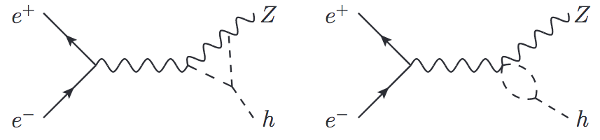
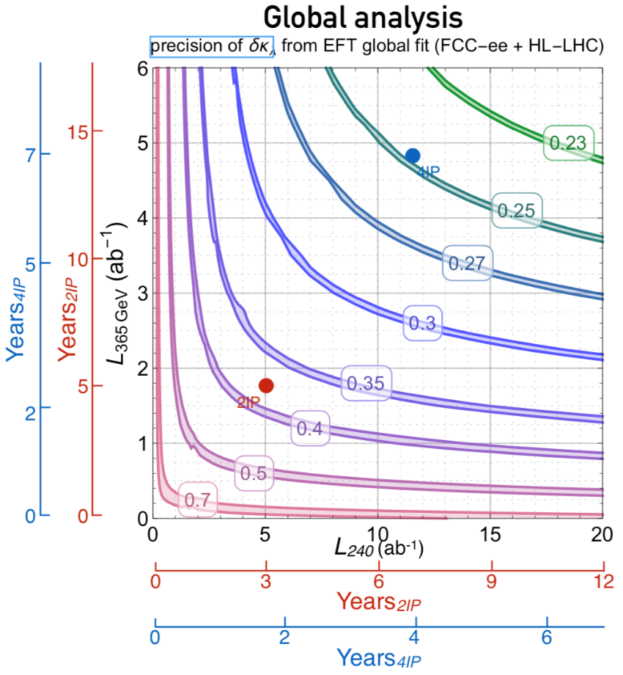
Higgs self-coupling λ
Sensitivity comes from loop corrections to the e+e- → ZH production x-section
... and the resulting change as function of Q.
+
λ
λ
Precision on λ FCC-ee + HL-LHC
present estimate → ≥2σ from 0 with 2 IPs and present run plan
-- dominated by the Z → leptons channel (mostly Z→ μ μ (e e) + Higgs )
-- hope for improvements from
-- better use of Z -->‾qq and other channels, optimization of data taking and analysis synergetic with precision Higgs mass measurement required before ee --> H
-- increase of statistics and optimization of run plan (see 1809.10041 & next slide*→) (increase duration of 240 and 365 runs, reduce Z and WW runs @constant statistics)
-- or better: increase overall running time (if its worth doing, its worth doing well)
Target: increase to 5σ (discovery) the separation between λ= 0 vs 1 vs 2
seems possible only with 4IP!

Slide 8

Improvement with 4IP, (as of arxiv 1809.10041)
AB,P. Janot 1809.10041
First scenario: keep the same operation model as with 2 IP
Total luminosity increases by a factor 1.7
Precision on Higgs couplings and Higgs width improves by a factor 1.3
Second scenario: optimize the operation model towards the Higgs
For example, maximize the sensitivity to the Higgs self-coupling
spend 10 years at 240 and 365 GeV, instead of the baseline 7 years
Say 3.5 years at 240 GeV and 6.5 years at 365 GeV (plus 0.5 yr at 340-350 GeV)
With a total luminosity / year ~1.7 larger than in the baseline
 | κ_{Z} | κ_{W} | κ_{b} | κ_{c} | κ_{g} | κ_{τ} | κ_{μ} | κ_{γ} | BR_{inv} | Γ_{H}
2 IP | 0.17% | 0.43% | 0.61% | 1.21% | 1.01% | 0.74% | 9.0% | 3.9% | < 0.3% | 1.3%
4 IP | 0.10% | 0.24% | 0.36% | 0.73% | 0.60% | 0.43% | 5.5% | 3.0% | <0.2% | 0.77%

Slide 9
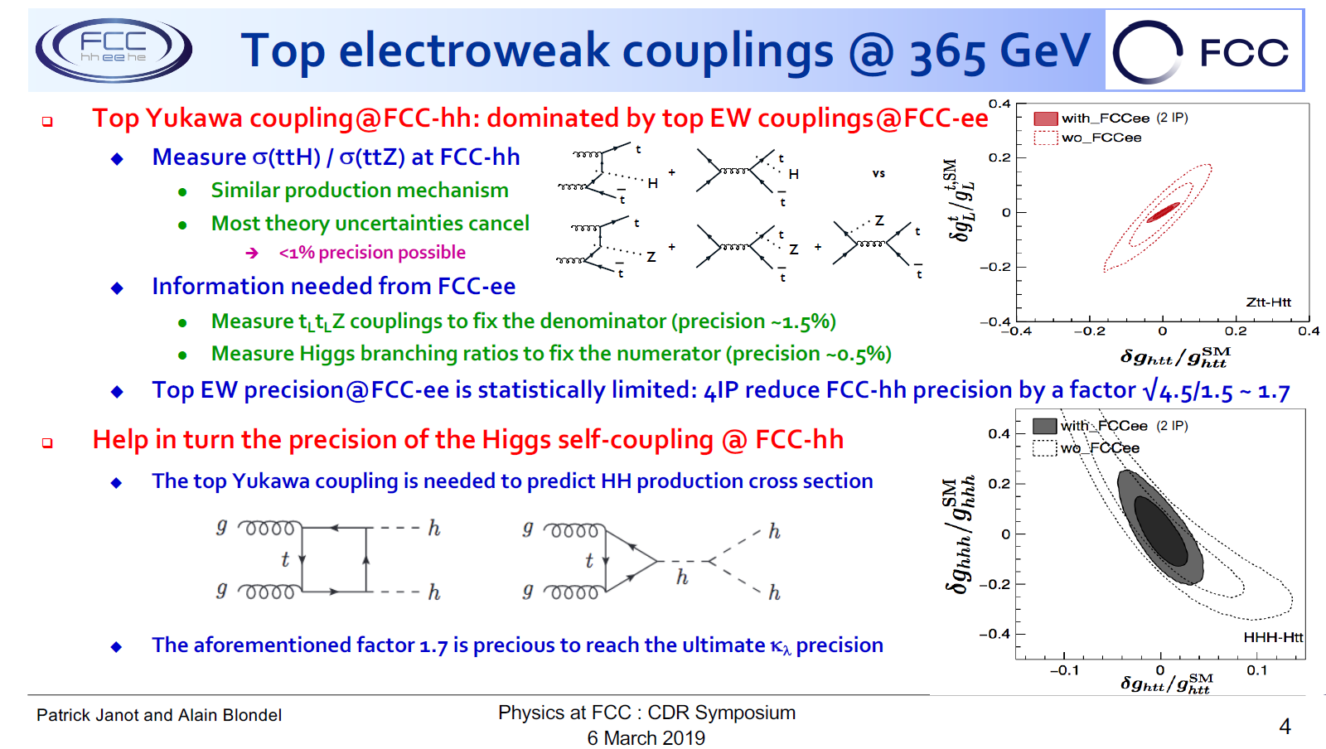

Slide 10
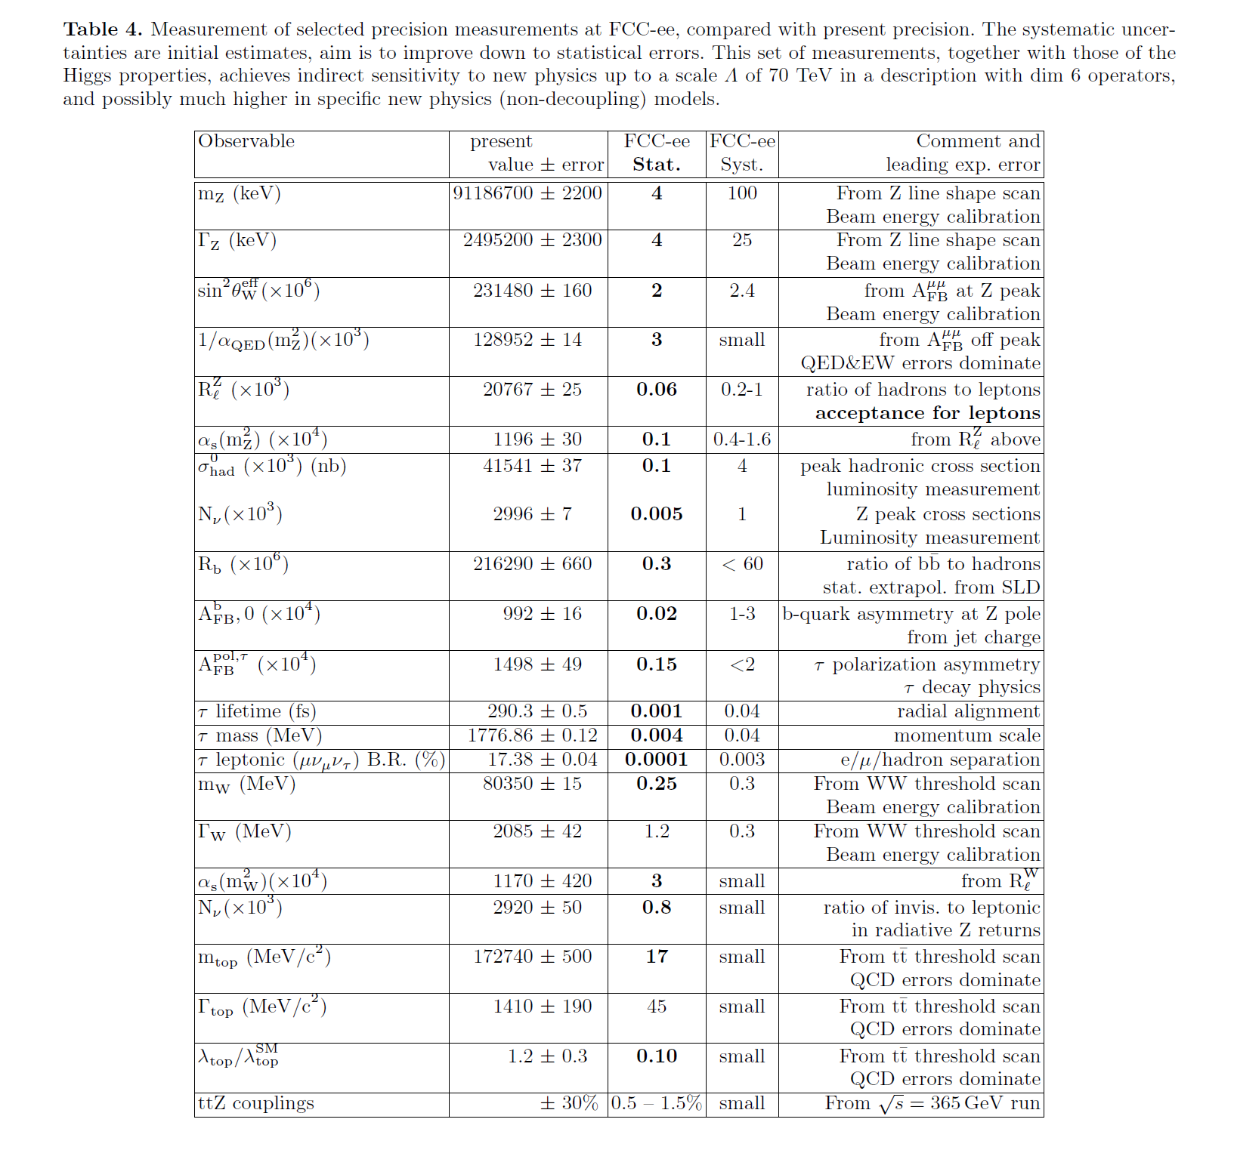
Precision measurements
Precision tests of the SM = relations between observables
α_{QED}(m_{Z}), m_{top}, S,T,U
m_{Z}
sin²θ_{W}^{eff}
α_{QED}(m_{Z}), m_{top}, S,T,U
m_{W}
m_{Z}
α_{s}(m_{Z}), m_{top}, T, N_{v}, δ_{vb}
Γ_{Z}
m_{Z}
m_{top}, S,T,U
m_{W}
sin²θ_{W}^{eff}
Rb → δ_{vb} ; R_{l} (Z) & R_{l} (W) → α_{s}(m_{Z}),
350GeV top scan + α_{s}(m_{Z}) → m_{top} etc, etc.
new physics (NP) ‘parameters’ in red
many interconnected measurements →
All FCC-ee run plan on Z, W and top is essential
Huge statistics → precision, real chance of discovery
Most of work will be on systematic errors
5. To spot and evaluate systematics
having >2 experiments is essential
Complementary to Higgs measts for NP
Will rebaseline the whole field of HEP for decades

Slide 11
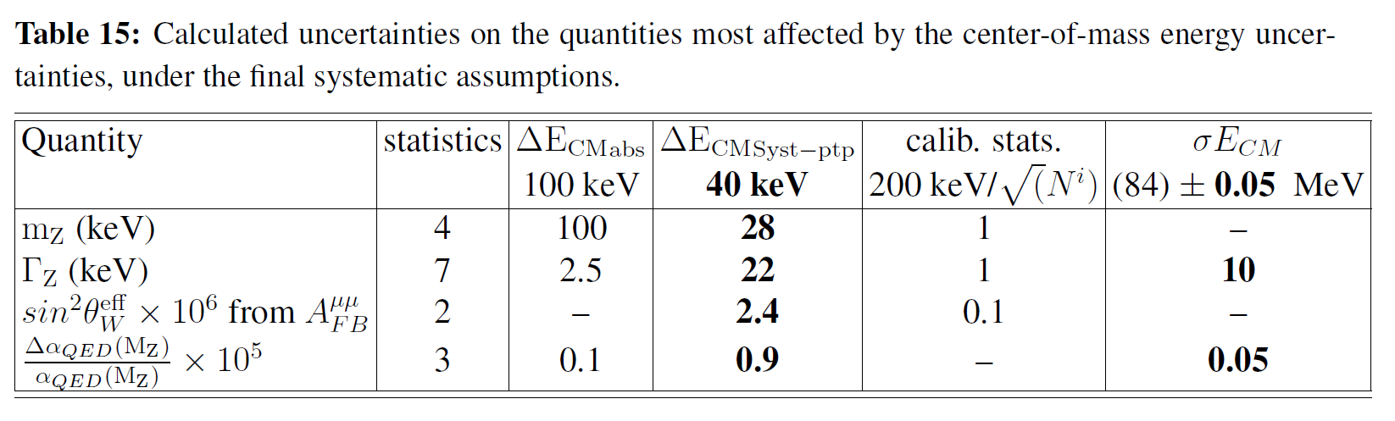
Statistics/systematics-limited precision measurements
Take the line shape:
arXiv:1909.12245v1
Traditionally obtained from calculation using the cross-sections γ, γ*/Z*→ hadrons cross-sections
at various smaller centre-of-mass energies → systematic error subject to debate.
Here for the first time a direct measurement of this important quantity itself is made (game-changer)
Enters as a limiting ‘parametric’ uncertainty in the NP interpretation of many past and future measurements.
Is statistics limited (off-peak asymmetries) and will directly benefit from more luminosity with 4 IP
α_{QED}(m_{Z})
FCC special
appear systematics limited by point-to-point energy uncertainties. However these are based on error
in the comparison btw ECM(exp from mu pairs) and spin-tune, obtained each day of running (100 times)
➔ At the end it boils down to statitics and to detector systematics.
This contains systematics such as stability in the magnetic field or tracker alignment etc.
➔ these are uncorrelated between experiments and will scale down as 1/√N(exp)
sin²θ_{W}^{eff} & Γ_{Z}
(also m_{W} vs m_{Z} )

Slide 12
Statistics/systematics-limited precision measurements
A. We often hear that more Z pole statistics is useless because the measurements are limited by systematics
this is a « passive » attitude and has always led to overly pessimistic expectations → wrong conclusions.
-- experience shows that a careful systematics analysis boils down to a statistical problem
-- if well prepared, ‘theory’ will go as far as useful (i.e at level of combined stats and systematics)
B. Precision measurements are all about redundancy
-- as seen in the following example, measuring the same quantity in several experiments can reveal overlooked sources of errors. →
-- in this context a given amount of luminosity is better used in four detectors than in one or even two. (and even better of course if more experiments means more statistics!)
-- a single experiment is quite vulnerable to unforeseen effects
-- comparison between two experiments can detect inconsistencies at level of > (exp. error *√2)
consistency can still happen ‘by chance’. → comparison is poor measurement of systematics.
-- such bad luck is much less likely in the case of four experiments
C. Detector requirements for the precision measurements are new wrt those at Higgs and top energies
-- fiducials must be known to O(10⁻⁵) level
-- magnetic field and energy calibrations must be very stable
-- ... ...

Slide 13
Z mass from 1991 Z scan
Effect of RF phases and voltages discovered
after the fact!
L3
ALEPH
OPAL
DELPHI
THIS could have remained
unnoticed for a long time
(or forever)
if there had been only
ALEPH and DELPHI
-- or –
OPAL and L3
around the ring!
91.160
91.170
91.180
91.190
91.200
??.... ... .... ??
preparing the 1991 scan results for Moriond 1992
G. Quast from OPAL (+M. Hildreth & others)
noticed this discrepancy and started investigation
within the LEP energy calibration WG.
Similar issues could occur in a 2IP machine in case of unexpected energy loss (impedance) in one of the rings.
This illustrates the competitive collaboration between the four LEP experiments and collaboration with the accelerator team

Slide 14
Precision measurements -- examples
Many key measurements lead to new detector systematics. Three examples:
-- R_{l} (Z) ≡ Γ_{Z→had} / Γ_{Z→leptons} : dominated by knowledge of acceptance boundary at 10 μm level → α_{s}(m_{Z})
-- σ⁰_{had} (peak hadronic cross-section); dominated by luminosity meast (acceptance boundary at 1 μm) → N_{ν} -- tau life-time, tau mass & tau branching ratios –> G_{F} from taus at O(10⁻⁵ ) precision (heavy neutrino mixing etc..)
Errors dominated by life-time scale error (few nm), detector momentum scale (10⁻⁶), lepton separation
For all of these, detector systematics will scale as 1/√N(exp) AND 4 exp will be instrumental in finding ‘unexpected effects’

Slide 15
Accelerator monitoring
*NEW* wrt LEP!
70kHz of events in each detector will allow very quick and high quality measurement of beam parameters
-- IR position in x,y,z and size in x,z (indirectly in y from intensity and luminosity)
-- CM boost → energy spread and (E_{e+}-E_{e-}) with high precision (2 MeV every second, 30 keV every hr) at four IR points
-- crossing angle of *colliding particles* in x,z plane (in y, if any) and possible deflection in y,z.
-- measurement of these parameters within bunch in x and z directions
-- others we haven’t thought about.
Huge amount of information on energy model and beam properties.
Will be enriched further with four detectors and four experimental teams
see arxiv:1909.12245

Slide 16
At the limit of sensitivity: feebly coupled particles and forbidden processes
Heavy Neutrinos
Massive Neutrinos is today the construction zone of the Standard Model
The search for Heavy neutrinos, motivated by the see-saw model (Dirac and Majorana mass terms) has become
an active branch of the Energy Frontier. We noted this already in 2013 (see FCC Kick-off meeting!)
The main region of interest is for couplings of magnitude m_{ν}/m_{N} =O(10⁻¹²).
Complementary with FCC-hh where Lepton Number Violation is “easier” to see...
➔ potentially of great impact on the design of FCC-hh detectors.
Dark Sector
The heavy neutrinos are almost sterile and constitute the poster child of a generic type of dark sector solutions to SM puzzles invoking feebly coupled particles. These have the added benefit of not affecting the SM radiative corrections and running of coupling constants thus avoiding associated hierarchy problem and Stability of the Universe
A good example is given by Axion-Like Particles (ALPs).
Any increase of luminosity is welcome!

Slide 17
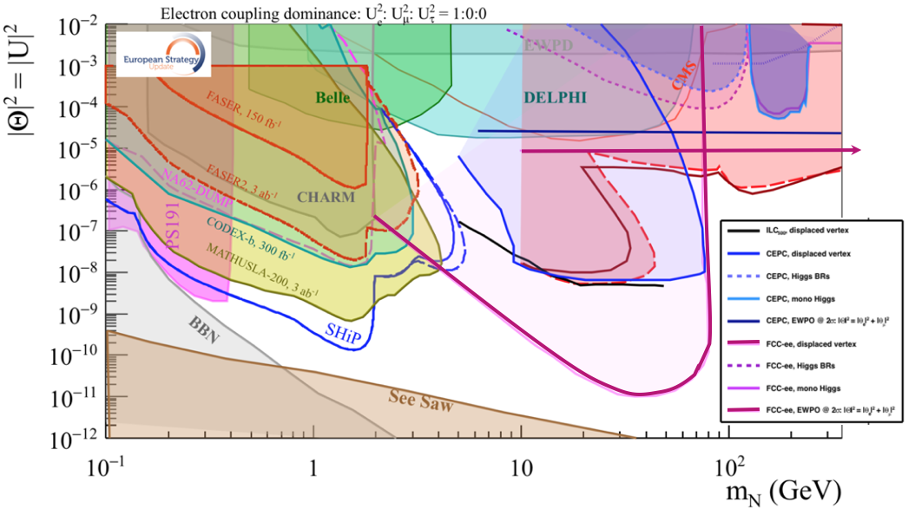
This picture from the briefing book is relevant to Neutrino, Dark sectors and High Energy Frontiers. FCC-ee (Z) compared to the other machines for right-handed (sterile) neutrinos
How close can we get to the ‘see-saw limit’? can we improve acceptance and reach?
-- the purple line shows the reach for observing heavy neutrino decays (here for 2.10¹² Z)
-- the horizontal line represents the sensitivity to mixing of neutrinos to the dark sector,
using EWPOs (G_{F} vs sin²θ_{W}^{eff} and m_{Z}, m_{W}, tau decays) which extends sensitivity
to 10⁻⁵ mixing all the way to very high energies (500-1000 TeV at least). arxiv:2011.04725

Slide 18
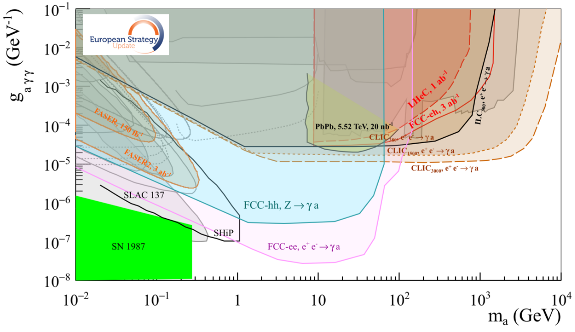
Similar situation for Axion-like-particles; Luminosity is key to the game
Complementarity with High energy lepton collider,
much to explore at FCC-ee-Z and FCC-hh!

Slide 19
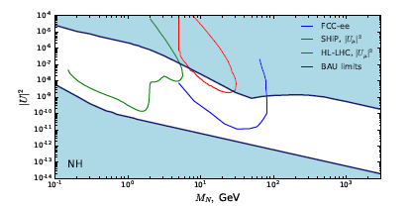
For right-handed-neutrino HNLs, the region of greatest interest is the parameter set which is consistent with the see-saw mechanism and with the leptogenesis over the largest possible range of Rhnu mass.
FCC-ee study from 2014 show that the see-saw line can be reached with a Z run of 10¹³Z. Z→ νν is 20%, N→ l ± W* is 50%. (1/(10¹³ x 0.2 x2 x0.5 (x0.5_{acc,kin}) = 10⁻¹²)
for Long Lived Particles, no significant source of background identified at this point
2. It may take of O(100) evts to establish the Fermion Number Violating nature of the discovered HNL. (work in progress, probably in central detector only)
3. This search might have large impact on the design of the FCC-hh detectors!
These ‘common plots’
only refer to 2.10¹² Z
.
-- Approx 4IP line 1 evt
(M. Drewes, J. Hijer)
arXiv:2008.13771
More integrated luminosity → more chance of discovery of HNL and LNV!!!

Slide 20
Heavy Flavour Physics
Flavour (number of families, spectrum, quark-lepton correspondance etc...) is a great mystery for HEP.
FCC-ee is of special relevance for b and t quark as well as τ lepton physics (unique among ‘Higgs Factories’)
at the Z very large samples of highly boosted:
B hadrons of all type (10¹²)
tau leptons (1.510¹¹)
at the W and above: 310⁸ W decays for direct measurements of V_{cb} and V_{cs}
Many analyses are statistics limited
-- CP violation, b, c and tau rare decays, will benefit of an increase of statistics.
-- and τ precision measurements will benefit both from statistics and of the increased number of detectors
-- One of the repeated conclusion of Flavours discussion in Granada ESPP was “at least 5 10¹² Z” desirable (more = better)
Detector requirements are varied with many new things w.r.t. ‘Higgs Factory’ and precision measurements
hadron particle ID, high resolution e/γ calorimeter etc. (top physics likely to change « color » with these added features)
Some incompatibility with each other or with EW precision measurements or particle flow ➔ need several different detectors to explore the full physics program
The heavy flavor community is both
-- numerous (2000 members between BELLE II and LHCb)
-- highly competent ... and with high expectations

Slide 21
These detectors look similar at first sight BUT
-- different coil location
-- different tracker (silicon vs drift chamber)
-- dedicated PID (TOP CKOV, TOF, dE/dx )
-- EM calorimeter High Energy resolution vs high granularity vs Energy flow
-- Hadron calorimeter (scintillator vs RPC vs...)
Intense studies in the next ~5 years!

Slide 22
CP violation / CKM program:
Two categories of the most important statistically limited observables :
-- The CP-violating phases γ and the φ_{s} phase.
Determined at the Z pole, the precision w/ 5 10¹² Z is commensurate w/ LHCb upgrade II.
-- The Vcb CKM matrix element magnitude: a critical element of the CKM profile (normalisation) but also a key element of the New Physics energy scale one can set from B mixing observables.
FCCee is unique here with the on-shell W decays (FCC-ee at W threshold and higher energies)
Any statistical gain translates into a higher NP energy scale.

Slide 23
Rare decays
Taking an increasingly important role in the BSM model buildings (following LHCb anomalies):
The helicity-suppressed leptonic decays B⁰ →μ⁺μ⁻ and B_{s} →τ⁺τ⁻ are SUSY-killers (drivers).
Both benefit from the luminosity increase.
The semileptonic b→ sll : the transitions with tau leptons benefit most from the luminosity increase.
They are instrumental in exploration of Lepton-Flavour-Universality violating (LFV) models
and a motivation per se of any Flavour program.
The rare many-bodies tau decays are also directly limited by statistics.
The tau rare/forbidden decay modes are all benefitting from 4 IPs LFV τ→μγ and τ→ 3l
(critical on tracking)

Slide 24
The ultimate e/mu/tau universality test: targets G_{F} from taus at O(10⁻⁵) precision
extremely demanding on lifetime meast, momentum scale precision and e/mu separation (1/√N_{exp} )
→ sensitive to heavy neutrino mixing with the ν_{τ} up to very high mass scale (>> 50 TeV)

Slide 25
This picture from the briefing book is relevant to Neutrino, Dark sectors and High Energy Frontiers. FCC-ee (Z) compared to the other machines for right-handed (sterile) neutrinos
How close can we get to the ‘see-saw limit’? can we improve acceptance and reach?
-- the purple line shows the reach for observing heavy neutrino decays (here for 2.10¹² Z)
-- the horizontal line represents the sensitivity to mixing of neutrinos to the dark sector,
using EWPOs (G_{F} vs sin²θ_{W}^{eff} and m_{Z}, m_{W}, tau decays) which extends sensitivity
to 10⁻⁵ mixing all the way to very high energies (500-1000 TeV at least). arxiv:2011.04725

Slide 26
Conclusion(I): FCC-ee really calls for four interaction points
One of the great advantages of the circular e+ e- colliders is:
-- The possibility of serving several interaction points with net overall gain
both in integrated luminosity and luminosity/MW.
The FCC-ee is a machine with a very rich menu of physics possibilities
-- precision measurements that will rebaseline particle physics for many years
on Higgs, top, Electroweak, QCD and Flavour Physics
-- significant chances of discovery from precision, rare processes and high sensitivity to feebly coupled particles
-- several will impact FCC-hh physics results and detector design
-- High luminosity, redundancy and careful preparation of detector set-ups will be key to success
-- many measurements are statistics limited and will immediately benefit from four Interaction points.
-- several key physics targets are tantalizingly close (but missed) with the present set-up
Having four IPs will allow for a range of detector solutions to cover FCC-ee all physics potential opportunities
-- example: EM calorimeter requirements (high precision vs high granularity vs high stability vs geometric accuracy vs PID vs cost)
unlikely to be all satisfied with only two detector concepts.
-- different solutions will be invaluable in uncovering hidden systematic biases and avoid conspiracy of errors. -- and provide an attractive challenge for all skills (detector design and R&D, software, analysis, theory...)

Slide 27
Conclusion(II): FCC-ee should be fully designed for 4IP
After review with the FCC Physics Experiments and Detectors coordination group
we have concluded emphatically that FCC-ee should be designed for four interaction points.
--- It will always be time to revert to two if absolutely necessary – the reverse is not true
so as to be able to
-- adapt to the guidelines resulting of the full exploration of the physics potential taking place in the next ~5 years
-- increase the interest of the community for the FCC;
eventually adapt to its resouces and size, and the quality of its proposals
THIS SHOULD NOT PRECLUDE CONSTANT EFFORTS TO INCREASE THE LUMINOSITY per IP

