Slide 1
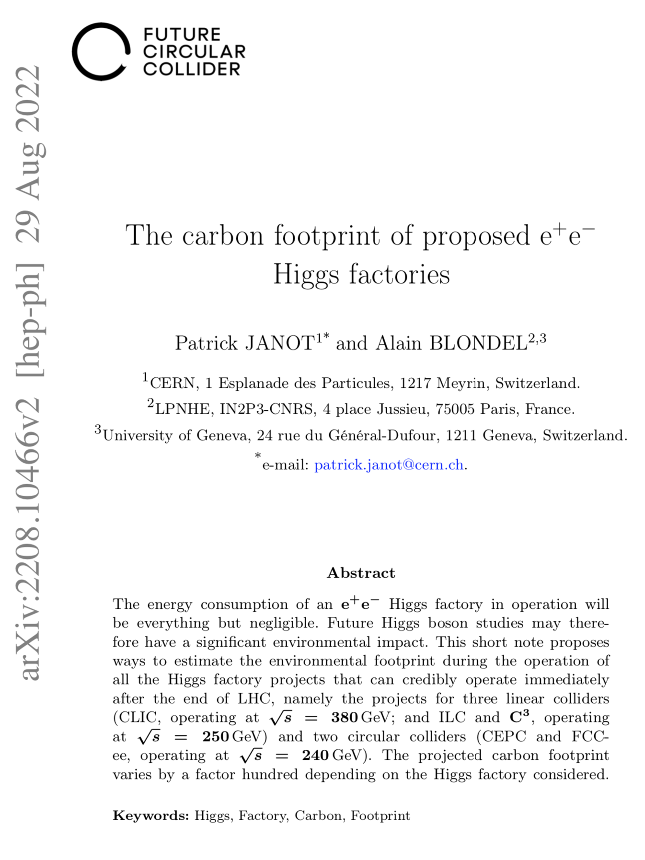
The carbon footprint of proposed e⁺e⁻ Higgs factories
Presentation based on arXiv:2208.10466
  In the context of the FCC Feasibility Study
    Contributed White Paper to Snowmass’21
Motivations
  We entered times of measurable climate change
    Yielding a global warming of unprecedented rapidity
  As a community, we must take stock of this situation
    And show that environmental concerns are essential
      E.g., in the choice of the next collider after LHC
  As physicists, our most important criterion is at least to
Maximise the physics outcome
for a given carbon footprint
(or to minimize the carbon footprint for a given physics outcome)

Slide 2
HEP strategy after ESU 2020 and Snowmass’21
European Strategy Update (January 2020)
  The highest priority next collider is an e⁺e⁻ Higgs factory
    Followed by a hadron collider with the highest achievable centre-of-mass energy
  Vision endorsed by CERN Council in June 2020
    FCC technical and financial Feasibility Study approved and funded in June 2021
      With focus on the first step, i.e., the tunnel and the FCC-ee (which includes an e⁺e⁻ Higgs factory)
Energy Frontier vision at the Snowmass’21 final community meeting (July 2022)
  Immediate future: HL-LHC
  Intermediate future: an e⁺e⁻ Higgs factory, based on
    Either a linear collider (ILC in Japan, C³ in the US, CLIC at CERN)
    Or a circular collider (CEPC in China, FCC-ee at CERN)
  Long-term future: a multi-TeV (μμ and/or pp) collider
What is the carbon footprint of these Higgs factories for the same physics outcome?
“Similar physics outcome”
(according to ESU’20 and Snowmass’21)

Slide 3
What you are usually shown
The power consumption of each collider (in MW) while in operation
  Higgs factories displayed in the plot (as suggested by Snowmass’21)
    CLIC @ √s = 380 GeV
    ILC @ √s = 250 GeV
    C³ @ √s = 250 GeV
    CEPC @ √s = 240 GeV
    FCC-ee @ √s = 240 GeV
  Conclusion often drawn from the plot
  True (even if linear colliders are also meant to operate at higher √s, with larger power)
    The power in operation is, however, only weakly linked to the collider carbon footprint
Linear colliders are less energy-hungry
than circular colliders

Slide 4
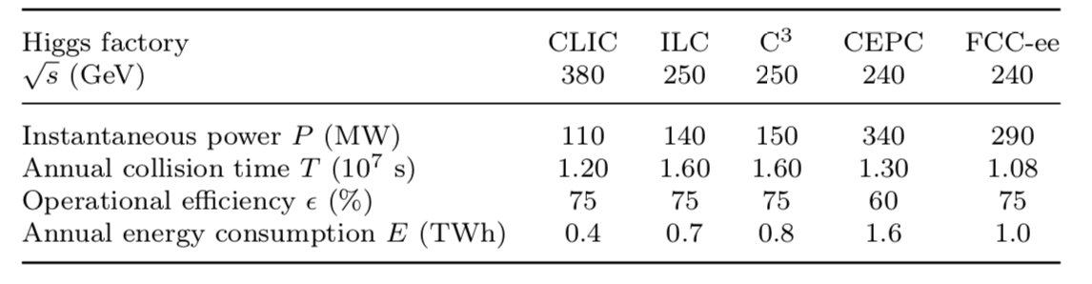
What you are less often shown
The annual energy consumption depends on WHEN the power is used
  Integrated luminosity projections based on significantly different assumptions
    Much longer physics runs for ILC/C³
  Less physics days give much flexibility
    To run only when electricity is available
    To run only when electricity is carbon-free
  Less physics days also reduce proportionally the annual energy consumption
    The annual energy consumption is, however, only weakly related to the collider carbon footprint

Slide 5
What you are rarely reminded
A Higgs factory physics outcome is 100% correlated to the number of Higgs produced
Circular colliders have a clear advantage here
  Allow for a much larger collision rate
    Beams are not lost at each crossing
  Can operate four detectors simultaneously
    ~550,000 Higgs/year with FCC-ee₂₄₀
    ~ 50,000 Higgs/year with ILC₂₅₀
    ~ 30,000 Higgs/year with CLIC₃₈₀
If desired physics outcome requires 1M Higgs
  Less than two years for FCC-ee (4 IPs)
  Up to 20/30 years for ILC and CLIC
Energy consumption / Higgs produced (or per physics outcome) is the proper estimator
  Circular colliders are much less energy-hungry than linear colliders
17
18
14
4.1
1.7
2IPs
4IPs

Slide 6
Apparte: Is this a lot of energy ?
Yes, 1 TWh per year is significant energy consumption
  But there is real value for mankind to do research as we do
    It is all the more important to maximise the corresponding physics outcome !
  Compared with other energy consumption / production per year
    CERN : 1.3 TWh
    Geneva in 2019: 2.8 TWh
    Dam in Verbois: 0.5 TWh ; Dam in Génissiat: 1.7 TWh
    Nuclear plant in Bugey: 25 TWh
    Largest solar panel farm (45 km2): 1 TWh
      Would require a 500m-wide band of solar panel along the FCC ring
    A 3MW wind turbine: 0.02 TWh
      Would require 500 such turbines (one every 200m) along the FCC ring
  Our first responsibility, as particle physicists, is to do the maximum of science
    For the minimum environmental impact with the necessary energy consumption
Highly variable sources
Require larger peak energy
Require energy storage
to run the collider 24h a day
➝ Large investment
➝ Environmental impact

Slide 7
What you are never told (until today)
The environmental impact depends on WHERE the consumed energy is produced
546g
Carbon intensity (g CO₂ eq. / kWh) for energy production in 2021
Source: https://app.electricitymaps.com/map

Slide 8
Carbon footprint per year
No surprise here: Higgs factories at CERN have a much smaller impact every year
  In addition, FCC-ee produces many more Higgs bosons every year than linear colliders
    And therefore needs to run for a much shorter period for the same physics outcome
Today’s estimate

Slide 9
Carbon footprint per physics outcome
Today, FCC-ee would be the least disruptive it terms of environmental impact
  When running as a Higgs factory (√s = 240 GeV)
    For a given physics outcome
The carbon footprint is large, even for FCC-ee
  Today, all developed countries are committed
    To reduce carbon intensity by 40% in 10 years
  What can we do at CERN ?
    Develop energy efficiency technology
      e.g., high-efficiency RF power sources
    Recover dissipated power (heat)
      To heat the neighbourhood (already with LHC)
    Think of alternative ways of energy storage
    Maximize synergies with developments towards carbon-free energy production
      Nuclear fusion, solar and wind energy, etc.
    Use electricity only when it is available and carbon-free: adapt power consumption with agility
    Find ways of efficient international collaboration that minimizes airplane travel
    Systematic use of electric vehicles; use bicycles to go to work; energy efficient buildings; etc.
9.4
Today’s estimate
6.8
2.2
0.8
0.1
2IPs
4IPs

Slide 10
Conclusion
Higgs factory energy consumption and carbon footprint per physics outcome
Suggestion: Always present our proposals not only in terms of cost and performance
  But also in terms of carbon footprint / physics outcome (and use it for design and decision)
    Because cost is mostly local, while carbon footprint affects everyone on the planet
17
18
9.4
Today
14
6.8
4.1
2.2
1.7
0.8
0.1
2IPs
4IPs
2IPs
4IPs

