Slide 1
Neuroscience in A3D3: annual project updates
October 7th, 2022

Slide 2
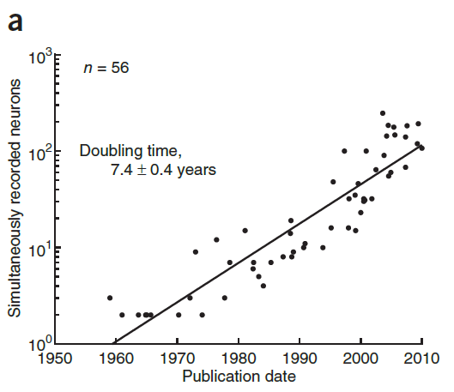
A3D3: using ML for low-latency, real-time neuroscience
A3D3 Seminar on October 24 from Dr. Nick Steinmetz – state of the art large-scale neural measurements
Neural data growing rapidly (measuring big brain networks)
Real-time manipulations allow causal manipulations of brain circuits to understand function
Data-driven approaches allow for hypothesis generation and discovery
Stevenson & Kording, Nature Neuroscience 2011
Ponce et al., Cell 2019

Slide 3
Main teams
UW – tools for low-latency detection/prediction of neural events
  Faculty: Amy Orsborn, Eli Shlizerman, Scott Hauk
  Trainees: Michael Nolan, Jinguan Li, Trung Le, Leo Scholl, Xiaohan Lu, Aidan Yokuda, Lauren Petersen
Purdue – tools for large-scale data analysis and system-identification
  Faculty: Maria Dadarlat, Eli Shlizerman
  Trainees: Megan Lipton, Seungbin Park

Slide 4
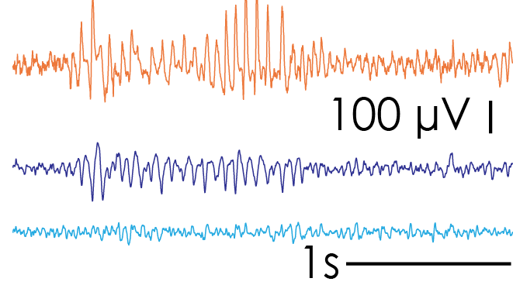
Low-latency example application: closed-loop stimulation to alter sleep-spindle events
“Spindles” are oscillation events that occur during sleep/rest
Thought to contribute to learning
Currently: detect a spindle starting and stimulate to disrupt
Goal: predict spindle will occur, stimulate to prevent
Local field potential measurements
(electrical activity of groups of neurons)
spindle (~rare)

Slide 5
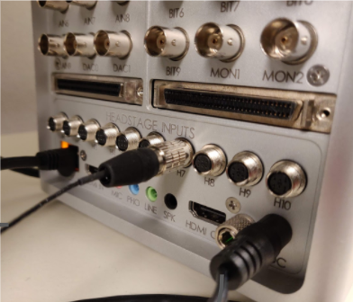
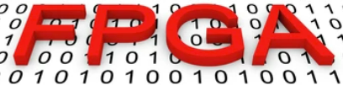
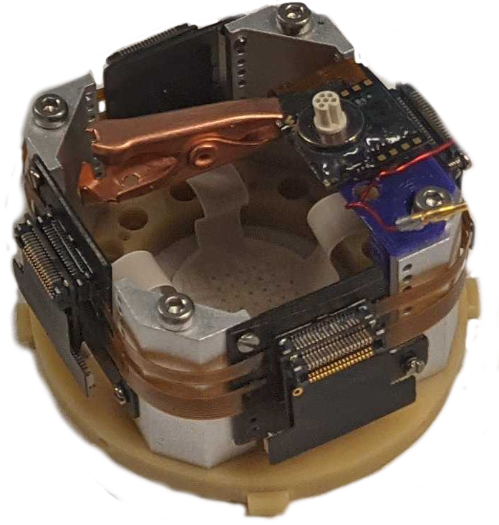

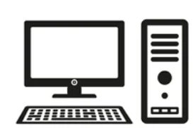
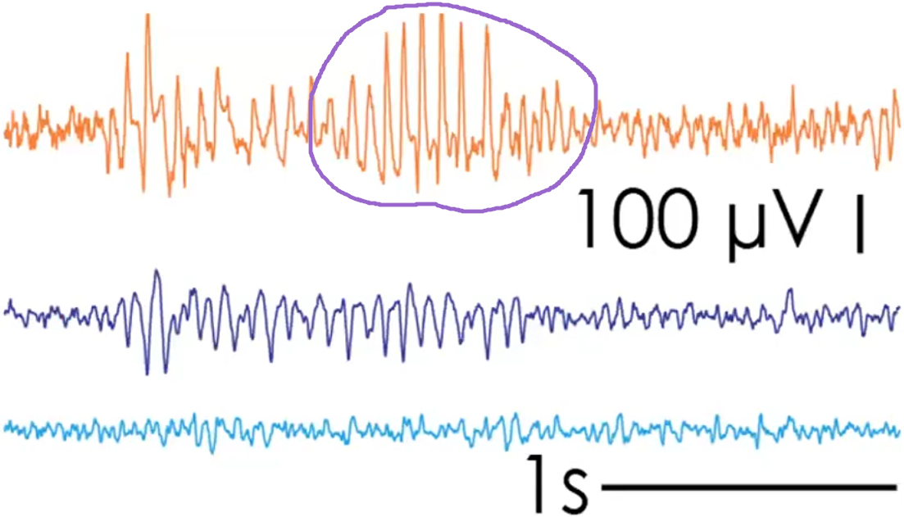
Low-latency example application: closed-loop stimulation to alter sleep-spindle events
Detect brain state (spindles), stimulate in real-time to disrupt
→ Insights into brain state’s impact on brain function/behavior
Achieving this requires completing 3 major goals:
New algorithms to reconstruct/predict neural signals
New algorithms to predict spindle events
Hardware-implementation for low-latency prediction
Stevenson’s law

Slide 6
Progress on goal 1.
Algorithms to reconstruct/predict broad-band neural signals (1/3)
Found that existing autoencoder methods for neural data are band-limited to model size
  Limits reconstructions of broad-band neural data such as micro-electricorticography
Developed new Multi-block Recurrent Auto-Encoder (MRAE) to increase model bandwidth more efficiently:
Nolan, Pesaran, Shlizerman & Orsborn, bioarxiv 2022

Slide 7
Progress on goal 1.
Algorithms to reconstruct/predict broad-band neural signals (2/3)
MRAE architecture improves reconstruction accuracy and bandwidth for longer reconstruction time windows
MRAE method is more scalable
  better reconstruction accuracy for fixed model size
Nolan, Pesaran, Shlizerman & Orsborn, in prep

Slide 8
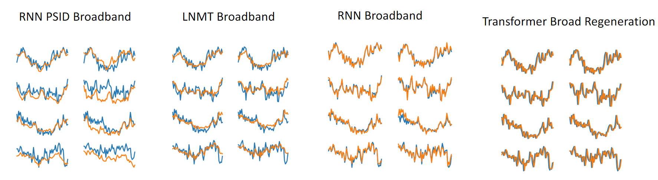
Progress on goal 1.
Algorithms to reconstruct/predict broad-band neural signals (3/3)
Alternative model architecture using transformers may significantly improve reconstruction bandwidth
RNN PSID = current state of the art
Li, Scholl, Rajeswaran, Shlizerman & Orsborn, in prep

Slide 9
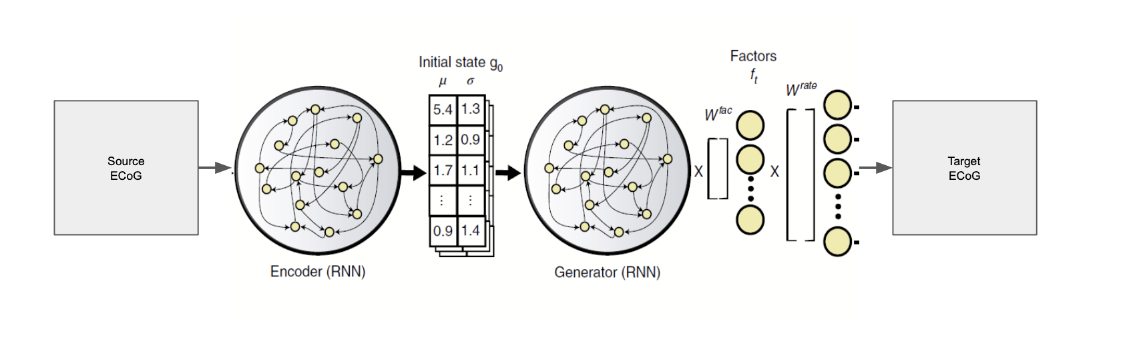
Progress on goal 3.
FPGA implementation of algorithms for neural data
Use existing published model (Latent Factor Dynamical Analysis, LFADs; Pandarinath et al., Nature Methods 2018)
Apply to publicly available datasets
  Neural Latent Benchmarks (https://neurallatents.github.io/)
Scale down model to explore FPGA implementation with hsl4ml
Xiaohan Lu, Aiden Yokuda, Michael Nolan, Scott Hauk, Shih-Chieh Hsu, in prep

Slide 10
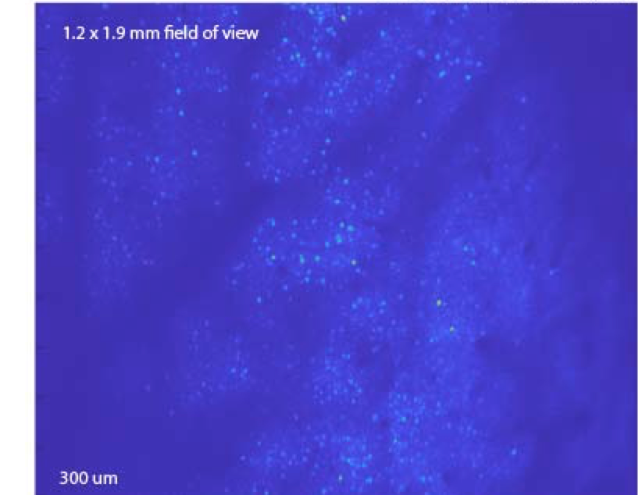
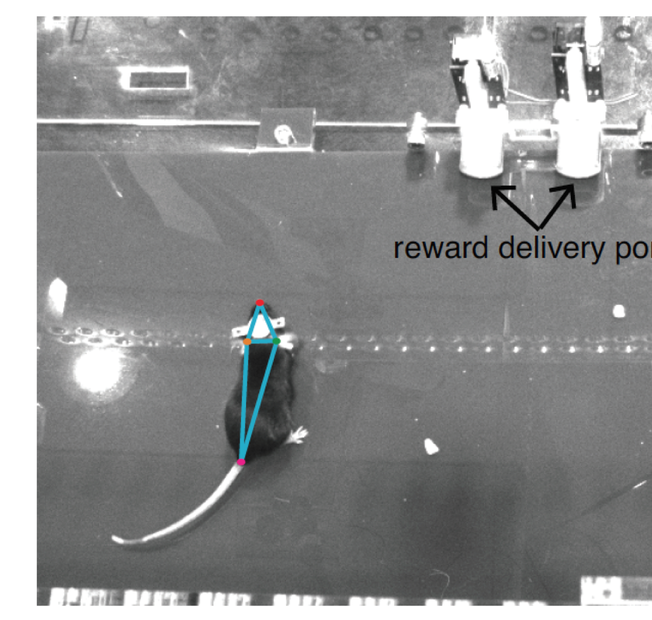
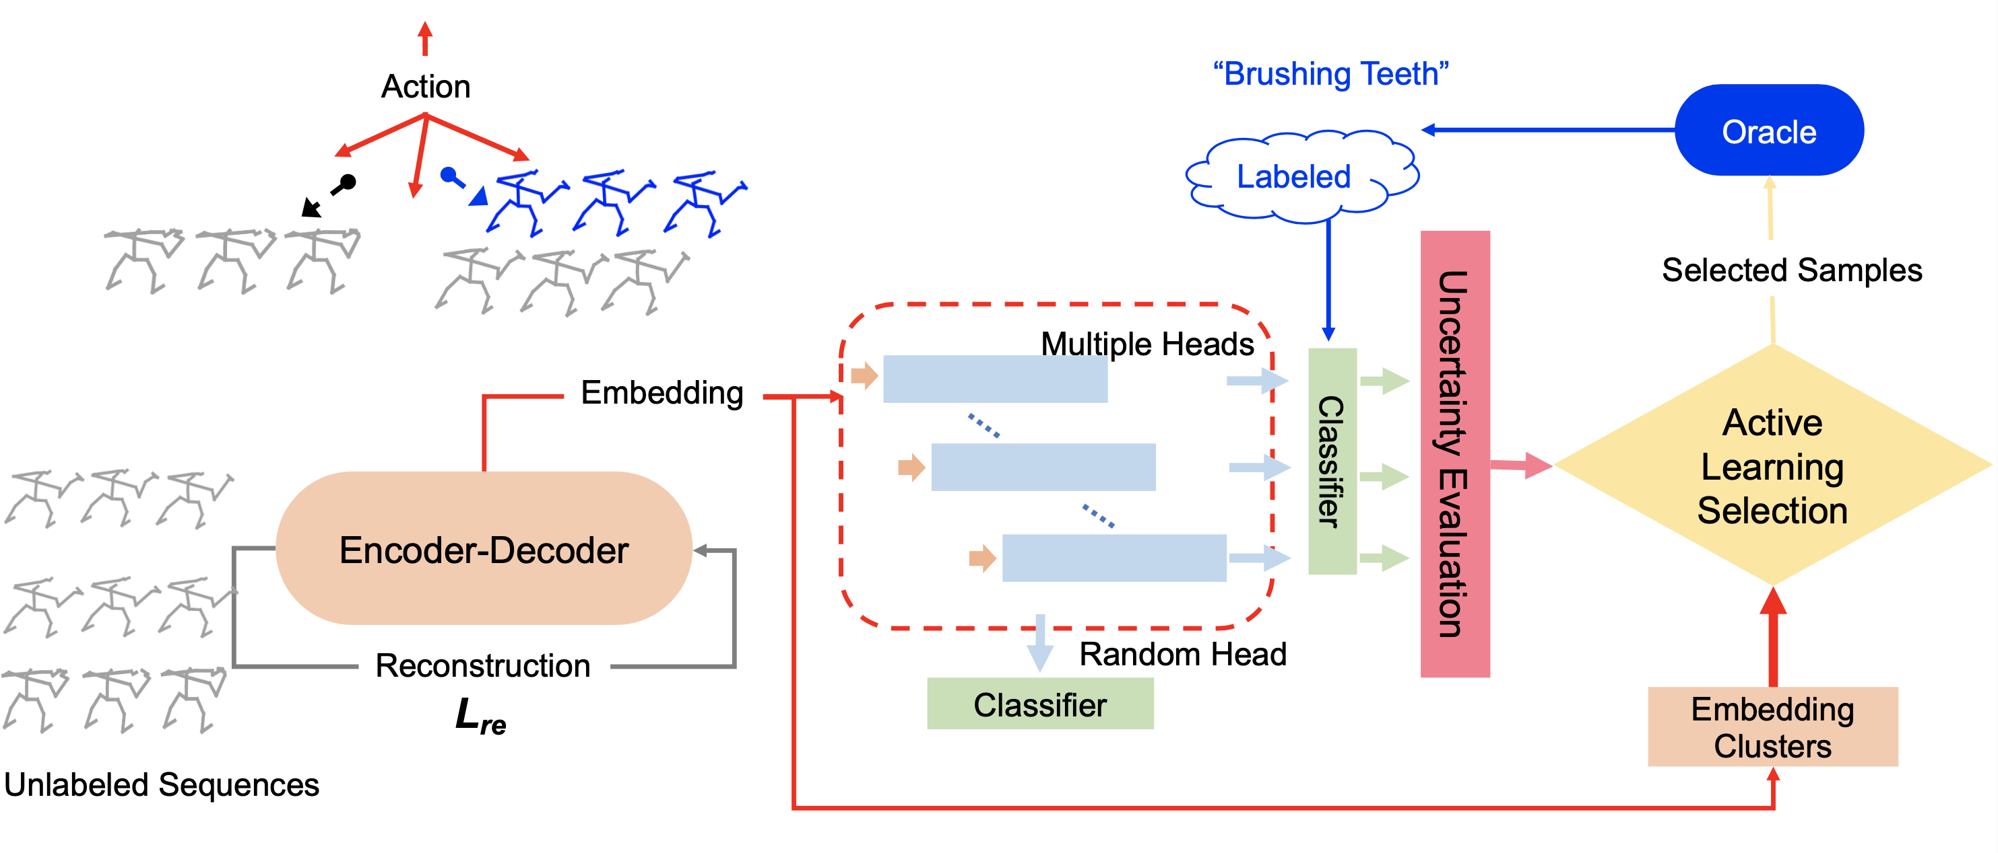
Large-scale data analysis example: data-driven feature extraction
Dadarlat lab, Purdue
Large-scale brain recording + behavioral monitoring
  → Identify brain-behavior relationships, structure from the data
Semi-supervised encoder-decoder methods
~3,000 neurons
Li & Shlizerman, Arxiv 2020

Slide 11
Key Outcomes and Achievements
Training and professional development
  NeuroAI weekly seminar (https://github.com/shlizee/NeuroAI) to promote discussion at the intersection of AI and neuroscience (undergrad, grad, postdoc, faculty)
  Postbacc Lauren Petersen started in Orsborn lab August 2022
  Neuro-AI workshop hosted at UW September 2022
Communication and outreach with research community
  NeuroAI seminars (open to all)
  Conference workshop proposal planned for Computational Systems Neuroscience Conference (CoSYNe), 2023
  Submitted algorithm to Neural Latents Benchmark challenge, currently the #1 entry in some performance categories

Slide 12
Key Products
Poster presentations
  Nolan, Pesaran, Shlizerman, & Orsborn, AI@UW workshop, University of Washington, May 2022
  Lipton & Dadarlat, Neural Control of Movement Conference, July 2022
Papers
  Nolan, Pesaran, Shlizerman & Orsborn, “Multi-block RNN autoencoders enable broadband ECoG signal reconstruction”, bioarxiv 2022
  Le, Shlizerman, “STNDT: Modeling Neural Population Activity with a Spatiotemporal Transformer”, Arxiv 2022
  Dadarlat, Canfield, & Orsborn, “Neural plasticity in sensorimotor brain-machine interfaces” Annual Reviews of Biomedical Engineering, in press

Slide 13
Impact
Within neuroscience:
  Developing improved modeling capabilities for broadband neural data will allow autoencoder approaches to be applied to a wider range of studies
  Developing improved methods for multi-modal modeling for neuroscience will open new ways to mine rich datasets (e.g. neural and behavioral recording; multi-scale neural measurements)
  Developing the first methods to implement these approaches with low latency will enable new real-time applications
Other disciplines:
  Potential extensions of multi-modal modeling methods to other experimental datasets
  Anomaly detection in time-series signals has broad applications
Teaching & Education:
  Cross-discipline training in ML and neuroscience will increase workforce skills in neural engineering

Slide 14
Next year
Continued progress on existing efforts:
  Broadband neural signal reconstruction and prediction algorithms
  Un/semi-supervised clustering of neural data
  Hardware implementation of existing algortihms
New directions
  Extend algorithms to new datasets, modalities
  Explore transformer network applications
  Joint behavior + neural data feature learning

