Slide 1
Cluster Size w.r.t. radial distance from Shower axis
Clusters sizes with 1 to 25 pixels are added to the distributions w.r.t distance from shower axis
Initially, mean values of clusters from all 47 chip are plotted against the respective radial distance for all energies.
The cluster size distribution with cluster center 0-1mm from shower axis shows minimum mean value with greater number of clusters having 1 and 2 pixels. Comparing this distribution with the cluster size distributions farther away from shower axis shows an increased number of clusters with pixels more than 3.

Slide 2
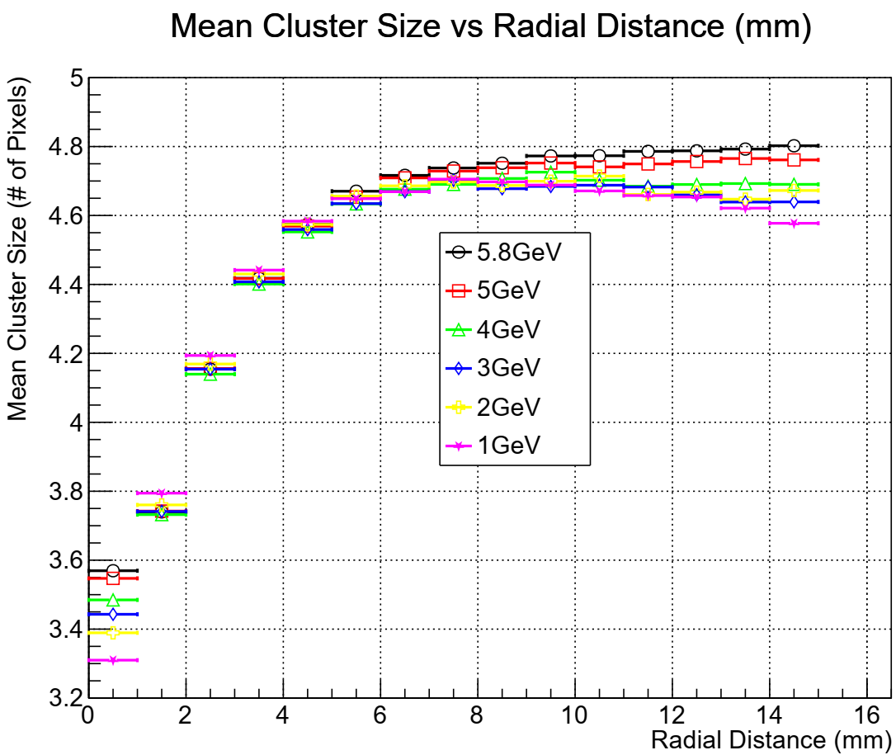

Slide 3
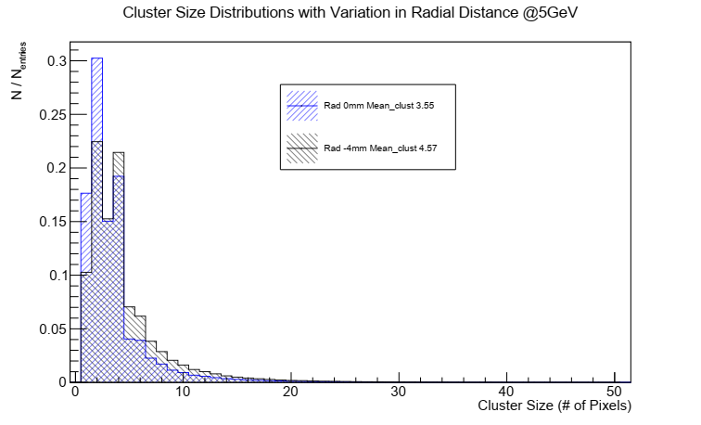
The distribution in blue represents the clusters detected (0-1mm) from the shower axis
Distribution in black shows the clusters with centers between 4-5mm from shower axis
The blue histogram has more entries in first and second bin while the black histogram has more entries in bin 4 and above
Taking the histogram in blue as reference, the cluster entries with 4 and more pixels in the black histogram are compared with the respective entries in blue
Once the entries in black exceeds the blue, the new entries in black histogram are added into the first and second bin (1 and 2 pixel clusters) until the maximum value of the existing black histogram is reached. The entries counter is reset, and the process is repeated for the whole run.

Slide 4
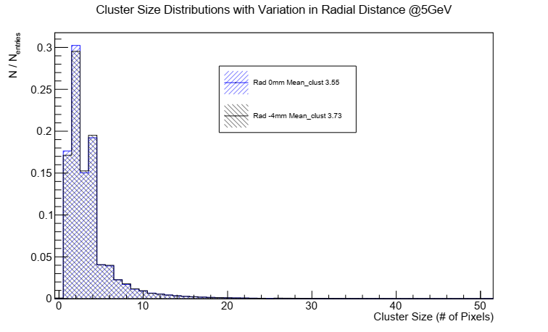

Slide 5
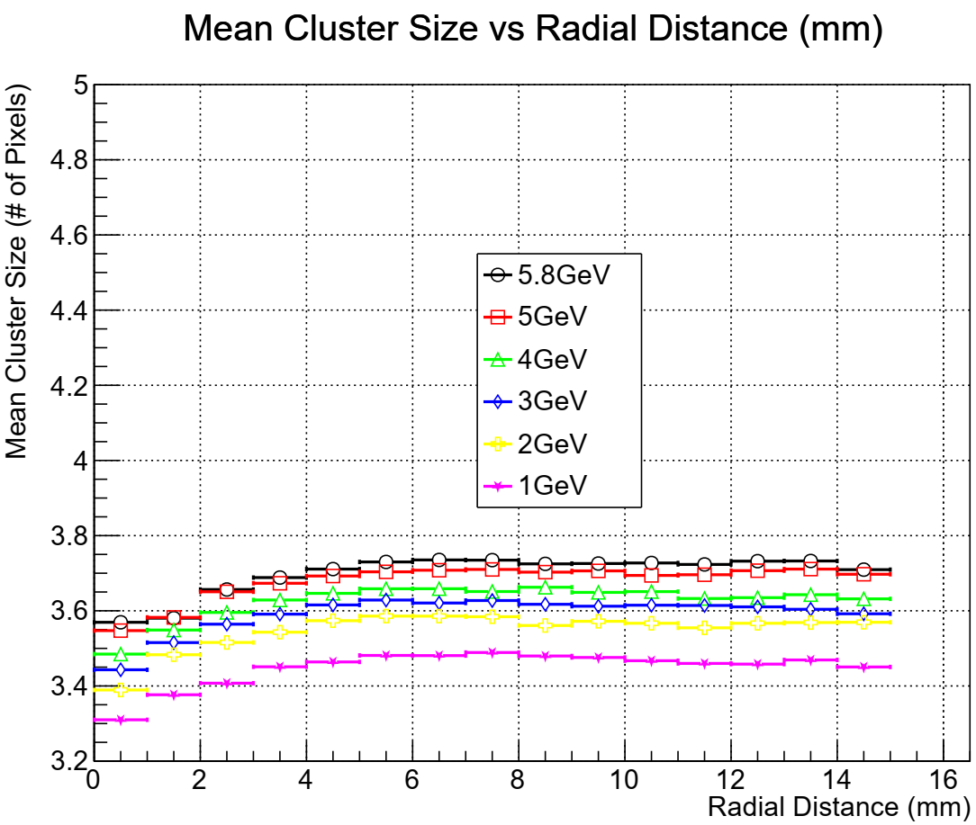

Slide 6
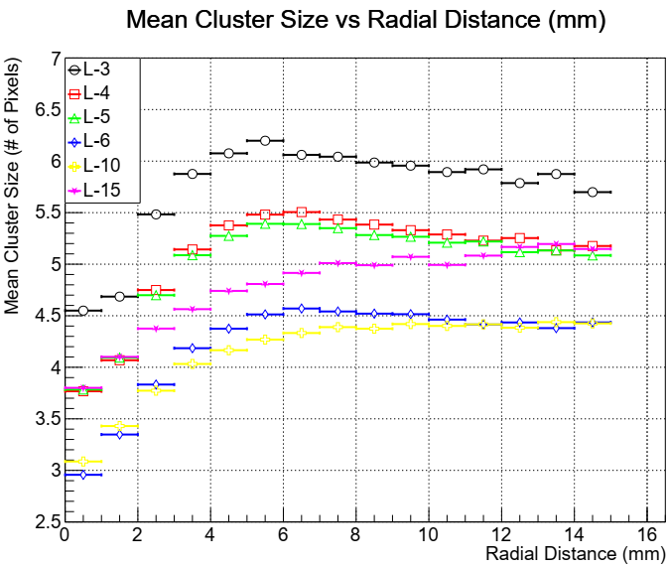

Slide 7
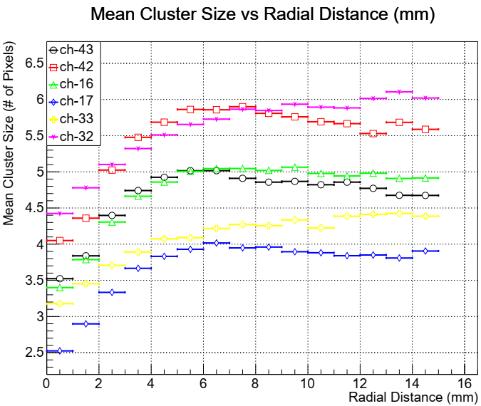

Slide 8
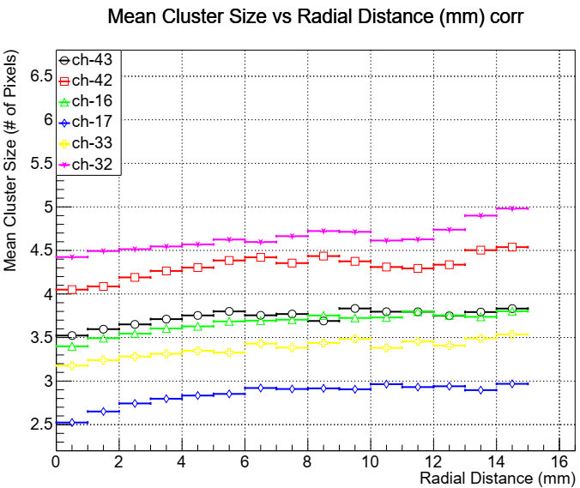

Slide 9
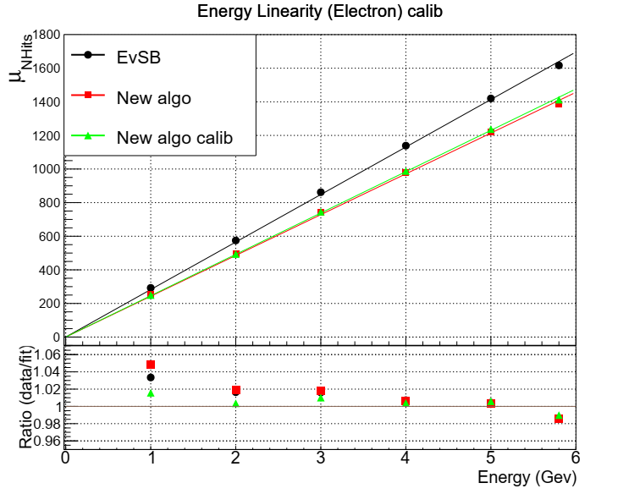
New Algo is the mean number of hits after adding the clusters (including the cluster with changed size) for mean number of hits
New algo calib represents the data after applying the chip calibration to the number of hits for each chip per event

Slide 10
Next Steps
Can try changing the reference distribution, e.g, (0-1mm) to 0-0.5mm
Compare the beam data with simulations and see if same effect is seen
Can use the simulations to categorize the cluster size w.r.t the angle of incidence

