Slide 1
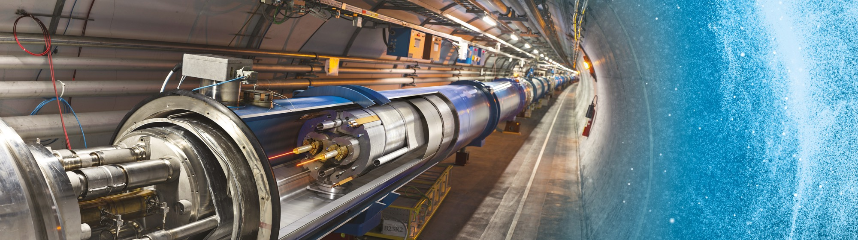
Doing Business with CERN
Thematic Industry Days
Daniel Schoerling
19.09.2022

Slide 2
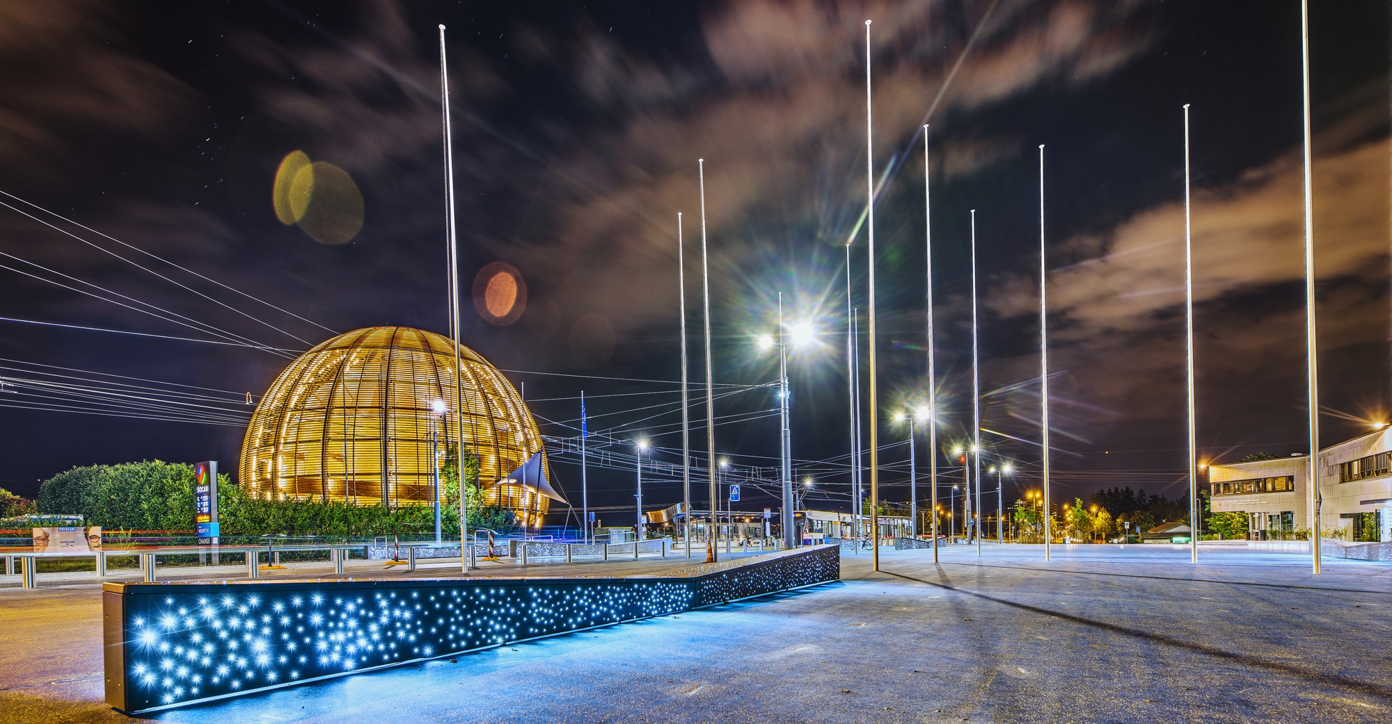
AGENDA
Introduction
Statistics
Procurement @ CERN - the rules
Impact of
Doing business with CERN
Procurement website

Slide 3

INTRODUCTION

Slide 4

CERN - the world’s biggest laboratory for particle physics.
International Organization
established on 1 July 1953 -
“Science for Peace”.
Immunity of jurisdiction
and execution.
Notes:
This slide addresses two questions:
“Where are we?”
Use the map to indicate the location of CERN, headquartered in Geneva, straddling the Franco-Swiss border
“What is CERN?”
CERN is one of the world’s leading laboratories for particle physics
CERN’s vision (long-term goal) is to understand the fundamental particles and laws of the Universe (This is the Vision statement that features in CERN’s communication strategy)
Thus, CERN is first and foremost a research laboratory

Slide 5

CERN is entitled to establish its own internal rules necessary for its proper functioning, including:
Procurement Rules
Safety Rules
Staff Regulation of its own personnel

Slide 6
In 1954 CERN had 12 Member States
Today CERN has 23 Member States
23 Member States
3 Associate Member States in the pre-stage to membership
7 Associate Member States
6 Observers
Geographical & cultural diversity
110 nationalities,
from 77 countries
~ 2676 Staff members
~ 2000 contractors’ employees
~ 13000 physicists /users
9/18/2022
Notes:
The speaker can highlight CERN’s second mission as stated when it was established: to foster peaceful collaborations between nations that had recently been at war.
This slide will have information on the country of the visiting delegation:
Location on the world map
Date of accession (if Member State or Associate Member State)
For information:
Member States – Austria, Belgium, Bulgaria, Czech Republic, Denmark, Finland, France, Germany, Greece, Hungary, Israel, Italy, Netherlands, Norway, Poland, Portugal, Romania, Serbia, Slovak Republic, Spain, Sweden, Switzerland, United Kingdom
Associate Member States in the pre-stage to membership – Cyprus, Estonia, Slovenia
Associate Member States – Croatia, India, Latvia, Lithuania, Pakistan, Turkey, Ukraine
Observers – USA, Russia, Japan, (EU, JINR, UNESCO)

Slide 7

Four pillars underpin CERN’s mission
RESEARCH
EDUCATION
& TRAINING
COLLABORATION
INNOVATION

Slide 8
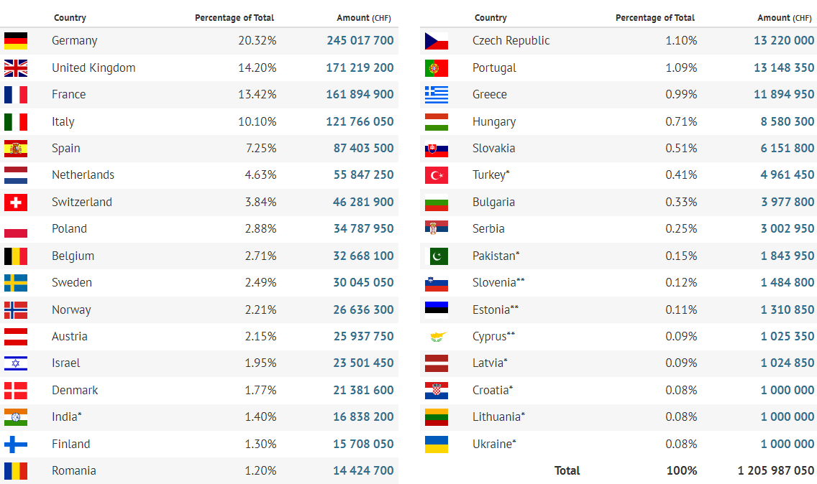
Yearly Budget (contributions 2022)

Slide 9

STATISTICS

Slide 10
Procurement Expenditure

Slide 11
Supplies (229MCHF spent in 2021 – CERN budget only)

Slide 12
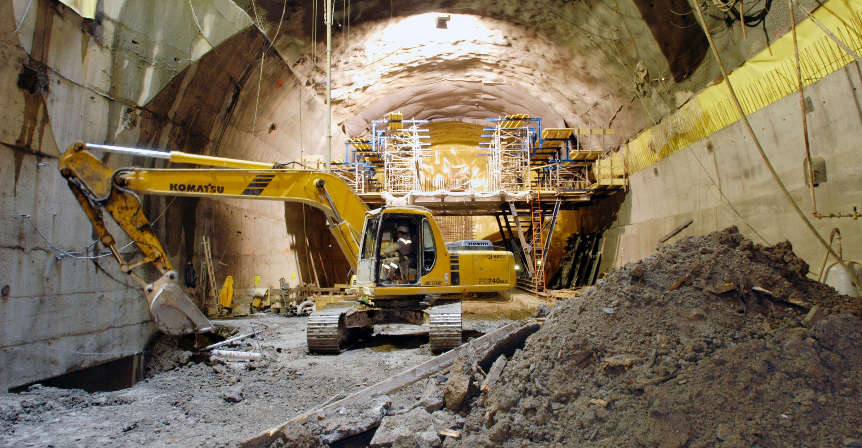
What do we buy?
Civil engineering:
  Construction
  Renovation of buildings
  Metallic structures
  Earthworks
  Roads
Cooling and ventilation
equipment

Slide 13
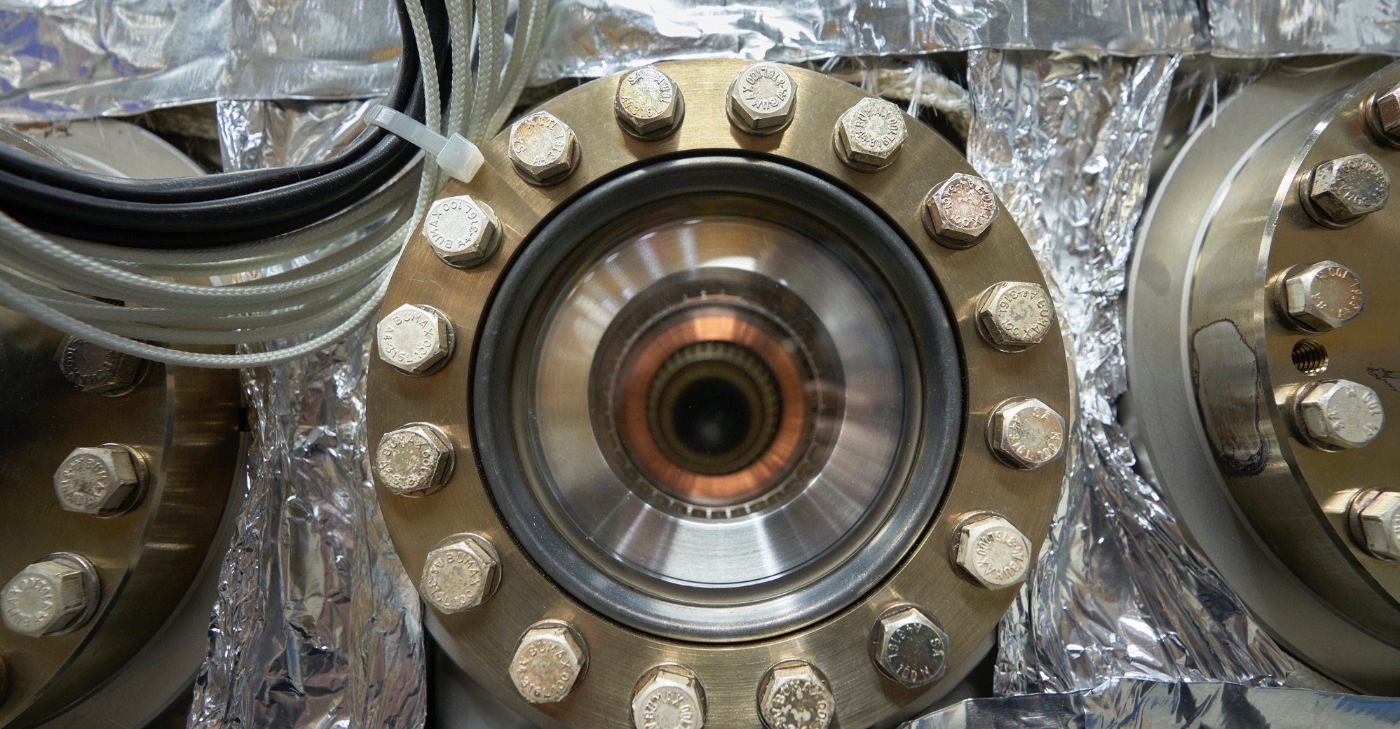
What do we buy?
Electrical engineering and magnets
  Transformers
  Switchboards and switchgear
  Cables
  Automation
  Power supplies
  Magnets

Slide 14
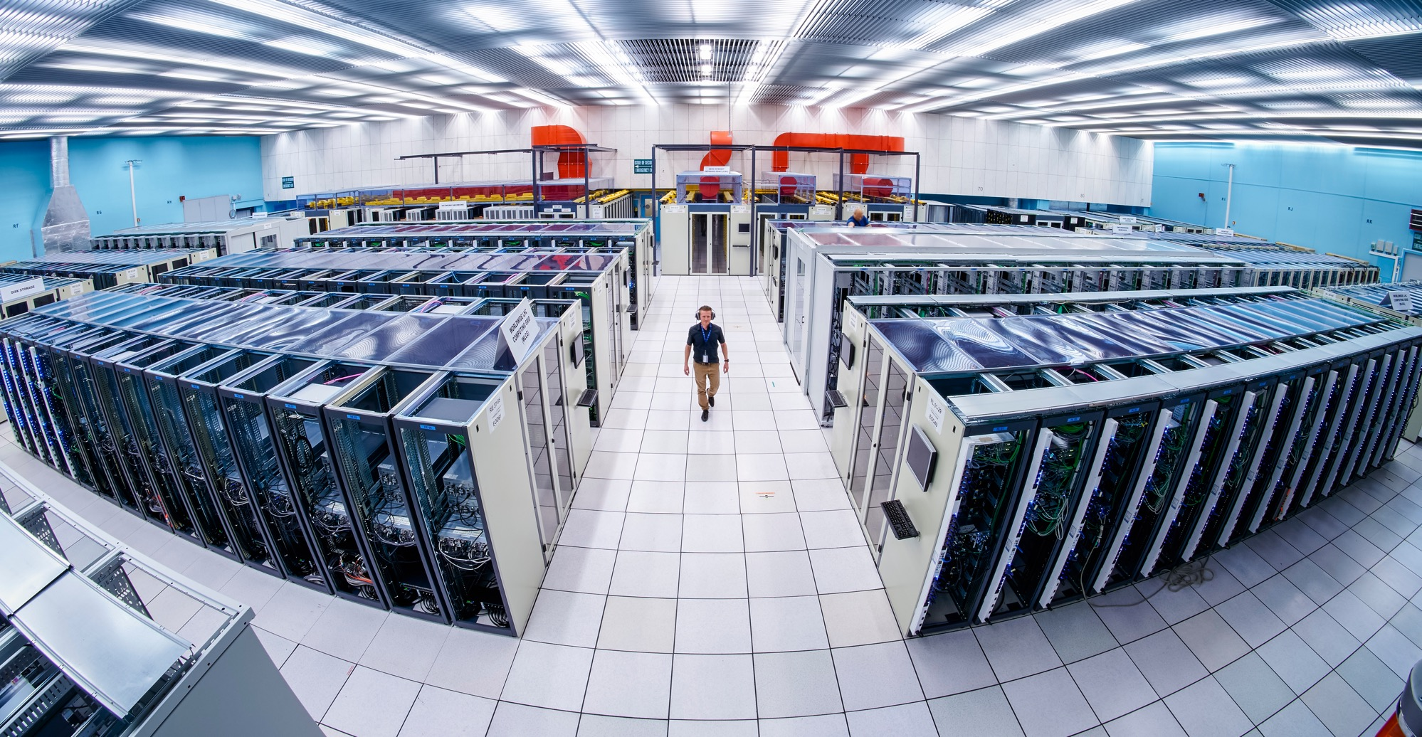
What do we buy:
Information Technology
  Computing systems
  Servers
  Software
  Network equipment
  Personal computer equipment

Slide 15
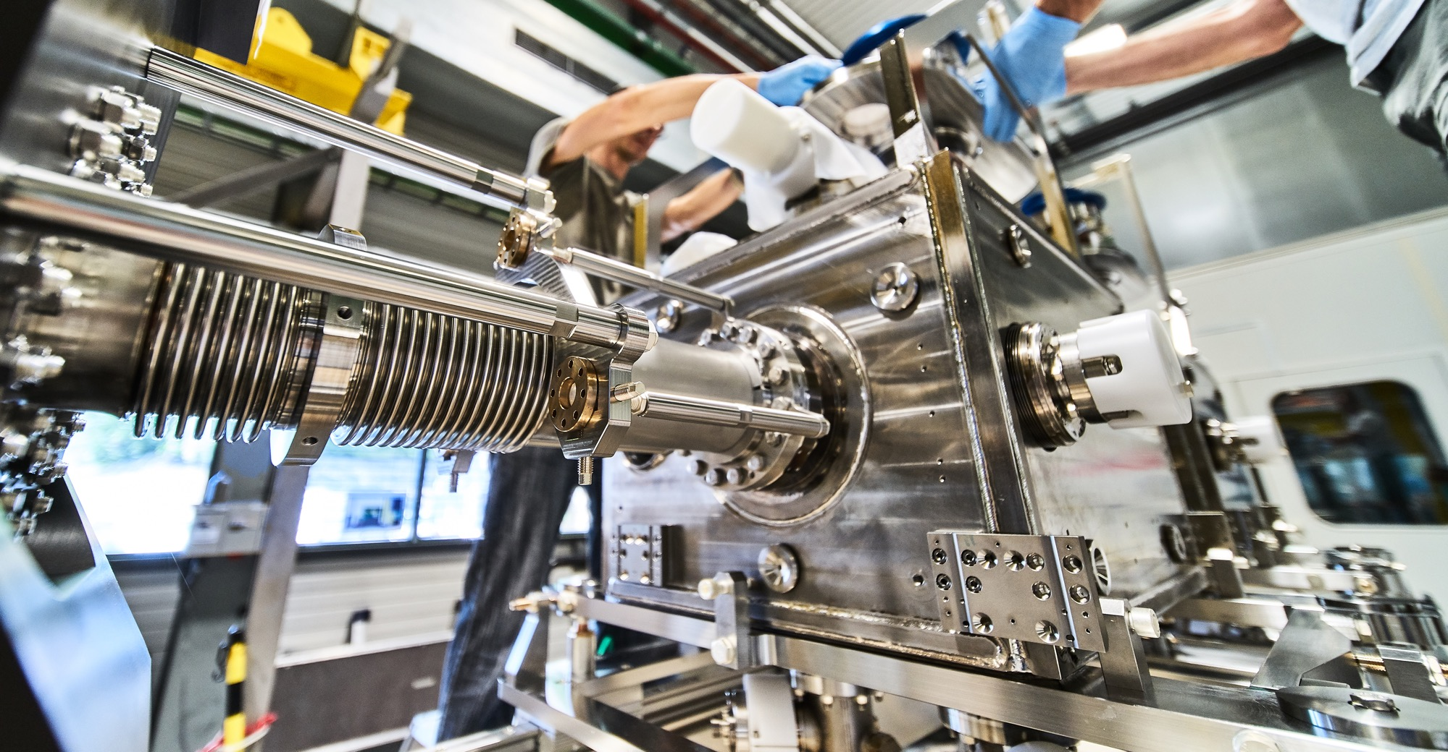
What do we buy?
Mechanical engineering and raw materials:
  Machining
  Sheet metal work and arc welding
  Special fabrication techniques
  Raw materials, finished and semi-finished products (plates, pipes, etc.)
  Offsite engineering and testing

Slide 16
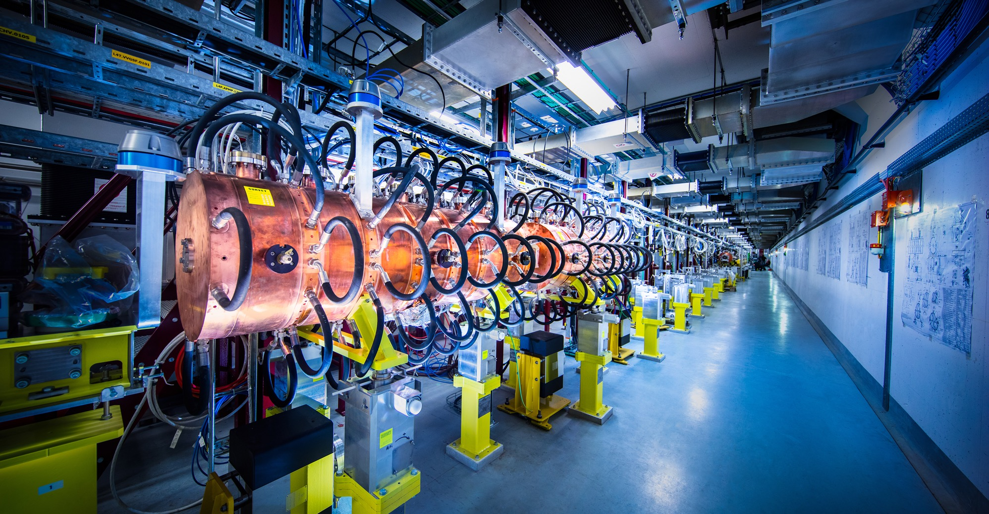
What do we buy?
Electronics and radiofrequency:
  Electronic components (active, passive)
  PCBs and assembled boards
  LV and HV power supplies
  Radiofrequency plants
  Amplifiers

Slide 17
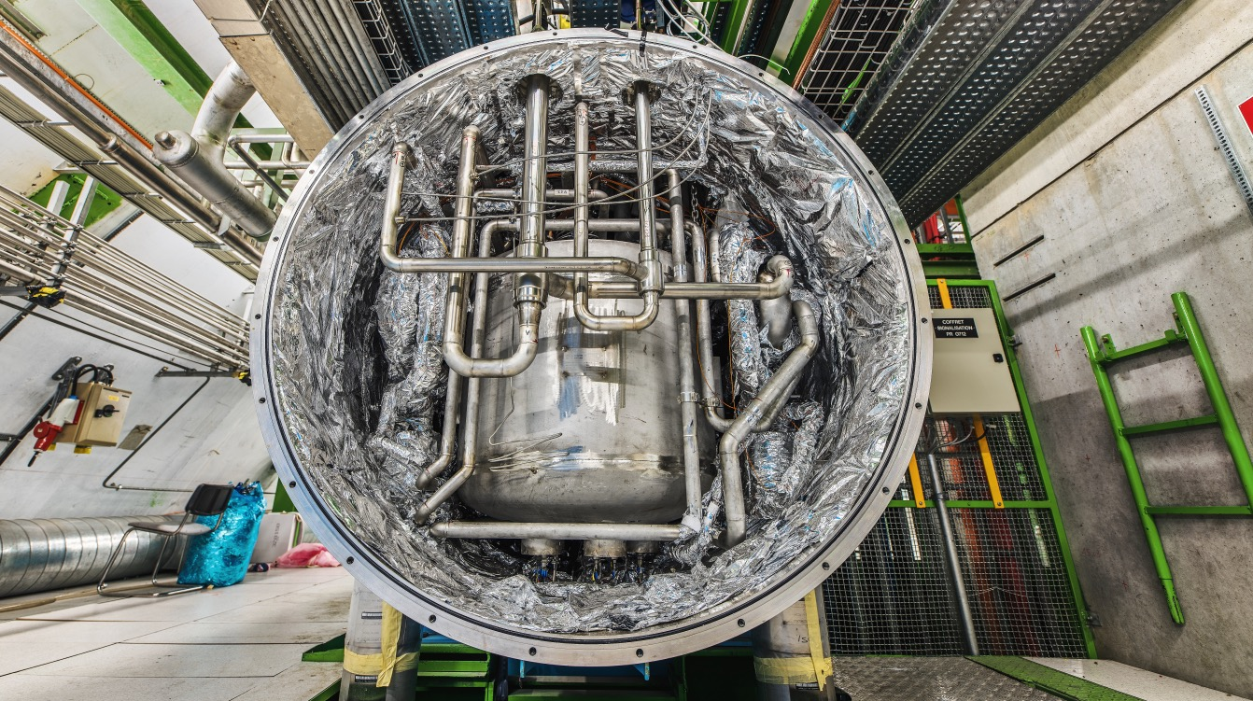
What do we buy?
As well as:
  Cryogenic and vacuum equipment
  Optics and photonics
  Particle and photon detectors
  Health and safety equipment,
  Transport and handling equipment
  Office supply, furniture
  Industrial services on the CERN site

Slide 18
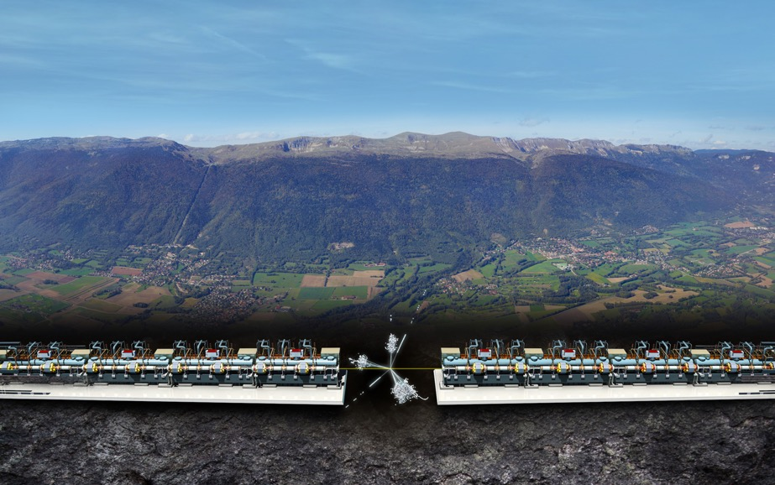
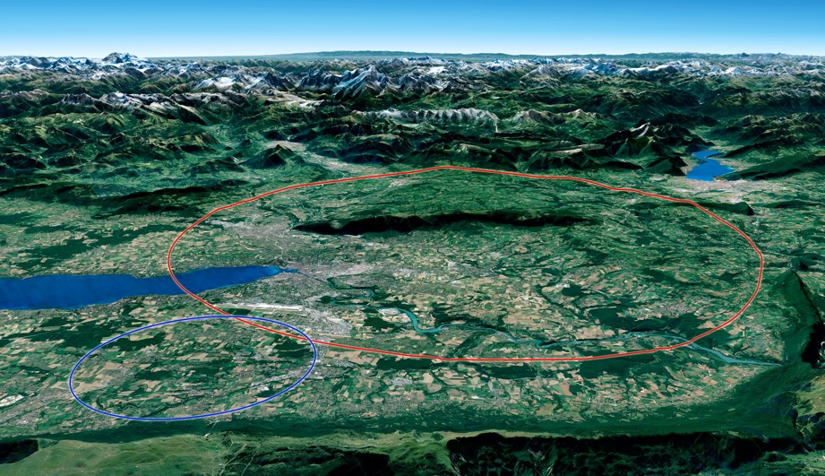

Two biggest projects for future of particle physics
Future Circular Collider (FCC)
New technology magnets 100 TeV pp collisions in 100km ring
e⁺e⁻ collider (FCC-ee) as 1st step?
FCC
Compact Linear Collider (CLIC)
Linear e⁺e⁻ collider √s up to 3 TeV
LHC

Slide 19
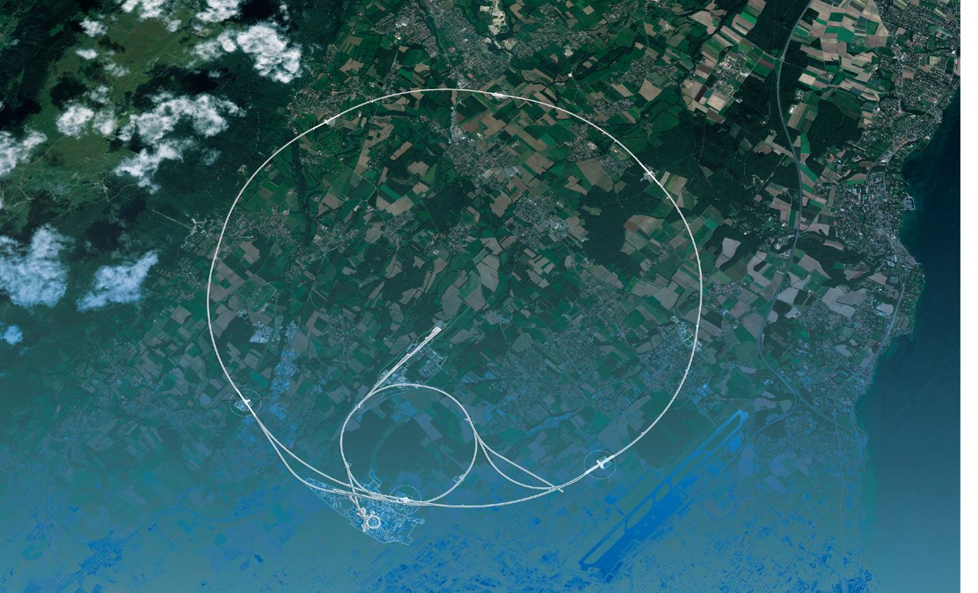
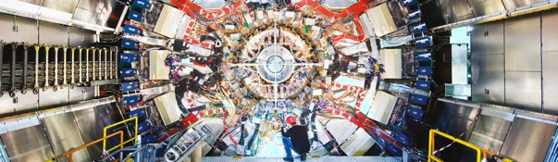
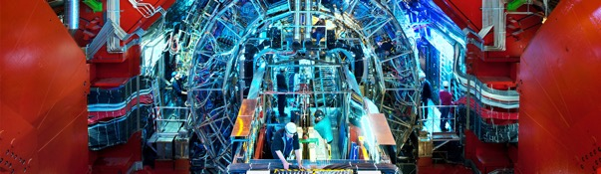
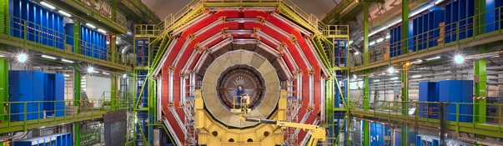
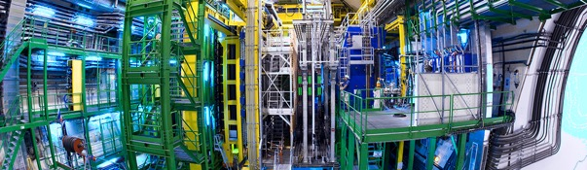
We also buy for the LHC experiments
CMS
ALICE
ATLAS
LHCb

Slide 20

How do we buy?
  Off-the shelf or non-standard products which can be produced with existing manufacturing techniques or technologies:
  Functional specification
  Non-standard products where industry has neither the required know-how nor the interest to develop and design the products:
  Build-to-Print specification
Prototypes and or Pre-series might be required.

Slide 21


PROCUREMENT @CERN
the rules

Slide 22
The Procurement Service
Mission
The Procurement Service (PS) procures all supplies and services for CERN
Meeting the specified and contractual technical, delivery
and performance requirements
At the lowest possible overall cost
While achieving balanced industrial return for CERN Member States
Respecting CERN
Procurement Rules

Slide 23
Principles of the Procurement Rules (1/4)
1
Transparency and Impartiality
2
Tenders open to Member States only
3
Objectivity and equal treatment: tendering packages are objective and impartial

Slide 24
Principles of the Procurement Rules (2/4)
Selective tendering procedures: CERN’s tendering procedures are not open to any interested firms
Confidentiality: Opening and evaluation of bids as well as negotiations are not public

Slide 25
Principles of the Procurement Rules (3/4)
Award for supplies (and services, exceptionally) based on:
Lowest compliant bid
Technical
Financial
2
Delivery

Slide 26

Enquiries between 10’000 and 200’000 CHF
“Price enquiry” (Demande d’Offre - DO)
Submission deadline: 4 weeks from date of dispatch;
All price enquiries above 50’000 CHF are also sent to the
Industrial Liaison Officers (ILOs) for information;
Price enquiries consist of:
  Technical specification and annexes;
  Tender form (and a technical annex - optional);
  CERN’s General Conditions (contracts, invitations to tender, safety, etc.)

Slide 27

Enquiries exceeding 200’000 CHF (1/2)
“Market Survey” (MS)
Prior announcement in CERN’s procurement website, see
“Business Opportunities”
  At this stage, interested firms are encouraged to contact CERN in
  order to have a clear understanding of the requirement, allowing
  them to begin their organization ahead of the tendering process.
Market surveys consist of:
  “Technical Description” and;
  “Qualification Questionnaire” (financial and technical).
Submission deadline: 4 weeks, or more if the MS is still online.

Slide 28
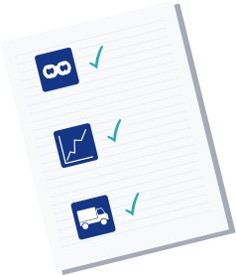
Enquiries exceeding 200’000 CHF (2/2)
“Invitation to tender” (IT)
Sent to qualified and selected firms only;
Submission deadline: 4 weeks from date of dispatch (with a longer period for more complex requirements);
Firms shall ask all necessary questions in writing to understand all requirements and prepare a bid that best matches CERN’s needs;
All invitations to tender are sent to the Industrial Liaison Officers (ILOs) for information;
Bids shall be submitted via CERN’s e-tendering application.
Notes:
Invitations to tender consist of:
Technical specification and annexes;
Tender form (and a technical annex - optional);
General Conditions of CERN (contracts, invitations to tender, Safety, etc.)

Slide 29
Country of origin
SUPPLIES
“Country(ies) where the supplies (including their components and sub-assemblies) are manufactured or undergo the last major transformation by the contractor or its sub-contractor”
If at least 60% of the total amount of the bid comes from a poorly balanced MS, then the whole bid will be treated as that from a bidder in a poorly balanced MS.
SERVICES
“Country(ies) in which the bidder is established.”
If at least 40% of the total amount of the bid comes from a poorly balanced MS, then the whole bid will be treated as that from a bidder in a poorly balanced MS.

Slide 30
Alignment rule
Applicable for:
1
Contracts awarded on the lowest
compliant basis (mainly supply contracts)
2
With a total amount exceeding
100’000 CHF.
Under certain conditions as defined in CERN Procurement Rules, a bidder offering goods originating* in poorly balanced Member States is allowed to align his price to that of the
lowest bidder and thereby be awarded the contract.
RULE
* At least 60% for supply contracts or; at least 40% for service contracts awarded on the lowest compliant basis.

Slide 31

Industrial return coefficient
Industrial return
coefficient
Over a 4-year period:
Very poorly balanced : < 0.40
Poorly balanced (PB) : 0.40 ≥ x < 1
Well balanced (WB): ≥ 1
For Supply contracts and for a
12-month period starting on
1st March, defined as:
“The ratio between a Member State's percentage share of the value of all Supply contracts and that Member State's percentage contribution to the CERN Budget over the same period”.
Status definition
% expenditure in the MS
Return Coef.=
% contribution to CERN budget for this MS

Slide 32
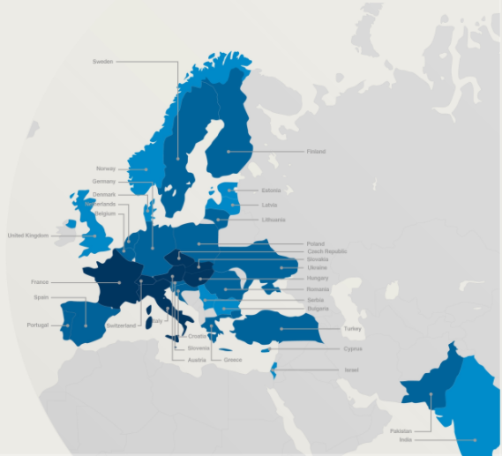

Poorly balanced Member States (Supplies)
(1st March 2022 – 28 February 2023, based on the previous 4 calendar years):
Well Balanced | Poorly Balanced | Very Poorly Balanced
Austria Czech Republic France Hungary Italy Slovakia Switzerland | Belgium Croatia* Cyprus* Finland Germany Greece Lithuania* Netherlands Pakistan* Poland Portugal Romania Slovenia* Spain Sweden Turkey* Ukraine* | Bulgaria Denmark Estonia* India* Israel Latvia* Norway Serbia United Kingdom
*Associate Member States

Slide 33
Limited tendering
« Limited tendering is foreseen by the CERN Procurement Rules to improve the industrial return of very poorly balanced Member States. »
Conditions
Firms established in very poorly balanced Member States only (industrial return <0.4);
ILO can ask to add firms, provided they are established in very poorly Member States.
Used in case where there is sufficient competition;

Slide 34

Impact of
Doing business with CERN

Slide 35
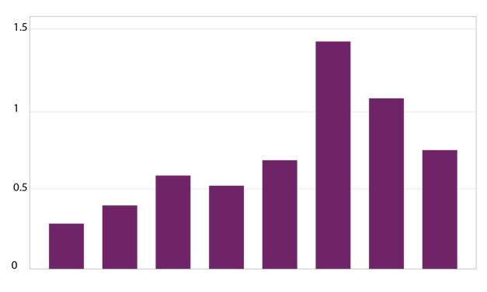
The economical impact of CERN Procurement on supplier’s performance (Castelnovo et al, 2018)
Empirical studies (by the analysis of financial data from 1995 to 2008 from 365 CERN suppliers for the LHC) show that after working with CERN on high-tech contracts, CERN suppliers
out-perform their peers by:
Investing more in R&D and filing more patents
Higher productivity, revenue and profitability
Order/contract received from CERN
Increase in R&D
Innovation
Productivity growth
increase revenues & profitability
Patents per firm
More than
2 years before
2-1 years before
Date of order
1,2 years later
3,4 years later
5,6 years later
7,8 years later
More than
8 years later
Notes:
Average number of patents filed before and after the beginning of the procurement relationship with CERN
The X-axis shows the «relative years», that are the difference between a given year and the year the first order is received. Therefore, CERN(0) is, for each company, the year of beginning of the procurement relationship.

Slide 36
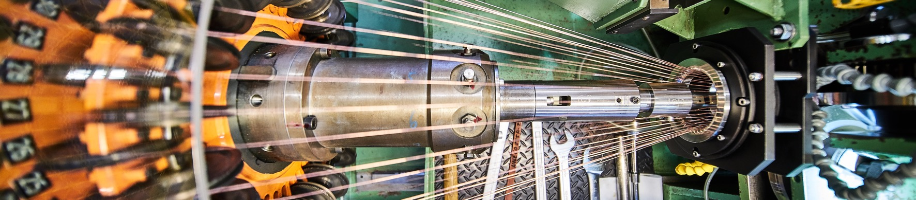
Doing business with CERN: the facts
Supplier survey (669 suppliers in 33 countries, 2017):
48%
improved products and services
42%
developed new products
55%
improved technical knowledge
in their field
18%
found or opened a new market to address
62%
used CERN as a marketing reference
Most firms experienced
no financial loss.
Notes:
The key message here is that CERN is an open institution: open to its neighbours, and open to citizens from across the globe. We welcome them to CERN and go out to meet them
This slides summarises the outreach activities carried out by CERN.
It also includes a mention of CERN’s fundraising activities, for projects that are not part of CERN’s core activity. These fall into three categories: education & outreach, culture and creativity, innovation and knowledge exchange

Slide 37
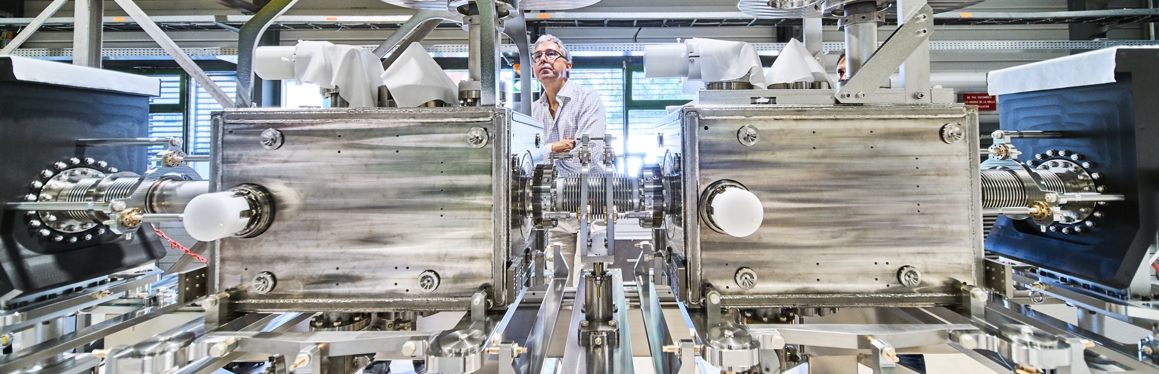
Doing business with CERN: the facts
Using CERN as a marketing reference improve
the reputation as suppliers

Slide 38

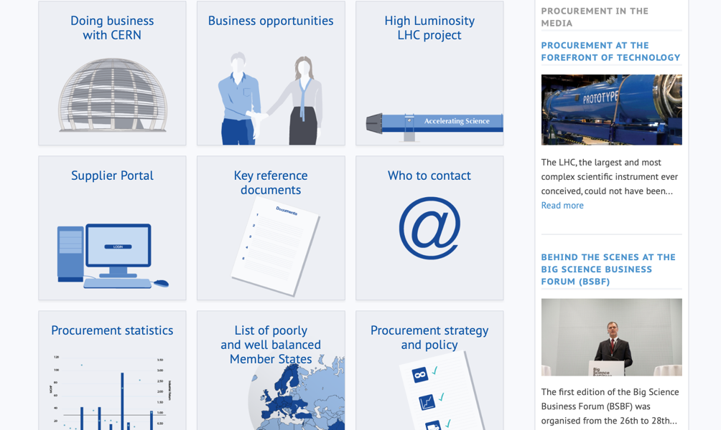
Procurement
website

Slide 39
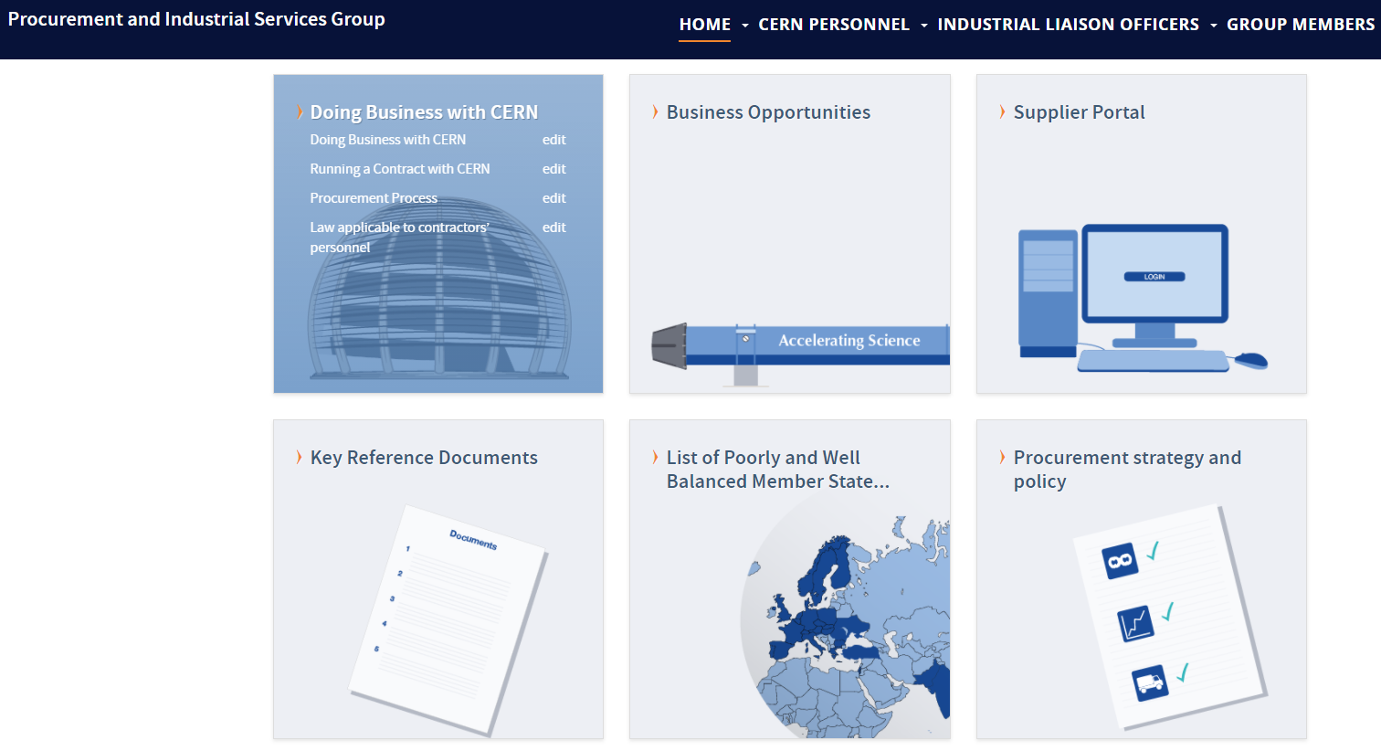
Website of the Procurement Service
http://procurement.web.cern.ch

Slide 40
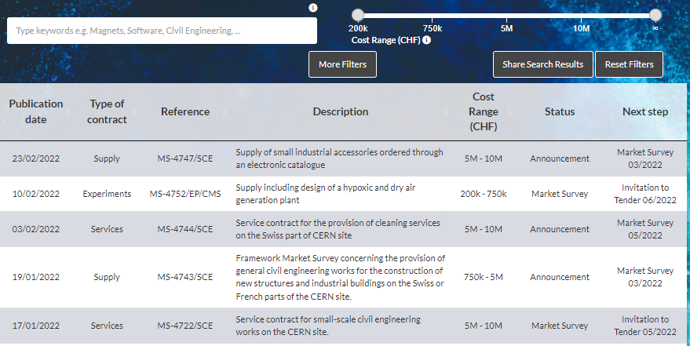
CERN Shopping List
https://forthcoming-ms.app.cern.ch/#!/

Slide 41
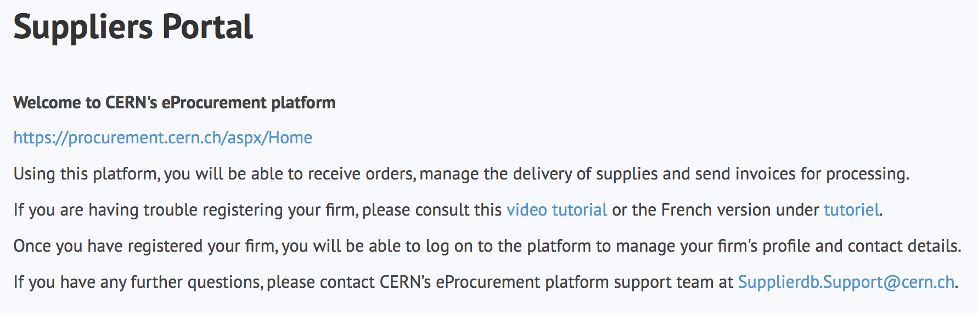
Register in the Suppliers Portal
for all exchanges with CERN, in particular to:
Be visible for future opportunities
(with the procurement codes you have indicated),
Receive and follow-up orders,
Send invoices.
MANDATORY

Slide 42
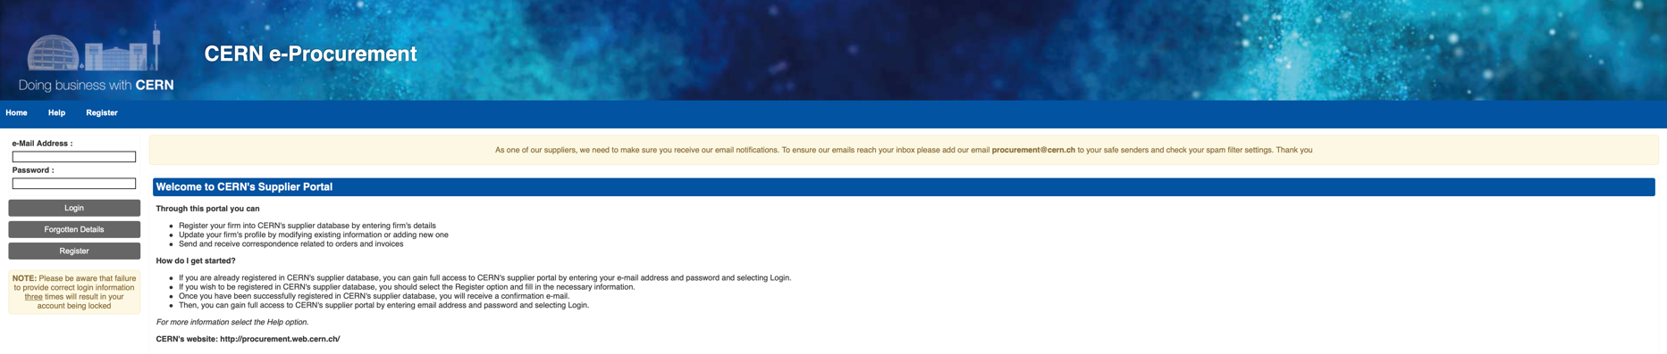
CERN e-Procurement
To ensure our emails reach your inbox please add our email procurement@cern.ch to your safe senders and check your spam filter settings.

Slide 43

Contacts at CERN (Procurement and Technical)
https://procurement.web.cern.ch/contact/who-contact-your-country

Slide 44

B2B Meetings
CERN meets Firms (by invitation of CERN only)
    Short presentation of company, 15 min
    Virtual visit (for example using a cell phone and walk through the factory, if acceptable by company), 15 min
    Discussion of possible collaboration, 15 min
Firm meets Firm (by initiative of firms)

Slide 45
Connection to B2B Meetings
Make sure you are using Chrome, Edge or Firefox
Login to B2Match https://electrical-cabinets-switchboards-power-converters.cern.b2match.io/
Go to «Meetings»
Click on the «Green Button» below the related meeting
Allow Access to your Camera + to Audio
For more information
-> Please refer to «How it Works» § 4a + §5 https://electrical-cabinets-switchboards-power-converters.cern.b2match.io/how-it-works
  §4a You want a colleague to join your meeting
  §5 Technical Requirements, Solutions for the Virtual Meetings and Other Solutions
  (Camera-Micro Issues, Sharing a Video,..)
Or contact Daniel:
  79588 (from CERN)
  +41 22 767 9588

Slide 46
Thank you

