Slide 1
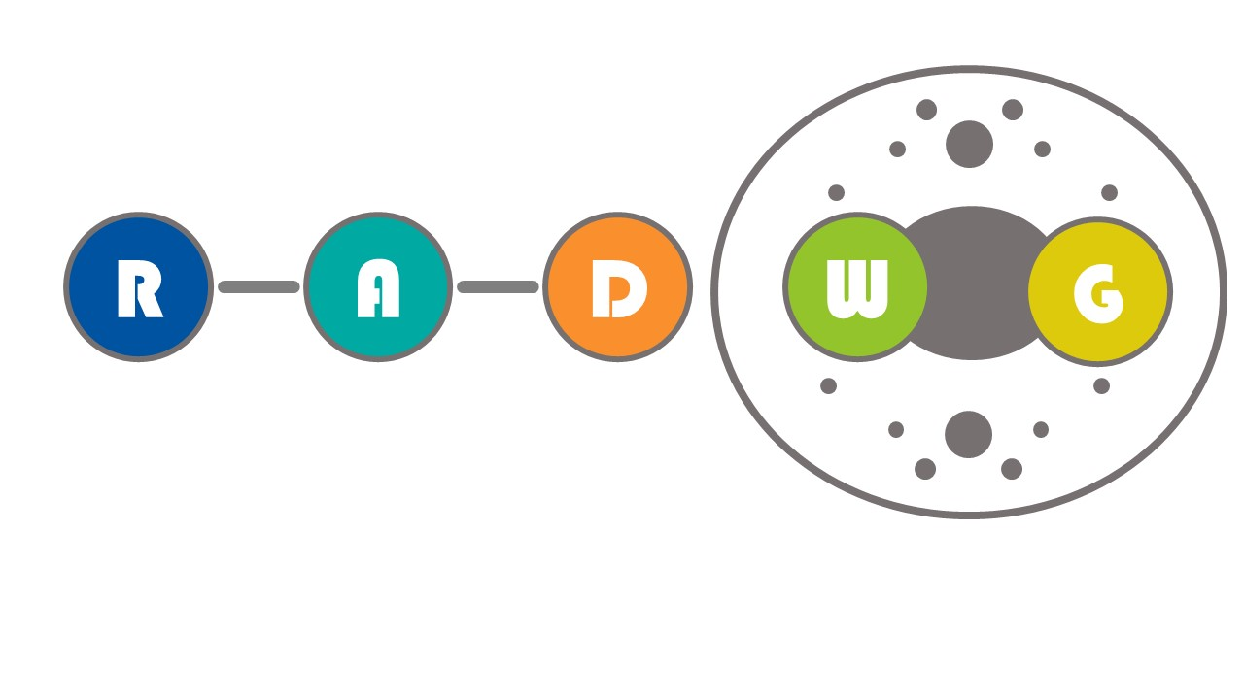
RADWG Meeting September 2022
Salvatore Danzeca BE-CEM-EPR
Manoel Barros Marin SY-BI-BP
on behalf of the RADWG

Slide 2
AGENDA
Introduction
Activities Overview by Rudy Ferraro
R2E-HL-LHC (60-120)A-10V power converter (SY-EPC-LPC) by Jérémie Clar
Energy Extraction Systems 13 kA & 600 A (TE-MPE-MP) by Bozhidar Ivanov Panev
LHC Beam Loss Monitoring Powering subsystem (SY-BI-BL) by William Vigano'

Slide 3
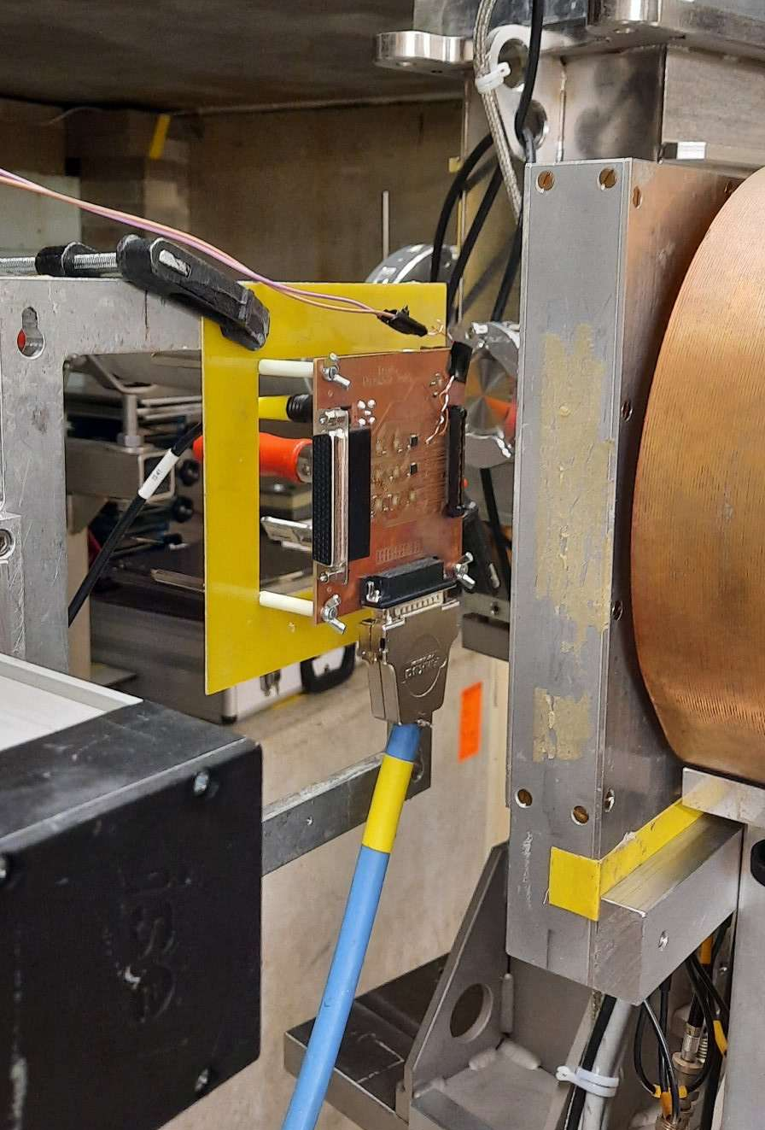
PSI Radiation test campaigns
PSI Facility Updates
  See next presentation from Rudy Ferraro
  5 Radiation test campaigns carried out
  Two slots left: October and November
  Submit the requests for:
    New devices to be tested
    Lot qualification

Slide 4

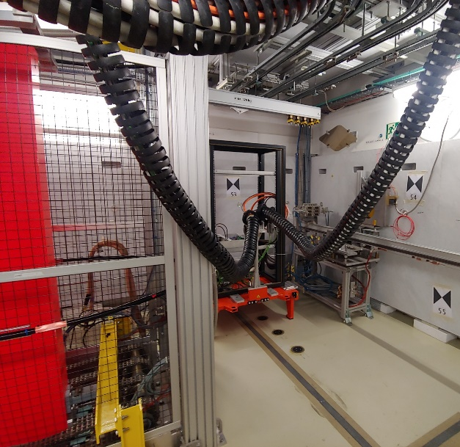
CHARM 2022
  1 slot = 1 Week
  9 slots remaining
    Rack slots:
      4 Slots in R13: DI/OT Testing
      1 Slot RADNEXT Project
  Overhead: 2 Slots available
  Still partial availability
  Requests to be done through the website :charm.web.cern.ch

Slide 5

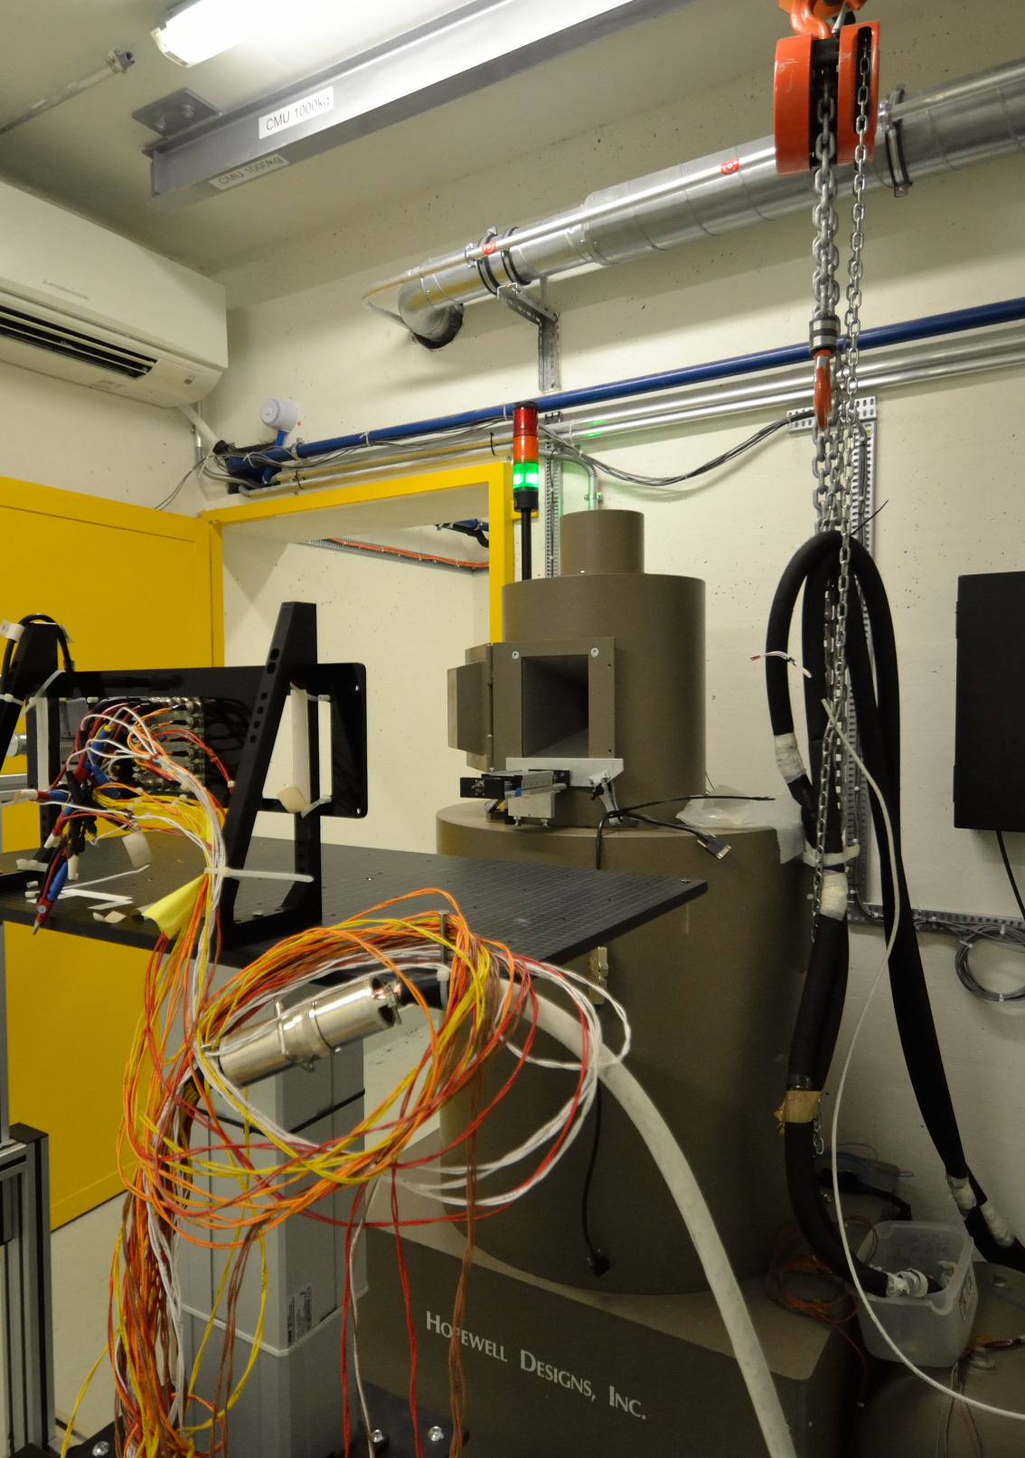
⁶⁰Co facility @ CERN
The CC60 facility is currently facing a major maintenance and all the tests are stopped
The maintainace should be finished for the beginning of next week
Users planning will be done once the facility is re-comissioned

Slide 6
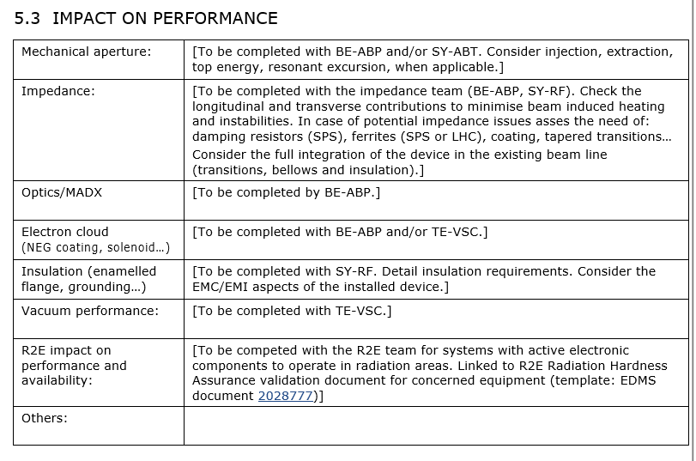
ECR Template

Slide 7
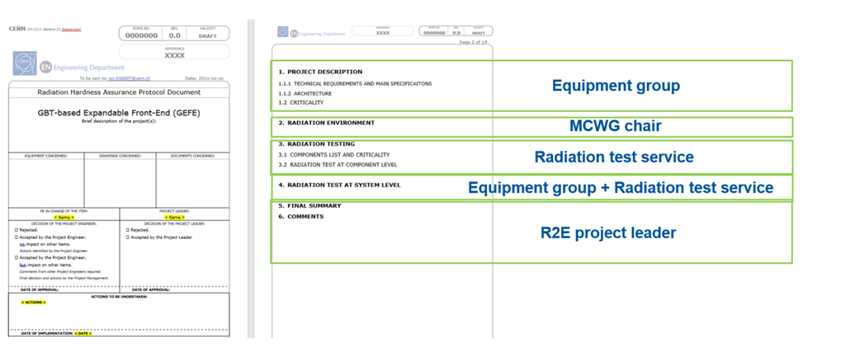
RHA Project Validation (RHAPV) details
Testing of electronic components by R. Ferraro (BE-CEM-EPR )

Slide 8
CTTB and CTSB request to the RADWG
Goal: Review the current situation regarding the use of low power supplies under radiation within the ATS with the objective to identify standardization opportunities
Scope:
  All types of low-voltage supplies under radiation
    Linear/switched, AC/DC, and DC/DC , Homemade/COTS
Deliverables:
  Inventory
  Performance required by the users
  RoadMap towards standard power supplies

Slide 9
Survey
We are going to send to the RADWG members a survey to be filled by the equipment responsible
Very simple survey
  22 questions
It should be filled per each project
We are going to provide:
  Inventory
  Parameters
If you have any suggestions do not hesitate

Slide 10
THANK YOU

