Slide 1
RADWG Activities Overview
Rudy Ferraro (BE-CEM-EPR)
RadWG Workshop – 14 September, 2022

Slide 2
Radiation Test Service
BE-CEM-EPR provides, through R2E resources, the service of radiation testing of electronic components supporting the Radiation Working Group (RadWG)
The RadWG supports the accelerator sector equipment groups for the assessment of radiation tolerance of electronic equipment to be installed in radiation exposed areas.
It is as a forum for electronic engineers to discuss
  design practices
  radiation tests
  radiation induced failures in the accelerators.
The RadWG is one of the pillars of the R2E project
RADWG Activities Overview by R. Ferraro (BE-CEM-EPR )

Slide 3
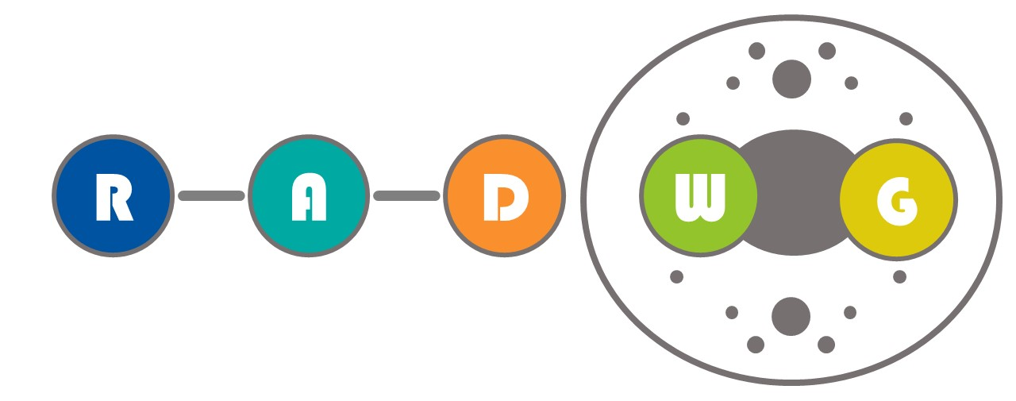

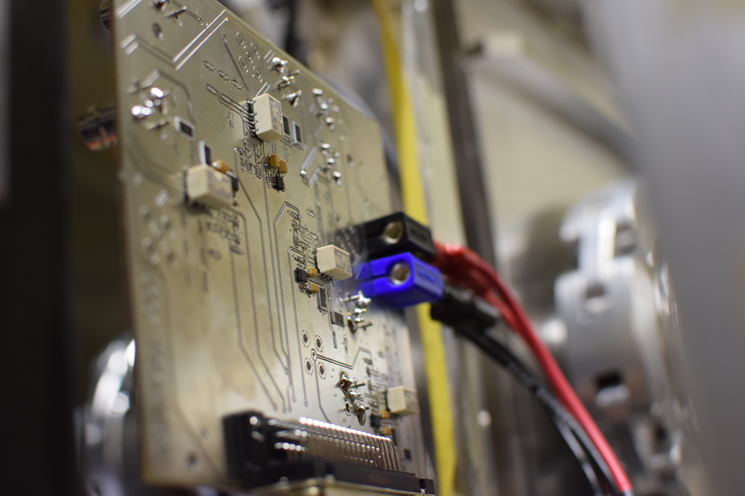
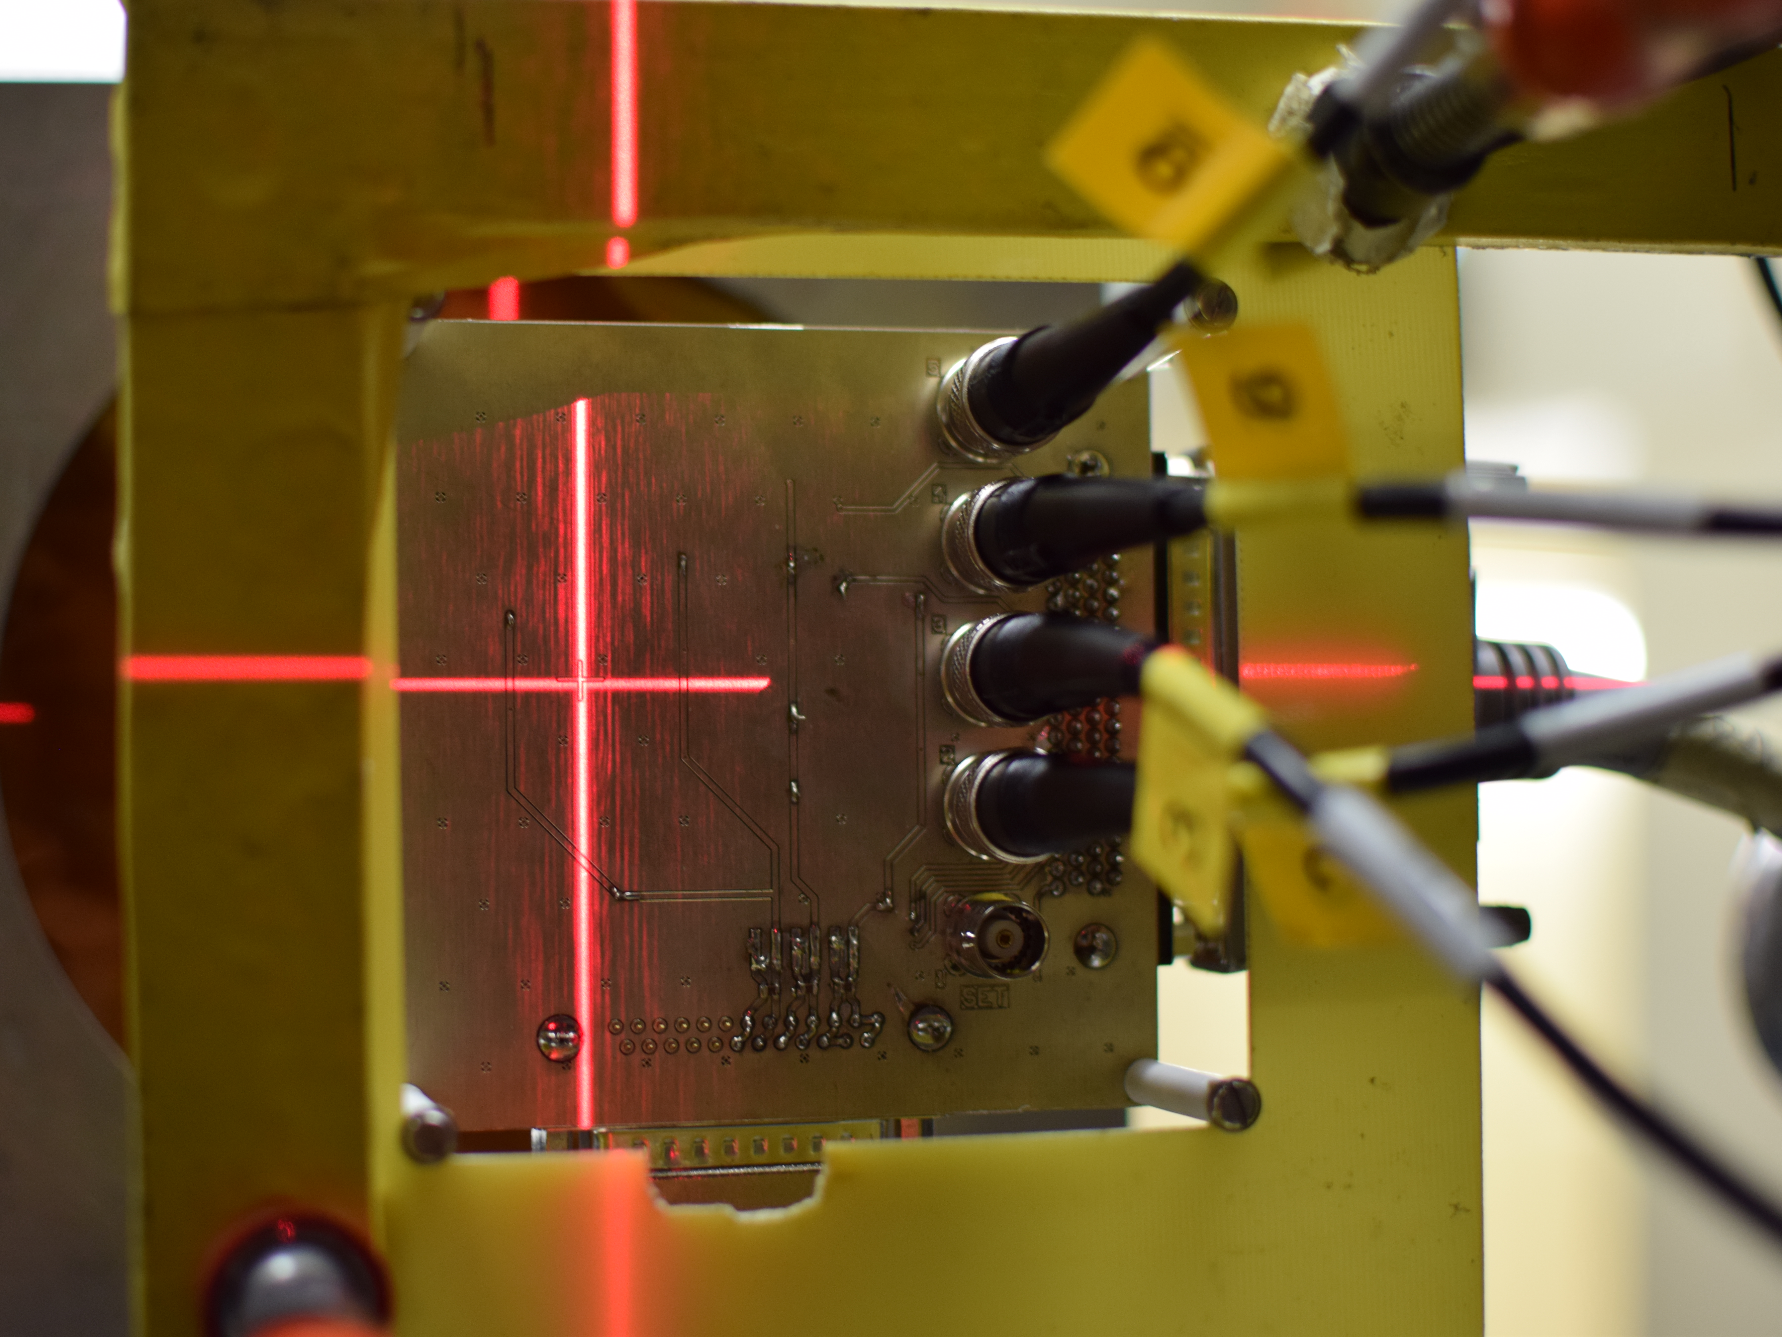
Radiation test service – BE-CEM-EPR
Request collection
The requests for radiation testing are collected and processed selecting the most suitable methodology and facilities
Database and Publication
The results are collected, stored and in EDMS and published in the RADWG database to allow an easy research of the best candidates for the new radiation tolerant designs
01
Test planning and structure
06
02
Each component/system is analyzed, and all the possible radiation effects are taken into account for planning the test and structure it
Result analysis
The results are analyzed during and after the tests for each component considering the end application and the possible operational issues
Board and instrumentation preparation
05
03
For each component a dedicated set of test board is prepared and the associated instrumentation is chosen to face the complexity of the radiation test
04
Testing
The test are carried out at CERN facilities such as CHARM or Co60 and in external facilities. The transport, personnel and instrumentation are selected considering the peculiar aspect of each facility
RADWG Activities Overview by R. Ferraro (BE-CEM-EPR )

Slide 4
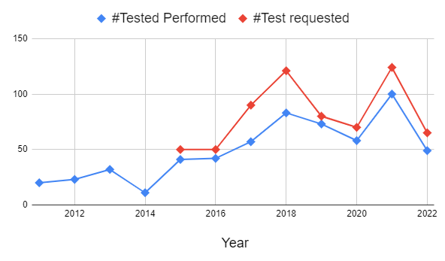
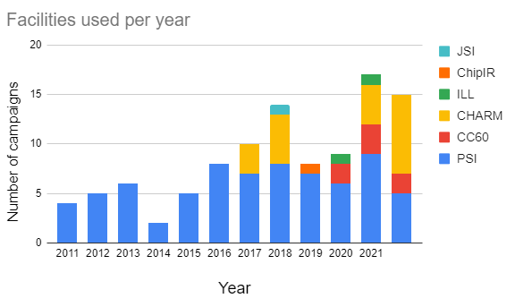
2022 in Numbers: Annual
65 test requests collected
49 components & Systems tested
  New components but also a lot of system consolidation
15 Radiation campaigns done (5*PSI, 8*CHARM, 2*CC60)
Other two planned at PSI and several at CHARM
RADWG Activities Overview by R. Ferraro (BE-CEM-EPR )

Slide 5
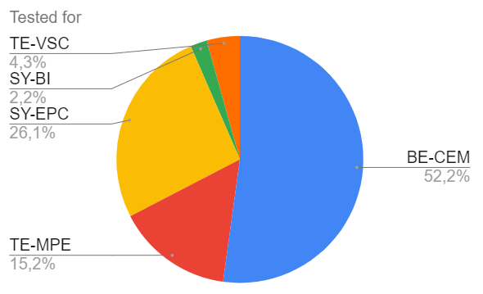
2022 in Numbers: User distribution
  Vacuum systems
  LHC BPM
  DIOT
  WorldFIP CuCu
  RaToPUS
  BatMON
  SpaceRadMON
  R2E-HL-LHC(60;120)A
  QDS
  LHC EE systems’ 600ADC
  CIBU
CIBU & WorldFIP fully qualified this year
RADWG Activities Overview by R. Ferraro (BE-CEM-EPR )

Slide 6
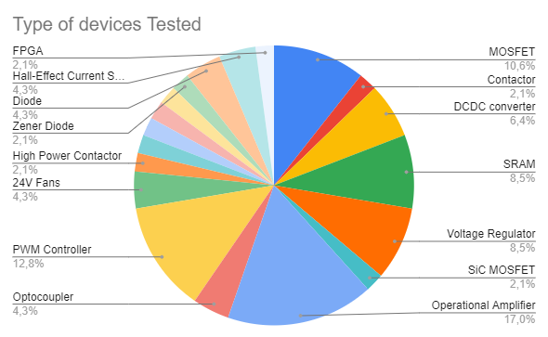




2022 in Numbers: DUT distribution
We tested from the simplest component (BJT) to the most complex ones (FPGAs) and even complete systems.
PWM
Opamps
Regulators
Most Tested Devices
RADWG Activities Overview by R. Ferraro (BE-CEM-EPR )
Notes:
Link to the radWG database

Slide 7
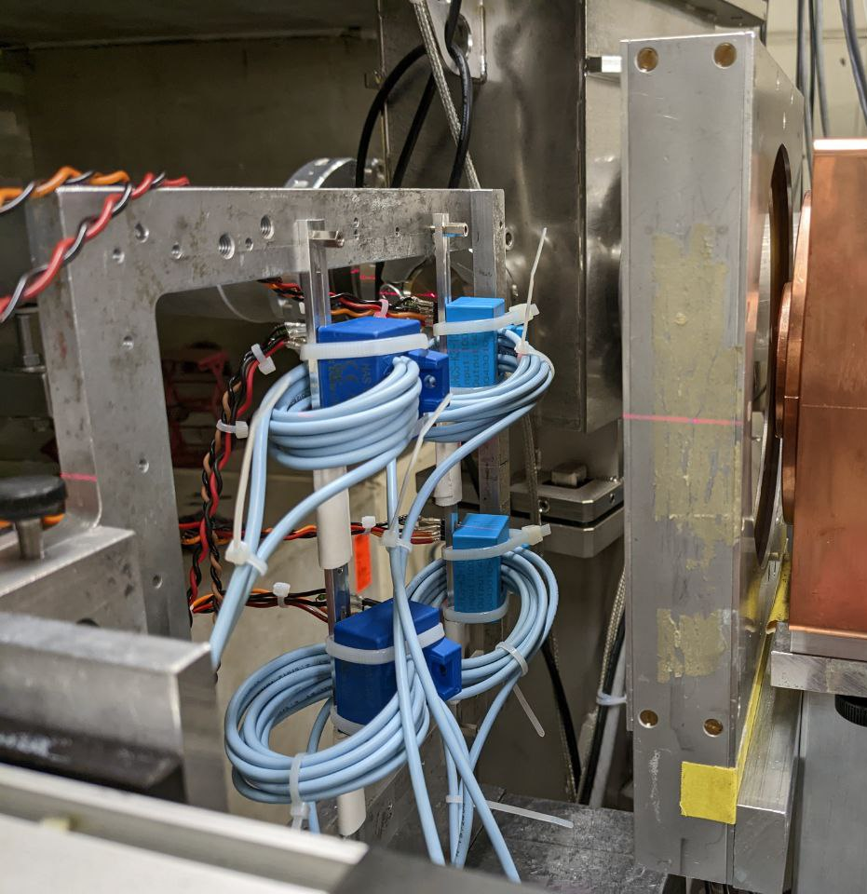
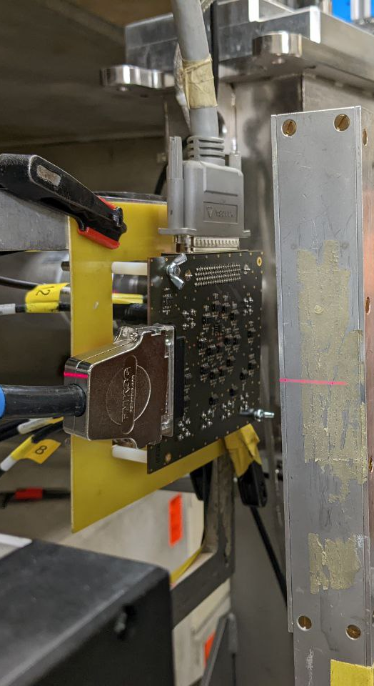
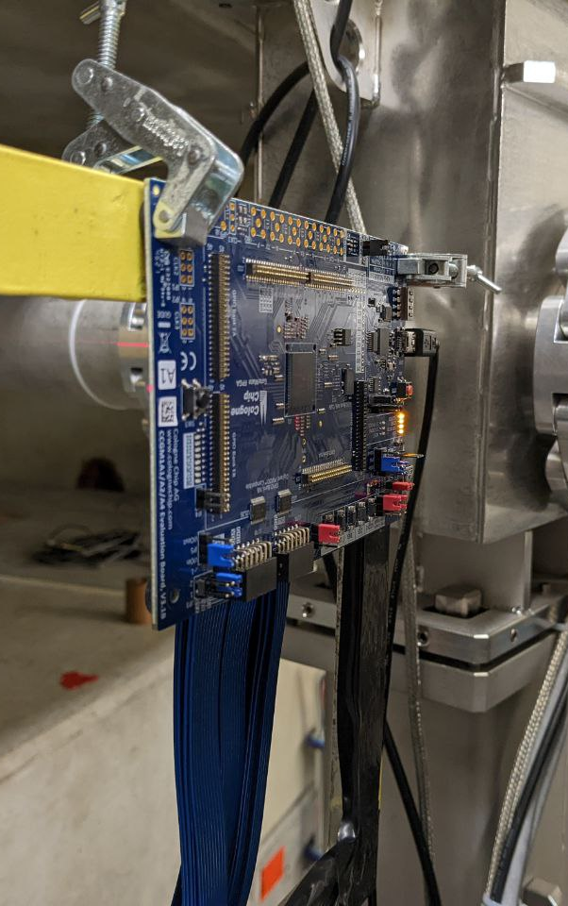
2022 in pictures: PSI
Current Sensor
Opamp
FPGAs
RADWG Activities Overview by R. Ferraro (BE-CEM-EPR )

Slide 8
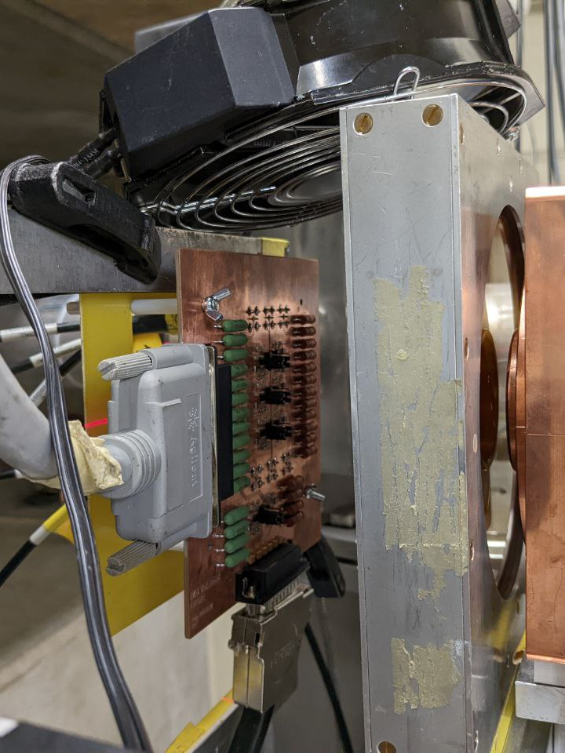
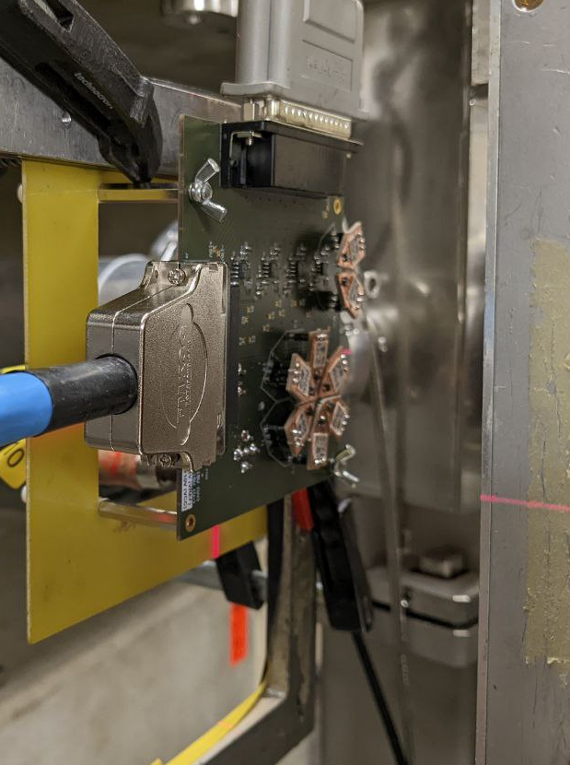
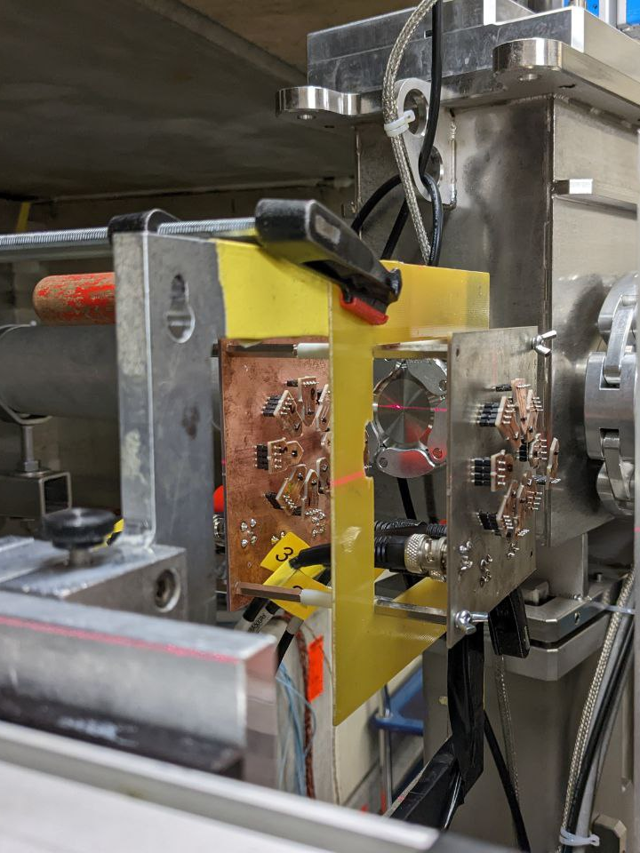
2022 in pictures: PSI
Voltage Regulator
BJTs
Diodes
RADWG Activities Overview by R. Ferraro (BE-CEM-EPR )

Slide 9
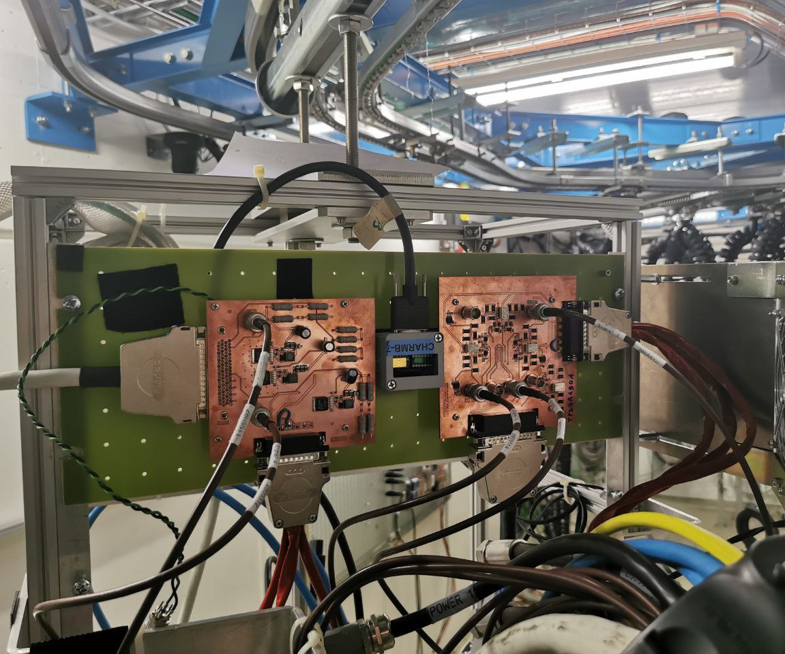
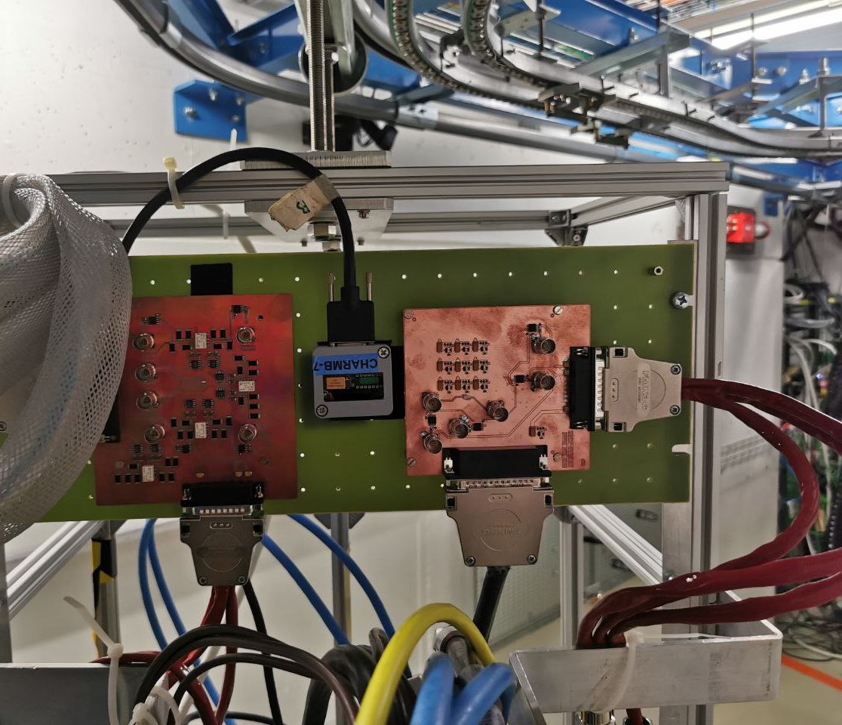
2022 in pictures: CHARM
Voltage Regulators
Voltage Regulators
RADWG Activities Overview by R. Ferraro (BE-CEM-EPR )

Slide 10
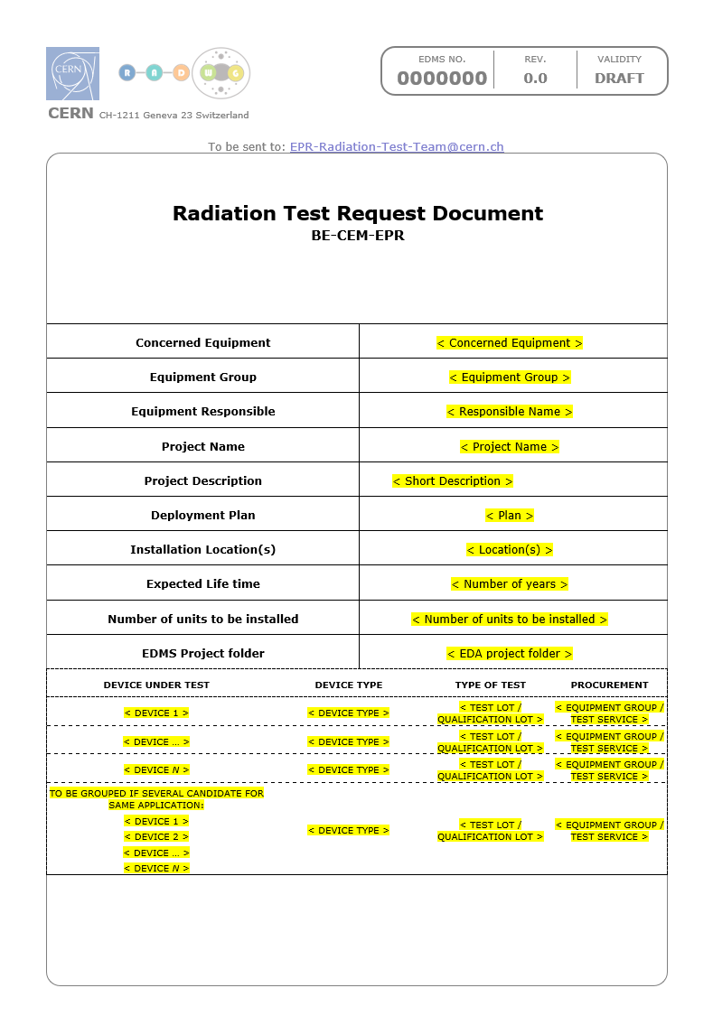
New Test Request Template:
New Test Request document: EDMS 2779784
Contains:
  Information about equipment:
    Locations, Deployment plan, lifetime, number of units in operation
  Information about radiation levels in operation: TID, DDEF, HeH, ThN
  Information about DUTs:
    Use in the system (schematic)
    Parameters of interest
    Radiation Design requirements
    Maximum tolerated failure rate (SEEs)
Will help us to track better the request and also to prepare better the tests
To be sent to: EPR-Radiation-Test-Team@cern.ch
RADWG Activities Overview by R. Ferraro (BE-CEM-EPR )

Slide 11
SEE Failure estimation in LHC areas
SEE Failure Estimation in LHC areas Table: EDMS 2779789
This document allows calculation the failure rate of a system in the different LHC areas based on the radiation response of all its components, the radiation levels in operation and the number of units
Can be used for SEL and SEE such as uC failure.
  The radiation response of each component of the system must be put in the “SEL Device cross-sections tab”:
Inputs from test reports
Calculates the lower and upper cross-section limit of the component
Calculates the total cross-section on system (considering the number of components in the system

Slide 12
SEE Failure estimation in LHC areas
SEE Failure Estimation in LHC areas Table: EDMS 2779789
This document allows calculation the failure rate of a system in the different LHC areas based on the radiation response of all its components, the radiation levels in operation and the number of units
Can be used for SEL and SEE such as uC failure.
  The radiation response of each component of the system must be put in the “SEL Device cross-sections tab” :
Works as well with 0 observed SELs:
With 0 events, only the upper limit is calculated
It is very important to list all the components even with 0 SELs observed to calculate the total system upper limit cross-section

Slide 13
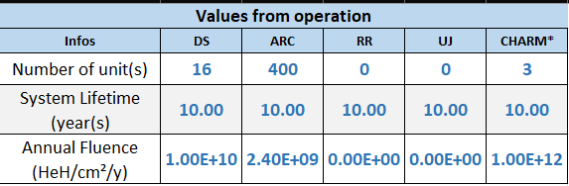
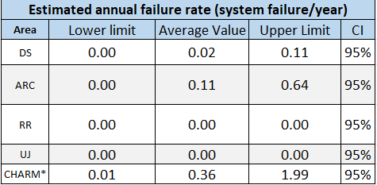
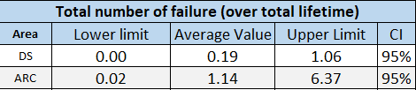
SEE Failure estimation in LHC areas
SEE Failure Estimation in LHC areas Table: EDMS 2779789
This document allows calculation the failure rate of a system in the different LHC areas based on the radiation response of all its components, the radiation levels in operation and the number of units
Can be used for SEL and SEE such as uC failure.
  The radiation response of each component of the system must be put in the “SEL Device cross-sections tab” :
  The number of units for each area and the corresponding radiation levels must be put in “SEL System Failure Estimation” tab:

Slide 14
SEE Failure estimation in LHC areas
SEE Failure Estimation in LHC areas Table: EDMS 2779789
This document allows calculation the failure rate of a system in the different LHC areas based on the radiation response of all its components, the radiation levels in operation and the number of units
Can be used for SEL and SEE such as uC failure.
  The radiation response of each component of the system must be put in the “SEL Device cross-sections tab” :
  The number of units for each area and the corresponding radiation levels must be put in “SEL System Failure Estimation” tab:
  Allows also calculating the failure rate in CHARM and compare it with the LHC areas:
Estimation for Vacuum system in CHARM for 3 systems tested for a week: between 0.02 and 2 failures
Observed failure during the test: 1

Slide 15
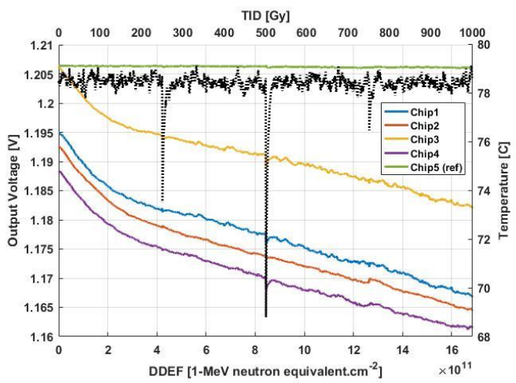
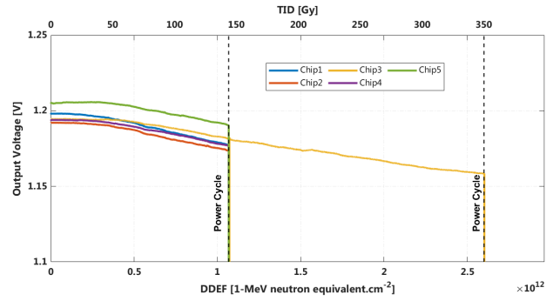
Voltage Regulator Qualification issue
Difference of behaviour between PSI and CHARM: Start-up circuit failure at CHARM
LT3083
DDEF reached at PSI
Power Cycle
Power Cycle
Power Cycle
Power Cycle
2044467
2734998
PSI
CHARM
Such differences where also observed with other bipolar components (like opamps) that was sometimes failing at a quarter of the dose/DDEF reached at PSI

Slide 16
Voltage Regulator Qualification issue
Difference of behaviour between PSI and CHARM: Start-up circuit failure at CHARM
LT3083
DDEF reached at PSI
Power Cycle
Power Cycle
Power Cycle
Power Cycle
2044467
2734998
PSI
CHARM
Integrated Bipolar Circuit must be validated in representative LHC DD/TID ratios: CHARM
Several explanations possible:
  Lot-to-Lot variations
  Enhanced Low Dose Rate Effect (ELDRS): On bipolar higher degradation can be observed at lower ionizing dose rate
  Combined TID-DD effects, bipolar ICs are affected by both TID & DD, the component response is a combination of the response of all its internal components to those effects. Different DD/TID ratio can lead to different component responses (see [1] and [2]). During this test the DD/TID ratio was 5 times higher than PSI

Slide 17
Qualified Voltage Regulator Devices
51 references tested at PSI, but only few qualified at CHARM.
Devices qualified in CERN representative environments (CHARM or neutron facilities):
Type | Ref. | Vin range [V] | Vout range [V] | Iout_{max} [A] | RMS noise (uV) | Dropout Voltage (mV) | comment
VLDO | LT3021 | 0.9 to 10 | Adj (0.9 to 9.5), Fixed | 0.5 | 300 | 120 | Up to 500 Gy at CHARM without issues (tested in fixed configuration)
Linear Regulator | LM317 | 4.25 - 40 | Adj(1.25 V to 37 V) | 1.5 | 45 | 3000 | Low degradation up to 6E12 neq.cm² with neutron Tested at CHARM at system level up to 800 Gy
 | μA7815* | 7 - 25 | Fixed 5,8,10,12,15,24 | 1.5 | 40 | 2000 | Tested at CHARM at system level up to 800 Gy Tested at CHARM at system level up to 600 Gy
Negative Regulator | LM7915CT* | - | Fixed -(5, 6, 8, 9, 10, 12,15,18,24) | 1 | 130 | 2000 | Tested at CHARM at system level up to 800 Gy Tested at CHARM at system level up to 600 Gy
UltraLowNoise | TPS7A49 | 3 V to 36 V | 1.194 to 33 | 0.150 | 15.4 | 260 | Up to 750 Gy at CHARM without issues
*Tested at system-level (ON-OFF test not performed, low visibility on degradation)
Those are mainly old components, more recent ones should be qualified
Other devices picked up from the database and tested at system-level by equipment groups must be also good candidate, but few reports are accessible

Slide 18
Qualified DCDC Devices
Devices qualified in CERN representative environments (CHARM or neutron facilities):
Type | Ref. | Vin range [V] | Iout_{max} [A] | Vout range [V] | Switch Freq. (kHz) | comment
Internal Power Switch Buck Regulators | LT1959 | 4 – 15 | 4.5 | 1.21 - 14 | 500 | Tested with success at CHARM & PSI

Slide 19
Voltage Regulator Test plan
Type | Ref. | Vin range [V] | Iout_{max} [A] | Switch Freq. (kHz) | comment
Internal Power Switch Buck Regulators | LT8610 | 3.4V – 42V | 3.5 | 200kHz to 2.2MHz | Tested by ATLAS, died at 3.5 kGy (gamma), 240 Gy (proton) and 4e14neq Tested with success at PSI
Type | Ref. | Vin range [V] | Vout range [V] | Iout_{max} [A] | RMS noise (uV) | Dropout Voltage (mV) | comment
Negative Regulator | MC7905 | -5 to -18 | Fixed (-5 to 24) | 1 | 40 | 1300 | Tested by ATLAS up to 1kGy and 1e12neq Tested by us at PSI with success
VLDO | LT3033 | 0.9 – 10.00 | Adj (0.2 to 10) | 3 | 95 | 22 | Same family as LT3021 validated at CHARM
 | MAX8556 | 1.4 – 3.6V | Adj (0.5 to 3.4) | 4 |  | 100 mV | Tested by ATLAS up to 2.4 kGy (proton) and 5e14neq
UltraLowNoise | LT3042 | 1.8 to 20 | 0 to 15 | 0.2 | 0.8 | 350 | Tested by us at PSI up to 500 Gy
Positive Linear Regulator | LT1085 | 2.6 to 30 | Adj (1.25 to 28.5), Fixed | 3 |  | 1300 | Tested by us at PSI up to 500 Gy

Slide 20
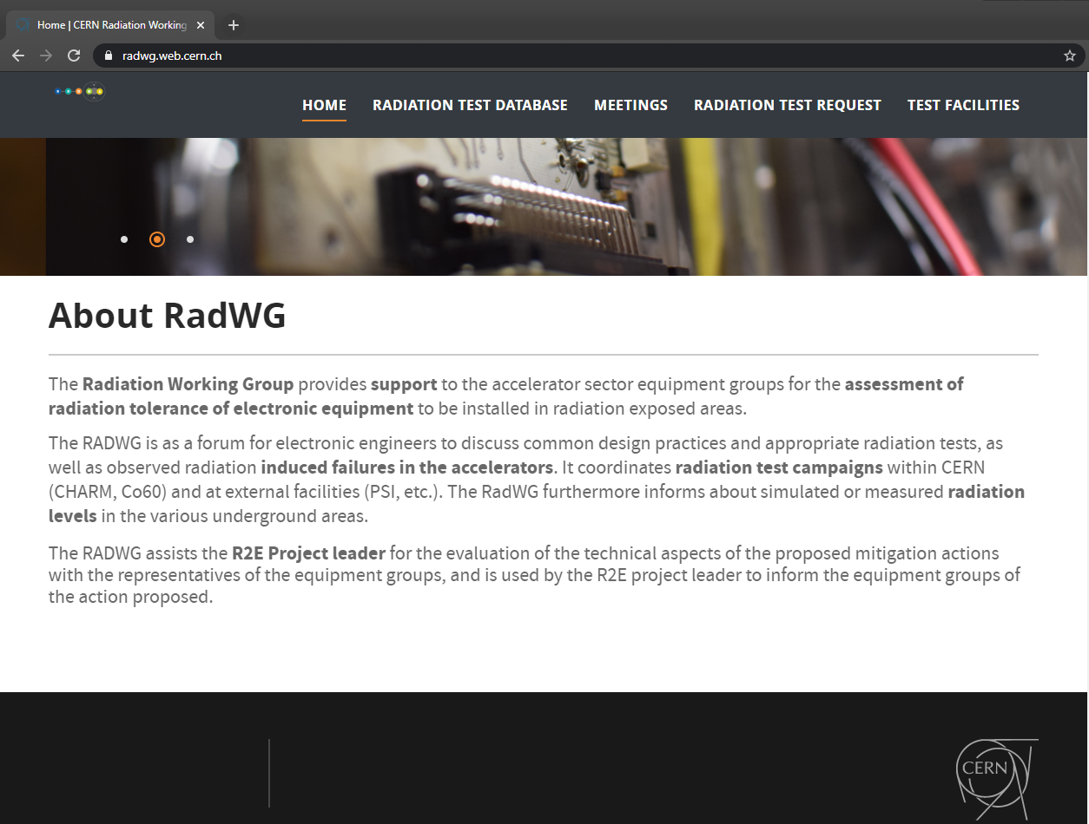
Test results analysis and reporting
The website https://radwg.web.cern.ch/ embeds an User-Friendly database
  More than 529 reports from the 2011 up to 2022
210 users subscribed to the mailing list lhc-proj-radwg-members
The service produces reports in a common template for all the components tested
  Test reports template ensure a coherent reporting
databases accessible by all the equipment groups
https://radwg.web.cern.ch
RADWG Activities Overview by R. Ferraro (BE-CEM-EPR )

Slide 21
Conclusions
BE-CEM-EPR provides the service of radiation testing of electronic components supporting the Radiation Working Group (RadWG)
Intensive testing activity in 2022
A lot of campaigns performed at CHARM this year
CIBU and WorldFIP CuCu production qualified
Effort will be put to fully qualify voltage regulators / DCDC converters for different applications
Other two PSI campaigns are planned this year together with CHARM campaigns
RADWG Activities Overview by R. Ferraro (BE-CEM-EPR )

Slide 22
Thank you for your attention!

