Slide 1
R2E-HL-LHC(60-120)A-10V power converter
Jérémie Clar with inputs from his colleagues
R2E Developments Review, CERN – 13th Sep. 2022
EDMS: 2775535
Indico: 1198481

Slide 2
Agenda
General description of the project
Development status
Radiation environment, requirements, design choices
Part procurement strategy and progress
Electrical prototype
Radiation Hardness Assurance Protocol
Component testing status and batch acceptance strategy

Slide 3
General Description
Project Owner & Involved People
Project owner(s): Thurel Yves │ project leader
Favres Benoit │ pwr. Elec designer
Bollazzi Alessio │ pwr. Elec designer │ Fellow 2021-09
Clar Jérémie │ radiation “expert” │ Fellow 2020-09
Jacques-Sermet Baptiste │ pwr. Elec designer │ Fellow 2022-01
Milovanovitch Jeanne │ pwr. Elec designer │ Fellow 2020-09
Project Main Purpose
Provide & manage the delivery of highly reliable & radiation tolerant – redundant – 60A & 120A converters for LHC (R2E) & HL-LHC (new units), for LS3
Project Main Deliveries
144 R2E-HL-LHC60A-10V
128 R2E-HL-LHC120A-10V

Slide 4
General Description
Converter redundancy
Generalisation of redundancy concept to new (< 120A) R2E versions.
  HL-LHC availability target (radiation or not induced impact on operation)
  New R2E-HL-LHC60A & R2E-HL-LHC120A will be redundant
Optimisation of Design effort
060A converters = 2 x 60A in // (n+1=1+1) = 2.0 x installed power
120A converters = 3 x 60A in // (n+1=2+1) = 1.5 x installed power
Designing 60A & 120A converters:
  One 60A Power Source only to design. Can operate in parallel for redundancy.

Slide 5
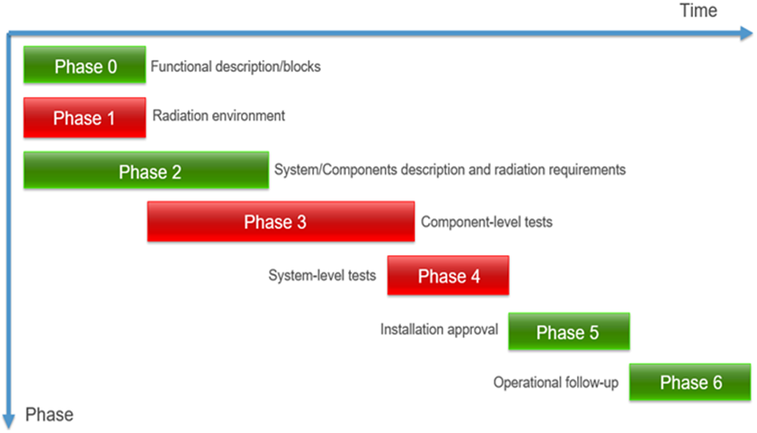
Development status

Slide 6
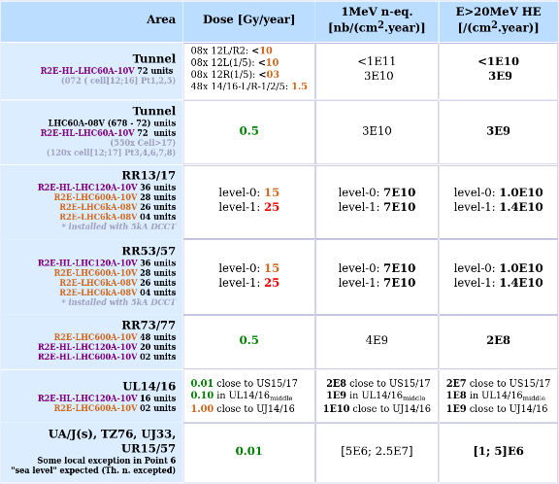
Radiation environment and requirements
Radiation levels (HL-LHC)
60A and 120A highly exposed
  [120 ; 300] Gy
  72 units in the tunnel (60A)
  92 units in RR1/5 (120A)
Design Target
[400;500]Gy for both 60A and 120A
Margin was taken for ELDRS and uncertainties

Slide 7
Design choice principles
Design choices
  Discrete components are prioritised
  Functions designed taking the degradation into account
    Simulation (LTSpice) of the functions with models of irradiated components
  Prioritise simple solutions that have been used before
  Minimisation of the number of references
Pros
  No black box, or as little as possible
  Predictable behaviour under radiation of most components
  Functions validated beforehand even under radiation
Cons
  No state of the art references
    More power consumption for example
  Time consuming selection process
  Still a risk of selecting the wrong reference
    Mitigated by the references that could be used instead

Slide 8
References and criticality
Four critical references
  UC2875N, Phase Shit PWM
    Only Texas Instruments
    Bipolar reference, sturdier than MOS but old design
    Difficult to find a replacement
  VS-FC420SA15, High Power MOSFET
    4Q stage based on this reference
    Difficult electrical screening
    Good behaviour under radiation up to 1kGy
  BST82, Low Power MOSFET
    Over 70k components used for this project
  Hall Effect Current Sensor
    Only black box type component used in this project
Other references, not a concern
  Bipolar transistors
    Functions designed to operate at minimum expected gain
  Diodes, Thyristor
    Not too sensitive to the HL-LHC radiation environment
  AOP, Analog Switch, Comparator, Voltage Reference, Fans
    Tested extensively or at twice the target TID
  Medium Power MOSFETs
    Driven between +5V and -5V
      Extended controllability
      Limited risk to encounter SEGD/R
      Limited V_{GSTH} drift
    V_{DS} derating to limit the risks of SEB

Slide 9
Part procurement progress
Context :
  Global semiconductor shortage
  36 references, approx. 600 000 parts (spare excluded), to buy and store
Requirements :
  Minimisation of the date codes by buying the whole quantity at once and asking for a single lot code when possible
  Working prototype to be built by beginning 2023
  Radiation testing units and reliability testing unit to be built by mid 2024
Progress
  25 references ordered, approx. 550 000 parts (spare included)
    6 references received, 50 000 parts
    3 single date code references, one dual date code reference, one triple date code reference
  Deliveries from September 2022 up to January 2024
    Lead time up to 200 weeks
    Most part are out of stock worldwide
  Procurement on going for 7 references, costly and/or needed in large quantities.
    Discussion with the Purchase Department
  Procurement foreseen to end in October 2022
    Procurement pending (rad. testing) for 4 parts

Slide 10
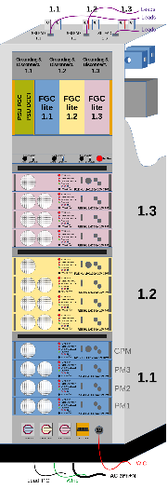
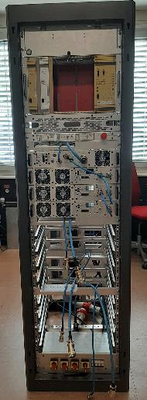
Electrical prototype
Composition
  Three 120A converters each containing:
    Three Power modules
    One control and protection module
Goal
  Validate the 120A configuration
Status
  Ready for electrical testing beginning 2023

Slide 11
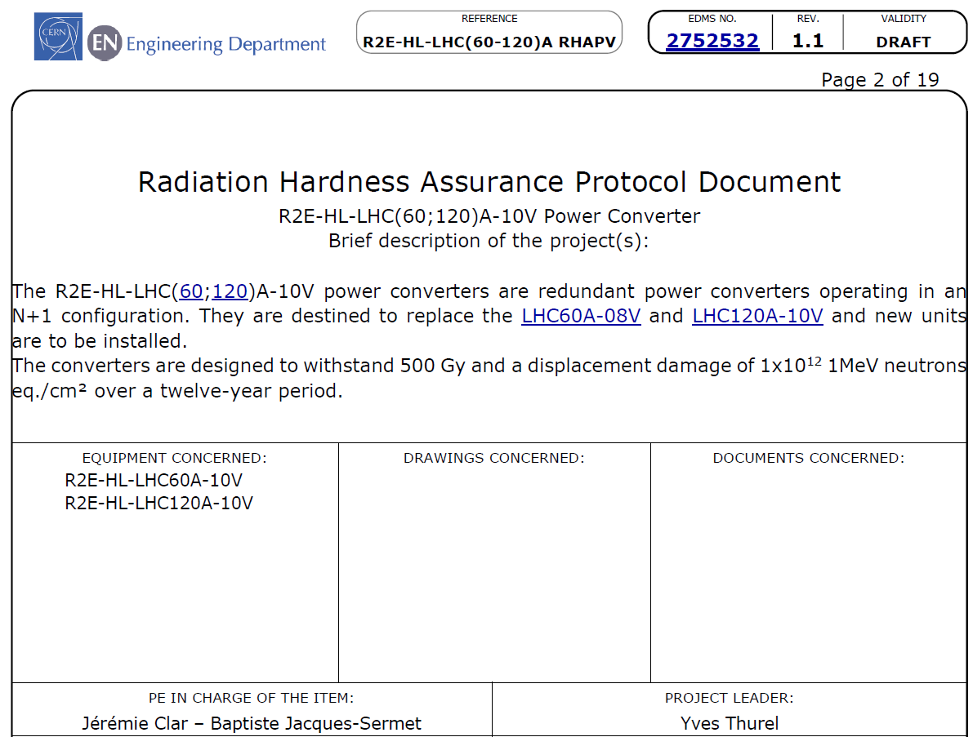
Radiation Hardness Assurance Protocol
RHAP is being drafted
Production lot testing rendered difficult by the shortage
  Difficult to buy small quantities for lot testing before buying the whole quantity
  Some parts to be delivered mid 2024, will probably be tested directly with the converter
  Our design can accommodate a wide variety of electrical characteristics for most components which mitigates the risks taken

Slide 12
Summary of project specific tests
Component Type | Packaging | Number of references | Test facility | Status | Test responsibility
AOP | SOIC(8) | 2 | PSI | Done | R2E
Low power MOSFET | SOT23 | 6 | CC60 | Done | R2E
Fans | - | 2 | CC60 - PSI | Done-Done | LPC - R2E
SiC MOSFET | TO-247 | 1 | PSI | Done | R2E
High Power MOSFET | SOT-227 | 2 | CC60 | Done | LPC
AOP as MOSFET driver | SOIC(8) | 4 | CC60 | Done | LPC

Slide 13
Summary of components tests still required
Component Type | Packaging | Number of references | Test facility | Status | Priority
Bipolar transistors | TO-220 | 4 | PSI | On-going (2022-10) | Medium
Current sensors | - | 2 | CC60 - PSI | PSI Done (2022-09) | Medium
Low leakage diode | SOT-23 | 1 | PSI | Done (2022-10) | Low
IGBT | TO-247 | 1 | CC60 - PSI | On-going | High
High Power MOSFET/Control loop | SOT-227 | 1 | CHARM | On-going | Medium
PWM (Test type and batch test at the same time) | DIP-20 | 1 | PSI | Done (2022-09) | High
Qualification for series | - | <30 | CHARM ? | Need and quantities to be validated ref. by ref. with R2E team, depends on delivery date. | Medium

