Slide 1
Energy Extraction Systems
13 kA & 600 A
Bozhidar Panev – on behalf of TE-MPE-MP
R2E Developments Status, CERN – Sept 14, 2022
https://indico.cern.ch/event//

Slide 2
Outline
Short description of energy extraction (EE) systems
Electronics in 13 kA and 600 A EE systems
Radiation environment and requirements
Development status
Summary

Slide 3
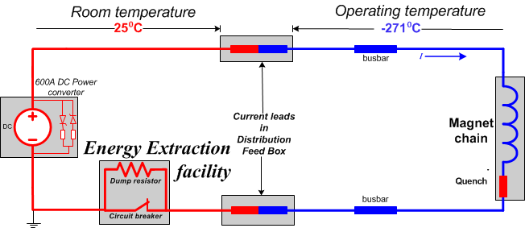
General descrition of EE systems

Slide 4
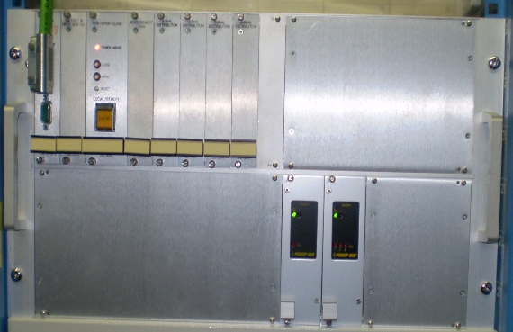
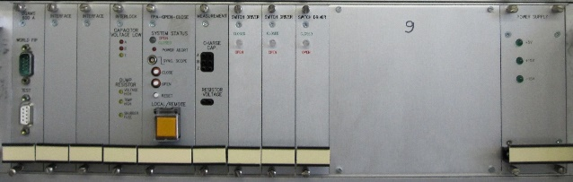
Electronics 13 kA & 600 A EE systems
Controls Electronics: 3U or 6U chassis
R&D on new versatile control electronics on-going
Prototype stage
600 A EES
control unit
13 kA EES
control unit
Power Electronics: (steering, powering and «field»feedback from the switching element
Customised per switching technology and even type within the same technology

Slide 5
Radiation environment and requirements
13 kA EE: P3, RR13/17, RR53/57, RR73/77
600A EE: RR13/17, RR53/57, RR73/77
RR13/17: according to document:
RADIATION LEVEL SPECIFICATIONS FOR HL-LHC - EDMS NO. 2302154
TID: RR1x – RR5x 15 Gy/yr (L0), 25 Gy/yr (L1)
In this future rad environment the existing control electronic designs have to be replaced

Slide 6
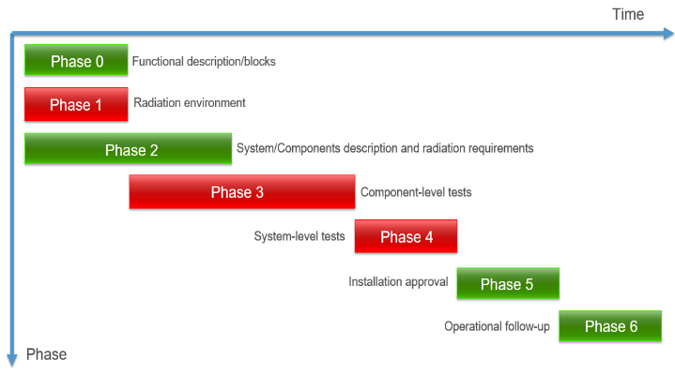
Development status
13 kA EE power electronics (two types 6U chasses):
Design completed
Prototypes produced
Operational functionalities fully tested
Rad Tolerance to be tested
600 A EE power electronics:
Design ongoing,
The first prototype produced
Functional tests ongoing
13 kA/600 A Control electronics (Versatile control electronics):
Concept and architecture finished
Design ongoing
  Layout of the first two PCBs started

Slide 7
Summary of requests to R2E group
PCB design to be verified whenever is finished. Tests to be defined and planned
13 kA & 600 A EE systems control electronics:
8 types of PCBs
13 kA EE systems power electronics:
5 types of PCBs
13 kA EE systems power electronics:
3 types of PCBs
Power Contactor: electronics to be modified and tested

Slide 8
Thank you for
your attention!

