Slide 1
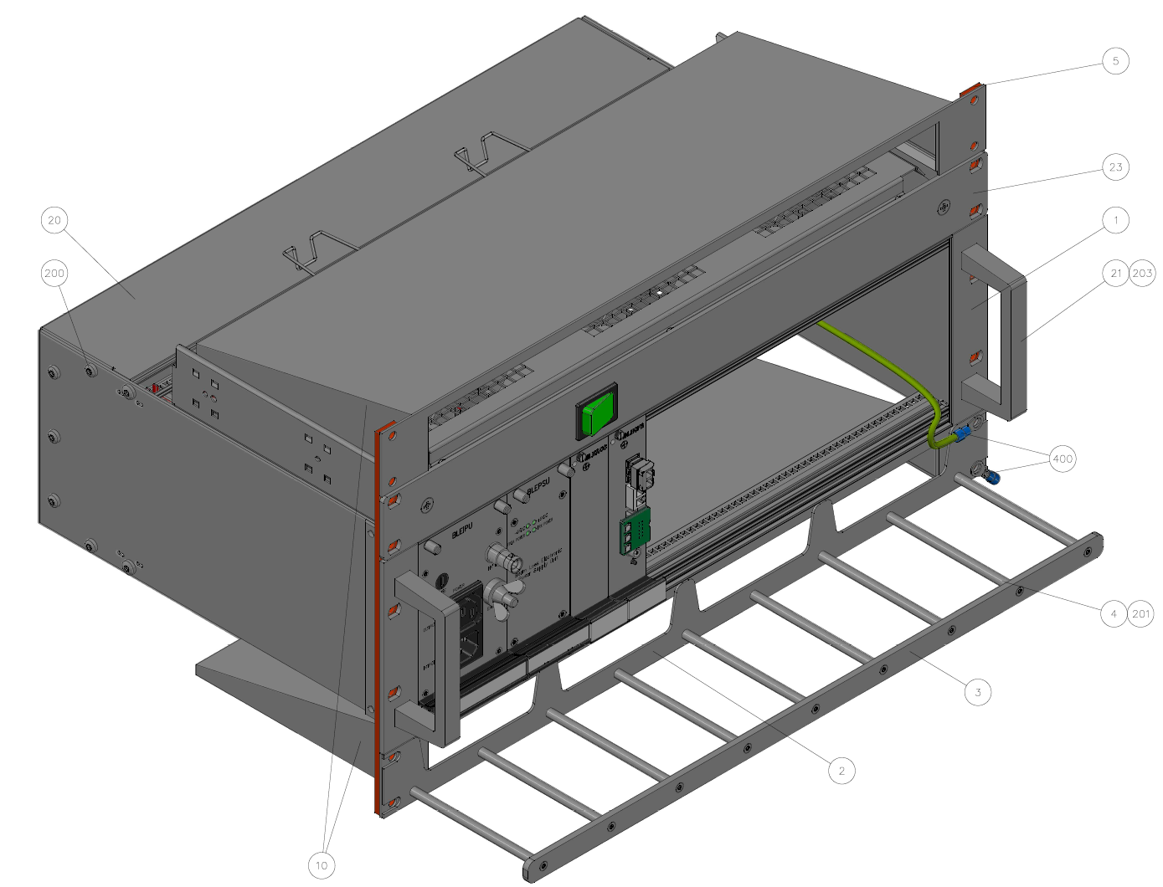
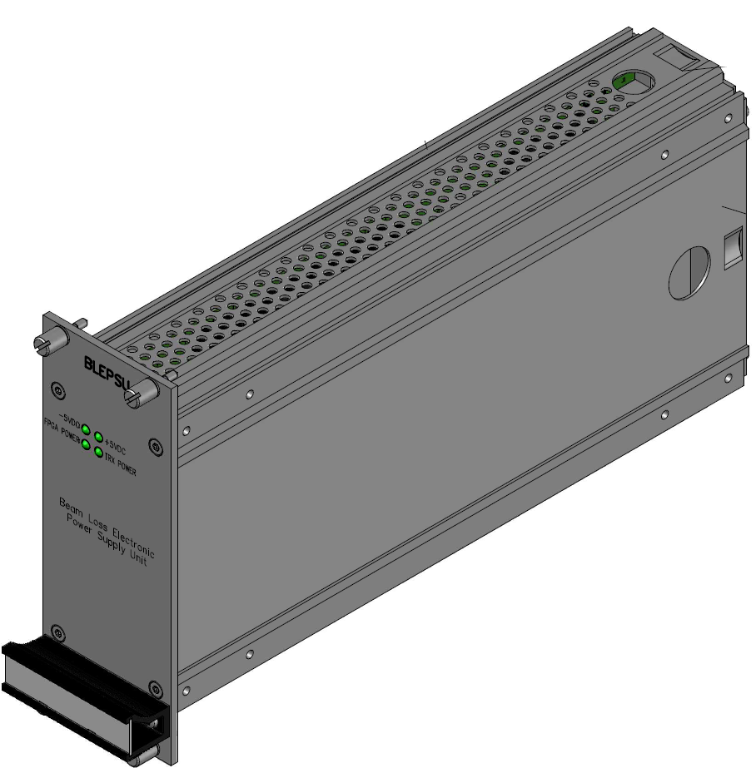
BLM Tunnel crate – Power Supply Unit
W. Viganò on behalf of the BLM Team
14th September 2022

Slide 2





Introduction
The Power Supply Unit (BLEPSU – EDA-03919) is a part of a BLM chassis compatible with both SPS and LHC for future upgrades.
The pinout of the Power Supply Unit is pin to pin compatible with the current LHC BLM chassis (backward compatibility).
It receives AC input voltages from another unit called BLEIPU (Input Power Unit) and it converts the AC voltages in DC voltages at the output
Radiation tolerance target (TID):
  Radiation tolerant up to 1KGy.
Safety target:
  Guaranteeing the SIL3 for safety critical systems.
  Protection against permanent short circuits.
  Protection against direct contacts to HV or 230VAC.
  Grounding improvements.

Slide 3
Input Power Unit (BLEIPU) – Block diagram
The Input Power Unit (BLEIPU – EDA-03918) is the chassis' element which converts the 230 VAC power input in the AC output voltages delivered to the Power Supply Unit.
In addition to the voltage conversions, the BLEIPU allows the Transformer diagnostic and the High Voltage chain return voltage conversion.

Slide 4
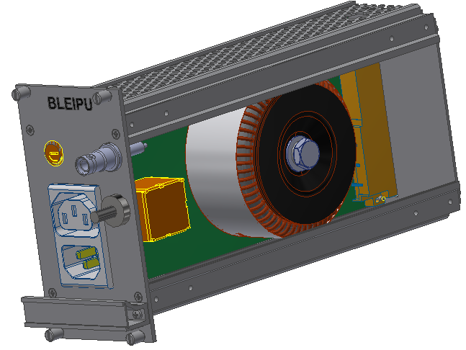
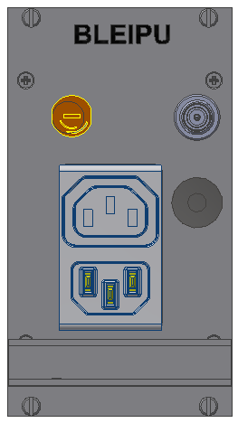
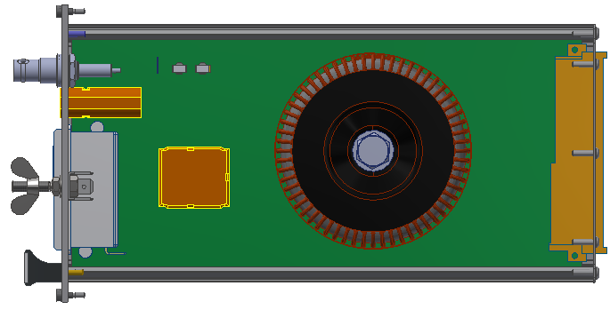
Input Power Unit (BLEIPU)
HV input connector
230 V_{AC} Inlet/Outlet
Main Fuse
Earth bonding screw
Radiation tolerant power transformer (custom design)
HV divider
Input filter

Slide 5
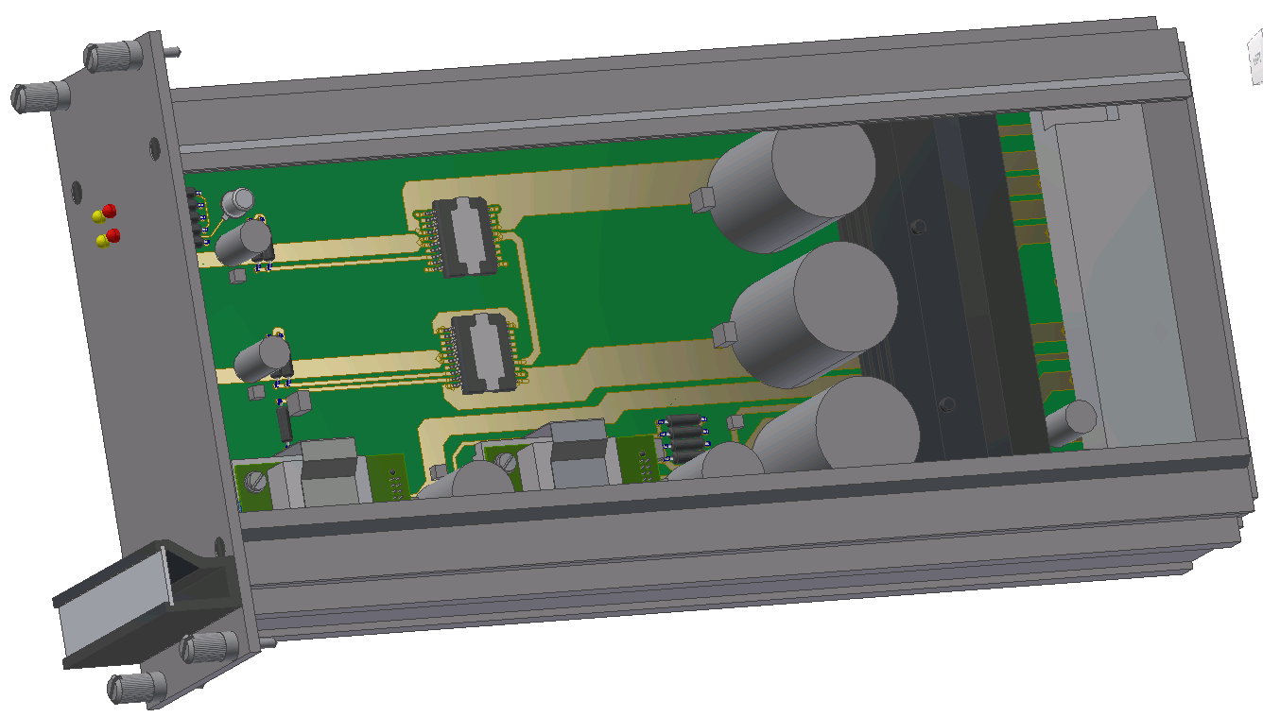
Power Supply Unit (BLEPSU) – Block diagram
Voltages for the digital circuitry are produced by DC/DC converters.
Voltages for the analog circuitry are produced by Linear voltage regulators.
External signals can activate power cycles.
The BLEIPU + BLEPSU have to stand permanent short circuits.

Slide 6
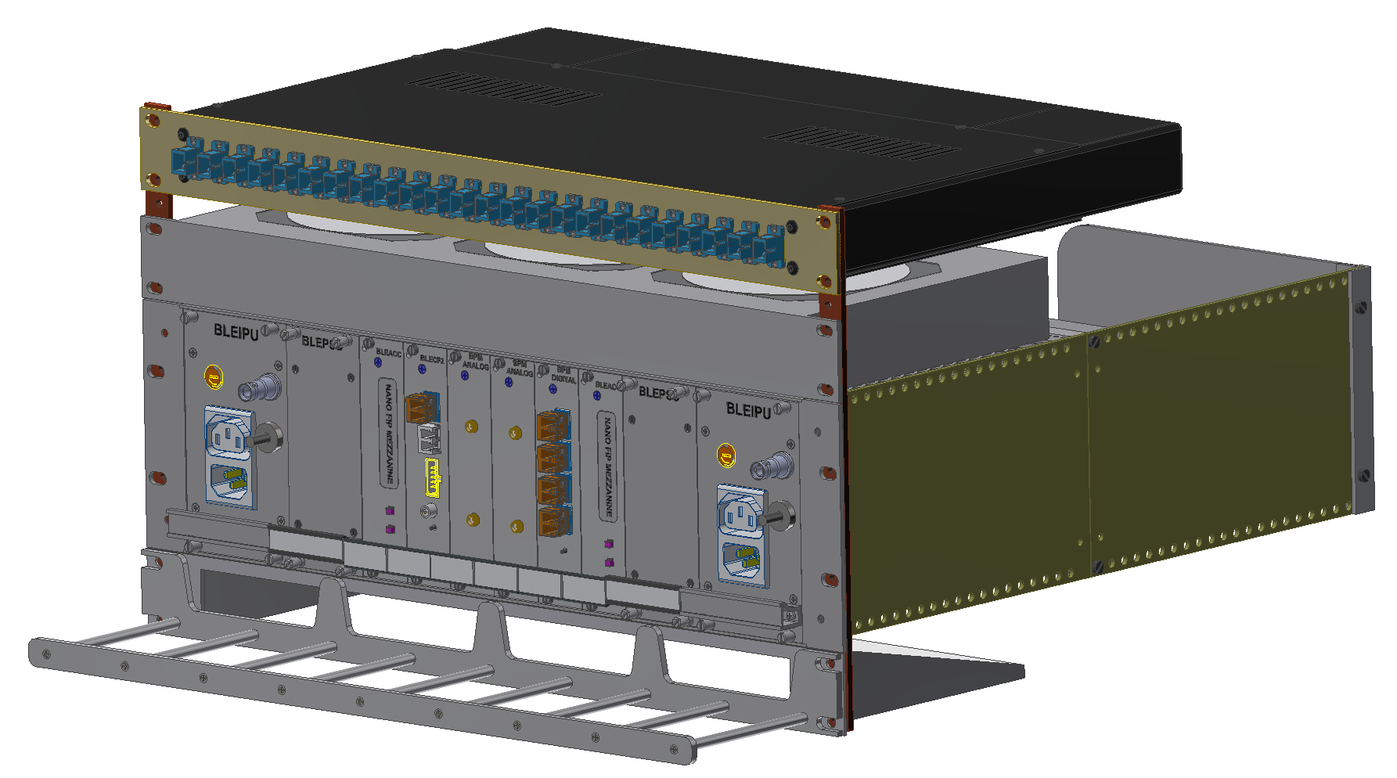
LHC Tunnel Crate for BLM & BPM
In the LHC Tunnel Crate, the BLM and the BPM systems are based on the same structure composed by: BLEIPU + BLEPSU + Controller Card, and they are independent one from the other.
BLM side
BPM side

Slide 7
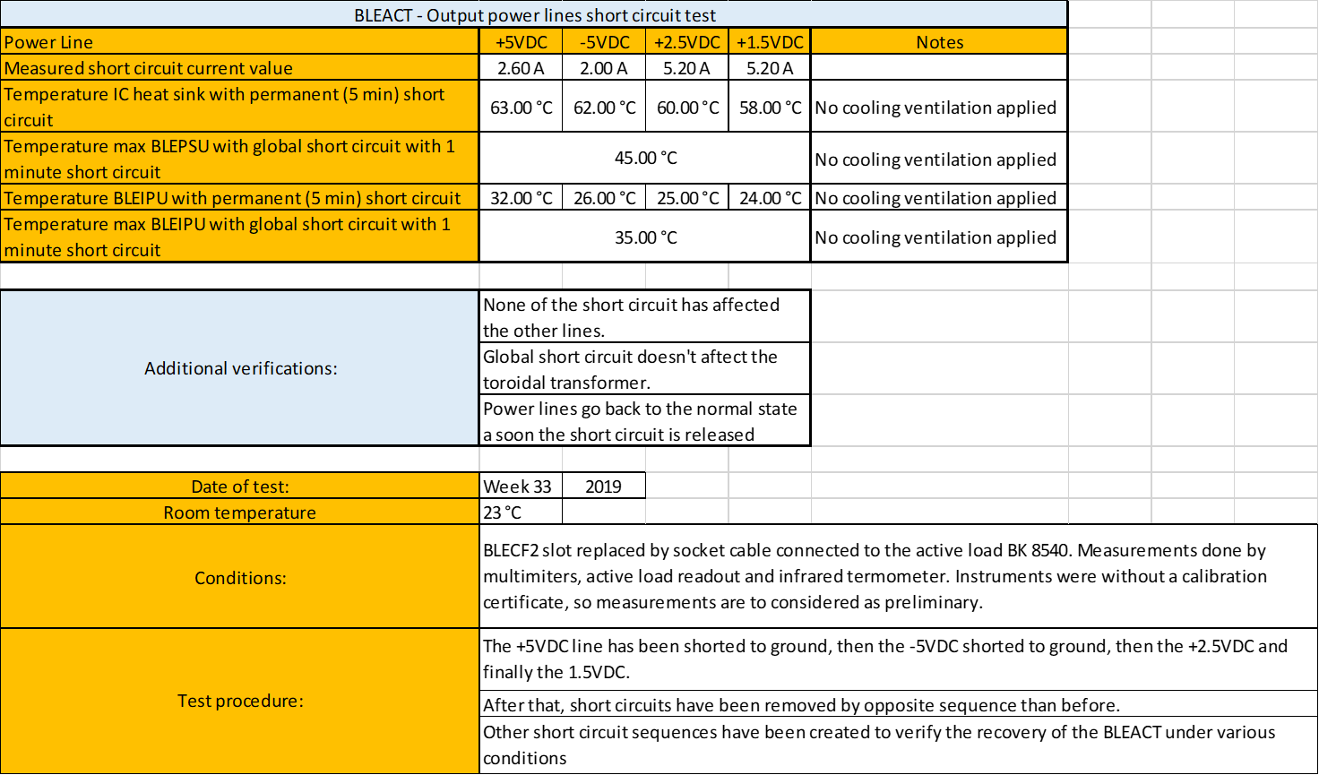
First prototype test campaign
Backward compatibility with LHC system.
Power-up time.
Output voltage ripple.
Short circuit tolerance.
Human interface survey.
All results are very positive, totally documented and available upon request.

Slide 8
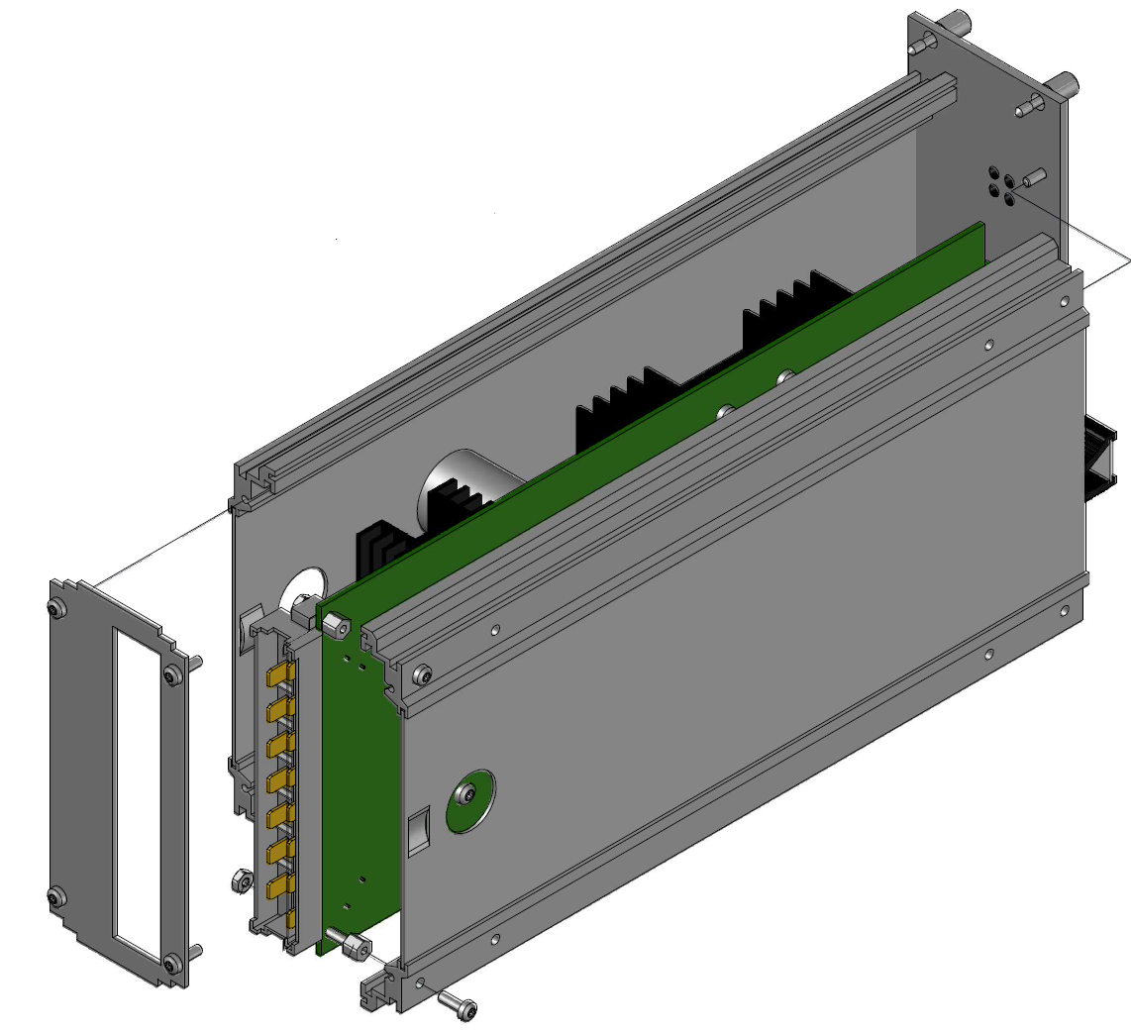
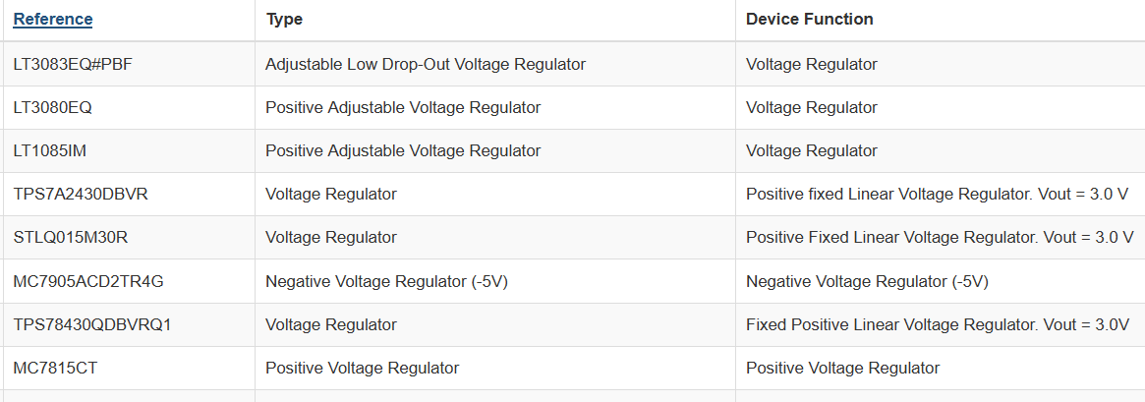
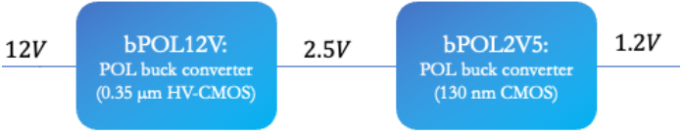
Outcome of the testing phase
All issues/modifications have been processed, documented, and the official design have been updated as:
https://edms.cern.ch/item/EDA-03919-V2-0/0
But the ST “LHC4913” and “LHC7913” have been declared as not anymore available.
A collaboration with BE-CEM-EPR has started to select and qualify possible substitutes of the ST solutions.
The FEAST DC/DC converters will be not anymore available so we are evaluating the possibility to replace them with a bPOL12V and a bPOL2V5.

Slide 9
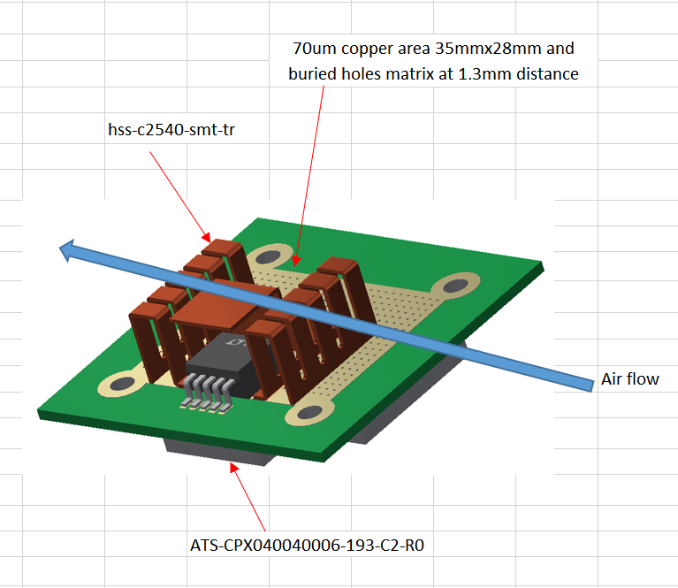
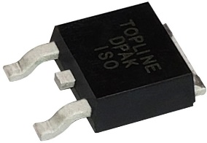
BLEPSU – Redesign
Standard component alternatives have been identified and tested under radiation:
  Positive Linear Voltage regulator [+5VDC] -> LT3083EQ#PBF radiation test issue -> TBD
  Negative Linear Voltage regulator [-5VDC] -> MC7905ACD2TR4G
Accordingly with the new part numbers, electrical specifications have been adjusted as follow:
  Max continuous positive output current = 1A (Protection set at 2A).
  Max continuous negative output current = 0.5A (Protection set at 1A).
  The ON/OFF function is guaranteed by relays, not anymore by digital signals.
  New cooling approach.
The expected form factor for the future linear voltage regulators is the DPAK.
Online viewer https://autode.sk/3U9C5i7

Slide 10
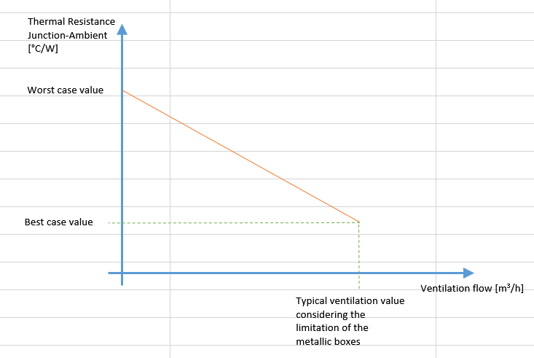
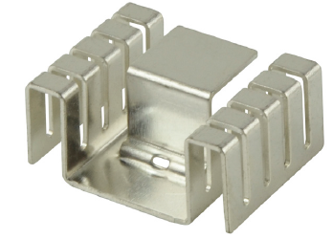
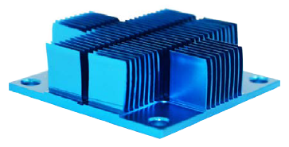
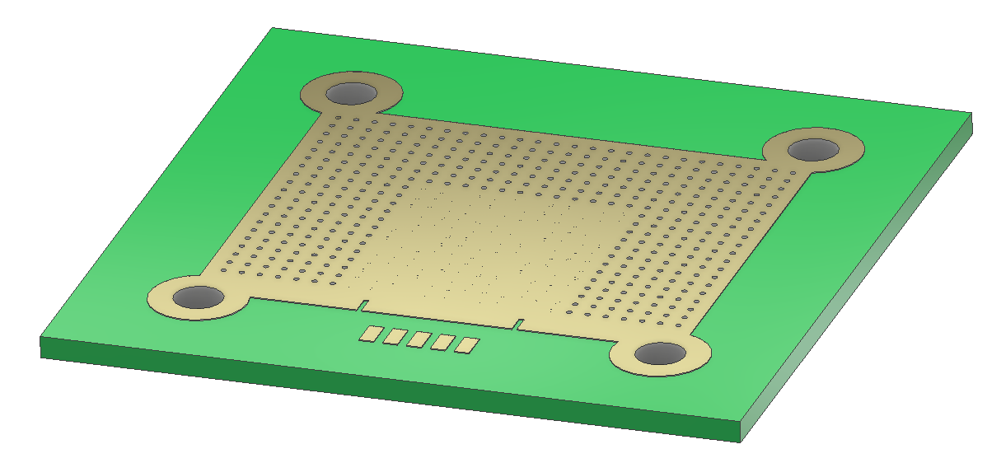
BLEPSU – Heatsink design
The performance of the heat sinks combination for the new linear voltage regulators have been studied and evaluated when a worst case condition happen.
TOP Heat Sink
Bottom Heat sink
PCB Heat Sink

Slide 11
BLEPSU – Power Dissipation spreadsheet

Slide 12
BLEPSU – Best Components Selection
Components selection is an important aspect of the core element of the Tunnel Crate.
Final decision is not yet taken but under evaluation.

Slide 13
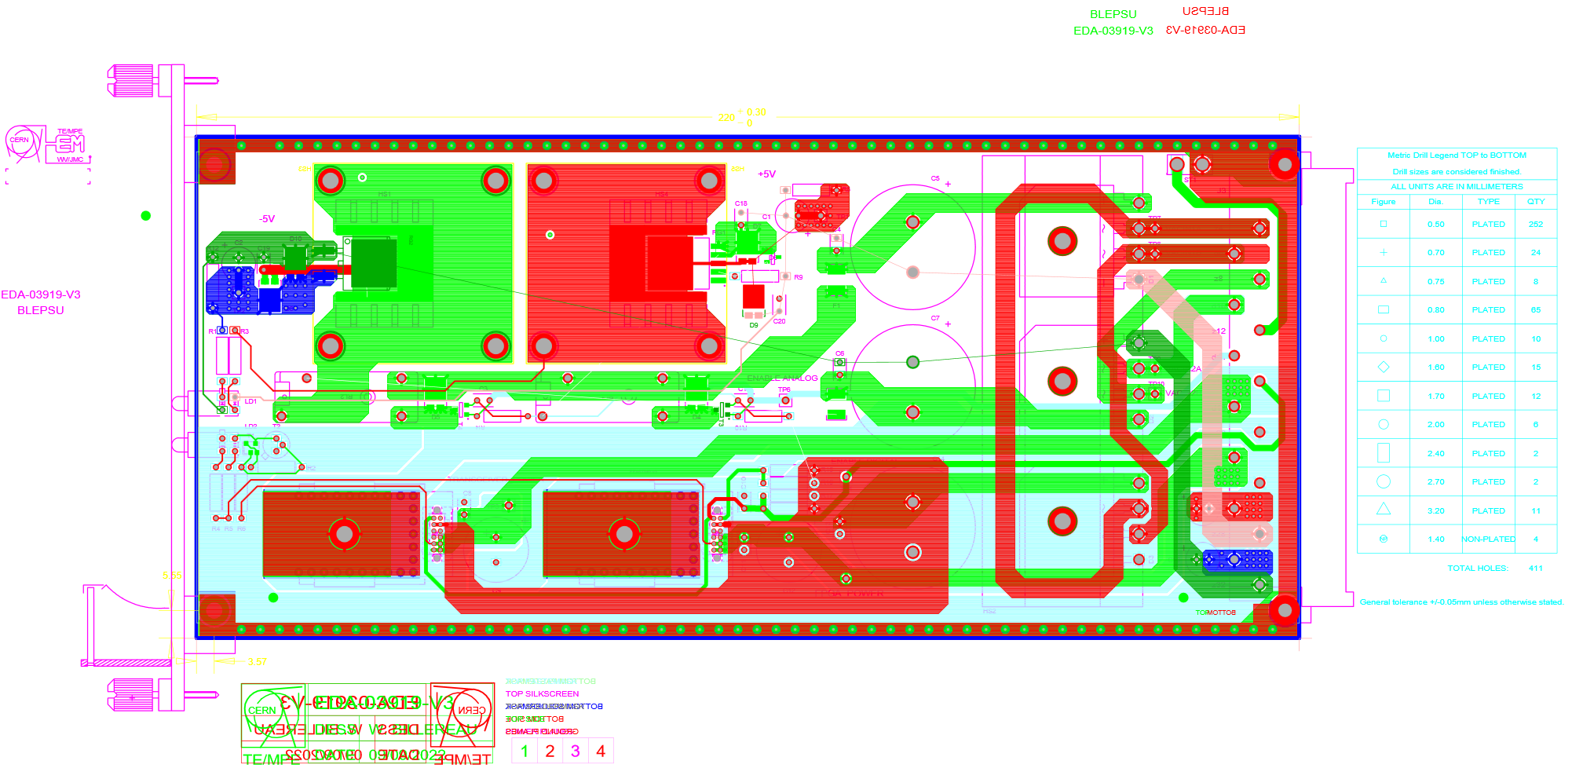
BLEPSU – V3 design
The design of V3 version was already started, but then it has been stopped as consequence of the poor LT3083EQ#PBF radiation test results.
We are waiting for the new part number validation under radiation to finalize the design.
Neg. LVR area
Pos. LVR area
Filtering
Rectification
On/Off relays
DC/DC converters area

Slide 14
Targets and quantities
The upgrade of the BLM system for SPS is foreseen for LS3.
The upgrade of the BLM system for LHC is foreseen for LS4.
System | Pos. LVR | Neg. LVR | 2.5 DC/DC | 1.5 (or 1.2) DC/DC
BLM | 1000 | 1000 | 1000 | 1000
BPM | 1000 | 1000 | 1000 | 1000
Total | 2000 | 2000 | 2000 | 2000
Same DC/DC with output variants

Slide 15
Conclusions
Input Power Unit (BLEIPU), Power Supply Unit (BLEPSU) and Backplane (BLEBPT) have been produced in a first prototype and fully verified from the electrical point of view.
Tests on the first prototype have verified good performance, robustness, usability and the collection of all info/corrections for the next prototype. V2 fully documented.
The redesign of the V3 PCB is ongoing aiming to replace the ST linear voltage regulators with new COTS, and also to replace the FEAST DC/DC with the bPOL series DC/DC converters.
A collaboration with BE-CEM-EPR is ongoing for the radiation tolerant components selection.
Thank you very much for your attention!

