Slide 1
HOMs ceramics absorbers
Pedro Morales
Date

Slide 2
HOM Loads advantages
Symmetric part

Slide 3
HOM material issue
Ekasic P is no longer available in the market as it was, change of the additives and it can influence or not in the performance.
There is no data why this material is working well but it is, so for finding a substitute we have ask Ping to run some measurements and we have asked 2 different materials from different suppliers
Mention, the cost surge because of the complicated shape. Can we carry out a sim of the tolerances we can accept?
I will work and a better holding method to make it simpler.

Slide 4
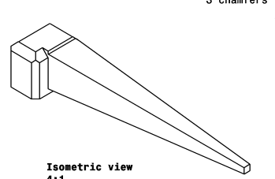
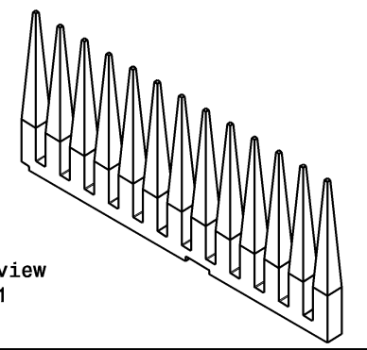
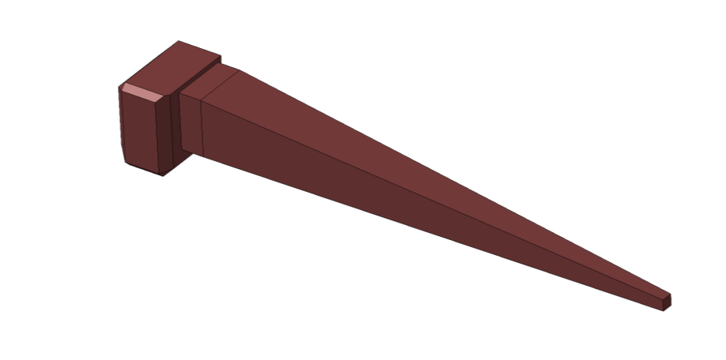
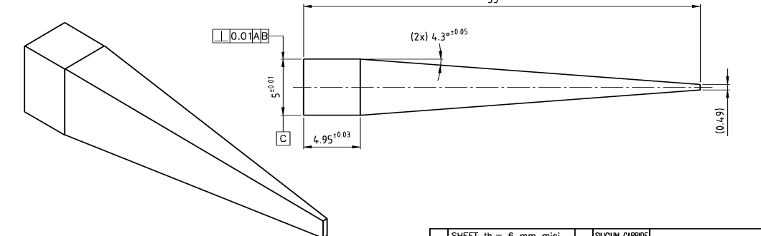
HOM Evolution
Folder

Slide 5
HOM References
https://edms.cern.ch/document/997123/1
https://edms.cern.ch/document/1009247/1
https://edms.cern.ch/document/1059157/1
https://edms.cern.ch/document/1211574/1
https://www.researchgate.net/publication/254469450_Analysis_of_long-range_wakefields_in_CLIC_main_Linac_Accelerating_Structures_with_Damping_Loads
CERN-OPEN-2008-019.pdf
https://indico.cern.ch/event/142416/contributions/1375573/attachments/129021/183157/gdemiche20110623-up.pdf
https://indico.cern.ch/event/72077/contributions/2074694/attachments/1036307/1476627/RF_development_meeting_13_01_10.pdf

Slide 6
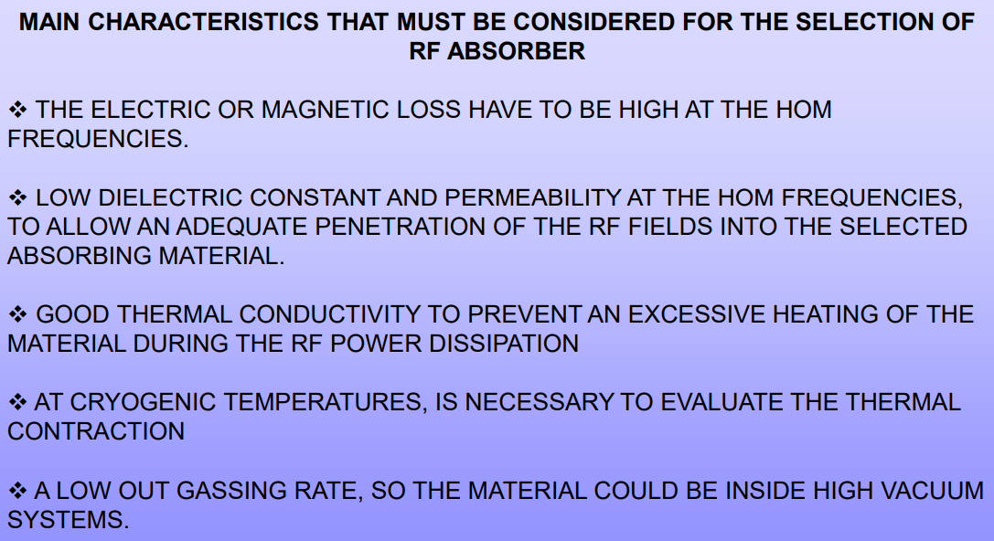
Parameters of material definition
20 < εr < 40 // 0.2 < tanδ < 0.4
εr = relative permittivity or real part of the permittivity
tanδ = loss tangent or tangent delta or Dielectric loss
Reference
Ref.
15 < ε < 25 // tanδ > 0.3
Reference
ε < 20 (as low as possible) // tanδ > 0.3
Reference
General Standard procedure to measure it:
ASTM-D150
Dielectric Constant and Dissipation Factor ASTM D150, IEC 60250 (intertek.com)
“Material for the loads must have ε’ in the range of 11-14 and tanδ > 0.15”
Reference

Slide 7
Manufacturers and material suppliers
They don’t measure (normally) those parameters and even less in the frequency ranges we need to explore.
Can we rely on their results given the fact that some of them are not following any procedure to measure the parameters?
Supply ussies. Not really much availability on the market. If we foreseen this with time there is no issue there.
Redesign of the current proposal to get something easier to machine. Keep the symmetrical advantages and the poka-yoke
Any comments on the mechanical properties? Porosity? Ekasic P was the more porous one. Density is important? CTE bellow 5 should works.

Slide 8
Materials summary
Excel table

