Slide 1
Introduction
#CERNIdeaSquare
11 October 2022
By Markus.Nordberg@cern.ch

Slide 2
IdeaSquare
The Innovation Space at CERN
IdeaSquare is the innovation space at CERN, that uses collaborative methodologies, access to CERN expertise and cross-connectivity to ideate solutions for the future of humankind. A place where people have the licence to dream.

Slide 3
Training and experimenting with the innovators of the future

Slide 4
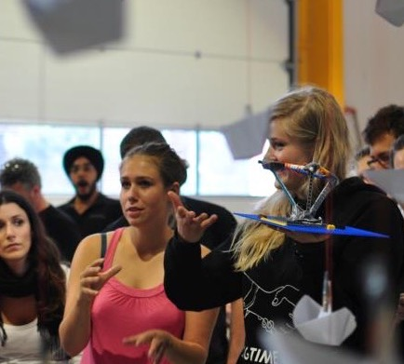
Challenge Based Innovation (CBI)
5 - 6 months MSc-level specialization course for product and service development, run by participating universities from 8 countries around the world
Over 1200 students have participated with more than 200 conceptual prototypes produced at IdeaSquare, contributing to UN Sustainable Development Goals
In the course, multidisciplinary student teams learn how to apply Design Thinking – process for new product/service development; engaging with CERN researchers who act as technological coaches in the process
“Work extremely hard, learn and have fun!” AND “Fail fast and often to succeed sooner”
Students prototype to TEDxCERN installation

Slide 5
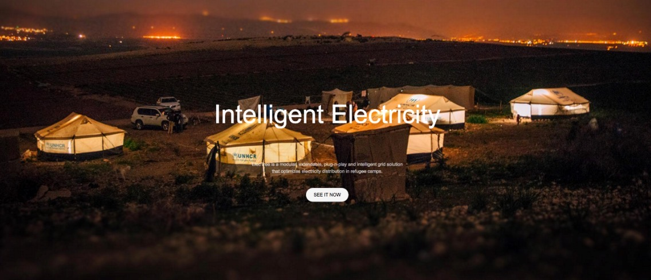

Slide 6
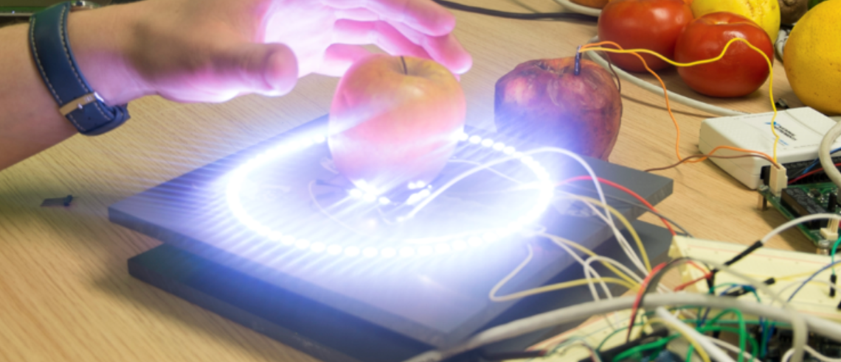

Slide 7
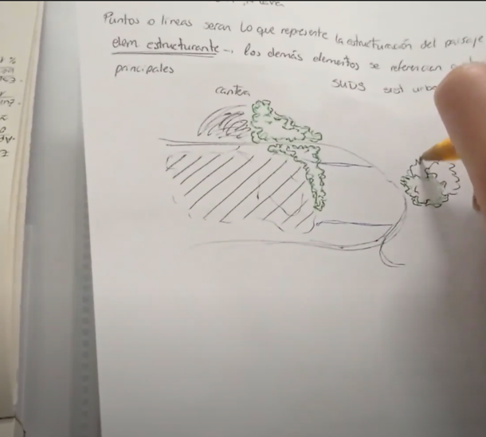
Design the Future
Design the Future is a programme which addresses so-called wicked problems and stimulates participants to use a combination of exponential thinking, system thinking as well as disruptive thinking. The aim of Design the Future is to provide students with a toolbox of methodologies combining the above thinking schools while stimulating their imagination. It is an invitation for designing our future society
Wristband ED project – UPV/EHU

Slide 8
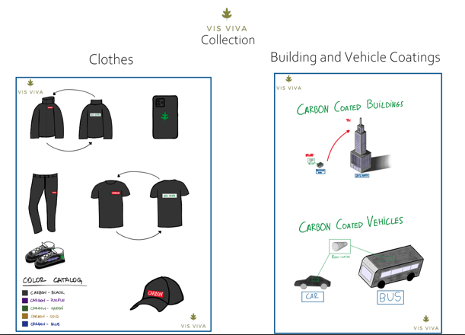
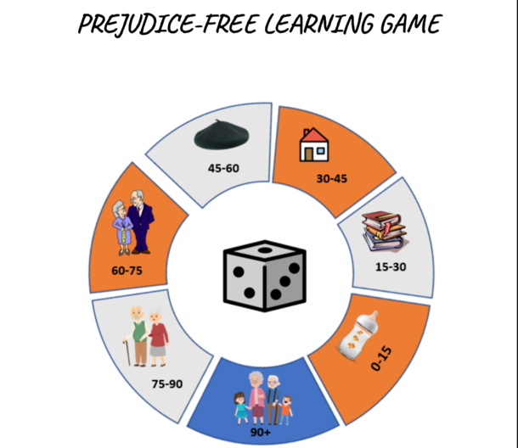
Design the future

Slide 9
Linking science innovation and the SDGs

Slide 10
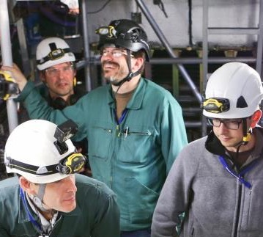
#ATTRACT EU Project
ATTRACT funds breakthrough projects in Detection & Imaging
Provides funding for developing early-stage ideas and prototypes
Focuses on high innovation with potential outside research
Engages with MSc-level, cross-disciplinary student activities, seeking for unforeseen entrepreneurial opportunities for the young
Strong collaboration with partners in most European countries
Purpose is to create a new innovation ecosystem in Europe
ATTRACT is coordinated by CERN (IdeaSquare)

Slide 11
WPET - Wearable PET scanner jacket prototype

Slide 12
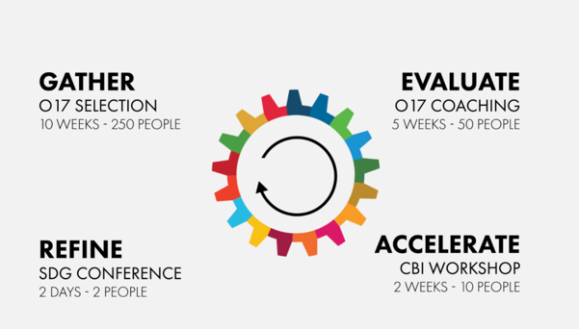
#Crowd4SDG
Crowd4SDG is a three-year Horizon 2020 Research and Innovation Action supported by the European Commission’s Science with and for Society (SwafS) programme.
Through an innovation cycle called GEAR (Gather, Evaluate, Accelerate, Refine), the transdisciplinary Crowd4SDG consortium of six partners will promote the development of citizen science projects aimed at tackling the SDG’s, with a focus on climate action.
Its goal is to assess the usefulness of practical innovations developed by the teams and to research how AI applications can enhance and provide effective monitoring of SDG targets and indicators by citizens

Slide 13
Well Yes! - monitoring groundwater quality, to empower users, allow for potential policy change and better water infrastructure.

Slide 14
Connecting curious minds

Slide 15
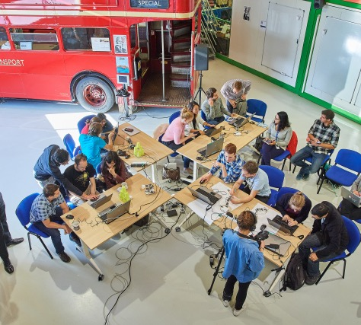
Events, workshops and hackatons
When the building is not in full use, Ideasquare can offer access to its open work areas, rapid prototyping facilities and its meeting rooms for short, deadline driven Challenge Events, such as :
Innovation Events,
Workshops
Hackathons ( an event compressed into a short number of days where participants work towards a concept prototype).
IdeaSquare Open Doors event 2018

Slide 16
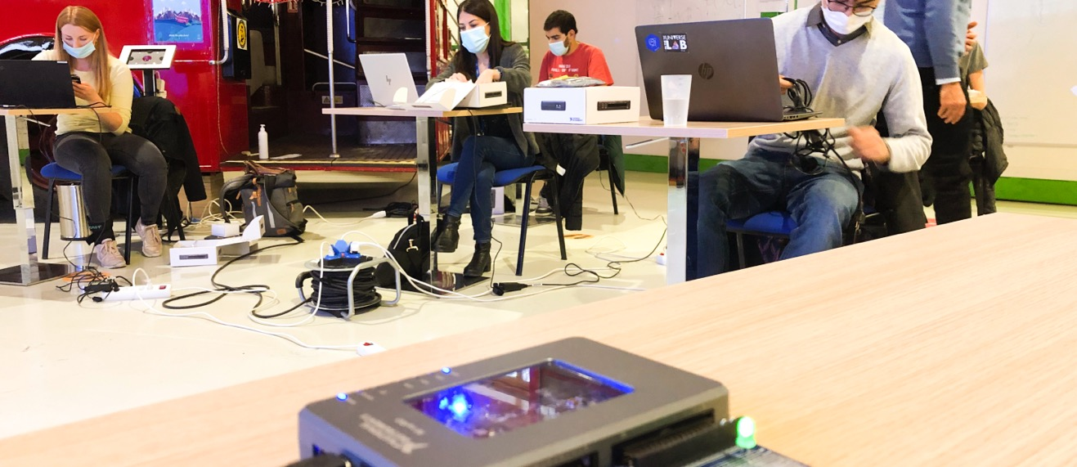
FPGA Workshop

Slide 17
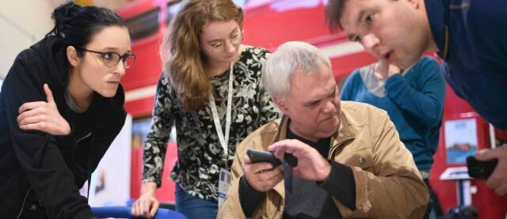
Hackathon for the visually impaired for the development of the CERN Exhibitions

Slide 18
Fast forward through prototyping

Slide 19
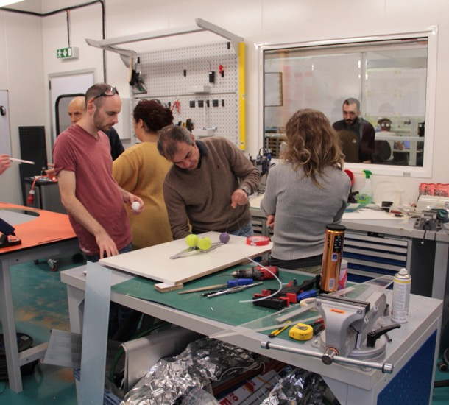
Our Facility
Our facility has 700m2 of office space, with 5 meeting room containers and 2 meeting rooms in our famous double-decker. Additionally, 140m2 of prototyping facilities including
An open space for ideation
An electro shop
A machine shop with a laser cutter
3D printing equipment
CMS Create

Slide 20
Stimulating instrumentation in research

Slide 21
Neutrino Platform
Neutrino Platform (CENF) fosters fundamental research in the field of Neutrino Accelerator Physics
CENF supports generic detector, neutrino beams R&D and large detector prototypes or demonstrators. It gives technical, financial and logistics support to approved projects
Currently includes seven projects, including significant involvement in (Proto) Dune
CERN & IdeaSquare provides a facility for R&D on future technologies (HW and SW) and partner in several neutrino research programs

Slide 22

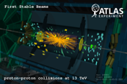


Detector R&D
Projects
Technology
MSc-Level Student Programs (e.g. CBI)
Initially undefined/open
Product
Process
Focus

Slide 24
#CERNIdeaSquare

Slide 25
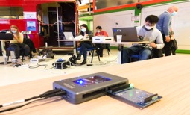
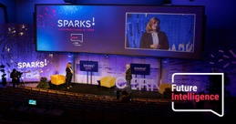
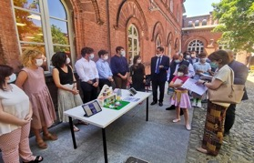

IdeaSquare
12 CBI-like courses (mostly by Zoom)
The innovation Space at CERN
Highlights of 2021:
Implementing new strategy and comms plan
Falling Walls Award (P. Tello)
Fabiola G. present at innovation4Change in Torino
And…
3 prototyping session (FPGA; 2 in-person)
3 Events (in-person; 2 at ID2)
2 EU projects launch (Attract and Crowd4SDG)
Publication of the 2 editions of CIJ journal
3 new CERN projects (using workshops)

