Slide 2
FTN beamline: feedback from ABT and OP. What is needed?
Y. Dutheil (SY-ABT-BTP)

Slide 3
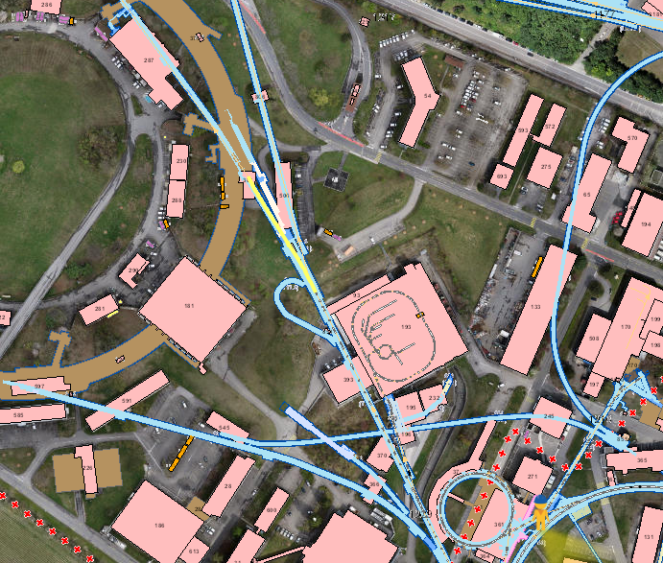
Introduction
100 m long beam line branching off F16
Delivers beam to the nTOF target
Beam specs
  20 GeV
  Longitudinally rotated for a bunch length of ~40ns
  ~8E12 protons per pulse and >3E12 protons per pulse for EAST parasitic bunch
  Typically up to a cycle every few seconds

Slide 4
Run3 line commissioning
New air-cooled target installed during LS2
Required beam size could not be achieved in 2021
Multiple discussions and studies steered by OP on a dedicated meeting here
Hardware changes during 21-22 YETS and commissioning of a new optics in March 2022

Slide 5
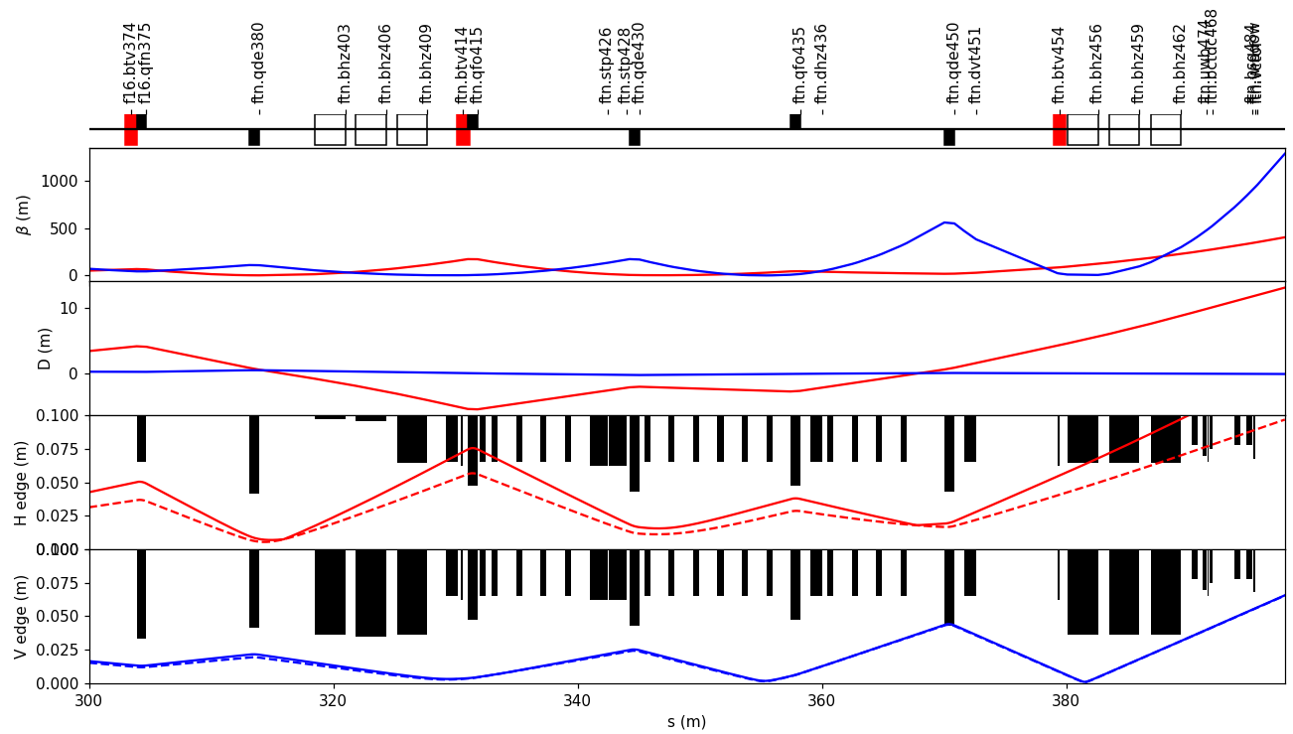
Current FTN optics and experience
3 BTVs along the line (red)
One SEM grid at the end of the line, just before the target
BLMs at each quadrupole
Complex trajectory
  2 bending sections of 6 degrees each, powered on 3 circuits
  3 dipole correctors
Experience
  The 3 BTVs + SEM were critical but do not give a full picture of the trajectory in the line
  Performance is limited by physical aperture, hence trajectory is critical everywhere along the line
  Optics and trajectory adjusted using BLM signals

Slide 6
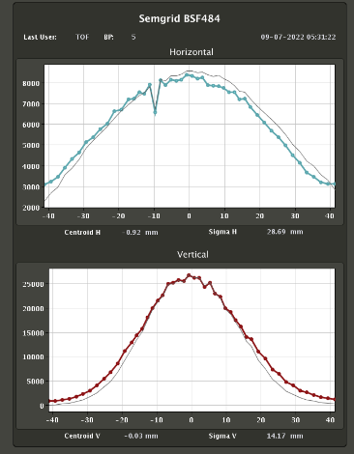
Input from OP-PS
Trajectory control
  The line is aperture-limited and natural drifts quickly and substantially increase the losses along the line
  BTVs
    Cannot be left IN and active for continuous monitoring
    Saturation does not provide precise measurement (414 & 374 have no filter wheel)
    Position determination is not coupled to YASP
  BPMs in the line + implementation in YASP would allow good and constant control of the trajectory
Activation and beam size
  Hot spot identified at the end of the line (window & grid) due to the large beam size required by the target
  Current grid covers ~90x90mm while beam sigma is ~ 30x13
    Larger grid would be desired to cover the whole beam (interlock on beam size and center more precise
BLM noise and noise spikes prevents from being used to interlock on

Slide 7
Conclusion
FTN line is limited by its aperture and both commissioning and operation requires careful control of optics and trajectory
Reliable control of the trajectory for operation requires the installation of non-intercepting beam position system (such as BPM)
A new design of the grid (BSG484) is desired to better cover the whole beam
A larger window and grid (tank + grid frame) to reduce interaction with the primary beam and activation
BLM noise should be addressed to make full use of them, and in particular to use as interlocl

Slide 8
Thank you

