Slide 1
Profile monitors of secondary lines: an urgent request for refurbishment of MWPCs & DWCs
Jocelyn TAN, Inaki ORTEGA RUIZ, Stephane DESCHAMPS
BI-XEI
EA-BI WG, 27th September 2022

Slide 2
Outlook
Status and motivations
Proposed solutions
Resources and planning

Slide 3
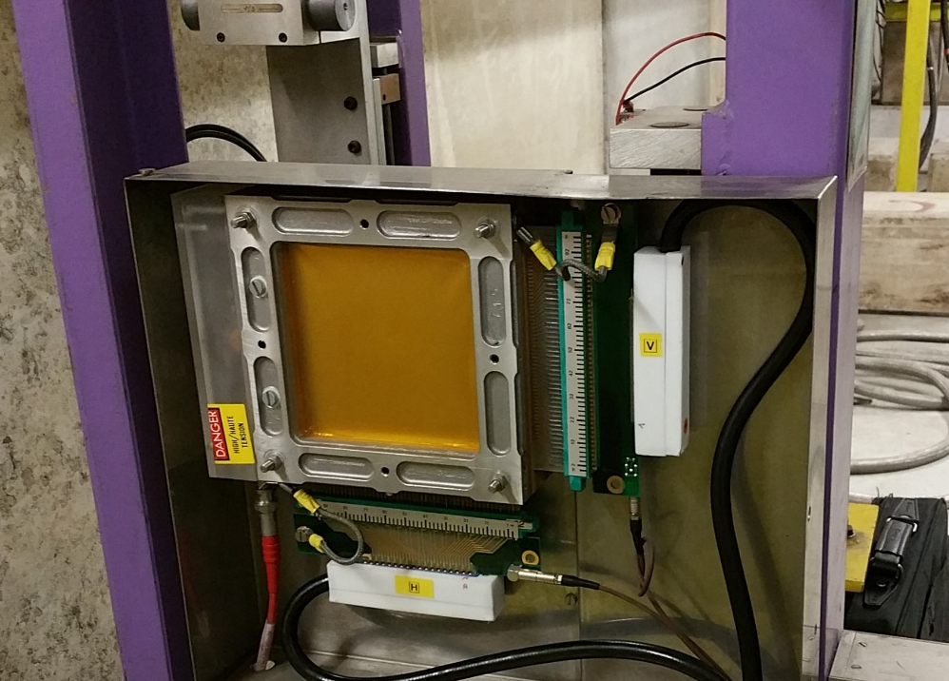
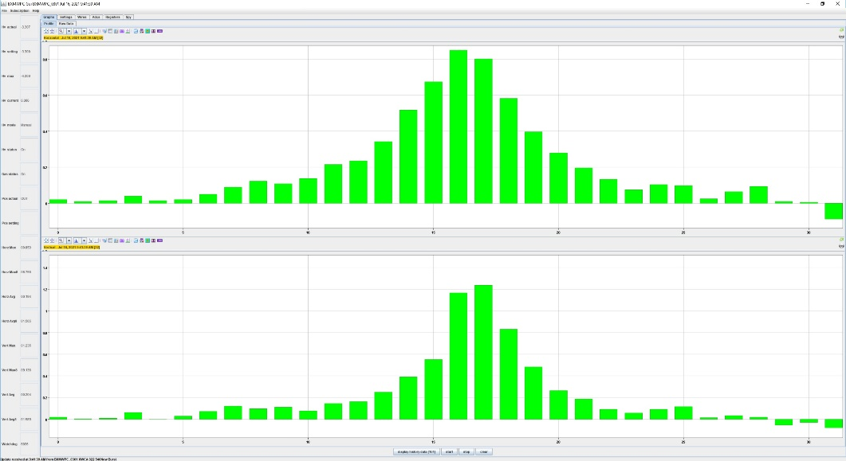
Multi Wires Proportional Chambers
Gaseous detector developed in early 70’s
Ar + CO₂ (50% each)
Anode: 32 tungsten wires (φ ~ 20-40 μm)/plane
Spill 10⁵ to 10¹¹ particles per second : ionised gas
HV applied to wires : ⇒ e- avalanche
Resolution 0.5mm to 1mm
Motorised in/out
In air

Slide 4
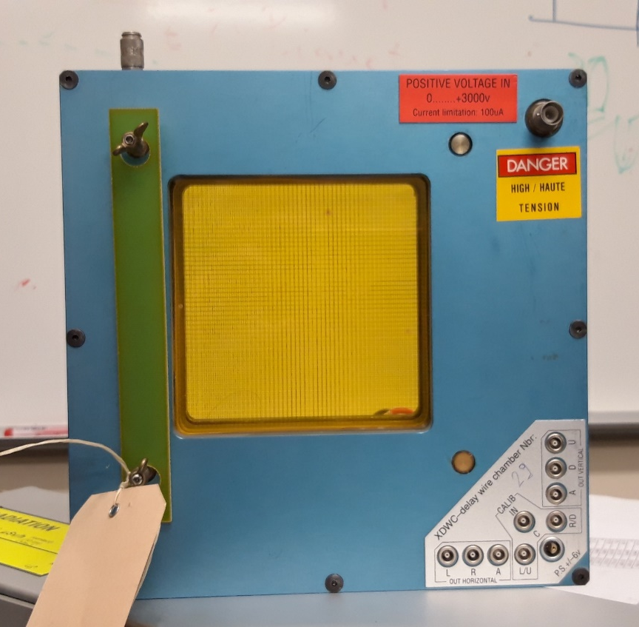
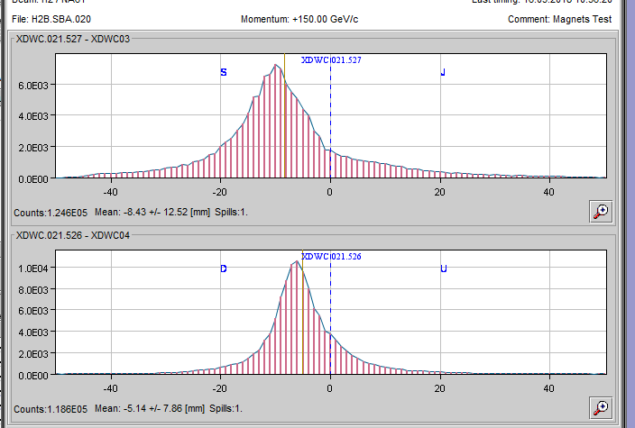
Delay Wire Chambers
Gaseous detector developed in early 80’s
Similar to MWPC
Spill up to 2x10⁵ particles per second
Resolution 0.2 mm
In air

Slide 5
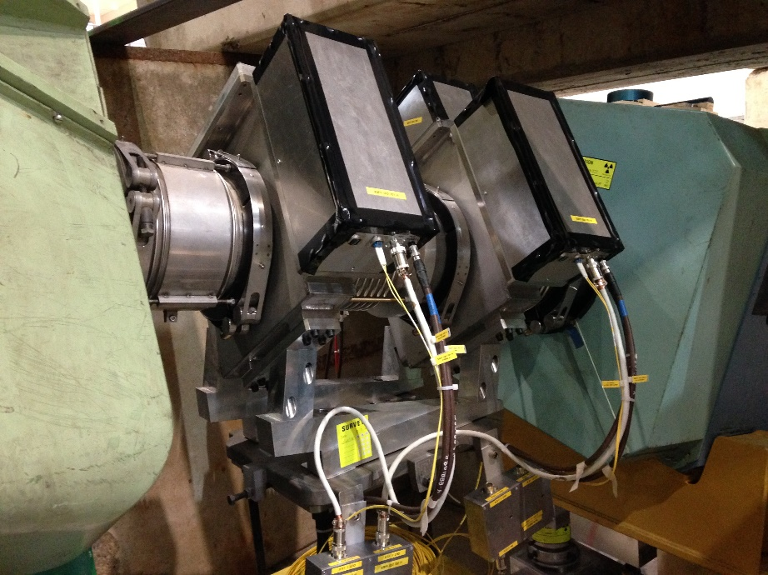
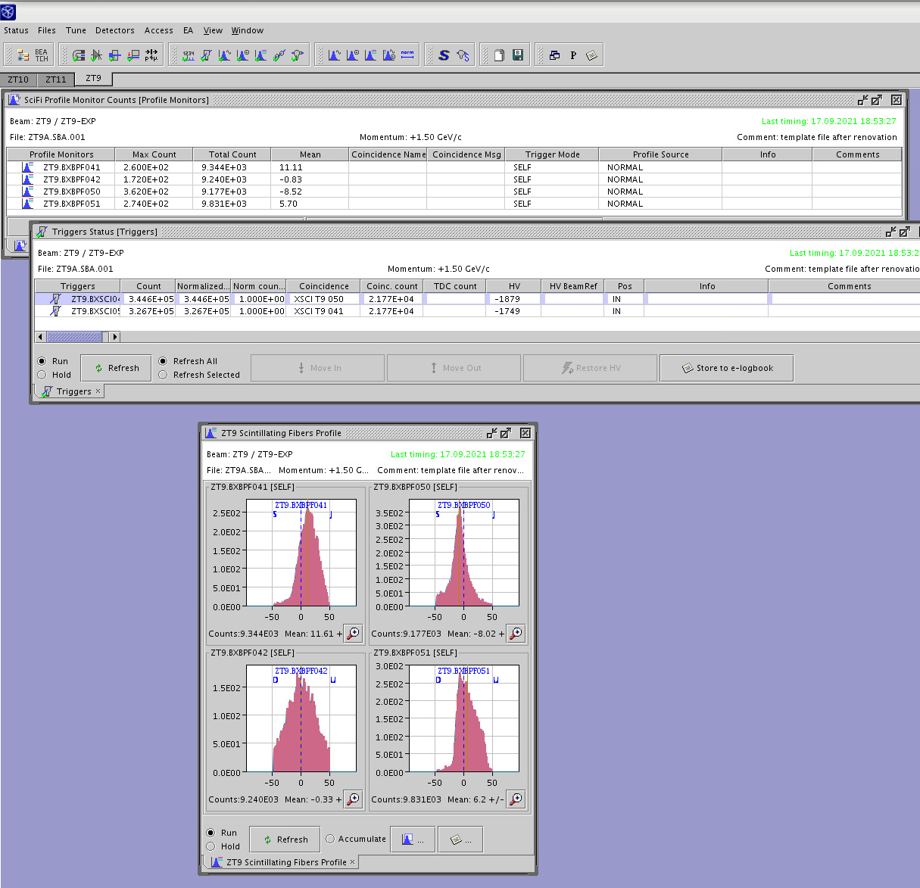
Scintillating Fibre profile monitors : XBPF
Replaced the wire chambers in NP and EA
100 or 200 scintillating fibres
Light from every fibre read-out by indiv Si PM
No gas, no HV
Vacuum Compatible : reduced material budget
In/out motorisation
Spill : 100 to 10⁷ particles/second/mm²
Resolution : 1 mm

Slide 6
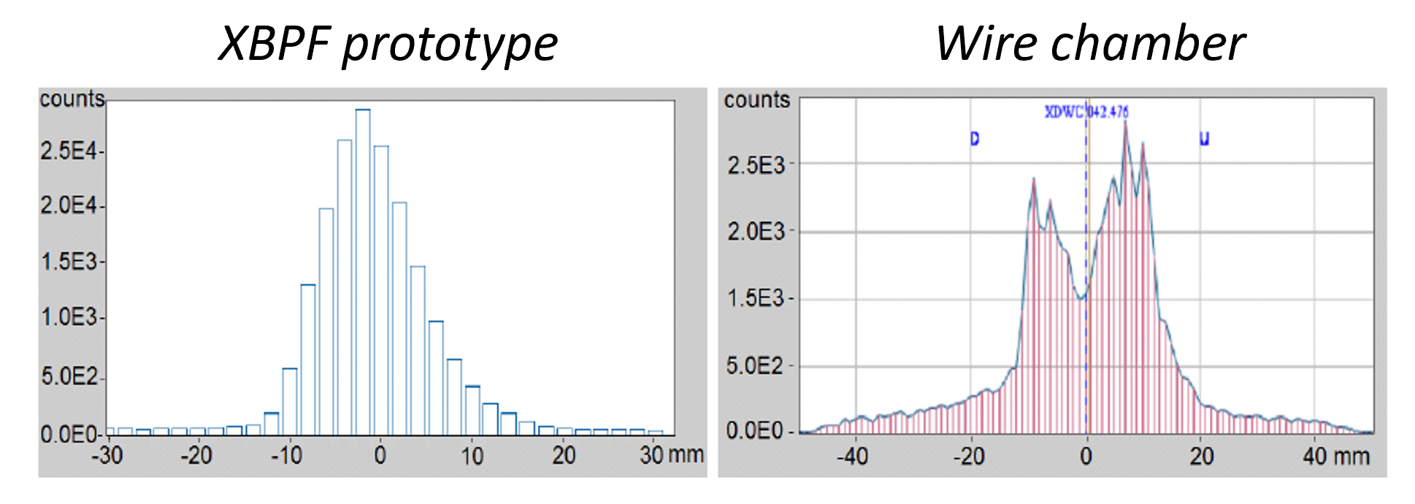
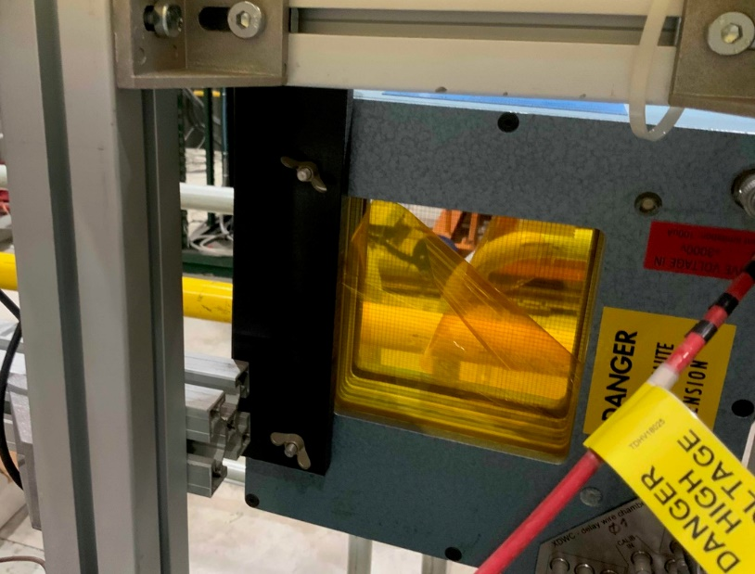
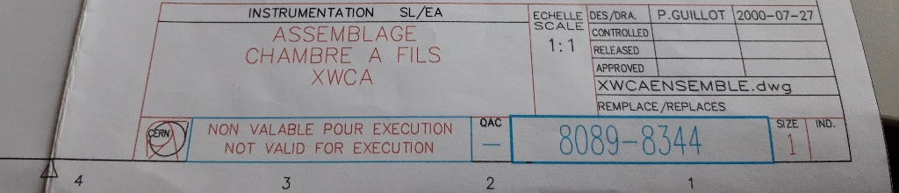
Problems (1)
Gaseous chambers : 40+ or 50+ years old
Radiation damage : PTFE
Loss of sensitivity ⇒ silicon deposit
Tooling and knowhow for repair are lost
Aug ‘22, two DWCs destroyed by users : overpressure of 3 bars
Only paper drawings available
SEM image of a wire with silicon deposit caused by exposure to highly ionising beams

Slide 7
Problems (2)
Essential for sec. lines commissioning, and daily operation
NA-CONS work units
  Electronics boards : Phase 1
  Replacenent by XBPF : Phase 2, ie deployed in 2030 !
Limited operational spares
 | Operational | In stock (ready) | In stock (broken)
Small MWPC | 21 | 2 | 9
Large MWPC | 16 | 1 | 7
Delay Wire Chamber | 16 | 3 | 12

Slide 8
Proposed solution
We propose a program to refurbish ten units of each type of wire chamber currently used in the North Area:
  10 small MWPC
  10 large MWPC
  10 Delay Wire Chambers
These quantities should cover eventual replacements of operational chambers until the new XBPF is fully deployed in LS4.

Slide 9
Resources : 220 kCHF
Material : 60 kCHF
  2 kCHF per monitor : PCB wire planes and local electronics x30 monitors
  re-use mech. frame
Manpower : 160 kCHF, two man.year of an electro-mechanical technician (ORIGIN)
  Study the current design and identify possible improvements.
  Investigate the use of radiation-hard materials.
  Provide CAD models and drawings of the new design.
  Build/optimize a prototype of the new detector.
  Write a procedure for the assembly of the new detector.
  Follow-up of series production: Lead the assembly and quality control of the new detectors.

Slide 10
Timeline
Due to the critical situation and increasing failure rate, it would be advisable to start in 2023.
The budget profile would be as follows:
  2023: 110 kCHF = 80 kCHF ORIGIN + 10 kCHF prototyping + 20 kCHF electronics.
  2024 : 110 kCHF = 80 kCHF ORIGIN + 30 kCHF series production.
To be urgently presented at the IEFC

Slide 11
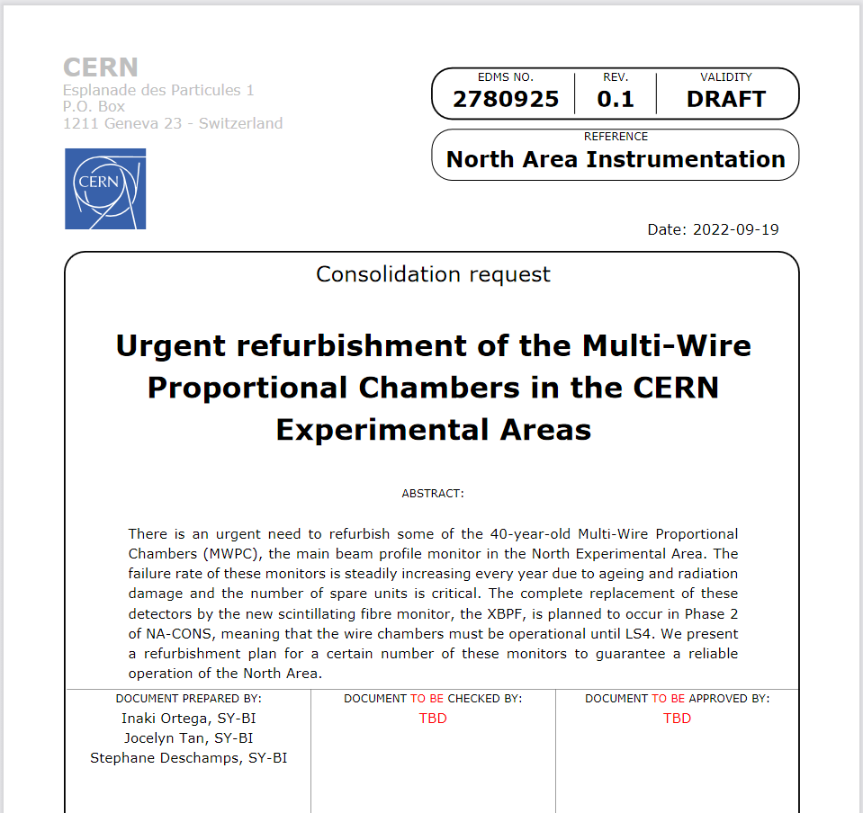
A consolidation request drafted

