Slide 1


Search for Dark Energy
— beyond ΛCDM
Hauke Fischer
Parallel talk at the TAUP conference, Vienna 29 / 09 / 23

Slide 2
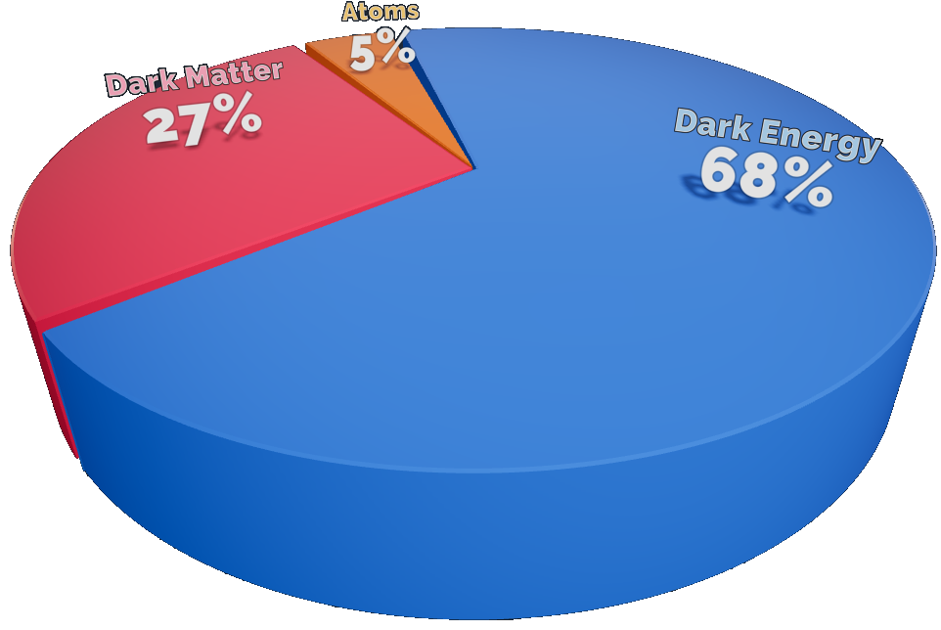
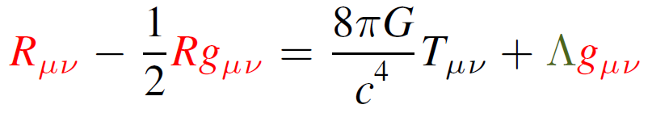
Background
Dark energy comprises the largest portion of energy in the universe¹
Its simplest description is given by a cosmological constant

Slide 3
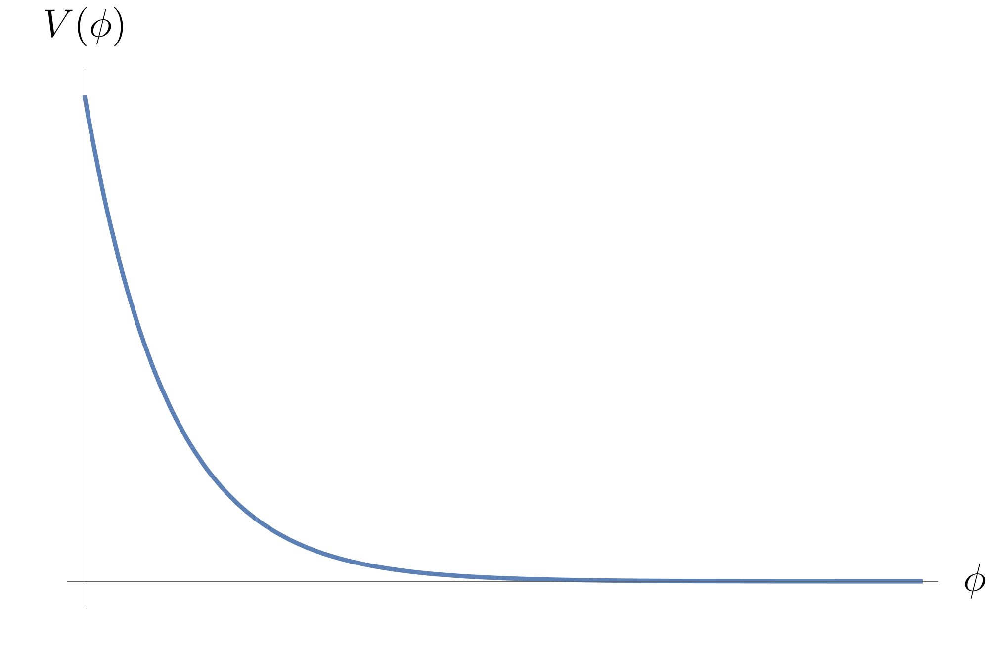
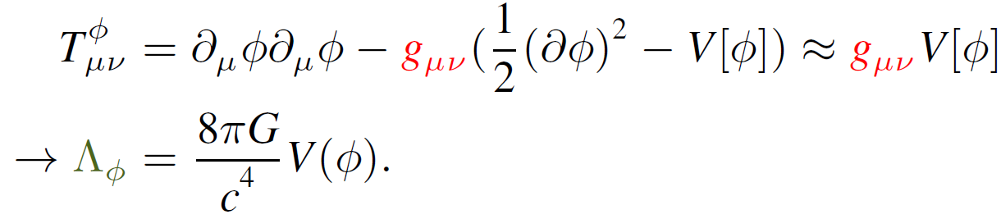
Background
Λ might be assosciated with the zero point energy of quantum fields, but there is a discrepancy of ~ 55-60 orders of magnitude^{2,3}
Alternatively, dark energy could be due to a slowly rolling scalar field
3. Sola, Joan. "Cosmological constant and vacuum energy: old and new ideas." Journal of Physics: Conference Series. Vol. 453. No. 1. IOP Publishing, 2013

Slide 4

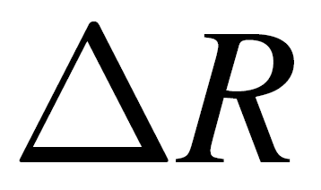
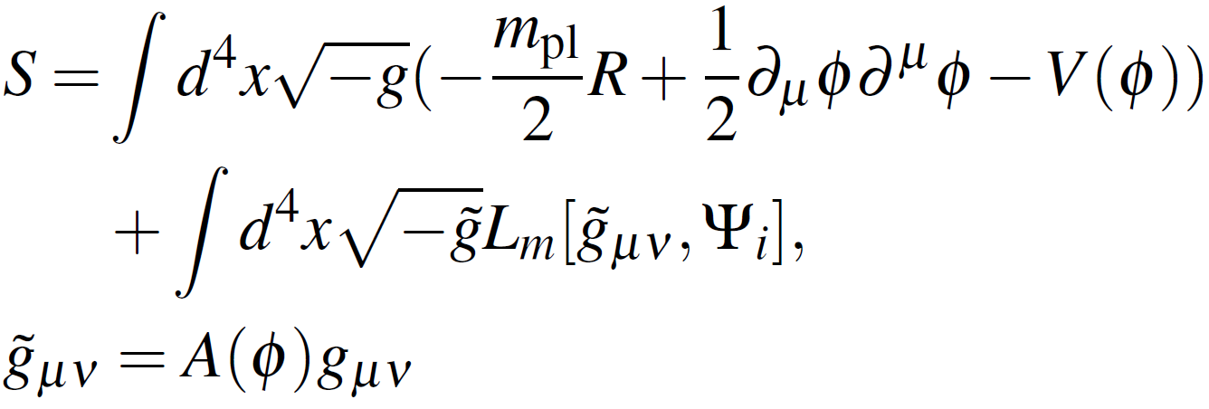
Background
These scalar fields generically lead to fifth forces in the solar system
Some screening mechanism⁴ should be present, in order to explain the null results from solar system tests

Slide 5
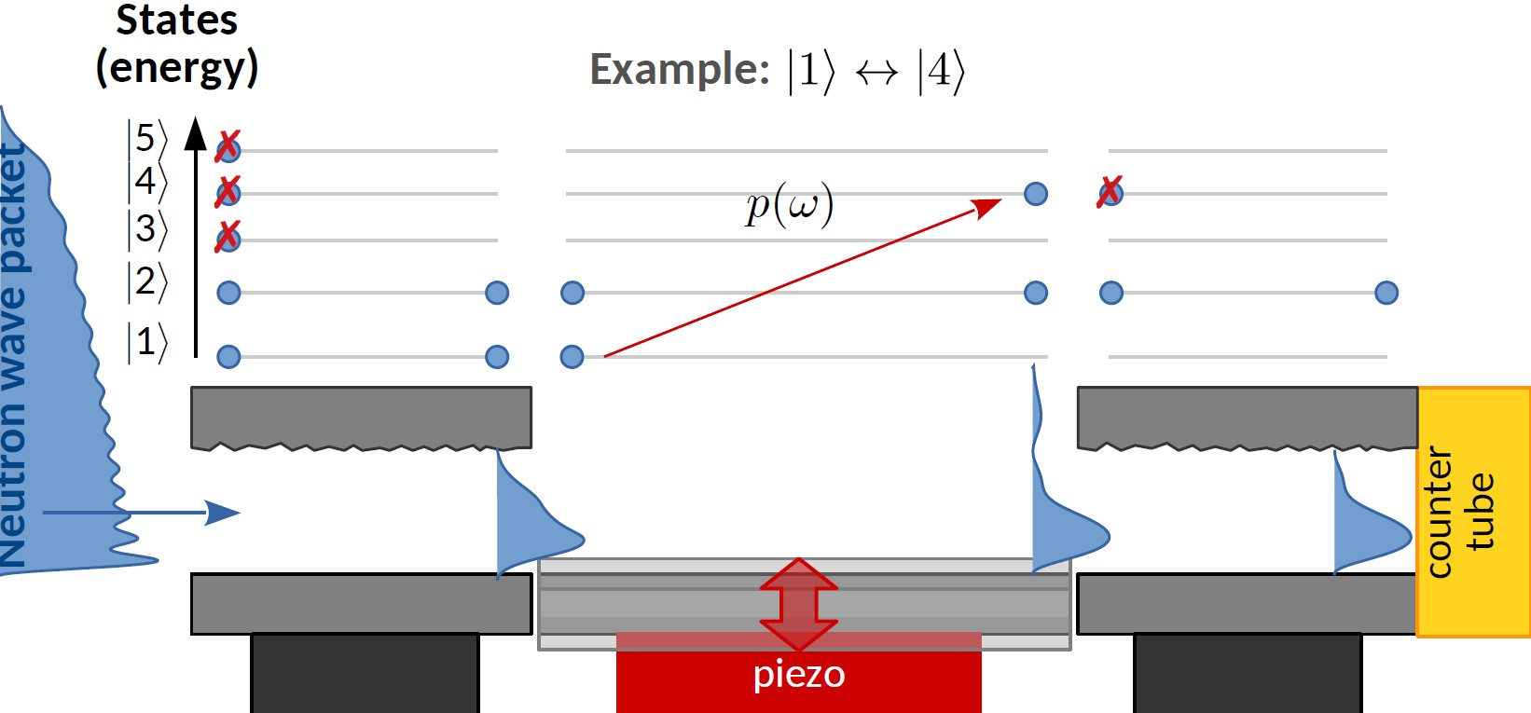
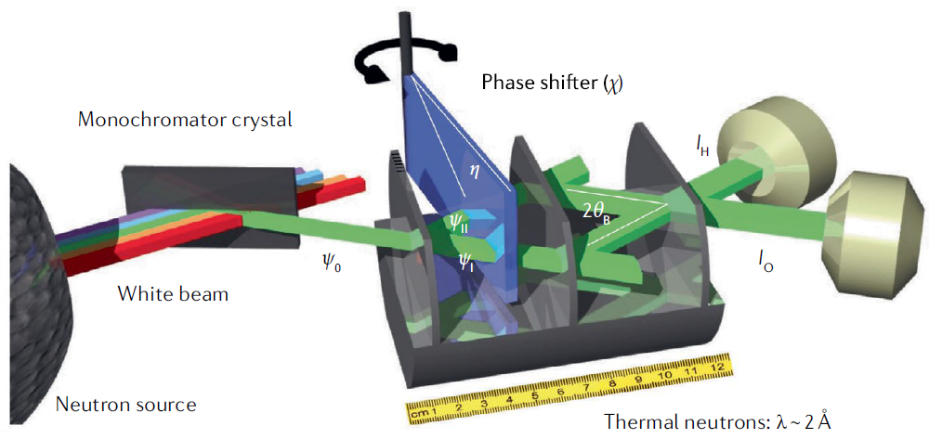
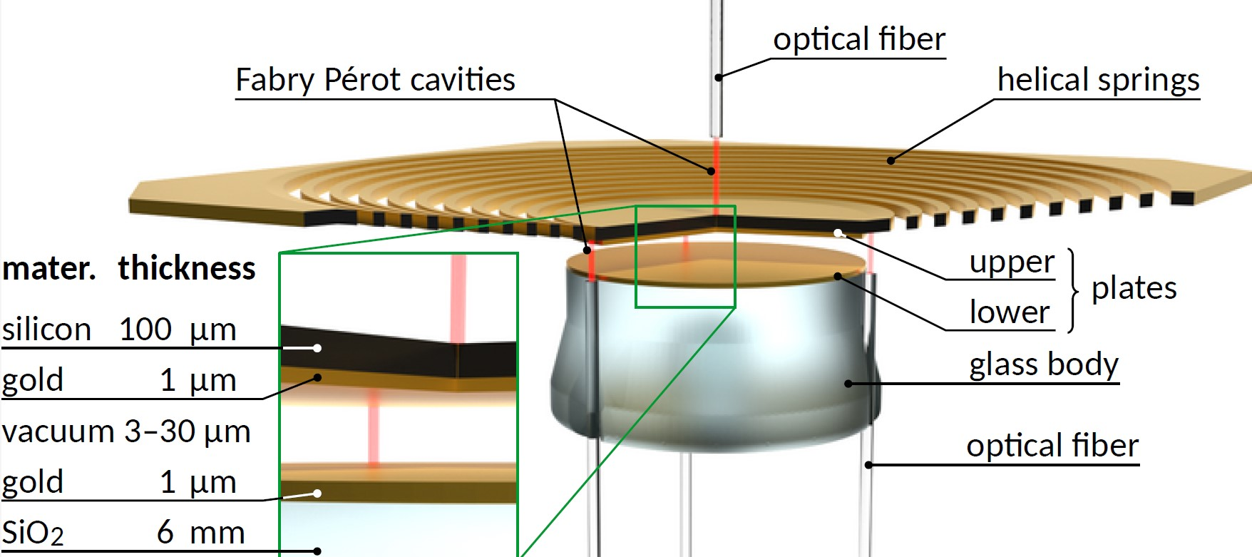
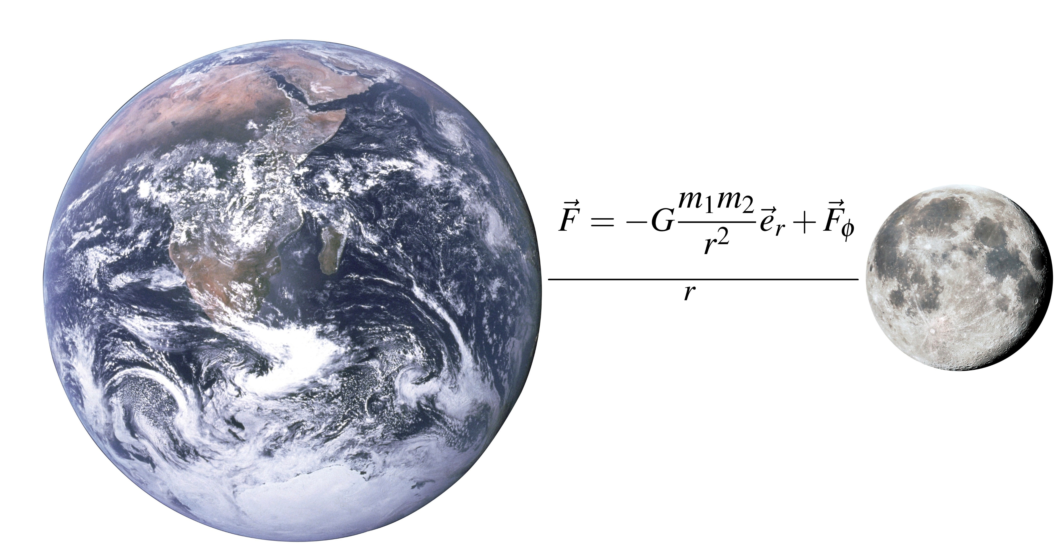
Methods: Analysis of experiments
Neutron interferometry
qBounce
Neutron interferometry⁵
Neutron interfermtry
CANNEX
Lunar Laser Ranging
Lunar Laser Ranging

Slide 6
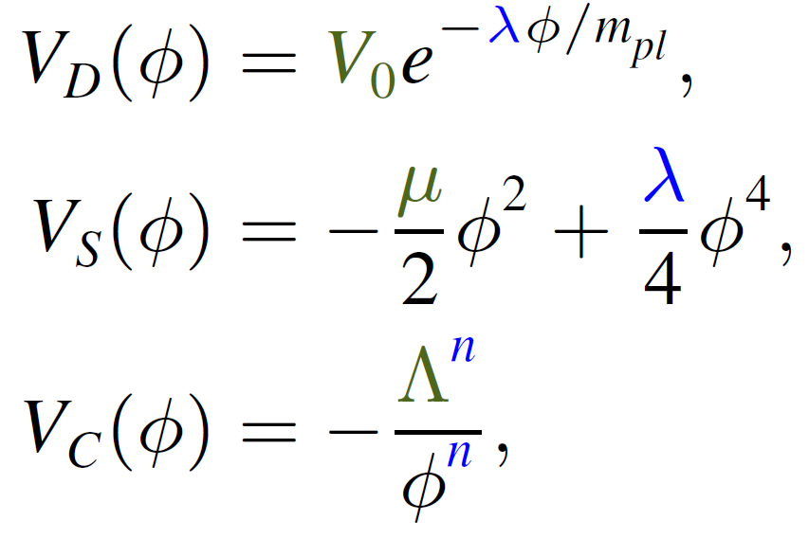
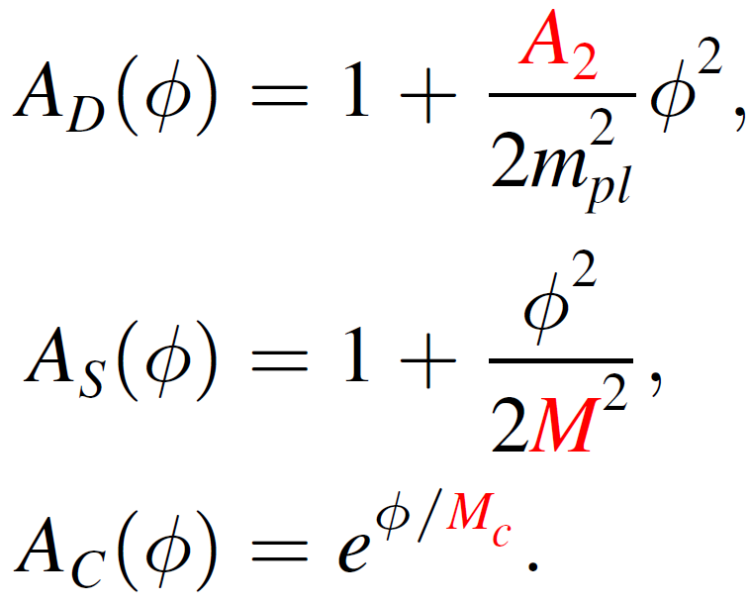
Research goals
Constrain the parameter space with table top experiments at the ATI
  Dilaton⁶:
  Symmetron⁶:
  Chameleon⁶:
Consult experimentalists
Gain physical insight into these models

Slide 7
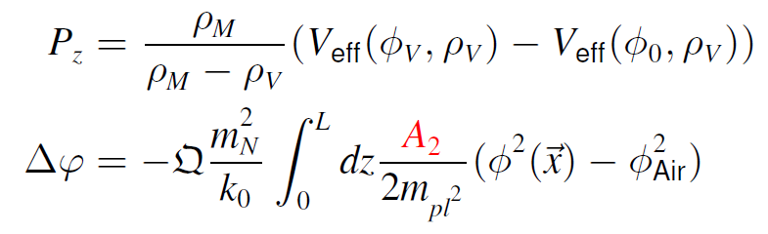
Analytical results
Derivation of scalar field dependent physical effects
  Pressure between plates (CANNEX)
  Relative phase shift (Interferometry)
  …
Derivation of precise screening mechanisms of the Dilaton field

Slide 8
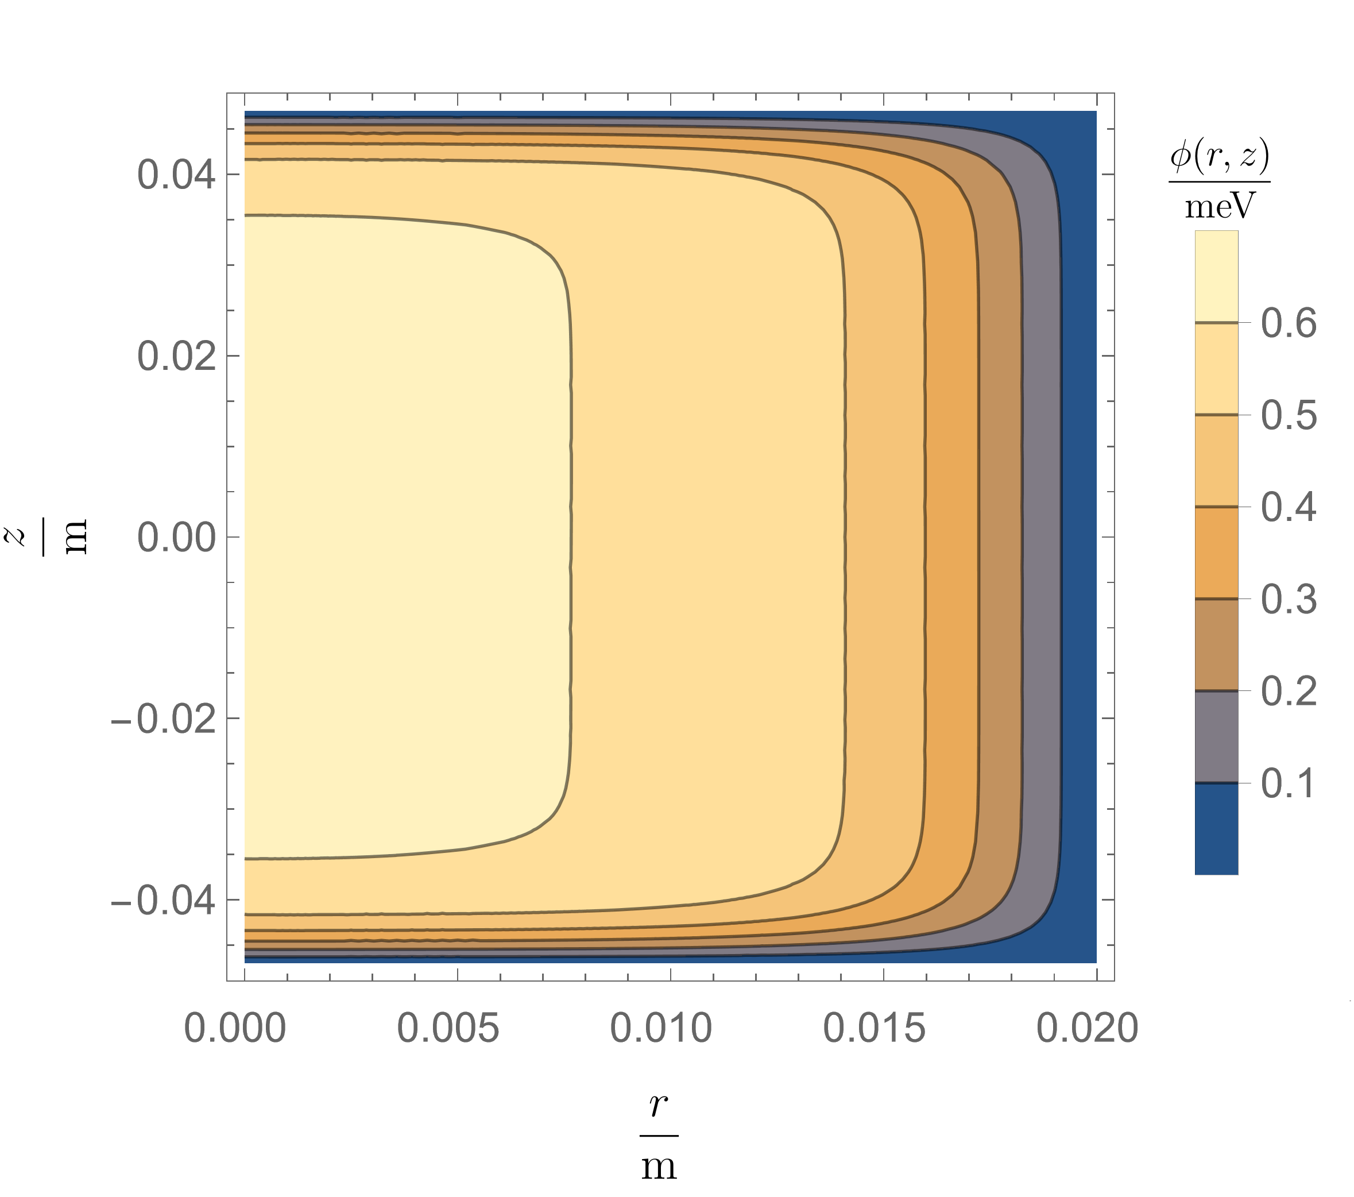
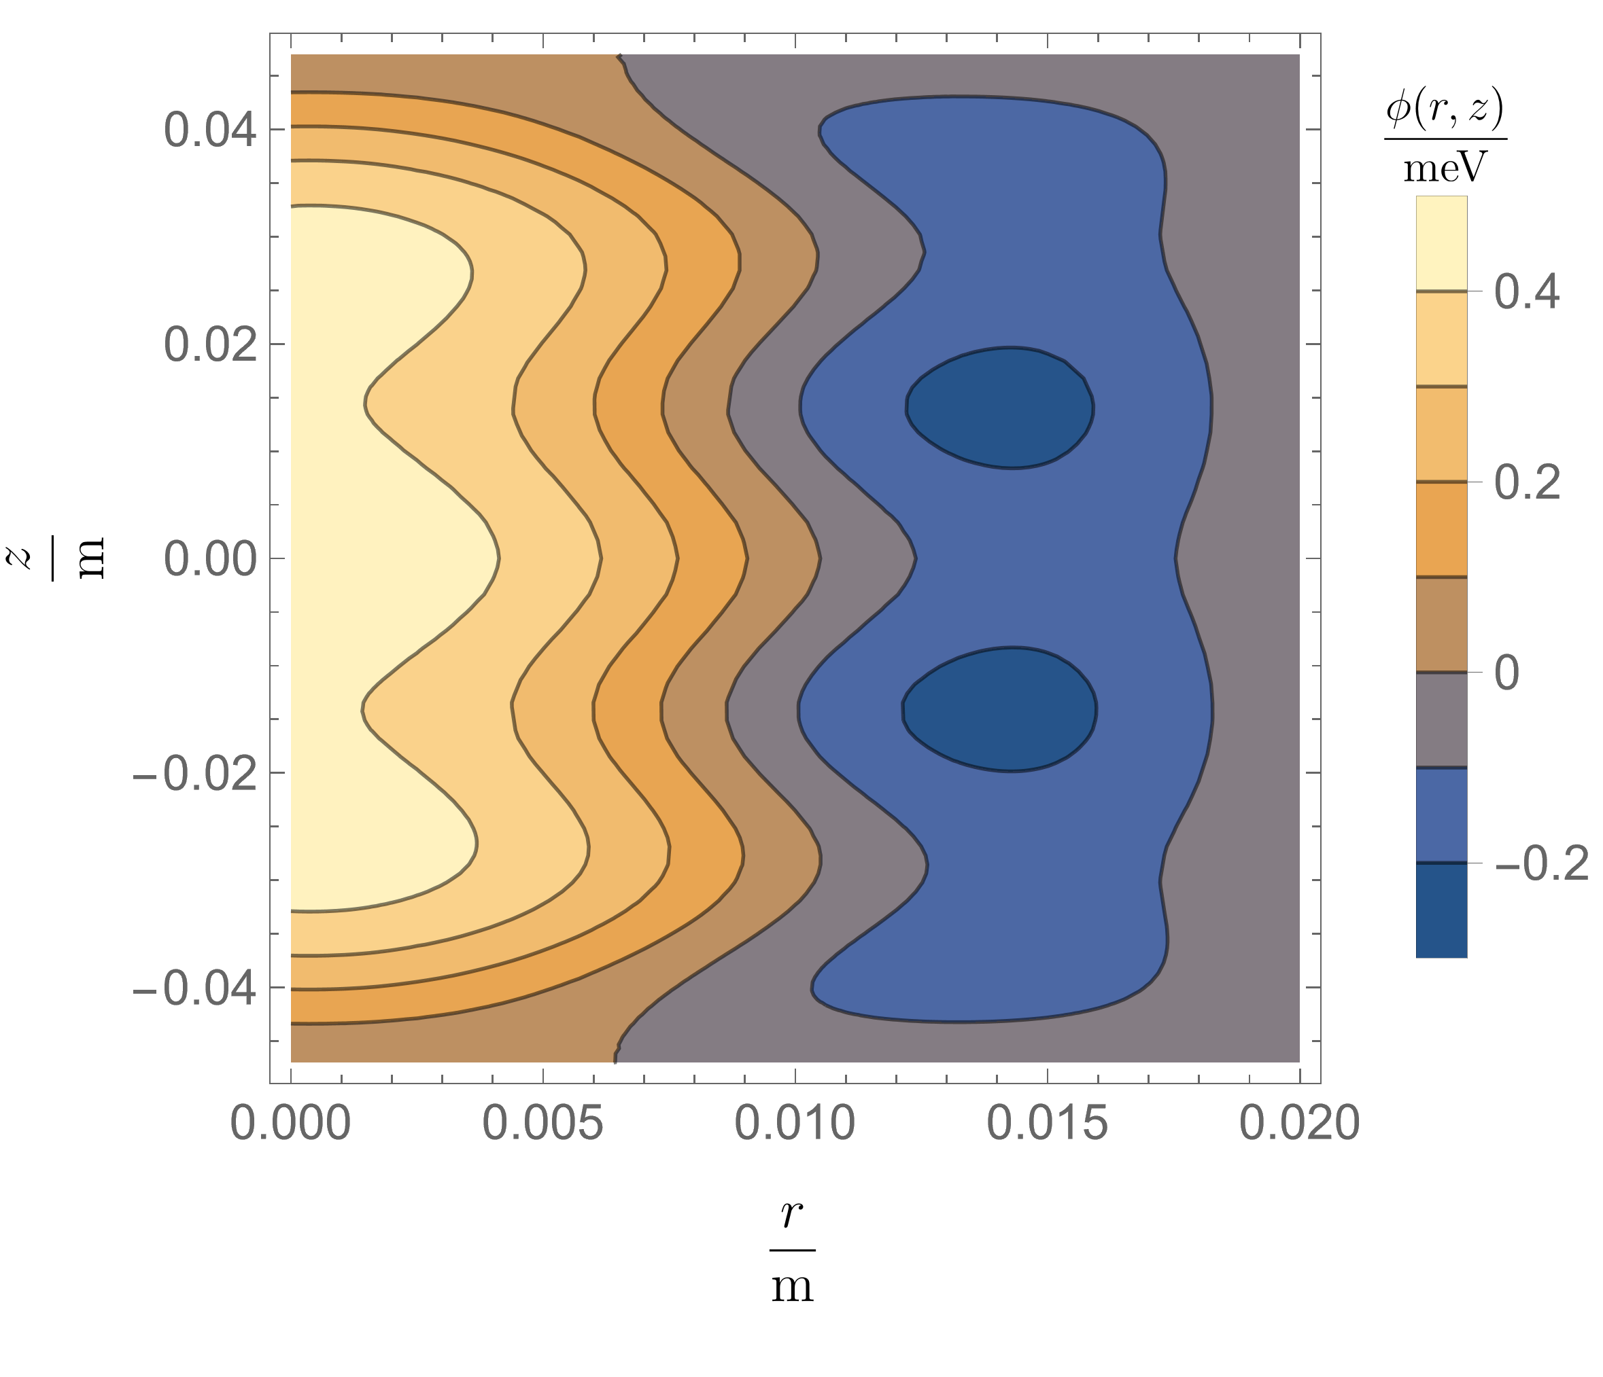
Numerical results
Solve non-linear field equations numerically

Slide 9
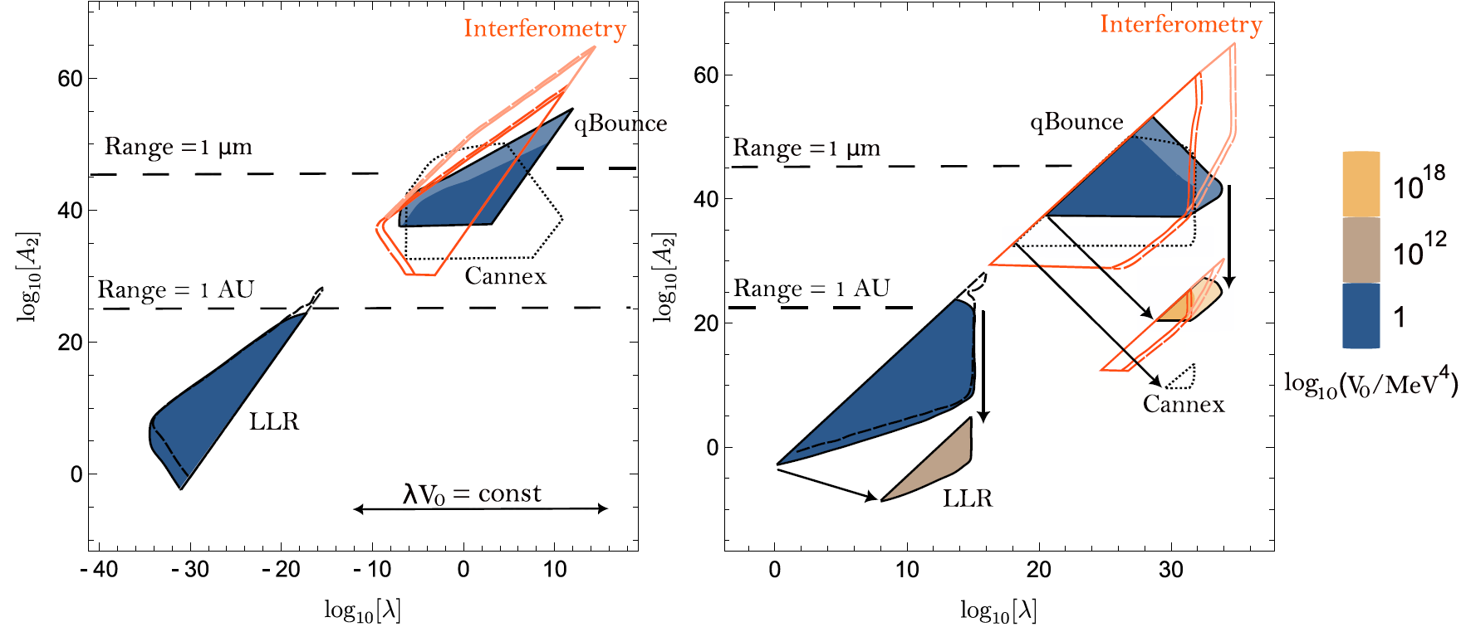
Resulting constraints on the dilaton model

Slide 10
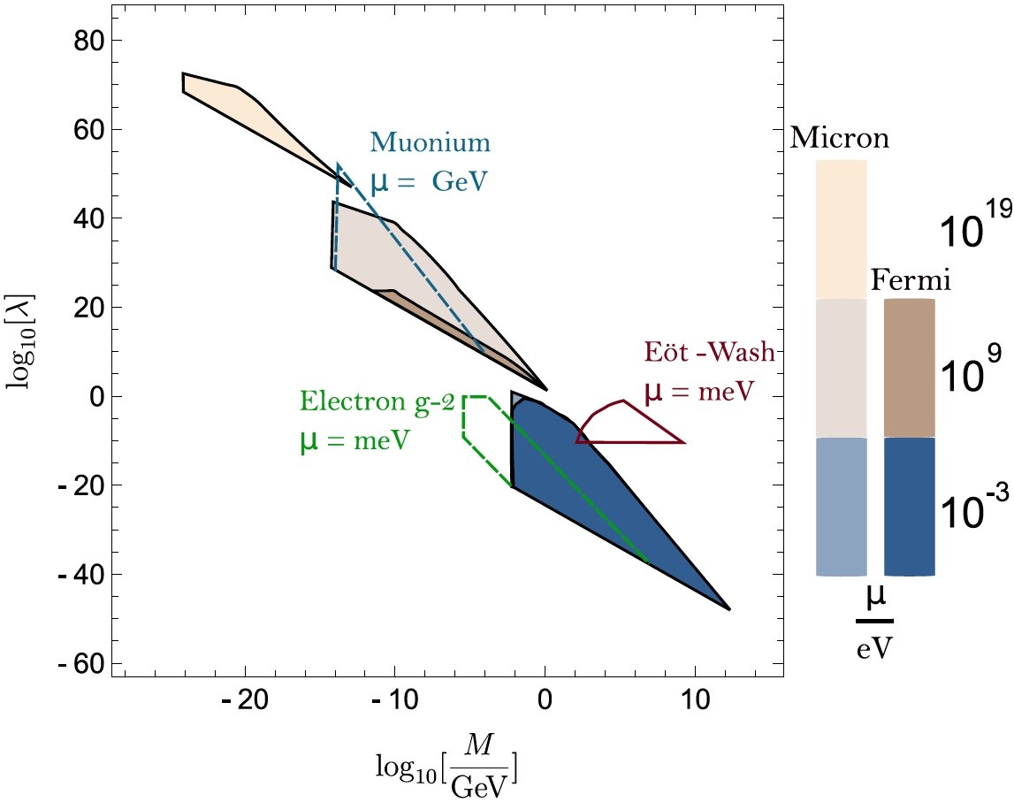
Resulting constraints on the symmetron model
8. Burrage, Clare, and Jeremy Sakstein. "Tests of chameleon gravity." Living reviews in relativity 21 (2018): 1-58.

Slide 11
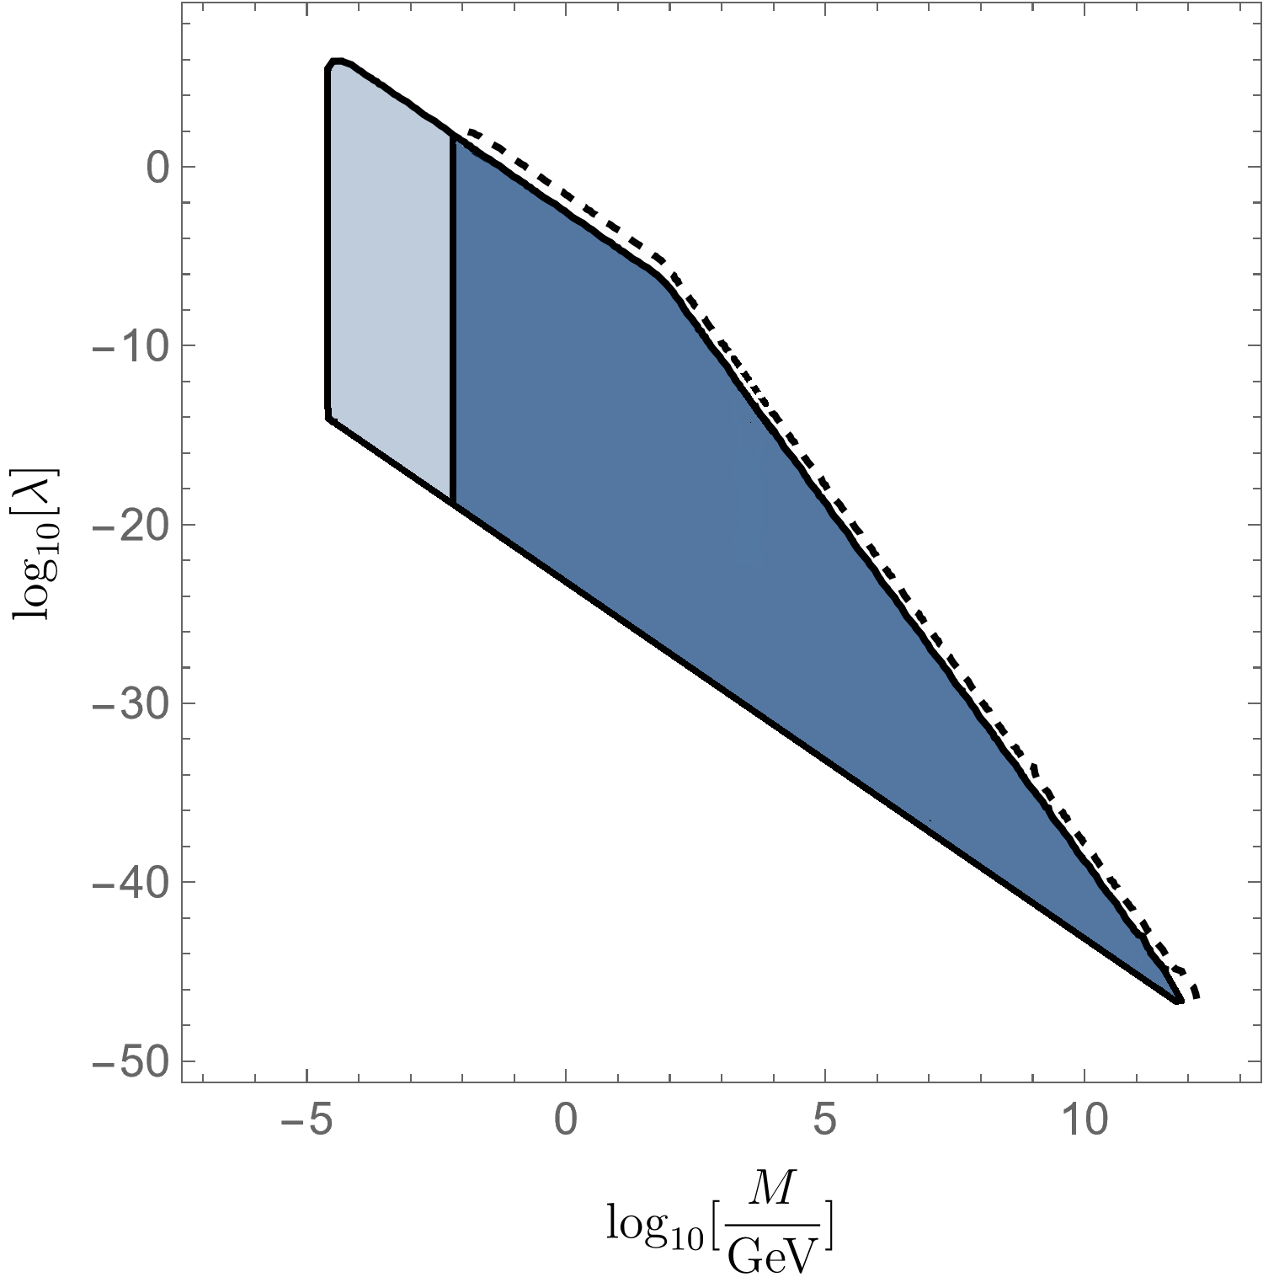
Future improvements
Dashed Line: Chamber length X 10
Light area: Better vacuum pressure
Ideal: Tunable vacuum pressure

Slide 12
Further material
[I]
Philippe Brax, H.F., Christian Käding, Mario Pitschmann. The environment dependent dilaton in the laboratory and the solar system. The European Physical Journal C 82.10 (2022): 934
[II]
H.F., Christian Käding, Réne Sedmik, Harmut Abele, Philippe Brax, Mario Pitschmann. Search for environment-dependent dilatons. arXiv preprint arXiv: 2307.00243 (2023) (submitted)
[III]
H.F., Christian Käding, Stephan Sponar, Hartmut Lemmel and Mario Pischmann. Search for dark energy with neutron interferometry. (to be submitted soon)

Slide 13
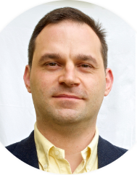
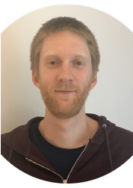

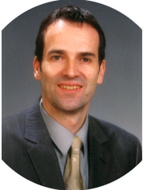
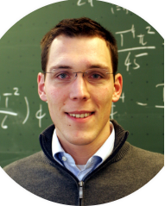

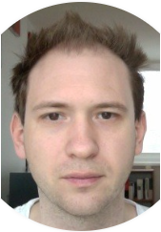
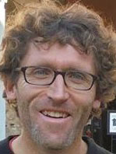
Contributiors
Theorists @ ATI:
M. Pitschmann
H. Fischer
C. Käding
Experimentalists @ ATI:
H. Abele
R. Sedmik
H. Lemmel
S. Sponar
Theorist @ Université Paris-Saclay:
P. Brax

Slide 14
Thank you for your attention!

Slide 15
Backup-slides

Slide 16
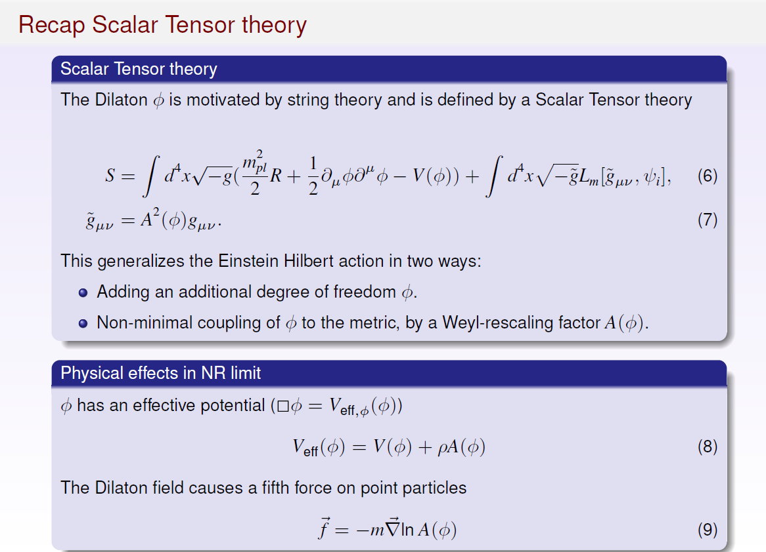

Slide 17
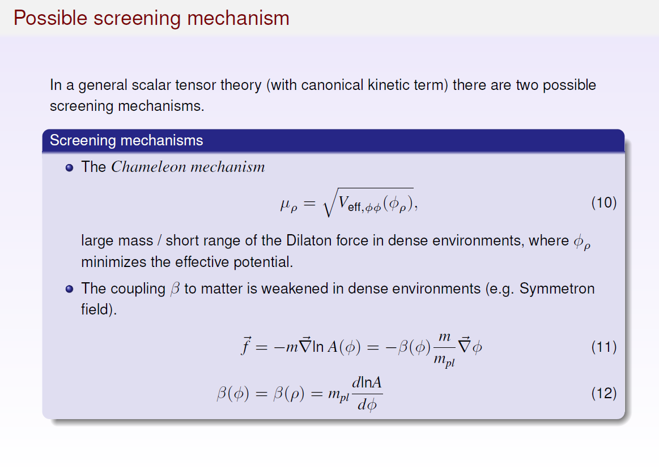

Slide 18
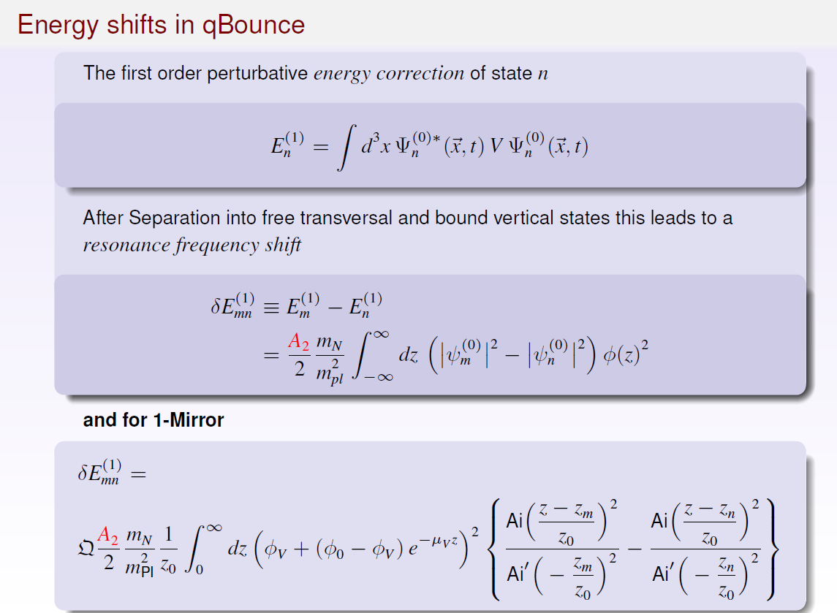

Slide 19
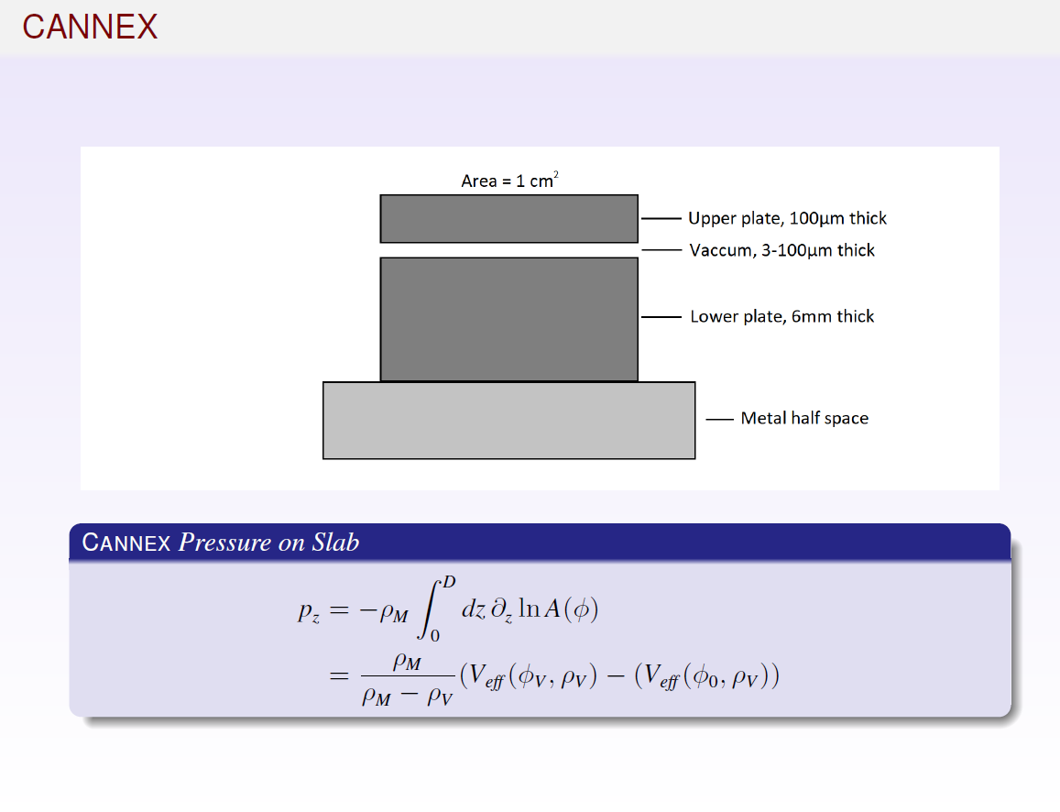

Slide 20
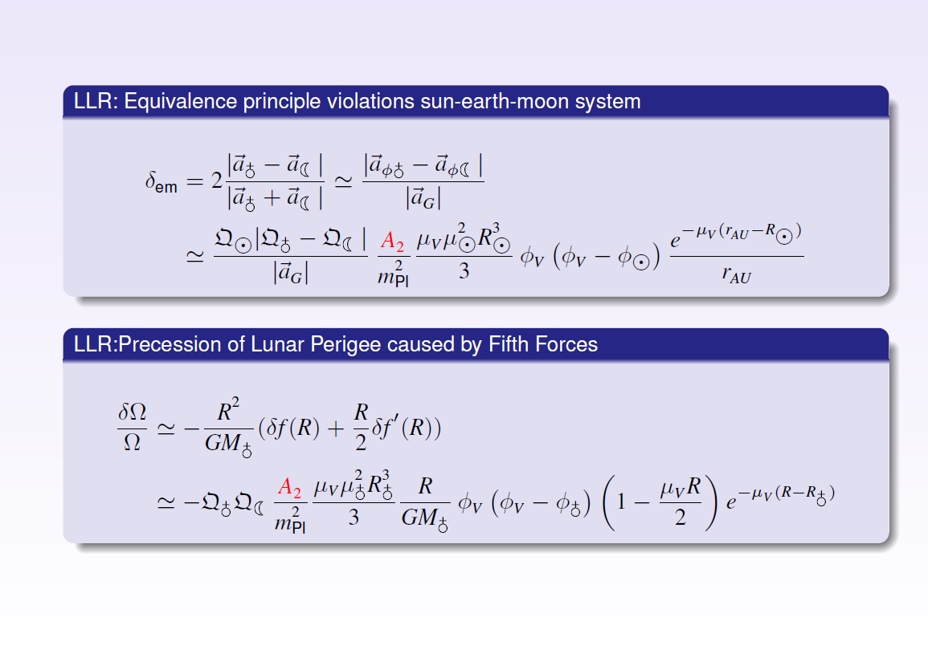

Slide 21
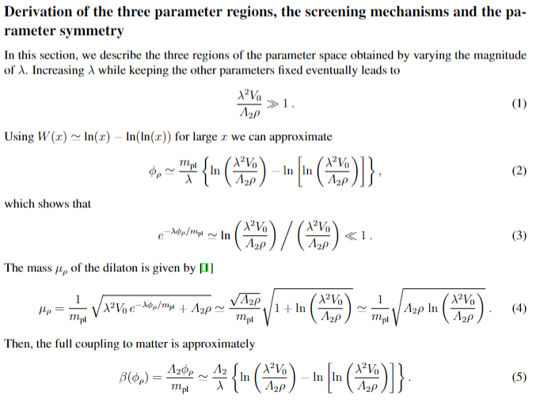

Slide 22
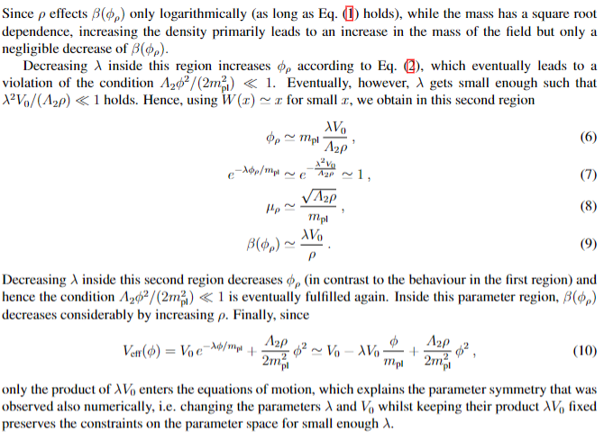

Slide 23
