Slide 1
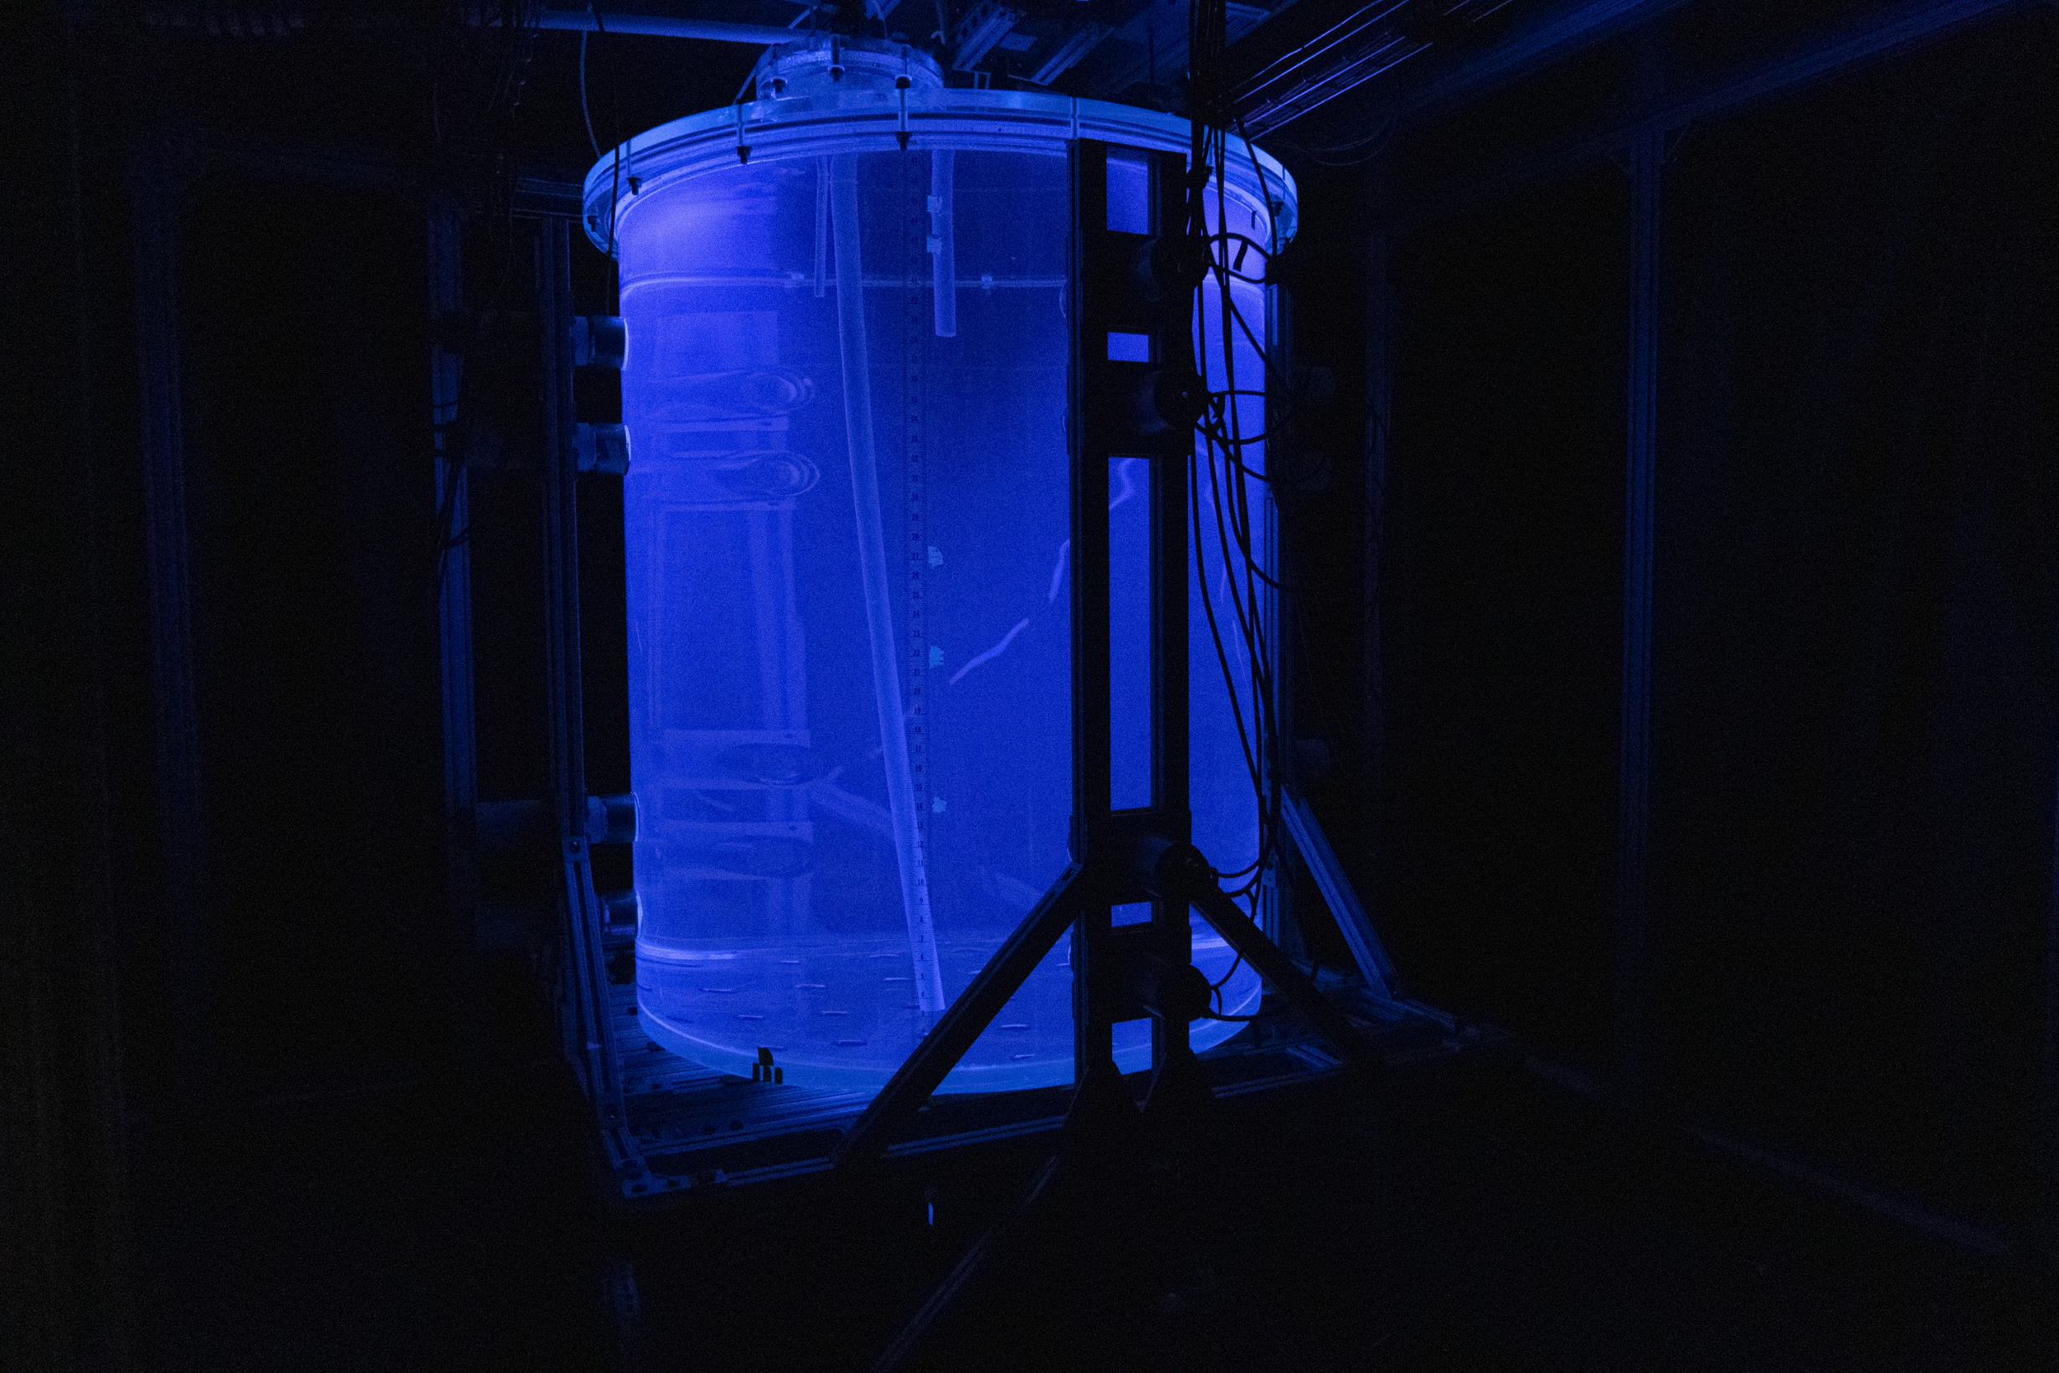
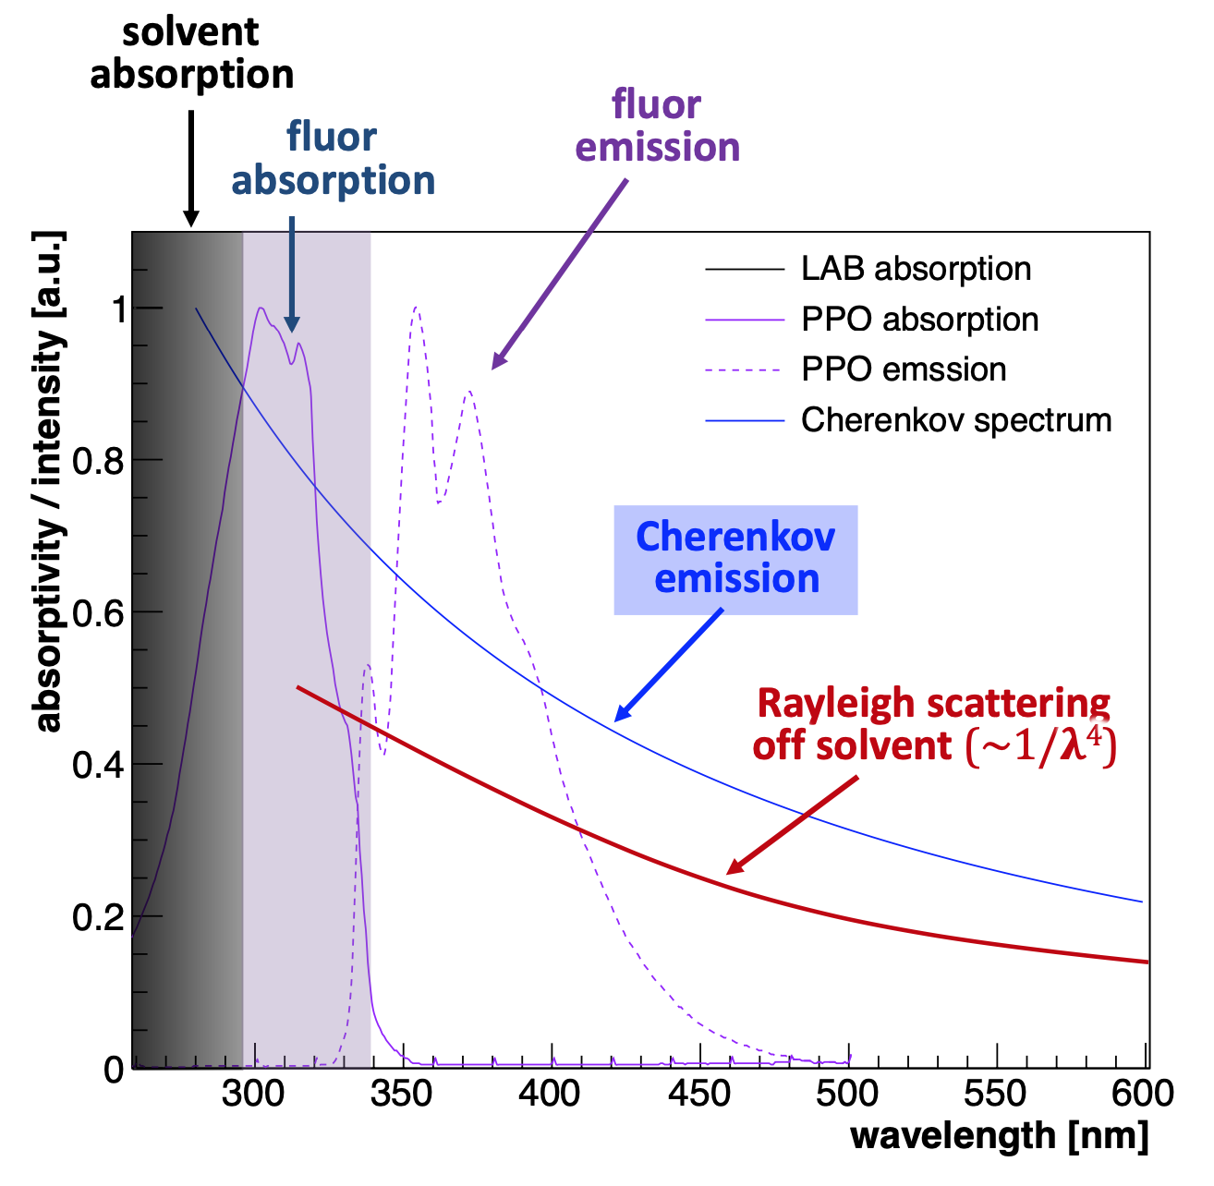

Status of the 30-ton Purification Demonstrator at Brookhaven

Slide 2
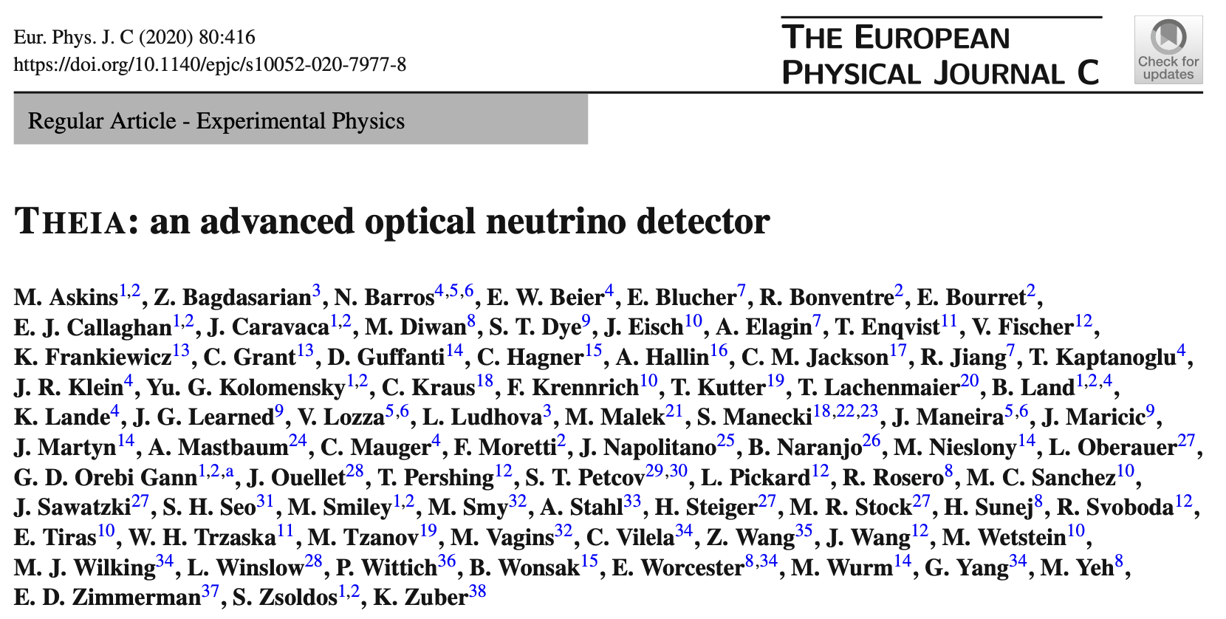
Theia White Paper details the science that could
be done by making a Hybrid Optical Detector
that could separate Cherenkov and scintillation
light using Water-based Liquid Scintillator

Slide 3
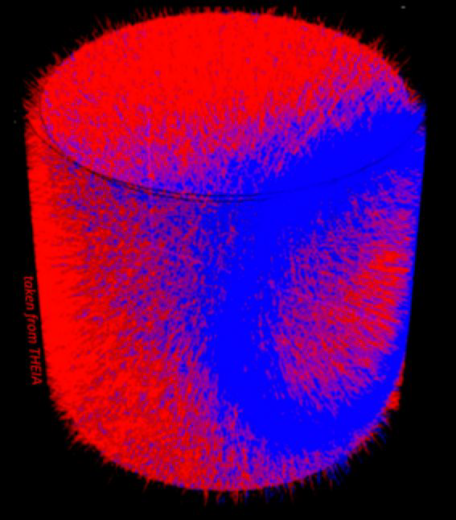
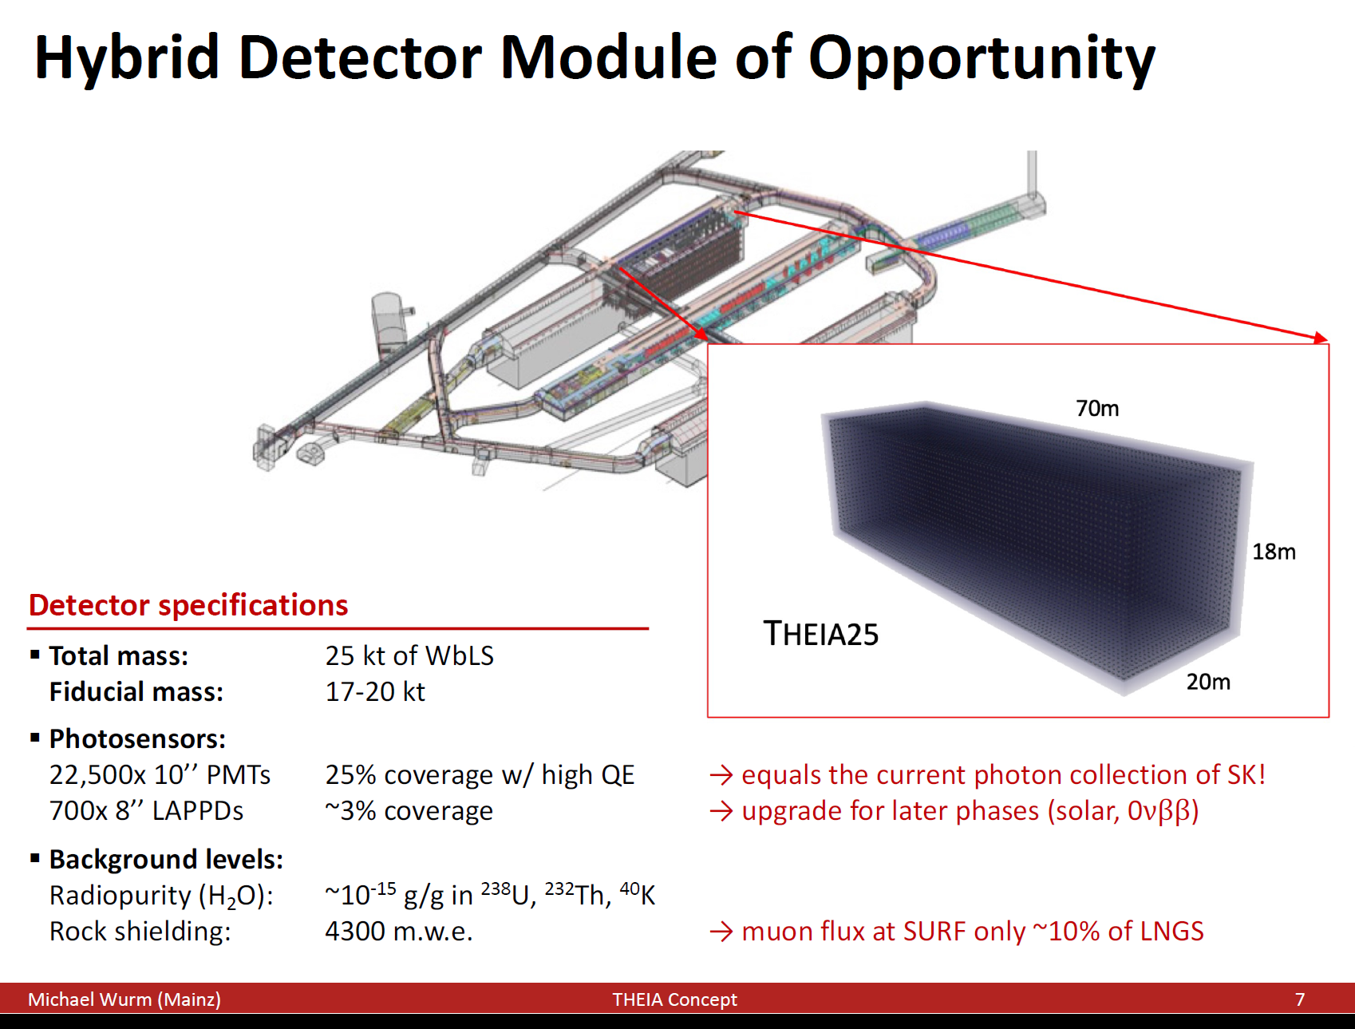
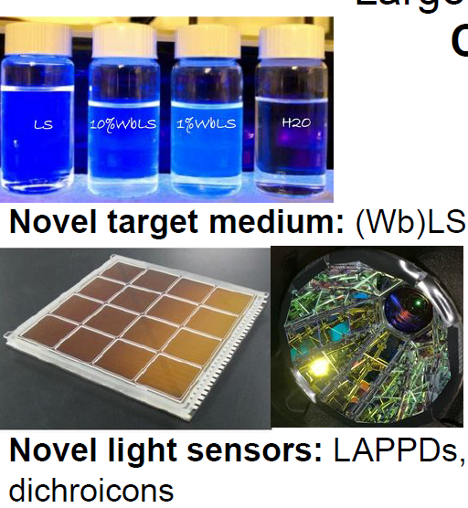
Hybrid Cherenkov/Scintillator Module (“Theia”)
Hybrid signals allow broad physics program:
CP violation with sensitivity same as 1 DUNE module for Theia25
  Low-Z target allows cross check with Hyper-K
  Requires changes to ND suite
Precision low-energy solar neutrinos (CNO, pep, ⁸B MSW transition)
Diffuse supernova background neutrinos
Literally complementary supernova burst signal: anti-ν_{e} vs. ν_{e}
Eventual 0νββ experiment with sensitivity beyond inverted ordering
Solar and Geo neutrinos
New technologies make this possible

Slide 4
How Does This Work?
Many aromatic organic compounds naturally scintillate due to benzene ring excitation. Addition of a fluor (e.g. PPO) is necessary for high light yield
unless a PPO molecule can absorb the energy, it will eventually be lost to heat. Thus, adding PPO increases the light yield in addition to speeding up the process
If one could dissolve aromatic compounds
in water in droplets with size larger than
the scale size of this molecular
process it should still work
The time it takes to transfer energy
to the PPO gets shorter as concentration increases.

Slide 5
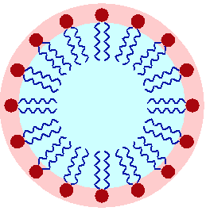
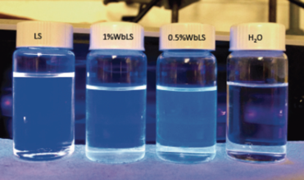
Water-based Liquid Scintillator
WbLS works by forming small (~10 nm scale) droplets called micelles in water that are stabilized by surfactant molecules with a hydrophilic head and hydrophobic tail. Micelles form under controlled chemical conditions and are shown to be stable over year time scales.
surfactant
molecules
Advantages: Disadvantages
Cheaper than LS Radiological cleanliness more difficult
Non-combustible Lower light yield than pure LS
Ease of loading Li, Te, etc
Environmentally friendly
Oxygen nuclei instead of Carbon
~10 nm
LS

Slide 6
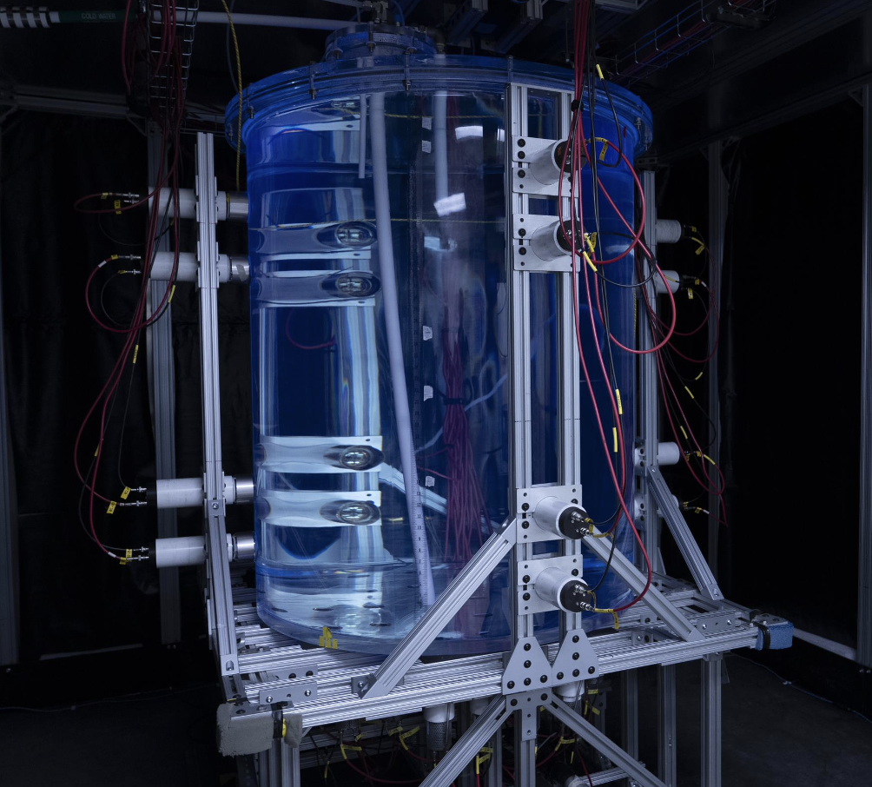
Large scale demonstrators are now under construction
The development of hybrid optical detectors is now beyond the “R&D stage”
A coherent program of prototyping is well underway. Expect completion by early 2025
These prototypes will allow us to complete the final work on most remaining technical options, including:
  fill media characterization
  photosensor array composition
  liquid purification system parameters
  low energy and high energy event reconstruction
BNL 1-ton demonstrator

Slide 7
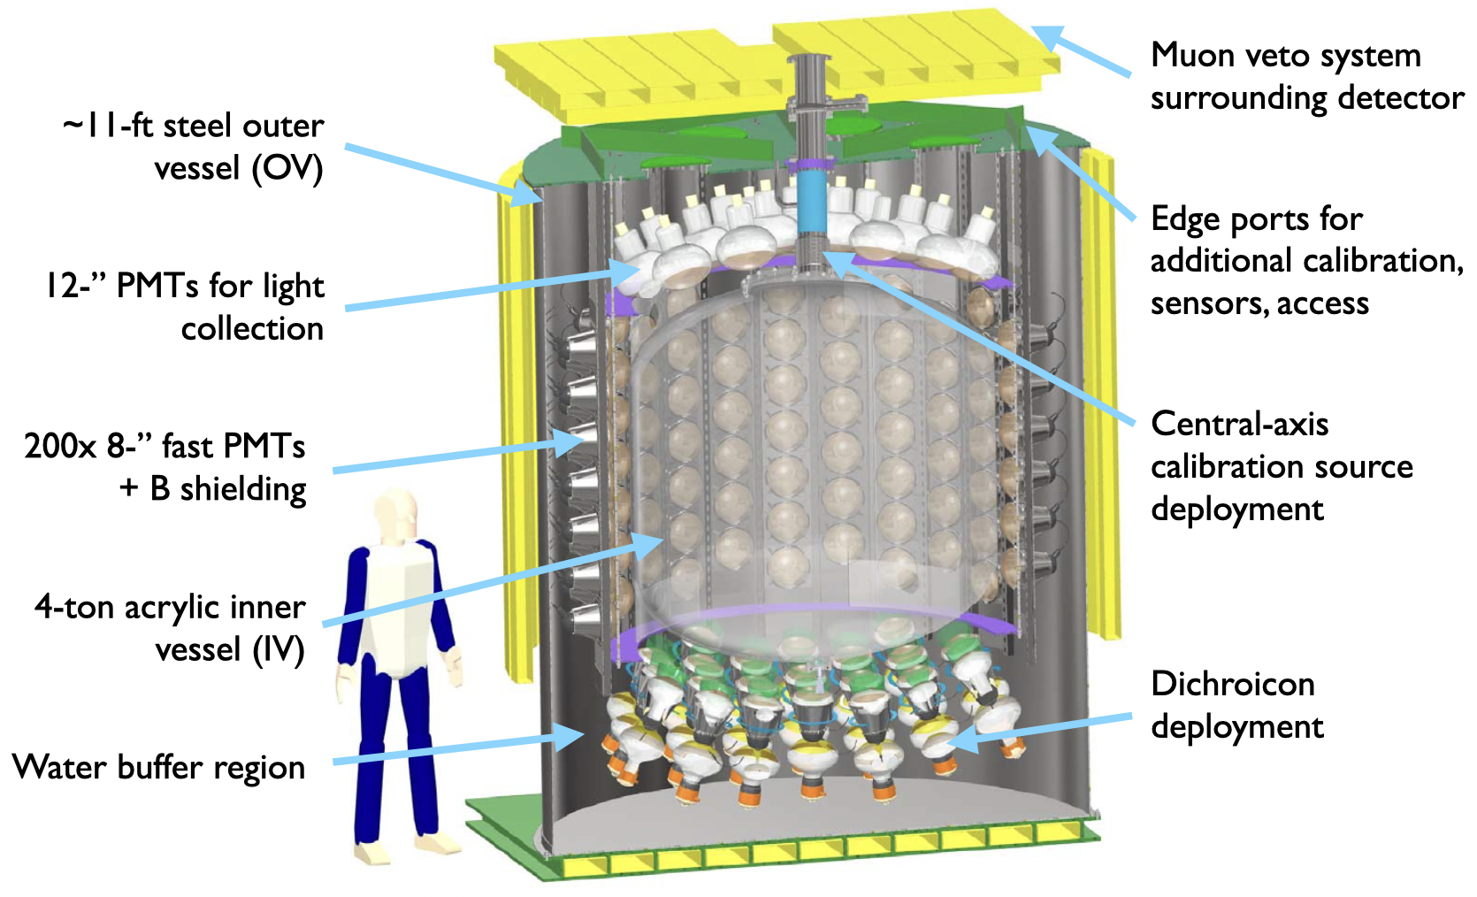
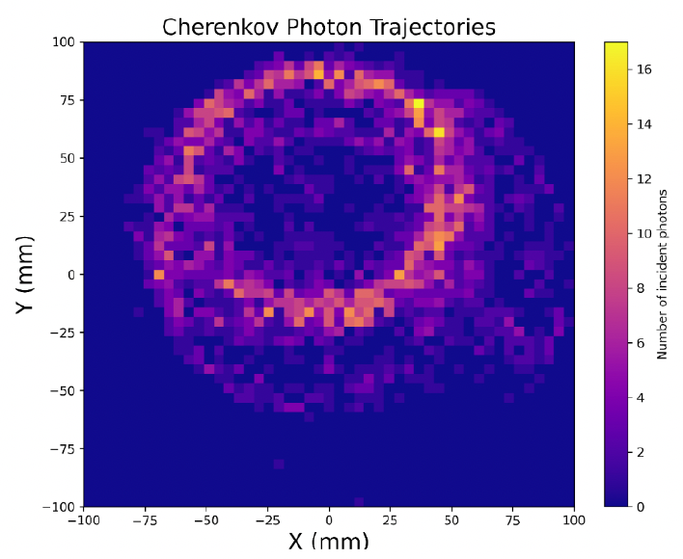
Eos: performance demonstrator
Project goals:
Demonstrate event reconstruction using hybrid Cherenkov + scintillation signatures
Validate models to support large-scale detector performance predictions
Provide a flexible testbed to demonstrate impact of novel technology
Integrated testbed to demonstrate the performance of novel technology:
4-ton target mass: water, WbLS, organic LS
200 8” PMTs: R14688-100, 900ps FWHM
CAEN V1730 readout
Dichroicon deployment for spectral sorting
Deployable sources for studies of vertex, energy, direction reconstruction & PID
Eos detector paper published: JINST 18 P02009 (2023),

Slide 8

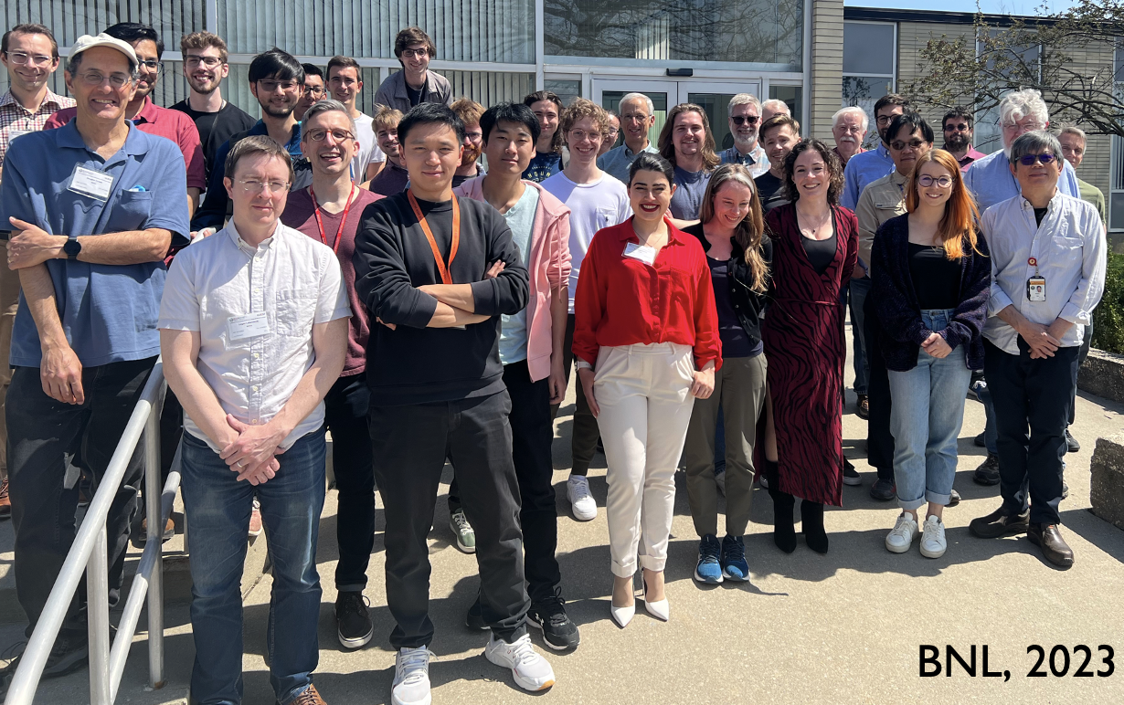

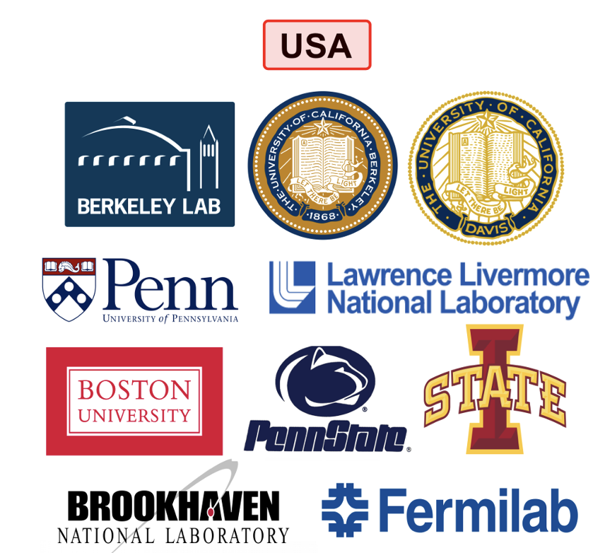

(see H.Steiger talk this conference)

Slide 9

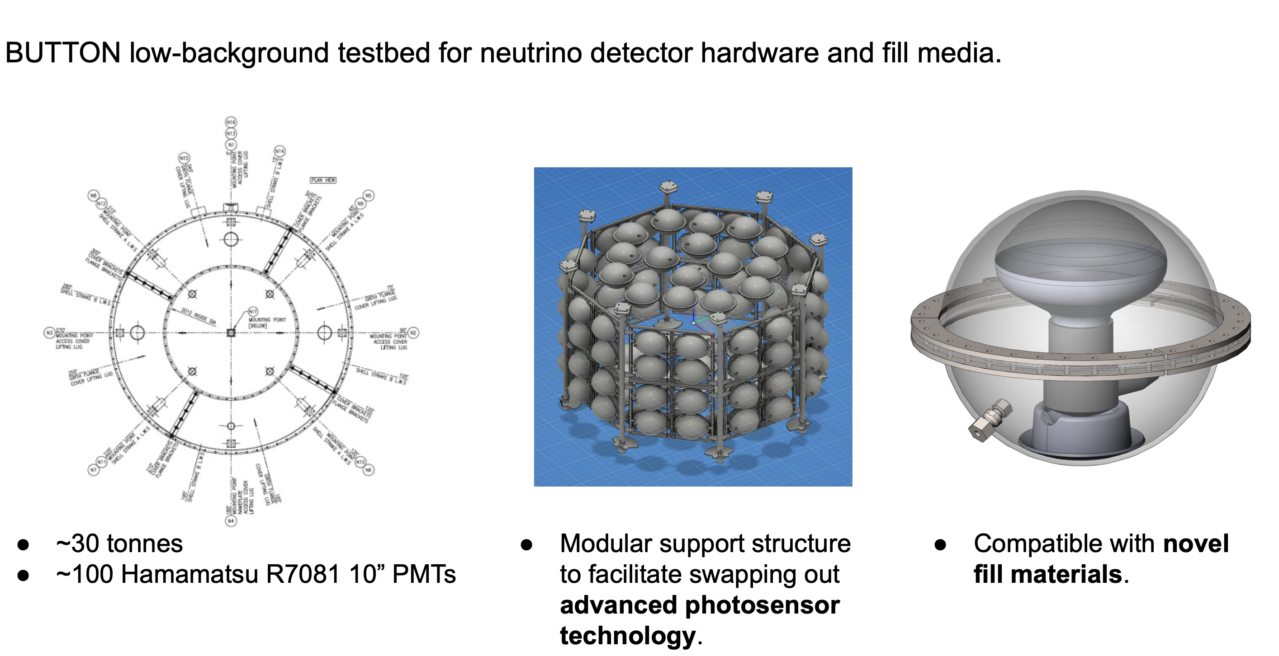
BUTTON
Boulby Underground
Technology Testbed
Observing Neutrinos
Underground 30-ton demonstrator to test radiological purity and backgrounds relevant to Theia physics program
Construction to be completed in 2024
Larger follow-on larger detector also being planned

Slide 10
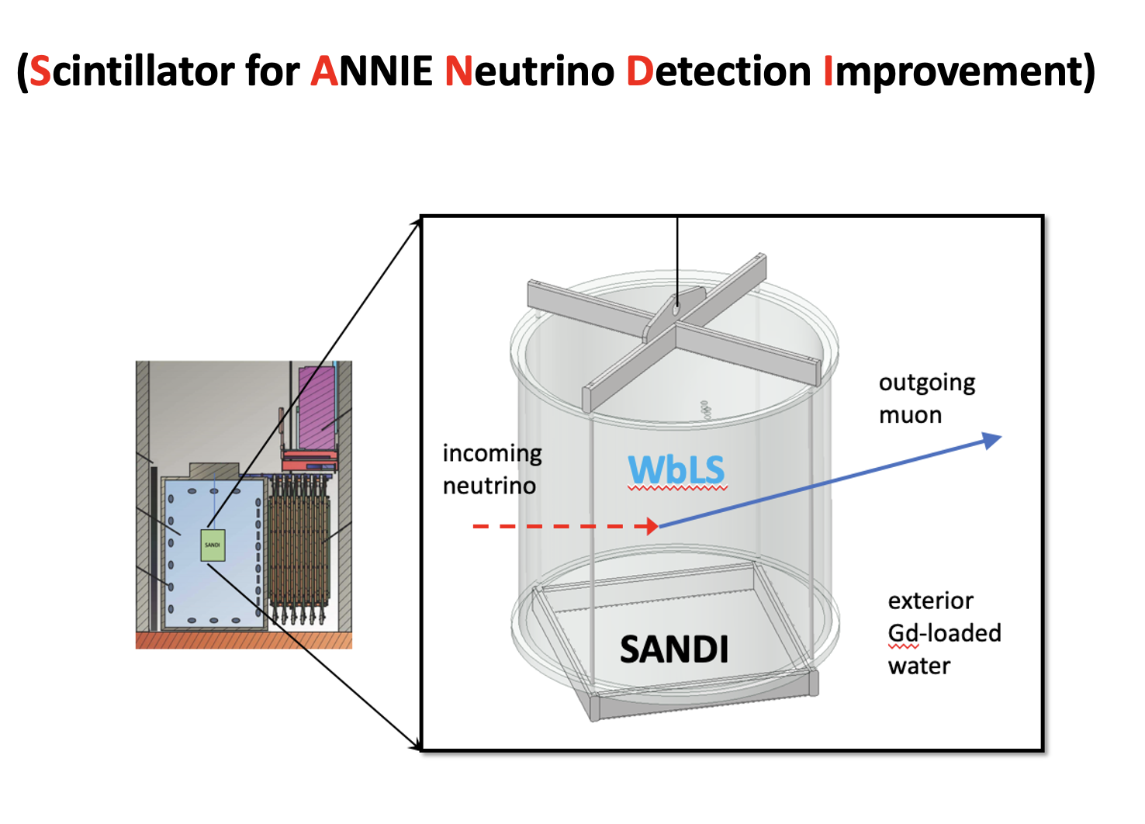
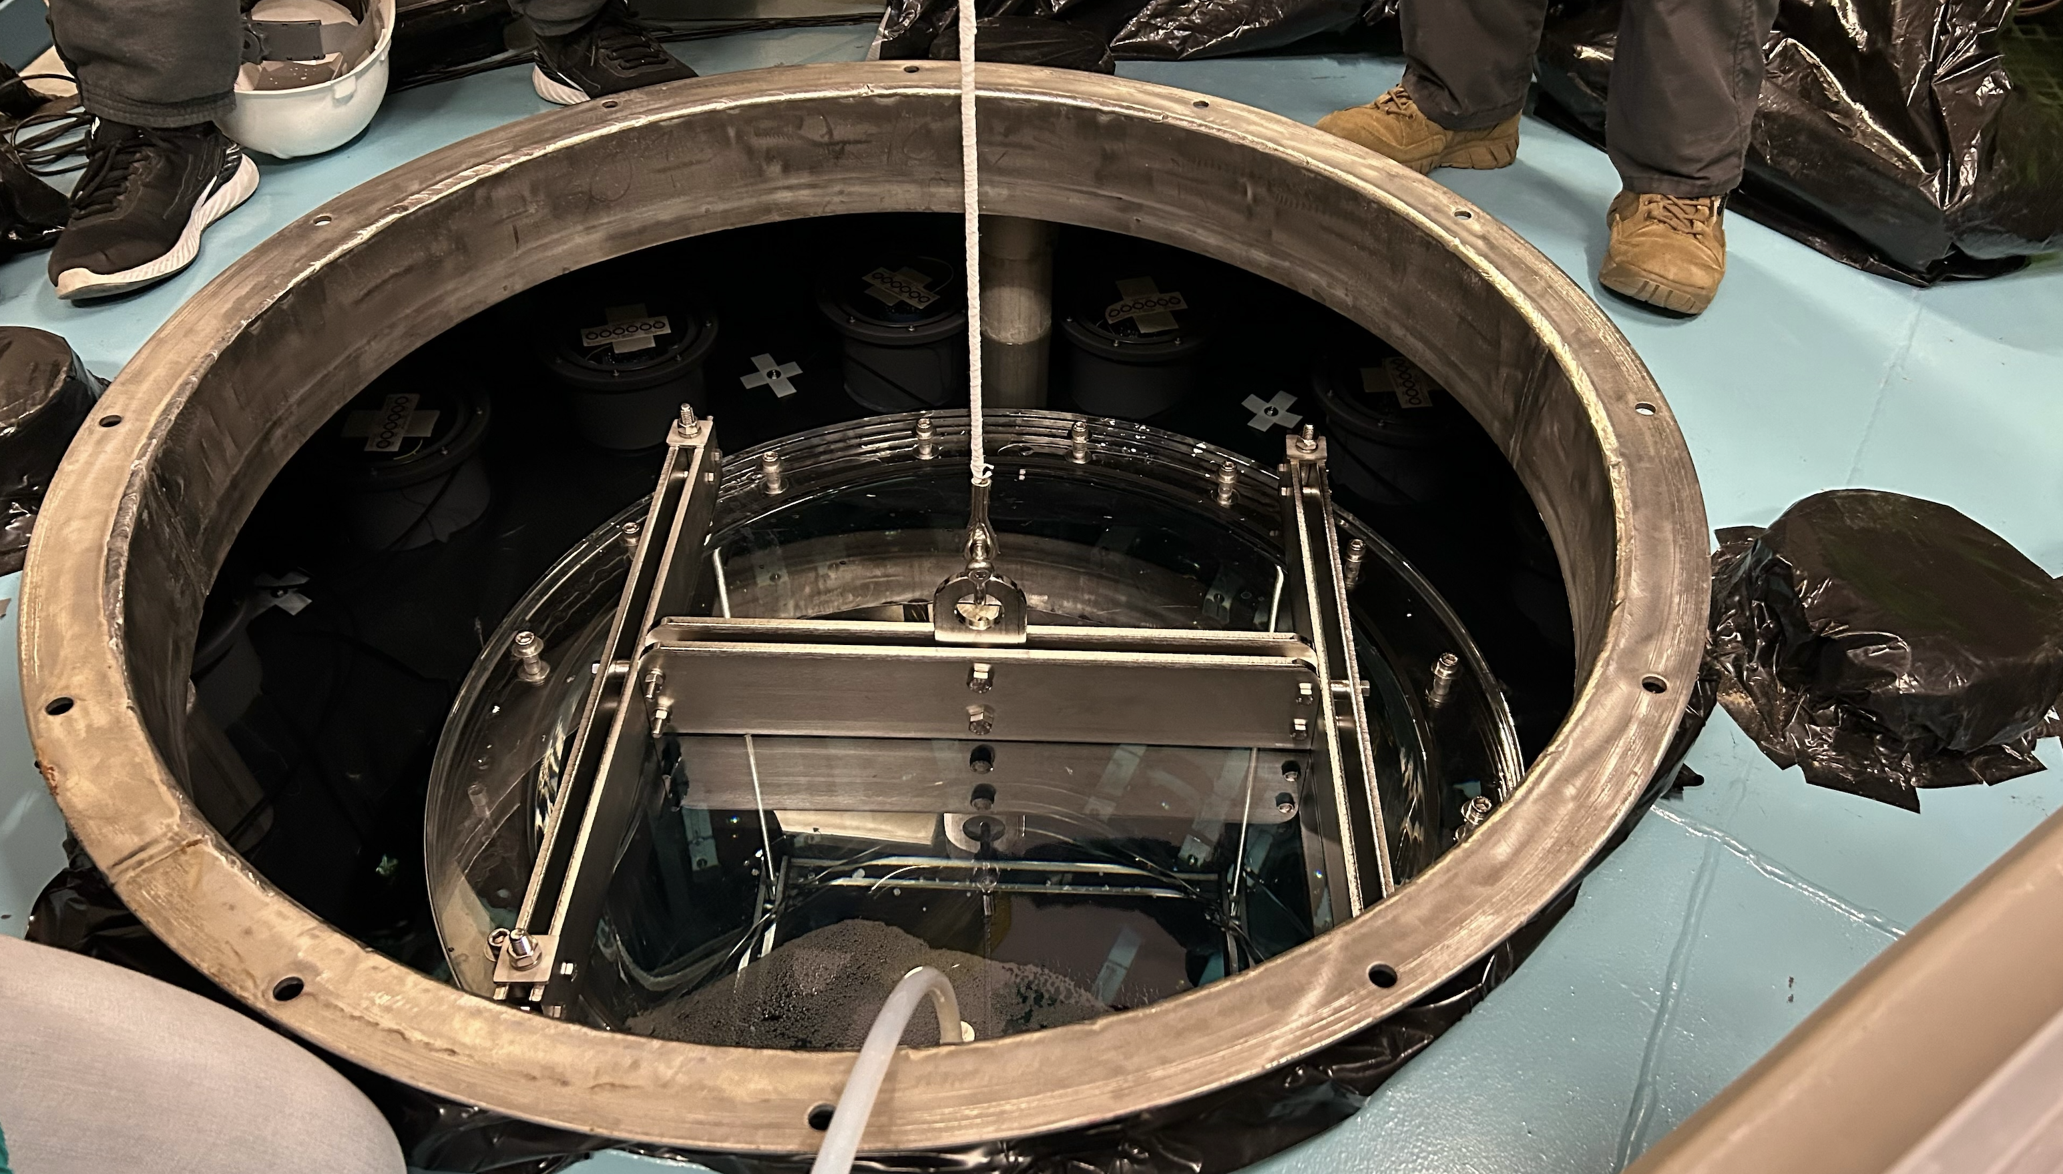
ANNIE High Energy Reconstruction Test
SANDI
(First deployment last March. See M.Wurm talk this conference)
Cherenkov
cone
“dirt”
muon
μ
downstream
PMTs
SANDI
neutrino
beam
upstream
PMTs
ANNIE
Tank
Front Muon
Veto (FMV)
Muon Range
Detector (MRD)
Tracking Calorimeter

Slide 11

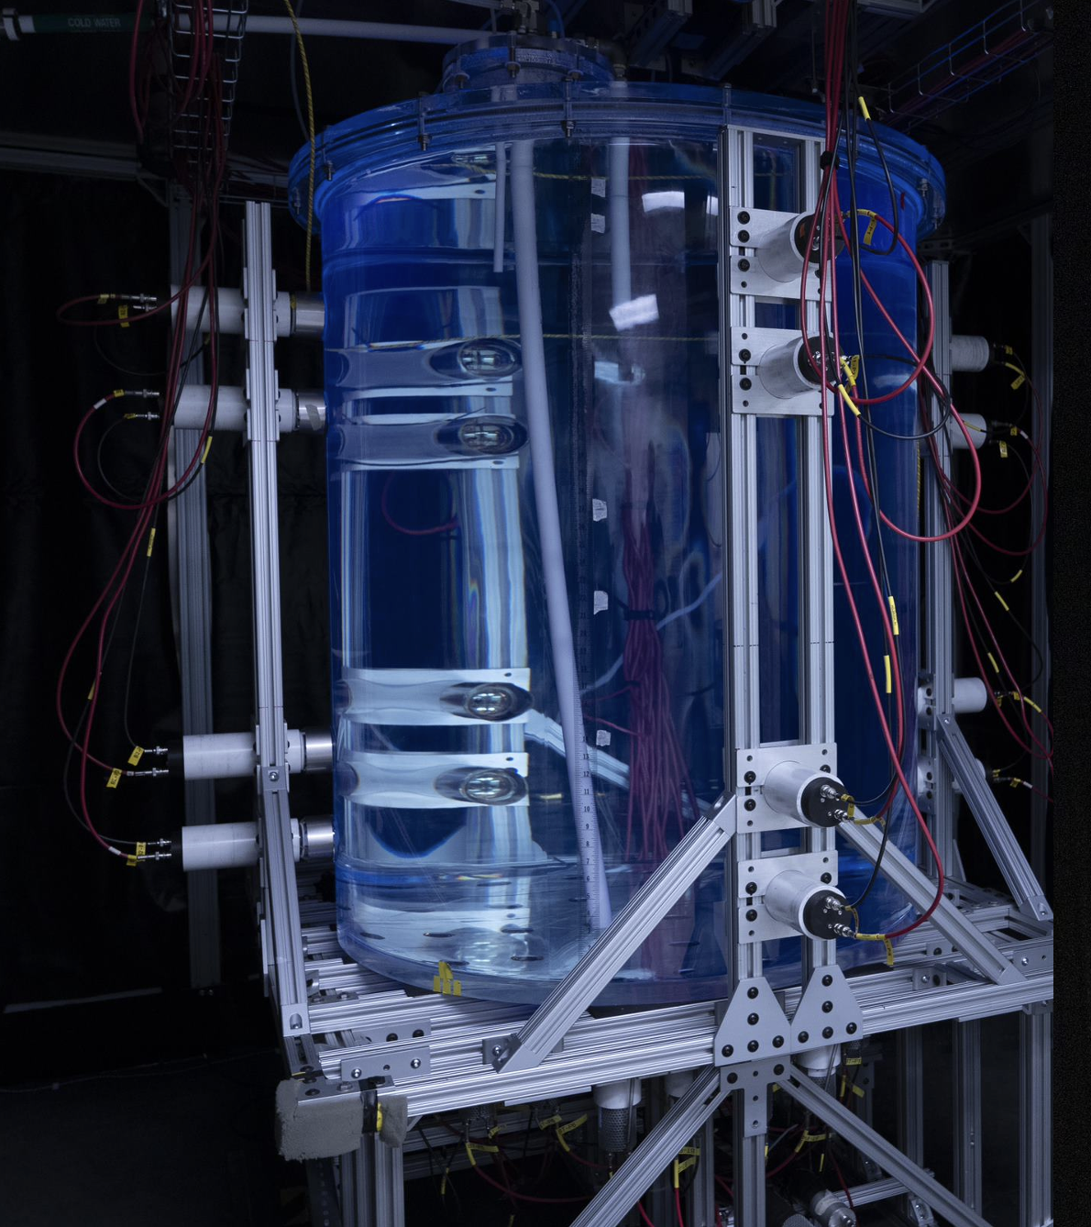
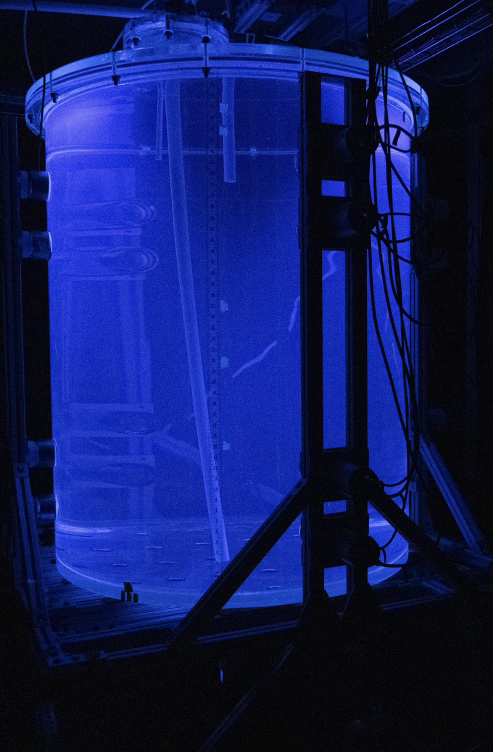
Theia Purification Demonstrators
Fully-functional recirculation and WbLS purification system.
  This system can also handle purification even with ion doping of the WbLS
  Demonstrator has instrumentation to determine effectiveness of recirculation and allow for spike tests of known optical and radiological contaminants (e.g. iron ions)
This project is a follow-on to the existing 1-ton Demonstrator, now running at BNL
1-ton Demonstrator
at Brookhaven
filled with WbLS

Slide 12
Why Do We Need This?
Leaching products from detector materials can absorb or scatter light
  Iron ions, colloids, compounds
  UV absorbers from plastics
  other possible ions (e.g. nitrates)
Can also contain radioactive contaminants
  238-Uranium g 222-Rn g 214-Bi (among others) g 210-Pb (22 year half life) g 210-Bi (Q=1.2 MeV)
  232-Th g 208-Tl (2.6 MeV gamma)
  40-K (1.4 MeV gamma)
  Radon (to a lesser extent)
    hard to remove from detector in short time scale, but leads to 214-Bi and 210-Pb
All large liquid detectors built to date require some form of in situ purification. Theia will need this.

Slide 13
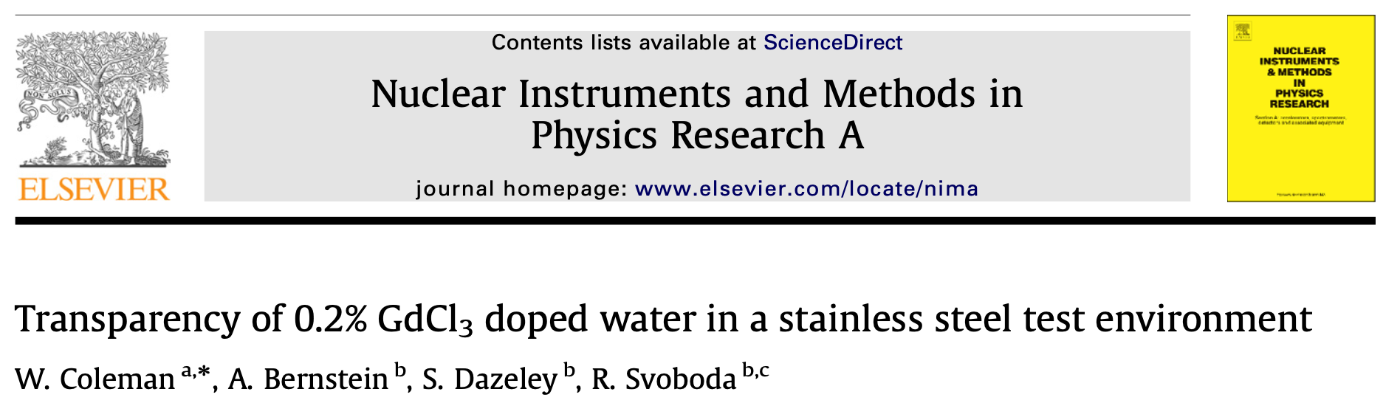
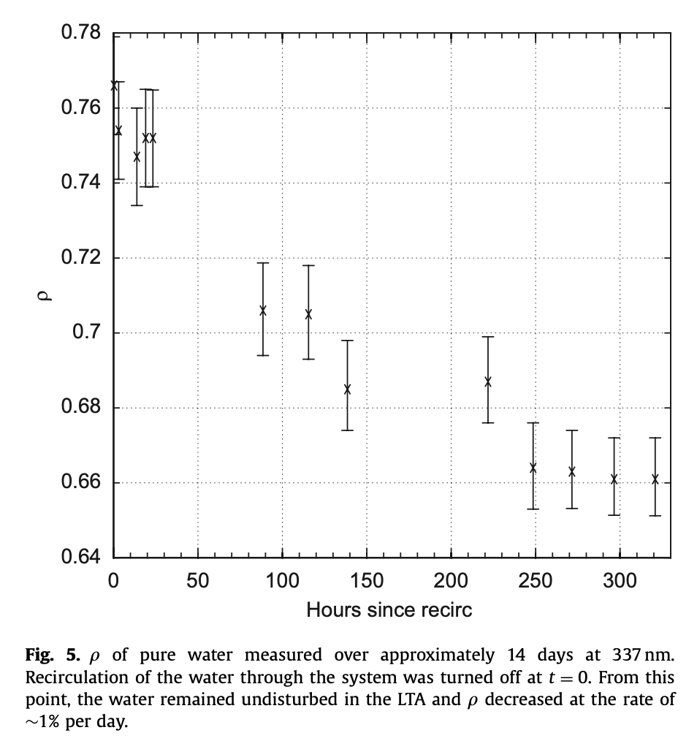
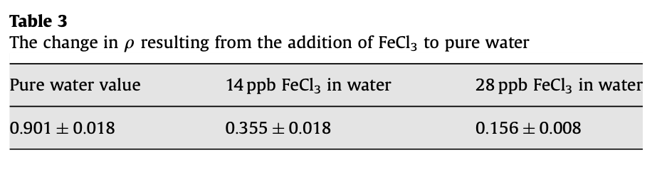
Example: Super-Kamiokande
Quantitative tests using a 19 meter
attenuation arm show that even clean
stainless steel exposed to ultrapure
water will leech impurities into the water
that absorb UV light.
It was also shown that this could be due
to iron ions going into solution even
at ppb levels.
relative transparency
Hours since recirculation stopped

Slide 14
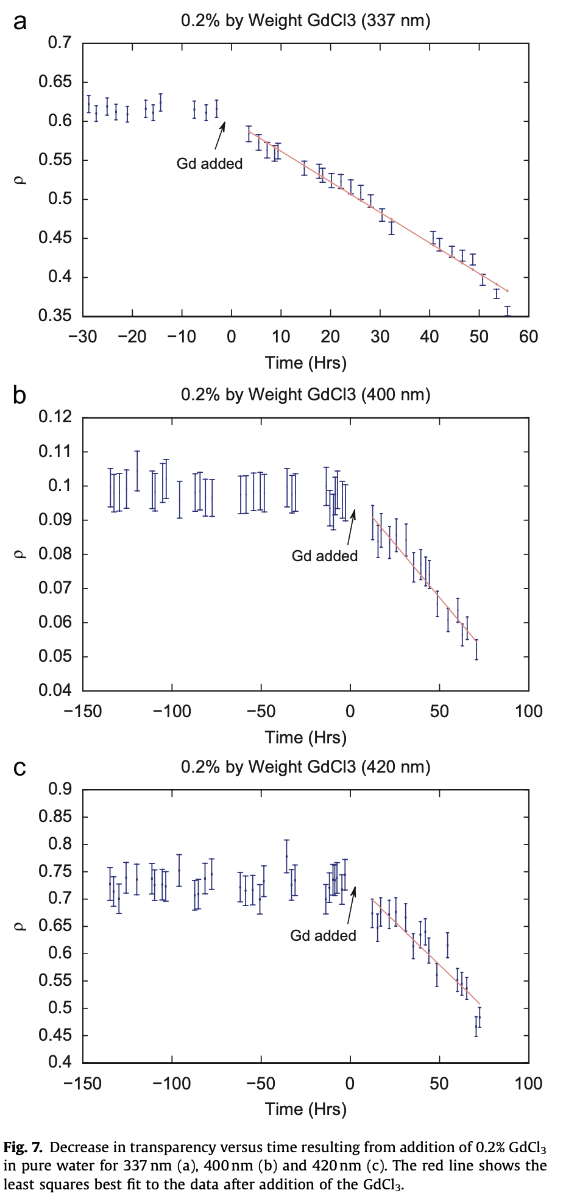
LLNL tests showed that the
loss of transparency
is broad spectrum, not
just Gd absorption lines
337 nm
Several of the potential physics topics that could be addressed involve the addition of dissolved ions: Gd, Li, Te
These same tests showed that for Gd the ion itself did not cause a loss of transparency - it was just that fact that the liquid can now conduct charge that accelerated the leeching of steel contaminants
400 nm
420 nm
Must solve this problem to make Theia WbLS
detector practical!

Slide 15
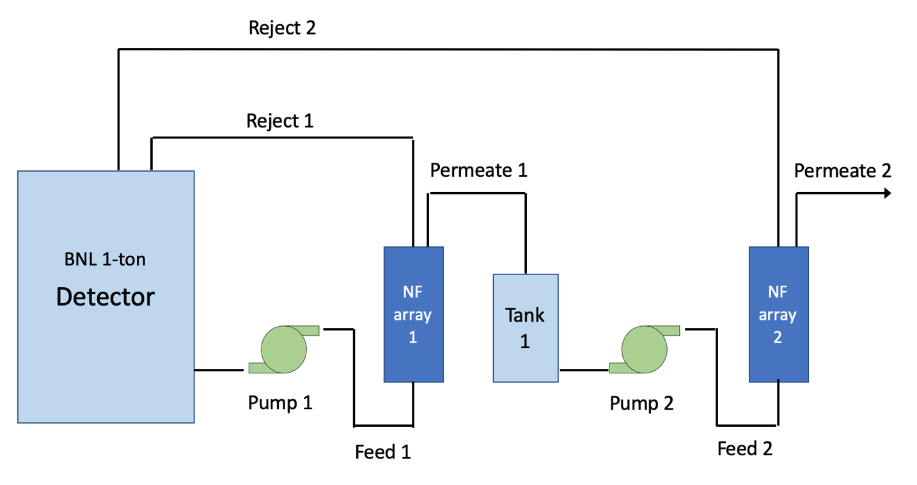
How to do this?
Separate the organic components from the water in order to clean the water
Contaminants must pass through however - this was a challenge now solved!
Actual tests for contaminants need to be done with spike tests for individual ions, molecules, and iron colloids
(university
physicist)
(BNL engineer)

Slide 16
Iron in solution is not an isolated ion…
Iron is usually surrounded by
6 OH₂ radicals, giving it an effective
molecular weight of 164 Da
The NF shown on the previous
slide has a MWCO of 150, so iron tends
not to go through much
To be compared with WbLS free
surfactants which have MW in the
range of 400-600

Slide 17
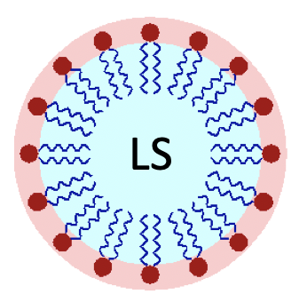
The basic idea
Step 1: remove the micelles from the
liquid without disrupting them
use nanofiltration
to remove the
large (~10 nm)
micelles

Slide 18

The basic idea
Step 2: remove ”free” (i.e. non-micellized)
surfactant from the permeate of NF array 1
free surfactant
use nanofiltration
to remove free
surfactant ~500 Da

Slide 19
The basic idea
Step 3: pass the “bad” ions to a standard water purification system for removal
bad ion
both nanofiltration
arrays must pass
bad ions

Slide 20

The basic idea
Step 4: but keep the good ions!
good ion
both nanofiltration
arrays must pass
bad ions

Slide 21
The basic idea
ALL TOGETHER NOW!
good ion
both nanofiltration
arrays must pass
bad ions

Slide 22
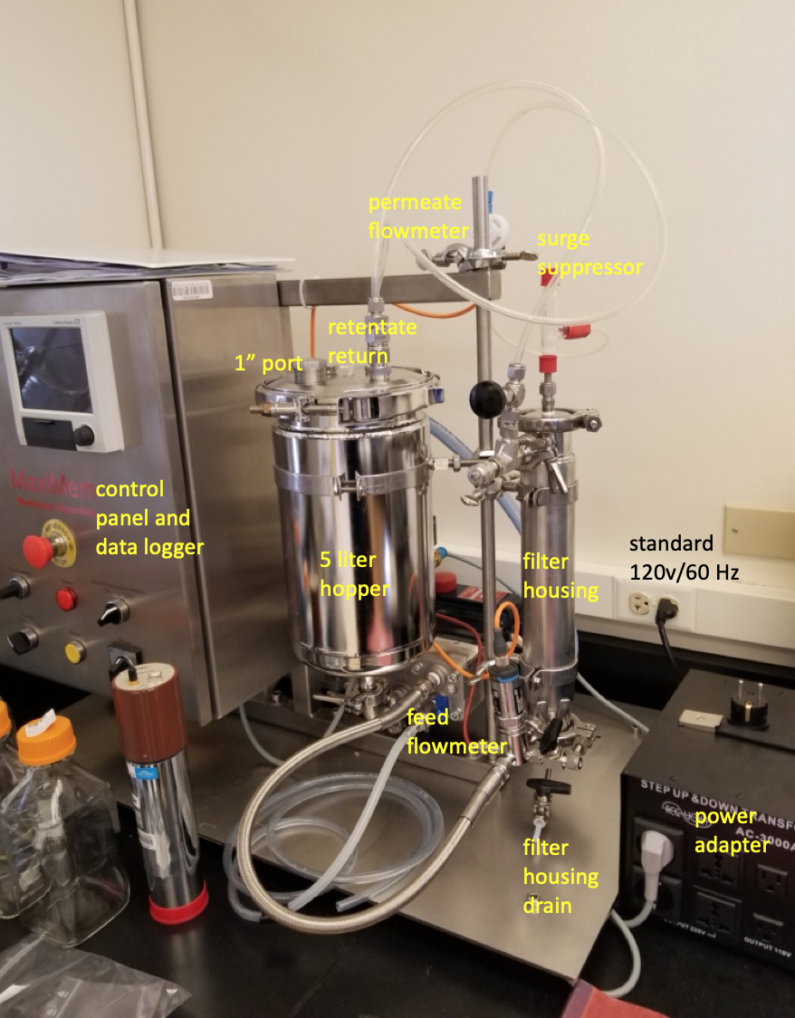
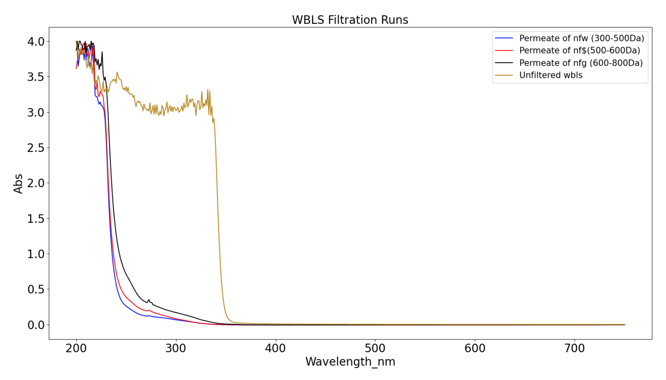
Nanofiltration process
development testbench
Array 1: removes
(without disruption)
the LS-filled
micelles. Test show
light yield is
not affected
micelles (PPO absorption edge)
Log(absorbance)
post-stage 1 residual
organics and ~100%
of dissolved Gd (good ion)
water from a SS316 3-year exposure before and after the stage 2 system
Array 2 passes
dissolved iron
through to the
“standard”
water purification
system but removes
residual organics
Log(absorbance)
MWCO 200
We are now ready to build a
scaled-up version of this!
wavelength (nm)

Slide 23
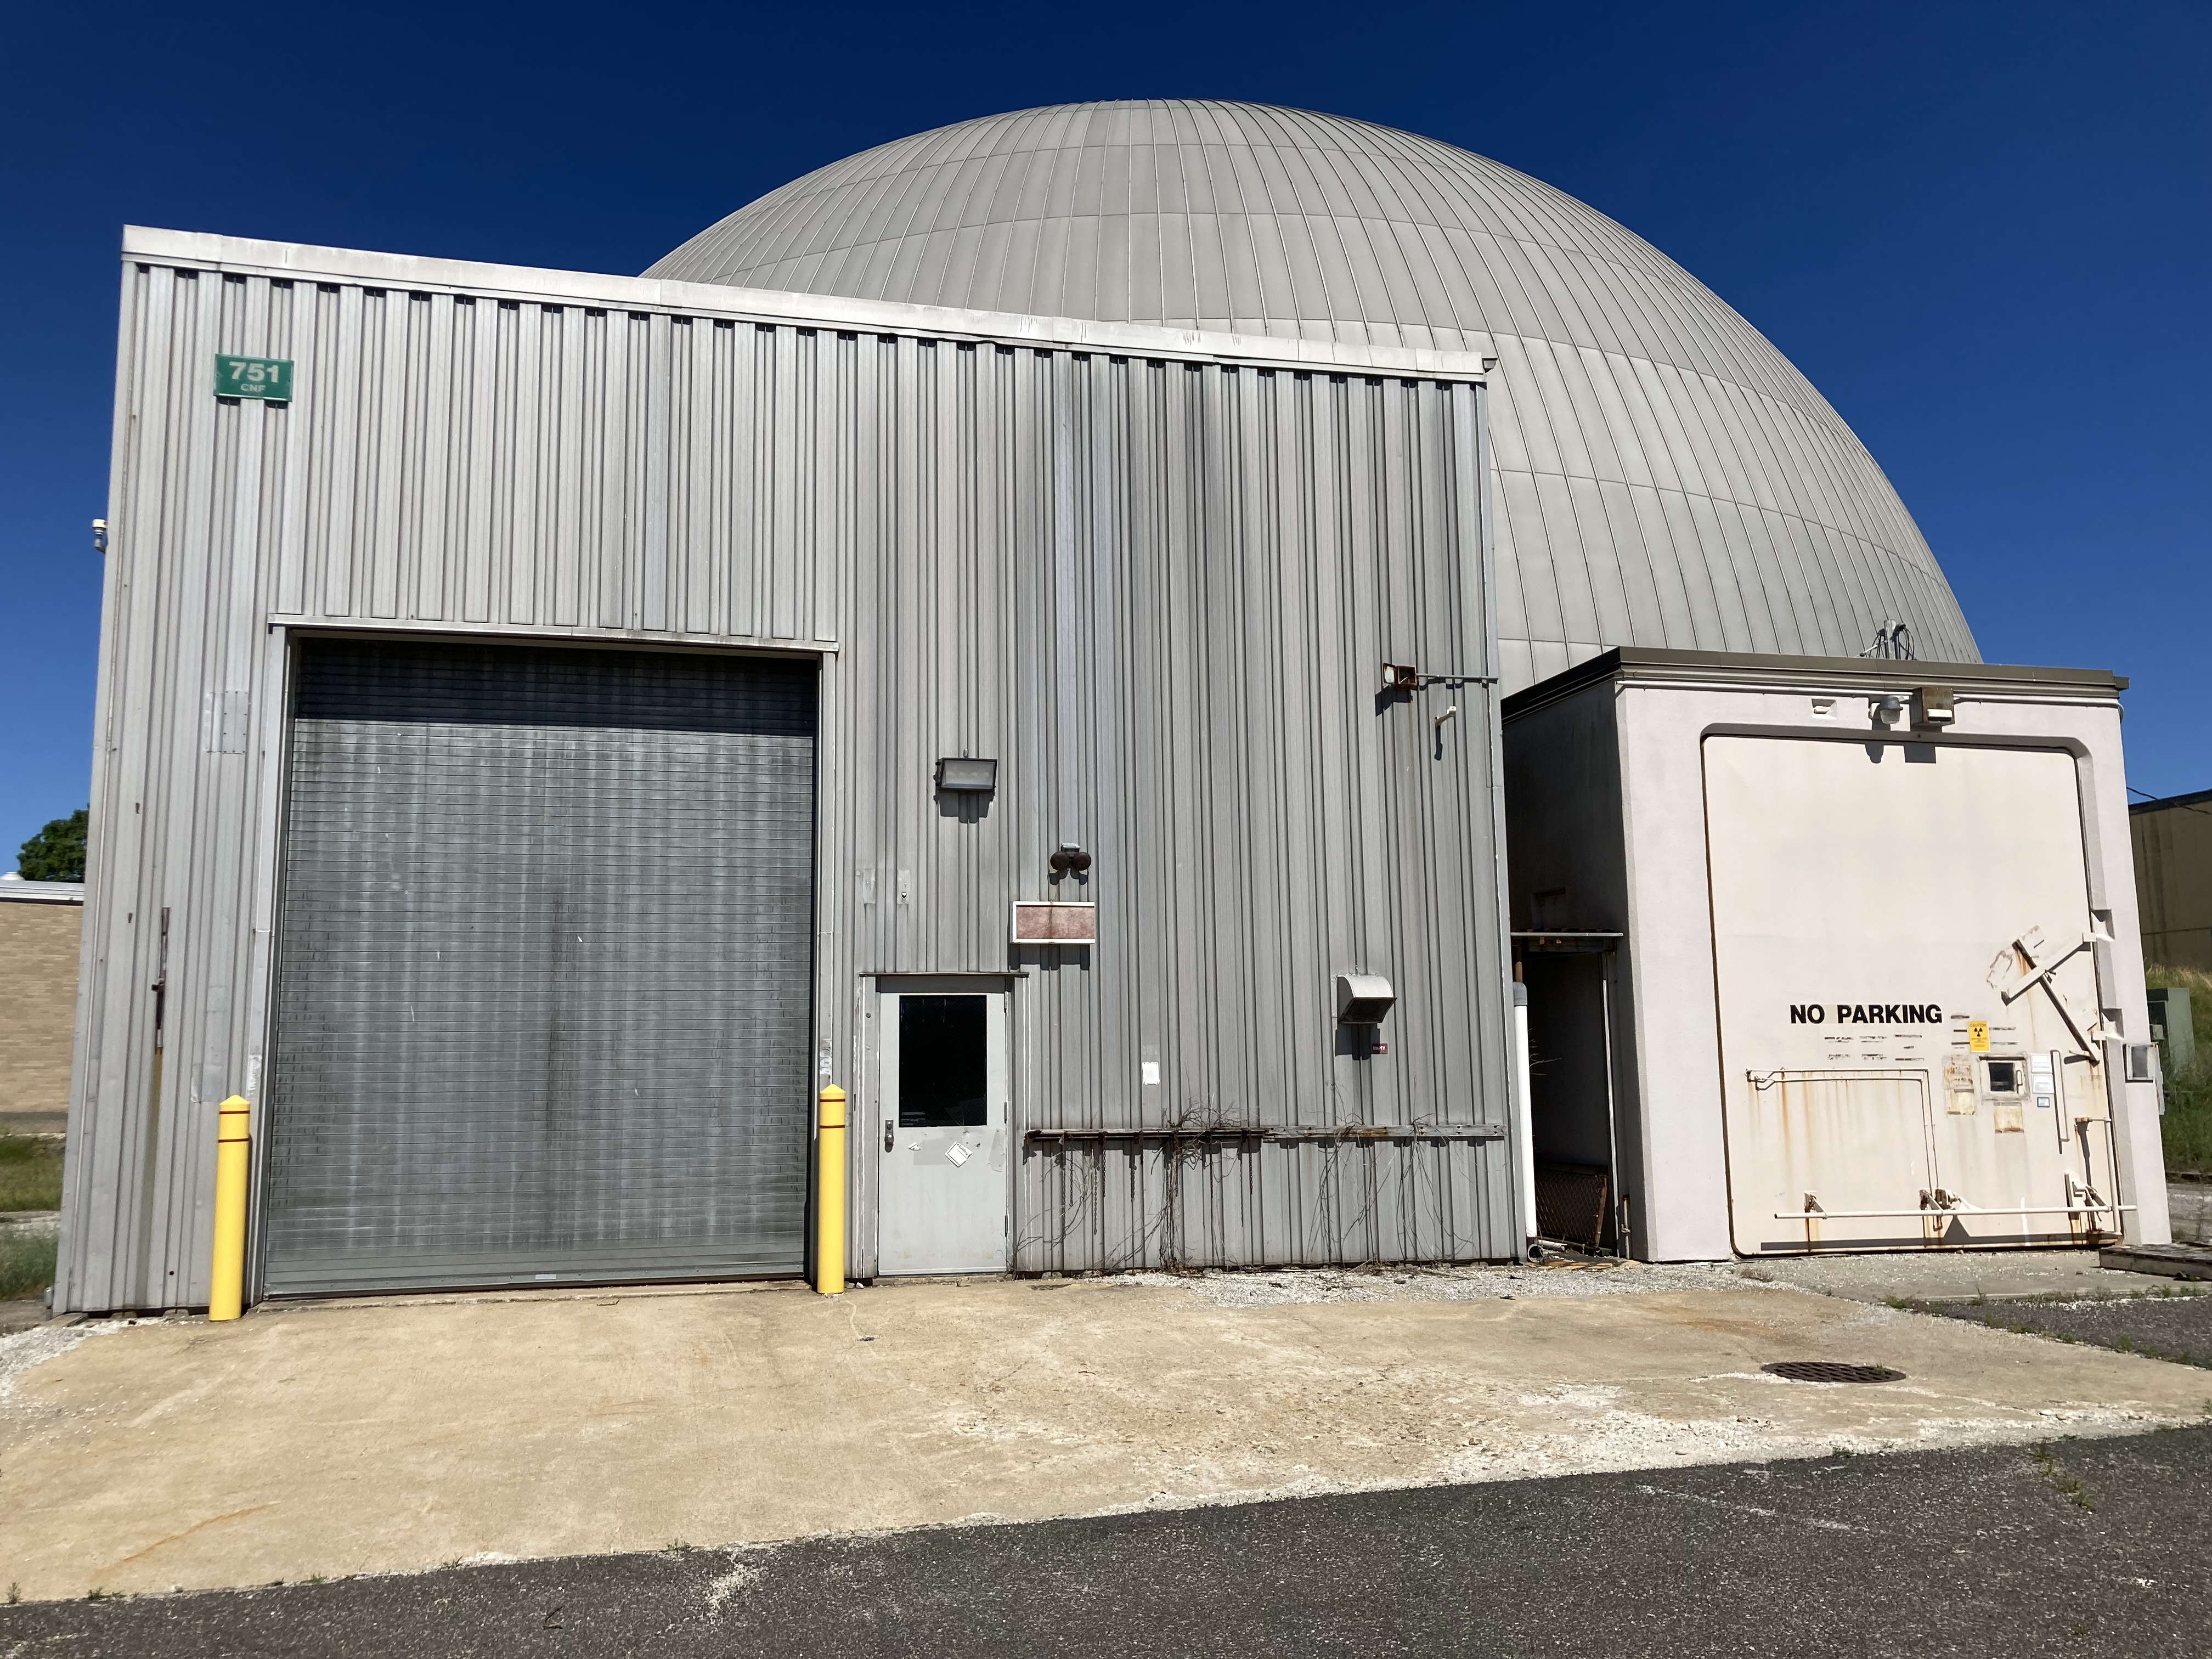
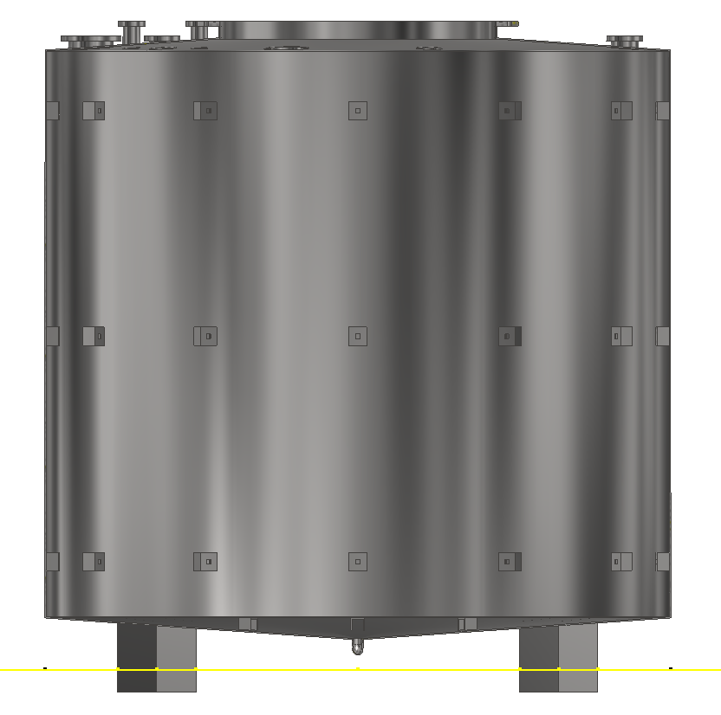
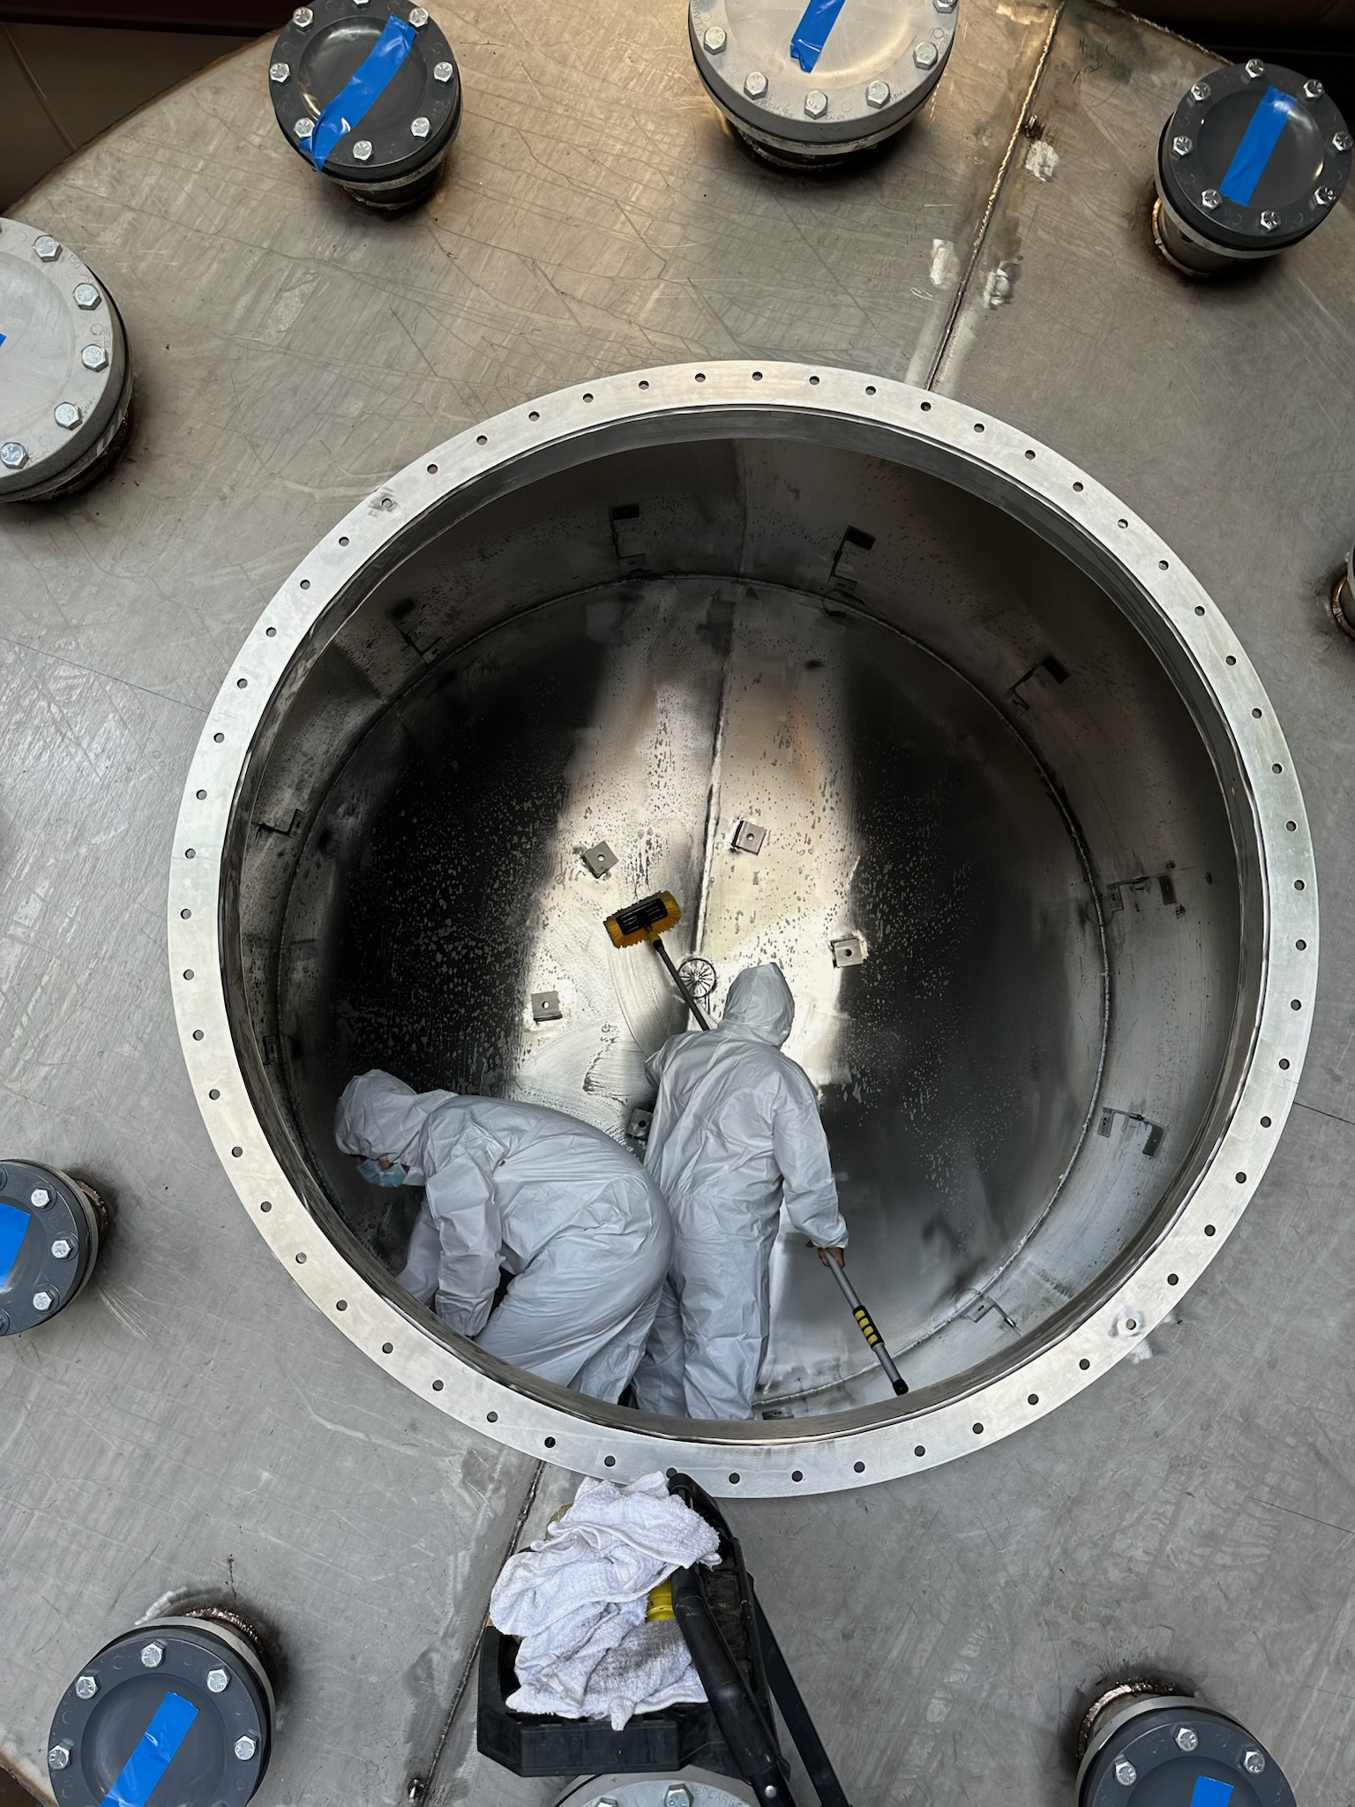
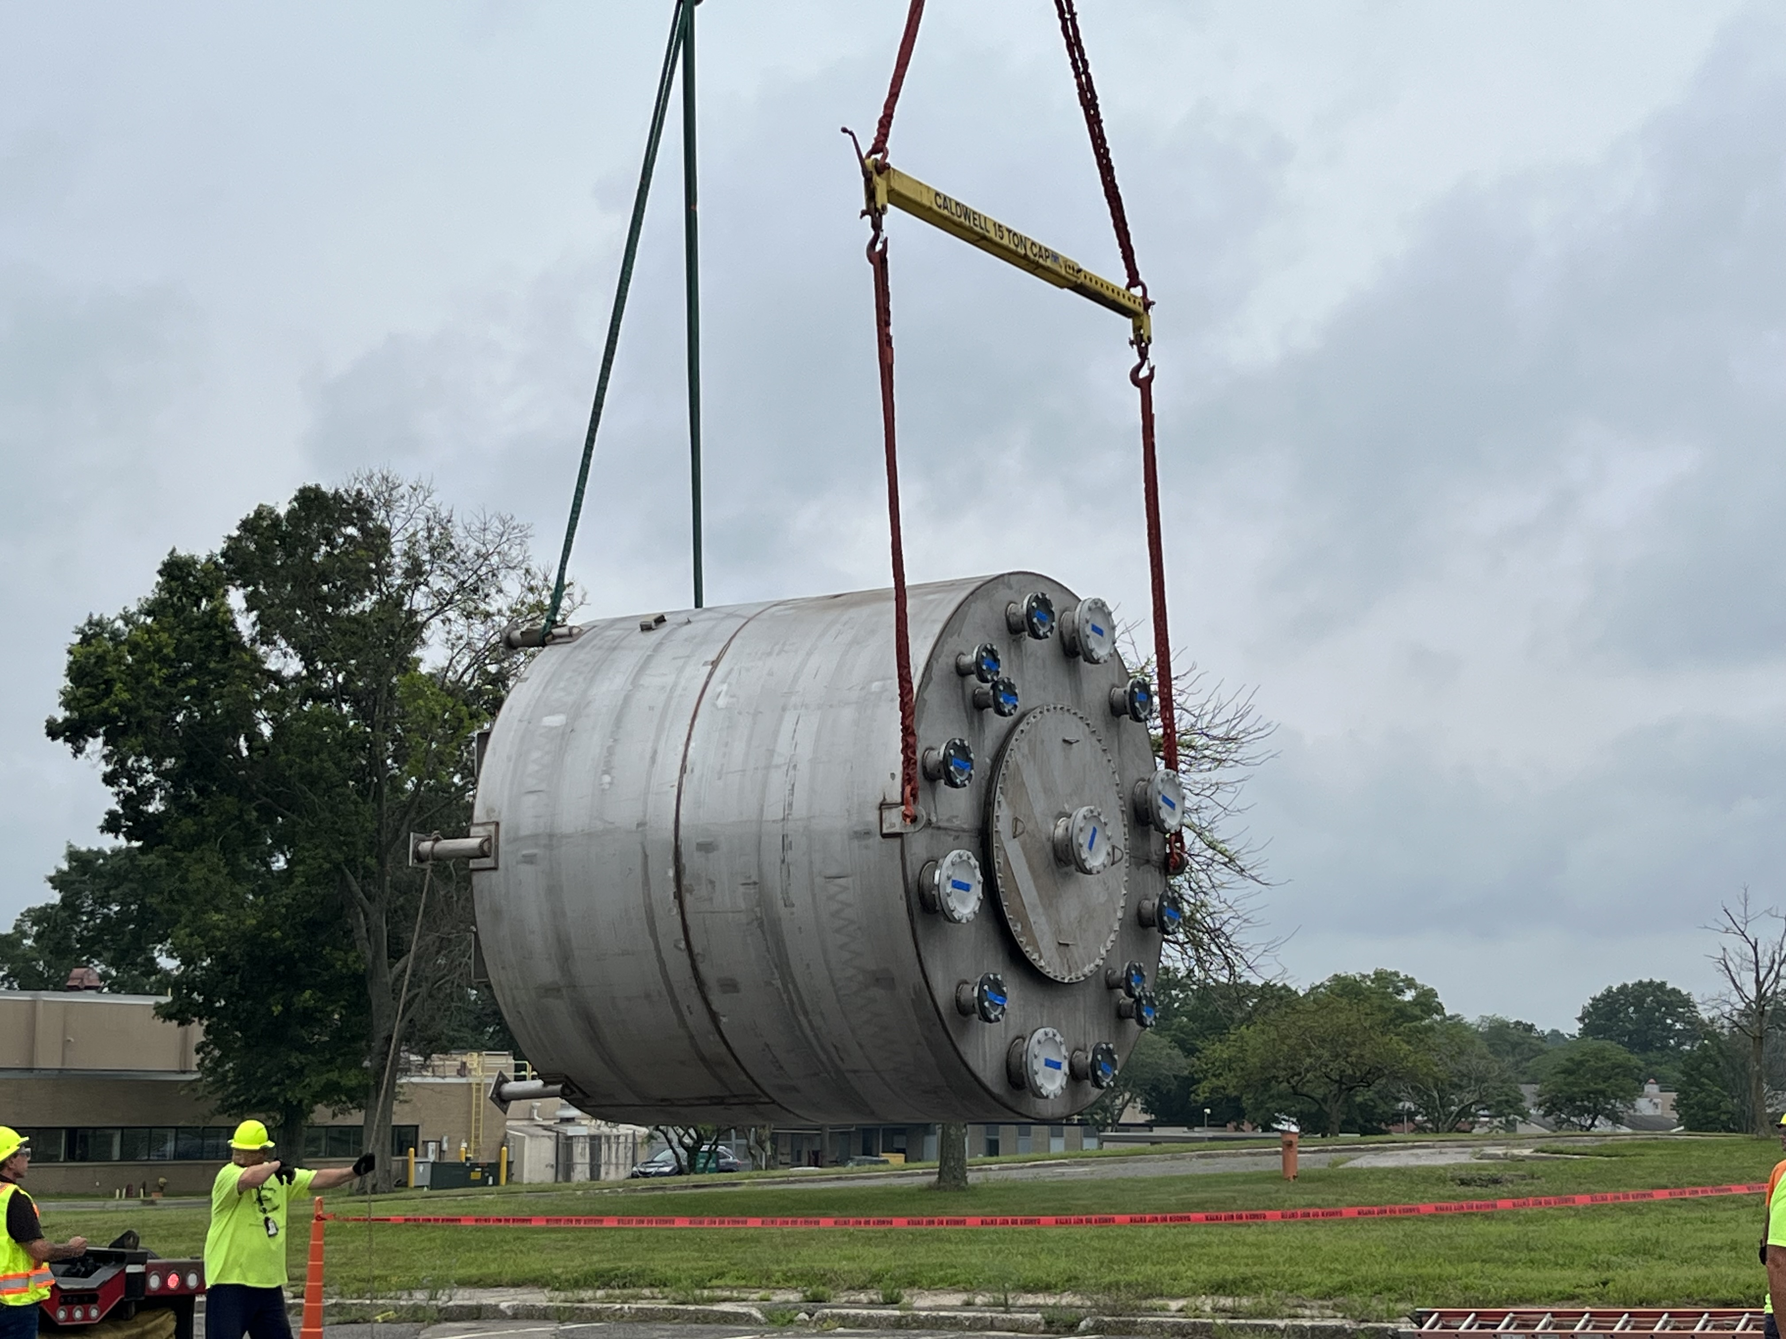
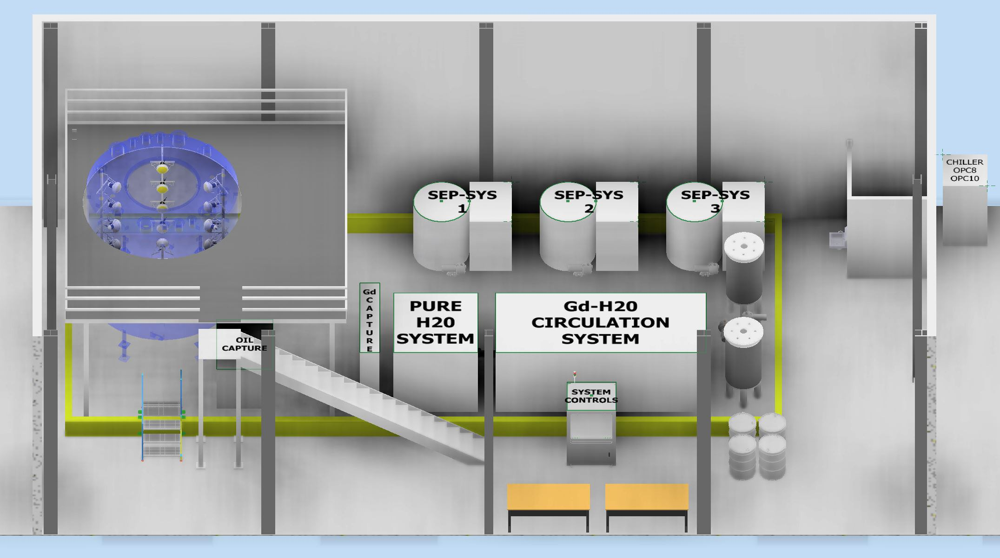
30-ton Demonstrator
A fully-equipped 30-ton optical detector with in-situ circulation system to demonstrate large-scale WbLS deployment
engineering studies of operation parameters, environmental controls and integration with metal purification system (Gd) and nanofiltration system.
      Performance stability, interface, and slow-control
Capable of adding an Inner Vessel (IV)
30-Ton

Slide 24
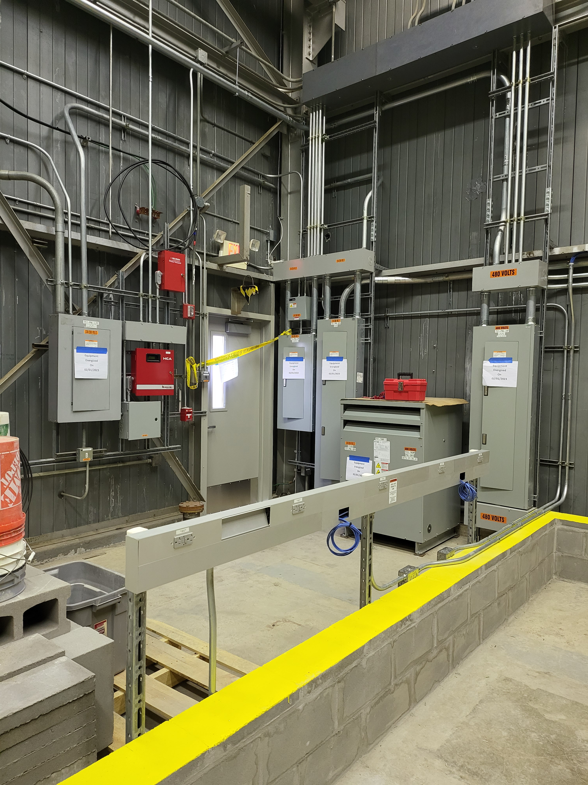
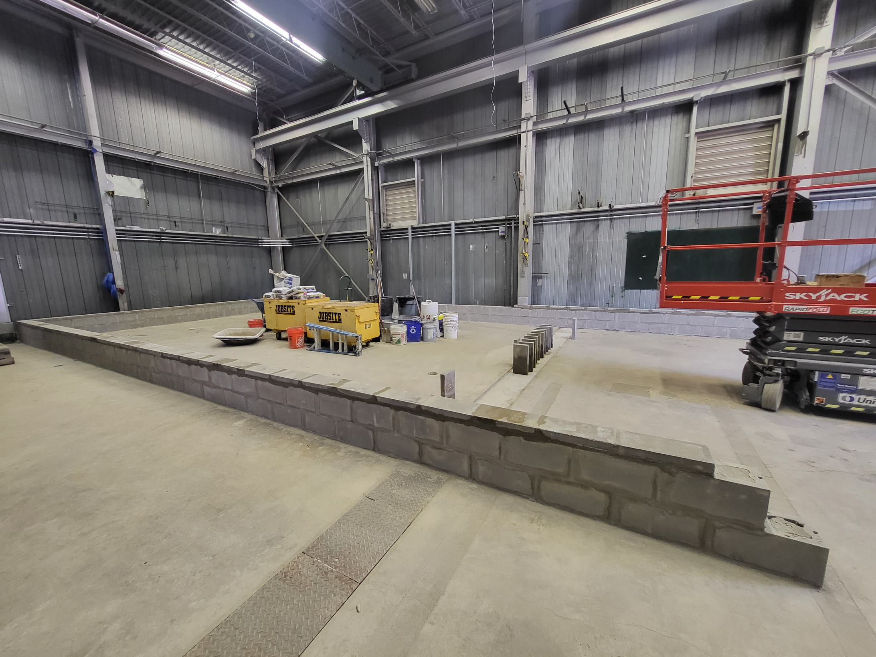
30-ton Demonstrator
Experimental site
at Brookhaven
National Lab
A fully-equipped 30-ton optical detector with in-situ circulation system to demonstrate large-scale WbLS deployment
engineering studies of operation parameters, environmental controls and integration with metal purification system (Gd) and nanofiltration system.
      Performance stability, interface, and slow-control
Capable of adding an Inner Vessel (IV)
power
upgrade
30x 10″ WbLS Compatible PMTs
30-Ton Tank will contain PMTs and other
instrumentation
secondary containment

Slide 25
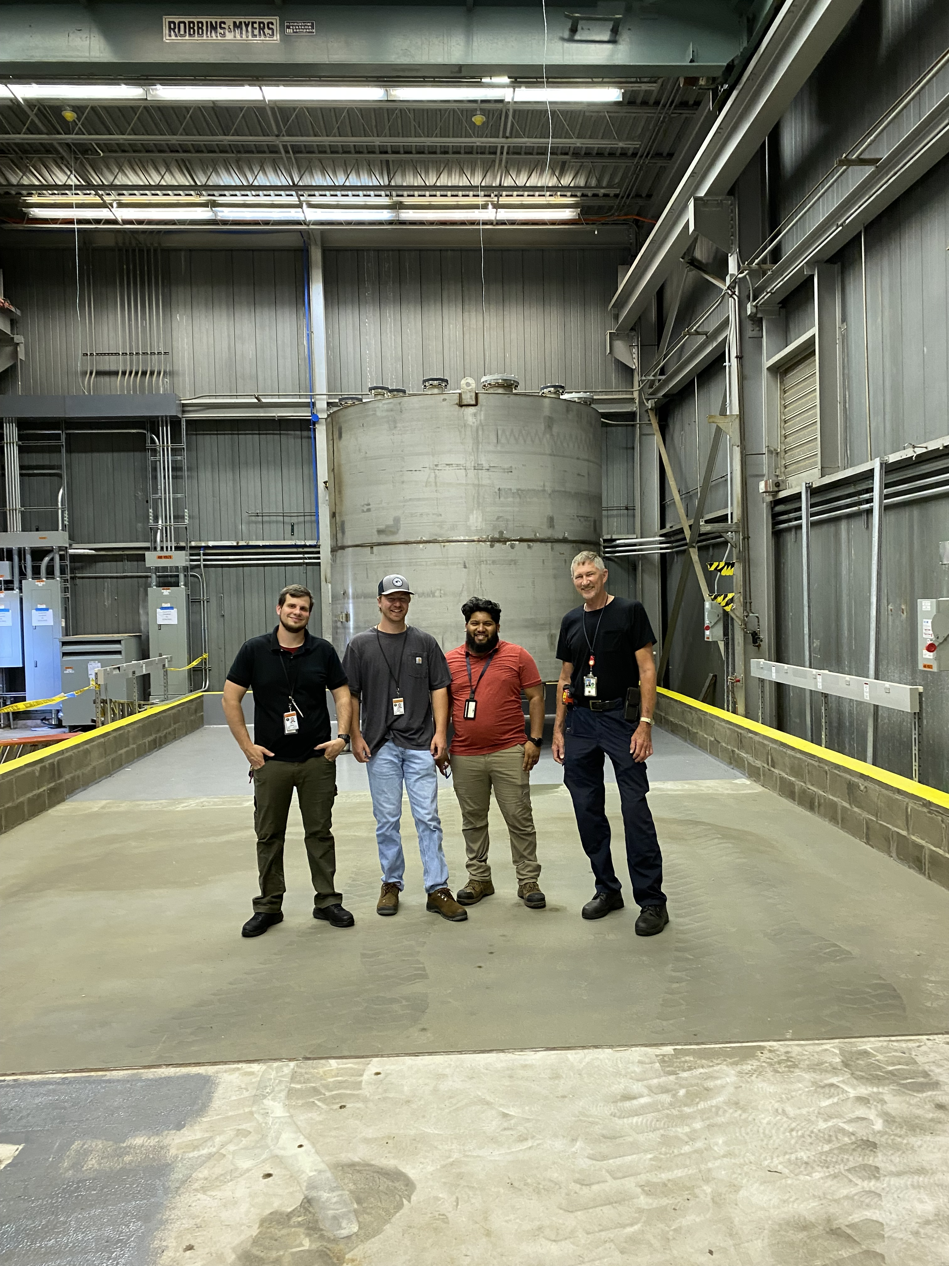
30-ton Demonstrator Tank

Slide 26
Summary
A major international effort has developed the the needed technology to build the first multi-kiloton scale Optical Hybrid Detector. Such a detector has a wide range of potential scoence opportunities - as discussed in other talks and in the published Theia White Paper.
A number of large-scale prototypes are now under construction to investigate technical alternatives. These will be completed in the over the next two years, providing date to optimize designs for unloaded WbLS in these large detector(s).
The R&D to load and purify WbLS with “good ions” has now started. A successful Gd-loaded WbLS has already been developed, and the first steps are being taken to load with Te and Li are just getting underway.

Slide 27
backup slides

Slide 28
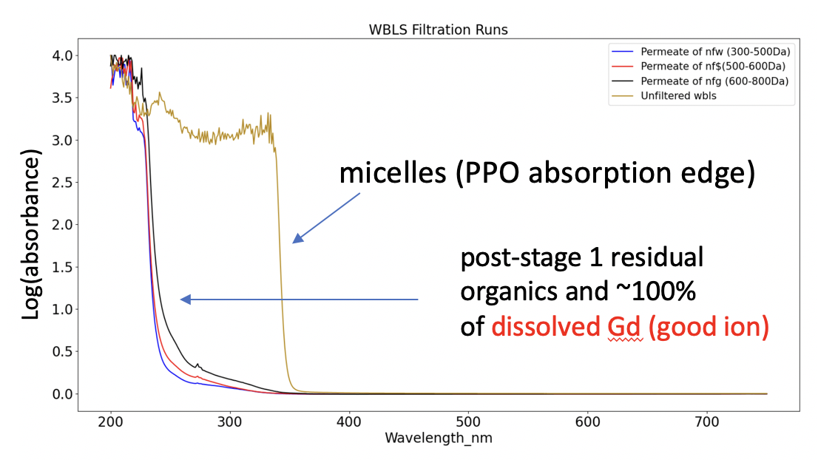
Step 1: Separate micelles from the WbLS

Slide 29
Steps 2&3: Pass the bad ions through and keep the good ions
iron soak water
Gd⁺³ optical
absorption peaks
retentate
permeate
This filter does not pass optical contamination from 316 steel leeching into water - BAD!
Filter does not pass good Gd
ions - GOOD!
Not a great candidate…why?

Slide 30
A good candidate for Steps 2&3 has been identified
MWCO 200 passes
nearly all “iron soak”
water
..but still not dissolved
Gd - a ”good” ion
good ion “bare” MW coordinated MW
Gd⁺³ 157 301-320
Te⁺³ 128 210-230
Li⁺¹ 7 79
(Fe⁺³ is 164)
Note: MW is not the only consideration. Filter materials also make a difference, as it can interact with the ions.

Slide 31
Nanofiltration process
development testbench
Array 1: removes
(without disruption)
the LS-filled
micelles. Test show
light yield is
not affected
micelles (PPO absorption edge)
Log(absorbance)
post-stage 1 residual
organics and ~100%
of dissolved Gd (good ion)
water from a SS316 3-year exposure before and after the stage 2 system
Array 2 passes
dissolved iron
through to the
“standard”
water purification
system but removes
residual organics
Log(absorbance)
MWCO 200
We are now ready to build a
scaled-up version of this!
wavelength (nm)

