Slide 1



Chiral phonons as dark matter detectors
HIT G 23.6
Wolfgang-Pauli-Strasse 27
marek.matas@mat.ethz.ch
Carl P. Romao, Riccardo Catena, Nicola A. Spaldin, Marek Matas

Slide 2
What are chiral phonons?

Slide 3
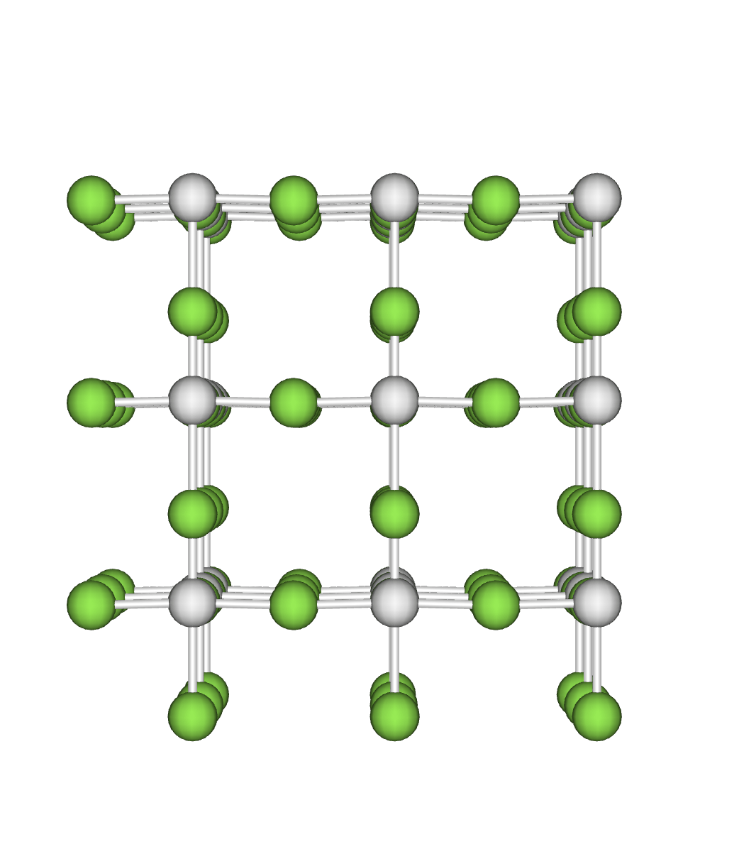
Chiral phonons
Regular phonon in a material lattice
Marek Matas

Slide 4
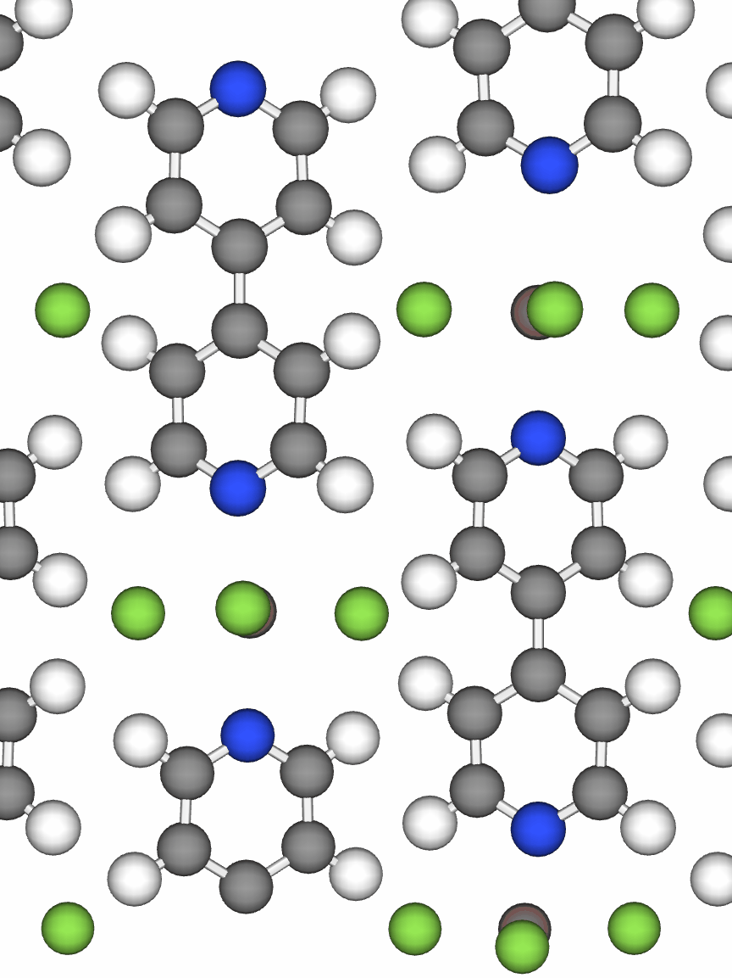
Chiral phonons
Regular phonon in a material lattice
Chiral phonon in InF₃(4, 4′-bipyridine)
Marek Matas

Slide 5
Chiral phonons
Romao, Catena, Spaldin, Matas, arXiv:2301.07617.

Slide 6
Why not regular phonons?

Slide 7
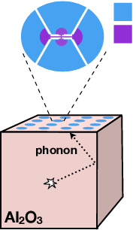
Dark matter detection using phonons
Current efforts to detect phonons created by dark matter rely on superconducting transition edge sensors (TES), in which the phonon energy causes the loss of superconductivity.
A TES requires an energy of ca. 100 meV to sense an excitation, and phonons with this energy have ps-scale lifetimes.
  These phonons can only travel < 1 µm within the detector
Phonons must pass through an interface to enter the TES (with probability ca. 10⁻³.¹
O(eV) of deposited energy carried by a multitude of phonons is required to create a detectable signal.¹
[2]
Musaab F. Albakry et al. (SuperCDMS), Snowmass Summer Study 2022, arXiv:2203.08463.
Snowmass2021-Letter of Interest The TESSERACT Dark Matter Project
Marek Matas

Slide 8

Dark matter detection using phonons
Current efforts to detect phonons created by dark matter rely on superconducting transition edge sensors (TES), in which the phonon energy causes the loss of superconductivity.
A TES requires an energy of ca. 100 meV to sense an excitation, and phonons with this energy have ps-scale lifetimes.
  These phonons can only travel < 1 µm within the detector
Phonons must pass through an interface to enter the TES (with probability ca. 10⁻³.¹
O(eV) of deposited energy carried by a multitude of phonons is required to create a detectable signal.¹
Carl P. Romao
Can we detect the magnetic moments of chiral phonons and use them as dark matter detectors?
Musaab F. Albakry et al. (SuperCDMS), Snowmass Summer Study 2022, arXiv:2203.08463.
Snowmass2021-Letter of Interest The TESSERACT Dark Matter Project
Marek Matas

Slide 9
Overview
As chiral phonons can have low energies and detectable (µ_{B}) magnetic moments, they could be used as sensors for low-energy (meV scale) excitations.
When phonons are created in a material, they will decay into the lowest energy phonon band.
Low-energy acoustic phonons can have angular momentum and magnetic moments in noncentrosymmetric materials.
These phonons could be localized and detected using quantum magnetometers (e.g., SQUIDs).
Romao, Catena, Spaldin, Matas, arXiv:2301.07617.
Marek Matas

Slide 10
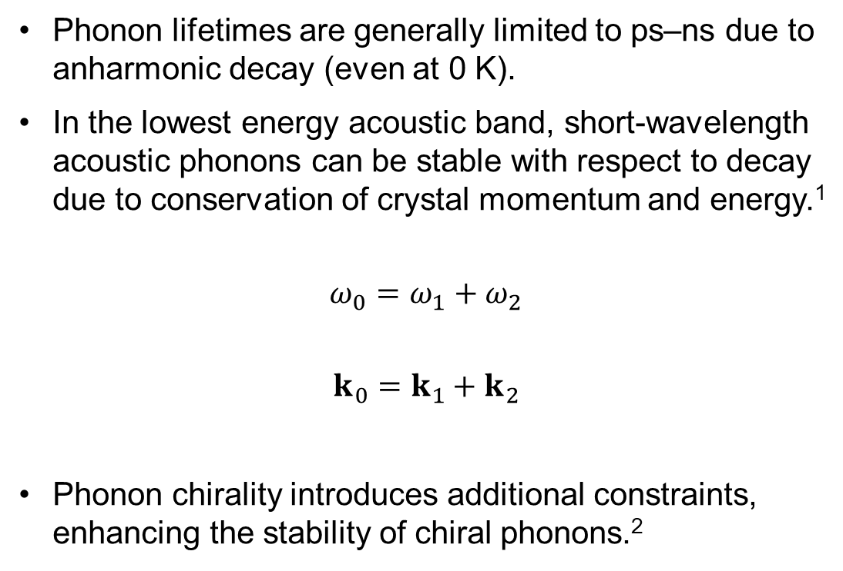
Stability of phonons
Phonon lifetimes are generally limited to ps–ns due to anharmonic decay (even at 0 K).
In the lowest energy acoustic band, short-wavelength acoustic phonons can be stable with respect to decay due to conservation of crystal momentum and energy.¹
$$ω_{0}=ω_{1}+ω_{2}$$
$$k_{0}=k_{1}+k_{2}$$
Phonon chirality introduces additional constraints, enhancing the stability of chiral phonons.²
Maris and Tamura, Phys. Rev. B 1993, 47, 727.
Pandey, Polanco, Cooper, Parker, Lindsay, Phys. Rev. B 2018, 98, 241405(R).
Marek Matas

Slide 11
How could we build a detector?

Slide 12
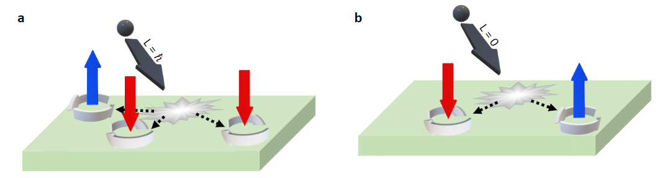
Chiral phonons generated by dark matter
First, dark matter deposits some combination of energy, momentum, and angular momentum into the phononic degrees of freedom of the material.
The initial excitation rapidly decays into a combination of stable phonons.
If the material is noncentrosymmetric, these stable phonons can be chiral.
Even an excitation which does not deposit angular momentum can create pairs of chiral phonons of opposite handedness.
A dark matter particle transferring angular momentum into a material and generating chiral phonons (a). Chiral phonons can be created via decay of achiral phonons even if the scattering event does not transfer angular momentum (b).
Romao, Catena, Spaldin, Matas, arXiv:2301.07617.
Marek Matas

Slide 13
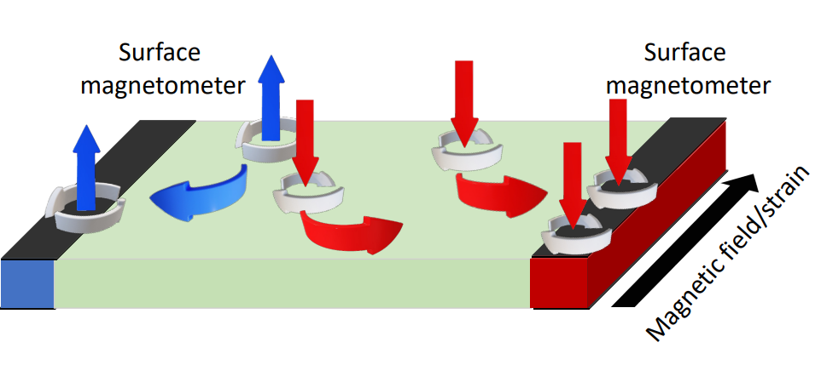
Localization and collection with the phonon thermal Hall effect
In order to detect chiral phonons, they should be localized, as a single phonon magnetic moment delocalized throughout the material would be undetectable.
Phonons can be both driven towards a detector and localized there using the phonon thermal Hall effect, in which a symmetry-breaking field drives phonons to the surfaces parallel to the field.¹
The crystallographic orientation of the surface can further enhance phonon localization and decrease transport velocity there.²
Zhang, Niu, Phys. Rev. Lett. 2015, 115, 115502.
Knipp, Phys. Rev. B 1989, 40, 7993.
Marek Matas

Slide 14
How to find the optimal material?

Slide 15
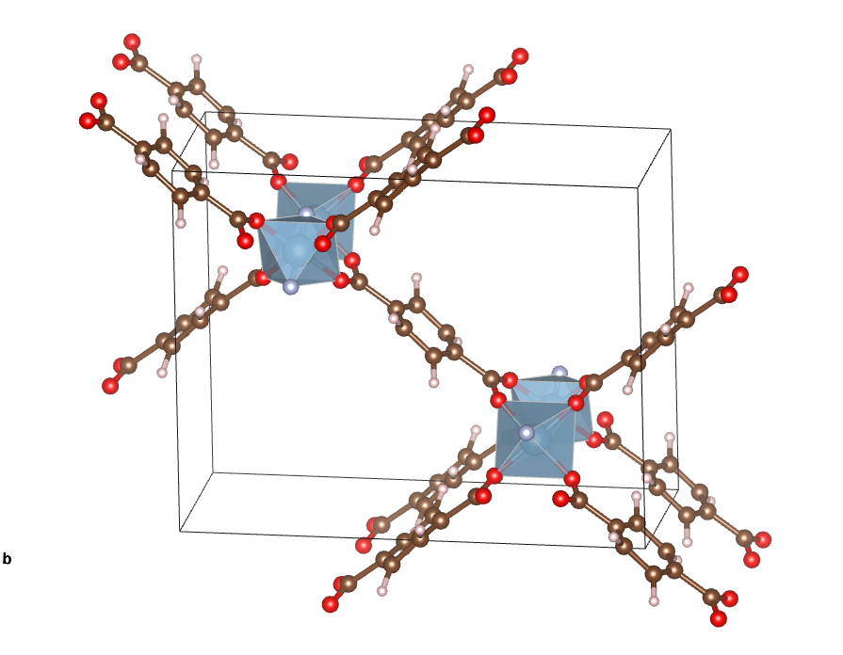
Metal–organic frameworks
Metal-organic frameworks (MOFs) have highly customizable structures with empty space in the unit cell leading to low-energy modes including circular motion of atoms.
MIL-53, a prototypical MOF. Its structure is tunable by substitution of the metals and organic linkers.
Marek Matas

Slide 16
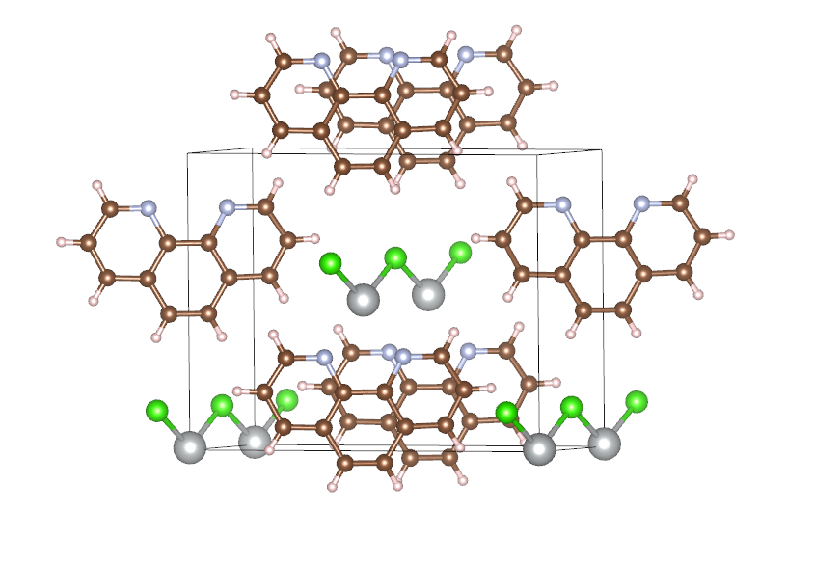
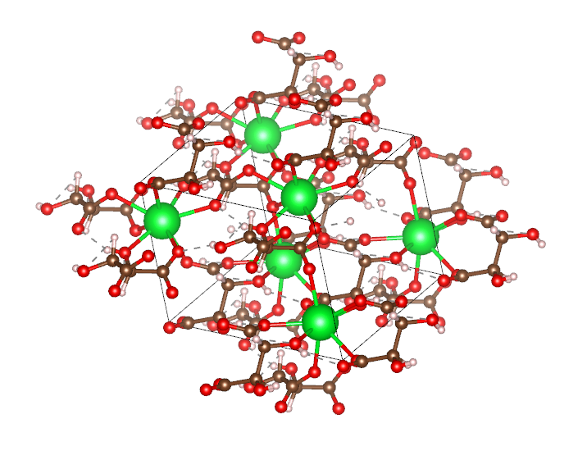
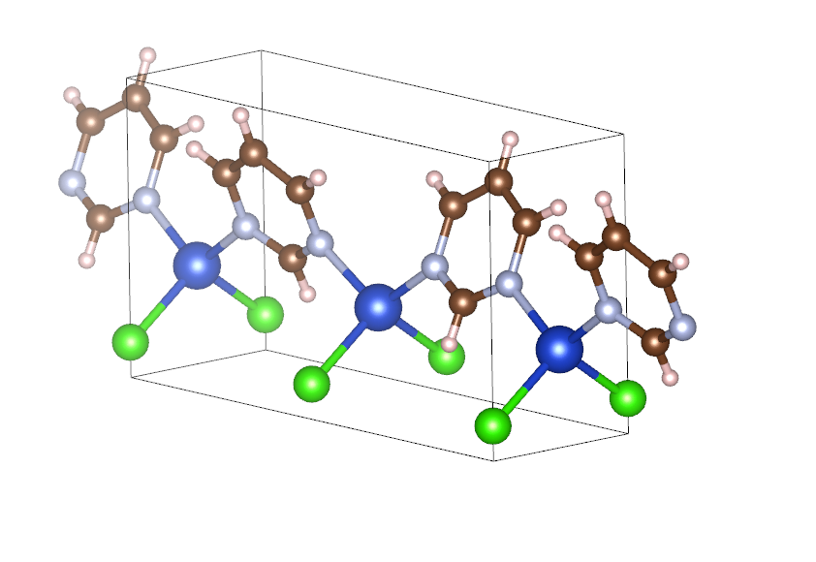
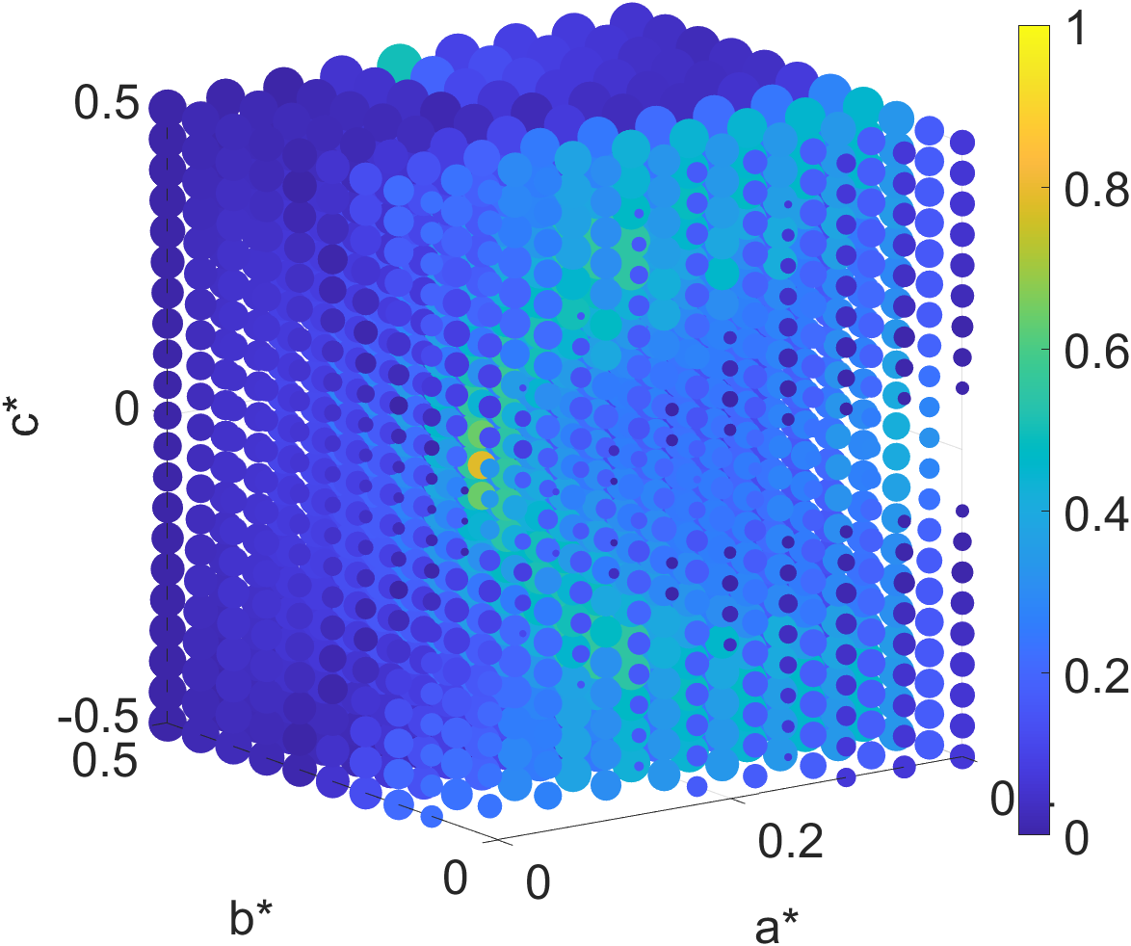
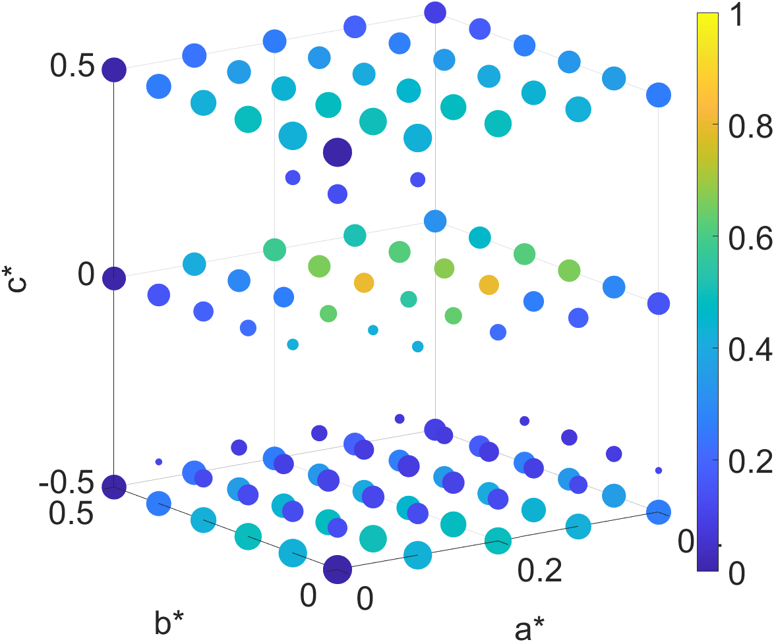
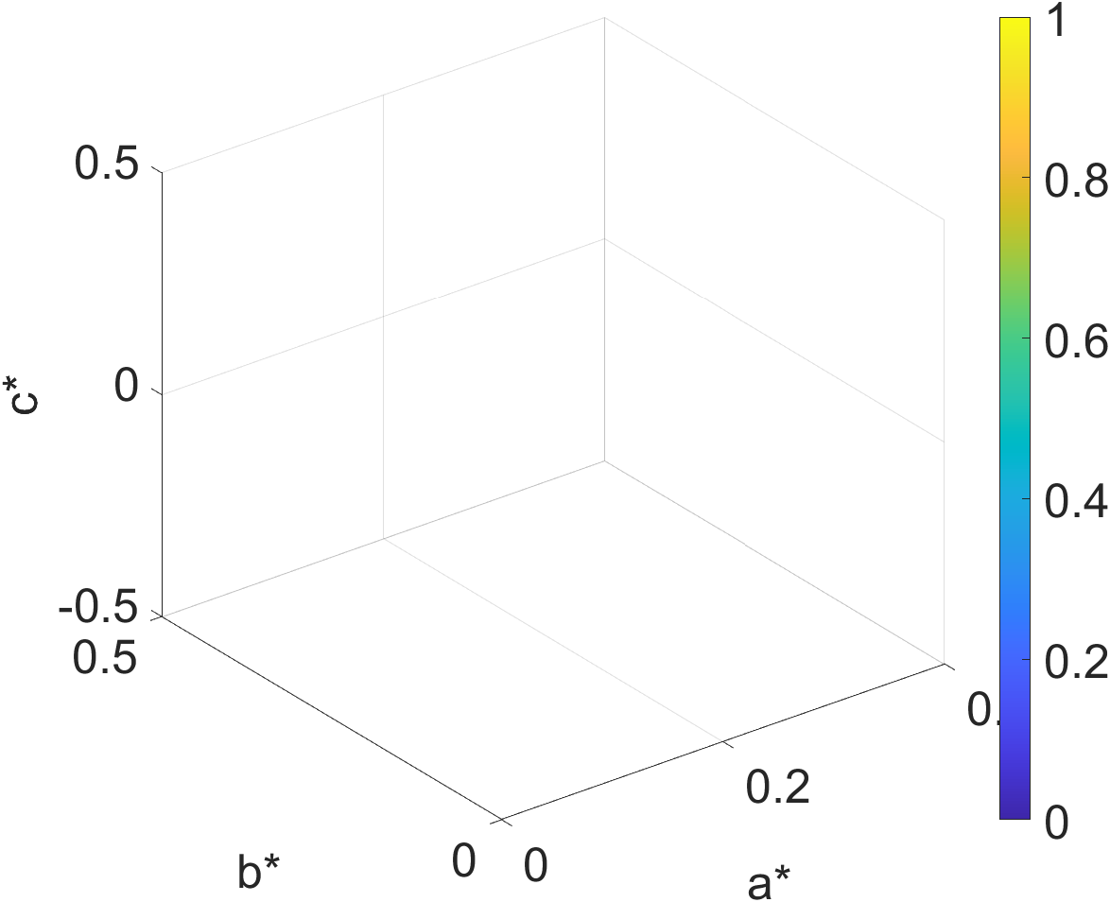
Screening MOFs by the chirality of their lowest energy phonons
CuCl(pyrimidine) (Pma2)
AgCl(phenanthroline) (C2)
Sr(tartrate) (C222₁)
Phonon circular polarization
Phonon circular polarization
Phonon circular polarization
Lowest-energy phonons on a grid of points in reciprocal space, omitting imaginary modes.
Marek Matas

Slide 17
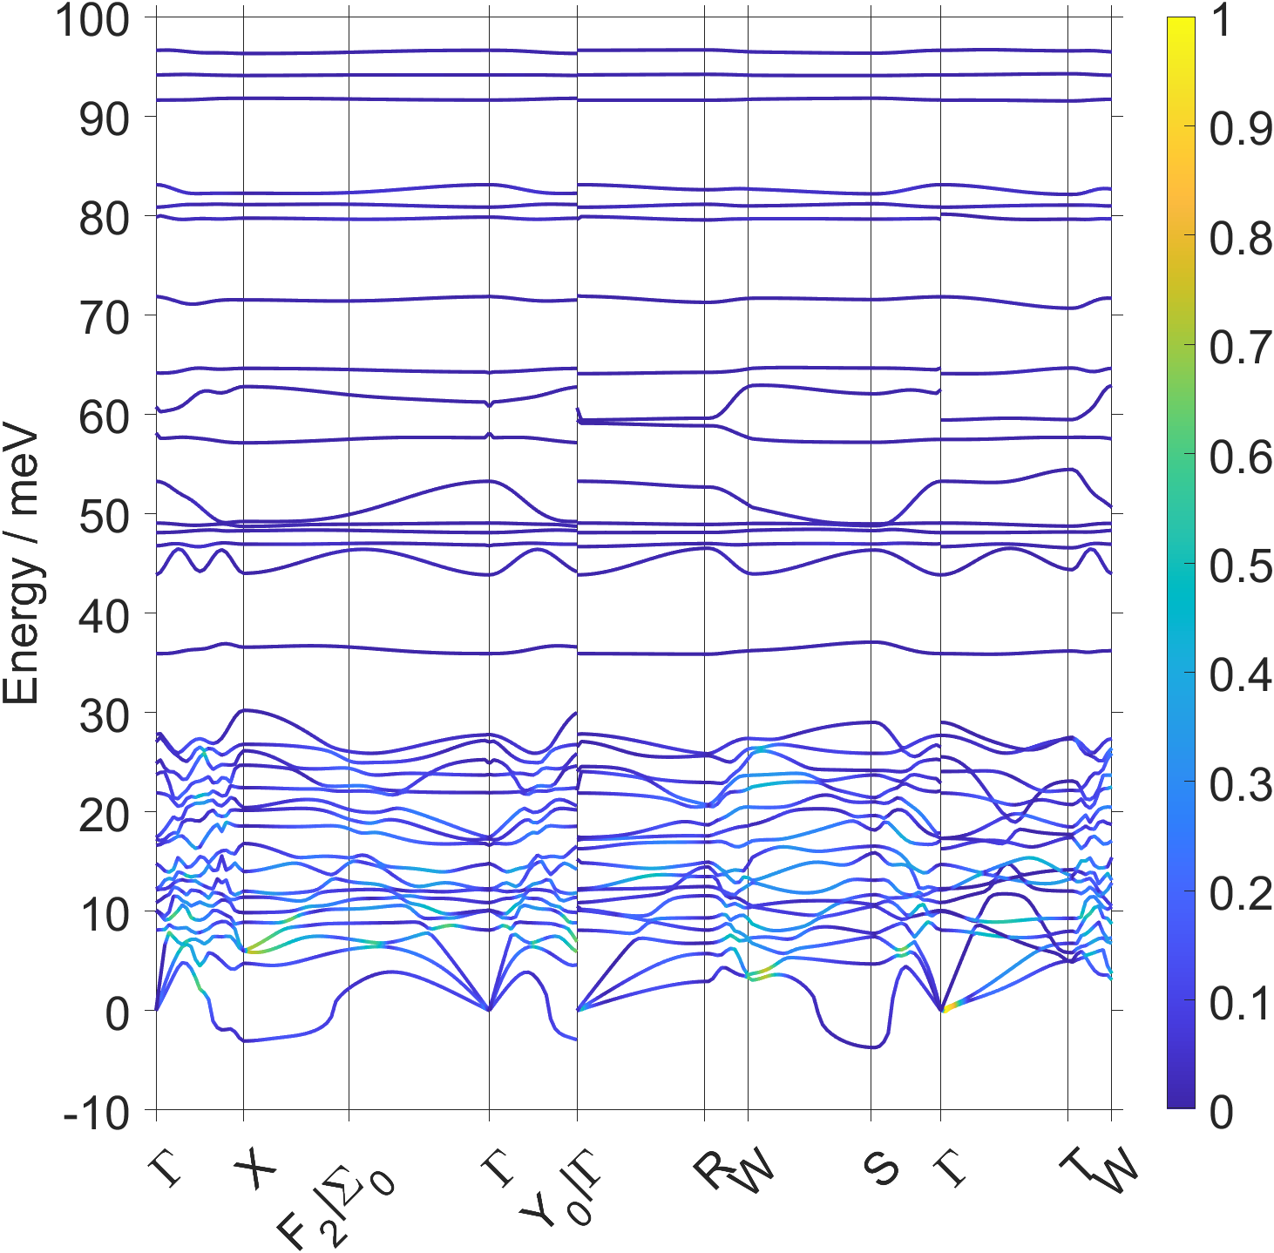
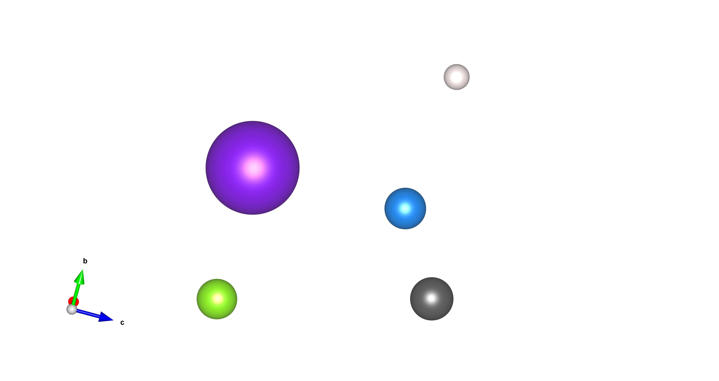
InF₃(4, 4′-bipyridine) – a promising material
T
In
F
Γ
c*
Phonon circular polarization
N
Phonon circular polarization
C
c
H
T′
b
Q₁
R
a*
V
b*
Chiral metal–organic framework with space group I222.
The lowest energy phonon band shows a highly anisotropic distribution of chiral modes in reciprocal space.
The chiral modes lie away from the high-symmetry directions in reciprocal space.
Romao, Catena, Spaldin, Matas, arXiv:2301.07617.
Marek Matas

Slide 18
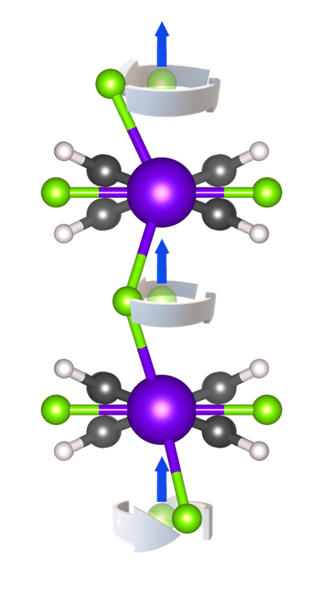
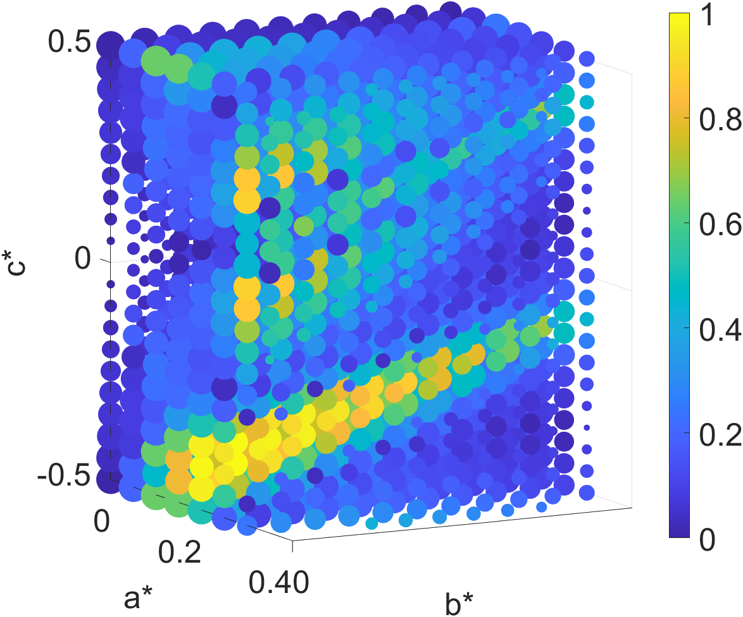
Phonon magnetism in InF₃(4, 4′-bipyridine)
b
T
a
c*
Γ
Relative phonon magnetic moment
Q₂
Phonon circular polarization (x component)
T′
Q₁
R
a*
V
b*
The phonon magnetic moments also show a high degree of anisotropy, leading to anisotropic detector response.
High density of low-energy vibrational modes that could decay into the chiral low-energy acoustic band.
Romao, Catena, Spaldin, Matas, arXiv:2301.07617.
Phonon at Q₁ (0.2 0 −0.4), showing fluorine atoms revolving about their average positions.
Marek Matas

Slide 19
Phonon magnetism in InF₃(4, 4′-bipyridine)
b
T
a
c*
Γ
Relative phonon magnetic moment
Q₂
Phonon circular polarization (x component)
T′
Q₁
R
a*
V
b*
The phonon magnetic moments also show a high degree of anisotropy, leading to anisotropic detector response.
High density of low-energy vibrational modes that could decay into the chiral low-energy acoustic band.
Romao, Catena, Spaldin, Matas, arXiv:2301.07617.
Phonon at Q₁ (0.2 0 −0.4), showing fluorine atoms revolving about their average positions.

Slide 20
Anisotropic detector response
T
The circular polarization of phonons (and therefore their magnetic moments) are anisotropic in momentum space, and therefore the detector response would be anisotropic.
This anisotropy would allow background exclusion by orienting the detector differently with respect to the DM wind.
c*
Γ
Relative phonon magnetic moment
Q₂
T′
Q₁
R
a*
V
b*
The phonon magnetic moments also show a high degree of anisotropy, leading to anisotropic detector response.
Boyd et al., arXiv:2212.04505.
Marek Matas

Slide 21
How would such a detector perform?

Slide 22
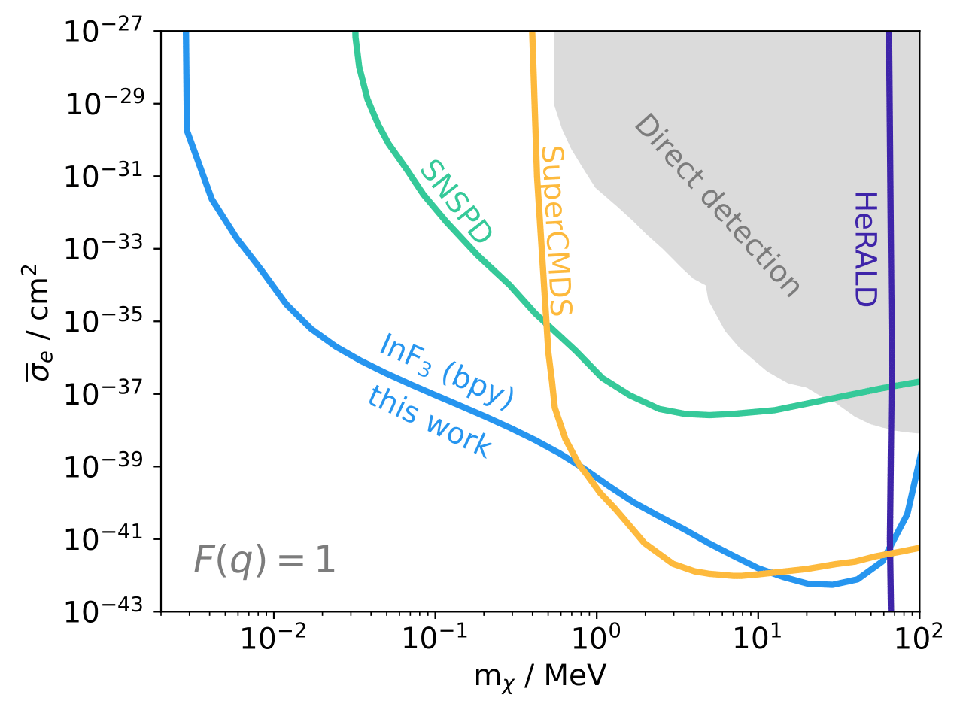
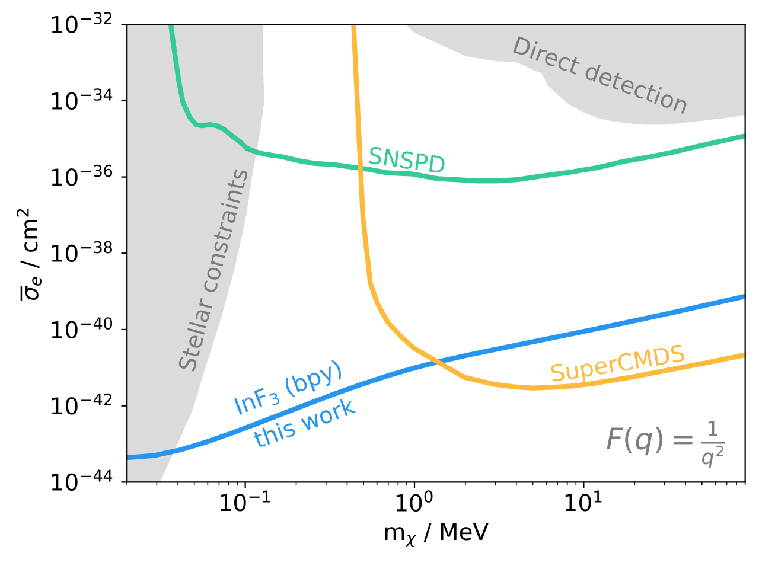
Single phonon DM detector reach
Heavy mediator
Light mediator
Detection of single chiral phonons via their magnetic moments would extend detector reach by orders of magnitude in terms of mass ($m_{χ}$) and cross-section (${\overline{σ}}_{e}$).
Romao, Catena, Spaldin, Matas, arXiv:2301.07617.
Marek Matas

Slide 23
Outlook and Summary

Slide 24
Outlook and Summary
Noncentrosymmetric materials with large phonon magnetism must be identified.
Methods to screen materials for their phonon magnetism in the acoustic bands must be developed.
Once materials with suitable phonon magnetism are identified, a detailed model of the sensitivity of the detector material can be obtained by calculating all phonon decay paths.
The ability of the detector to sense DM could be tested using other probes (e.g., neutrons).
Marek Matas

Slide 25
Outlook and Summary
Noncentrosymmetric materials with large phonon magnetism must be identified.
Methods to screen materials for their phonon magnetism in the acoustic bands must be developed.
Once materials with suitable phonon magnetism are identified, a detailed model of the sensitivity of the detector material can be obtained by calculating all phonon decay paths.
The ability of the detector to sense DM could be tested using other probes (e.g., neutrons).
Chiral phonons are a promising probe of sub-Gev DM!
Marek Matas

Slide 26
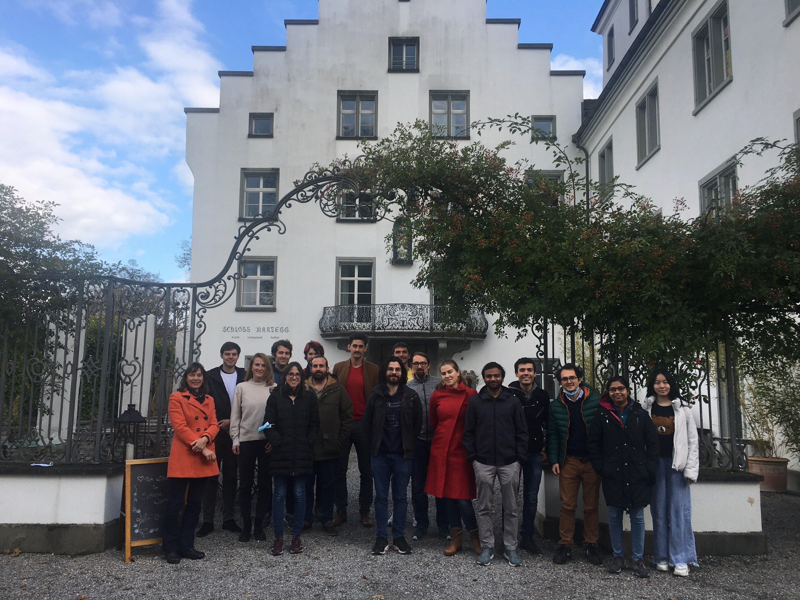


Acknowledgments

Slide 27
Material requirements
A noncentrosymmetric material is required for the acoustic bands to be inherently chiral.
Rotational motions of the atoms should have very low energy.
The material should have very large phonon magnetic moments or be modified such that it does.
  e.g., by introducing f electron paramagnetism or nontrivial electronic topology.
The distribution of chiral phonons should be anisotropic in momentum space.
Secondary requirements:
  Reasonably sized single crystals with a high degree of purity
  Large phonon thermal Hall effect.
Marek Matas

Slide 28
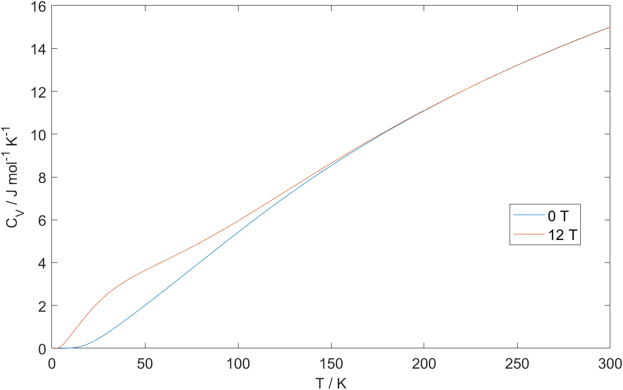
Heat capacity dependence on chiral magnetism
Heat capacity with respect to temperature of a material hosting chiral phonons with a magnetic moment of a Bohr magneton.
Marek Matas

Slide 29
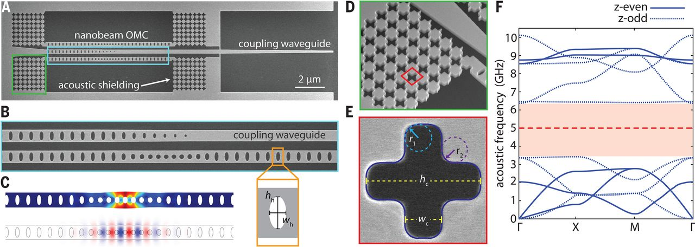
Stabilizing chiral phonons
Thermal isolation has been demonstrated to provide acoustic phonons with lifetimes of seconds at mK temperatures.³
SQUID sensitivity scales as T·Hz^{−1⁄2}; therefore enhancing the phonon lifetime and localization is required to render the phonon magnetic moments detectable.
A mechanical metamaterial provides thermal shielding via an acoustic bandgap, allowing second-scale phonon lifetimes and single phonon sensitivity.¹
MacCabe, Ren, Luo, Cohen, Zhou, Sipahigil, Mirhosseini, Painter, Science 2020, 370, 840.

Slide 30
Outlook
Noncentrosymmetric materials with large phonon magnetism must be identified.
Methods to screen materials for their phonon magnetism in the acoustic bands must be developed.
Once materials with suitable phonon magnetism are identified, a detailed model of the sensitivity of the detector material can be obtained by calculating all phonon decay paths.
These material properties would place limits on the design of the magnetometer and phonon thermal Hall systems.
The ability of the detector to sense DM could be tested using other probes (e.g., neutrons).
Large improvements on current DM exclusion limits could be obtained with small samples.
Further theoretical development into phonon magnetism and the phonon thermal Hall effect would be very useful.
Marek Matas

