Slide 1


Newest results from the NEWS-G dark matter experiment
Jean-Marie Coquillat
On behalf of the NEWS-G collaboration
TAUP conference, Vienna
August 30th 2023

Slide 2
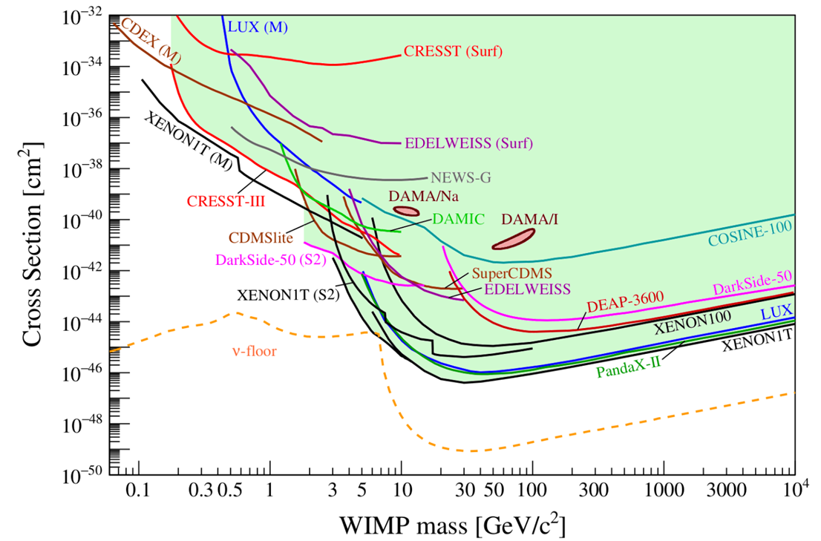
Low mass WIMP search motivation
Given the absence of canonical WIMPs, there is motivation to look at the parameter space left at lower masses (~0.1-1 GeV) for WIMP-like dark matter candidates.
arXiv:2104.07634 [hep-ex]
2

Slide 3
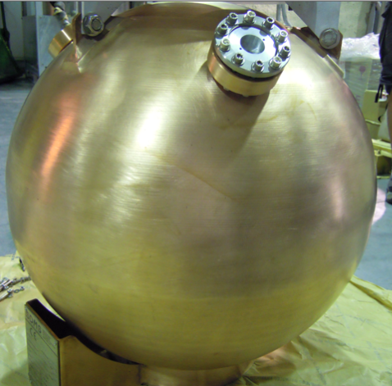
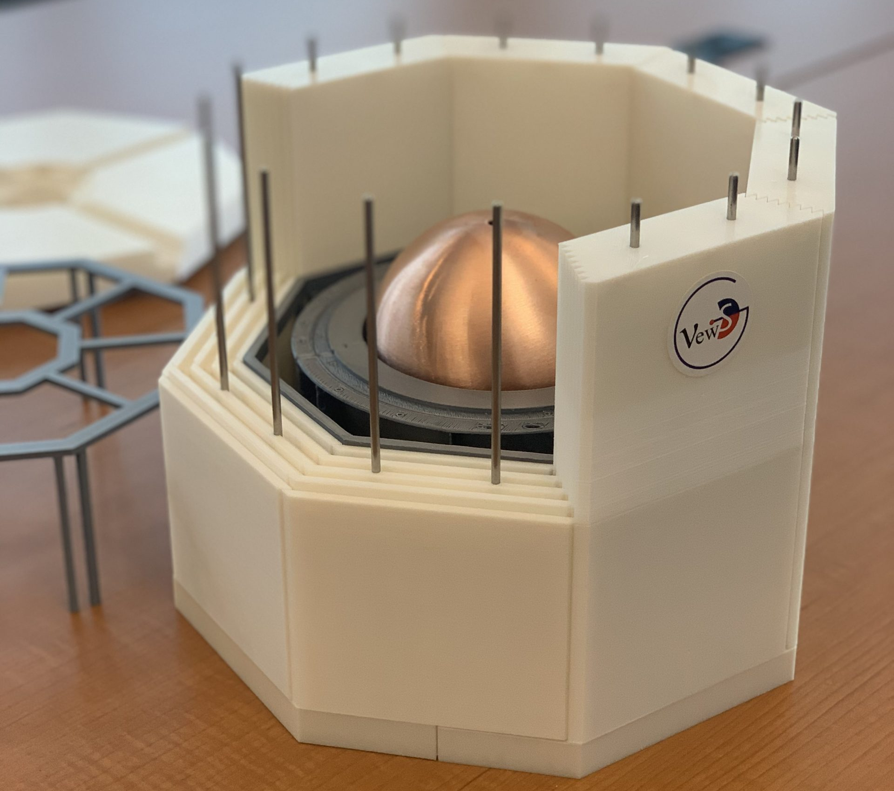
NEWS-G and SPCs
The SEDINE detector
The NEWS-G experiment uses spherical proportional counters (SPC) to search for low mass dark matter.
SPCs are metallic spheres filled with gas, with a central anode producing a radial electric field.
The last dark matter limits are from the SEDINE detector (60 cm diameter) at the Laboratoire Souterrain de Modane (LSM) in 2017.
The latest detector, S140, is a
135 cm of diameter copper
sphere currently at SNOLAB,
after a short commissioning at
the LSM in 2019.
S-140 detector model
doi: 10.1016/j.astropartphys.2017.10.009
3

Slide 4
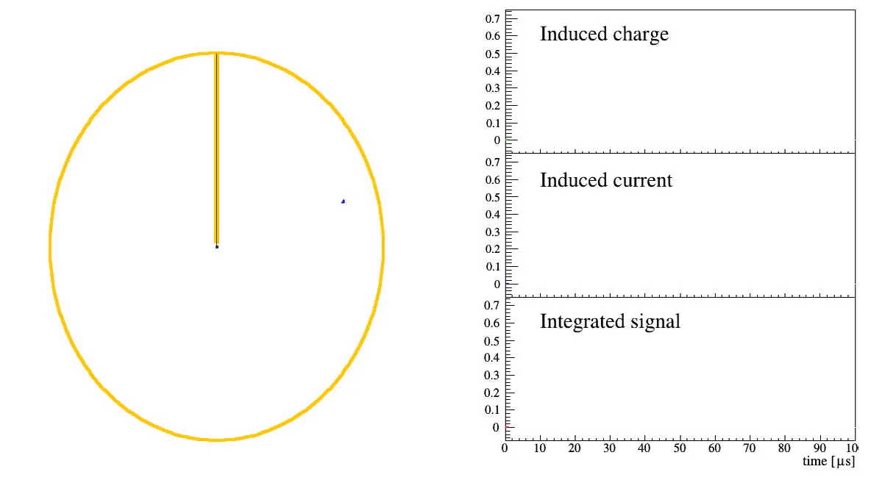
How an SPC works:
Atomic recoil causes ionization of the gas.
Primary electrons drift towards the central anode.
Townsend avalanche near the anode amplifies the signal.
Drifting secondary ions induce a current on the anode.
Animation by Philippe Gros
4

Slide 5
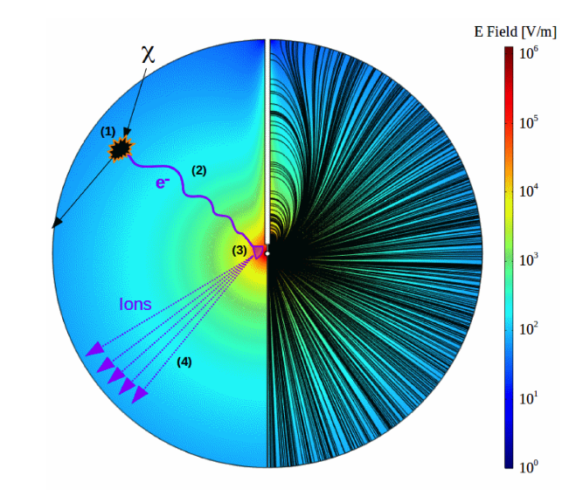
How an SPC works:
Atomic recoil causes ionization of the gas.
Primary electrons drift towards the central anode.
Townsend avalanche near the anode amplifies the signal.
Drifting secondary ions induce a current on the anode.
doi: 10.1016/j.nima.2019.162390
5

Slide 6
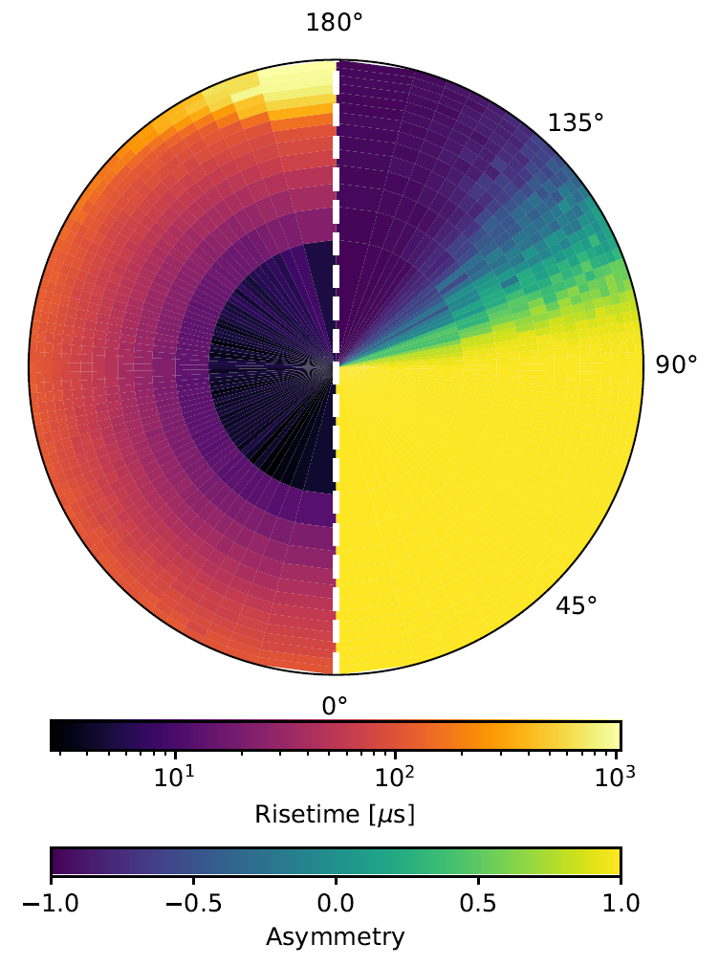
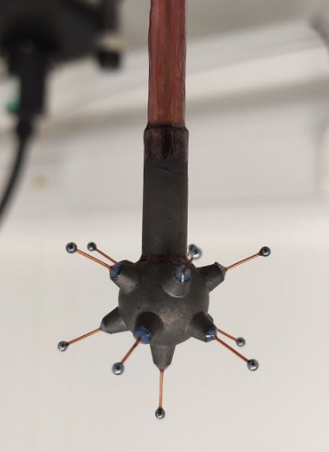
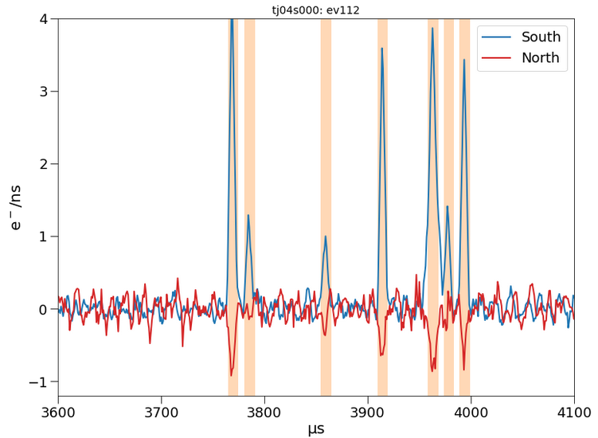
Sensor (achinos)
NEWS-G now uses a multi-anode sensor that can achieve high gain while keeping a strong electric field at a high radius.
The sensor is divided in two channels connecting the anodes of each hemisphere.
A signal on one channel induces a negative signal on the other one (Shockley-Ramo effect).
About 2/3 of the volume leads to the south anodes, due to the effect of the rod on the electric field.
arXiv:2301.05183
doi:10.1088/1742-6596/2156/1/012059
6

Slide 7
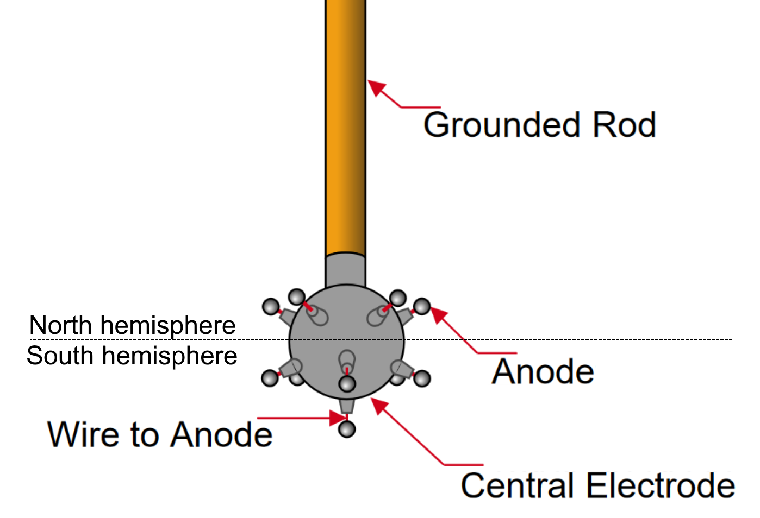
Sensor (achinos)
NEWS-G now uses a multi-anode sensor that can achieve high gain while keeping a strong electric field at a high radius.
The sensor is divided in two channels connecting the anodes of each hemisphere.
A signal on one channel induces a negative signal on the other one (Shockley-Ramo effect).
About 2/3 of the volume leads to the south anodes, due to the effect of the rod on the electric field.
arXiv:2301.05183
doi:10.1088/1742-6596/2156/1/012059
7

Slide 8
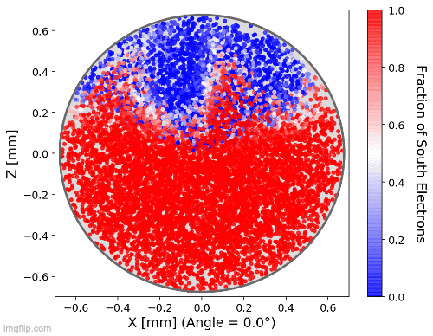
Sensor (achinos)
NEWS-G now uses a multi-anode sensor that can achieve high gain while keeping a strong electric field at a high radius.
The sensor is divided in two channels connecting the anodes of each hemisphere.
A signal on one channel induces a negative signal on the other one (Shockley-Ramo effect).
About 2/3 of the volume leads to the south anodes, due to the effect of the rod on the electric field.
doi:10.1088/1742-6596/2156/1/012059
Only pure south events were kept as candidate events.
8

Slide 9
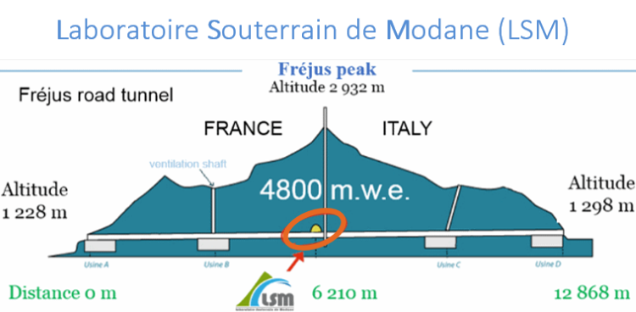
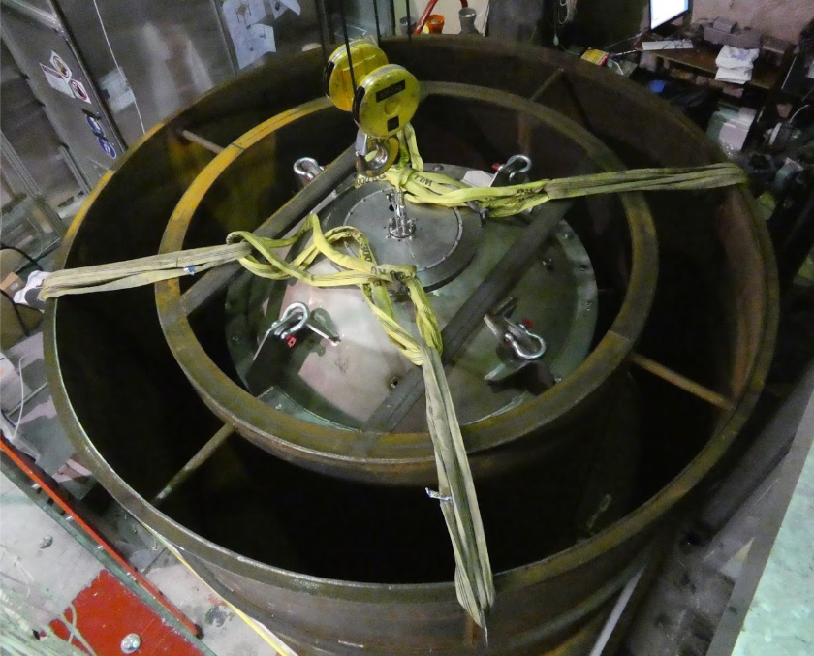

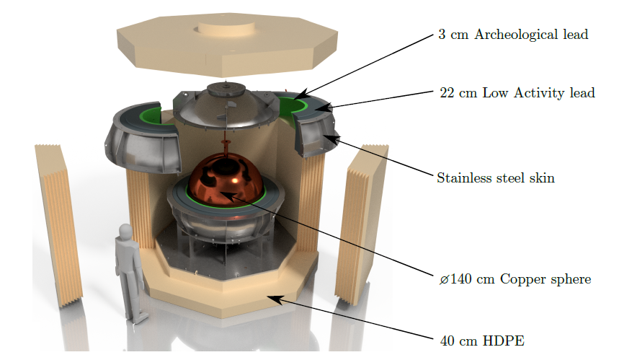

Shielding and data taking with S140
The sphere is made of C10100 copper, with the inner 0.5 mm being electroformed ultra-pure copper.
Lead, archeological lead and polyethylene (PE) make the shielding, although water was used at the LSM since the PE shield was unfinished.
10 days of physics data taken in 135 mbar of CH₄ at the LSM before the detector was shipped to SNOLAB.
SNOLAB detector paper
doi:10.1088/1748-0221/18/02/T02005
9

Slide 10
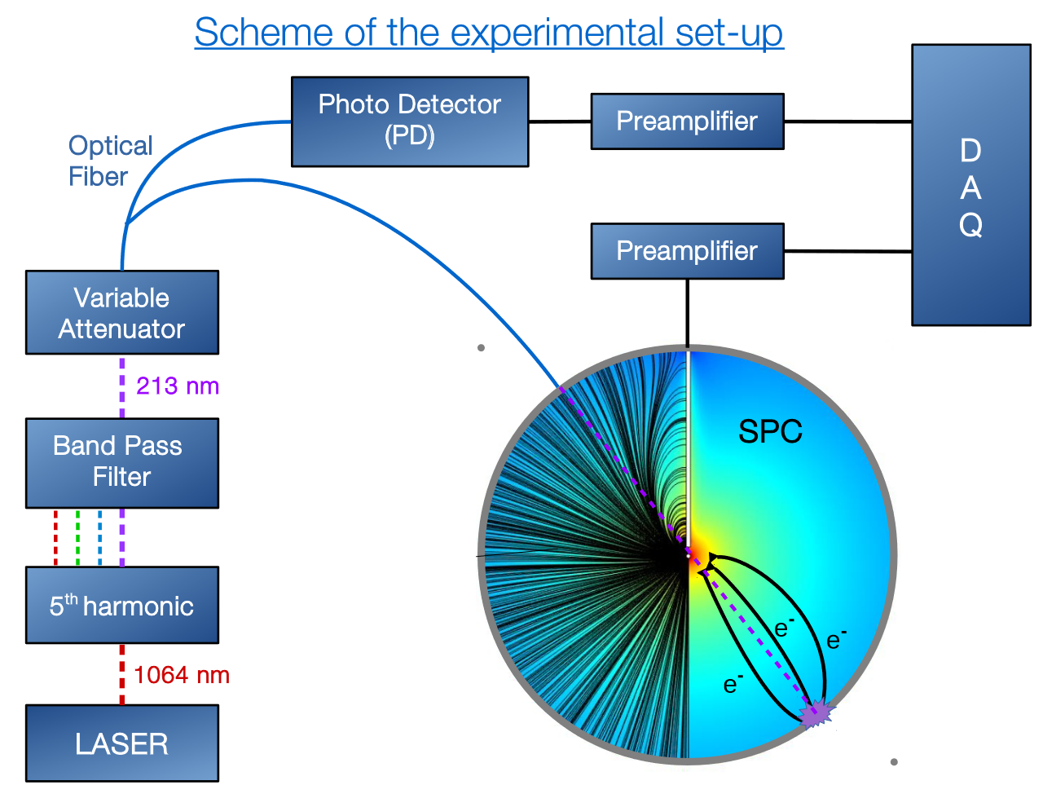
Calibration
A UV laser is directed at the inner copper surface of the sphere and releases electrons through the photoelectric effect. The UV light also goes to a photodetector so the laser events can be tagged as a control.
10

Slide 11
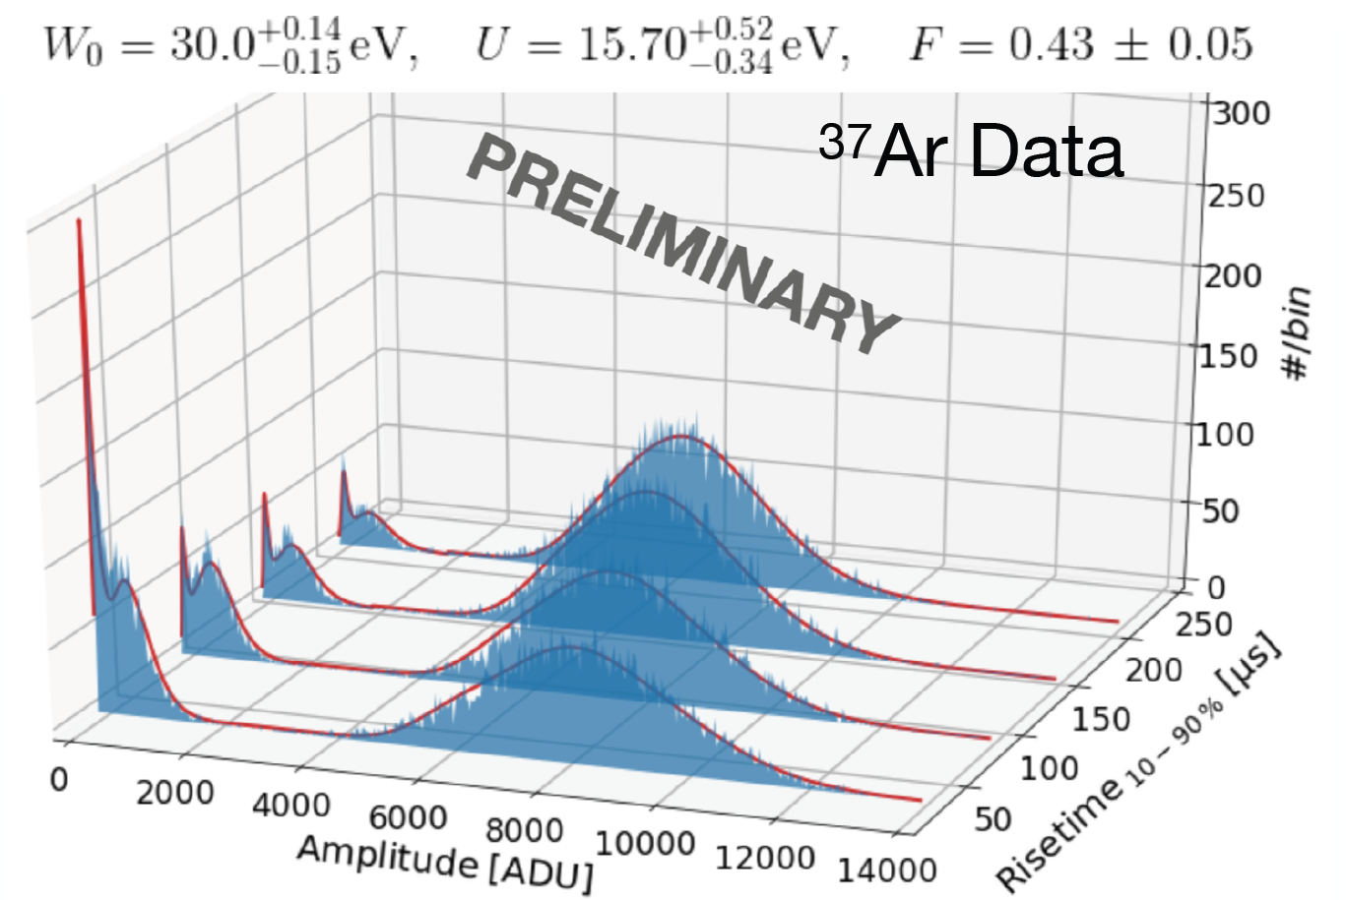
Calibration
A UV laser is directed at the inner copper surface of the sphere and releases electrons through the photoelectric effect. The UV light also goes to a photodetector so the laser events can be tagged as a control.
Some argon-37 is released inside the sphere, and the gas diffuses in the whole volume. This isotope is radioactive and has two peaks that enable energy calibration, as well as ionisation and attachment parametrization .
270 eV peak
2.8 keV peak
doi:10.1088/1742-6596/2156/1/012059
11

Slide 12
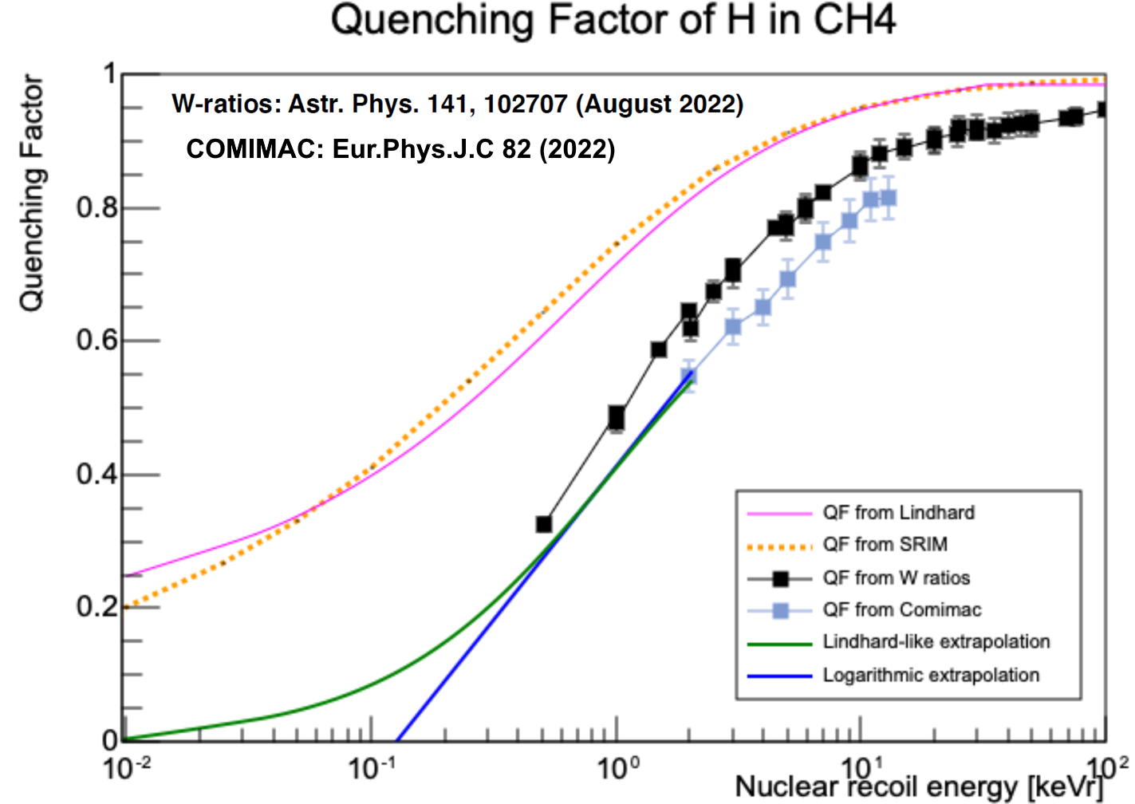
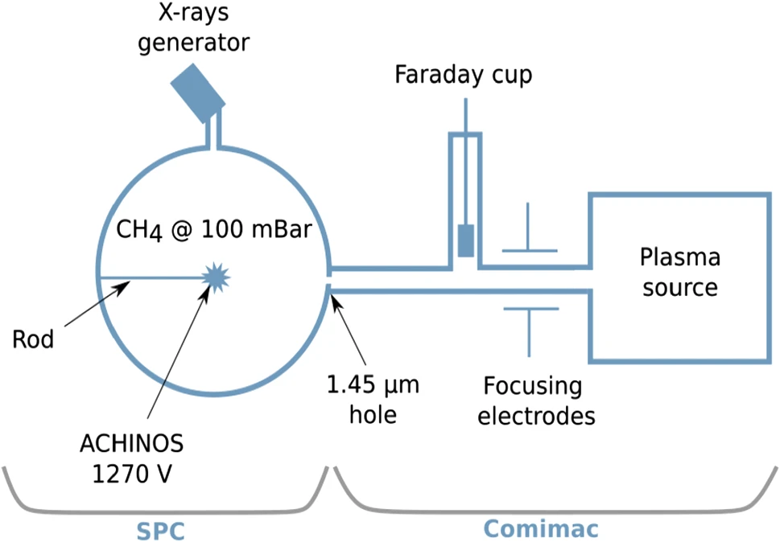
Calibration
A UV laser is directed at the inner copper surface of the sphere and releases electrons through the photoelectric effect. The UV light also goes to a photodetector so the laser events can be tagged as a control.
Some argon-37 is released inside the sphere, and the gas diffuses in the whole volume. This isotope is radioactive and has two peaks that enable energy calibration, as well as ionisation and attachment parametrization .
The quenching factor was measured
at COMIMAC as well as obtained
from literature W-values.
270 eV peak
2.8 keV peak
doi:10.1088/1742-6596/2156/1/012059
doi:10.1140/epjc/s10052-022-11063-9
12

Slide 13
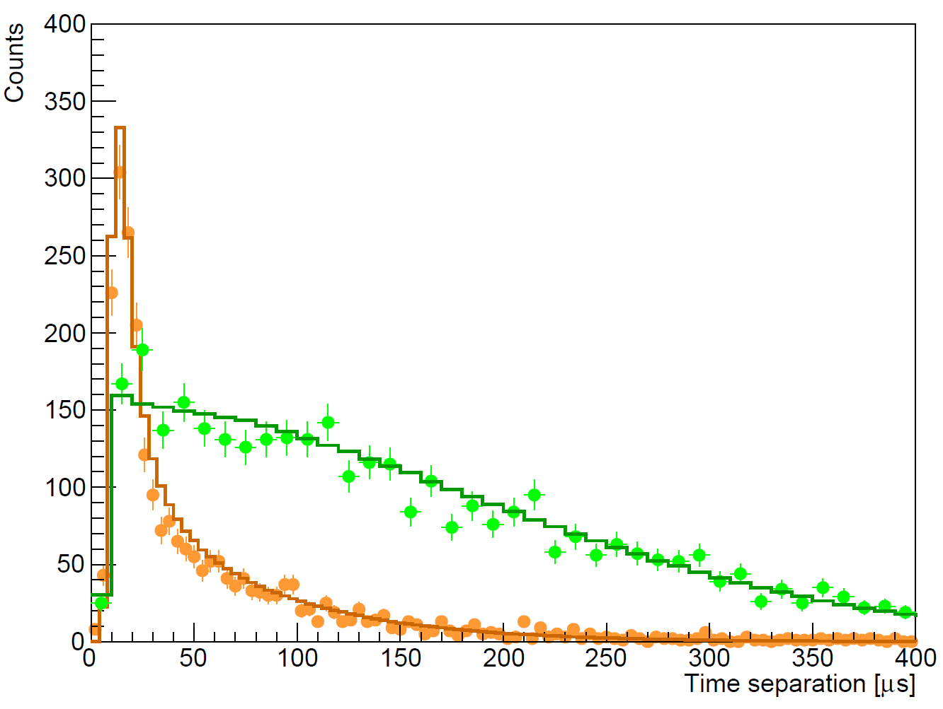
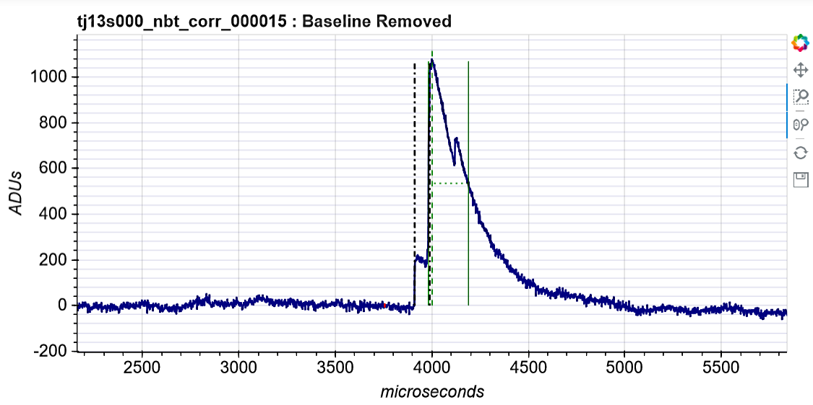
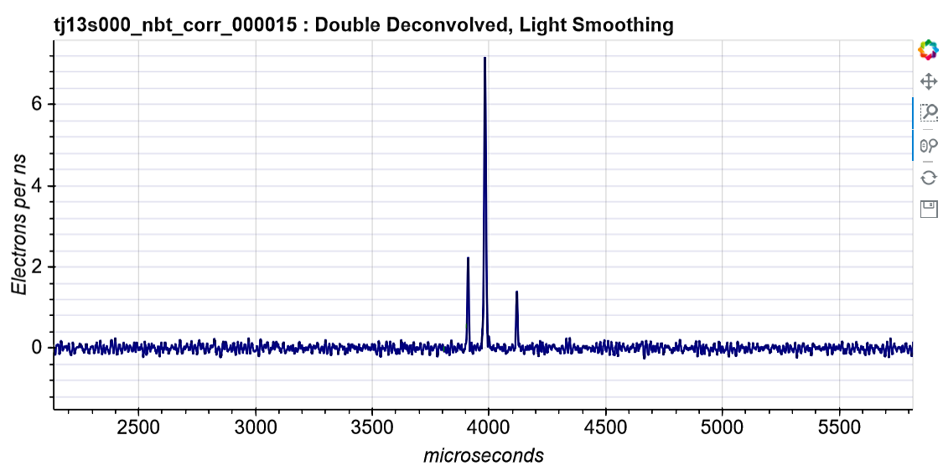
Peak counting and time separation
scipost_202210_00005v1
The exponential decay of the preamplifier and the ion response are deconvolved from the raw signal.
It is possible to count individual primary electrons.
Surface events experience more diffusion than volume events, which causes the time separation between the first and last peak to be larger.
VOLUME (³⁷Ar)
SURFACE (laser)
DOUBLE-DECONVOLUTION
13

Slide 14
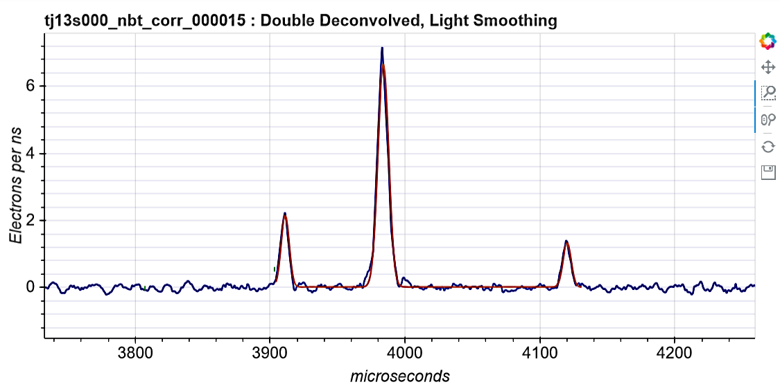
Peak counting and time separation
scipost_202210_00005v1
The exponential decay of the preamplifier and the ion response are deconvolved from the raw signal.
It is possible to count individual primary electrons.
Surface events experience more diffusion than volume events, which causes the time separation between the first and last peak to be larger.
VOLUME (³⁷Ar)
SURFACE (laser)
DOUBLE-DECONVOLUTION
14

Slide 15
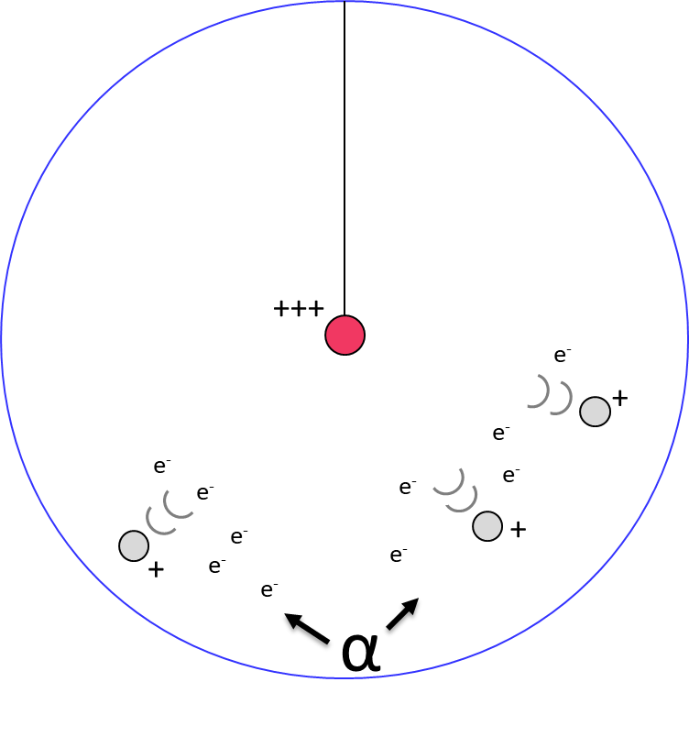
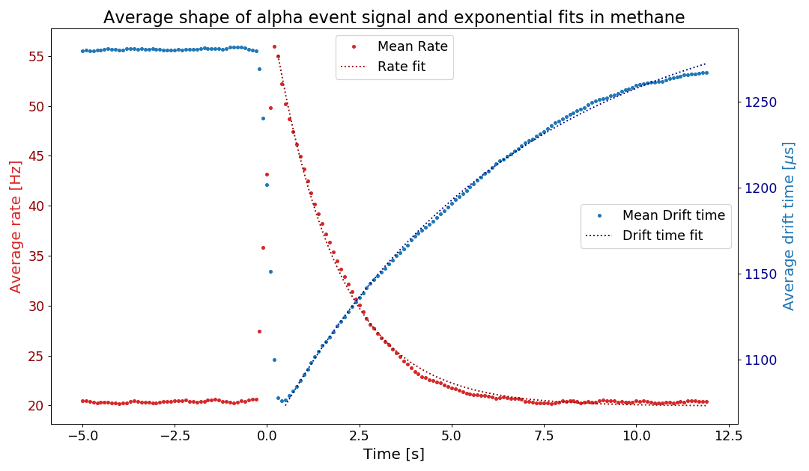
Alpha contamination
There is ~25 mHz of alphas from ²¹⁰Po contamination in the copper surface.
Alphas ionize a lot of gas and create a space charge that disturbs the electric field, and changes the electron drift time.
For some still unknown reason, a high rate of low energy events keep happening for around 5s after each alpha.
We remove most of the low-energy background due to alphas with a 5s cut after each one, keeping 88% of the total time.
DRIFT TIME
Methane
135 mbar
1630 V
RATE
15

Slide 16
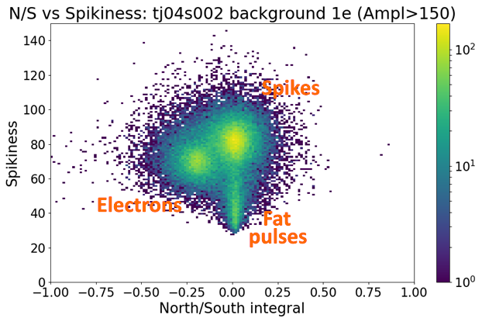
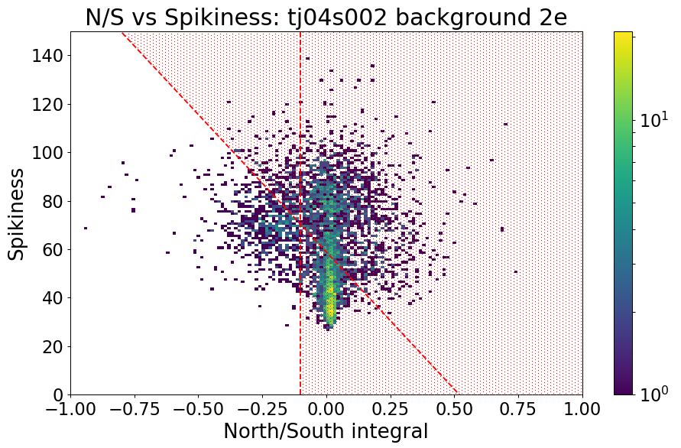
Pulse shape discrimination
There are spurious pulses caused by electronic discharges in the data.
Those can be discriminated from physical events with two different methods:
  Spurious pulses are either measurably spikier or wider than physical events.
  Spurious pulses do not cause a negative induced pulse on the opposite channel.
Around 95% of the spurious pulses are removed with cuts usings theses discriminants, while still keeping 77% of the physical events.
Wide
16

Slide 17
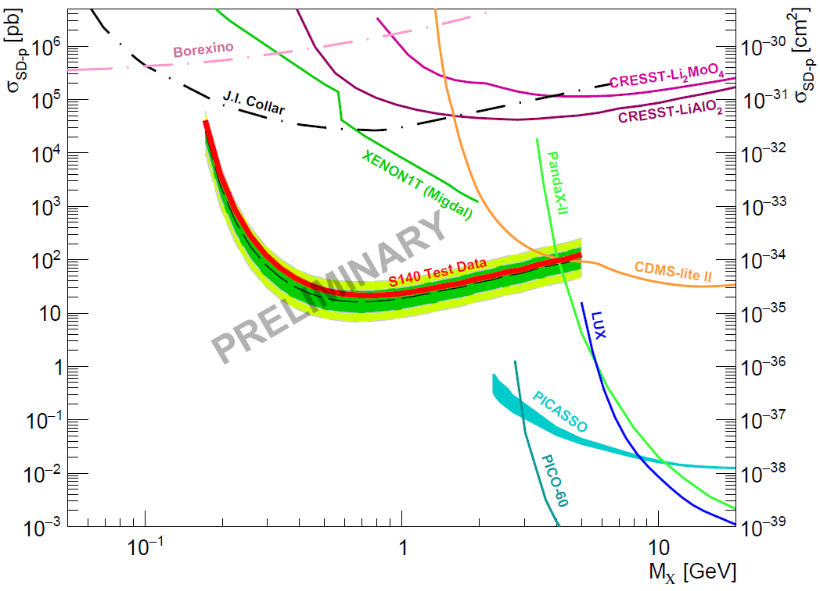
Physics data fits
30% of the full data was set aside as a test data before the rest is unblinded.
Profile likelihood fits of the test data were made for 2-3-4 peak data
Fits with contributions from surface background, coincidences and WIMP signal.
No significant WIMP signal was detected.
WIMP exclusions limits with ~0.12 kg·days of data
Strongest constraints for the proton spin-dependent interaction in the 0.2 - 1 GeV range.
Final blind data results to come in a few weeks.
scipost_202210_00005v1
17

Slide 18
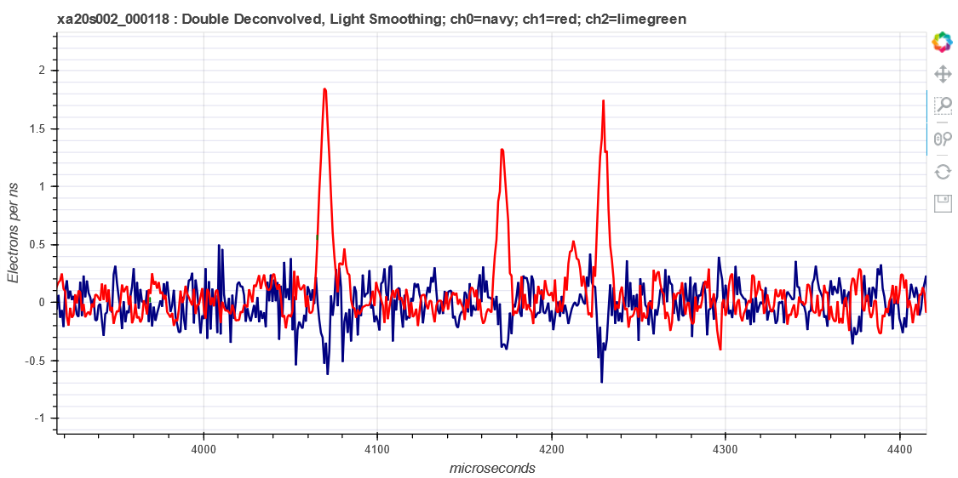
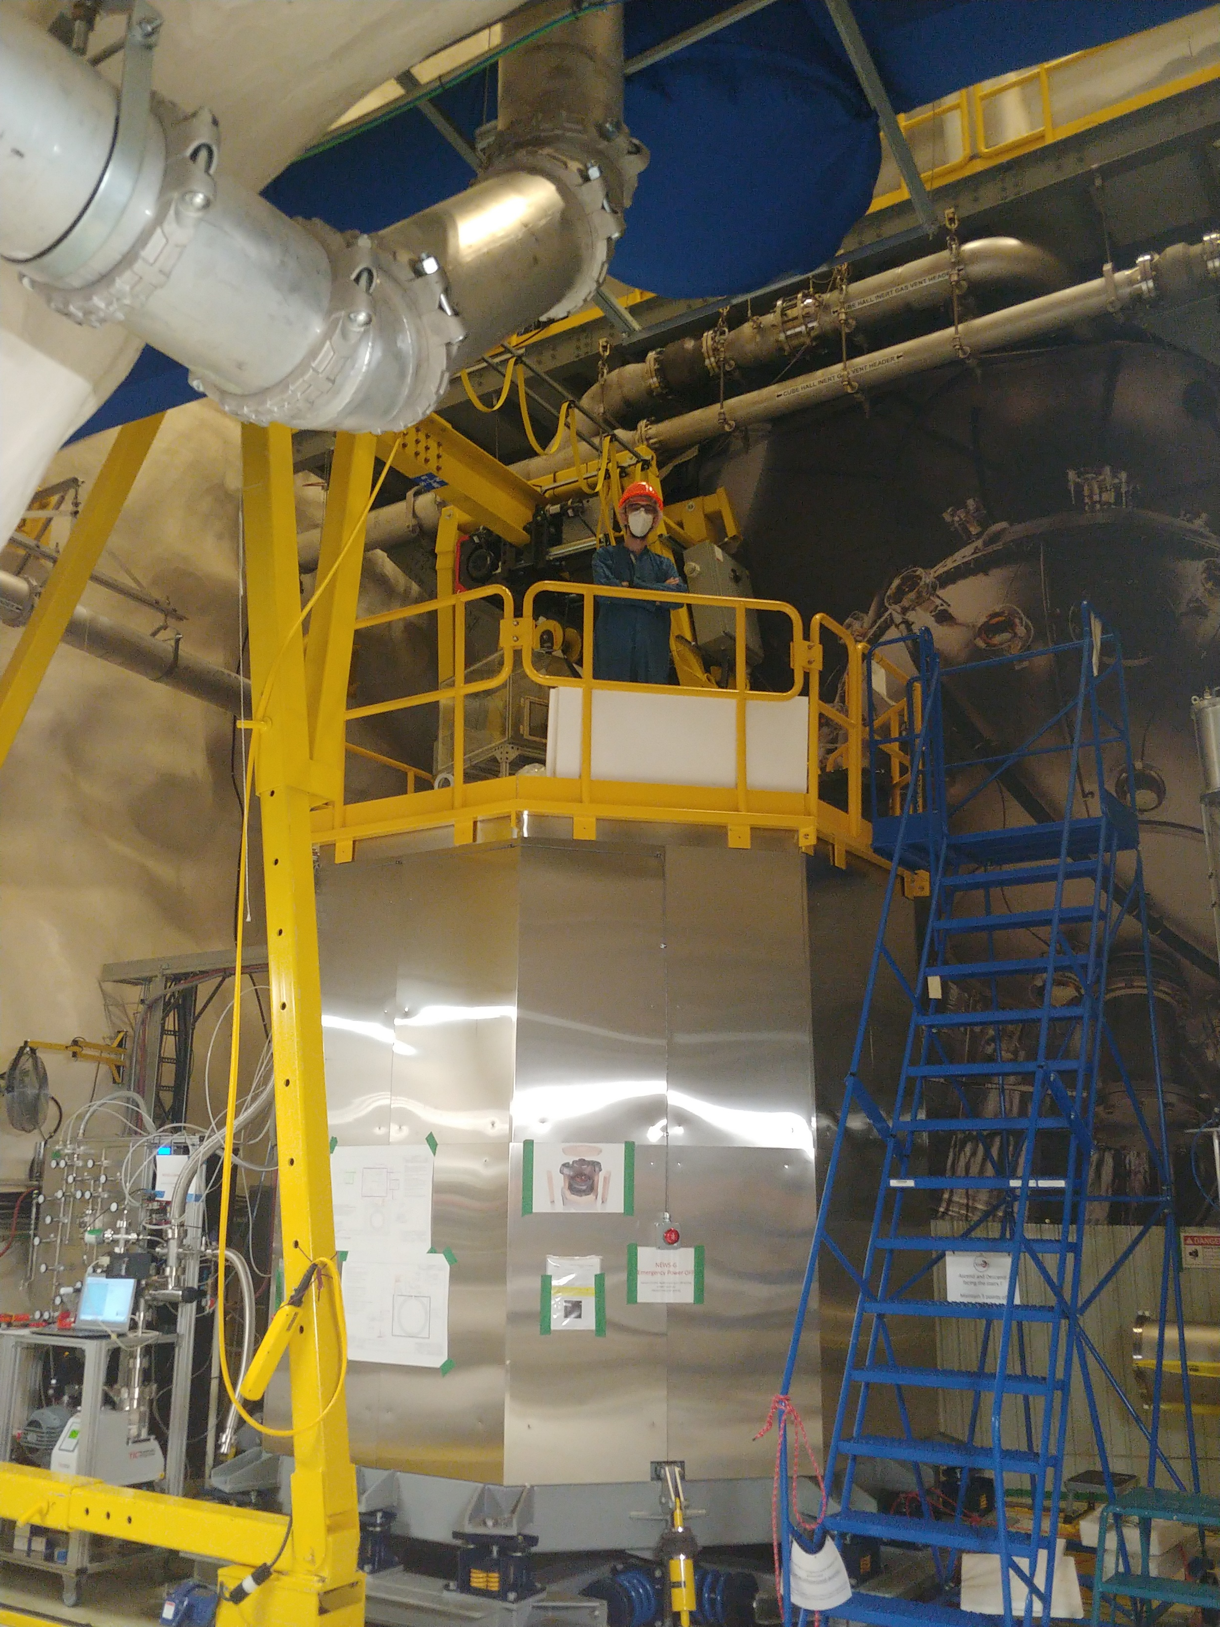
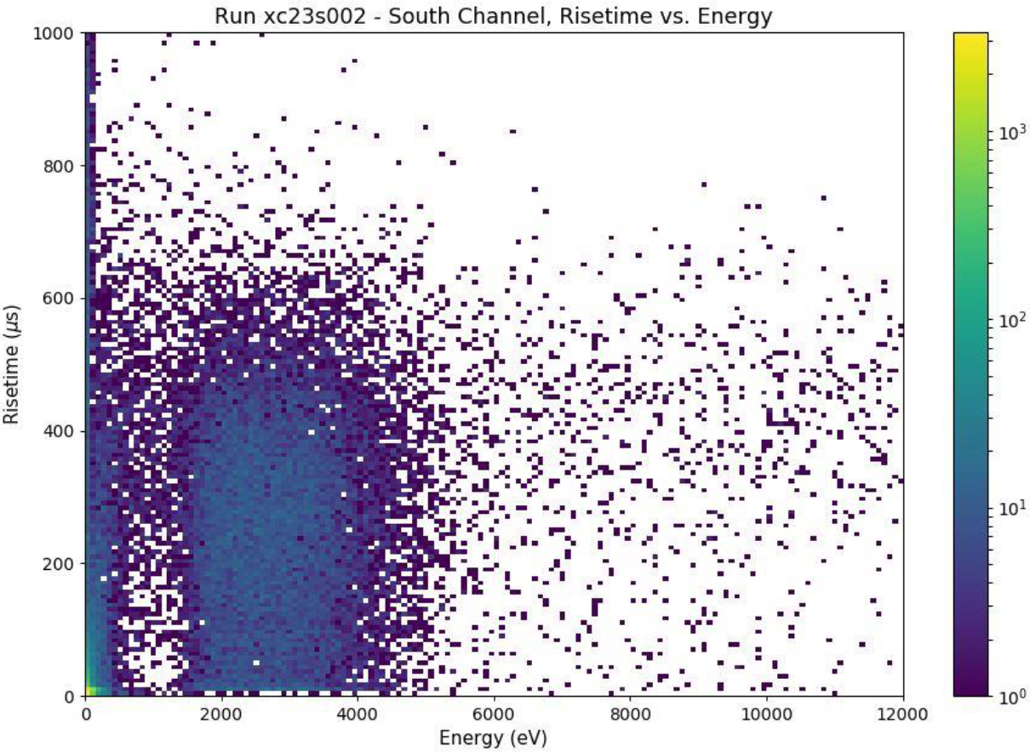
News from SNOLAB
laser
event
One physics data campaign taken, preparing the next one
Still countable electrons
Improvements from LSM:
  Trigger on three channels (North, South, PD)
  Reduced noise
  No spurious pulses
  Better gas purity
  Neon+2%CH₄, CH₄,
  Ar+CH₄, He+CH₄ etc.
³⁷Ar
18

Slide 19
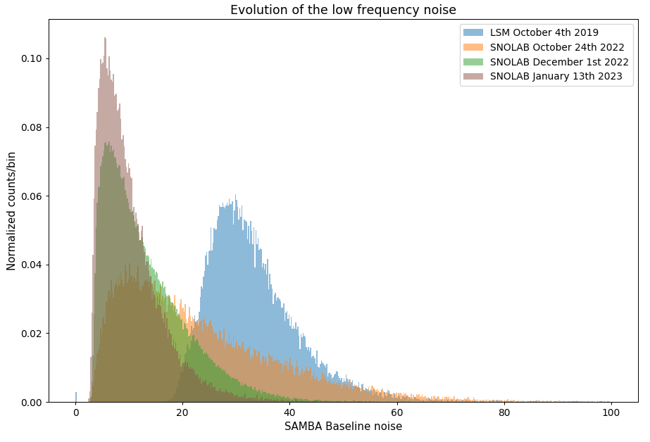
SNOLAB noise
Multiple improvements (dampening vibrations, better electronic isolation) across months slowly reduced the background noise.
Expected improvements for the rest of the year: Second etching, new gas purifier, new radon trap, new sensors
Better gas quality was shown to reduce the alpha induced background.
Low energy background reduced from 1-2 orders of magnitude compared to LSM data.
19

Slide 20
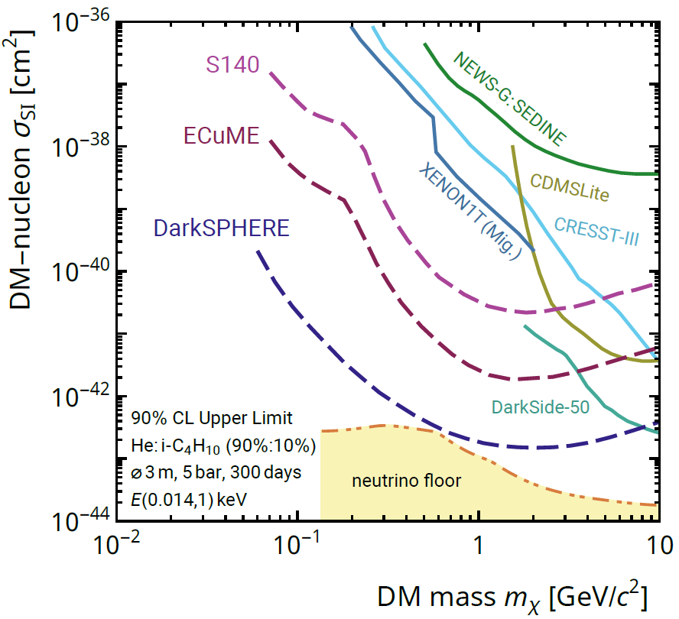
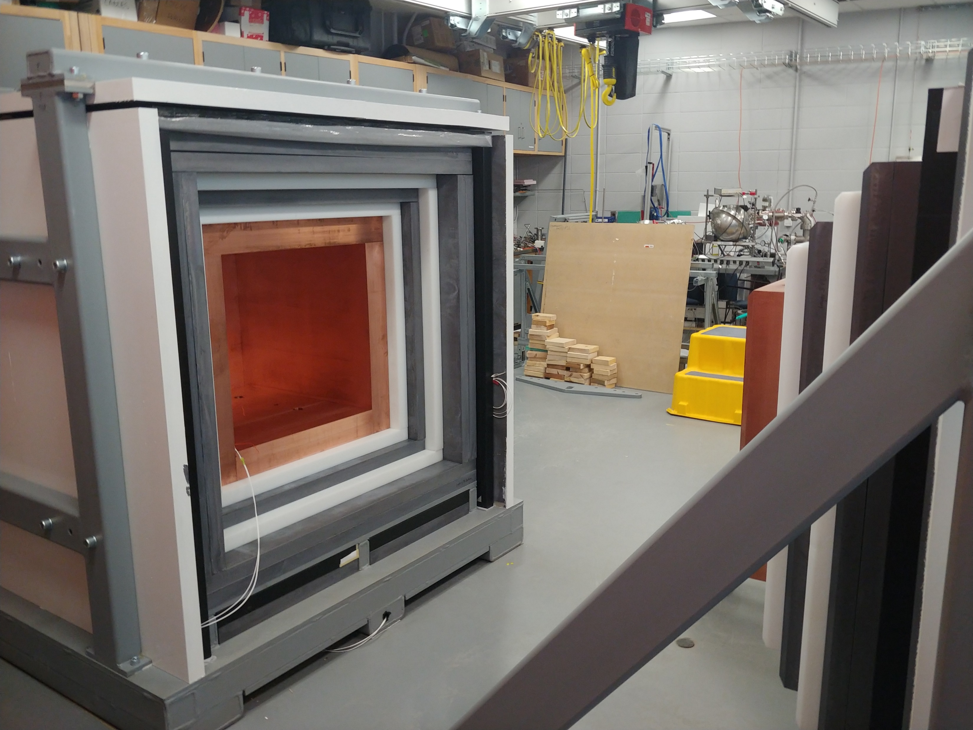
Future projects
ECuME (& miniECuME):
  Fully underground electroformed 140 cm of diameter copper sphere in SNOLAB.
  (30 cm prototype to be built in 2023 at PNNL)
DarkSPHERE:
  Fully electroformed 3m of diameter sphere in a water shield in Boulby.
  (under consideration)
NEWS-G³ (or G3):
  Shield at Queen’s University intended for CEνNS detection at nuclear reactors.
  (shield completed, ongoing testing and calibration)
arXiv:2301.05183
20

Slide 21
Conclusion
NEWS-G and SPCs well suited for low mass dark matter search.
LSM data able to set new SD-p WIMP constraints with CH₄.
Currently taking physics data at SNOLAB with many improvements.
Promising future projects in the works.
21

Slide 22







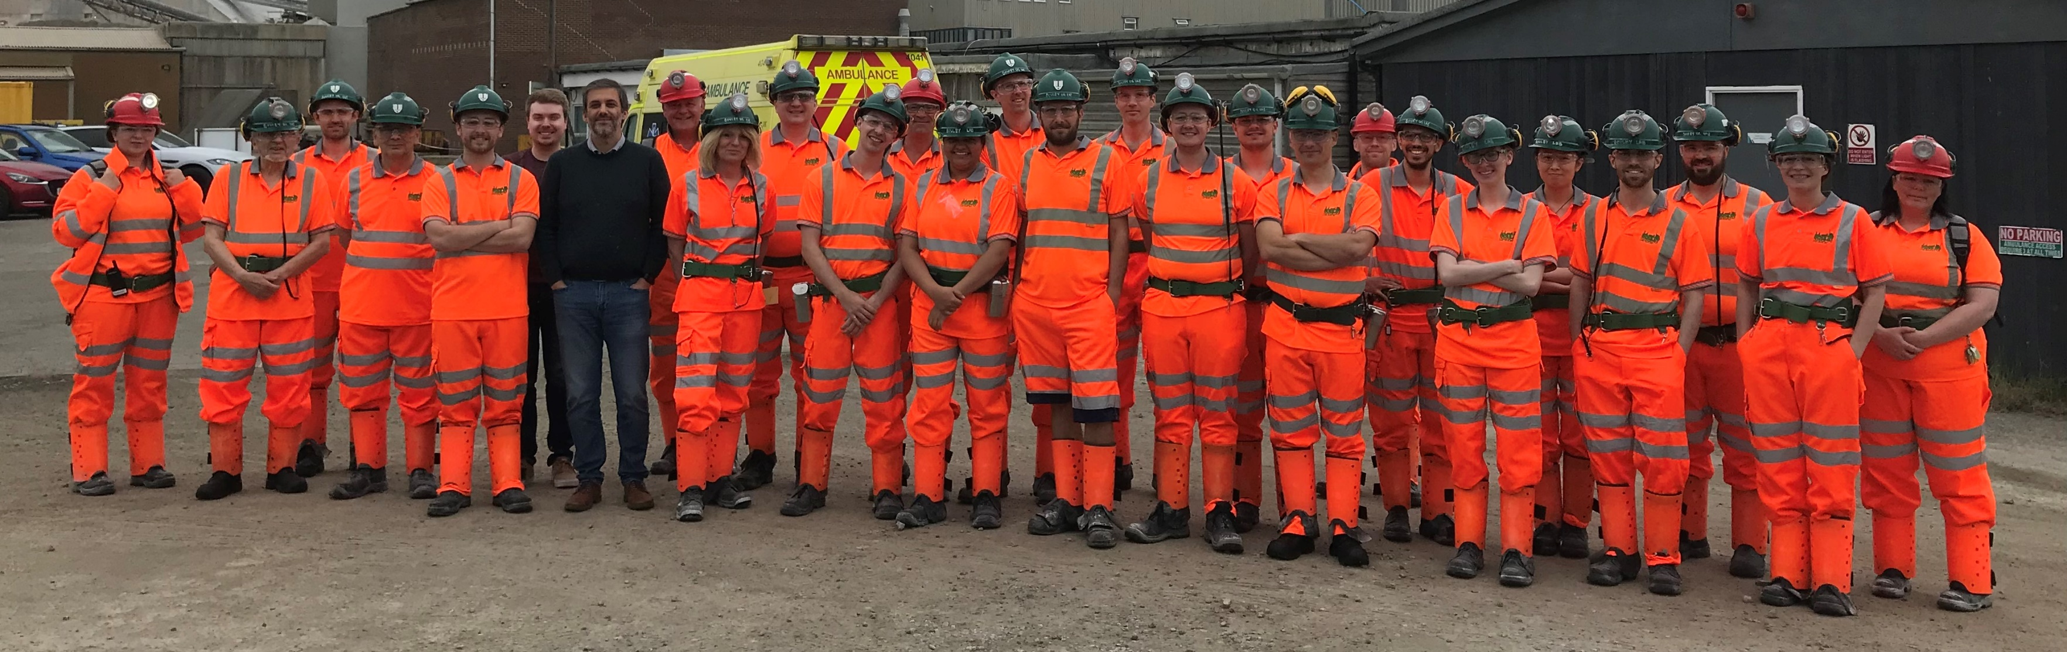




Danke
!!!

Slide 23
Extra slides

Slide 24
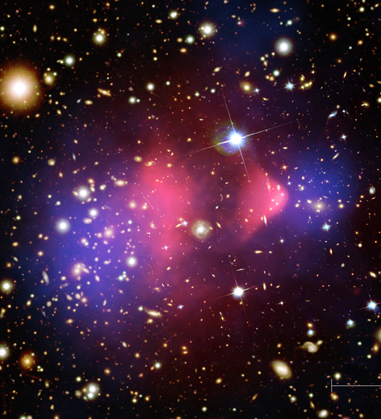
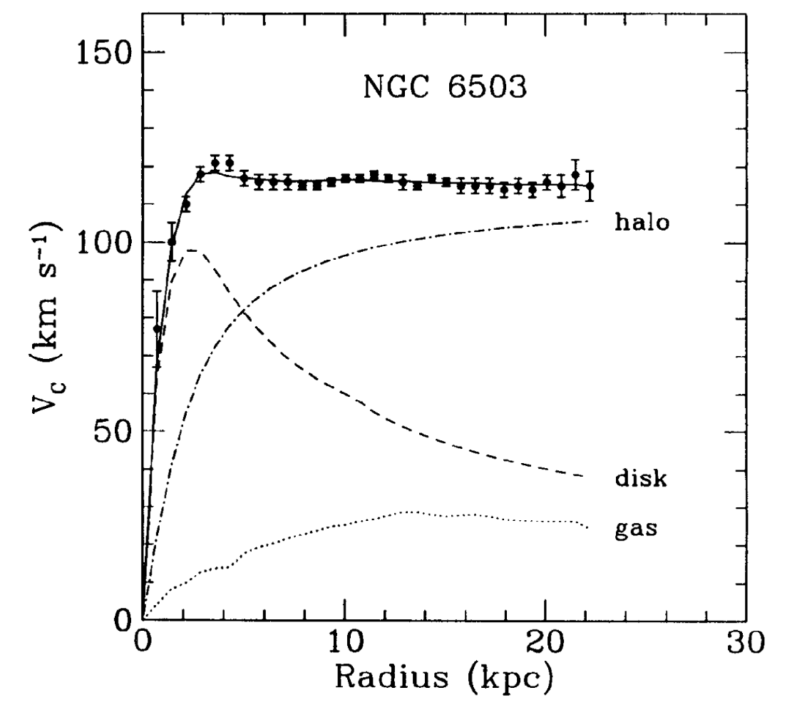
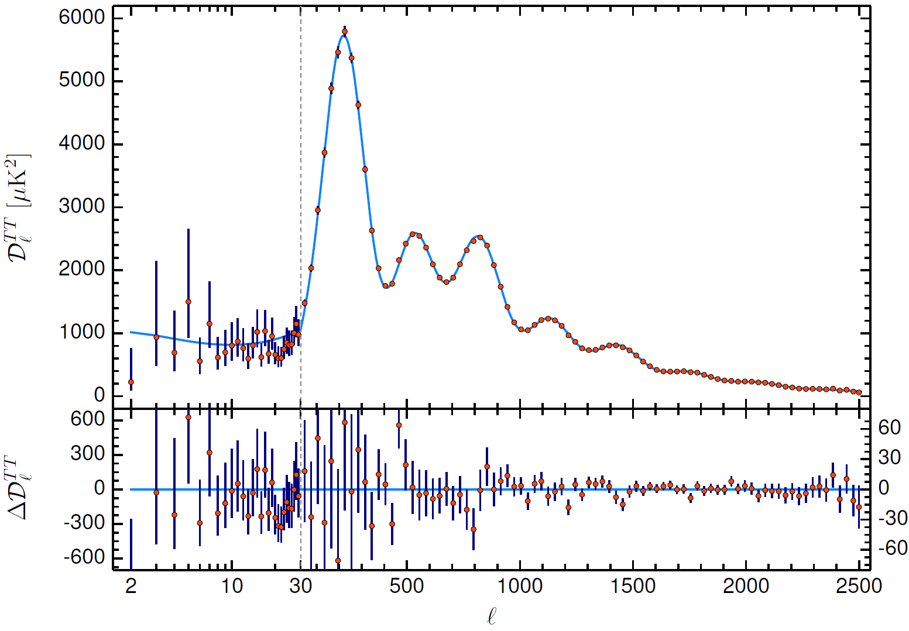
Dark matter theory
Dark matter (DM) evidence:
  First Zwicky (1933): Visible mass of galaxies much lower than expectation from virial theorem.
  Rotation curves have velocities stay higher than expected from Kepler’s 3rd law.
  Fits on the CMB show 85% of the Universe’s mass as non-baryonic matter
  Gravitational lensing shows the actual mass distribution of galaxies. Most of the Bullet cluster’s mass is invisible and less interacting.
24

Slide 25
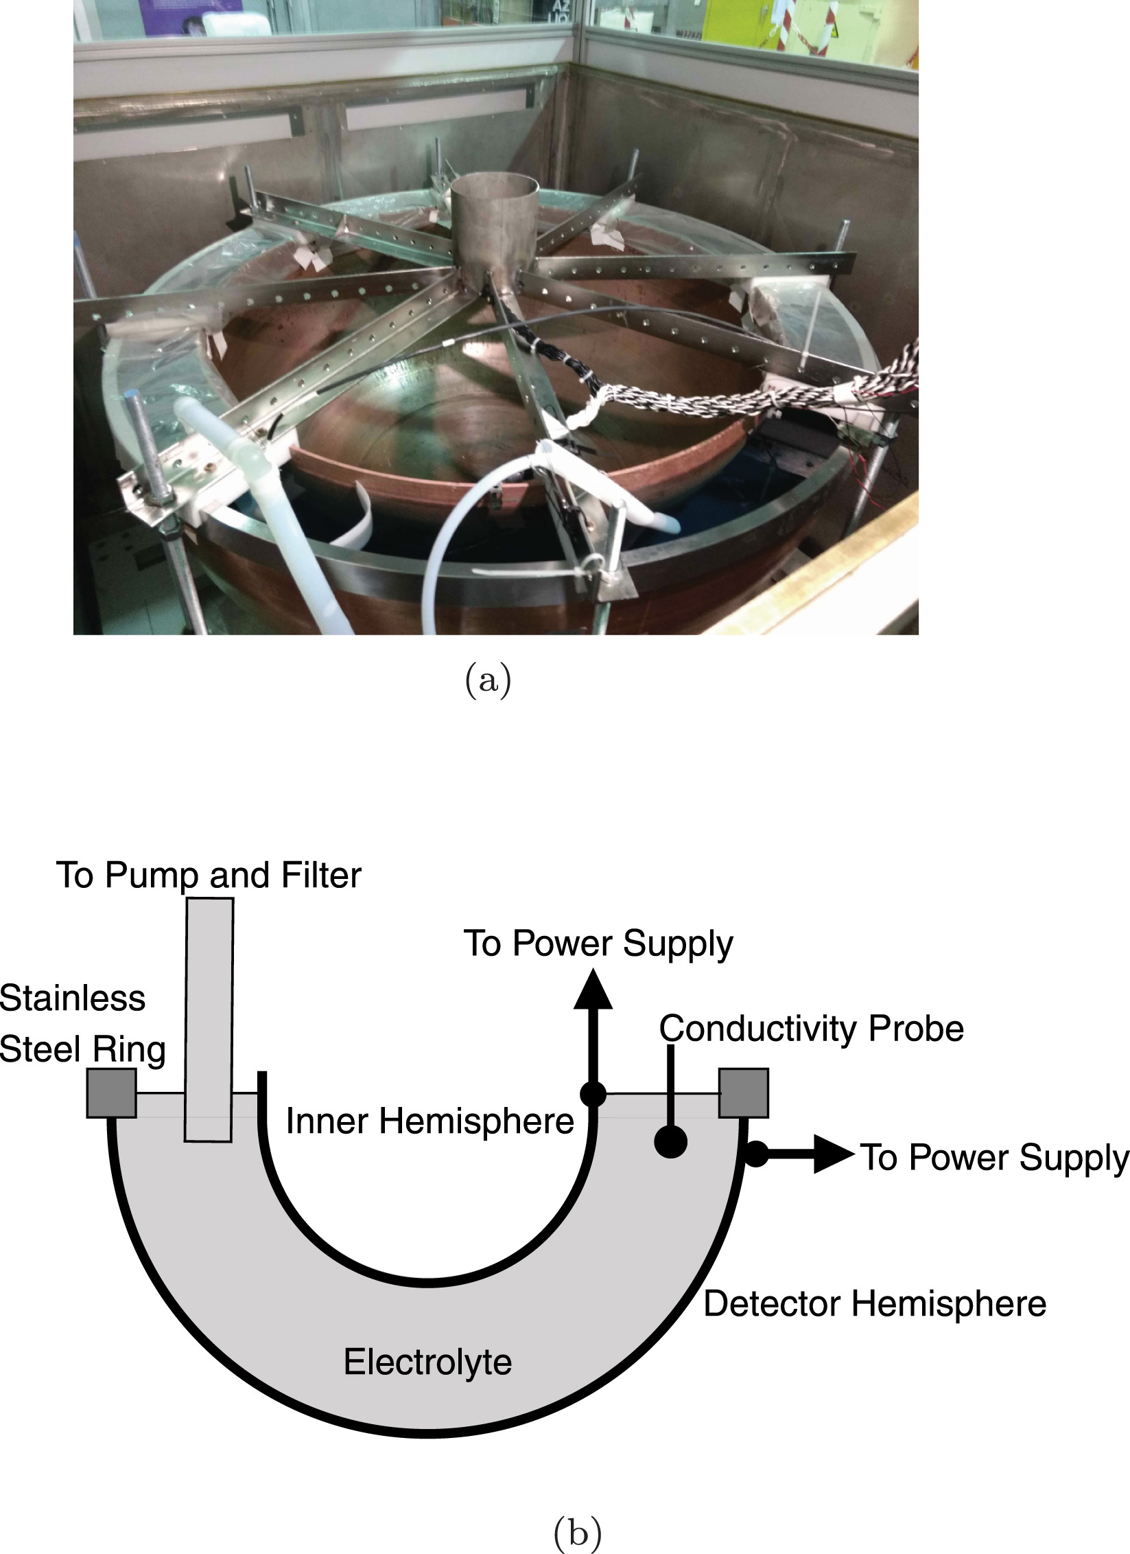
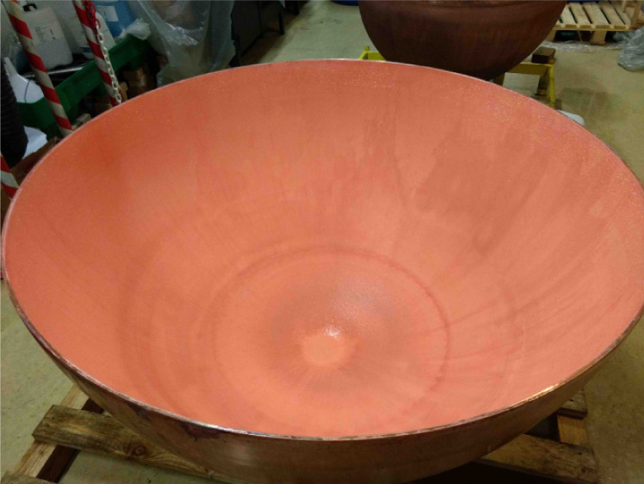
Copper electroforming
Even the C10100 copper bulk contains traces of ²¹⁰Pb, which emits bremsstrahlung X-rays through their beta decay.
The electroforming of the 0.5mm inner copper surface was done in collaboration with the Pacific Northwest National Lab at the LSM.
This reduces the overall background by 98%, and the sub-keV background by 70%.

Slide 26
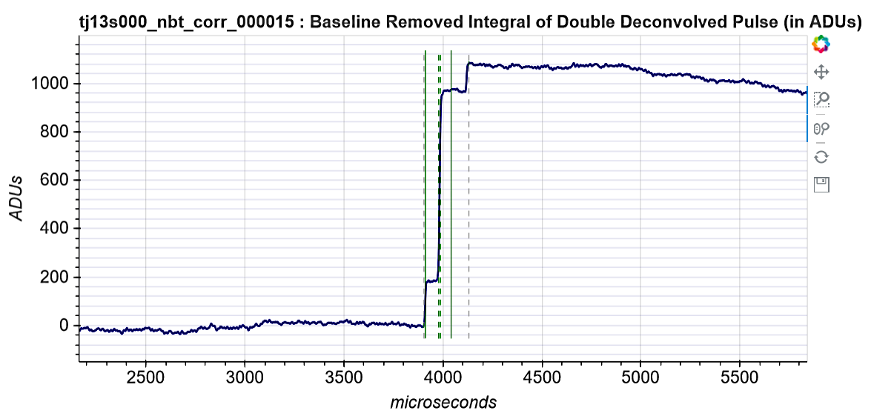
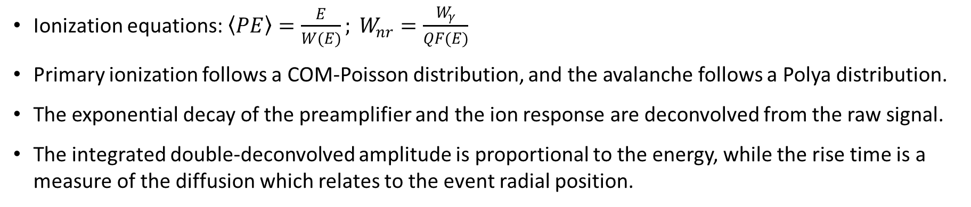
Double deconvolution
Ionization equations: $\left\langle PE\right\rangle =\frac{E}{W(E)}; W_{nr}=\frac{W_{γ}}{QF(E)}$
Primary ionization follows a COM-Poisson distribution, and the avalanche follows a Polya distribution.
The exponential decay of the preamplifier and the ion response are deconvolved from the raw signal.
The integrated double-deconvolved amplitude is proportional to the energy, while the rise time is a measure of the diffusion which relates to the event radial position.
DOUBLE-DECONVOLUTION
INTEGRATION
There is work on using machine learning as an alternative
26

Slide 27
Peak counting and time separation
With the large sphere of S140, it is possible to count individual primary electrons using ROOT TSpectrum.
The single-electron trigger efficiency is 60%, with a noise trigger proportion around 10⁻⁴.
Surface events experience more diffusion than volume events, which causes the time separation between the first and last peak to be larger.
Number of electrons is a measure of the energy.
scipost_202210_00005v1
VOLUME (³⁷Ar)
SURFACE (laser)
27

Slide 28
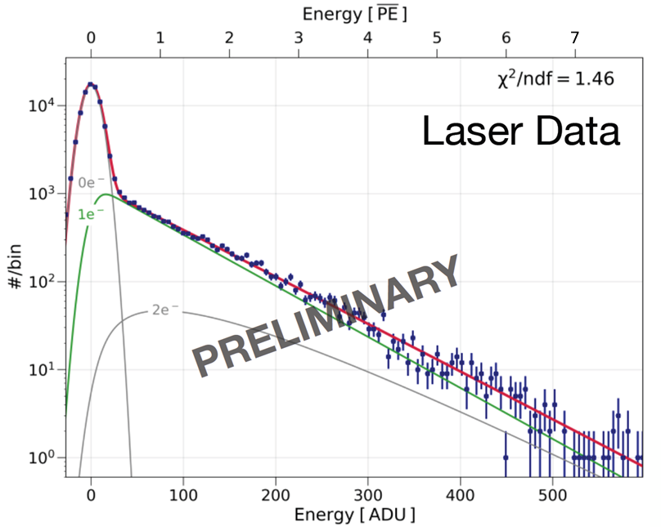
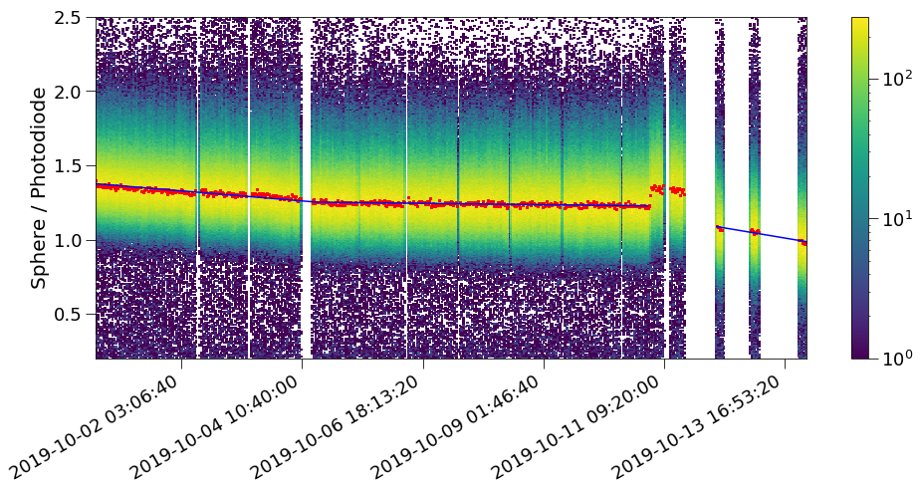
Laser calibration
A 213nm UV laser is directed at the inner copper surface of the sphere and releases electrons though the photoelectric effect.
The UV light also goes to a photodetector so the laser events can be tagged.
Low-intensity laser data enables measurements of the single electron detector response (gain, avalanche statistics, trigger efficiency, peak detection threshold).
High intensity laser data
is used in all runs to
enable constant
monitoring of the
detector.
Gas degradation
inducing a decrease
in gain can be seen
through laser events.
28

Slide 29
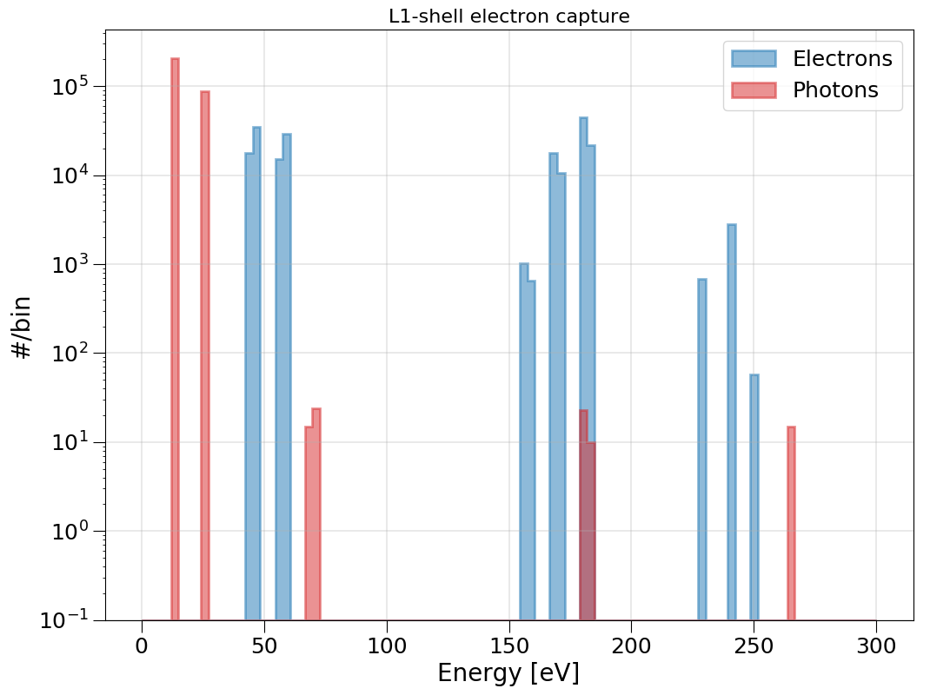
³⁷Ar Calibration
Some argon-37 is released inside the sphere, and the gas diffuses in the whole volume. ³⁷Ar is produced at the Royal Military College in Kingston, in their SLOWPOKE-II reactor from CaO irradiation.
This isotope is radioactive and has two main X-ray peaks (270 eV and 2.8 keV). It decays with a half-life of 35 days through electron capture.
Argon-37 enables:
  Energy calibration
  Electron attachment parametrization
  W-value and Fano factor measurements
  South-channel anodes gain measurements
270 eV peak
2.8 keV peak
doi:10.1088/1742-6596/2156/1/012059
29

Slide 30
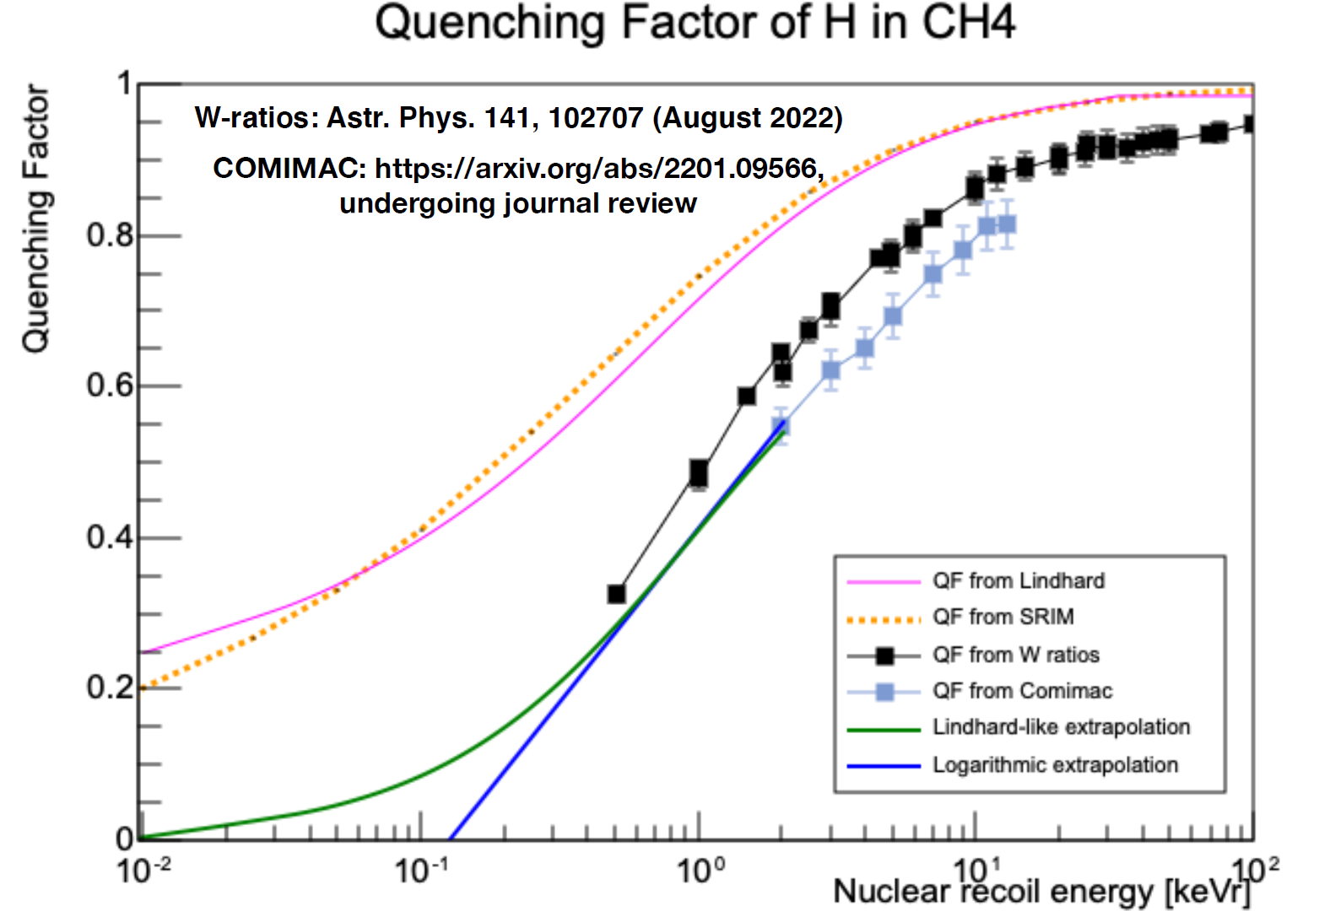
Quenching factor
The quenching factor was measured at COMIMAC as well as obtained from literature W-values.
Lower energy quenching factor were extrapolated logarithmically (more conservative).
Future quenching factor measurements for lower energies and other gas mixtures in preparation.
doi:10.1140/epjc/s10052-022-11063-9
30

Slide 31
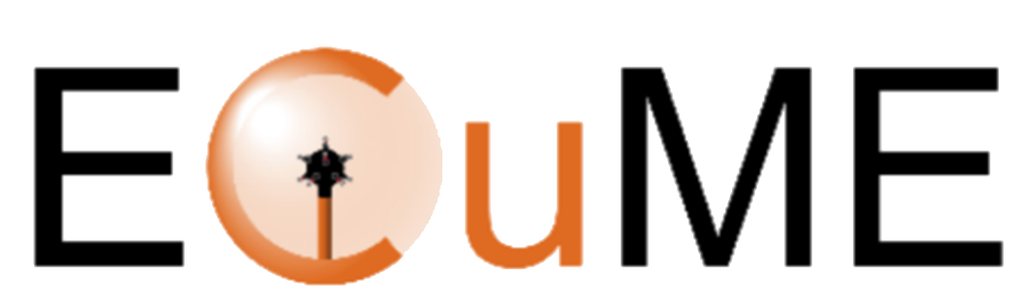
Future DM projects
ECuME
Fully underground electroformed 140 cm of diameter copper sphere to be made inside SNOLAB.
Mini-ECUME prototype with 30 cm of diameter to be built during the second half of 2023 at PNNL.
Last tests before Mini-ECUME currenlty being completed.
DarkSPHERE
  Fully electroformed 3m of diameter sphere in a water shield for the Boulby Underground Laboratory, in England (under consideration).
arXiv:2301.05183
31

Slide 32
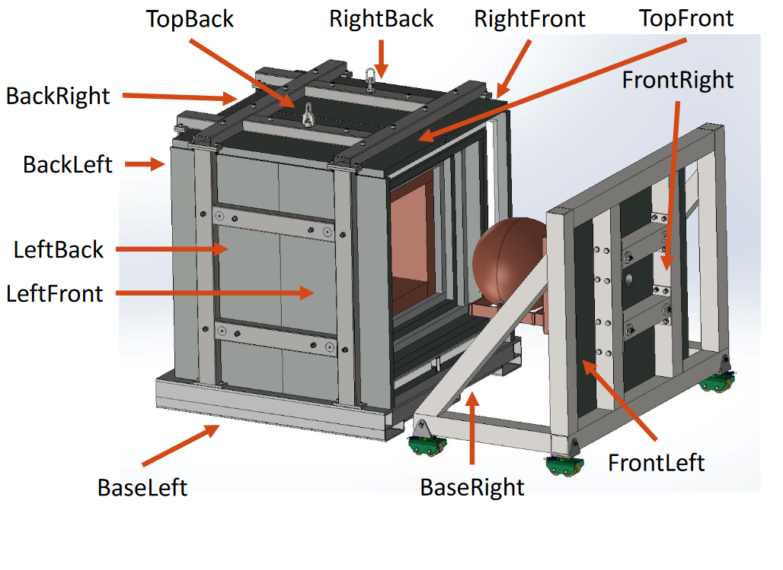
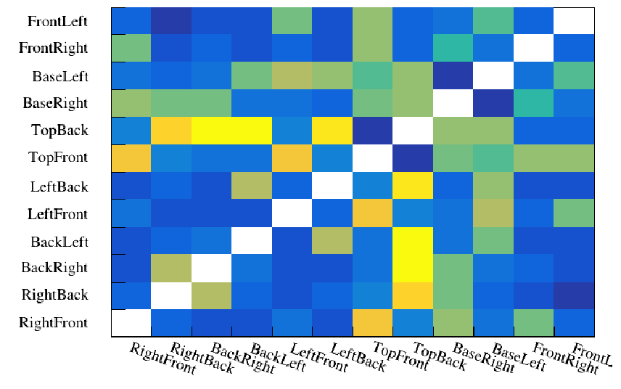
Neutrino research
NEWS-G³ (or G3)
Shield at Queen’s University intended for CEνNS detection at nuclear reactors.
The shield is comprised of multiple layers of lead, polyethylene, scintillators (muon veto) and copper. It was completed last summer.
Tests, simulations and calibrations are currently being done at Queen’s.
32

Slide 33
Double deconvolution
Double deconvolution
Integration
The ballistic deficit is the signal amplitude that gets underestimated due to the exponential decay of the preamplifier.
The full amplitude (energy) is retrieved by doing a double deconvolution of the raw signal, and then integrating the pulses.
33

