Slide 1
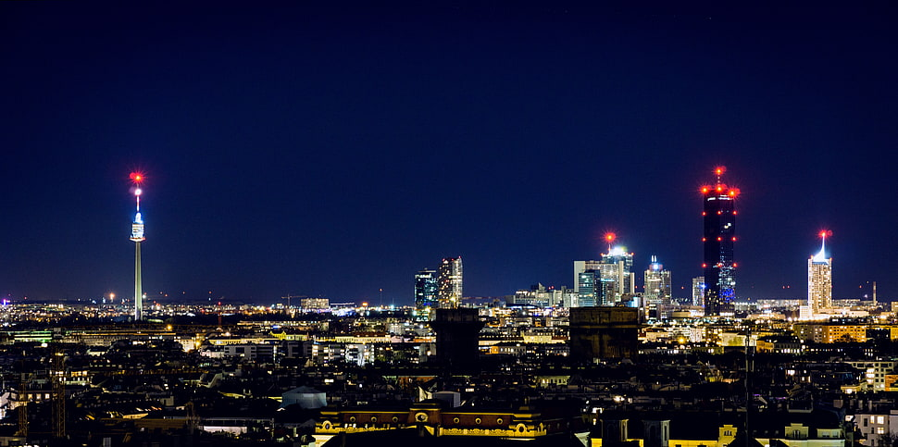


Searches for Axion Dark Matter with IBS-CAPP
XVIII International Conference
on Topics in Astroparticle and Underground Physics
Aug. 28. 2023 University of Vienna
SungWoo YOUN
Center for Axion and Precision Physics Research (CAPP)
Institute for Basic Science (IBS)

Slide 2

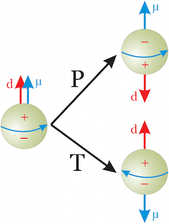
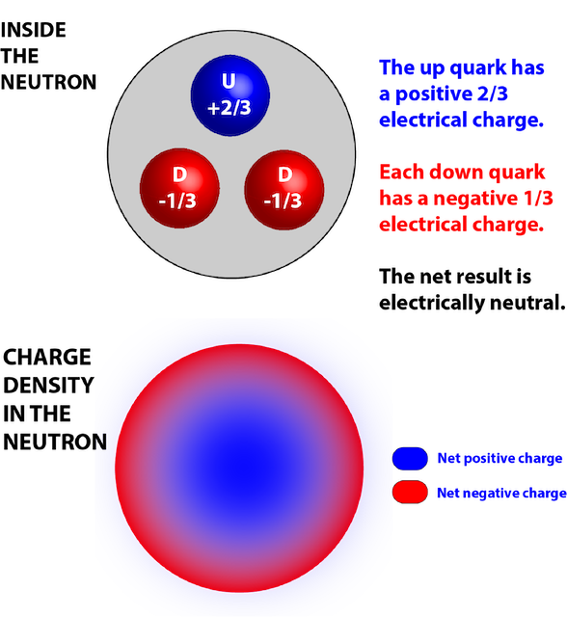
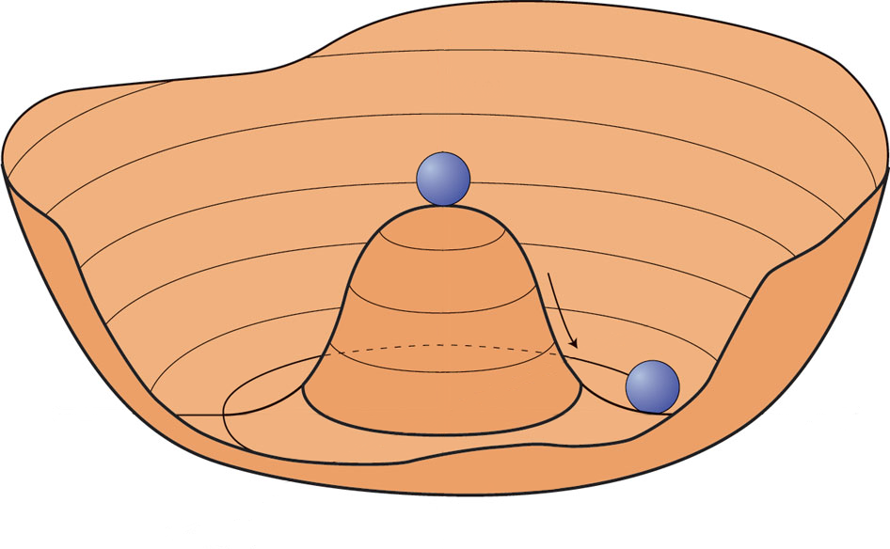
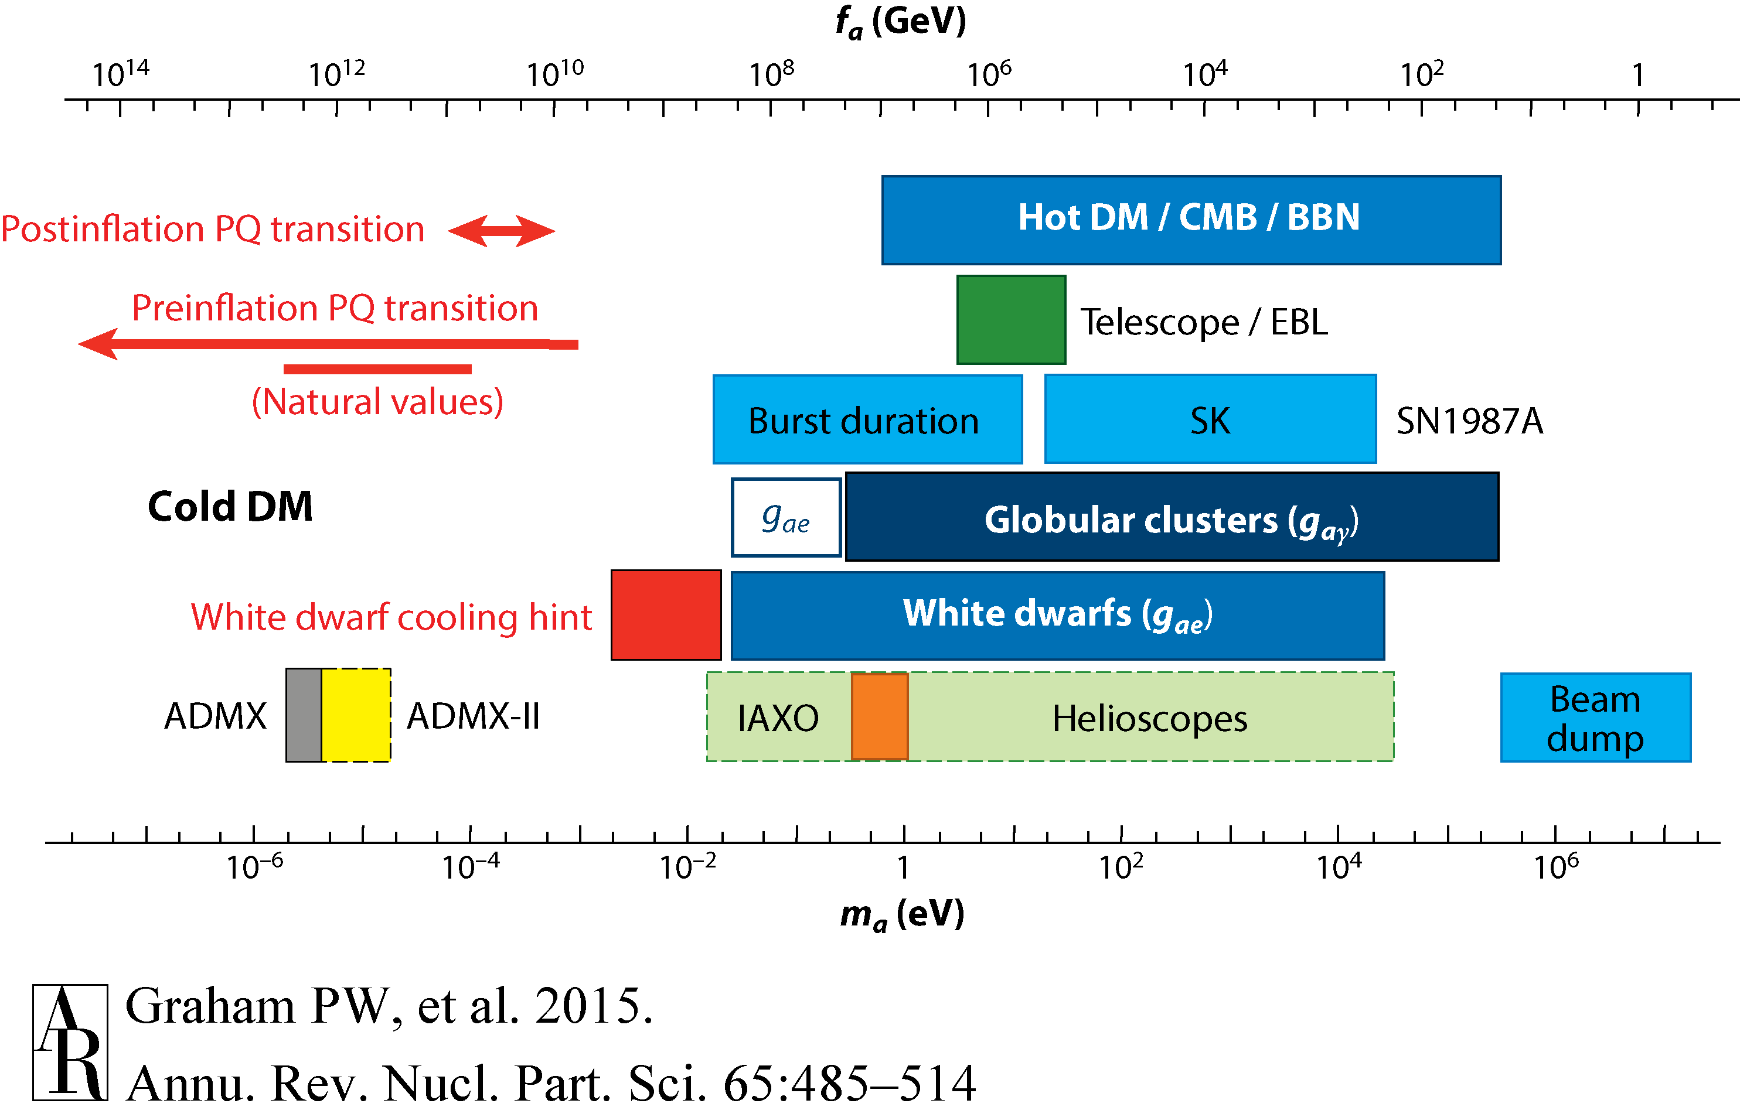
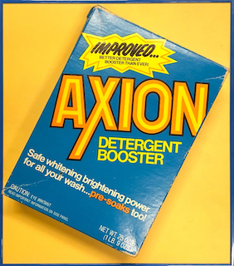
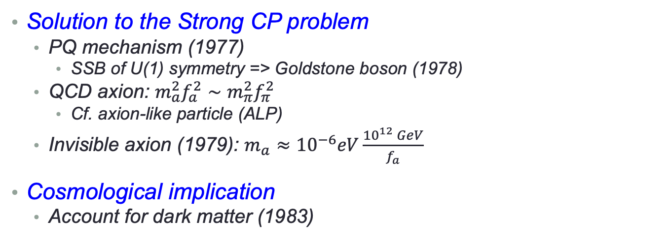
Axion dark matter
Solution to the Strong CP problem
  PQ mechanism (1977)
    SSB of U(1) symmetry => Goldstone boson (1978)
  QCD axion: $m_{a}^{2}f_{a}^{2}∼m_{π}^{2}f_{π}^{2}$
    Cf. axion-like particle (ALP)
  Invisible axion (1979): $m_{a}≈{10}^{−6}eV\frac{{10}^{12} GeV}{f_{a}}$
Cosmological implication
  Account for dark matter (1983)
vs.
Absence of nEDM
Spontaneuous PQ symmetry breaking
Goldstone boson
Annu. Rev. Nucl. Part. Sci. 65 485 (2016)
Details by A. Ringwald (Wed.)

Slide 3
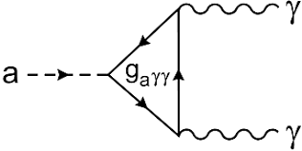
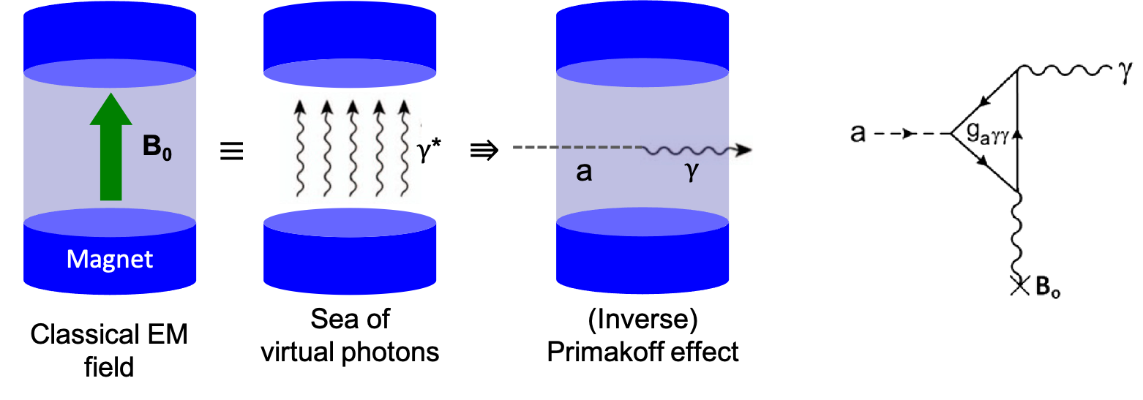

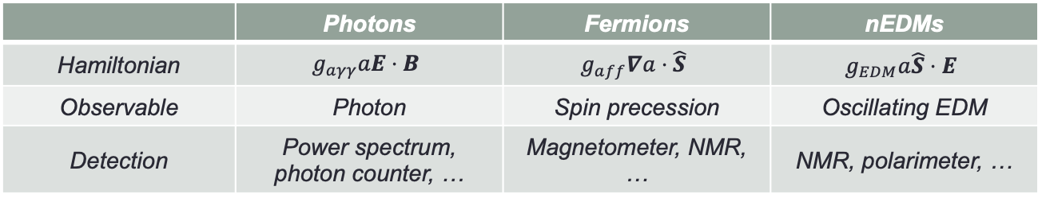

Axion models and detection
Axion coupling to SM
Axion models
Detection principle
  Sikivie effect (1983)
    Macroscopic Primakoff
 | Photons | Fermions | nEDMs
Hamiltonian | $$g_{aγγ}aE⋅B$$ | $$g_{aff}∇a⋅\hat{S}$$ | $$g_{EDM}a\hat{S}⋅E$$
Observable | Photon | Spin precession | Oscillating EDM
Detection | Power spectrum, photon counter, … | Magnetometer, NMR, … | NMR, polarimeter, …
SM fermions
BSM fermions
PQWW
(2Higgs)
DFSZ
(2Higgs+singlet)
KSVZ
(Higgs+singlet)
Standard ($f_{a} \sim v_{EW}$)
Invisible ($f_{a}≫v_{EW}$)

Slide 4
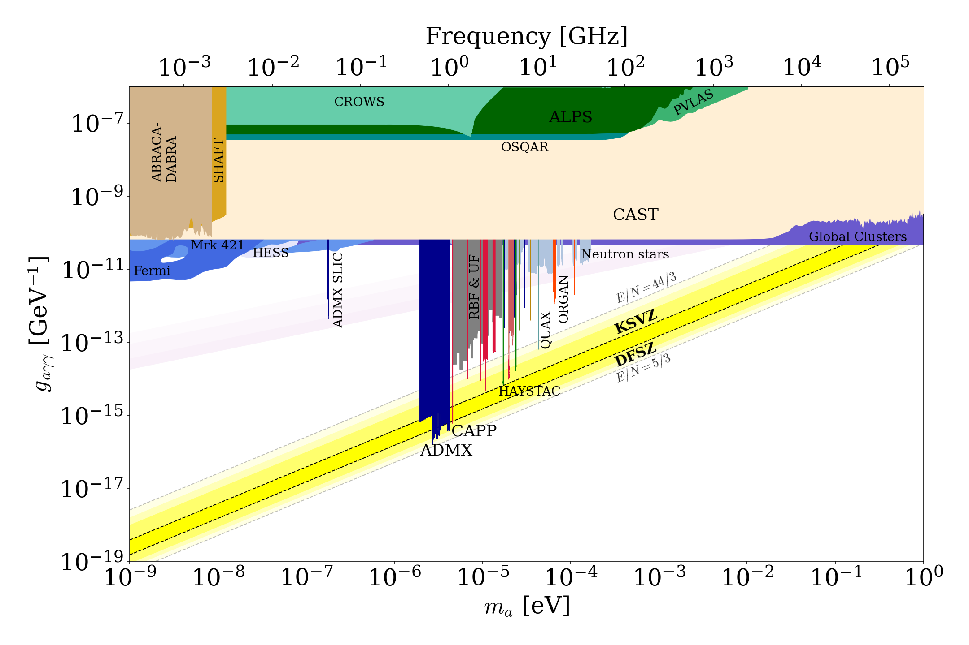
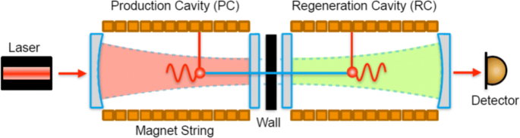
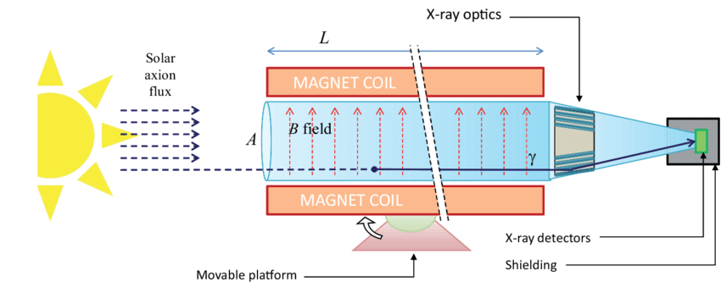
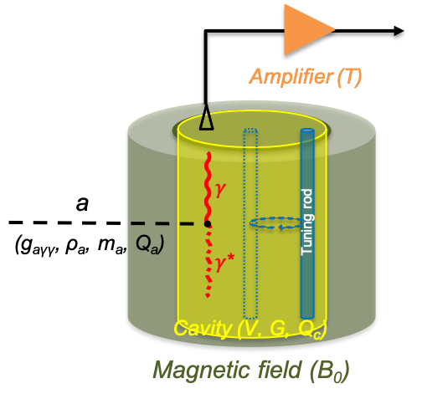
Axion searches
1 GHz = 4.2 ueV
Helioscope (solar axion)
LSW (axion at lab)
Haloscope (DM axion)

Slide 5
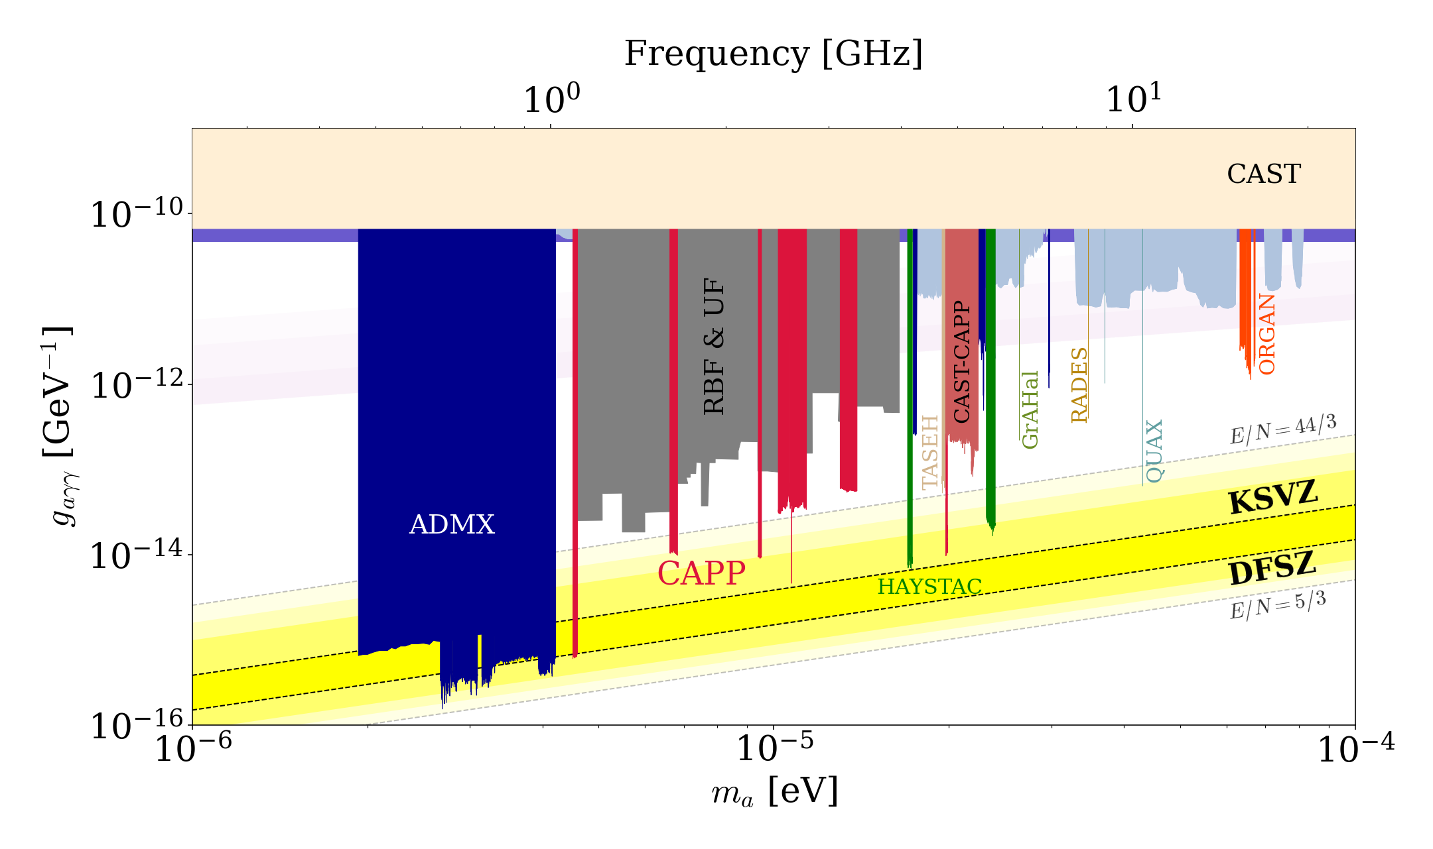
Haloscope searches

Slide 6
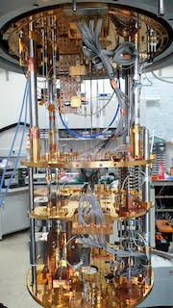
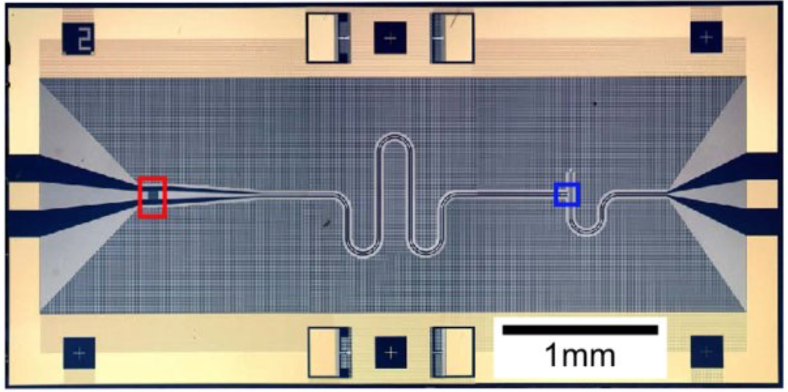
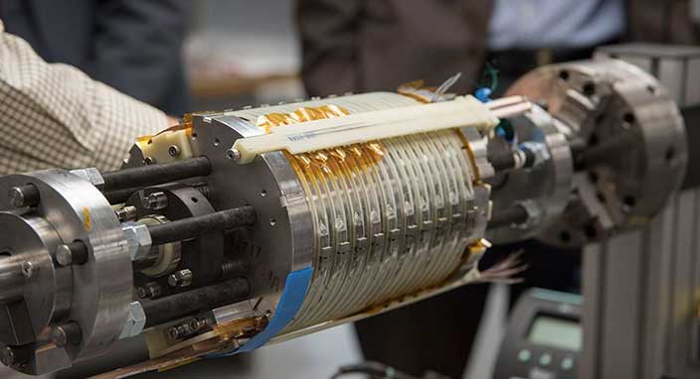
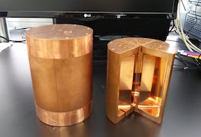



Cavity haloscope – in a nutshell
Most sensitive in the ueV region
Cryogenics T
Quantum noise limited amplifier T
P ~ 10^{–23} W
Signal amplification w/ minimal noise added
Lowering thermal noise
$$a$$
$$γ$$
Tunable High-Q resonator
V, Q, C, Δf
High field Magnet B
$γ$*
Small-scale experiments!
Boosting a→γγ conversion rate
Resonant frequency tuning

Slide 7
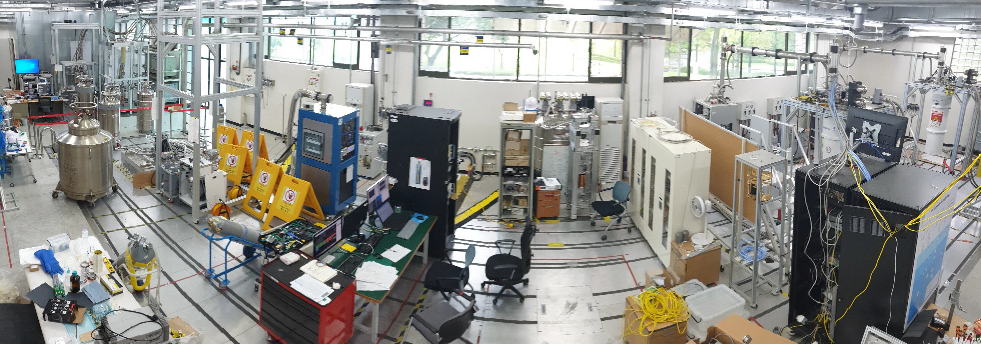
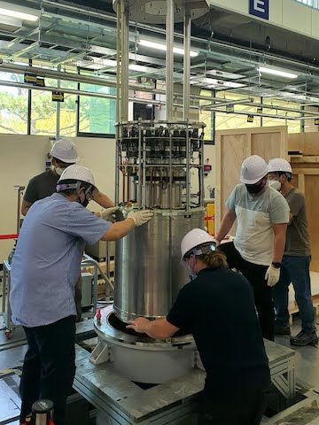
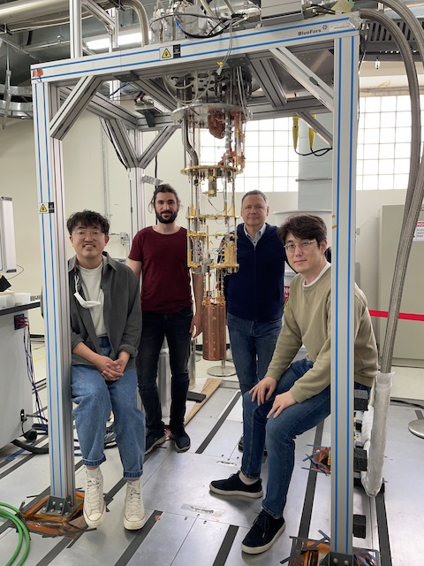
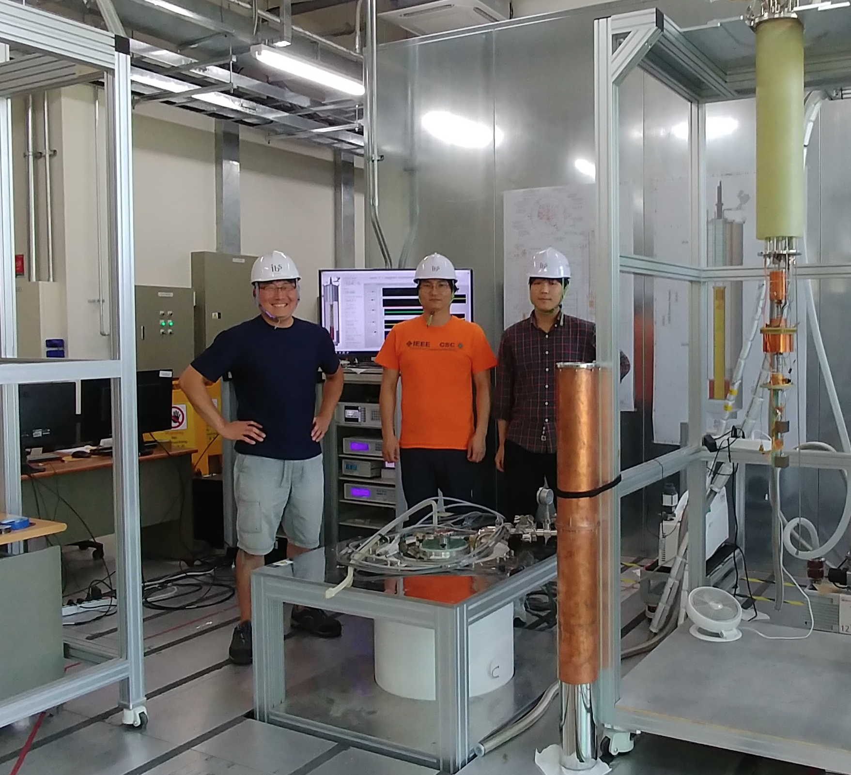
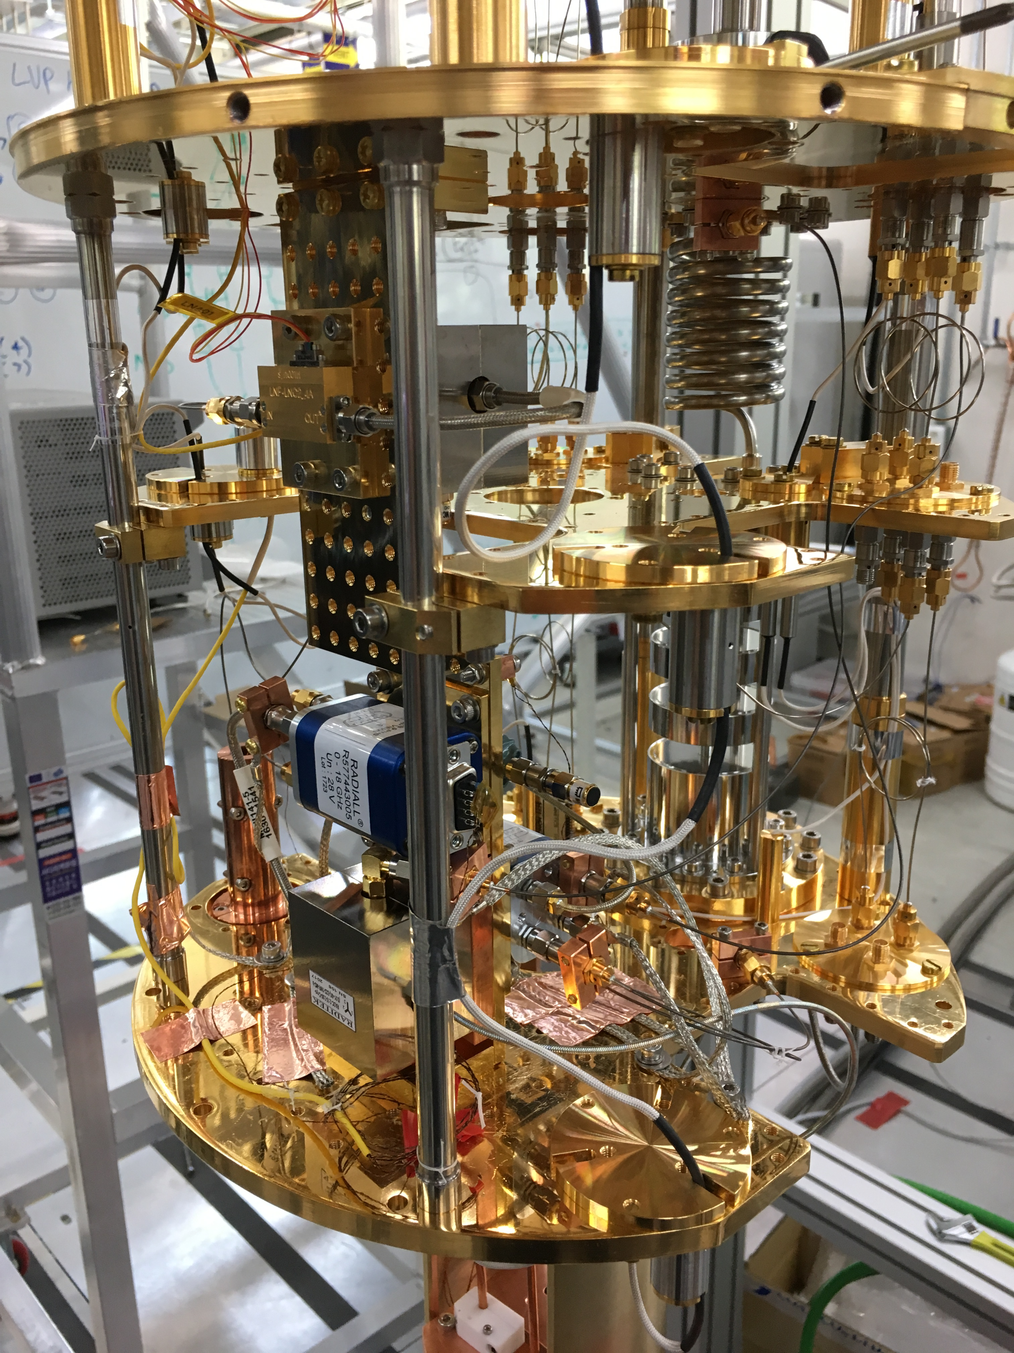
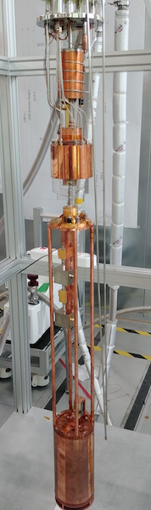
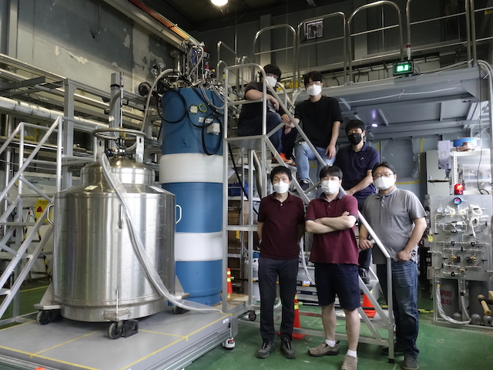
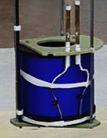
IBS-CAPP (since 2013)
CAPP-9T
CAPP-12TB
CAPP-18
CAPP-PACE
CAPP-8TB

Slide 8
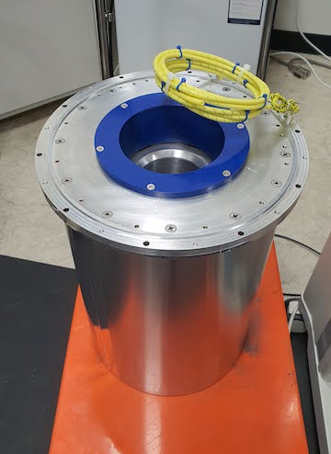
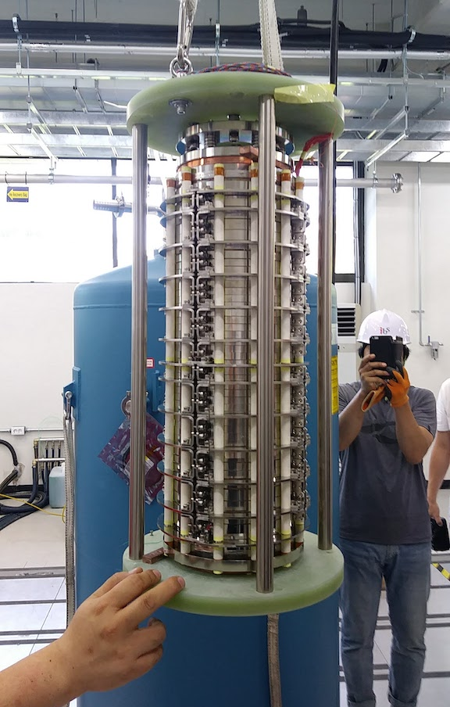
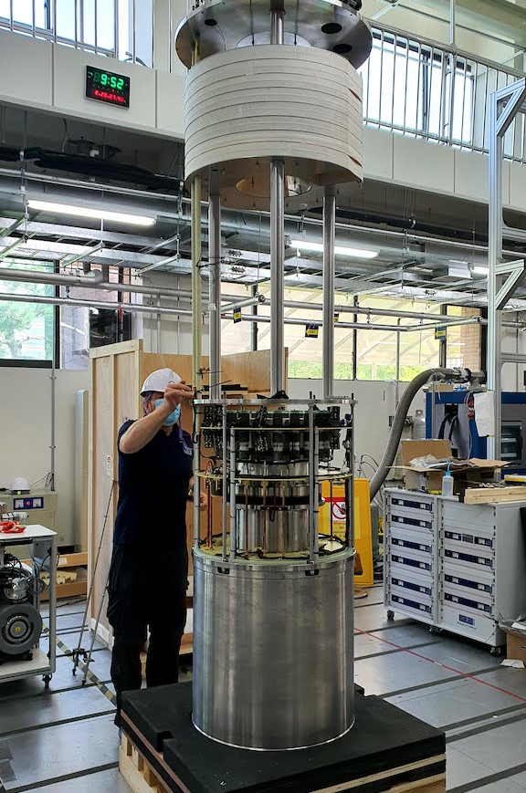
High-field SC magnets
Magnet | CAPP-8T(B),12T | CAPP-18T | CAPP-12TB
Manufacturer | AMI, Cryomagentics | SuNAM | Oxford
B_{max} @ 4 K | 8-12 T | 18 T | 12 T
Bore (clear) | 96-165 mm | 70 mm | 320 mm
SC material | NbTi, Nb₃Sn | GdBCO (HTS) | Nb₃Sn
Delivery | 2017-2021 | 2017 | 2020
Frequency | > 2 GHz | > 4 GHz | > 1 GHz
Sensitivity | KSVZ | KSVZ | DFSZ

Slide 9
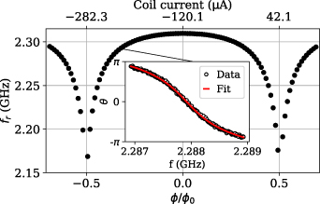
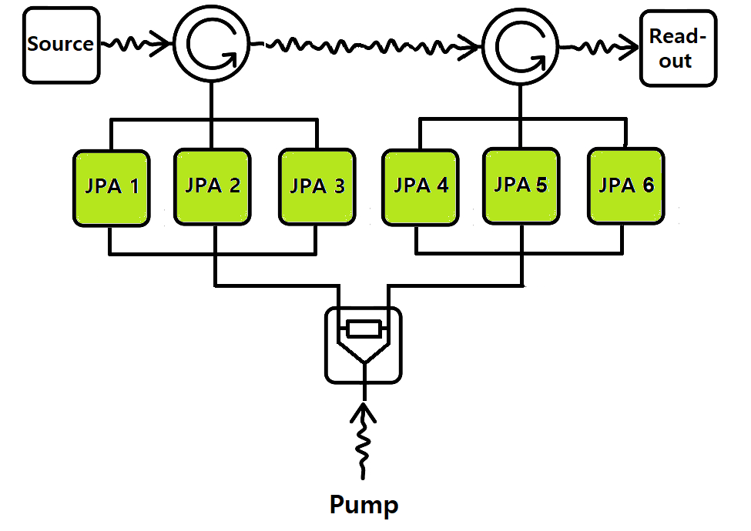
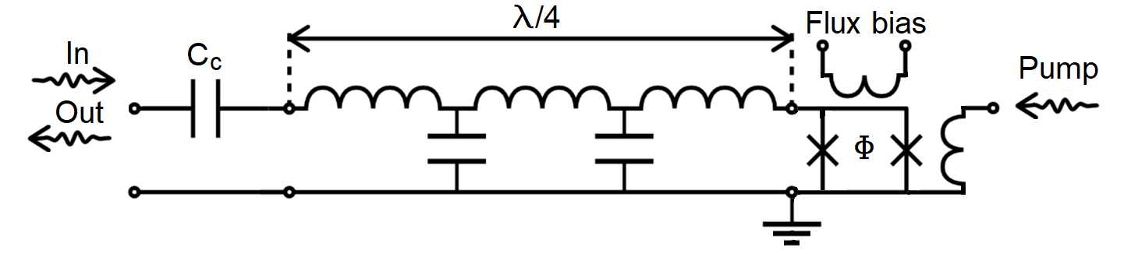
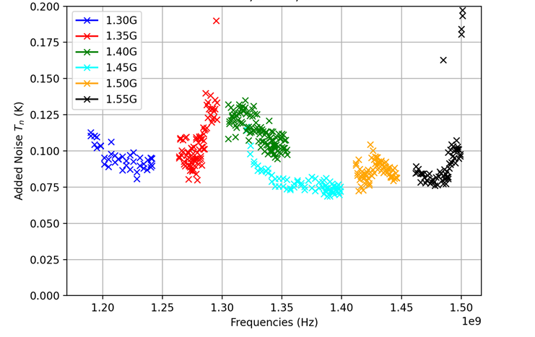
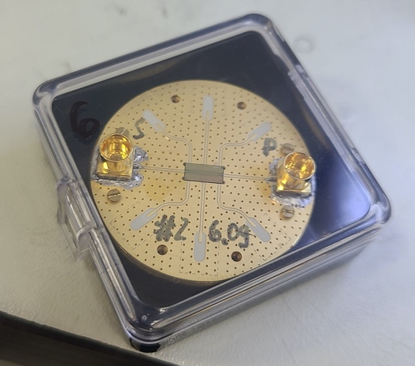
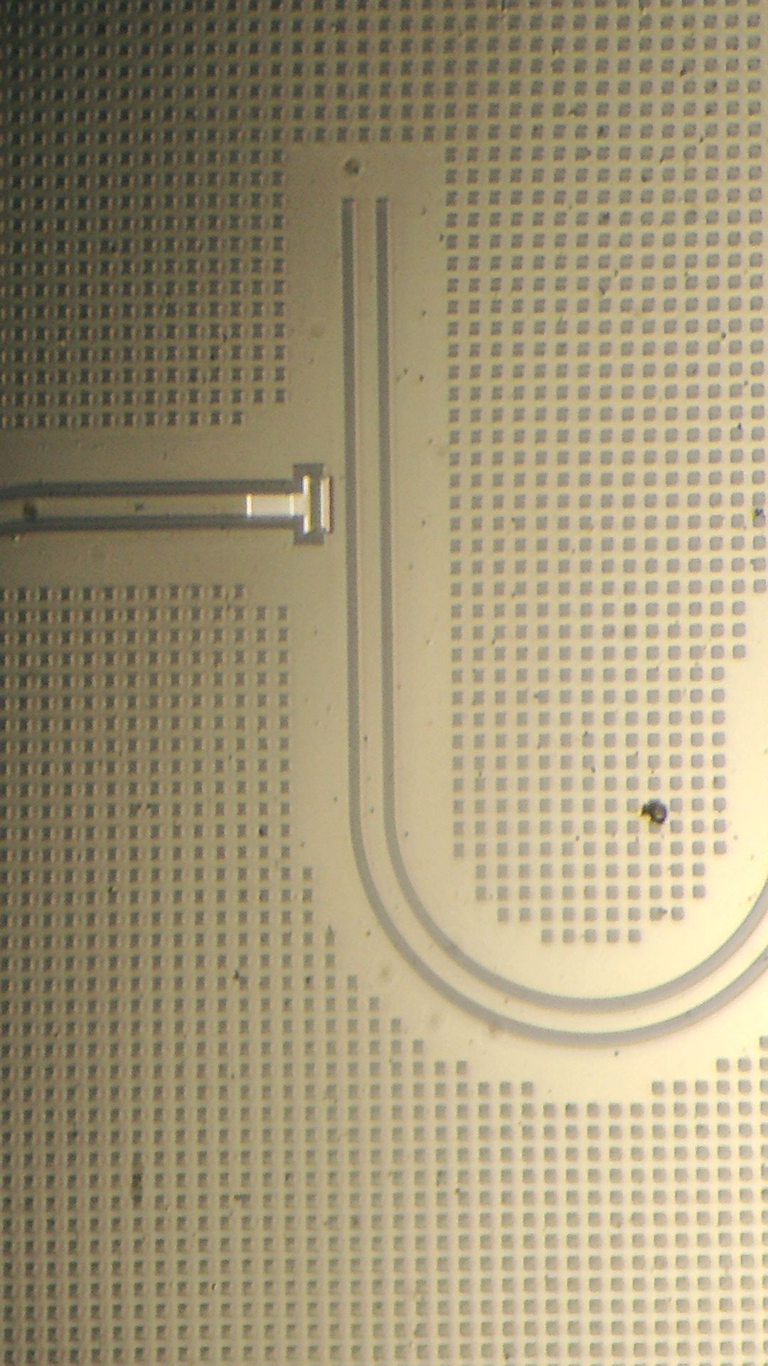
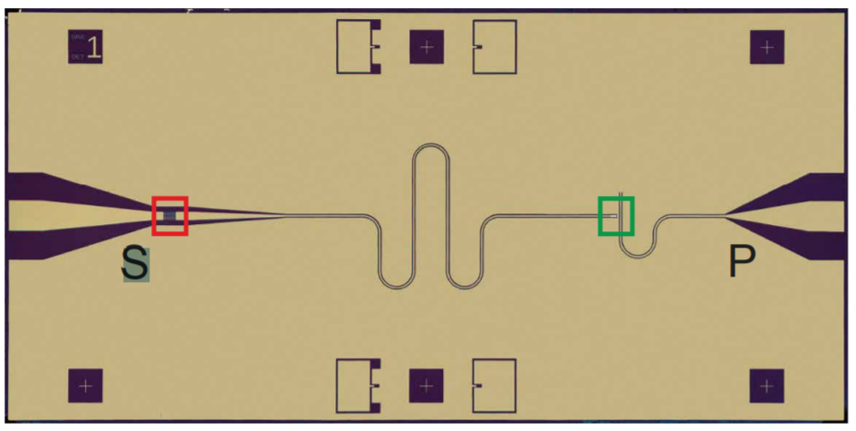
QNL amplification
Flux-driven Josephson parametric amplifiers (JPAs)
SST 34 085013 (2021)
Parallel-Serial configuration
High perform.
Wideband search
SQUID
(nonlinear inductance)
Standard quantum limit
U. of Tokyo & RIKEN

Slide 10
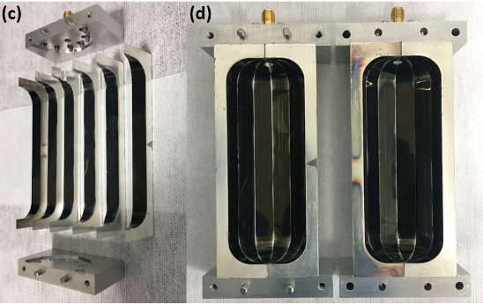
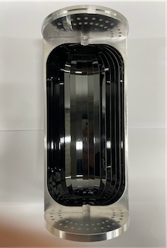
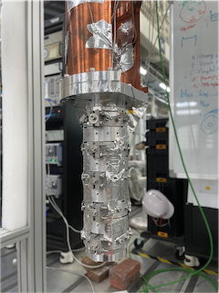
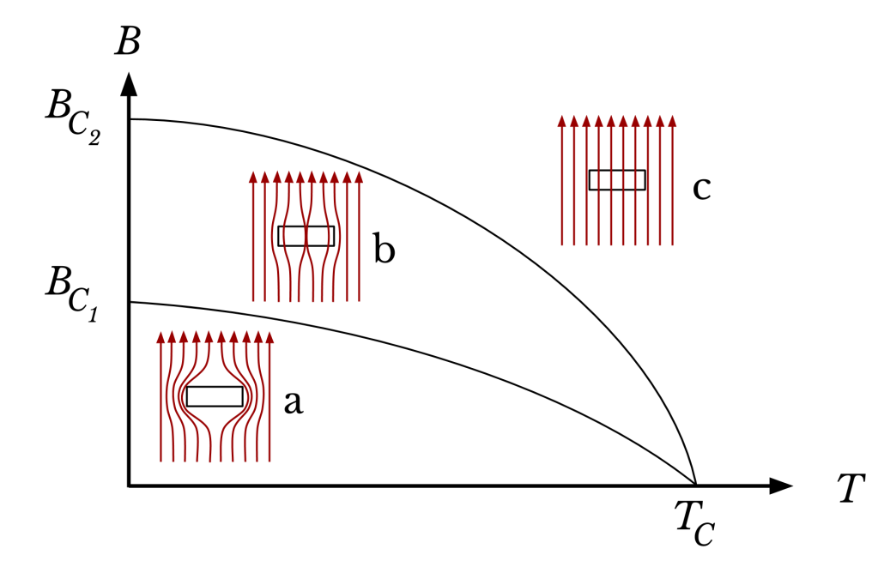
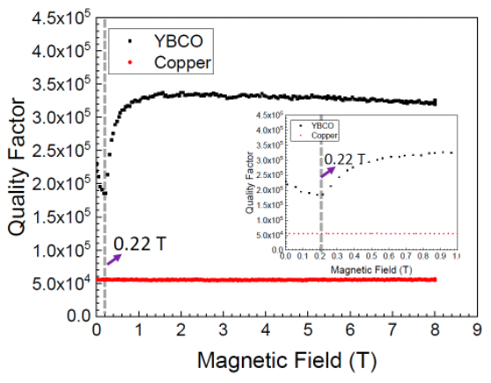
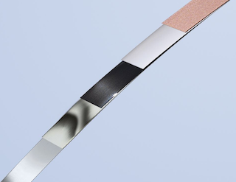
Superconducting cavities
High-Temp. Superconductor (HTS)
Normal state
Vortex state
PRA 17 6 (2022)
Meissner state
13.7 M
AMSC
ReBCO HTS tapes (2D)
Stabilizer (Cu) 20 um
Protection layer (Ag) 2 um
TM010
TM011
Superconducting
layer (GdBCO) 2 um
Buffer layer (MgO) 0.7 um
Substrate [Hastelloy) 50 um
Generation | 1st | 2nd | 3rd
Material | YBCO | GdBCO | EuBCO+APC
Substrate | NiW | Hastelloy | Hastelloy
V [L] | 0.3 | 1.5 | 1.5 | 0.2
f [GHz] | 6.9 | 2.3 | 2.2 | 5.4
Q | 0.33 M | 0.5 M | 4.5 M | 13 M
+ 3D body = SC cavity

Slide 11
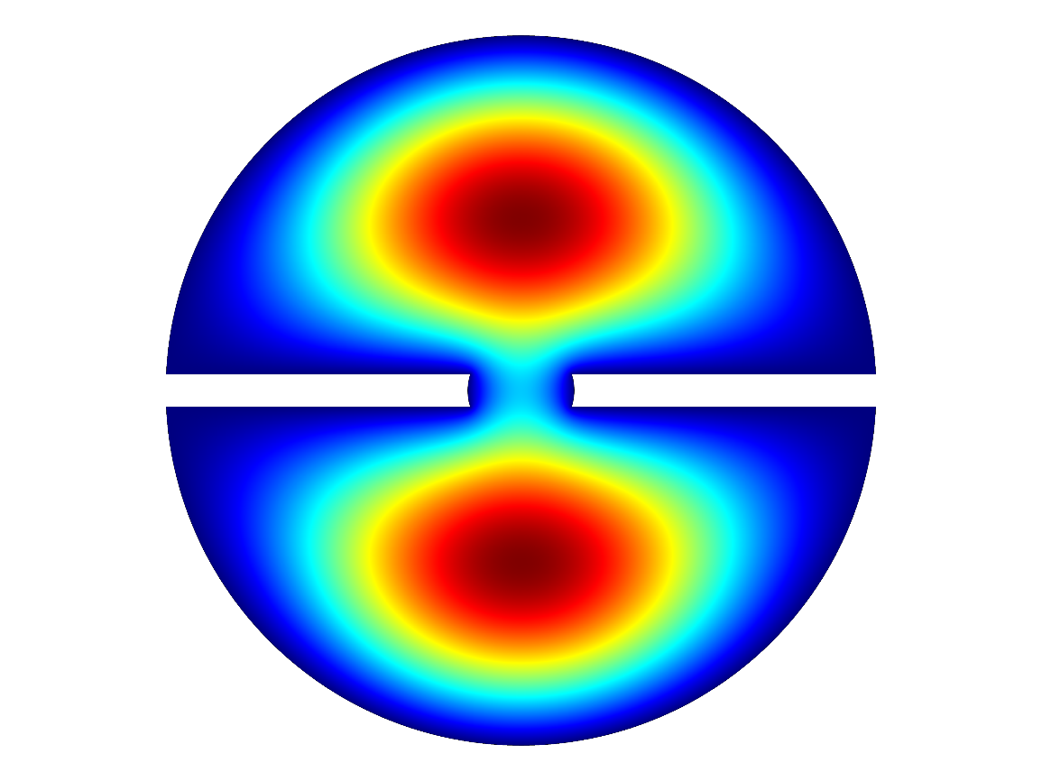
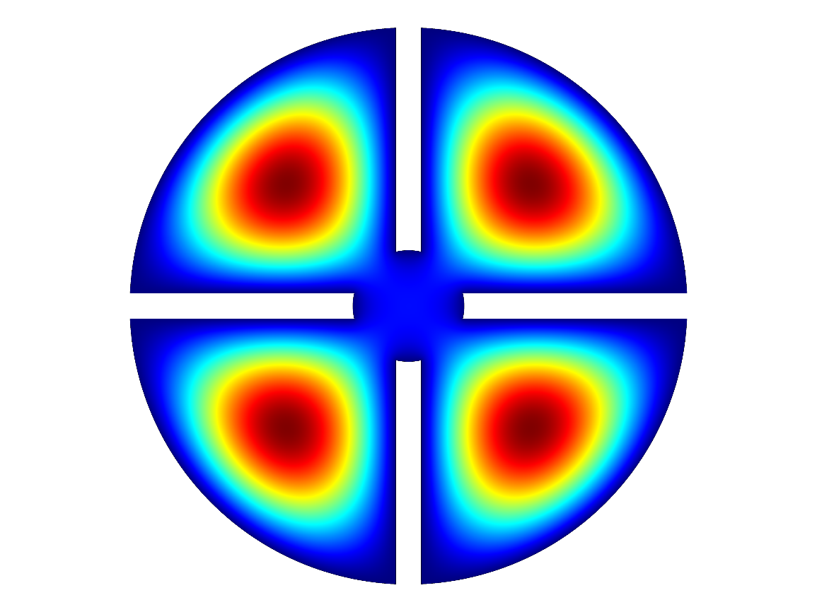
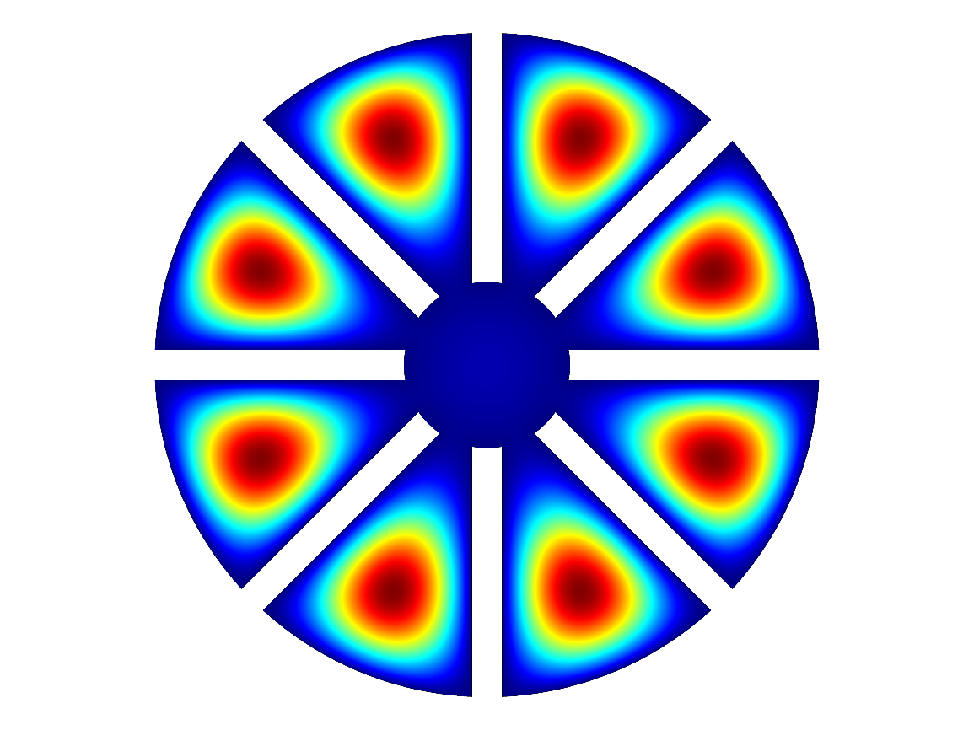
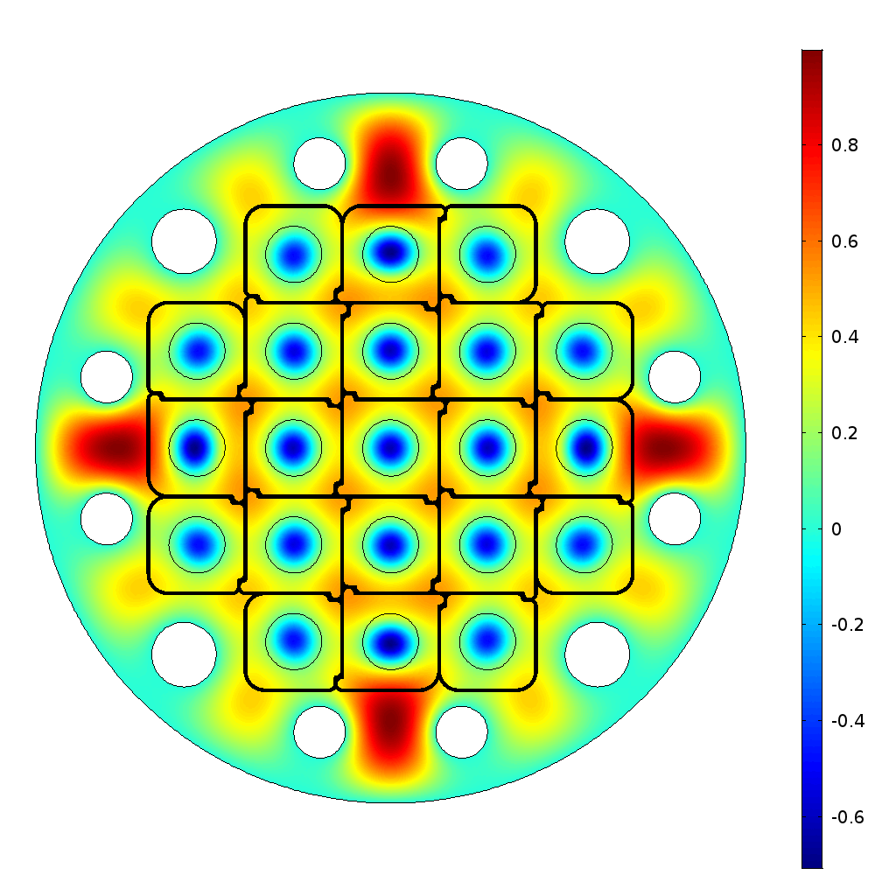

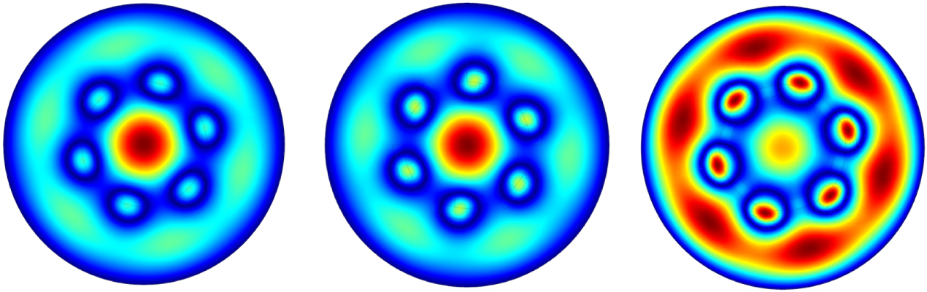
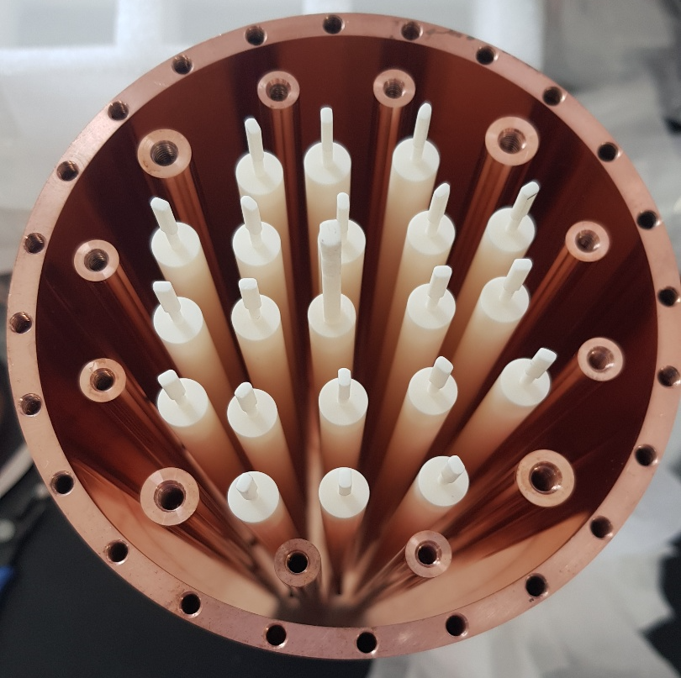
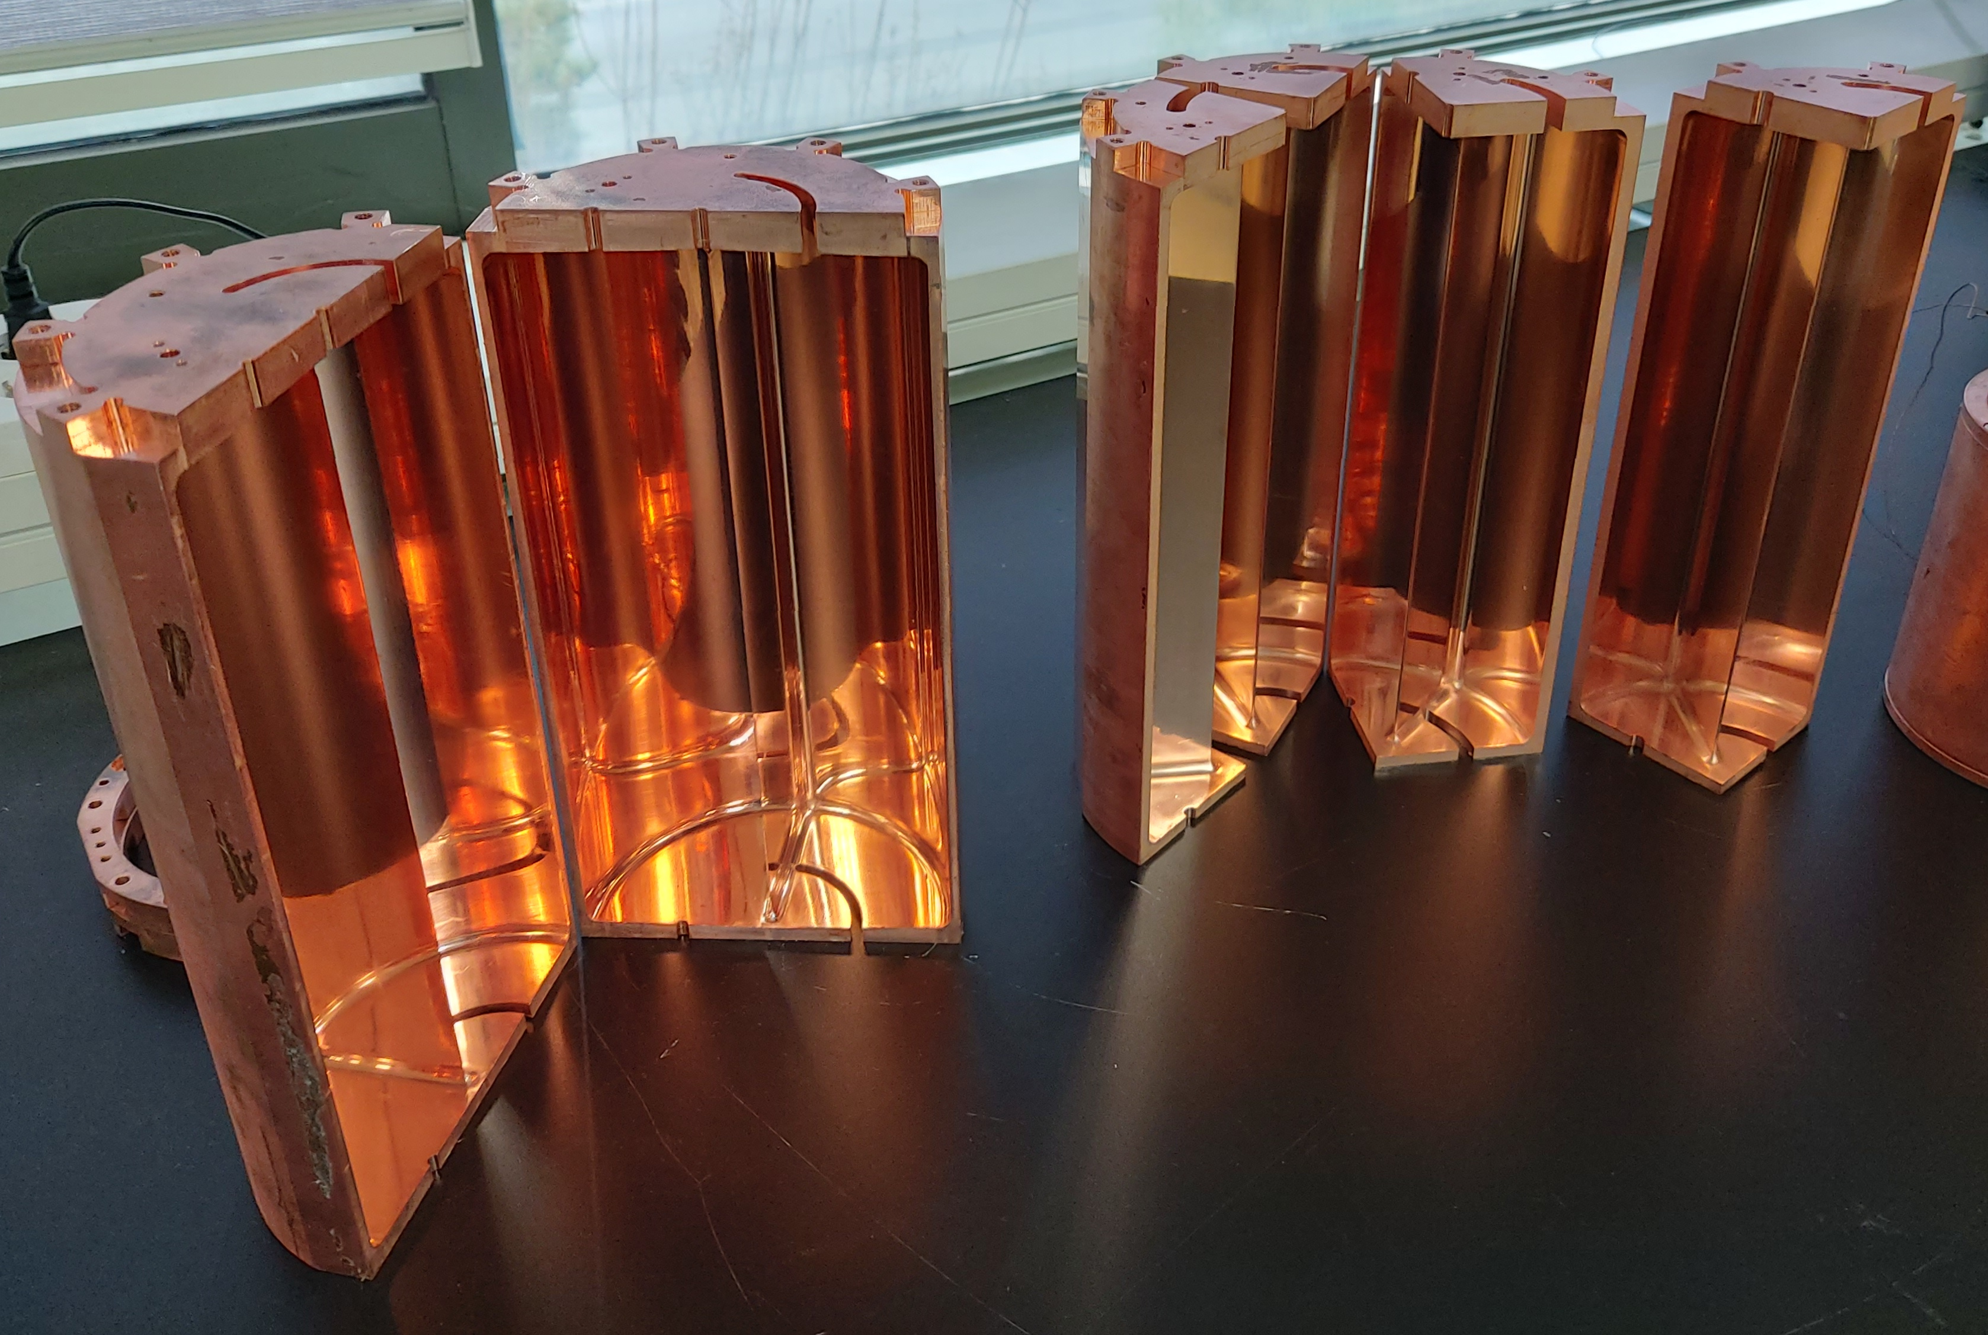


High-frequency approach
Multiple-cell (pizza)
Higher-mode (wheel)
Photonic crystal
PLB 777 412 (2018)
Mode | f_{rel} | Q_{rel} | V_{rel} | C_{abs}
TM₀₁₀ | 1 | 1 | 1 | 0.69
TM₀₃₀ | 3.6 | 1.9 | 1 | 0.05
PRD 107 015012 (2022)
JPG 47 035203 (2020)
vs.
Larger volume
Simpler receiver chain
~4 x f_{TM010}
f $∝$ spacing
~10 x f_{TM010}
Boosting effect

Slide 12



Search highlight
CAPP-12TB
(12T/320mm)
T_{sys} < 250 mK
df/dt~1.5 MHz/day @ DFSZ
DFSZ club!
PRL 130 071002 (2023)
Extended scan ($∆f$~120 MHz)
to be published
Ready for up to 1.5 GHz

Slide 13


Search highlight
CAPP-PACE
(8T/125mm)
JPA (T_{sys} ~ 200 mK)
PRL 130 091602 (2023)
HTS SC cavity (Q ~ 0.5 M)
KSVZ
To be published

Slide 14



Search highlight
CAPP-8TB
(8T/165mm)
8-cell pizza cavity
T_{sys} ~ 400 mK
KSVZ @ 6 GHz
To be published
Extended setup underway

Slide 15


Search highlight
CAPP-12T & 9T
(12T/96mm & 9T/127mm)
3-cell pizza cavity
KSVZ run undeway
Photonic crystal (f~10 GHz)
Physics run this Fall

Slide 16

Summary
Axion addresses fundamental questions
  Strong CP problem and dark matter mystery
Experimental efforts are growing internationally
CAPP makes substantial contributions to this business
  Powerful equipment and high-performance devices
  Unique development of high-frequency, high-quality cavities
  Multi-experimental search in different mass regions
Next decade must be exciting
  Uncovering the nature of dark matter
Please stay tuned!

Slide 18

Dark matter business expanding
WIMPs may be down, but not out
Samuel Velasco/Quanta Magazine

Slide 19


WISP zoo
Pseudo-scalar
WISP
Axion
  PQ solution to strong CP problem (1977)
  $$m_{a}f_{a}\sim Λ_{QCD}$$
  Invisible axion (1979)
  Dark matter candidate (1983)
Mili-chaged particle
.
.
.
J^{p} = 0–
J^{p} = 0⁺
Axion-Like Particle (ALP)
  Generic axion w/o solving strong CP problem
  $$m_{a}f_{a}≁Λ_{QCD}$$
ALP
Chameleon
Axion
Scalar
  Chameleon (2003)
    Dark energy candidate
J = 1
Hidden photon
Vector
  Hidden photon
    Gauge field in hidden sector
Others
  Mili-charged particle, …

Slide 20





Where are dark matter axions?
Different PQ breaking scenarios
=> Different mass ranges
=> Different search strategies
Depending on $λComp$ w.r.t. $Dexp$
Theoretical scenarios
Photon coupling
Fermion/gluon coupling
Quasistatic regime
$$λComp≫D_{exp}$$
Cavity regime
$$λComp \sim D_{exp}$$
Radiation regime
$$λComp≪D_{exp}$$

Slide 21

Detector of halo axions
Most sensitive approach in $μ$eV regime
  Microwave photons resonantly converted from axions
Conversion signal power (a→γγ)
Signal-to-noise ratio (SNR)
Scanning rate (F.O.M.):
- theoretical parameters
- experimental parameters
Cavity Q factor
Axion Q factor
Coupling constant
Effective volume
Axion number density
Magnetic field
Integration time
Axion bandwidth (~10⁻⁶ f)
System noise temperature

