Slide 1

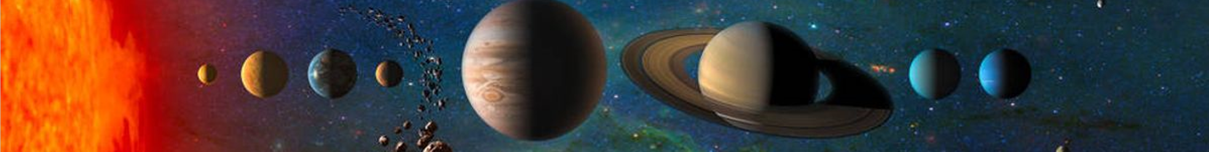

Search for solar neutrino and light dark matter in the PandaX-4T experiment
Qing Lin
（on behalf of PandaX collaboration）
University of Science and Technology of China
TAUP, 2023.08.28

Slide 2
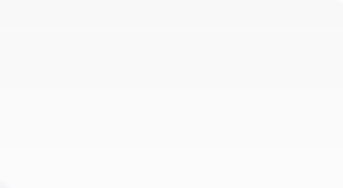
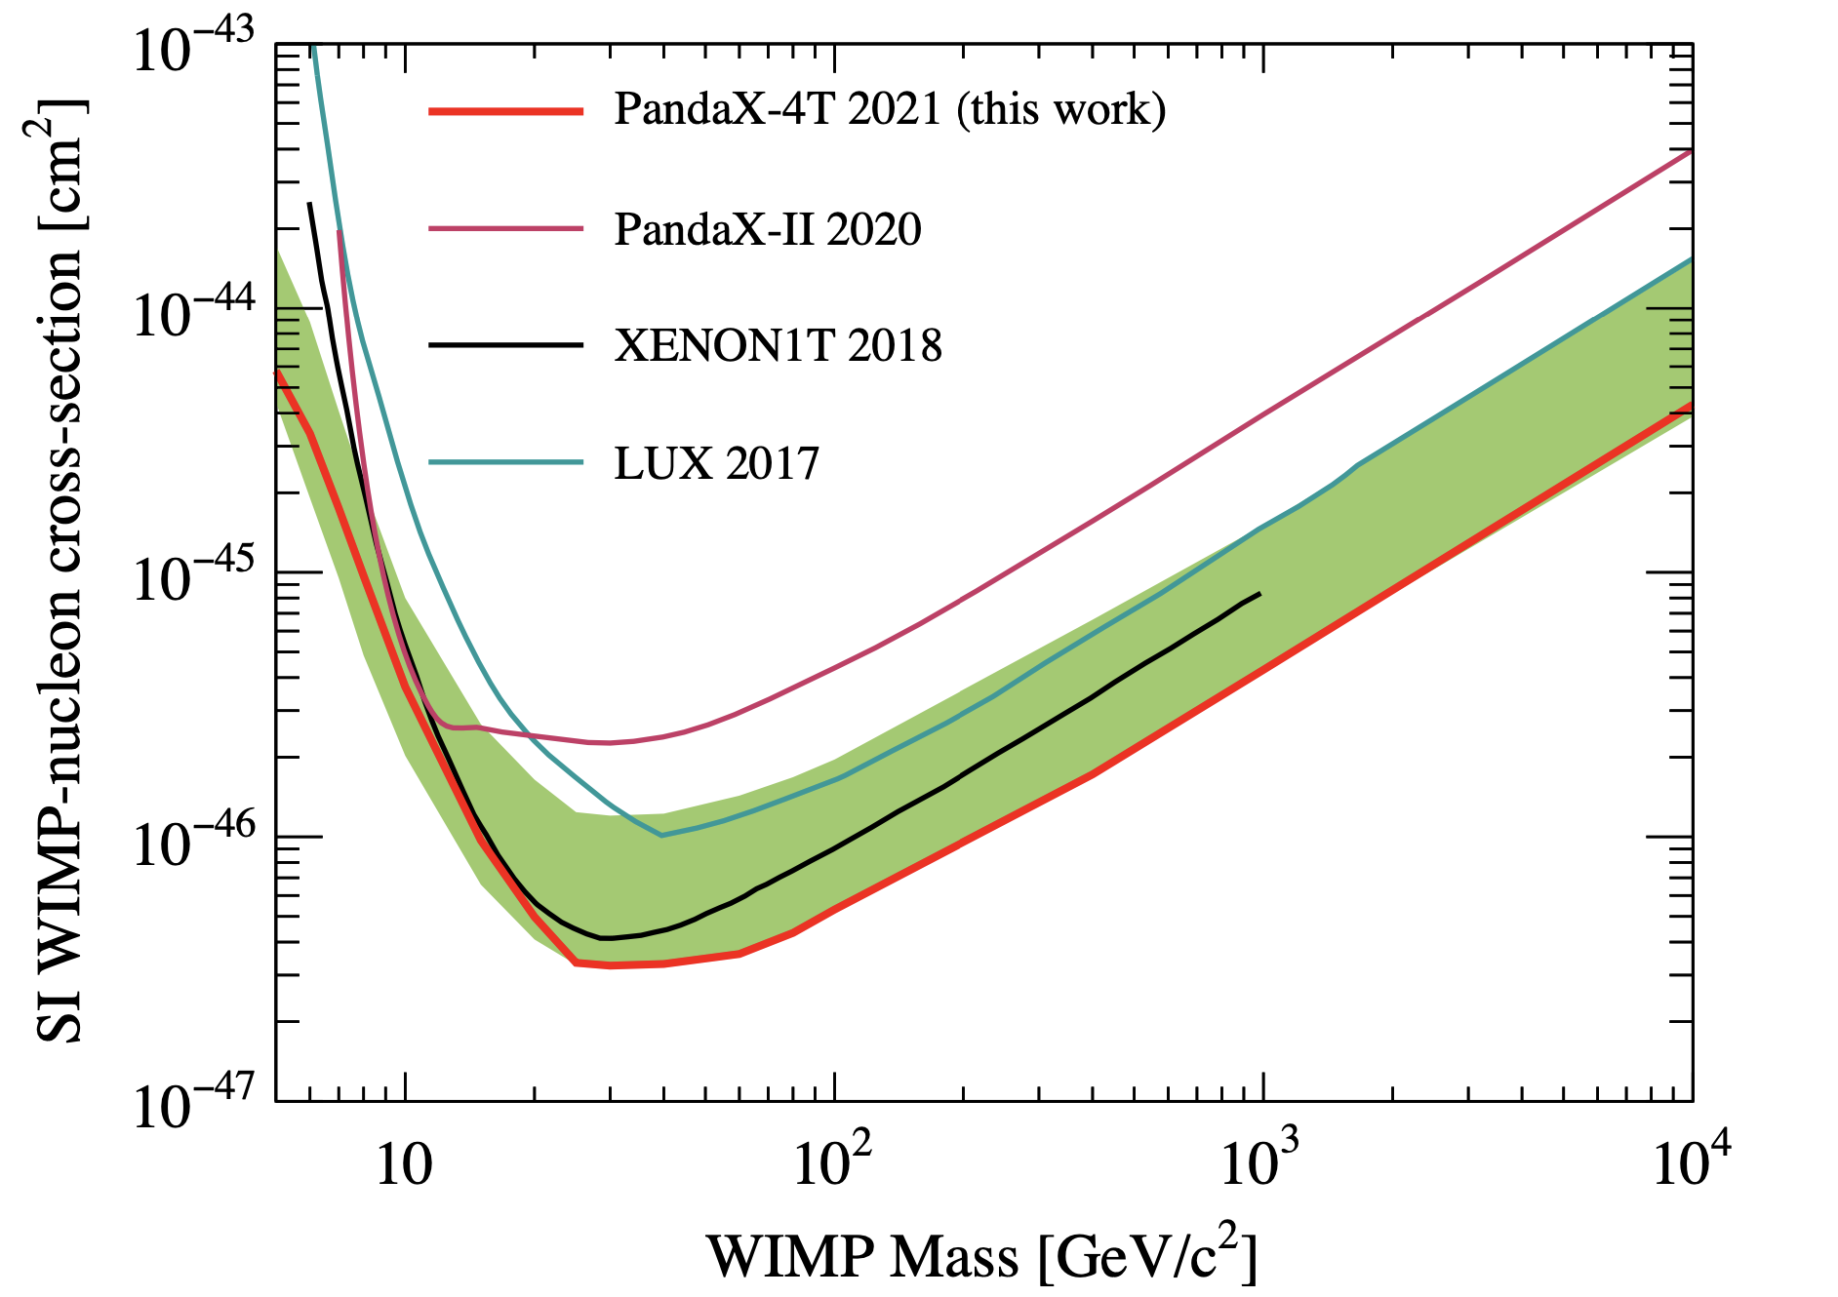
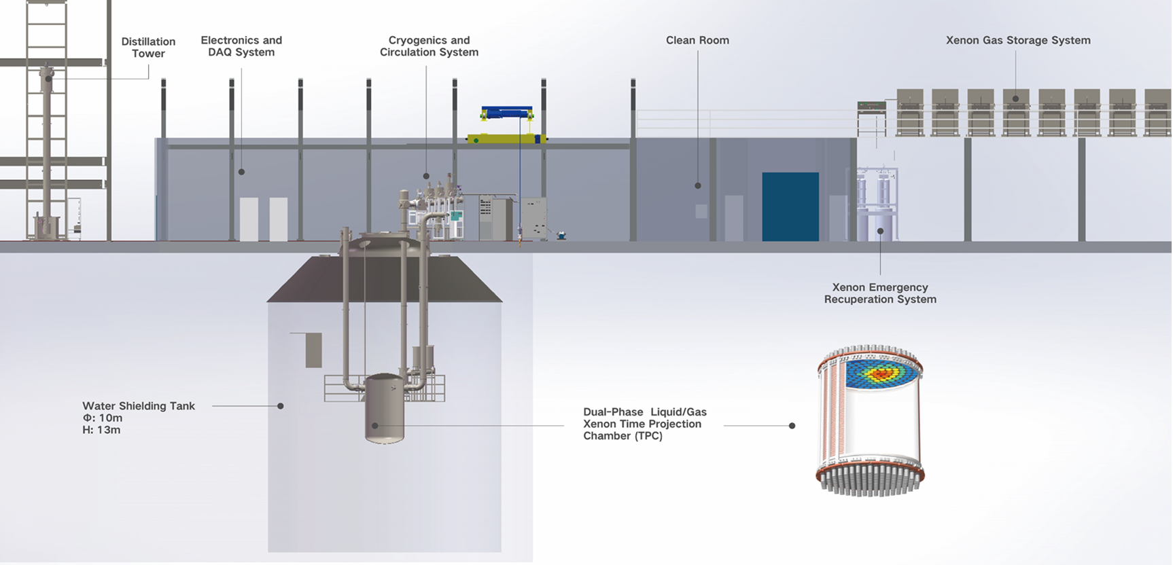
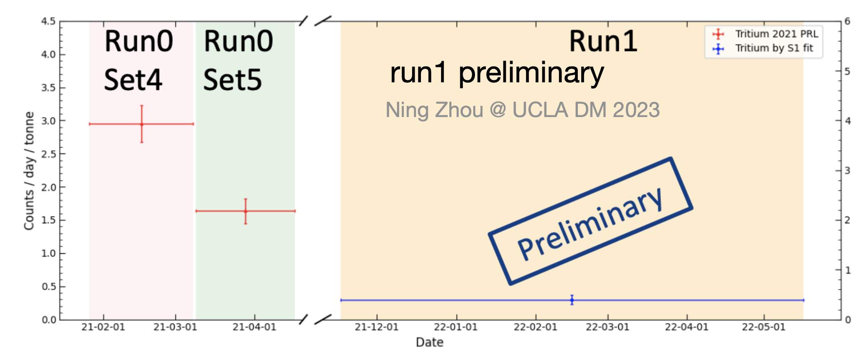
PandaX-4T Experiment & Its first data
5.6-tonne liquid xenon detector at CJPL-II;
2020-2021: Commissioning run (run0), 95 days;
2021-2022: Tritiated methane removal and run1, ~160 days
Ultrapure water shield: 13 m (H) x 10 m (D)～900 m³
TPC: 1.2 m (H) x 1.2 m (D)
3-in PMTs: 169 top/199 bottom
Sensitive volume: 3.7-tonne
2

Slide 3
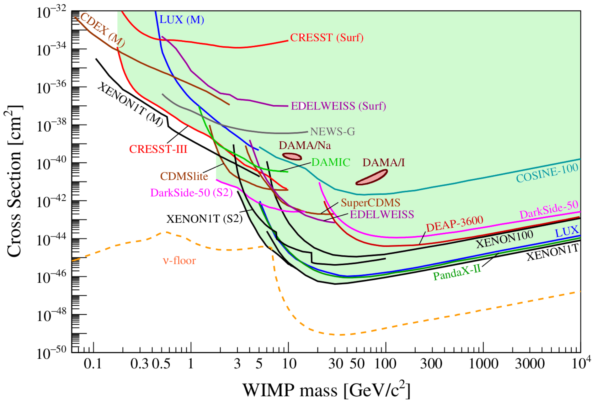
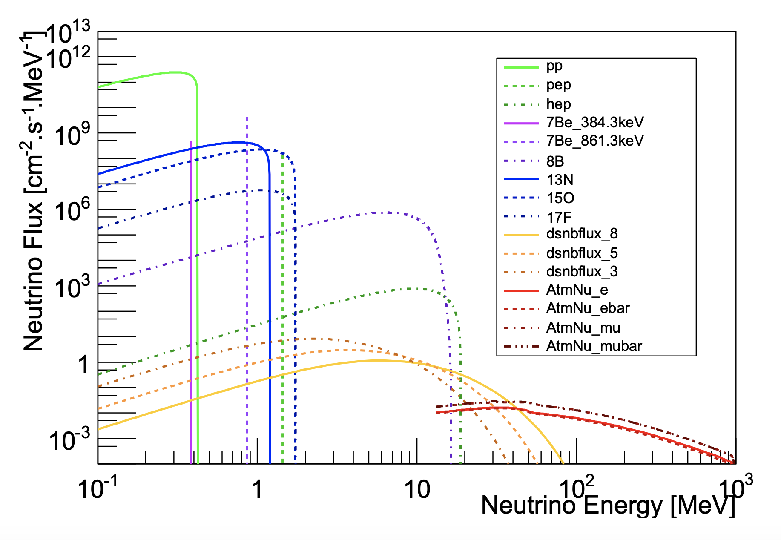
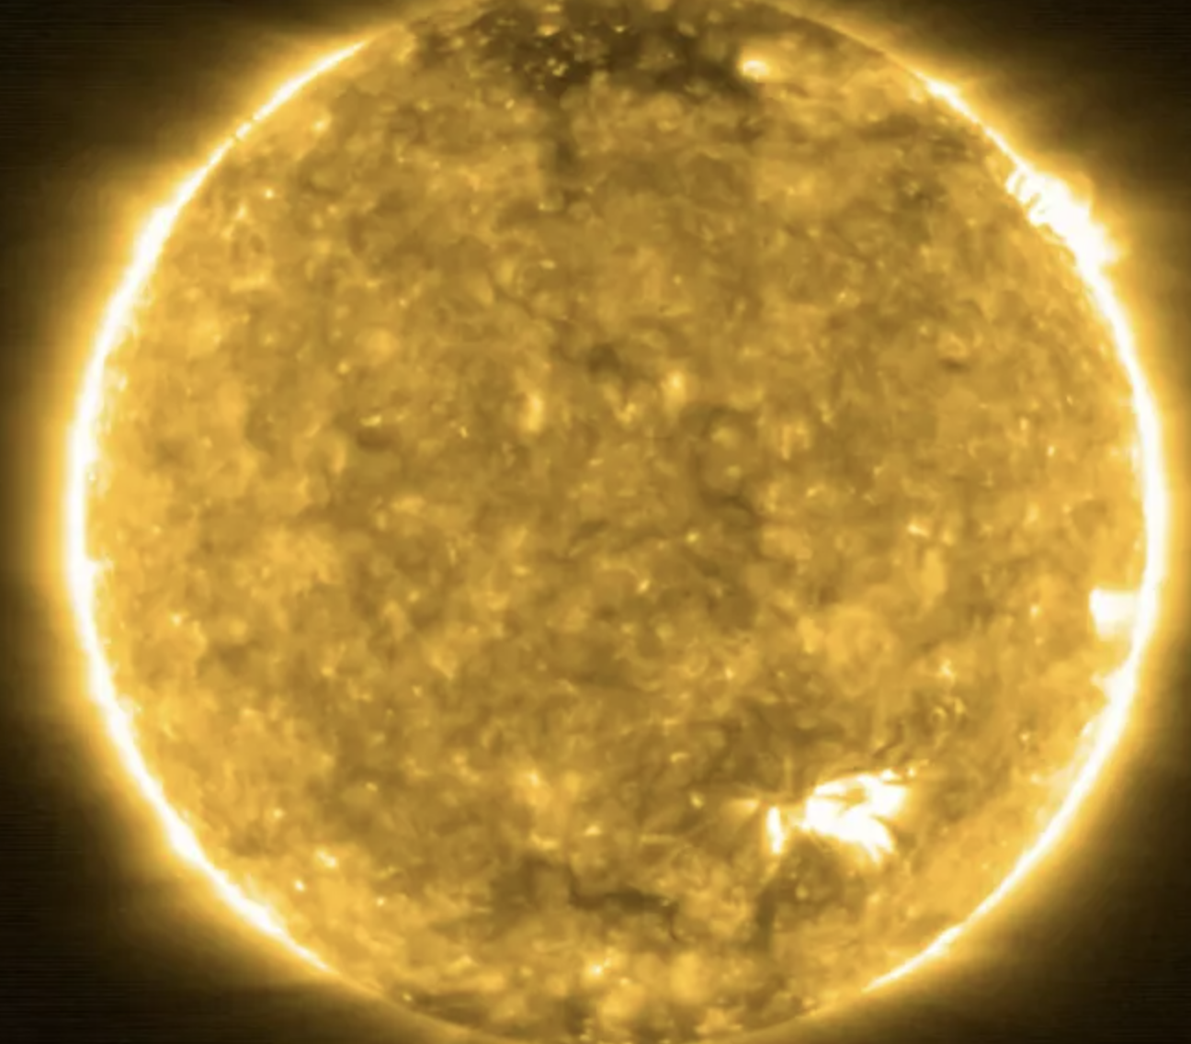
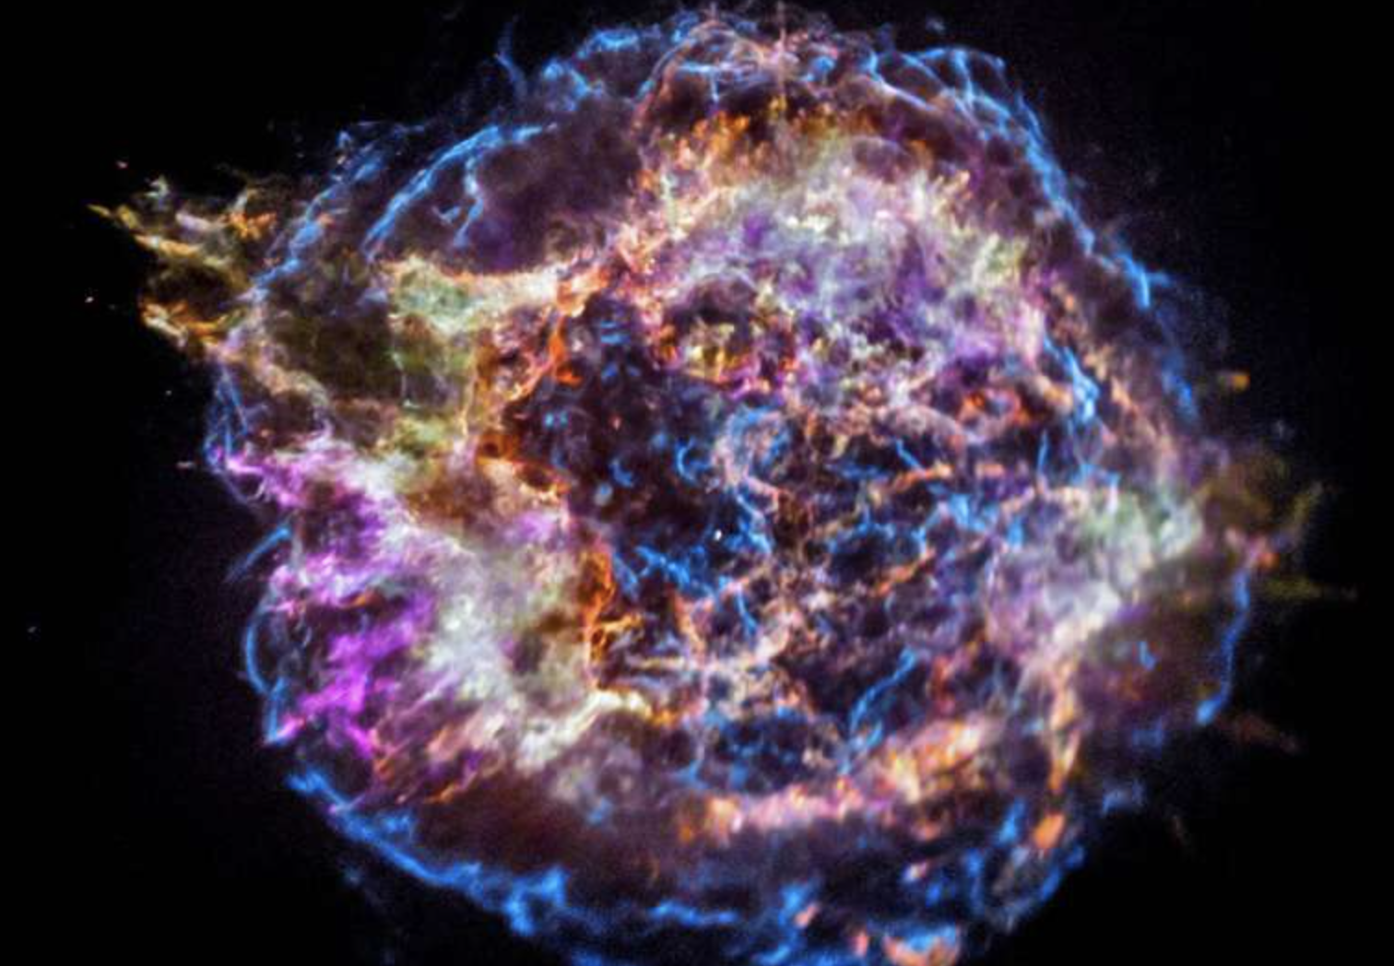
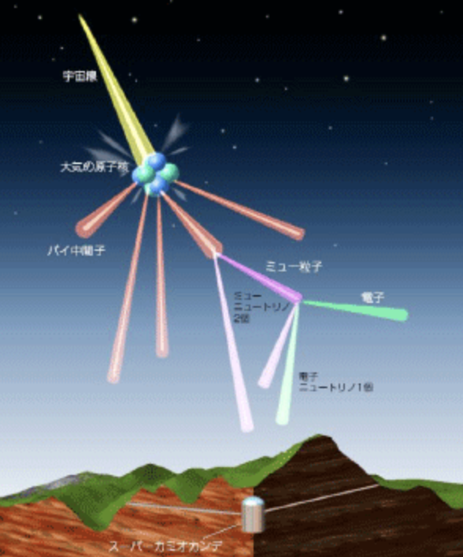
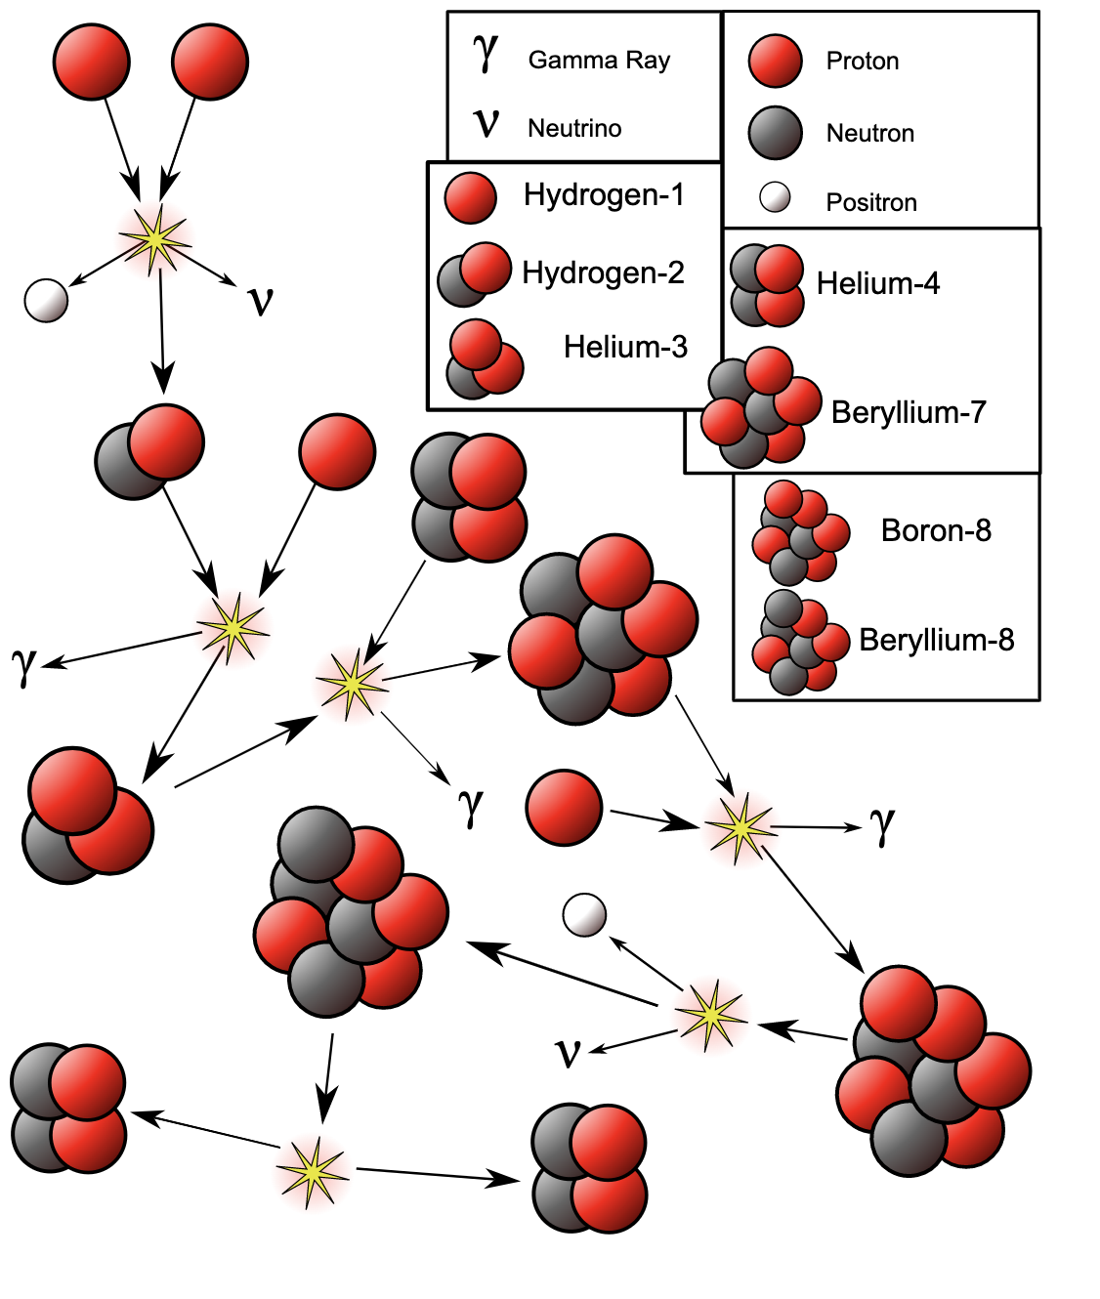
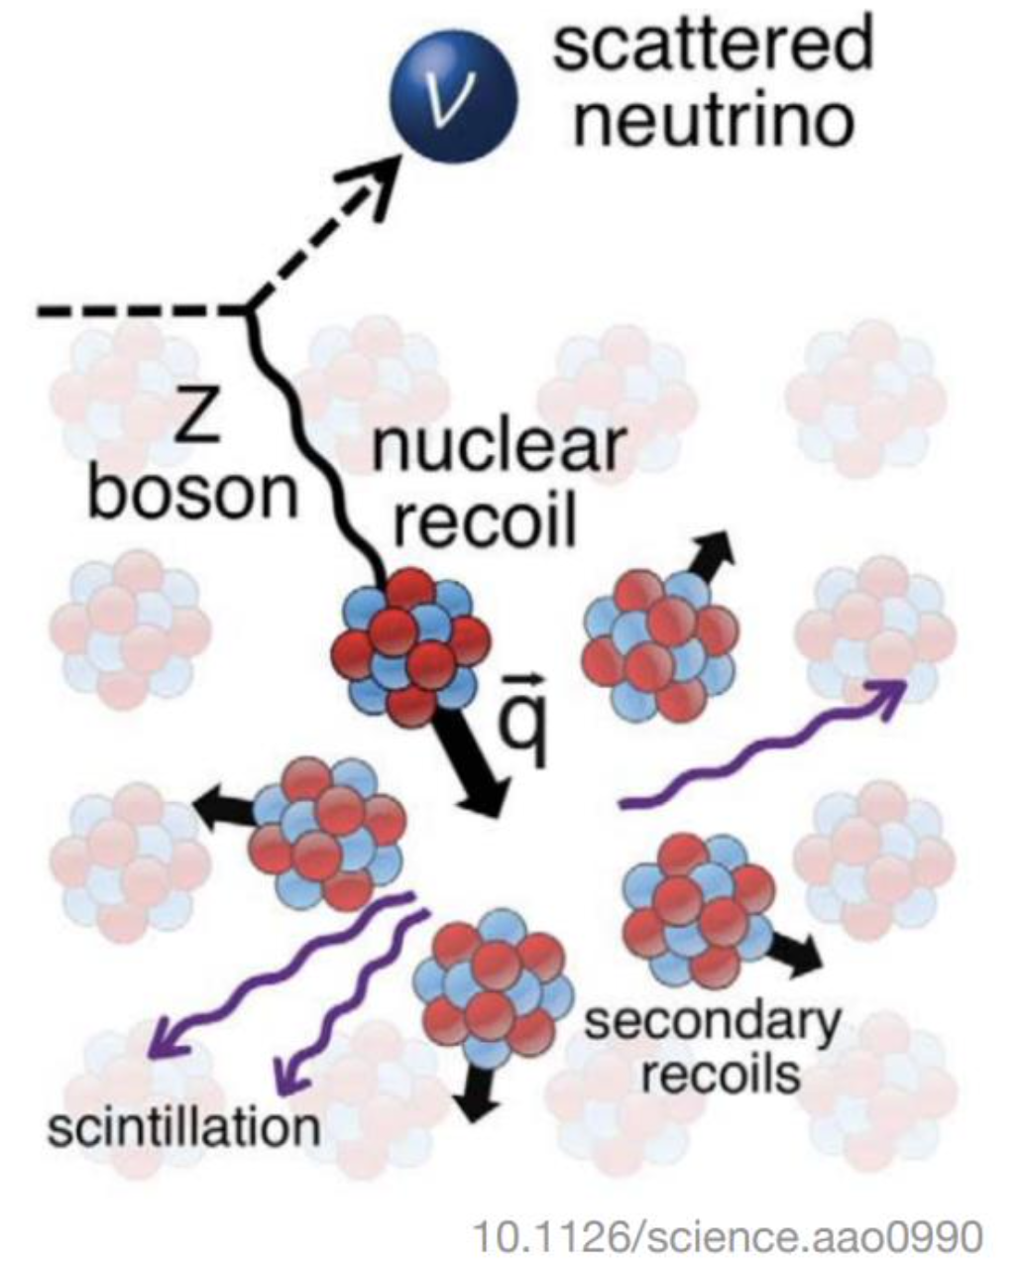
Solar neutrino CEvNS detection in DM experiment
Solar
SN
Atomspheric
Large underground experiment is going to be able to see Coherent Elastic v_{e}-Nuclear Scatting (CEvNS)
4

Slide 4
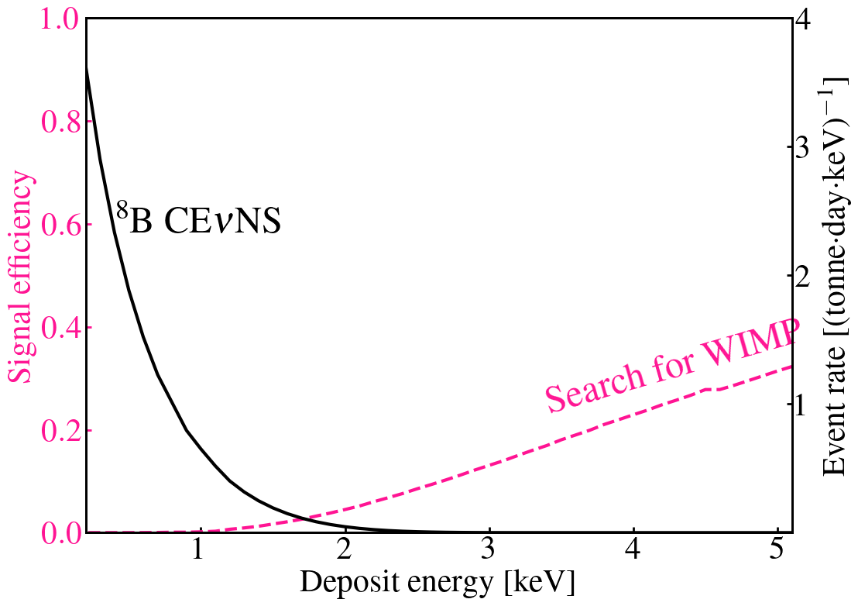
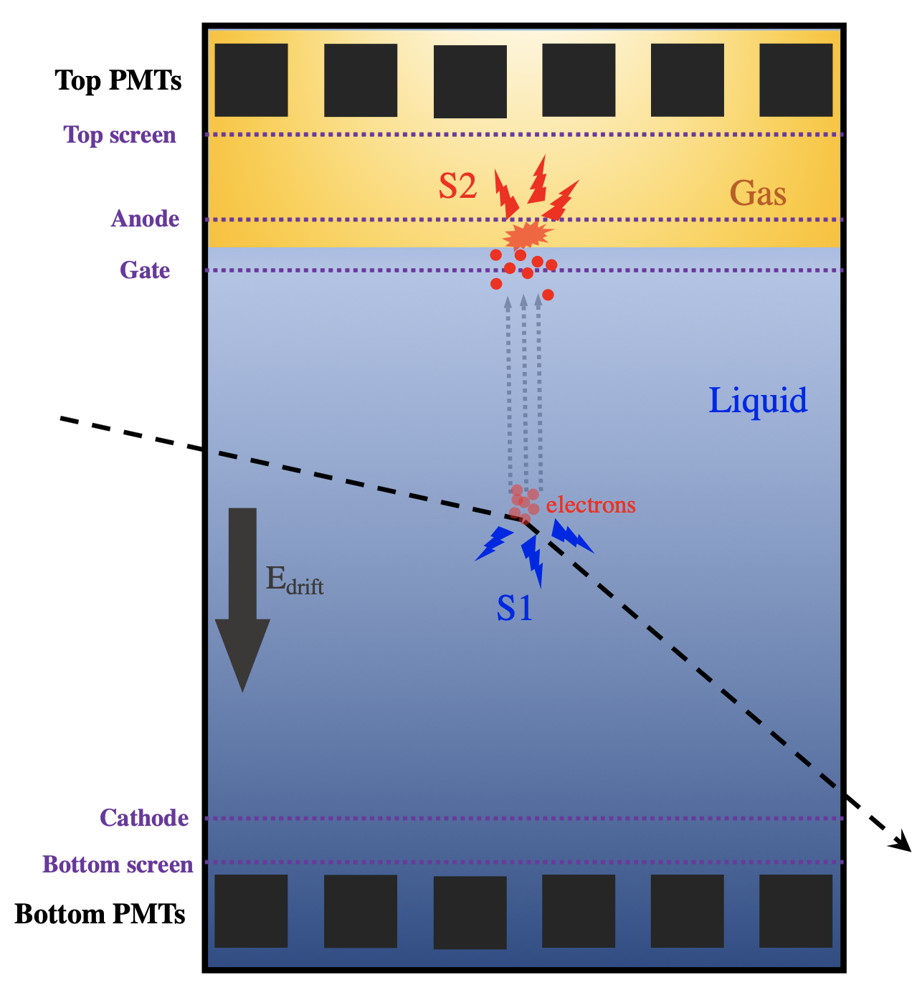
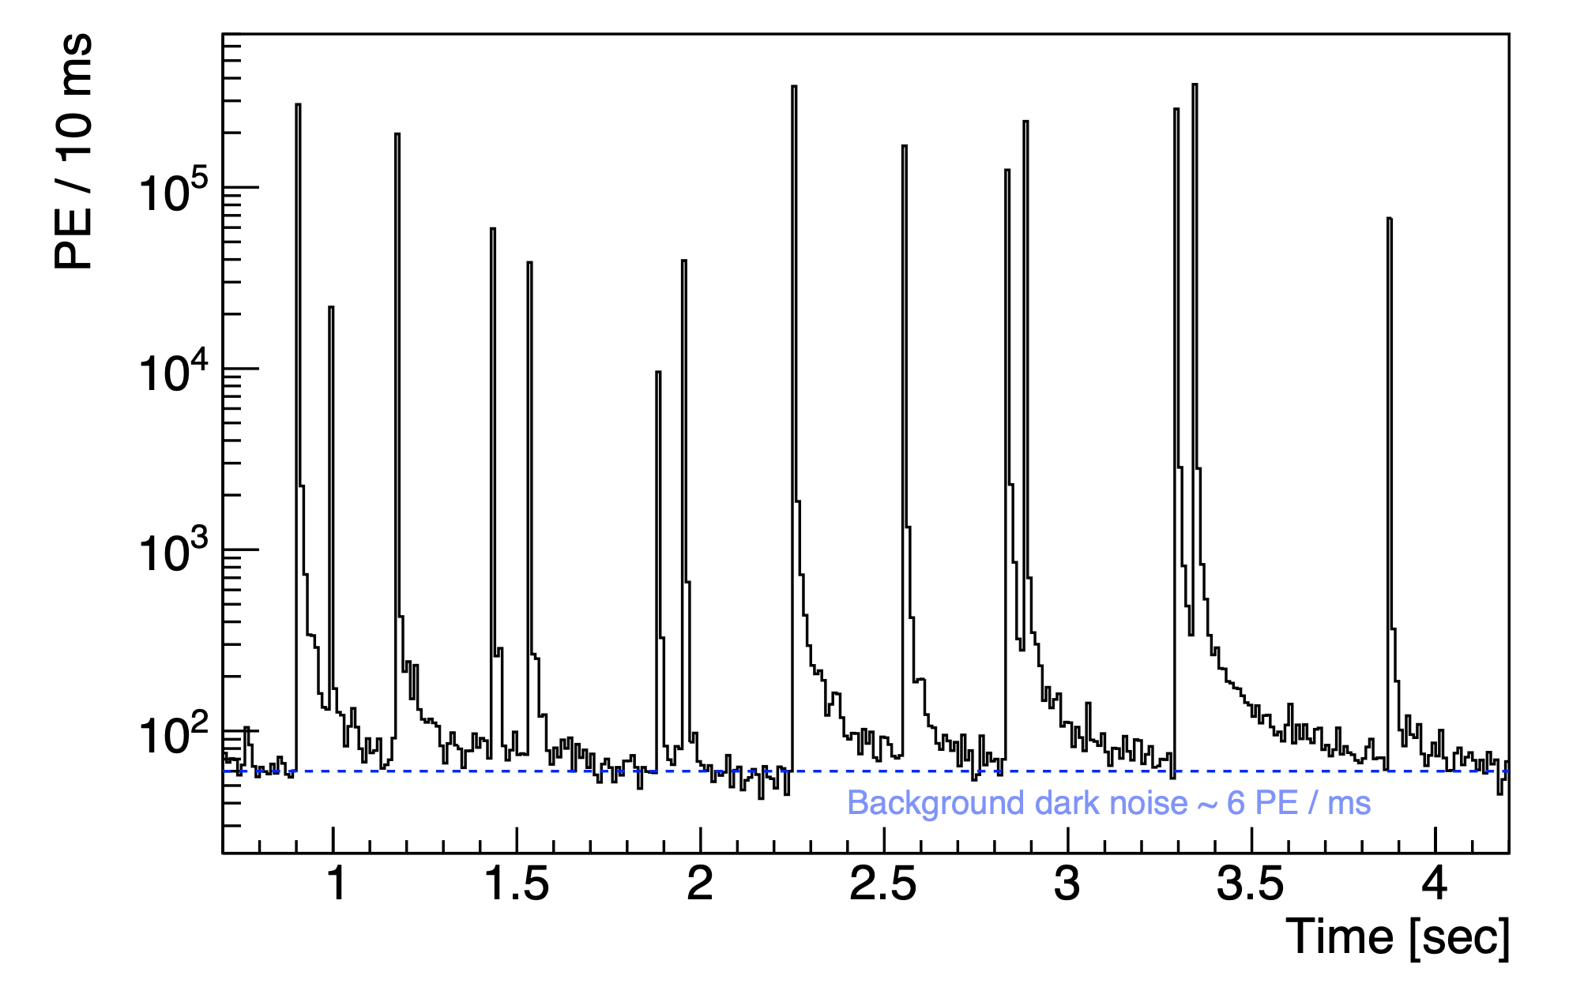
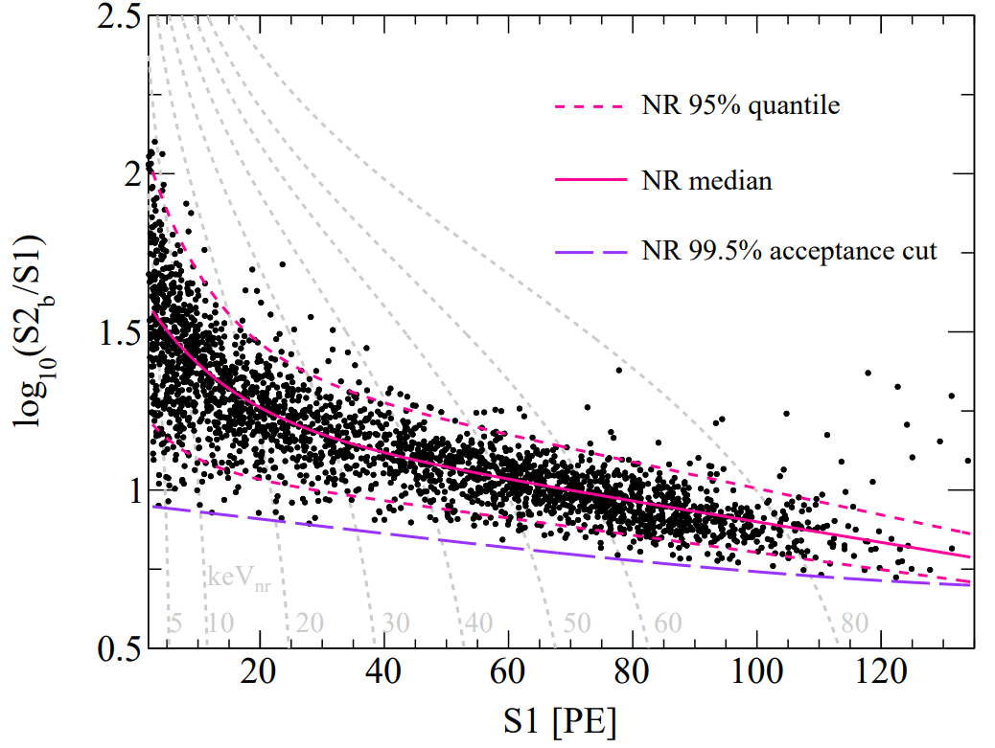
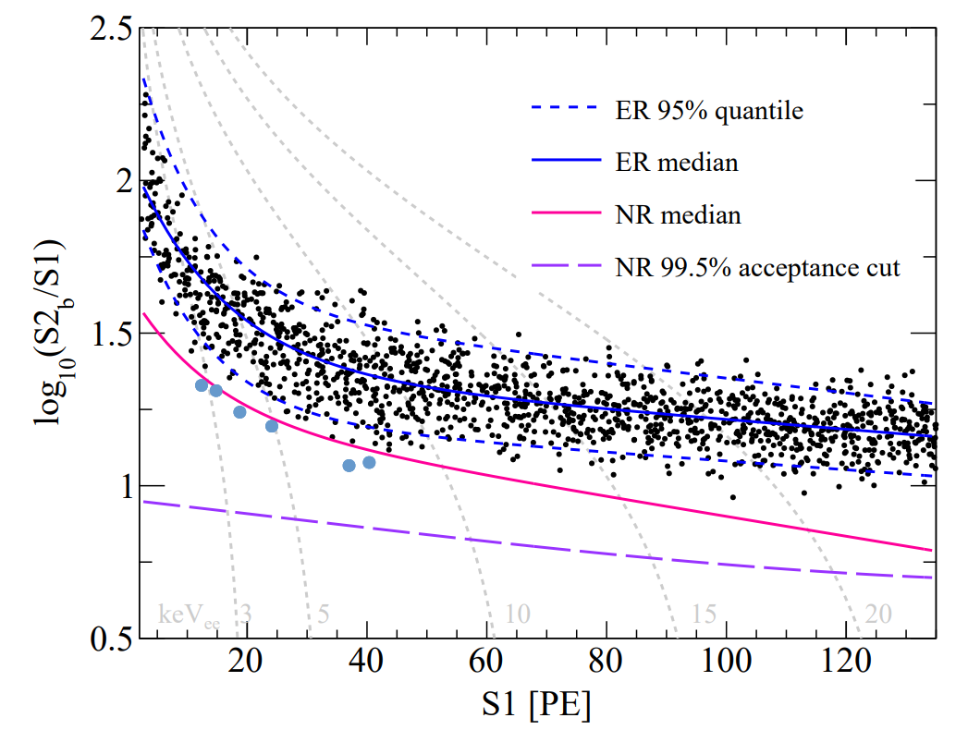
Difficulties of B8 CEvNS search
High rate of accidental pileups
1 -> ~ 100
S1 detection eff low
Low stats of calibration
10% detection
>90% detection
S1>2hit
S1>2PE
S2
NR calibration
ER calibration
S1
1.6 per year in 2.7 ton FV.
S1=2，3hit
S2~[65,200]PE
Eff?
5

Slide 5
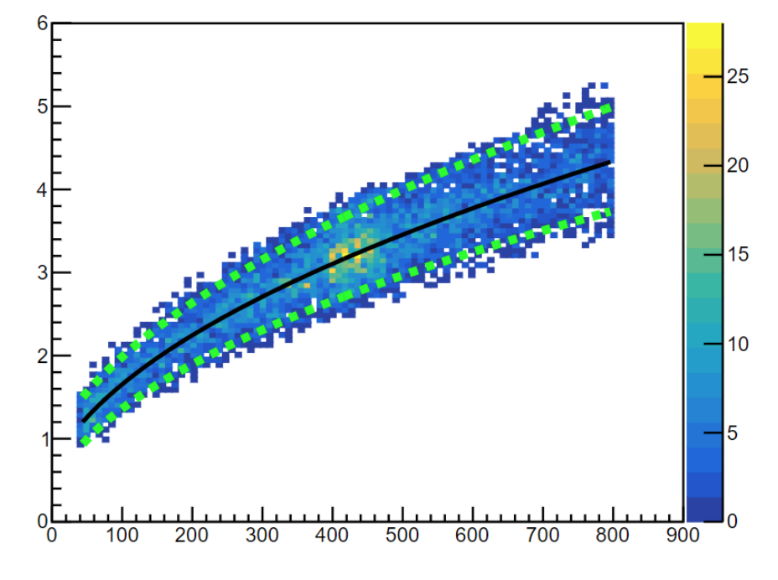
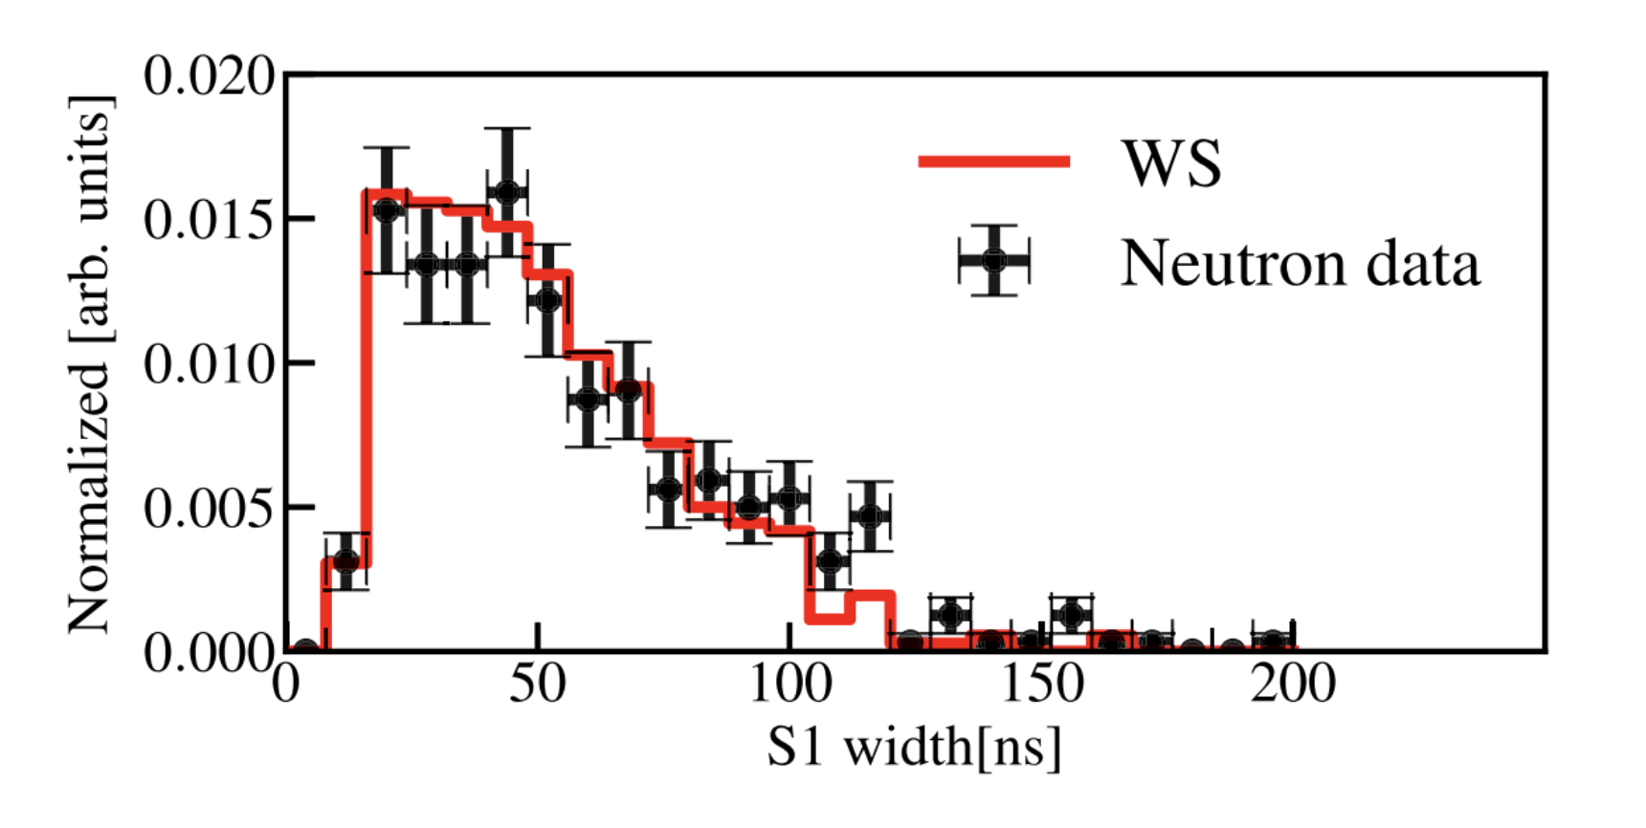
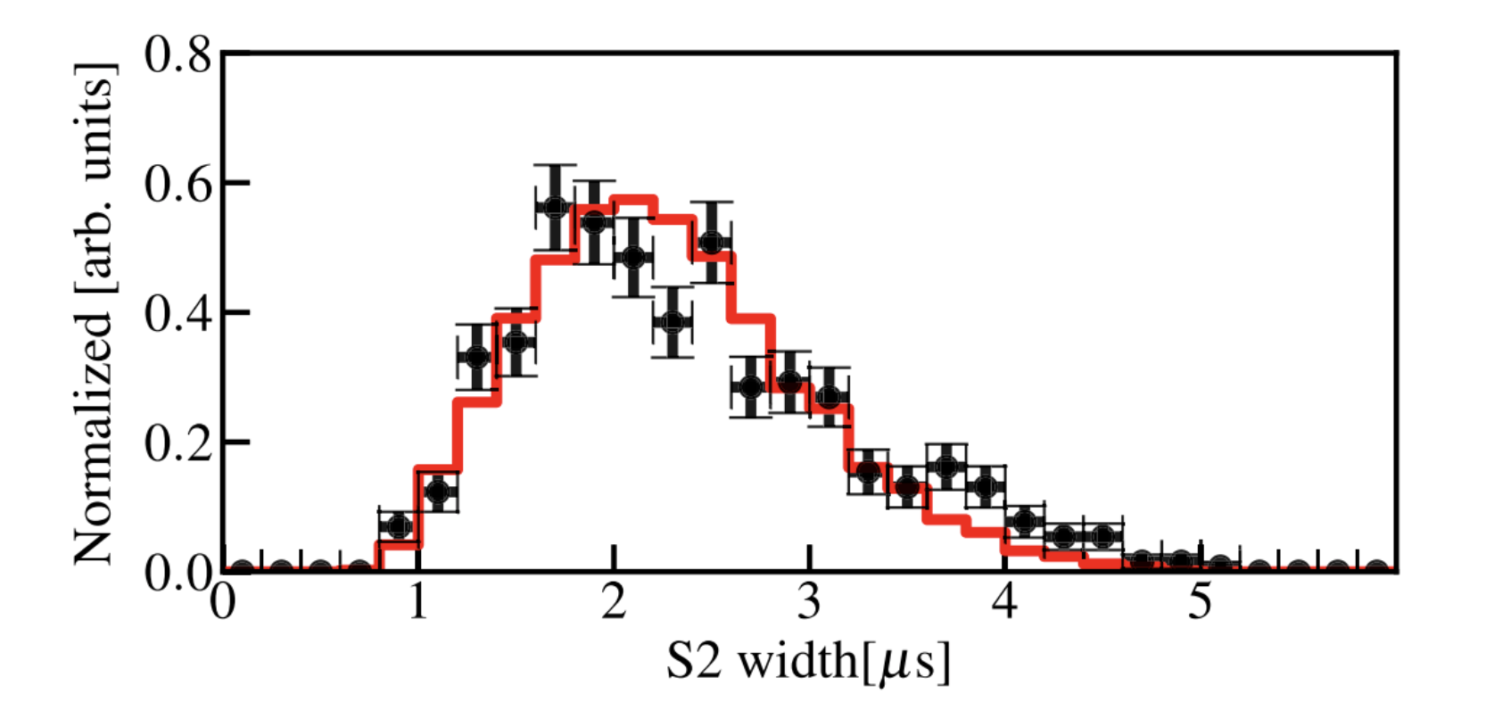
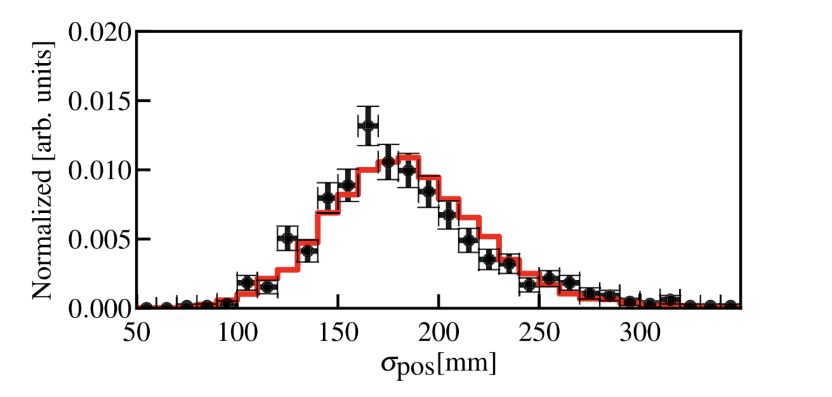
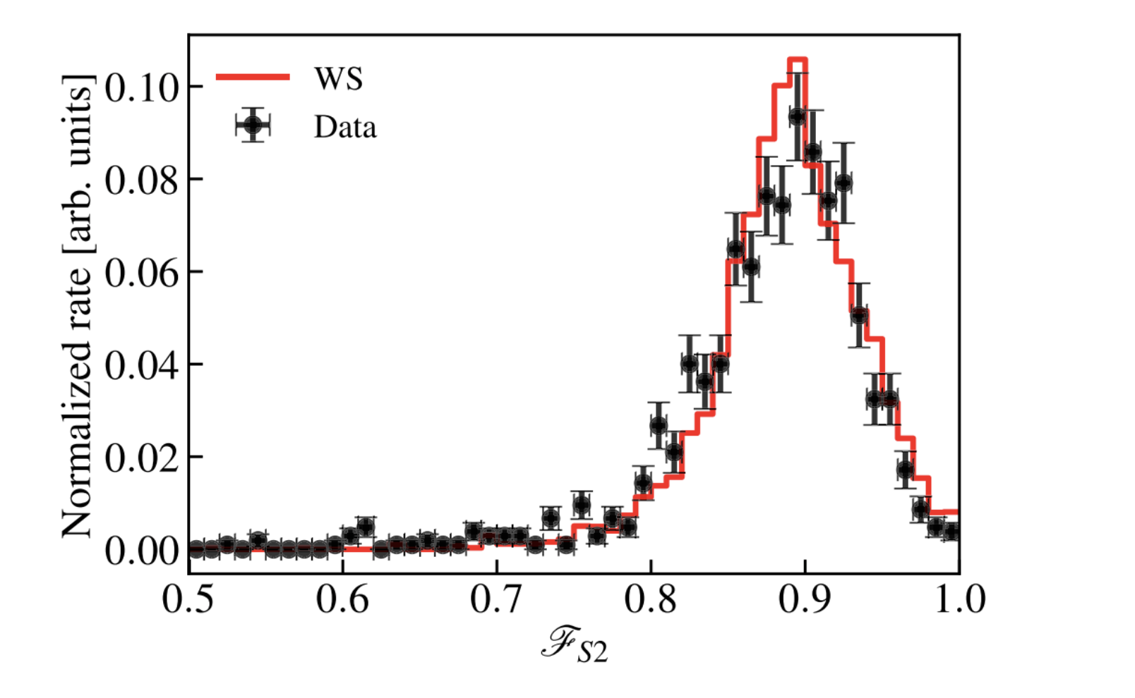
Waveform simulation
Reassembling data waveform segments
Neutron calibration
S1 width
S2 width
PMT dark count
S2 width [us]
Drift time [us]
S2 pattern parameter
Else charge / Total charge
Main S1
Main S2
PMT afterpulsing
Impurity photoionization;
Electron trapping at surface;
Delayed electrons
Good match between data and wf-sim in terms of S1/S2 shape, pattern, and waveform “dirtiness”.
6

Slide 6
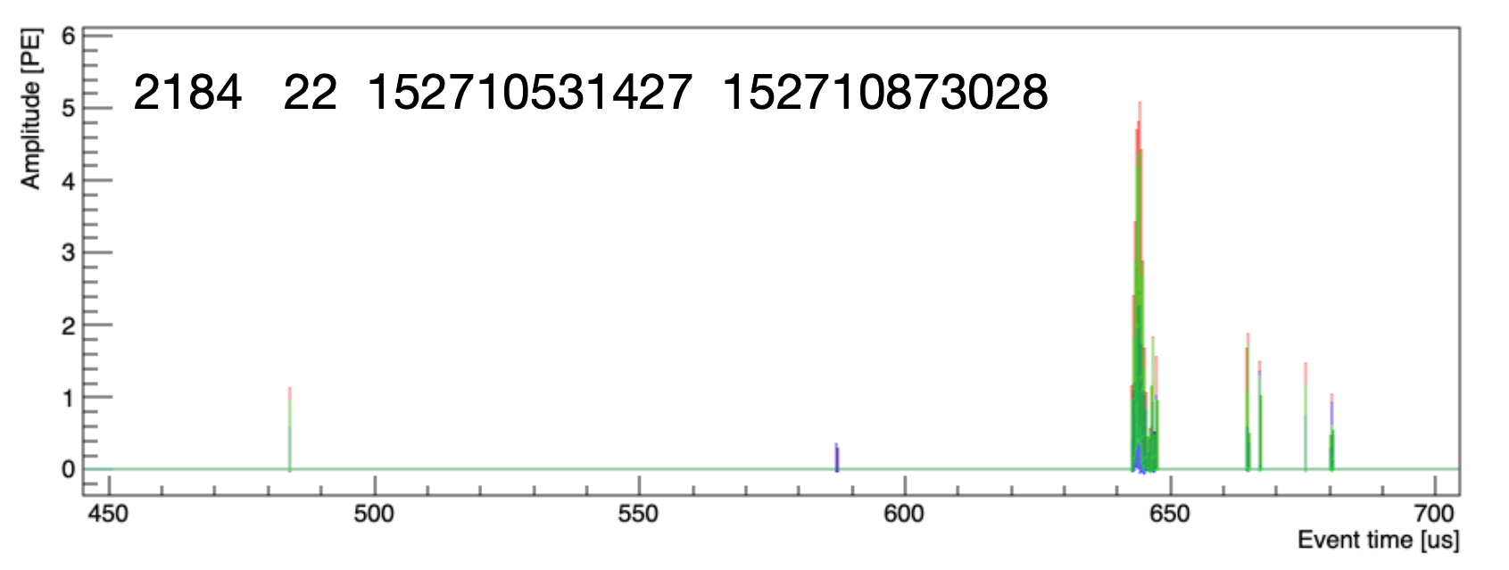
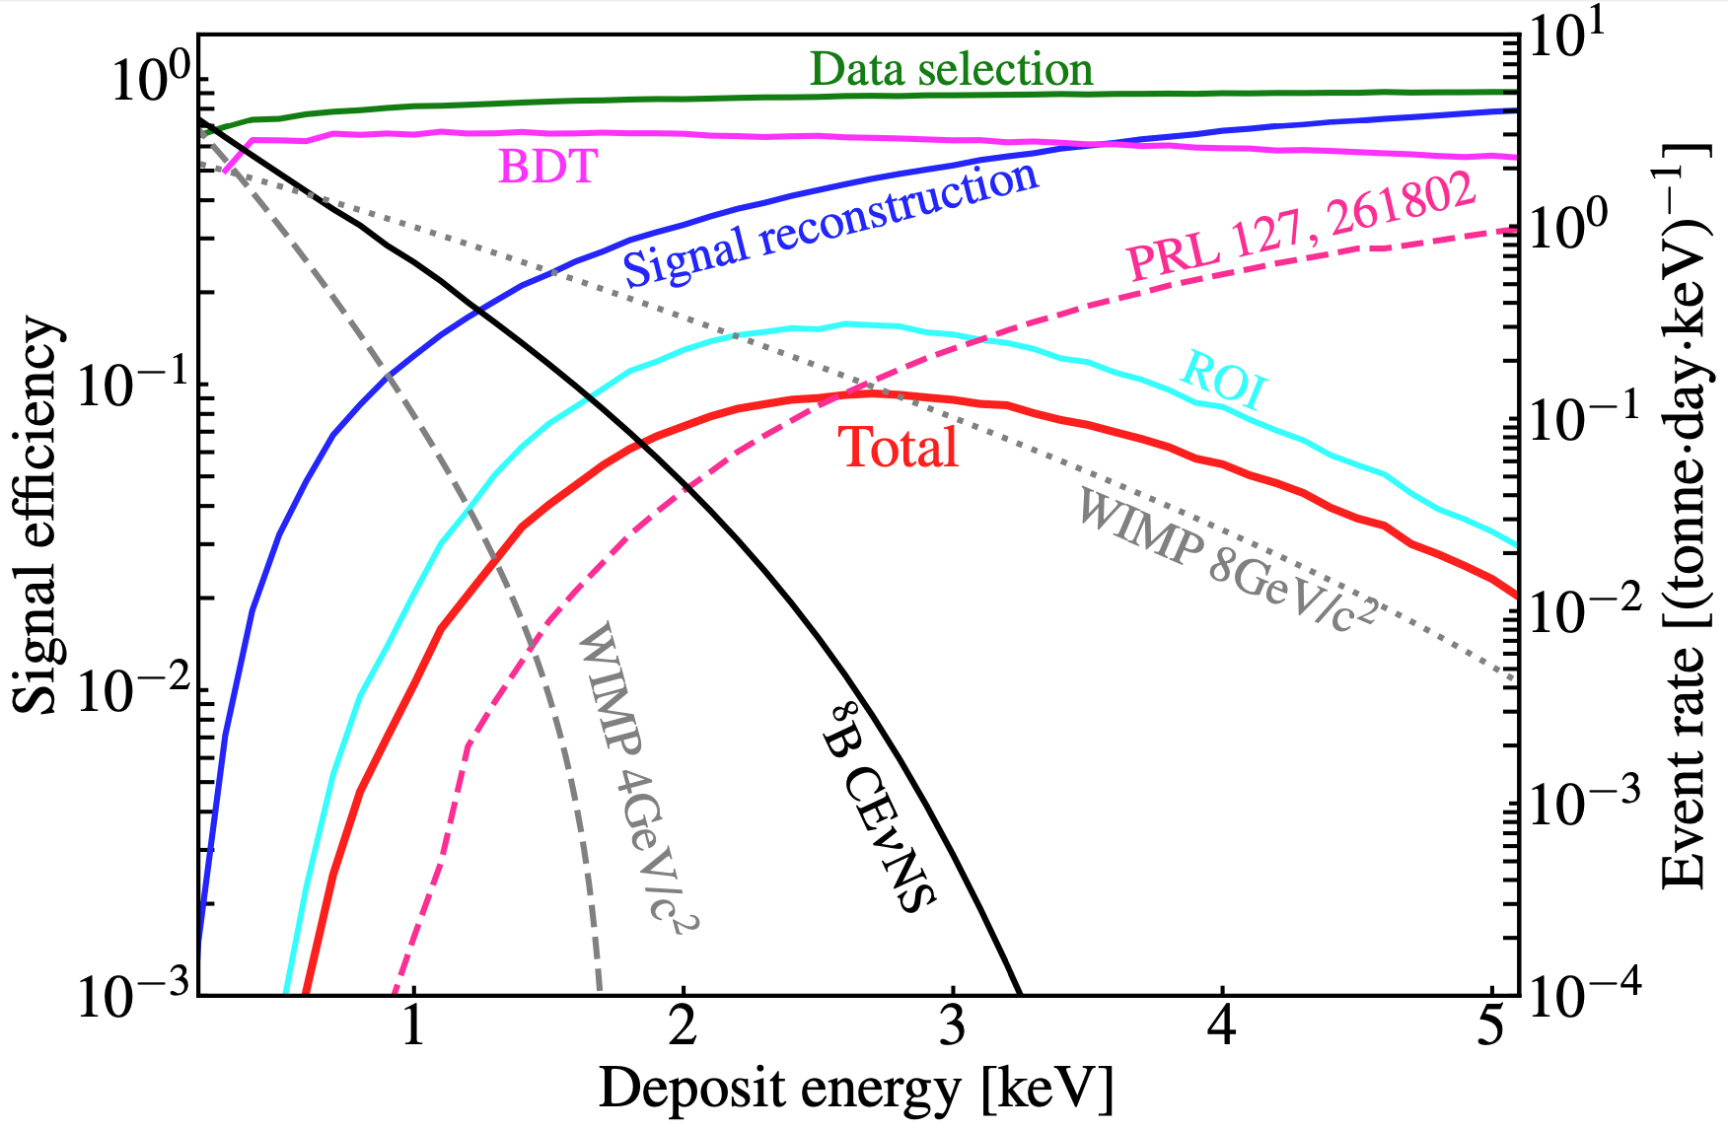
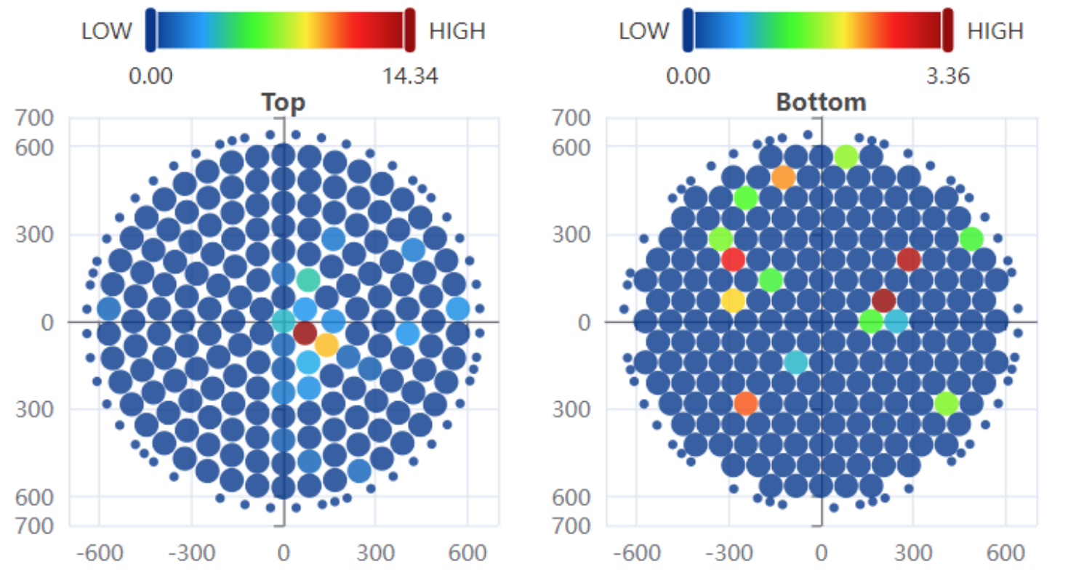
Machine-Learning based selection
Boosted Decision Tree (BDT)
S1 & S2 width
Spurious charges beside S1&S2
S2 pulse shape
Width/height ….
WF-sim as signal sample;
Randomly paired S1-S2 as bkg sample;
18 variables as BDT input;
Difference of reconstructed positions;
Goodness-of-fit between data and sim;
Top-bottom asymmetry
7

Slide 7
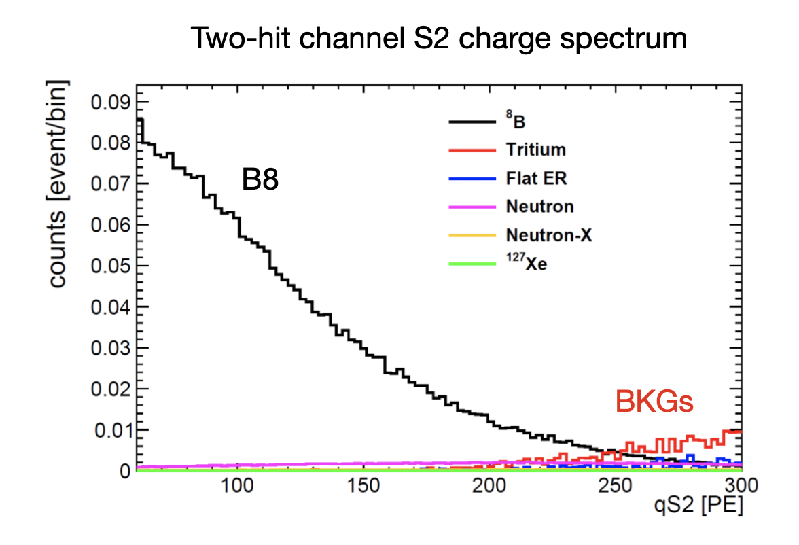
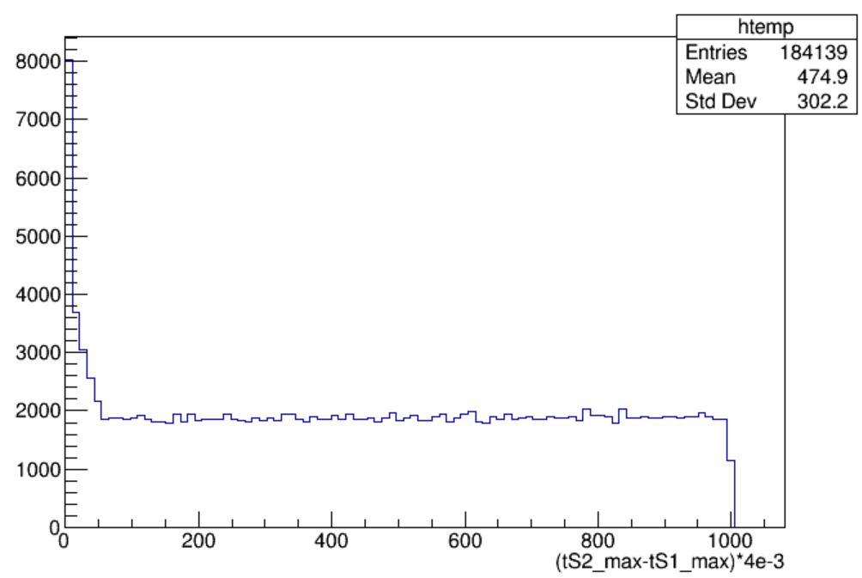
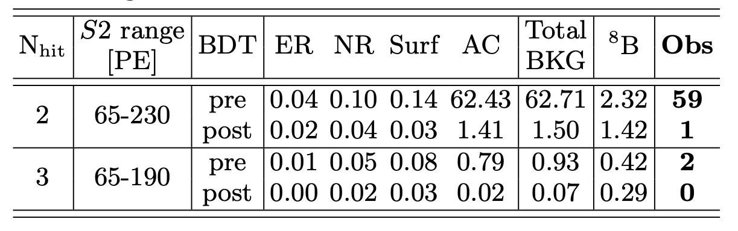
Background budget
Physical bkg negligible!
cathode
AC is the dominant bkg;
Use data with drift length > max drift length as sideband check;
Good match between data and model;
ROI
Sideband
Drift time[us]
8

Slide 8
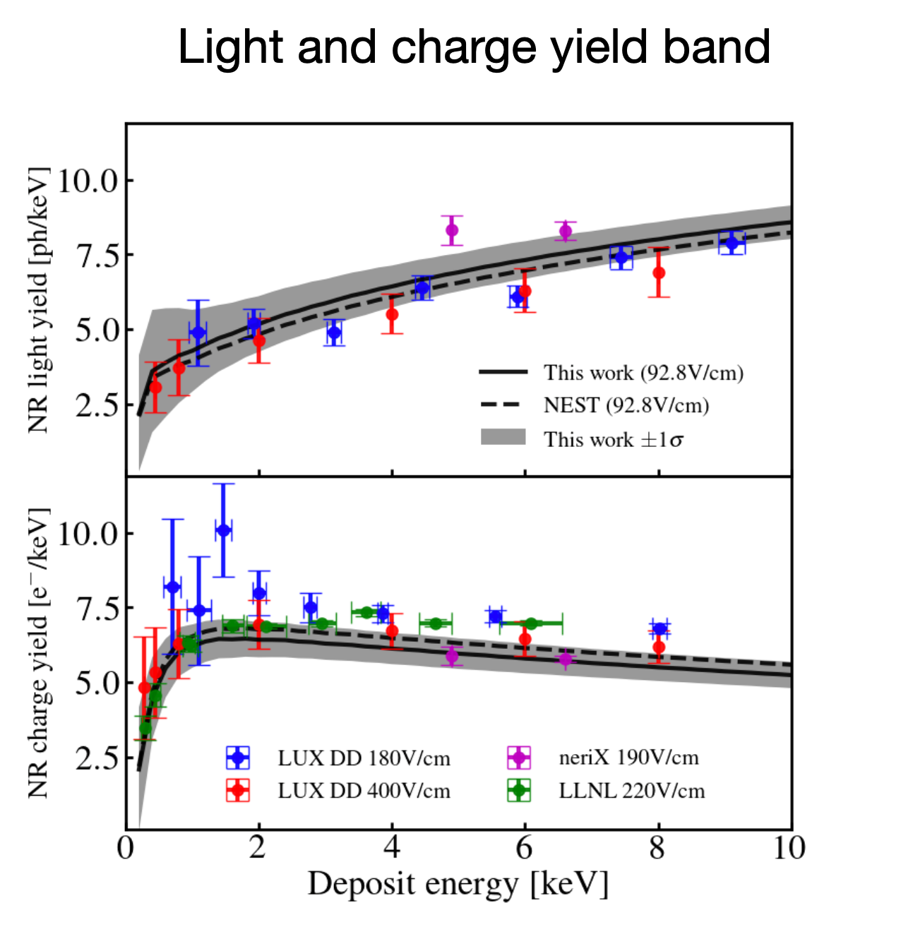
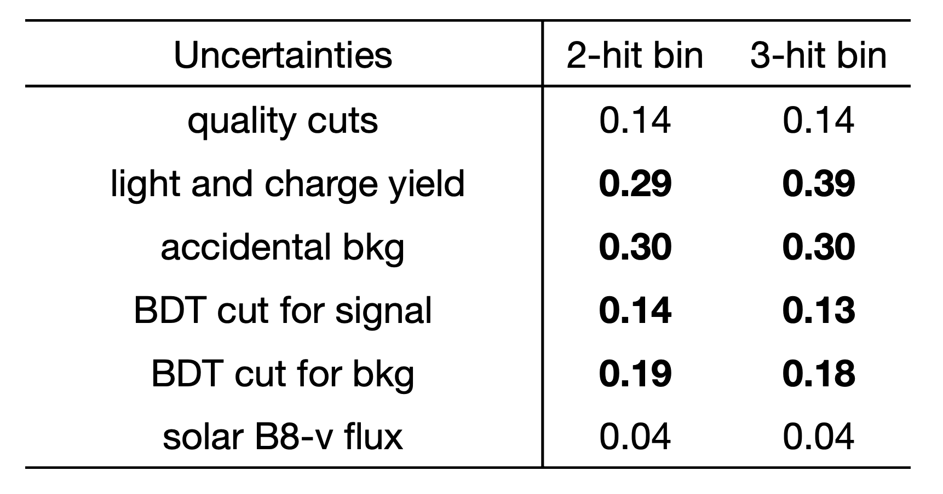
Uncertainty analysis
Use secondary S2s or events without S1 for checking sys.
Main S1
Secondary S2
Systematic uncertainties
Main S2
Diff between data and sideband
9

Slide 9
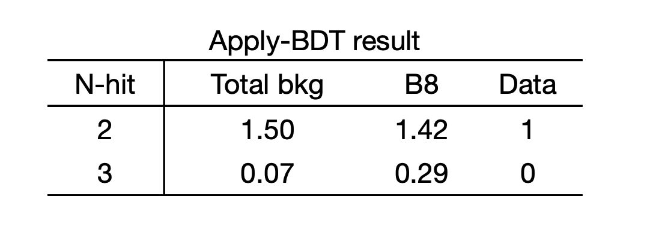
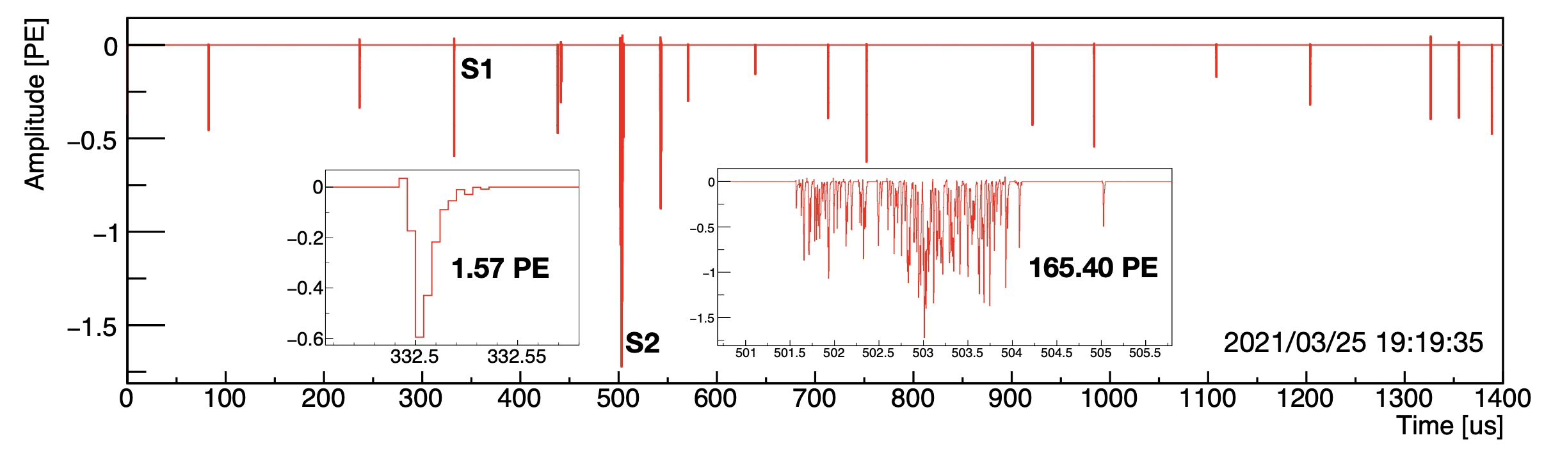
Unblinding
One event found after unblinding；
Statistically consistent with our expectation.
10

Slide 10
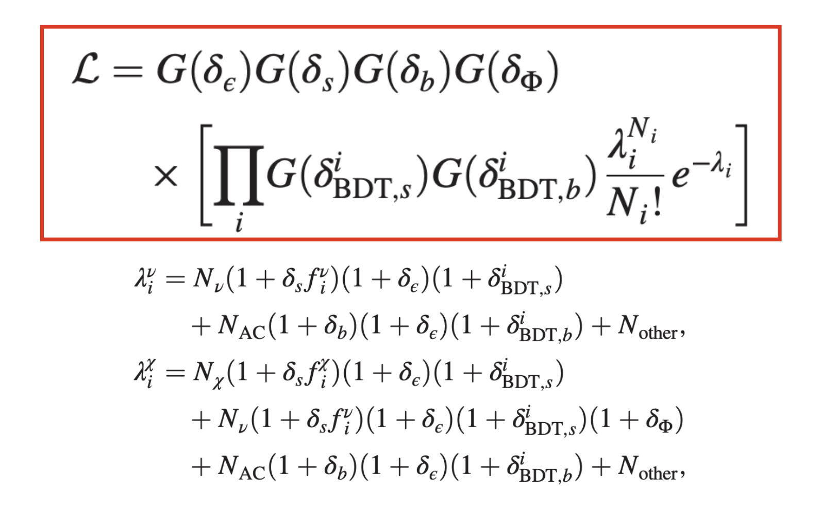
First B8 CEvNS search in PandaX-4T
Phys. Rev. Lett. 130, 021802
Profile Likelihood Ratio method, combining 2-hit and 3-hit data;
Most stringent limit to solar neutrino flux using CEvNS channel;
Also updated the GeV DM upperlimit.
11

Slide 11
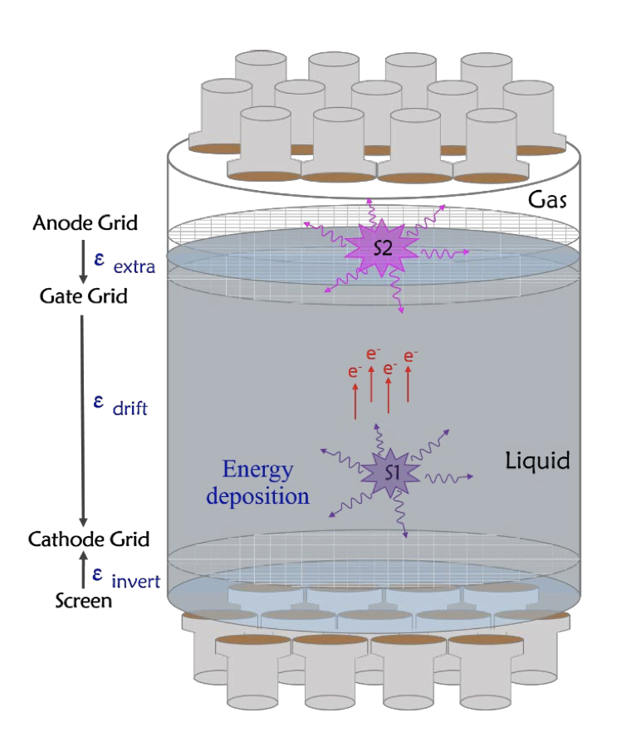
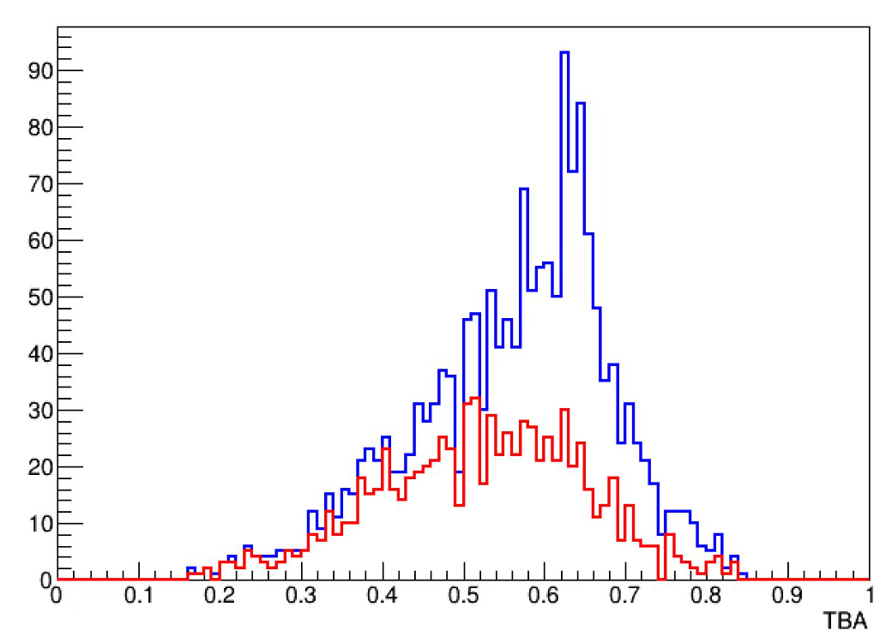
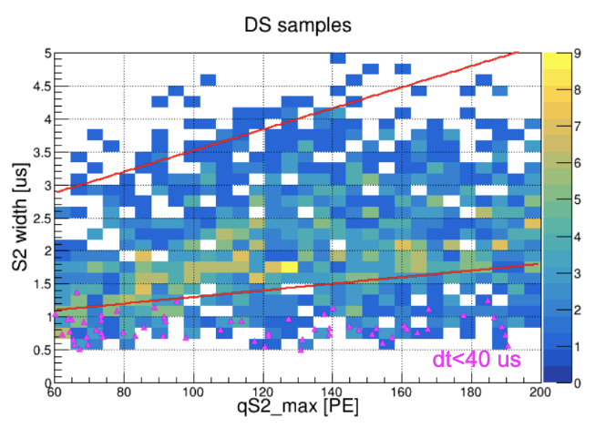
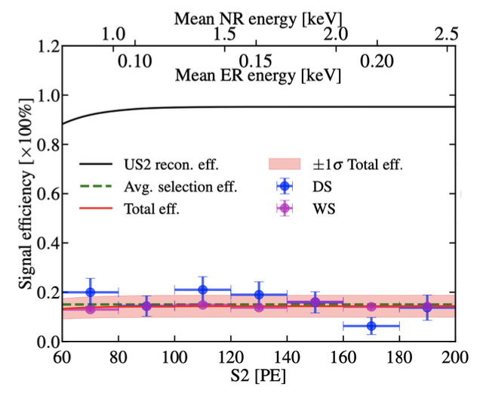
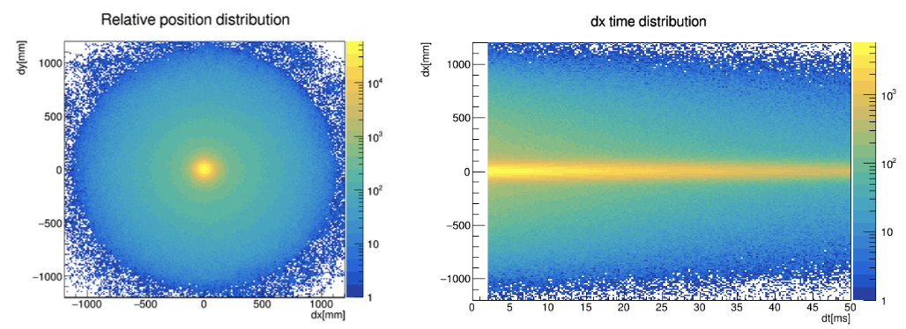
S2-only approach
Cathode event and gas event
Gas event
Physics event
Electron burst event
12

Slide 12
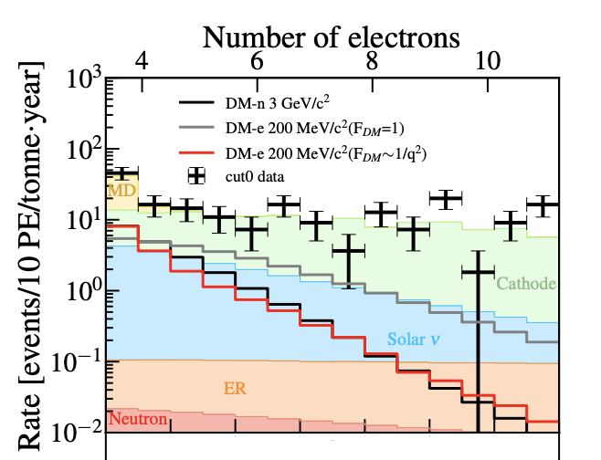
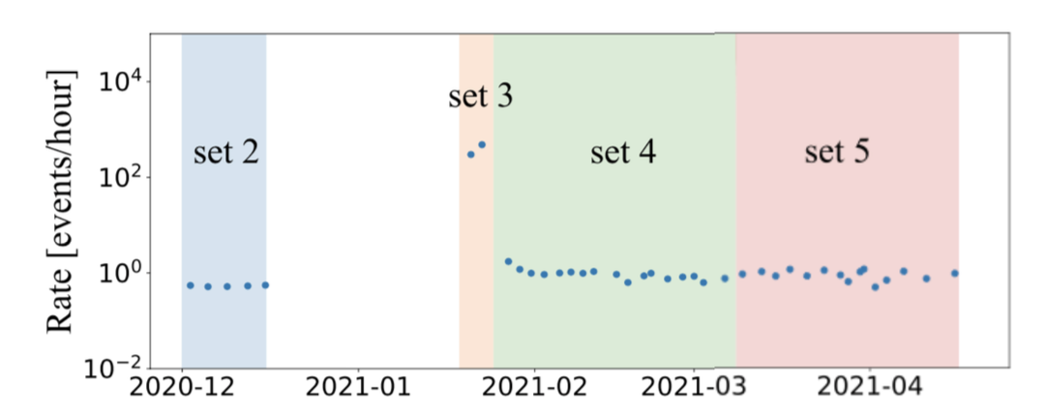
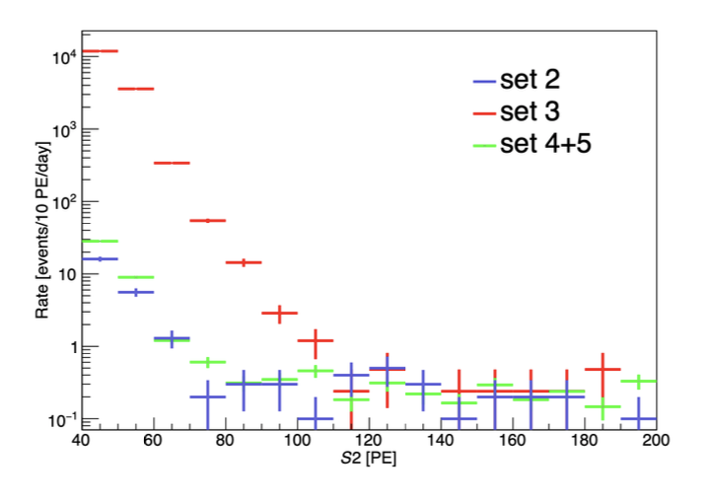
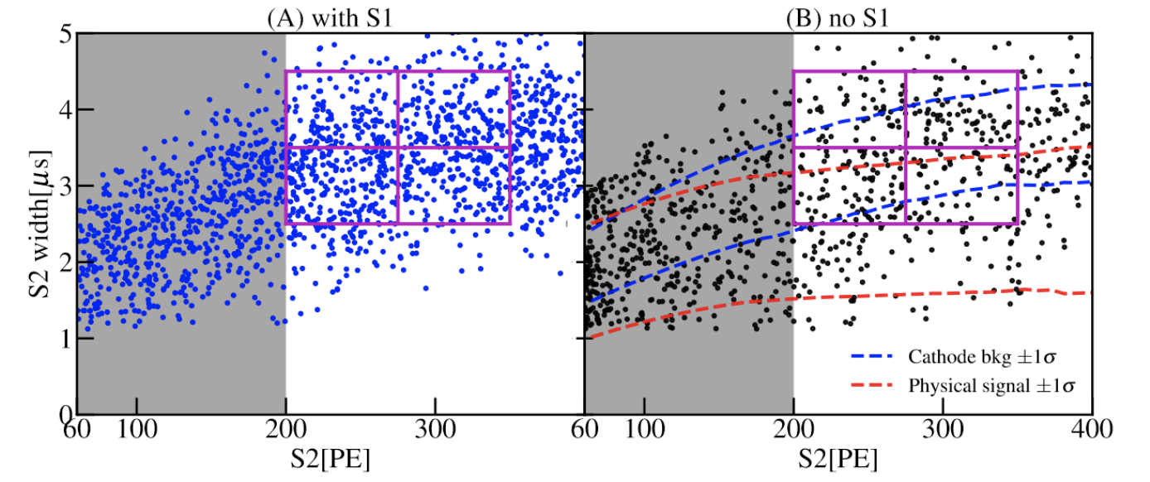
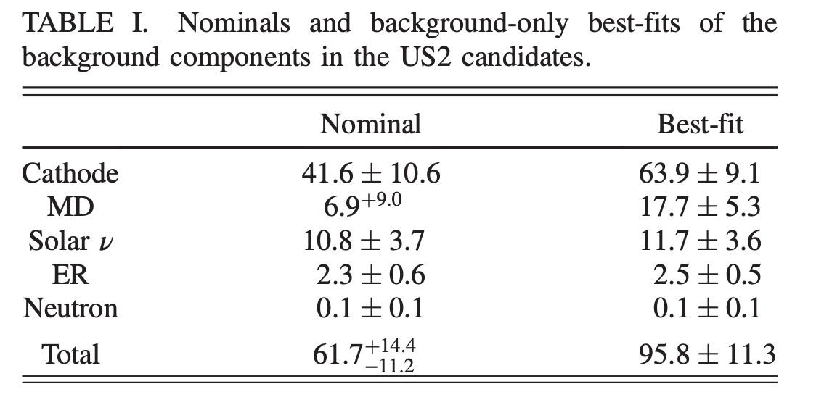
Background for S2-only data
g2=17.9 PE/e
Set 3 with very high rate as template for MD
Use fixed-dt data as estimate for cathode!
13

Slide 13
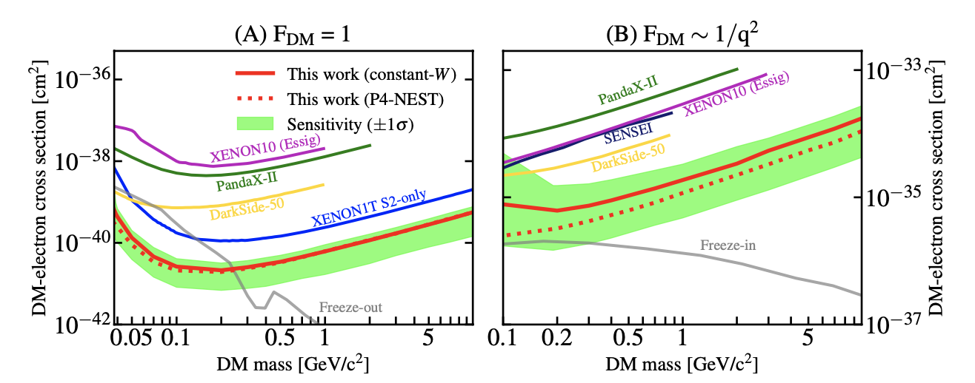
Low-mass DM-e search
PRL 130, 261001 (2023)
The most stringent constraints for the DM- electron interactions with mass in range of 40 MeV/c² to 10 GeV/c² with F_{DM} =1, and 100 MeV/c² to 10 GeV/c² with F_{DM} ∼ 1/q²
Our results challenge the freeze-out mechanism for DM mass range from 0.04 to 0.25 GeV/c² with F_{DM}=1, and are closing in on the freeze-in prediction with F_{DM} ∼ 1/q², assuming such light DM provides the entire DM abundance.
14

Slide 14
Summary & Prospect
Most stringent constraint on solar neutrino flux using CEvNS channel was obtained, using S1-S2 paired data.
We understand the bkg component of S2-only channel, mostly surface bkg from cathode and S2 pileup from micro-discharging;
Using S2-only data, the most stringent constraint on low-mass DM through DM-e scattering is given;
Analysis combining Run0 and newly taken Run1 is ongoing;
Dedicated calibration on ultra-low energy region is planned.
15

Slide 15
Thanks for listening!
21

Slide 16
Backups
21

Slide 17
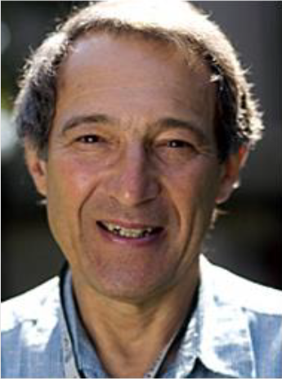
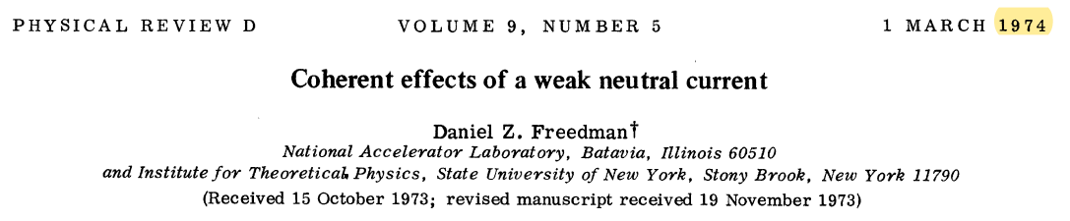
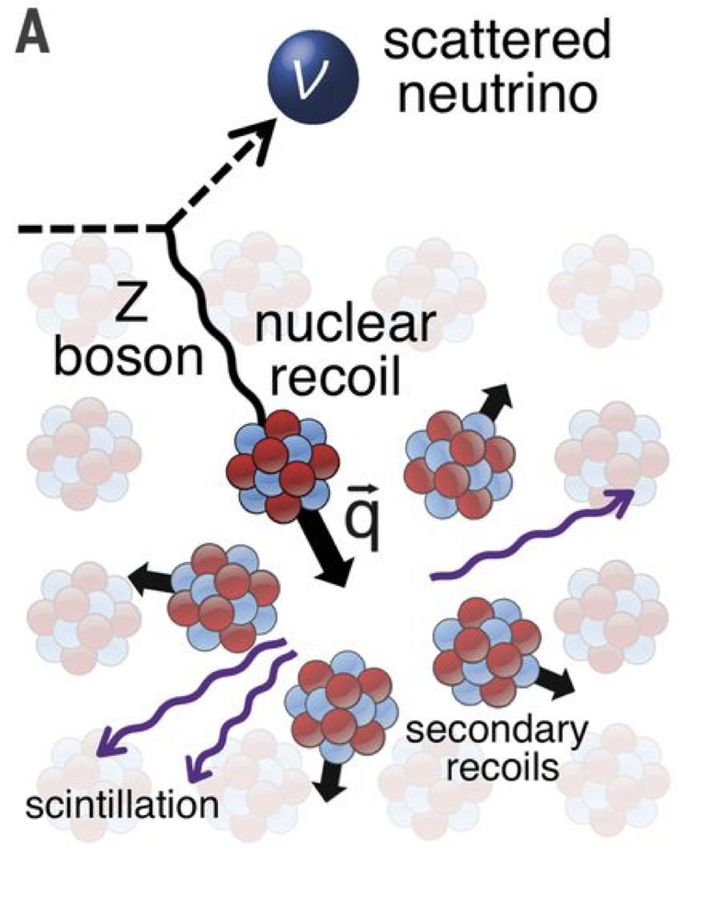
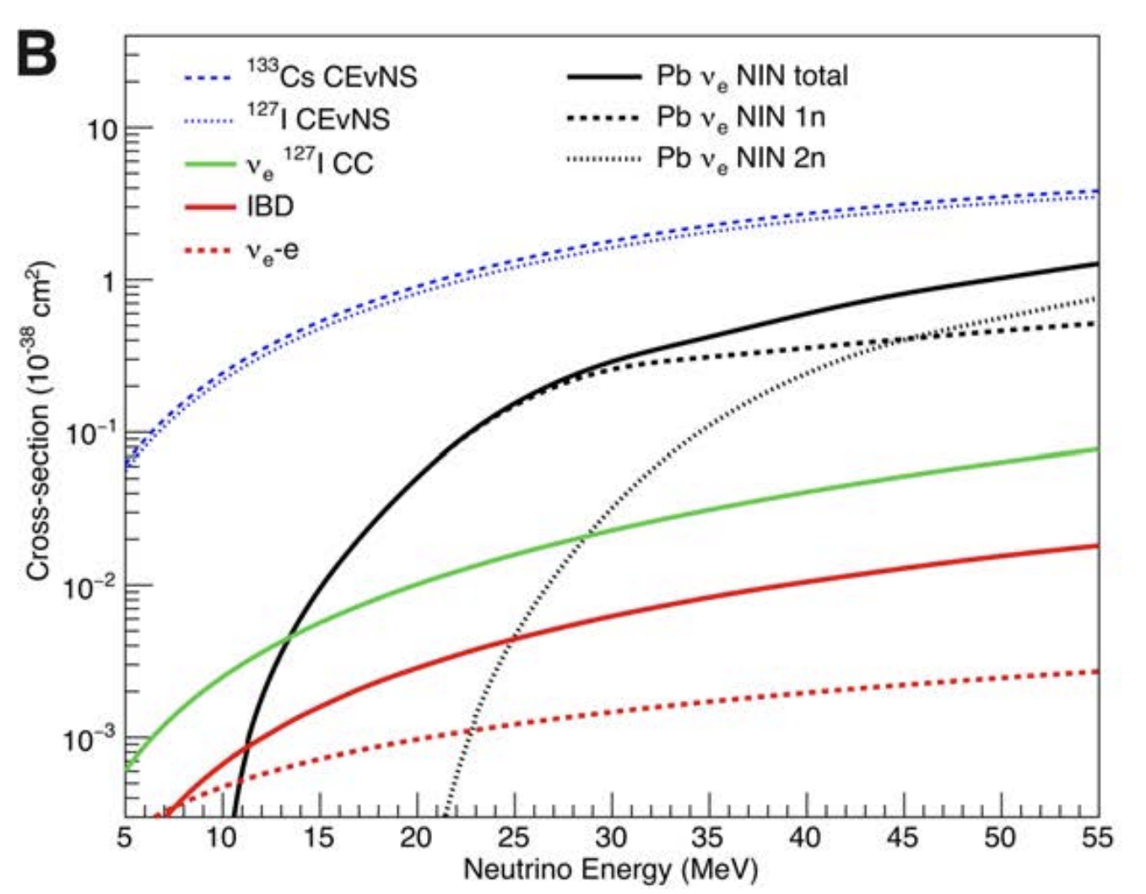
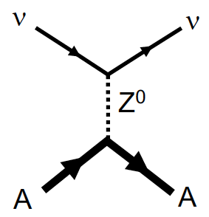
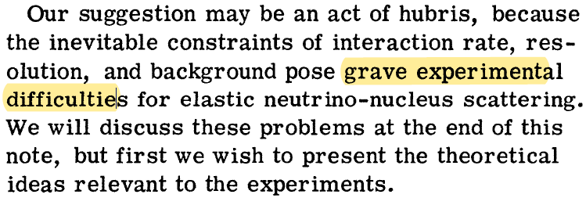




Coherent Elastic Neutrino-Nucleus Scattering (CEvNS)
～100x
Scientific goals of detection:
New channel for cosmic neutrino detection；
Weak mixing angle under low momentum transfer；
Non-standard neutrino interaction；
Technique for remove nuclear safeguard;
3

Slide 18





Neutrino sources
Spallation neutron source
Nuclear reactor
Solar
e&𝛍 flavors;
1e6/s/cm2 @ 20m;
E<50MeV;
Observed in 2017;
～5e6/s/cm2 for B8 𝛎;
Mostly E<0.4MeV;
Not observed yet.
1e13/s/cm2 @ 25 m with 3GW power;
E<2MeV;
Not observed yet;
18

Slide 19

Validation of bkg model
Use a (loose cut – final cut) sample as control for bkg validation;
Good match between data / control data both in width and S2 spectral shape
20

