Slide 1
CERN branding on the web
Dan Noyes, January 2011
Notes:
Cern.ch : many challenges

Slide 2
cern.ch today
Previous attempts at branding on cern.ch
The way forwards
  A single website for official communications
  Consistent branding on other sites
Notes:
I will talk about….
Not particularly in this order – I will move back and forth between these topics.
A single managed site for official communications
Clear positioning of all other websites
Engaging wider problems of cern.ch
What I hope you will get out of this is:
- An understanding of DG-CO’s plans for official communication via the web
- An appreciation that the challenges that cern.ch faces run much, much deeper than branding, and that addressing these challenges is going to require considerable effort over a long period of time.

Slide 3
cern.ch today: we have a problem
10 000 + websites
No architecture
Unmanaged
Poor metadata
Unclear ownership / responsibilities
No archival policy
Range of technologies
….
Notes:
10 000 + websites – MOST OF THEM OF A VERY POOR STANDARD. INFORMATION IS DUPLICATED, WRONG, OUT OF DATE…
No architecture
Unmanaged
Poor metadata – AND THEREFORE SEARCH DOESN’T WORK. KNOWING WHO OWNS CONTENT AND WHEN IT WAS LAST UPDATED IS NOT EASY.
Unclear ownership / responsibilities – I’LL TALK ABOUT WHY THIS IS A PROBLEM LATER
No archival policy – WEBSITES NEVER DIE.
Range of technologies – NOT A PROBLEM IN ITSELF NECESSARILY, BUT IMPLEMENTING CHANGES ACROSS CERN.CH NOT POSSIBLE.
….

Slide 4
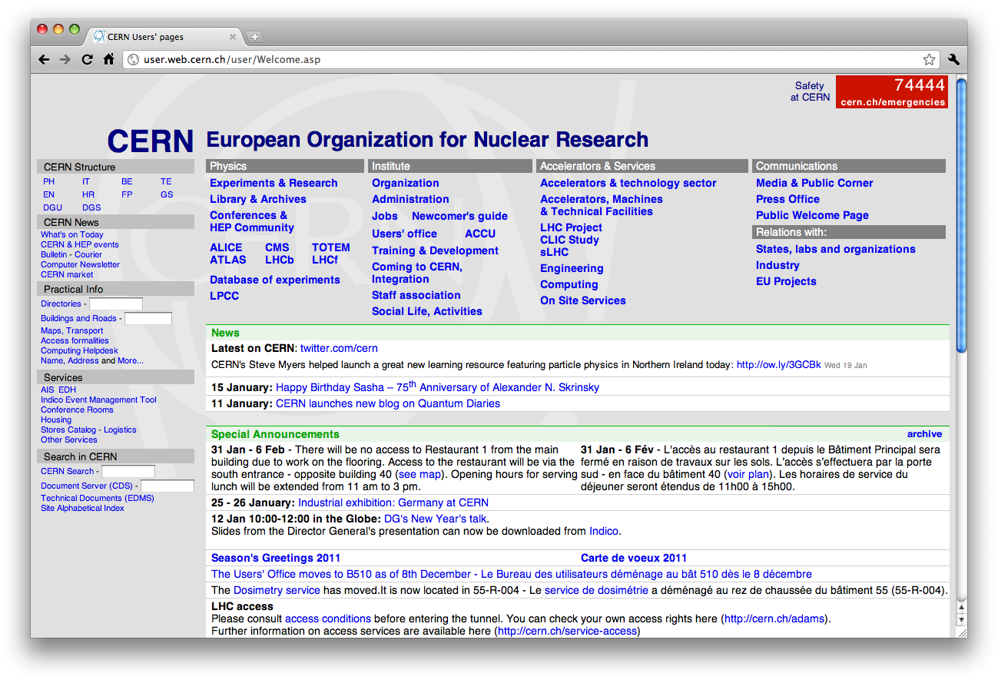
Notes:
There is no ‘CERN website’ – user/ public/ split
The users’ page is a product of its environment. In the context of a massive number of websites with no overall structure, poor metadata and search, we need a page that regroups links to the resources one needs when working at CERN. This is what many websites were like before Google – Alta Vista, Yahoo, Lycos, AOL…

Slide 5
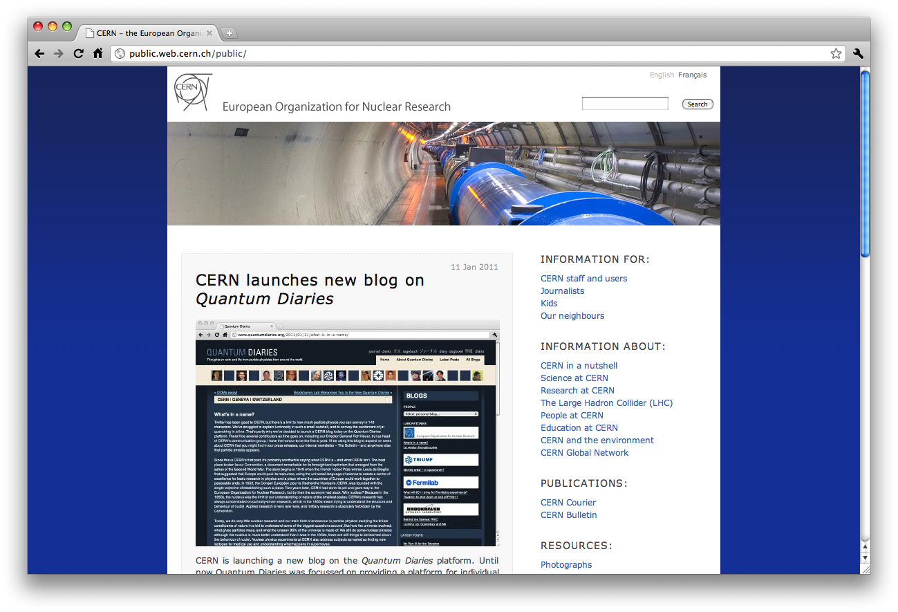
Notes:
There is no ‘CERN website’ – user/ public/ split

Slide 6
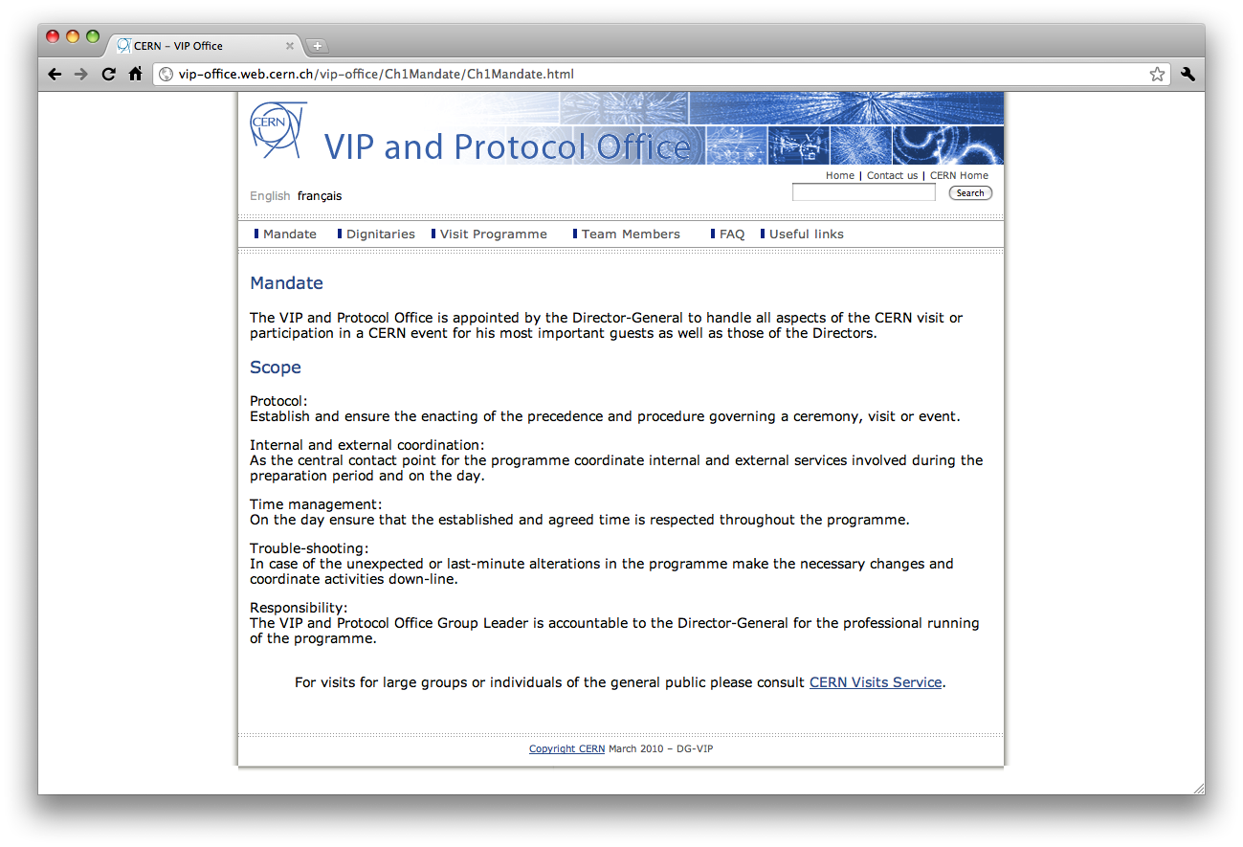
Notes:
In terms of look and feel, there was a big drive two years ago to standardize.
CERN logo top-left
Site name
Logo didn’t link to CERN but to site’s homepage, thus the links above the search box
Blue background showing standard image – bubble chamber images
Section navigation across the top of the page
One of my first tasks when I joined CERN two years ago was to ‘Roll out the template’ -
But this failed…

Slide 7
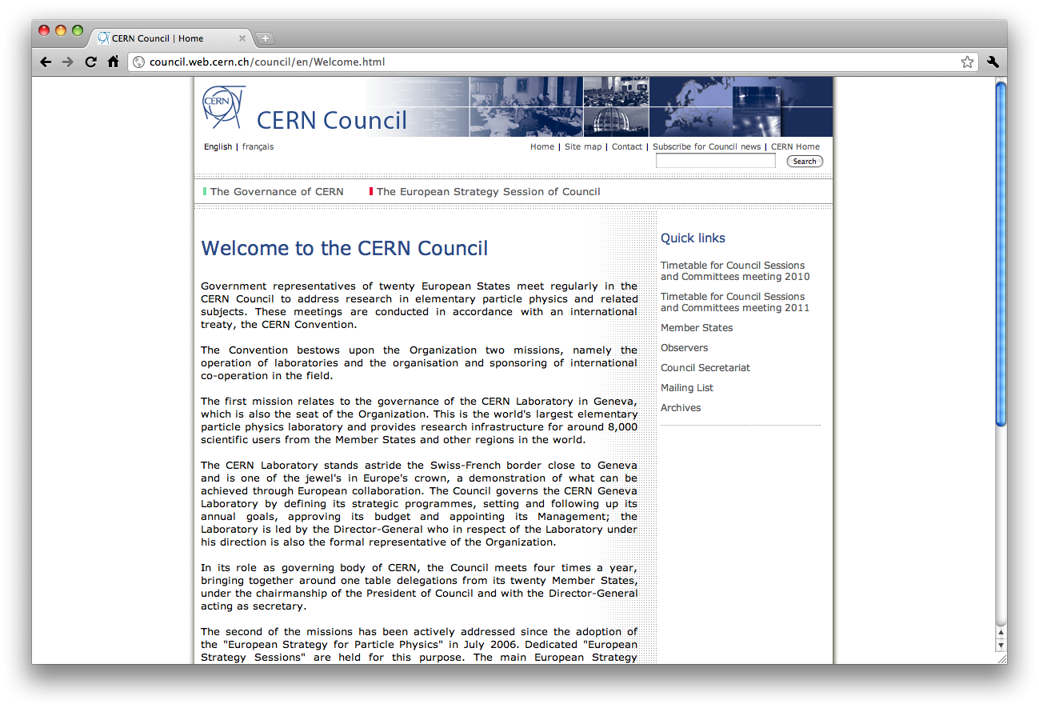
Notes:
Notice the bubble chamber images have gone…

Slide 8
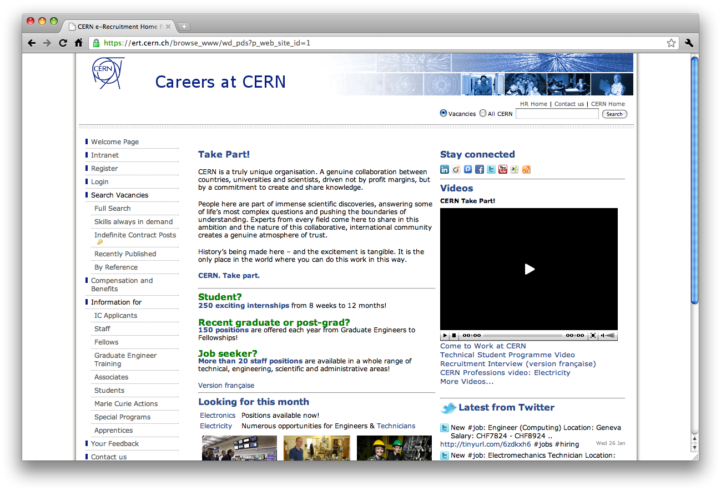
Notes:
Page width has changed – oh and look: people!

Slide 9
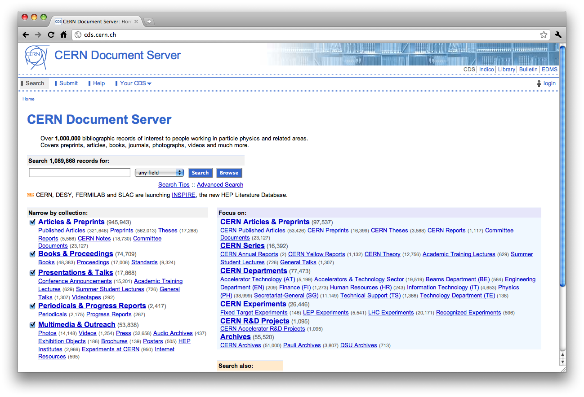
Notes:
Full width now!
Books!
Different blue!
Two titles!

Slide 10
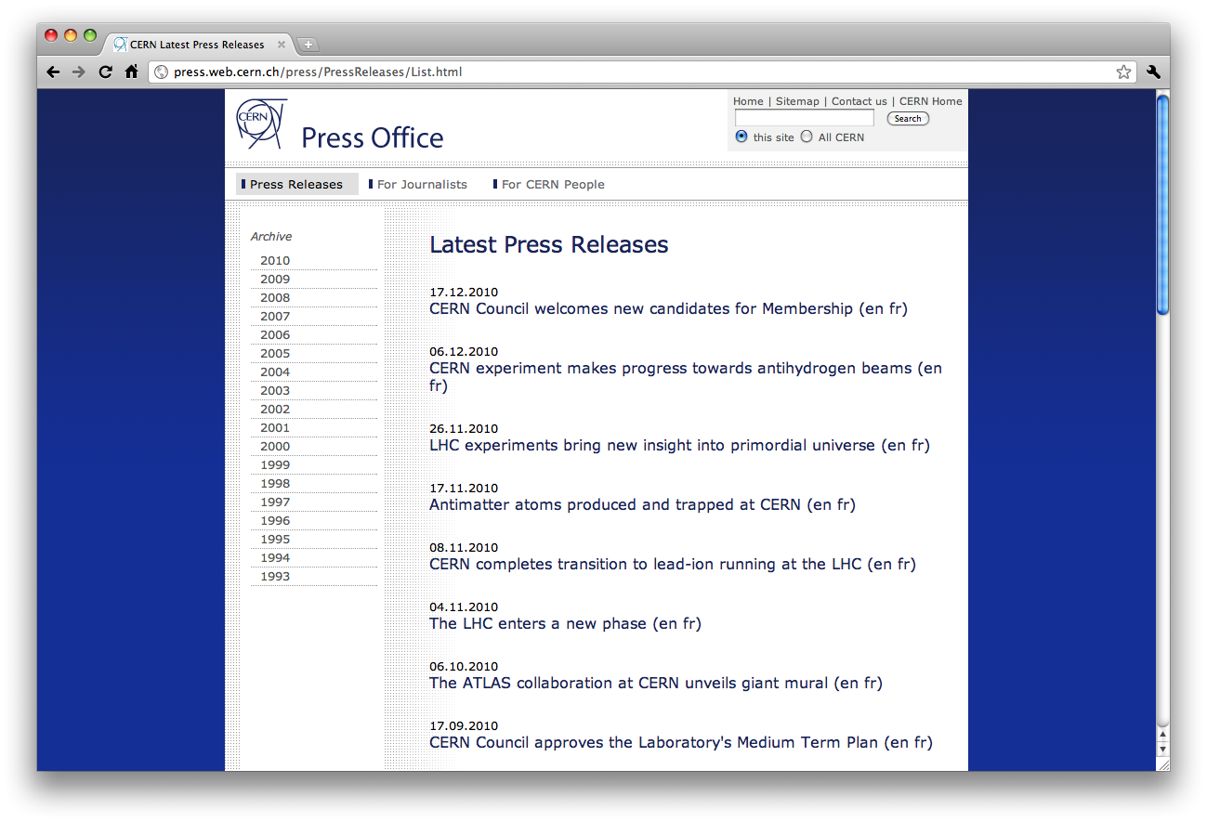
Notes:
There were in fact 2 ‘templates’ – one with coloured backgrounds - like this – intended for pages targeted primarily at external audiences, and pages with white backgrounds for internal audiences.

Slide 11
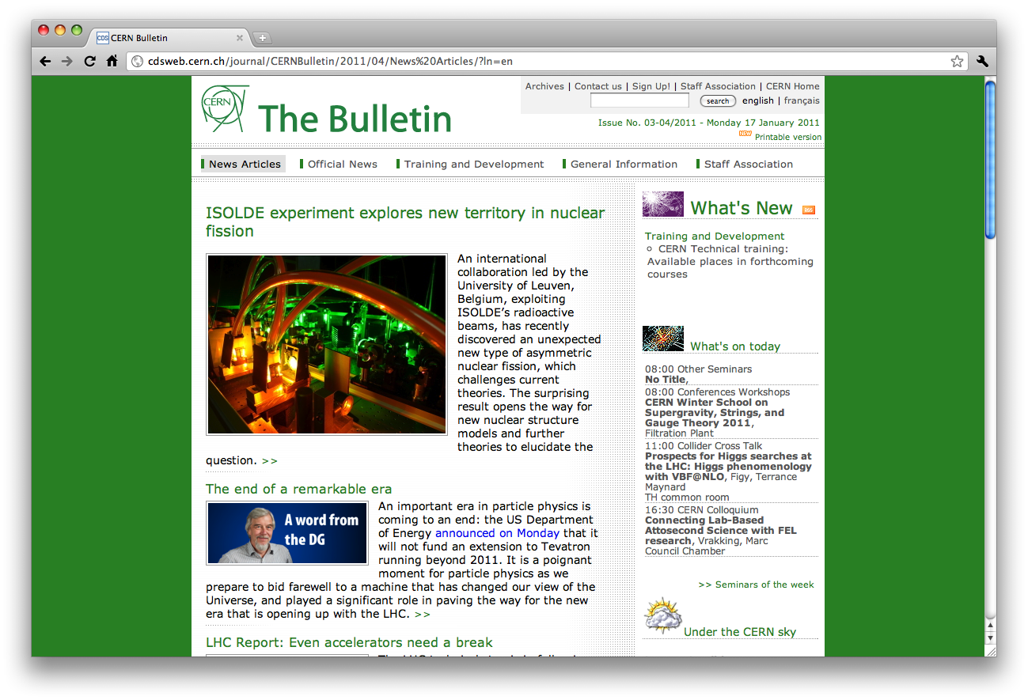
Notes:
…but this logic was clearly not respected. Even by ourselves.
(Here green was used to denote English content; blue, French)
In this example there are also more subtle differences – search box for example searches CDS!

Slide 12
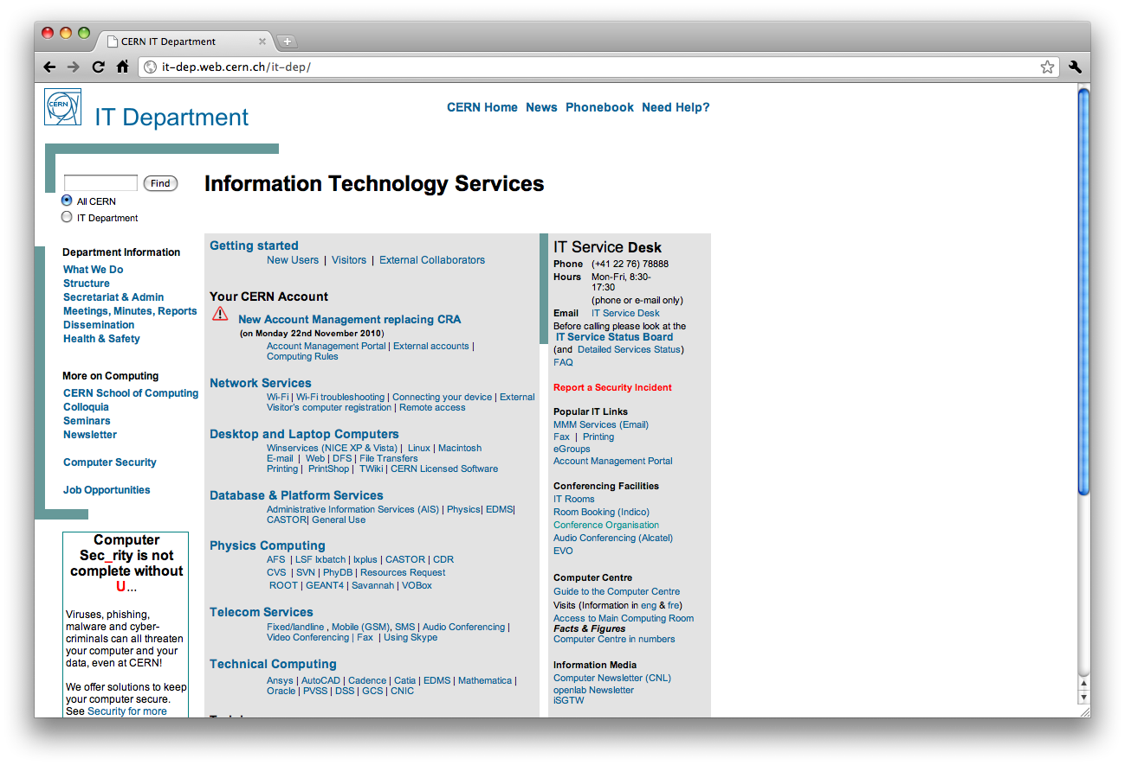
Notes:
And then there was the lack of adoption…

Slide 13
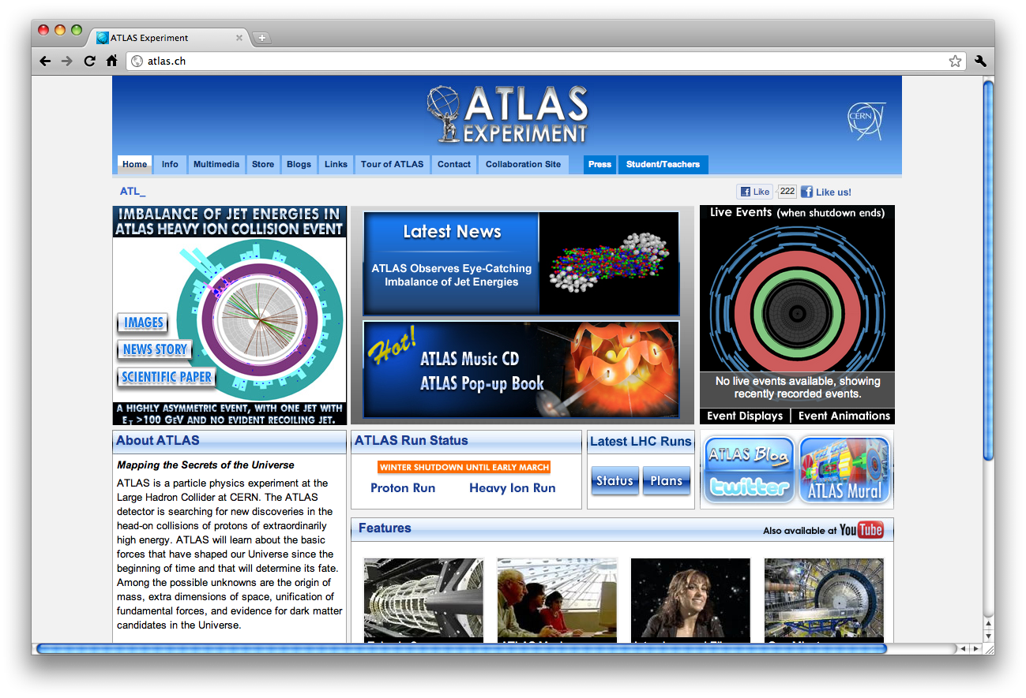
Notes:
…including the ATLAS experiment’s website – not hosted on cern.ch

Slide 14
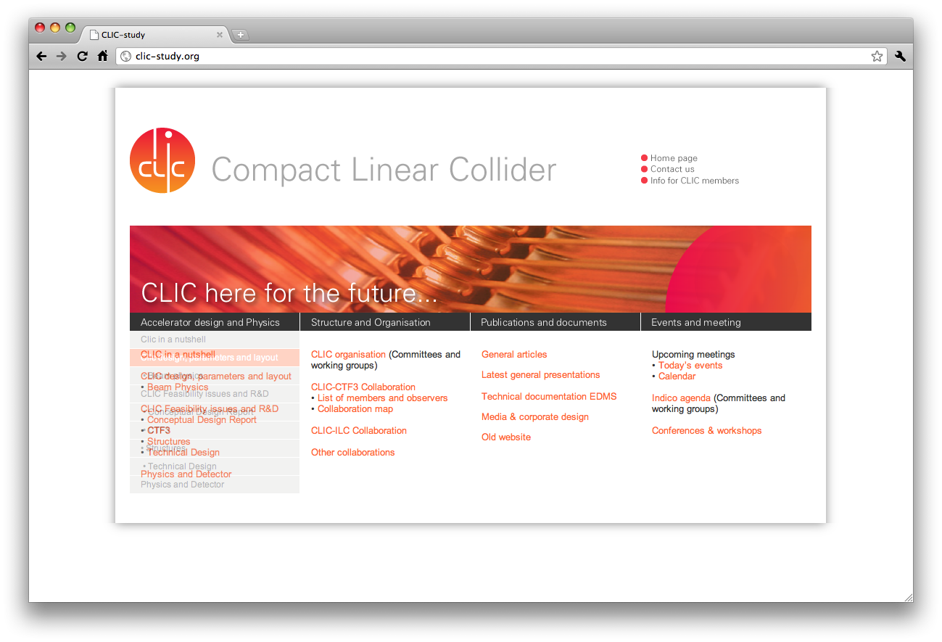
Notes:
… and we see this trend continue.
There is clearly a demand for diversity of design and positioning.

Slide 15
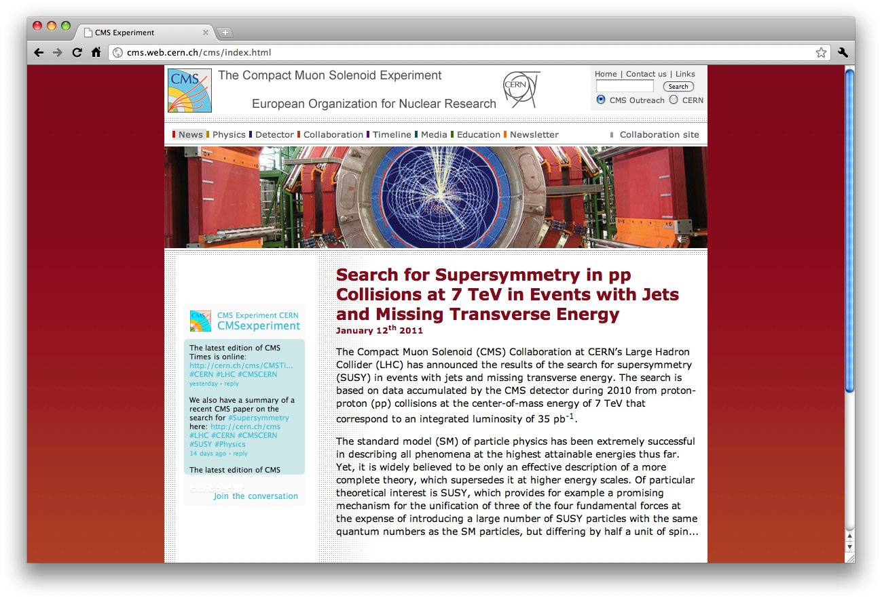
Notes:
Co-branding for CERN and some CERN constituents is clearly problematic; especially so in the context of the template that we were trying to roll out.

Slide 16
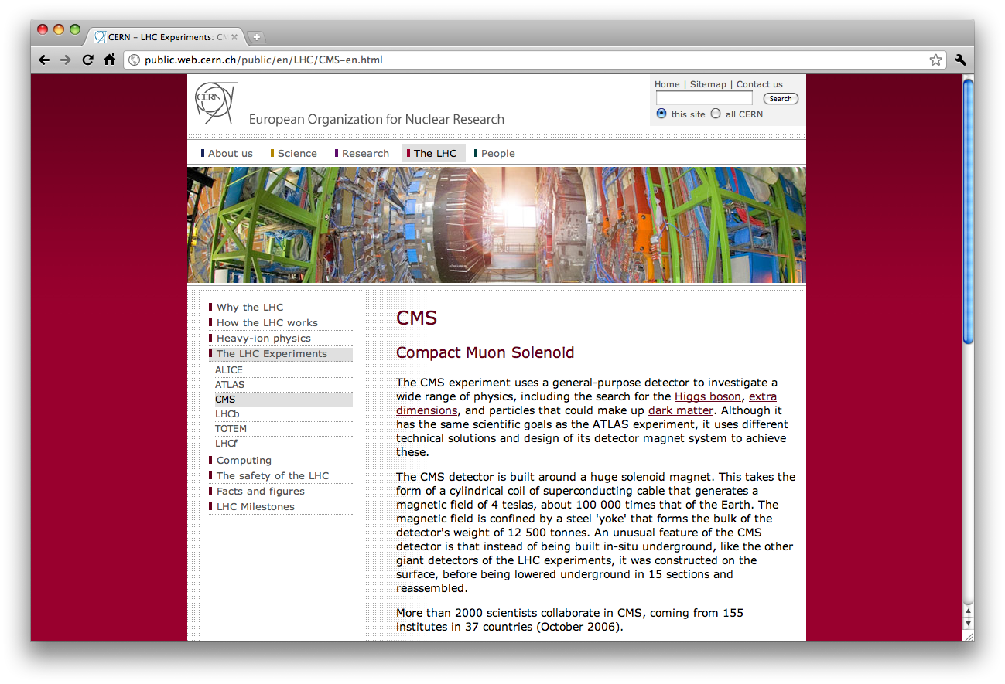
Notes:
To the end user, this became baffling. Here, for example, is the CERN page about the CMS experiment. One would have to be particularly observant to discern the difference.
It is my opinion that branding in the form of a strict layout and strong design would be simply unworkable at CERN, as I hope these examples have shown.

Slide 17
Strict templates have not worked at CERN
  Collegiate culture
  Range of technologies
  Lack of design and front-end developer skills
  Demand for divergent designs

Slide 18
Pragmatic branding
Allow design flexibility
Easy to implement
Consistent
Can be applied retrospectively
Notes:
In order to address this need for flexibility of design, the need to work with strong co-branding, and provide a baseline standard for cern.ch websites, DG-CO suggested a new graphic charter for the web.
This has not yet been officially launched – we are awaiting final confirmation from the directorate and the legal service on the name to use (“European Organization for Nuclear Research” versus “European Laboratory for Particle Physics” – the latter denoting the facility (the lab), the former the organization (council)). Once approved this branding will become mandatory and will be widely advertised a conformance timeline published.

Slide 19
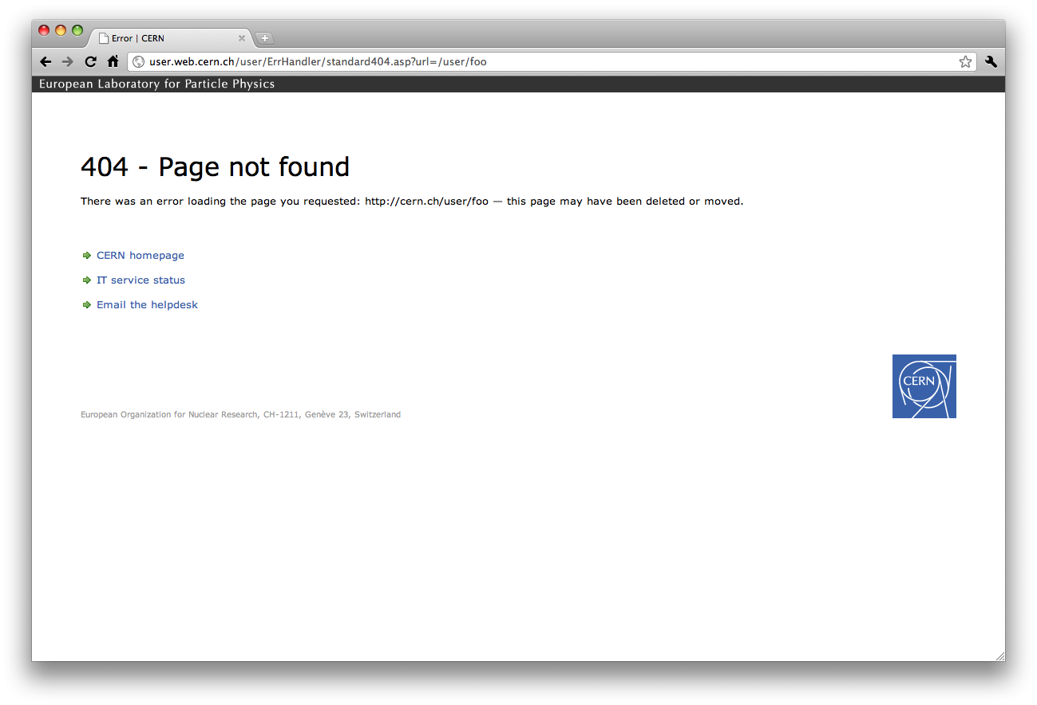
Notes:
The new guidelines require that every page under cern.ch have 2 elements:
A grey strapline with the laboratory’s name at the top of the viewport
The CERN logo (any corner)

Slide 20
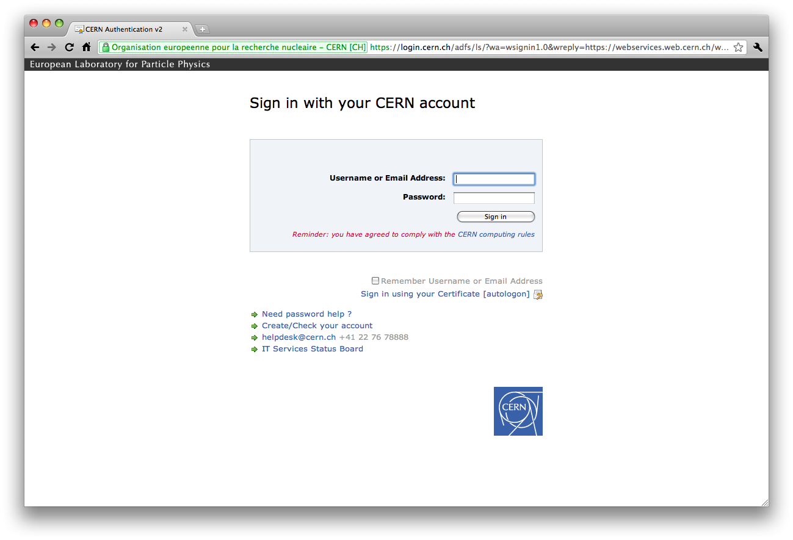
Notes:
You will notice that the logo is NOT placed at the top-left (it may be placed top-right, bottom-right, or bottom-left). This is quite deliberate. It allows for strong co-branding, easier adoption with existing websites, and even automated application (the two elements frame the HTML content in this example).

Slide 21
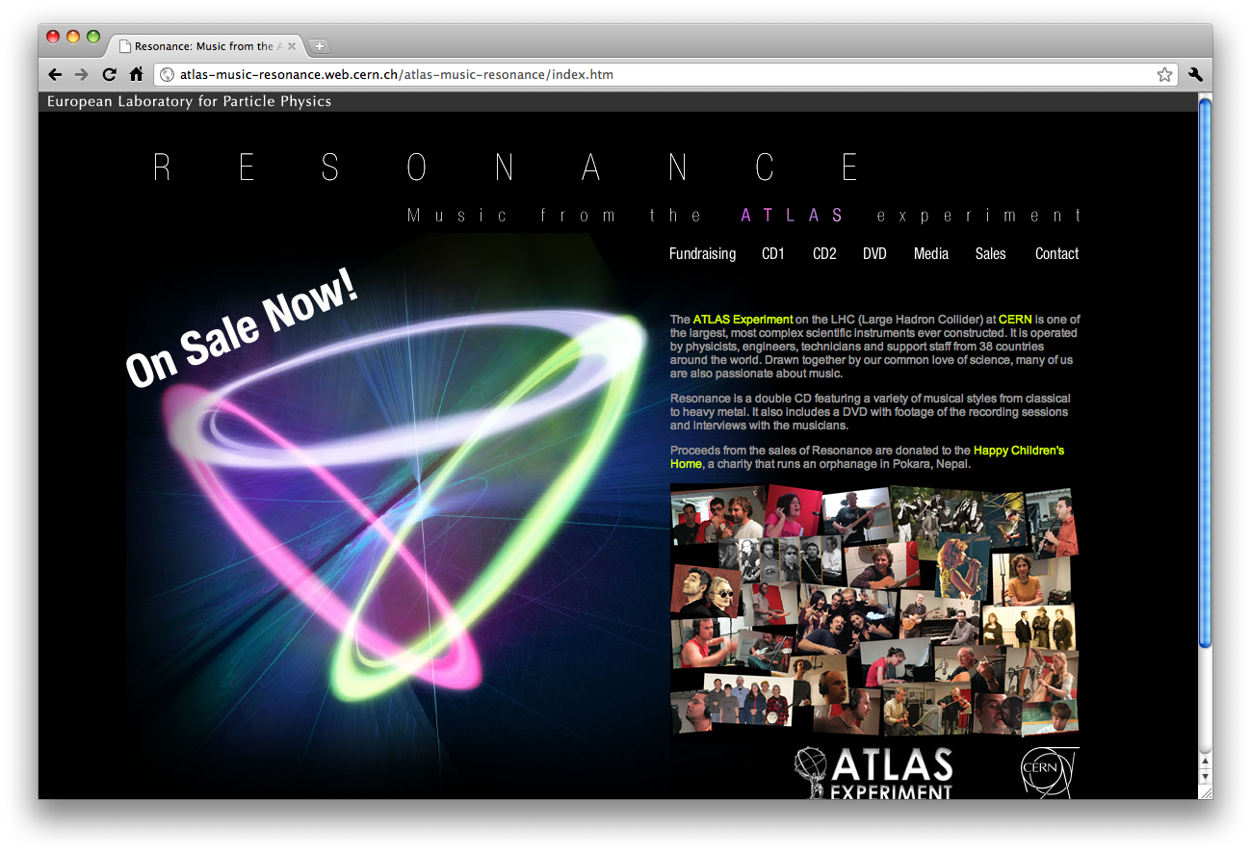

Slide 22
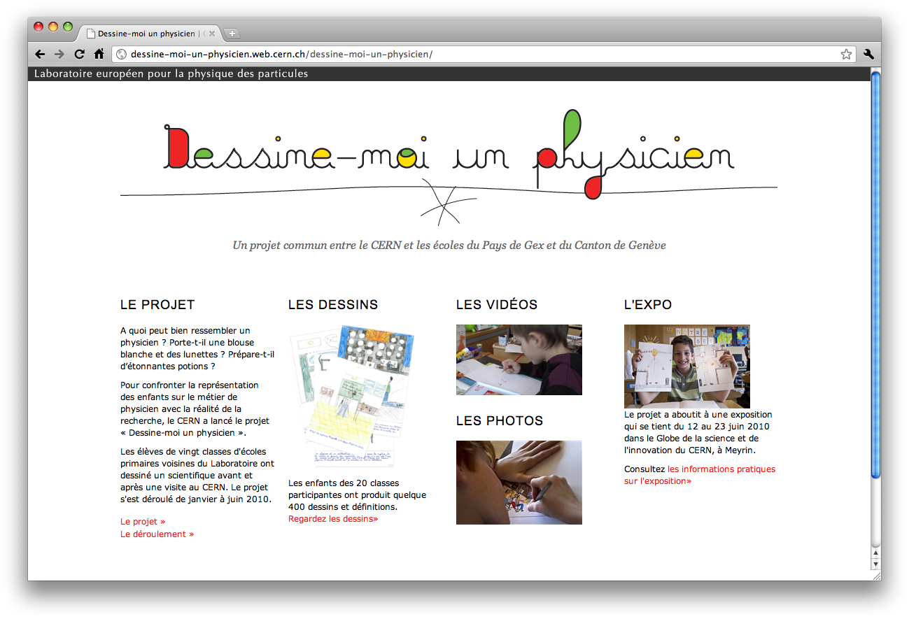

Slide 23
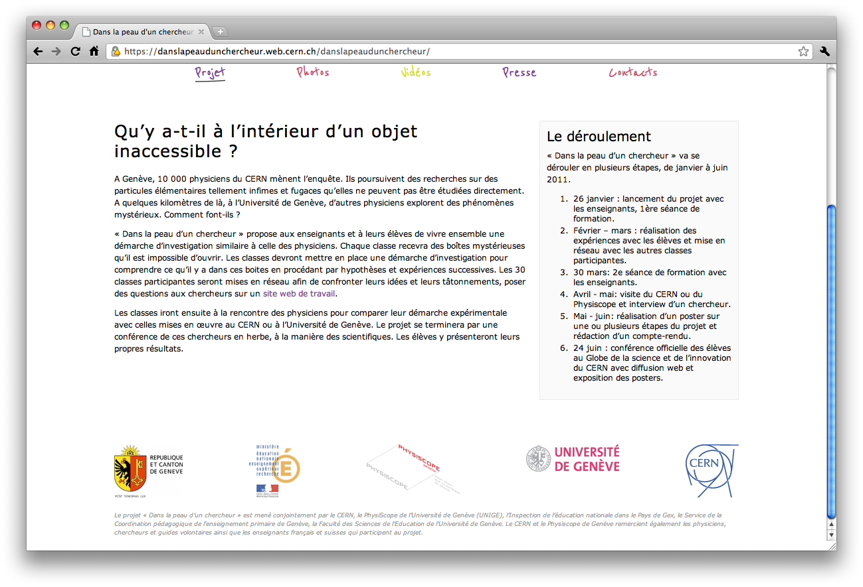
Notes:
….allows us to position CERN as one of several partners in a particular project. (Think back to CLIC).

Slide 24
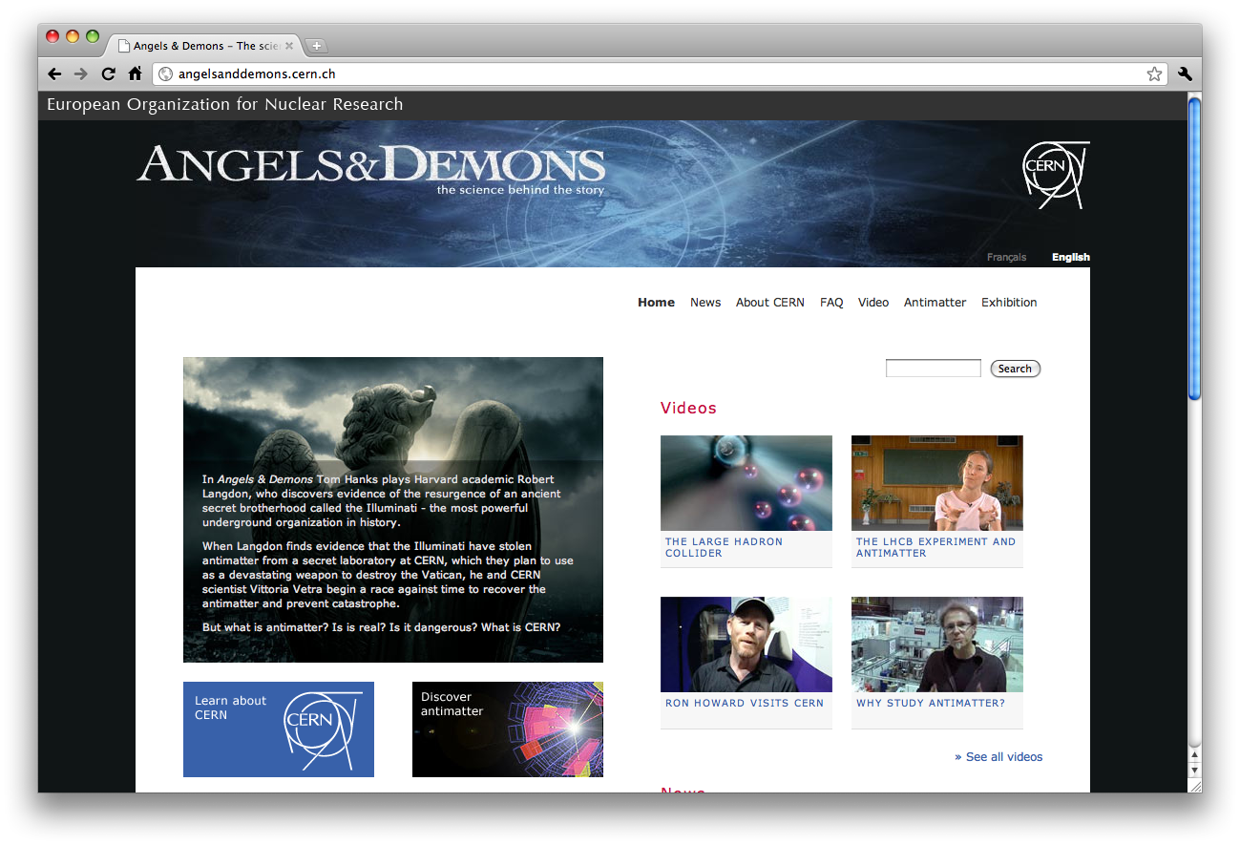

Slide 25
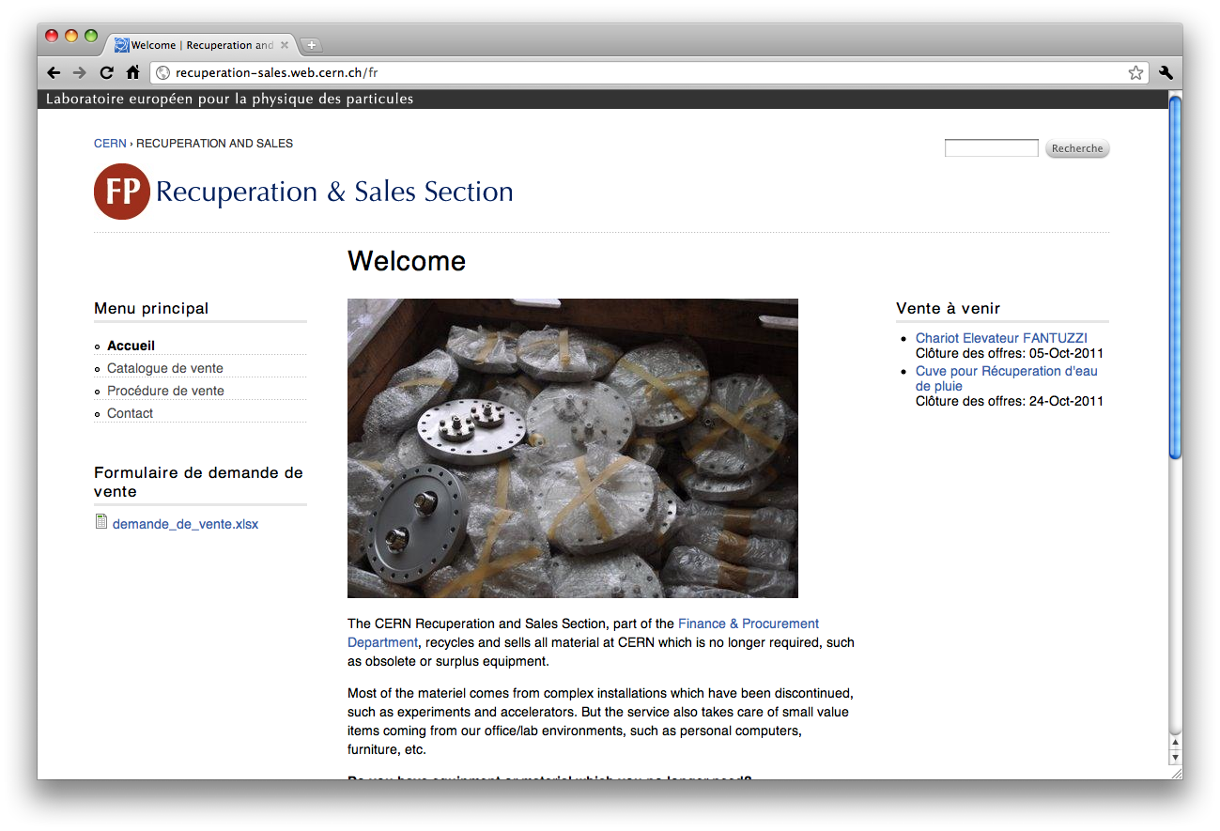

Slide 26
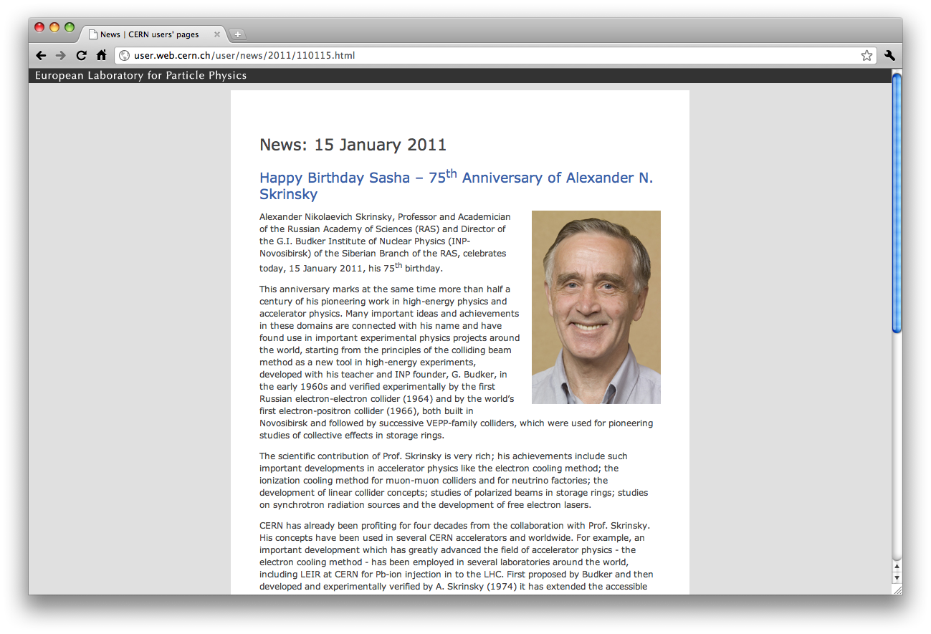
Notes:
Can be applied to old designs.
The CERN logo doesn’t always have to be visible.

Slide 27
A website for CERN

Slide 28
Communications ‘spray’
Press releases
Users’ page announcements
Twitter
YouTube
Bulletin
Custom websites
Email
…

Slide 29
CERN needs a website
News
Announcements
Key events
Information for the public
Official blogs
…

Slide 30
CERN’s website needs to be…
Trusted
Managed
Structured
Identifiable
Prioritized in search
  Our current environment has none of these things

Slide 31
Brand
Time
Message
Consistency
Honesty
Management and stewardship

Slide 32
cern.org

Slide 35
URLs are important
http://user.web.cern.ch/user/Institute/Integration/GetToCERN/GetToCERN.html
http://cern.ch/directions-to-cern/

Slide 36
URIs are for humans
/news
fr/news
/news/users
/news/2010/december/
/news/2010/december/council-welcomes-candidates

Slide 37
URI structure of cern.org
cern.org/news
cern.org/fr
cern.org/news/all/2010/01/LHC-schedule-announced
cern.org/news/users
cern.org/discover
cern.org/discover/physics/standard-model

