Slide 1
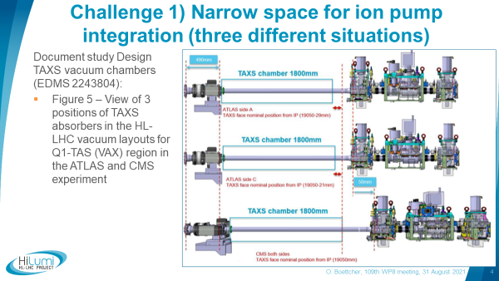
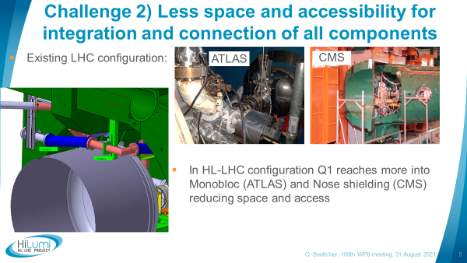
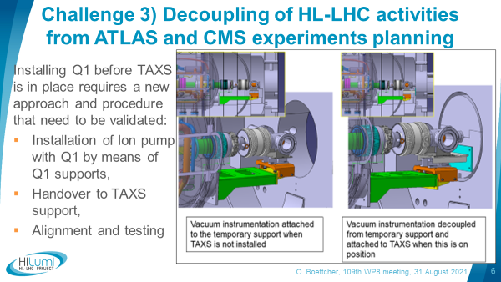
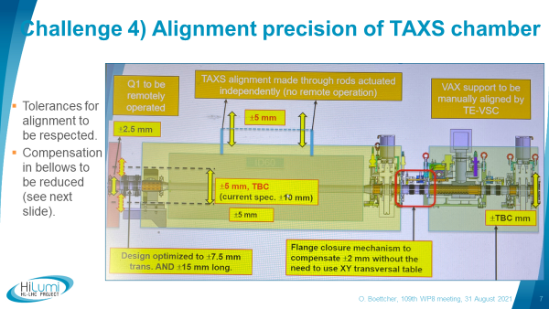
Why a Q1-TAXS region mock-up ?
Main challenges for LS3 !
1) Narrow space for ion pump integration (three different tunnel situations)
2) Less space and accessibility for integration and connection of all components related to LHC
3) Decoupling of HL-LHC activities from ATLAS and CMS experiments planning
4) Alignment precision of TAXS chamber
(clipped slides taken from WP8 meeting – 31 August 2021)

Slide 2
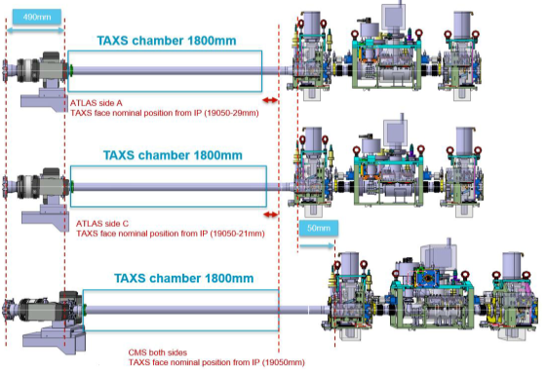
Challenge 1) Narrow space for ion pump integration (three different situations)
Only 490 mm on ATLAS A side between Q1 chamber and TAXS chamber flanges (before 1.3m in LHC)
For ATLAS and CMS in total 3 different TAXS chamber flange positions to be studied (see EDMS 2243804 - Design TAXS vacuum chambers study)

Slide 3
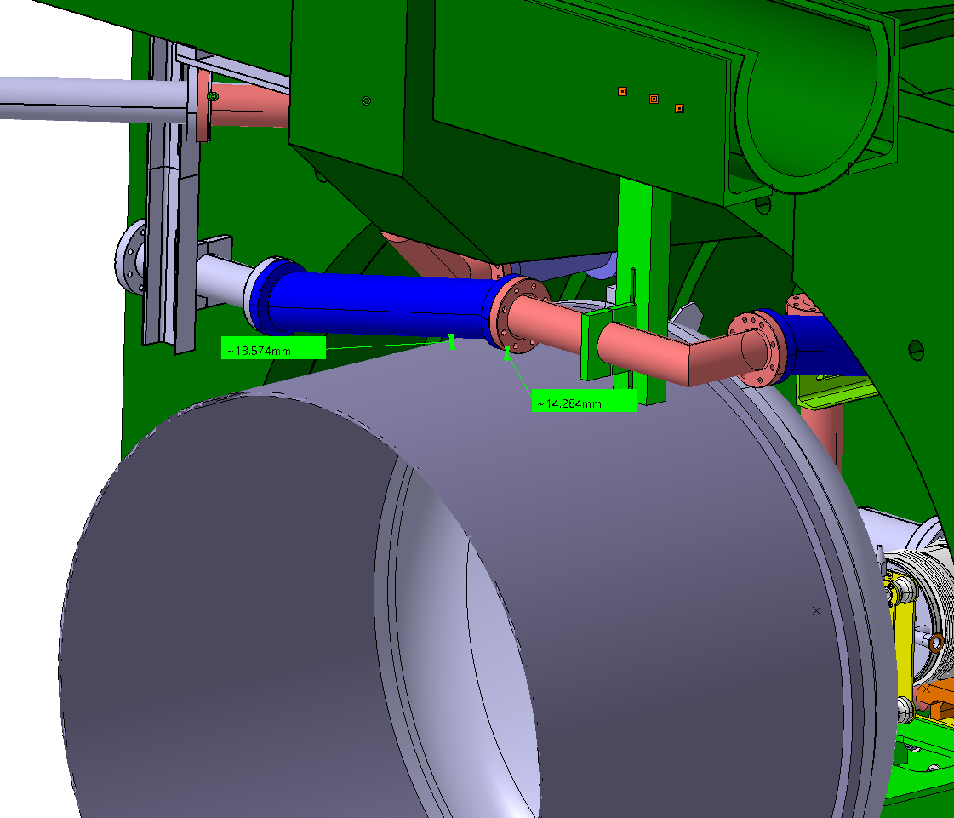
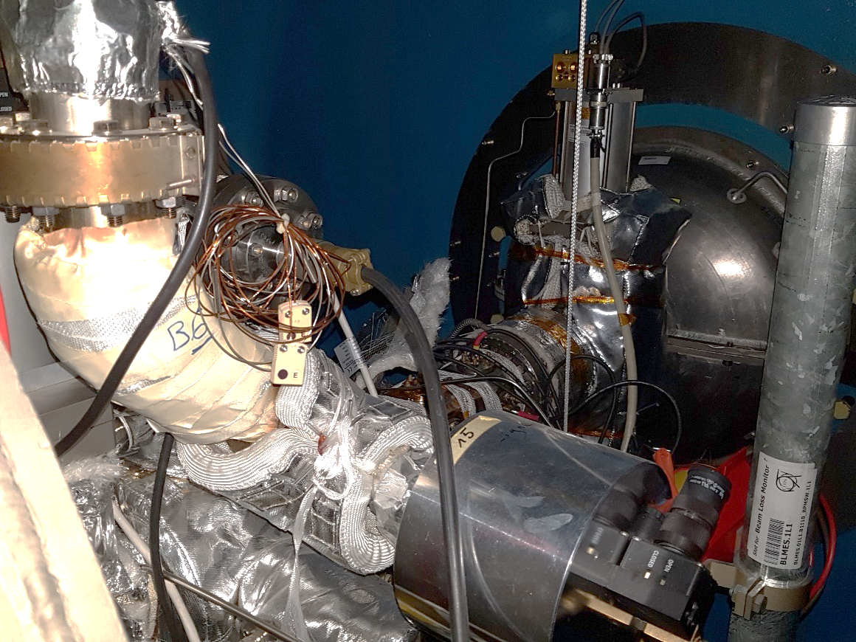
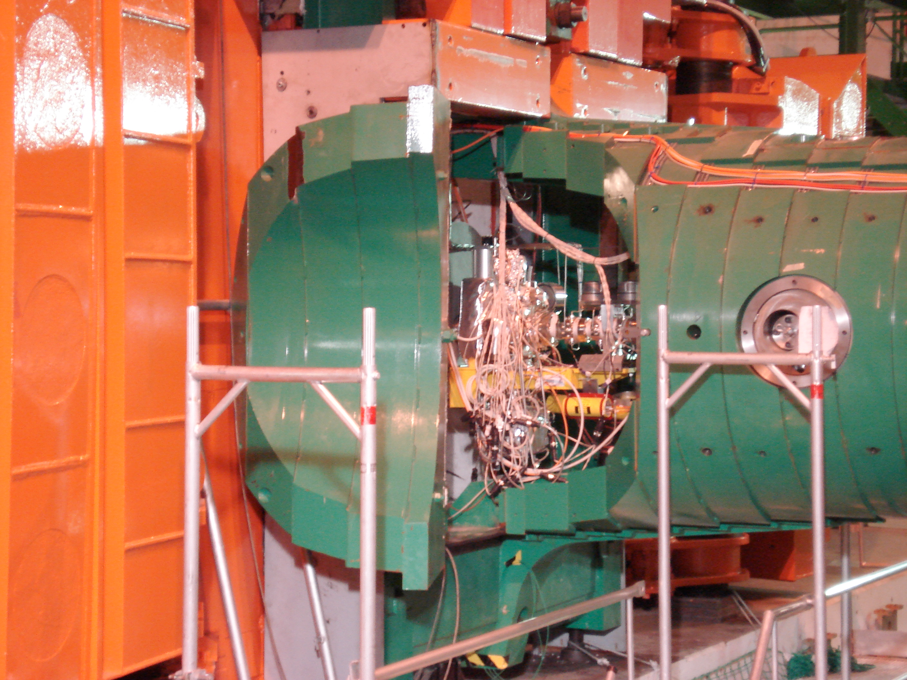
Challenge 2) Less space and accessibility for integration and connection of all components
HL-LHC configuration
Existing LHC configuration
ATLAS
CMS
In HL-LHC configuration Q1 reaches more into Monobloc (ATLAS) and Nose shielding (CMS).
After Q1 insertion CMS Q1-TAXS region only accessible via Lateral Doors in open position.

Slide 4
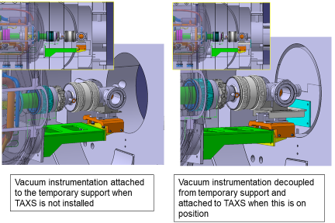
Challenge 3) Decoupling of HL-LHC activities from ATLAS and CMS experiments planning
Installing Q1 before TAXS is in place requires a new approach and procedure that need to be validated:
Installation of Ion pump with Q1 by means of Q1 supports,
Handover to TAXS support,
Alignment and testing

Slide 5
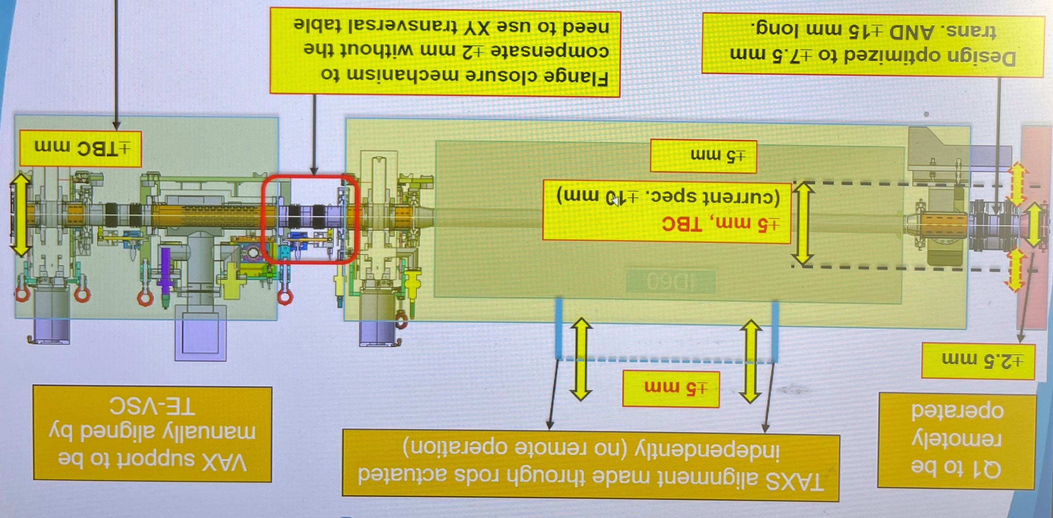
Challenge 4) Alignment precision of TAXS chamber
Tolerances for alignment to be respected.
Compensation in bellows to be reduced (see next slide).

Slide 6
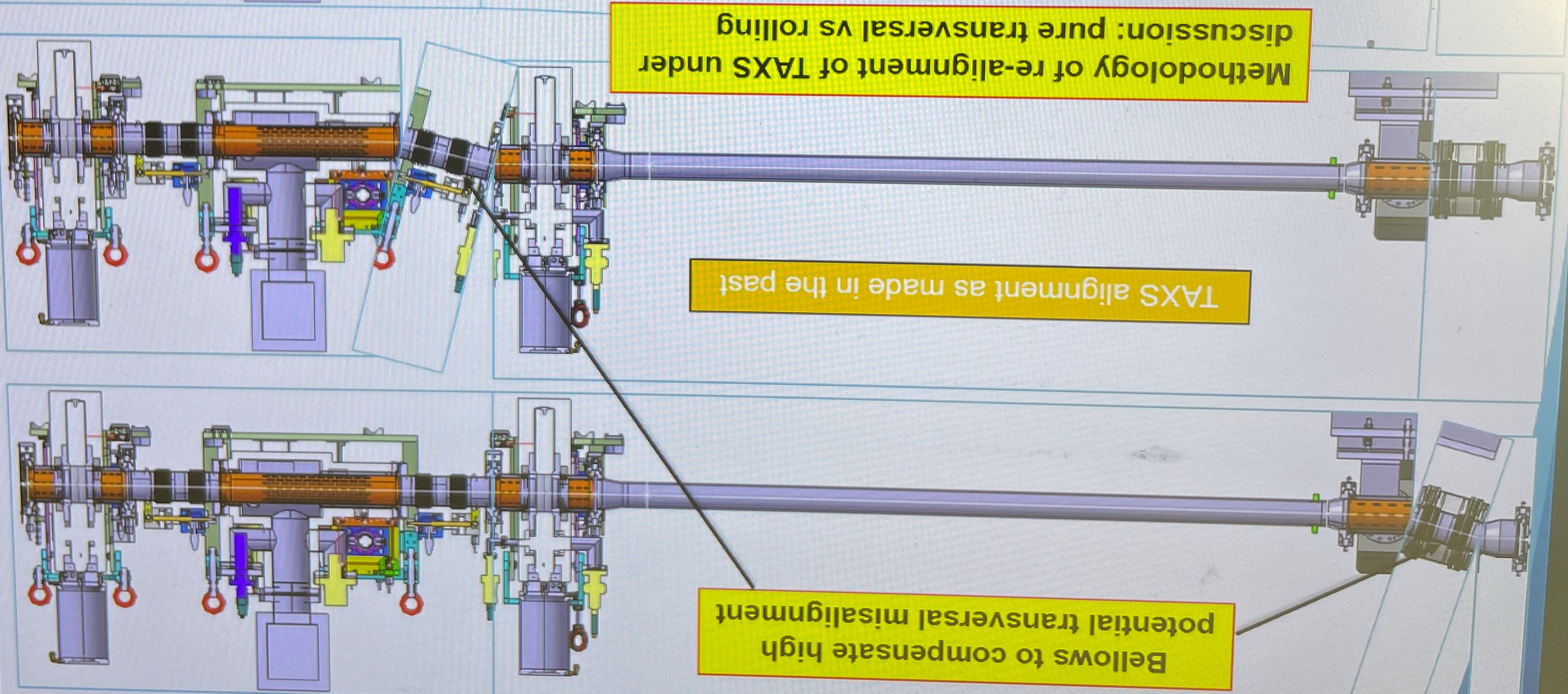
Challenge 4) Alignment precision of TAXS chamber (continued)
“Rolling” approach in discussion!
Compensation in bellows could be reduced by rolling approach (TAXS chamber inclined → ½ compensation in both bellows)

