Slide 1
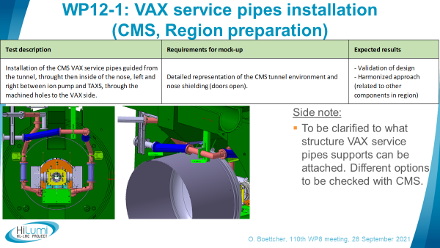
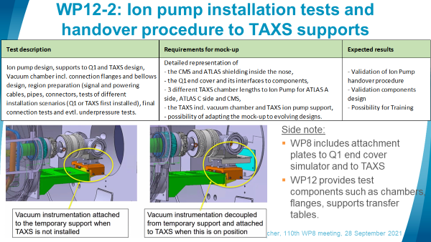
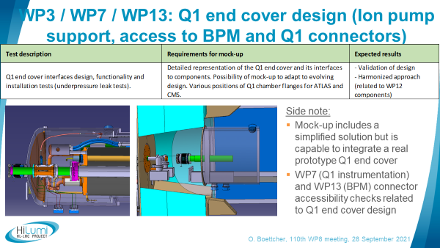
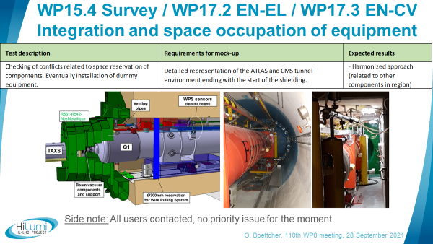
Overview Q1-TAXS mock-up user tests
Resume WP8 meeting – 31 August 2021
UserCat. | User-Case | User test title | Regions | LS3 related | Test description
 | WP8-1 | VAX service pipe passages drilling in CMS nose (d=140mm, l=250mm) | CMS only | Region preparation | Simulation of the machining process, realization of approx. 15mm drilling in narrow envirionment (CMS shielding doors open).
 | WP8-2 | Development and installation of TAXS Z-stopper | ATLAS + CMS | TAXS installed | TAXS z-stopper design, functionality and installation tests (incl. mechanical stress tests). Additional z-stopper between Cradle and Monobloc for ATLAS.
Main Users | WP8-3 | HiLumi Helium barrier - for CMS: TAXS-shielding - for ATLAS: TAXS-Cradle-Shielding | ATLAS + CMS | TAXS installed | Helium barrier design, functionality and installation tests (He leak simulation)
 | WP12-1 | VAX service pipes installation in CMS tunnel through nose shielding | CMS only | Region preparation | Installation of the CMS VAX service pipes guided from the tunnel, throught then inside of the nose, left and right between ion pump and TAXS, through the machined holes to the VAX side.
 | WP12-2 | Ion pump design and installation tests incl. Q1 supports, handover to TAXS supports. (3 different TAXS chamber lengths to Ion Pump for ATLAS A side, ATLAS C side and CMS ) | ATLAS + CMS | Region preparation TAXS preparation Q1 preparation Q1+TAXS installed Q1+TAXS connected | Ion pump design, supports to Q1 and TAXS design, Vacuum chamber incl. connection flanges and bellows design, region preparation (signal and powering cables, pipes, connectors, tests of different installation scenarios (Q1 or TAXS first installed), final connection tests and evtl. underpressure tests.
 | WP3-1 | Q1 end cover design + Ion pump support plate | ATLAS + CMS | Q1 preparaton Q1 installed | Q1 end cover interfaces design, functionality and installation tests (underpressure leak tests).
Secondary Users | WP13-1 | Access and functional test of Q1 BPM cryostat flange connections | CMS only | Region preparation Q1 preparaton Q1 installed | Verification of accessibility of the Q1 BPM cryostat feedthrough flanges for connection and disconnect of long coaxial cables linking the BPM with the electronics in a technical gallery.
 | WP7-1 | Access and functional test of to Q1 instrumentation connectors | CMS only | Region preparation Q1 preparaton Q1 installed | Verification of accessibility of the Q1 instrumentation flanges for connection and disconnect of cables linking the in the Q1 with the electronics in a technical gallery.
 | WP15.4-1 | Integration and space occupation of the survey alignment system. | ATLAS + CMS | all phases: from region preparation to finalization | Checking of conflicts related to space reservation of compontents. Eventually installation of dummy equipment.
Services-with-Equipm. | WP17.3-1 | Integration and space occupation of cooling + ventillation equipment. | ATLAS + CMS | Region preparation | Checking of conflicts related to space reservation of compontents. Eventually installation of dummy equipment.
 | WP17.2-1 | Integration and space occupation of the electrical power supply and other EN-EL equipment. | ATLAS + CMS | Region preparation | Checking of conflicts related to space reservation of compontents. Eventually installation of dummy equipment.
Services-Integration | WP15-1 | Optimisation of space occupation | ATLAS + CMS | all phases: from region preparation to finalization | Ongoining reporting, dicussions and updates of evolving components and integration designs related to HL-LHC integration environment.
Services-Planning | WP15-1 | Planning optimisation of LS3 activities and installation sequences | ATLAS + CMS | all phases: from region preparation to finalization | Ongoining reporting and documentation of test results related to HL-LHC planning.
Services-Operation | WP15.5-1 | Validation of TAXS and Q1 insertion and adjustment procedure | ATLAS + CMS | TAXS installation Q1 installation | In case of possible conflicts, reporting and demonstration of risks, distances and margins and discussions of measures.

Slide 2
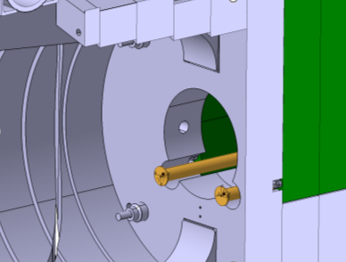
WP8-1: Vax service pipe passages drilling (CMS, Region preparation)
Side note:
Challenge was presented to EN-MME workshop and drillings seems to be feasible for them.
Drilled holes D_{max} ~150 mm and through 235mm shielding

Slide 3
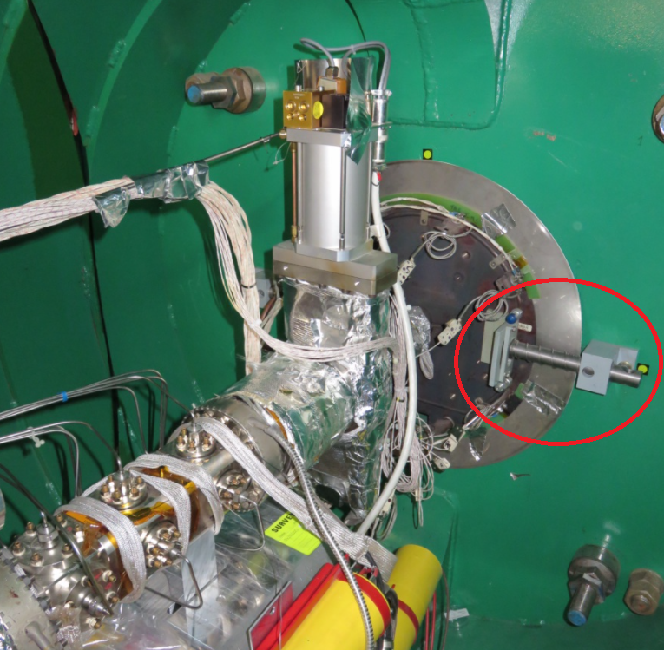
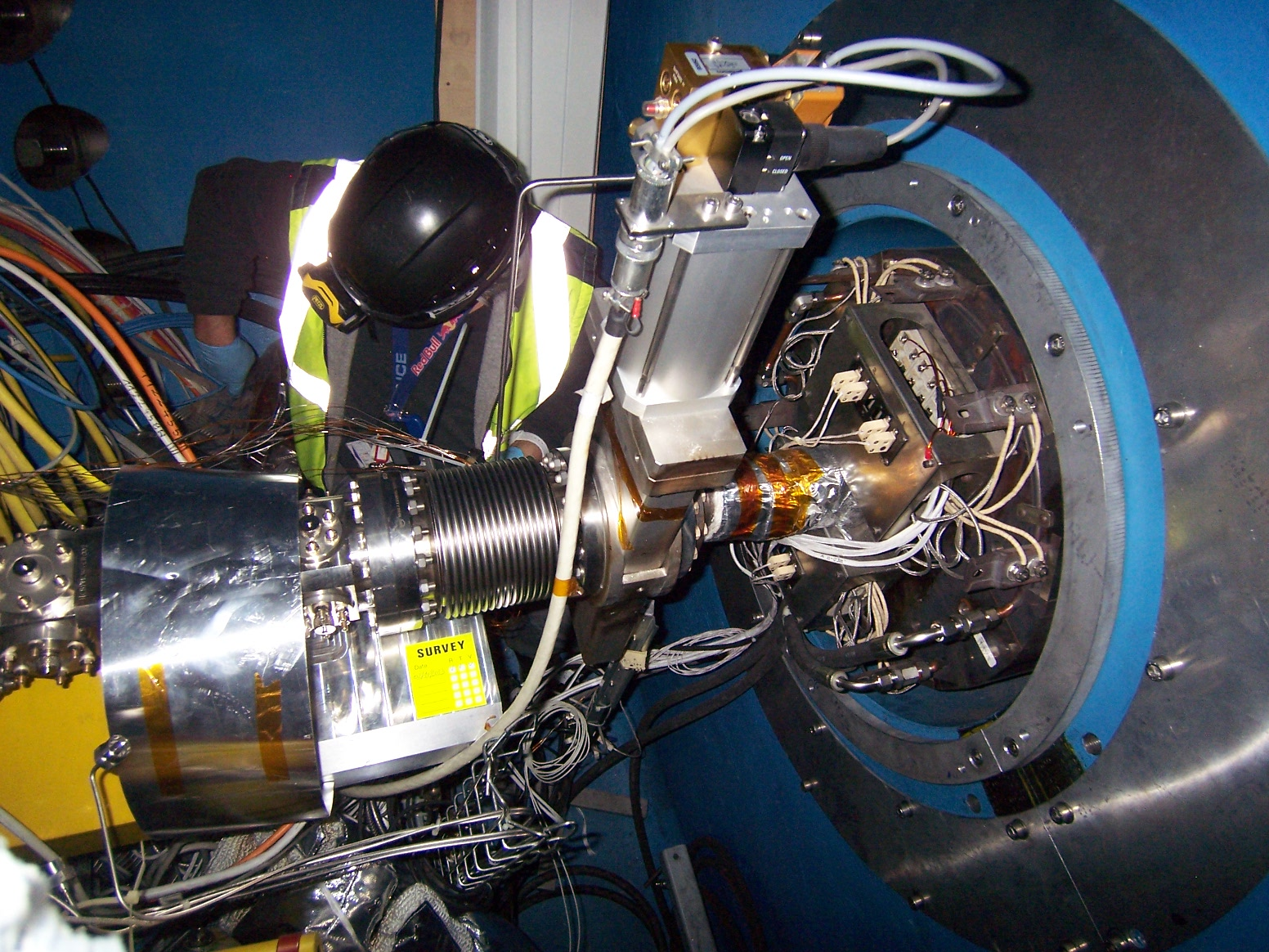
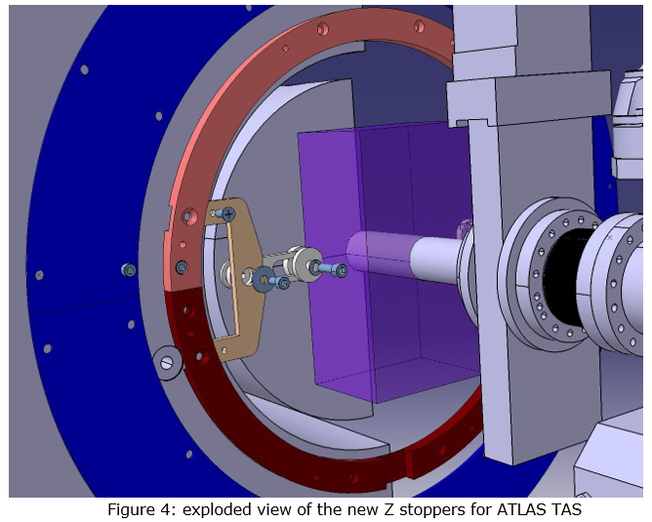
WP8-2: Development and installation of TAXS Z-stopper (ATLAS + CMS, TAXS installed)
Additional information helpful: How actually z-stopper is realized for ATLAS TAS? (EDMS 1386628 design is not implemented in CMS)

Slide 4
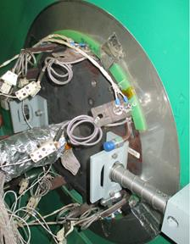
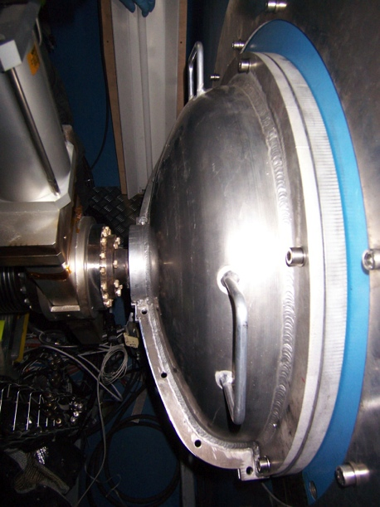
WP8-3: Helium barrier TAXS-shielding (CMS), TAXS-cradle and Cradle-shielding (ATLAS)
Side note:
For CMS add. 2x ~150 mm drilled holes (see WP8-1) to be included in He barrier solution.

Slide 5
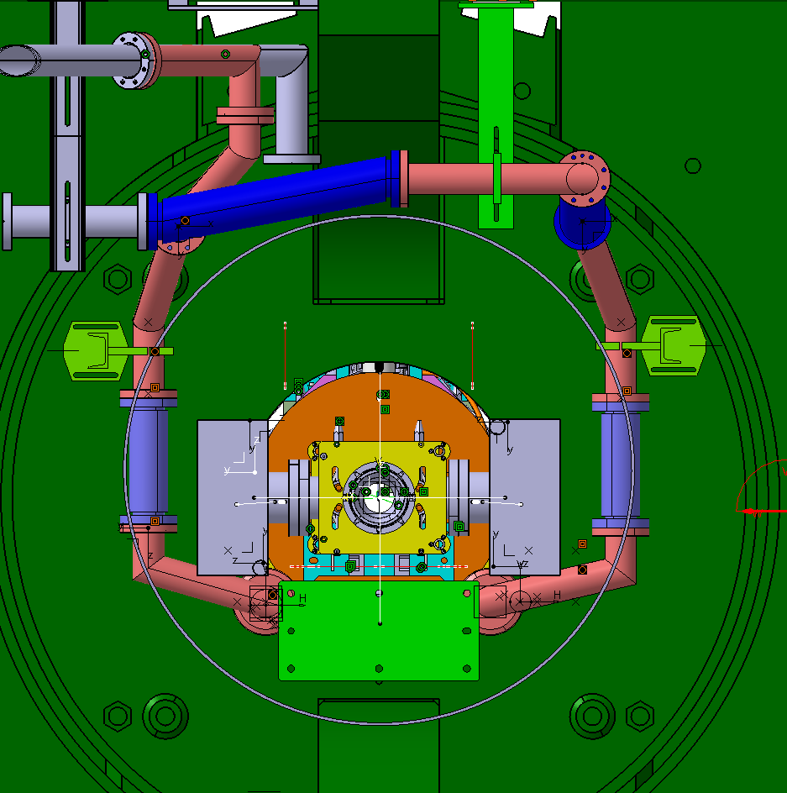
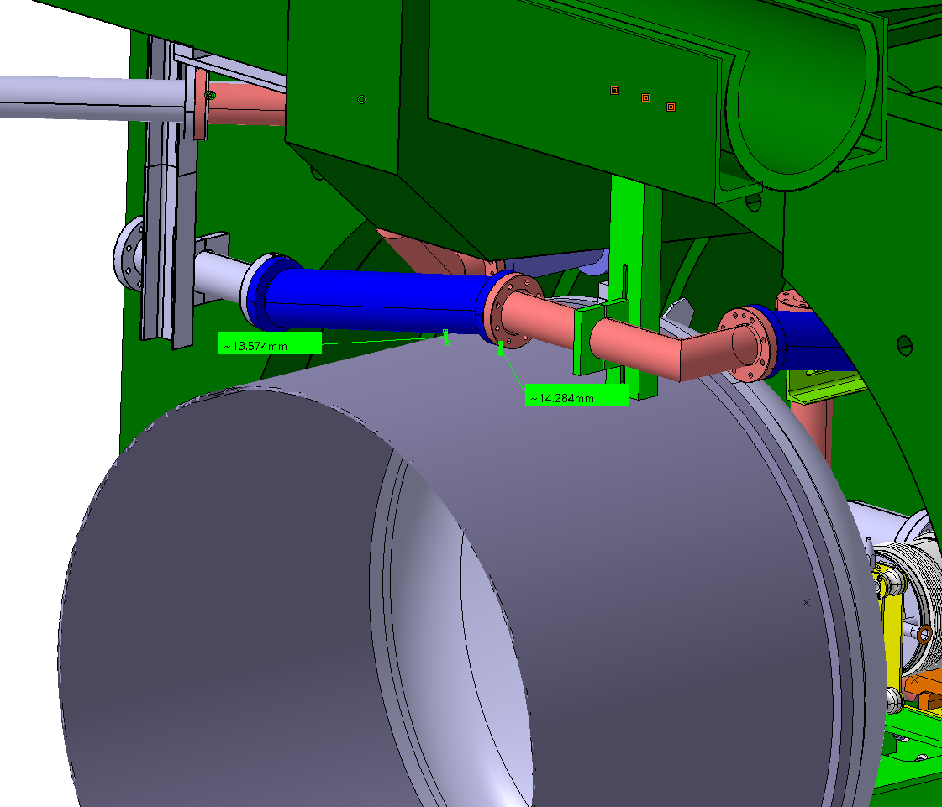
WP12-1: VAX service pipes installation (CMS, Region preparation)
Side note:
To be clarified to what structure VAX service pipes supports can be attached. Different options to be checked with CMS.

Slide 6
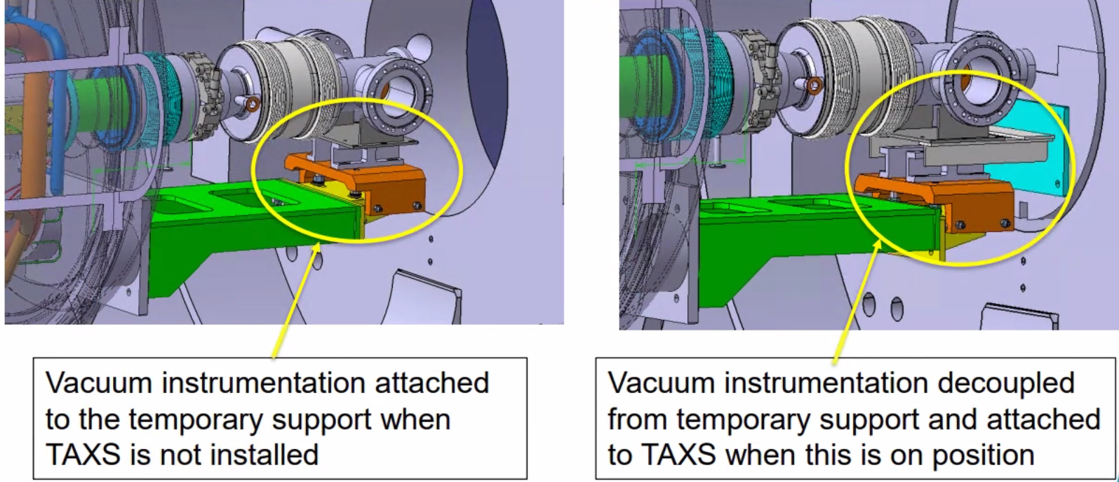
WP12-2: Ion pump installation tests and handover procedure to TAXS supports
Side note:
WP8 includes attachment plates to Q1 end cover simulator and to TAXS
WP12 provides test components such as chambers, flanges, supports transfer tables.
(Cortesy Rita)

Slide 7
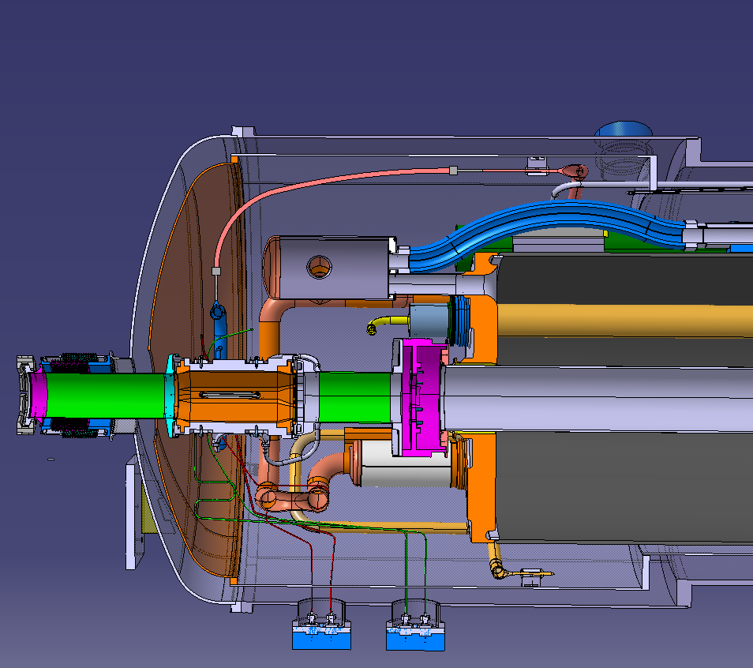
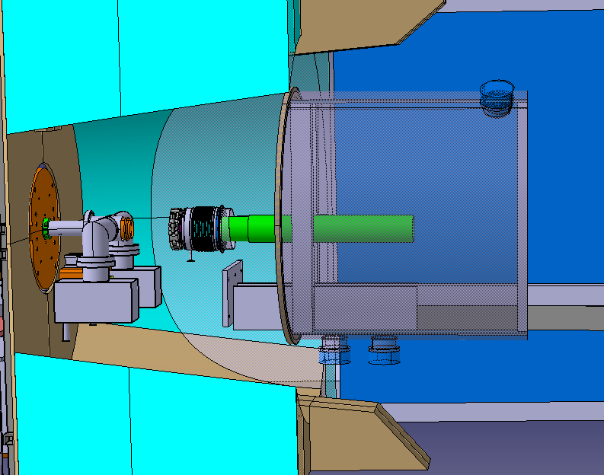
WP3 / WP7 / WP13: Q1 end cover design (Ion pump support, access to BPM and Q1 connectors)
Side note:
Mock-up includes a simplified solution but is capable to integrate a real prototype Q1 end cover
WP7 (Q1 instrumentation) and WP13 (BPM) connector accessibility checks related to Q1 end cover design

Slide 8
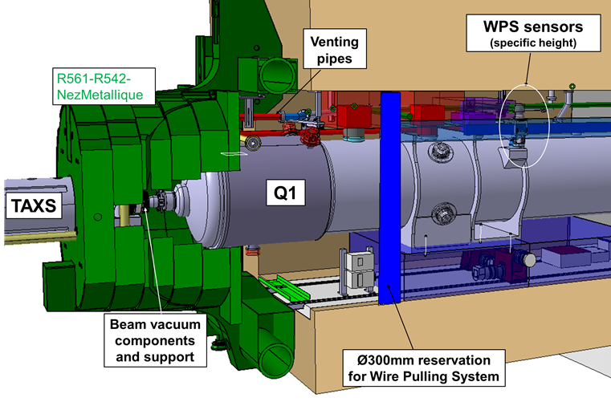
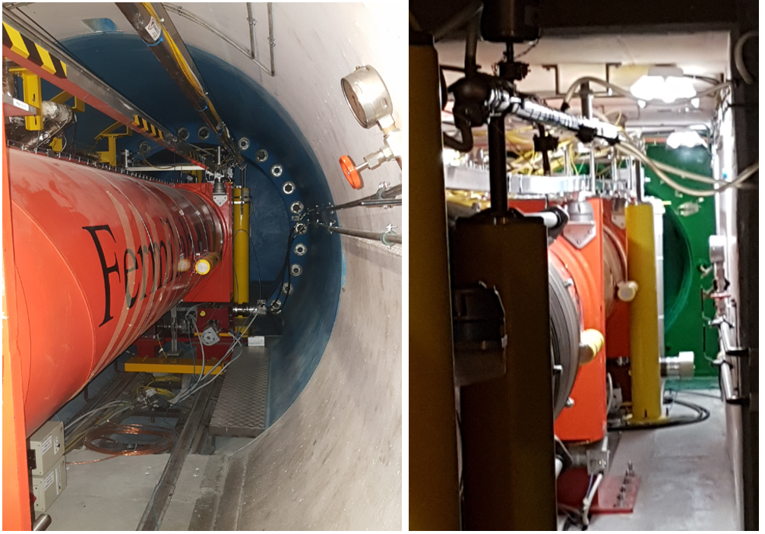
WP15.4 Survey / WP17.2 EN-EL / WP17.3 EN-CV Integration and space occupation of equipment
Side note: All users contacted, no priority issue for the moment.

Slide 9
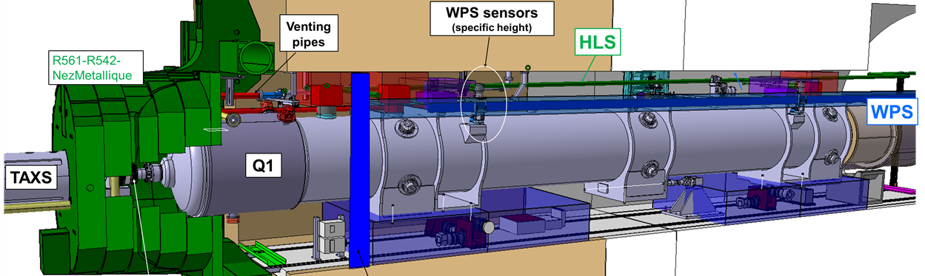
WP15 Integration and Planning + WP15.5 Transport

