Slide 1
One bunch at a time: wakefield damping in a distributed coupling accelerating structure
Evan Ericson, Alexej Grudiev
RF Development Meeting

Slide 2
Overview
Motivation
SW cell design
Distributed coupling cell design
Wakefield modelling of a distribution network
Nose cone cell design
Structure & cryogenic structure performance

Slide 3
Overview
Motivation
SW cell design
Distributed coupling cell design
Wakefield modelling of a distribution network
Nose cone cell design
Structure & cryogenic structure performance

Slide 4
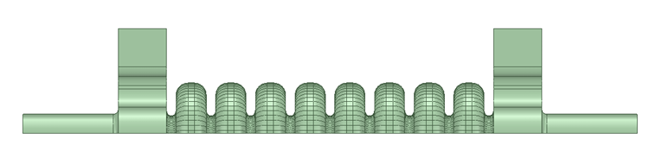
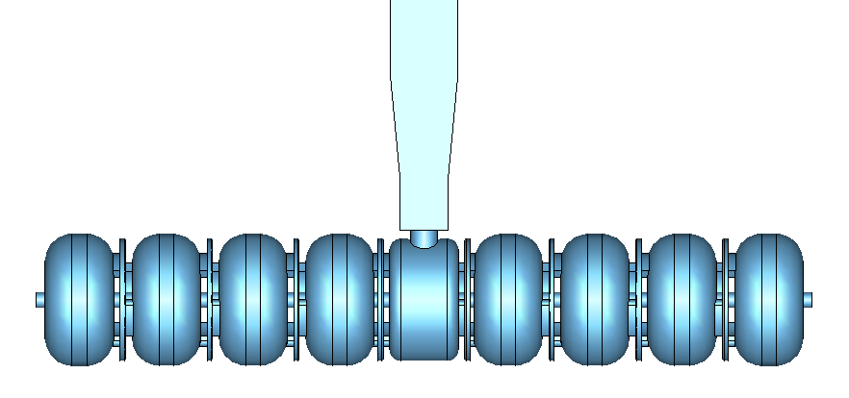
Motivation
SW structure for CLIC could have higher RF-to-beam efficiency than TW structure ~31% vs ~28% (A Standing Wave Structure Possibility For CLIC Main LINACs, Vasim Khan at HG2013 workshop)
SW cells have shown better RF breakdown performance (Study of basic RF breakdown phenomena in hight gradient vacuum structures, Dolgashev et al. at LINAC2010)
Number of cells before mode overlap π-mode: 9 π/2-mode: 83
TW structure
(source: High gradient structures and rf systems for high brightness electron linacs, Marco Diomede)
SW structure
(source: Ping Wang)

Slide 5
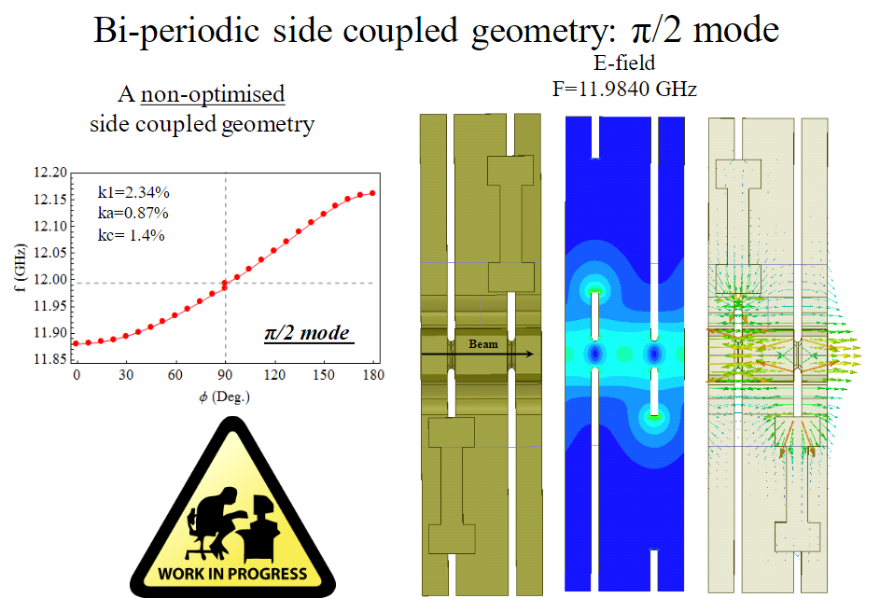
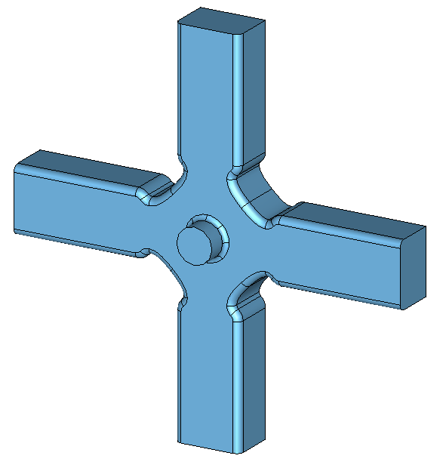
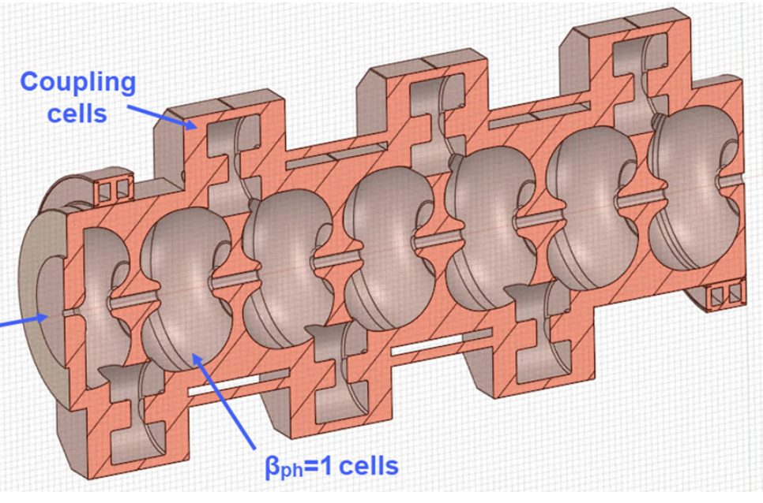
Motivation
Operating using π/2-mode with biperiodic structure difficult to realize because of cells’ HOM waveguides
Biperiodic structure with CLIC-G* cell
(source: A Standing Wave Structure Possibility For CLIC Main LINACs, Vasim Khan at HG2013 workshop)
Biperiodic structure
(source: Electron bunchers for industrial RF linear accelerators: theory and design guide, Sergey Kutsaev)

Slide 6
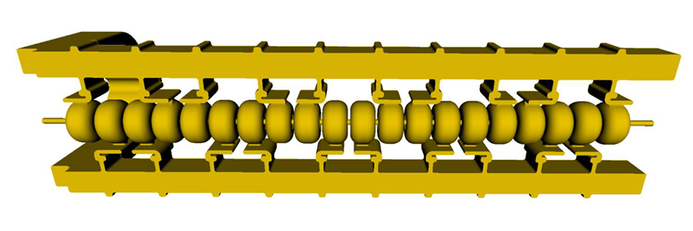
Motivation
Distributed coupling scheme treats cells as individual SW cavities, avoiding mode overlap
Other advantages of distributed coupling:
  Coupling between cells does not need to be a design constraint allowing cell shape to be optimized for RF performance
  Limited coupling/power flow through irises of SW cell may reduce RF breakdowns in this sensitive area
Disadvantages of distributed coupling:
  Complexity of design and fabrication
  Cost of fabrication
source: (SLAC research Activities on normal conducting RF accelerators, Sami Tantawi at Linear collider workshop 2019)

Slide 7
Overview
Motivation
SW cell design
Distributed coupling cell design
Wakefield modelling of a distribution network
Nose cone cell design
Structure & cryogenic structure performance

Slide 8
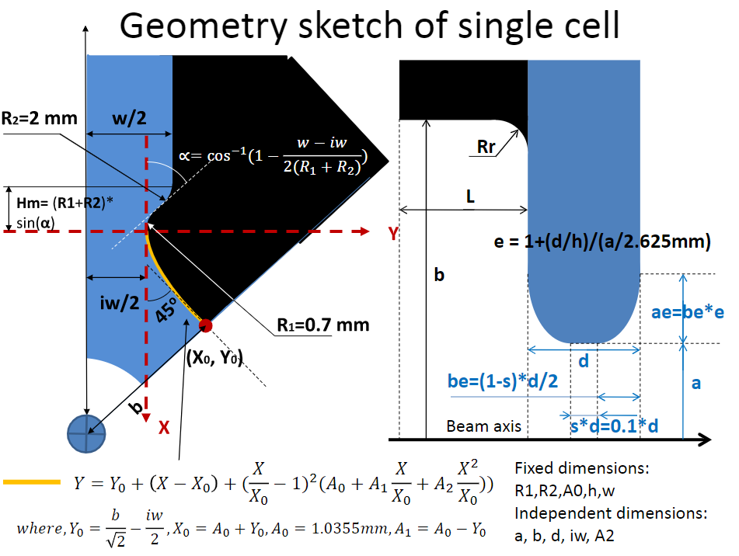
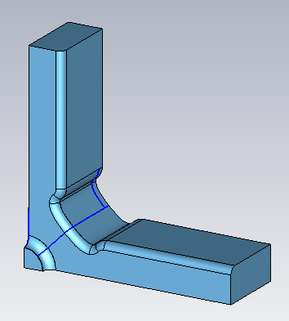
SW cell design
Started with CLIC-G* TW cell design
Adjusted length for π-mode
Adjusted A0, A2 of outer wall to minimize surface magnetic field
source: RF design and parameters of 2015 re-baselined 3TeV CLIC main linac AS at 12 GHz with compact couplers: CLIC-G* or TD26_vg1.8_R1_CC

Slide 9
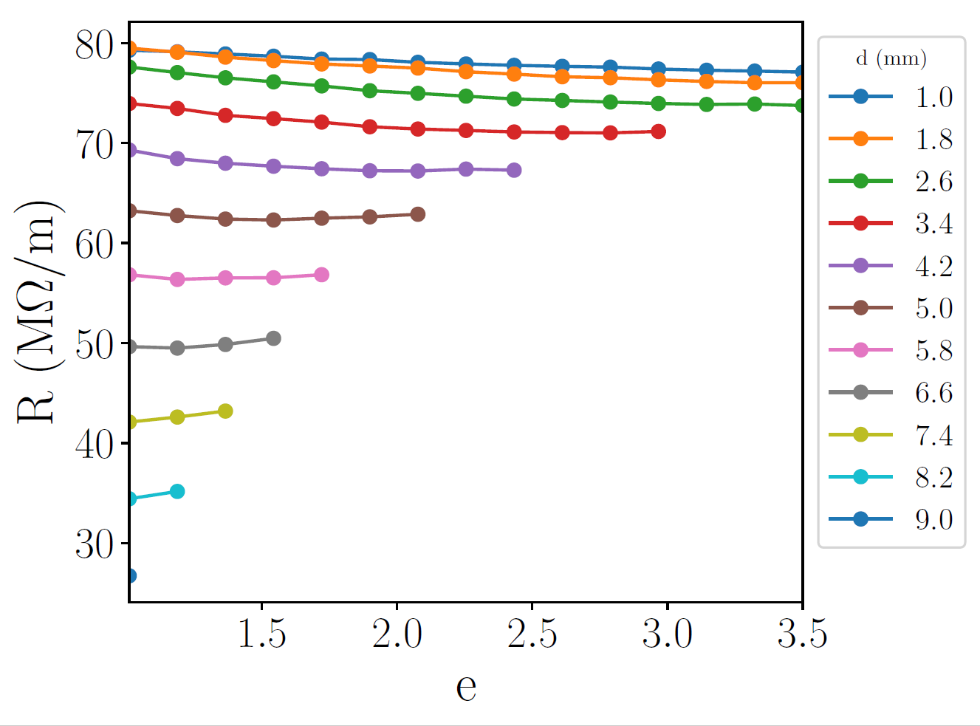
SW cell design

Slide 10
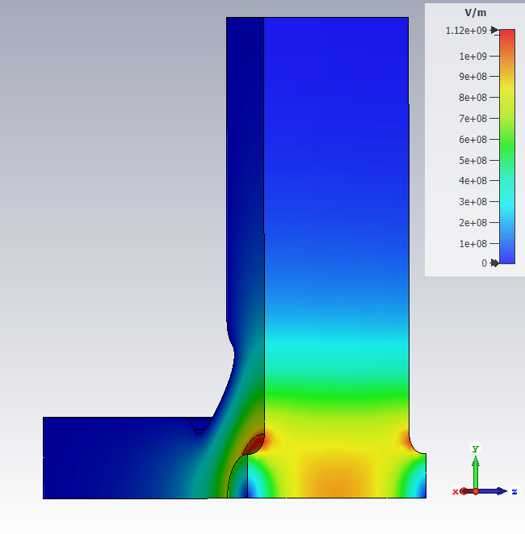
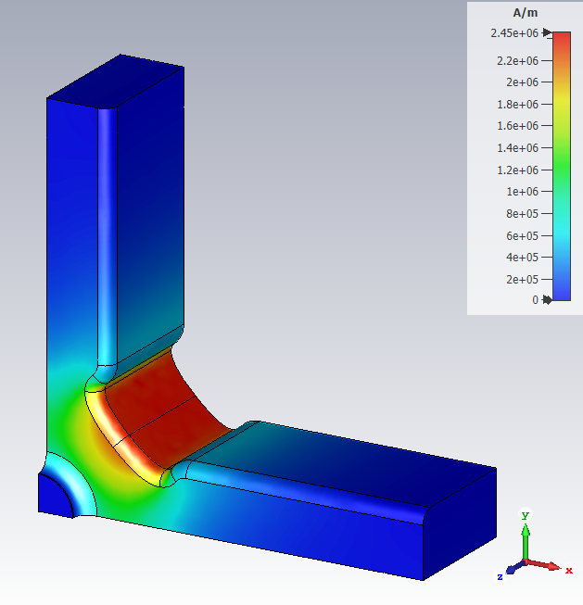
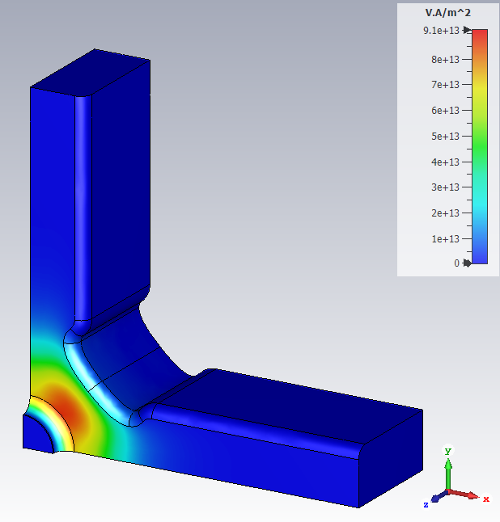
SW cell design
 | unit | TW – Mid cell | SW – Opt0 | SW – Opt1 | SW – Opt2 | SW – Opt3
b | mm | 8.5249 | 8.4286 | 8.5638 | 8.4918 | 8.4709
h | mm | 8.3316 | 12.5 | 12.5 | 12.5 | 12.5
d | mm | 1.333 | 1.333 | 2.6 | 2.3 | 2.35
e |  | 1.153 | 1.102 | 2.400 | 1.600 | 1.179
f₀ | GHz | 11.9949 | 11.9939 | 11.9945 | 11.9938 | 11.9946
Φ | ° | 120 | 180 | 180 | 180 | 180
Q₀ |  | 5,855 | 7,133 | 6,927 | 6,937 | 6,913
R/Q₀ | Ω/m | 16,466 | 11,208 | 10,962 | 11,184 | 11,350
R | MΩ/m | 96.40 | 79.95 | 75.93 | 77.58 | 78.48
v_{g}/c | % | 1.226 | 0 | 0 | 0 | 0
E_{s}/E_{a} |  | 1.98 | 2.49 | 1.80 | 1.99 | 2.09
H_{s}/E_{a} | mA/V | 3.73 | 4.43 | 4.67 | 4.62 | 4.60
S_{c}/E_{a}² | mA/V | 0.33 | 0.30 | 0.35 | 0.34 | 0.33
Opt3: E, H, S_{c} fields

Slide 11
SW cell design
Dashed line orientation
Horizontal | Beam dynamics transverse wakepotential threshold: 6 V/pC/m/mm
Vertical | Witness bunch positions (0.5 ns spacing)

Slide 12
SW cell design
Iris geometry does not have strong effect on long-range wakepotentials
Issues with 4 HOM waveguide cell for distributed coupling application:
  Transverse wakepotential above threshold at 2nd bunch
  No way of coupling power into individual cells (solve this first since we might get a good wakepotential for free)

Slide 13
Overview
Motivation
SW cell design
Distributed coupling cell design
Wakefield modelling of a distribution network
Nose cone cell design
Structure & cryogenic structure performance

Slide 14
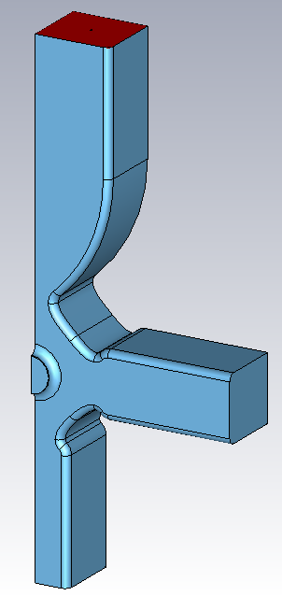
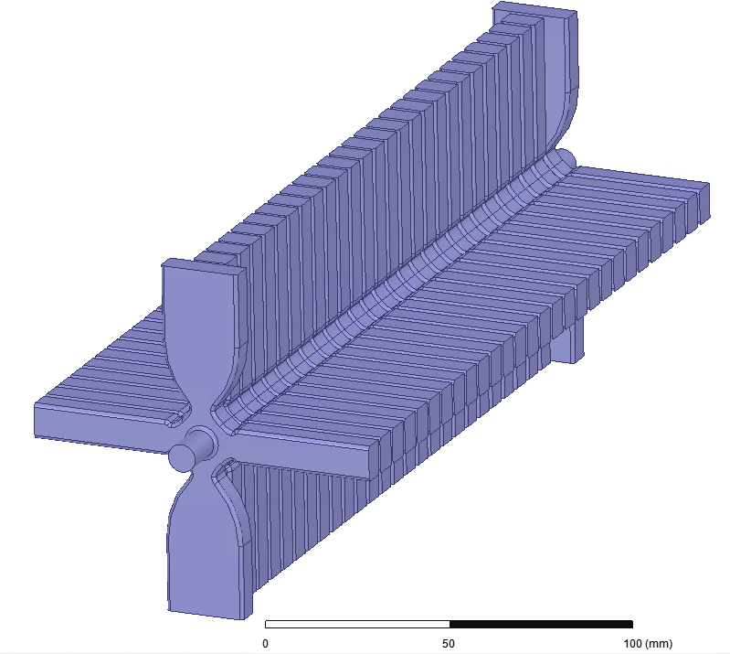

Distributed coupling cell design
Use design TW structure coupler cell to couple power into cell
Reduce coupler waveguides from 2 to 1 to improve damping
Match cell to power source, β = 1.93, by adjusting icw, b
b (mm) | 8.5833
icw (mm) | 5.963
f (GHz) | 11.9938
Q₀ | 7,025
Q_{ext} | 3,595
R/Q (Ω/m) | 11,479
R (MΩ/m) | 80.6
E_{s}/E_{a} | 2.06
H_{s}/E_{a} (mA/V) | 4.42
S_{c}/E_{a}² (mA/V) | 0.33

Slide 15
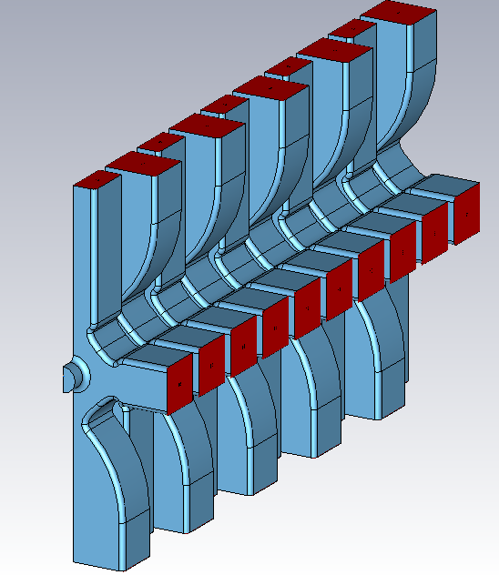
Distributed coupling cell design
Alternate orientation of couplers to reduce kick
Reducing symmetry from ¼ to ½ gives 2 wake polarizations
While coupler cell has input power, wakepotentials are above threshold

Slide 16
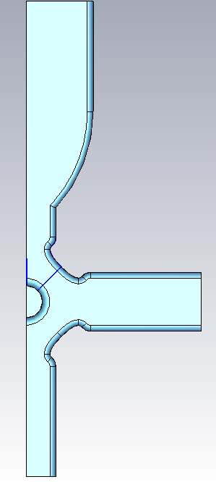
Distributed coupling cell design
Introduce HOM waveguide transition between cell and high-power waveguide
Match cell to power source by adjusting slot length, b
b (mm) | 8.4660
slot length (mm) | 7.55
f (GHz) | 11.9946
Q₀ | 6,867
Q_{ext} | 3,508
R/Q₀ (Ω/m) | 11,321
R (MΩ/m) | 77.74
E_{s}/E_{a} | 2.15
H_{s}/E_{a} (mA/V) | 4.58
S_{c}/E_{a}² (mA/V) | 0.33
slot length

Slide 17
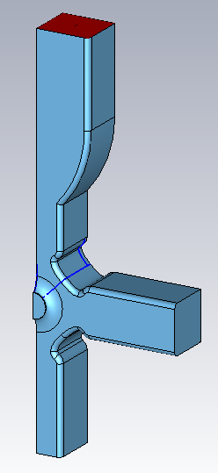
Distributed coupling cell design
Wakepotential of this geometry (longSlot2) is lower than coupler cell but still above threshold
Impedance peaks of longSlot2 geometry almost same as 4 HOM waveguide cell but 22 GHz mode has higher Q-ext for longSlot2 geometry

Slide 18
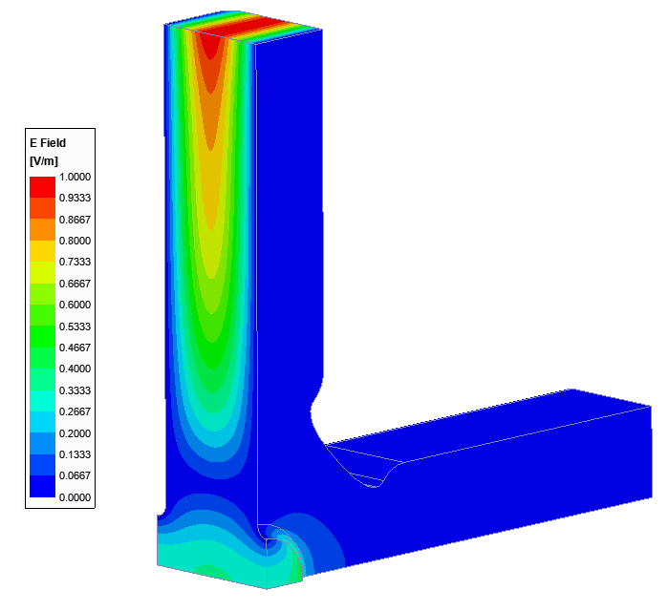
Distributed coupling cell design
 | Mode 1 | Mode 2 | Mode 3
f (GHz) | 17 | 22 | 28.2
Q-ext | 10 | 20 | 34
R = 2*Z | 10,000 | 22,500 | 6,200
22 GHz mode dominates wake at 2nd bunch position
 | Mode A
f (GHz) | 21.9
Q-ext | 17.5
R = 2*Z | 19,900

Slide 19
Distributed coupling cell design
 | Mode 1 | Mode 2 | Mode 3
f (GHz) | 17 | 22 | 28.2
Q-ext | 10 | 20→15 | 34
R = 2*Z | 10,000 | 22,500 | 6,200
Reducing Q-ext of 22 GHz mode from 20 to 15 gives a wake below threshold at 2nd bunch position

Slide 20
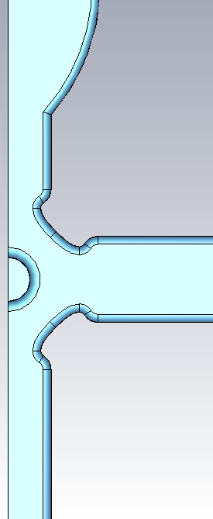
Distributed coupling cell design
What cell geometry has a 22 GHz mode with Q-ext = 15?
Strategy: vary w, iw
Since cell frequency is sensitive to iw, find b for every iw that gives f = 11.994 GHz
During sweeps, the cell will no longer be matched. We focused on finding a design that satisfied damping requirement before matching the cell
iw
w

Slide 21
Distributed coupling cell design
iw (mm) | b (mm) for f0 =11.994 | f (GHz) | Q_ext
8.09 | 8.4660 | 21.93 | 21
8.19 | 8.4355 | 21.90 | 19.5
8.29 | 8.4035 | 21.96 | 19.5
8.39 | 8.3703 | 21.82 | 19.75
8.49 | 8.3361 | 21.8 | 17
8.59 | 8.3008 | 21.74 | 16.5
8.69 | 8.2644 | 21.7 | 15.5
iw

Slide 22
Distributed coupling cell design
w (mm) | b (mm) for f0 =11.994 | f (GHz) | Q_ext
10.1 | 8.4660 | 21.93 | 21
10.2 | 8.4660 | 21.93 | 20.75
10.3 | 8.4660 | 21.93 | 20.5
10.4 | 8.4660 | 21.93 | 20.25
10.5 | 8.4660 | 21.93 | 20
10.6 | 8.4660 | 21.93 | 18.5
10.7 | 8.4660 | 21.93 | 17.5
w

Slide 23
Distributed coupling cell design
Chose to vary w since increasing iw decreases Q₀, increases surface magnetic field (heating)
Expected Q-ext = 15 for wakepotential to be below threshold but Q-ext = 17.5 was sufficient
  Q-ext of Mode 1 at 17 GHz was also affected by geometry changes
  Impedance peaks are asymmetric, fitting was done by eye
Wakepotentials of cell with different waveguide w = 10.1 mm, wVert = 10.7 mm
Vary w of vertical HOM waveguides

Slide 24
Distributed coupling cell design
Wakepotentials are now below threshold
We can now simulate wakes of distribution network
b (mm) | 8.4395
slot length (mm) | 9.4
w (mm) | 10.7
f (GHz) | 11.9937
Q₀ | 6,766
Q_{ext} | 3,557
R/Q₀ (Ω/m) | 11,476
R (MΩ/m) | 77.65
E_{s}/E_{a} | 2.15
H_{s}/E_{a} (mA/V) | 4.67
S_{c}/E_{a}² (mA/V) | 0.33
w/2
w
w/2
Vary w of all HOM waveguides

Slide 25
Overview
Motivation
SW cell design
Distributed coupling cell design
Wakefield modelling of a distribution network
Nose cone cell design
Structure & cryogenic structure performance

Slide 26

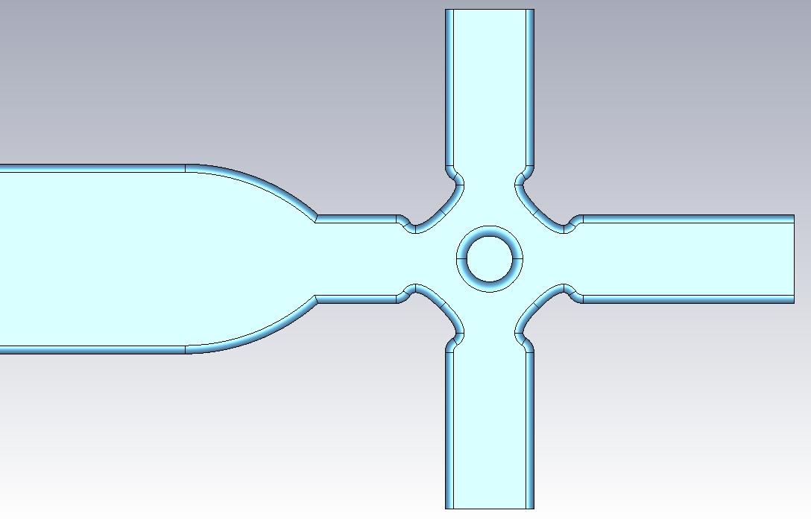
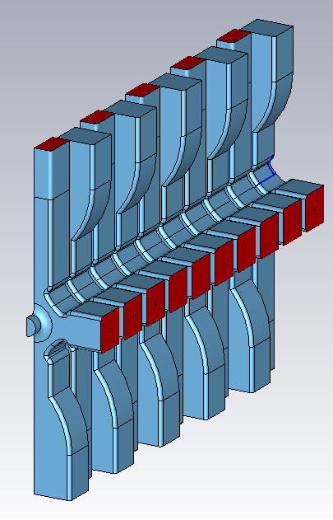
Wakefield modelling of a distribution network
Approximate RF device feeding accelerating structure with a PEC plane
Pessimistically assume all wakefields that “see” feed network are reflected back into cell
Open Boundary
Effective Electric Boundary
Power distribution network

Slide 27
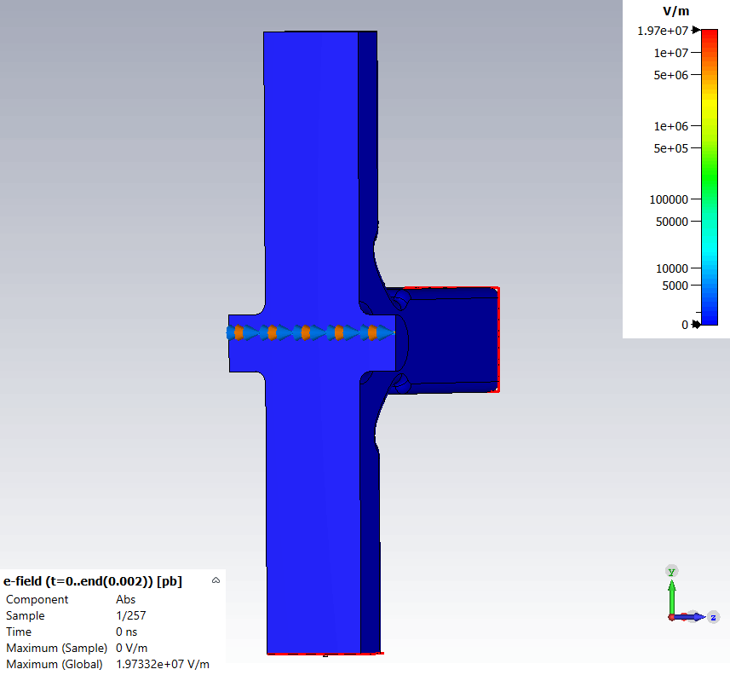
Wakefield modelling of a distribution network
Electric Boundary
Open Boundary

Slide 28
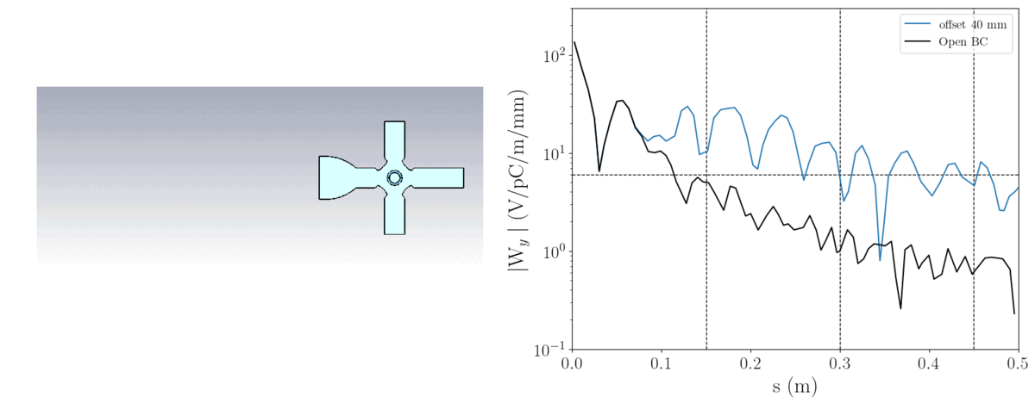
Wakefield modelling of a distribution network
Distance between the distribution network and the beam-axis determines the arrival time of the reflected wake

Slide 29
Wakefield modelling of a distribution network
Offset of 100 mm between PEC plane and beam axis
Reflected modes group around non-reflected impedance modes (17, 22 GHz)
Impedance peaks are very narrow (high Q-ext, slow damping)
Different arrival, decay times for the 2 families

Slide 30
Wakefield modelling of a distribution network
Larger offsets have lower amplitude, longer lasting reflected wakepotentials due to:
  The difference in arrival time of the modes is exaggerated
  Dispersion causes the modes to be “spread” in time

Slide 31
Wakefield modelling of a distribution network
Can the reflected wakes be damped by increasing w or iw?
Offet of 150 mm between PEC plane and beam axis
Reflected wake is unaffected by increasing w or iw

Slide 32
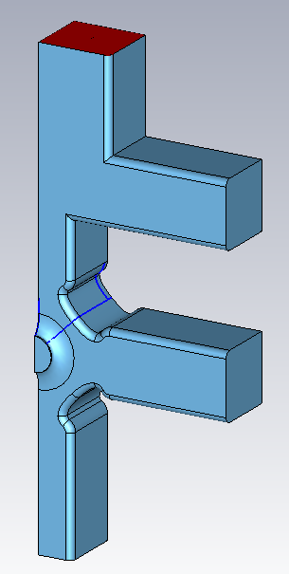
Wakefield modelling of a distribution network
Biplane cell has 5 HOM waveguides
Wakepotential at 3rd witness bunch very close to threshold
b (mm) | 8.5440
slot length (mm) | 8.95
w (mm) | 10.7
f (GHz) | 11.9937
Q₀ | 6,786
Q_{ext} | 3,604
R/Q₀ (Ω/m) | 10,873
R (MΩ/m) | 73.8
E_{s}/E_{a} | 1.78
H_{s}/E_{a} (mA/V) | 4.69
S_{c}/E_{a}² (mA/V) | 0.34

Slide 33
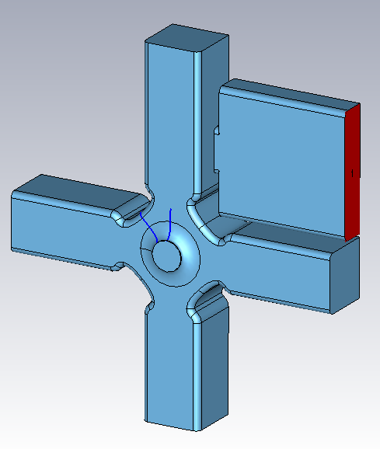
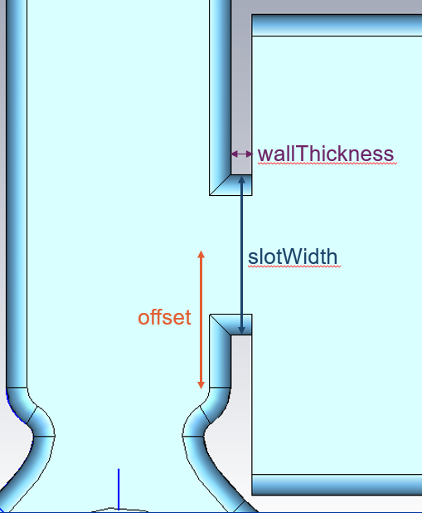
Wakefield modelling of a distribution network
Horizontal coupler cell is fed power from the side of one of the HOM waveguides
Wakefields extracted through HOM waveguide couple weakly to high power waveguide
b (mm) | 8.5380
offset | 6
wallThickness (mm) | 1
slotWidth (mm) | 8.2
w (mm) | 10.7
f (GHz) | 11.9943
Q₀ | 6,759
Q_{ext} | 3,570
R/Q₀ (Ω/m) | 10,822
R (MΩ/m) | 73.1
E_{s}/E_{a} | 1.78
H_{s}/E_{a} (mA/V) | 4.72
S_{c}/E_{a}² (mA/V) | 0.35

Slide 34
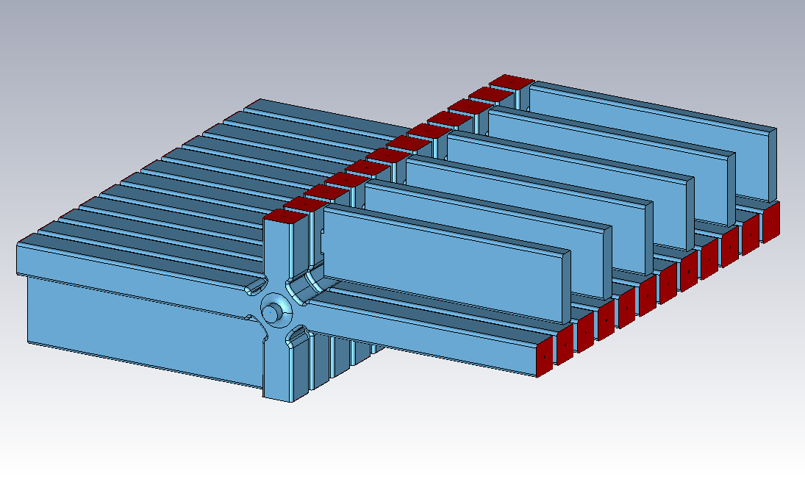
Wakefield modelling of a distribution network
Reflected wakepotential very similar to wakepotential when open boundaries are used
Wakefields in cell do not “see” distribution network
Power feed structure can be designed separately

Slide 35


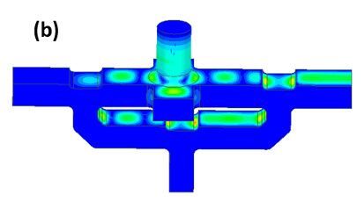
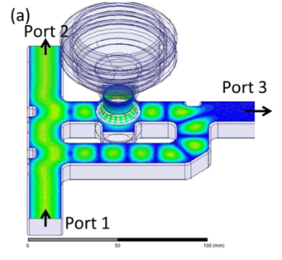
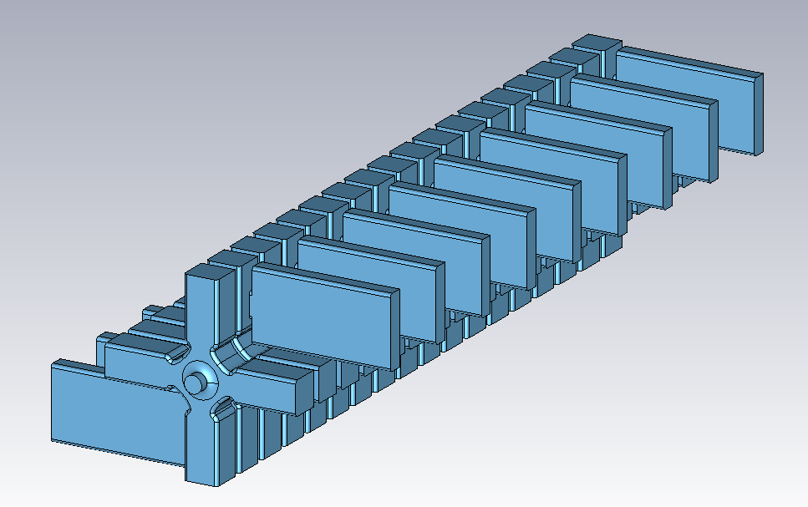
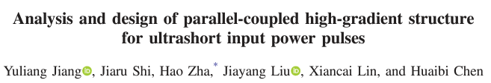
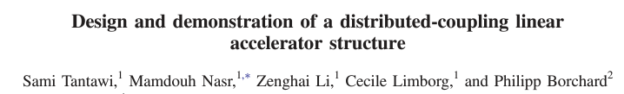
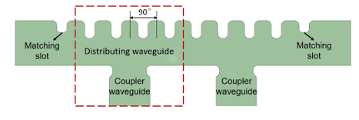
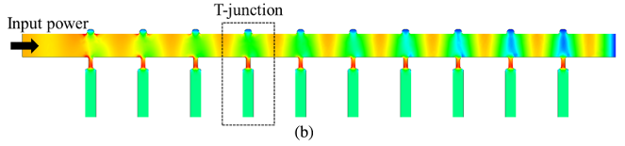
Wakepotential at 4th bunch

Slide 36
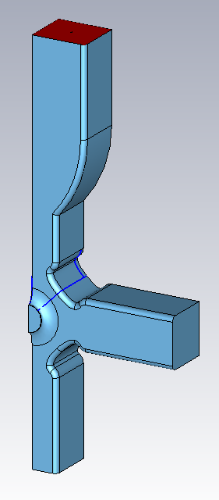
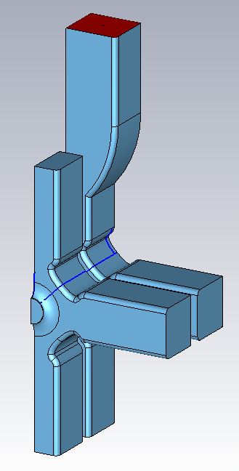
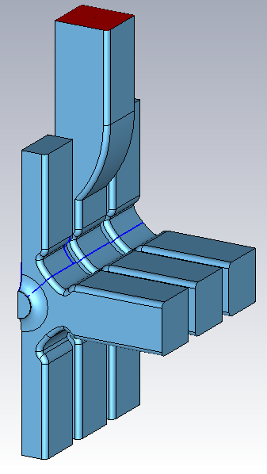
Wakefield modelling of a distribution network
Alternating coupler cell and normal cells increases the number of HOM waveguides and potential damping

Slide 37
Wakefield modelling of a distribution network
Doublet, triplet structures have acceptable wakes at all bunch positions
Wakepotentials of doublet, triplet structures show low amplitude mode beating after 4th bunch (0.45 m)

Slide 38
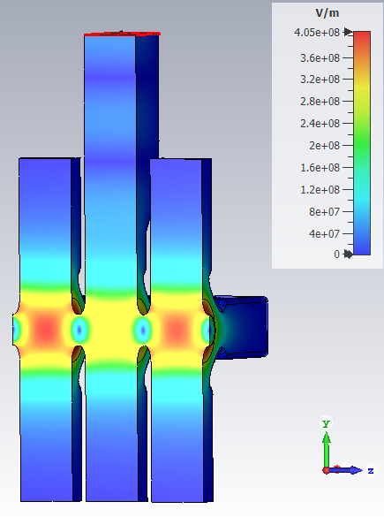
Wakefield modelling of a distribution network
Doublet, triplet structures require:
    less feed waveguides
    coupling between cells (iris radius = 2.75 mm)
    consideration of 0 mode (doublet) or 0, π/2 modes (triplet)
    Balancing of on-axis field by adjusting cells in module

Slide 39
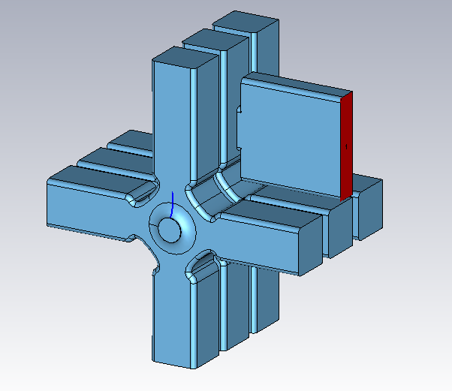
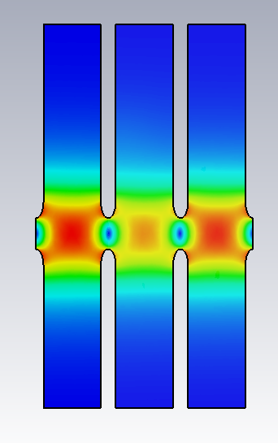
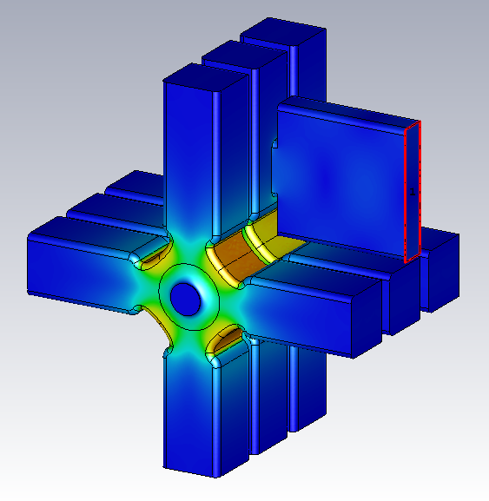
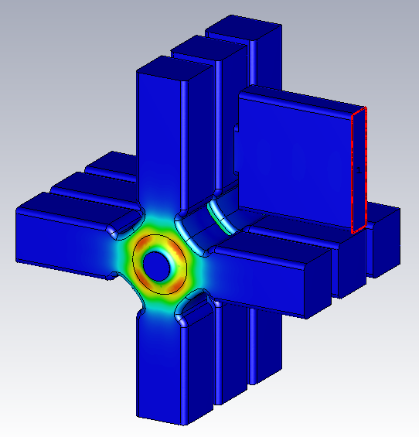

Wakefield modelling of a distribution network
w (mm) | 10.7
b (mm) | 8.5388
slotWidth (mm) | 9.78
f (GHz) | 11.9938
Horizontal coupler and triplet topologies were be combined
Surface field values of operating mode are not reported since fields need to be balanced first
Horizontal coupler triplet: E, H, S_{c} fields
$$k=0.57 \%$$

Slide 40
Wakefield modelling of a distribution network
Motivation
SW cell design
Distributed coupling cell design
Wakefield modelling of a distribution network
Nose cone cell design
Structure & cryogenic structure performance

Slide 41
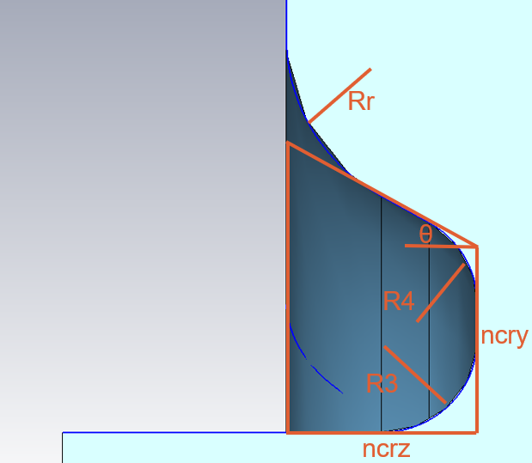
Nose cone cell design

Slide 42
Nose cone cell design

Slide 43
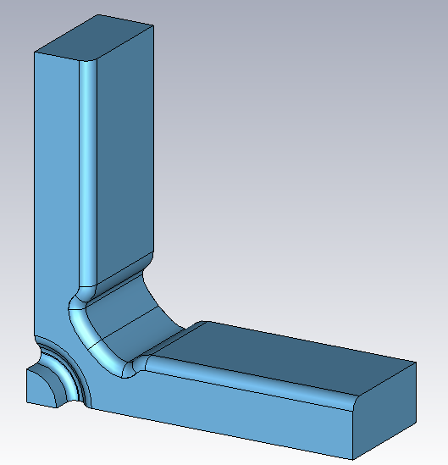
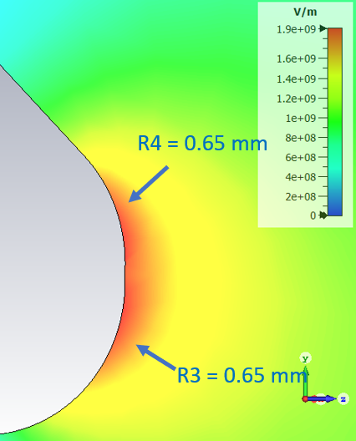
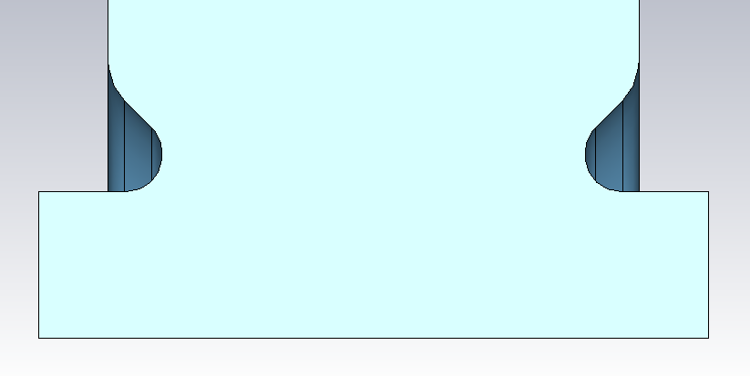
Nose cone cell design
 |  | Nose cone | Opt1
ncrz | mm | 1.00 | -
ncry | mm | 1.00 | -
theta | deg | 45 | -
R3 | mm | 0.65 | -
R4 | mm | 0.65 | -
A0 | mm | 0.9 | 1.0355
A2 |  | 0.17665 | 0.17665
w | mm | 10.1 | 10.1
b | mm | 7.8067 | 8.5638
f | GHz | 11.994 | 11.9945
Q₀ |  | 6,118 | 6,927
R/Q₀ | Ω/m | 13,552 | 10,962
R | MΩ/m | 82.9 | 75.9
E_{s}/E_{a} |  | 3.27 | 1.80
H_{s}/E_{a} | mA/V | 4.86 | 4.67
S_{c}/E_{a}² | mA/V | 0.72 | 0.35

Slide 44
Nose cone cell design
Nose cones give larger peak wake at s = 0 m than elliptical iris
Lower Q-ext of mode above 20 GHz gives faster damped wakes
Reduced radius of nose cone cell helps damping since HOM waveguides are higher % of surface
No increase in w required for wakes to be sufficiently low at 2nd bunch

Slide 45
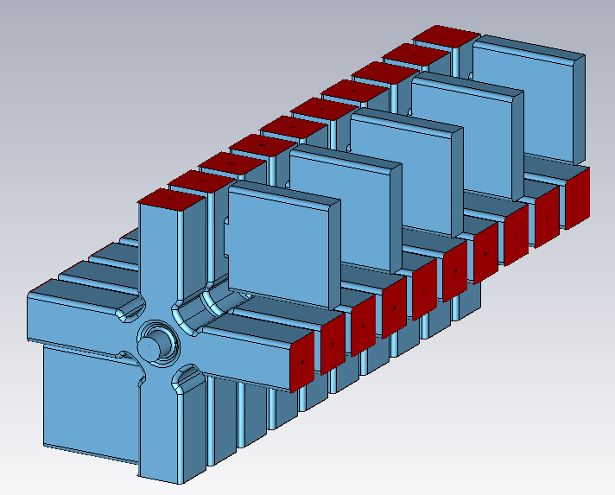
Nose cone cell design
Reflected wake simulations show wakepotential below threshold for offsets above 40 mm

Slide 46
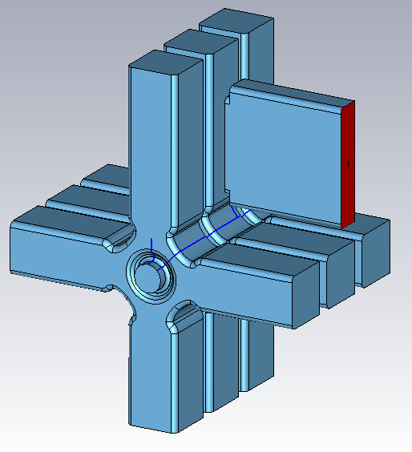
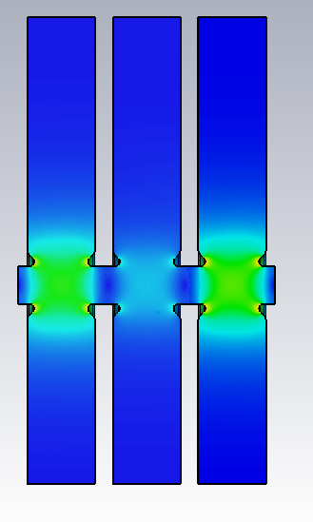
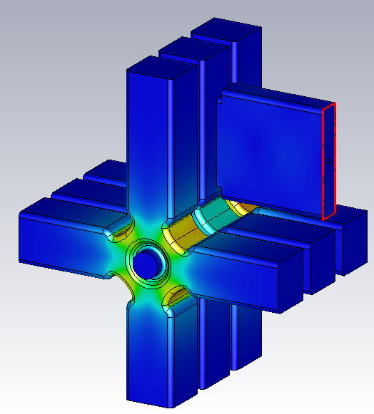


Nose cone cell design
w (mm) | 10.7
b (mm) | 7.7580
offset (mm) | 10
slotWidth (mm) | 19.2
f (GHz) | 11.9942
Horizontal coupler, triplet and nose cone topologies were be combined
Accelerating field even more unbalanced in coupling cell than for flat iris horizontal coupler triplet
Horizontal coupler nose cone triplet: E, H, S_{c} fields
$$k_{NC}=0.099 \%$$

Slide 47
Overview
Motivation
SW cell design
Distributed coupling cell design
Wakefield modelling of a distribution network
Nose cone cell design
Structure & cryogenic structure performance

Slide 48



Structure & cryogenic structure performance
Interest in cryogenic accelerators comes from:
  Q₀ of resonant cells ↑ (source: Experimental demonstration of particle acceleration with normal conducting accelerating structure at cryogenic temperature by Nasr et al.)
  RF pulsed heating ↓ (source: High gradient experiments with X -band cryogenic copper accelerating cavities by Cahill et al.)
  Operating limits before breakdown ?
Surface magnetic field depends on cell design, not power coupling method

Slide 49

Structure & cryogenic structure performance
 |  | 300 K | 77 K
f | GHz | 11.994 | 11.994
E_{a} | MV/m | 100 | 100
H_{s}/E_{a} | mA/V | 4.67 | 4.67
H_{s} | MA/m | 0.467 | 0.467
t_{p} | ns | 238 | 238
rho | kg/m^3 | 8.95e3 | 8.95e3
R_{s} | Ohm | 0.027 | 0.011
k | W/m/K | 4.01e2 | 5.00e2
c_{ε} | J/K/kg | 385.2 | 200.0
ΔT | K | 43.59 | 22.07
Cell parameters
Copper parameters
Operating at 77 K, temperature increase due to pulsed heating is 50% of temperature increase when operating at 300 K

Slide 50
Structure & cryogenic structure performance
CLIC DB source: What are the efficiency, gradient and breakdown indicators structure when it is fed the CLIC drive beam pulse?
Other source: What are the P_{in}, t_{p} requirements for a power source if we wanted to operate a structure at 100 MV/m?

Slide 51
CLIC drive beam source
 | unit | TW – mid cell | Opt1 | Opt1 (300K) | Opt1 (77K) | limits
Q₀ |  | 5,637 | 6,927 | 6,927 | 15,586
R/Q₀ | Ohm/m | 16,227 | 10,962 | 10,962 | 10,962
R | MOhm/m | 91.5 | 75.93 | 75.93 | 170.85
E_{s}/E_{a} |  | 1.98 | 1.8 | 1.8 | 1.8
H_{s}/E_{a} | mA/V | 3.73 | 4.67 | 4.67 | 4.67
S_{c}/Ea² | mA/V | 0.33 | 0.35 | 0.35 | 0.35
E_{acc}^{load} avg | MV/m | 100 | 100 | 108.25 | 140.75
number of bunches in train |  | 312 | 312 | 314 | 242
P_{in} | MW | 62.3 | 56.3 | 63.6 | 63.6 | 63.5
t_{fill} | ns | 66 | 82.0 | 87.3 | 123.1
t_{b} | ns | 156 | 156 | 157 | 121
t_{p} | ns | 222 | 238.0 | 244.3 | 244.1 | 244
RF-steady state efficiency | % |  | 47.3 | 45.4 | 59.0
RF-pulse efficiency | % |  | 65.5 | 64.3 | 49.6
total RF-beam efficiency | % | 28.4 | 31.0 | 29.2 | 29.2
E_{s} scaled to 200 ns | MV/m | 201 | 185 | 201 | 262 | 200 (300)
ΔT | K | 26.86 | 43.59 | 51.75 | 44.28 | 40 (cryo: ?)
S_{c} scaled to 200 ns | MW/mm2 | 5.50 | 3.71 | 4.38 | 7.41 | 4 (cryo: 8)
Cell parameters
Structure parameters
Efficiencies
CLIC accelerating structure RF breakdown limits
with 20% margin

Slide 52
Other power source
 | unit | TW – mid cell | Opt1 (300K) | Opt1 (77K) | limits
Q₀ |  | 5,637 | 6,927 | 15,586
R/Q₀ | Ohm/m | 16,227 | 10,962 | 10,962
R | MOhm/m | 91.5 | 75.93 | 170.85
E_{s}/E_{a} |  | 1.98 | 1.8 | 1.8
H_{s}/E_{a} | mA/V | 3.73 | 4.67 | 4.67
S_{c}/Ea² | mA/V | 0.33 | 0.35 | 0.35
E_{acc}^{load} avg | MV/m | 100 | 100 | 100
number of bunches in train |  | 312 | 312 | 312
P_{in} | MW | 62.3 | 56.3 | 39.81 | -
t_{fill} | ns | 66 | 82.0 | 88.0
t_{b} | ns | 156 | 156 | 156
t_{p} | ns | 222 | 238.0 | 244 | -
RF-steady state efficiency | % |  | 47.3 | 66.92
RF-pulse efficiency | % |  | 65.5 | 63.9
total RF-beam efficiency | % | 28.4 | 31.0 | 42.8
E_{s} scaled to 200 ns | MV/m | 201 | 185 | 186 | 200 (300)
ΔT | K | 26.86 | 43.59 | 22.35 | 40 (cryo: ?)
S_{c} scaled to 200 ns | MW/mm2 | 5.50 | 3.71 | 3.74 | 4 (cryo: 8)
Cell parameters
Structure parameters
Efficiencies
CLIC accelerating structure RF breakdown limits
with 20% margin

Slide 53
Other power source
 | unit | Opt1 (77K) | limits
Q₀ |  | 15,586
R/Q₀ | Ohm/m | 10,962
R | MOhm/m | 170.85
E_{s}/E_{a} |  | 1.8
H_{s}/E_{a} | mA/V | 4.67
S_{c}/Ea² | mA/V | 0.35
E_{acc}^{load} avg | MV/m | 100
number of bunches in train |  | 1,400
P_{in} | MW | 39.81 | -
t_{fill} | ns | 88.0
t_{b} | ns | 700
t_{p} | ns | 788 | -
RF-steady state efficiency | % | 66.92
RF-pulse efficiency | % | 88.83
total RF-beam efficiency | % | 59.4
E_{s} scaled to 200 ns | MV/m | 226 | 200 (300)
ΔT | K | 40.16 | 40 (cryo: ?)
S_{c} scaled to 200 ns | MW/mm2 | 5.53 | 4 (cryo: 8)
Cell parameters
Structure parameters
Efficiencies
CLIC accelerating structure RF breakdown limits with 20% margin

Slide 54
Summary
Opt1 iris design was selected as the best SW cell design due to its low surface electric field
Horizontal coupler cell design is transparent to wakefields and allows power distribution system to be designed separately
Doublet and triplet cell designs take advantage of cell-to-cell coupling while damping wakefields
Nose cone design has high surface fields and may be better-suited for a low gradient, high efficiency application
Cryogenic structures are more “RF” efficient and have lower breakdown indicators than room temperature counterparts

Slide 55

Summary
Recommend continuing design and optimization using cell with:
  Opt1 iris (d=2.6 mm, e=2.4) for low surface electric field
  Power coupled through the side of a HOM waveguide for minimal reflected wakefields
  Triplet module to take advantage of cell-to-cell coupling

