Slide 1
Finance and Reporting
Carsten P Welsch
INFN-LNF
University of Liverpool
The Cockcroft Institute

Slide 2
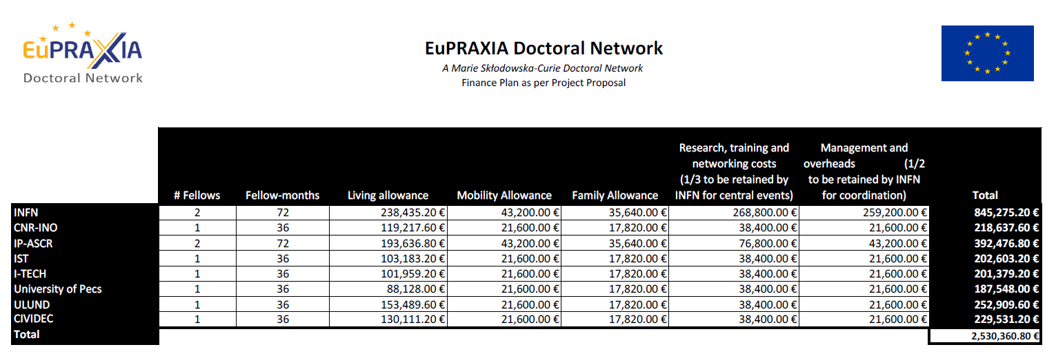
Budget Overview
Not shown: ULIV – will make identical contributions to central costs and receive transfer from INFN for its activities.

Slide 3
Cost Categories
Costs for Recruited Researchers:
Living Allowance
Mobility allowance
Family allowance
Institutional Costs:
Research, Training and Network costs
Management and Indirect costs

Slide 4
Researcher Costs
Living Allowance = 3,400 € per month
Fellow must have employment contract
This is the Fellow salary before any deductions
Contributions of both employers and employees to social insurance, pension, tax and other voluntary deductions

Slide 5
Living Allowance
Can a Fellow be paid less or more ?
Fellow cannot be paid less than the living allowance
Breach of contract!
Can be paid more - topped up from other funds
Can be paid in local currency, but must be reported in Euros

Slide 6
Mobility Allowance
Mobility Allowance = 600 € per month
Household, relocation and personal travel expenses
This is usually paid as part of the salary and is taxable
This Allowance covers private cost of the researchers, not professional costs, e.g. secondments which are covered by ‘Research Training and Networking costs

Slide 7
Family Allowance
*Family allowance = 660 € per month
*Family means persons linked to the researcher by marriage or relationship equivalent to a marriage recognised by the legislation of the country where this relationship was formalised or dependent children who are being maintained by the researcher.
Payable if researcher status at the time of recruitment is equivalent status to a marriage

Slide 8
Institutional Costs
Research, Training and Networking costs
Management and Indirect costs
Note: The eligibility of the Institutional costs is linked to the eligibility of the costs for the recruited researcher. Your implemented person-months are the sole factor determining this budget!

Slide 9
Research, Training and Networking
Contribution to expenses related to, for example:
Research costs
Consumables
Training courses
Participation of researchers in training events & Conferences
Scientific meetings
Co-ordination between partners
Secondments (including travel & accommodation)
Visa Costs for Fellow
Tuition Fees
Allowable by the end of the project = total person-months implemented x 1,600 €
1/3 will be retained by Coordinator for central training events as per proposal and Grant Agreement.

Slide 10
Research, Training and Networking
MSCA Fellows may NOT be requested to
  pay tuition fees for their research training and / or
  PhD degree programme from their own funds or
  from the researcher unit cost
All costs (except travel, unless indicated differently) for our network-wide events will be covered centrally.

Slide 11
Management and Indirect Costs
How is this split between management and overheads?
The Split between management and overheads is decided by the beneficiaries; please liaise with your administration.
This needs to ensure a sufficient budget is allocated to implement the management tasks described in the Description of the Action.
50% is retained by Coordinator as per our proposal and GA/CA.

Slide 12
Partner Organizations
The costs of Partner Organisations can be reimbursed by the beneficiaries.
It is for the beneficiary(ies) and partner organisation(s) concerned to reach a mutual agreement on arrangements for reimbursement.

Slide 13
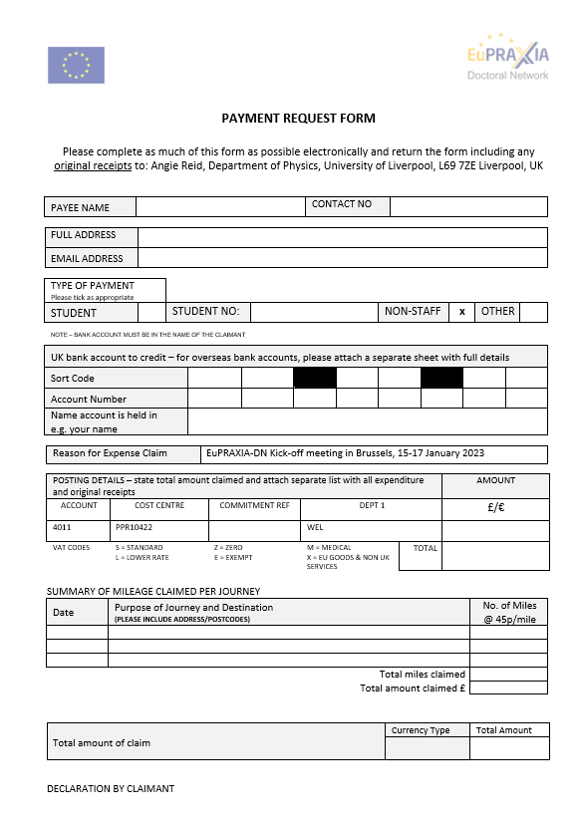
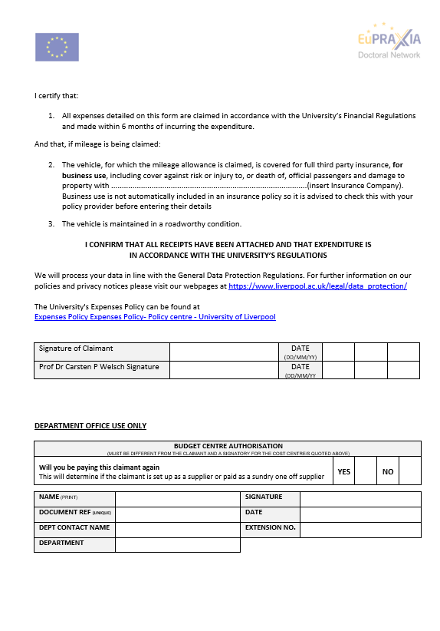
Example: Travel claim

Slide 14
Participant Guarantee Fund
Set up to manage the financial risks of the Action and is managed by the European Investment Bank.
No collective financial responsibility between project beneficiaries.
5% of the maximum Grant amount is retained from the pre-financing and paid into the Fund.
The interest generated covers the risks incurred by the non-reimbursement of amounts due by the beneficiaries.
The money paid into the Fund will be returned to the consortium at the end of the Action.

Slide 15
Financial Lifecycle
TOTAL EU CONTRIBUTION = 100%
Pre – financing = 80%
Interim payment
Max: 10%
Final payment incl Guarantee Fund
75% - Consortium
5% - Guarantee Fund
Project Duration: 48 months

Slide 16
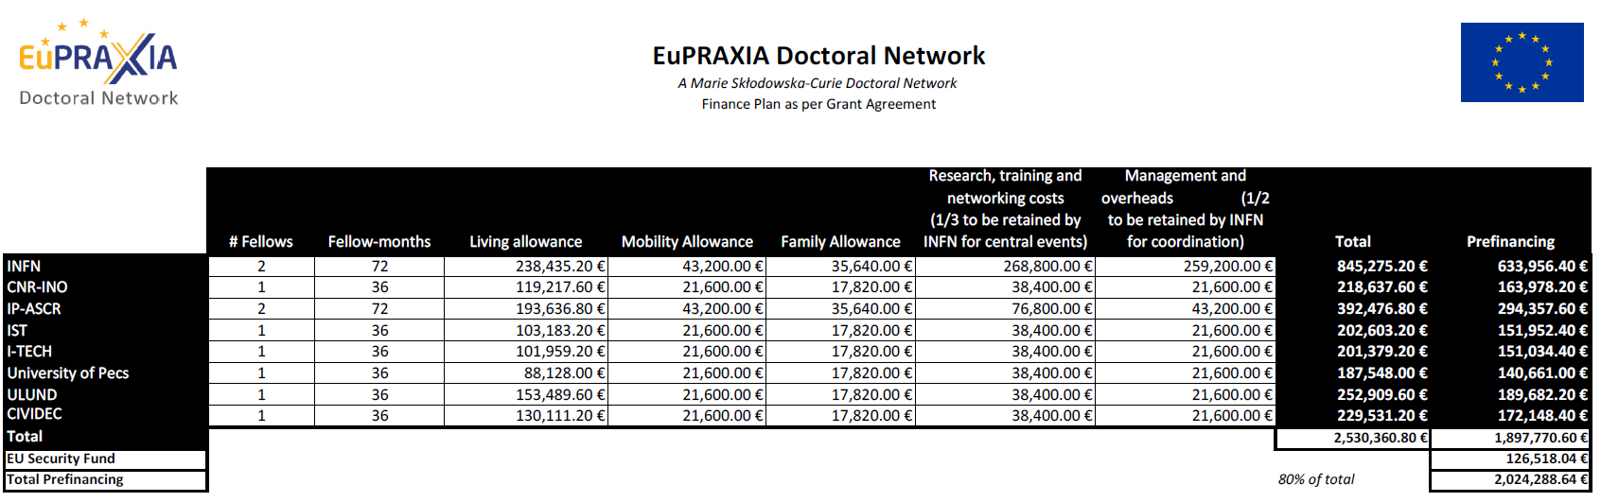
Pre-financing
These are the amounts you will receive NOW. Please provide this table and the total budget table to your administration.

Slide 17
Reporting
Continuous reporting – throughout entire network life cycle
Researcher declaration
Network wide training events
Deliverables / Milestones
Dissemination activity / Communication
Periodic reports
Publications
Patents
Questionnaires (for ESR - Evaluation and follow-up)

Slide 18
Reporting
Start 24 months 48 months
+ 60 days
+ 60 days
1st Periodic report:
Technical report
Financial report
2nd Periodic reports:
Technical report
Financial Report
Coordinator will put together these extensive reports with input from Fellows/supervisors/WP leaders.

Slide 19
Reporting - Timeline
All deliverables defined in Grant Agreement, see Ricardo’s talk.
We will contact you 3 months before the submission deadline and need your final draft 1 month before the submission deadline.
Several iterations likely – we will help you every step of the way to make this is smooth and not-too-onerous process.

Slide 20
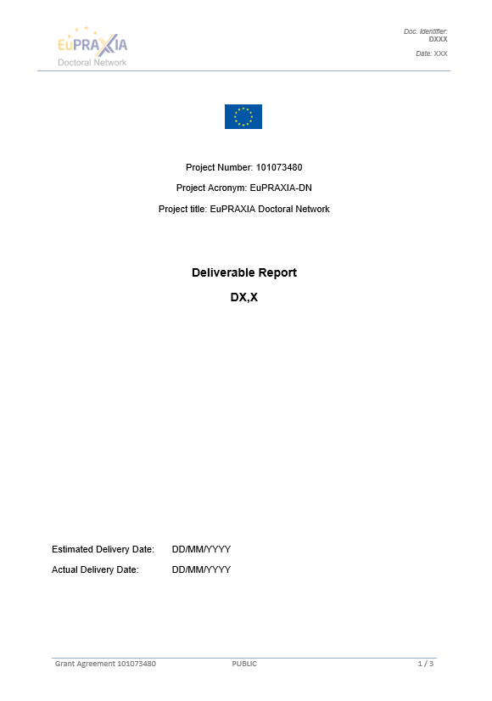
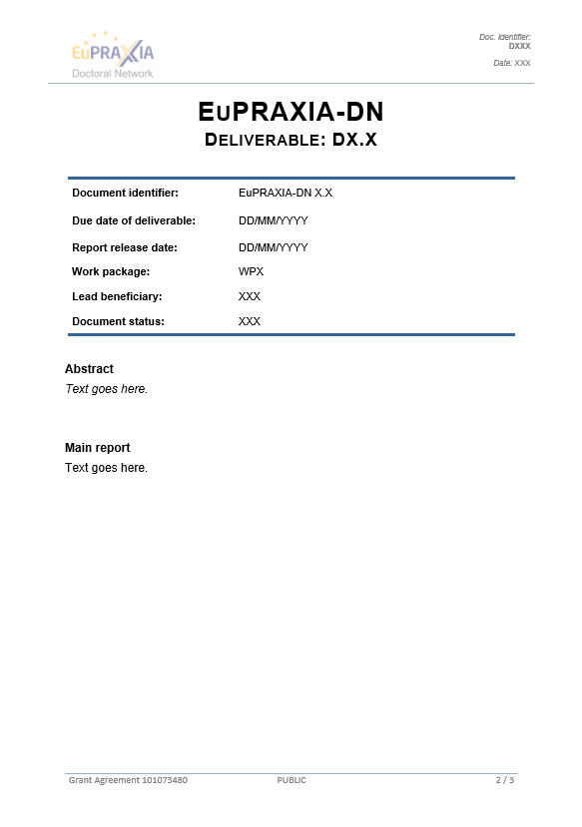
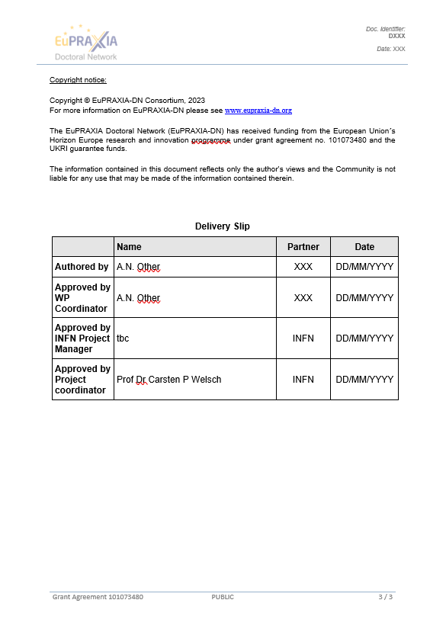
Reporting - Template

Slide 21
Reporting – who submits what?
Coordinator
Progress Report
Periodic Report
Beneficiaries incl Coordinator
Each Fellow
Questionnaires
Amendments
Financial Statement
Researcher Declarations
Notifications
Deliverables
All based on input from Beneficiaries

Slide 22
Summary
Consortium Agreement can now be signed by all partners; deadline to return electronically and in paper form: end of January 2023.
Pre-financing will be distributed as per our Grant Agreement this week
Please use templates provided and engage with early deadlines – this will help all of us to implement the project smoothly.
Any problem, any time – let the Project Manager and Coordinator know (early on)!

Slide 23



This project has received funding from the European Union´s Horizon Europe research and innovation programme under grant agreement no. 101073480.

