Slide 1
EuPRAXIA
R. Assmann, INFN & DESY
EuPRAXIA-DN Kickoff Meeting, Brussels, 16 – 17 Jan 2023

Slide 2
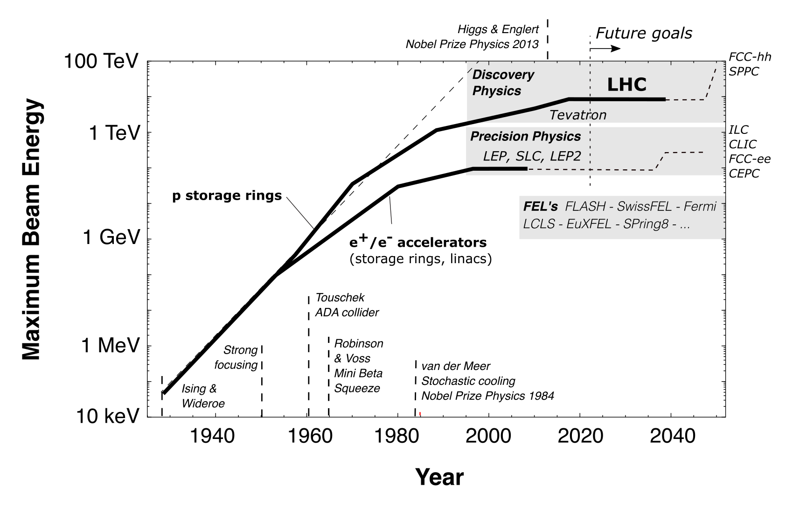
Progress in Particle Accelerators: Limits

Slide 3
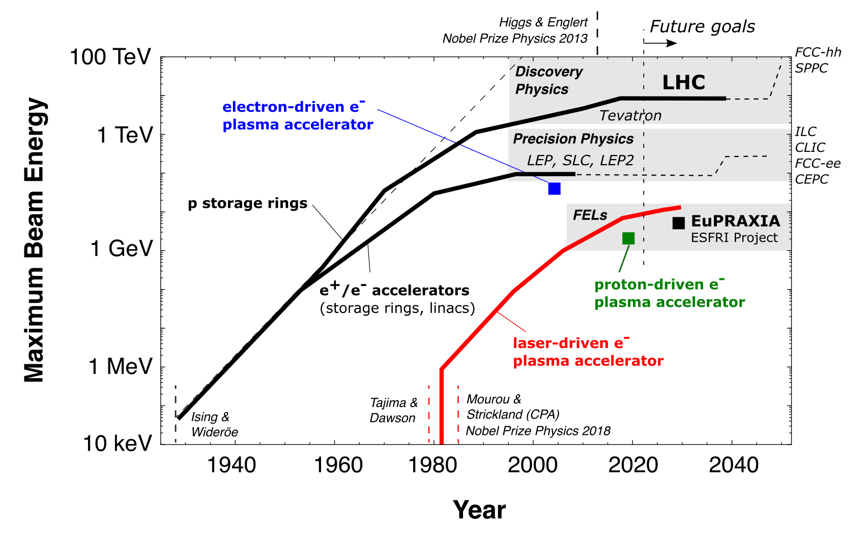
Progress in Particle Accelerators: Potential

Slide 4
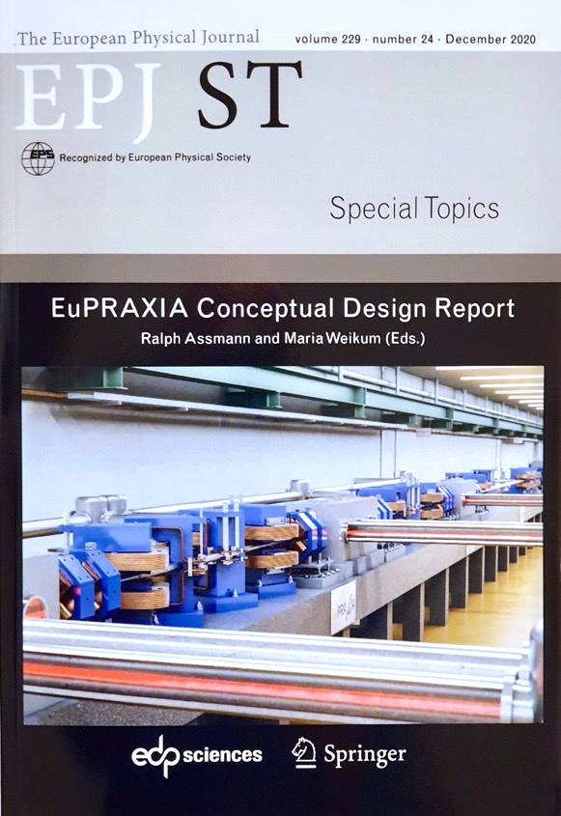
The EuPRAXIA Project
http://www.eupraxia-project.eu/
First ever design of a plasma accelerator facility.
Conceptual Design Report for a distributed research infrastructure funded by EU Horizon2020 program. Completed by 16+25 institutes.
Challenges addressed by EuPRAXIA since 2015:
  Can plasma accelerators produce usable electron beams?
  For what can we use those beams while we increase the beam energy towards HEP and collider usages?
Next phase consortium: > 50 institutes
Preparatory Phase project: 2022 – 2026 (approved)
Start of 1st operation: 2028
600+ page CDR, 240 scientists contributed

Slide 5
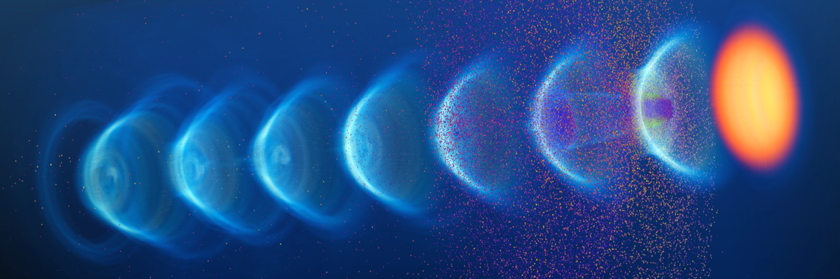

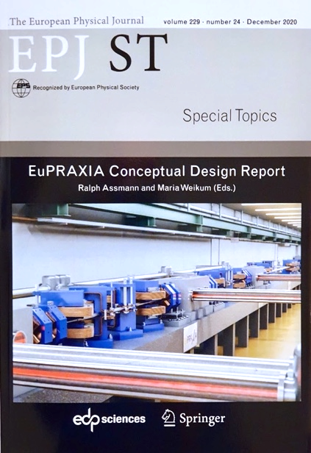
A New European High-Tech Research Facility Delivering Frontier Science
Building a facility with very high field plasma accelerators, driven by lasers or beams
1 – 100 GV/m accelerating field
Shrink down the facility size
1
2
2020 Publication of Conceptual Design Report
600+ page CDR, 240 scientists contributed

Slide 6
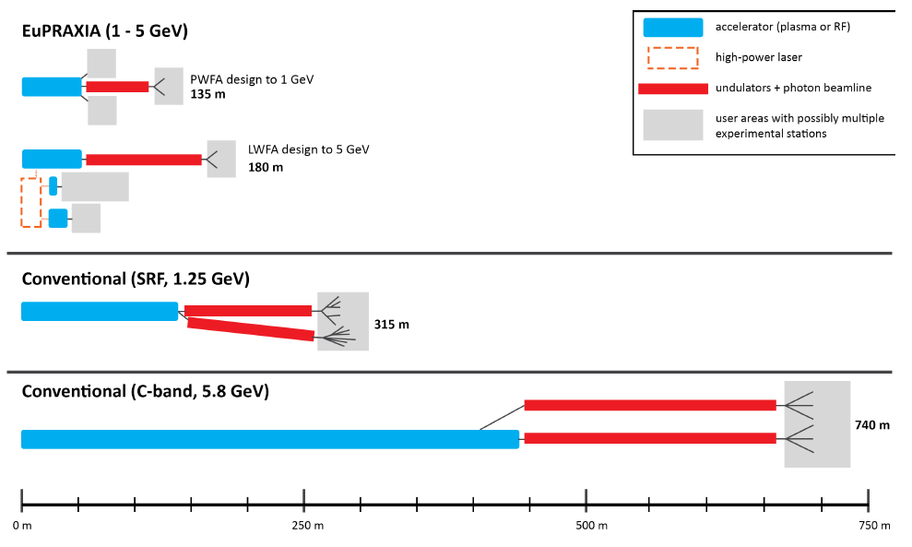
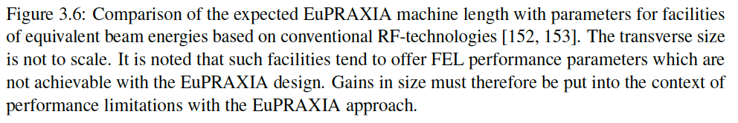
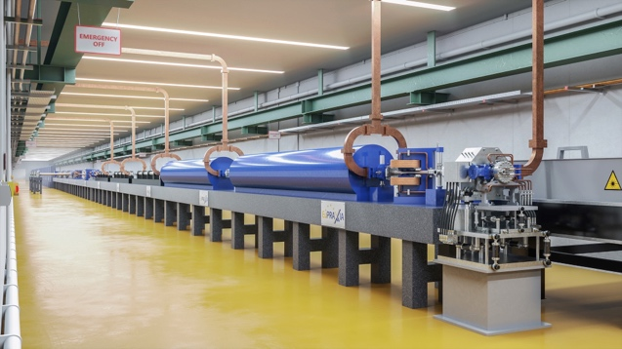
EuPRAXIA Facility Size: C O M P A C T
Distributed
2 Construction Sites
Several Excellence Centers
EuPRAXIA at
Frascati
  IMPORTANT:
  EuPRAXIA design includes
  innovative concepts & solutions
  but also lab space, RF injectors, transfer lines,
  undulator lines, shielding, ... (the real space needed)
EuPRAXIA at ELI-Beamlines or EPAC
or Pisa or ???

Slide 7
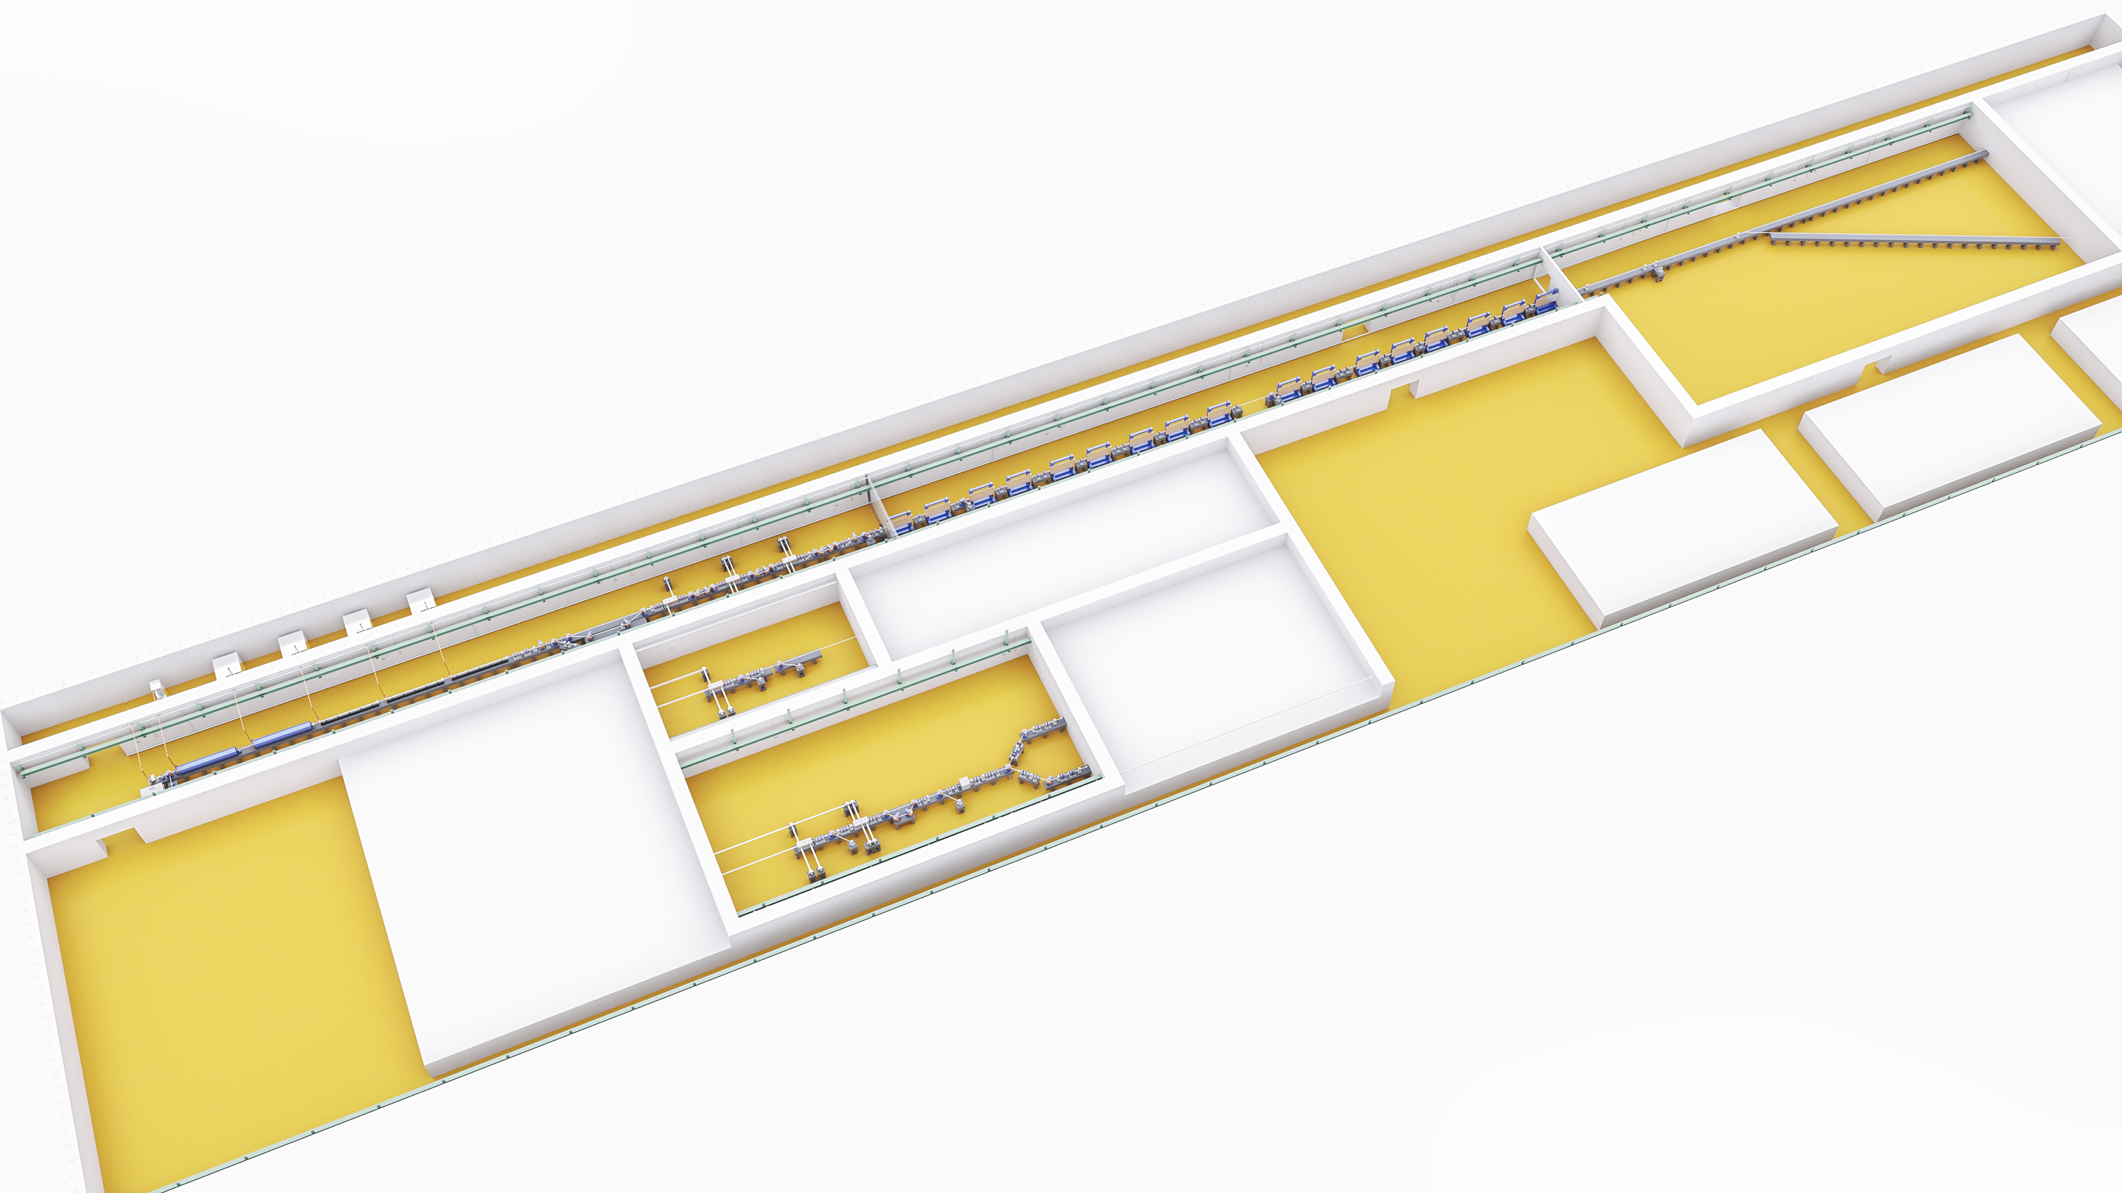
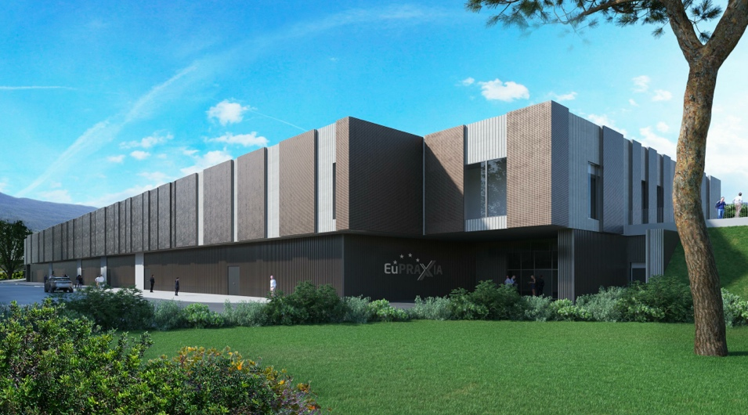


135 – 175 m
∼35 m

Slide 8
A New European High-Tech Research Facility Delivering Frontier Science
Building a facility with very high field plasma accelerators, driven by lasers or beams
1 – 100 GV/m accelerating field
Shrink down the facility size
1
Producing particle and photon pulses to support several urgent and timely science cases
Enable frontier science in new regions and parameter regimes
2

Slide 9

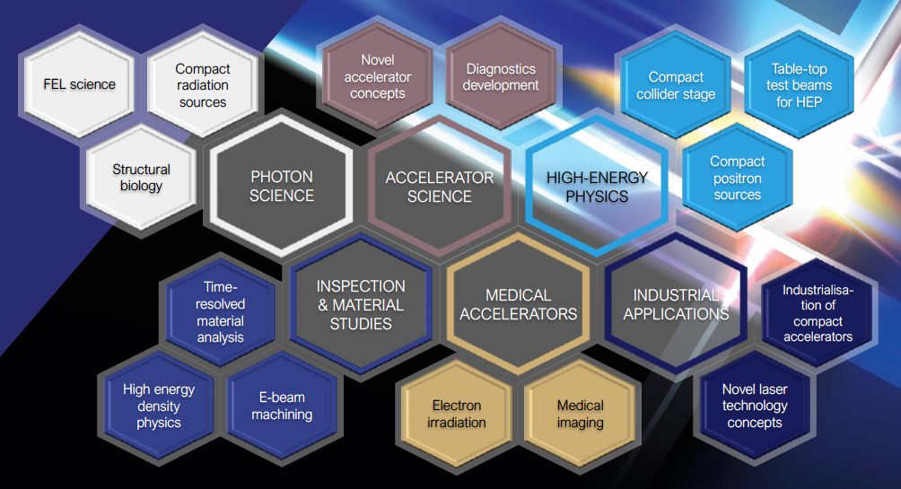

European Plasma Research Accelerator with eXcellence In Applications
Versatile – Designed for Users in Multiple Science Fields
Delivers 10-100 Hz ultra-short pulses
Electrons
(0.1-5 GeV, 30 pC)
Positrons
(0.5-10 MeV, 10⁶)
Positrons (GeV source)
Lasers
(100 J, 50 fs, 10-100 Hz)
Betatron X rays
(1-110 keV, 10¹⁰)
FEL light
(0.2-36 nm, 10⁹-10¹³)
Topics of research: proteins, viruses, bacteria, cells, metals, semiconductors, superconductors, magnetic materials, organic molecules

Slide 10
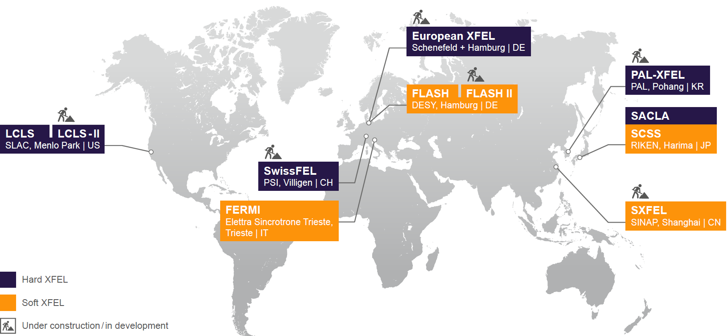
X Ray FEL User Facilities World-Wide
Tremendous success story
New facilities and strong upgrade program
New projects:
  MAX IV FEL (CDR)
  EuPRAXIA (TDR, ESFRI Project)
  POLFEL
  UK FEL
2016
17,5 GeV
2015
10 GeV
2005
1,2 GeV
2015
1,2 GeV
2010
3,5 GeV
2009
14 GeV
2020
4 GeV
2016
2,1 GeV
5,8 GeV
2010
1,2 GeV
2015
0,2 GeV
2005: 1 → 2015: 5 → 2022: 8 → 2029: 10 (?) → 2036: ???

Slide 11

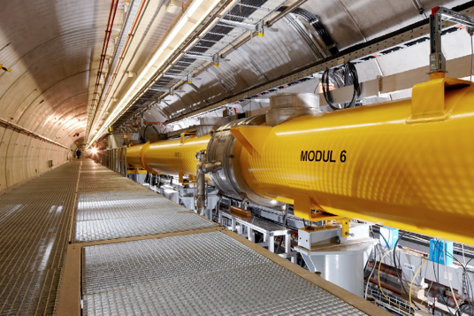
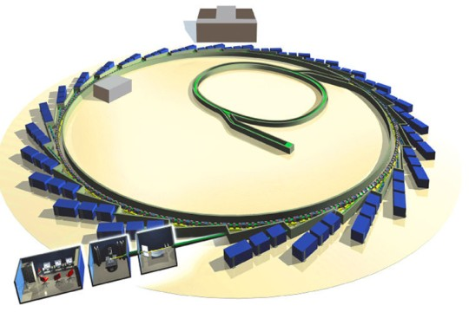






Human-made Sources of Light
Visible
light
New capabilities with light sources based on circular (1970) and linear (2005) particle accelerators
X rays with extremely high brilliance and time resolution capabilities
Problem: BIG and expensive
Ultraviolet light
Soft X Rays
Compact plasma-based source
Hard X Rays
Gamma Rays
1 μm 100 nm 10 nm 1 nm 100 pm 10 pm 1 pm 100 fm 10 fm

Slide 12
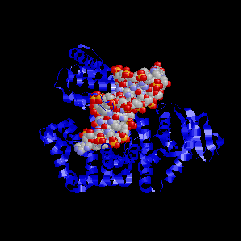
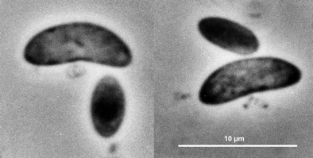
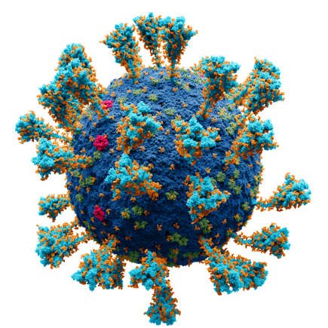
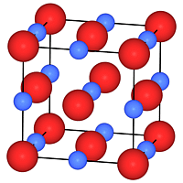
Why Additional Compact (Less Powerful) FEL`s?
Visible
light
Practically unlimited number of study objects with potentially high impact on our lives:
About 320,000 unknown viruses that infect mammals
There may be a million bacterial species in 30 grams of rich soil in Norway
Need for access and screening time – work for students at many universities
Ultraviolet light
Soft X Rays
Hard X Rays
Gamma Rays
1 μm 100 nm 10 nm 1 nm 100 pm 10 pm 1 pm 100 fm 10 fm

Slide 13

Distributed RI Concept

Slide 14
EuPRAXIA Project Overview & Funding Lines
162.6 M€ resources approved, 25 M€ applied for

Slide 15
EuPRAXIA Project Overview

Slide 16
EuPRAXIA Project Overview

Slide 17
EuPRAXIA Project Overview

Slide 18
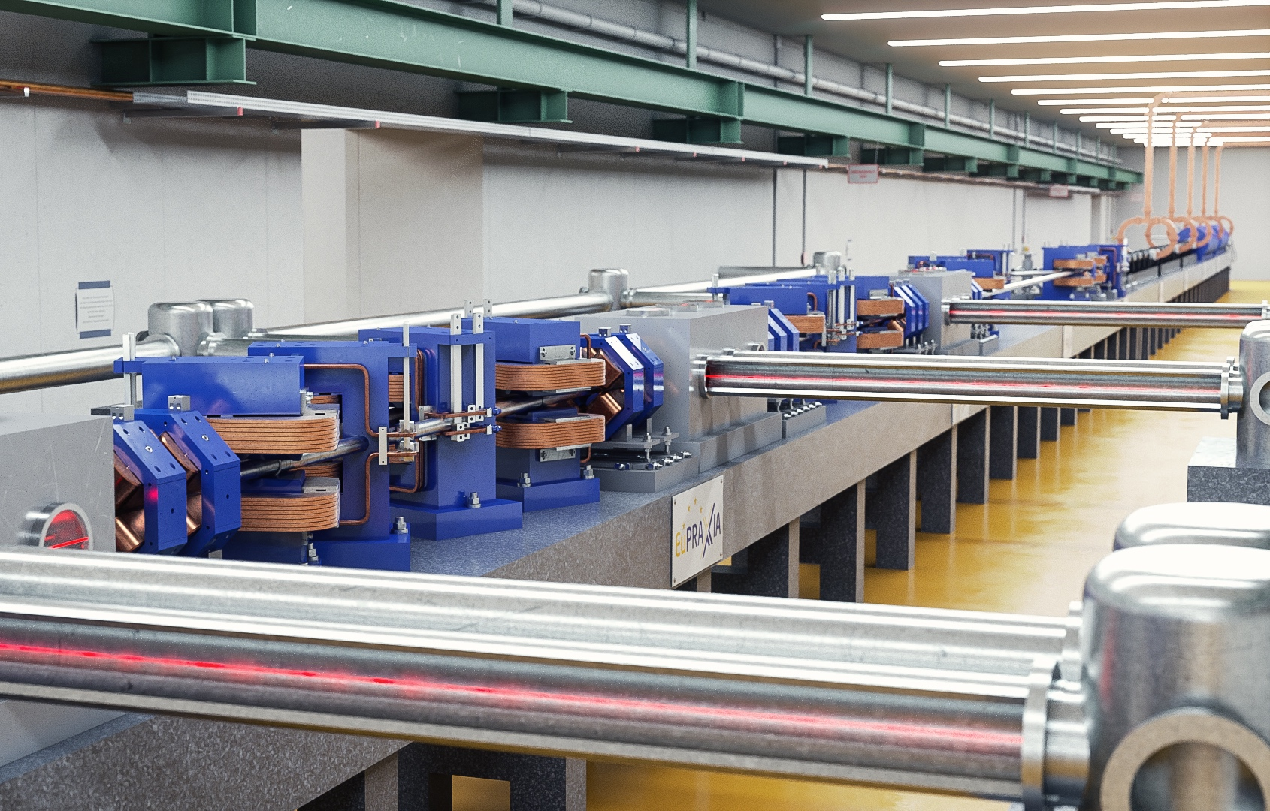


ESFRI Roadmap Update December 2021
E uropean
S trategy
F orum on
R esearch
I nfrastructures
https://roadmap2021.esfri.eu
Roadmap projects selected after thorough review by ESFRI committee and approved by EU governments every few years
2006 – 2008 – 2012 – 2016 – 2018 – 2021
EuPRAXIA facility rendering picture

Slide 19
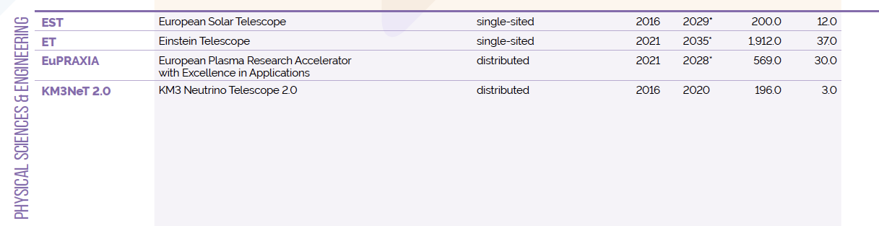

ESFRI Projects Roadmap 2021
https://roadmap2021.esfri.eu
Two new entries in 2021: Einstein Telescope (ET) and EuPRAXIA
EuPRAXIA is the only accelerator facility selected in the last 6 years
EuPRAXIA is the first plasma accelerator facility ever included

Slide 20
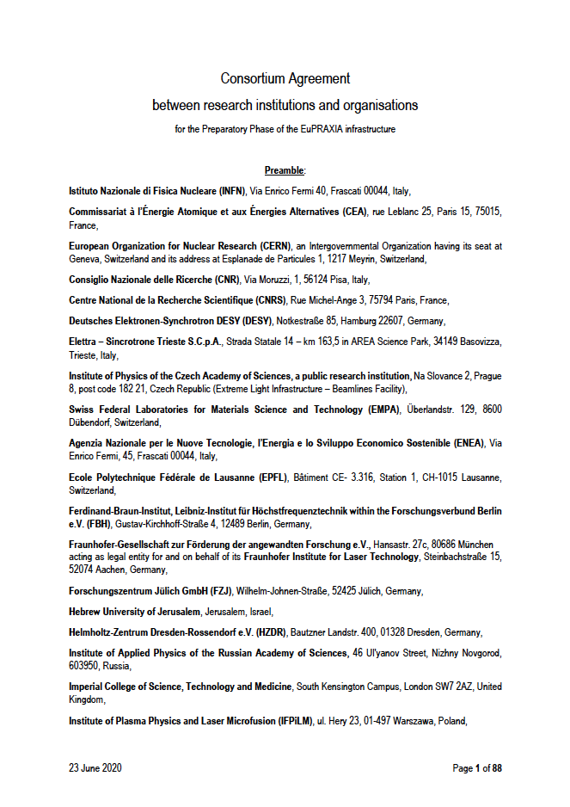
Reference Documents EuPRAXIA-ESFRI

Slide 21
EuPRAXIA Project Overview

Slide 22
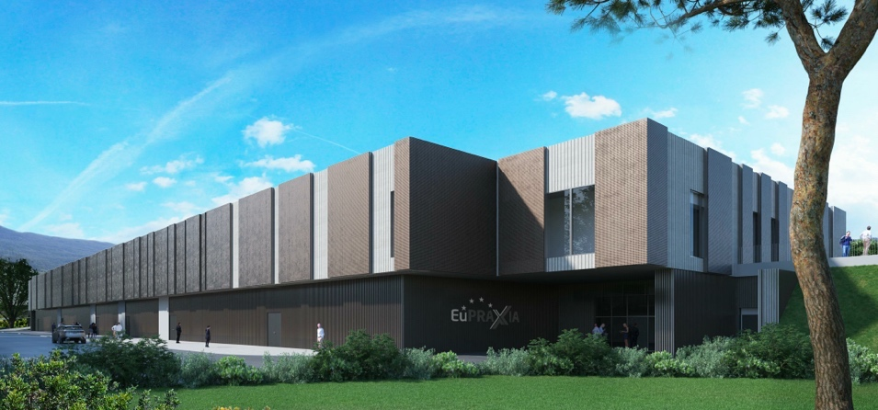

EuPRAXIA-PP (Preparatory Phase) Key Facts
Prepares the implementation of the full RI in Europe
Total project volume (including in-kind): 8.3 M€
  EU funding: 2.49 M€ (EU without in-kind)
  Outside EU 0.69 M€ (Switzerland)
  0.51 M€ (UK)
Work organized in 16 Work Packages
Project dates: 1 Nov 2022 – 31 Oct 2026
Coordinator and location of headquarters: INFN
34 participating organizations from 12 countries
Will establish a “Board of Financial Sponsors“ with representatives of funding agencies.
So far ~ 25% of total M&P funding (569 M€) secured. Site 1 is essentially financed.

Slide 23
Relevant Questions for Preparatory Phase
Updates to CDR concepts – towards a TDR
Second site on LWFA: Location and definition.
Excellence centres (add excellence centre lines to project overview and funding lines):
  Define final number and concepts (single hub, multi hub, connections)
  Can be cross-WP or single WP → EuPRAXIA PP workshop in first year
  Specify R&D, prototyping, testing and possible deliverables (baseline or upgrades) to construction sites for each excellence center
  Determine required budget and discuss implementation possibilities
User services and access models
E infrastructure requirement and integration
Legal and financial models. Open science and open innovation.
Rules and organization. Extension of membership.
…

Slide 24

EuPRAXIA-Preparatory Phase Consortium
34 Institutes from 12 Countries → to be merged with ESFRI Consortium
Preparatory Phase
Complemented by institutes in EuPRAXIA ESFRI consortium: additional 17 institutes from France, Germany, Poland, Sweden, United Kingdom, China, Japan, United States. Russian institutes presently suspended.

Slide 25
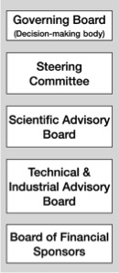
PP Steering Committee: Leaders Behind EuPRAXIA
WP1 - Coordination & Project Management
R. Assmann, INFN & DESY
M. Ferrario, INFN
WP2 - Dissemination and Public Relations
C. Welsch, U Liverpool
S. Bertellii, INFN
WP3 - Organization and Rules
A. Specka, CNRS
A. Ghigo, INFN
WP4 - Financial & Legal Model. Economic Impact
A. Falone, INFN
WP5 - User Strategy and Services
F. Stellato, U Tor Vergata
E. Principi, ELETTRA
WP6 - Membership Extension Strategy
B. Cros, CNRS
A. Mostacci, U Sapienza
WP7 - E-Needs and Data Policy
R. Fonseca, IST
S. Pioli, INFN
WP8 - Theory & Simulation
J. Vieria, IST
H. Vincenti, CEA
WP9 - RF, Magnets & Beamline
Components
S. Antipov, DESY
F. Nguyen, ENEA
WP10 - Plasma Components & Systems
K. Cassou, CNRS
J. Osterhoff, DESY
WP11 - Applications
G. Sarri, U Belfast
E. Chiadroni,U Sapienza
WP12 - Laser Technology, Liaison to Industry
L. Gizzi, CNR
P. Crump, FBH
WP13 - Diagnostics
A. Cianchi, U Tor Vergata
R. Ischebeck, EPFL
WP14 - Transformative Innovation Paths
B. Hidding, U Strathclyde
S. Karsch, LMU
WP15 - TDR EuPRAXIA @SPARC-lab
C. Vaccarezza, INFN
R. Pompili, INFN
WP16 - TDR EuPRAXIA Site 2
A. Molodozhentsev, ELI-Beamlines
R. Pattahil, STFC
WP’s on coordination & implementation as ESFRI RI (organization, legal model, financing, users)
WPs on technical implementation and sites

Slide 26
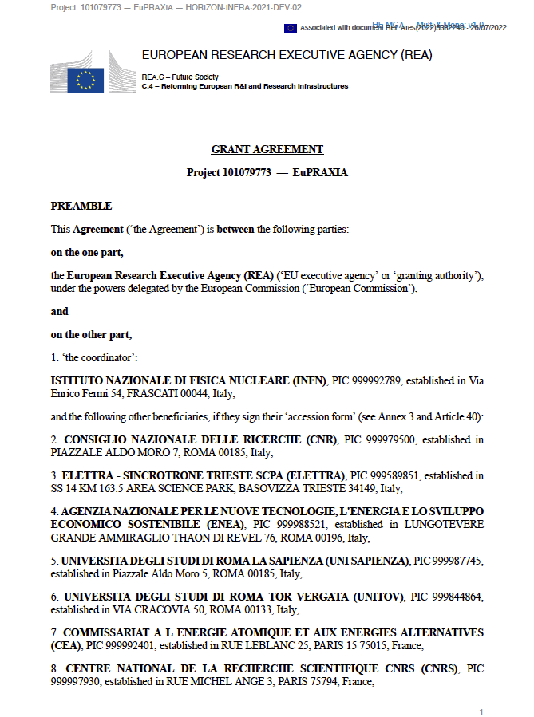
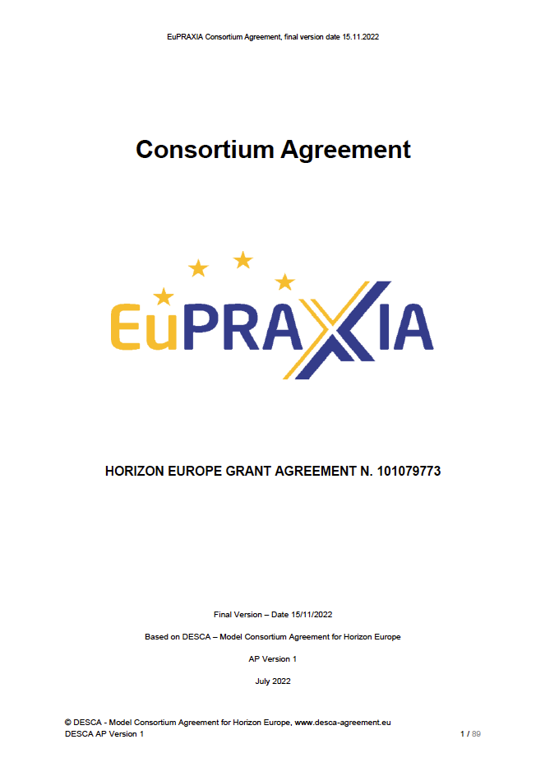
Reference Documents EuPRAXIA-PP

Slide 27
EuPRAXIA Project Overview

Slide 28
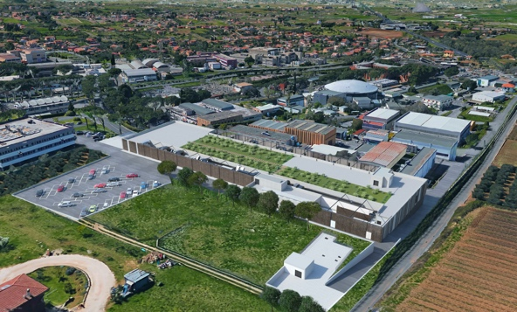
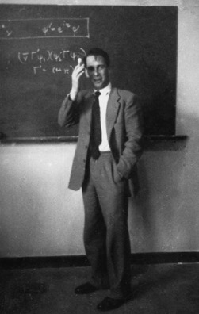
Headquarter and Site 1: EuPRAXIA@SPARClab
Frascati`s future facility
> 130 M€ invest funding
Beam-driven plasma accelerator
Europe`s most compact and most southern FEL
The world`s most compact RF accelerator (X band with CERN)

Slide 29
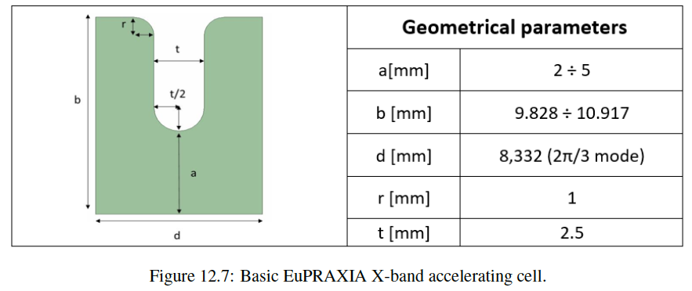
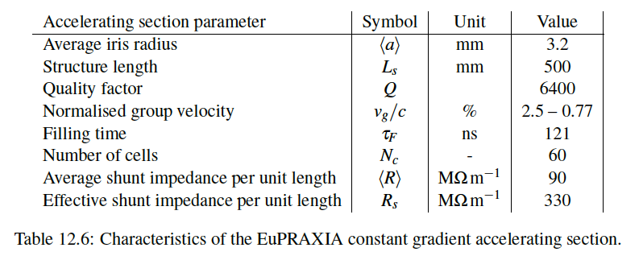
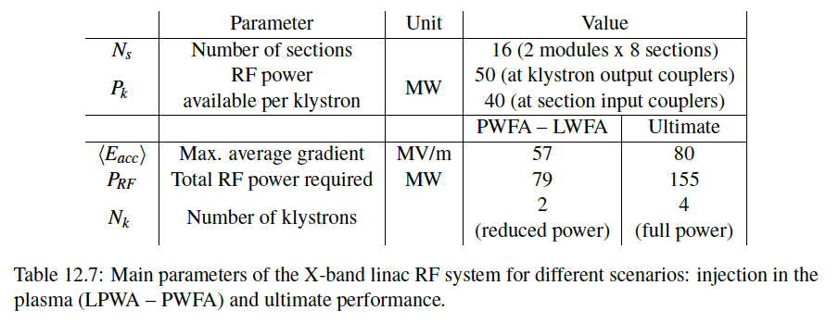
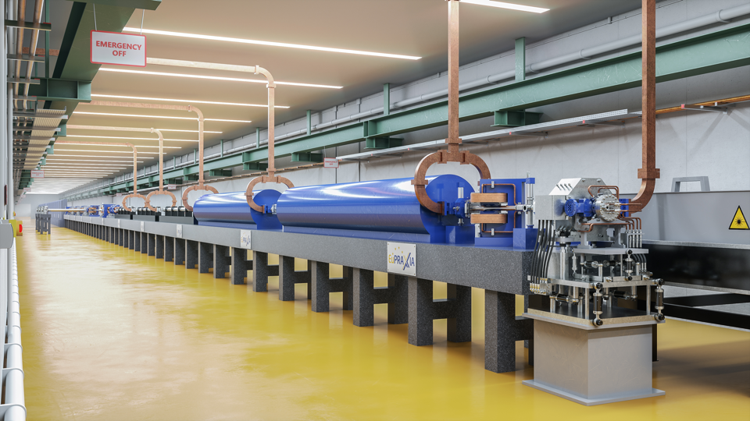
Electron Driver: X Band RF Linac

Slide 30
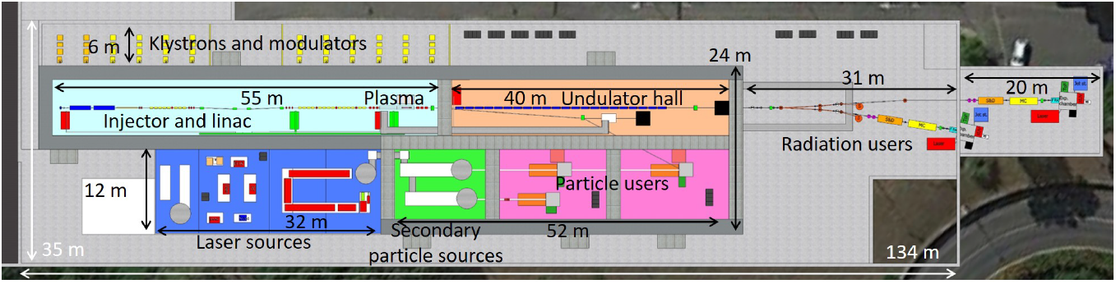
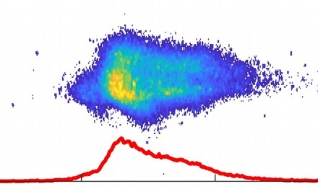
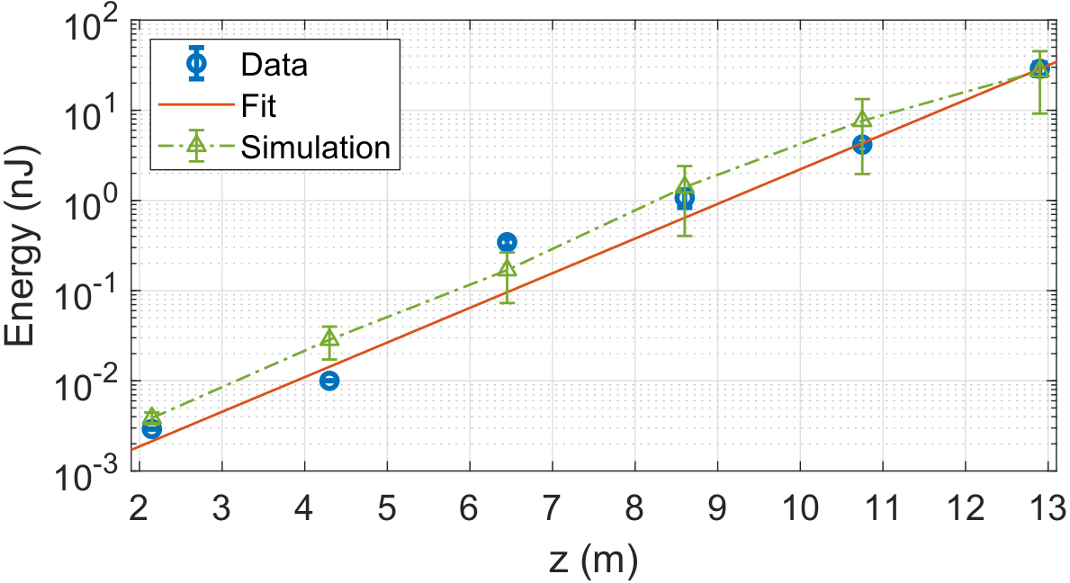
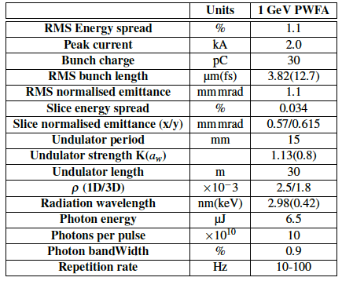
Site 1: EuPRAXIA@SPARClab

Slide 31
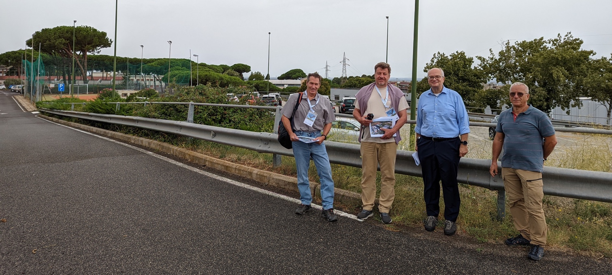
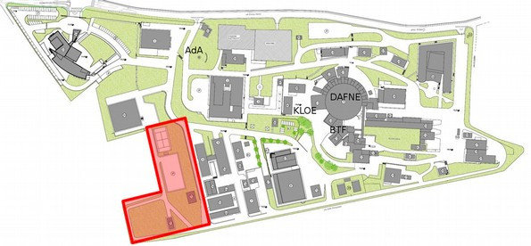
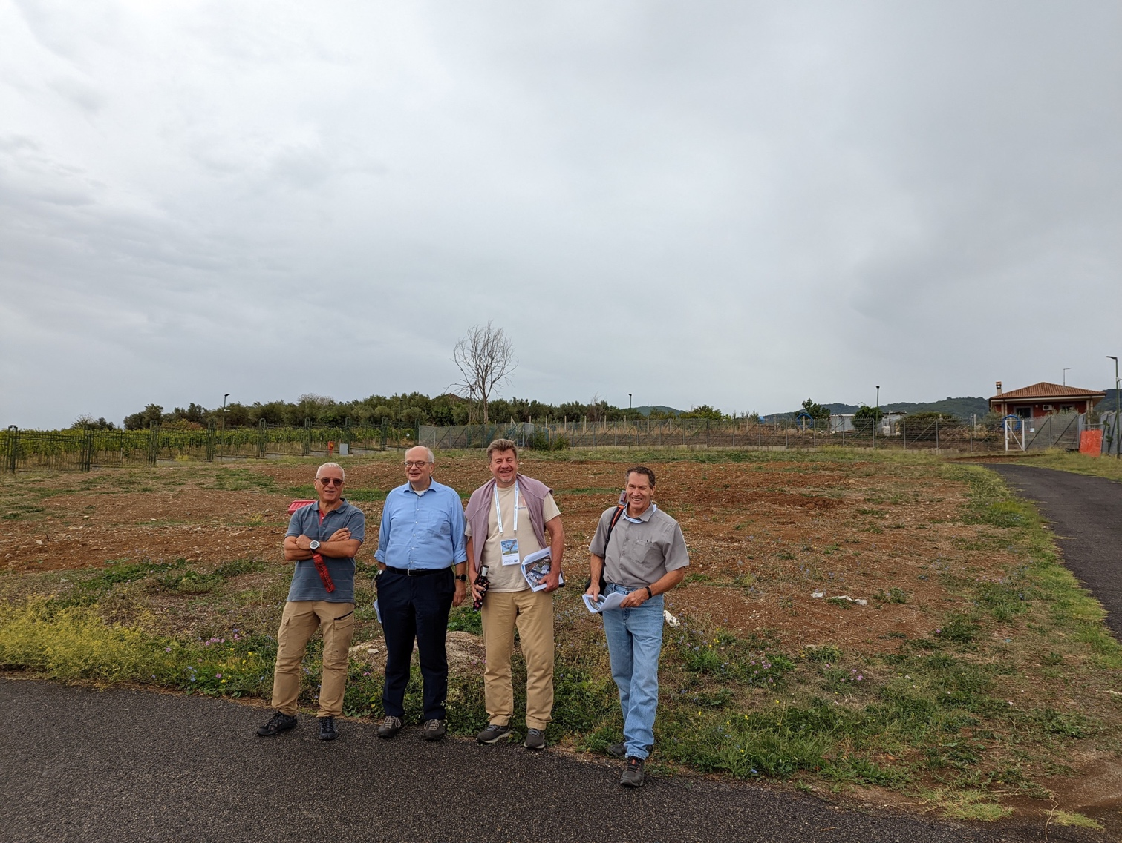
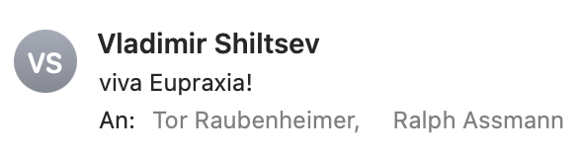

It Fits the Frascati Site
(also fits sites at a large university, hospital, company, …)
Directorate building
Canteen
INFN central administra-tion
SPARClab (seeding with plasma acc.)
Tor Raubenheimer
SLAC, Stanford University, USA
@ SPARClab
(European site 1)
Vladimir Shiltsev, Fermilab National Laboratory, USA

Slide 32
EuPRAXIA Project Overview

Slide 33
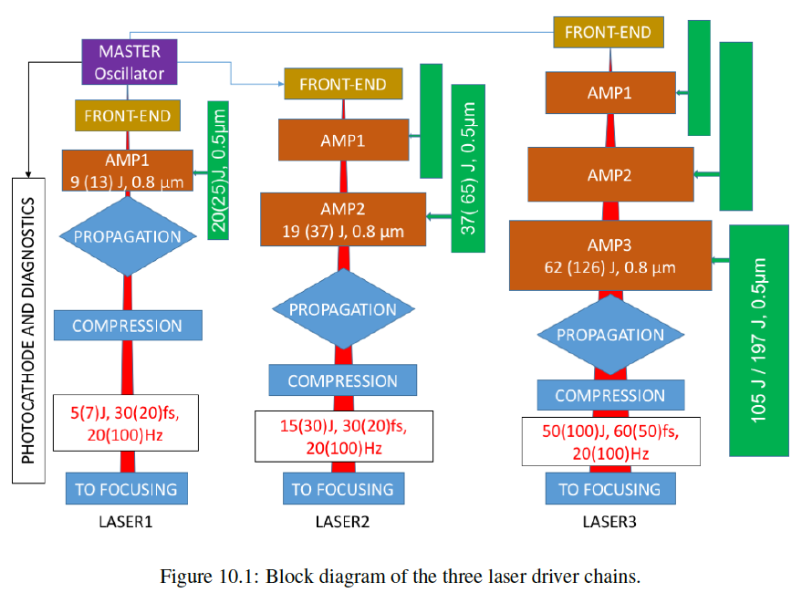
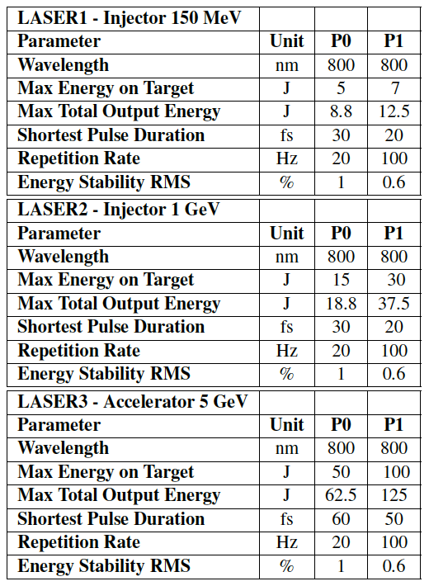
Laser-Driver Chain

Slide 34
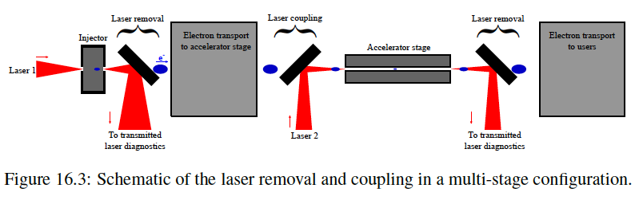
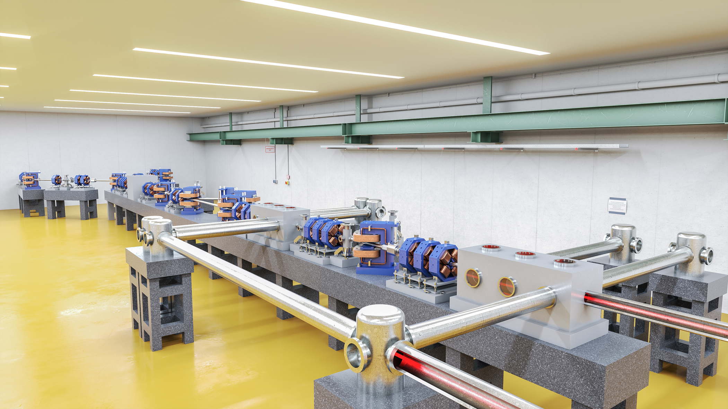
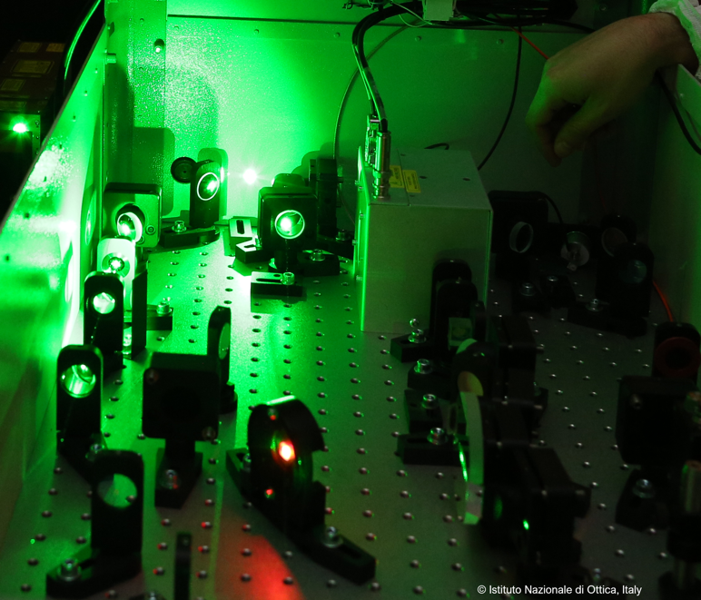
Laser Transport Lines: In- and Outcoupling

Slide 35
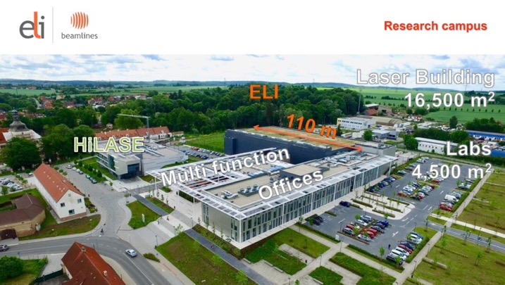
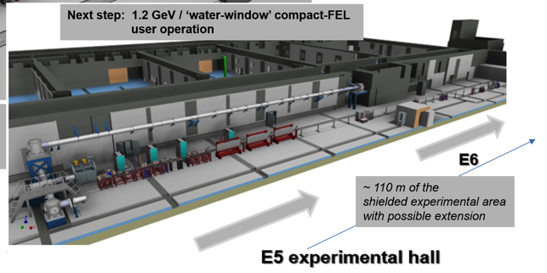


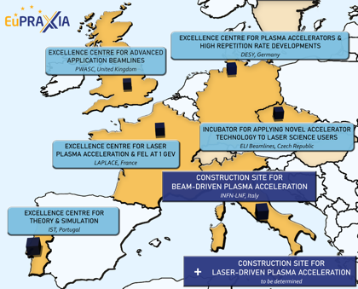



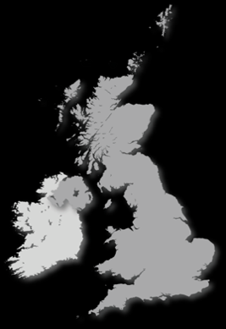

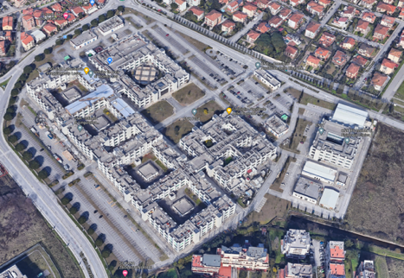


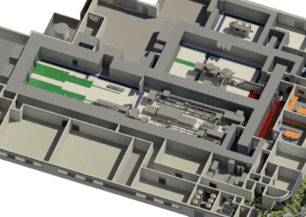









Reminder: Candidate 2nd Sites from CDR
Prague, Czech Republic
↑
@ EPAC
Rutherford, STFC, UK
PWASC
CNR Campus Pisa
Notes:
Maria

Slide 36


Visit to ELI-Beamlines (13 - 14 Oct 2022)
Prague, Czech Republic
Notes:
Maria

Slide 37



Conclusion
EuPRAXIA is so far highly attractive for young scientists and funding: high tech and urgent science!
The doctoral network EuPRAXIA DN is an important corner stone of our work:
  DN provides a central contact, support and networking resources
  DN connects students to the many interesting subjects we have in our project: scientific, technical, managerial challenges
  DN trains students in this promising field
Many thanks to Carsten and his team for organizing the funding application and the DN project
Please feel free to contact us for any questions. Any feedback, ideas and proposals are very welcome!

Slide 38
Thank You

