Slide 1
ISOLDE wk. 44
  GPS:
  Target #534 Sn for Cd Solid State Physics collections at GLM
  STAGISO beam from PSB with low p-current
  Smooth and successful run
  The run finished Monday morning. Target change for #784 UC done.
  Full ISOLDE facility running!
  HRS / REX-HIE ISOLDE:
  Replacement Target #789 UC VD5 plasma for 130Sn to HIE ISOLDE experiment Miniball
  Reduced setting up time (original target failed). Difficult molecular Tin Sulfide beam (130Sn34S). However, managed to start the run Thursday-night, ahead of schedule – appeared to be very useful to debug and commission the Miniball DAC system.
  Very good target production: running with low NORMHRS p-current from PSB (~0.2 uA)
  The run finished this morning. Yield test will follow.
  Technical issues:
  Several, acceptable, trips of the REX and SRF RF amplifiers
  Main issue on Friday-night when the HRS separator magnet MAG60 B-field regulation failed as well as the MAG90 controls in the process of restarting.
  Support from ISO OP colleagues E. Piselli, A. Rodriguez and V. Di Capua (MSC magnet FESA class responsible – from his holiday address), EPC-Control piquet D. Zielinski and First-Line D. Bozon.
  MAG90 returned operational by swapping the G64 controller crate for its spare (First-Line). The MAG60 issue could not be solved, and the magnet was set manually to the current corresponding to the 130Sn34S mass to continue physics and save the run.
  Specialists have been contacted to attack the issue after the run has finished (as of this morning)

Slide 2
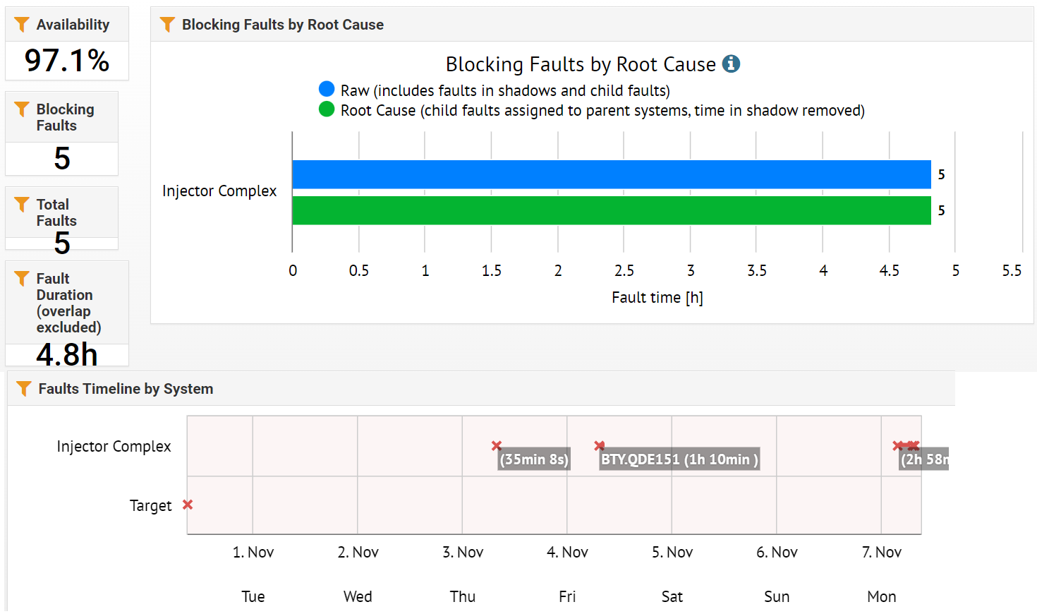
GPS wk.44

Slide 3
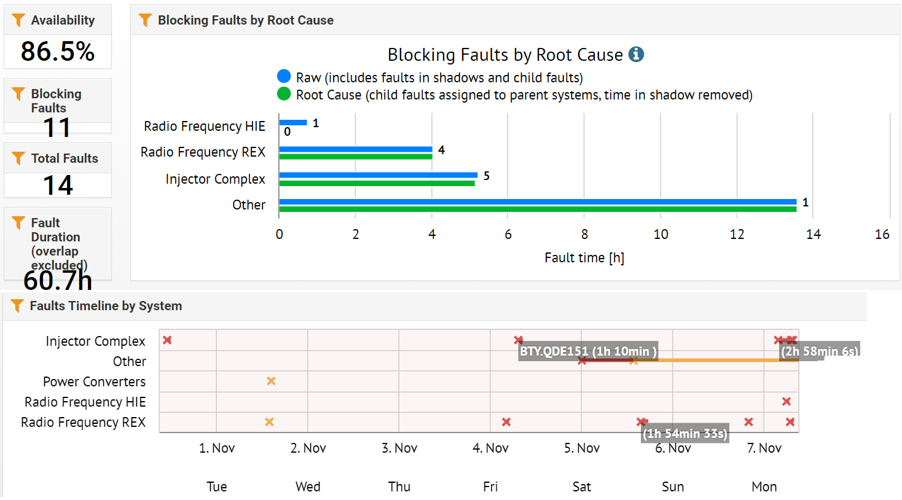
HRS / REX-HIE ISOLDE availability wk. 44

